Slide 1

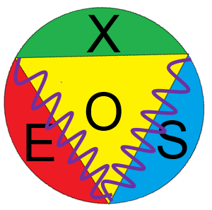
VOXES, a graphite mosaic crystal based Von Hamos spectrometer for extended and diﬀused sources
Alessandro Scordo, HPXM2025
Laboratori Nazionali di Frascati INFN

Slide 2
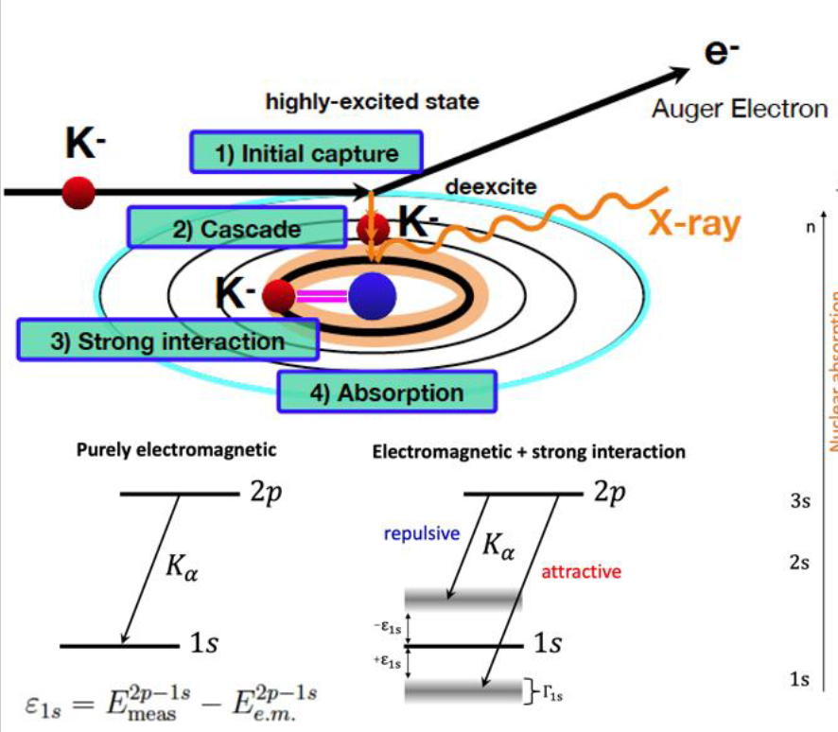
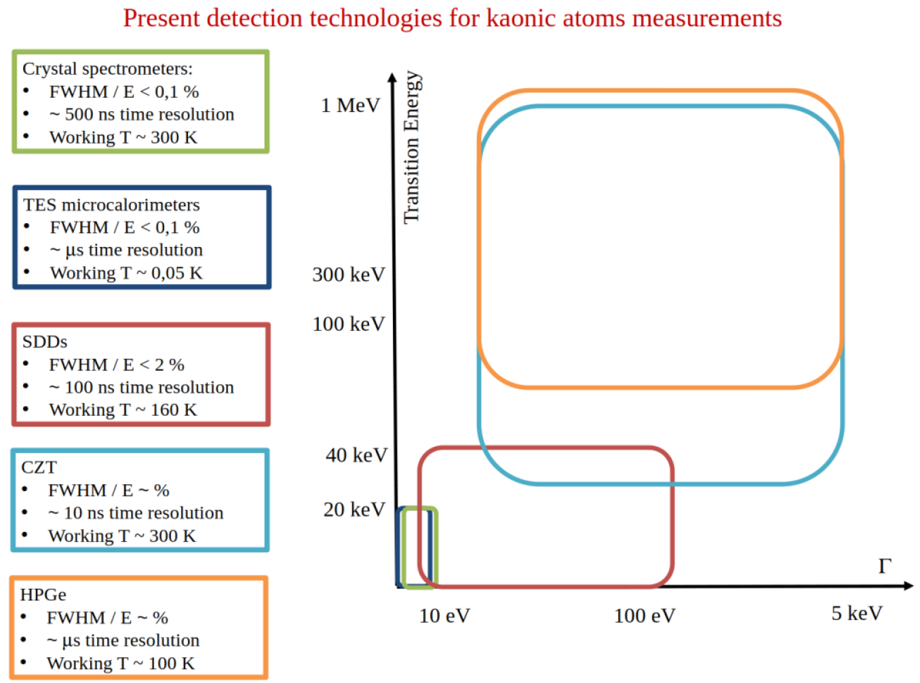
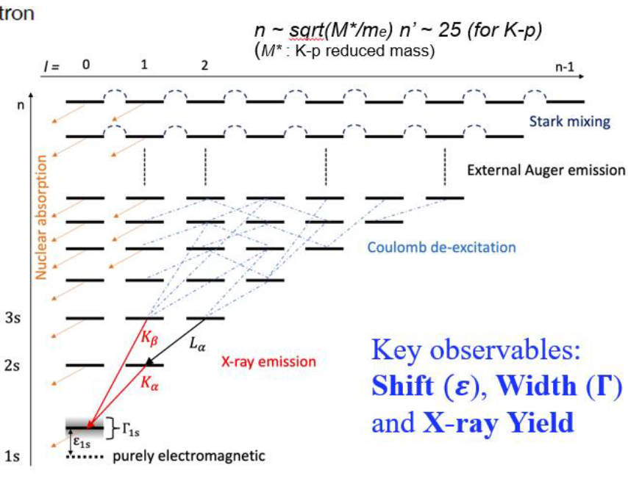
Original motivations
Kaonic atoms provide information on low energy strangeness QCD
Still open questions in the field require new and more precise measurements of low energy and sub-eV width transitions
See talks from F. Sgaramella and F. Artibani Thu 19/06 @ 15:00

Slide 3
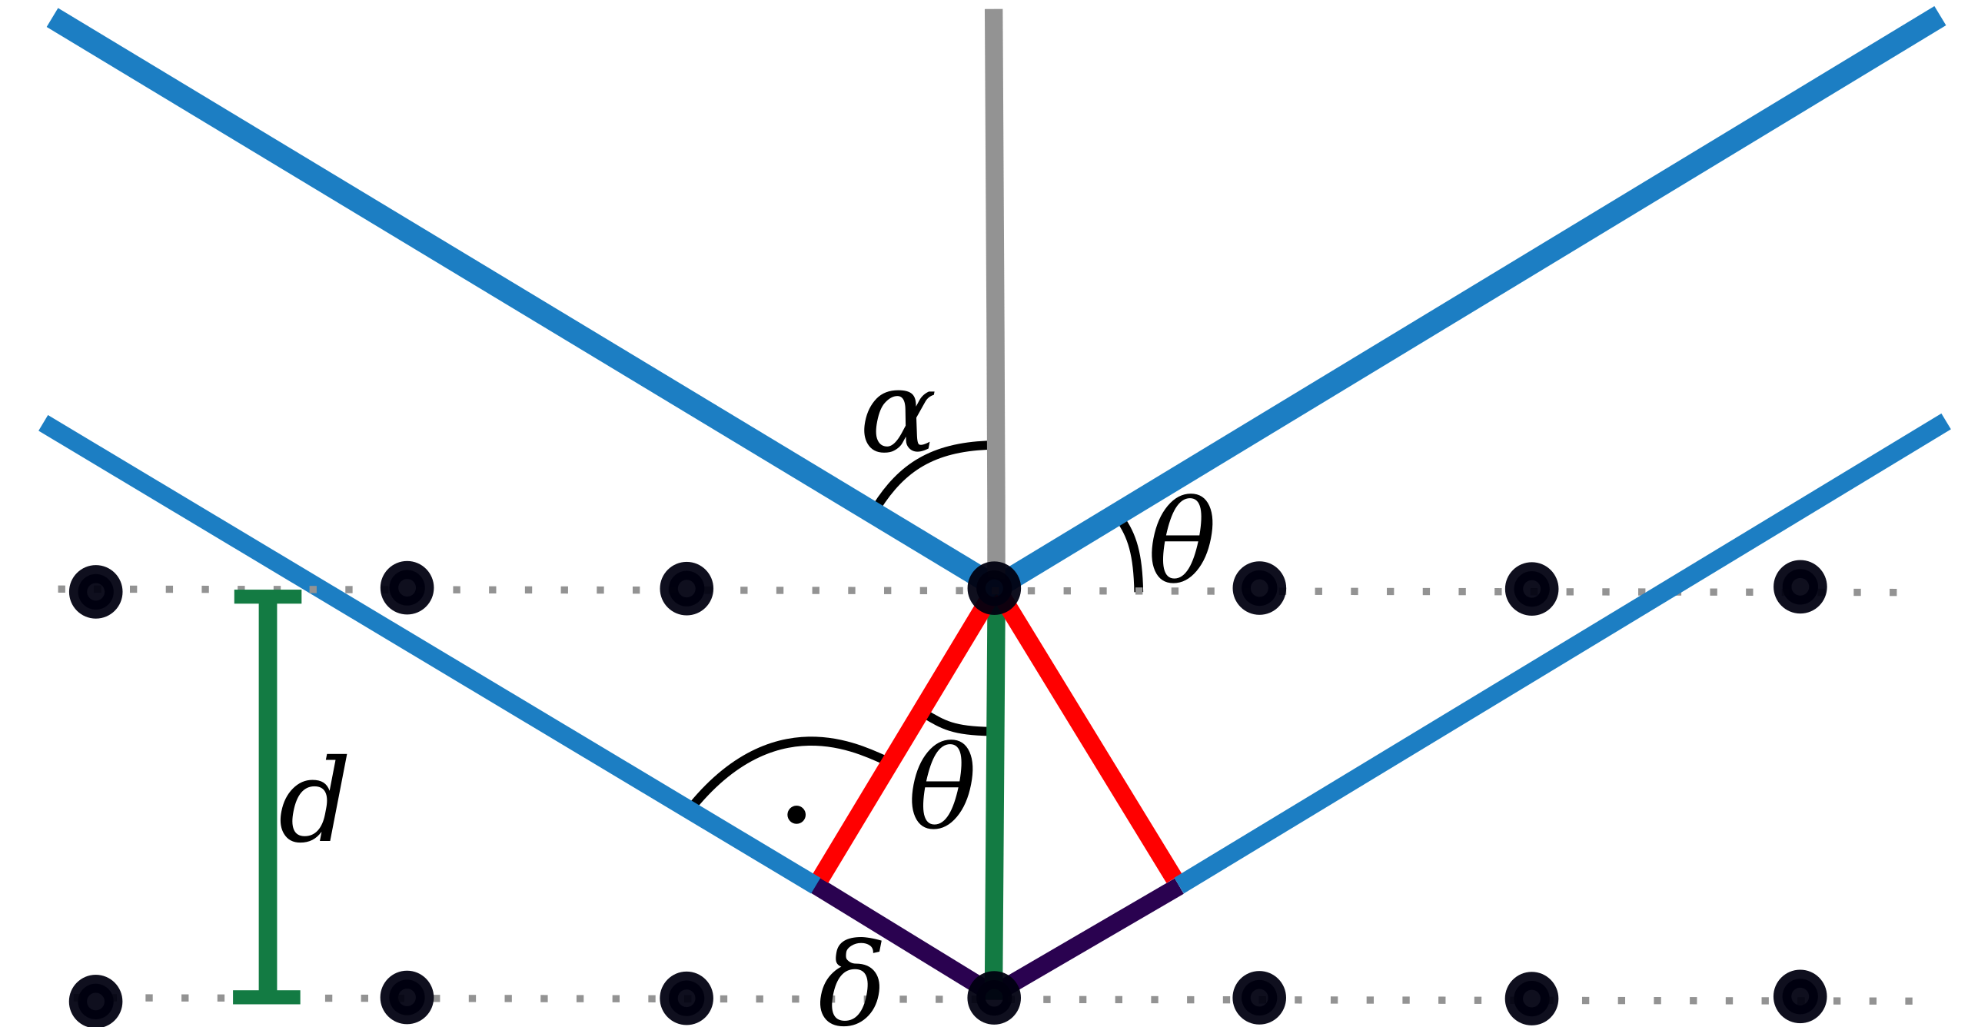
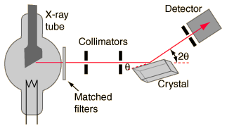
Bragg Spectroscopy
nλ = 2dsinθ_{B}
FWHM ~ 1-10 eV can be achieved depending on the quality of the crystal and the dimensions of the detectors
Natural background reduction from geometry
But….
- Small solid angles can be covered
- Typical efficiencies : 10⁻⁵ – 10⁻⁸
- Typical d (Si) ≈ 5.5 Å (good for E < 6 keV)
- Typical source size 10-100 μm

Slide 4
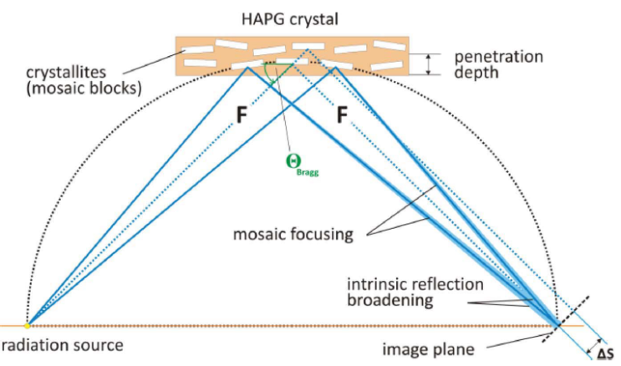
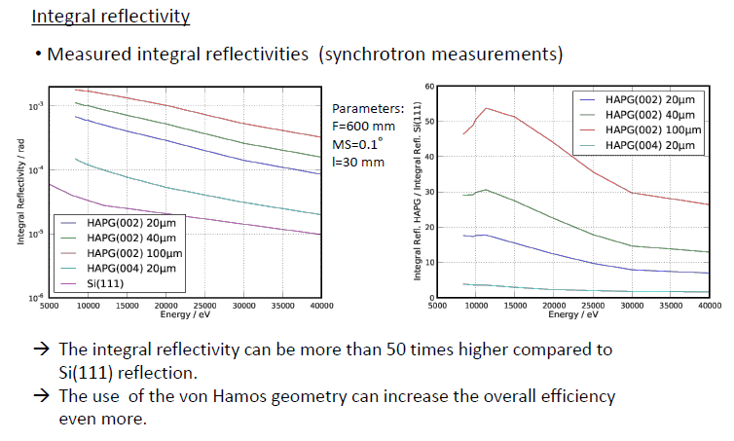
Mosaic Crystals
Mosaic crystal consist in a large number of nearly perfect small crystallites.
Mosaicity makes it possible that even for a fixed incidence angle on the crystal surface, an energetic distribution of photons can be reflected
Increase of efficiency
(focusing) ~ 50
Loss in resolution
Talk from I. Grigorieva (Optigraph) Mon 16/06 @ 17:40
Pyrolitic Graphite mosaic crystals (d = 3.354 Å):
Bending does not influence resolution and intensity
Mosaic spread down to 0.05 degree
Integral reflectivity ~ 10² higher than for other crystals
Variable thickness (efficiency)
Excellent thermal and radiation stability

Slide 5
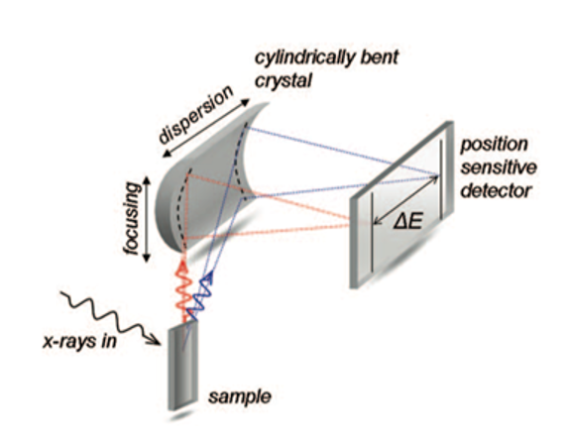
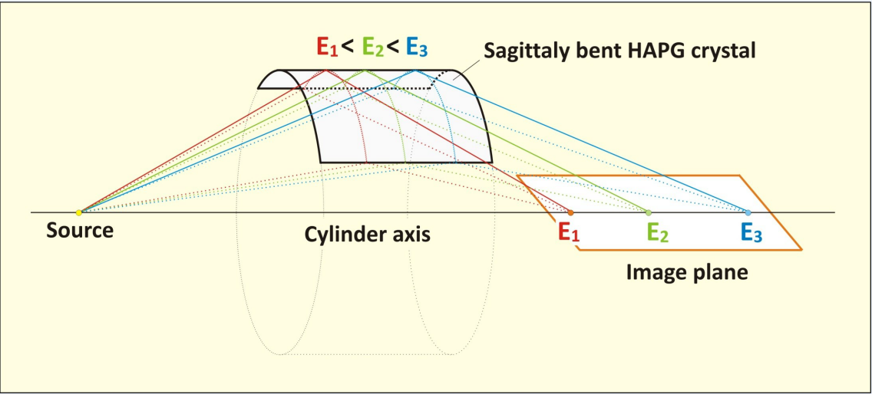
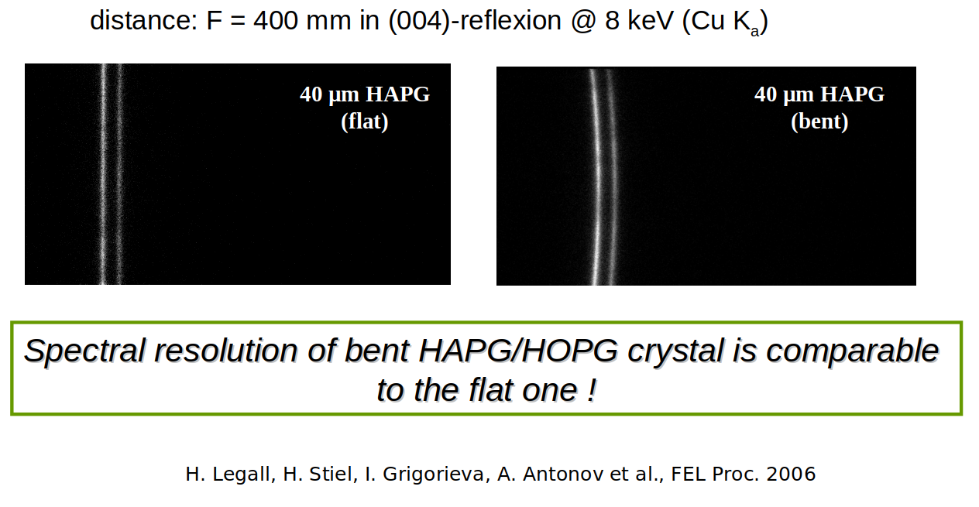
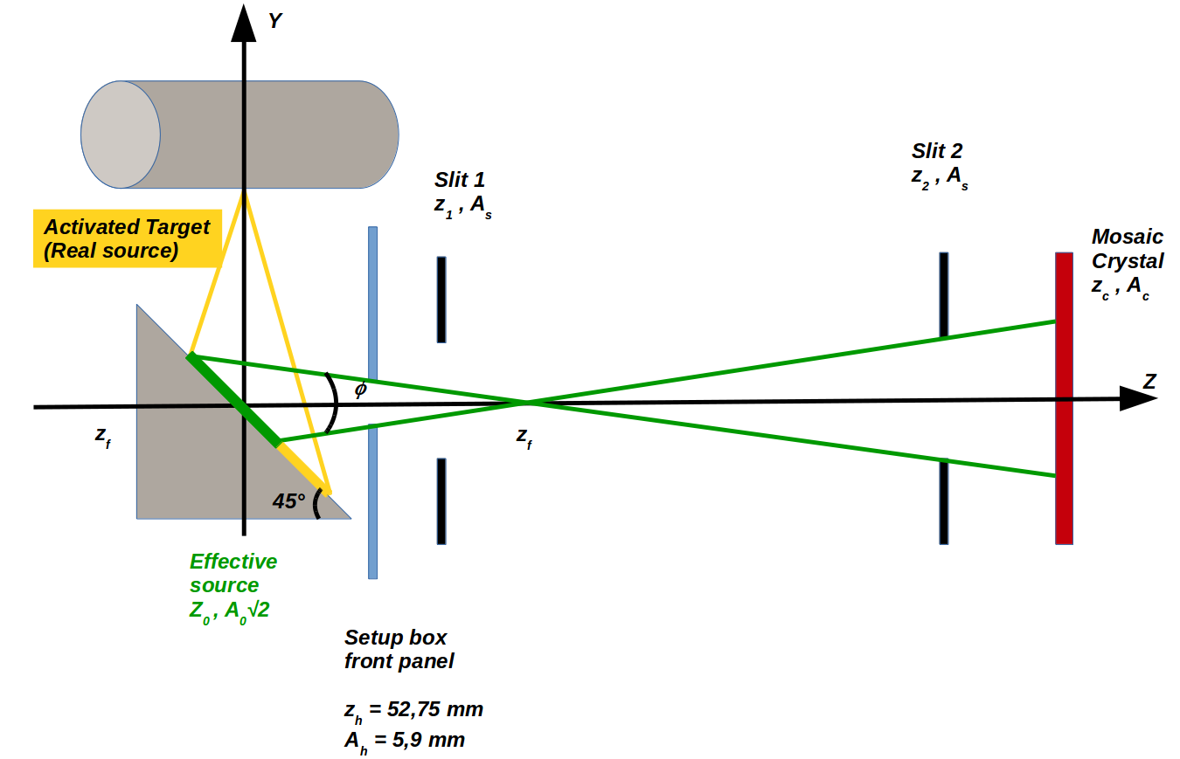
Von Hamos configuration
VH configuration can further improve the signal collection efficiency.
In this configuration, also the vertical dimension of the X-ray source can be exploited

Slide 6
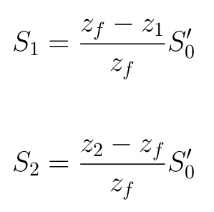
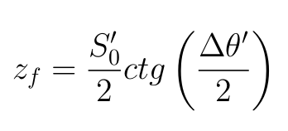
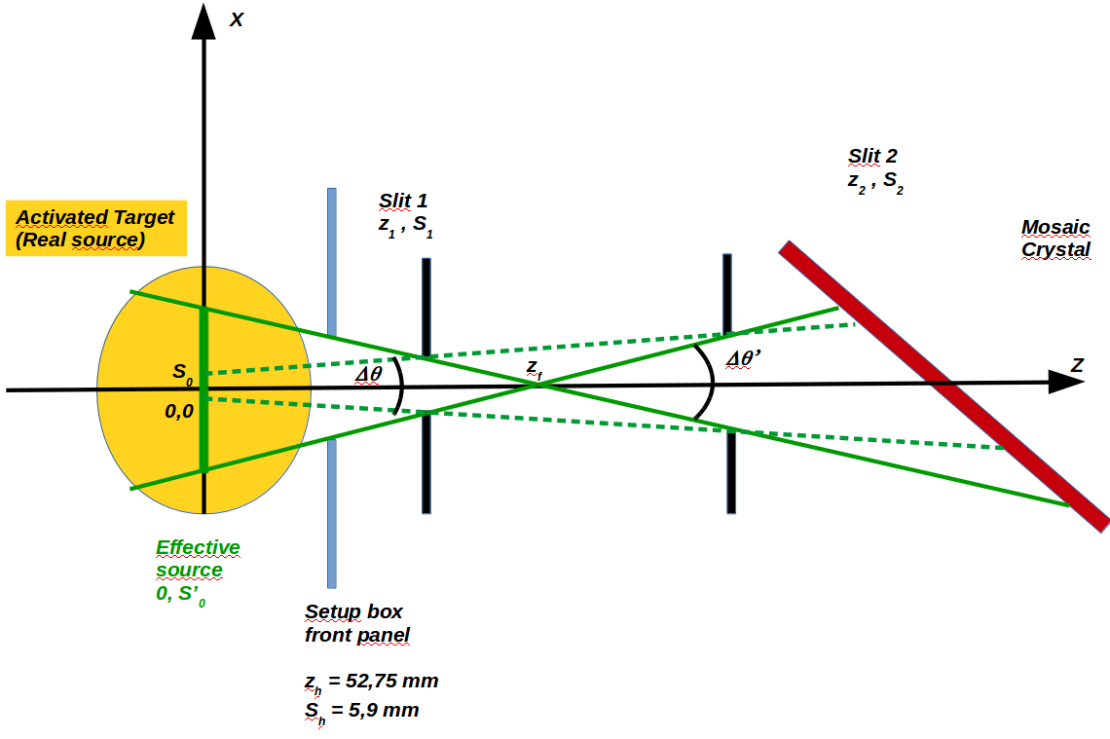
Increasing source size?
For each ∆θ’ , S₀’ pair, the 2 values of the slits can be found
Is it all? Are the red lines really (only) background?
X ray source
Slits
HAPG
Signal photons
Background (?)
With this configuration you are limited to few tens of microns sources and very compact spectrometers….

Slide 7
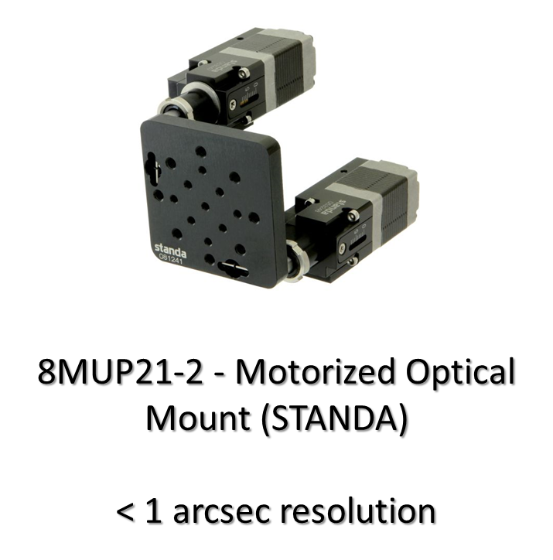
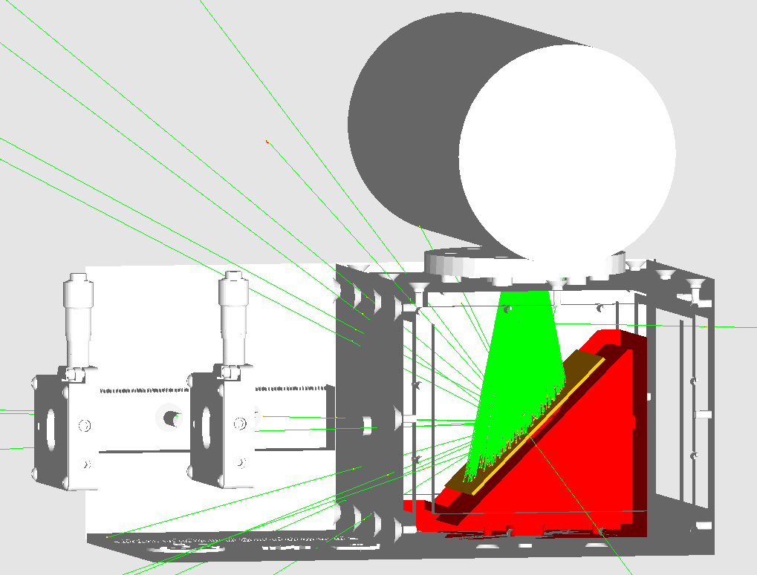
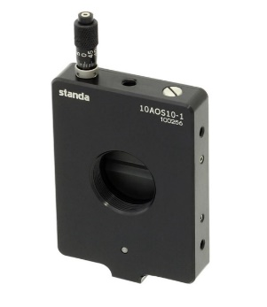
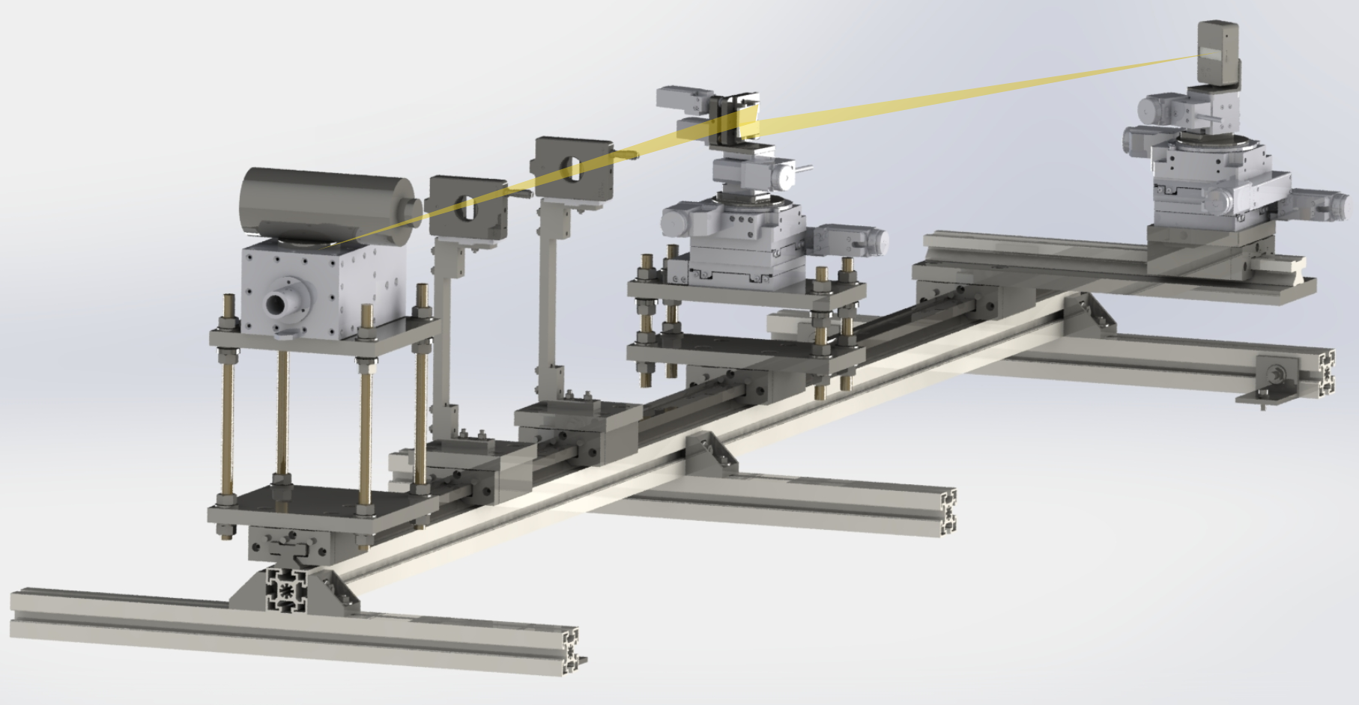
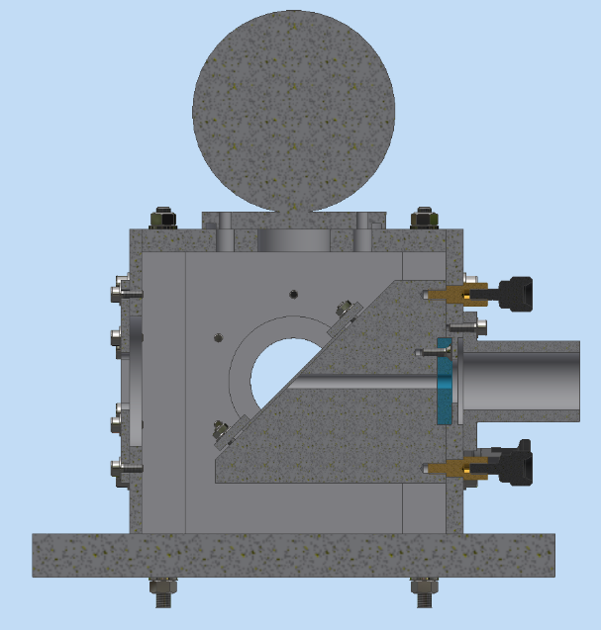
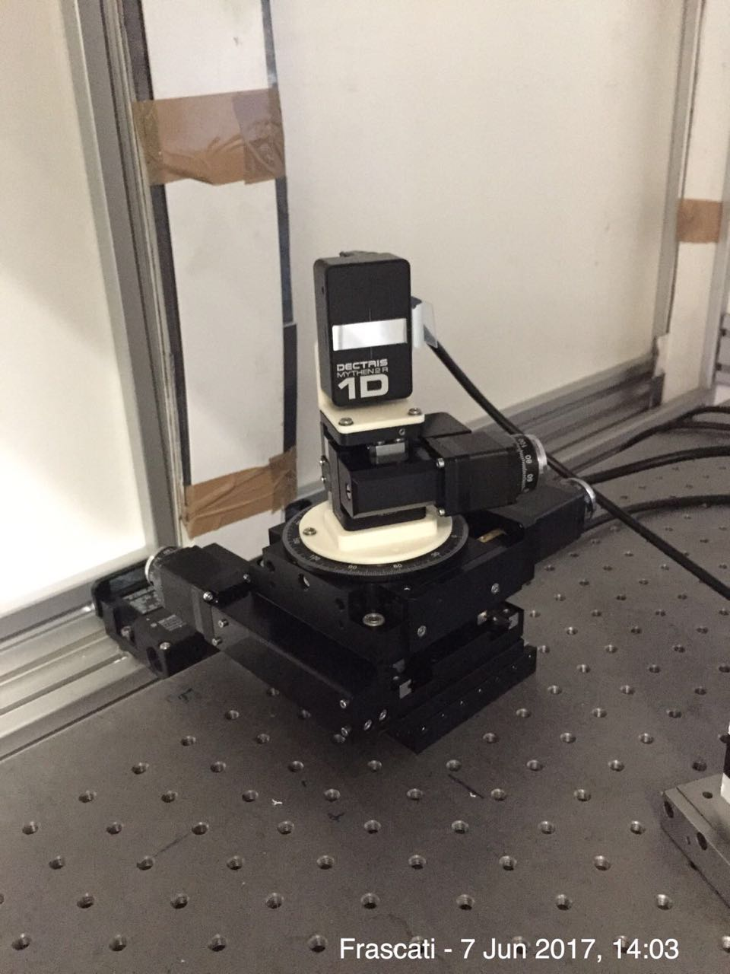
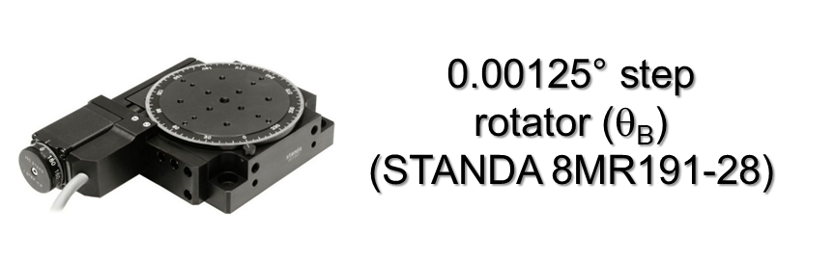
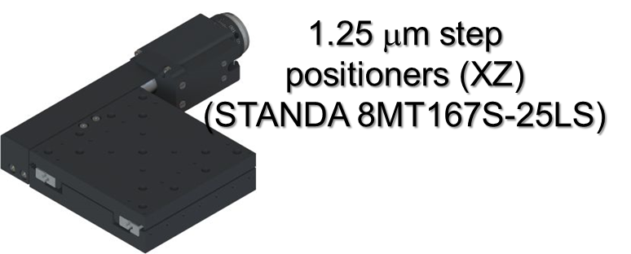
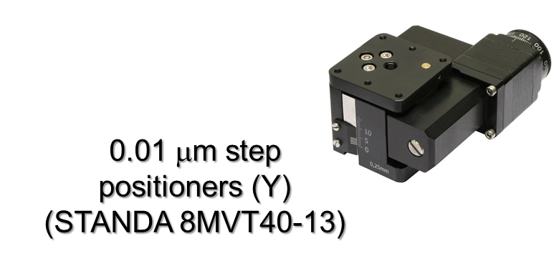
VOXES
0-10 mm opening
26 mm circular frame
< 1 μm sensitivity
Slits
(STANDA 10MAOS10-1)
Dectris Ltd
MYTHEN2 detector:
32 x 8 mm surface
640 channels → 50 μm resolution
4-40 keV range
Working @ room temperature
Talk from V. Radicci (Dectris) Thu 19/06 @ 17:00

Slide 8
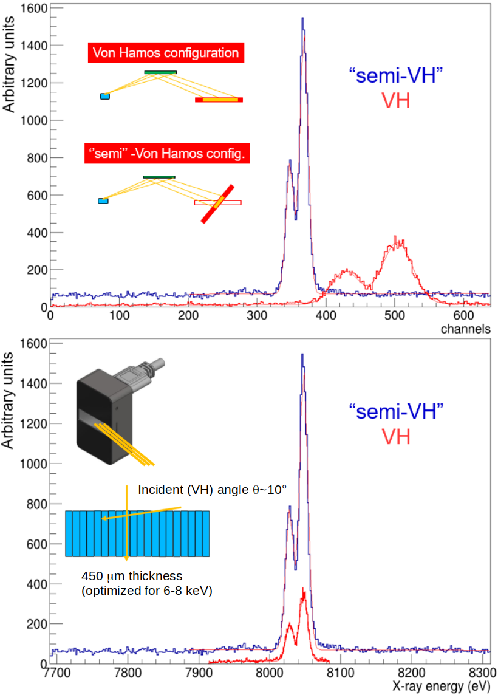
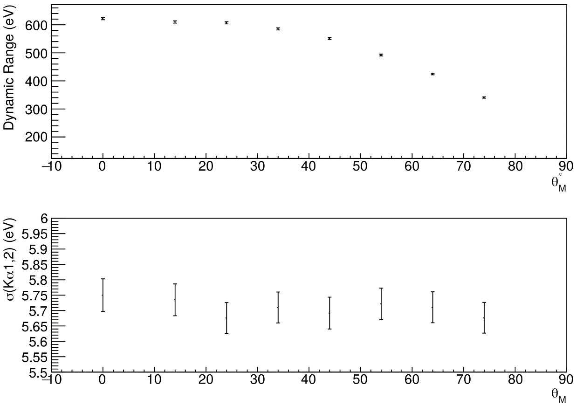
Semi-VH configuration
Position detector rotation allows a wider dynamic range and a higher efficiency without worsening peak resolution

Slide 9
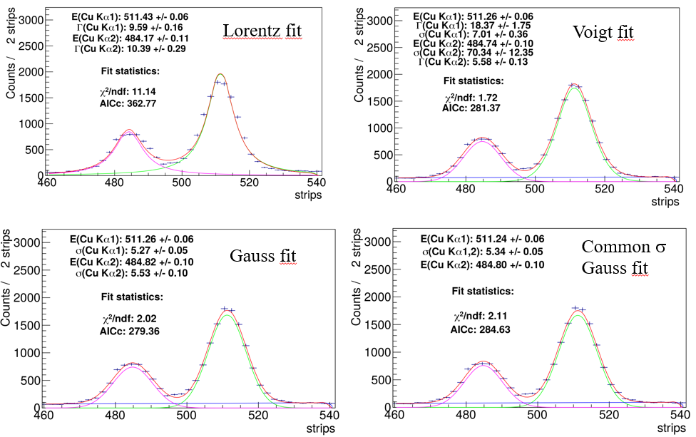
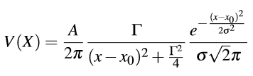


Peak fitting function
Which is the correct shape to be used for peak fitting? (Natural linewidths are Lorentzian but….)
Is Voigt really better?
Akaike Information Criteria:
N = num of fitted points
p = num of fit parameters
(for N/p < 40)
For each model i the quantity e^{−0,5(AICcmin−AICi)} is proportional to the probability of the i-th model to minimize the (estimated) information loss as good as the minimum AICc one.
Not much information loss using gaussian shape

Slide 10
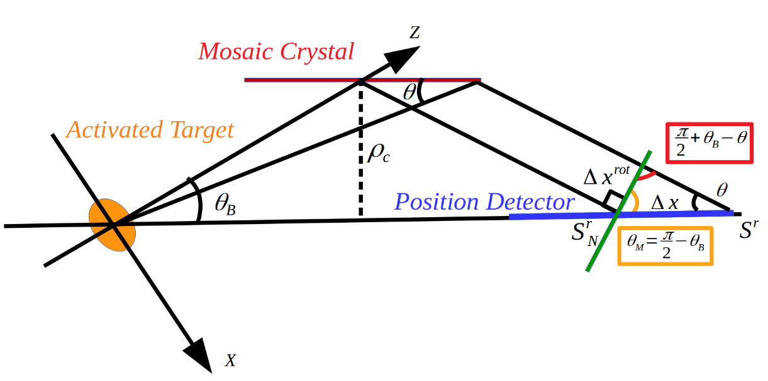
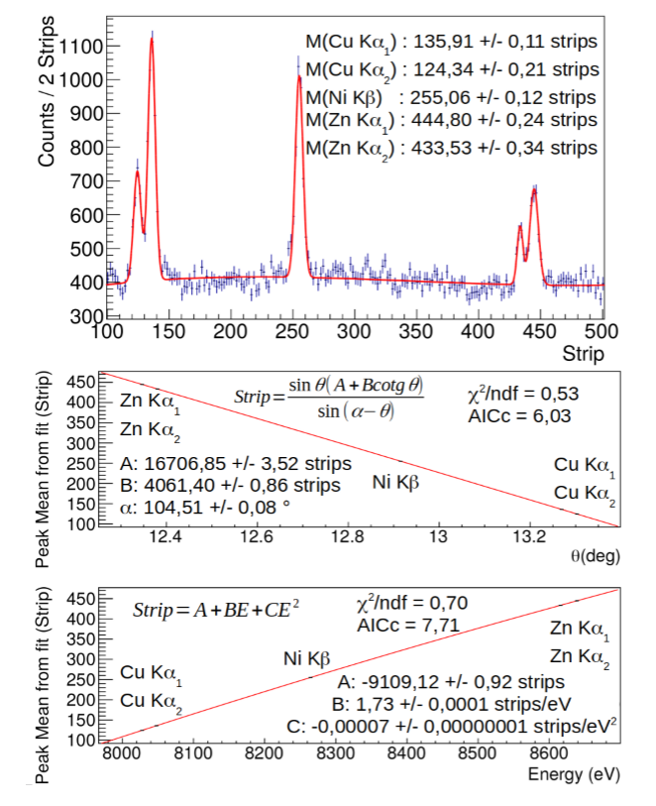
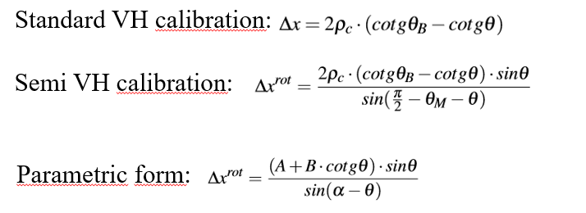
Calibration method(s)
For small θ values (sinθ ≈ θ) or small ranges,
is it also possible to calibrate with a linear function

Slide 11
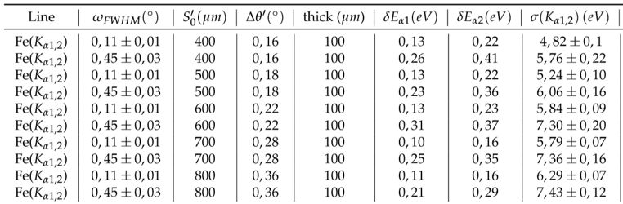
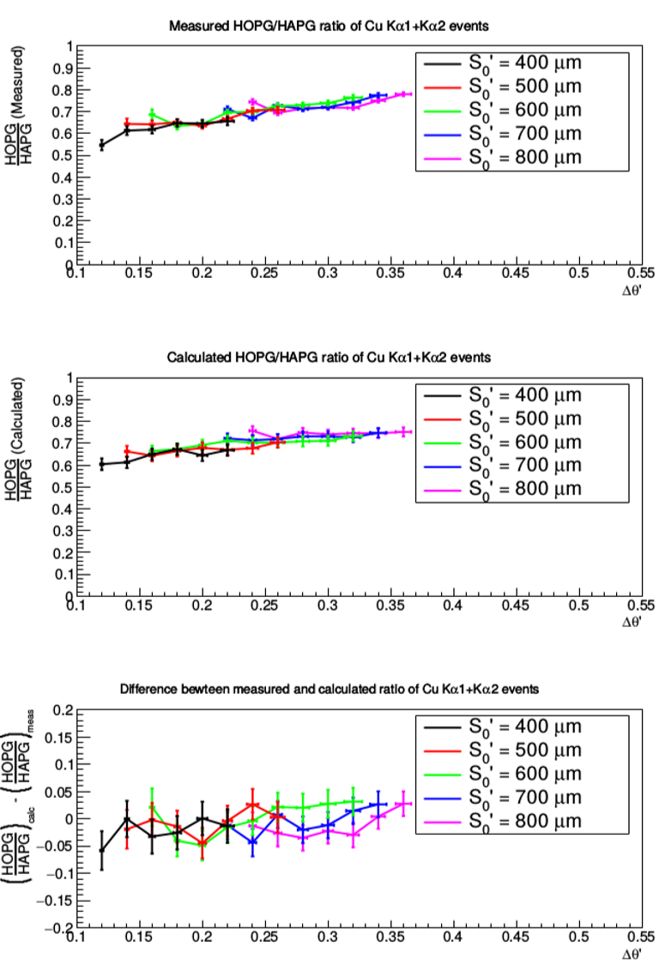
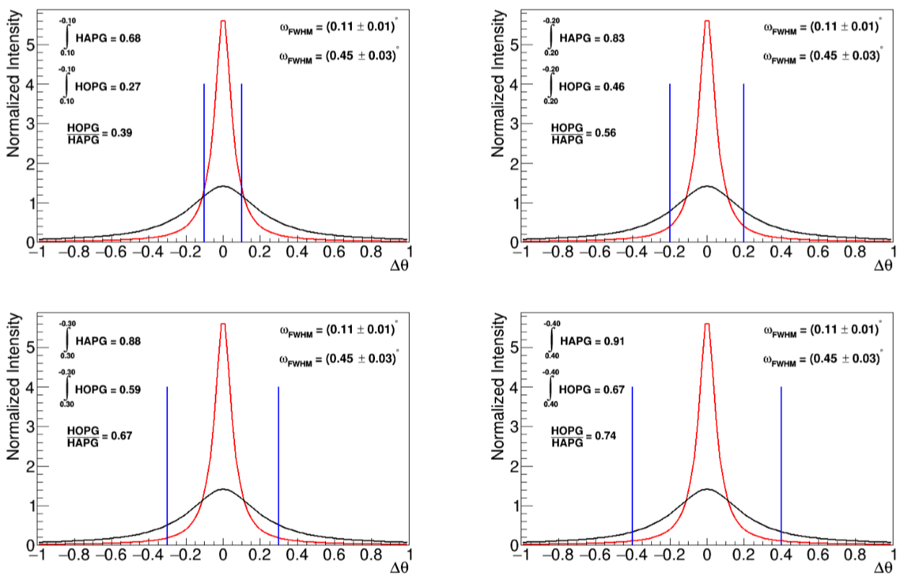
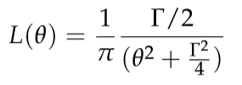
Effect of mosaicity
Mosaic spread is worsening resolution (as expected…)
…but why not increasing the rate???
Mosaicity should be chosen depending on the application

Slide 12
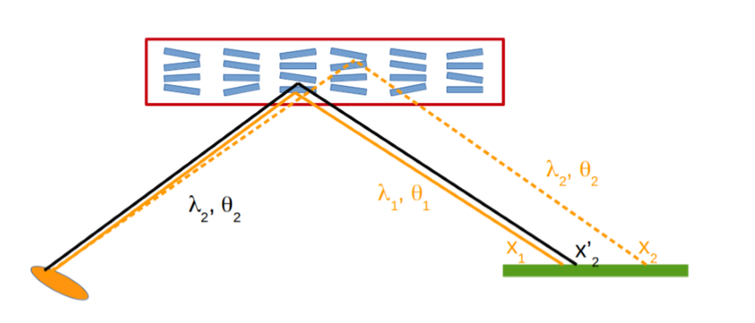
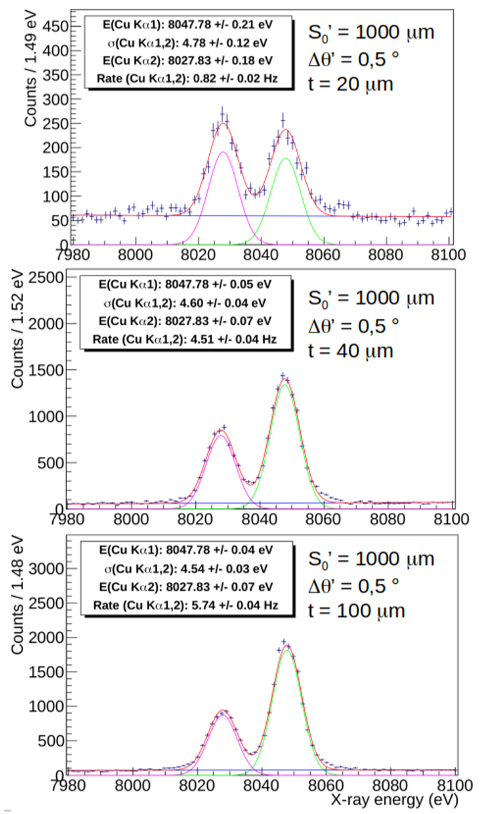
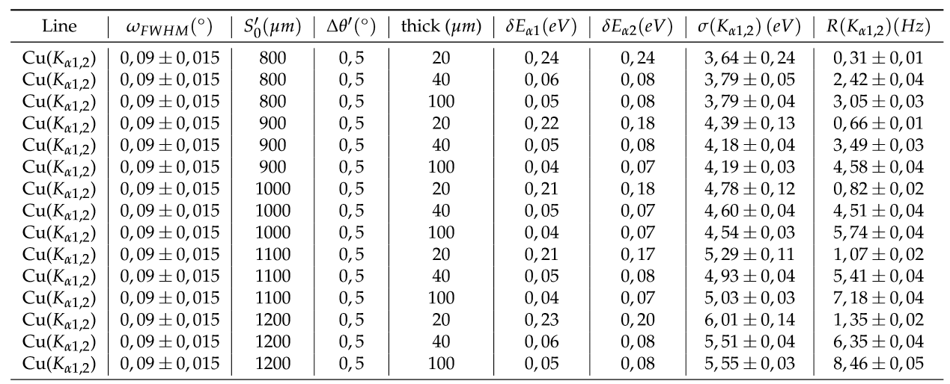
Effect of crystal thickness
The resolution worsening effect induced by the crystal thickness is not anymore predominant; on the contrary, the resolution broadening induced by the source size is more important.

Slide 13
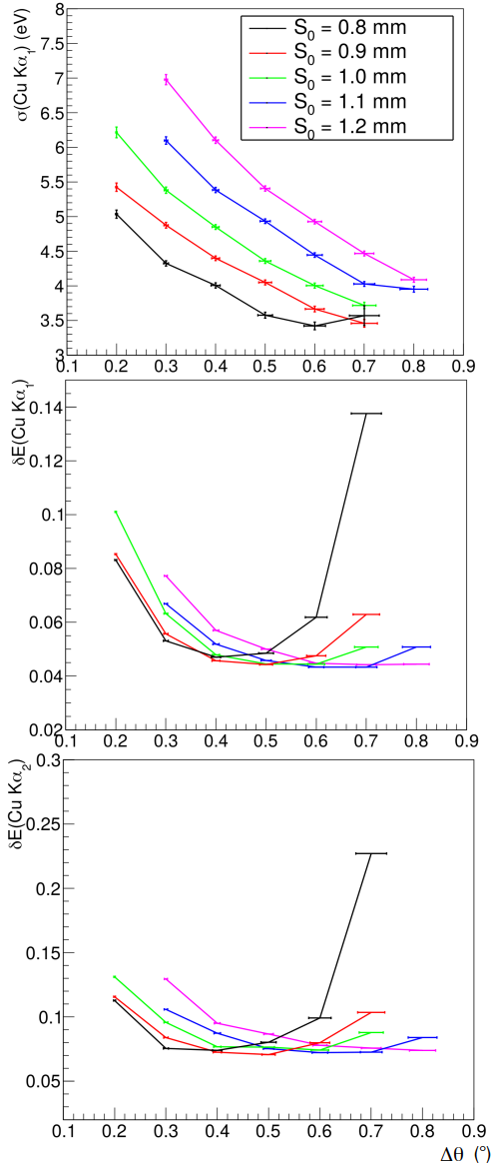
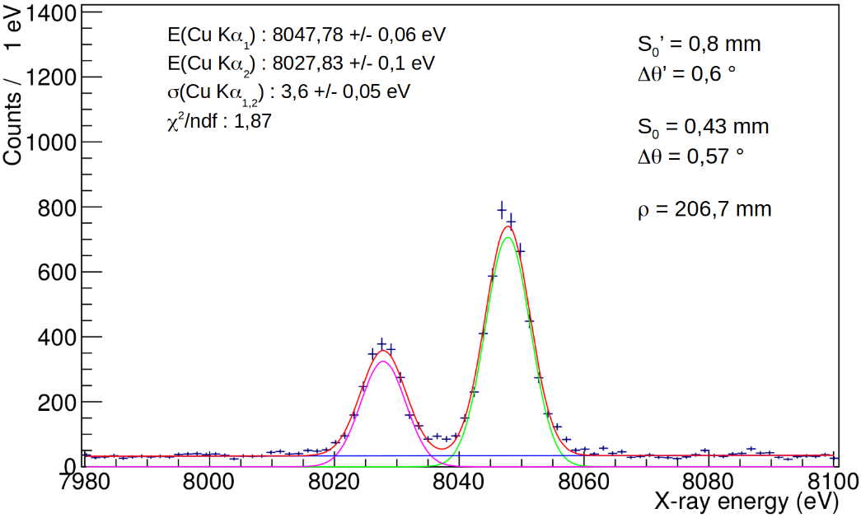

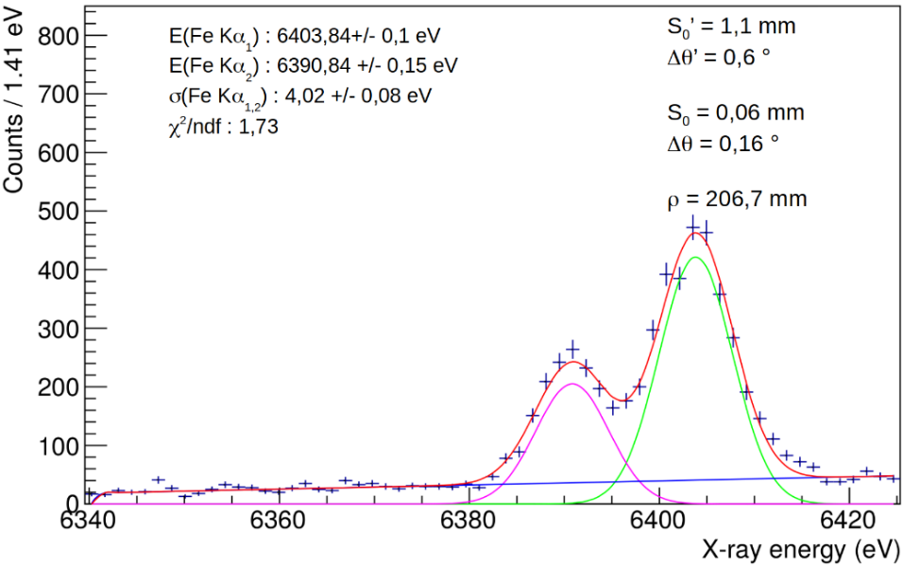
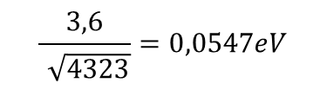
VOXES: Main results
In the limit of a background free pure gaussian peak, the precision is related to the resolution via:
$$\frac{3,6}{\sqrt{4323}}=0,0547eV$$
Given the energy and ρ_{c} it is alwasy possible to find the optimal configuration to obtain the best peak position precision
Valid for all energies
(tested for 6-20 keV)

Slide 14
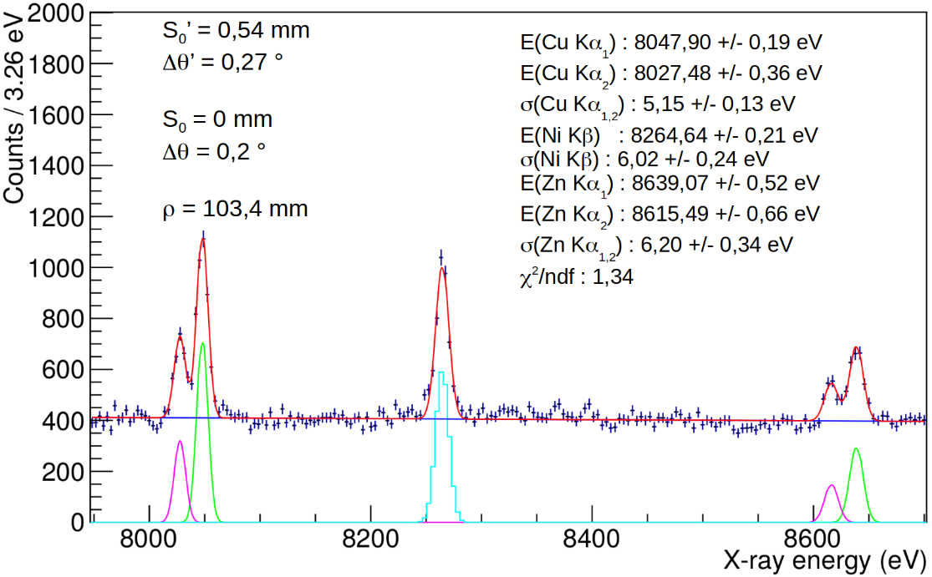
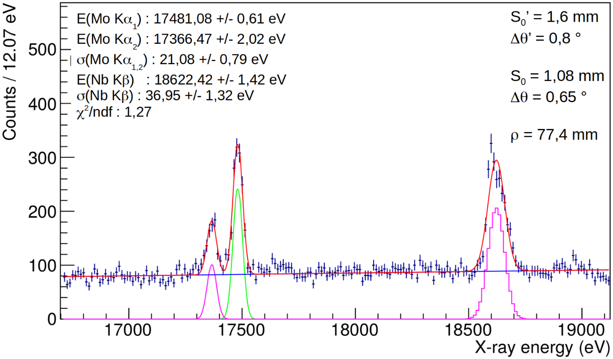
VOXES: Main results
700 eV dynamic range (one shot)
Resolution still at 6 eV level (σ)
>1 keV dynamic range
Resolution still at 1,2 ‰
Almost 2 mm source size
Did we understand the geometry properly?
How can we test the actual source size?
Do we get what we should?
X-ray tracing simulations

Slide 15
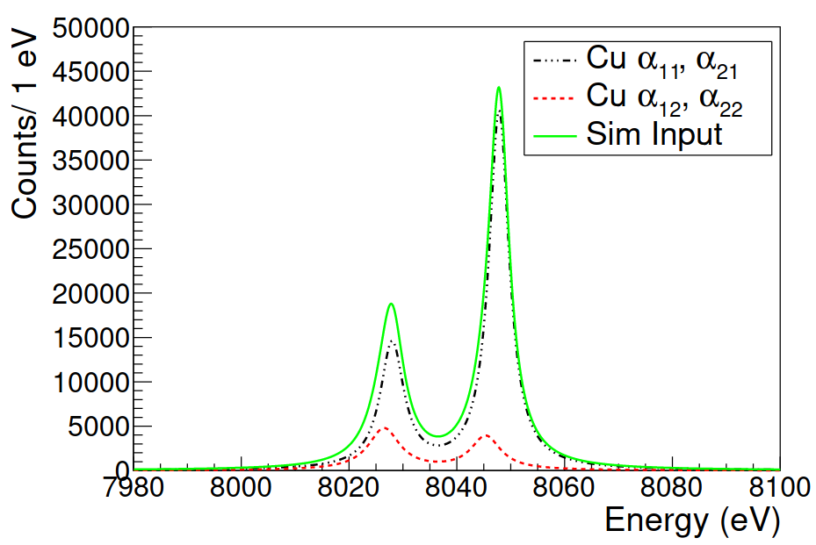
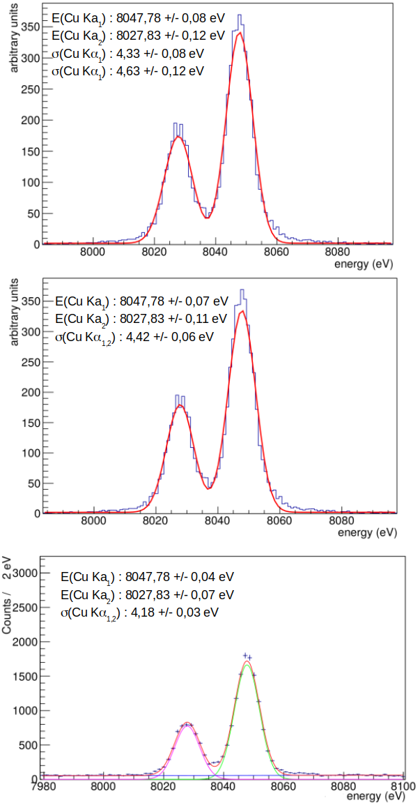
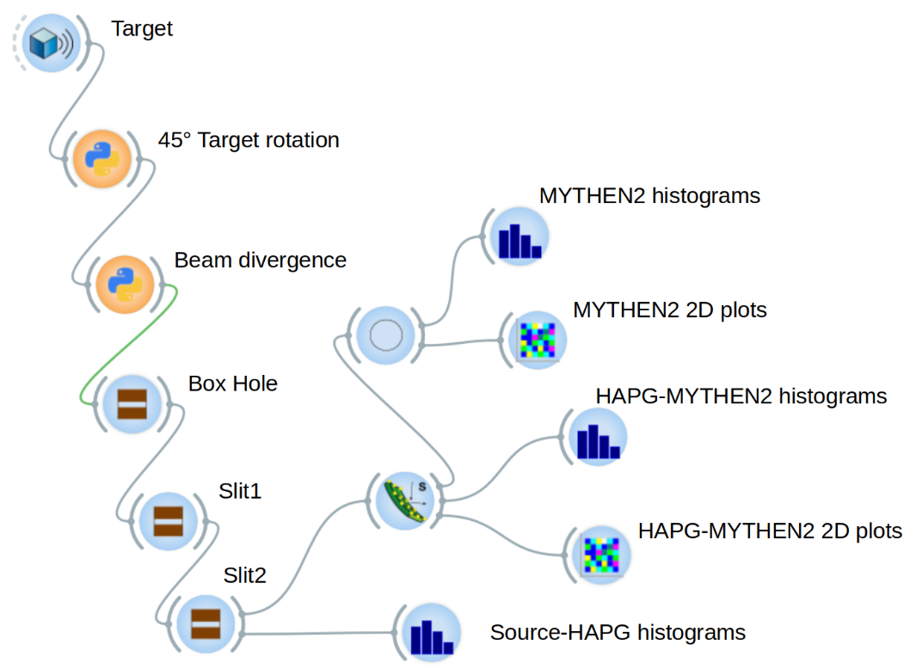
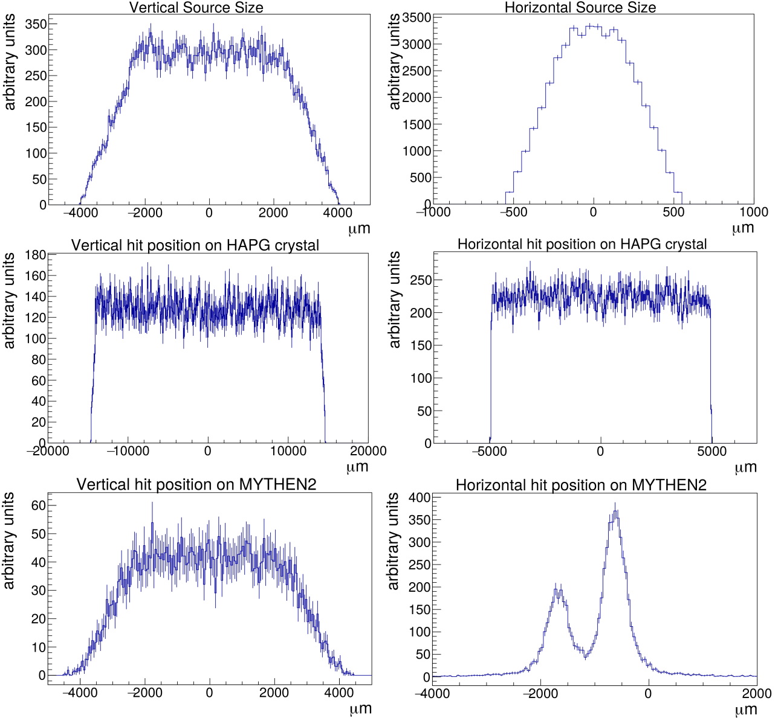
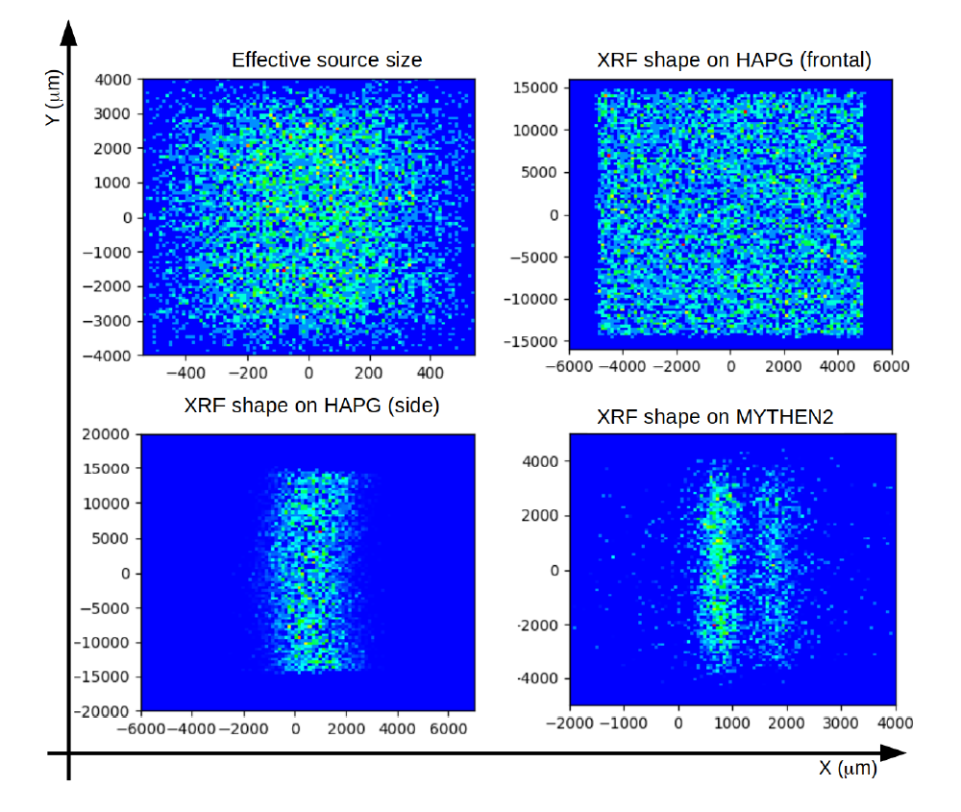
Ray tracing simulations
Shadow + XOP code embedded in OASYS framework
Peak position and σ well reproduced
(MYTHEN2 cross talk not included)
Source dimensions in agreement with the horizontal and vertical expected values
RT
Talk from M. Sanchez del Rio Wed 18/06 @ 15:30
Exp.

Slide 16
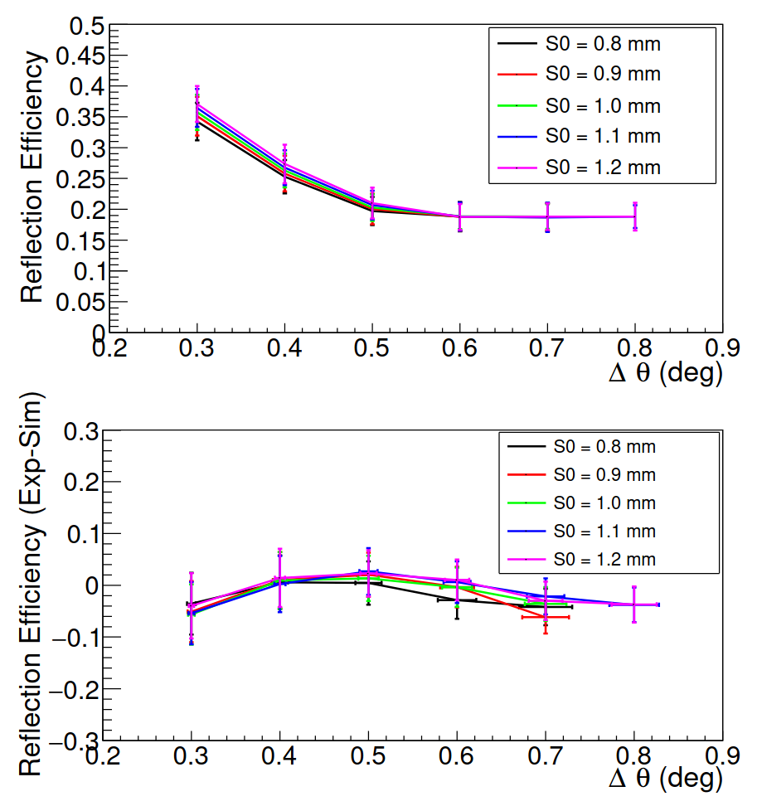

Ray tracing simulations
Reflection efficiencies are also well reproduced and under control

Slide 17
Summary
HAPG based Bragg spectrometers represents a concrete possibility for future sub-eV precision measurements from large isotropic sources
VOXES collaboration developed in Frascati a version of such a spectrometer, to be used also with sources up to mm/cm dimensions
The obtained results are very promising, showing precisions and resolution (well) below 1 eV and 10 eV, respectively
MC ray tracing simulations have been also performed, which proved to be solid and to perfectly match the data. All these ingredients represent a fundamental starting point for future application
VOXES have many possible applications in agrifood, material investigations, fundamental physics….others?
See talk from S. Manti Wed 18/06 @ 15:50
References:
V. De Leo et al., Condensed Matter, 2022, 7,1
A. Scordo et al., RAP Conference Proceedings, 6 (2021), 82–86
A. Scordo et al., J. Anal. At. Spectrom., 2021, 36, 2485-2491.
A. Scordo et al., J. Anal. At. Spectrom., 2020, 35, 155–168.
A. Scordo et al., Condensed Matter, 2019, 4, 59.
A. Scordo et al., JINST, 2018, 13, C04002.
A. Scordo et al., Acta Phys. Polon., 2017, B48, 1715.

