Slide 1

The hidden becomes apparent:
Measurements of Carbon Layer Thickness in Air
High Precision X-Ray Measurements 2025
Elena Blokhina ¹, Gennadi Gudi ²,
Inna Grigoreva ², Falk Reinhardt ¹
¹⁾ Bruker Nano GmbH
²⁾ Optigraph GmbH
Frascati 2025 10 June 2025

Slide 2

Measurements of Carbon Layer Thickness with X-Ray Fluorescence in Air
The hidden becomes apparent
01
04
Measurements of Carbon Layer Thickness: Instrument Calibration
Graphite Optics
02
05
Measurements of Carbon Layer Thickness: practical Examples
Quality Control of Graphite Optics
03
Measurements of Carbon Layer Thickness: Methodological Approach
06
Summary

Slide 3
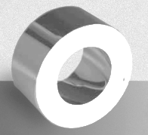
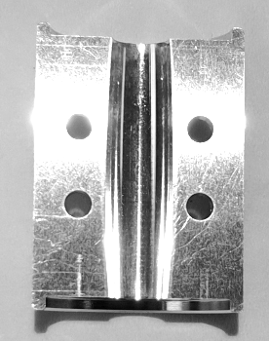
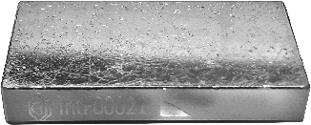
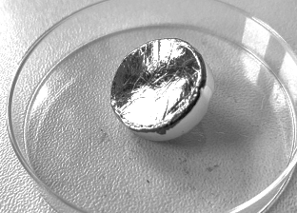
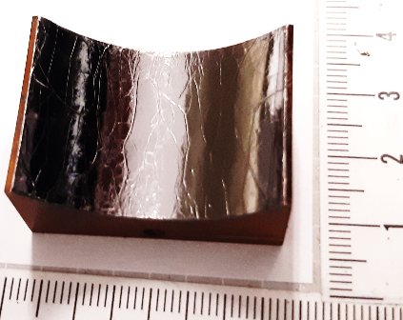
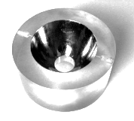
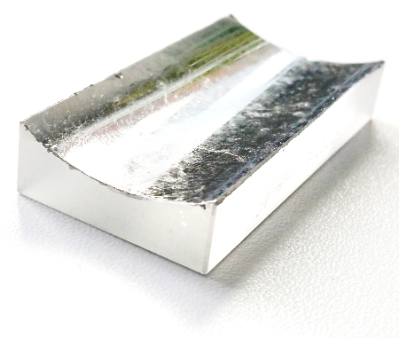
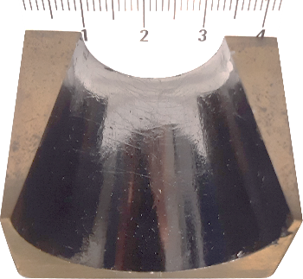
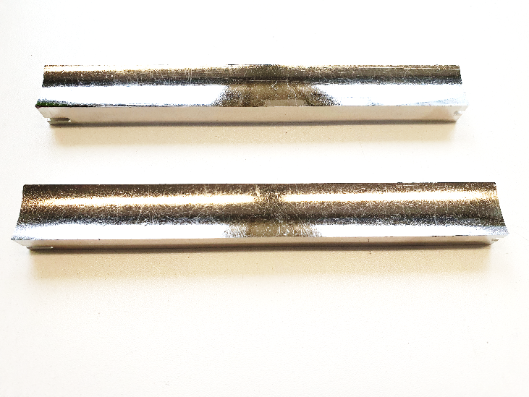
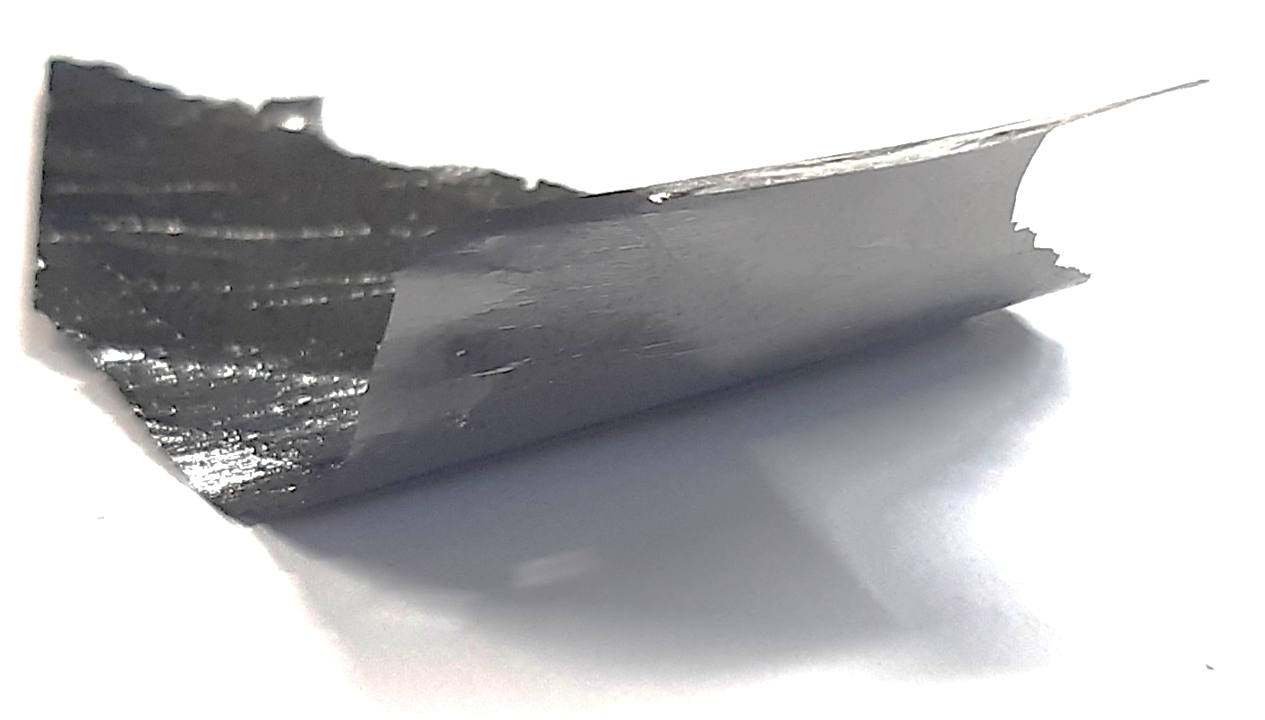
Examples of Graphite Optics produced by Optigraph GmbH
Graphite Optics
The following examples illustrate the range of Graphite Optics (GO) produced by Optigraph GmbH as Graphite coatings on substrates of different shapes and different materials:
non-measurable
measurable in the fixed X-ray geometry
with limited measurability due to their geometry
Flat on glass substrate
special complex shape
Full revolution shape
Cylindric on glass or aluminum
Elliptical on aluminum
conical
Freestanding films
Log spiral on a PMMA plastic

Slide 4

X-Ray Fluorescence as a Method for Controlling of GO Thickness
Quality Control of Graphite Optics
The quality of GO depends among others on its thickness and homogeneity. The control method must be non-destructive and allows to inspect foils in a wide thickness range on different substrates.
One of the most common methods for controlling of coating thickness in micrometer range is X-ray fluorescence, which provides information about a number of emitting atoms, i.e., about the mass per area of the element of interest.
e⁻
Detector
Typically, an X-ray fluorescence spectrum of a coated sample contains emission lines of all substrate- and layer-elements. The ratio of the line intensities from coating and substrate changes depending on the coating thickness due to attenuation of characteristic emission lines.
Notes:
Which information about measured samples could be obtained from X-ray spectra?
We typically talk about analyzing the sample composition because spectra contain characteristic lines of chemical elements. However, in the case of a coated sample, not only the composition of individual layers, but also their thicknesses as area density can be determined, because in spectra we effectively register the number of atoms emitting from the layer.

Slide 5
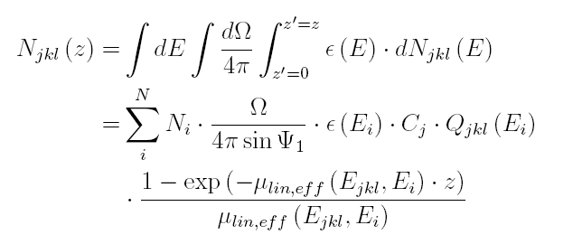

Thickness Determination Using X-ray Spectra of Coated Samples: Emission versus Absorption
Quality Control of Graphite Optics
Intensity ratio of observed elemental lines, enables the calculation of respective layer thicknesses
Usability of fluorescence lines of coatings elements is limited by saturation caused by self-absorption. The maximal measurable thickness varies from 0.5 µm up to 70 µm depending on the coating composition and measurement conditions
Layer fluorescence
rel. intensity
Base fluorescence
$$d$$
Layer thickness →
Sherman equation: emission from a finite layer
e⁻
Detector
Usability of fluorescence lines of substrate elements is limited by saturation caused by the absorption in coatings. The maximal measurable thickness varies from a few nanometers up to hundreds micrometers depending on the sensitivities of coating elements and measurement conditions
Notes:
intensity of the layer element line increase with the layer thickness: initially linear with very thin layers, then rises to saturation at a certain layer thickness, which depemds on the material and the measurement geometry.
Generally, the number of the eminning layer atoms can be expressed by the Sherman equation, where Ω is the solid angle of detector, ε(Ei) – the detector efficiency, µ_{lin;eff} (E_{jkl};E_{i}) – the effective linear absorption coefficient, Ψ₁ – the incidence angle and Q_{jkl}(E) =τ_{jk}(E) ω_{!jk} p_{jkl} is the excitation factor as a product of emission yield, photoabsorption cross-section and radiation transition probability.
In the same time the intensity of the base element line decreases with the increasing thickness of the covering layer.

Slide 6
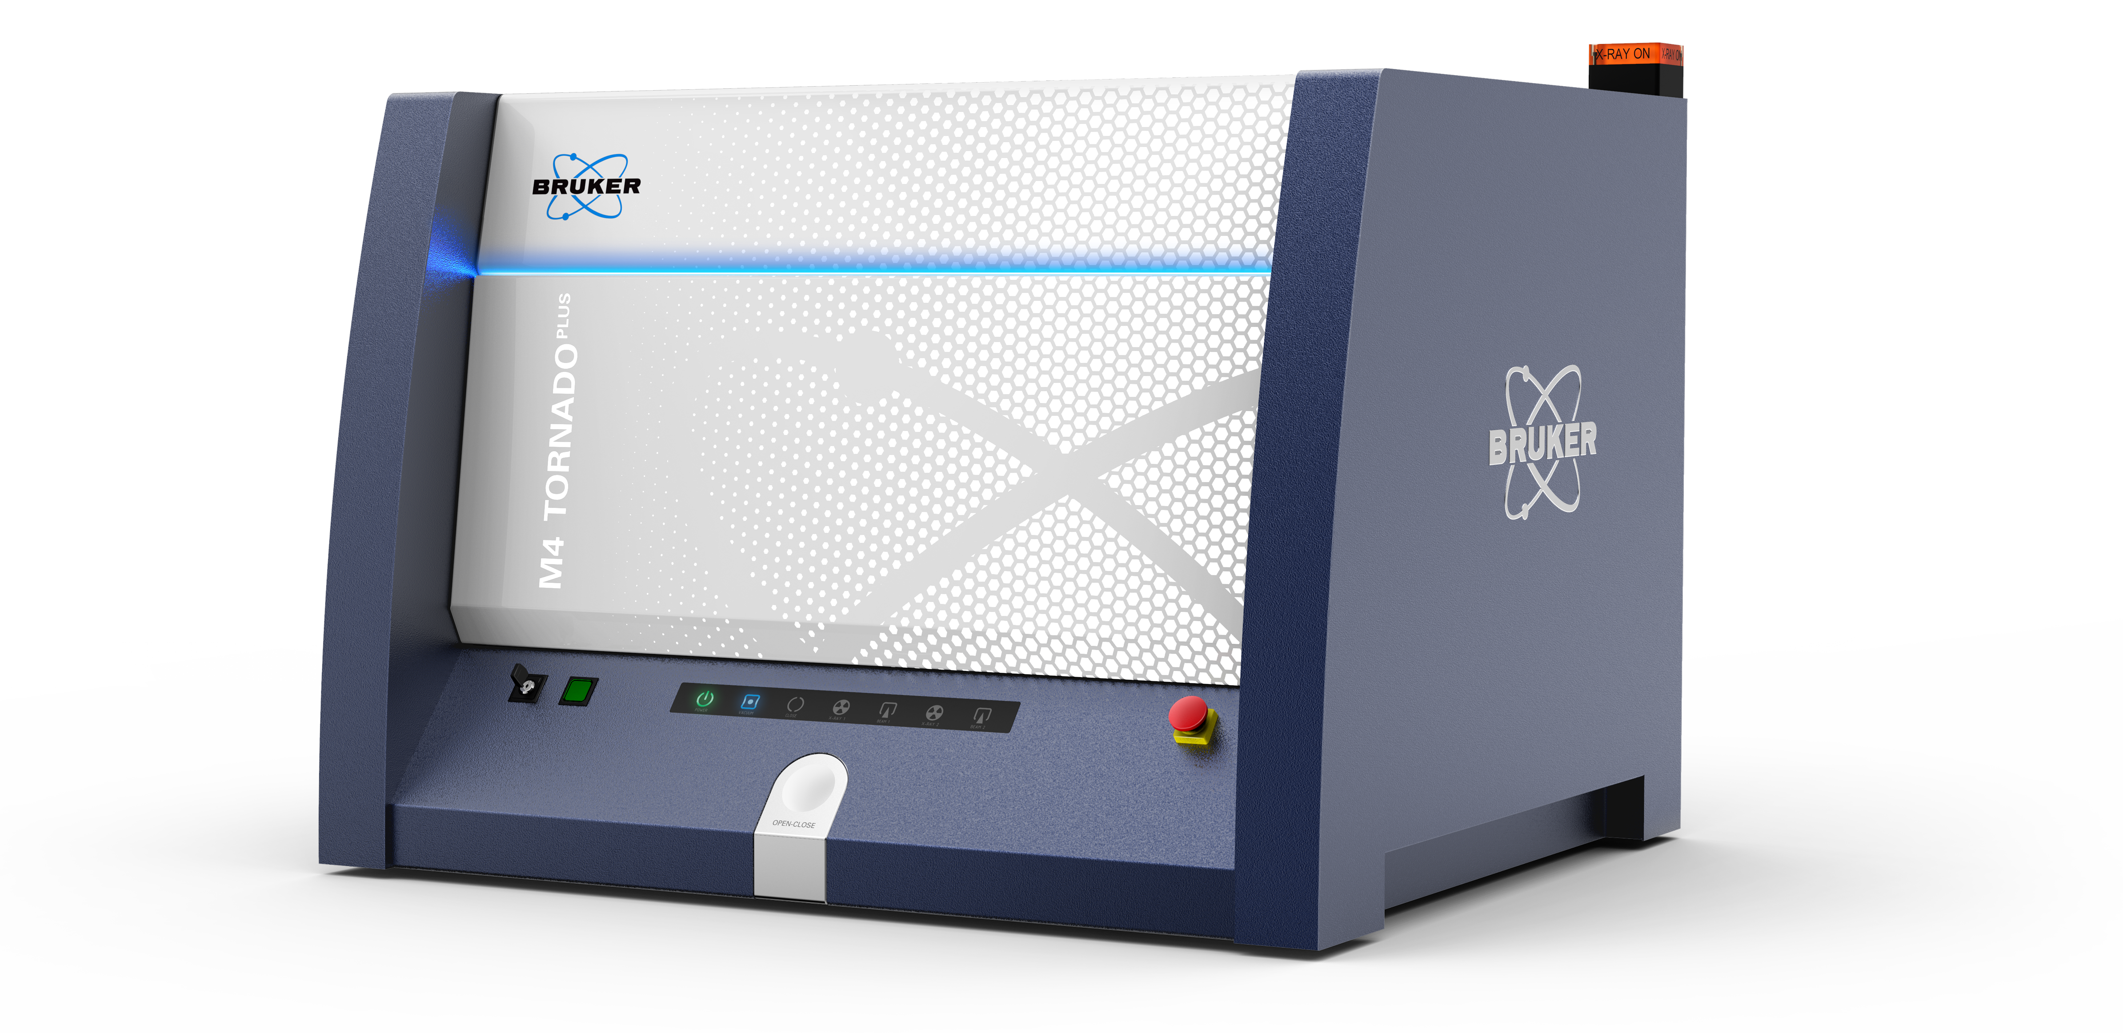
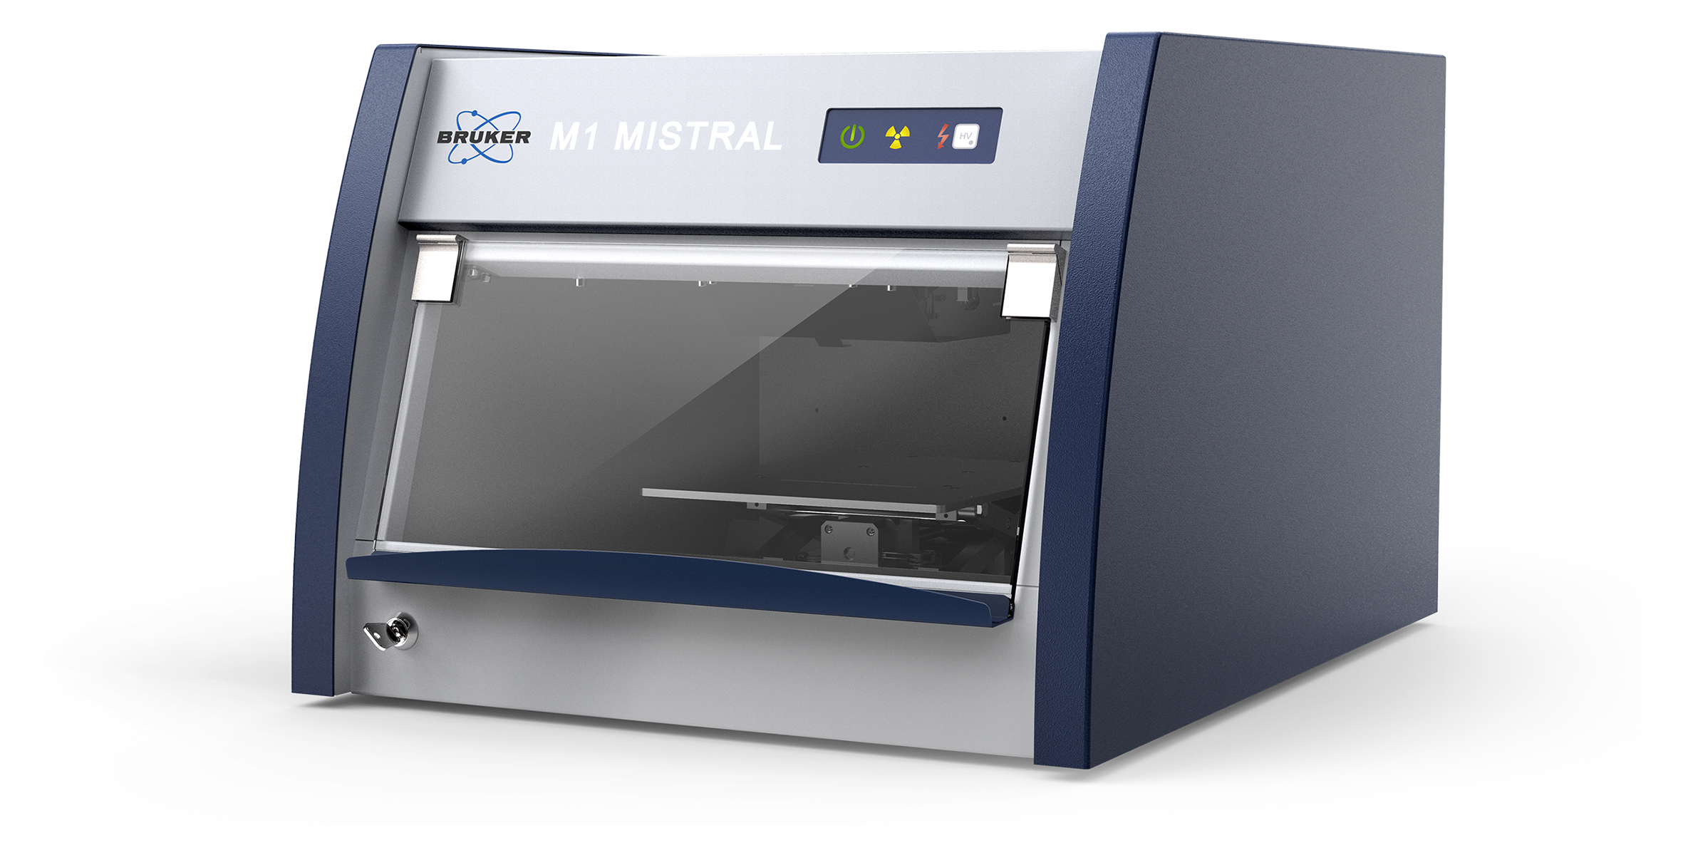
X-ray Instruments used for Graphite Foil Thickness Measurements
Quality Control of Graphite Optics
Two X-ray fluorescence analyzers with different measurement capabilities were used to develop a technique for rapid control of thickness and homogeneity of GO without the use of vacuum.
 | M1 MISTRAL | M4 TORNADO plus
Excitation | Microfocus-X-Ray tube with Rh target and Be window | Flexible excitation through use of up to 2 X-ray tubes and 5 filters
Spacial resolution | Collimator changer from 0,1 mm up to 1,5 mm diameter round or slit | Polycapillary X-ray optics for spot sizes 25 - 15 μm for Mo-K
Vacuum | no vacuum | down to 2 hPa
Detection | SDD 30 mm² | SDD 60 mm², optionally 2nd detector
Measurable elements | Element range from Al to U | Elements from C to U
Video | Top view video camera (30x) | 2 cameras for sample images in 10x and 100x magnifications
Sample positioning | Easy Load funktion | Easy Load function and overview camera
Sample stage | Programmable X-Y-Z-stage | TurboSpeed X-Y-Z stage
Working modes | Single and Multi-point / raster measurements | Single, Multi-point, Line scan and Mapping measurements
Quantification | Bulk, liquids, coatings | Bulk, liquids, coatings
Visualisation | Spectra displaying with deconvolution mode, trend lines | Spectra displaying with deconvolution mode, line scan, QMaps
Method setup | Method editor for all kinds of samples | Direct setup for bulk sample analysis or Method editor for coatings analysis and special calibrations
Operation | Simplified mode with Touch UI optionally
M4 TORNADO plus
M1 MISTRAL

Slide 7
Quantification Methods for X-ray Spectra:
Advantages and Limitations
Measurements of Carbon Layer Thickness: Methodological Approach
Emission mode, using the layer element fluorescence lines for calculation of layer thickness and composition:
    direct information, no additional element/lines measurements are necessary
    in consideration of secondary excitation effects
    physical limitation of the information depth due to self-absorption depends on the element and selected emission lines, for Carbon Ka line it is appr. 2 µm in the used measurement geometry
Absorption mode, using the substrate element emission lines for calculation of layer thickness:
    if the emission lines of layer element can not be measured, for example were absorbed by the medium
    the stability of the thickness calculation in emission mode is decreased in the saturation region or affected by other factors, for example by secondary excitation or by line overlap
    physical limitation of the information depth due to absorption of the substrate signal in the coating
Layer fluorescence
rel. intensity
Base fluorescence
Relative mode, using the layer to substrate element emission lines ratio:
    stabilizes the coating thickness calculation
    advantageous if both coating and substrate emission lines are measurable
Layer thickness →
Notes:
All methods for quantification of X-ray spectra can be divided into 3 groups:
methods working in the Emission mode
methods working in the Absorption mode
and methods working in the Relative mode

Slide 8
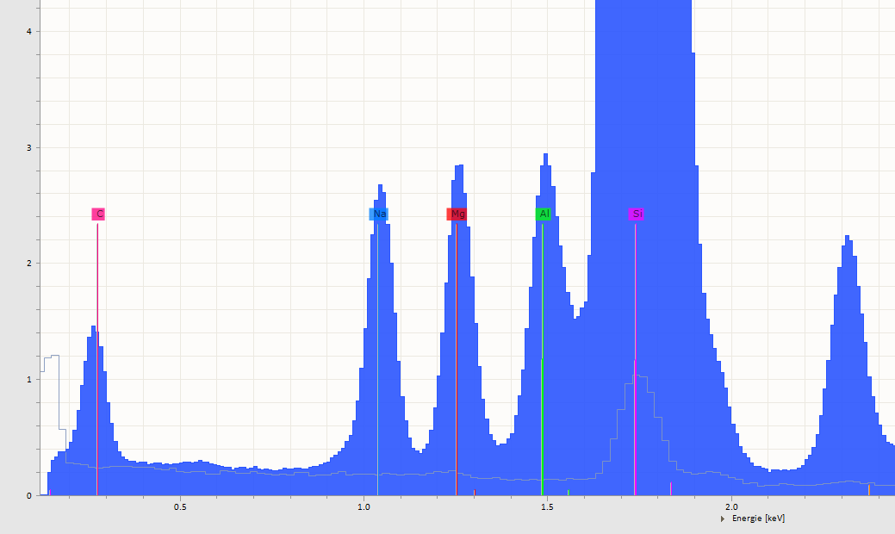
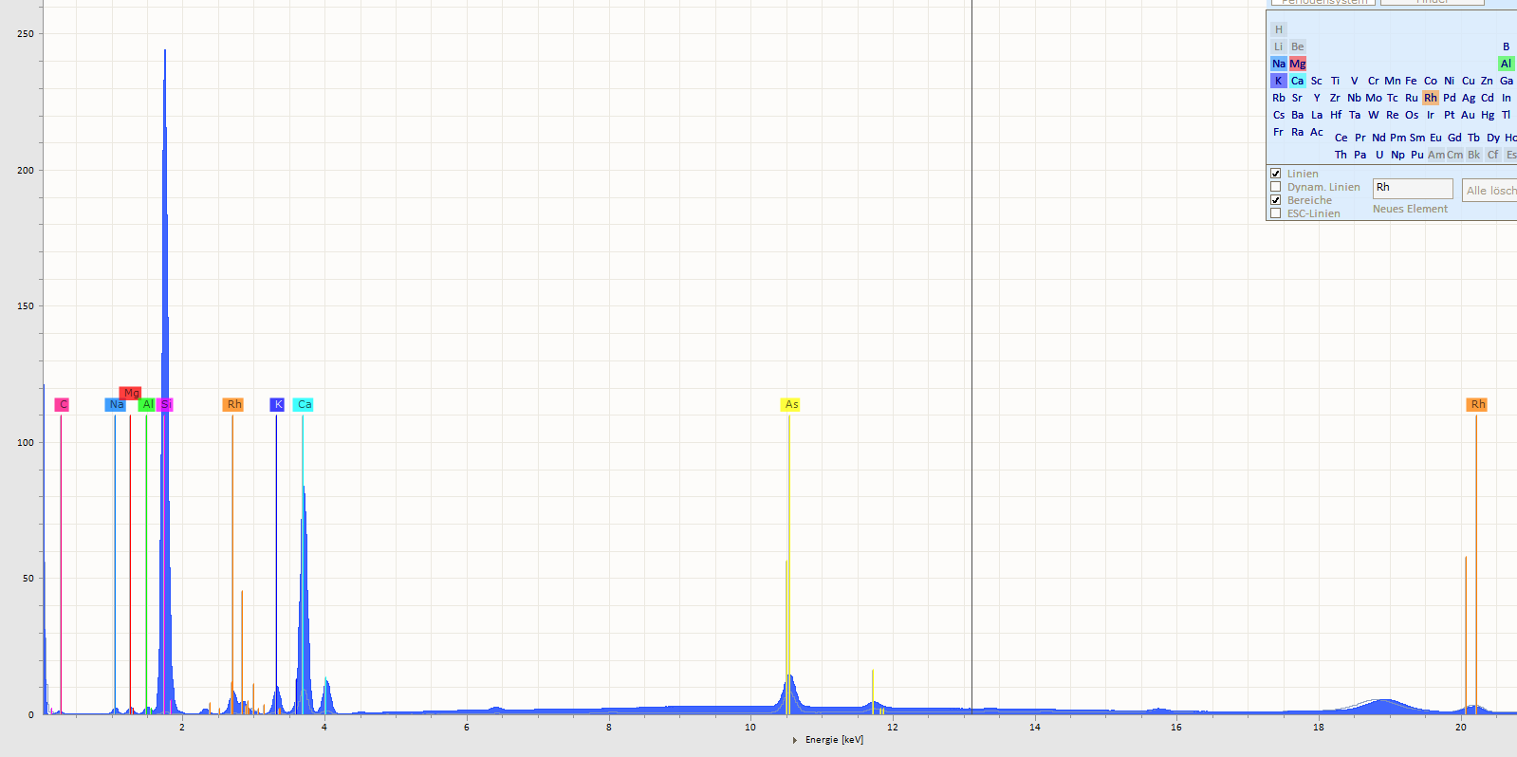
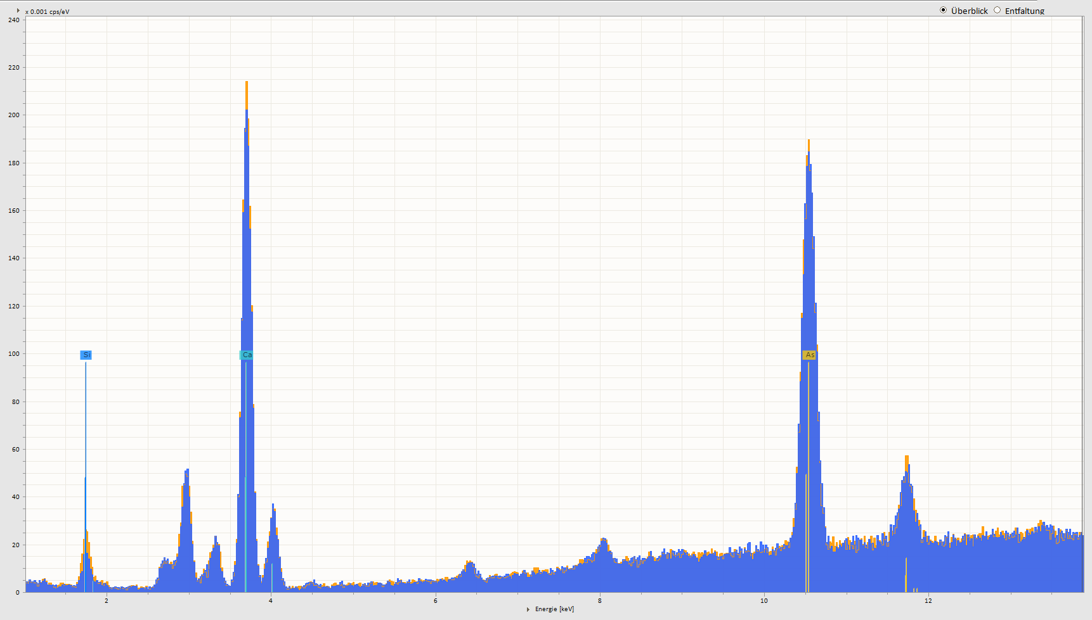
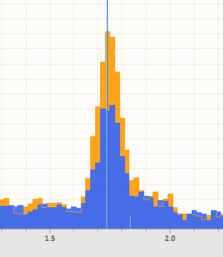
Typical X-ray Spectra of a Graphite Optics:
Selection of Analytical Lines and Quantification Methods
Measurements of Carbon Layer Thickness: Methodological Approach
The selection of the analytical line for measurement of the GO thickness depends on different factors:
Absorption in the transmission medium:
  Thin coatings need vacuum
Si
Mg
Al
Na
Si
C
Si
As
Si
K
Ca
As
Si
Ca
Spectrum of GO on a glass substrate measured on M4 TORNADO in vacuum. Carbon emission line is easily detectable, it can be used approximately up to 2 µm. For thicker Carbon layers the absorption of some line of substrate elements should be used.
M1 MISTRAL measurements in air, spectra:
Yellow – of the glass substrate without coating;
Blue – of the Graphite foil approx. 2 µm on a glass substrate.
Carbon emission line is not detectable, but Si K line is very sensitive for thin absorbing Carbon layers.
Notes:
Depending on the used instrument and available measurement conditions different kinds of quantification are suitable. For example, the emission mode for measurement of Carbon layer thickness can be used only in M4 TORNADO in vacuum, where the C K lines are detectable. Also, it is possible only up to approximately 2 µm layer thickness because of saturation in this measurement geometry.
In M1 MISTRAL spectra, measured under normal pressure, Carbon lines were absorbed by air completely and coating thickness calculation is possible only by the absorption of one of substrate lines. In case of glass substrate multiple lines are measurable, so that the selection of the analytical line depends mostly on their sensitivity to the absorption by Carbon and the thickness range of the coating to be measured.
On this slide we see spectra of the carbon layer approximately 2 µm thick, so the Si K lines are a good choice.

Slide 9
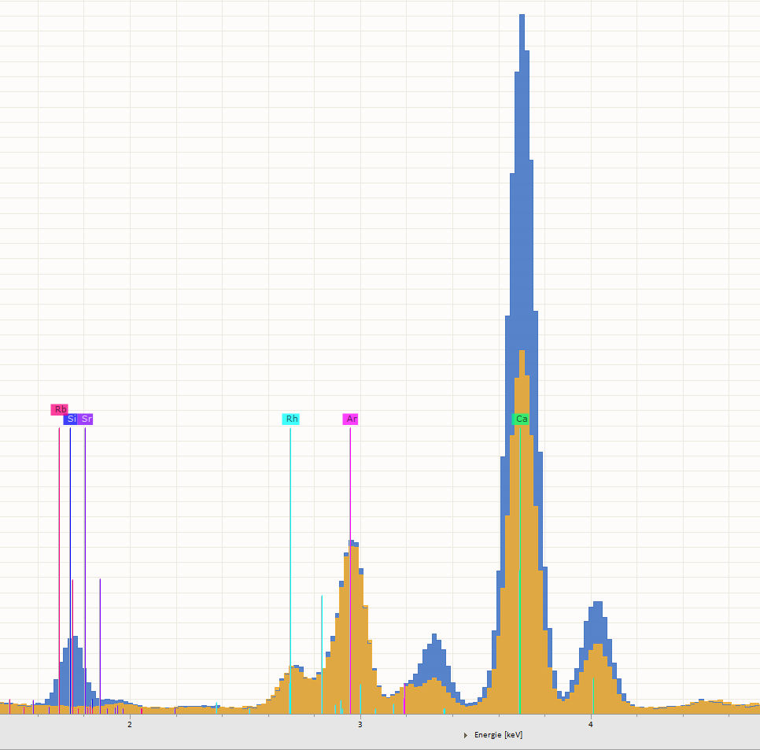
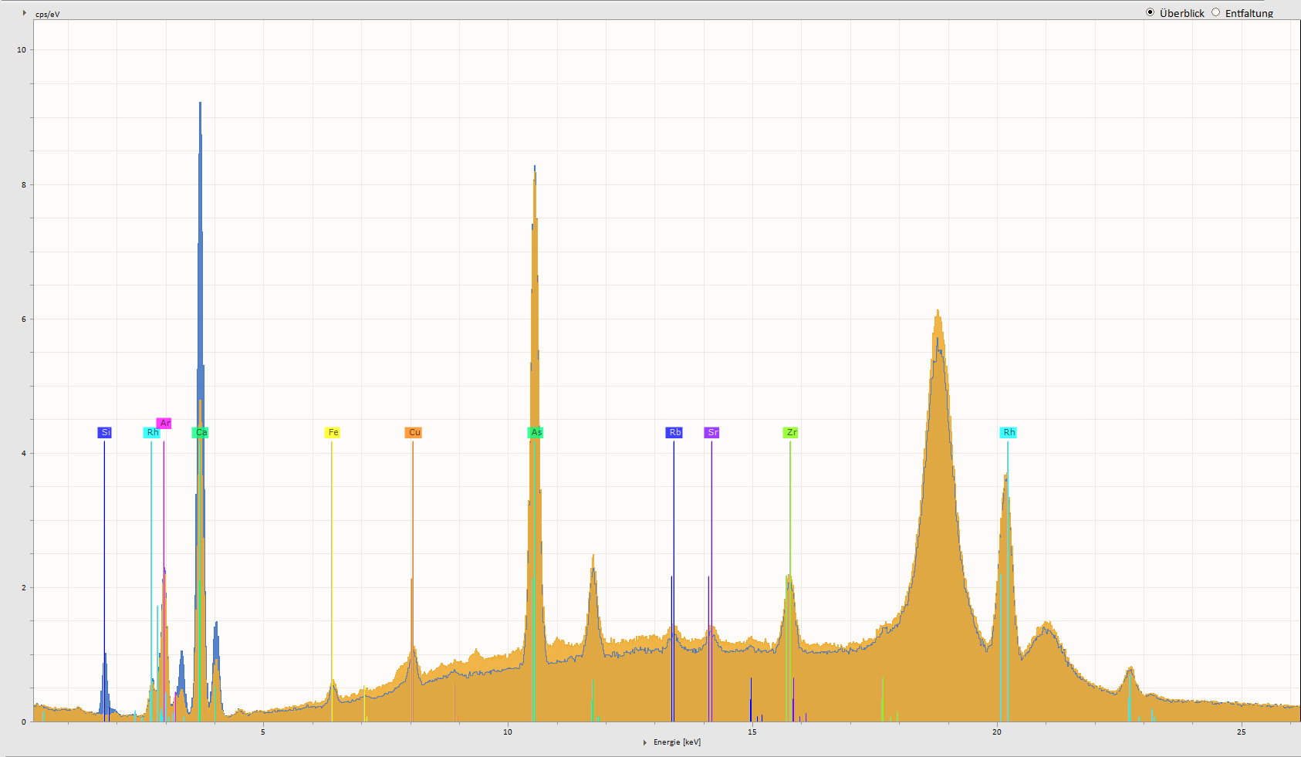
Selection of Analytical Lines :
Foil 30 µm on Glass
Measurements of Carbon Layer Thickness: Methodological Approach
Sensitivities of different lines for the coating thickness variation should be considered depending:
  on the selected coating thickness range
Measurement statistics: averaging over the surface
 | Micrometer | M1 MISTRAL
Average, µm | 30 | 31.7
StD, µm |  | 5.0
Variation, % |  | 15.9
Minimum, µm | 25 | 26.9
Maximum, µm | 38 | 47.3
Range, % | 43.3 | 64.5
Ca
Ca
Si
As
Si
M1 Mistral measurements with the collimator 1.5 mm on the glass substrate compared with the measurements with a mechanical micrometer at the same 7 x 4 points.
Measured surface is approx. 27 mm x 10 mm
Notes:
This foil shows the spectrum of the Carbon foil approximately 30 µm thick on a glass substrate (yellow), compared with the spectrum of the substrate without coating (blue). In this case the Si K lines are absorbed completely and can’t be used for calculation. Instead, the Ca K lines is favorable to the benefit in this thickness range.

Slide 10
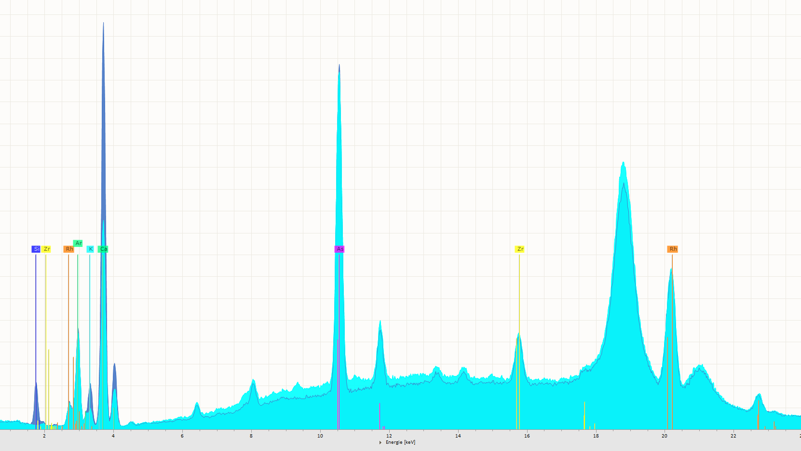
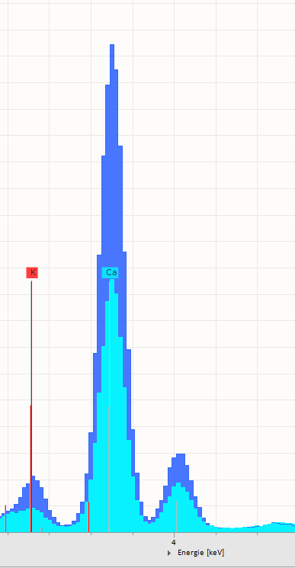
Selection of Analytical Lines :
Foil 50 µm on Glass
Measurements of Carbon Layer Thickness: Methodological Approach
Sensitivities of different lines to the coating thickness variations should be considered depending:
  on the selected coating thickness range
  on the required measurement statistics
As
Ca
K
Ca
Si
Rh
Zr
Rh
K
M1 MISTRAL measurements in air, spectra:
Blue – of the glass substrate without coating; Hell-blue – of the Graphite foil approx. 50 µm on a glass substrate.
Notes:
In this case the Si K lines are absorbed completely and can’t be used for calculation. Instead, the Ca K lines is favorable to the benefit in this thickness range. Using K K-lines is possible, but it hat worse measurement statistics.

Slide 11
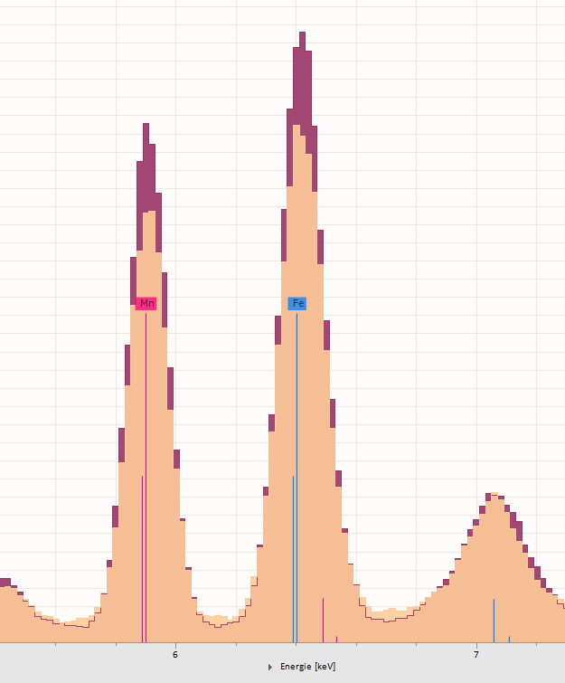
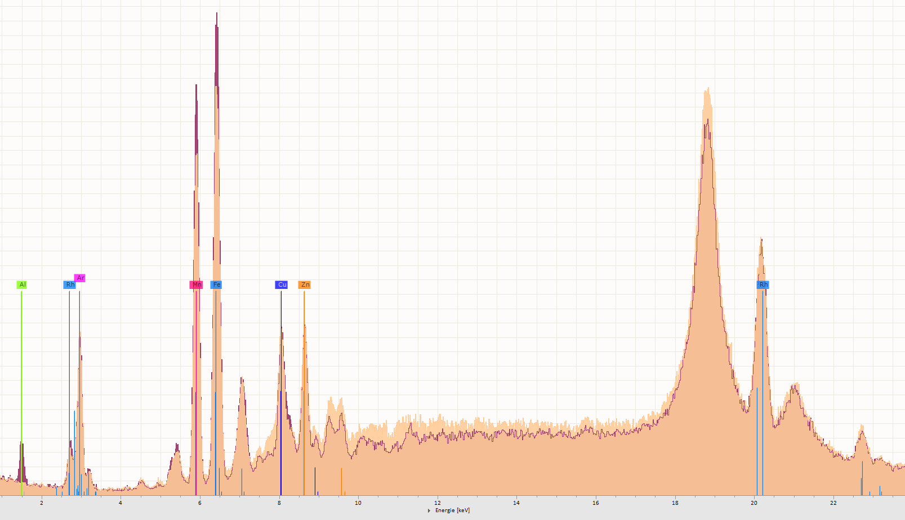
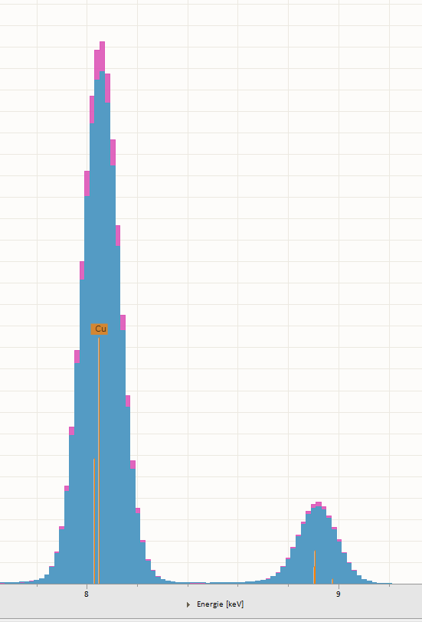
Selection of Analytical Lines :
Foil 50 µm on Aluminum Alloy and Copper
Measurements of Carbon Layer Thickness: Methodological Approach
Sensitivities of different lines to variations of the coating thickness should be considered depending:
  on the selected coating thickness range
  on the required measurement statistics
Fe
Mn
Fe
Mn
Rh
M1 MISTRAL measurement in ai:
Red - spectrum of the Cu substrate
Blue – spectrum of the Graphite foil
approx. 50 µm on a copper
substrate.
.
Al
Rh
Ar
Cu
Zn
Cu Ka
Cu Kb
M1 MISTRAL measurements in air, spectra:
Bordeaux – of an Aluminum alloy without coating;
Peach-colored – of the Graphite foil approx. 50 µm on the Aluminum alloy .
Notes:
Here the same foil is placed on the Aluminum alloy, which spectra with (peach-colored) and without coting (Bordeaux) are present on this slide. Here two element lines can be used for quantification: The Ka of Manganese or this of Iron. Copper or other metals can also be used as substrates. Even if the Cu K-lines are not so sensitive to absorption by carbon.

Slide 12
Selection of Analytical Lines :
Foil 50 µm on Different Substrates
Measurements of Carbon Layer Thickness: Methodological Approach
1
2
3
Measurements in M1 Mistral with the collimator 1.5 mm on different substrates:
1 - Glass (Ca Ka)
2 - Aluminum (Mn Ka)
3 - Copper (Cu Ka)
Measured surface is approx.
12 mm x 15 mm: 5 x 4 points
Measurement statistics: averaging over the surface
Variation of the measured results is affected not only by the line sensitivity:
  but also, on its intensity
  and on the required level of lateral resolution
 | Micrometer | Ca Ka | Mn Ka | Cu Ka
Average, µm | 52.1 | 50.5 | 52.9 | 51.2
StD, µm | 1.0 | 1.1 | 8.7 | 3.5
Variation, % | 1.94 | 2.2 | 16.6 | 6.7
Minimum, µm | 50.4 | 49.2 | 30.7 | 46.6
Maximum, µm | 53.5 | 53.4 | 70.3 | 59.1
Range, % | 5.9 | 8.2 | 75.6 | 24.3
Notes:
This slide represents the comparison of the measurements on glass, Aluminum and copper substrates with the measurements made with a high precision micrometer.
The same structure is clearly recognizable.
The table shows the calculated foil thickness averaged over the surface and statistics. The mean values are equal within the scope of the measurement statistics.
Note that the variation on the copper substrates is comparable with that calculated by Ca lines from glass, which are much more sensitive for 50 µm Carbon foil.
The extremely high variation on Aluminum is partially due to the heterogeneity of the Mn distribution in the alloy.

Slide 13
Selection of Analytical Lines :
Foil 100 µm on Aluminum Alloy and Copper
Measurements of Carbon Layer Thickness: Methodological Approach
1
2
3
In some cases, selection possibilities are limited:
  by the given substrate material
  by the thickness of coating
  For example, the foil 100 µm is too thick for measurements on Glass
Measurement statistics: averaging over the surface
Measurements in M1 Mistral with the collimator 1.5 mm on:
1 - Copper (Cu Ka)
2 - Aluminum (Mn Ka)
3 – Measurement with micrometer
Measured surface is approx.
12 mm x 15 mm
 | Micrometer | Cu Ka | Mn Ka
Average, µm | 95.5 | 96.3 | 95.6
StD, µm | 2.4 | 3.4 | 7.7
Variation, % | 2.6 | 3.5 | 8.0
Minimum, µm | 93.0 | 90.2 | 80.3
Maximum, µm | 104.1 | 102.2 | 115.2
Range, % | 11.7 | 12.4 | 36.5
Notes:
Here we see results of the similar comparative measurements of the 100 µm thick film on Cu and Al substrates with M1 MISTRAL. Again, the result variation is lower on the Cu substrate that is preferable for thick film, if possible. Sometimes the selection possibilities are limited, for example, by the given substrate material. Or if the carbon layer is so thick that it absorbs substrate lines.

Slide 14
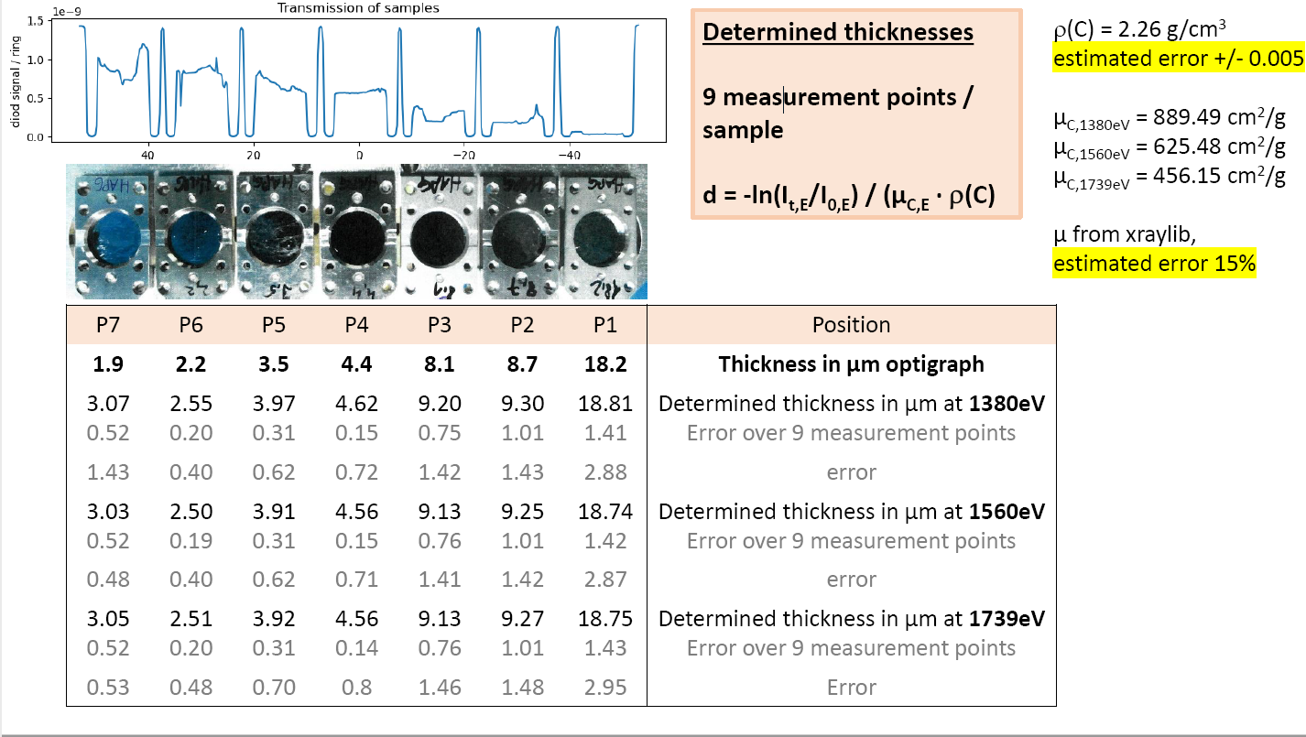
X-Ray Measurements of Carbon Coating Thickness in Air:
Calibration Samples
Measurements of Carbon Layer Thickness: Instrument Calibration
To increase the accuracy of the measurements, some reference Graphite foils with different thickness were measured by PTB in the group of Dr. Beckhoff on BESSI II.
This table represents the measurement results, performed by transmission of 3 different beam energies. For calibration of the labor instrument the average values were used.
Physikalisch-Technische Bundesanstalt
X-ray Spectrometry
Working Group 7.24
https://www.ptb.de/cms/en/ptb/fachabteilungen/abt7/fb-72/ag-724.html
Notes:
All previous data were obtained using theoretical quantification model based on Fundamental Parameter. To improve the accuracy of the measurement results an additional calibration can be used. For this purpose, some freestanding Graphite films with different thicknesses were made and measured by PTB in the group of Dr. Beckhoff on BESSI II.

Slide 15
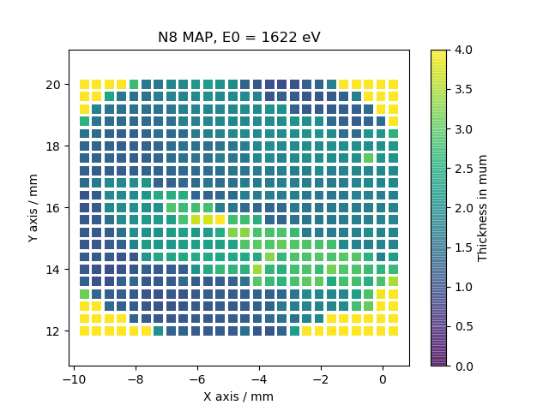
Calibration Samples:
Raster Measurements on the Samples 1.8 µm and 18.75 µm
Measurements of Carbon Layer Thickness: Instrument Calibration
Raster measurements in M1 MISTRAL with the collimator 0.1mm x 0.3mm on glass substrate.
Measured surface is approx.
12 mm x 15 mm
The table shows comparison of average results of raster measurements in M1 MISTRAL on the calibration samples N1 and N8 with the PTB measurements by transmission.
Using a larger collimator reduce the variation by the similar mean values.
Measurements in PTB by transmission:
Mean and Std of N8 MAP (edges of map are due to sample holder and are not included in mean and std calculation):
1.8µm+-0.6µm
KF-N8 | PTB | M1 MISTRAL
 | Colli | 0.1 x 0.3 mm
Average, µm | 1.8 | 2.0
StD, µm | 0.6 | 1.3
KF-N1 | Colli | 1.5 mm
Average, µm | 18.75 | 19.29
StD, µm | 1.43 | 0.54
ρ(C) = 2.26 g/cm³ , µ_{C,1622eV} = 558.7 cm²/g
estimated error 15%
Physikalisch-Technische Bundesanstalt
X-ray Spectrometry, Working Group 7.24
https://www.ptb.de/cms/en/ptb/fachabteilungen/abt7/fb-72/ag-724.html
Notes:
This slide shows maps of the calibration foil 1.8 µm, obtained in the transmission measurements on BESSI and in M1 MISTRAL using two different collimators, glass substrate and Si Ka line for quantification.

Slide 16
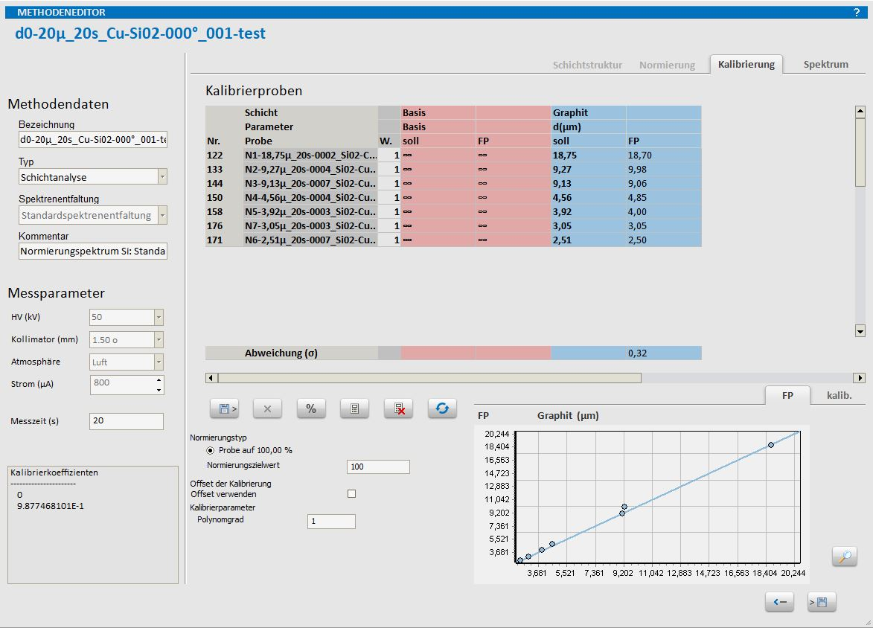

Example of the Instrument Calibration:
Graphite Foils on Glass (Si Ka)
Measurements of Carbon Layer Thickness: Instrument Calibration
Here an example of the calibration of the method for measurements of GO thickness on a glass substrate in the range up to 20 µm is present.
Note that even the theoretical values for calibration points match very well with the given values. This, the linear calibration can also be used for layers far above 20 µm.
Calibration factor 0.9877
Notes:
These films were used later for calibration of special quantification methods for different substrates.

Slide 17
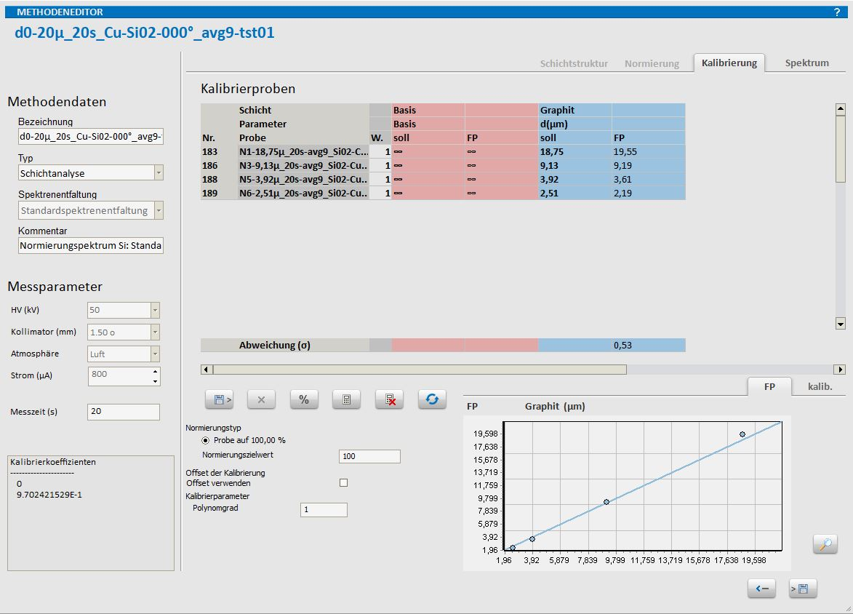
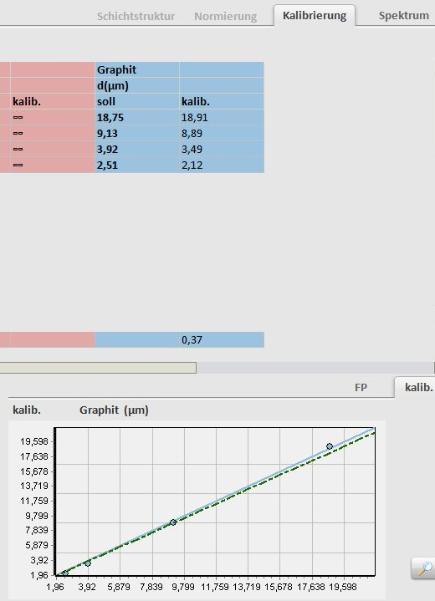
Example of the Instrument Calibration:
Graphite Foiles on Copper (Cu Ka)
Measurements of Carbon Layer Thickness: Instrument Calibration
One more example of the calibration of the method for measurements of GO thickness, now on Copper substrate in the range up to 20 µm.
Like the previous case the theoretical values match very well with the given ones. That enables to get reliable results for layers up to multiple tens of micrometer, what only make sense by using the Copper substrate.
Calibration factor 0.9702

Slide 18
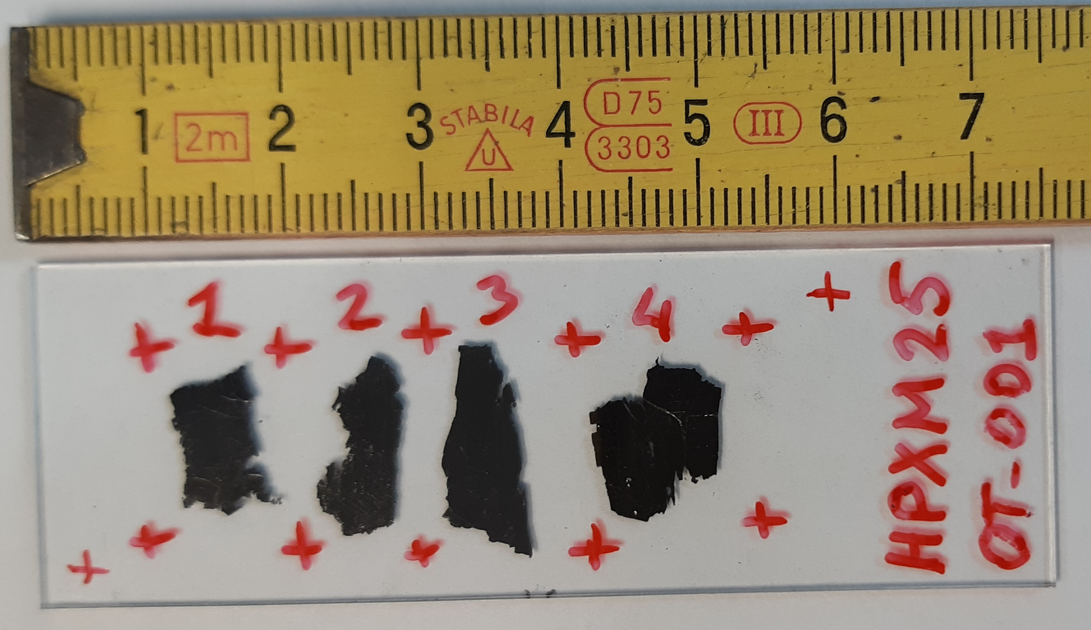
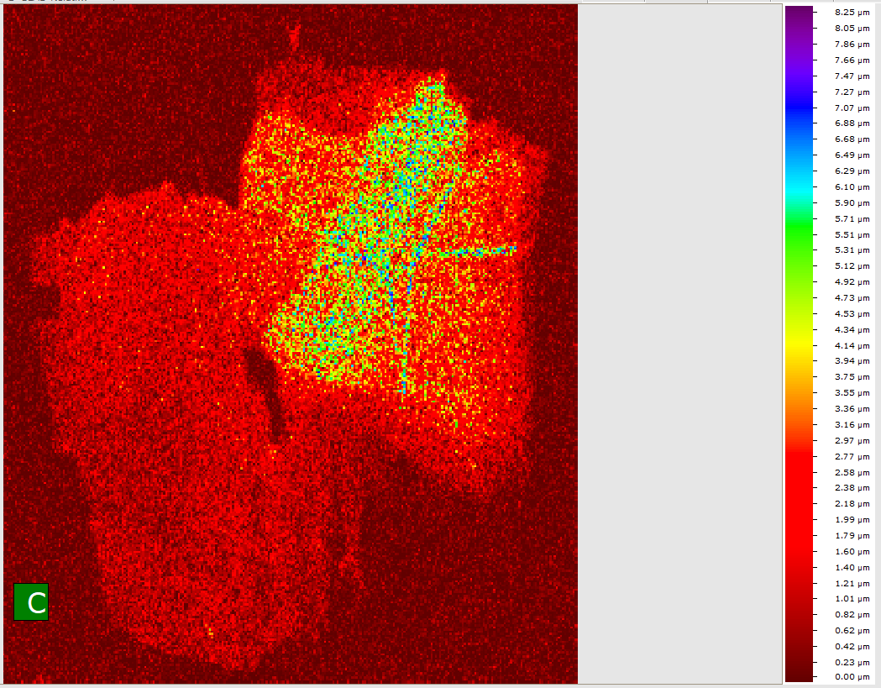
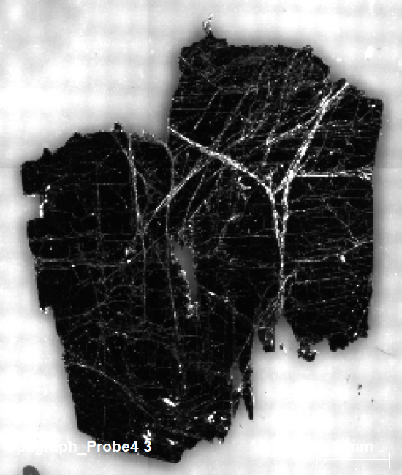
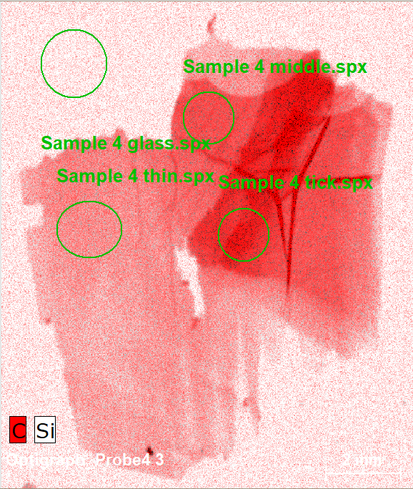
Some Practical Examples:
Measurement on the Foil 4 on Glass
Measurements of Carbon Layer Thickness: practical Examples
Mapping of the sample 4 in M4 TORNADO: Rh tube, 50kV, 200 µA tube current, no primary filter, vacuum, spot 20 µm.
1 – sample size
2 – video image
3 – distribution of C and
Si element intensities
4 - QuantMap
Raster measurement of the sample 4 in M1 MISTRAL: Rh tube, 50kV, 200 µA tube current, no primary filter, air,
collimator 0.1 mm x 0.3 mm
µm
8.0
1
6.0
1
4
3
4.0
2
4
2.0
2
0.0
3
Thickness values presented in the table for M1 MISTRAL were obtained using the collimator 1.5 mm approximately in the same regions as highlighted on the M4 map. That leads to higher averaging over the surface and to effective lower calculated thickness.
CarbonThickness, µm | M4 | M1
1 – glass | 0.00 | 0.00
2 – thin region | 0.90 | 0.75
3 – middle region | 2.29 | 1.14
4 – thick region | 3.36 | 2.30
Notes:
Two last slides show comparative measurements of Graphite films with unknown variable thicknesses on glass substrate, performed in M4 TORNADO – vacuum, mapping “on the fly” with the spot 20 µm, Rh tube without primary filter, quantification in relative mode using C K and Si K lines –
and in M1 MISTRAL – air, raster measurements with the collimator 0.1 mm x 0.3 mm, Rh tube without primary filter, quantification in absorption mode using Si Ka line.
We see very nice pictures of the M4 element intensity map: here red signifies the intensity of Carbon K lines, for Silicon K lines white color is selected.
On the map 4 regions – pure substrate, thin, medium and thick coatings – were selected. The calculated thickness is present in the table in the first column. The second column represents results of thickness measurements at the same points in M1 MISTRAL with the collimator 1.5 mm. The measurement spot is comparable with the areas of selected map objects, but nevertheless larger. The averaging over larger surface leads to effective lower values. Moreover, the exact positioning of the samples for measurements at the same points was difficult.

Slide 19
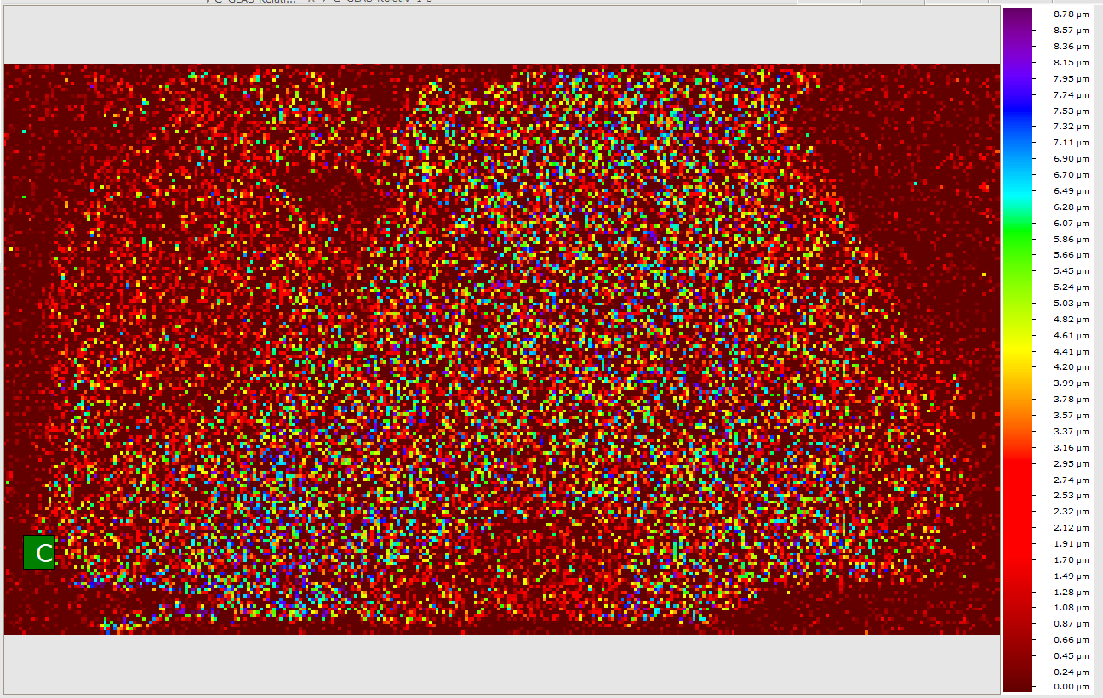
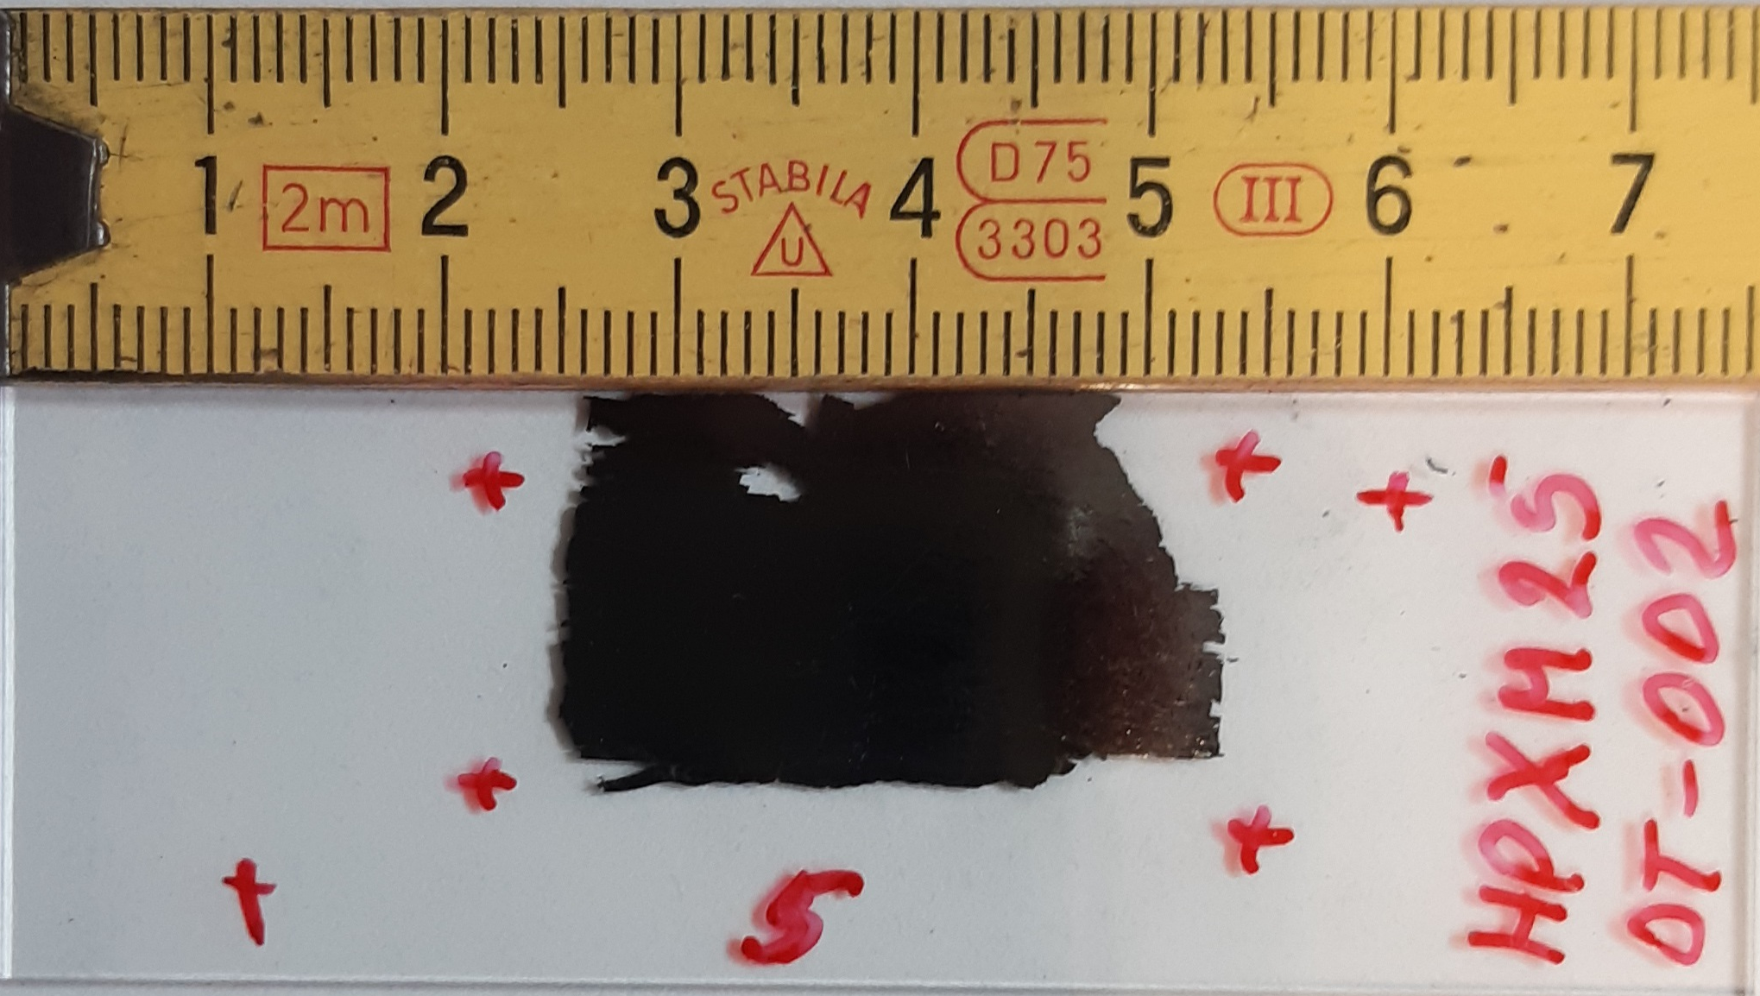
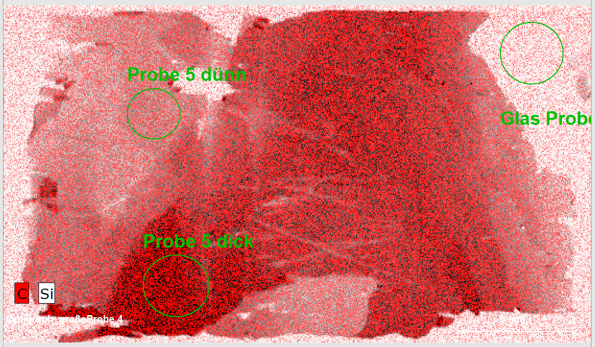
Some Practical Examples:
Mapping on the Foil 5 on Glass, M1 MISTRAL vs. M4 TORNADO
Measurements of Carbon Layer Thickness: practical Examples
µm
Mapping of the sample 5 in M4 TORNADO: Rh tube, 50kV, 200 µA tube current, no primary filter, vacuum, spot 20 µm.
1 – sample size
2 – distribution of C and
Si element intensities
3 - QuantMap
8.0
1
3
6.0
2
4.0
1
This sample has larger homogeneous area regions, nevertheless, the averaging effect by using the large collimator is not to be overlooked.
2
2.0
0.0
3
Raster measurement of the sample 5 in M1 MISTRAL: Rh tube, 50kV, 200 µA tube current, no primary filter, air,
collimator 1.5 mm
CarbonThickness, µm | M4 | M1
1 – glass | 0.02 | 0.03
2 – thin region | 1.1 | 1.2
3 – thick region | 4.78 | 3.41
Notes:
The next measured film is generally slightly thicker and has larger homogeneous regions. The measurements in air in M1 MISTRAL were made only with the collimator 1.5 mm. In this case the agreement of the measured thickness values is better, even if in the 3rd thick region, the M1 value is less, since the measurement spot of the collimator covered partially thinner neighboring region.

Slide 20
Summary
Summary
The new non-destructive method, based on the X-ray measurements in air at normal pressure, developed for M1 MISTRAL (Bruker Nano GmbH, Germany), allows the accurate and reliable quality control of Graphite Optics without its damaging, as well as the quality of freestanding films for novel applications, such as specific X-rays windows and electronic stripping foils
The method gives information about thickness distribution over the GO that allows users induce digital corrections in their measurements
Using different substrates depending on the thickness of the GO, an acceptable balance between measurement time and required measurement statistics can be found for every single case
The method is generally based on standard-free quantification model using Fundamental Parameter approach
Calibration standards permit to improve the standard-free FP calculation
No specific calibration is required for every series of measurement, the general calibration can be easily adjusted for a new substrate composition

Slide 21
Elena.Blokhina@bruker.com

