Slide 1
High Precision X-ray Measurements 2025
16–20 June 2025 Laboratori Nazionali di Frascati INFN
3D Cadmium-Zinc-Telluride Drift Strip Detectors for Room Temperature X-ray and Gamma Ray Spectroscopic Imaging
A. Buttacavoli^{1,2}, F. Principato^{1,2}, G. Gerardi¹, M. Bettelli³, S. Del Sordo⁴, N. Auricchio⁵, E. Caroli⁵, A. Zappettini³, L. Abbene^{1,2}
¹University of Palermo, Department of Physics and Chemistry-E. Segrè, Palermo, Italy
²LNF-INFN, Laboratori Nazionali di Frascati, Italy
³IMEM/CNR, Parma, Italy
⁵INAF/IASF, Palermo, Italy
⁵INAF/OAS, Bologna, Italy

Slide 2
Outline
Motivations
Drift strip concept for 3-D detection
Detectors and Electronics
Charge pulses in drift strip detectors
Spectroscopic investigations
Spatial resolution
Conclusions

Slide 3
Motivations
Goal: Development of room temperature spectroscopic imagers for X-ray and Gamma Ray imaging (5 kev - 1 MeV).
Italian Research Project (MUR)
PRIN2022 PNRR, Italy
Requirements
Proposed 3-D Systems
Room temperature operation
Sub-millimetre 3-D spatial resolution (< 0.5 mm)
Energy resolution < 2 % FWHM at 662 keV
CZT Drift Strip Detectors
and
Digital Electronics

Slide 4
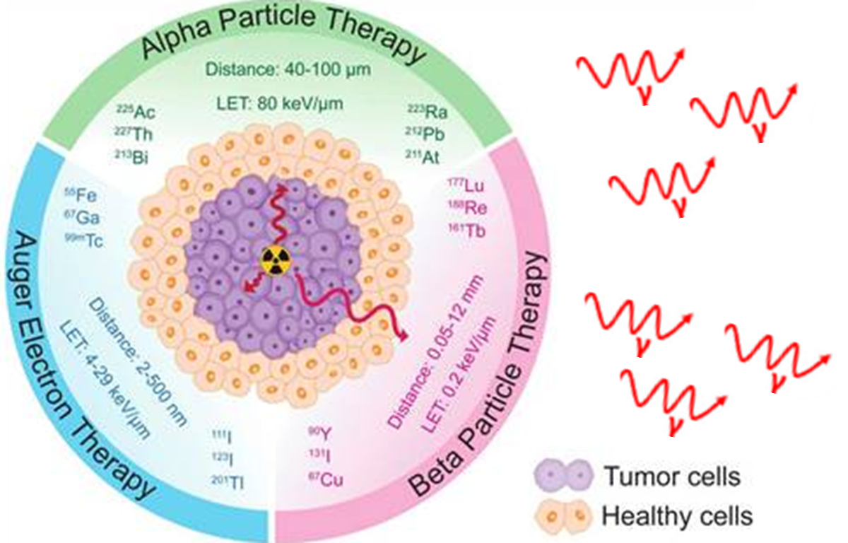
Motivations
THERANOSTICS is an established tool for specific molecular targeting in nuclear medicine, both for diagnostics and therapy. The theranostic approach couples diagnostic imaging and therapy using the same molecule: the gamma ray/positron emission is used for imaging and alpha/beta particles for therapy.
REAL-TIME DIAGNOSTICS through multi-isotope gamma ray imaging (5 keV-1 MeV) with 3D cadmium-zinc-telluride (CZT) drift strip detectors.

Slide 5
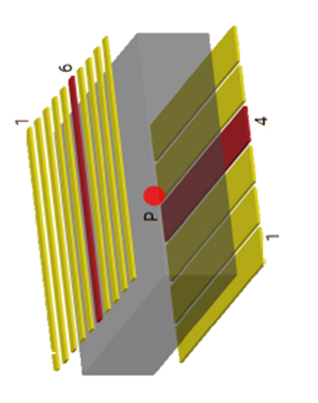
Drift strip concept for 3-D detection
Planar Transverse Field (PTF) and Parallel Planar Field (PPF) irradiation geometries.
y
2D position
3rd position
x
z
PTF
cross-strips on the cathode/anode electrodes
cathode/anode ratio
PPF
Advantages
Critical Issues
moderate charge sharing
low number of read-out channels
increased detection efficiency (PTF)
leakage current between drift strips
complex analysis of charge pulses

Slide 6
Detectors and Electronics

Slide 7
Cadmium Zinc Telluride detectors
Semiconductor | Si | Ge | CdZnTe
Density (gr/cm³) | 2.33 | 5.33 | 5.75
Z (max) | 14 | 32 | 52
Band-gap (eV) | 1.12 | 0.67 | 1.57
w (eV) | 3.62 | 2.96 | 4.64
μτ_{e} (cm²/ V) | >1 | >1 | 10⁻³ 10⁻²
μτ_{h} (cm²/ V) | ~1 | >1 | 10⁻⁵ 10⁻⁴
High detection efficiency and Reduction of Compton scattering
Room temperature operation
Reduction of charge collection efficiency
Distortions in the spectra (hole tailing)
High Z
Wide band-gap
Poor mobility-lifetime products
Difference between μτ_{e} and μτ_{h}

Slide 8
The detectors
CZT drift strip detectors were realized at IMEM-CNR of Parma in collaboration with due2lab company.
The detectors (20 x 20 x 6 mm³) were fabricated from Redlen CZT pixel detectors (low flux CZT crystals).
The ANODE (top) is characterized by gold strips with a pitch of 0.4 mm (0.15 mm strip width and 0.25 mm inter-strip gap).
The CATHODE (bottom) is divided into ten gold strips orthogonal to the anode strips with a pitch of 2 mm (1.9 mm strip width and 0.1 mm inter-strip gap).
The detectors are characterized by low-leakage currents between the drift strips (< 2 nA at 100 V)

Slide 9
Working mode of the detectors
The strips are organized into anode/cathode collecting strips (1.6 mm pitch) and anode drift strips (0.4 mm pitch), negatively biased to optimize electron charge collection.
Each detector is characterized by
12 drift cells;
- Each drift cell consists of: a collecting anode strip, surrounded by drift strips on the right (RD) and left (LD) side and 10 collecting cathode strips.

Slide 10
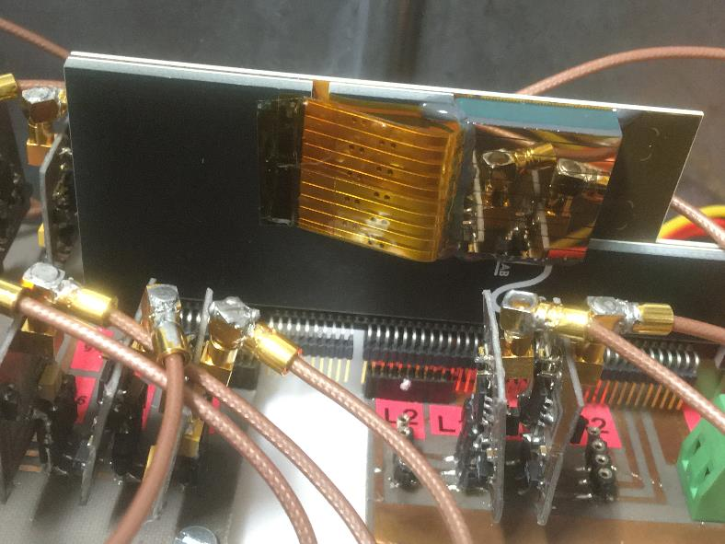
Set-up and front-end electronics
Bonding: each strip is electrically connected through conductive glue to gold lines insulated by Kapton film.
all channels are AC coupled to custom CSPs developed at University of Palermo, Italy
(ENC 100 electrons)
- each detector drives 25 readout
channels (12 collecting anode strips, 10 cathode strips and 3 drift anode strips).

Slide 11
Digital electronics
The output signals from CSPs are processed through a custom 64-channel digital electronics, developed at University of Palermo.
No empty zones in the waveform
The digital system performs for each channel:
- online pulse detection, provides to PC a sequence of selected pulses with the related arrival time (Snapshot Waveform).
- therefore, these pulses are analysed offline for dedicated pulse shape and height analysis and coincidence analysis.

Slide 12
Charge pulses in drift strip detectors

Slide 13
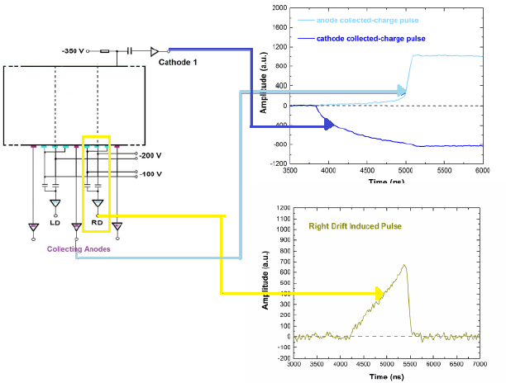
Collected and induced-charge pulses
The complex electrode geometry and the effects of physical processes occurring in CZT detectors (charge sharing, charge trapping) give rise to several charge pulses with different features and shapes.
In our detectors:
Collected-charge pulses
Induced charge pulses (or transient pulses) with zero-saturation level
- Induced charge pulses with negative and positive saturation levels

Slide 14
Single Interaction Pulses
Induced charge pulses with negative saturation levels
The negative saturation level is due to the charge
induced by holes trapped in the detector
M. Bettelli, et al. NIM A 960 (2020) 163663.

Slide 15
Double Interaction Pulses
Pulses generated by Compton scattering and then Photoelectric interaction occurring in the same drift cell

Slide 16
Double Interaction Pulses
Different drift cells
Pulses generated by Compton scattering and then Photoelectric interaction occurring in different drift cell

Slide 17
Spectroscopic investigations

Slide 18
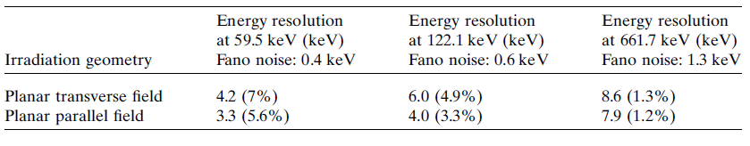
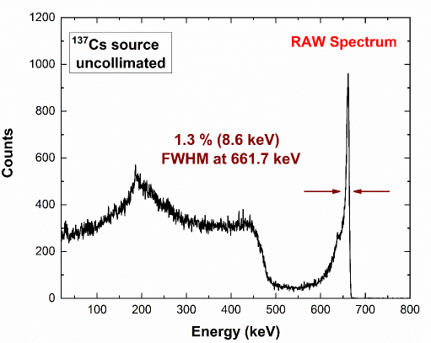
Overview of the spectroscopic performance
Good energy resolution of
1.3% FWHM at 661.7 keV
(¹³⁷Cs source)
with no correction.

Slide 19
Degradations over the cathode–anode depth
We observed non-uniform spectroscopic response over the cathode–anode depth, with increasing degradations for photon interactions near the anode.
Collimated ⁵⁷Co photon beams irradiated in PTF geometry at three different positions between the cathode and anode.
Photopeak shifts
Worsening of energy resolution

Slide 20
Spectroscopic improvements with cathode signals
Cathode to Anode C/A ratio.
Energy resolution FWHM of 1 % at 661.7 keV after correction

Slide 21
Spectroscopic improvements with a new technique
We measured the negative saturation levels of the induced charge pulses from drift-strips.

Slide 22
Spectroscopic improvements with a new technique
We used the negative saturation levels for performance improvements

Slide 23
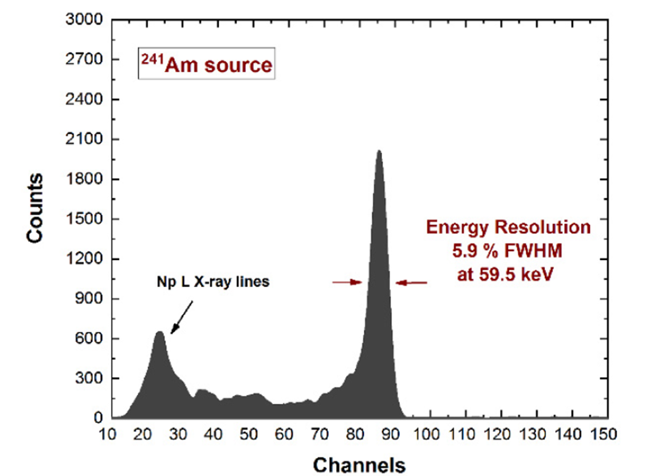
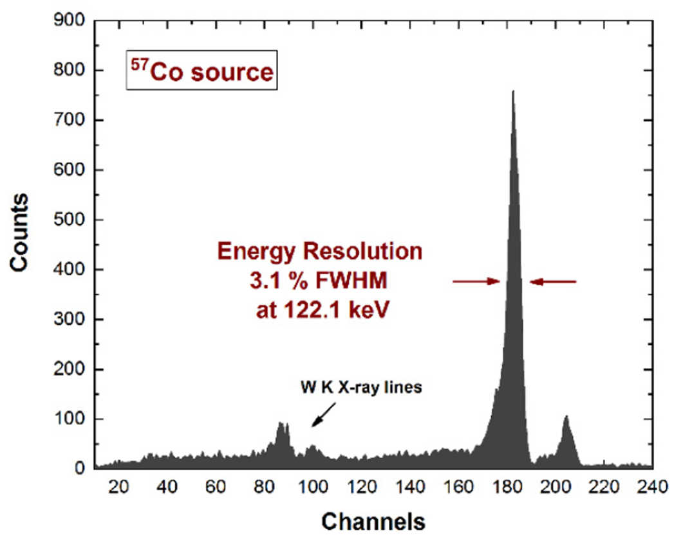
Spectroscopic improvements with a new technique
Excellent room temperature energy resolution after spectral correction
with induced pulses from drift strips
L. Abbene et al. J. Synchrotron Rad. (2020) 27 (6), 1564-1576; https://doi.org/10.1107/S1600577520010747.
L. Abbene et al. Sensors (2022), 22 (4), 1502; https://doi.org/10.3390/s22041502.

Slide 24
Spatial resolution

Slide 25
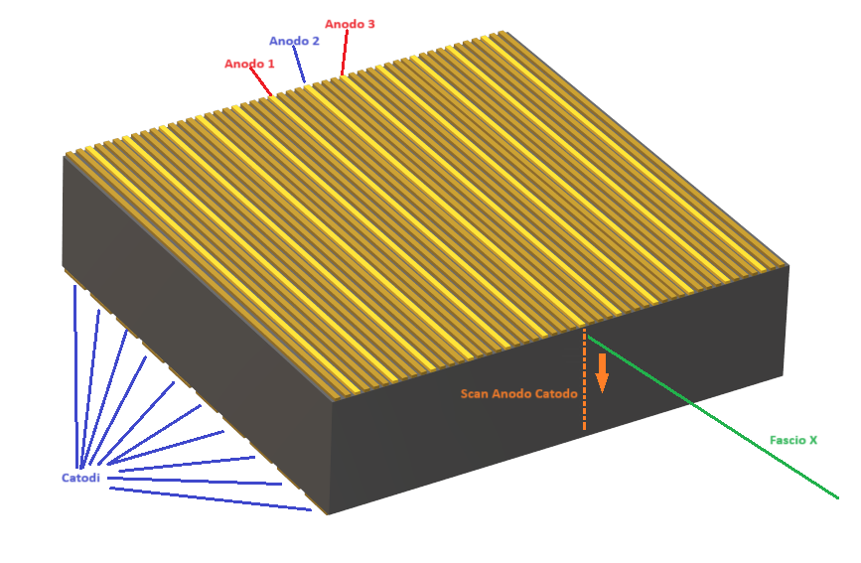
Spatial Resolution
Spatial resolution was investigated with collimated synchrotron X-rays (20 μm) at European Synchrotron Radiation Facility

Slide 26
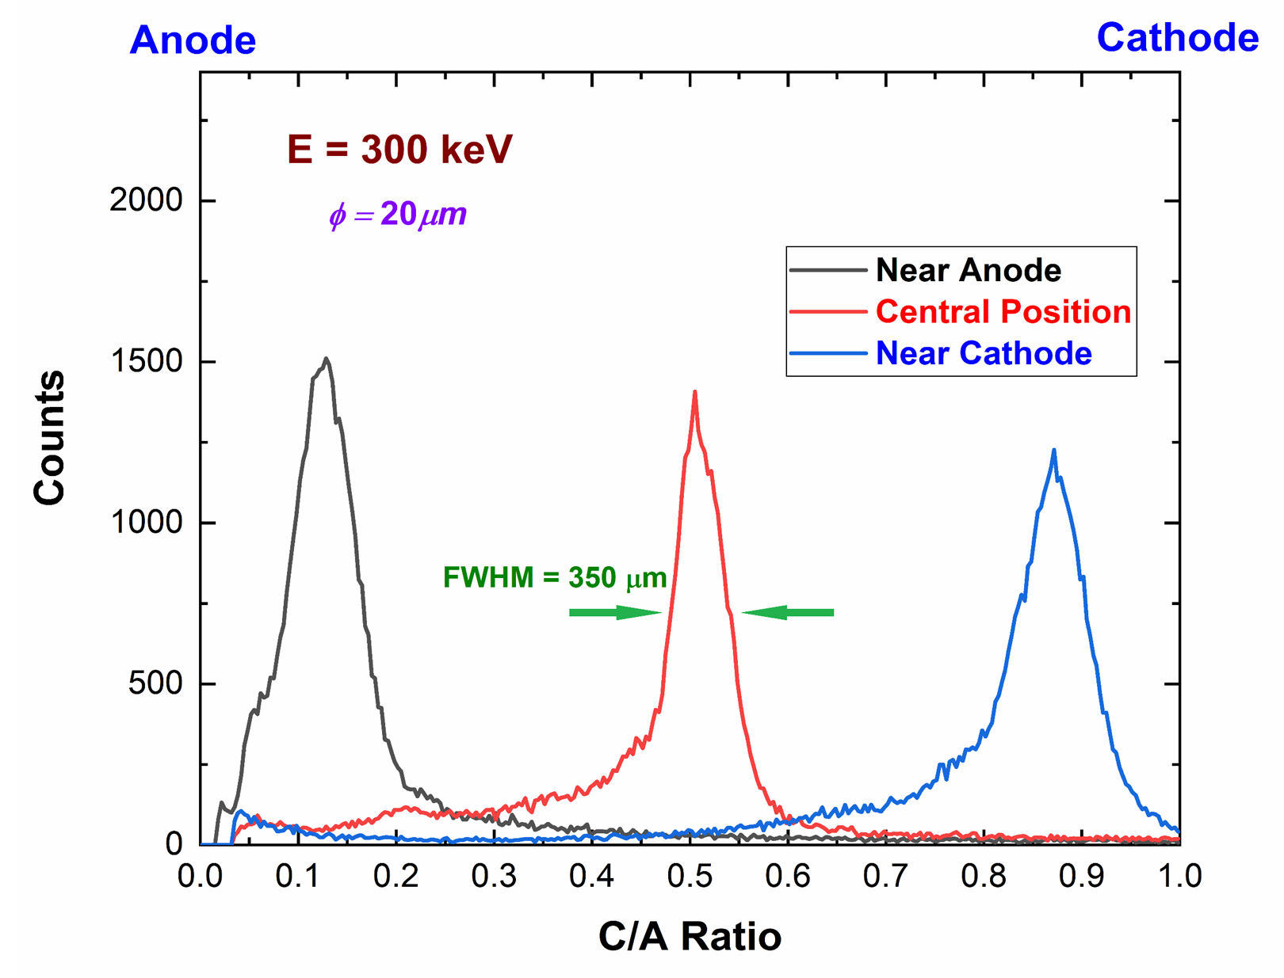
Spatial Resolution
Cathode/Anode pulses
under collimated
synchrotron X-rays.
Spatial Resolution
350 μm (FWHM)

Slide 27
Conclusions
SPECT modules based on CZT drift strip detectors are successfully developed for theranostics
Good room temperature energy resolution (1.3% FWHM at 662 keV) of the raw energy spectra (with no correction) demonstrates the important advances in device technology.
A dedicated digital pulse processing allowed us to exploit the different features of the wide range of collected and induced charge pulses from the strips.
Excellent spectroscopic improvements (0.8–0.9% FWHM at 662 keV) are obtained with a new approach, based on the relation between the anode strip pulses with the negative saturation levels of the induced-charge pulses from the drift strips.
Good spatial resolution was obtained (350 μm ) for Anode-Cathode scan under collimated
synchrotron X-rays .

Slide 28
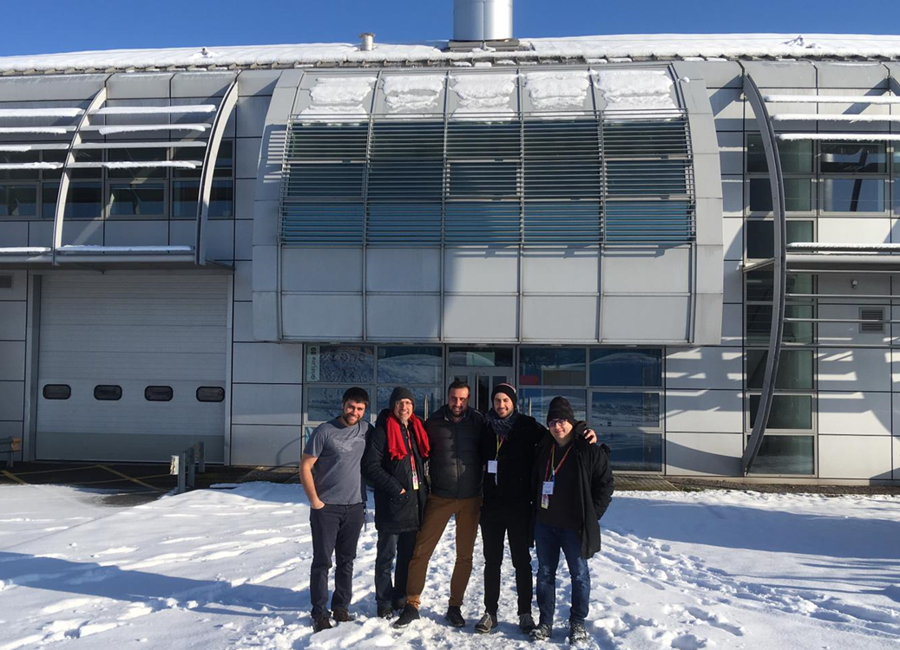
Thank you for your kind attention

Slide 29
SPECT Radionuclides in Theranostics

