Slide 1


Francesco Stellato
University of Rome Tor Vergata & INFN on behalf of the WA8 collaboration team
& (in particular/in addition)
Emiliano De Santis, Tomas André, Richard Bean, Massimo Ferrario, Augusto Marcelli, Velia Minicozzi,
Emiliano Principi, Nicusor Tımneanu, Carl Caleman
@
Photon Science at EuPRAXIA@SPARC_LAB:
Free Electron Laser Biological Applications
Frascati - June 16th, 2025

Slide 2


Outline
The EuPRAXIA project
The EuPRAXIA@SPARC_LAB Free-Electron Laser beamline(s)
Biological applications:
  Coherent Diffraction Imaging
  Coulomb Explosion Imaging
  X-ray Spectroscopy
Outlook

Slide 3
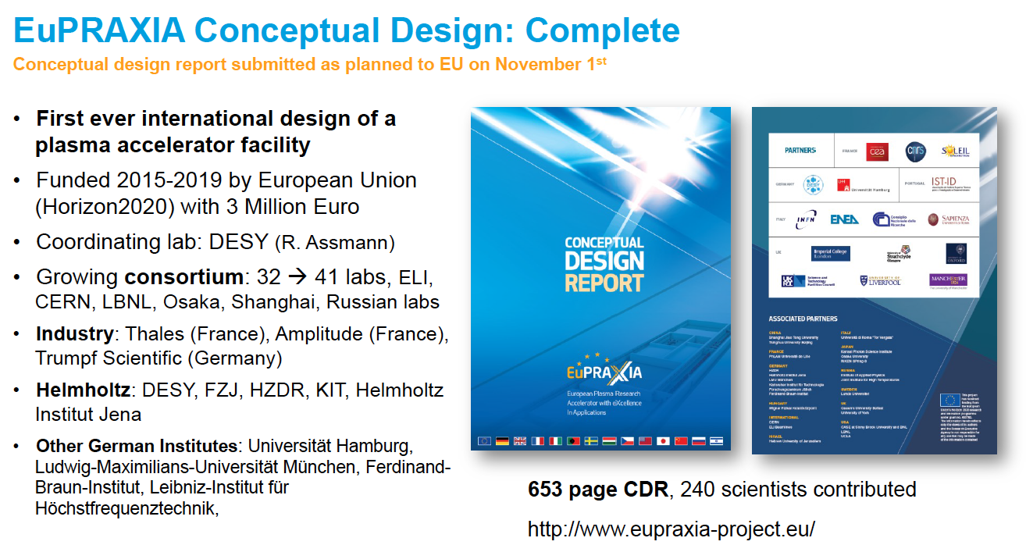

The EuPRAXIA project
EuPRAXIA: first European project to develop a particle accelerator research infrastructure based on plasma acceleration concepts driven by laser and linac technologies.
EuPRAXIA is one of the projects on the European Strategy Forum on Research Infrastructures (ESFRI) Roadmap of 2021.
The accelerated beam will drive a Free Electron Laser (FEL) source
https://www.eupraxia-pp.org/
Assman et al. Eur. Phys. J. (2020)

Slide 4
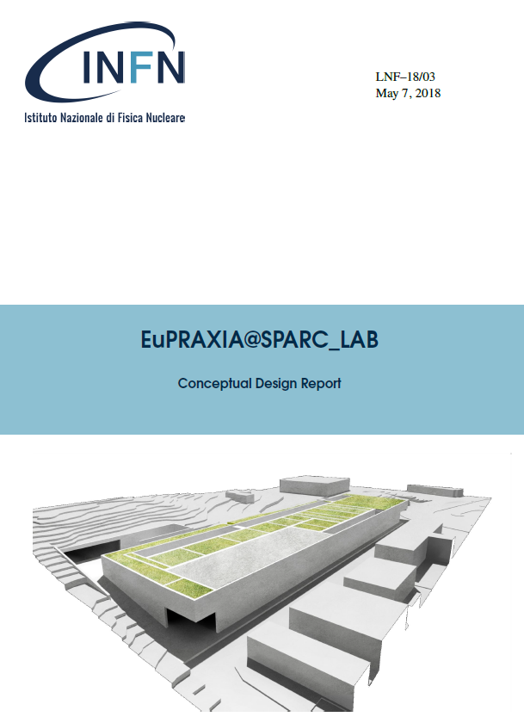
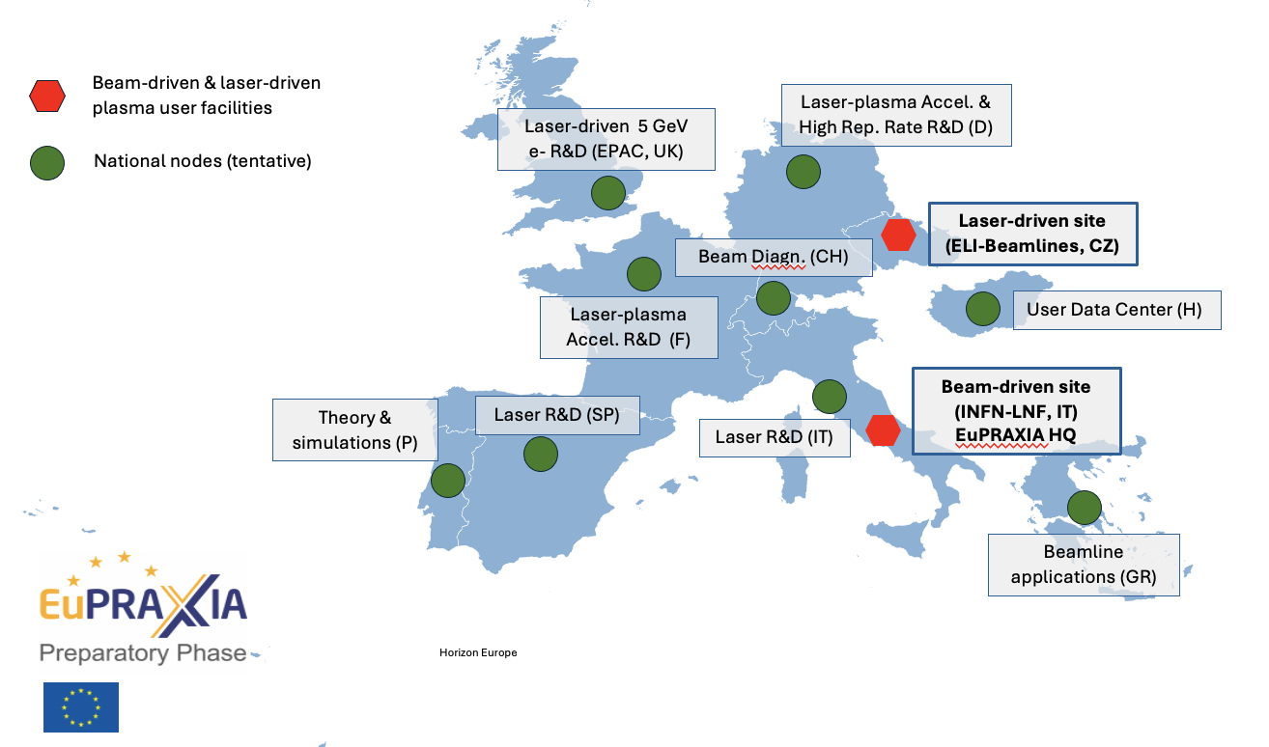
The EuPRAXIA project
Two sites: one TBD
One: here! Frascati National Laboratory (INFN, Italy).
  EuPRAXIA@SPARC_LAB
Ferrario et al. Nucl. Instr. Met. (2018)

Slide 5
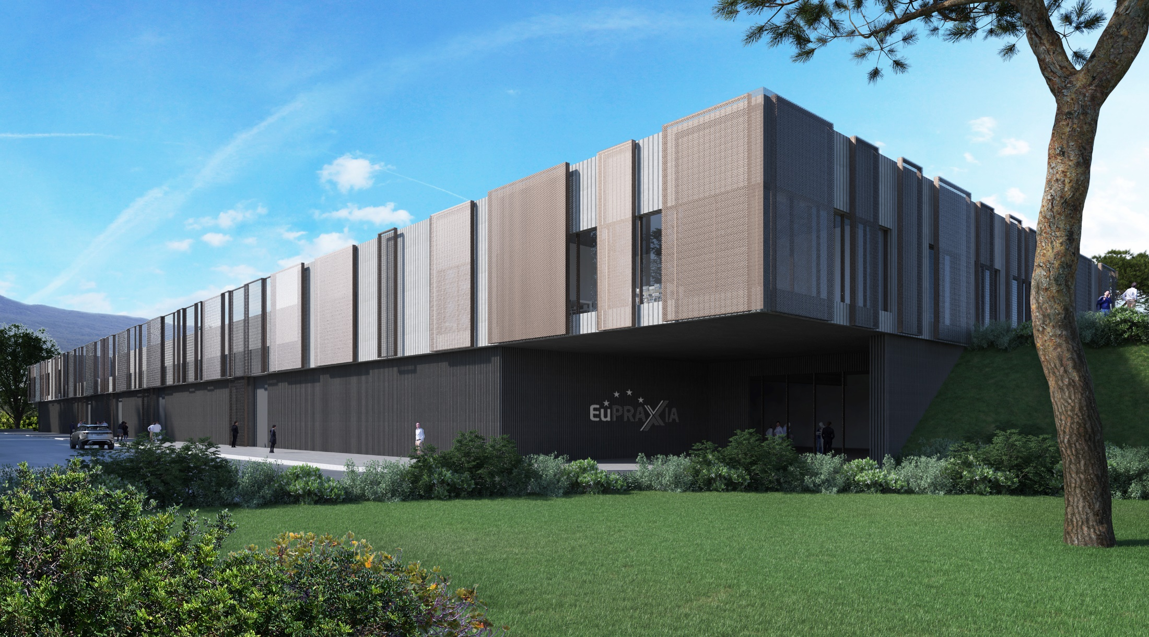
EuPRAXIA@SPARC_LAB
Electron beam-driven FEL
1 GeV X-band RF linac and an upgraded FLAME laser up to the 0.5 PW range
Compact FEL source, equipped with a user beamline and an experimental endstation at 4-10 nm wavelength, driven by a high gradient plasma accelerator
(+ a VUV beamline @ 50-180 nm)
https://sparclab.lnf.infn.it/sparc_lab-home/eupraxiasparc_lab/

Slide 6
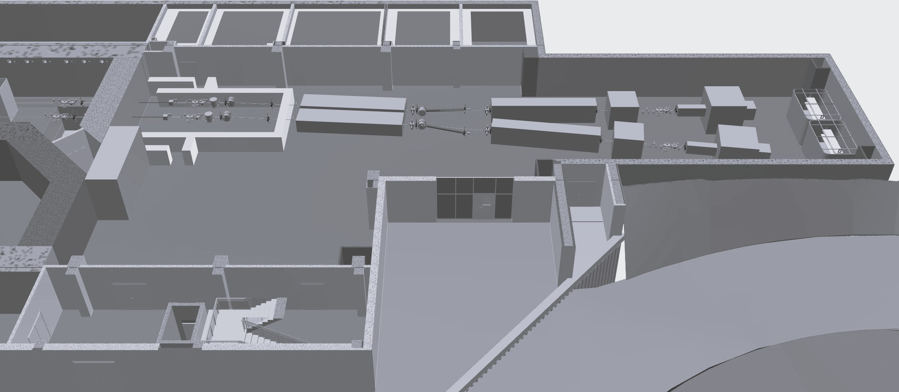
EuPRAXIA@SPARC_LAB - FEL Beamlines
Beamline 1 AQUA
Beamline 2 ARIA
Endstation

Slide 7
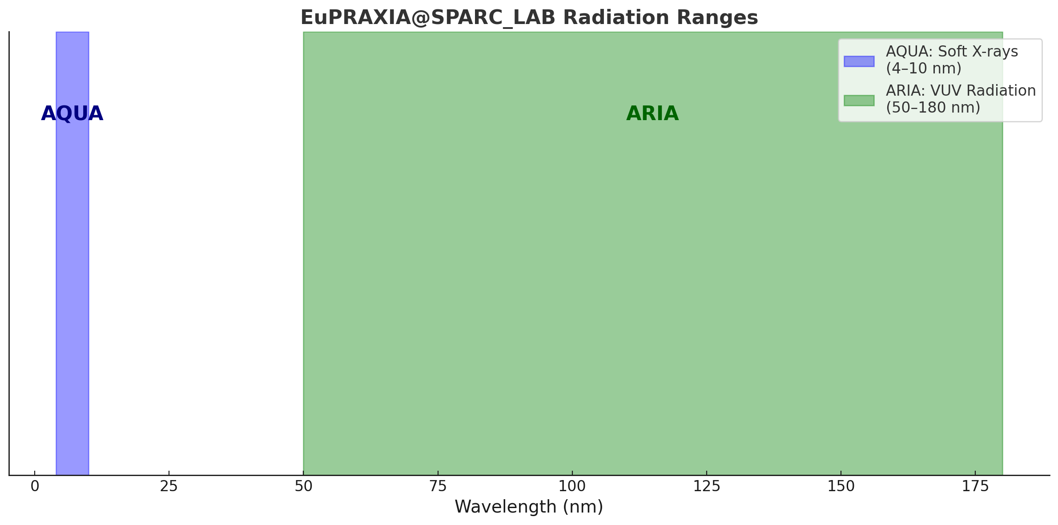
EuPRAXIA@SPARC_LAB - FEL Beamlines
AQUA
Self Amplified Spontaneous Emission (SASE) FEL
lasing in the soft X-rays
@ 4-10 nm
(covering the water-window)
+
ARIA
seeded FEL lasing in the VUV
@ 50-180 nm

Slide 8
WA 8 – Users
EuPRAXIA@SPARC_LAB - Beamlines
AQUA ARIA
Parameter | Value
Wavelength | 4-10 nm
Photons/pulse on sample* | 10 ¹⁰ - 10 ¹¹
Pulse duration | < 10 fs
Repetition rate** | 100 Hz
Parameter | Value
Wavelength | 50-180 nm
Photons/pulse | 10 ¹³ - 10 ¹⁴
Pulse duration | 20/200 fs
Repetition rate** | 100 Hz
* An order of magnitude range is given, since final numbers will depend on the beamline optics
** Options to run @ 400 Hz are being explored

Slide 9
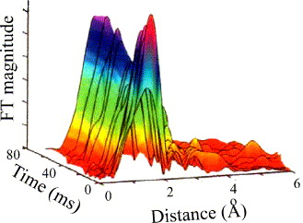
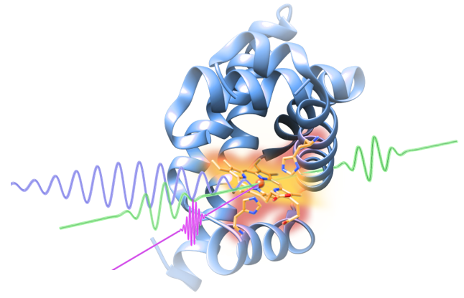
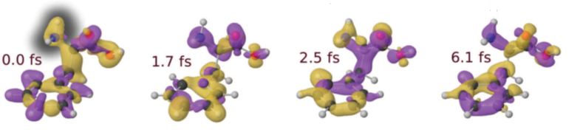
Science @ AQUA
Proteins
Viruses
Bacteria
Cells
Metals
Semiconductors
Superconductors
Magnetic materials
Organic molecules
Coherent imaging
X-ray absorption
Raman
spectroscopies
Photoemission
Ions
Coulomb Explosion

Slide 10
Science @ AQUA
Technique | Samples
Coherent imaging | Cells, organelles, nanomaterials Water window for high-contrast hydrated samples
Photon scattering | Molecules, nanoparticles Structural and dynamical characterization
X-ray Spectroscopy | Warm-dense matter, organo-metallic compounds, magnetic materials K, L and M edges falling in the FEL energy range
Photoelectron Spectroscopy | Carbon-based materials, batteries, biomolecules Chemical dynamics
Ion Spectroscopy | Astrochemistry, biomolecules Radiation-matter interaction dynamics
This is a general overview and, besides coherent imaging, these techniques are possible both at the baseline AQUA beamline and at the “beyond-the-baseline” ARIA
Pump-probe experiments to perform time-resolved measurements

Slide 11
Biological applications @ AQUA

Slide 12
Coherent Diffraction Imaging (CDI)
When the photons hit the sample, a diffraction pattern is originated
The diffraction pattern is the |FT| of the sample electron density
|FT|⁻¹
Diffraction pattern
k - space
Sample image (electron density)
real space

Slide 13
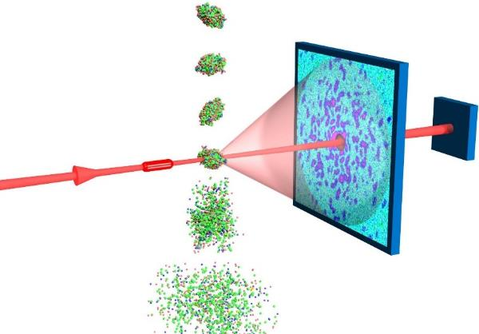
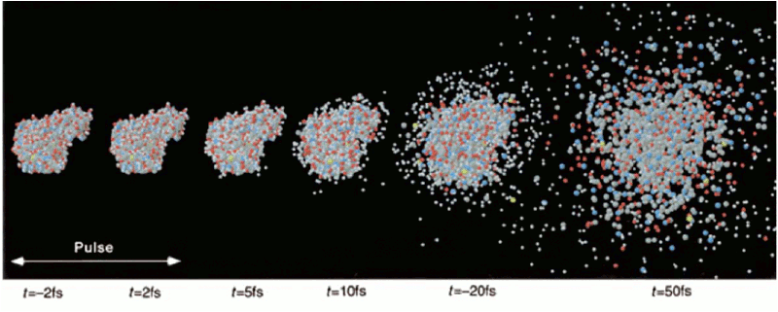
Diffract-and-destroy @ FELs
One pulse,
one measure
Particle injection
A detectable signal must be recorded before the sample is destroyed
FEL pulses are so bright and short that the signal is damage free
> 10⁶ patterns needed
Experimentally & computationally challenging…
Diffraction pattern
R. Neutze et al, Nature 406 (2000)
Courtesy of SLAC

Slide 14
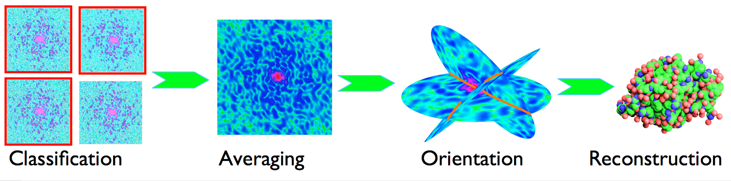
Bio-samples Coherent Imaging
3D images can be obtained merging info from several shots
Since the sample is destroyed by the FEL photons,
many identical samples are needed
Ekeberg et al. PRL (2015)

Slide 15
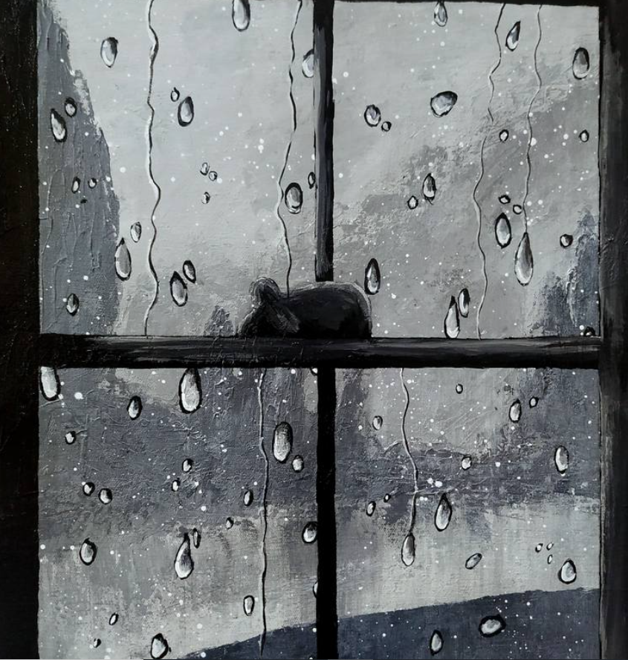
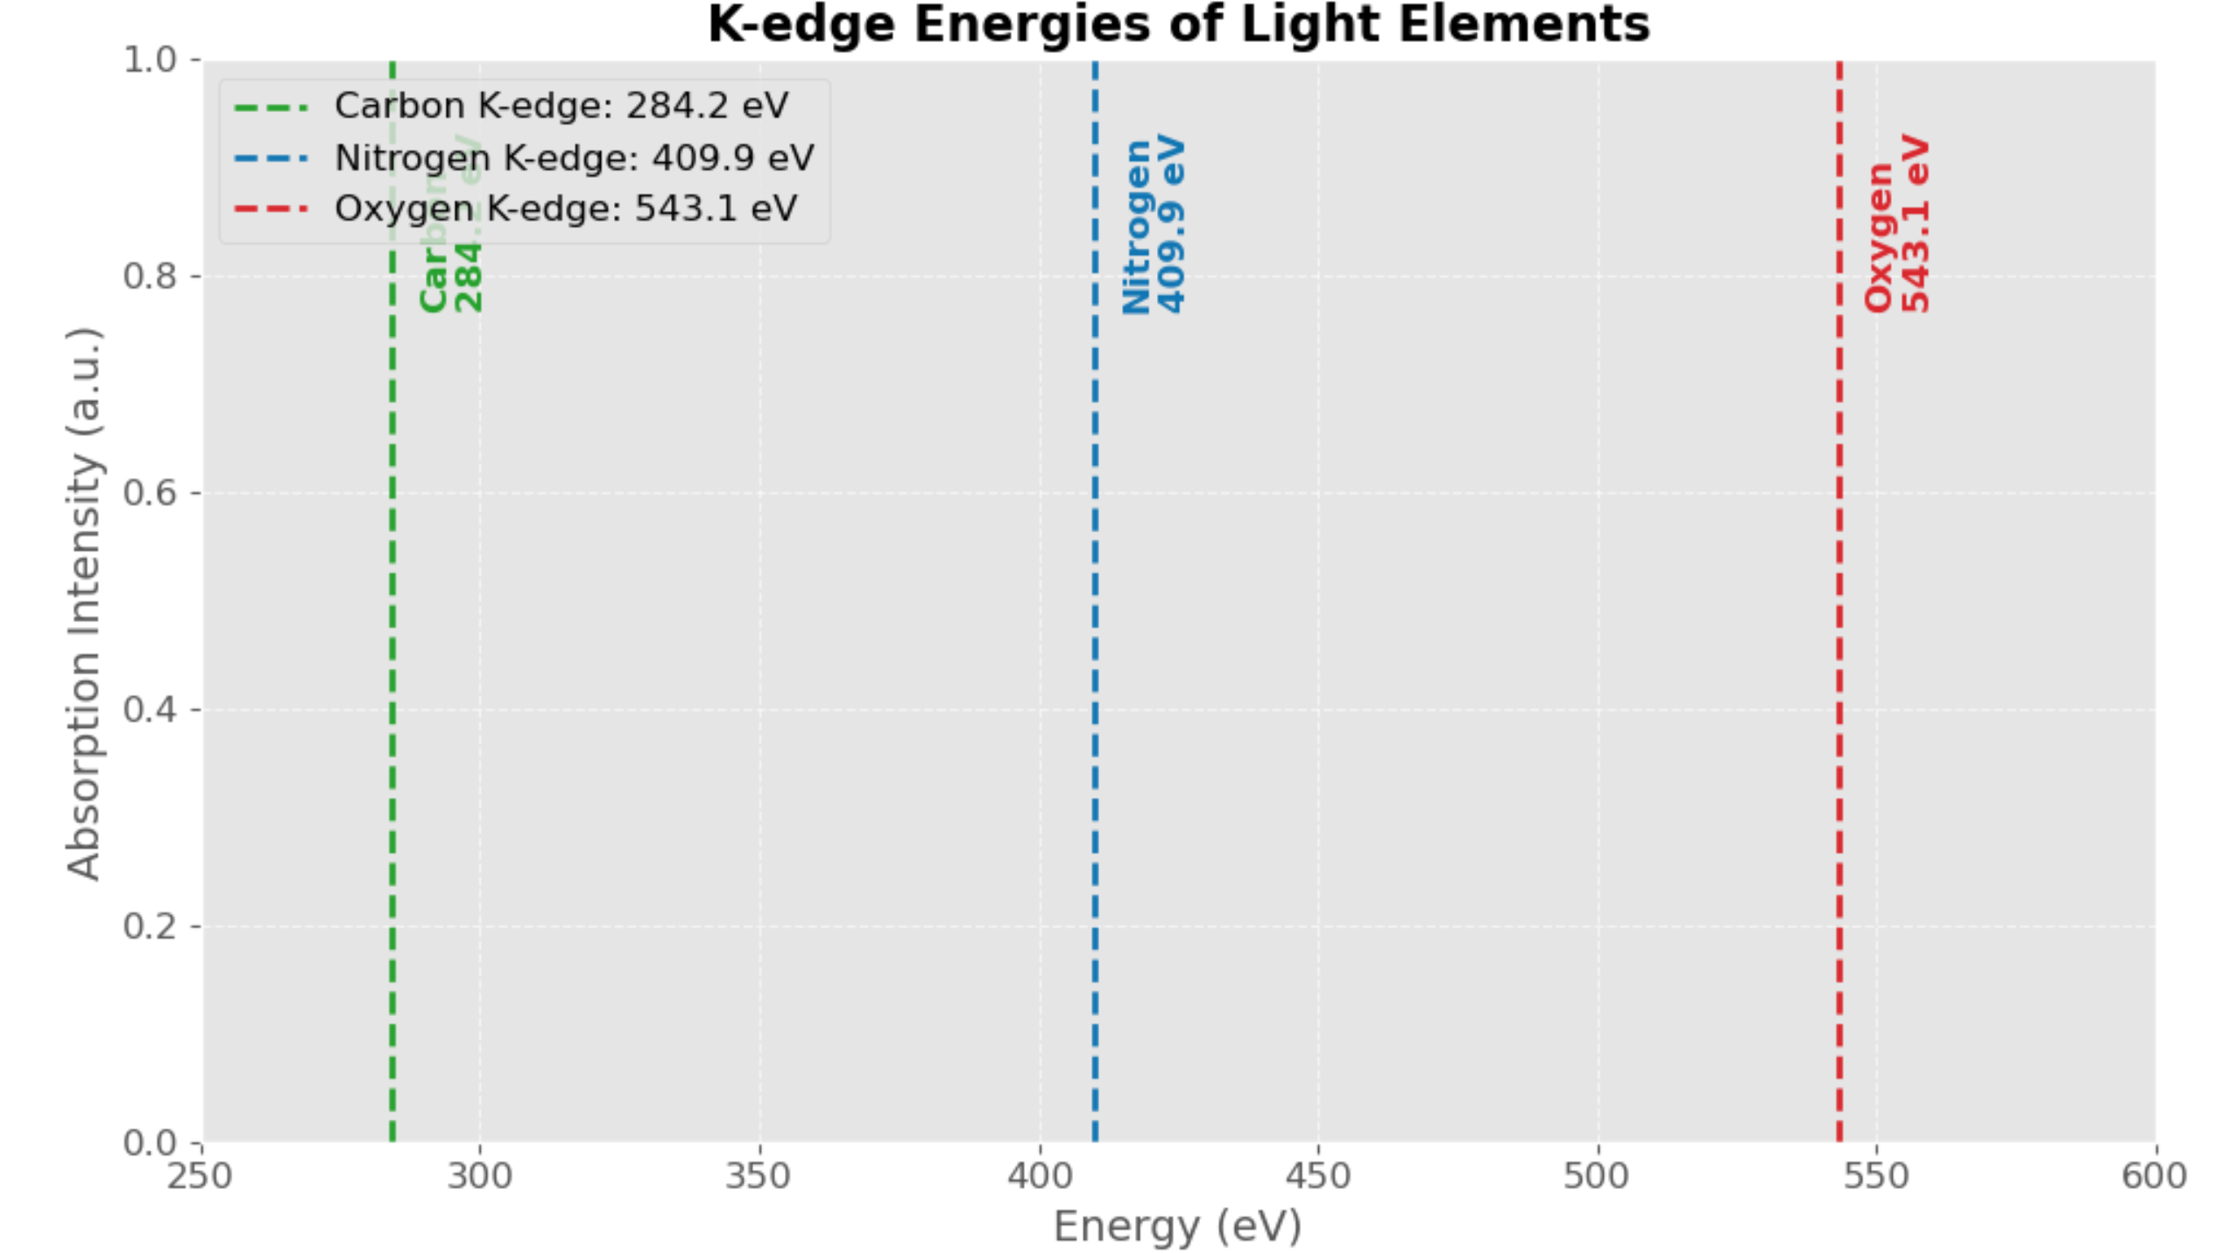
Why AQUA? The «water-window»

Slide 16
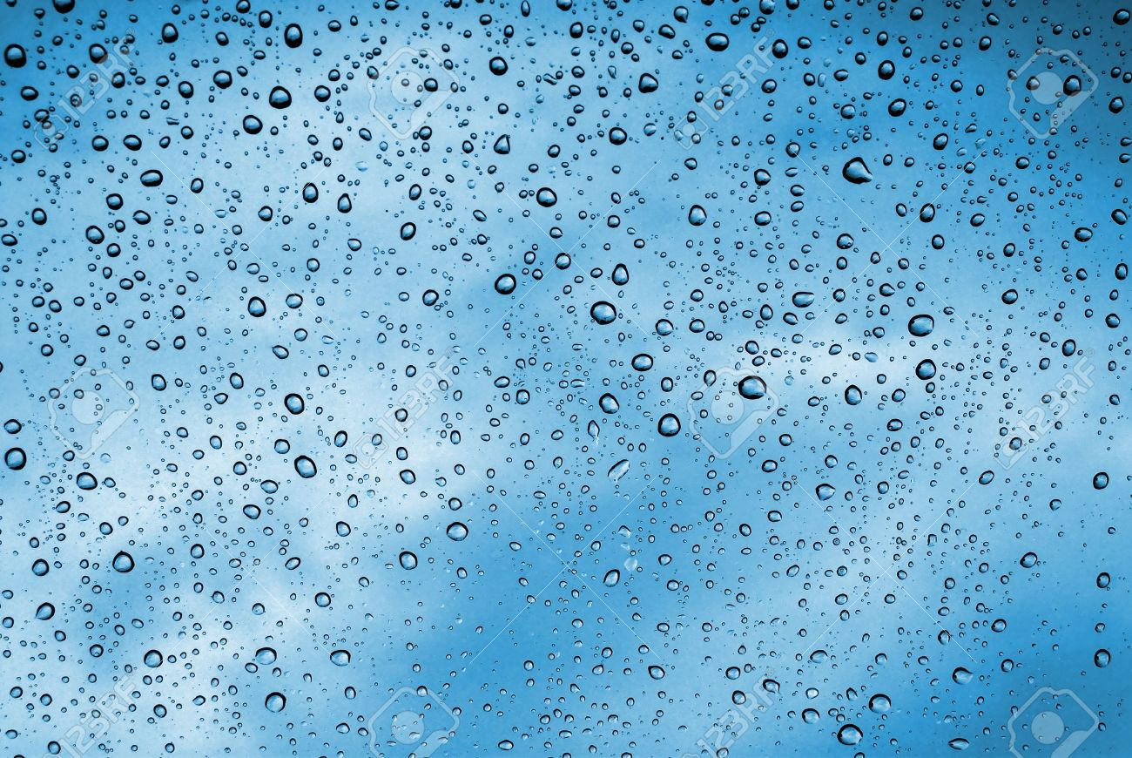
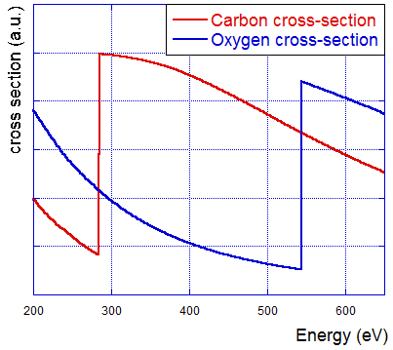
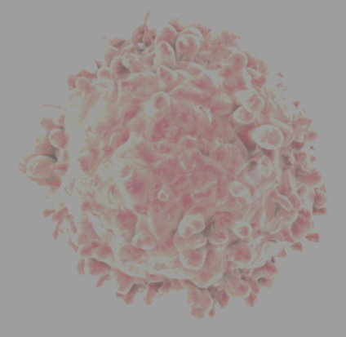
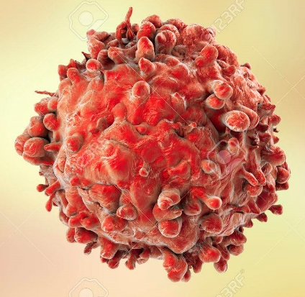
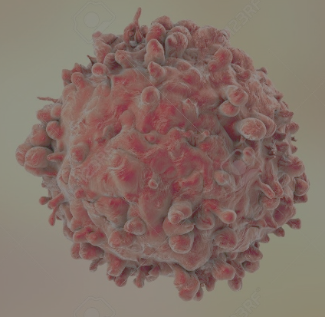
CDI in the «water-window»
Water window: energy region between
Oxygen and Carbon K-edge
2.34 nm – 4.4 nm (530 eV -280 eV)
«Sweet spot» for imaging of biological samples in their native environment: water is transparent, the samples are not!
4 nm
2 nm
The expected resolution is tens of nanometers
However, only room-temperature measurements of fully hydrated samples allow aquiring 2D images of living cells and of organelles in their native state

Slide 17
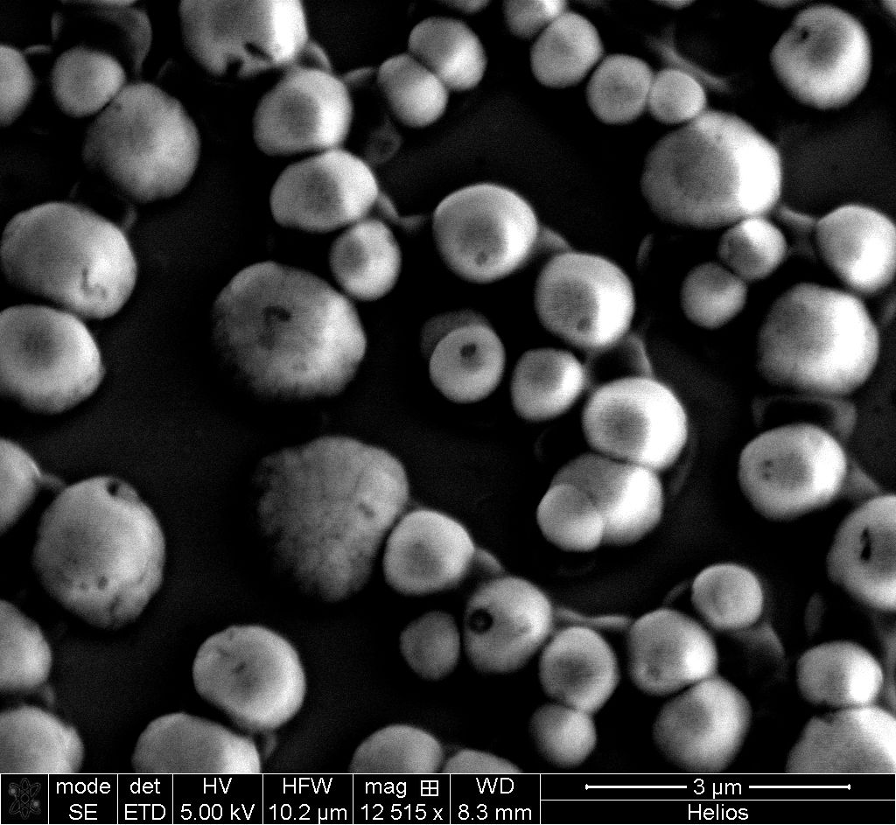
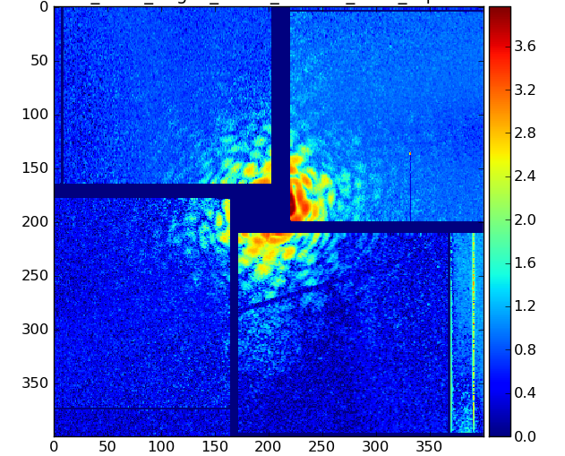
CDI @ LCLS
Atomic Molecular and Optical science beamline
CAMP Chamber
pnCCD
Water jet
pnCCD
pnCCD
FEL beam
A yeast nucleus diffraction pattern exhibiting clearly visible speckles
LCLS experiments
(still) unpublished data
520 eV (2.4 nm) photons
3x2 μm² focus - 2 μJ

Slide 18
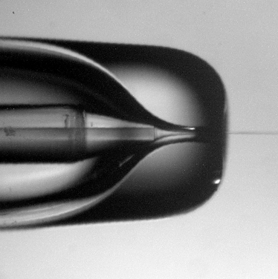
CDI @ AQUA – Sample Delivery
A gas-dynamic virtual nozzle (GVDN)
will inject micron-sized liquid
columns in the FEL beam
Gas line
Liquid jet
Liquid line
Gas line
Gas bottle
Sample reservoir

Slide 19
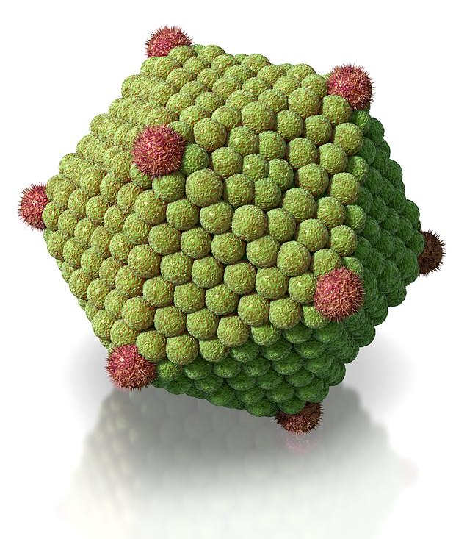
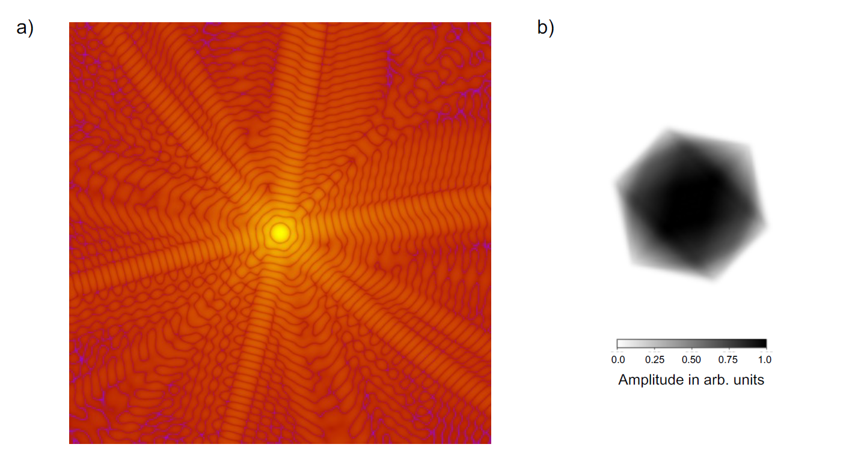
CDI @ AQUA – Simulated experiments
Enables 2D/3D imaging of hydrated biological samples
Acheivable resolution ≈20 nm
'Diffraction-before-destruction' mode
Simulated diffraction pattern of an icosahedral 500 nm virus hit by an AQUA pulse:
10¹¹ photons @ 4.3 nm, 5 µm diameter beam
2D CCD detector
@ 15 cm camera-length
with 1024x1024 75 µm pixels
Reconstructed electron density

Slide 20
CDI @ AQUA – Simulated experiments
Schematization of a 500 nm diameter virus injected in a 1 μm thick water jet.
500 nm C₄₀H₆₀O₂₀N₁₀10
500 nm H₂O
Wavelength | Relative Absorption (Virus vs. Water)
4.3 nm (just above C K-edge) | 3.3X more absorption by virus
4.4 nm (just below C K-edge) | 0.85X absorption (virus < water)
Within the water window, the signal-to-background ratio improves nearly 4X, enabling enhanced contrast for imaging carbon-rich structures like viruses.

Slide 21
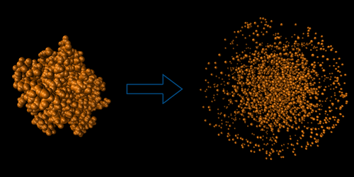
Coulomb Explosion Imaging (CEI)
FEL pulses ionize molecules. The ionized atoms repel each other and “explode” due to Coulomb forces.
In pump-probe, time-resolved experiments: ultrafast structural changes at femtosecond resolution.
André, T., Dawod, I., Cardoch, S., De Santis, E., Tîmneanu, N., & Caleman, C. (2025). Protein Structure Classification Based on X-Ray-Laser-Induced Coulomb Explosion. Physical Review Letters, 134(12), 128403

Slide 22
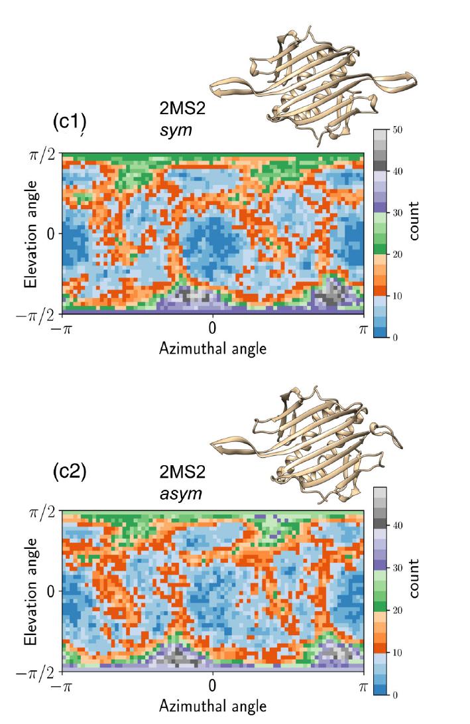
Coulomb Explosion Imaging (CEI)
Tracking ion trajectories allows distinguishing among macromolecules in different conformational states.
André, T., Dawod, I., Cardoch, S., De Santis, E., Tîmneanu, N., & Caleman, C. (2025) Physical Review Letters, 134(12), 128403

Slide 23
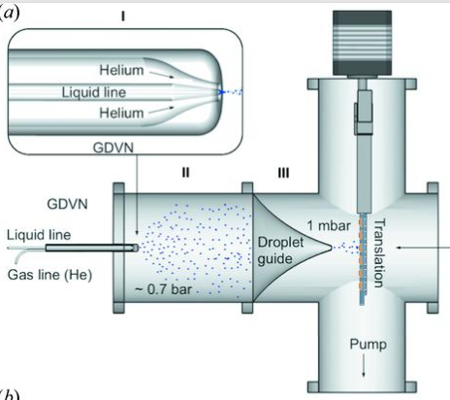
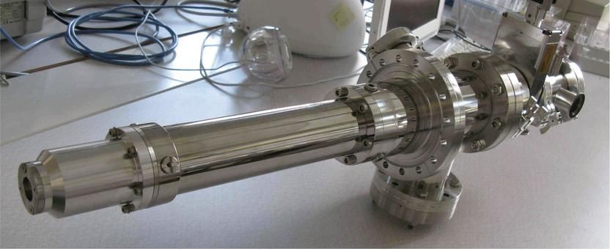
CEI @ AQUA – Sample Delivery
A liquid jet is sprayed into a system of aerodynamic lenses, producing small droplets with a thin solvent layer surrounding the sample.
The droplets quickly dry, and the samples are surrounded by no or very few solvent molecules.

Slide 24
CEI @ AQUA – Experimental Scheme
Sample Delivery
Molecules (e.g., proteins) are injected as isolated particles via aerosol jets.
Ionization and Explosion
The FEL pulse causes multi-ionization.
A Coulomb explosion occurs, ejecting ions radially.
Detection
Ion positions are recorded by position-sensitive detectors.
The spatial pattern reflects the original molecular geometry.
Analysis
Simulations and clustering help reconstruct and classify 3D shapes.

Slide 25
CEI @ AQUA – Experiment Simulation
100 MD independent simulations per protein FEL Explosion simulation using the MC/MD code MOLDSTRUCT.
  FEL Gaussian pulse: 12 fs (EuPRAXIA@SPARC LAB)
  Simulation time: 300 fs
  Ion trajectories projected onto a virtual 4π spherical detector
Pattern Classification
  Dimensionality reduction
  Each explosion = a point in 2D space

Slide 26
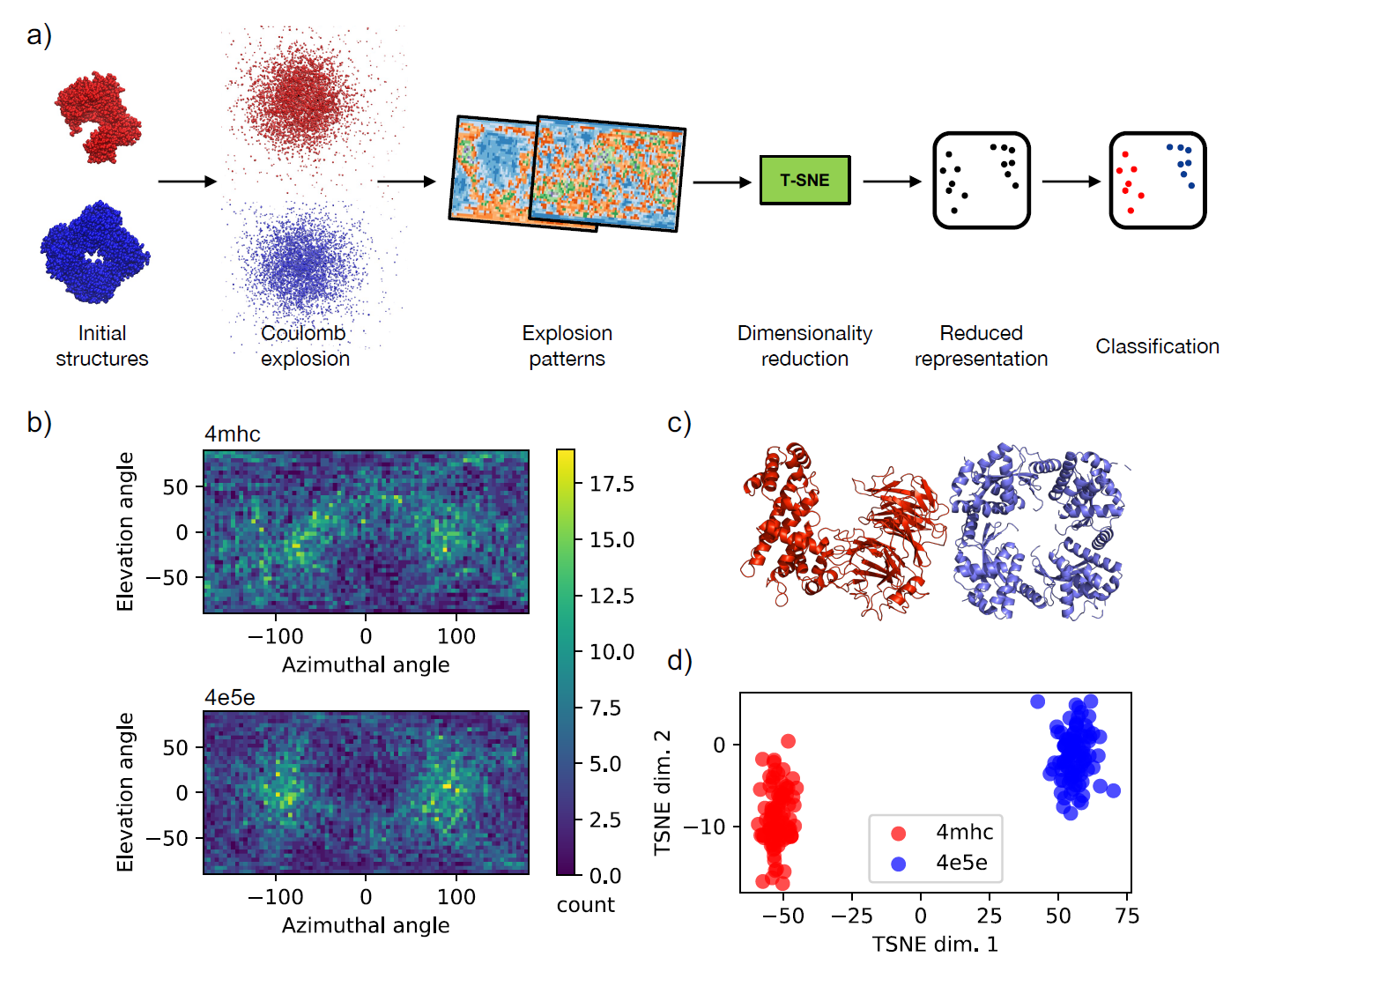
CEI @ AQUA
2 proteins have been simulated
Nucleoporin
(pdb ID:4mhc)
PAN Avian Influenza Virus protein
(pdb ID: 4e5e)
Distinct patterns between different proteins → effective classification

Slide 27
Soft X-ray Spectroscopy @ AQUA
Absorpion Spectroscopy
No monochromator @ day-one
SASE w/o monochromator (👻ghost-spectroscopy) scheme
Emission Spectroscopy
Downstream spectrometer (dispersive crystal + photon detector) for X-ray emission measurements
Klein, Y., Tripathi, A. K., Strizhevsky, E., Capotondi, F., De Angelis, D., Giannessi, L., ... & Shwartz, S. (2023). High-spectral-resolution absorption measurements with free-electron lasers using ghost spectroscopy. Physical Review A, 107(5), 053503.

Slide 28
Experimental Techniques
X-ray spectroscopy: absorption (and emission)
The AQUA energy spectrum allows scanning:
K-edge: Carbon
Hydrocarbons, aminoacids
L-edges: Sulphur, phosphorus, chlorine
Aminoacids,
M-edges: transition metal, lanthanides
Porphyrins, metalloproteins, imaging contrast agents, anti-cancer drugs

Slide 29
Conclusions & Outlook
AQUA will enable biological imaging experiments at nanometric resolution.
Molecular Dynamics simulations support the effectiveness of CDI and CEI on hydrated biosamples with the AQUA parameters.
X-ray spectroscopy → atomic resolution structures around selected elements
🔬 Imaging of organelles and whole living cells
🦠 even in the presence or absence of pathogens (e.g., viruses)

