Slide 1
Experimental study of Positron Emission Tomography with polarimetric capability Mihael Makek Department of Physics, Faculty of Science, University of Zagreb, Croatia
High-precision X-ray Measurements 2025 16-20 June 2025, Laboratori Nazionali di Frascati INFN

Slide 2
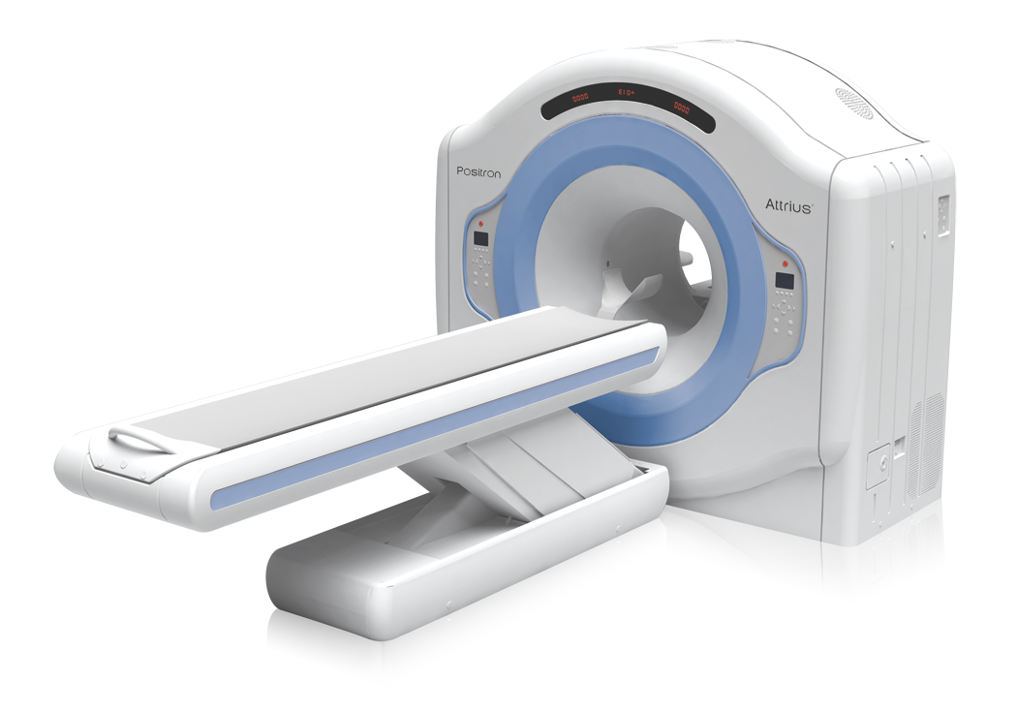
Positron Emission Tomography (PET)
Medical imaging modality
Physical basis: positron annihilation
Principle of operation
Inject positron emmiting radipharmaceutical (mostly FDG)
Detect emitted pair of gamma photons from positron annihilation e⁺e⁻ --> γ γ
Reconstruct the image of the source distribution based on detector hits
Quantify the activity distribution – attenuation, scatter, random corrections
Imaged by Siemens Biograph Quadra, Inselspital Bern, Switzerland
M. Makek

Slide 3
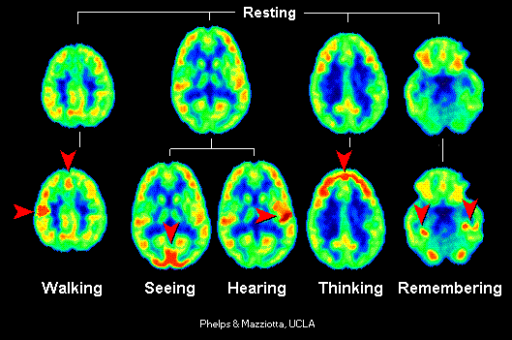
Application of Positron Emission Tomography
Oncology
Hearth function
Brain function
Limitations
Image resolution (~4-5 mm)
Contrast reduced by backgrounds
Sensitivity - scan duration (typ. 20-30 mins)
Radiation dose
The cost
Motivation for improvement and development of more sensitive and cost-efficient detectors
M. Makek

Slide 4
How does PET work?
M. Makek

Slide 5
Standard PET detector
Injection and metabolisation of positron labeled radiopharmaceutical
Positron annihilation:
e⁺e⁻ -> γ γ
The pair of γs identified based on:
coincidence time
Energy of each 511 keV
Back-to-back geometry assumed
RING OF DETECTORS
Positron annihilation in tissue
e⁺+e⁻→ γ+γ
Positron-labeled radiopharmaceutical
M. Makek

Slide 6
Standard PET detector
RING OF DETECTORS
Injection and metabolistion of positron labeled radiopharmaceutical
Positron annihilation:
e⁺e⁻ --> γ γ
The pair of γs detected based on:
coincidence time
Energy of each approx 511 keV
Back-to-back geometry assumed
Line-of-response (LOR) formed
M. Makek

Slide 7
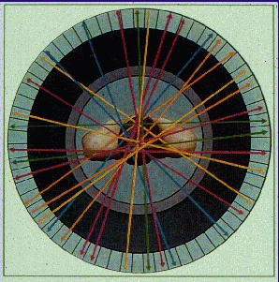
Standard PET detector
Injection and metabolistion of positron labeled radiopharmaceutical
Positron annihilation:
e⁺e⁻ --> γ γ
The pair of γs detected based on:
coincidence time
Energy of each approx 511 keV
Back-to-back geometry assumed
Line-of-response (LOR) formed
LORs --> reconstructed image
RING OF DETECTORS
M. Makek

Slide 8
Background in PET
Backgrounds due to:
Compton scatter in patient's body
Scatter
γ’
γ
M. Makek

Slide 9
Background in PET
Backgrounds due to:
Compton scatter in patient's body
Random coicidence
Multiple coincidence events
-> Fake LORs -> reduced image contrast
Multiple events
M. Makek

Slide 10
Polarization of annihilation quanta
M. Makek

Slide 11
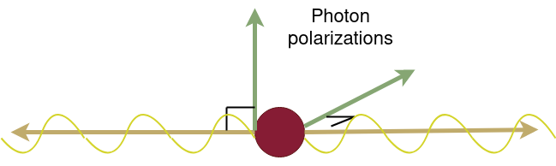
Polarization of annihilation quanta
In positron annihilation back-to-back gammas generated
They are entangled and polarized in orthogonal directions [P. Dirac, Proc. Camb. Philos. Soc. 26 (1930) 361; R. Hanna, Nature 162 (1948) 332]
How to measure polarization correlations?
Use of polarization correlations in PET imaging?
Cost-efficient implementation?
γ (511 keV)
γ (511 keV)
M. Makek

Slide 12
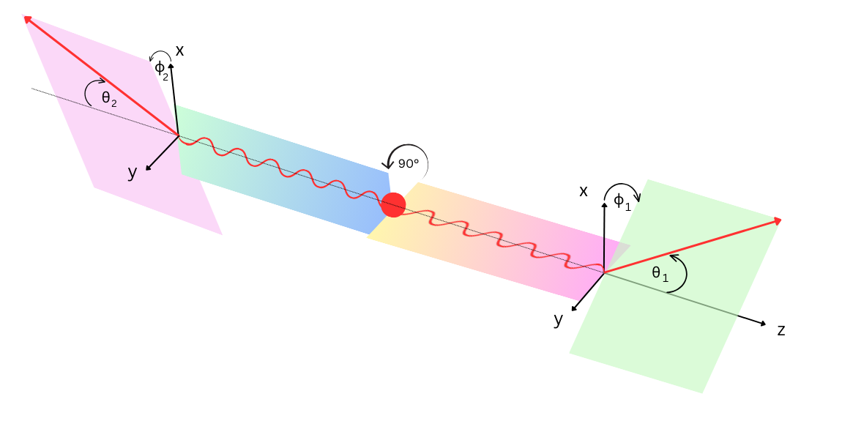
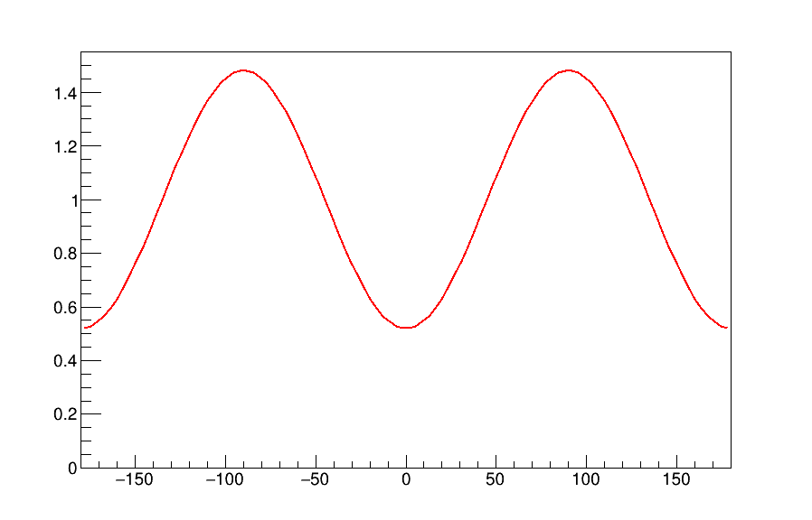
How to measure polarization correlations
When both linarly polarized annihilation photons undergo Compton scattering:
Visibility:
μ=A₁(θ₁) x A₂(θ₂) - product of analyzing powers A
μ_{max} (for E₀=511keV) = 0.48 @ θ₁= θ₂= 81.7°
In experiment reduced due to finite acceptance
with:
[Pryce and Ward, Nature 160 435; Snyder, Pasternak, Hornbostel, Phys. Rev. 73 (1948) 440-8]
a.u.
Δφ (deg)
M. Makek

Slide 13
Polarization correlations in PET
Potential of polarization correlations for S/B improvement in PET?
The polarization correlations are expected only for signal pairs
Discriminate true coincidences at high rates - rejection of false positives, randoms, multiple coincidences
Standard event ID in PET: - back to back, coincidence
- 511 keV
Additional event ID in PET:
Scatter
γ
a.u.
γ
Random conicidences
γ
γ
[Kuncic et al., NIM A648 (2011), McNamara et al., Phys. Med. Biol 59 (2014), M. Toghyani et al., Phys. Med. Biol 61 5803(2016)]
Δφ (deg)
M. Makek

Slide 14
How to (cost-efficiently) measure gamma polarization in PET?
Modern PET detectors: - highly segmented, - large axial coverage
Typical Compton polarization measurement:
detectors with 2 sensitive layers: 1st for measuring the recoil electron, 2nd for the scattered gamma
A PET system based on 2-layer detectors would dramaticaly increase the cost of the apparatus
-> Investigate the feasibility of the measurement of polarization correlations using single-layer detectors​
M. Makek

Slide 15
Development of PET system with polarization measurement capability
M. Makek

Slide 16
The single-layer polarimeter
M. Makek

Slide 17
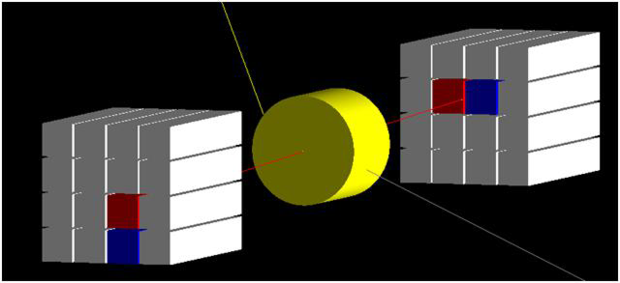
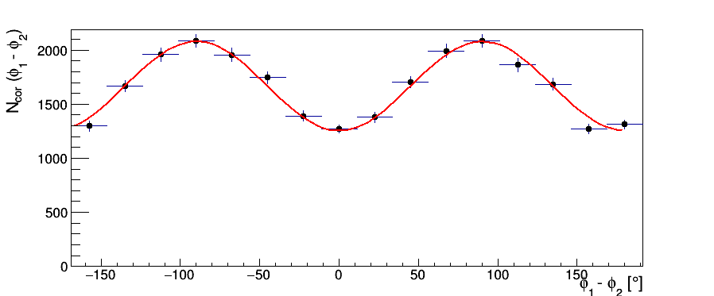
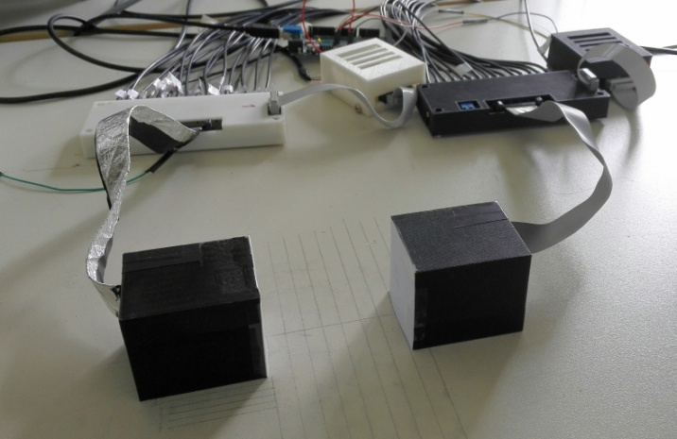
(I) Proof-of-concept for single-layer polarimeter
Two detector modules with:
16 scintillation crystals in 4x4 configuration
Silicon Photomultiplier array on only ONE side
Digital electronics for readout and DAQ
Results:
γ
γ
e⁺e⁻
Polarimetric modulation: μ =0.25 ± 0.01​
[M. M. et al., Nucl. Instr. Meth. A 958 (2020) 162835.]
[M. M. et al., Acta Physica Polonica B, vol. 48 (2017)]
M. Makek

Slide 18
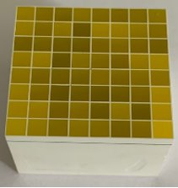
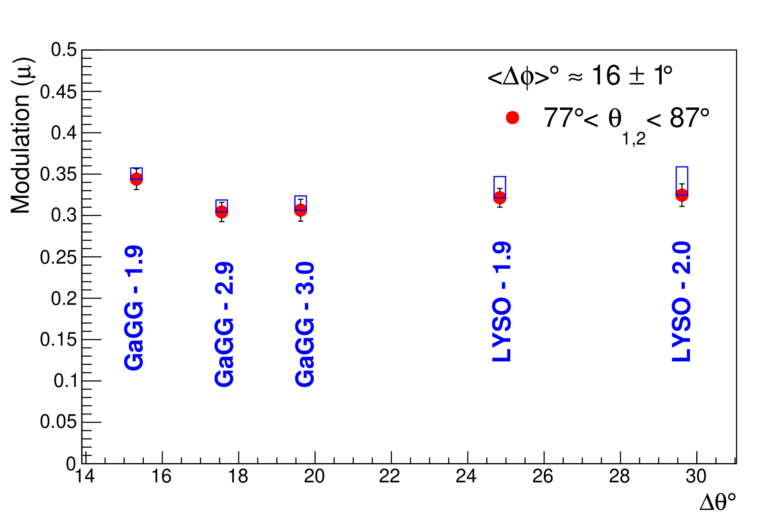
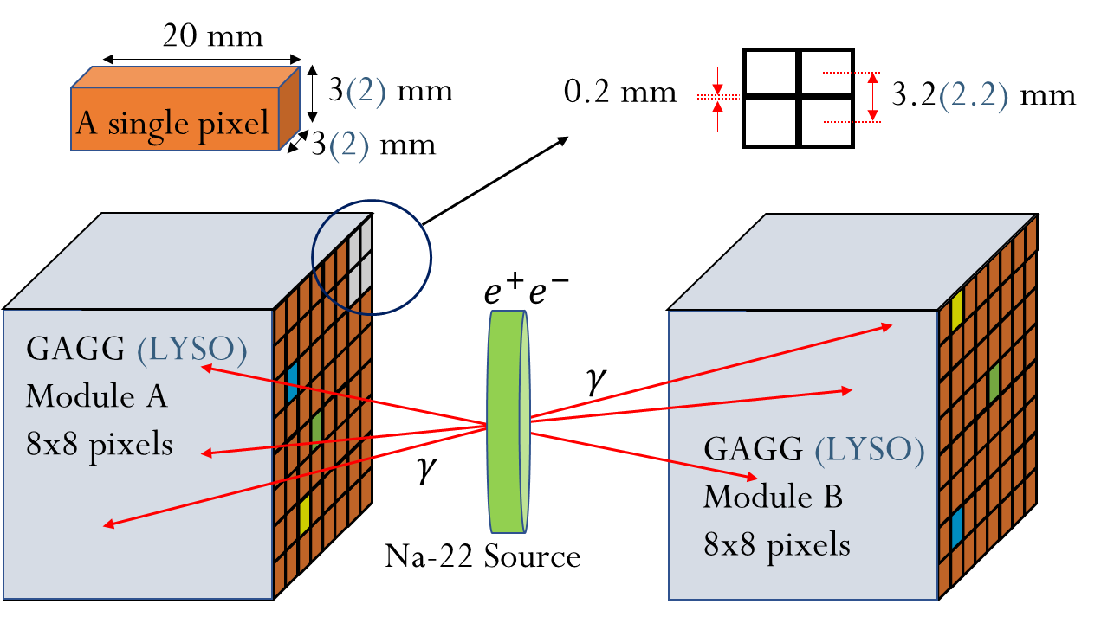
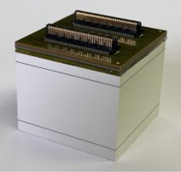
(II) Optimization of the single-layer configuration
Select material and geometry for maximum polarization sensitivity:
better energy resolution → higher θ resolution
finer segmentation → higher φ resolution
Energy resolution @ 511 keV:
LYSO ~14%
GAGG ~ 8%
SiPM +
detector matrix
Segmentation:
3x3x20 mm pixels
2x2x20 mm pixels
Single-sided readout by SiPM!
[S. Parashari et al. (2022), Nucl. Instrum. Methods Phys. Res. A, 1040: 167186]
M. Makek
Fig. 1. Schematic diagram of experimental setup - example for GaGG:Ce 8x8 matrix

Slide 19
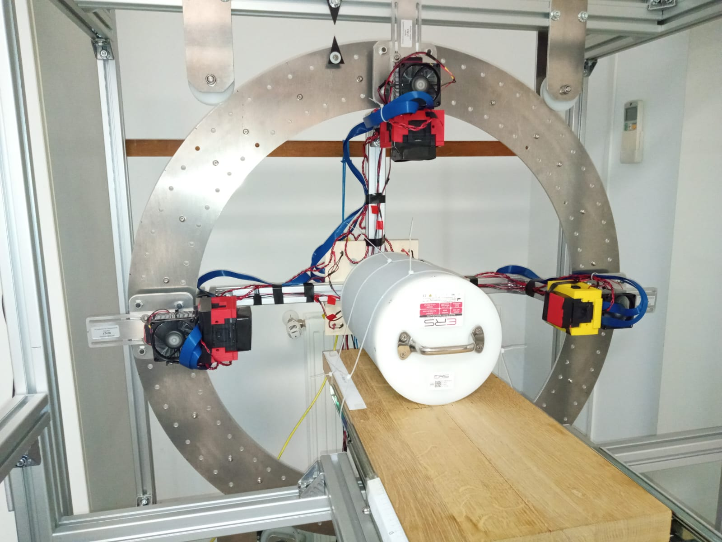
(III) The PET demonstrator
Four modules with 16 x 16 scintillator pixels
2 modules 3.2 mm pitch, GAGG
2 modules 2.2 mm pitch, LYSO
Annular structure allowing diameters 420 – 700 mm
Rotation around the scanner axis to emulate the full ring
Tests with high activity sourced at University Hospital Centre Zagreb
M. Makek
HPXM2025

Slide 20
PET imaging with polarization-correlated events
M. Makek

Slide 21
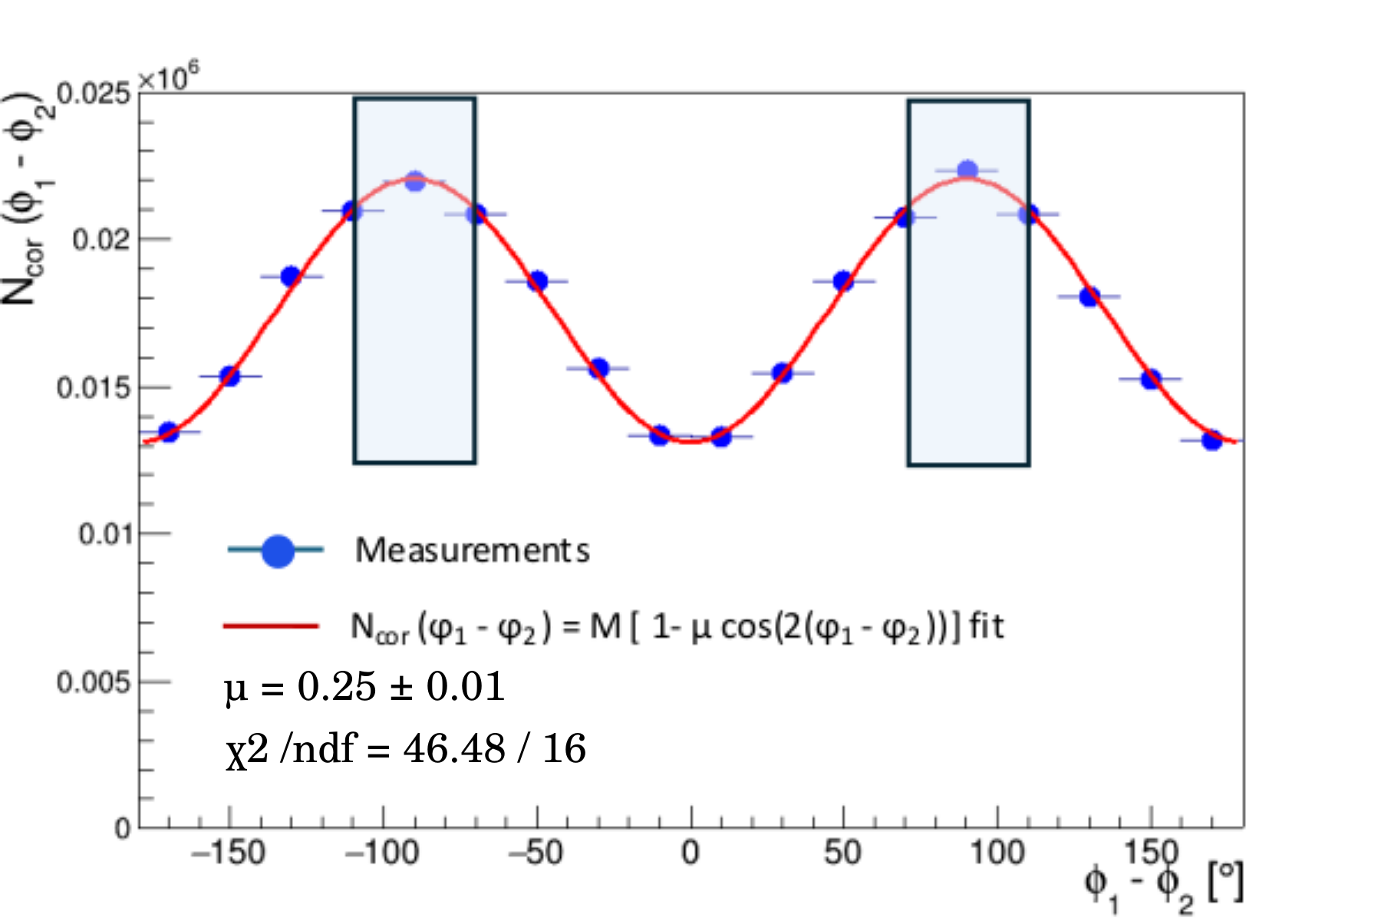
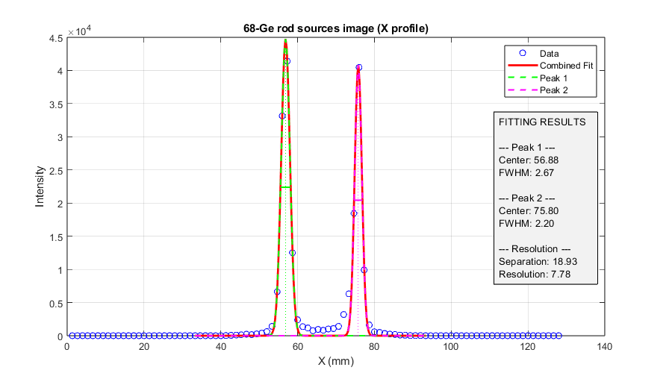
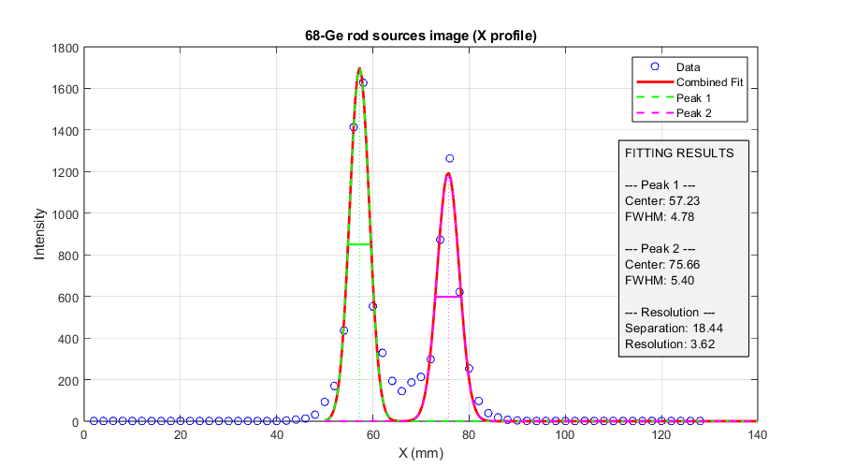
The spatial resolution
PRELIMINARY
1 pixel events, E_{px}=511 keV
Pol.-cor. Events, φ₁−φ₂|=90°±20°
FWHM ~2.5 mm
FWHM ~5.1 mm
LOR ambiguity
Line sources Ge-68 ~45 MBq each, in epoxy phantom, 2 cm distance
Ring diameter: 430 mm; GAGG-3mm modules
[A. M. Kožuljević, PhD Thesis, University of Zagreb, 2025]
M. Makek

Slide 22
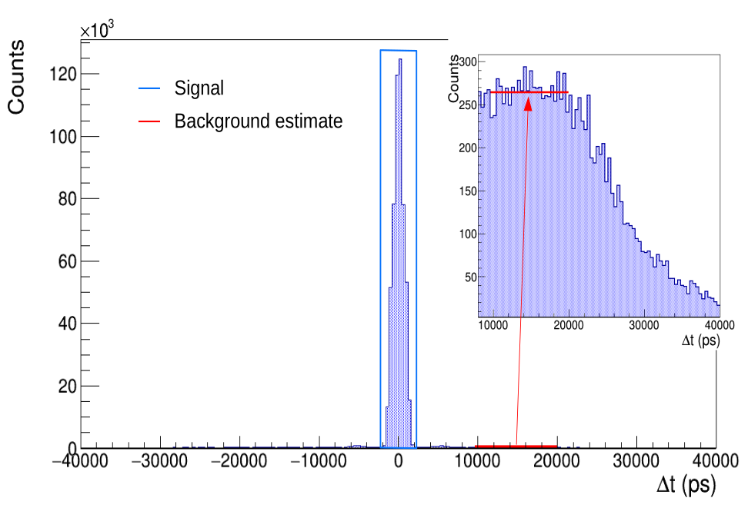
Random background rejection
PRELIMINARY
S/B_{rand} from coincidence time spectrum, 5 ns window
Single pixel events
Pol-cor events, 72°<θ<90°, 70°<|Δφ|<110°
Pol-cor events, 72°<θ<90°, -20°<|Δφ|<20°
[A. M. Kožuljević, PhD Thesis, University of Zagreb, 2025]
M. Makek
HPXM2025

Slide 23
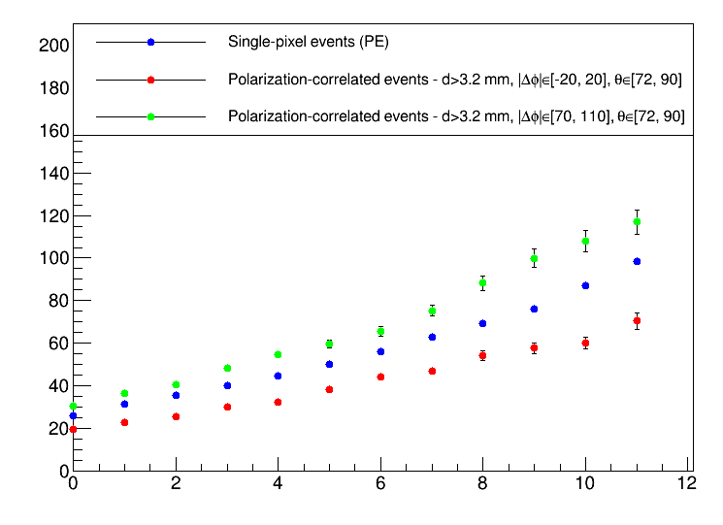
Random background rejection
PRELIMINARY
NEMA-NU4, Ga-68, 400 MBq initial activity
Single pixel events
Pol-cor events, 72°<θ<90°, 70°<|Δφ|<110°
SBR
Pol.cor events |Δφ|=90°±20° Single pixel events Pol.cor events |Δφ|=0°±20°
SBR improvement up to 30% for Pol.-Cor. events
Pol-cor events, 72°<θ<90°, -20°<|Δφ|<20°
Position #
[A. M. Kožuljević, PhD Thesis, University of Zagreb, 2025]
M. Makek
HPXM2025

Slide 24
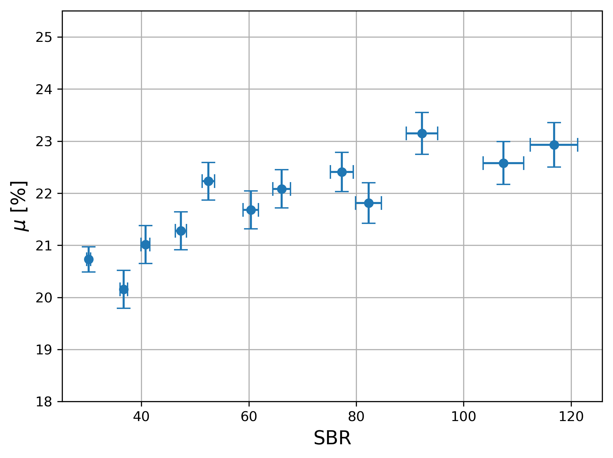
Random background rejection
PRELIMINARY
NEMA-NU4, Ga-68, 400 MBq initial activity
SBR
Pol.cor events |Δφ|=90°±20° Single pixel events Pol.cor events |Δφ|=0°±20°
Modulation vs SBR
SBR improvement up to 30% for Pol.-Cor. events
Position #
M. Makek
HPXM2025

Slide 25
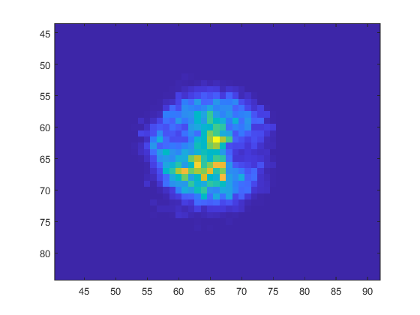
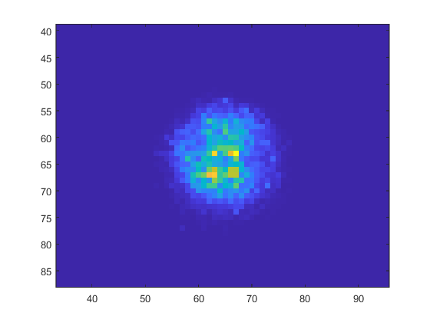
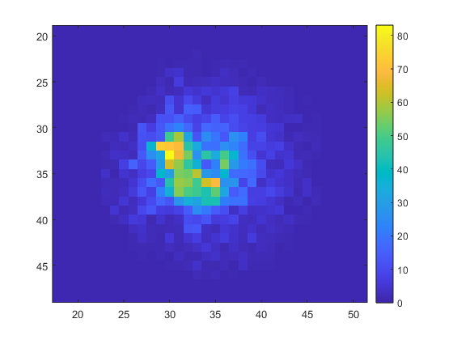
Standard vs. Pol-Cor Image
Ga-68
400 MBq
1-Pixel events
Pol. correl. events
PRELIMINARY
Ring diameter: 420 mm; GAGG-3mm modules
M. Makek
HPXM2025

Slide 26
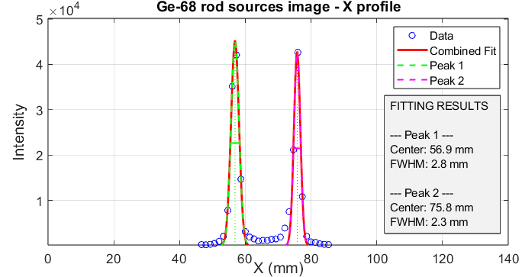
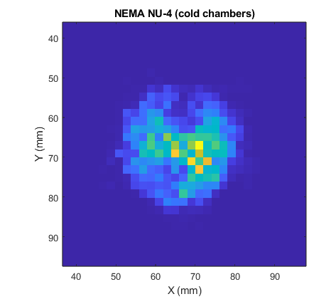
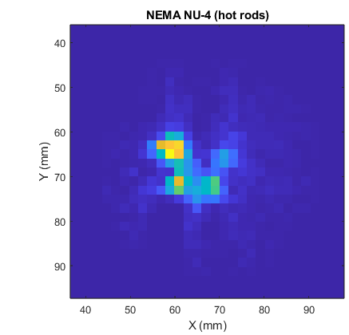
Standard and Pol-Cor PET synergy
Single-pixel (standard) + Pol-Cor(10% extra) data
Spatial resolution
NEMA NU-4 Phantom
PRELIMINARY
10% data increase, resolution and image quality preserved
M. Makek
HPXM2025

Slide 27
Conclusions
On PET using polarization-correlated events
First imaging with clincally relevant activities performed
Improved signal to background, diluted spatial resolution
Evidence of sensitivity benefit observed for the first time
M. Makek

Slide 28
ACKNOWLEDGEMENTS
THANK YOU!
This work was supported by Croatian Science Foundation under the project IP-2022-10-3878 and in part by the “Research Cooperability” Program of the Croatian Science Foundation, funded by the European Union from the European Social Fund under the Operational Programme Efficient Human Resources 2014–2020, grant number PZS-2019-02-5829

Slide 29
Backup slides

Slide 30
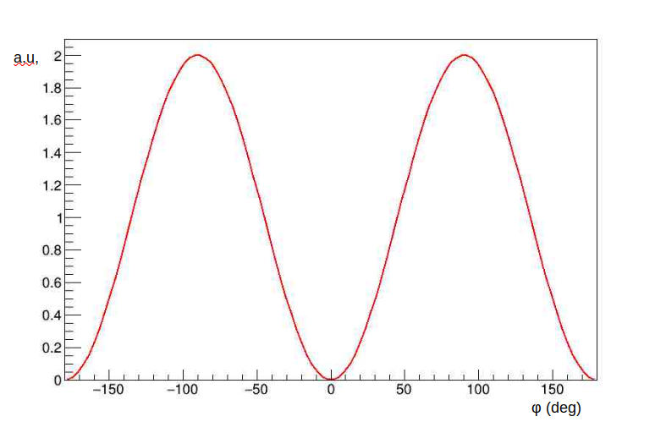
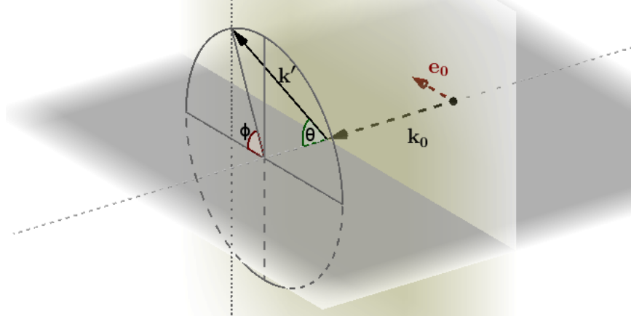
How is gamma-ray polarization measured?
Compton scattering - Klein-Nishina relation for Compton scattering of a polarized gamma:
Gamma is most likely to be scattered at azimuthal angle φ perpendicular to the polarization vector (cosφ=0)
The sensitivity to polarization is the largest for scattering at θ=90°
Polarization is correlated to the azimuthal scattering angle φ
M. Makek

Slide 31
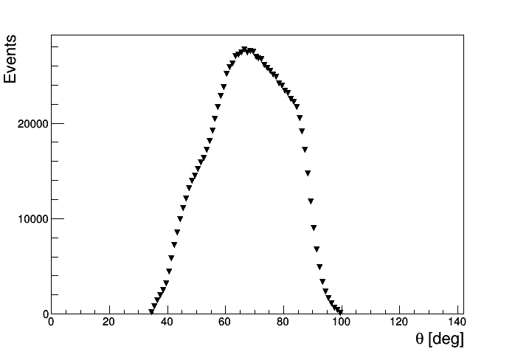
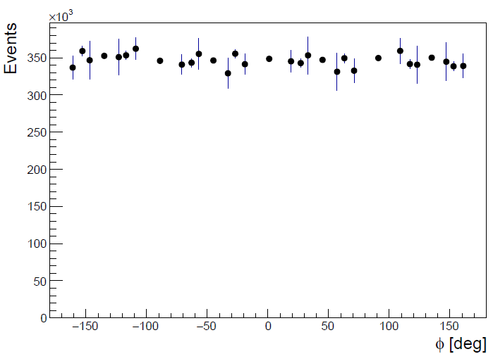
Compton event reconstruction
Compton angles reconstruction:
$$θ=\operatorname{acos}\left[m_{e}c^{2}\left(\frac{1}{E_{γ}}−\frac{1}{E_{γ^{′}}}\right)+1\right]$$
After acceptance correction:
M. Makek

Slide 32
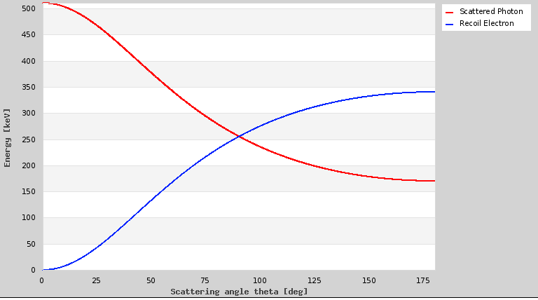
The „θ−ambiguity”
Which of the two pixels fired first?
Ambiguous for θ>60°
511 keV gamma Compton energies
γ
M. Makek

Slide 33
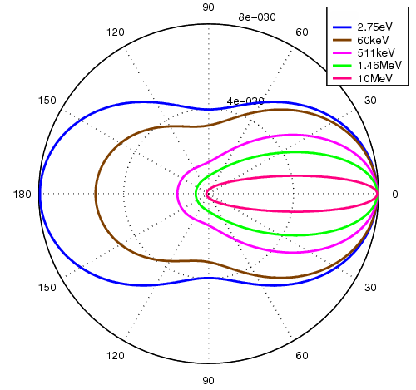
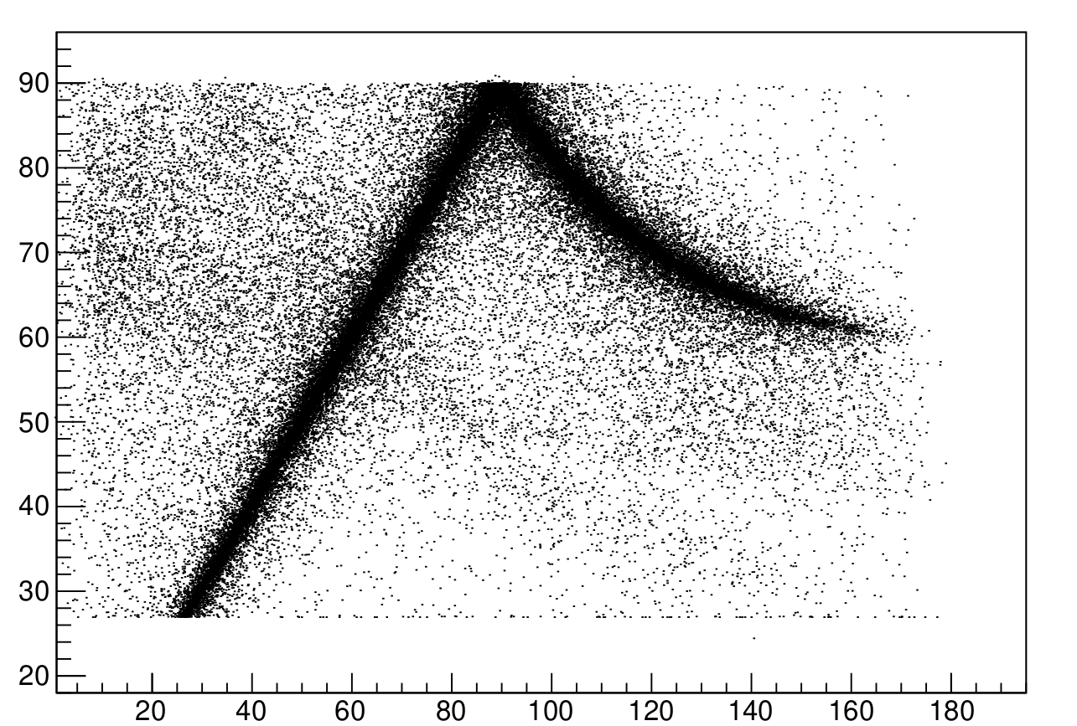
The „θ−ambiguity”
The cross section favors forward angles
Backward scattered gammas, θ>90°:
-> lower energy -> shorther absorption length
always assume forward scenario (i.e. the pixel with lower energy corresponds to e⁻)
θ_{Reco} (deg)
SIMULATION
160 140 120 100 80 60 40 20 0
θ_{Sim} (deg)

Slide 34
The „θ−ambiguity”
Event topology helps: events with larger inter-pixel distances d have a higher fraction of correctly determined angles
Implication on LOR determination:
30% correct pixel in both modules
50% correct pixel in only one module
20% incorrect LOR
Table: the fraction of correctly determined θ in GAGG, assuming forward scattering
[A. M. Kožuljević et. al., Condensed Matter 2021, 6, 43]
LORs
M. Makek

