Slide 1
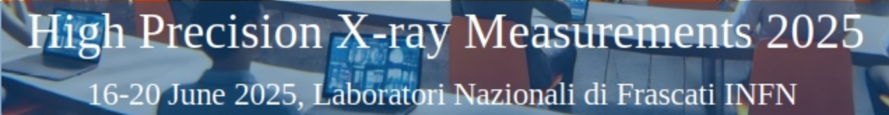
X-ray imaging detectors based on optical active defects induced in lithium fluoride crystals and films
F. Bonfigli¹, S. Botti¹, R.M. Montereali^{1,2}, E. Nichelatti³, V. Nigro¹, M. Piccinini¹, M.A. Vincenti¹
¹ ENEA Nuclear Dept., C.R. Frascati, Via E. Fermi 45 – 00044 Frascati (Italy)
²Present address: V. A. Cassani, 39 00046 Grottaferrata (RM), Italy
³ENEA Nuclear Dept., C.R. Casaccia, Via Anguillarese 301 – 00123 Rome (Italy)

Slide 2
Outline
X-ray detector based on defects, called color centers, in LiF films and crystals induced by X-rays
Overview of the main results obtained during the study and the development of this imaging detector in the fields of X-ray imaging and X-ray beam diagnostic.
Imaging experiments performed with different X-ray sources
table top, e.g. laser plasma sources and conventional X-ray tubes,
large-scale facilities, e.g. synchrotrons and free-electron lasers
emitting in several regimes and spectral ranges from EUV-Soft X-rays to hard X-rays
Performances and the peculiarities of the LiF-based imaging detector
the high intrinsic spatial resolution across a large field of view
the wide dynamic range
the versatility
F. Bonfigli, XPXM 2025, INFN-LNF 20 June 2025

Slide 3
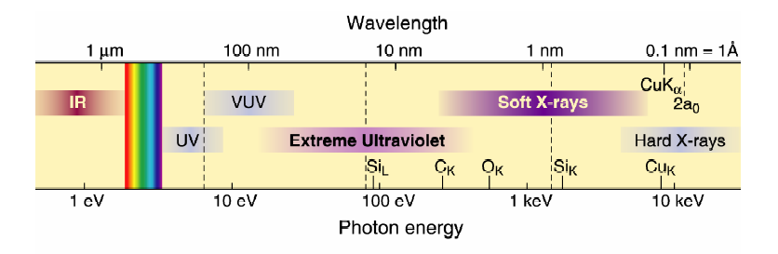
X-ray imaging
X-ray imaging: the short wavelength gives the potential for high-resolved resolution imaging.
The great progress achieved and the future perspectives are now enough mature to be applied to a number of different scientific fields, such as life sciences, nanoscience and nanotecnology, material engineering, cultural heritage, security, etc.
X-Ray Microscopy
X-ray microscopy techniques using shorter wavelengths than visible light have a resolving power that fills the gap between optical and electron microscopy.
Penetration depth
Spatial resolution
Intrinsic contrast
No preliminary preparation
Living samples
Internal structures of samples at a high spatial resolution and avoiding all specimen preparation (biological samples in their normal living state, wet or dry)
The development of X-ray imaging relies on the improvement of three key objects
X-ray sources
Optics
Detectors
Conventional x-ray tubes
Compact laboratory sources (laser plasma source)
Third generation x-ray synchrotron light sources
Fourth generation free electron lasers.
Zone plates, multilayer or refractive lenses, polycapillary optics
CCDs, photographic films, phosphor-based imaging plates, photoresists
F. Bonfigli, XPXM 2025, INFN-LNF 20 June 2025
Notes:
3

Slide 4
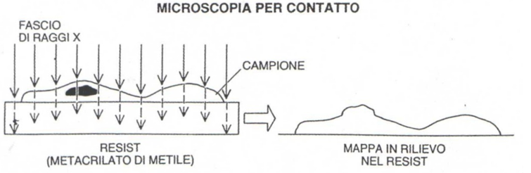
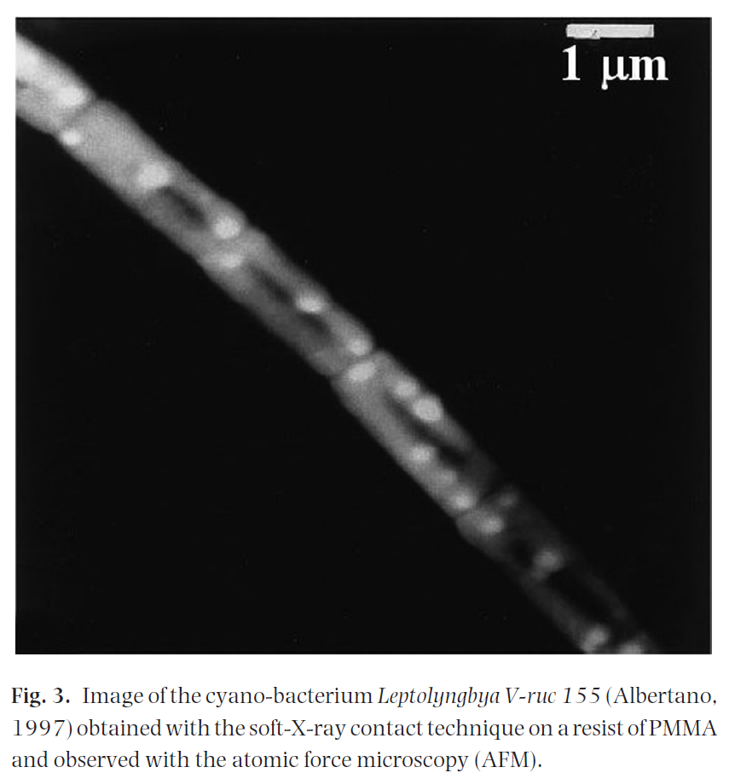
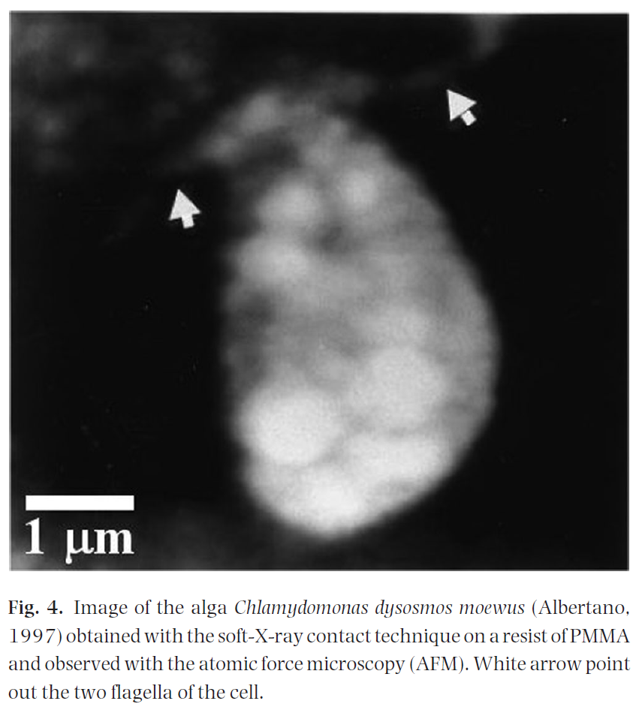
Contact X-ray microscopy in absorption contrast
Contact X-ray microscopy
The «contact mode» in absorption contrast is one of the simpler imaging technique.
No need of optical elements
No coherent radiation
Imaging of biological samples in their living state in single shot exposure
- Spatial resolution limited by: diffraction effect, penumbra blurring, detector.
Laboratory and compact X-ray sources
High resolution imaging detector
PMMA detector
- high spatial resolution - 10-nm scale spatial resolution
- required a relatively high-energy density of illumination (≥ 2 mJ/cm²),
- very poor dynamic range (5-6 bits).
- after exposure they need a development process and a complicated and time-consuming data acquisition reading through an Atomic Force Microscope
- limited field of view
X-ray
Sample
Photoresist
Poly-Metyl-MetAchrilate PMMA
L. Reale et al, Journ of Microscopy 258, 2, pp.127-139 (2015).
F. Bonfigli, XPXM 2025, INFN-LNF 20 June 2025

Slide 5
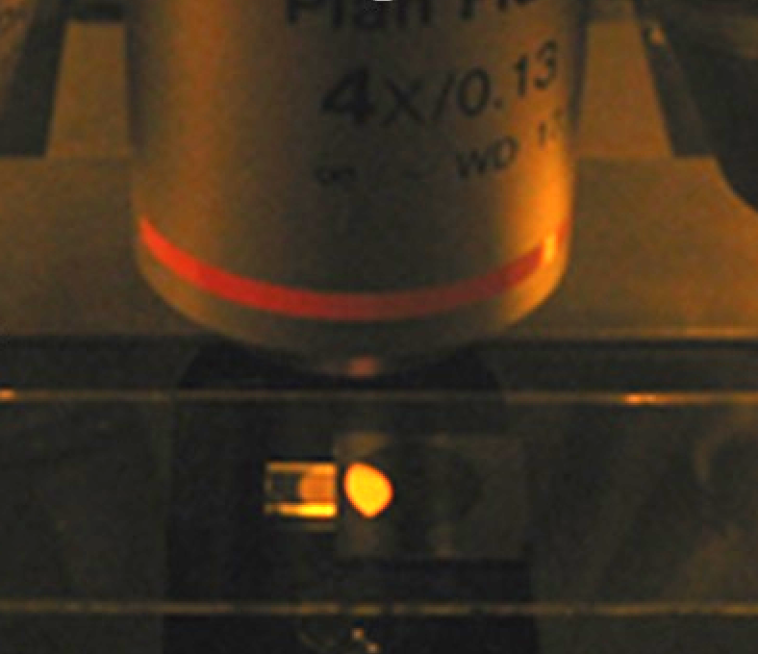
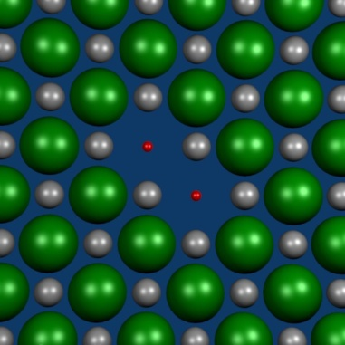

LiF-based X-ray imaging detectors
F ⁻
Li⁺
e⁻
F₂ CC
PECULIARITIES
Multi-purpose: X-rays (20 eV-30 keV), thermal neutrons, protons, low-energy electrons, γ rays, …..
high spatial resolution (intrinsic < 2 nm, standard < 250 nm)
large field of view ( > 1 cm² )
wide dynamic range ( > 10³)
easy handling: no development needs and no sensitivity to visible light
versatility: film geometry compatible with protective layers and different substrates
F. Bonfigli, XPXM 2025, INFN-LNF 20 June 2025

Slide 6
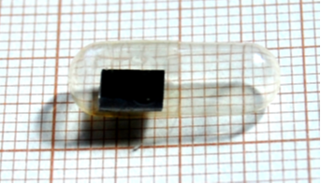

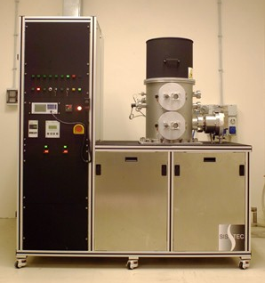
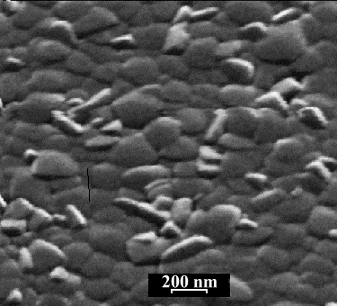
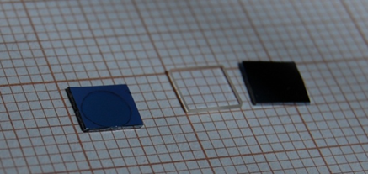
LiF film deposition by physical vapour deposition
Polycrystalline LiF films are grown by thermal evaporation on amorphous (glass, silica, silica on silicon, …) and crystalline (LiF single crystals, NaF, MgF₂, silicon, …) substrates. The structural, morphological and optical properties of the films are strongly dependent on
the nature of the substrate
the deposition parameters: T_{s} , t, R
SEM micrograph of the surface of a LiF film 1.8 μm thick thermally evaporated on a silicon substrate at Ts = 250 °C
LiF film on Si substrate
Deposition parameters
Pressure P < 10-6 mbar
Evaporation rate R = 0.5-2 nm/s
Total film thickness t up to 6 μm
Substrate temperature Ts = 30-350 °C
F. Bonfigli, XPXM 2025, INFN-LNF 20 June 2025

Slide 7
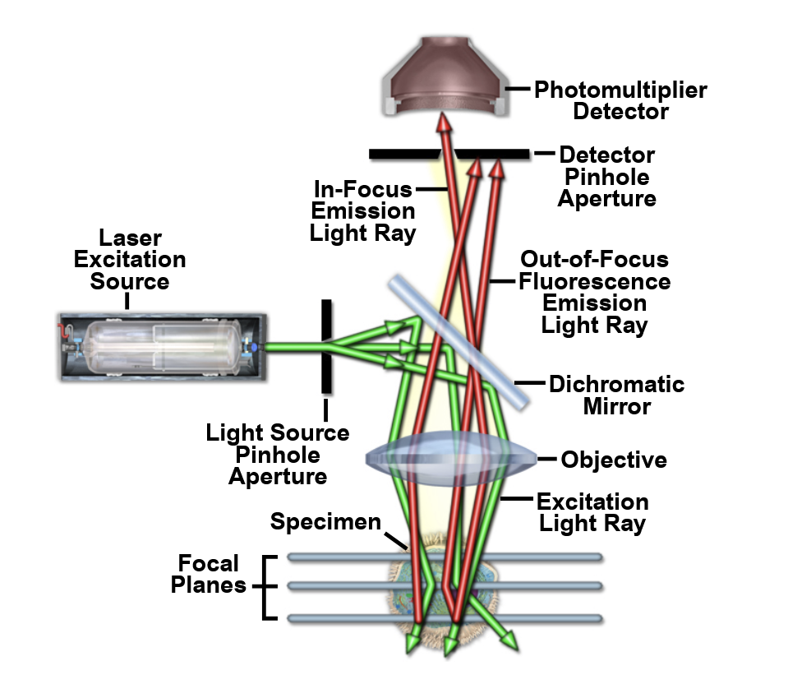
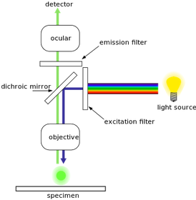
Read out: Confocal Laser Scanning Microscope
Light source: laser diodes (λem = 445 nm, 532 nm).
XY slices of Z scanning
XY = (636x636) μm²
ΔZ = 500 μm
Detection system The fluorescence signals are recorded simultaneously by two photomultipliers with proper emission filters to select the green and red emissions.
The detection can also operate in reflection mode.
F. Bonfigli, XPXM 2025, INFN-LNF 20 June 2025

Slide 8
X-ray sources
Laboratory and compact X-ray sources
Laser plasma sources - Soft X- rays – Water window for cells (also in vivo)
Contact X-ray micro-radiography
LiF response vs X-ray fluences
collab. with University of Tor Vergata
ENEA
X-ray tubes - 8 keV - Contact X-ray micro-radiography
Beam diagnostic (combined with policapillary optics)
collab. with Xlab INF-LNF
CNR-IFN
Capillary Discharge Soft X-ray Laser (46.9 nm, 2.3 ns) – Beam diagnostic
collab. with University of L’Aquila
Large facilities
Synchrotrons
- ANKA Synchrotron (KIT, Germany) – Broadband X-rays 4-40 keV - in line projection imaging – edge enhancement imaging
Monocromatic X-rays: 8 and 16 keV – volumetric storaging
SOLEIL Synchrotron (France) - Monocromatic X-rays: 7 keV – LiF response vs X-ray doses
Edge enhancement imaging
XFEL
- FERMI/ELETTRA XFEL – (FEL1, λ = 32nm, 60 fs) - Beam diagnostic
- SACLA Spring-8 Angstrom Compact free electron Laser, Japan– 10 keV, 7 fs - Beam diagnostic
F. Bonfigli, XPXM 2025, INFN-LNF 20 June 2025

Slide 9
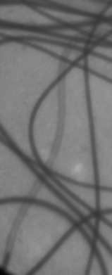
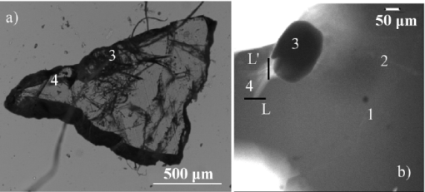
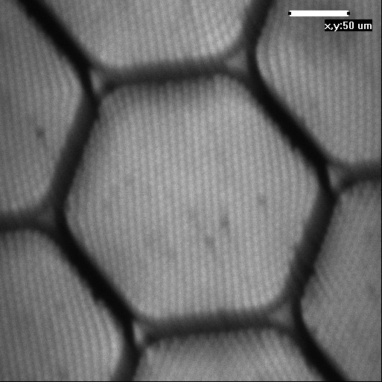
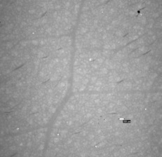
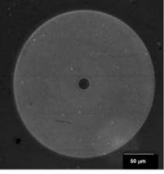
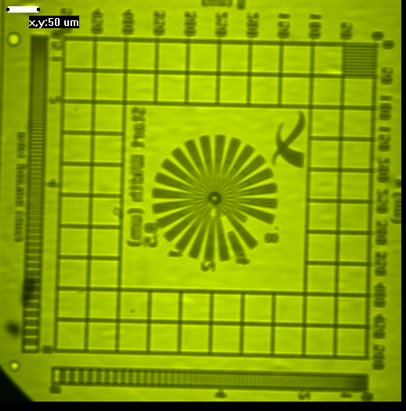
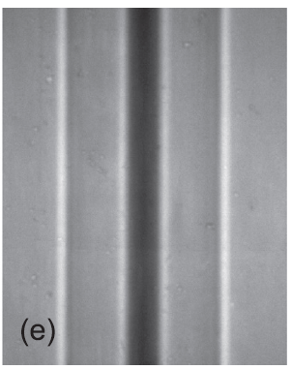
X-ray imaging with LiF detectors
Biological samples (in vivo cells in the water window spectral range, mosquito wings, pollens) - laser plasma sources
X-ray micro-radiographies
F. Bonfigli et al, Microscopy Research and Technique 71, 35-41 (2008).
L. Reale et al, Journ of Microscopy 258, 2, pp.127-139 , (2015).
@ CNR-IFN
Biological samples (leafs, human hairs, onion cataphils - X-ray tubes (8 keV)
Geological samples (volcanic minerals) - X-ray tubes (8 keV)
@ Xlab LNF-INFN
D. Hampai, et al. Europhysics Letters 96 (2011) 60010 p1-p4.
5 um
Micro-nano structures (Phase Fresnel Zone Plate optics) - X-ray tubes (8 keV)
@ CNR-IFN
S. Almaviva et al, Applied Physics Letters 89, 054102-4 (2006).
Micro-nano structures (polycapillary X-ray optics) - X-ray tubes (8 keV)
D. Hampai, et al, NIMA 720, pp. 113-115, (2013).
@ Xlab LNF-INFN
Micro-nano structures (X-radia test pattern, boron fibre)– @ANKA(KIT, Germany) synchrotron radiation
F. Bonfigli et al. Radiation Measurements 56 (2013) 277-280.
E. Nichelatti et al NIMA 833 (2016) 68–76.
F. Bonfigli, XPXM 2025, INFN-LNF 20 June 2025

Slide 10
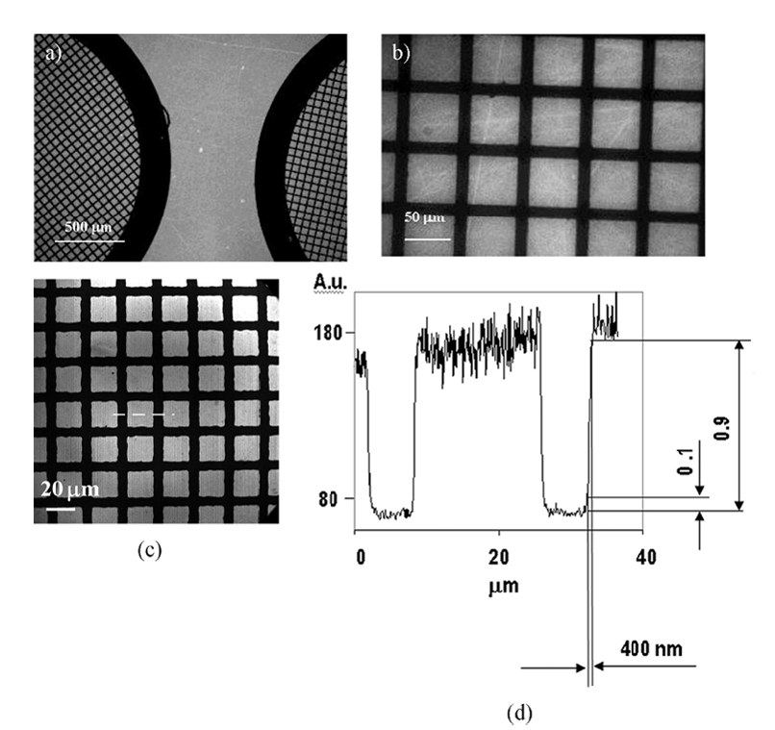
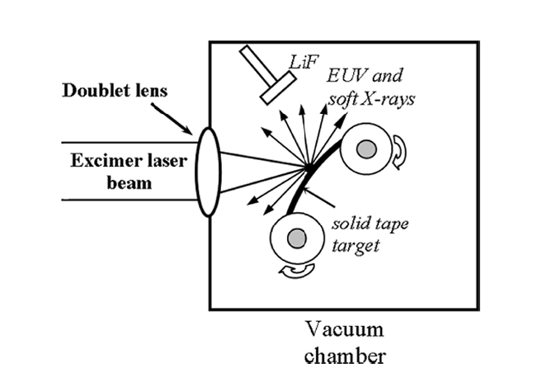
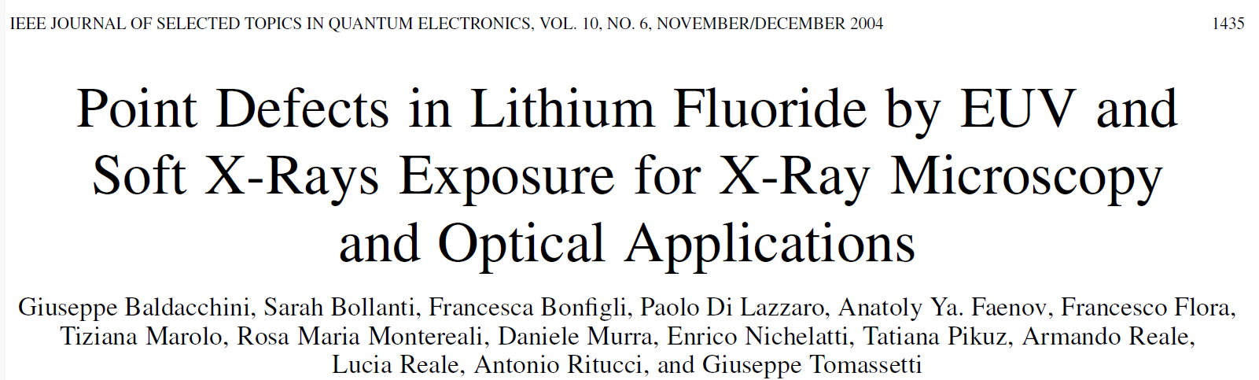
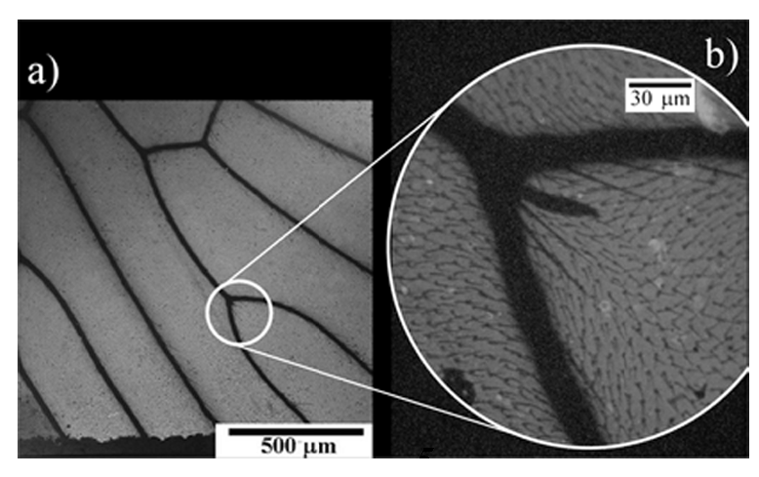
Contact X-ray micro-radiographies
LASER PLASMA SOURCE developed at the ENEA Laboratories, Frascati. The source of EUV and soft X-ray radiation was obtained by focusing a powerful excimer laser beam on a solid tape target placed in a vacuum chamber.
XeCl active medium (emission wavelength 308 nm) pumped by an X-ray triggered self-sustained electric discharge. The 2-J 10-ns laser beam is focused on the target which is a tantalum or copper tape having a thickness of 100 μm placed inside the vacuum chamber. Depending on the target material and on the laser power density on the target, the X-ray emission covers the spectral range from 0.6 to 60 nm ( 20 eV – 2 keV), which corresponds to the full EUV region and part of the soft X-ray region
a), b) Fluorescence images of LiF crystal exposed at 1000 shots of EUV radiation through a contact copper mesh, observed by a confocal optical microscope in fluorescence mode. (b), but on an LiF film, with EUV radiation emitted by a copper target in 2000 shots and passing through a 25.4-μm-period mesh.
Microradiography of a mosquito wing imaged on LiF film and observed under a fluorescence confocal microscope with a zooming of the circled area, Small hair diameter is about 1 μm.
F. Bonfigli, XPXM 2025, INFN-LNF 20 June 2025

Slide 11
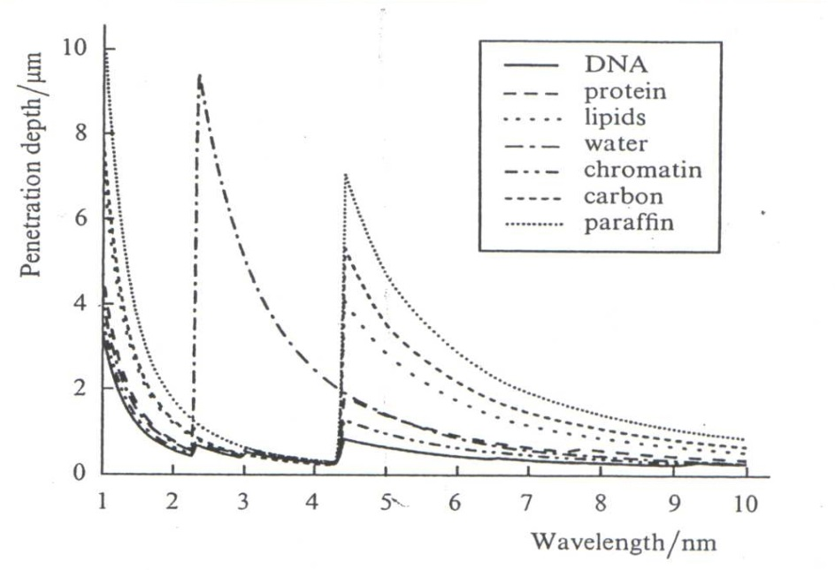
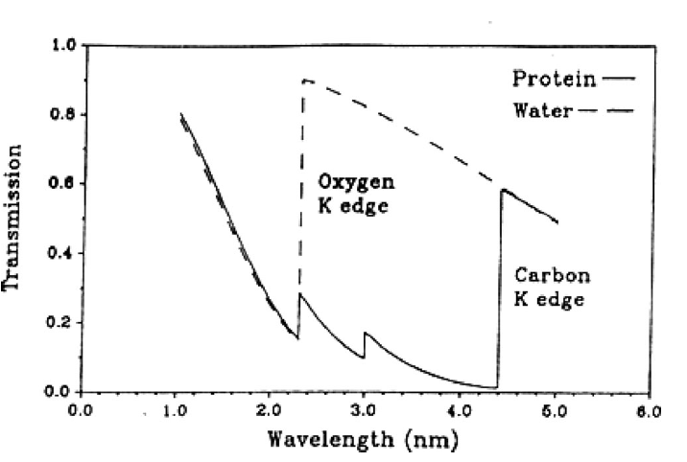
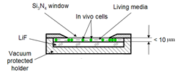
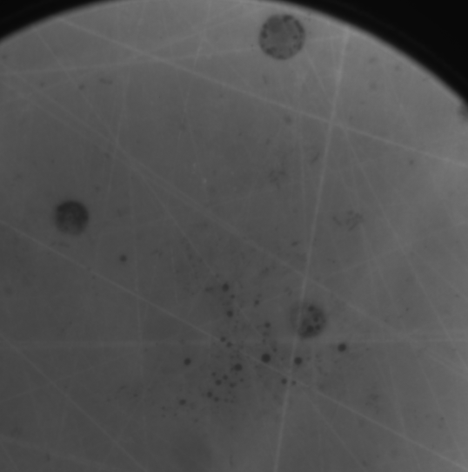
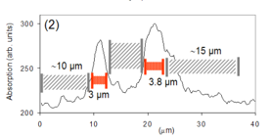
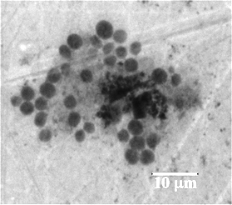
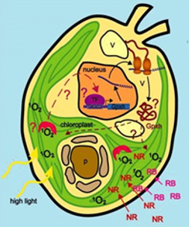
In vivo single-shot soft X-ray contact microscopy in the Water Window spectral interval
In the soft X-ray spectral interval (water window), imaging of biological samples in their living state can be performed. The sample is observed in water suspension, without staining or fixing. Collab. ENEA/University of L’Aquila/University of Tor Vergata
Laser Plasma Produced (LPP) source developed at Tor Vergata University (Engineering Dep.) uses a 1 GW, tabletop, multistage Nd:YAG/Glass laser system, delivering infrared (IR) pulses with nanosecond width (15 ns) and 1064 nm wavelength focused on a solid target in a vacuum chamber.
Water Window
4.4 - 2.3 nm (0.28 - 0.53 keV)
The spectral interval called water-window is generally used, because of the strong absorption of carbon (as compared with that of water) which allows to obtain a natural contrast in cells imaging.
Microscope holder of living cells in their water solution on LiF
Leptolyngbya v-ruc cells
Chlamydomonas reinhardtii cells
Chlorella algae
5 μm
10 μm
F. Bonfigli et al, Microscopy Research and Technique 71, 35-41 (2008).
L. Reale et al, Journ of Microscopy 258, 2, pp.127-139 , (2015).
F. Bonfigli, XPXM 2025, INFN-LNF 20 June 2025

Slide 12
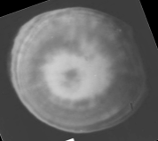
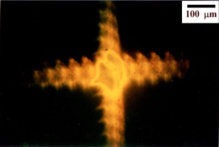
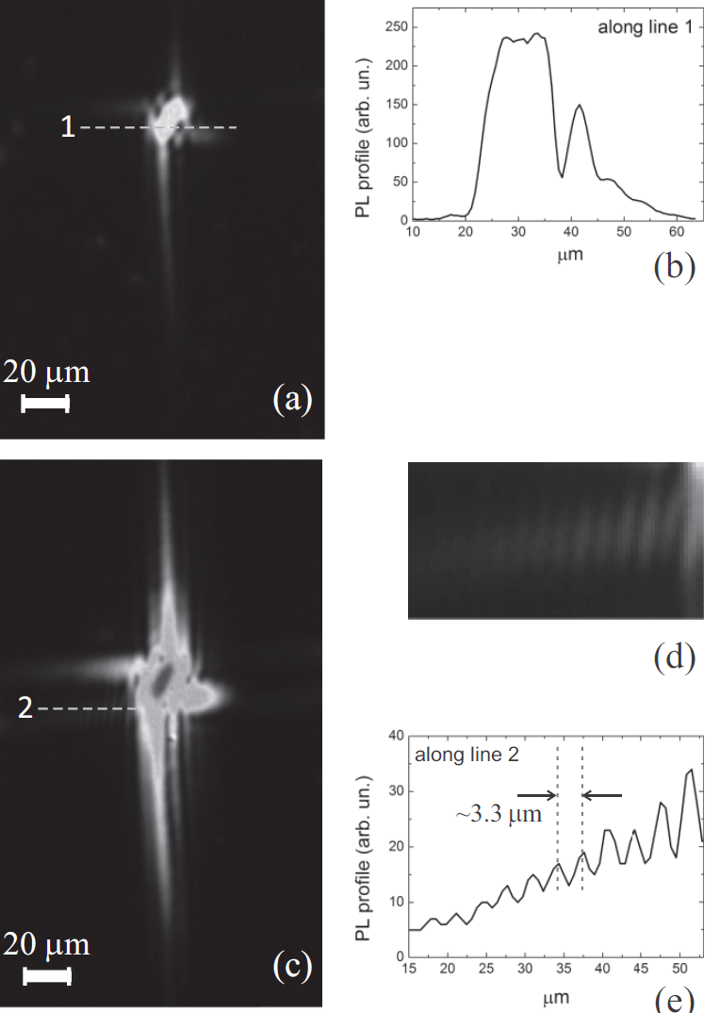
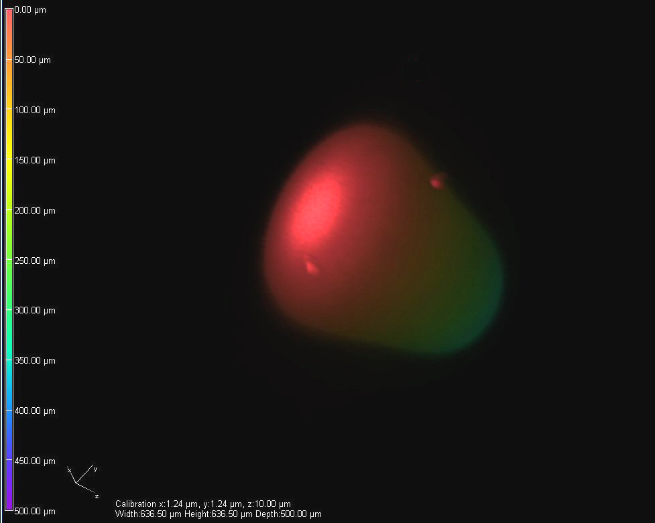
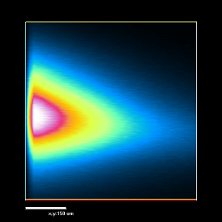
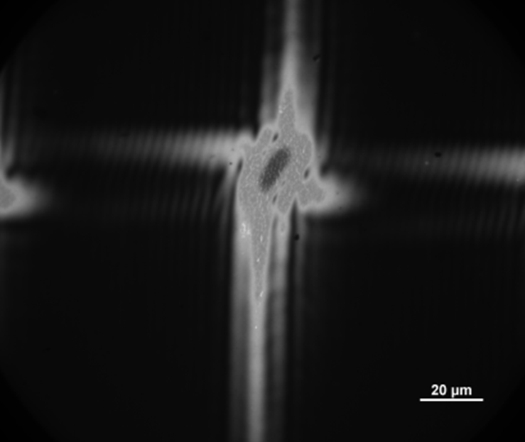
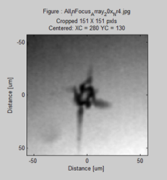
2D/3D X-ray beam diagnostic
Capillary Discharge Soft X-ray Laser (46.9 nm, 2.3 ns)
@ University of L’Aquila
50 μm
Baldacchini et al Rev. Sci Instr. 76 (2005) 1131041
E = 0.1 μJ
F = 75 mJ/cm²
Focused X-ray beam from policapillary optics coupled with X-ray tube (8 keV) @ Xlab LNF-INFN
F. Bonfigli, et al Optical Materials 58 (2016) 398-405
X-FEL beam detection@SACLA Japan (10 keV)
F. Bonfigli et al, Proc. of SPIE Vol. 11035 (2019) 110350N-1
E = 1 μJ
F = 750 mJ/cm²
Single-shot focused X-FEL beam detection @FERMI ELETTRA(λ = 32 nm, 60 fs)
DiProI (Diffraction Projection Imaging) Beamline
F. Bonfigli et al, IL NUOVO CIMENTO 42 C (2019) 237
F. Bonfigli, XPXM 2025, INFN-LNF 20 June 2025
PMMA

Slide 13
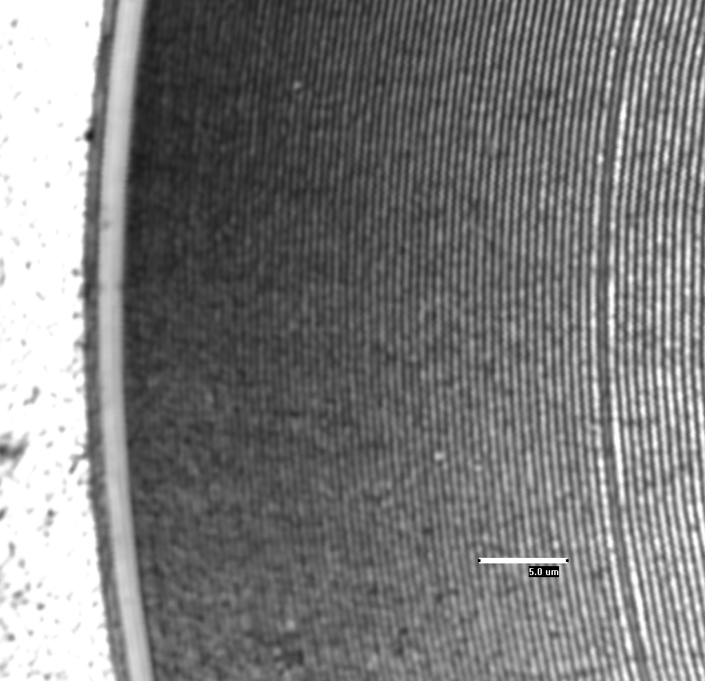
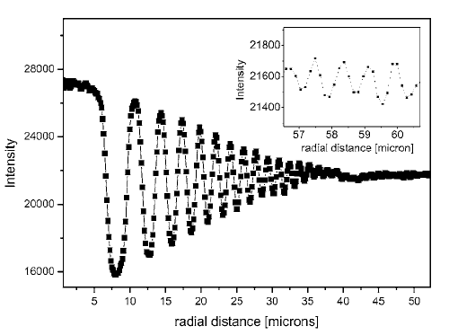
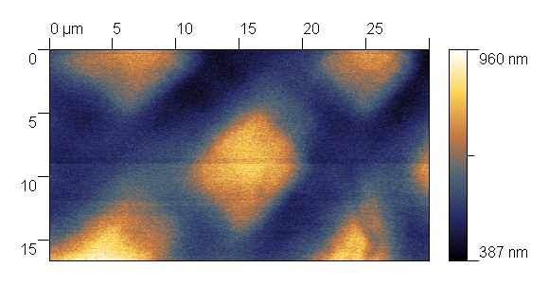
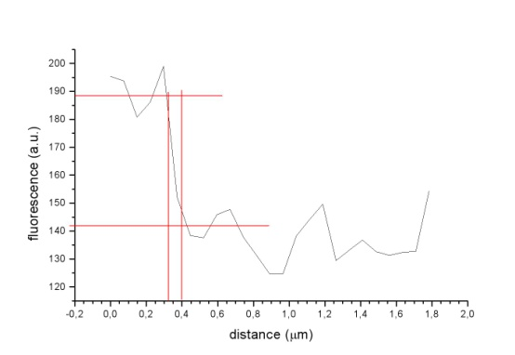
Spatial resolution of LiF-based detectors
Read out: Confocal optical microscope in fluorescence mode
250 nm
Spatial resolution
Contact X-ray micro-radiography of a Phase Fresnel Zone Plate stored on a LiF film
S. Almaviva et al, Applied Physics Letters 89, 054102-4 (2006).
Read out: Scanning Near Optical Microscope SNOM
75 nm
Edge resolution
Contact X-ray micro-radiography of a copper mesh stored in a LiF film
A. Ustione, et al, Appl. Phys. Lett. 88, 141107-9 (2006).
F. Bonfigli, XPXM 2025, INFN-LNF 20 June 2025

Slide 14
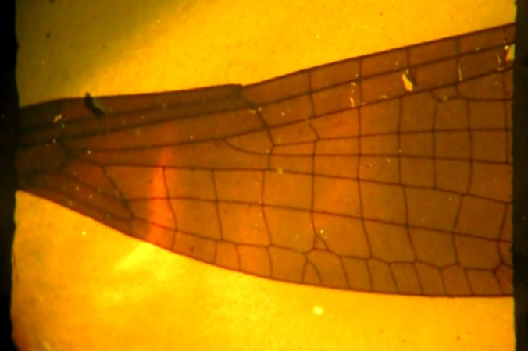
High spatial resolution on a wide field of view
2 mm
Wide field fluorescence microscope
X-ray micro-radiography of a dragonfly (Pyrrhesoma nymphula) wing on a LiF film
Confocal fluorescence microscope
Near field optical microscope
F. Bonfigli, XPXM 2025, INFN-LNF 20 June 2025
X-ray micro-radiography of a mosquito wing stored in a LiF film

Slide 15
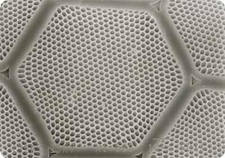
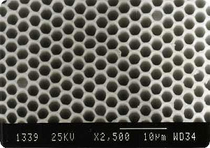
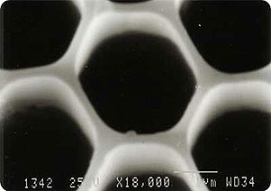
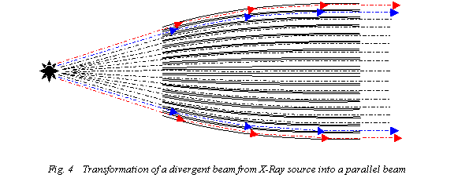
Characterization of X-ray polycapillary optics with LiF detectors
Electron microscope image of polycapillary lens transversal section
(http://unisantis.com/kumakhov-optics.html)
The polycapillary optics is composed by many bundles containing thousands of channels with a length of about 60 mm; each single channel is characterized by an average diameter of about 4 µm.
Transformation of a divergent beam from X-ray source into a parallel beam by a polycapillary lens
Collaboration with Xlab INFN-LNF
Poly-capillary
semi-lens
LiF detector
X-ray tubes
Cu anode
LiF crystal placed at the semi-lens exit
F. Bonfigli, XPXM 2025, INFN-LNF 20 June 2025
15

Slide 16
Single channel X-ray transmission of the semi-lens stored by LiF detector
Each glass channel, even if it is stretched due to the melting during the lens drawing process transports effectively X-radiation resulting in a quite uniform X-ray distribution behind the optics.
Additionally, it confirms that the channels remain mainly opened along the entire optics length.
The possibility of LiF detectors to store images with high spatial resolution on a wide field of view simultaneously, in this case allowed to obtain images of the transmitted X-rays through the entire lens and through the single channels.
D. Hampai, F. Bonfigli, S.B. Dabagov, R.M. Montereali, G. Della Ventura, F. Bellatreccia and M. Magi, Nuclear Instruments & Methods In Physics Research A, Vol. 720, p. 113-115, (2013).
F. Bonfigli, XPXM 2025, INFN-LNF 20 June 2025

Slide 17
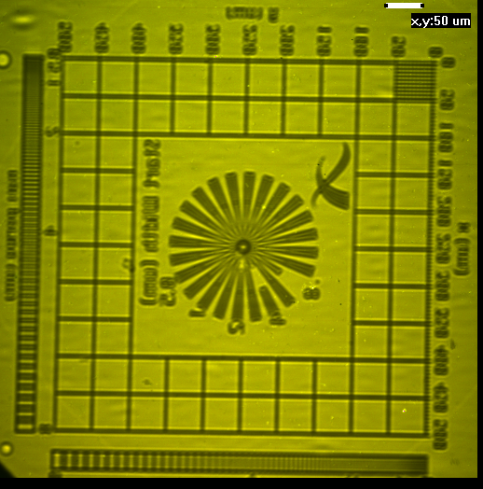
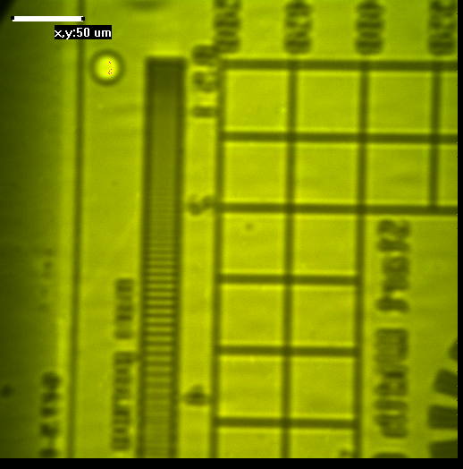
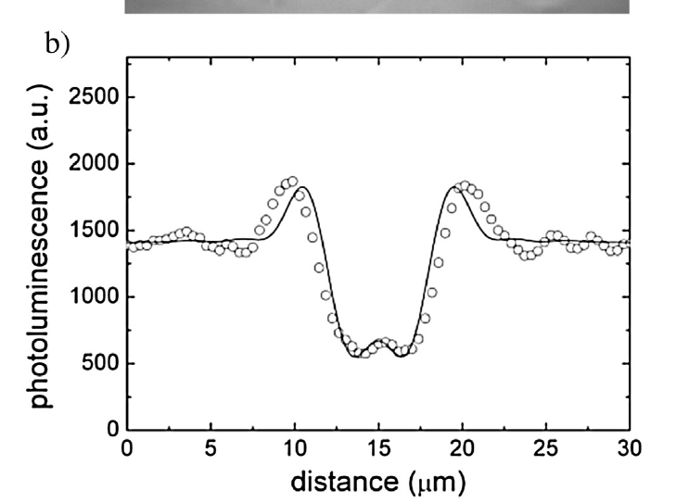
X-ray in-line projection imaging at ANKA synchrotron
TOMO-TOPO Beamline at ANKA light source (Karlsruhe Institute of Technology KIT, Germany) - Dr. A. Cecilia
Energy: 2-40 keV, White and parallel beam, Magnification 1, Be filter(500μm) at the output, Beam Dimensions (800x800)μm
Xradia test pattern
Gold pattern on Si₃N₄ window
dimensions (500x500) μm
X-ray microradiography of a X-radia test pattern stored in a LiF film (thickness 1 μm, glass substrate) and read by an optical confocal microscope in fluorescence mode
(X-ray exposure time 30 s)
Edge enhancement effect
F. Bonfigli et al., Radiation Measurements 56 (2013) 277-280.
S. Heidari Bateni, et al.,NIMA, Vol. 120, (2013), 109-112.
F. Bonfigli, XPXM 2025, INFN-LNF 20 June 2025

Slide 18



High spatial resolution on a wide field of view
Spring-8 Angstrom Compact free electron LAser (SACLA) - Japan. Beam line BL3
XFEL pulses: photon energy of 10 keV (bandwidth of 0.6%) duration of ~ 7 fs, f = 30 Hz average energy per pulse 0.36 mJ with fluctuations of ± 10 % ( σ).
Spot 3
Spot 3
Spot 1
Spot 4
Spot 1
Spot 4
Spot 2
Fluorescence images of an external detail of colored Spot1 (2000 shots) in LiF crystal irradiated with SACLA XFEL beam (Objective magnification=4x, exposure time of the s-CMOS camera = 400 ms).
Spot 2
1000 μm
Picture of the irradiated LiF crystal (20 mm diameter, 2 mm thickness): the four colored spots obtained with different number of accumulated shots of SACLA XFEL beam at 10 keV are clearly visible under blue light excitation.
Fluorescence image of the four colored spots obtained on LiF crystal with different numbers of accumulated shots of SACLA XFEL beam at 10 keV. The size of image is limited by field of view of microscope. (Objective magnification=2x – exposure time of the s-CMOS = 300 ms – 16 bits).
A LiF crystal irradiated with four spots (at four different fluences) of 10 kev XFEL beam (pulse duration ~ 7 fs) at Spring-8 Angstrom Compact free electron LAser (SACLA) in Japan. Four accumulation spots were irradiated with distinct numbers of XFEL shots: 2000, 1000, 500, 100 shots (SPOT1,2,3,4): 0.039 J, 0.195 J, 0.387 J and 0.781 J.
F. Bonfigli, et al., Proc. of SPIE Vol. 11035, pp. 110350N-1,11 © 2019
F. Bonfigli, et al. Il Nuovo Cimento 44 C (2021) 146. Invited Paper
F. Bonfigli, XPXM 2025, INFN-LNF 20 June 2025

Slide 19
XFEL beam fluorescence image reconstruction with full dynamic range
Spring-8 Angstrom Compact free electron LAser (SACLA) - Japan. Beam line BL3
XFEL pulses: photon energy of 10 keV (bandwidth of 0.6%) duration of ~ 7 fs, f = 30 Hz average energy per pulse 0.36 mJ
SPOT1
Reconstruction algorithm
F. Bonfigli, et al., Proc. of SPIE Vol. 11035, pp. 110350N-1,11 2019
F. Bonfigli, et al. Il Nuovo Cimento 44 C (2021) 146. Invited Paper
F. Bonfigli, XPXM 2025, INFN-LNF 20 June 2025

Slide 20









XFEL beam spot size characterization
SPOT1
SPOT2
SPOT3
SPOT4
F. Bonfigli, et al., Proc. of SPIE Vol. 11035, pp. 110350N-1,11 2019
F. Bonfigli, et al. Il Nuovo Cimento 44 C (2021) 146. Invited Paper
F. Bonfigli, XPXM 2025, INFN-LNF 20 June 2025

Slide 21




Volumetric storage of LiF crystals combined with confocal optical microscopy
TOMO-TOPO Beamline at ANKA light source (Karlsruhe Institute of Technology KIT, Germany)
Energy: 2-40 keV, White and parallel beam, Magnification 1, Be filter(500μm) at the output, Beam Dimensions (800x800)μm
Xradia test pattern
Gold pattern on Si₃N₄ window
dimensions (500x500) μm
X-ray microradiography of a X-radia test pattern stored in a LiF crystal
Z = (0-800) μm
F. Bonfigli et al., Radiation Measurements 56 (2013) 277-280.
S. Heidari Bateni, et al., NIM A, Vol. 120, (2013), 109-112.
X,Y = 636x636 (μm)²
F. Bonfigli, XPXM 2025, INFN-LNF 20 June 2025
F. Bonfigli et al., Condens.Matter 2021, 6, 37.

Slide 22



Volumetric storage of LiF crystals combined with 3D confocal optical microscopy and 3D Raman micro-spectroscopy
Confocal optical microscope in fluorescence mode
(XY = 636 × 636 μm², Z = 0-1 mm)
Confocal Raman micro-spectroscopy
8 keV 16 keV
The X-ray penetration in solids strongly depends on the X-ray energy, and so does the depth of the colored layer in LiF.
The attenuation length of X-rays in LiF: in the EUV (20 - 200 eV ) it results of a few tens of nanometers, it raises to several micrometers in the soft X-rays region (200 eV – 2 keV) and reaches up to 100 microns and more at higher energies. In particular, for the used X-ray energy, 8 and 16 keV, the corresponding attenuation length in LiF is about 330 μm and about 2650 μm .
TOMO-TOPO Beamline at ANKA light source (Karlsruhe Institute of Technology KIT, Germany)
F. Bonfigli, XPXM 2025, INFN-LNF 20 June 2025
F. Bonfigli et al., Condens.Matter 2021, 6, 37.

Slide 23


Investigation by 3D confocal fluorescence microscopy of coloured LiF crystals by a focused X-ray beam
Collaboration with Xlab INFN-LNF
Polycapillary lens
LiF crystal
The optical sectioning was performed by an objective 20x (N.A. 0.5).
The samples were analysed over a Z interval of 500 μm acquiring 50 2D-images with a step size of 10 μm.
X-ray source
X-ray tubes
Cu anode
CCs produced
by X-rays
F. Bonfigli, D. Hampai, S. B. Dabagov, R. M. Montereali, Optical Materials 58 (2016) 398-405
F. Bonfigli, XPXM 2025, INFN-LNF 20 June 2025
23

Slide 24



LiF film detectors with enhanced sensitivity
The reflective properties of Si clearly help in recovering a relevant part of light emission that would be otherwise lost in the opposite direction of the observation one. This reflected part and all the internal multireflections can even constructively interfere with the directly emitted one provided the LiF thickness is a suitable one.
E. Nichelatti, et. al, NIMB 268, 3035 (2010).
LiF crystal
LiF film on Si
CLSM fluorescence images of X-ray contact micro-radiographies of a dragonfly wing on LiF films on glass and silicon substrates obtained in the same irradiation conditions.
LiF film on glass
LiF film on silicon
F. Bonfigli, XPXM 2025, INFN-LNF 16-20 June 2015

Slide 25








Confocal Raman/luminescence micro-spectroscopy
Luminescence maps
Confocal fluorescence microscope
5X-Step 30 μm
10X-Step 5 μm
Laser: 535 nm
Nikon Eclipse 80i C1
Contact X-ray micro-radiography of a dragonfly wing stored in a LiF film (100 nm thick) on Si substrate irradiated at Laser PlasmaSource
10X-Step 20 μm
680 nm
100X-Step 2 μm
Raman/fluorescence micro-scopectroscopy
Raman maps
Horiba XploRA Plus
(1600-1800) cm⁻¹
100X-Step 5 μm
(1600-1800) cm⁻¹
F. Bonfigli,et al. Condensed Matter 2023, 8, 103, pp. 1-13.
F. Bonfigli, XPXM 2025, INFN-LNF 20 June 2025
25
Laser: 638 nm

Slide 26





Raman spectra of X-ray irradiated LiF crystals and films
Raman spectra broading of polycristalline LiF films with respect LiF crystals due to the different structures
Raman spectra broading of 120 nm LiF films with respect 1um LiF film due to different structures
Raman spectra shift of polycristalline LiF films with respect LiF crystals (1070 cm⁻¹ 1080 cm⁻¹) due to structure stress
LiF film (120 nm) on Al/Si
LiF film (1000 nm) on Al/Si
Mean grain size about 100 nm
Mean grain size about 150 nm
Courtesy of A. Rufoloni (ENEA)
Courtesy of A. Rufoloni (ENEA)
F. Bonfigli,et al. Condensed Matter 2023, 8, 103, pp. 1-13.
F. Bonfigli, XPXM 2025, INFN-LNF 20 June 2025

Slide 27
Summary
The presented results have demostrated that the peculiarities of LiF-based detectors can be employed in:
- High spatial resolution imaging with contact X-ray microscopy at laboratory X-ray sources, also for in vivo cells
- High spatial resolution X-ray imaging combined with a wide field of view and a wide dynamic range (X-ray micro-radiography, X-ray optics characterizations, diffraction imaging, etc.)
- Beam diagnostic at high spatial resolution and wide dynamic range also for ultra-bright and ultra-short focused X-ray laser beam.
- Volumetric storage of X-ray distributions in LiF bulk
The versatility of LiF-based detectors can be employed for imaging requiriments
F. Bonfigli, XPXM 2025, INFN-LNF 20 June 2025

Slide 28
Acknowledgements
P. Gaudio
M. Richetta
R. Rossi
Universita’ di Roma Tor Vergata
A. Reale
L. Reale
Dip. Fisica Universita’ dell’Aquila
F. Somma
S. Heidari Bateni
Dip. Fisica Universita’ Roma Tre
Dr. S. Lagomarsino
Dr. A. Cedola
IFN-CNR Roma
S. Almaviva
A. Lai
S. Bollanti
P. Di Lazzaro
F. Flora
L. Mezi
D. Murra
A. Rufoloni
G. Baldacchini
ENEA
F. Capotondi, M. Kiskinova, N. Mahne, M. Manfredda, E. Pedersoli, L. Raimondi, M. Zangrando
Elettra Sincrotrone Trieste S.C.p.A.
S. Dabagov
D. Hampai
INFN –LNF XLab
L. Giannessi
INFN -LNF
Thank you
for your attention
Dr. A. Cecilia
Dr. P. Vagovic
D. Pelliccia
T. Baumbach
Research Center Karlsruhe/K.I.T., Institute for Synchrotron Radiation-ANKA, Germany
Dr. T. Pikuz
Dr. A.Faenov
Open and Transdisciplinary Initiatives, Osaka University, Suita, 565-0871 Osaka, Japan;
Joint Institute for High Temperatures, Russian Academy of Science, 125412 Moscow, Russia
A. Cricenti
M. Luce
ISM-CNR Roma
G. Della Ventura
F. Bellatreccia
Dip. Scienze Geologiche-Universita’ Roma Tre

