Slide 1
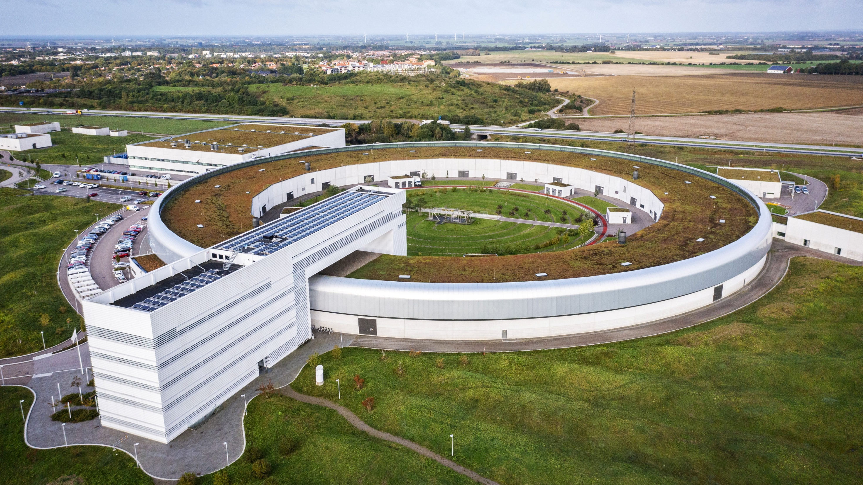
X-ray spectrometers with curved crystal optics
Konstantin Klementiev
MAX IV Laboratory

Slide 2
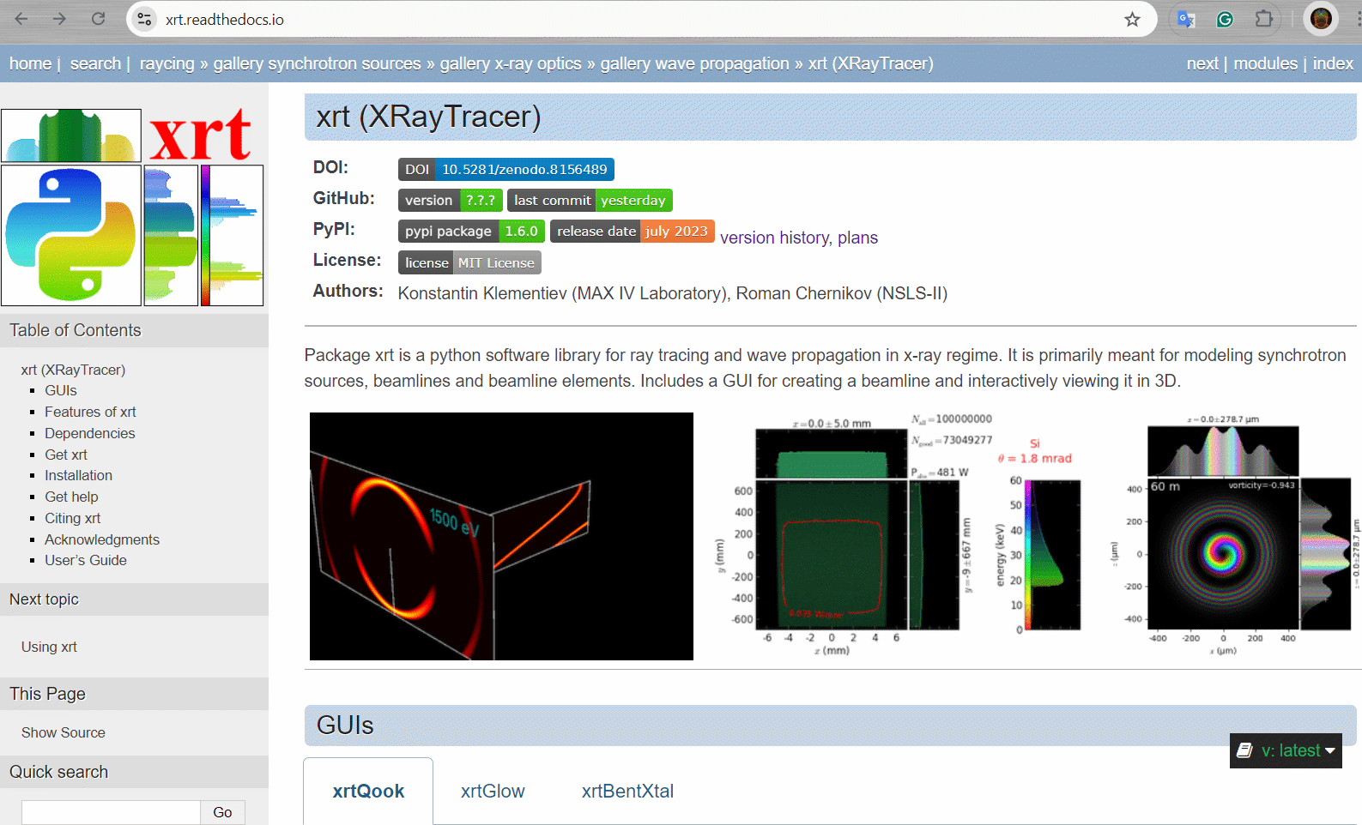
Software library xrt
xrt can calculate reflectivity and transmittivity of elastically deformed bent crystals (added in 2023)

Slide 3
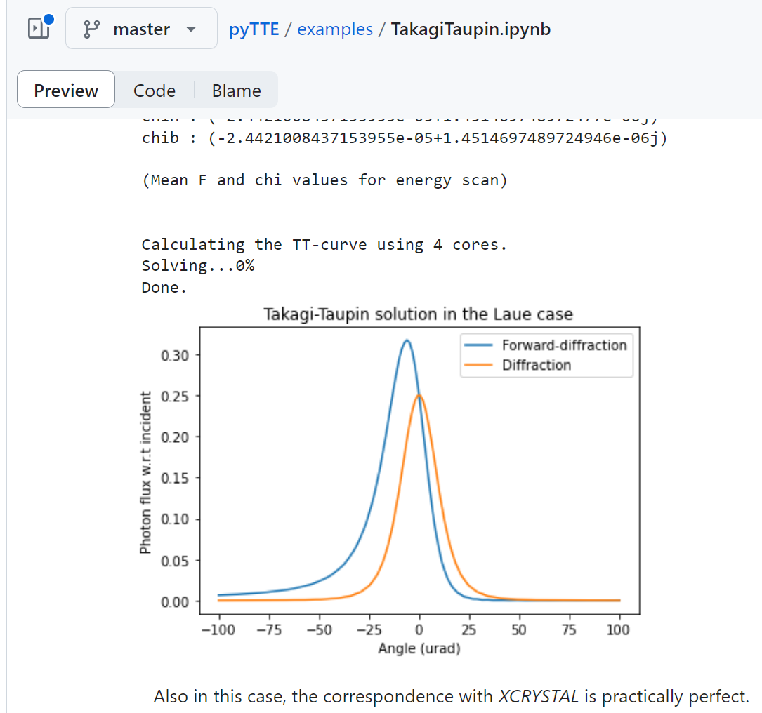
pyTTE — a package to calculate XRD of deformed crystals
https://github.com/aripekka/pyTTE
Honkanen & Huotari, General method to calculate the elastic deformation and X-ray diffraction properties of bent crystal wafers. IUCrJ (2021) 8, 102-115, https://doi.org/10.1107/S2052252520014165
pyTTE is (was) the state-of-the-art bent crystal calculator
Notes:
Components of the strain tensor in terms of transverse stretching stress. This is in addition to the pure bending strain.

Slide 4
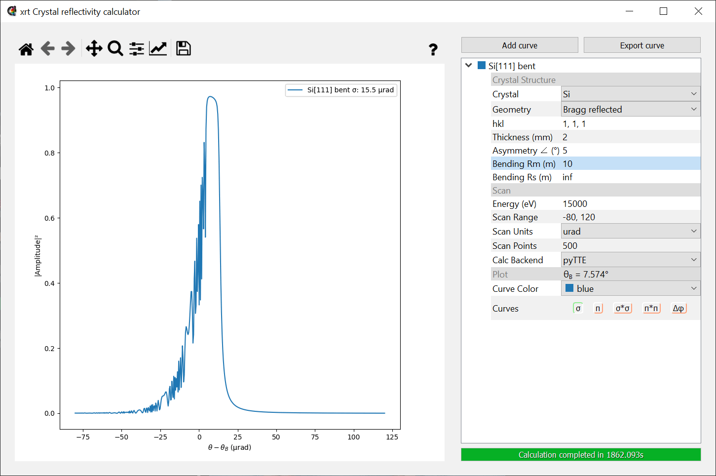
Bent crystal reflectivity calculator of xrt
xraylib → xrt.materials (effortless installation)
scipy.integrate.BDF → RKDP 45 (SIMD parallelization)
multiprocessing → OpenCL (performance gain up to ×25000)
Conversion
from pyTTE to xrt
xrt accelerates pyTTE by up to 4 orders of magnitude
Notes:
backward-differentiation formulas, Dormand–Prince, Single Instruction Multiple Data, direct methods vs adaptive

Slide 5
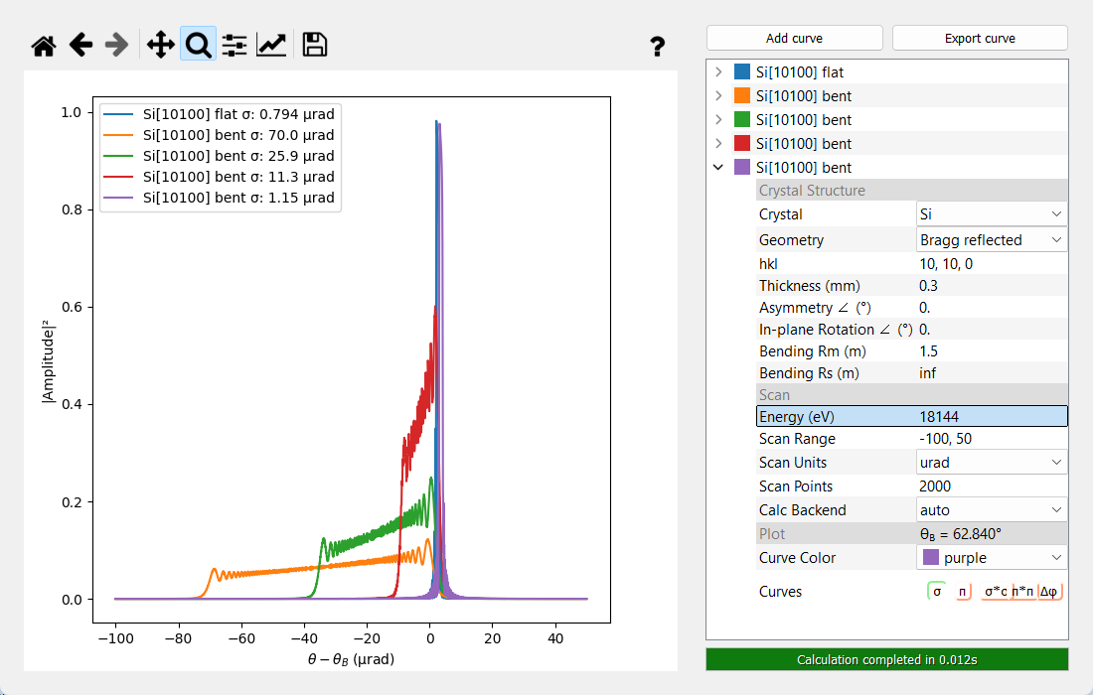
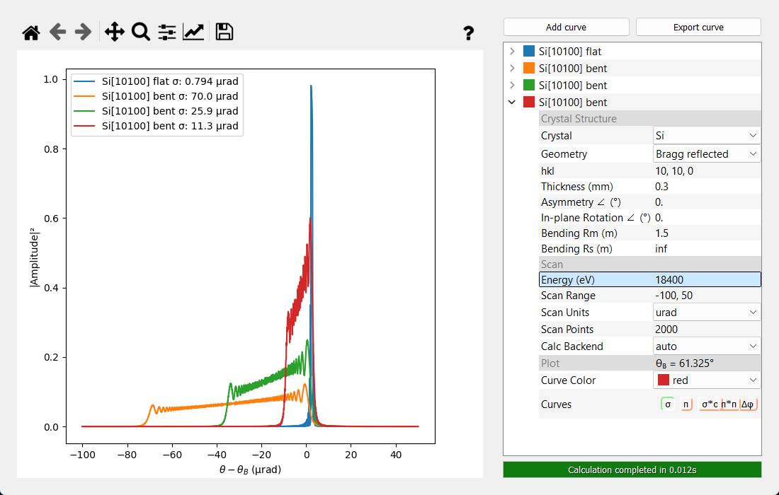
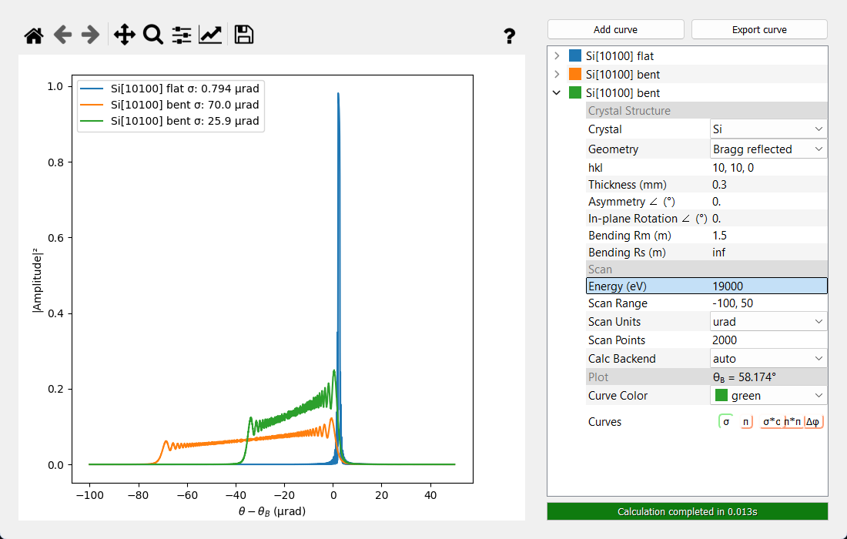
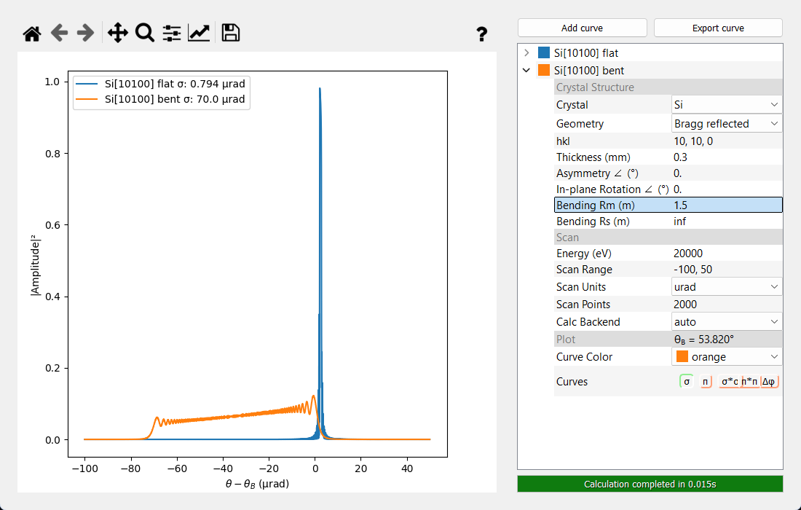
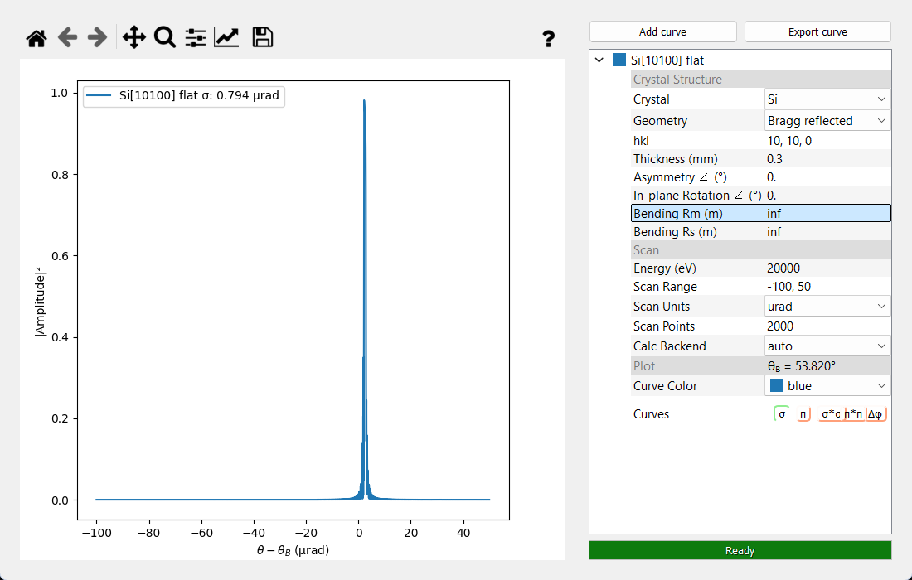
Bent crystal reflectivity calculator of xrt: xrtBentXtal
“magic” angles
Si111: 64.900°
Si220: 62.865°
Si200: 58.214°
xrtBentXtal is a GUI for comparative bent crystal calculations

Slide 6
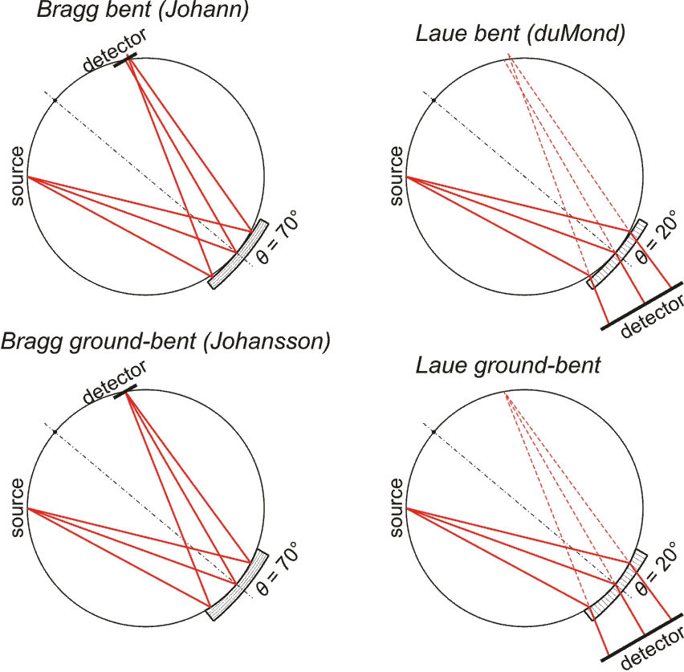
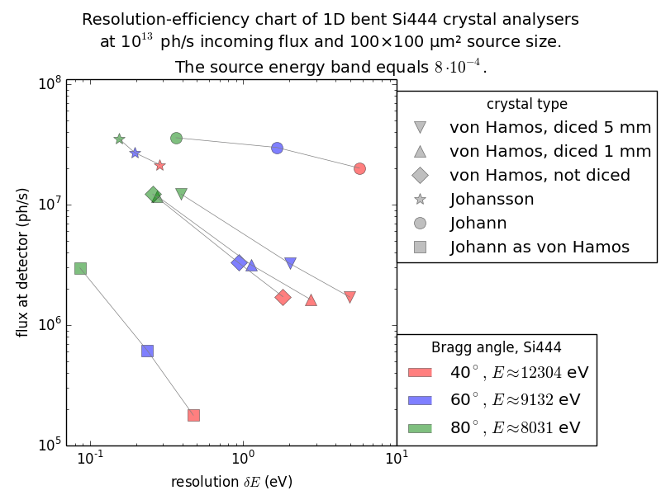
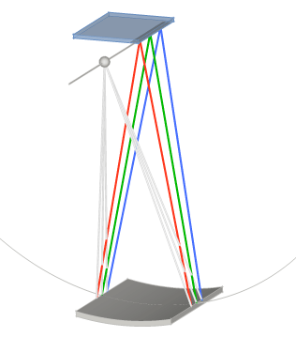
Comparison of XES spectrometer types
von Hámos
See more about spectrometer studies by ray tracing here: xrt.readthedocs.io/gallery2.html
Johansson geometry provides (almost) exact point-to-point imaging and is the best for efficiency and energy resolution. Balder’s spectrometer SCANIA-2D is of this type.

Slide 7
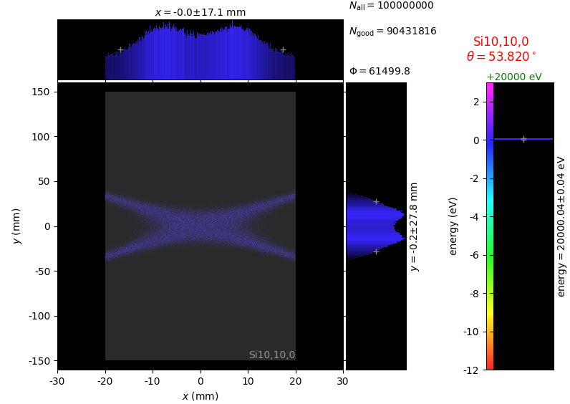
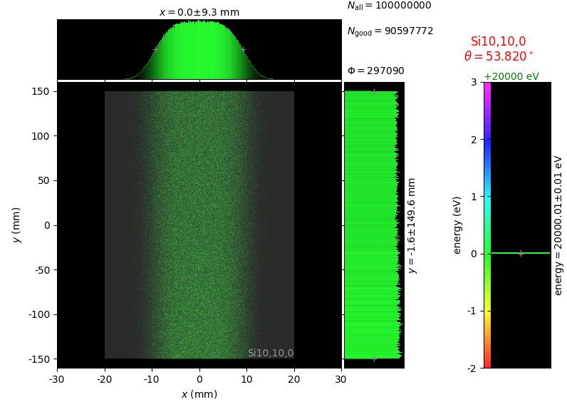
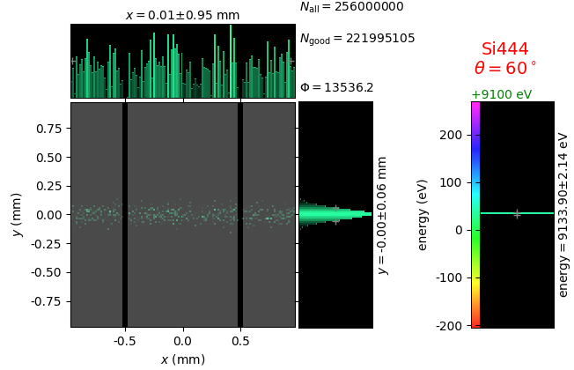
Why the efficiency is different?
Johann
Johansson
von Hámos
Only the central part is effective
but easy to make
The complete crystal length is effective
Only a very narrow crystal band is effective, but the crystal is usable in dispersive detection
Especially efficient for fixed emission energy detection (HERFD XANES)
Especially attractive for fixed excitation energy XES
Johansson is best for fixed emission energy applications, von Hamos is convenient for (wide band) XES

Slide 8
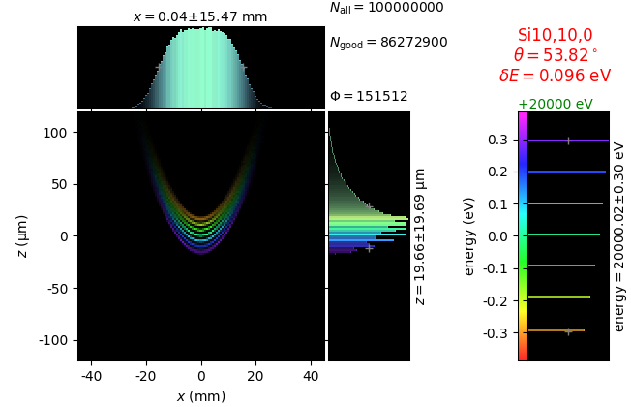
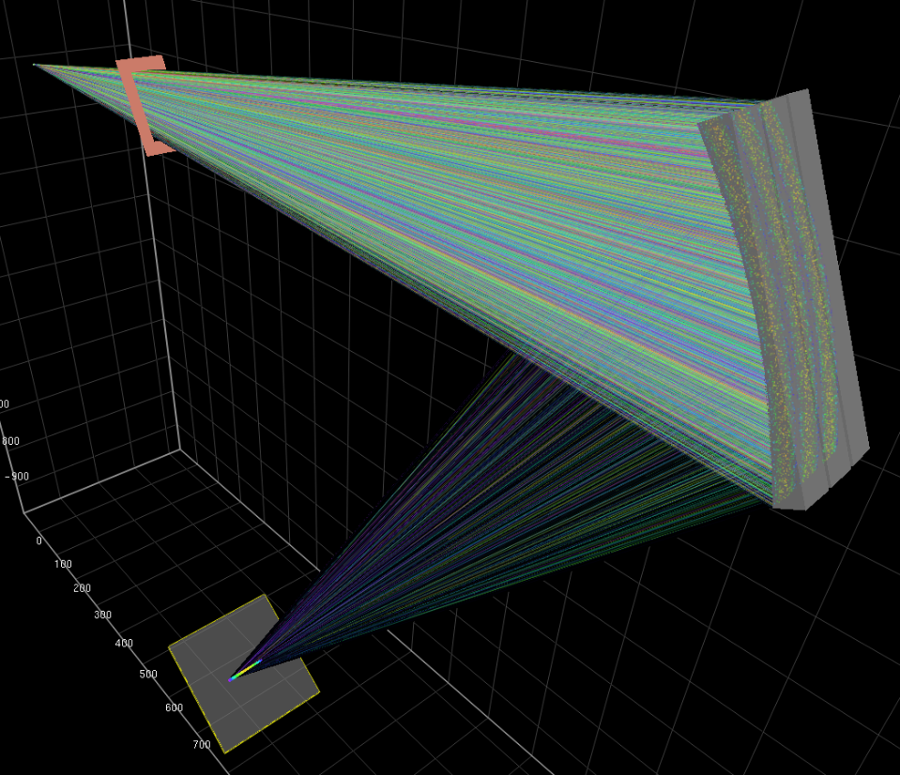
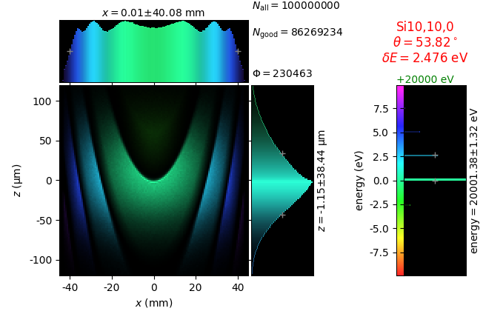
XES spectrometer at Balder beamline
Without crystal deformation:
With crystal deformation by means TT eqs:
Even a mild 1D bending force affects energy resolution of crystal analysers at high index reflexes

Slide 9
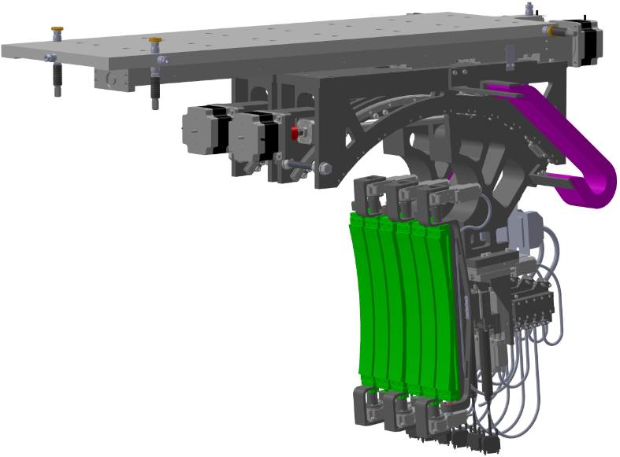
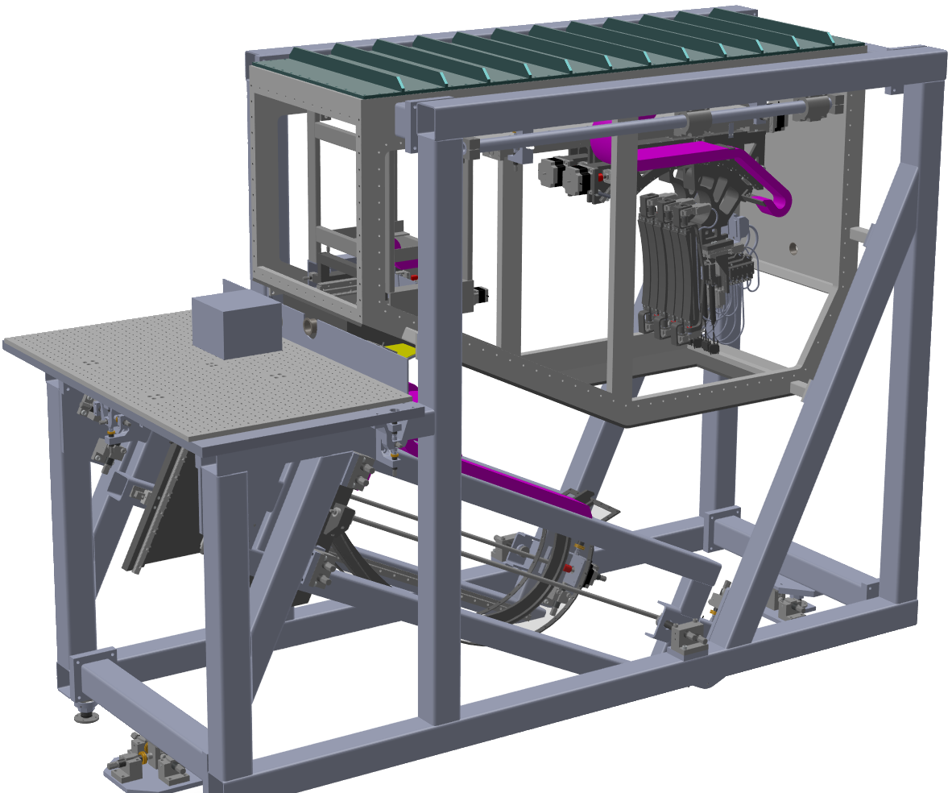
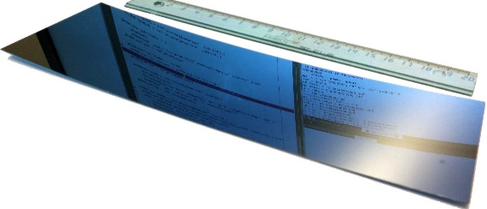
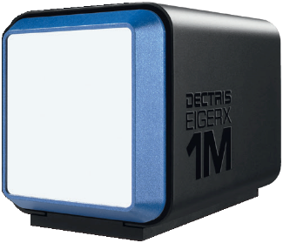
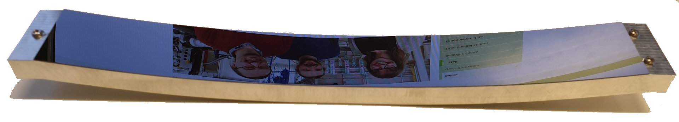
XES spectrometer at Balder beamline
Main design ideas
Backscattering relative to the sample
Detector under the table
Large Bragg angle range (85° – 35°)
2 independent
crystal branches for
“2-color” detection
Dectris EigerX 1M
Hybrid-pixel detector
3 kHz frame rate
Ground,
polished and
thinned (300 µm) test crystal
Notice: it is not bent, it is ground!
Made by Iulian Preda
Designed and built in-house.
Named as SCANIA-2D — Segmented Crystal ANalyzer with Image Acquisition in 2D.

Slide 10
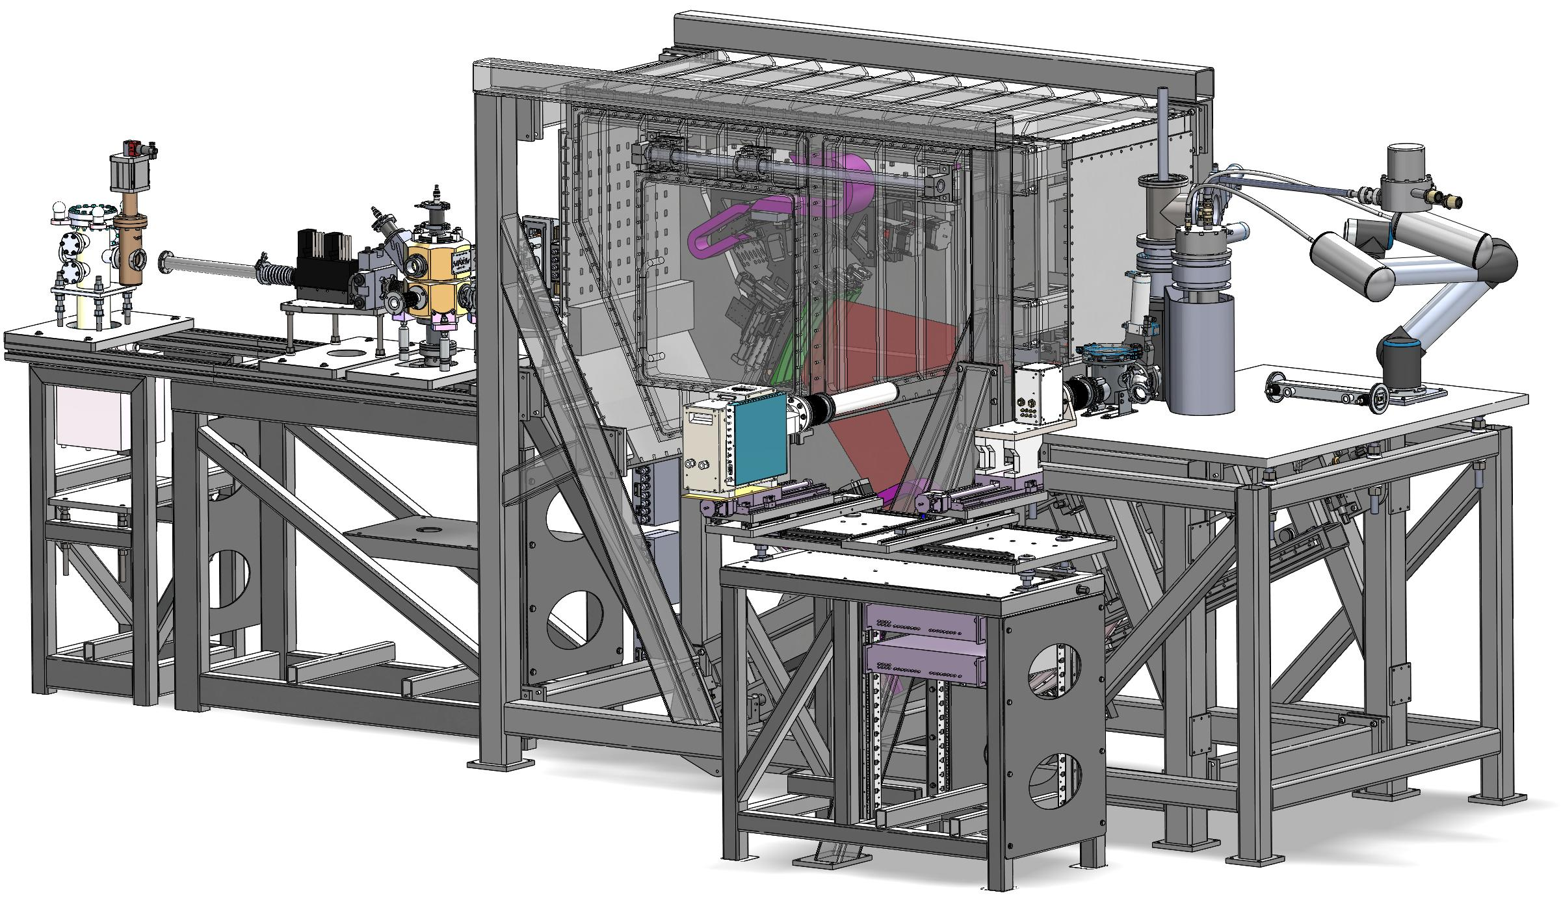
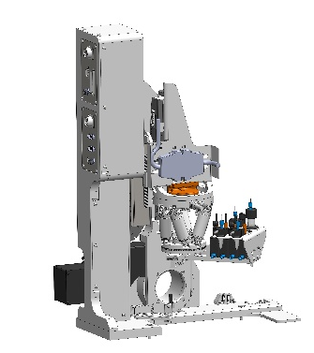
Balder experimental hutch
XES spectrometer SCANIA-2D
beam conditioning
LHe cryostat
2D XRD detector
In-situ
sample cells
  1000ºC furnace and controller
  MAX IV gas-flow cell for catalysis research
  Microfluidic liquid flow cell
Normal
sample holder
gas system
(not shown)
2 fluorescence detectors
7-element SDD, 2-20 keV – Canberra
7-element Ge detector, 5-40 keV – Canberra
up to 50 bar with fast mixing, vapor and MS
SCANIA-2D takes a significant part of the hutch. Compatible with all our sample environments and detection techniques except XRD that in practice requires a small slitted-down beam.

Slide 11
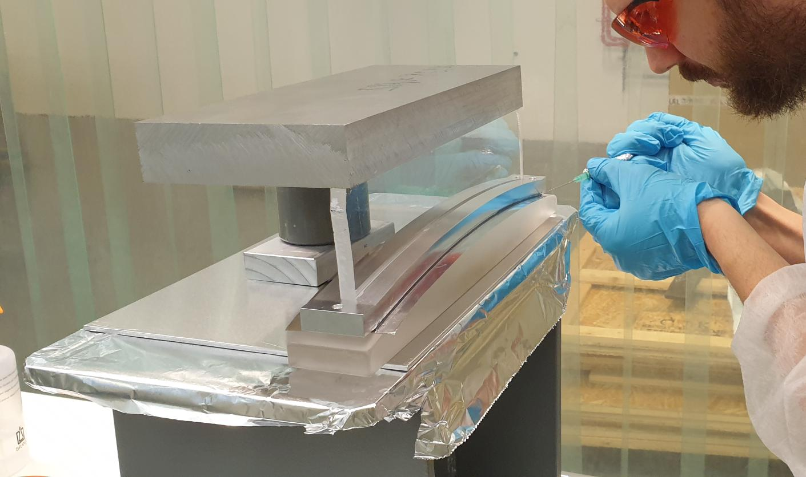
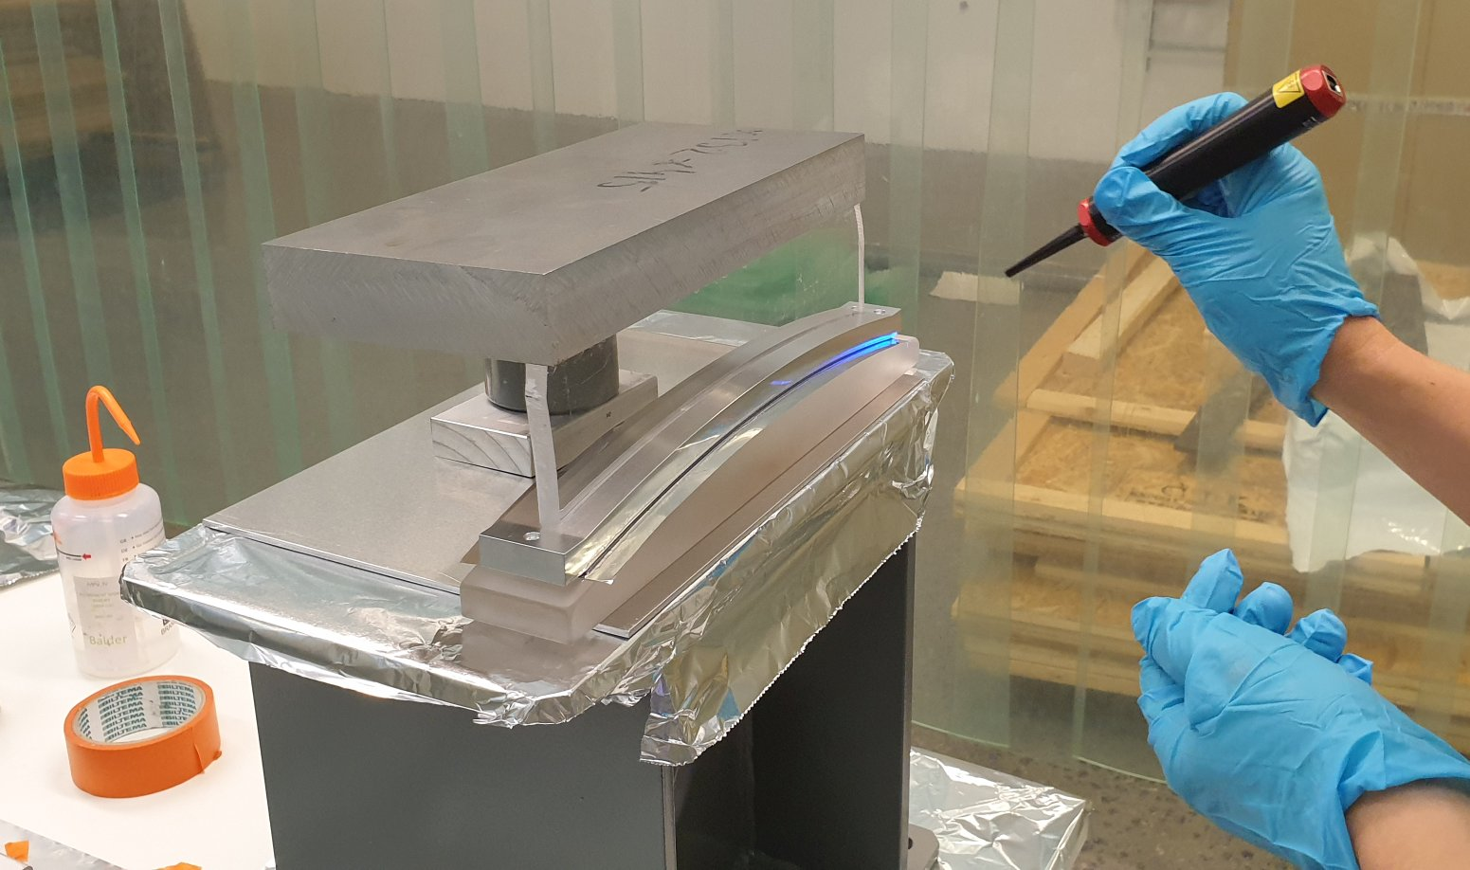
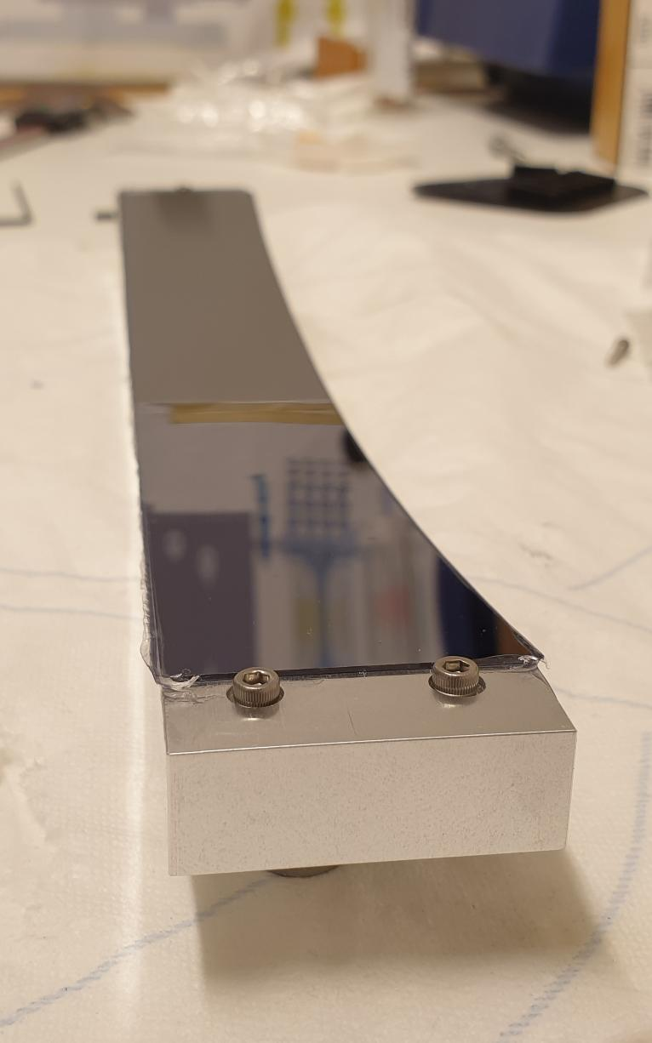
Crystal assembly technology
Assembly technology and optical quality measurements were established in Nov 2020.
Main limitations seem to come from dust particles between crystal and reference cylinder.

Slide 12
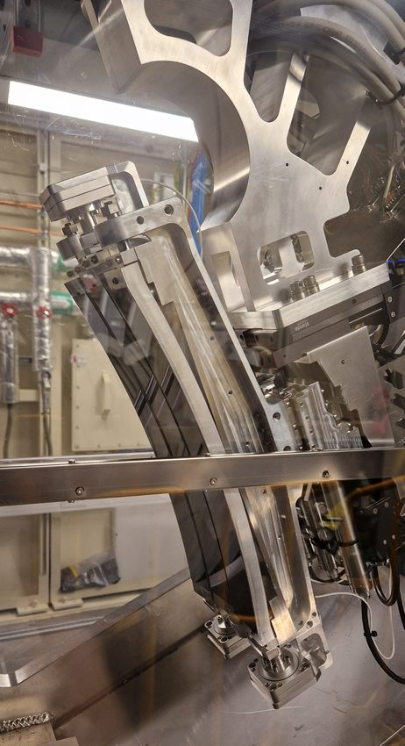
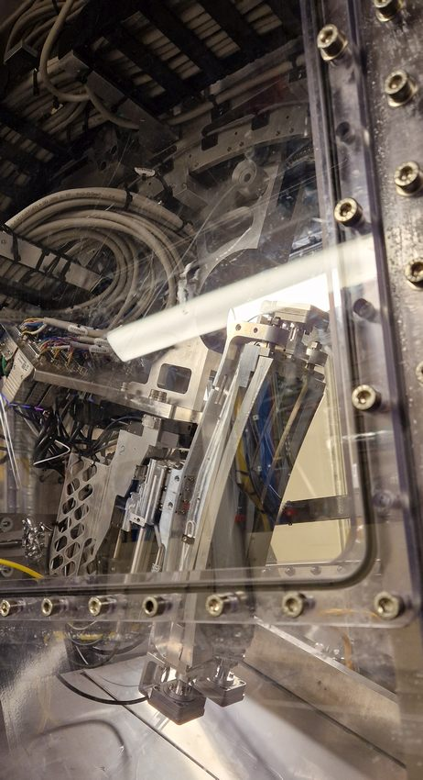
SCANIA-2D in metal
SCANIA-2D has been built with one branch so far. The chamber is a plastic helium box.

Slide 13
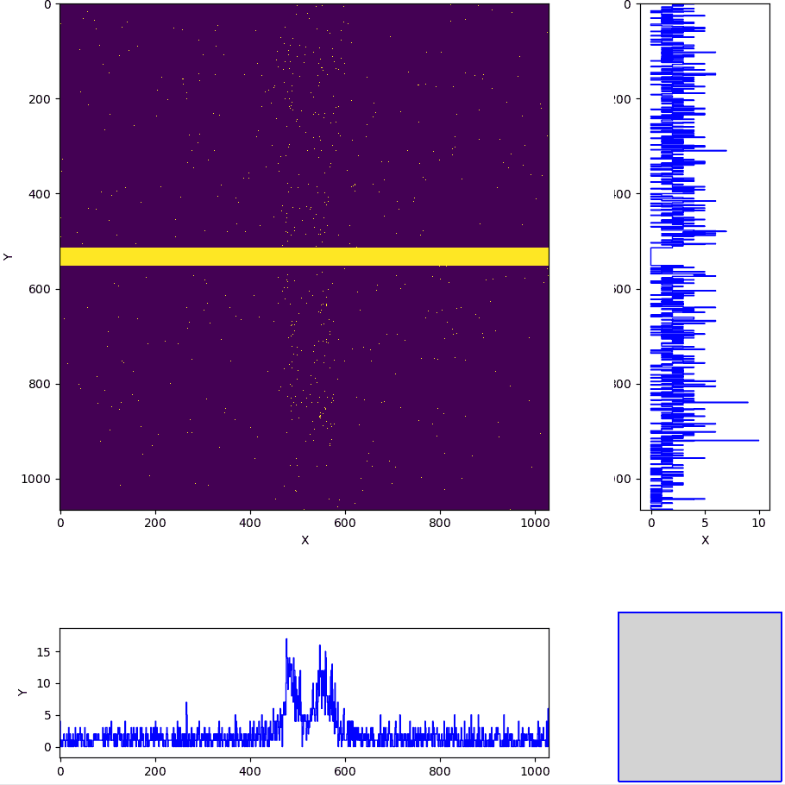
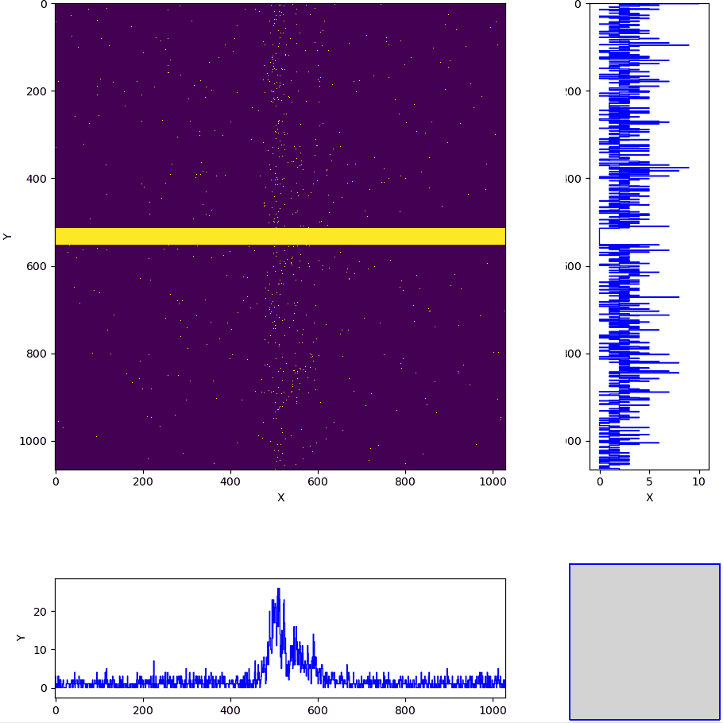
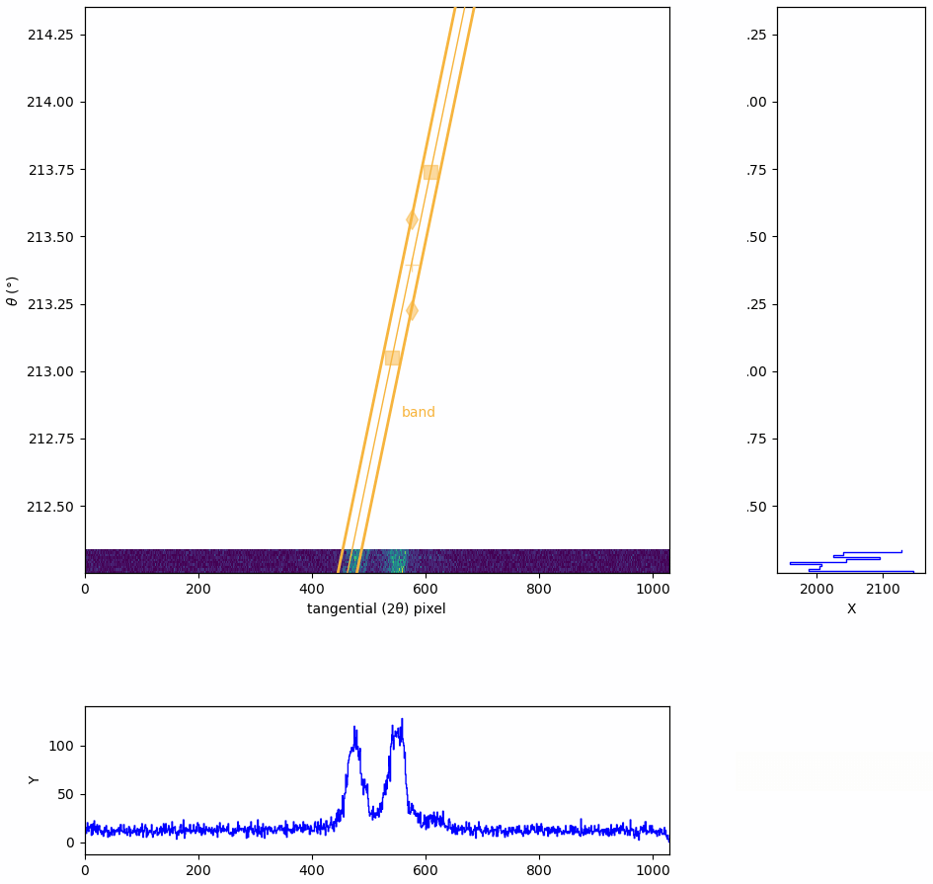
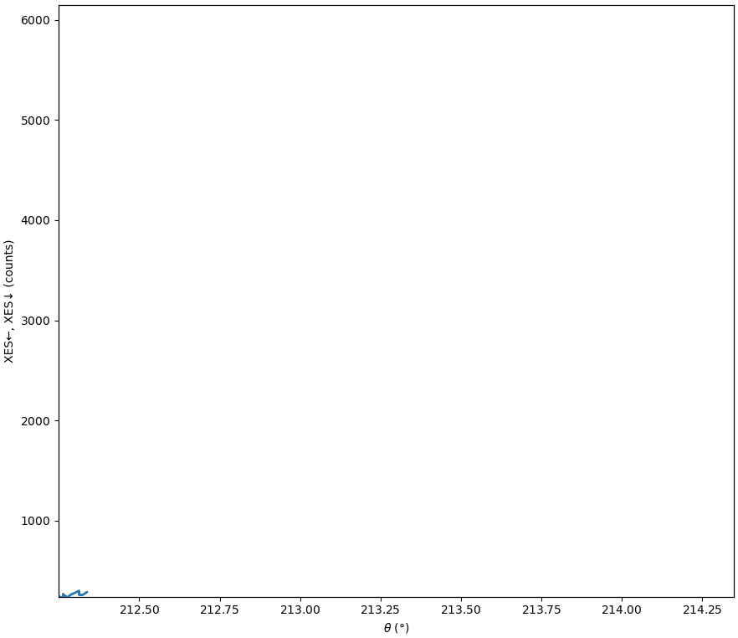
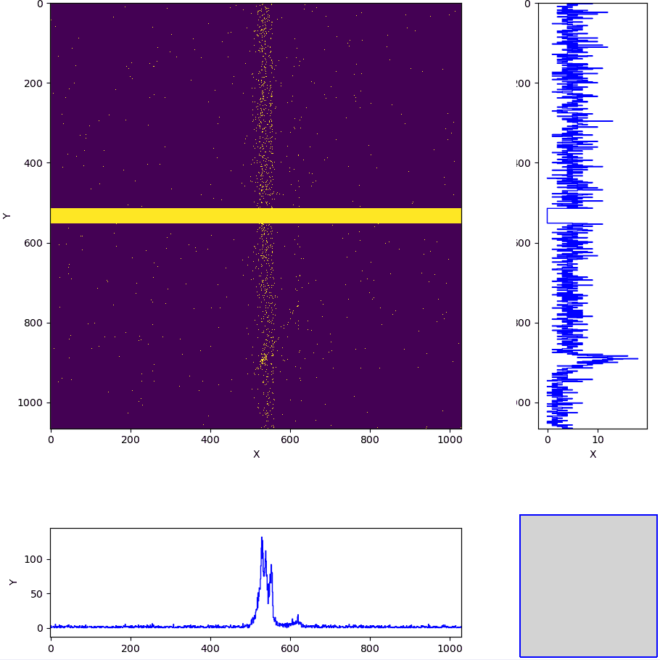
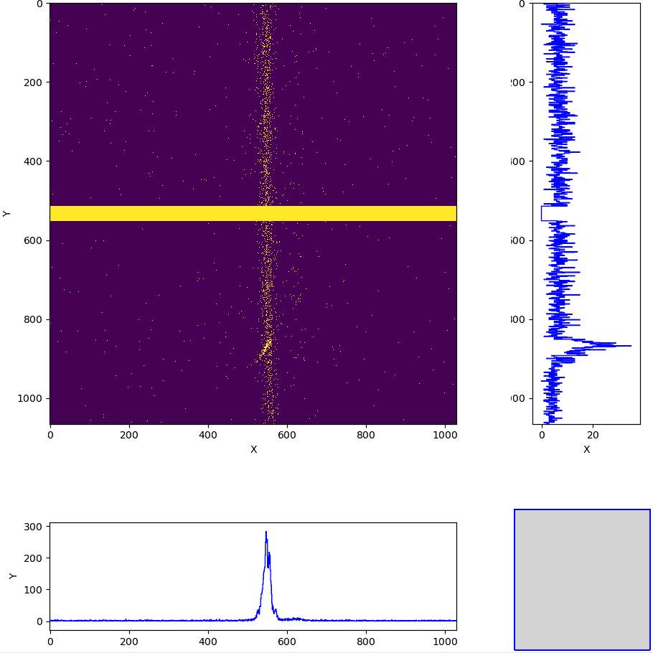
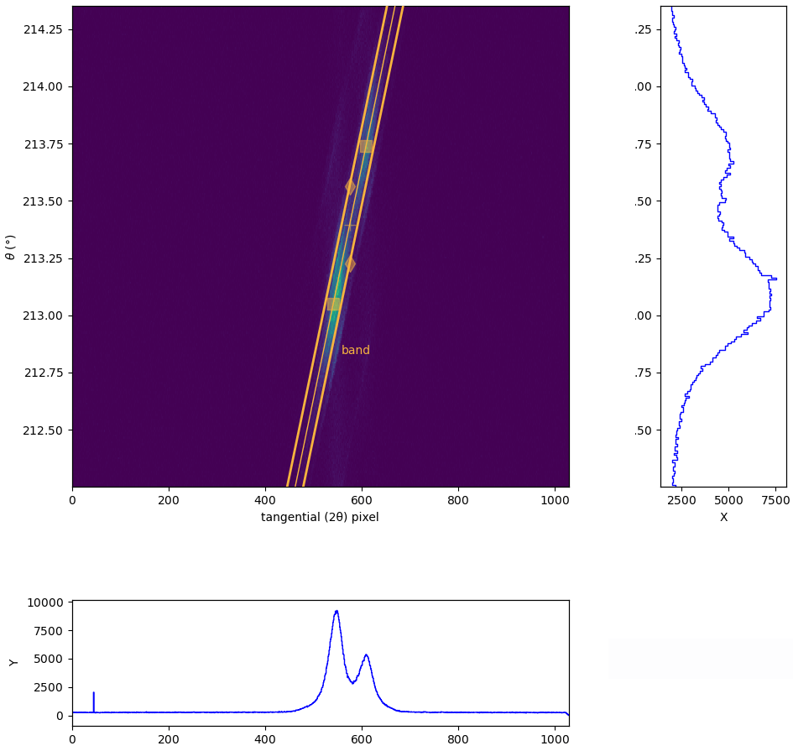
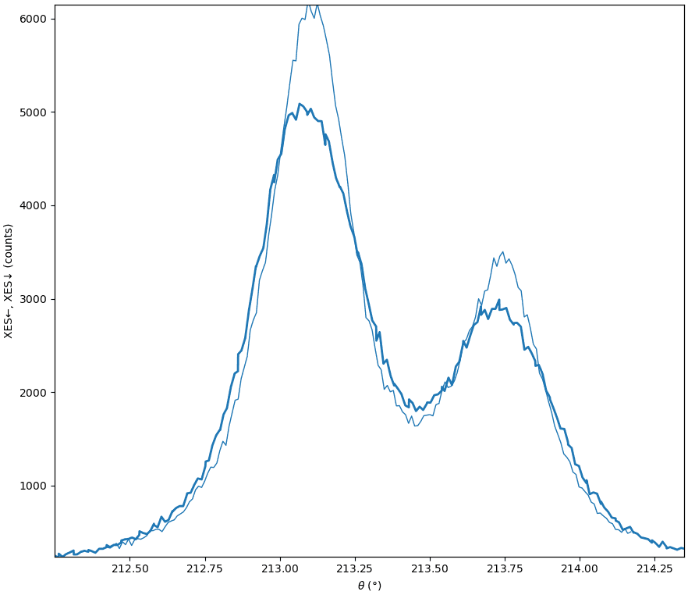
On-the-fly data reduction pipeline for SCANIA-2D
Original 3D data
Reduced 2D data
XES or HERFD XAS
Sheer correction,
sagittal integration
θ-2θ band integration
Scanning axis
Sagittal detector axis
Scanning axis
XES
Tangential detector axis
Tangential detector axis
Scanning axis or
projected tangential-to-scanning
Note: The animation timeline is not real. The actual scans have a few hundred scan points with a typical total scan duration of ~10 min.
Press Enter to see animations
The reduction pipeline was implemented in 2024, running automatically and asynchronously

Slide 14
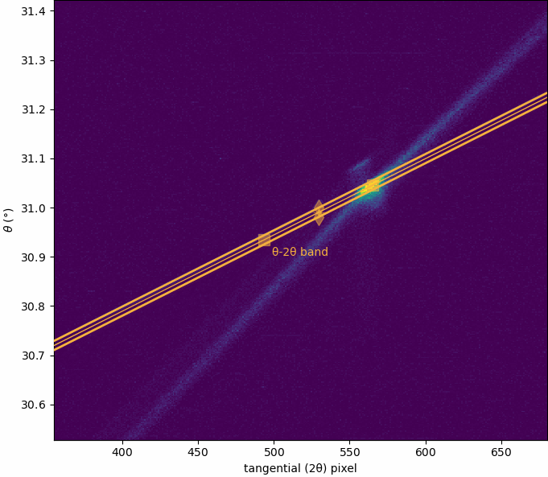
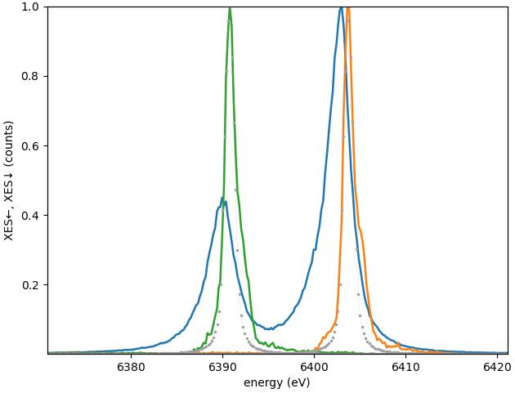
XES energy calibration by elastic lines
θ-θ band (rotates together with the crystal) due to the Borrmann effect and the scattering from the back of the crystal
With a 2D detector we see a zoo of effects: Borrmann, powder diffraction from the back surface, multiple diffraction. The θ-θ band dictates the alignment strategy: all crystal are used together, not individually.

Slide 15
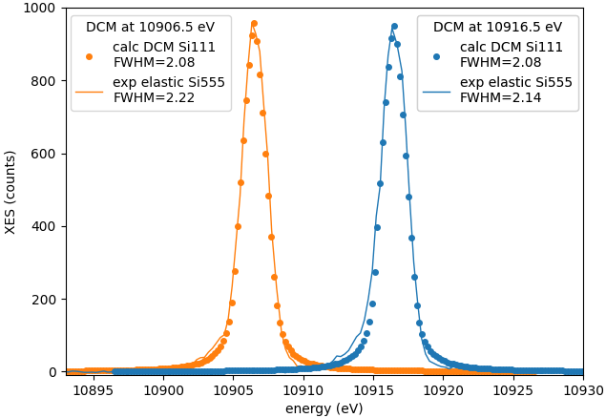
Energy resolution as given by elastic lines
At the magic Bragg angle (here, 64.9°), energy resolution is much better than the band width of Si111 DCM

Slide 16
Conclusions
xrt can calculate elastically bend crystals and do ray tracing with these calculations applied to each ray.
There exists a magic angle at which the reflectivity curve shrinks.
Johansson spectrometer offers both high efficiency and high resolution.
The SCANIA-2D spectrometer at Balder beamline has begun its user operation.
Thank you for your attention!

Slide 17
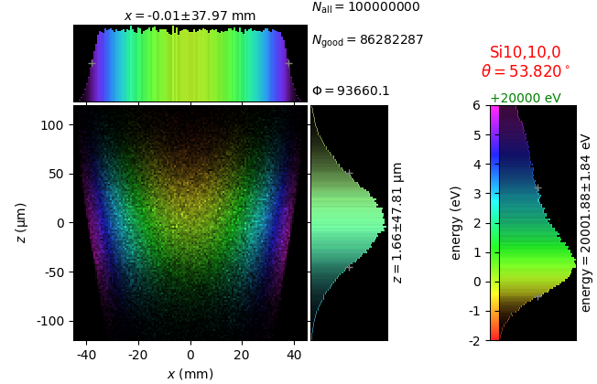
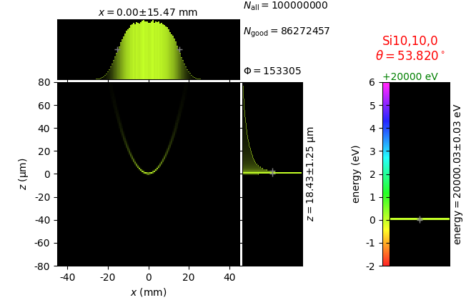
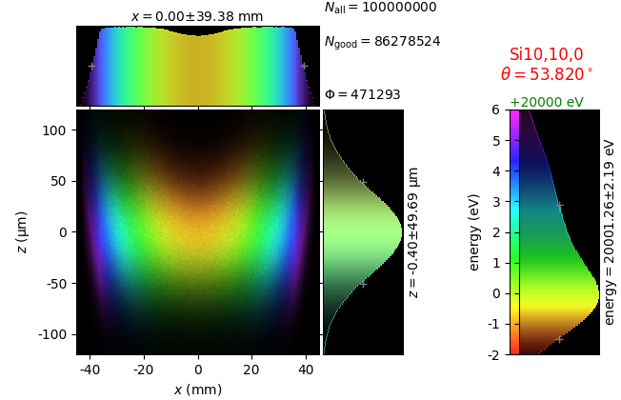
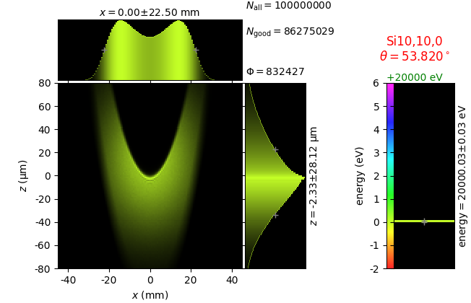
Johansson analyzer with elastically deformed crystal
flat source | line source | 7 lines
perfect crystal
deformed crystal
(Takagi- Taupin)
The calculated DCM bands match the experimental ones

Slide 18
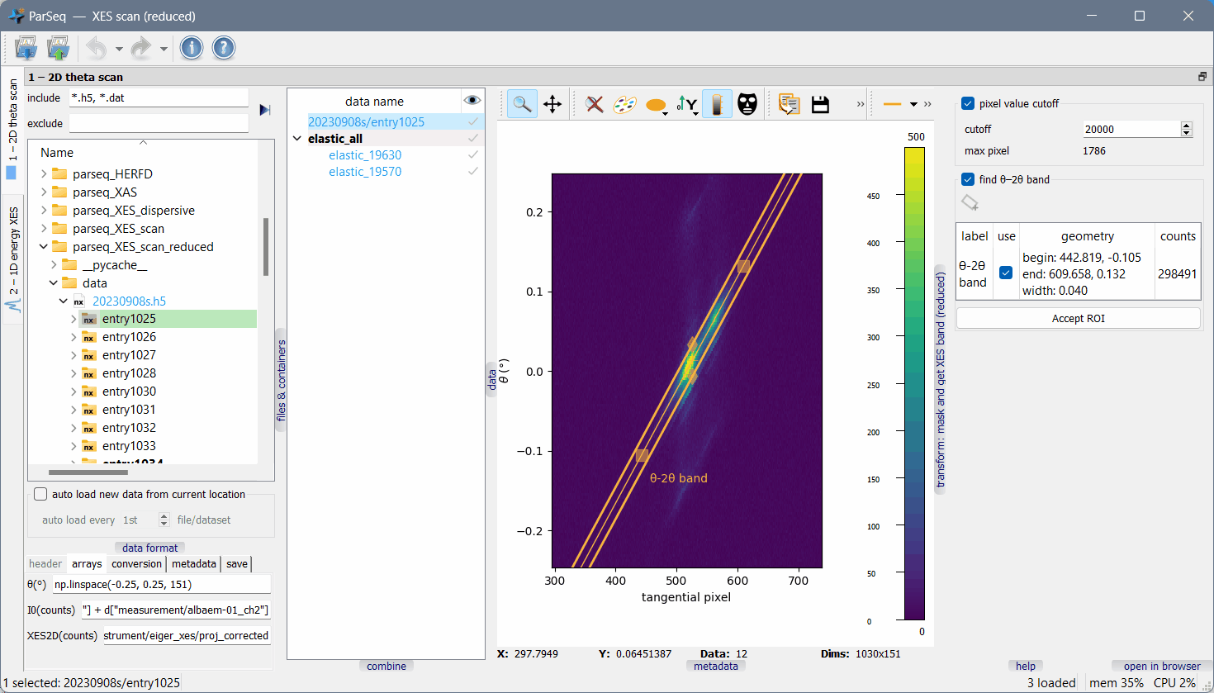
ParSeq-XES data pipeline

Slide 19
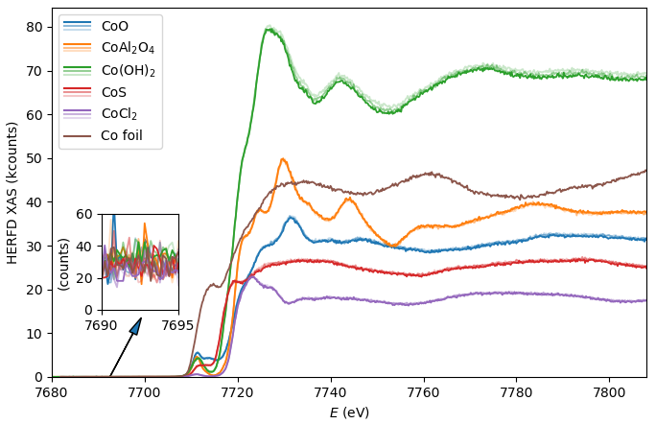
HERFD XANES
The Co Ka1 HERFD (High Energy Resolution Fluorescence Detected) XANES spectra were collected together with expert commissioning users (A. Jentys group from TU Munich) in July 2022. A full spectrometer branch (3 crystals) was used for the first time.
Here, the scanning range had 650 points (rather excessive) at 0.5 sec per point. Note the noise level in the inset plot that would remain much smaller than signal with a sample dilution down to 1wt%.
HERFD XANES is one of the main applications mode of SCANIA-2D

Slide 20
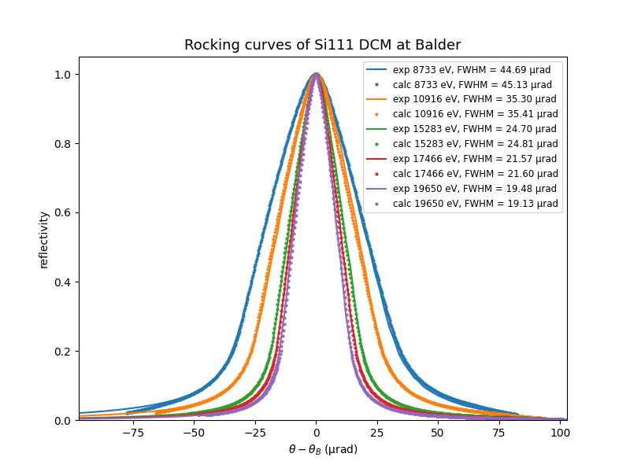
DCM bands
The calculated DCM bands match the experimental ones

