Slide 1
Characterisation of MÖNCH 0.5,
a 25 μm pitch prototype charge-integrating hybrid pixel detector
J. Heymes, A. Bergamaschi, R. Dinapoli, K. Moustakas,
M. Brückner, M. Carulla, S. Ebner, K. Ferjaoui, E. Fröjdh, V. Gautam,
D. Greiffenberg, S. Hasanaj, V. Hinger, V. Kedych, T. King, S. Li, C. Lopez-Cuenca,
A. Mazzoleni, D. Mezza, A. Mozzanica, M. Müller, J. Mulvey, K.A. Paton, C. Posada,
C. Ruder, B. Schmitt, P. Sieberer, S. Silletta, D. Thattil, X. Xie, J. Zhang
High Precision X-ray Measurements 2025, INFN Frascati, 20 June 2025

Slide 2
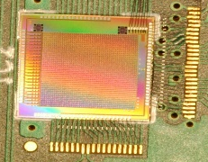
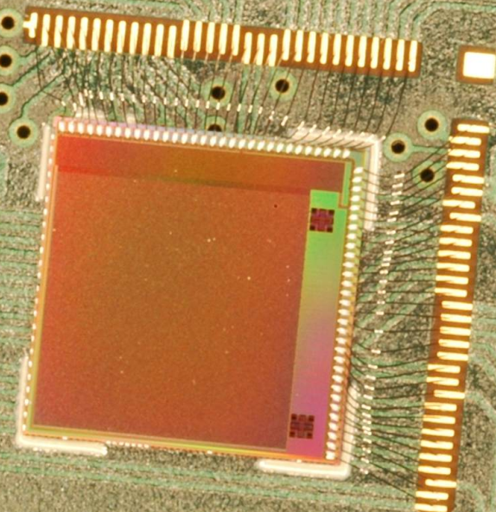
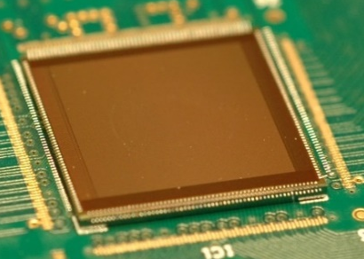
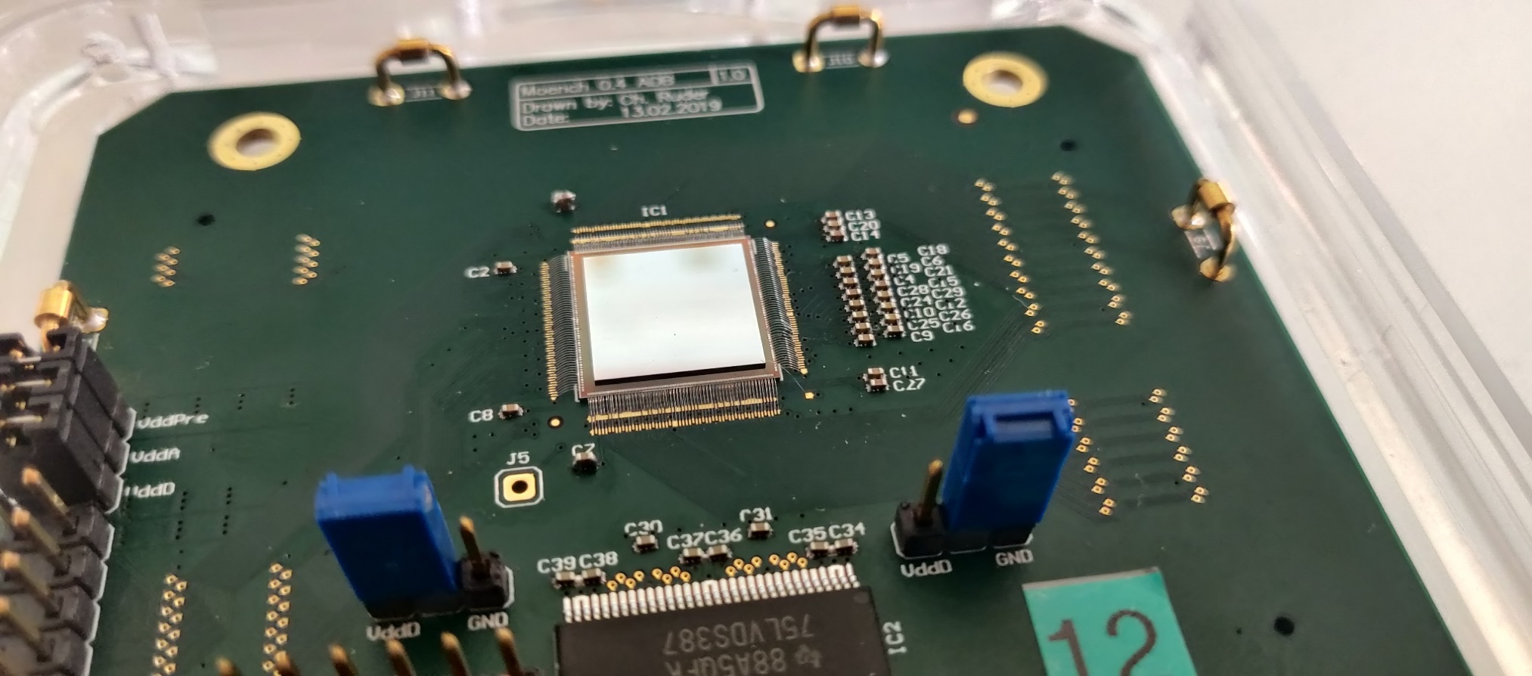
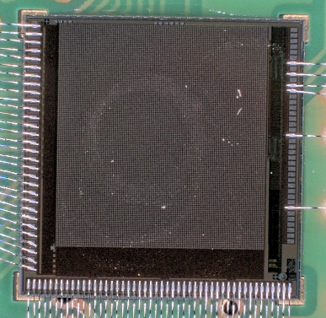
MÖNCH: Micropixel with enhanced pOsition rEsolution usiNg CHarge integration
MÖNCH 0.1
Test structures in Jungfrau 0.1 – 2012
MÖNCH 0.2
4×4 mm², 4 pixel designs – 2012
Charge integrating Hybrid Pixel Detector with analogue readout
Small pixel (25 µm pitch) → low noise (high energy resolution), reduced dark current, high spatial resolution (with charge sharing), limited pixel area
Designed in UMC 110 nm
Sensors: 300-320 µm thick n-type Si, LGADs, high-Z
Applications for MÖNCH:
(In-vivo) tomography, Resonant Inelastic X-ray Scattering (RIXS), Fourier ptychography, High-resolution imaging, colour imaging, electron microscopy, (Laue diffraction), …
MÖNCH 0.3
1 cm², 1 pixel design – 2014
MÖNCH 0.4
1 cm², 19 pixel designs – 2018
MÖNCH 0.5
4×3.75 mm², 6 pixel designs – 2024

Slide 3
Using charge sharing to increase spatial resolution
Cluster size depends on photon energy, sensor material, sensor bias,
sensor thickness
Charge sharing
Low resolution analog
Interpolation
High resolution digital
Spatial resolution with interpolation
Energy resolution from clustering
Charge sharing region in 320 µm Si at 120 V ≈ 15-20 µm
Increasing the SNR: low noise and/or hard X-rays
Subpixel interpolation with η function-based algorithms
Retrieved analog value in cluster proportional to the detected charge
(i.e. photon energy)
Preservation of the spectral information
Isolated photons required (~1 % occupancy) ➔ Fast frame rates and low flux

Slide 4
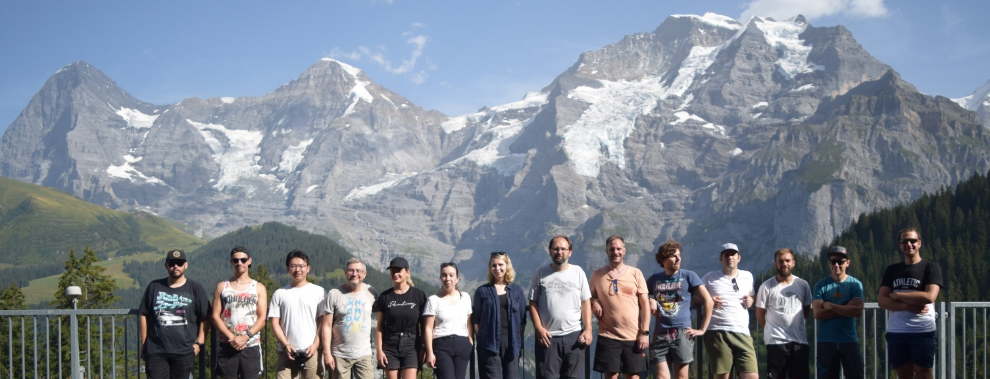
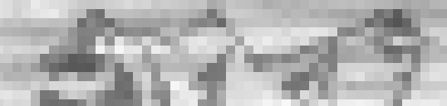
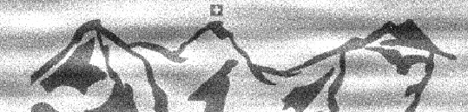
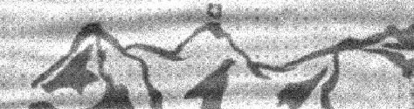

Interpolation: imaging example with MÖNCH 0.3
Eiger
Mönch
Jungfrau
2 µm gold on 200 µm silicon sample fabricated at LXN, PSI
Measurement with 10 keV photons at TOMCAT, PSI
1 kHz frame rate (6 kHz now available)
Low flux for single photon detection (~1 % occupancy)
Max flux at 1kHz: 1.6 Mph/cm²/s = 10 photons/pixel/s
Using charge sharing (small pixel and low noise) to interpolate and rebin photon position into virtual sub-pixels
Native resolution (25 µm pitch)
7 µm
S. Chiriotti, High-spatial resolution measurements with GaAs sensor with the charge integrating MÖNCH detector, iWoRiD 2021
https://indico.cern.ch/event/820476/contributions/4373144/
S. Chiriotti et al., High-spatial resolution measurements with a GaAs:Cr sensor using the charge integrating MÖNCH detector with a pixel pitch of 25 μm, 2022, JINST 17 P04007,
10.1088/1748-0221/17/04/P04007
Interpolated to 2.5 µm bins
GaAs:Cr
25 µm
Si

Slide 5
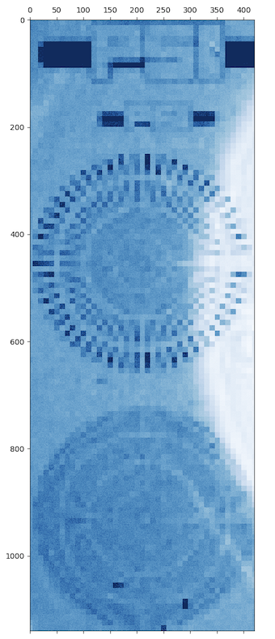
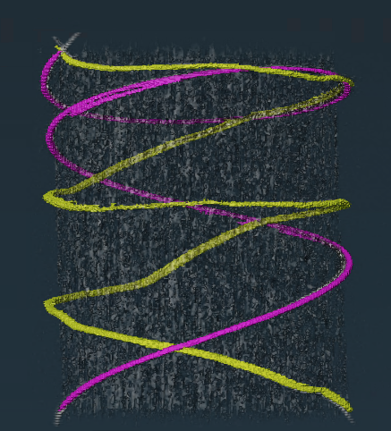
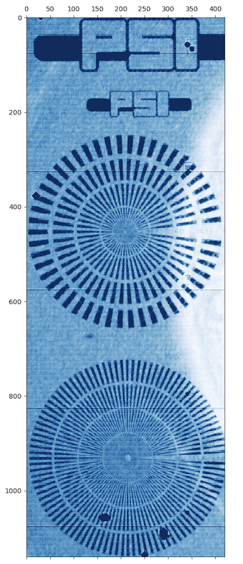
A wide variety of experiments with MÖNCH
Full field fluorescence
imaging
Marone et al.
Tender X-ray
Emission Spectrometry
Huthwelker et al.
Interpolation with LGAD sensor at 500 eV
J. Zhang et al., unpublished
100 µm
25 µm pixels
2.5 µm bins
Energy resolved tomography
Cu and Mo wires around a toothpick
Fluorescence imaging using a pinhole
No interpolation (pinhole limited)
Spectrometry of Cl-Kα (2.622 keV), and Cl-Kβ (2.815 keV)
Energy resolution linked to the sensor’s spatial resolution
➔ Interpolation used
Focal spot limited
RIXS: Energy resolution linked to the sensor’s spatial resolution
Soft X-rays ➔ LGADs
LGADs with MÖNCH: longer exposure times (full duty cycle) possible than with Jungfrau (due to lower sensor leakage current)

Slide 6

MÖNCH 0.5
Performance target for MÖNCH 1.0
65 Msps capable (2 kHz readout rate, 1024 x 768 pixels)
High linearity and stability
Low noise: < 80 e⁻ at 500 µs exposure time
(full duty cycle)
Power dissipation minimisation
MÖNCH 0.5
Main features
25 µm pixel pitch
160 x 150 pixels (in 3 x 50 supercolumns); pixel area: 4 x 3.75 mm²
Pixel designs
6 designs (each 80 x 50 pixels)
Very high CSA gain (Low feedback capacitance)
Non-selectable CDS gain (+ 1 passive CDS)
SF pixel output buffer replaced by a class AB differential amplifier (SF in previous versions)
Updated analog readout chain
Optimised for fast settling time, high linearity, and capable of driving high capacitive loads
Large capacitor at the bottom of the column to emulate MÖNCH 1.0
Additional features and considerations
Special care on power distribution
Possibility to bias the ASIC with internal DACs adapted from Matterhorn 0.2
On chip SAR ADC prototype¹
5mm
Primordial for soft X-rays with LGADs
CSA (LG/HG)
CDS x2
Minimum
Precharge
Side Shift Register
5mm
ADC SAR 0.5
CSA (LG/HG)
Default
Passive CDS
DACs
Periphery (Buffers, SR, etc.)
Designed in UMC 110 nm
Submitted early June 2024, arrived mid-October 2024
Silicon sensors bump-bonded in December 2024
¹P. Sieberer, First results of the ADC-SAR-05 prototype towards On-chip digitization of the JUNGFRAU charge-integrating X-ray pixel detector, NIMA, 2025, https://doi.org/10.1016/j.nima.2025.170697

Slide 7
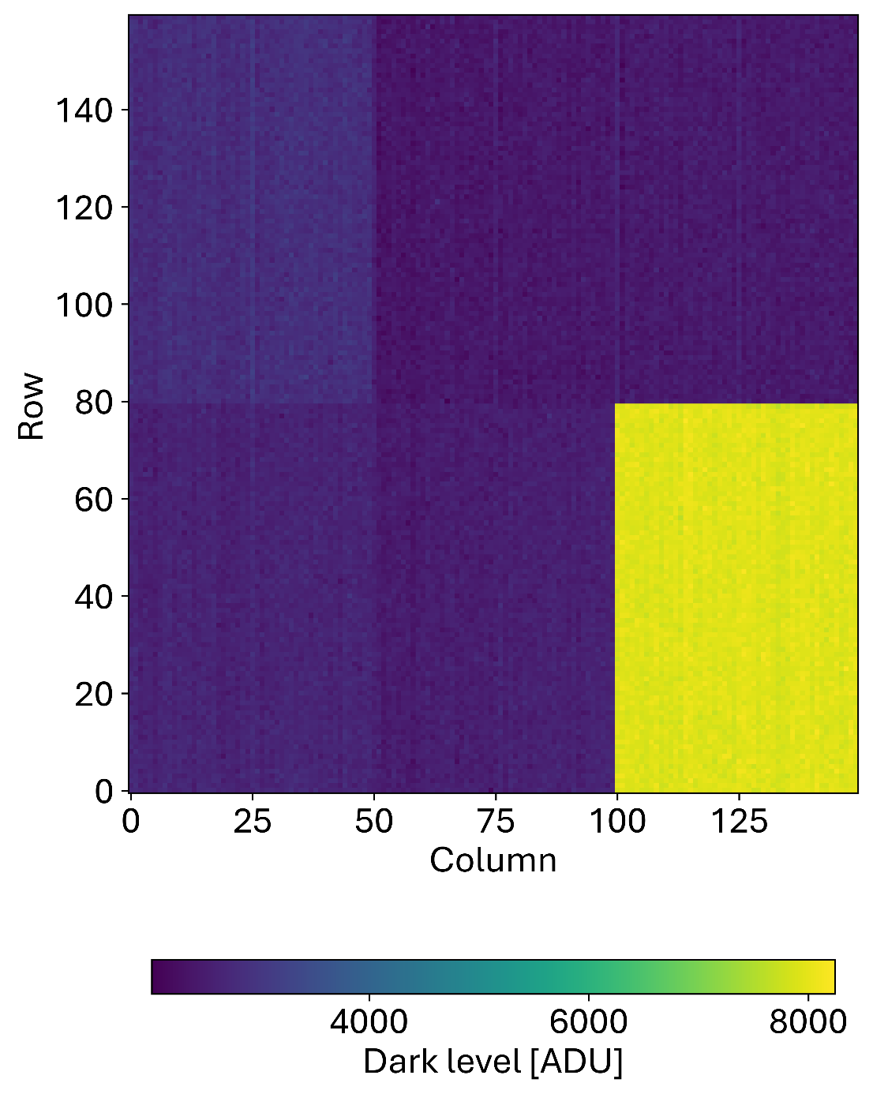
Pixel designs and first image (without sensor)
Std CDS
4
5
6
CSA
CDS
Storage Cells
Readout
Passive CDS
Test structures
1
2
3
Max. static analog power [µW/pixel]
1
HG / LG
G1
Pulsing
2.7
2
HG
3
Passive
2.4
4
HG / LG
G2
2.7
5
HG
G1
No test structure
6
Pulsing + precharge Sto

Slide 8
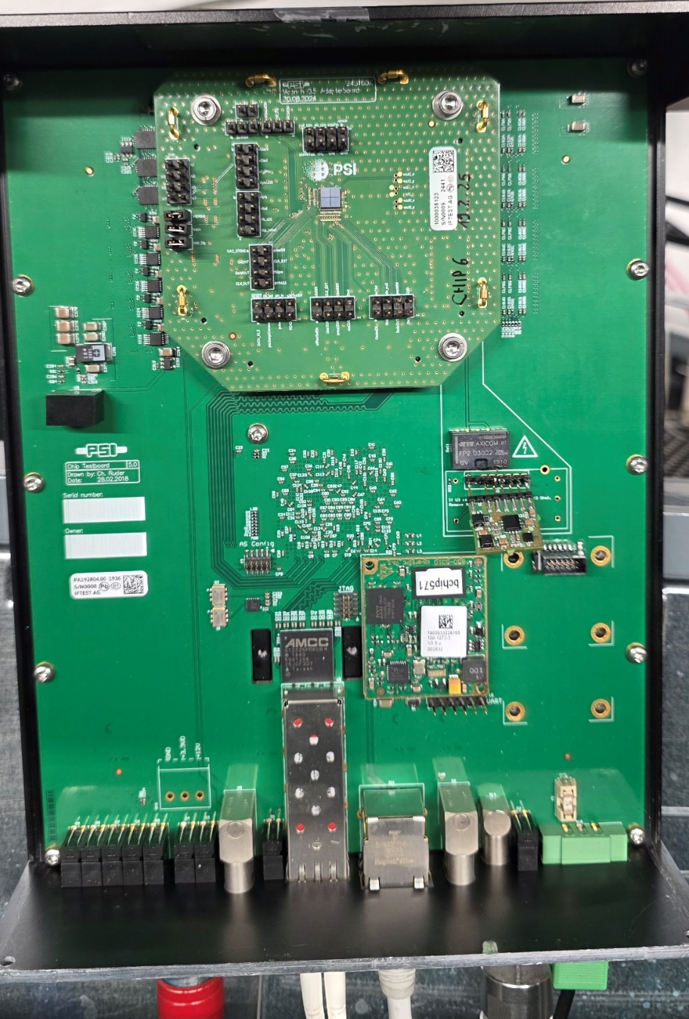
Pixel characterisation methods
ASIC bump-bonded to standard Si sensors (320 µm thick)
1 kHz max readout rate
ADC sampling rate: 40 Msps (firmware limited)
Using internal DACs (offering better noise performance)
Coolant temperature: 18°C
X-ray clustering: 2×2
Energy scan
  Fixed exposure time: 10 µs
  Using fluorescence photons (Ti, Fe, Cu, Mo). X-ray source with W anode
  Extraction of the calibration, energy resolution and linearity
Exposure time scan
  Using fluorescence photons (Cu target)
  Extraction of the calibration, and energy resolution
  Without photons and using the X-ray calibration: extraction of noise, dark current, and estimation of the dynamic range
MÖNCH 0.5
Module PCB
Chip Test Board

Slide 9
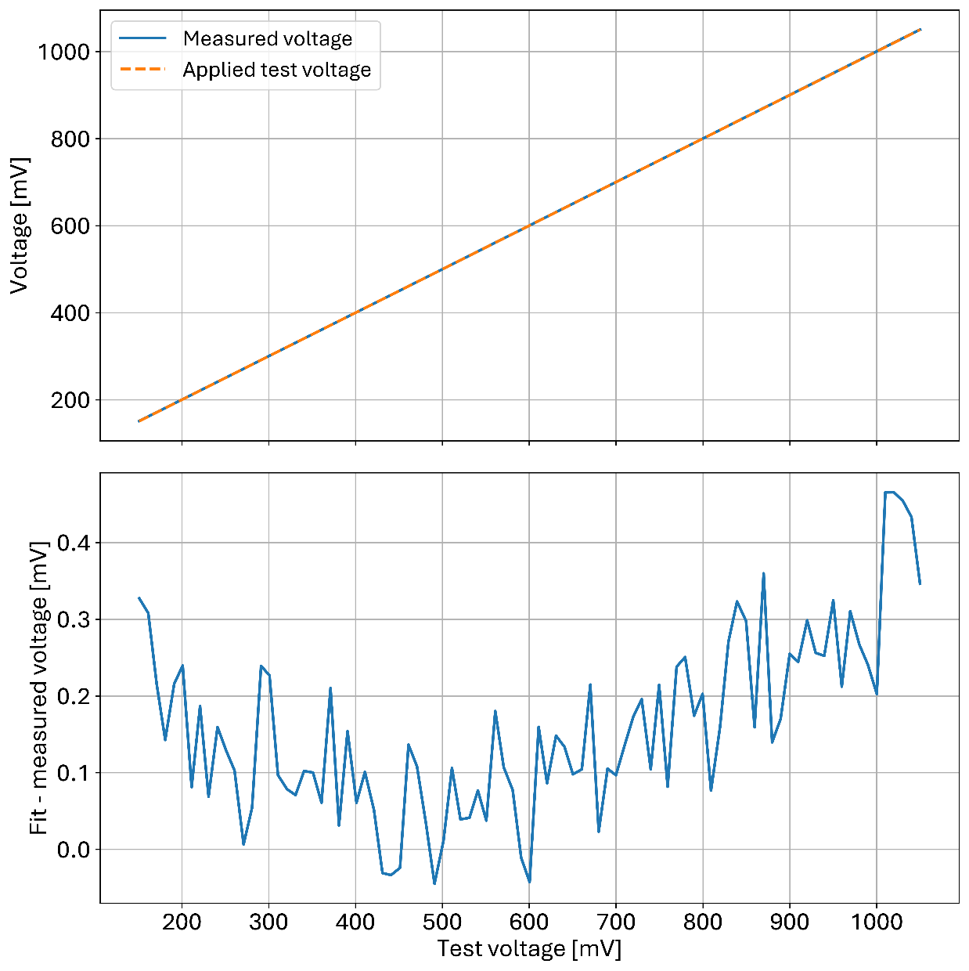
Readout chain linearity test
Buffer chain test
Signal injected at the column buffer
Pixel buffer
Compact, class-AB differential amplifier with unity gain capable of driving high capacitive loads
High linearity from 100 mV to 1V. (Vdd = 1.2 V)
“ON” power consumption: 10 µW. Power cycling operation
Column buffer
Folded-cascode class-AB amplifier
Designed for fast settling time, high phase margin, and high linearity
Power cycled
Off-chip ADC driver
Single ended to differential amplifier
Settling time < 15 ns allowing sampling rates of 65 Msps
(2 kHz frame rate for MÖNCH 1.0)
K. Moustakas

Slide 10
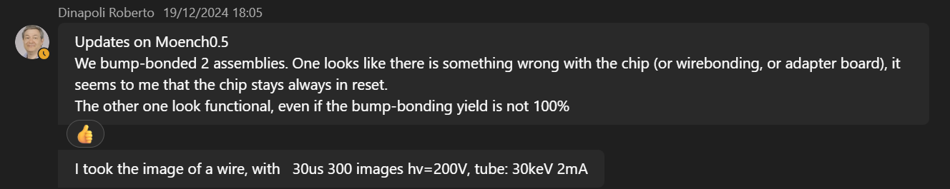

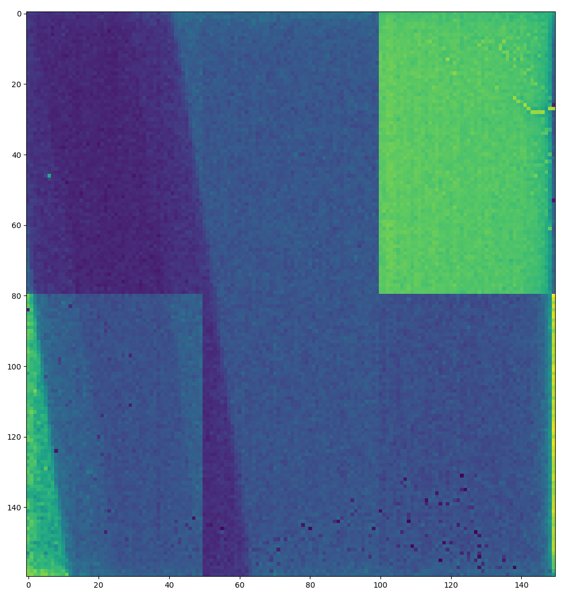
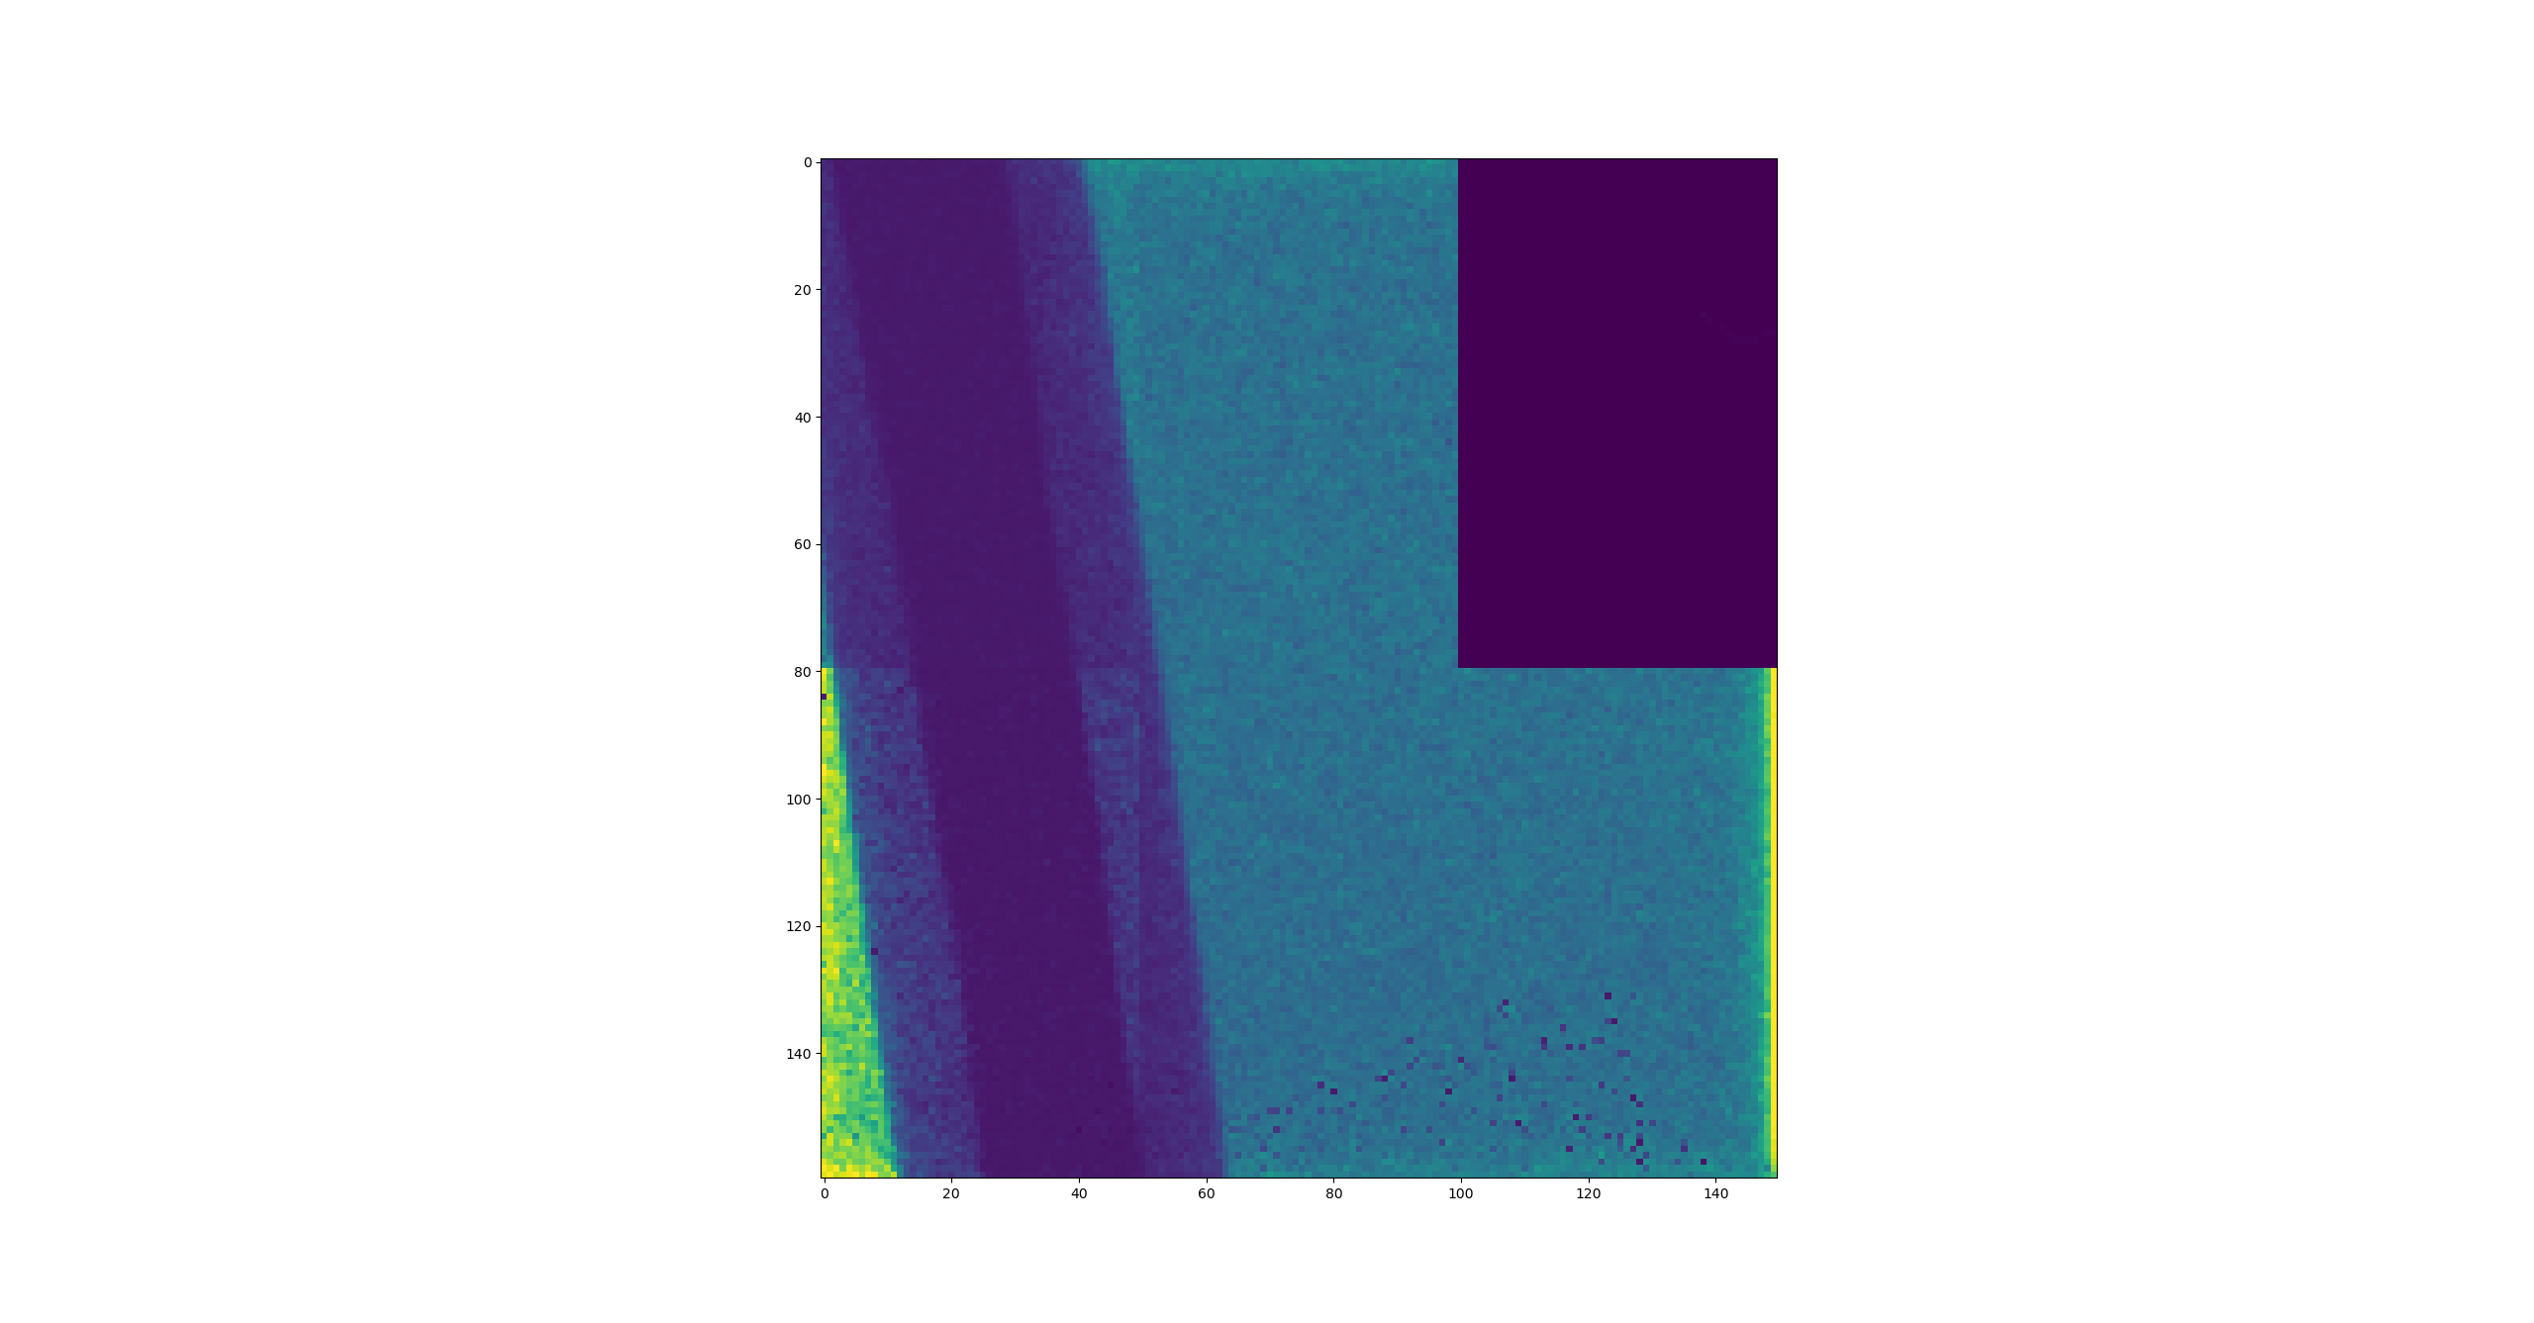
Very first X-ray image (A Christmas miracle)

Slide 11
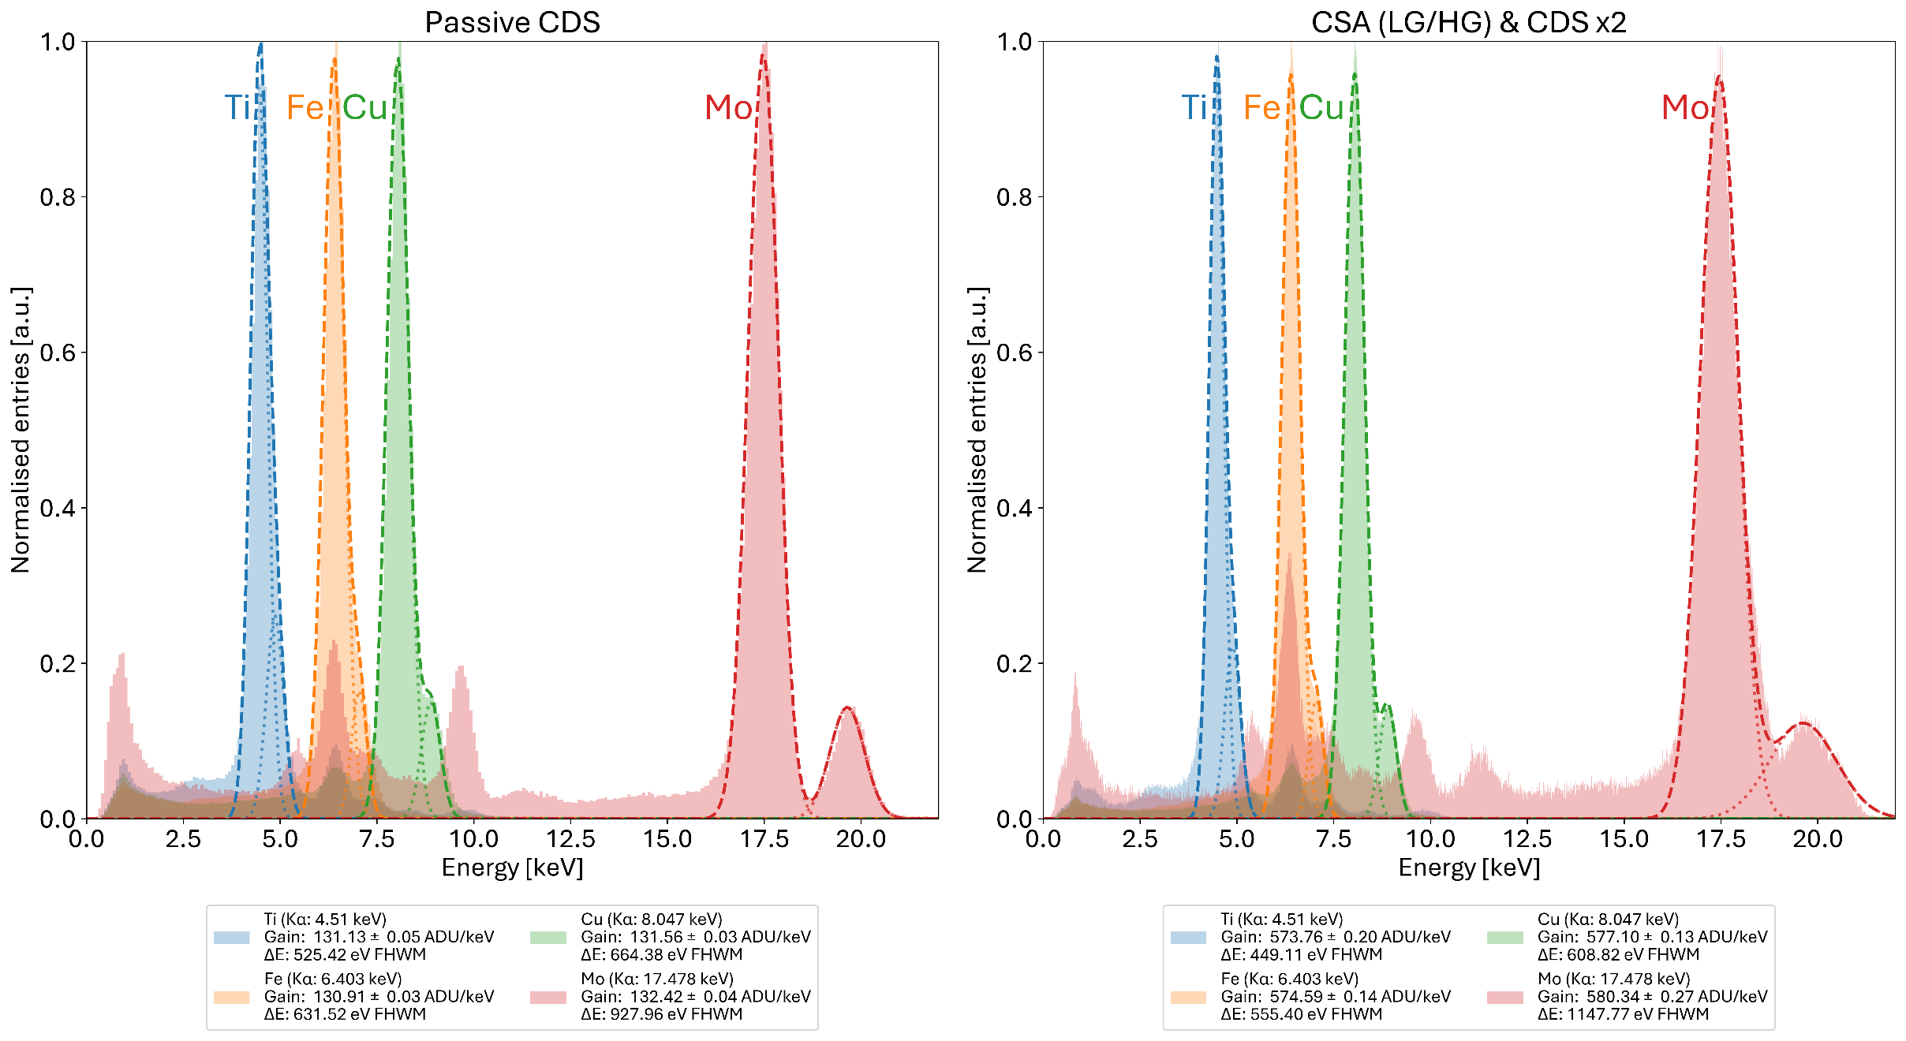
Energy scans: Fluorescence spectra (2×2 clusters)
Gain difference: ~ ×4.5
Small energy resolution difference

Slide 12
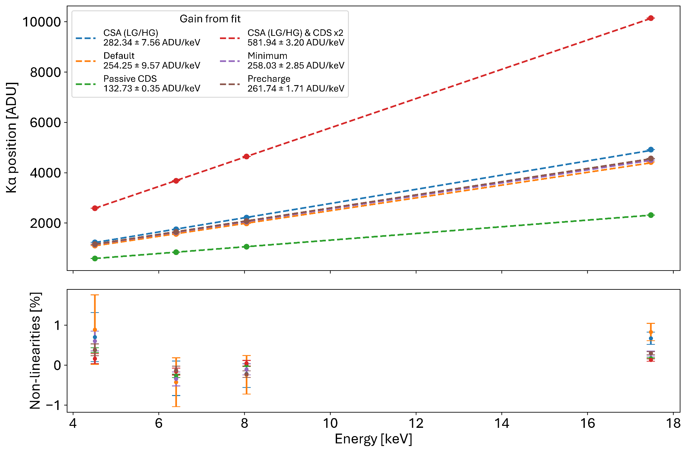
Energy scans: Gain and Linearity (using fluorescence data)
Non linearities ± 1%

Slide 13
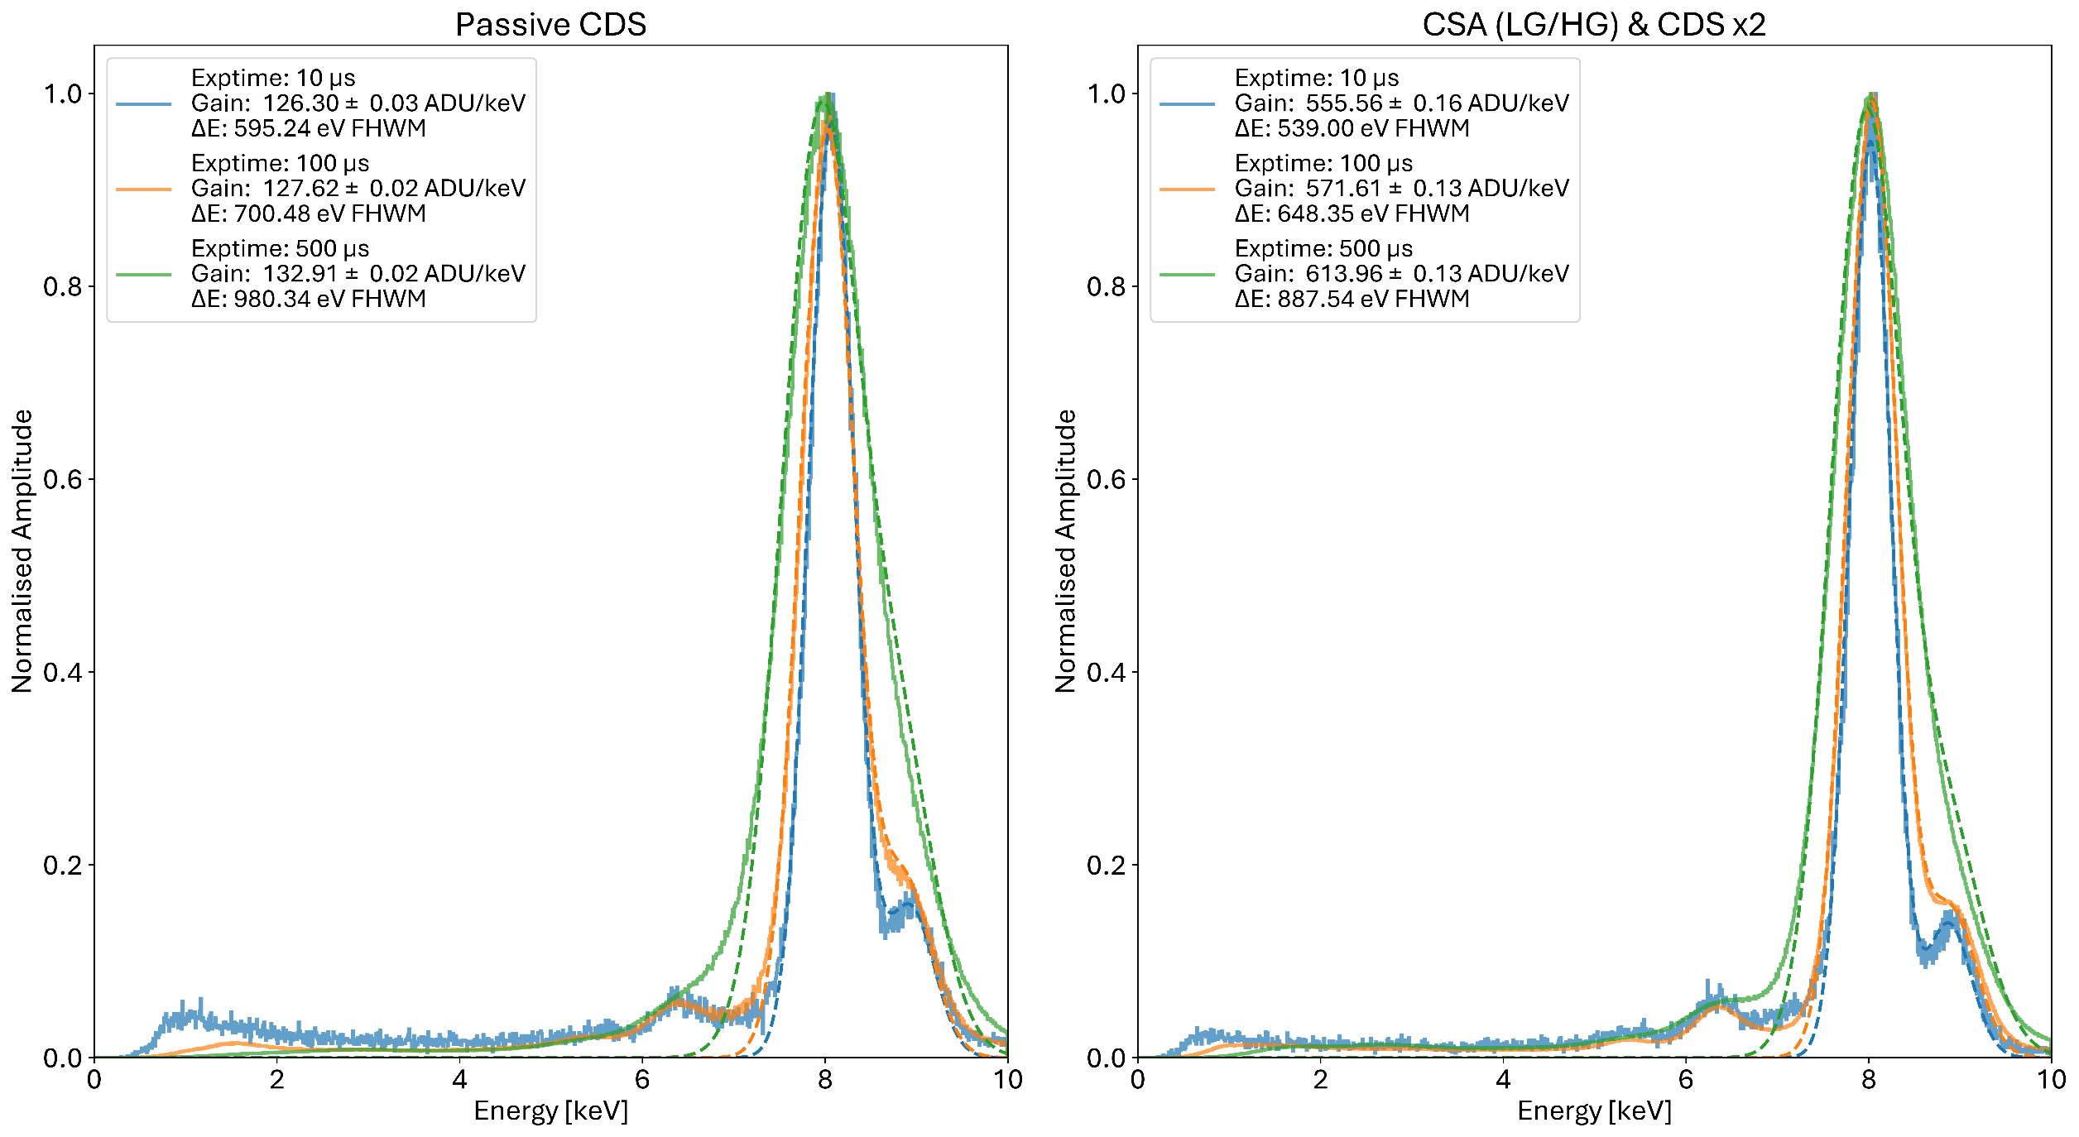
Cu fluorescence spectra at different exposure times
T_{coolant}: 18°C
Energy resolution degrades with exposure time
Small energy resolution difference
Notes:
Add take home messages etc.

Slide 14
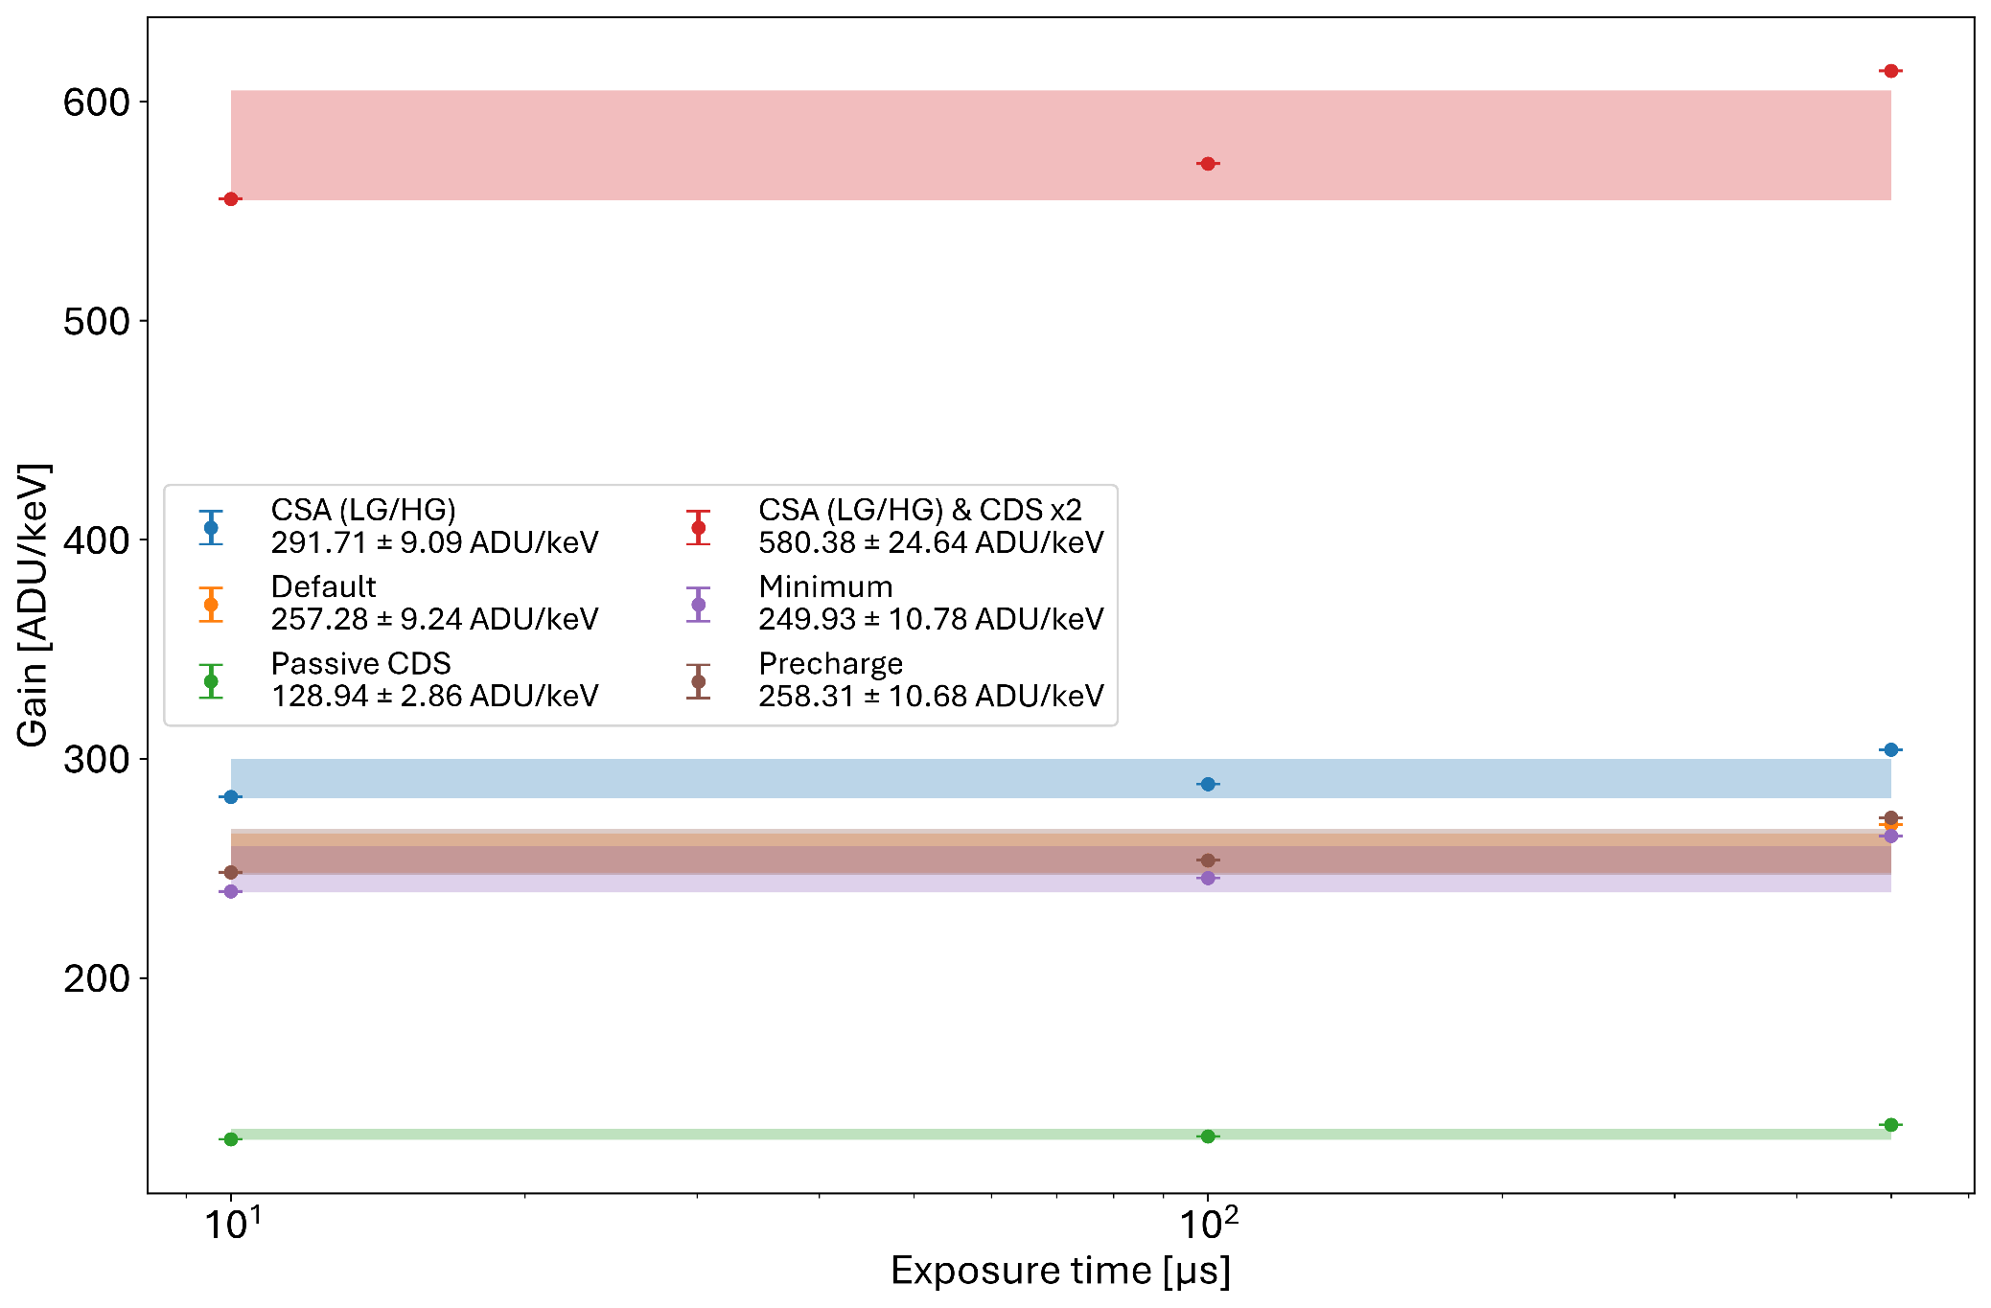
Gains vs exposure time
Gain increase with exposure time to be studied

Slide 15
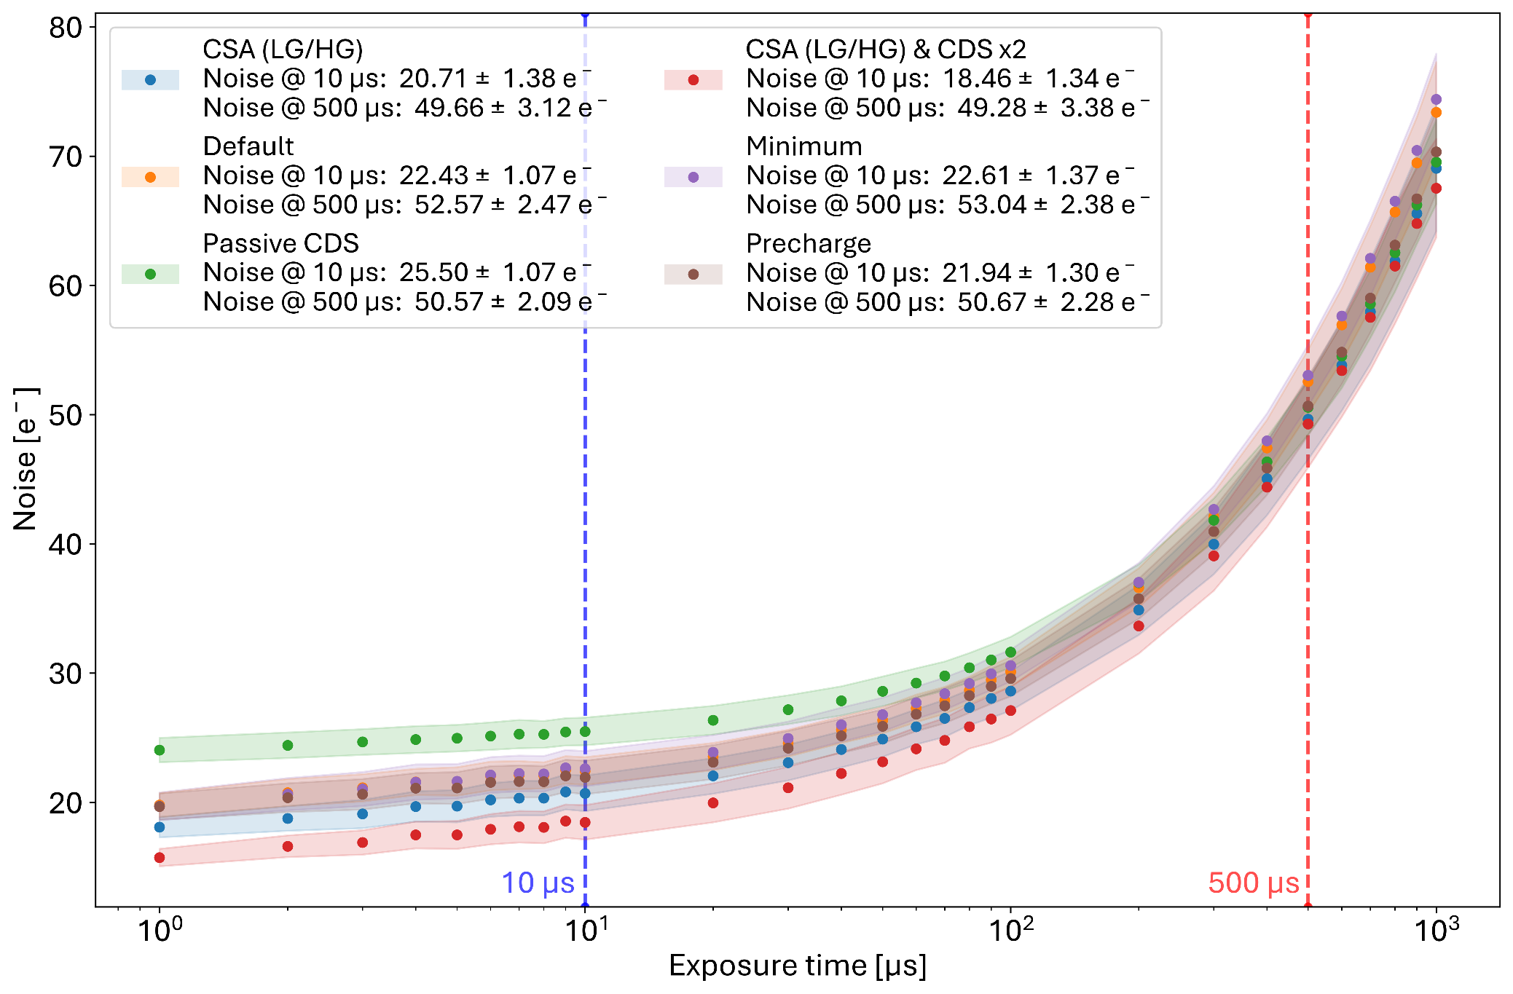
Noise
Single gain (at 500 µs)
T_{coolant}: 18°C
At short exposure time: minimum noise in the highest gain
Equivalent noise performance at long exposure times
Notes:
Mostly shot noise from sensor contributor.
And add roomish temperature of coolant

Slide 16
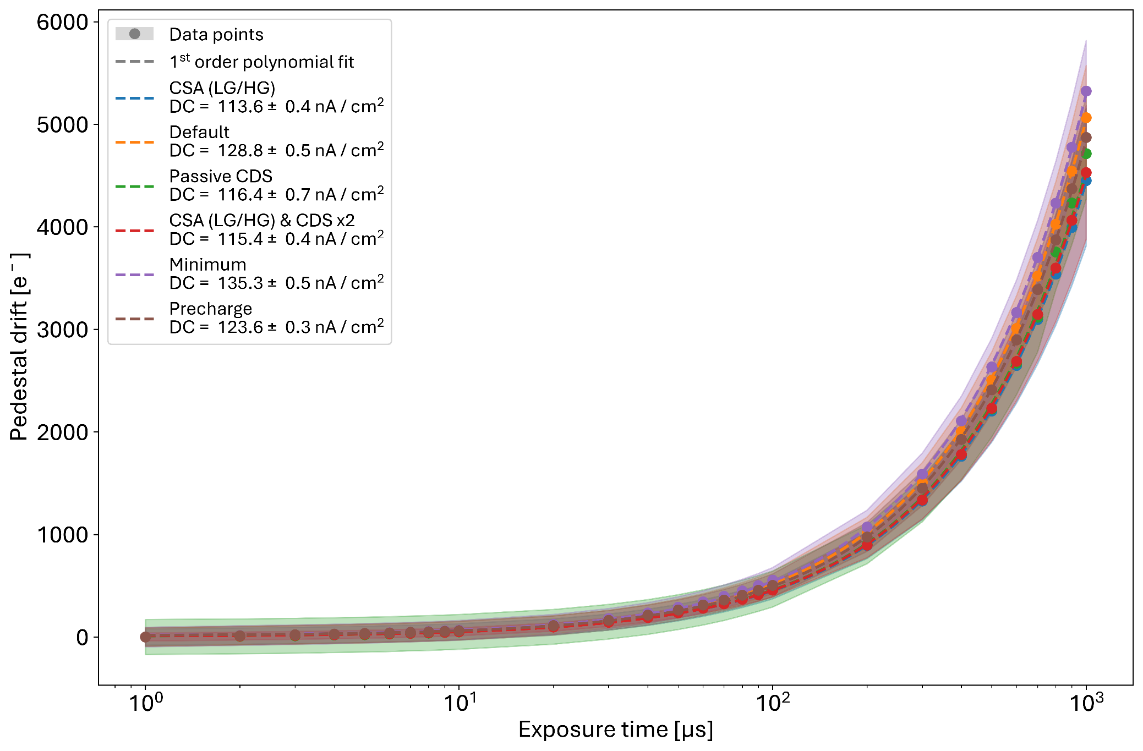
Dark current
Single gain (at 500 µs)
T_{coolant}: 18°C
Sensor dark current dominates
No significant influence from the pixel design

Slide 17
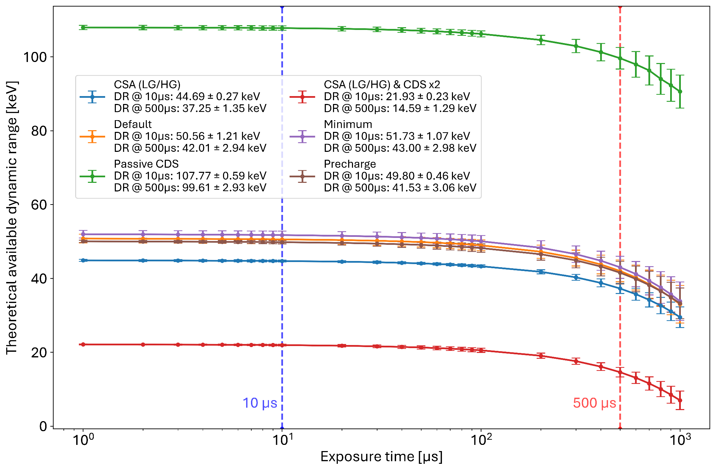
Dynamic range
Single gain (at 500 µs)
T_{coolant}: 18°C
With LGADs: available DR divided by the amplification gain
Passive CDS offers a very large dynamic range

Slide 18
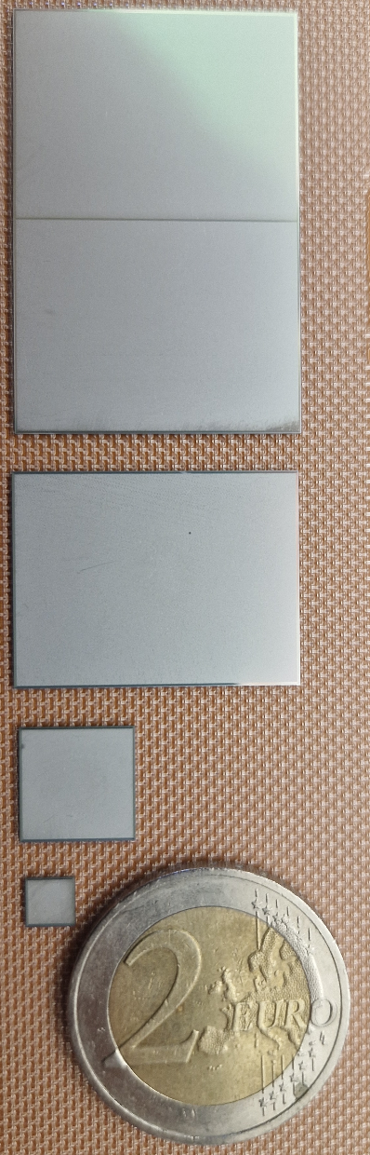
The future of MÖNCH 0.5, …
Sensors
Characterisation summary
Improved stability and linearity of the readout chain wrt. previous versions
The full readout chain seems compatible with the expected rates for a full chip
Low noise operation (18.5 – 25 e⁻ at 10 µs exposure time; ~ 51 e⁻ at 500 µs exposure time)
Passive CDS design appears to be a good candidate for a large chip: equivalent performance, with lower power consumption, and large dynamic range
Observed gain variation to be explored
Future work with MÖNCH 0.5
Confirm current results with additional prototype assemblies, explore the gain variations, and determine if further optimization is achievable
Performance assessment with LGADs
Pilot experiments to validate the design choices → Open to collaborate
2x MÖNCH1.0
1-side butted
2.56 x 3.84 cm²
>2028
2027
MÖNCH1.0
2.56 x 1.92 cm²
2015
M0.3/M0.4
1 x 1 cm²
2013
M0.2/M0.5
4 x 4 mm²

Slide 19
… towards a full-scale MÖNCH 1.0
Sensors
MÖNCH 1.0 (current plans)
Planned submission in 2026 with single chip modules available in 2027
Image area: 2.56 x 1.92 cm² (1024 x 768 pixels)
At least 1-side buttable
ADC on chip very likely not implemented (yet)
Still open to suggestions from future users
Open challenges:
  Power distribution and power consumption
  (large scale, high density, buttability)
  Large data rates and volumes expected
  (e.g., for a single chip module at 2 kHz: 3.16 GB/s → 11.38 TB/hour)
  Software for online data processing and potential use of ML for hits and clusters extraction
2x MÖNCH1.0
1-side butted
2.56 x 3.84 cm²
>2028
2027
MÖNCH1.0
2.56 x 1.92 cm²
2015
M0.3/M0.4
1 x 1 cm²
2013
M0.2/M0.5
4 x 4 mm²

Slide 20
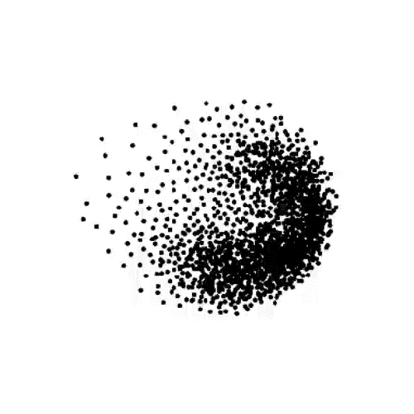
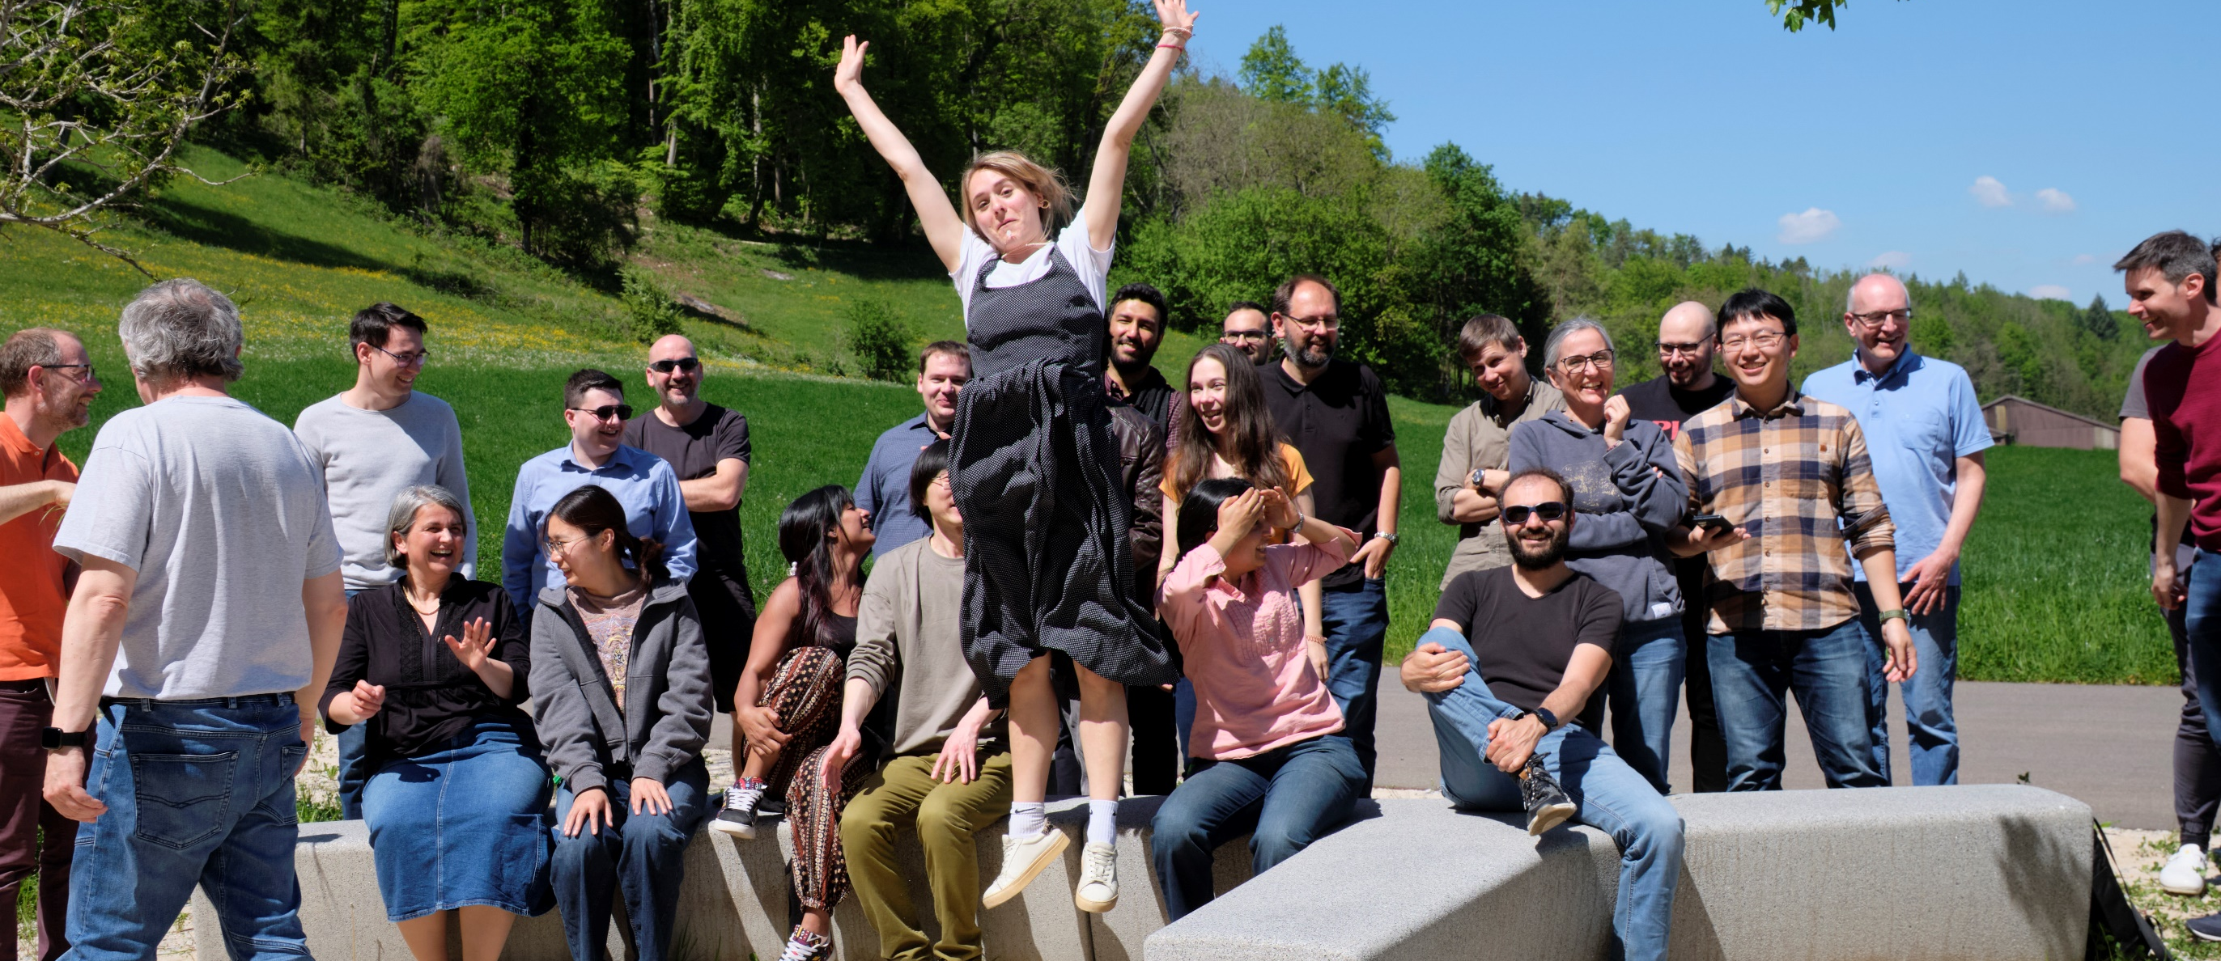
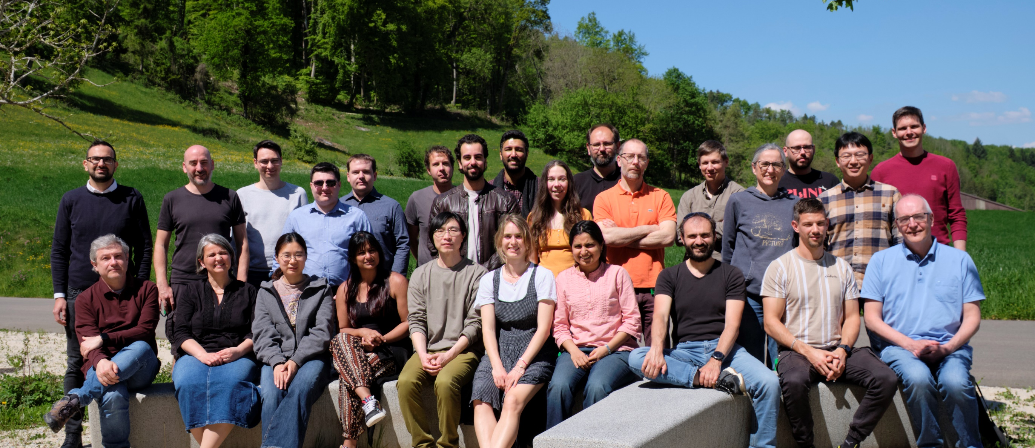
V. Kedych, M. Müller, P. Sieberer, K. Ferjaoui, M. Brückner, E. Fröjdh, J. Heymes, C. Lopez-Cuenca,
K. Moustakas, C. Ruder, J. Mulvey, S. Silletta, V. Hinger, A. Mozzanica, M. Carulla, X. Xie,
R. Dinapoli, A. Bergamaschi, S. Li, D. Thattil, J. Zhang, A. Mazzoleni, V. Gautam, D. Mezza, T. King, B. Schmitt.
Missing: S. Ebner, D. Greiffenberg, S. Hasanaj, K.A. Paton, C. Posada.

Slide 21
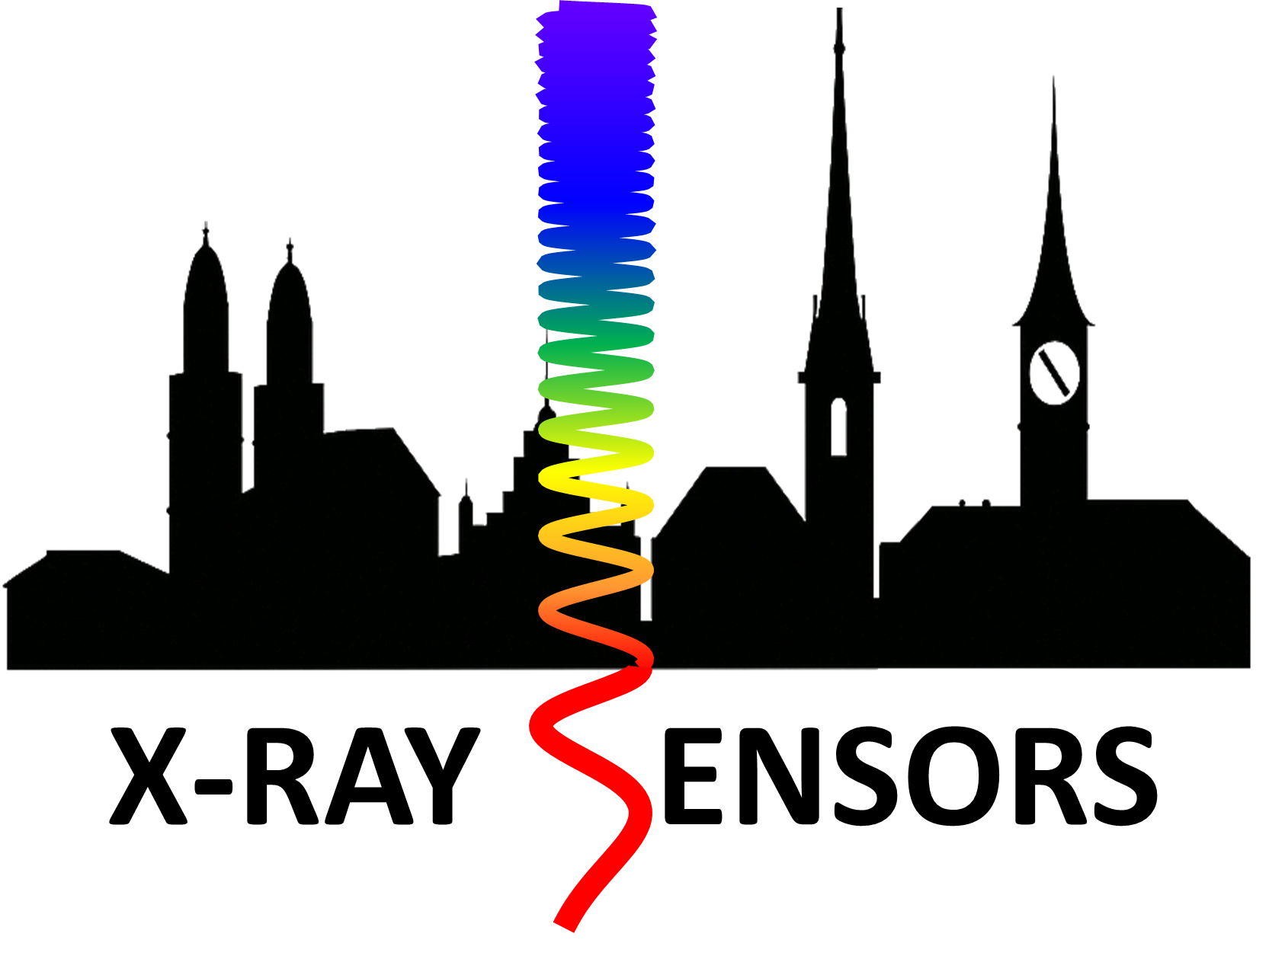



1st Joint X-ray Sensor Workshop
From Soft to Hard X-rays
ETH Zurich (Switzerland)
12.-16. January 2026
Bridging Science and Detection Technology for Soft X-ray Applications
Applications and detector requirements in the soft X-ray energy range
CCD, CMOS, LGAD technologies, etc.
Sensor design and manufacturing for soft X-rays
Sensor characterization
Detector calibration techniques
Simulations
High-Z Pixel Array Detectors for Photon Science
High-Z detector developments
GaAs:Cr, CdTe, CZT, Perovskites, PbS QDs, etc,.
Contacts and interconnects
Material characterization
Detector requirements for high photon energy applications
Simulations
Webpage and registration:
https://indico.psi.ch/e/XRaySensors2026
Registration for the two workshops is separate.

Slide 22
BACKUP SLIDES

Slide 23
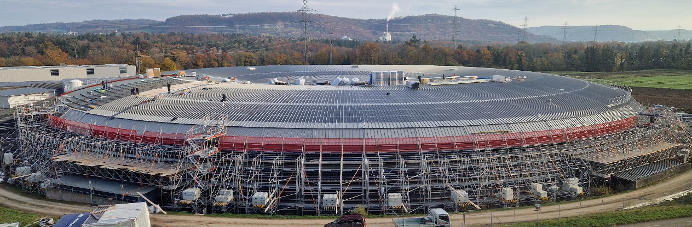
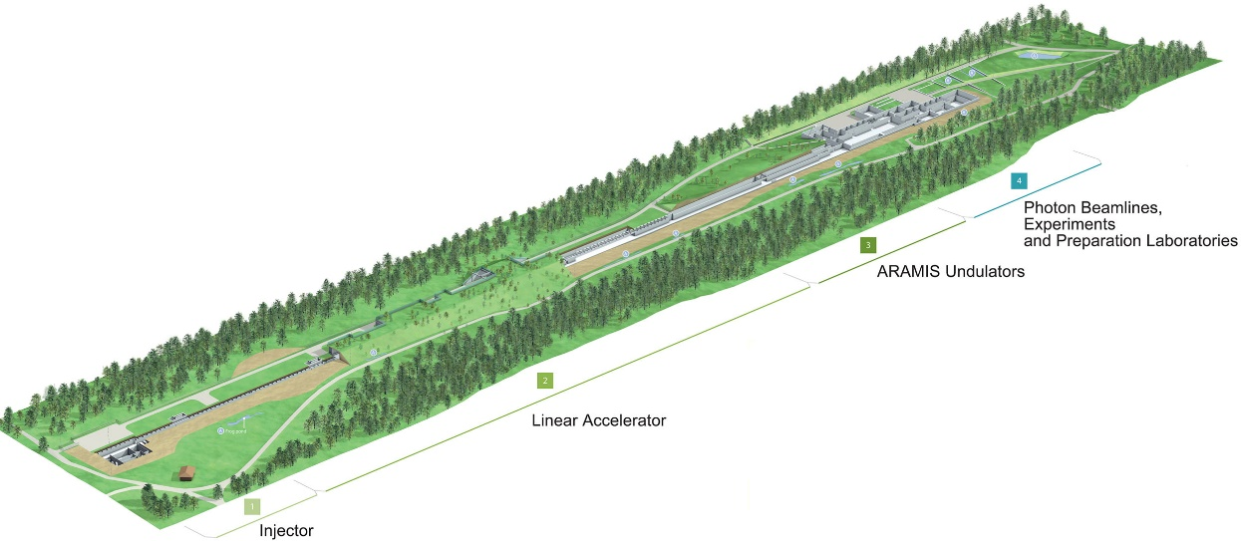
A versatile charge integrating pixel detector
Photon starved experiments with X-ray tubes or at synchrotron beamlines
Static gain with low noise for single photon detection (low occupancy ≈ 1 %)
Fast frame rates (> 1 kHz) with large duty cycles (exposure time ≈ frame time)
High flux experiments at bright synchrotron beamlines
Static gain with large dynamic range to integrate photons
Dynamic gain switching to detect single photons with low noise and integrate larger signals
Fast frame rates (> 1 kHz) with large duty cycles (exposure time ≈ frame time)
Experiments at X-ray Free Electron Lasers
Dynamic gain switching to detect single photons with low noise and integrate larger signals
Shorter exposure times (~10 µs) with readout between bunches
(SwissFEL: 100 Hz repetition rate)
➔ Jungfrau

Slide 24
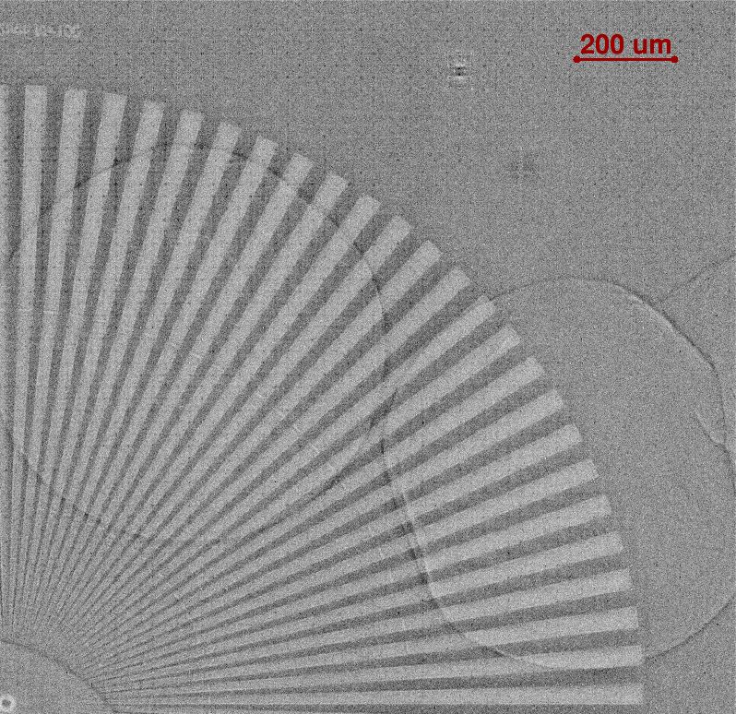
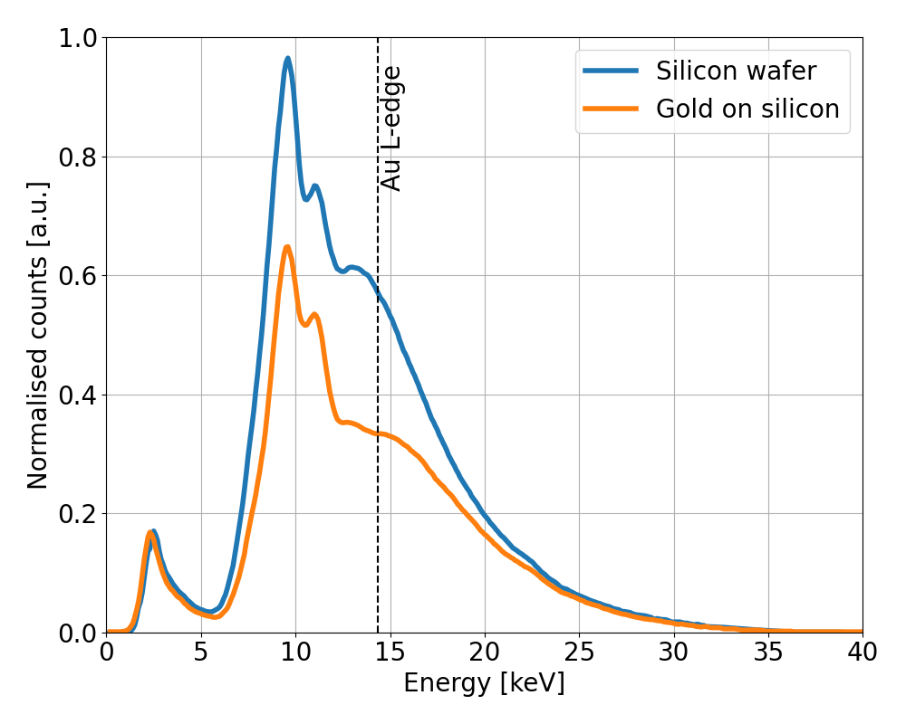
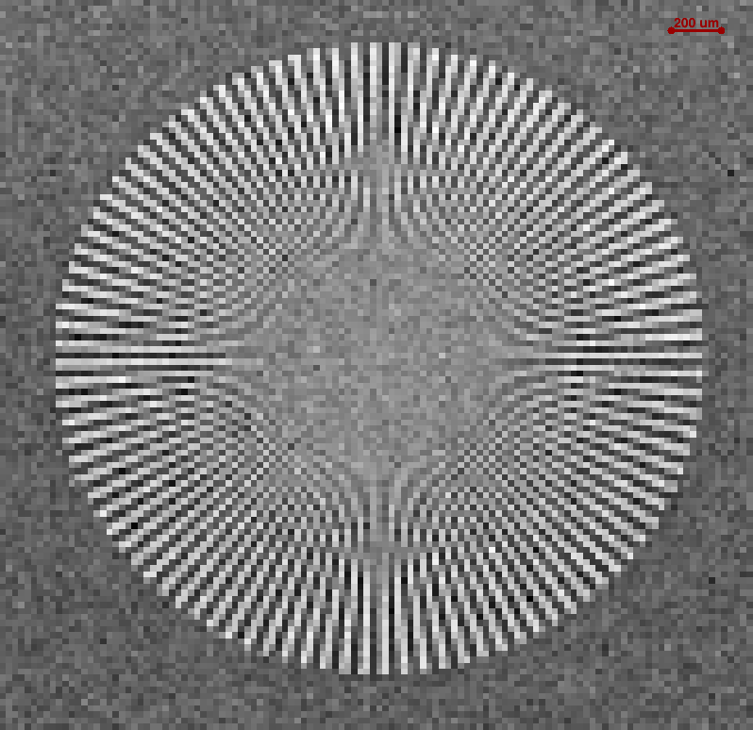
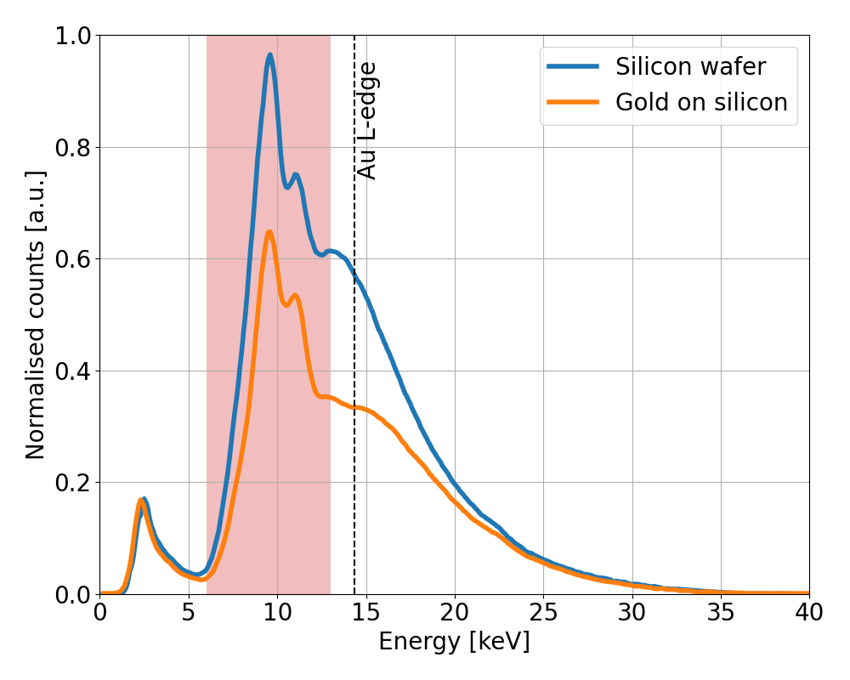
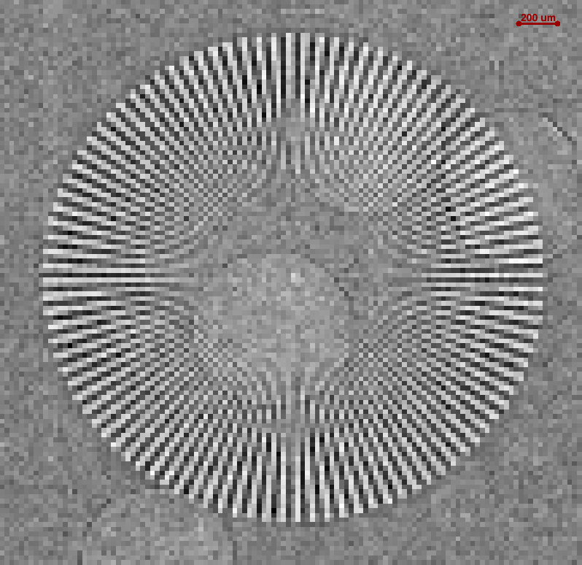
High resolution energy resolved (colour) imaging
MÖNCH0.3 - Siemens Star with spokes 60-0.5 µm gold on silicon with silicon microspheres
W-anode X-ray tube (40 kV, 200 µA)
Interpolated to 1 µm bins
2x2 cluster spectrum
Low flux required for single photon detection
Native resolution – Below Au L-edge
Native resolution – Full spectrum
Color imaging works also in combination with interpolation.
Challenges due to polychromatic beam.
Images can be binned in energy
Below the L-edge gold becomes “transparent” to X-rays
A full spectrum with an energy resolution of about 750 eV FWHM is acquired for each pixel
A Bergamaschi et al., Hybrid Detectors for High Resolution Imaging., Microscopy and Microanalysis, Volume 24, Issue S2, 1 August 2018, Pages 316–319

Slide 25
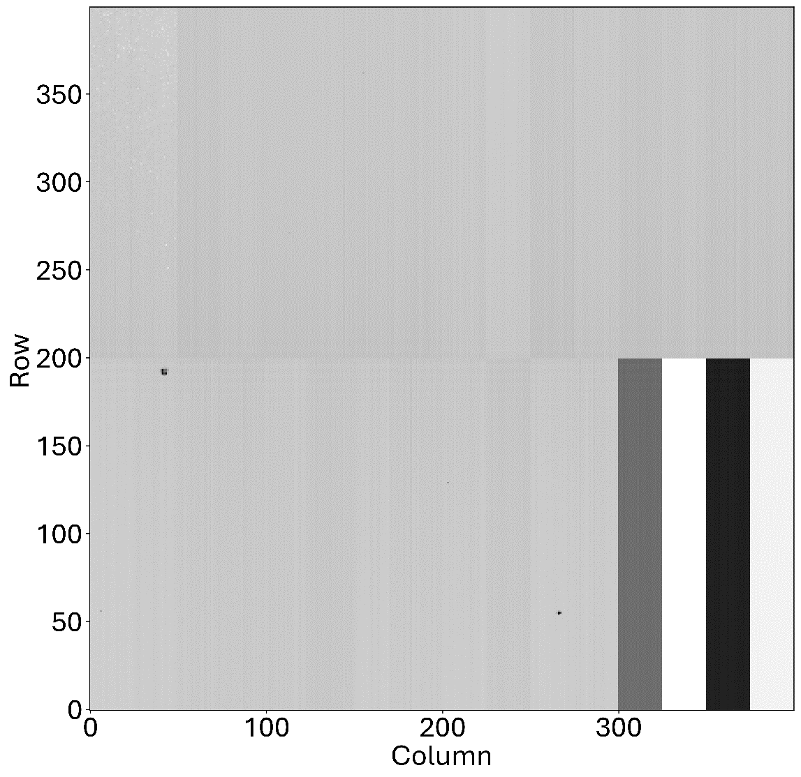
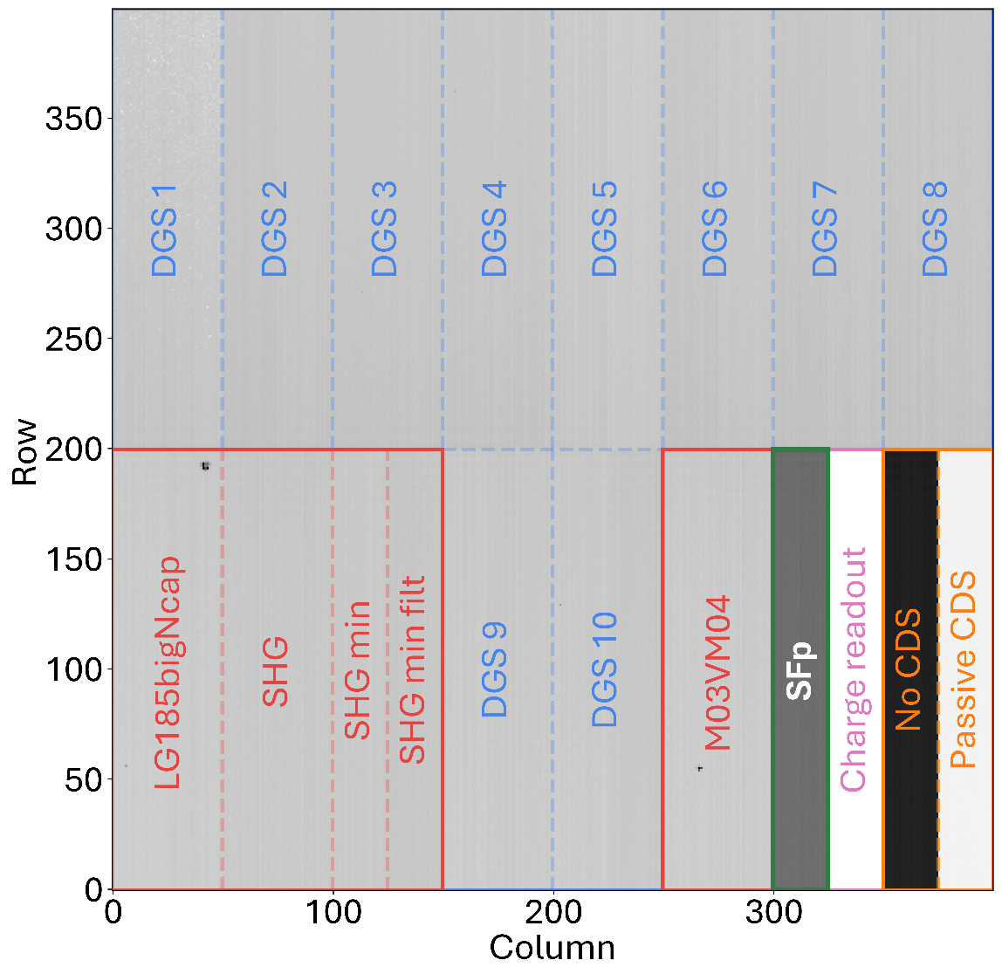
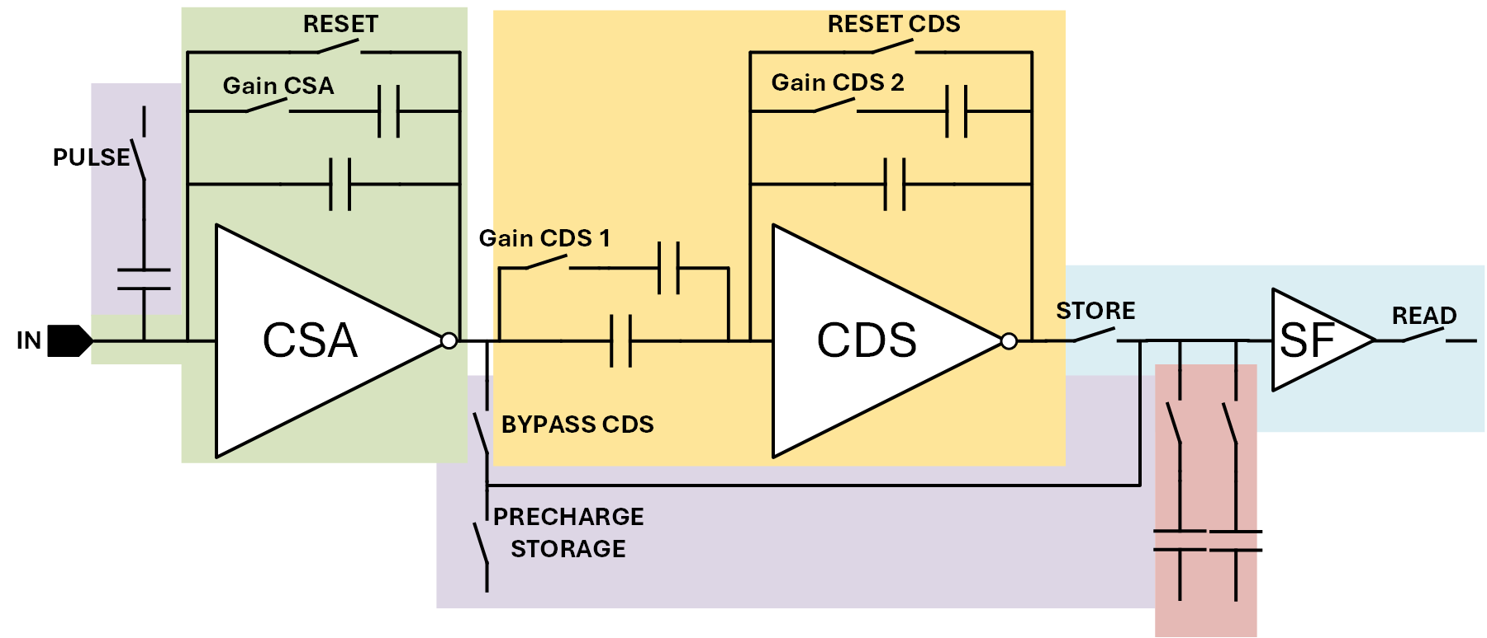
MÖNCH0.4
400 x 400 pixels, 25 µm pitch, 1 x 1 cm²
Designed in UMC110
19 Different pixel variants
Analogue readout up to 1.2 kHz
14bit ADC on board (CTB)
CSA
CDS
Storage Cells
Readout
Test structures
2
3
4
5
1
1
HG / LG
G1/G2/G4
Test structures in pixel
2
HG / SLG
3
SHG / LG
G2/G4/G8
Static gains
Alternative CDS
Charge readout
4
SHG
No test structure
Dynamic Gain Switching
Source follower
5
G2/G4/G8 + FILTER

Slide 26
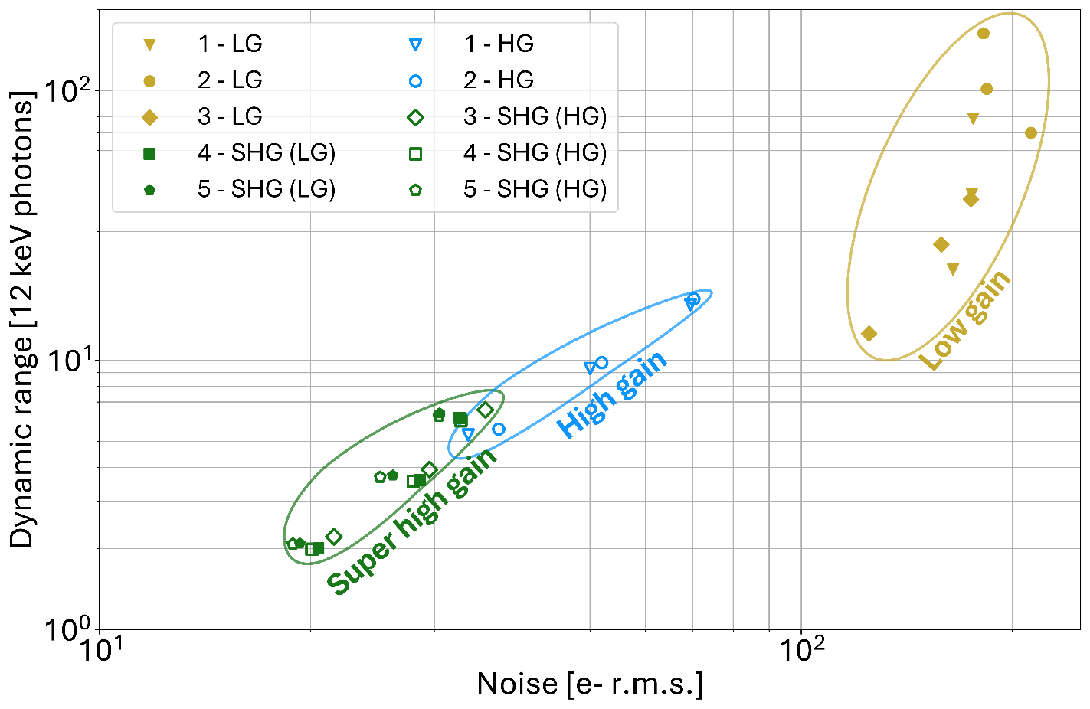
Balance of noise and dynamic range (static gains)
Noise [e⁻] / Dynamic range [12 keV photons]
 |  | LG-G1 | LG-G2 | LG-G4 | HG-G1 | HG-G2 | HG-G4
 | Default: M03VM04 | 176/79 | 175/41 | 164/21.7 | 70/16 | 50/9.3 | 33.5/5.3
 | LG185BigNcap | 182/164 | 184/102 | 212/70 | 70/17 | 52/9.8 | 37/5.5
 |  | LG-G2 | LG-G4 | LG-G8 | SHG-G2 | SHG-G4 | SHG-G8
 | SHG | 174/40 | 158/27 | 125/12.5 | 35.5/6.5 | 29.5/3.9 | 21.6/2.2
 |  | SHG-G2 | SHG-G4 | SHG-G8 | SHG-G2 | SHG-G4 | SHG-G8
 | SHG min | 32.6/6.1 | 28.6/3.6 | 20.5/2 | 32.8/6 | 28/3.6 | 20.1/2
 | SHG min filt | 30.5/6.4 | 26.2/3.7 | 19.3/2.1 | 30.5/6.2 | 25.1/3.7 | 18.9/2.1
1
2
3
4
5
1
HG / LG
G1/G2/G4
Test structures in pixel
2
HG / SLG
3
SHG / LG
G2/G4/G8
4
SHG
No test structure
5
G2/G4/G8 + FILTER
J. Heymes et al., Balancing gain and dynamic range in a 25 µm pitch hybrid pixel detector, 2024 JINST 19 C01012

Slide 27
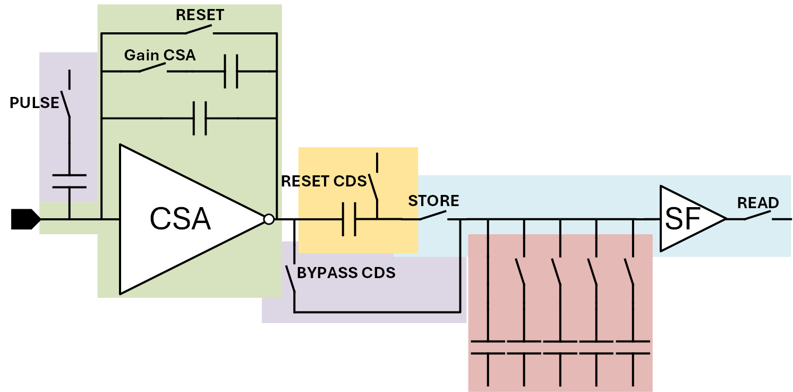
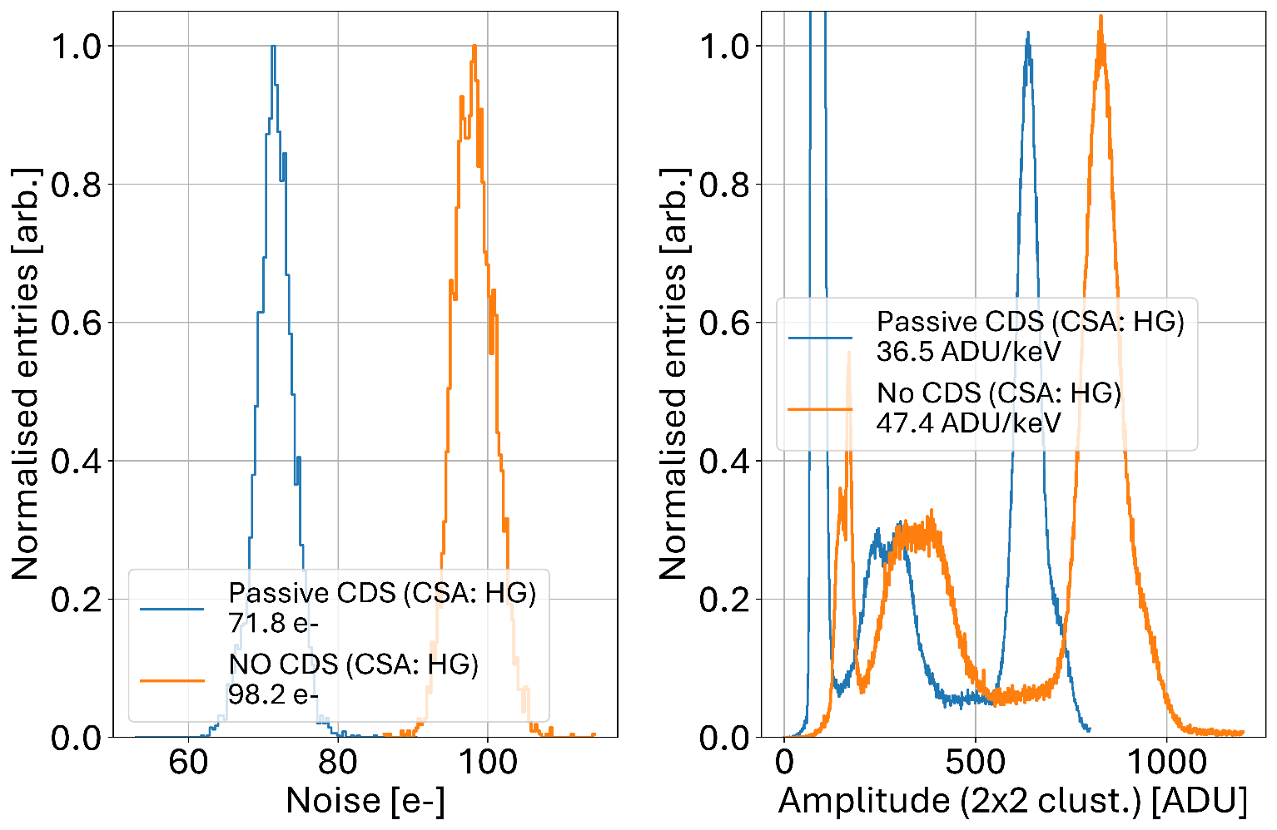
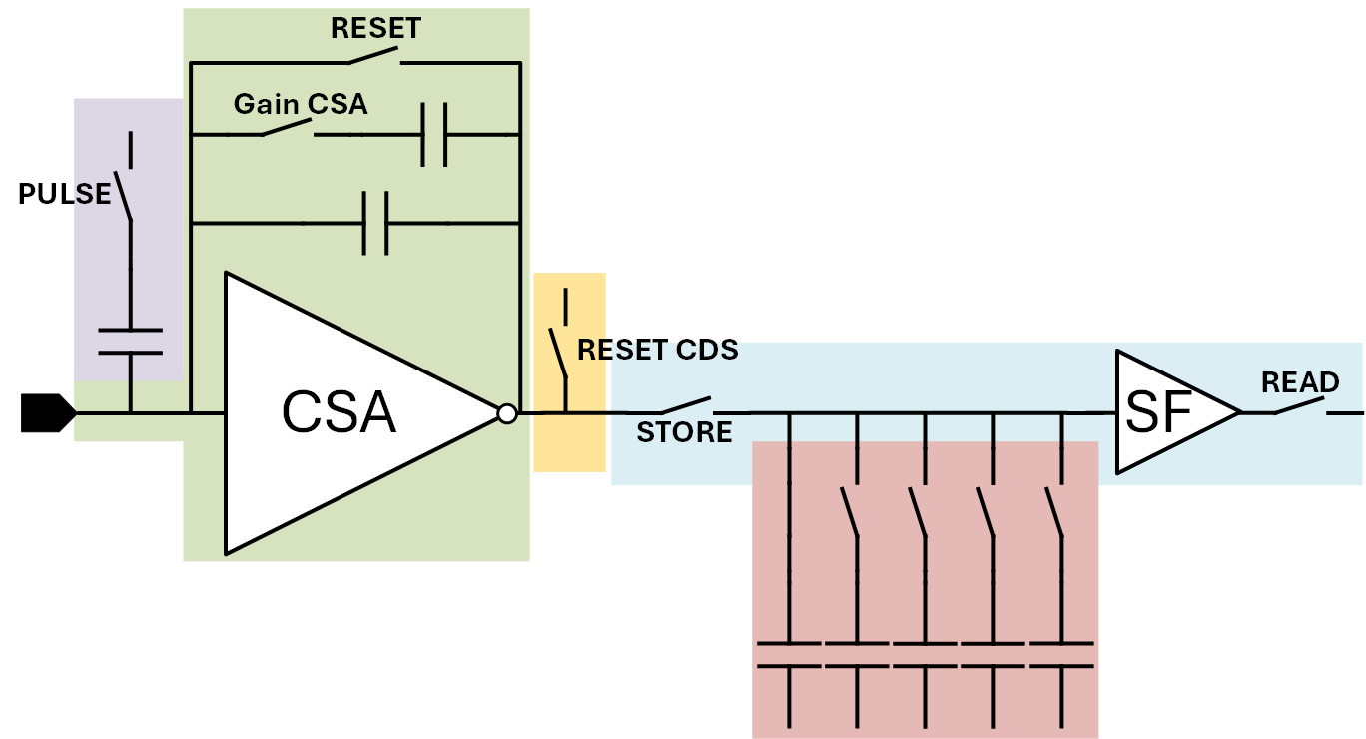
Alternative CDS performance
CSA
CDS
Storage Cells
Passive CDS
Readout
Test structures
No CDS
Standard architecture in HG:
G1: 70 e⁻, G2: 50 e⁻, G4: 33.5 e⁻
X-ray tube w/ W anode
Mo target (Mo-Kα=17.478 keV)

Slide 28
MÖNCH0.4 LESSONS
MÖNCH0.5 CONCEPT
PIXEL DESIGN
ANALOG READOUT CHAIN
CONSIDERATION FOR POWER, BIASES, AND SAMPLING
19 pixel variants (10 DGS, 9 Static)
➔ Too many with shared biases and signals
400 x 400 pixels, 1 x 1 cm²
Higher CSA gain and/or sacrificed testability
➔ Lower noise
Passive CDS can be considered for power reduction
Pixel buffer: source follower (offset sensitive to temperature, reduced range, non-linearities)
Improvement on the linearity and stability required
Fast settling times needed for fast frame rates in a large chip
Specific attention on power distribution required for a full scale ASIC
On-chip DAC would be preferred for stability
On-chip ADCs would improve the performance
6 pixel designs with limited variations
➔ Uniform behaviour
160 x 150 pixels, 4 x 3.75 mm²
Increased CSA Gain (low feedback capacitance)
Non selectable CDS gain (+ 1 passive CDS variant)
Minimal testability (1 variant without any)
Pixel buffer: class AB differential amplifier
Full analog chain redesigned for fast settling time, high-linearity and capable of driving high capacitive loads
Large capacitor at the bottom of the column to emulate MÖNCH1.0
Special care on power distribution
Internal DACs available
(adapted from Matterhorn0.2)
On chip ADC-SAR-05 prototype¹
(can be connected to MÖNCH via the PCB)
¹P. Sieberer, Design of a 12-Bit SAR-ADC for Charge Integrating Pixel Detectors, Poster presented at TWEPP 2024

Slide 29
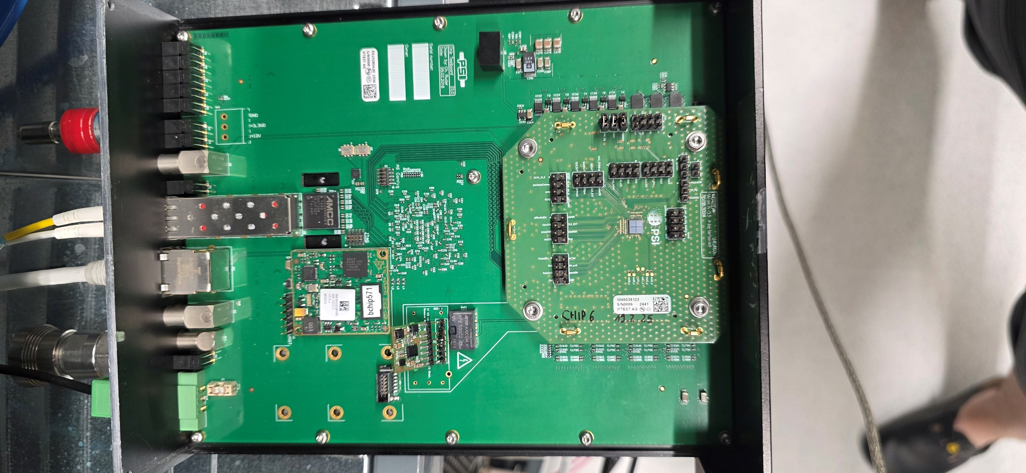
Test setup
High voltage source
Power
Blackfin µprocessor
(w/ embedded linux)
Chilled water IN
Control/Data
(RJ45 /100Mbps)
MÖNCH 0.5
UDP data stream
(Optical fibre /10 Gbps)
Hot water OUT
Module PCB
Chip Test Board
Control software: slsDetectorPackage (https://github.com/slsdetectorgroup/slsDetectorPackage)
Data analysis library: aare (https://github.com/slsdetectorgroup/aare)*
*See Erik Fröjdh’s poster during iWoRiD in July: https://indico.cern.ch/event/1428808/contributions/6505584/
Notes:
Too many arrows
Simplify it
All arrows smaller expect M0.5
Board with parameter to drive prototype. All control over it
Carrier different from chip to chip. So meant to do prototype
Can generate patterns. Full control over signals and biases to test in details

Slide 30
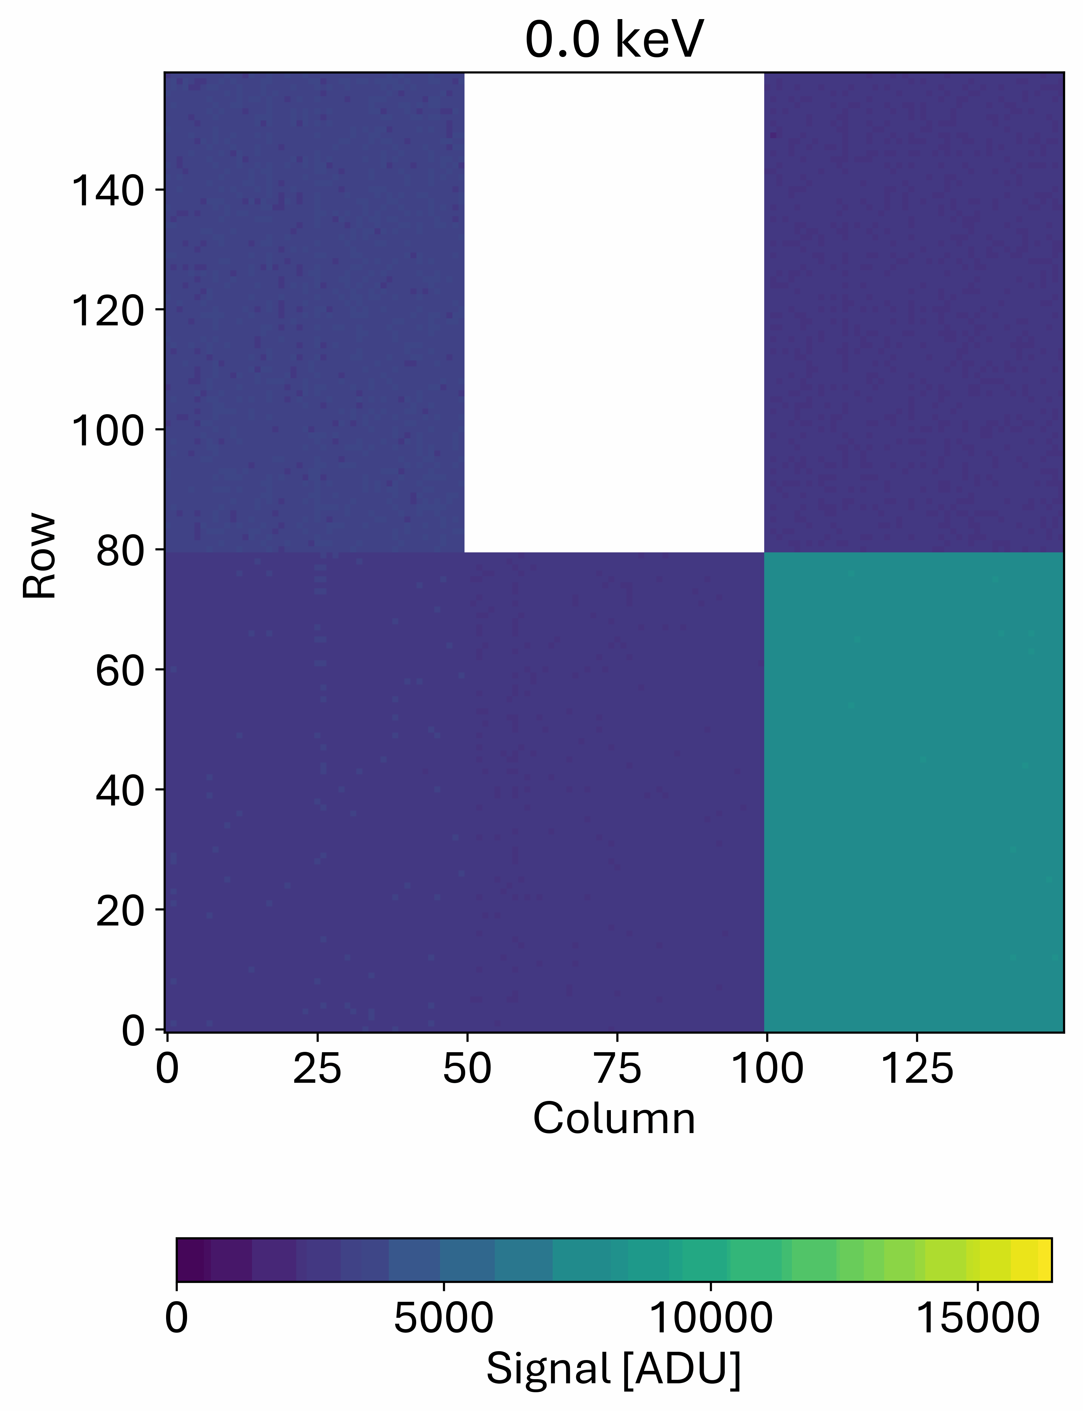
Pulsing for initial calibration
CDS Gain 2
No Pulsing
No sensor bump-bonded (no UBM)
All pixels in supercolumn pulsed one by one
(i.e. 3 pixels per frame, same row, 50 columns interval)
Increasing pulse height from 0 to 400 mV (40 mV steps)
➔ With C_{pulse}=3.86 fF: Injection of up to 9189 electrons (33.26 keV)
Exposure time: 10.3 µs
100 samples per pixel per pulse height
Single frame reconstructed for each pulse height to extract key performance
Passive CDS

Slide 31
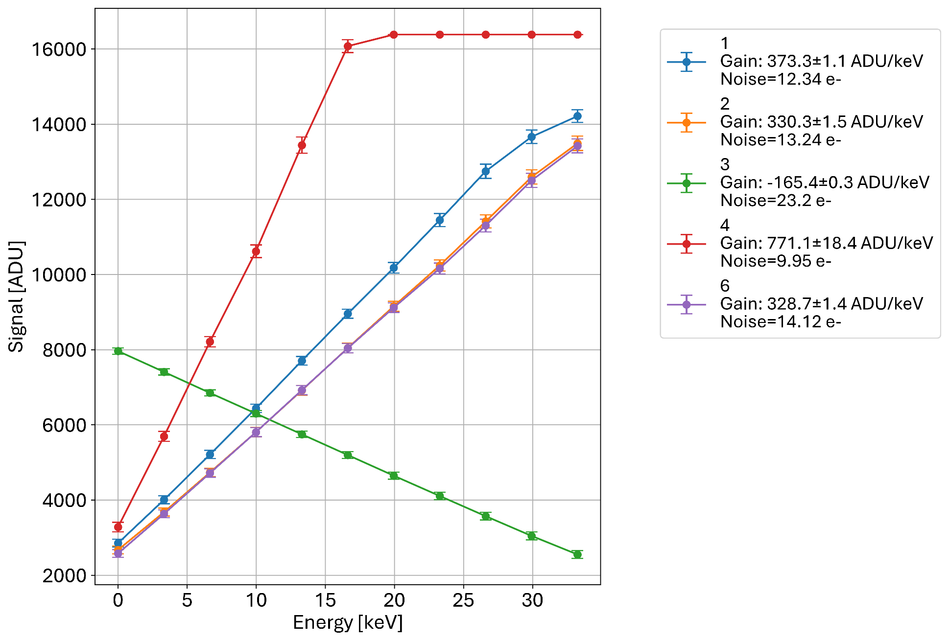
First performance estimations using pulsing (no sensor)
1
HG / LG
G1
Pulsing
2
HG
3
Passive
4
HG / LG
G2
5
HG
G1
No test structure
6
Pulsing + precharge Sto

Slide 32
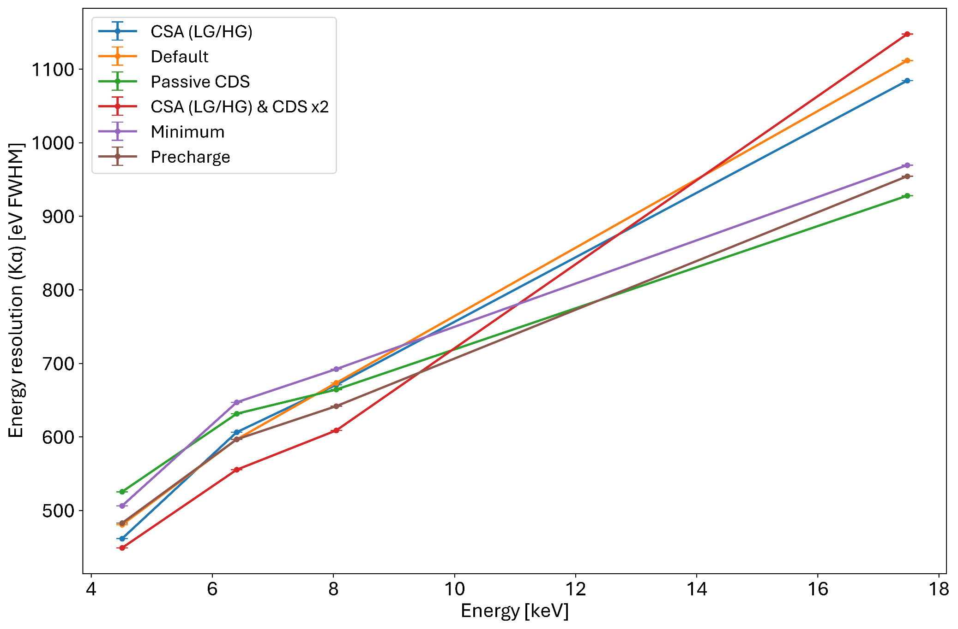
Energy scans: Energy resolution
2×2 clusters
10 µs exposure time
T_{coolant}: 18°C
Notes:
Exposure time and 2x2 clusters
Gain mismatches?
Only show passive CDS

