Slide 1


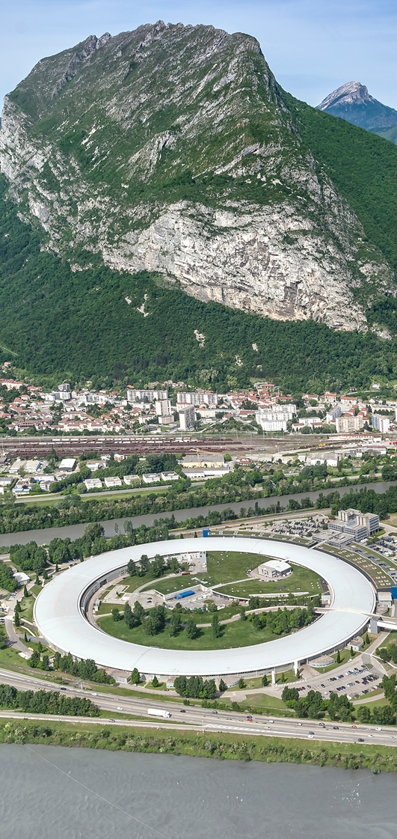
SHADOW4: Advanced Ray-Tracing for the Design and Simulation of X-Ray Optical Systems
Manuel Sánchez del Río
srio@esrf.eu
¹Advanced Analysis & Precision Unit, MEG/ISDD, ESRF
(Thanks to Juan Reyes-Herrera, Xianbo Shi and Luca Rebuffi)
Contents
Ray tracing
SHADOW history
OASYS ecosystem
Shadow4
  API
  Components (examples)
Doc/education

Slide 2
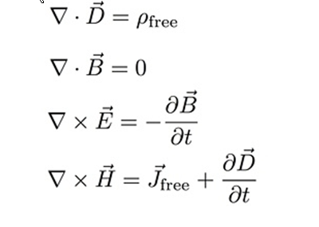
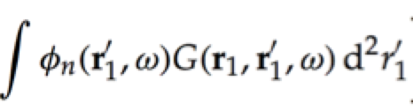
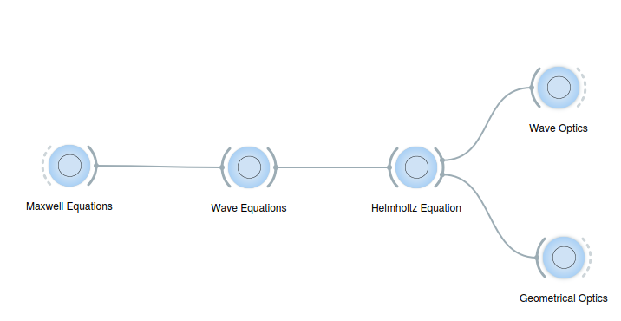

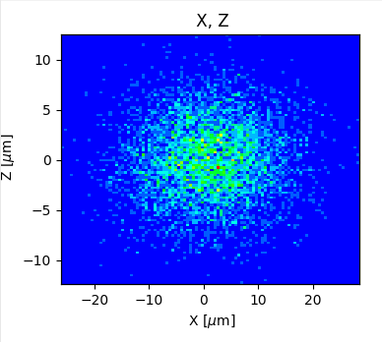

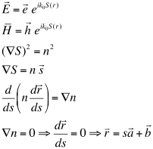



Ray Tracing and Geometrical Optics
Ray tracing in X-ray optics is a simulation method used to model how X-rays propagate and interact with optical components, like mirrors, lenses, and monochromators.
It relies on approximate solutions to Maxwell's equations that are valid as long as the light waves propagate through and around objects whose dimensions are much greater than the light's wavelength.
It's essential for designing and optimizing beamlines at synchrotrons as well as any X-ray optical system.
z
$${\vec{x}}_{0}=(x_{0},y_{0},0) \\ \vec{v}=(v_{x},v_{y}≈1,v_{z})$$
$${\vec{k}}_{o}={\vec{k}}_{i}−2\left({\vec{k}}_{i}⋅\vec{n}\right)\vec{n}$$
x
Energy, Intensity
y
z
z
p
q
x
$$\vec{x}={\vec{x}}_{0}+t\vec{v} \\ z=0$$
y
x

Slide 3



Ray Tracing and Geometrical Optics
Applications:
Determine beam characteristics: shape, size, divergence, and focal spot.
Determine spectral resolution.
Optimize optical alignment and component positioning.
Diagnose aberrations or misalignments.
Limitations:
Pure ray tracing doesn’t account for coherence, diffraction, or interference
DLSR: CohFract=100%
EBS-ESRF: coherence fraction at 10-100 keV: 1-10%
Software (synchrotron world):
SHADOW: https://github.com/oasys-kit/shadow4
XRT: https://github.com/kklmn/xrt
McXtrace: https://www.mcxtrace.org
RAY and RAY-UI Franz Schaefers et al. https://www.helmholtz-berlin.de/forschung/oe/np/optik-strahlrohre/arbeitsgebiete/ray_en.html

Slide 4
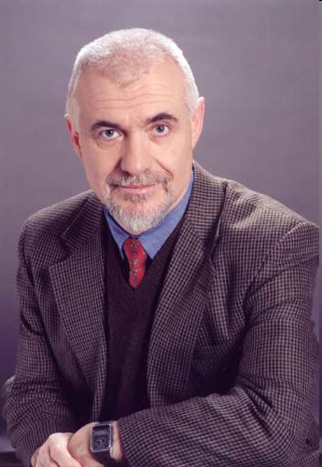
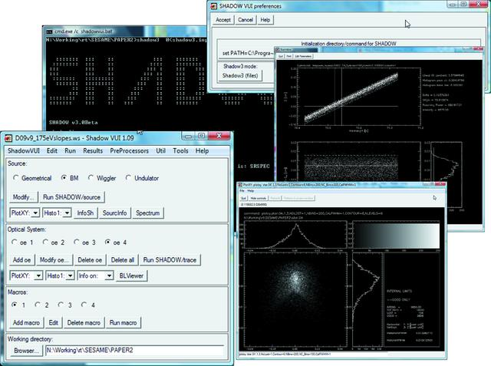
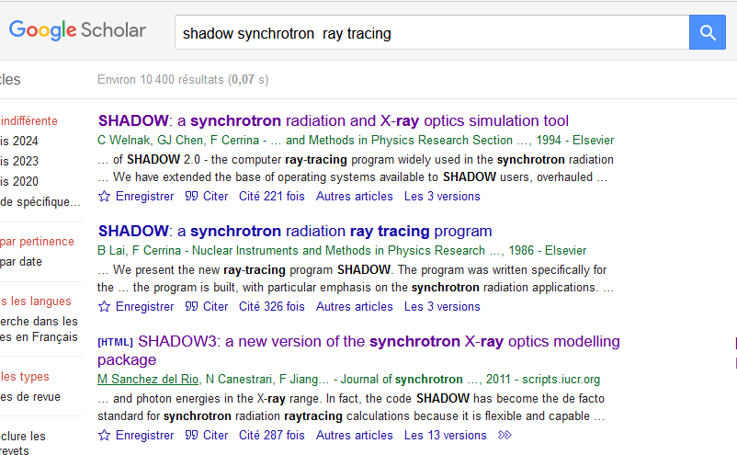
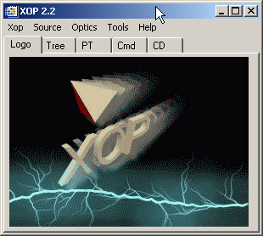
40 YEARS OF Shadow
SHADOW
SHADOW 1 & 2
SHADOW3
Generic ray tracing package for optics
Specialized in SR (storage ring sources, grazing optics, crystals…)
Helped to most 2-4th generations of SR facilities
Used/cited in a huge number of papers
M. Sanchez del Rio, et al.J. Synchr. Rad.18, (2011) http://dx.doi.org/10.1107/S0909049511026306
Kernel (Fortran9x)
Python API
Franco Cerrina (♰2010)
XOP/ShadowVUI
Teaching about the birth of synchrotron light:
the role of Frascati and a missed opportunity
G. Margaritondo
https://doi.org/10.1107/S160057752400300X
SHADOW1 1984-1990 VAX-VMS mainframes
SHADOW2 1990-2010 Unix workstations+Windows

Slide 5

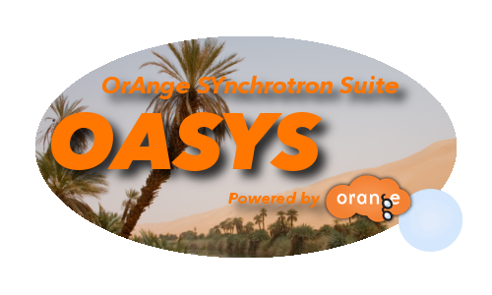
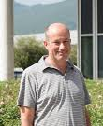
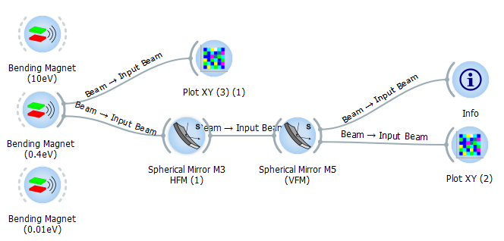
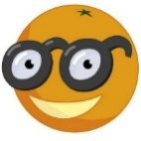


OASYS – ShadowOui (2014)
Manuel Sanchez Del Rio
Luca Rebuffi
XOPPY
SRW
WOFRY
ShadowOUI
Utilities
SYNED
ShadowOUI = Shadow3 in OASYS
Orange
https://orangedatamining.com/

Slide 6
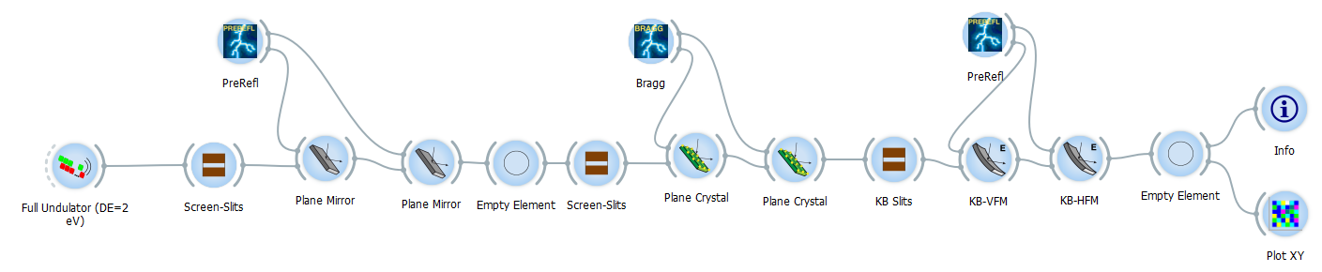
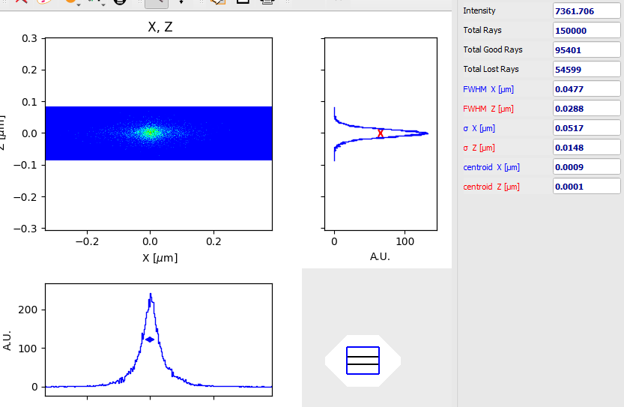
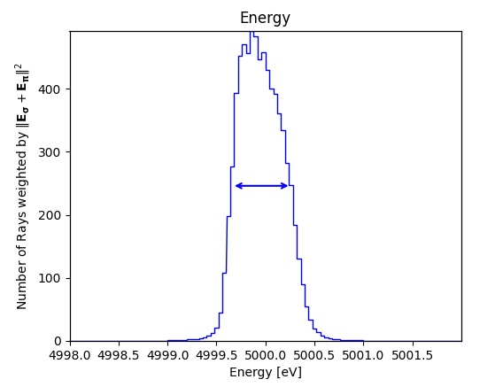
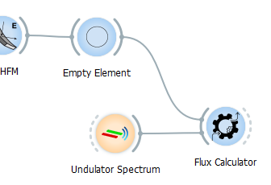
2014: ShadowOUI¹= SHADOW3 + ORANGE²
SIZE RESOLUTION FLUX
0.6 eV
---> Integrated Flux : 1.25321e+13 ph/s
[1] L Rebuffi and M Sanchez del Rio J Synchr. Rad. 23 1357-1367 (2016) https://doi.org/10.1107/S1600577516013837
[2] https://orangedatamining.com/

Slide 7

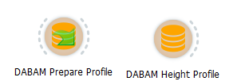


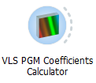
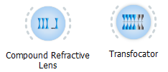
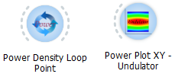

ShadowOUI: not only SHADOW3
Corrections for coherent optics (HYBRID¹)
Surface error databases DABAM², DABAM2D
Preprocessors (surfaces, reflectivity, VLS, diaboloids³)
Elements: CRL, TF, Benders, etc.
Loops & Heat load loops⁴
New crystal structures (high d-spacing⁵)
[1] Shi et al. 2014 https://doi.org/10.1107/S160057751400650X
[2] Sanchez del Rio et al. 2016 https://doi.org/10.1107/S1600577516005014
[3] Sanchez del Rio et al. 2021 https://doi.org/10.1107/S160057752100401X
[4] Rebuffi et al. 2020 https://doi.org/10.1107/S160057752000778X
[5] Yu et al. 2022 https://doi.org/10.1107/S160057752200707X

Slide 8
OASYS add-ons
OASYS Main
Tools
SYNED
XOPPY
XRayServer, …
SHADOWOUI
Ray tracing
INTEROPERABILITY
SHADOW4
1.3
SRW
Wave optics
https://oasys-kit.github.io
WOFRY
WISER
Facility Add-Ons, e.g. ESRF
Extensions
Notes:
Before starting, I would like to do the following statement, all calculations presented here were performed using OASYS tools

Slide 9
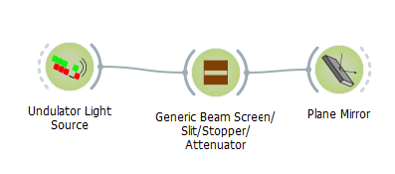
SHADOW4
SHADOW3 problems:
Fortran: compilation: obsolete technology, poorly structured code
Python API maintenance and extension
Python packaging (wheels)
Sustainability
SHADOW4 is a new Kernel, and a new interface, for new generations of sources
Fully developed in Python
OO programming
OASYS experience and ad-hoc developments
Fast enough
SHADOW is an interactive tool adapted for common laptops
Just called SHADOW4
Simplified interface (less widgets, generic mirrors, crystals, etc.)
Optimized (better communication)
Automatic scripting
Preparing 5th generation
Facilitate interoperability with other tools (e.g. for partial coherence)
Adapted for AI integration and Digital Twins
Easy transition from laptop prototyping to High-Performance Computing (HPC) and Cloud Computing
Open Source and Collaborative Development
Educational material for interactive learning

Slide 10
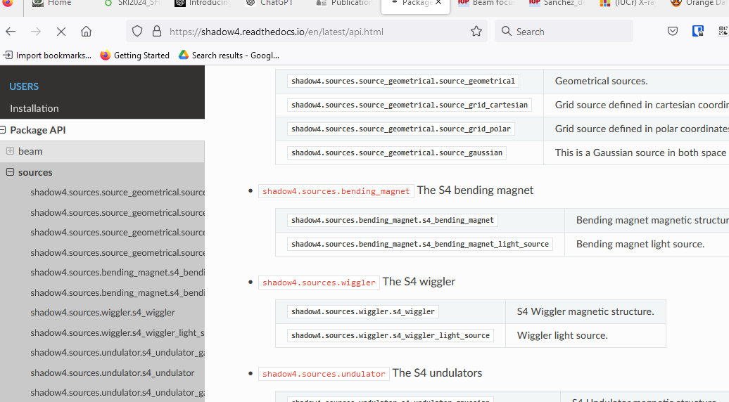
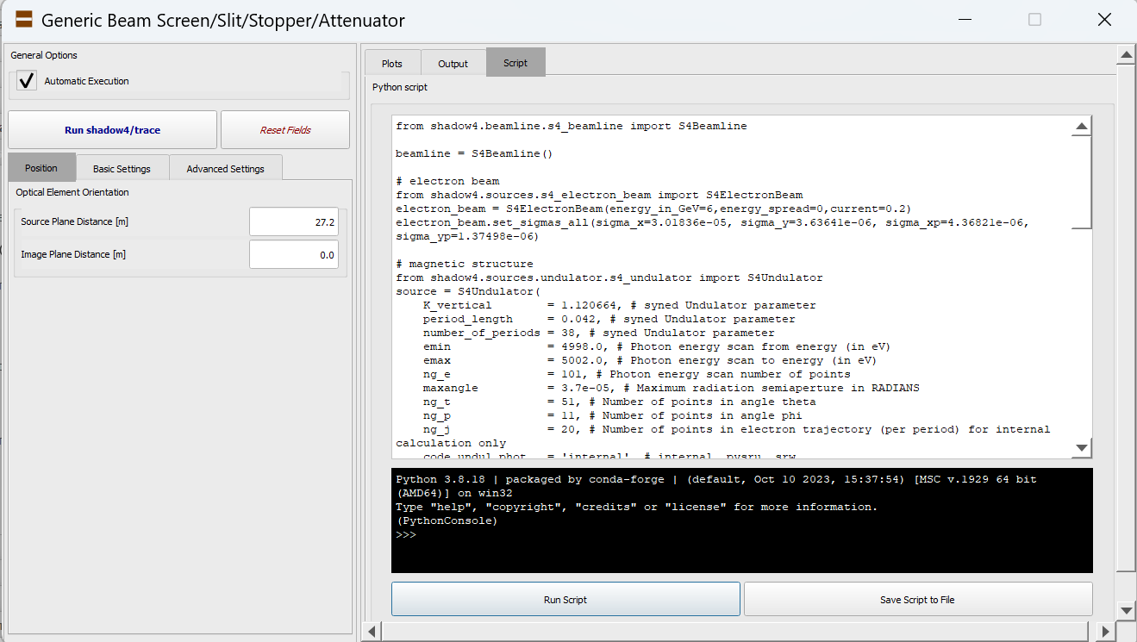
Shadow4 Kernel: Application User Interface
S4Beam: traditional beam data (nrays, 18)
API
S4Beamline
S4LightSource
S4BeamlineElement
…
S4ElectronBeam
S4MagneticStructure
S4OpticalElement
ElementCoordinates
Automated scripts with OASYS
Documentation: https://shadow4.readthedocs.io

Slide 11


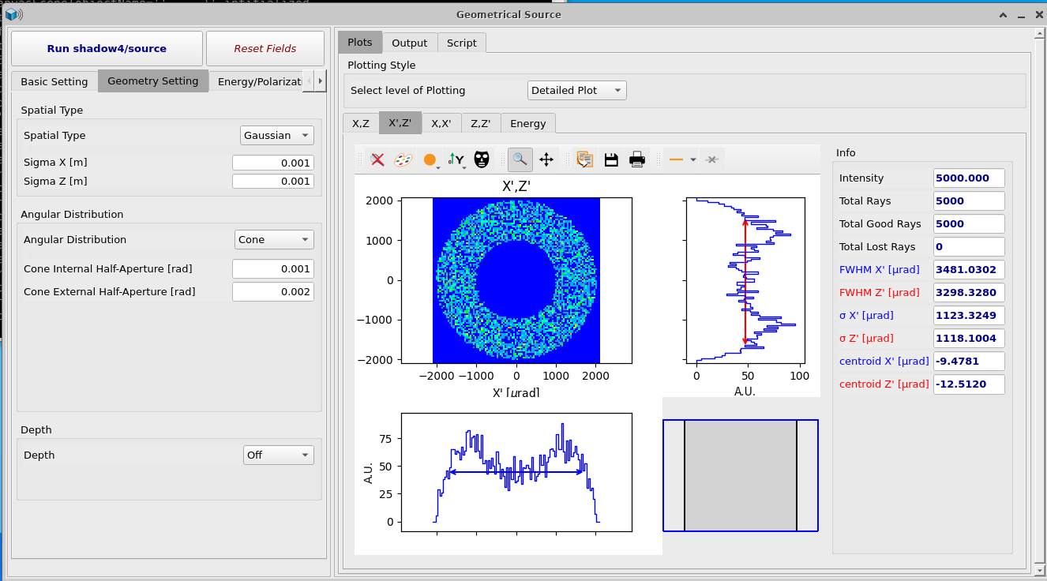
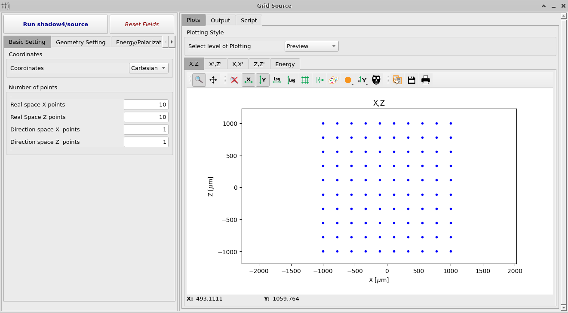
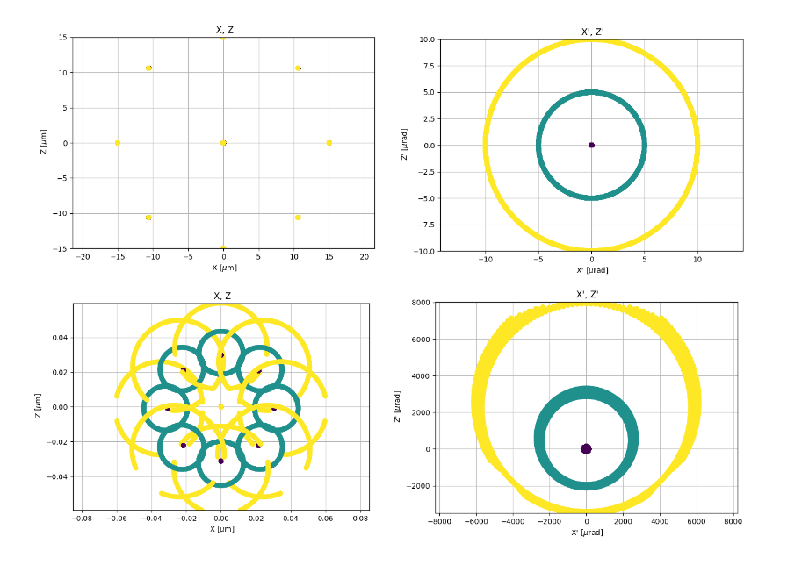
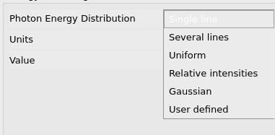
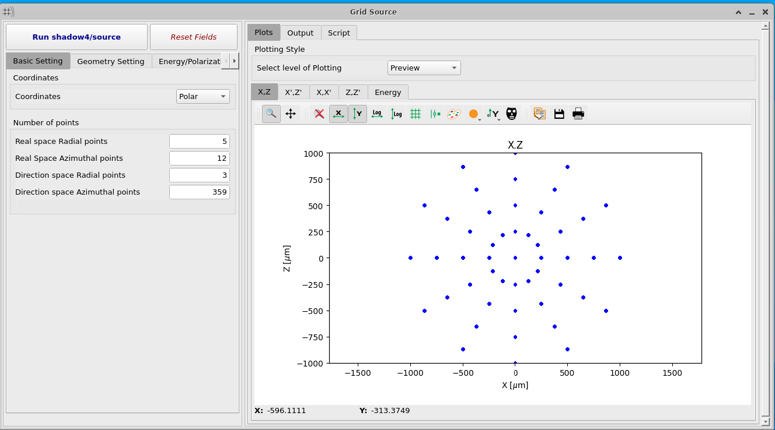
Shadow4: Geometrical Sources
Sources/Magnetic structures
  SourceGeometrical, SourceGridCartesian, SourceGridPolar)
In cartesian coordinates
Source: Real space Source Divergence
In polar coordinates
Focus with an ellipsoidal mirror
Real space Divergence

Slide 12
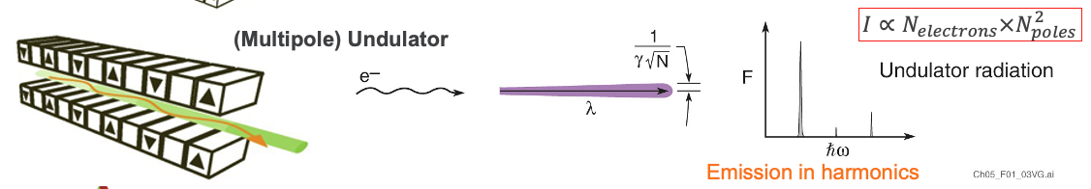
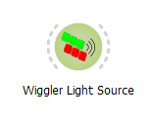


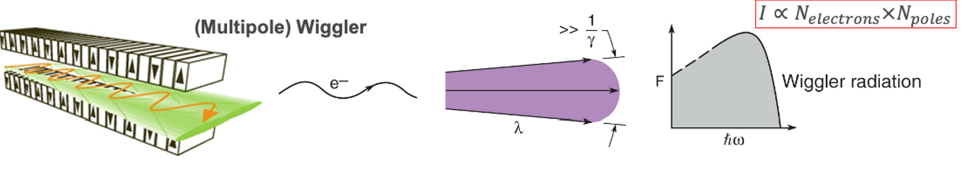
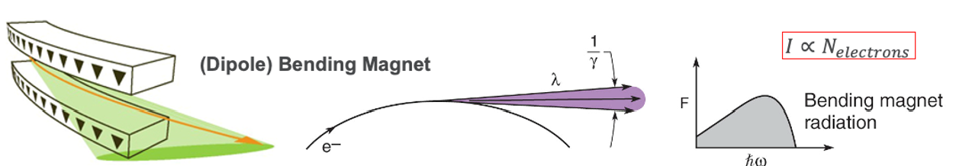
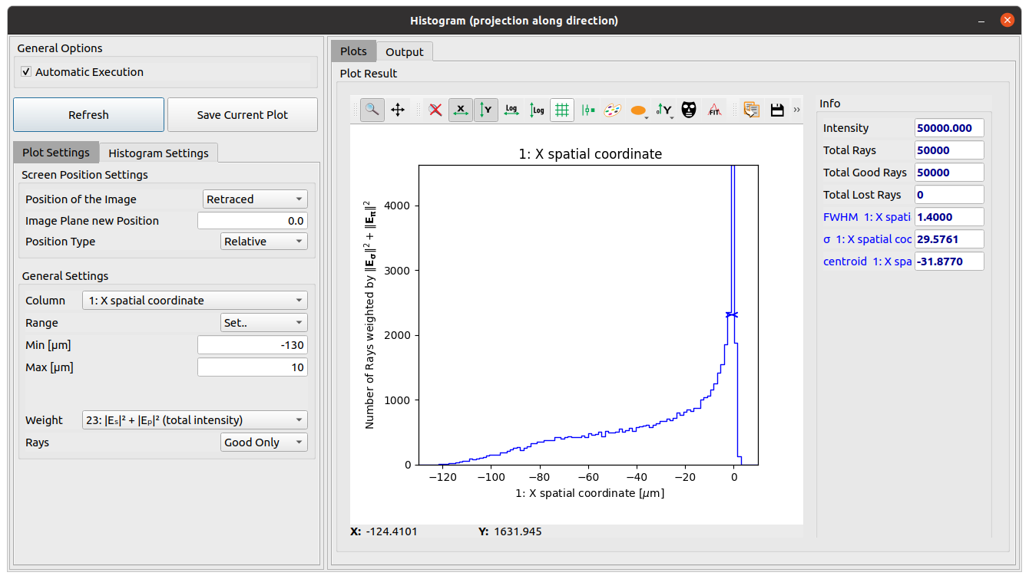
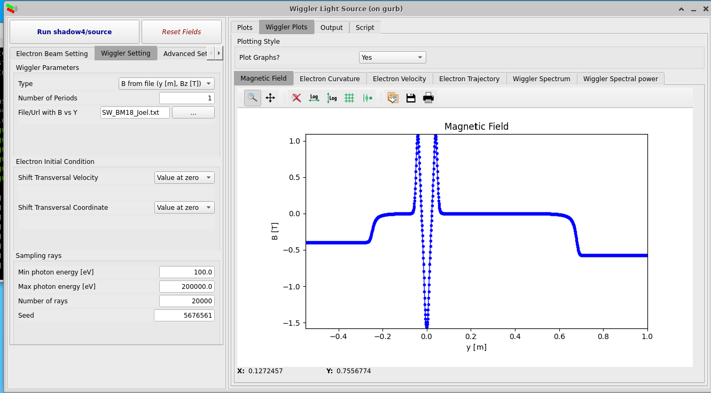
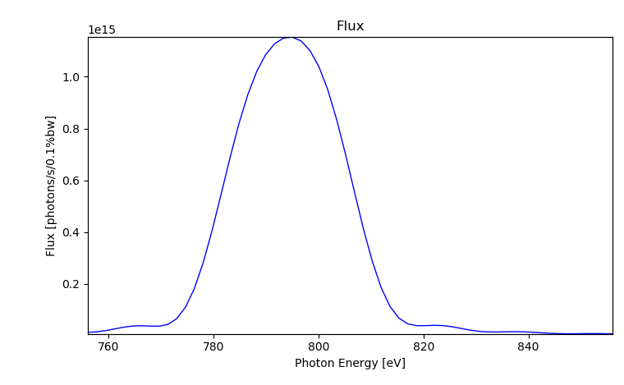
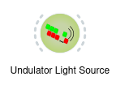
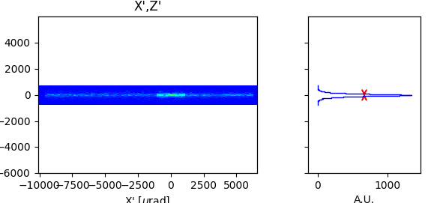
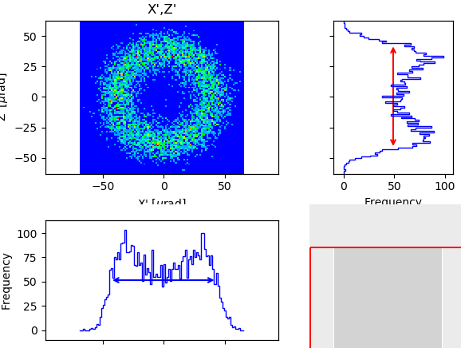
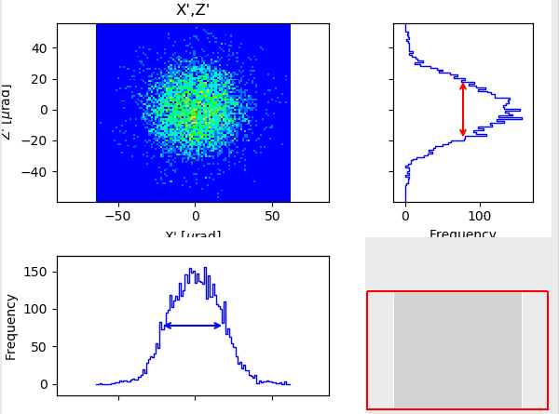
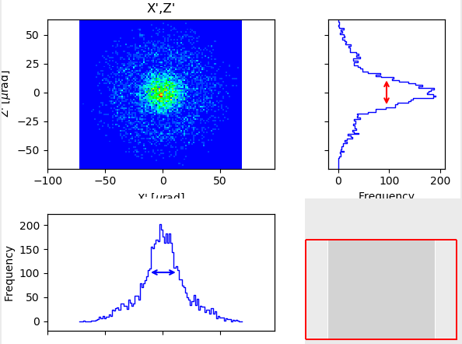
Shadow4: Synchrotron Sources
Sources/Magnetic structures
  S4BendingMagnet (upgraded methods¹)
  S4Wiggler (included short IDs)
  S4GaussianUndulator, S4Undulator (upgraded methods²)
Fake Geometrical Source
(Gaussian spatial + Gaussian divergency + e- energy spread)
789.938eV
806.060eV
814.121eV
1) https://doi.org/10.48550/arXiv.2406.16446
2) https://doi.org/10.1107/S1600577525000190

Slide 13
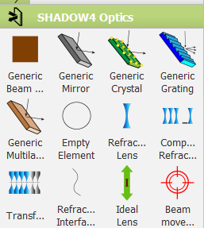
Shadow4: Optical Elements
Optical elements
  S4Screen (screens, slits, stops, absorbers)
  S4IdealLens, S4Empty,… (ideal elements)
  S4PlaneMirror, S4SphereMirror, S4EllipsoidalMirror, …, S4AdditionalNumericalMeshMirror
  S4PlaneGrating, … (including VLS)
  S4PlaneCrystal, … (undistorted perfect crystals in reflection)
  S4PlaneMultilayer, … (also graded, in depth or laterally)
  S4Interface, S4Lens, S4CRL, S4Transfocator (refractors)

Slide 14
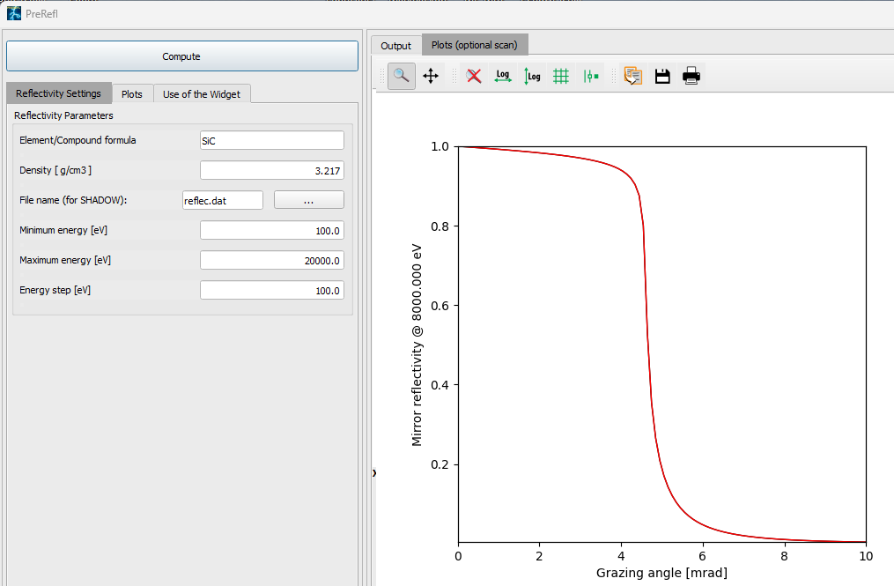

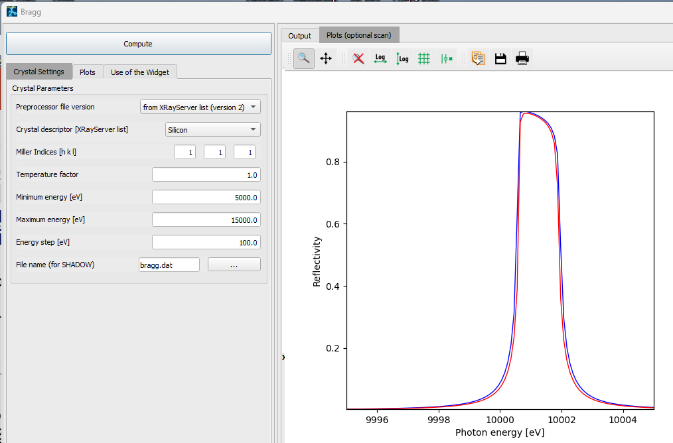
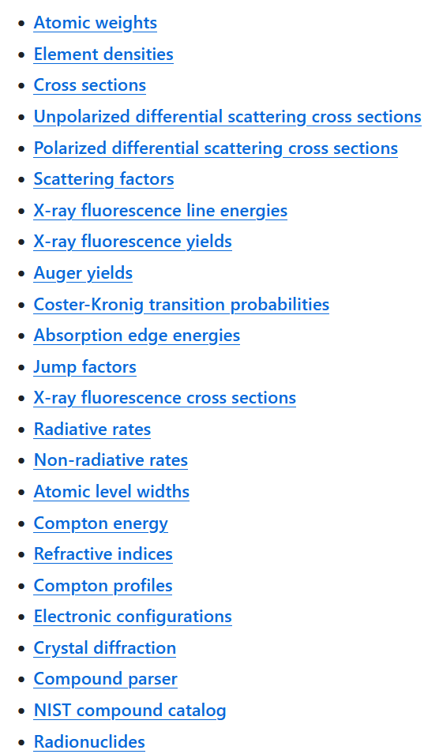
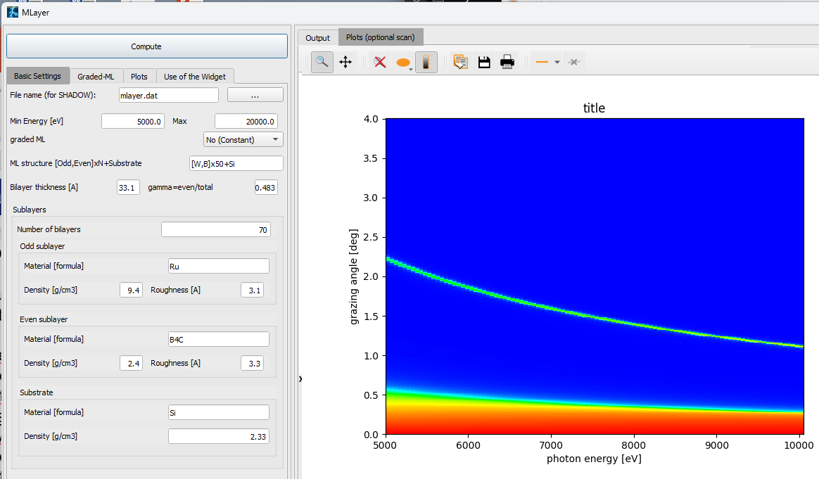
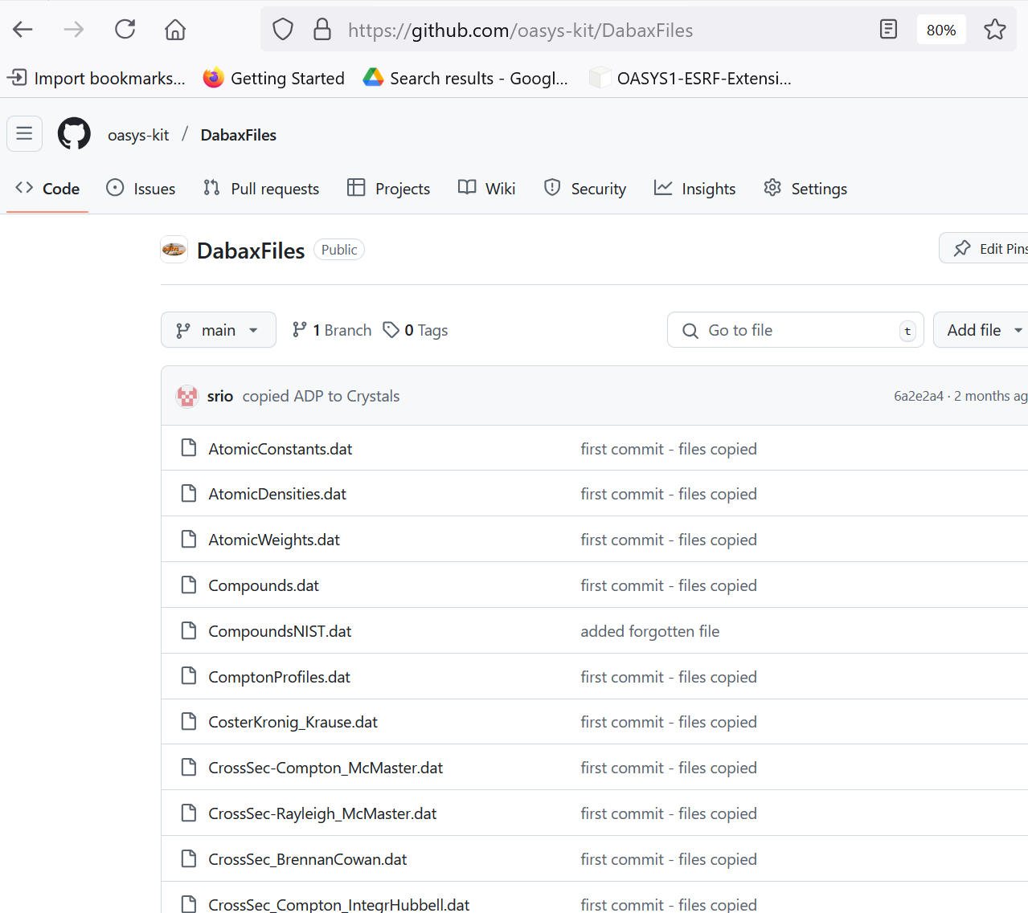
Shadow4 Kernel: models and algorithms
Geometrical model
  S4OpticalSurface (S4Conic¹, S4Toroid, S4Mesh)
  Include methods for reflection, refraction, scattering (gratings, crystals)
Physical model (reflectivities)
preprocessors
code
  PreRefl: Absorption/refraction for attenuators, mirrors, lenses
  crystalpy²: library for Crystals
  MLayer
Optical constants (scattering factors, refraction indices, crystal structures)
  preprocesor data file
  direct link
    xraylib³
    DABAX⁴
[1] https://arxiv.org/abs/2406.04079
[2] http://dx.doi.org/10.1107/S160057752400924X
[3] https://github.com/tschoonj/xraylib
[4] https://github.com/oasys-kit/dabax

Slide 15
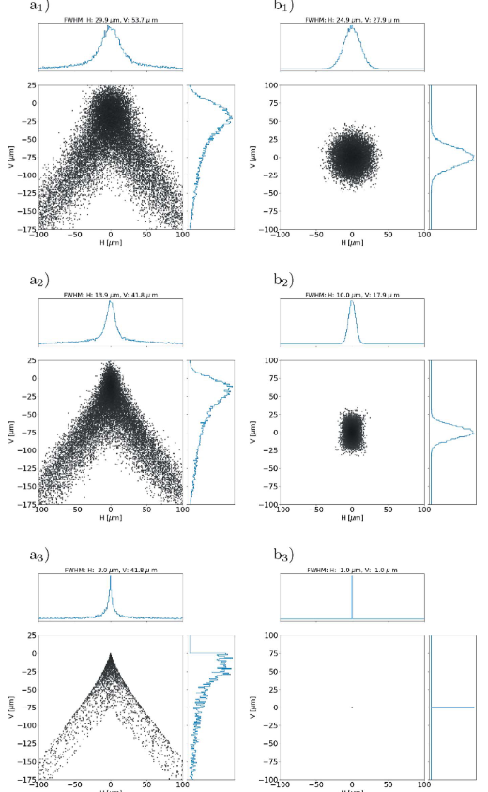
Mirror Optics
Aberrations/beam wavefront distortion:
Surface shape: looking for optimized shape (e.g. diaboloid)
Surface error:
  methods (geometrical, hybrid) and databases (DABAX)
  thermal load (optics evaluation, avoid and correction)
Misalignement tools / Tolerances
Toroid Diaboloid
ALS
ALS-U
Zero emittance
H
V
Point-to-point focusing (stigmatic):
Ellipsoid (exact)
Toroid (approx.)
Optimized toroid: p:q = 2:1
Diaboloid: 4th degree surface
Parabolic (meridional) section
Elliptical (sagittal) approx. section
Sanchez del Rio et al. 2021 https://doi.org/10.1107/S160057752100401X

Slide 16
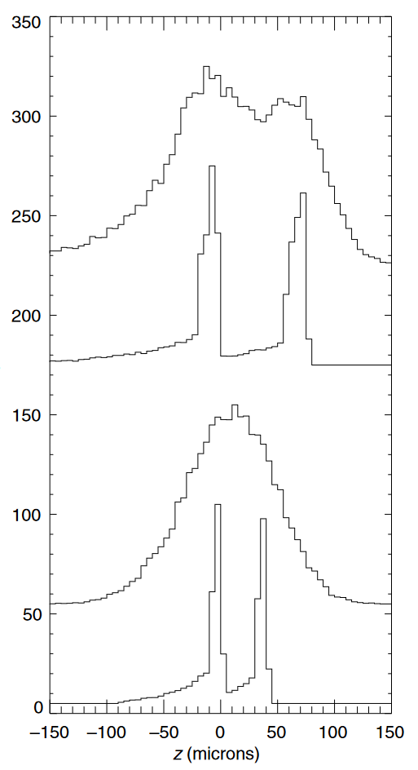


Grating Optics (in reflection)
Resolution:
Schemes (SX700, DRAGON, PGM, SGM, VLS, etc.)
Surface error: shape, thermal, slope errors
Aberration reduction (e.g. Czerny-Turner RAMAN spectrometer)
70 μm (FWHM) source (double monoch.)
Point source (double monoch.)
70 μm (FWHM) source (single monoch.)
Point source (single monoch.)
M5
M5
θ = 5◦ for all M
θ = 3.7◦ for M2 and M5
M4
M4
λ = 514.5 nm (green)
Sanchez del Rio et al (2006) http://doi.org/10.1088/0031-8949/73/5/014

Slide 17





Lens Optics
Individual trace of each surface:
Effects of lens distance and depth (adiabatic focusing)
Misalignement tools / Tolerances
Surface error:
  Wave/hybrid methods and databases (DABAX2D https://github.com/oasys-esrf-kit/dabam2d )

Slide 18


Crystal Optics
Dynamical theory for undistorted crystals (crystalpy)
Bragg:
  Flat symmetric (most Double Crystal Monochropmators)
  Asymmetric
    beam expansion (real or divergence)
    high resolution
    backscattering (rainbow)
  Distorted/bent crystal diffraction profile via external reflectivity (TO DO)
  Geometric effect of bending (Johann, Rowland, etc.)
  Johansson (TO DO)
  Types
    Si, Ge, C*
    High d-spacing: Quartz, sapphire, ADP, YB66
    (any structure)
Laue (TO DO) (Thin undeformed crystals in shadow3)
(TO DO) (symmetric Bragg in shadow3)
Perfect
Mosaic

Slide 19



Complementary with other OASYS methods
Analytical model (by hand)
Ray tracing (Shadow4)
Hybrid model (Shadow4)
Wave optics & partial coherence 1D (WOFRY)
2D partial coherence:
Monte Carlo (multi e⁻) (SRW)
Coherent Mode Decomposition (COMSYL)
COMPLEXITY
[1] M. Sanchez del Rio et al. 2019 https://doi.org/10.1107/S160057751901213X

Slide 20


User Support / Teaching / OASYS schools
I Grenoble (ESRF) 2019
II Lemont IL (ANL) 2019
III Berkeley (LBNL) 2023
https://github.com/oasys-kit/bloms2023
IV Hamburg (DESY) 2025
https://github.com/oasys-kit/oasys_school_desy
…

Slide 21

Summary / Conclusions
SHADOW version 4 is a python-based new version, completely rebuilt, of the traditional ray tracing code by Franco Cerrina
It is fully integrated in the OASYS ecosystem
Sustainable software (maintainable, reusable, open source, documented, with tests, funding support, reproducible, adaptable)
We encourage users and developers to try it, use it, and play with it.
We are open for collaborations and further developments

Slide 22
Extra Slides

Slide 23

Shadow4: advanced tools – Hybrid¹ method
Corrects ray tracing considering scattering and diffraction when the beam has a high coherence
Includes scattering by o.e.’s boundaries (slits, mirrors, gratings, lenses)
Manages the surface error (delegated from o.e.)
Fully rewritten code²
Scriptable
[1] Shi et al. 2014 https://doi.org/10.1107/S160057751400650X
[2] https://github.com/oasys-kit/shadow4-advanced

Slide 24

Shadow4: beta testers are welcomed!
Shadow3
beam converter
matching results
Shadow4
Send issues in https://github.com/oasys-kit/shadow4/issues

