Slide 1
High Performance Computing - HPC
Daniele Cesini – INFN-CNAF
Enrico Mazzoni – INFN-Pisa

Slide 2
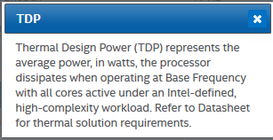
Glossary: GFLOPS and TDP
GFLOPS: Billions of Floating Point Operations per second
Max GFLOPS of a system can be calculated using:
G
(Clock in GHz)
TDP: Thermal Design Power is the maximum amount of heat generated by the CPU that the cooling system in a computer is required to dissipate in typical operation (*)
FROM ARK.INTEL
(*) From wikipedia

Slide 3
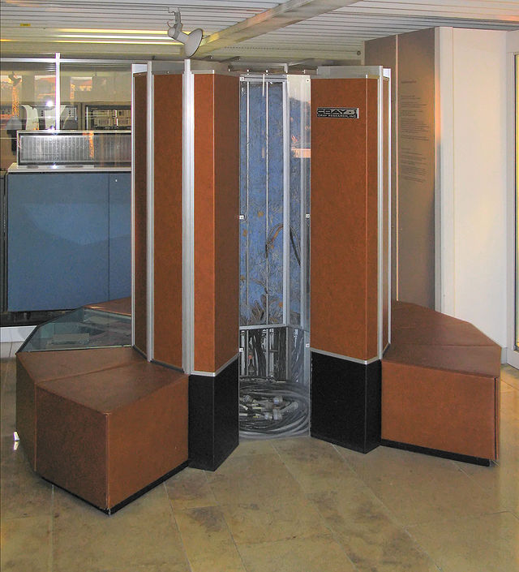
Once upon a time....
The vector machines
Serial number 001 Cray-1™
Los Alamos National Laboratory in 1976
$8.8 million
80 MFLOPS scalar, 160/250 MFLOPS vector
1 Mword (64 bit) main memory
8 vector registers
64 elements 64bit each
Freon refrigerated
5.5 tons including the Freon refrigeration
115 kW of power
330 kW with refrigeration
Serial number 003 was installed at the National Center for Atmospheric Research (NCAR) in 1977 and decommissioned in 1989
(*) Source: Wikipedia

Slide 4
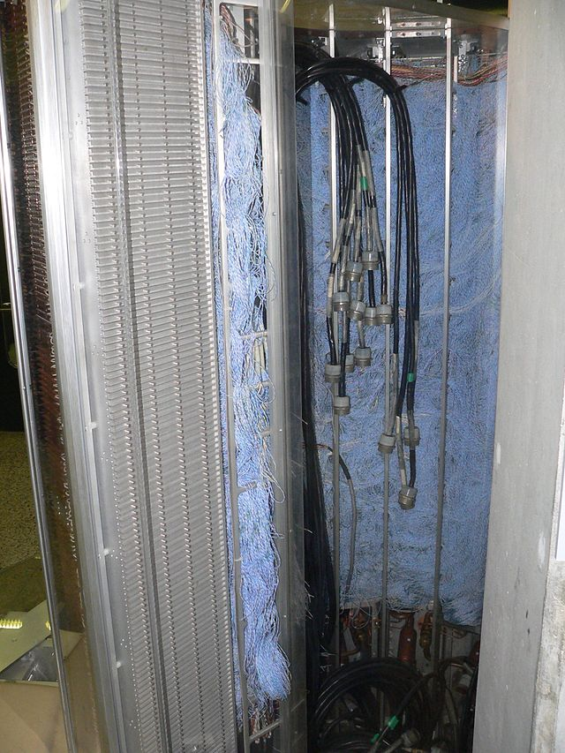
Wireless technology inside

Slide 5
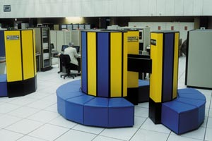
CRAY-XMP...Vector MultiProcessor
1982 CRAY-XMP 2 processors
9.5 ns clock cycle (105 MHz)
2x200MFLOPS
2Mwords (64 bit) = 16MB
1984 CRAY-XMP four processors
800 MFLOPS
8Mwords
64 MB main memory
about US$15 million
plus the cost of disks!!!
CRAY-XMP48 @ CERN in 1984
(*) source: http://cerncourier.com/cws/article/cern/29150

Slide 6
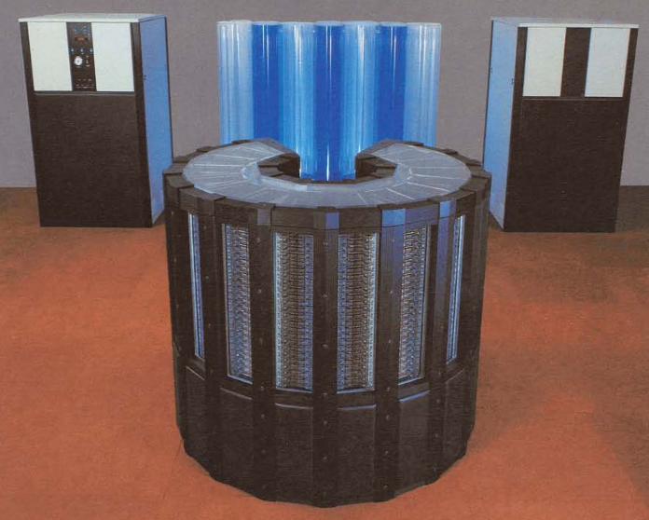
The Cray-2
The Cray-2 released in 1985
4 processors
250MHz (4.1 ns)
256 Mword (64bit) Main Memory
2 GByte
1.9 GFLOPS
150 - 200 kW
Fluorinet cooling
16 sq ft floor space
5500 pounds
About $17 million
(*) http://archive.computerhistory.org/resources/text/Cray/Cray.Cray2.1985.102646185.pdf

Slide 7
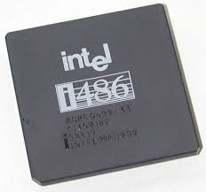
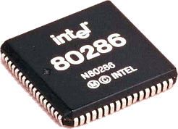
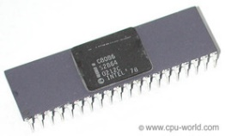
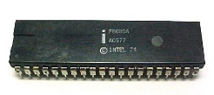
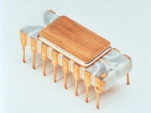
Microprocessors
The Intel 80486
1989
The Intel 80286
1982
The Intel 8086
1978
The Intel 8080
1974
The Intel 4004
1971
In the 80s started the replacement of vector supercomputers with Massively Parallel Processors (MPP) and Clusters assembled from a larger number of lower performing microprocessors

Slide 8
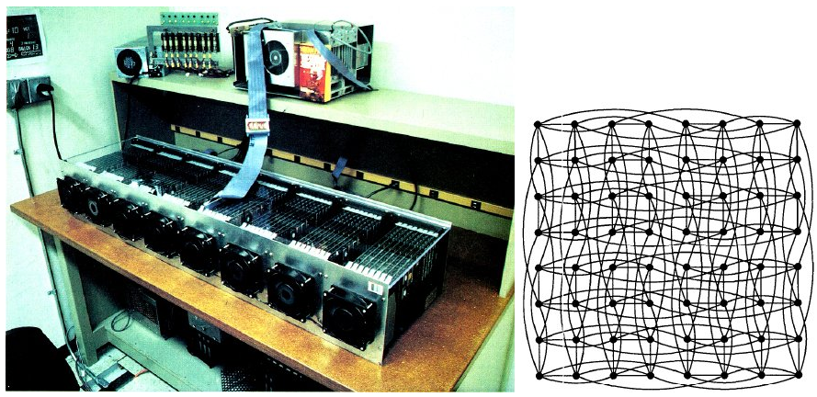
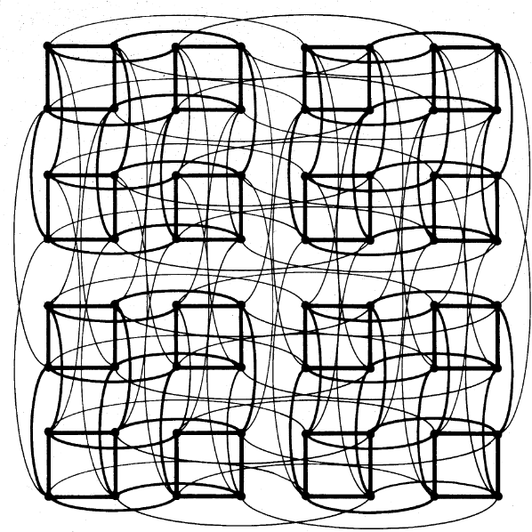
The attack of the Killer Micros
Taken from the title of Eugene Brooks' talk "Attack of the Killer Micros"
at Supercomputing 1990
Caltech Cosmic Cube
By Charles Seitz and Geoffrey Fox in1981
64 Intel 8086/8087 processors
128 kB per processor
6 dimensions hypercube
(*)http://calteches.library.caltech.edu/3419/1/Cubism.pdf

Slide 9
Massively Parallel Processor (MPP)
A single computer with many networked processors
Specialized interconnect networks
Low latency interconnection
Up to thousands of processors
Some examples
Connection Machines (CM-1/2/200/5)
Intel Paragon
ASCI series
IBM SP
IBM BlueGene

Slide 10
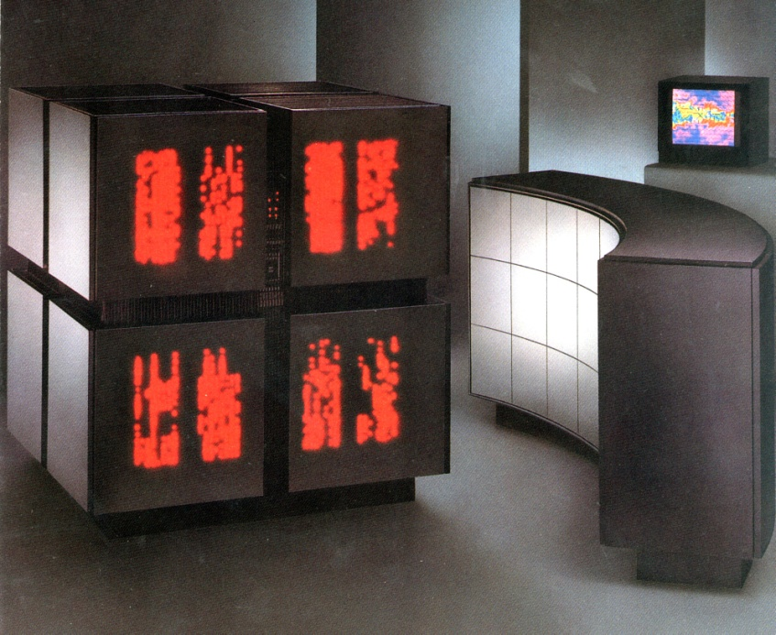
Thinking Machines
1985: Thinking Machines introduces the connection Machine CM-1
Connection Machine CM-200
maximum configuration of 65536 1-bit CPUs(!)
floating-point unit for every 32 1-bit CPUs
A cube composed of 8 cubes
each cube contains up to 8096 processors
(The curved structure is a Data Vault - a disk array)
40 GFLOPS peak
1991: CM-5
Featured in “Jurassic Park”
(*) Sources:
http://www.corestore.org/cm200.htm
http://www.new-npac.org/projects/cdroms/cewes-1999-06-vol1/nhse/hpccsurvey/orgs/tmc/tmc.html
http://en.wikipedia.org/wiki/Thinking_Machines_Corporation

Slide 11
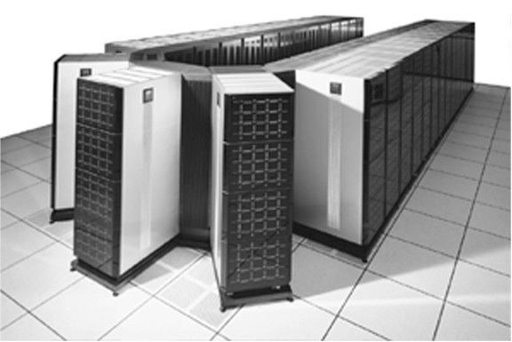
Intel Paragon MPP
Launched in 1993
Up to 2048 (later 4000) Intel i860 RISC microprocessors
Connected in a 2D grid
Processors @ 50 MHz
World most powerful supercomputer in 1994
Paragon XP/S140
3680 processors
184 GFLOPS peak
(*) Source: Wikipedia

Slide 12
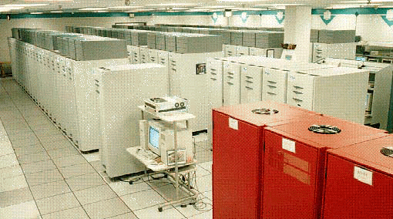
ASCI Red MPP
1996 At Sandia Laboratories
Based on the Paragon architecture
Fastest supercomputer from 1997 to 2000
1.4 TFLOPS (peak) in 1997
9152 cores
3,2 TFLOPS (peak ) in 1999
9632 cores
1st supercomputer above
1 TFLOPS
TERA SCALE
(*) Source: Wikipedia

Slide 13
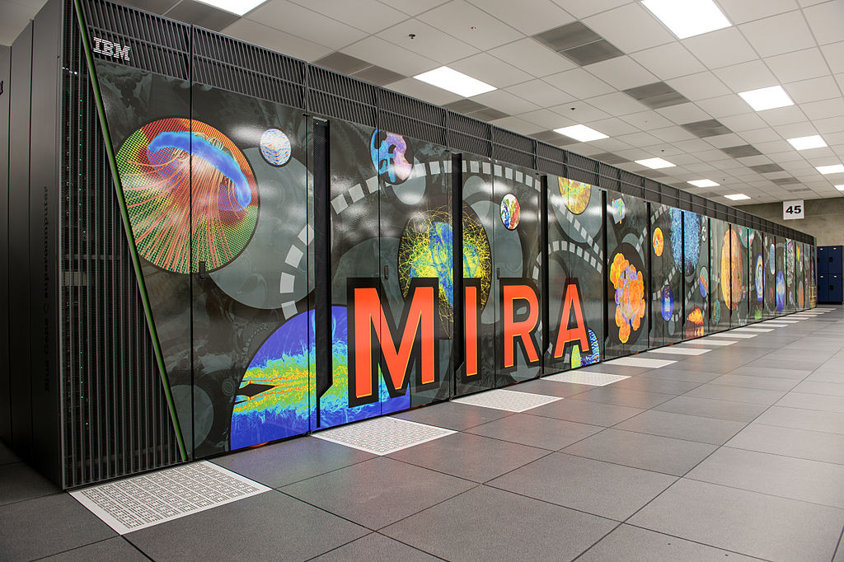
IBM BlueGene/Q MPP
Trading the speed of processors for lower power consumption
System-on-a-chip design. All node components were embedded on one chip
A large number of nodes
5D xTorus interconnect
Compute chip is an 18 core chip
The 64-bit PowerPC A2
4-way simultaneously multithreaded per core
1.6 GHz
a 17th core for operating system functions
chip manufactured on IBM's copper SOI process at 45 nm.
204.8 GFLOPS and 55 watts per processor
Up to 20 PFLOPS (peak)
16384 cores
PETA SCALE
(*) Source: Wikipedia

Slide 14
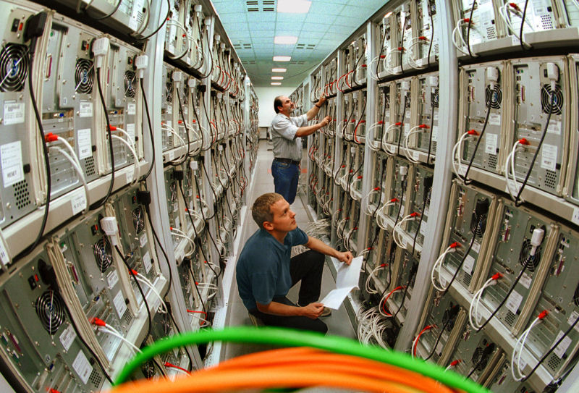
Clusters
[a cluster is a] parallel computer system comprising an integrated collection of independent nodes, each of which is a system in its own right, capable of independent operation and derived from products developed and marketed for other stand-alone purposes
Dongarra et al. : “High-performance computing: clusters, constellations, MPPs, and future directions”, Computing in Science & Engineering (Volume:7 , Issue: 2 )
(*) Picture from: http://en.wikipedia.org/wiki/Computer_cluster

Slide 15
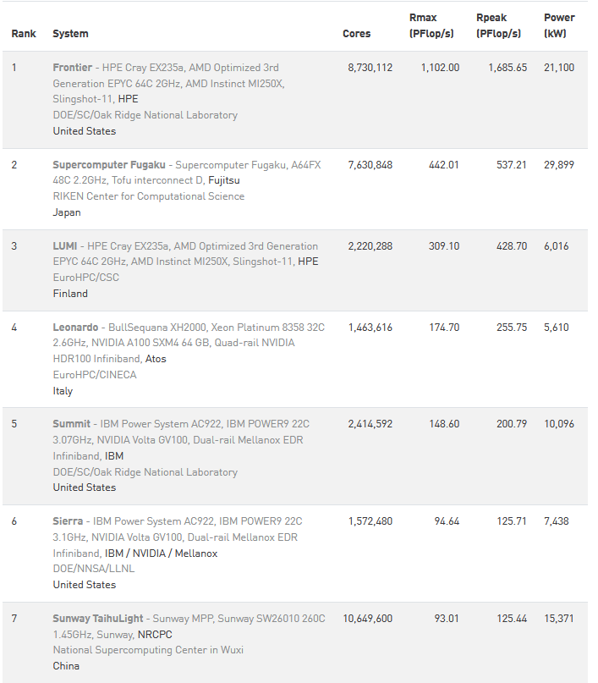
Top500.org
Nov 2022 List

Slide 16
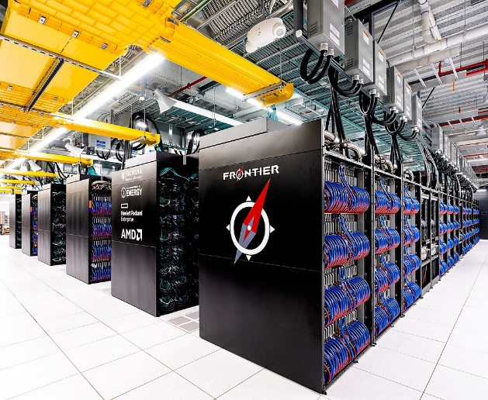
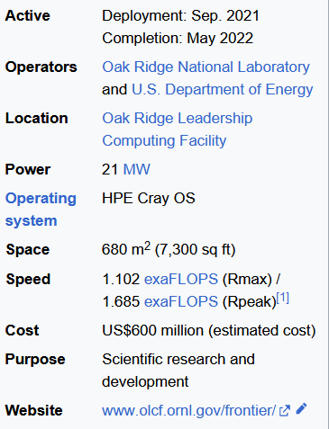
Frontier
© Wikipedia
Frontier, or OLCF-5, is the world's first and fastest exascale supercomputer, hosted at the Oak Ridge Leadership Computing Facility (OLCF) in Tennessee, United States
It is based on the Cray EX and is the successor to Summit (OLCF-4).
As of March 2023, Frontier is the world's fastest supercomputer.
Frontier achieved an Rmax of 1.102 exaFLOPS
Frontier uses 9,472 AMD Epyc 7453s "Trento" 64 core 2 GHz CPUs (606,208 cores) and 37,888 Radeon Instinct MI250X GPUs (8,335,360 cores).

Slide 17
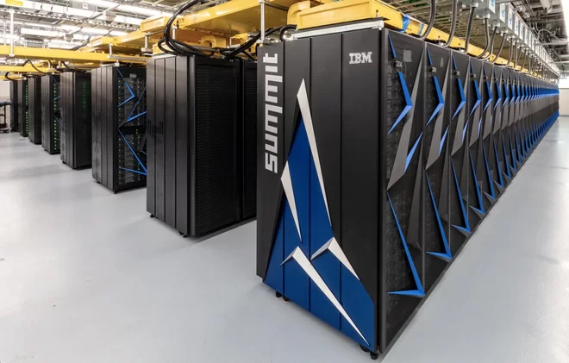
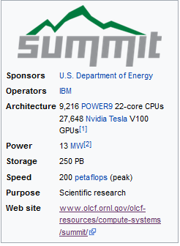
Summit OLCF-4 supercomputer
600 GB of coherent memory addressable by all CPUs and GPUs
800 GB of non-volatile RAM that can be used as a burst buffer or as extended memory.
Non-blocking fat-tree topology using a dual-rail Mellanox EDR InfiniBand interconnect for both storage and inter-process communications traffic
United States Department of Energy awarded a $325 million contract in November, 2014 to IBM, Nvidia and Mellanox for the construction of Summit and Sierra
Summit is tasked with civilian scientific research and is located at the Oak Ridge National Laboratory in Tennessee.
Sierra is designed for nuclear weapons simulations and is located at the Lawrence Livermore National Laboratory in California.
Summit is estimated to cover the space of two basketball courts and require 136 miles of cabling
© Wikipedia

Slide 18
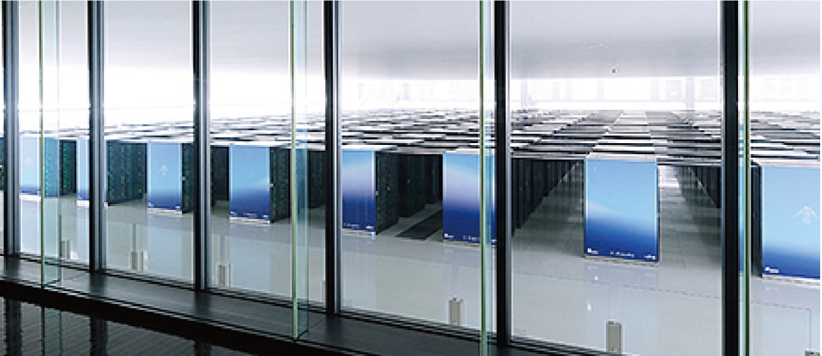
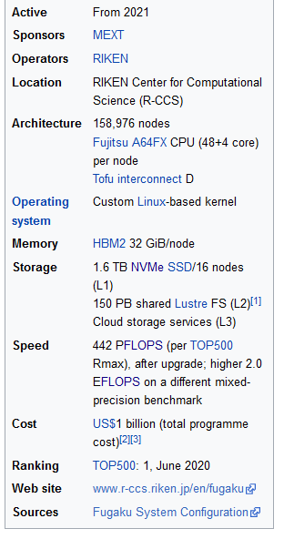
Fugaku Supercomputer
The supercomputer is built with the Fujitsu A64FX microprocessor.
Based on the ARM version 8.2A processor architecture
Fugaku was aimed to be about 100 times more powerful than the K computer
i.e. a performance target of 1 exaFLOPS
The initial (June 2020) configuration of Fugaku used 158,976 A64FX CPUs joined together using Fujitsu's proprietary torus fusion interconnect.
An upgrade in November 2020 increased the number of processors
To reach 442 petaFLOPS
1 Billion $ total cost

Slide 19
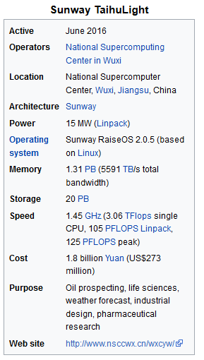
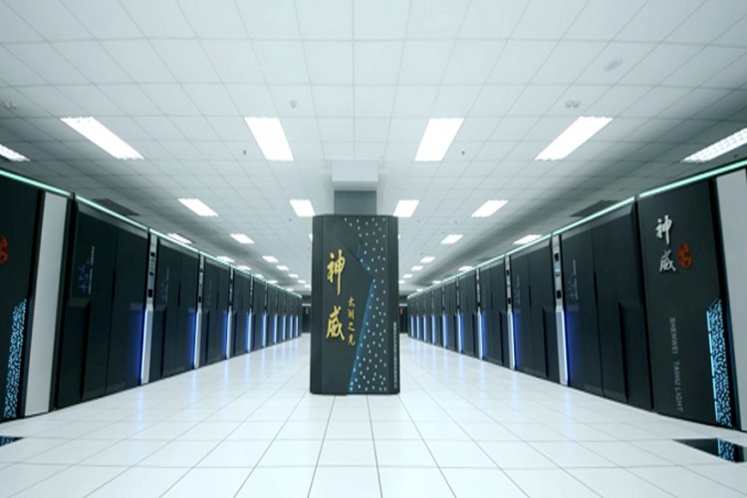
Sunway TaihuLight

Slide 20
Sunway TaihuLight
Architecture
The Sunway TaihuLight uses a total of 40,960 Chinese-designed SW26010 manycore 64-bit RISC processors based on the Sunway architecture.
Each processor chip contains 256 processing cores, and an additional four auxiliary cores for system management (also RISC cores, just more fully featured) for a total of 10,649,600 CPU cores across the entire system.
The processing cores feature 64 KB of scratchpad memory for data (and 16 KB for instructions) and communicate via a network on a chip, instead of having a traditional cache hierarchy.
http://www.netlib.org/utk/people/JackDongarra/PAPERS/sunway-report-2016.pdf

Slide 21
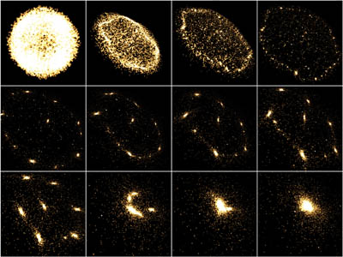
Applications

Slide 22
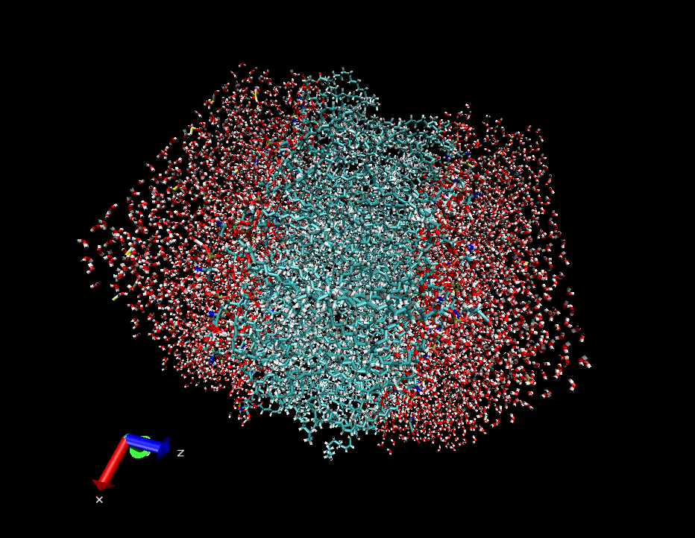
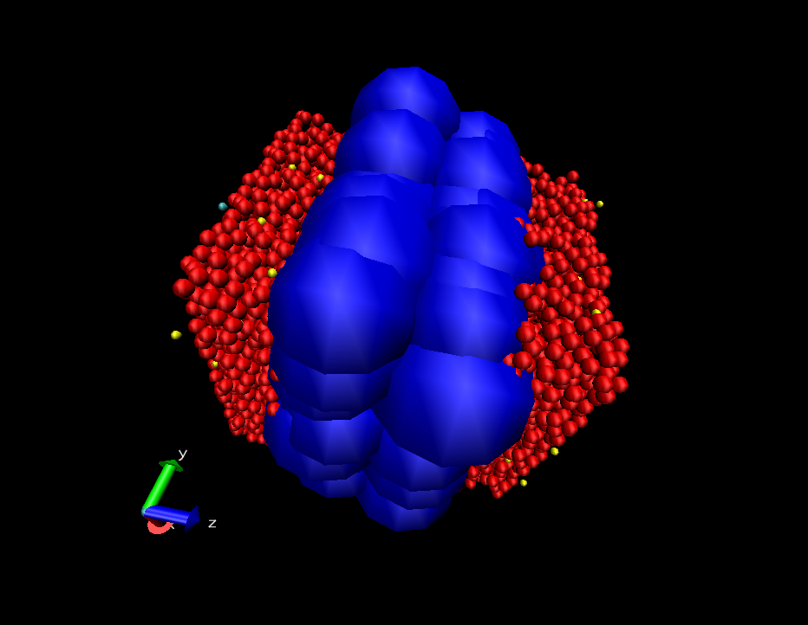
HPC - Applications
Molecular Dynamics
NAMD, Quantum Espresso, Gromacs, Gaussian, etc..

Slide 23
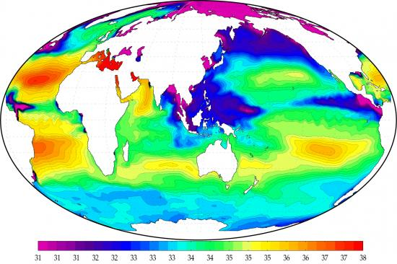
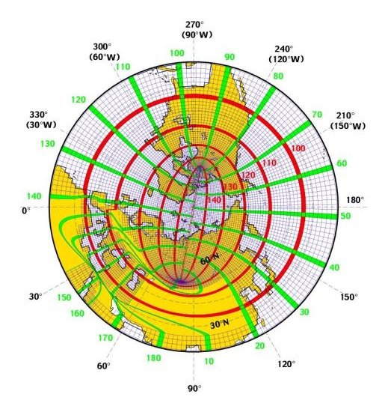
HPC - Applications
Earth simulation
WRF, MM5, GLOBO, NEMO, etc..

Slide 24
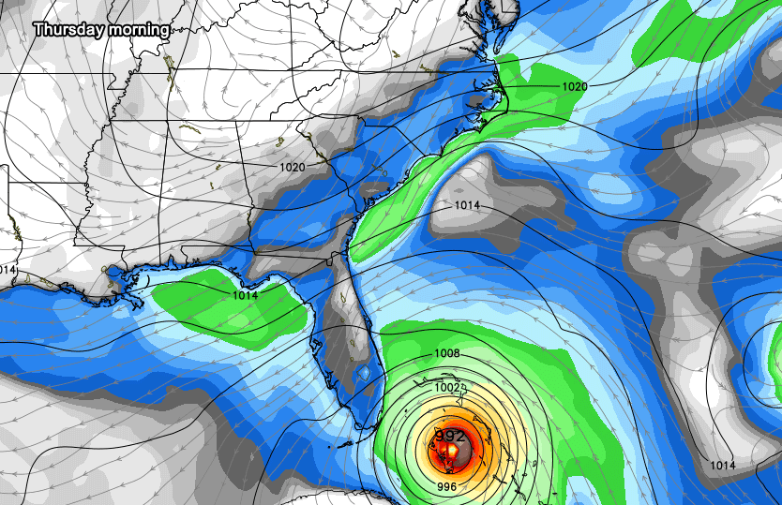
HPC- Applications

Slide 25
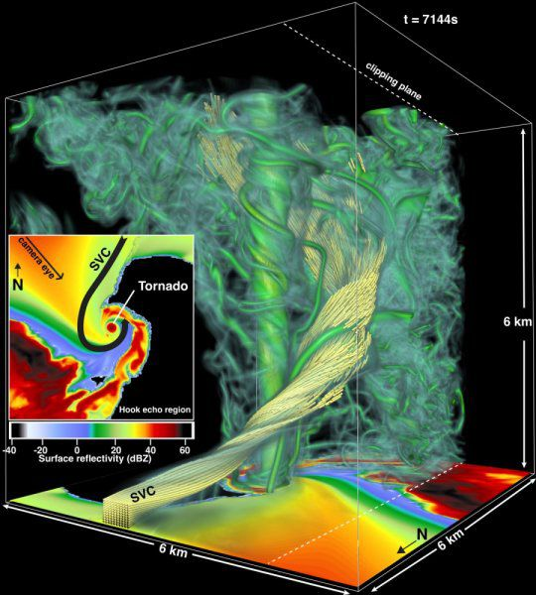
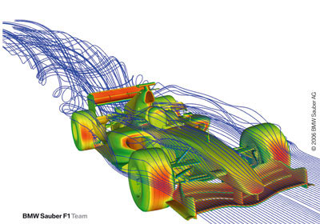
HPC - Applications
Fluid Dynamics

Slide 26
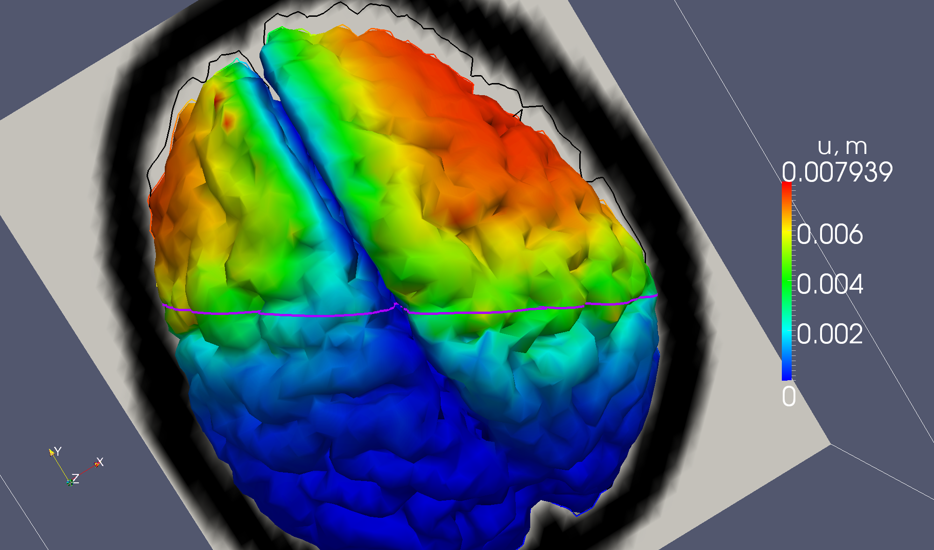
HPC - Applications
Brain Simulation

Slide 27
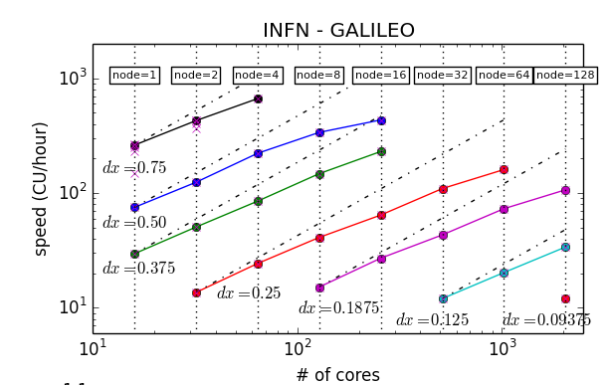
HPC - Applications
General relativity
The scientific case: high resolution simulation of inspiral and merger phase of binary neutron stars system
one of source of the gravitational waves that are the observational target of the LIGO/VIRGO experiment
Computation performed using The Einstein ToolKit
Result obtained on Galileo at CINECA
© Roberto De Pietri , Roberto Alfieri - INFN Parma and Parma University, 2012

Slide 28
HPC – key components

Slide 29
Componenti chiave
Interconnessione dei nodi
Condivisione dei dati
Gestione dei job e contesa delle risorse

Slide 30
Interconnessione dei nodi
In tutti i campi di applicazione dell’HPC il calcolo in un punto del dominio dipende dai risultati nei punti prossimi vicini
Questo comporta la necessità di scambio continuo di dati fra i nodi coinvolti nel calcolo
Quindi la rete deve garantire grande banda passante e bassa latenza, oggi giorno si hanno due possibilità InfiniBand o OmniPath

Slide 31
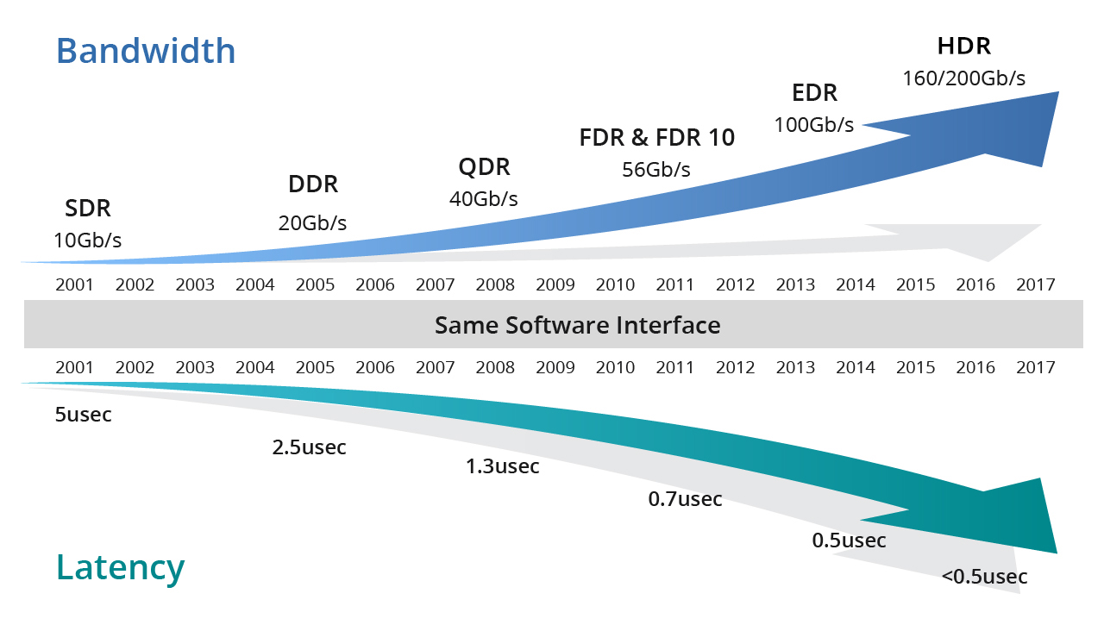
InfiniBand
(*) Source: FS
Nasce nel 1999 dalla fusione di due progetti Future I/O e NextGeneration I/O
Nello stesso anno nasce Mellanox
Oggi arriviamo fino a 800Gb/s (XDR)
La vera forza è l’offload: RDMA, GPUDirect RDMA, SHARP

Slide 32
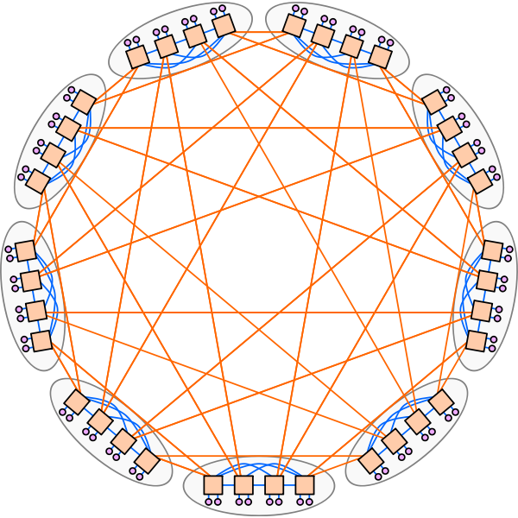
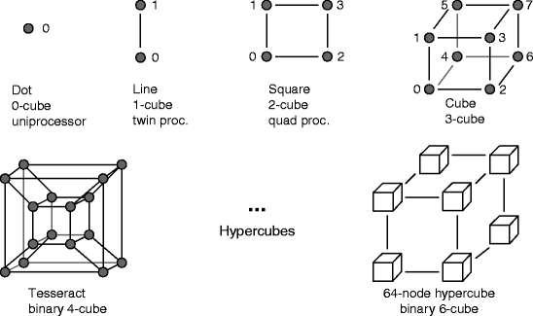
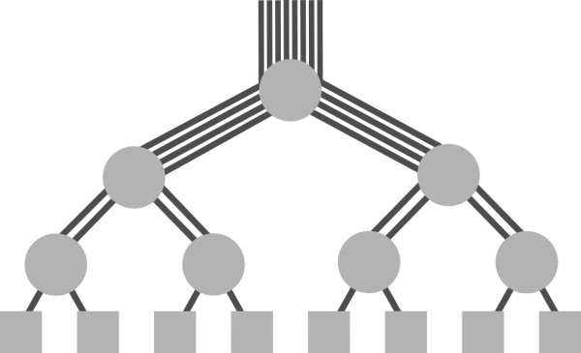
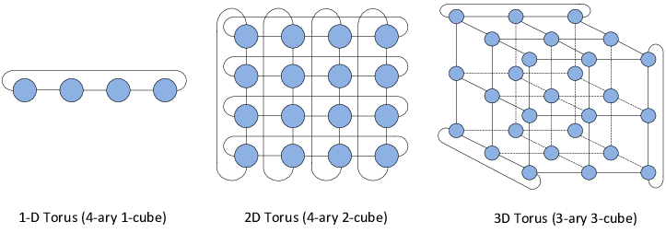
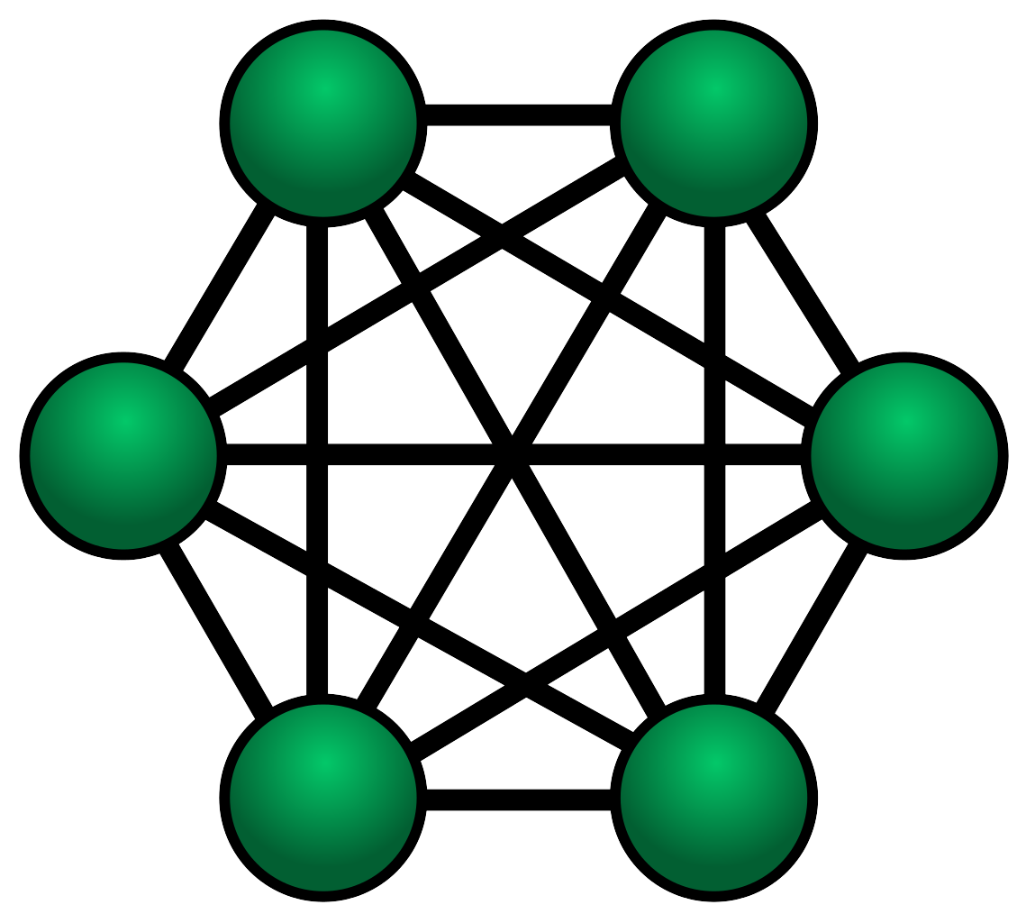
InfiniBand: topologie
Fat-Tree: connessione gerarchica multilivello, salendo dalle radici (nodi) al tronco si aumenta il numero di link
Dragonfly: i nodi sono raggruppati in sottogruppi di piccole dimensioni completamente connessi, i sottogruppi sono collegati fra di loro
Hypercube
Torus
Mesh
| Topology | Scalability | Latency | Bandwidth | Fault Tolerance | Complexity |
|--------------|-------------|-----------|-----------|-----------------|------------|
| Fat-Tree | High | Moderate | High | High | High |
| Dragonfly | Very High | Low | Very High | Moderate | High |
| Hypercube | Moderate | Low | Moderate | High | Moderate |
| Torus | High | Low | High | Moderate | High |
| Mesh | Moderate | Moderate | Moderate | Low | Low |

Slide 33
OmniPath?
Fratello economico di InfiniBand
Prestazioni simili, latenza leggermente più alta
Scalabilità (n. di nodi) simile
Manca la parte di off-load

Slide 34
Condivisione dei dati
Un filesystem che sia accessibile da tutti i nodi del cluster, ma:
Sia in grado di reggere all’accesso parallelo delle applicazioni, magari molti processi che accedo a pochi file
Evitare il lock a file, necessario lock a blocchi
Esere in grado di scalare le prestazioni
File System Parallelo

Slide 35
Parallel File Systems
Dati distribuiti fra più server conenssi in rete
I/O coordinato fra nodi client e server in modo da ottimizzare le prestazioni
Stripe a livello di file, i singoli blocchi sono scritti su diversi storage gestiti da diversi server
Non è necessario sapere dove si trovano i file, name space globale
Avere la possibilità di separare metadati e dati
Si aumentano le prestazioni aggiungendo sistemi di storage e/o server spesso in modo trasparente all’utenza
Due possibilità
IBM SpectrumScale (GPFS)
Lustre

Slide 36
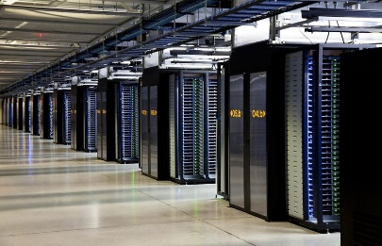
Gestione dei job
Tipicamente si hanno molti utenti che condividono la risorsa HPC, quindi:
Necessario ottimizzare l’accesso per non sprecare tempo CPU e potenza elettrica
Utenti diversi possono avere diritti diversi sul tempo macchina
Utenti diversi possono avere priorità di accesso diverse
Il sistema di batch permette una regolazione da “gentiluomini” di queste varie esigenze
Ma deve sapere che è un cluster HPC

Slide 37
Batch System per HPC
Deve “concepire” il fatto che un job giri su più nodi
Quindi saper tener traccia dei nodi assegnati ad un job
Fornire all’utente le informazioni relative ai nodi assegnati al job
Possibilmente: meccanismi furbi di gestione delle risorse come reservation e backfill

Slide 38
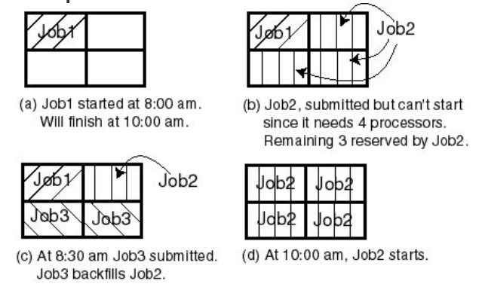
Reservation / Backfill
© IBM LSF https://www.ibm.com/support/knowledgecenter/en/SSETD4_9.1.3/lsf_admin/backfill.html

Slide 39
Batch System per HPC
Esistono vari Batch System, quelli che vanno per la maggiore nel settore HPC sono
LSF, di IBM a pagamento
SLURM, progetto opensource nato dalla collaborazione fra varie entità, nasce esplicitamente per il supporto HPC molti dei più grandi presenti nella Top500 lo usano

