Slide 1
Module Register Reading with FELIX
Zaza Chubinidze¹, Marianna Testa¹, Vakhtang Tsiskaridze², Leonardo Vannoli¹
¹ LNF – INFN, ² University of Toronto

Slide 2
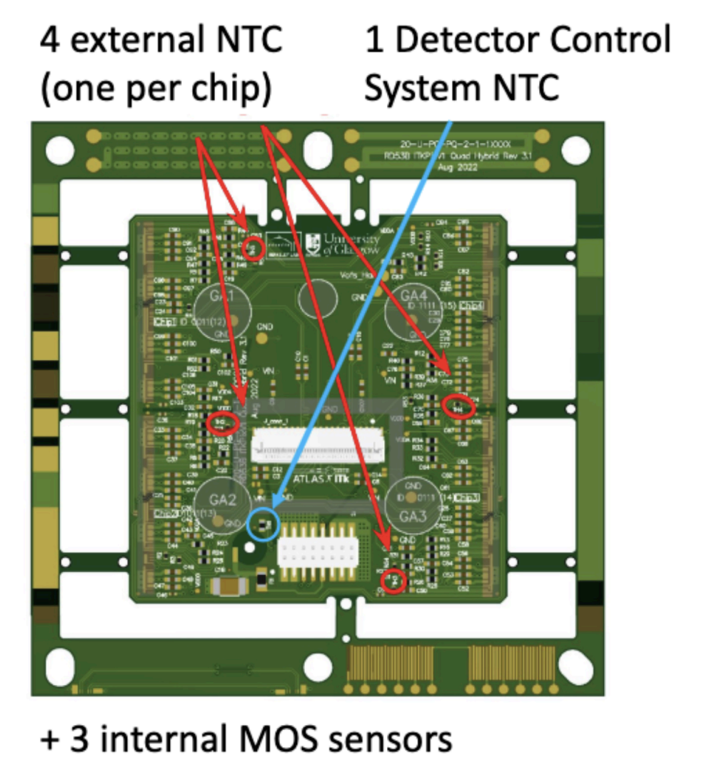
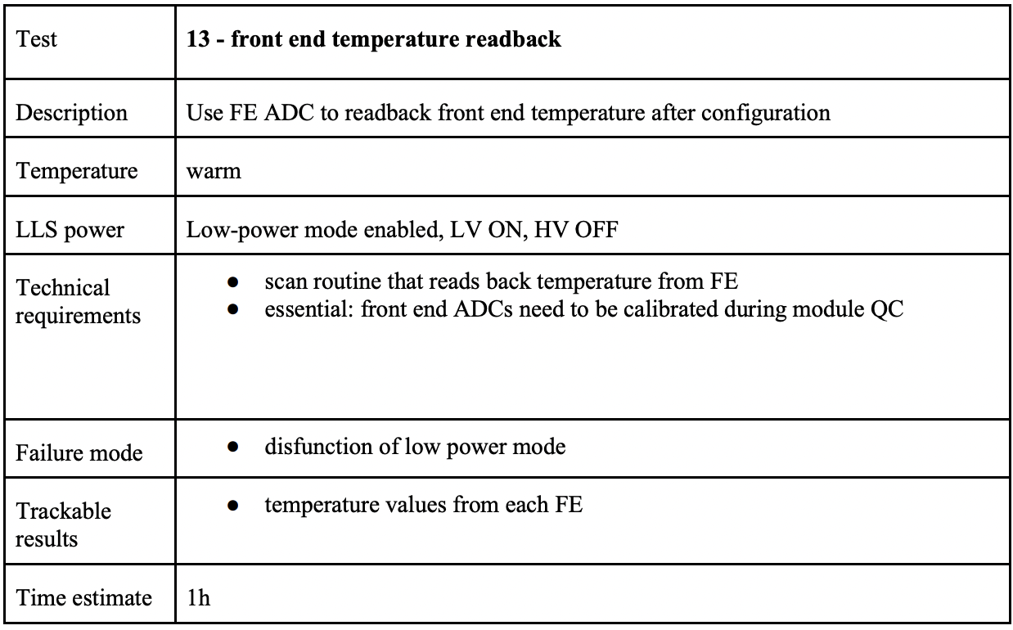
Register Reading
During the integration, the register reading is essential to test the full layer and full endcap configurations
From the Electrical QC Testing Procedure of ITk Pixel Loaded Local Supports we need, for each FE, to read at least the ADC registers for NTC and VDDD/VDDA
(link)
Temperature monitor in quad modules
1 external NTC per front-end
3 internal MOS sensors per front-end
digital SLDO, analog SLDO, ACB
DCS NTC per quad module

Slide 3
Register reading with Orion
The total output of the register reading routine
VMUX = 0, val = 0xfff, val = 4095, ADC_V = 0.762 V
VMUX = 2, val = 0x227, val = 551, ADC_V = 0.114 V
VMUX = 3, val = 0x846, val = 2118, ADC_V = 0.400 V
VMUX = 4, val = 0xc71, val = 3185, ADC_V = 0.596 V
VMUX = 5, val = 0x317, val = 791, ADC_V = 0.157 V
VMUX = 6, val = 0x6cd, val = 1741, ADC_V = 0.331 V
VMUX = 7, val = 0x11b, val = 283, ADC_V = 0.064 V
VMUX = 8, val = 0x080, val = 128, ADC_V = 0.036 V
VMUX = 9, val = 0x088, val = 136, ADC_V = 0.038 V
VMUX = 10, val = 0x38c, val = 908, ADC_V = 0.179 V
VMUX = 11, val = 0x467, val = 1127, ADC_V = 0.219 V
VMUX = 12, val = 0x43c, val = 1084, ADC_V = 0.211 V
VMUX = 13, val = 0xd8c, val = 3468, ADC_V = 0.647 V
VMUX = 14, val = 0x632, val = 1586, ADC_V = 0.303 V
VMUX = 15, val = 0xd7b, val = 3451, ADC_V = 0.644 V
VMUX = 16, val = 0x628, val = 1576, ADC_V = 0.301 V
VMUX = 17, val = 0xd8b, val = 3467, ADC_V = 0.647 V
VMUX = 18, val = 0x645, val = 1605, ADC_V = 0.306 V
VMUX = 19, val = 0x000, val = 0, ADC_V = 0.013 V
VMUX = 31, val = 0x96e, val = 2414, ADC_V = 0.454 V
VMUX = 32, val = 0xca7, val = 3239, ADC_V = 0.605 V
VMUX = 33, val = 0x7aa, val = 1962, ADC_V = 0.372 V
VMUX = 34, val = 0xc80, val = 3200, ADC_V = 0.598 V
VMUX = 35, val = 0xc57, val = 3159, ADC_V = 0.591 V
VMUX = 36, val = 0x512, val = 1298, ADC_V = 0.250 V
VMUX = 37, val = 0x7b2, val = 1970, ADC_V = 0.373 V
VMUX = 38, val = 0xc46, val = 3142, ADC_V = 0.588 V
MON NTC = 21.347 C
IMUX = 0, val = 0x082, val = 130, ADC_I = 3.648 uA
IMUX = 1, val = 0xfff, val = 4095, ADC_I = 76.208 uA
IMUX = 2, val = 0x98e, val = 2446, ADC_I = 46.031 uA
IMUX = 3, val = 0x084, val = 132, ADC_I = 3.685 uA
IMUX = 4, val = 0x7ee, val = 2030, ADC_I = 38.418 uA
IMUX = 5, val = 0x391, val = 913, ADC_I = 17.977 uA
IMUX = 6, val = 0x000, val = 0, ADC_I = 1.269 uA
IMUX = 7, val = 0x000, val = 0, ADC_I = 1.269 uA
IMUX = 8, val = 0xfff, val = 4095, ADC_I = 76.208 uA
IMUX = 9, val = 0x1d6, val = 470, ADC_I = 9.870 uA
IMUX = 10, val = 0x000, val = 0, ADC_I = 1.269 uA
IMUX = 11, val = 0x000, val = 0, ADC_I = 1.269 uA
IMUX = 12, val = 0x9b2, val = 2482, ADC_I = 46.690 uA
IMUX = 13, val = 0xd25, val = 3365, ADC_I = 62.849 uA
IMUX = 14, val = 0xa51, val = 2641, ADC_I = 49.599 uA
IMUX = 15, val = 0xfff, val = 4095, ADC_I = 76.208 uA
IMUX = 16, val = 0xeb0, val = 3760, ADC_I = 70.077 uA
IMUX = 17, val = 0xfff, val = 4095, ADC_I = 76.208 uA
IMUX = 18, val = 0xfff, val = 4095, ADC_I = 76.208 uA
IMUX = 19, val = 0x91b, val = 2331, ADC_I = 43.926 uA
IMUX = 20, val = 0xd72, val = 3442, ADC_I = 64.258 uA
IMUX = 21, val = 0x915, val = 2325, ADC_I = 43.817 uA
IMUX = 22, val = 0x95c, val = 2396, ADC_I = 45.116 uA
IMUX = 23, val = 0xd68, val = 3432, ADC_I = 64.075 uA
IMUX = 24, val = 0x94b, val = 2379, ADC_I = 44.805 uA
IMUX = 25, val = 0x96d, val = 2413, ADC_I = 45.427 uA
IMUX = 26, val = 0x000, val = 0, ADC_I = 1.269 uA
IMUX = 27, val = 0x000, val = 0, ADC_I = 1.269 uA
IMUX = 28, val = 0x5a0, val = 1440, ADC_I = 27.621 uA
IMUX = 29, val = 0x013, val = 19, ADC_I = 1.617 uA
IMUX = 30, val = 0x7ea, val = 2026, ADC_I = 38.345 uA
Quad module 20UPGR92110474
Only chip 4 was read
The routine loop over the registers reading the ADC values
The conversion is performed using the ADC calibration parameters in the Chip configuration file
The conversion of the NTC temperature value is done using the NTC calibration parameters
NTC pad V
NTC pad I
VDDA/2
VDDD/2

Slide 4
Next steps

Slide 5
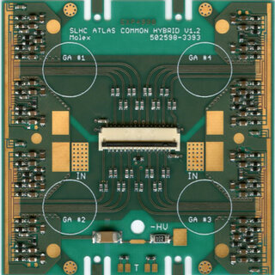
Serial Powering Test
A step-by-step approach to test the serial powering of quad modules, ensuring electrical stability and performance
Preliminary Testing:
Check circuit continuity and resistance along the bus tape.
Configure modules for serial power mode.
Test Order:
Start by testing the other module with a sensor.
Test the digital module on the HR (Optional).
After initial tests, proceed to serial connection with the digital module already in use.
Power Connection:
Instead of using the bus tape, create bridges between the power boards to facilitate the connection between modules.

Slide 6
Thank you for your attention!

Slide 7
Backup Slides

Slide 8
Data-cable Extenders Tests

Slide 9
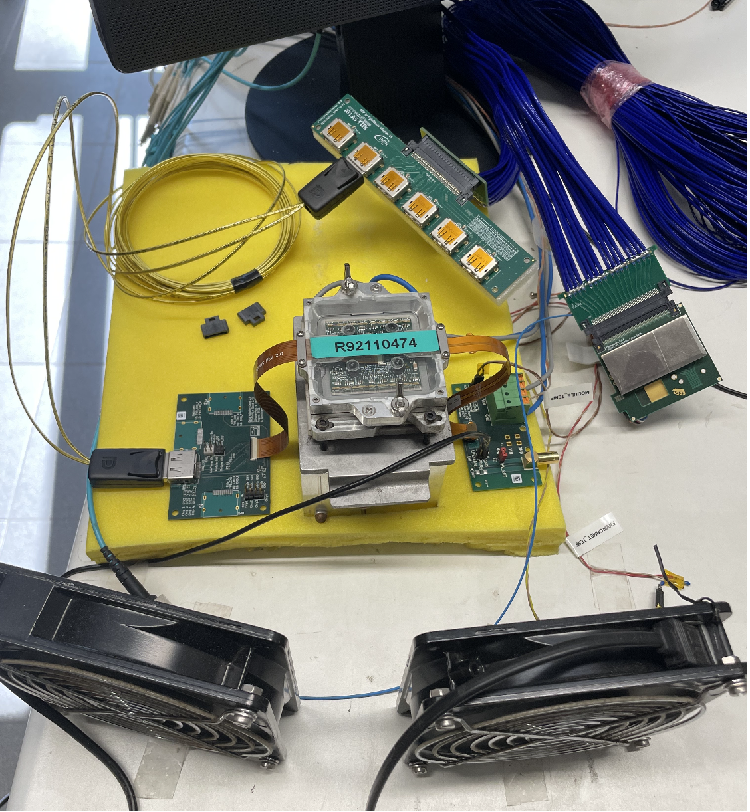
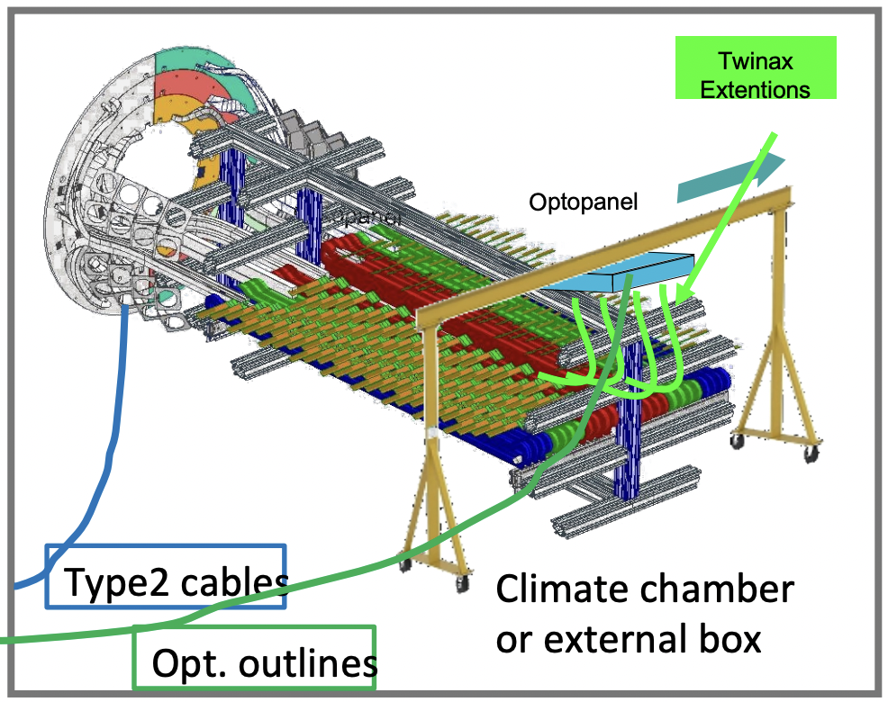
BER Test at LNF - Pietro Albicocco
The Setup
Module
Module to DP board
Comercial Twinax terminated with DP
28AWG
6m long
DP to optoboard board
Data-cable Extenders
3m extenders
3m + 2m extenders
As requested by OB
Optoboard
Tested a single channel
Data cable extenders will be used during OE and OB integration and at SR1 for the combined OE+OB tests (link to Zografos)
Service support

Slide 10
BER Test at LNF - Pietro Albicocco
6m twinax + extenders
Setup with 6m twinax & No extender/3m extender/3m+2m extenders
6m twinax is 28 AWG: better characteristics than experiment
Extenders do not affect significantly the BER results
Length of the extenders is not constraining

Slide 11
YARR + Trenz | Orion | YARR + FELIX
We tested the register reading with the three different software on the quad module 20UPGR92110474
VMUX Registers
YARR + Trenz card
Orion+ FELIX
YARR + FELIX
MON MUX_V: 0, Value: 4095 => 0.762 V
MON MUX_V: 2, Value: 562 => 0.115 V
MON MUX_V: 19, Value: 0 => 0.012 V
MON MUX_V: 20, Value: 0 => 0.012 V
MON MUX_V: 21, Value: 0 => 0.012 V
MON MUX_V: 22, Value: 0 => 0.012 V
MON MUX_V: 23, Value: 0 => 0.012 V
MON MUX_V: 24, Value: 0 => 0.012 V
MON MUX_V: 25, Value: 0 => 0.012 V
MON MUX_V: 26, Value: 0 => 0.012 V
MON MUX_V: 27, Value: 0 => 0.012 V
MON MUX_V: 28, Value: 0 => 0.012 V
MON MUX_V: 29, Value: 0 => 0.012 V
MON MUX_V: 30, Value: 0 => 0.012 V
MON MUX_V: 34, Value: 3202 => 0.598 V
MON MUX_V: 38, Value: 3143 => 0.587 V
MON NTC: 21.137415 C
VMUX = 0, val = 0xfff, val = 4095, ADC_V = 0.762 V
VMUX = 2, val = 0x227, val = 551, ADC_V = 0.114 V
VMUX = 19, val = 0x000, val = 0, ADC_V = 0.013 V
VMUX = 20, val = 0x000, val = 0, ADC_V = 0.013 V
VMUX = 21, val = 0x000, val = 0, ADC_V = 0.013 V
VMUX = 22, val = 0x000, val = 0, ADC_V = 0.013 V
VMUX = 23, val = 0x000, val = 0, ADC_V = 0.013 V
VMUX = 24, val = 0x000, val = 0, ADC_V = 0.013 V
VMUX = 25, val = 0x000, val = 0, ADC_V = 0.013 V
VMUX = 26, val = 0x000, val = 0, ADC_V = 0.013 V
VMUX = 27, val = 0x000, val = 0, ADC_V = 0.013 V
VMUX = 28, val = 0x000, val = 0, ADC_V = 0.013 V
VMUX = 29, val = 0x000, val = 0, ADC_V = 0.013 V
VMUX = 30, val = 0x000, val = 0, ADC_V = 0.013 V
VMUX = 34, val = 0xc80, val = 3200, ADC_V = 0.598 V
VMUX = 38, val = 0xc46, val = 3142, ADC_V = 0.588 V
MON NTC = 21.347 C
MON MUX_V: 0, Value: 3904 => 0.727 V
MON MUX_V: 2, Value: 512 => 0.106 V
MON MUX_V: 19, Value: 7 => 0.014 V
MON MUX_V: 20, Value: 7 => 0.014 V
MON MUX_V: 21, Value: 7 => 0.014 V
MON MUX_V: 22, Value: 3 => 0.013 V
MON MUX_V: 23, Value: 7 => 0.014 V
MON MUX_V: 24, Value: 7 => 0.014 V
MON MUX_V: 25, Value: 3 => 0.013 V
MON MUX_V: 26, Value: 3 => 0.013 V
MON MUX_V: 27, Value: 7 => 0.014 V
MON MUX_V: 28, Value: 7 => 0.014 V
MON MUX_V: 29, Value: 7 => 0.014 V
MON MUX_V: 30, Value: 7 => 0.014 V
MON MUX_V: 34, Value: 3072 => 0.575 V
MON MUX_V: 38, Value: 2816 => 0.528 V
MON NTC: 20.30456 C
NTC pad V
VDDA/2
VDDD/2
YARR version: branch V1.5.1 (link)
YARR + Trenz and Orion are comparable within 2%
YARR + Felix seems to show some discrepancies with the other two reading results,
we will check with new YARR version just released.

Slide 12
YARR + Trenz | Orion | YARR + FELIX
We tested the register reading with the three different software on the quad module 20UPGR92110474
IMUX Registers
YARR + Trenz card
Orion + FELIX
YARR + FELIX
MON MUX_C: 1 Value: 4095 => 76.160 uA
MON MUX_C: 2 Value: 2446 => 45.983 uA
MON MUX_C: 3 Value: 134 => 3.673 uA
MON MUX_C: 4 Value: 2031 => 38.389 uA
MON MUX_C: 5 Value: 914 => 17.947 uA
MON MUX_C: 6 Value: 0 => 1.221 uA
MON MUX_C: 7 Value: 1900 => 35.991 uA
MON MUX_C: 8 Value: 3739 => 69.645 uA
MON MUX_C: 9 Value: 473 => 9.877 uA
MON MUX_C: 10 Value: 0 => 1.221 uA
MON MUX_C: 11 Value: 0 => 1.221 uA
MON MUX_C: 26 Value: 0 => 1.221 uA
MON MUX_C: 27 Value: 0 => 1.221 uA
IMUX = 1, val = 0xfff, val = 4095, ADC_I = 76.208 uA
IMUX = 2, val = 0x98e, val = 2446, ADC_I = 46.031 uA
IMUX = 3, val = 0x084, val = 132, ADC_I = 3.685 uA
IMUX = 4, val = 0x7ee, val = 2030, ADC_I = 38.418 uA
IMUX = 5, val = 0x391, val = 913, ADC_I = 17.977 uA
IMUX = 6, val = 0x000, val = 0, ADC_I = 1.269 uA
IMUX = 7, val = 0x000, val = 0, ADC_I = 1.269 uA
IMUX = 8, val = 0xfff, val = 4095, ADC_I = 76.208 uA
IMUX = 9, val = 0x1d6, val = 470, ADC_I = 9.870 uA
IMUX = 10, val = 0x000, val = 0, ADC_I = 1.269 uA
IMUX = 11, val = 0x000, val = 0, ADC_I = 1.269 uA
IMUX = 26, val = 0x000, val = 0, ADC_I = 1.269 uA
IMUX = 27, val = 0x000, val = 0, ADC_I = 1.269 uA
MON MUX_C: 1 Value: 3072 => 57.487 uA
MON MUX_C: 2 Value: 3072 => 57.487 uA
MON MUX_C: 3 Value: 3072 => 57.487 uA
MON MUX_C: 4 Value: 3072 => 57.487 uA
MON MUX_C: 5 Value: 3968 => 73.884 uA
MON MUX_C: 6 Value: 2176 => 41.089 uA
MON MUX_C: 7 Value: 159 => 4.179 uA
MON MUX_C: 8 Value: 1792 => 34.063 uA
MON MUX_C: 9 Value: 768 => 15.323 uA
MON MUX_C: 10 Value: 3 => 1.324 uA
MON MUX_C: 11 Value: 3 => 1.324 uA
MON MUX_C: 26 Value: 2112 => 39.919 uA
MON MUX_C: 27 Value: 3072 => 57.487 uA
NTC pad I
YARR version: branch V1.5.1 (link)
YARR + Trenz and Orion are comparable within 2% except
The registers IMUX 7 and 8 correspond to CMLBias2 and CMLBias3, and they has to be different in value between FELIX and Trenz to allows the two different readout.
YARR + Felix seems to show some discrepancies with the other two reading results,
we will check with new YARR version just released.

Slide 13
YARR + Trenz | Orion | YARR + FELIX
We tested the register reading with the three different software on the quad module 20UPGR92110474
YARR + Trenz card
Orion + FELIX
YARR + FELIX
MON MUX_V: 0, Value: 4095 => 0.762 V
MON MUX_V: 2, Value: 562 => 0.115 V
MON MUX_V: 19, Value: 0 => 0.012 V
MON MUX_V: 20, Value: 0 => 0.012 V
MON MUX_V: 21, Value: 0 => 0.012 V
MON MUX_V: 22, Value: 0 => 0.012 V
MON MUX_V: 23, Value: 0 => 0.012 V
MON MUX_V: 24, Value: 0 => 0.012 V
MON MUX_V: 25, Value: 0 => 0.012 V
MON MUX_V: 26, Value: 0 => 0.012 V
MON MUX_V: 27, Value: 0 => 0.012 V
MON MUX_V: 28, Value: 0 => 0.012 V
MON MUX_V: 29, Value: 0 => 0.012 V
MON MUX_V: 30, Value: 0 => 0.012 V
MON MUX_V: 34, Value: 3202 => 0.598 V
MON MUX_V: 38, Value: 3143 => 0.587 V
MON NTC: 21.137415 C
VMUX = 0, val = 0xfff, val = 4095, ADC_V = 0.762 V
VMUX = 2, val = 0x227, val = 551, ADC_V = 0.114 V
VMUX = 19, val = 0x000, val = 0, ADC_V = 0.013 V
VMUX = 20, val = 0x000, val = 0, ADC_V = 0.013 V
VMUX = 21, val = 0x000, val = 0, ADC_V = 0.013 V
VMUX = 22, val = 0x000, val = 0, ADC_V = 0.013 V
VMUX = 23, val = 0x000, val = 0, ADC_V = 0.013 V
VMUX = 24, val = 0x000, val = 0, ADC_V = 0.013 V
VMUX = 25, val = 0x000, val = 0, ADC_V = 0.013 V
VMUX = 26, val = 0x000, val = 0, ADC_V = 0.013 V
VMUX = 27, val = 0x000, val = 0, ADC_V = 0.013 V
VMUX = 28, val = 0x000, val = 0, ADC_V = 0.013 V
VMUX = 29, val = 0x000, val = 0, ADC_V = 0.013 V
VMUX = 30, val = 0x000, val = 0, ADC_V = 0.013 V
VMUX = 34, val = 0xc80, val = 3200, ADC_V = 0.598 V
VMUX = 38, val = 0xc46, val = 3142, ADC_V = 0.588 V
MON NTC = 21.347 C
MON MUX_V: 0, Value: 3904 => 72712296 V
MON MUX_V: 2, Value: 512 => 0.106387004 V
MON MUX_V: 19, Value: 7 => 0.013972 V
MON MUX_V: 20, Value: 7 => 0.013972 V
MON MUX_V: 21, Value: 7 => 0.013972 V
MON MUX_V: 22, Value: 3 => 0.01324 V
MON MUX_V: 23, Value: 7 => 0.013972 V
MON MUX_V: 24, Value: 7 => 0.013972 V
MON MUX_V: 25, Value: 3 => 0.01324 V
MON MUX_V: 26, Value: 3 => 0.01324 V
MON MUX_V: 27, Value: 7 => 0.013972 V
MON MUX_V: 28, Value: 7 => 0.013972 V
MON MUX_V: 29, Value: 7 => 0.013972 V
MON MUX_V: 30, Value: 7 => 0.013972 V
MON MUX_V: 34, Value: 3072 => 0.574867 V
MON MUX_V: 38, Value: 2816 => 0.528019 V
MON NTC: 20.30456 C
MON MUX_C: 1 Value: 4095 => 76.160 uA
MON MUX_C: 2 Value: 2446 => 45.983 uA
MON MUX_C: 3 Value: 134 => 3.673 uA
MON MUX_C: 4 Value: 2031 => 38.389 uA
MON MUX_C: 5 Value: 914 => 17.947 uA
MON MUX_C: 6 Value: 0 => 1.221 uA
MON MUX_C: 7 Value: 1900 => 35.991 uA
MON MUX_C: 8 Value: 3739 => 69.645 uA
MON MUX_C: 9 Value: 473 => 9.877 uA
MON MUX_C: 10 Value: 0 => 1.221 uA
MON MUX_C: 11 Value: 0 => 1.221 uA
MON MUX_C: 26 Value: 0 => 1.221 uA
MON MUX_C: 27 Value: 0 => 1.2214 uA
IMUX = 1, val = 0xfff, val = 4095, ADC_I = 76.208 uA
IMUX = 2, val = 0x98e, val = 2446, ADC_I = 46.031 uA
IMUX = 3, val = 0x084, val = 132, ADC_I = 3.685 uA
IMUX = 4, val = 0x7ee, val = 2030, ADC_I = 38.418 uA
IMUX = 5, val = 0x391, val = 913, ADC_I = 17.977 uA
IMUX = 6, val = 0x000, val = 0, ADC_I = 1.269 uA
IMUX = 7, val = 0x000, val = 0, ADC_I = 1.269 uA
IMUX = 8, val = 0xfff, val = 4095, ADC_I = 76.208 uA
IMUX = 9, val = 0x1d6, val = 470, ADC_I = 9.870 uA
IMUX = 10, val = 0x000, val = 0, ADC_I = 1.269 uA
IMUX = 11, val = 0x000, val = 0, ADC_I = 1.269 uA
IMUX = 26, val = 0x000, val = 0, ADC_I = 1.269 uA
IMUX = 27, val = 0x000, val = 0, ADC_I = 1.269 uA
MON MUX_C: 1 Value: 3072 => 57.487 uA
MON MUX_C: 2 Value: 3072 => 57.487 uA
MON MUX_C: 3 Value: 3072 => 57.487 uA
MON MUX_C: 4 Value: 3072 => 57.487 uA
MON MUX_C: 5 Value: 3968 => 73.884 uA
MON MUX_C: 6 Value: 2176 => 41.089 uA
MON MUX_C: 7 Value: 159 => 4.179 uA
MON MUX_C: 8 Value: 1792 => 34.063 uA
MON MUX_C: 9 Value: 768 => 15.323 uA
MON MUX_C: 10 Value: 3 => 1.324 uA
MON MUX_C: 11 Value: 3 => 1.324 uA
MON MUX_C: 26 Value: 2112 => 39.919 uA
MON MUX_C: 27 Value: 3072 => 57.487 uA

Slide 14
Register reading with YARR on FELIX-Star
The registers of quad module’s chip 4
Quad module 20UPGR92110474
To read the quad module registers with YARR it was followed the wiki (Thanks Angira!)
FELIX-star software was used to interact with FELIX
The Felix-star is a culmination of three different processes:
felix-tohost: to bring readout data
felix-toflx: to send commands from client applications (e.g. YARR)
felix-register: to set the FELIX registers dynamically, to monitor FPGA properties etc.
With the module-qc-tools we read the module register running: ./bin/scanConsole -r configs/controller/felix_client_pixels.json -s configs/scans/rd53b/reg_readall.json –c configs/connectivity/example_rd53b_setup.json

Slide 15
BER Test at LNF
1m twinax + extenders
Setup with 1m twinax & No extender/3m extender/3m+2m extenders
Extenders do not affect significantly the achivable BER results

Slide 16
Register reading with YARR on FELIX-Star
The whole register reading output
MON MUX_C: 1 Value: 3072 => 57.4867008253932 uA
MON MUX_C: 2 Value: 3072 => 57.4867008253932 uA
MON MUX_C: 3 Value: 3072 => 57.4867008253932 uA
MON MUX_C: 4 Value: 3072 => 57.4867008253932 uA
MON MUX_C: 5 Value: 3968 => 73.88350059045479 uA
MON MUX_C: 6 Value: 2176 => 41.08990106033161 uA
MON MUX_C: 7 Value: 159 => 4.178800281806616 uA
MON MUX_C: 8 Value: 1792 => 34.062701161019504 uA
MON MUX_C: 9 Value: 768 => 15.323499610531144 uA
MON MUX_C: 10 Value: 3 => 1.3239999816505588 uA
MON MUX_C: 11 Value: 3 => 1.3239999816505588 uA
MON MUX_C: 12 Value: 3968 => 73.88350059045479 uA
MON MUX_C: 13 Value: 416 => 8.881899702828377 uA
MON MUX_C: 14 Value: 3 => 1.3239999816505588 uA
MON MUX_C: 15 Value: 3 => 1.3239999816505588 uA
MON MUX_C: 16 Value: 2176 => 41.08990106033161 uA
MON MUX_C: 17 Value: 3072 => 57.4867008253932 uA
MON MUX_C: 18 Value: 2304 => 43.43230102676898 uA
MON MUX_C: 19 Value: 4032 => 75.05469693569466 uA
MON MUX_C: 20 Value: 3328 => 62.171493482310325 uA
MON MUX_C: 21 Value: 3840 => 71.5410933480598 uA
MON MUX_C: 22 Value: 4032 => 75.05469693569466 uA
MON MUX_C: 23 Value: 2048 => 38.74750109389424 uA
MON MUX_C: 24 Value: 3072 => 57.4867008253932 uA
MON MUX_C: 25 Value: 2048 => 38.74750109389424 uA
MON MUX_C: 26 Value: 2112 => 39.91870107711293 uA
MON MUX_C: 27 Value: 3072 => 57.4867008253932 uA
MON MUX_C: 28 Value: 2048 => 38.74750109389424 uA
MON MUX_C: 29 Value: 2176 => 41.08990106033161 uA
MON MUX_C: 30 Value: 3 => 1.3239999816505588 uA
MON MUX_C: 31 Value: 1 => 1.2873999821749749 uA
MON MUX_V: 0, Value: 3904 => 0.72712296 V
MON MUX_V: 2, Value: 512 => 0.106387004 V
MON MUX_V: 3, Value: 1792 => 0.340627 V
MON MUX_V: 4, Value: 2816 => 0.528019 V
MON MUX_V: 5, Value: 704 => 0.14152299 V
MON MUX_V: 6, Value: 1536 => 0.29377902 V
MON MUX_V: 7, Value: 272 => 0.062467 V
MON MUX_V: 8, Value: 155 => 0.041056 V
MON MUX_V: 9, Value: 159 => 0.041788 V
MON MUX_V: 10, Value: 768 => 0.153235 V
MON MUX_V: 11, Value: 1024 => 0.20008299 V
MON MUX_V: 12, Value: 1024 => 0.20008299 V
MON MUX_V: 13, Value: 3072 => 0.574867 V
MON MUX_V: 14, Value: 1408 => 0.27035502 V
MON MUX_V: 15, Value: 3072 => 0.574867 V
MON MUX_V: 16, Value: 1408 => 0.27035502 V
MON MUX_V: 17, Value: 3072 => 0.574867 V
MON MUX_V: 18, Value: 1408 => 0.27035502 V
MON MUX_V: 19, Value: 7 => 0.013972 V
MON MUX_V: 20, Value: 7 => 0.013972 V
MON MUX_V: 21, Value: 7 => 0.013972 V
MON MUX_V: 22, Value: 3 => 0.01324 V
MON MUX_V: 23, Value: 7 => 0.013972 V
MON MUX_V: 24, Value: 7 => 0.013972 V
MON MUX_V: 25, Value: 3 => 0.01324 V
MON MUX_V: 26, Value: 3 => 0.01324 V
MON MUX_V: 27, Value: 7 => 0.013972 V
MON MUX_V: 28, Value: 7 => 0.013972 V
MON MUX_V: 29, Value: 7 => 0.013972 V
MON MUX_V: 30, Value: 7 => 0.013972 V
MON MUX_V: 31, Value: 2176 => 0.410899 V
MON MUX_V: 32, Value: 3072 => 0.574867 V
MON MUX_V: 33, Value: 1664 => 0.31720302 V
MON MUX_V: 34, Value: 3072 => 0.574867 V
MON MUX_V: 35, Value: 2816 => 0.528019 V
MON MUX_V: 36, Value: 1152 => 0.22350699 V
MON MUX_V: 37, Value: 1664 => 0.31720302 V
MON MUX_V: 38, Value: 2816 => 0.528019 V
MON MUX_V: 39, Value: 2816 => 0.528019 V
MON NTC: 20.30456 C

