Slide 1
ITk Assembly Tooling update
Emiliano Dané
08 October 2024

Slide 2
What we are doing in Frascati:
New Detector supports (Heads)
T-Trolley for the test in CC
X-rail support modification
System for the shipping
Shipping/test box
Other tasks
HR insertion tool (Lecce)
Cable tooling holder and service trolley
Piping tool insertion and test (Milano)
PP1 welding manifolding (LNF-Milano)
Prototypes: the idea is to produce the entire detector

Slide 3
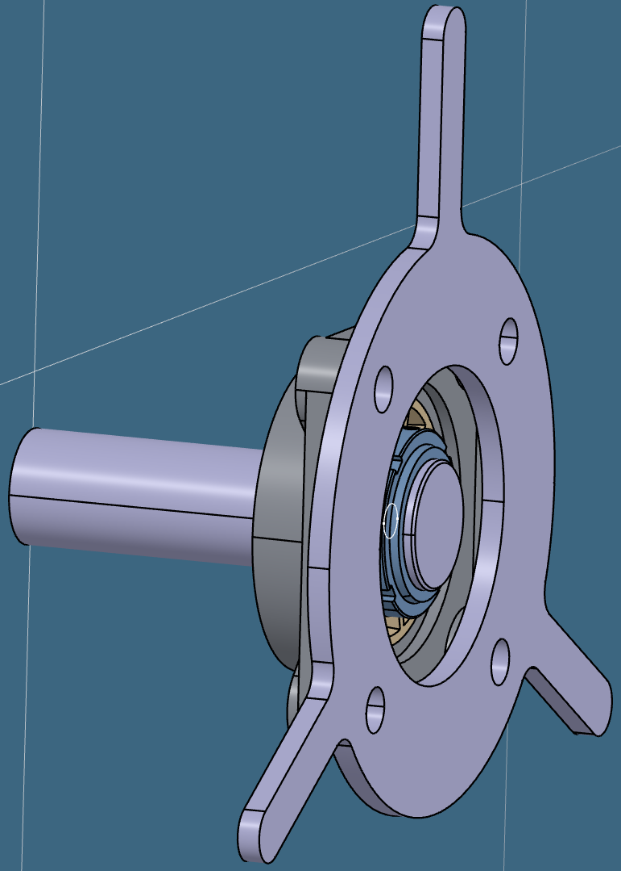
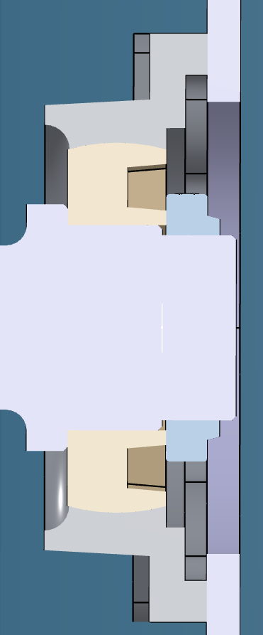
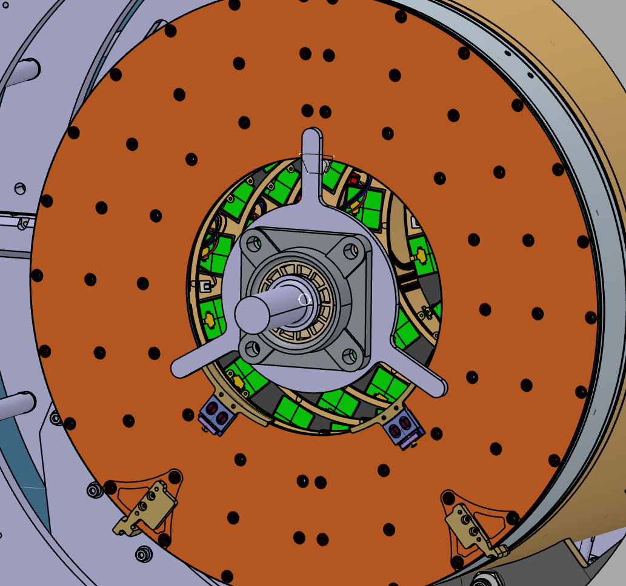
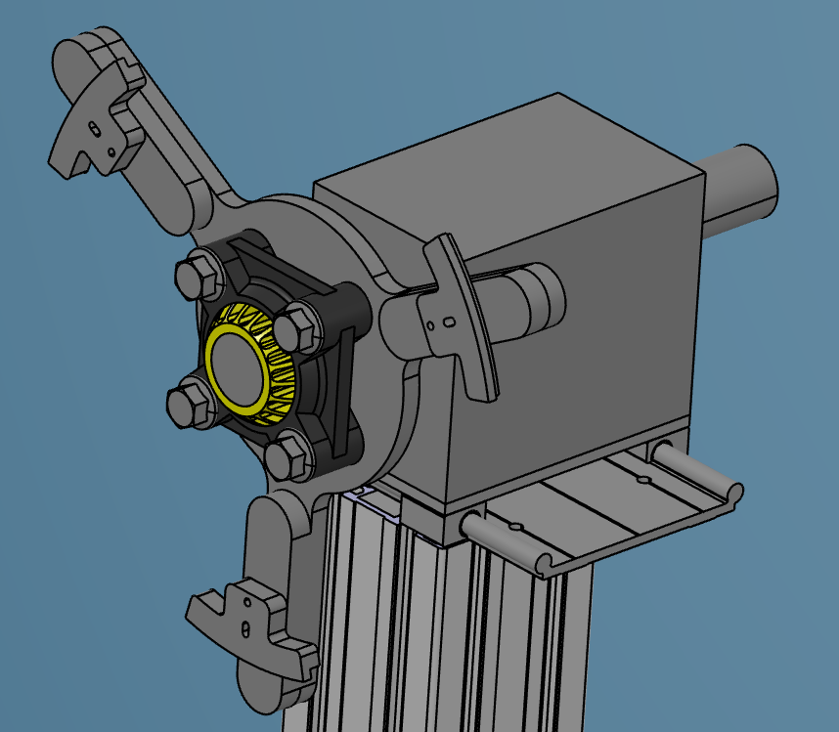
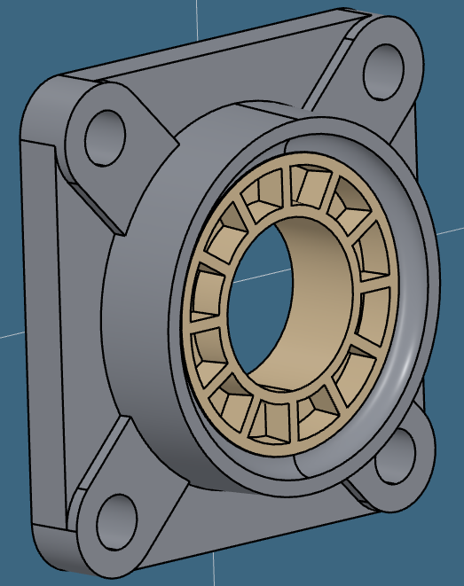
LOW Z INTERFACE
3 arms with supports having the same curvature of the flange.
A spring could be added for the holding.
Longitudinal shift available.
3
4
spring
1
2
Design notes:
Shaft made of Stainless steel.
Flanges made of CFRP.
Ring.
Flange bearing
Transverse rail to compensate axial disalignment
Filippo Rosatelli and Bruno Ponzio are working on that
Simulation on the detector with this system should be done
Spherical joint
We are going to purchais couple of it as a prototype

Slide 4
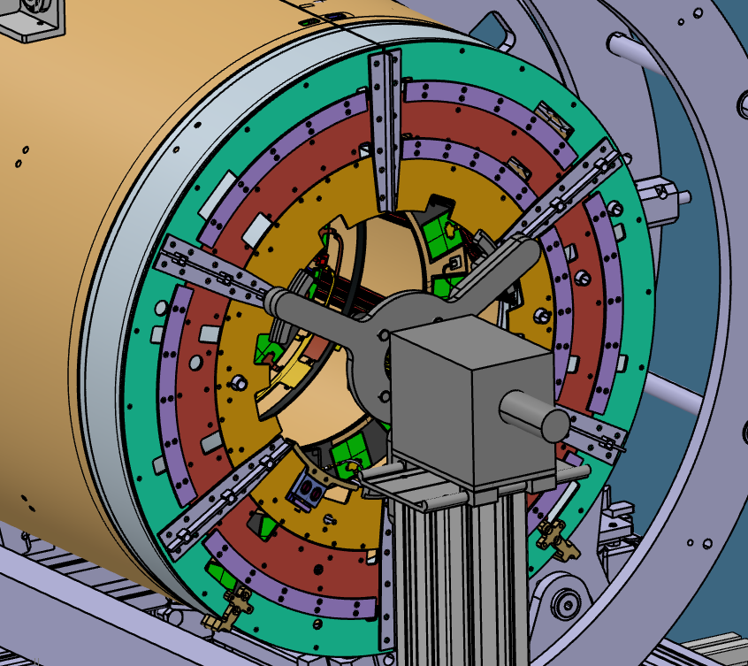
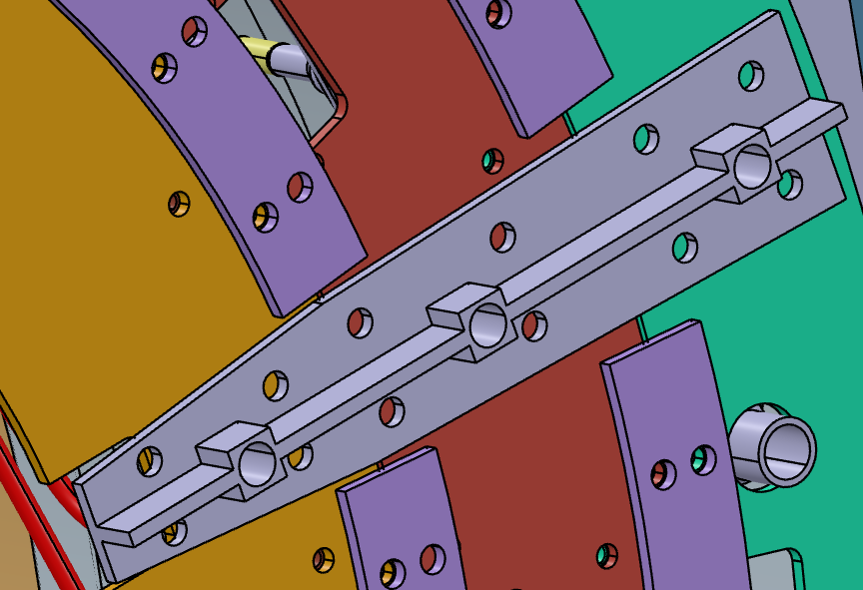
HIGH Z INTERFACE
SPOKE
What are these holes for?
3 arms maybe not enough because the 2 halves
How the spoke will be assembled? At the end after the layer 4 mating?
Spokes material?

Slide 5
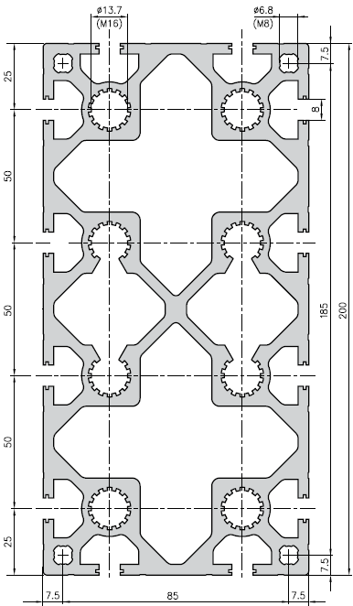
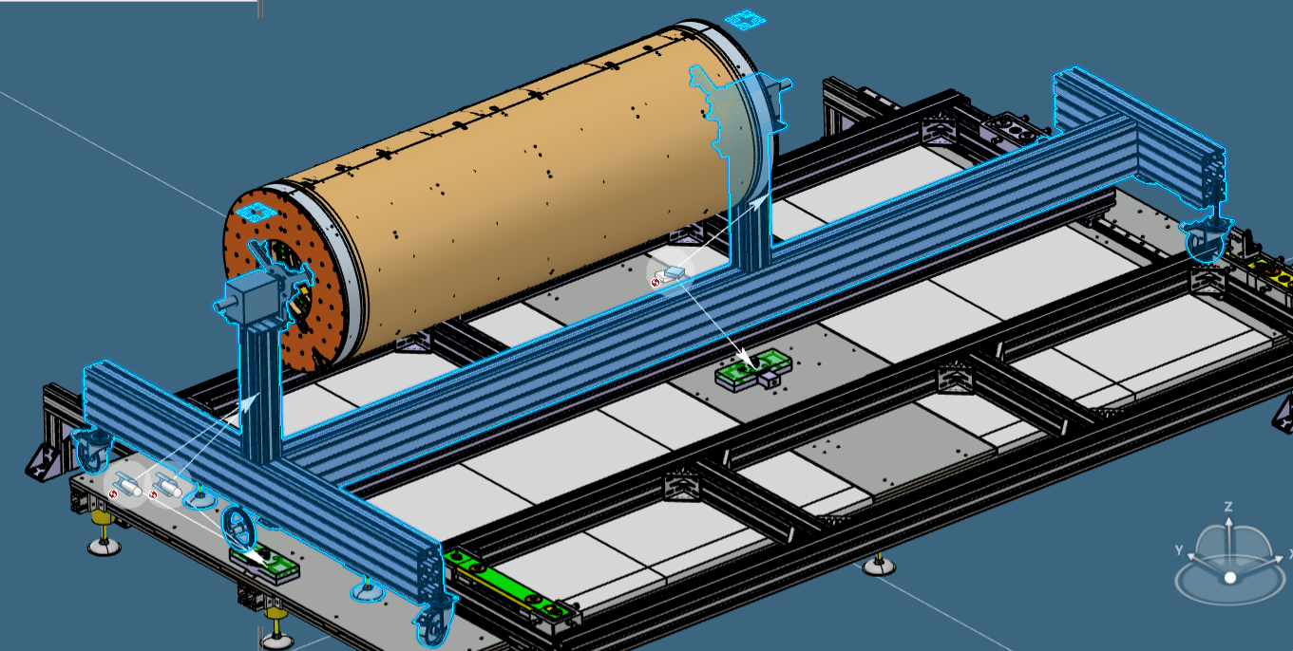
T-trolley
Bruno Ponzio and Marco Battisti are working on that
section of the beams

Slide 6
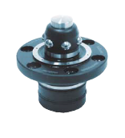
Upper view of the system
Centering system
Wheels
Controlled lifting system on sphere system
Wheels
Detector
Pillars
Service
Pillars
Wheels

Slide 7
Schematic view of the system with loads when the trolley is on wheels in Climatic Chamber
cables tot. 2 kN
detector and services 0.55 kN
own weight of the beam
+
a
b
16.5kg/m
tot. 66kg
Contraction due to the -35°C
Angles and deflection will be compensated by the spherical joints on the two heads

Slide 8
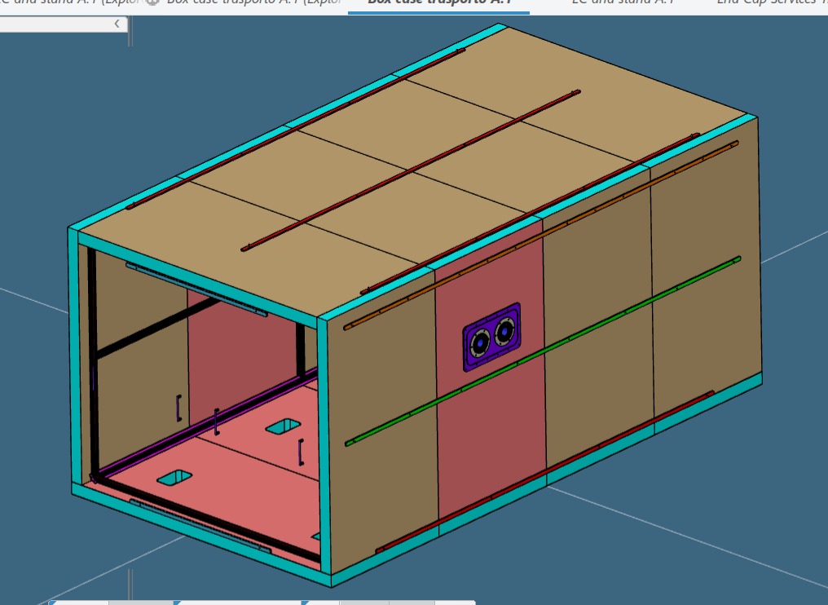
Shipping trolley and shipping/test box
rail
rail support
Shipping/test box is under definition
Not clear how to go in the box
The idea is to use the T-trolley for the shipping and a system supporting the rails is under study.

Slide 9
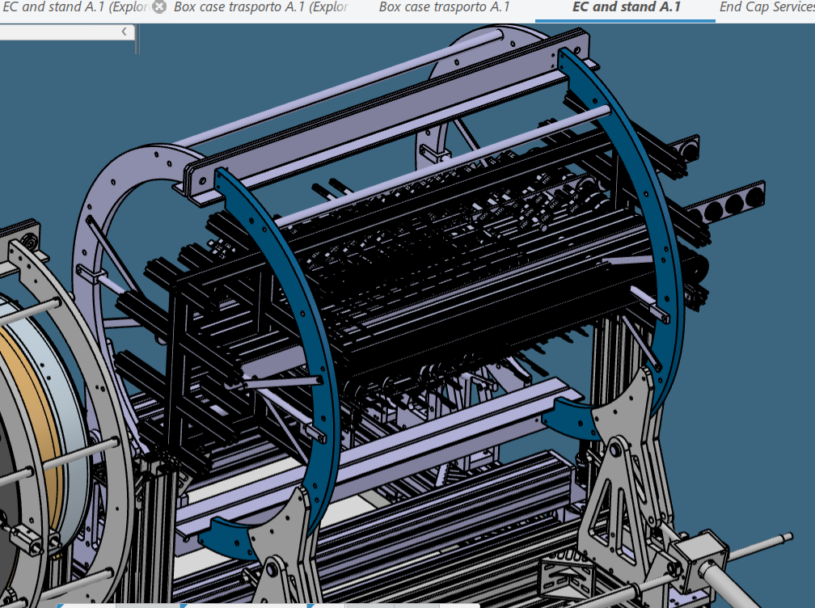
Cable insertion tool and service trolley
The part of the services in the rotating trolley is going to be produced (Emilio and Lorenzo)
Lorenzo designed and produced the holder for the connectors following the last version of the service trolley.
what is unclear to me is the procedure for the cabling positioning starting from the shape of the cables then how to put on the rotating trollery and then on the service trolley..
also I don't know the routing from the Hz-flange to the trolley. We need to leave some room in order to take out the "head".

Slide 10
Pipe welding and PP1 manifold welding
The tool for the pipe insertion is produced and is under test (Simone)
On the manifold PP1 pipe welding, some solution is under discussion (Polysoude) and a test in Milan or LNF will be performed soon. In the next days we will have a meeting to discuss the technical details.
Same thing have to be done for the Liverpool side (Swagelok)
2° welding

Slide 11
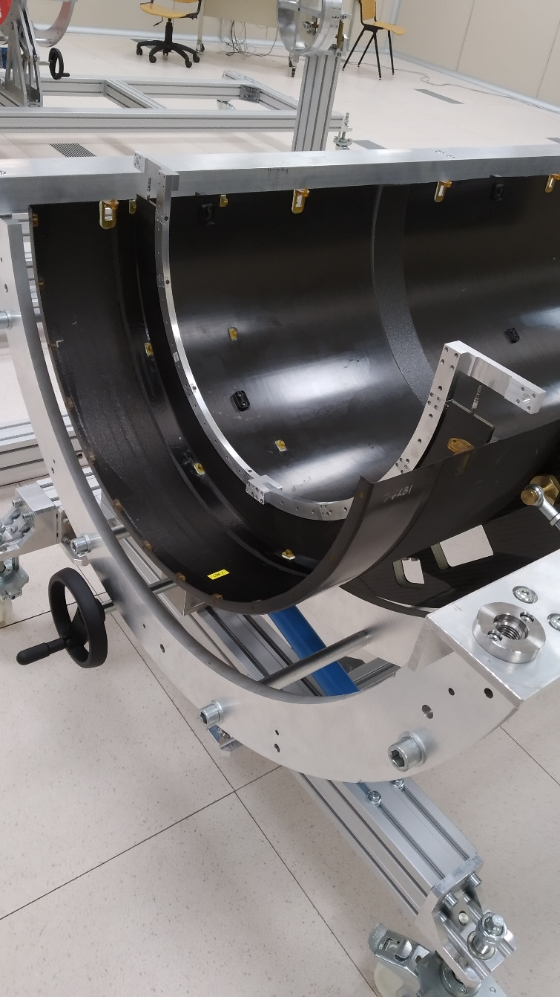
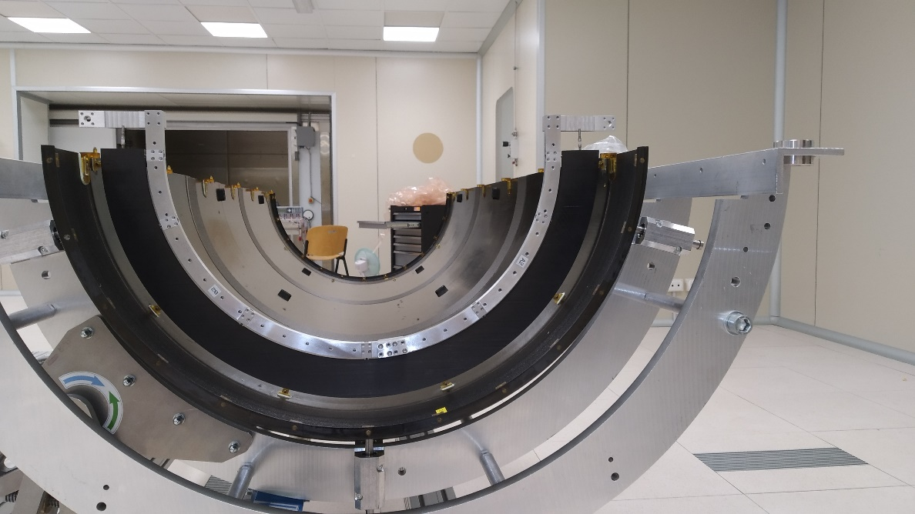
Half ring insertion tool
First prototype HR (from Gabriele) has been assembled in the L4 (from Liverpool) Half Shell. Not particular problem detected. Alessandro and Salvatore from Lecce are working on a simplified version of the insertion tool.

Slide 12
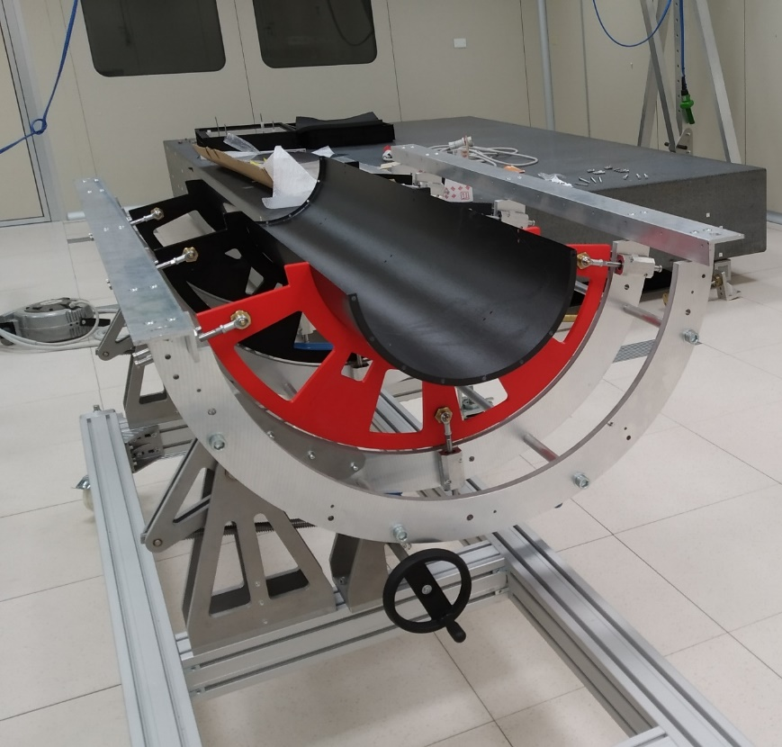
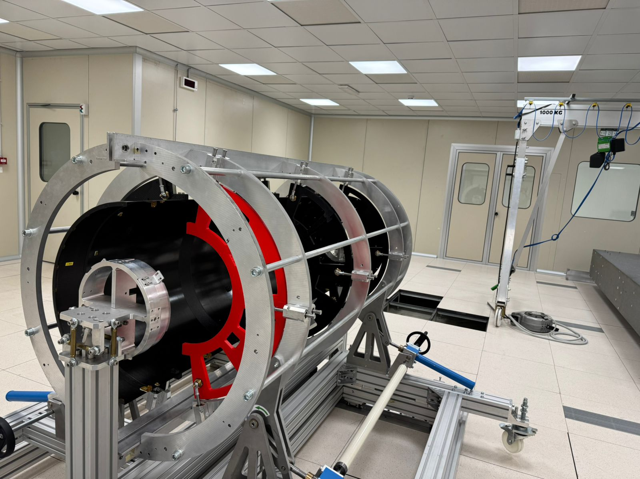
Prototypes
The idea is to have the whole detector in a prototype/mockup version.
Half Shell: we have one L4 (Liverpool) and 2 L2 (Aviacompositi). For this L2 we have to print all the plastic part inside (lugs, part to connect the centine..). Also the positioning and the gluing of these part will be not trivial.
Half rings: we want to make the skin in CF and the foam in Rohacell. Some could have the piping also, to perform some welding test.
Lz flange: already printed
Hz flange: it will be printed after
Giuseppe is in charge on that

