Slide 1


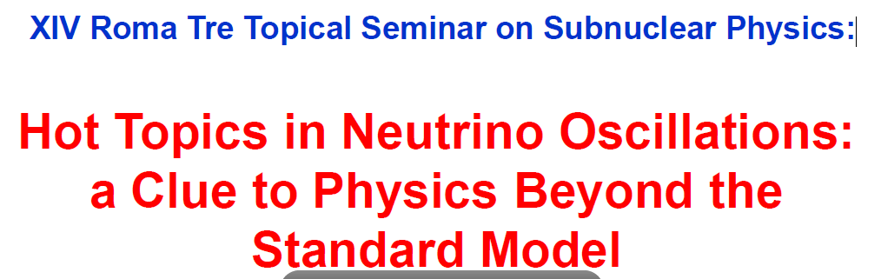
Status and perspectives for Double Beta Decay measurements
Andrea Giuliani
CSNSM, CNRS/IN2P3
France

Slide 2
Outline
Introduction
Why Double Beta Decay is important
Challenges in front of us
Technologies and experiments
Looking into the crystal ball

Slide 3
Outline
Introduction
Why Double Beta Decay is important
Challenges in front of us
Technologies and experiments
Looking into the crystal ball

Slide 4
Decay modes for Double Beta Decay
2ν Double Beta Decay
allowed by the Standard Model
already observed – τ ≥ 10¹⁹ y
①
(A,Z) → (A,Z+2) + 2e⁻ + 2ν_{e}
②
neutrinoless Double Beta Decay (0ν-DBD)
never observed (except a discussed claim)
τ > 10²⁵ y
(A,Z) → (A,Z+2) + 2e⁻
Processe ② would imply new physics beyond the Standard Model
violation of total lepton number conservation
Very sensitive tests to new physics since the phase space term
is much larger for them than for the standard process
interest for 0ν-DBD lasts for 70 years !
Goeppert-Meyer proposed the standard process in 1935
Racah proposed the neutrinoless process in 1937

Slide 5
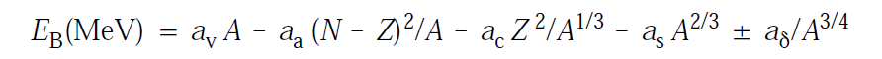
Double Beta Decay and elementary nuclear physics
Even-even
Weiszaecker’s formula for the binding energy of a nucleus
Odd-odd
Nuclear mass as a function of Z,
with fixed A (even)
MASS
Odd-odd
β
X
β⁺β⁺
ECEC
Even-even
DBD
Q-value
Z

Slide 6
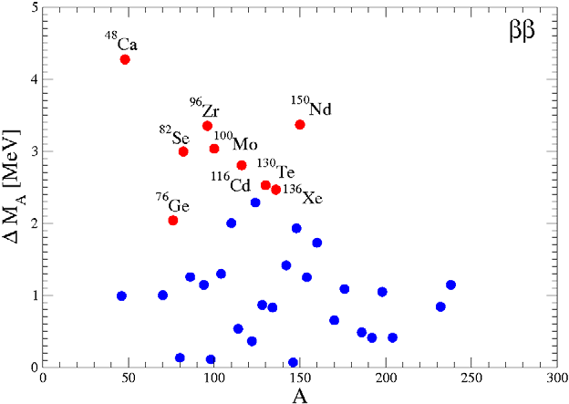
How many nuclei in this condition?
Q-value [MeV]
A

Slide 7
Outline
Introduction
Why Double Beta Decay is important
Challenges in front of us
Technologies and experiments
Looking into the crystal ball

Slide 8
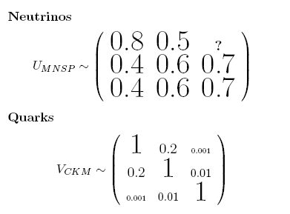
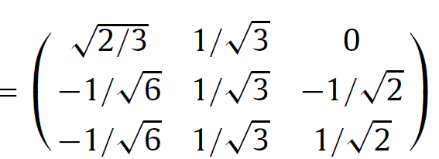

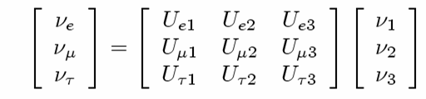
Info from neutrino oscillations
TBM mixing
①
< 0.2
oscillations do occur
neutrinos are massive

given the three ν mass eigenvalues M₁, M₂, M₃ we have
approximate measurements of two ΔM_{ij}²
(ΔM_{ij}² ≡ M_{i}² – M_{j}²)
ΔM₁₂² ~ (9 meV)² Solar
|ΔM₂₃² | ~ (50 meV)² Atmospheric
③
approximate measurements and/or constraints on U_{lj}
elements of the
ν mixing matrix
ν₃
ν₂
ν₁
ν_{e}
ν_{μ}
ν_{τ}

Slide 9
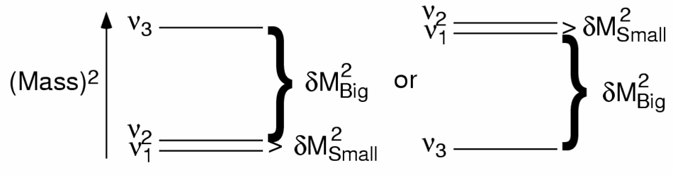
What oscillations don’t tell us
①
absolute neutrino mass scale
degeneracy ? (M₁~M₂~M₃ )
②
neutrino mass hierarchy
direct
inverted
③
DIRAC or MAJORANA nature of neutrinos
ν ≠ ν
ν ≡ ν

Slide 10
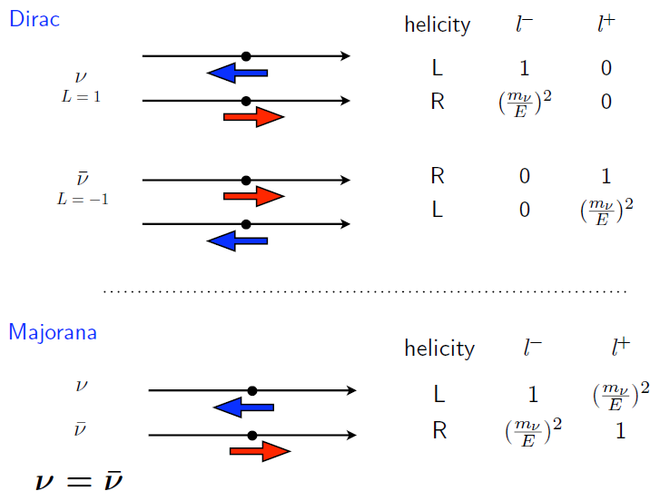
Dirac and Majorana neutrinos, neutrinos and antineutrinos
Probability to produce a charged lepton

Slide 11
Dirac vs Majorana: phenomenology
m_{ν} ≠ 0
DIRAC and MAJORANA neutrinos
have different behaviors
Helicity depends on the reference frame,
while Lepton number does not.
“gedanken” experiment:
High energy
proton
1 GeV
antineutrino
Rest proton
①
1 GeV, 1 eV mass RH antineutrino
Interacts with a rest proton
a positron is produced
via charge currents
②
The same antineutrino is pursued
by a very energetic proton
It is seen as a 1 Gev,
LH particle by the proton
will an electron or will a positron be produced ?
MAJORANA’s answer: H counts.
DIRAC’s answer: L counts.

Slide 12
Double beta decay and the light neutrino exchange (mass mechanism)
u
a LH neutrino (L=1)
is absorbed at this vertex
e⁻
d
With massless neutrinos, the process is forbidden because neutrino has no correct helicity / lepton number to be absorbed at the second vertex
W⁻
ν_{e}
W⁻
ν_{e}
a RH antineutrino (L=-1)
is emitted at this vertex
d
u
e⁻
IF neutrinos are massive DIRAC particles:
0ν-DBD
is forbidden
Helicities can be accommodated thanks to the finite mass,
BUT Lepton number is rigorously conserved
IF neutrinos are massive MAJORANA particles:
0ν-DBD
is allowed
Helicities can be accommodated thanks to the finite mass,
AND Lepton number is not relevant

Slide 13
The mass mechanism
how 0ν-DBD is connected to neutrino mixing matrix and masses
in case of process induced by light ν exchange (mass mechanism)
neutrinoless
Double Beta Decay
rate
Phase
space
Nuclear
matrix elements
Effective
Majorana mass
1/τ = G(Q,Z) |M_{nucl}|²⟨M_{ββ}⟩ ²
< 0.2
what the experimentalists
try to measure
parameter containing
the physics:
Effective Majorana mass
what the nuclear theorists
try to calculate
⟨M_{ββ}⟩ = ||U_{e1} | ²M₁ + e^{iα1} | U_{e2} | ²M₂ + e^{iα2} |U_{e3} | ²M₃ |

Slide 14
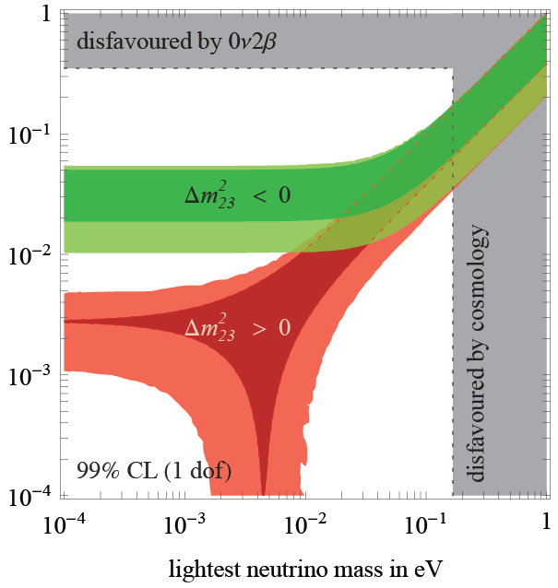
The neutrino mass pattern
⟨M_{ββ}⟩
[eV]

Slide 15
Outline
Introduction
Why Double Beta Decay is important
Challenges in front of us
Technologies and experiments
Looking into the crystal ball

Slide 16

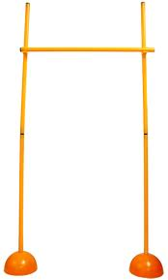
Three hurdles to leap over
⟨M_{ββ}⟩
[eV]
100-1000 counts/y/ton
400 meV
Klapdor’s claim
95% c.l.
0.5-5 counts/y/ton
20 meV
0.1-1 counts/y/(100 ton)
1 meV

Slide 17
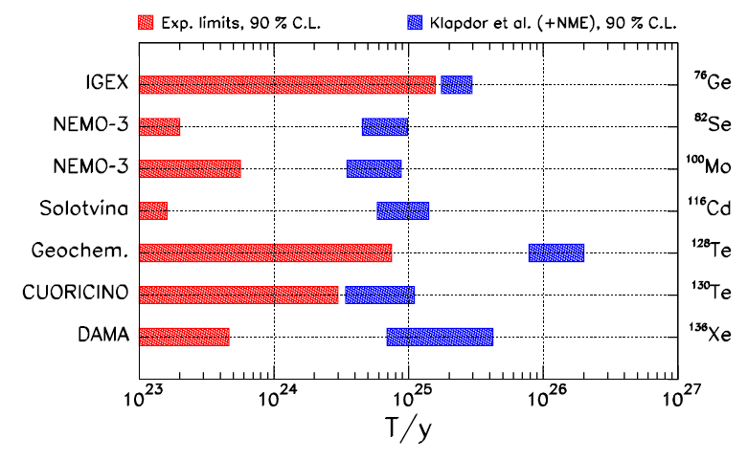
The first leap looks easy but for the moment nobody did it…
A. Faessler et al., Phys. Rev. D79,053001(2009)

Slide 18
Background demands
Present generation experiments, under commissioning or construction, aim at scrutinizing Klapdor’s claim and possibly attacking the inverted hierarchy region
To start to explore the inverted hierarchy region
Sensitivity at the level of 1-10 counts / y ton
To cover the inverted hierarchy region
Sensitivity at the level of 0.1 -1 counts / y ton
The order of magnitude of the target bakground is
~ 1 counts / y ton

Slide 19
Background sources
Natural radioactivity of materials
(source itself, surrounding structures)
Muons and neutrons
Cosmogenic induced activity (long living)
2 ν Double Beta Decay

Slide 20
Experimental approaches
Two approaches:
☹ constraints on detector materials
☺ very large masses are possible
demonstrated: up to ~ 50 kg
proposed: up to ~ 1000 kg
e⁻
①
e⁻
Source ≡ Detector
(calorimetric technique)
☺ with proper choice of the detector,
very high energy resolution
scintillation
phonon-mediated detection
solid-state devices
gaseous/lquid detectors
Ge-diodes
bolometers
☺ in gaseous/liquid xenon detector,
indication of event topology
e⁻
detector
☹ in contradiction
②
source
☹ it is difficult to get large source mass
e⁻
detector
☺ neat reconstruction of event topology
Source ≠ Detector
scintillation
gaseous TPC
gaseous drift chamber
magnetic field and TOF
☺ several candidates can be studied
with the same detector

Slide 21
The sensitivity
sensitivity F: lifetime corresponding to the minimum detectable number
of events over background at a given confidence level
b ≠ 0
b: specific background coefficient
[counts/(keV kg y)]
b = 0
live time
energy resolution
source mass
F ∝ (MT / bΔE)^{1/2}
F ∝ MT
importance of the nuclide choice
(but large uncertainty due to nuclear physics)
1
bΔE
1/4
sensitivity to ⟨M_{ββ}⟩ ∝
Q^{1/2}
|M_{nucl}|
MT

Slide 22
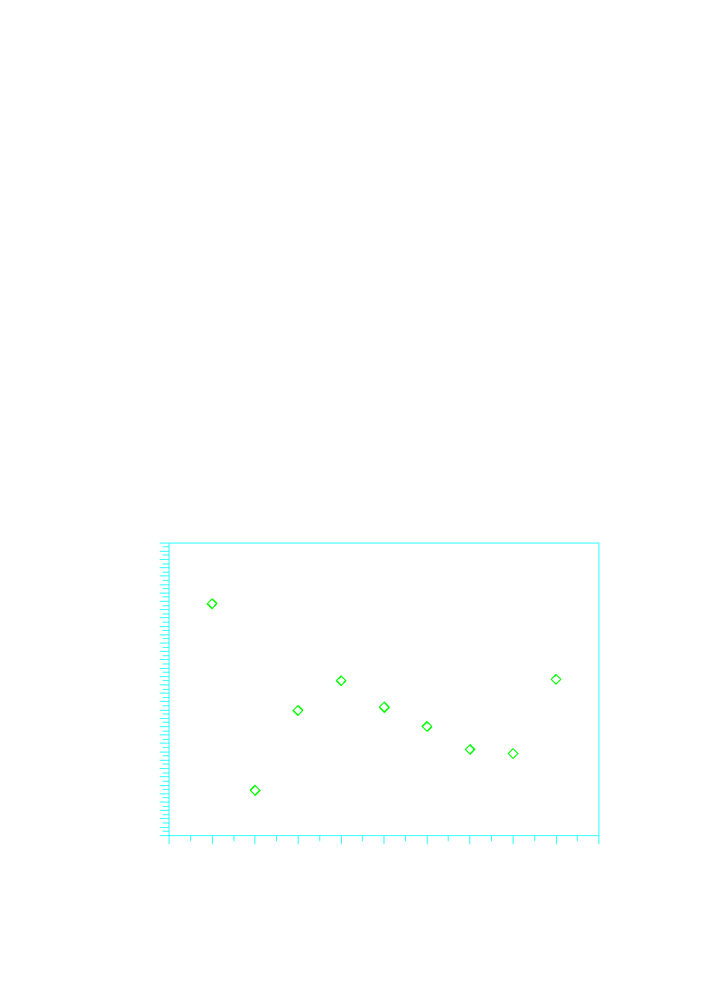

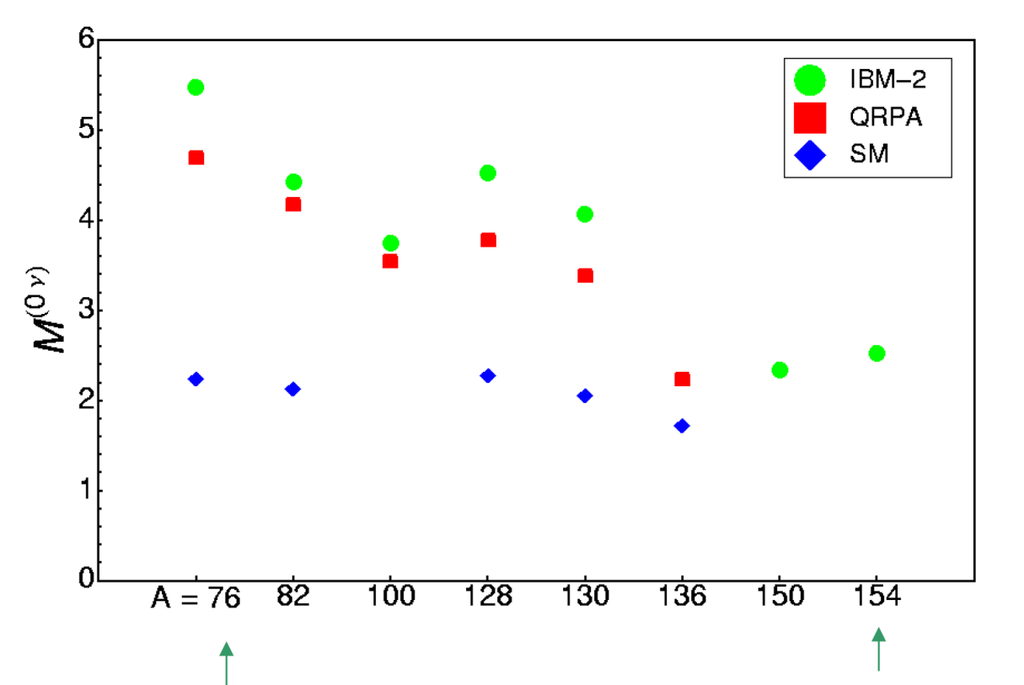
Choice of the nuclide
Transition energy (MeV)
Isotopic abundance (%)
5
40
4
20
3
2
0
Nuclear Matrix Element
⁴⁸Ca
⁷⁶Ge
⁸²Se
⁹⁶Zr
¹⁰⁰Mo
¹¹⁶Cd
¹³⁰Te
¹³⁶Xe
¹⁵⁰Nd
⁴⁸Ca
⁷⁶Ge
⁸²Se
⁹⁶Zr
¹⁰⁰Mo
¹¹⁶Cd
¹³⁰Te
¹³⁶Xe
¹⁵⁰Nd
No super-favoured isotope !
Sign of convergence!

Slide 23
Outline
Introduction
Why Double Beta Decay is important
Challenges in front of us
Technologies and experiments
Looking into the crystal ball

Slide 24
Class 1 experiments
e⁻
GERDA – ⁷⁶Ge
Array of enriched Ge diodes operated in liquid argon
First phase: 18 Kg; second phase: 40 Kg - LNGS
Proved energy resolution: 0.16 % FWHM
CUORE – ¹³⁰Te
Array of low temperature natural TeO₂ calorimeters operated at 10 mK
First step: 200 Kg (2014) – LNGS – it can take advantage from Cuoricino experience
Proved energy resolution: 0.25 % FWHM
MAJORANA – ⁷⁶Ge
Array of enriched Ge diodes operated in conventional Cu cryostats
Based on modules; first step (demonstrator): 2x20 Kg modules
Proved energy resolution: 0.16 % FWHM
LUCIFER – ⁸²Se – ¹¹⁶Cd – ¹⁰⁰Mo
Array of scintillating bolometers operated at 10 mK (ZnSe or CdWO₄ or ZnMoO₄)
First step: ~ 10 Kg (2014) – LNGS – essentially R&D project to fully test the principle
Proved energy resolution: 0.3 - 1 % FWHM
e⁻
High energy resolution («1%)
No tracking capability
Source ≡ Detector
Easy to approach the ton scale
Easy to reject 2ν DBD background
e⁻
detector
source
e⁻
detector
Low energy resolution (≥1%)
Tracking / topology capability
Source ≠ Detector
Easy to get tracking capability
Easy to approach zero background
(with the exception of
2ν DBD component)

Slide 25
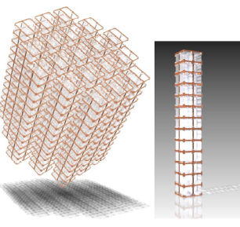
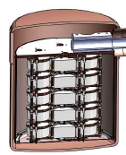
Class 1 experiments
Granularity
CUORE
Majorana

Slide 26
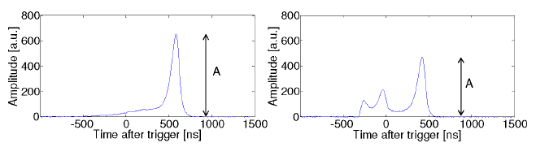
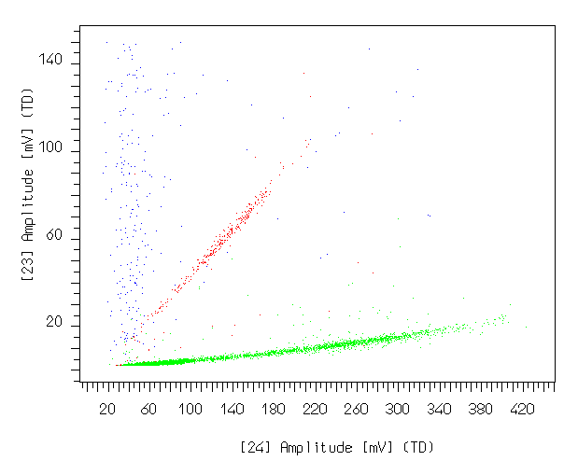
Class 1 experiments
Active background discrimination
GERDA-Majorana - Pulse shape discrimination
LUCIFER – rejection test in ZnSe
α
β,γ, cosmic

Slide 27
CLASS 1
CUORE
Technique/location: natural TeO₂ bolometers at 10 mK– LNGS (Italy)
⇒ evolution of Cuoricino
Source: TeO₂ – 741 kg with natural tellurium - 9.5x10²⁶ nuclides of ¹³⁰Te
Sensitivity: 35 – 82 meV (with target background ~ 10⁻² counts/(keV kg y))
Timeline: first CUORE tower in 2011 – data taking with full apparatus in 2014
CUORE-0 under commissioning
Structure of the detector
Detector in the custom fridge

Slide 28
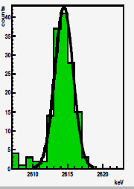
CLASS 1
CUORE - status
The production of the crystals in SICCAS (Shanghai) is going on smoothly
The crystals are tested as bolometers in CUORE configuration by sampling.
Excellent results are routinely obtained in:
- Bolometric performance
- Radiopurity
3.1 keV FWHM at 2.6 MeV
The CUORE assembly line is ready and will be used this to assemble CUORE-0 in the next months
The first base temperature test of the CUORE cryostat is foreseen for 2012
Only concern for background comes from alpha surface radioactivity in Copper ⇒ Cleaning procedure are well established – a background of the order of 5x10⁻² was measured in a dedicated test in hall A – this number will be lower in CUORE just for geometry

Slide 29
CLASS 1
LUCIFER / scintillating bolometers
Technique/location: scintillating bolometers containing high Q-value candidates
(⁸²Se, ¹⁰⁰Mo, ¹¹⁶Cd) ⇒ high phase space, beyond natural gamma radioactivity
Site: for LUCIFER, LNGS is the most natural location; possibility of a scintillating bolometer section in EURECA (Modane extension)
Source: ZnSe, ZnMoO₄, CdWO₄ single crystals
Sensitivity: for LUCIFER, 10 kg enriched Se is feasible with present funding corresponding to ~100 meV (with target background ~ 10⁻³ counts/(keV kg y))
Timeline: LUCIFER ready to take data within 2015 – main difficulty: quality and reproducibility of the crystals ⇒ enrichment, purification, crystal growth chain
Basic idea: Alphas emit a different amount of light with respect to beta/gamma of the same energy (normally lower → α QF < 1, but not in all cases).
Alpha background can be fully rejected in a region where it dominates

Slide 30
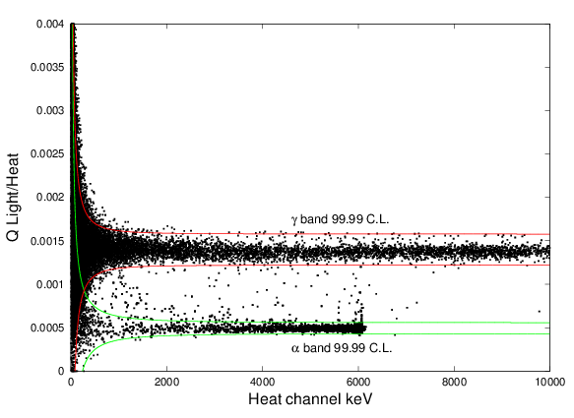
CLASS 1
Scintillating bolometers
The Molybdenum way is very promising, based on ZnMoO₄ crystals
Search is active also with CaMoO₄ crystals (AMORE experiment)
Excellent alpha / beta separation in a ZnMoO₄ prototype operated at CSNSM Orsay

Slide 31
Class 2 experiments
e⁻
e⁻
High energy resolution («1%)
No tracking capability
Source ≡ Detector
NEXT – ¹³⁶Xe
High pressure gas TPC
Total mass: 100 kg
Aims at energy resolution down to 1% FWHM exploiting electroluminesce in high field region
NEXT-10, a 10kg prototype, should provide data in CANFRANC in 2013
COBRA - ¹¹⁶Cd competing candidate – 9 ββ isotopes
Array of ¹¹⁶Cd enriched CdZnTe of semiconductor detectors at room temperatures
Small scale prototype at LNGS
Proved energy resolution: 1.9% FWHM
Pixellization can provide tracking capability
Easy to approach the ton scale
Easy to reject 2ν DBD background
e⁻
detector
source
e⁻
detector
Low energy resolution (≥1%)
Tracking / topology capability
Source ≠ Detector
Easy to get tracking capability
Easy to approach zero background
(with the exception of
2ν DBD component)

Slide 32
Class 2 experiments
e⁻
KamLAND-ZEN – ¹³⁶Xe
Dissolve Xe gas in KAMLAND liquid scintillator – feasable at 3% wt
Use a dedicated balloon immersed in the main vessel
Increase number of PM and change scintillator – 400 kg of enriched Xe in the first phase
Data taking from september
SNO+ – ¹⁵⁰Nd
SNO detector filled with Nd-loaded liquid scintillator
0.1% loading with natural Nd → 1000 Kg Nd in 1000 tons scintillators → 56 Kg of isotope
Crucial points: Nd enrichment and purity; ¹⁵⁰Nd nuclear matrix elements
XMASS – ¹³⁶Xe
Multipurpose scintillating liquid Xe detector (Dark Matter, Double Beta Decay, solar neutrinos)
Three development stages: 3 Kg (prototype) ⇒ 1 ton ⇒ 10 ton
DBD option: low background in the MeV region
Special development with an elliptic water tank to shield high energy gamma rays
High light yield and collection efficiency ⇒ energy resolution down to 1.4% ⇒ control 2ν background
Target: to cover inverted hierarchy with 10 ton natural or 1 ton enriched
CANDLES – ⁴⁸Ca
Array of natural pure (not Eu doped) CaF₂ scintillators
Prove of principle completed (CANDLES I and II)
Proved energy resolution: 3.4 % FWHM (extrapolated from 9.1 % at 662 keV)
The good point of this search is the high Q-value of ⁴⁸Ca: 4.27 MeV
out of γ (2.6 MeV end point), β (3.3 MeV end point) and α (max 2.5 MeV with quench)
Other background cuts come from PSD and space-time correlation for Bi-Po and Bi-Tl
e⁻
High energy resolution («1%)
No tracking capability
Source ≡ Detector
Easy to approach the ton scale
Easy to reject 2ν DBD background
e⁻
detector
source
e⁻
detector
Low energy resolution (≥1%)
Tracking / topology capability
Source ≠ Detector
Easy to get tracking capability
Easy to approach zero background
(with the exception of
2ν DBD component)

Slide 33
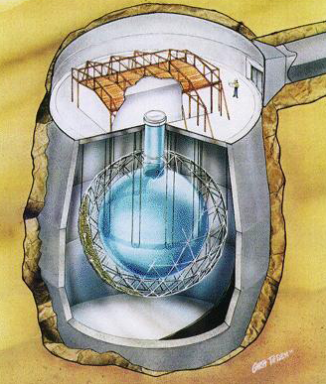
Class 2 experiments
SNO+ vs. KamLAND-ZEN
Insert a balloon
Fill the whole volume

Slide 34
Class 3 experiments
e⁻
EXO – ¹³⁶Xe
TPC of enriched liquid (first phase) and gaseous (second phase) Xenon
Event position and topology; in prospect, tagging of Ba single ion (DBD daughter) through optical spectroscopy ⇒ only 2ν DBD background
Next step (EXO-200: funded, under data taking): 200 kg – WIPP facility – sensitivity: 270-380 meV
Discovery of 2n double beta decay of ¹³⁶Xe
Further steps: 1-10 ton
Proved energy resolution: 3.3 % FWHM (inproved thanks to simultaneous measurement of ionization and light)
In parallel with the EXO-200 development, R&D for Ba ion grabbing and tagging
NEXT – ¹³⁶Xe
High pressure gas TPC
Total mass: 100 kg
Aims at energy resolution down to 1% FWHM exploiting electroluminesce in high field region
NEXT-10, a 10kg prototype, should provide data in CANFRANC in 2013
COBRA - ¹¹⁶Cd competing candidate – 9 ββ isotopes
Array of ¹¹⁶Cd enriched CdZnTe of semiconductor detectors at room temperatures
Small scale prototype at LNGS
Proved energy resolution: 1.9% FWHM
Pixellization can provide tracking capability
e⁻
High energy resolution («1%)
No tracking capability
Source ≡ Detector
Easy to approach the ton scale
Easy to reject 2ν DBD background
e⁻
detector
source
e⁻
detector
Low energy resolution (≥1%)
Tracking / topology capability
Source ≠ Detector
Easy to get tracking capability
Easy to approach zero background
(with the exception of
2ν DBD component)

Slide 35
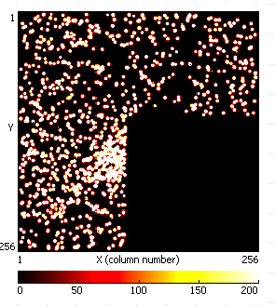
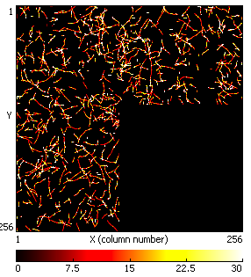
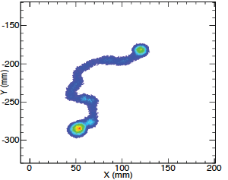
Class 3 experiments
Topology
NEXT – double track signature
alphas
betas
COBRA – solid state TPC

Slide 36
Class 4 experiments
SUPERNEMO - ⁸²Se or ¹⁵⁰Nd
Modules with source foils, tracking (drift chamber in Geiger mode) and calorimetric (low Z scintillator) sections
Magnetic field for charge sign
Possible configuration: 20 modules with 5 kg source for each module ⇒ 100 Kg in Modane extension
Energy resolution: 4 % FWHM
it can take advantage of NEMO3 experience
MOON - ¹⁰⁰Mo or ⁸²Se or ¹⁵⁰Nd
Multilayer plastic scintillators interleaved with source foils + tracking section (PL fibers or MWPC)
MOON-1 prototype without tracking section (2006)
MOON-2 prototype with tracking section
Proved energy resolution: 6.8 % FWHM
Final target: collect 5 y x ton
DCBA - ¹⁵⁰Nd
Momentum analyzer for beta particles consisting of source foils inserted in a drift chamber with magnetic field
Realized test prototype DCBA-T2: space resolution ~ 0.5 mm; energy resolution 11% FWHM at 1 MeV
⇒ 6 % FWHM at 3 MeV
Test prototype DCBA-T3 under construction: aims at improved energy resolution thanks to higher magnetic field (2kG) and higher space resolution
Final target: 10 modules with 84 m² source foil for module (126 through 330 Kg total mass)
e⁻
e⁻
High energy resolution («1%)
No tracking capability
Source ≡ Detector
Easy to approach the ton scale
Easy to reject 2ν DBD background
e⁻
detector
source
e⁻
detector
Low energy resolution ≥1%)
Tracking capability
Source ≠ Detector
Easy to get tracking capability
Easy to approach zero background
(with the exception of
2ν DBD component)

Slide 37
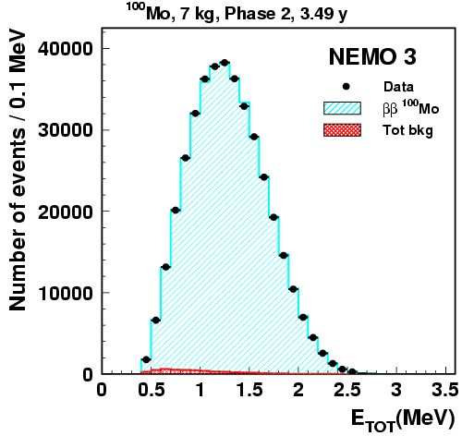
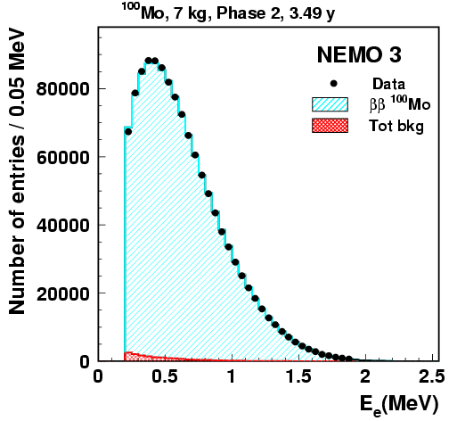
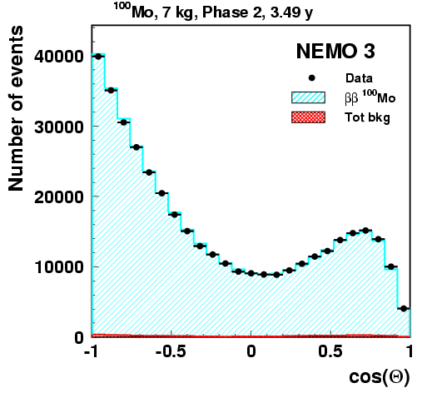
Class 4 experiments
Neat event reconstruction
Unique SuperNEMO capability
Angle btw electrons
Single
electron

Slide 38
Outline
Introduction
Why Double Beta Decay is important
Challenges in front of us
Technologies and experiments
Looking into the crystal ball

Slide 39
Future scenarios (1)
⟨M_{ββ}⟩ range
Requirements and Timeline
degenerate hierarchy
100-200 kg isotope – 1-5 year scale
100 - 500 meV
if this range holds (or if ⁷⁶Ge claim is right):
- GERDA phase 1 / 2 will see it 0ν-DBD ⁷⁶Ge
EXO-200, KamLAND-ZEN, NEXT will see it in ¹³⁶Xe
SNO+ could see it in ¹⁵⁰Nd
CUORE will see it in ¹³⁰Te and may do multi-isotope searches
simultaneously (¹³⁰Te - ¹¹⁶Cd - ¹⁰⁰Mo)
LUCIFER R&D could marginally see it in ⁸²Se or ¹¹⁶Cd or ¹⁰⁰Mo
SuperNEMO may investigate the mechanism (⁸²Se or ¹⁵⁰Nd)
→ reduction of uncertainties in NME
→ precision measurement era for 0ν-DBD!
15 - 50 meV
inverted hierarchy - atmospheric ΔM² region
1000 kg isotope – 5-10 year scale
2 - 5 meV
direct hierarchy - solar ΔM² region
100 tons of isotopes
unpredictable time scale

Slide 40
Future scenarios (1)
if this range holds:
SuperNEMO could marginally see it in ⁸²Se or ¹⁵⁰Nd
- GERDA phase III / MAJORANA could see it in ⁷⁶Ge
CUORE could marginally see it, but could clearly detect it in ¹³⁰Te if enriched or in ⁸²Se / ¹¹⁶Cd / ¹⁰⁰Mo if upgraded to LUCIFER-mode
Kamland-ZEN and NEXT could see it in ¹³⁶Xe if the background anticipations are correct
→ large scale enrichment required
discovery in 3 or 4 isotopes necessary (and possible...)
to confirm the observation and to improve ⟨M_{ββ}⟩ estimate
⟨M_{ββ}⟩ range
Requirements and Timeline
degenerate hierarchy
100-200 kg isotope – 1-5 year scale
100 - 500 meV
15 - 50 meV
inverted hierarchy - atmospheric ΔM² region
1000 kg isotope – 5-10 year scale
2 - 5 meV
direct hierarchy - solar ΔM² region
100 tons of isotopes
unpredictable time scale

Slide 41
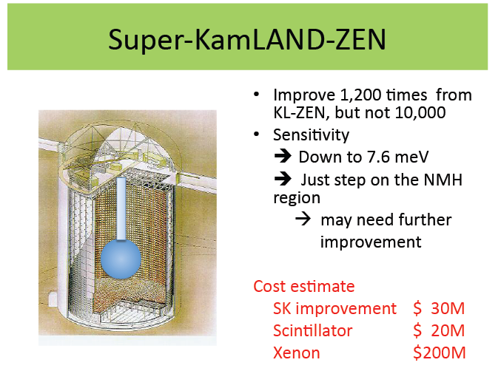
Future scenarios (1)
From Yoichiro Suzuki – NOW2010
⟨M_{ββ}⟩ range
Requirements and Timeline
degenerate hierarchy
100-200 kg isotope – 1-5 year scale
100 - 500 meV
if this range holds:
- new strategies have to be developed
- it is worthwhile to start to elaborate them now
- next generation experiments are precious
for the selection of the future approaches
- a colossal investment in enrichment is required
40 tons of ¹³⁶Xe
15 - 50 meV
inverted hierarchy - atmospheric ΔM² region
1000 kg isotope – 5-10 year scale
2 - 5 meV
direct hierarchy - solar ΔM² region
100 tons of isotopes
unpredictable time scale

Slide 42
Conclusions
Exciting times for double beta decay and neutrino masses:
degeneracy will be deeply probed
discovery potential in case of inverted hierarchy
Next generation
⟨M_{ββ}⟩ [eV]

