Slide 2
Contents
The TESLA Collaboration Framework
TTF and the Free-Electro Laser
Parallel Development of TESLA and XFEL
XFEL Approval and TESLA going to the ILC

Slide 3
Contents
The TESLA Collaboration Framework
TTF and the Free-Electro Laser
Parallel Development of TESLA and XFEL
XFEL Approval and TESLA going to the ILC

Slide 4
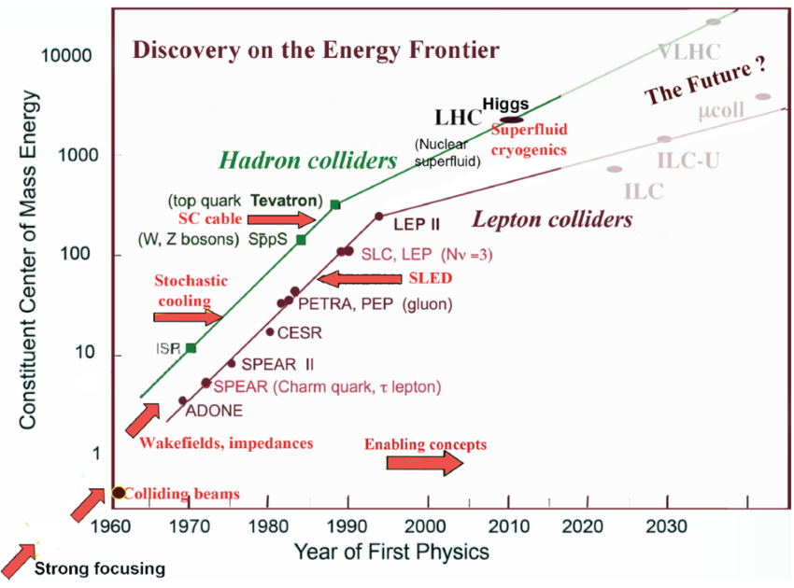
From 1979 HEP drives Accelerators R&D
CEPC-hh
CEPC
K. Yokoya, 2014

Slide 5
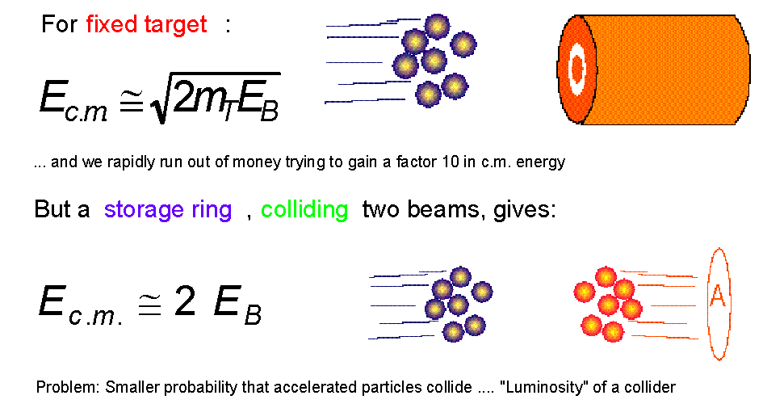
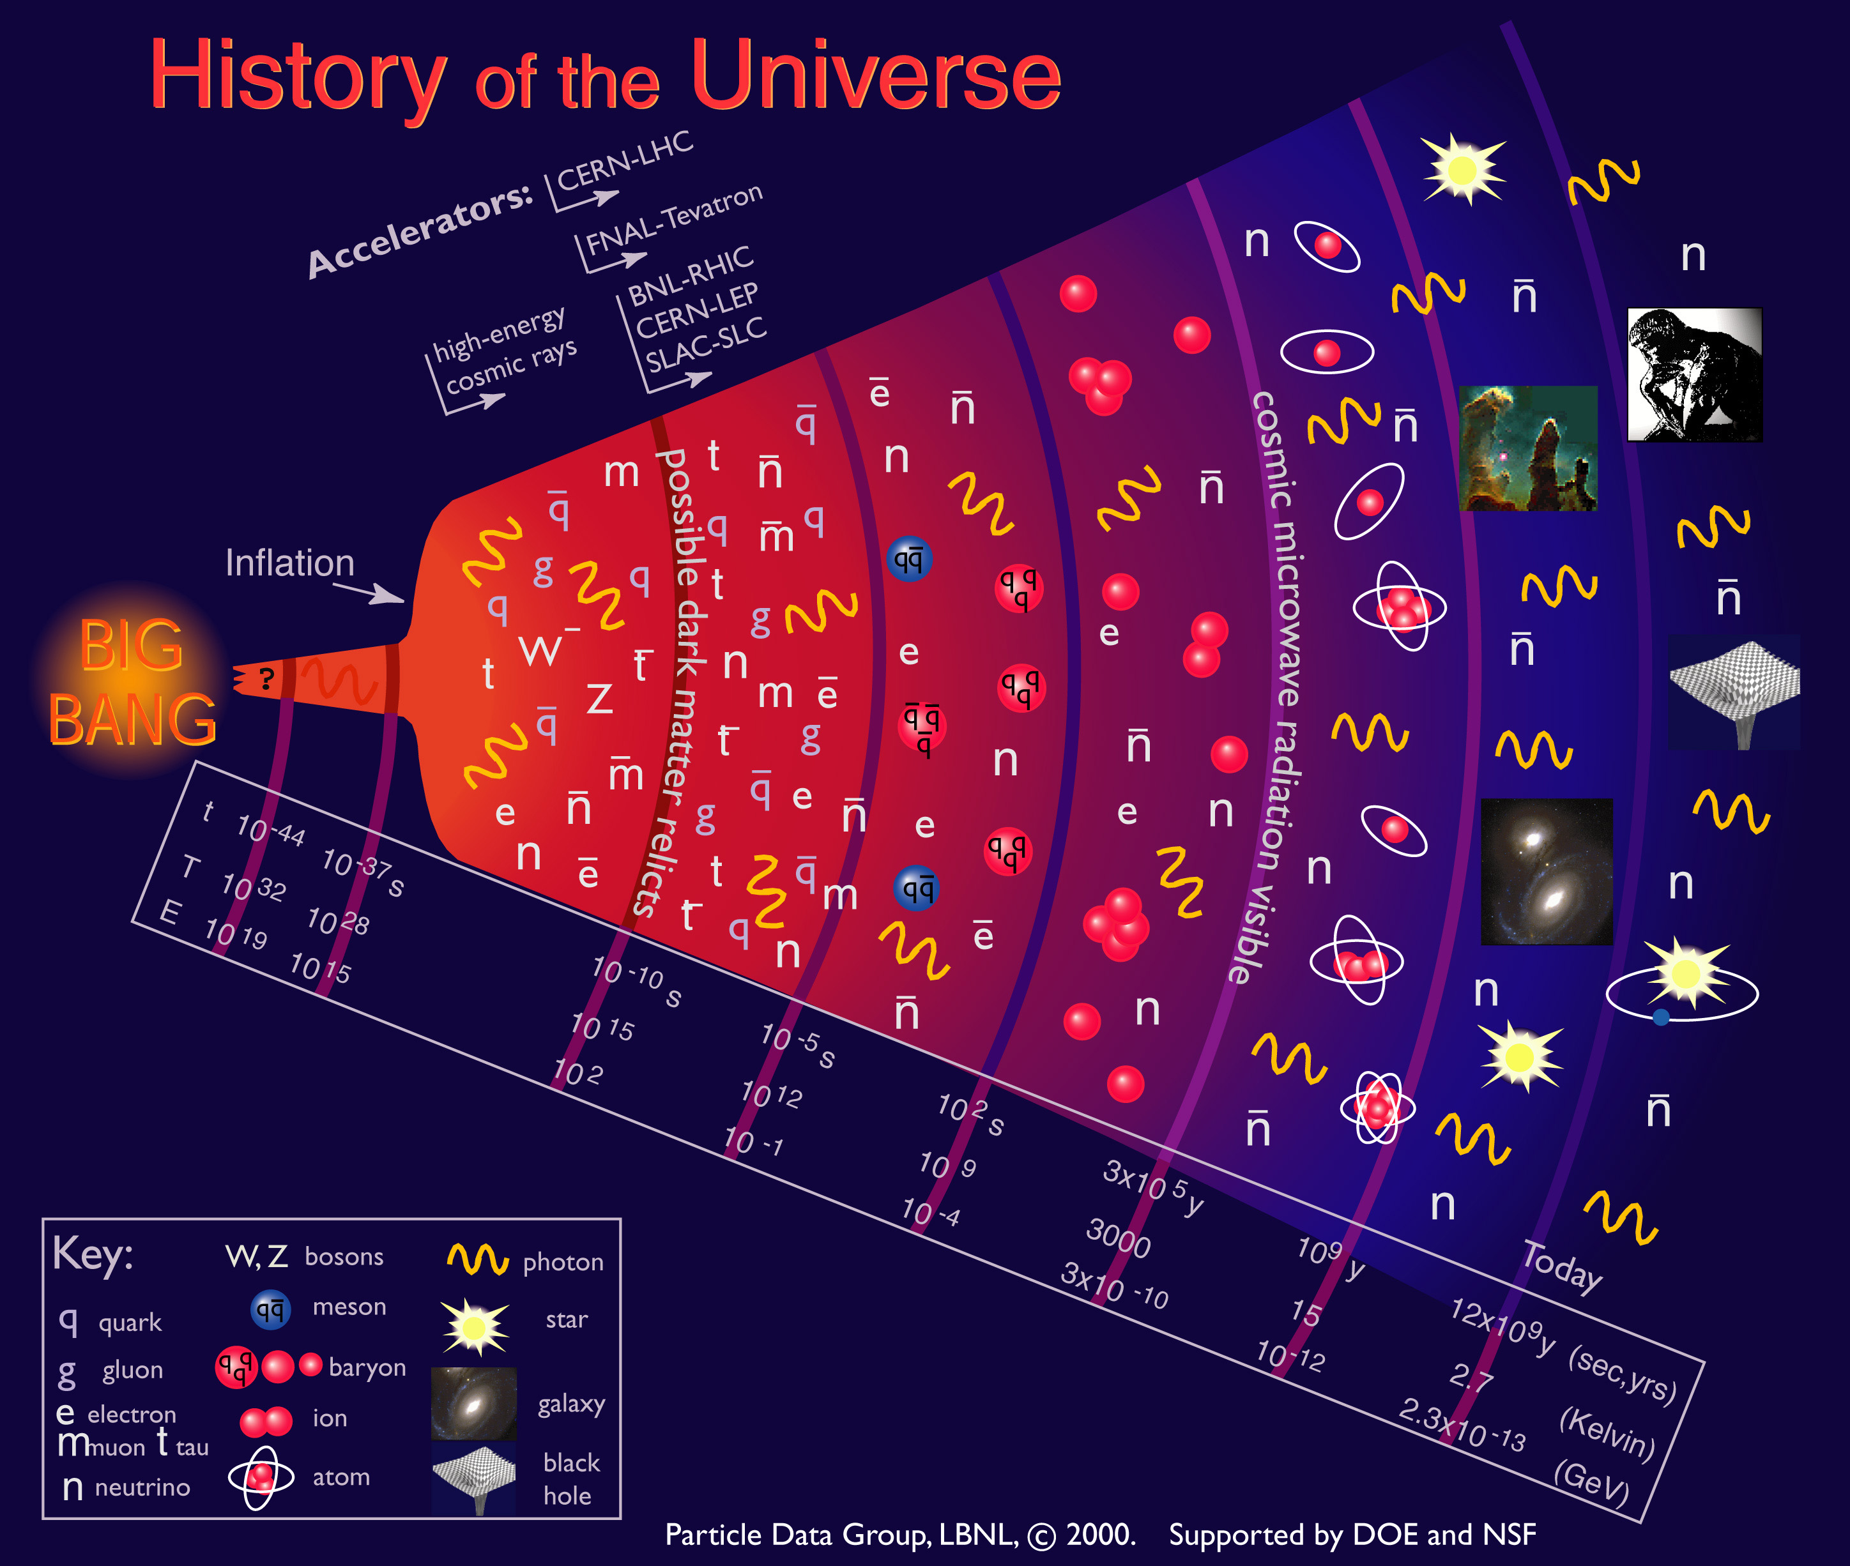
Colliders for center of mass Energy, E_{c.m.}
  The center-of-mass Energy, E_{c.m.}, is the energy created at the center-of-mass of the collision point. This evolution of E_{c.m.} creates particles, fermions and bosons, and through them we are looking deeper and deeper in the microscopic scale of space and time.

Slide 6
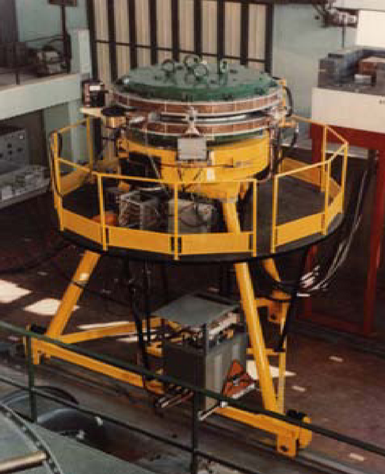
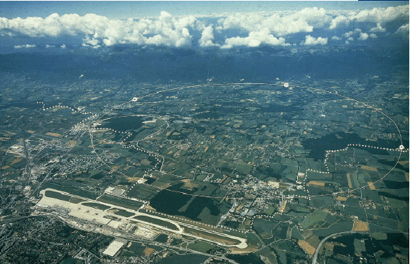
From Ada to LEP & LHC in the CERN area
CERN
LEP/LHC
Geveva Airport
Ada, the first e⁺e⁻ collider
Designed and built at Frascati in 1960
LEP-II e⁺e⁻ lepton collider E_{c.m.} = 200 GeV
LHC pp hadron collider E_{c.m.} = 14 TeV

Slide 7
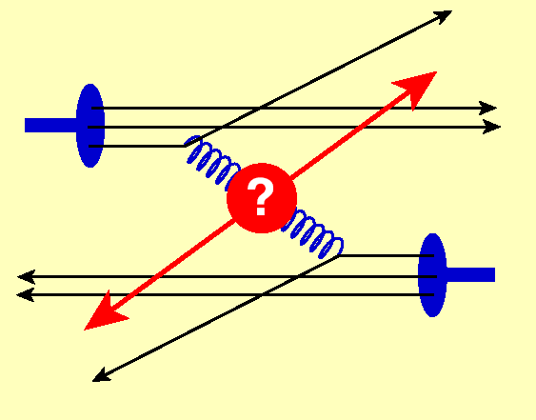
Why also leptons are needed?
Leptons (e⁻, e⁺, μ⁻, μ⁺) are Fermions, i.e. matter constituents
e⁺
e⁻
E_{react.} = E_{c.m.} = 2 E_{beam}
Hadrons (p, , ions) are complex composite particles
u
u
u
d
u
d
p
p
E_{react.} << 2 E_{beam}
Gluon-Gluon Collision
E_{react.} cannot be controlled and it is unknown

Slide 8
No Circular e⁺e⁻ Collider after LEP
Synchrotron Radiation:
charged particle in a magnetic field:
Energy loss dramatic for electrons
γ_{proton} / γ_{electron} ≈ 2000
Impractical scaling of LEP II to
E_{cm} = 500 GeV and L = 2 . 10³⁴
  170 km around
  13 GeV/turn lost
  1 A current/beam
  26 GW RF power
  Plug power request > Germany
Energy loss replaced by RF power
cost scaling $ ∝ E_{cm}²

Slide 9
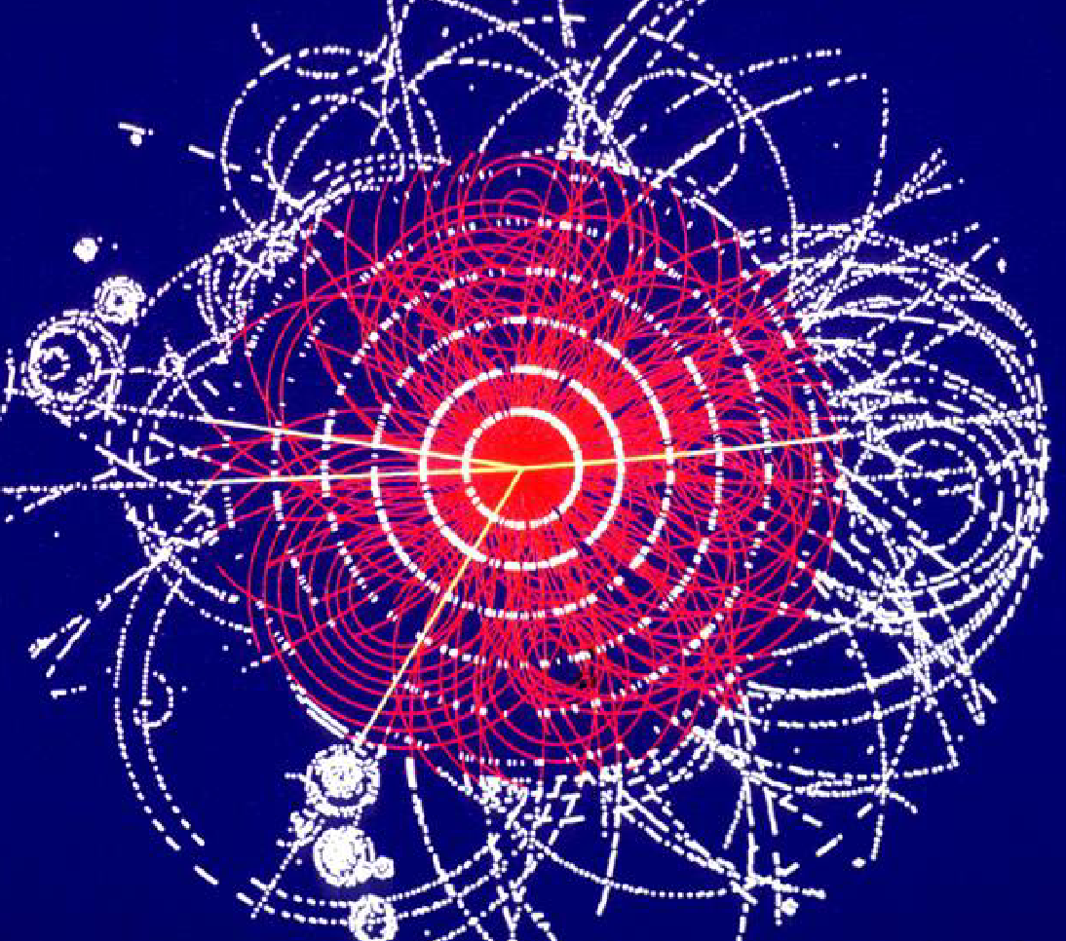
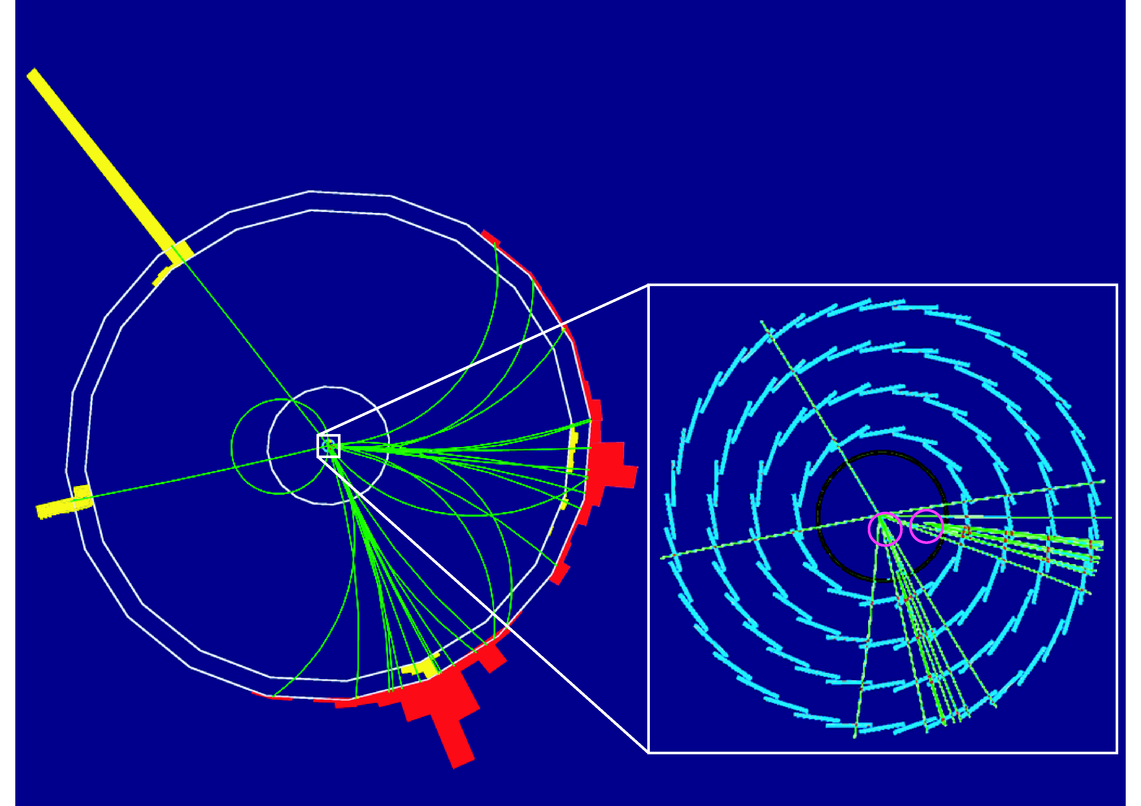
Higgs event Simulation Comparison
LHC: hadron collision
ILC: lepton collision
ILC
e⁺ e– → Z H Z → e⁺ e–, H → b

Slide 10
Origin of the Linear Collider Idea
M. Tigner,
Nuovo Cimento 37 (1965) 1228
A Possible Apparatus for Electron-Clashing Experiments (*).
M. Tigner
Laboratory of Nuclear Studies. Cornell University - Ithaca, N.Y.
“While the storage ring concept for providing clashing-beam experiments (¹) is very elegant in concept it seems worth-while at the present juncture to investigate other methods which, while less elegant and superficially more complex may prove more tractable.”

Slide 11
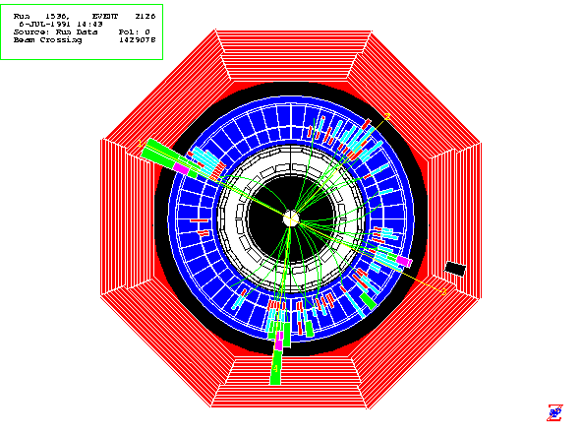
Linear Collider Conceptual Scheme
Final Focus
Demagnify and collide beams
Main Linac
Accelerate beam to IP energy without spoiling DR emittance
Bunch Compressor
Reduce σ_{z} to eliminate hourglass effect at IP
Damping Ring
Reduce transverse phase space (emittance) so smaller transverse IP size achievable
Positron Target
Use electrons to pair-produce positrons
Electron Gun
Deliver stable beam current

Slide 12
Fighting for Luminosity
C. Pagani - ISLC08 - Lecture 1
Oak Brook, October 20, 2008
L = Luminosity
N_{e} = # of electron per bunch
σ_{x,y} = beam sizes at IP
IP = interaction point
n_{b} = # of bunches per pulse
f_{rep} = pulse repetition rate
P_{b} = beam power
E_{c.m.}= center of mass energy
Parameters to play with
Reduce beam emittance (ε_{x} .ε_{y} ) for smaller beam size (σ_{x}.σ_{y} )
Increase bunch population (N_{e} )
Increase beam power
Increase beam to-plug power efficiency for cost

Slide 13
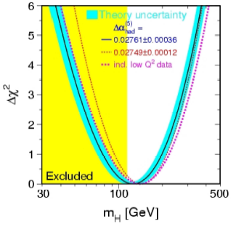
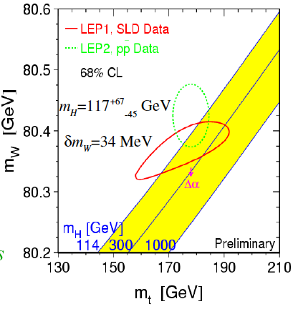

Higgs mass from SM: 117-200 GeV
$$m_{H}=125 GeV$$
Measured at the LHC

Slide 14
Complementarity between LHC and ILC
Since the ILC will start after the start of LHC, it must add significant amount of information. This is the case!
Neither LC nor HC’s can draw the whole picture alone. ILC will add new discoveries and precision of ILC will be essential for a better understanding of the underlying physics.
There are probably pieces which can only be explored by the LHC due to the higher mass reach. Joint interpretation of the results will improve the overall picture
In the Higgs Boson Scenario
LHC will make the discovery
ILC will behave as a Higgs Boson factory to precisely determine its properties and the consequences for physics beyond the standard model

Slide 15
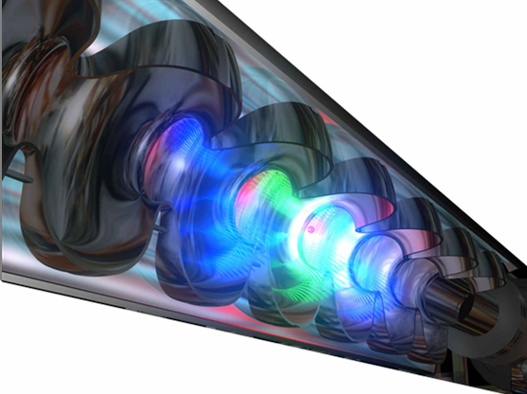
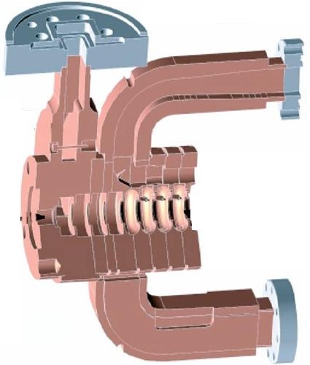

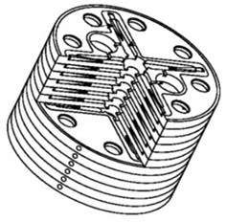


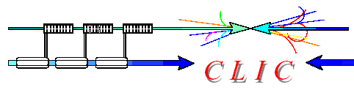
Competing technologies for the ILC Linac
C. Pagani - ISLC08 - Lecture 1
Oak Brook, October 20, 2008
1.3 GHz - Cold
11.4 GHz - Warm
30 GHz-Warm

Slide 16
The TESLA Mission since 1990
Develop SRF Technology for the future Linear Collider
Basic goals on SRF Technology
  Increase gradient by a factor of 5: from 5 to 25 MV/m
    Push cavity performances close to the physical limit, understanding practical limits
    Set all the required quality control for reproducibility and industrial production
  Make possible pulsed operation: Lorentz force detuning
    Combine SRF and mechanical engineering in cavity design
    Develop efficient Modulators and Klystrons
    Develop new ancillaries: slow and fast tuners, couplers
  Reduce cost per MV by a factor 20: to make the LC feasible
    New cryomodule concept for cryolosses, cost and filling factor (for real estate gradient)
    All subsystems designed for large scale production
    Reliability and quality control as a general guideline
Basic goals on Machine Design
  Design a Linear Collider based on the Cold Linac peculiarities
  Maximize Luminosity and optimize cost for a given plug power
  Design and quote major subsystems: DR, Positron Source, BDS, etc.
  Put all together in a consistent TDR, including cost estimation

Slide 17
Contents
The TESLA Collaboration Framework
TTF and the Free-Electro Laser
Parallel Development of TESLA and XFEL
XFEL Approval and TESLA going to the ILC

Slide 18
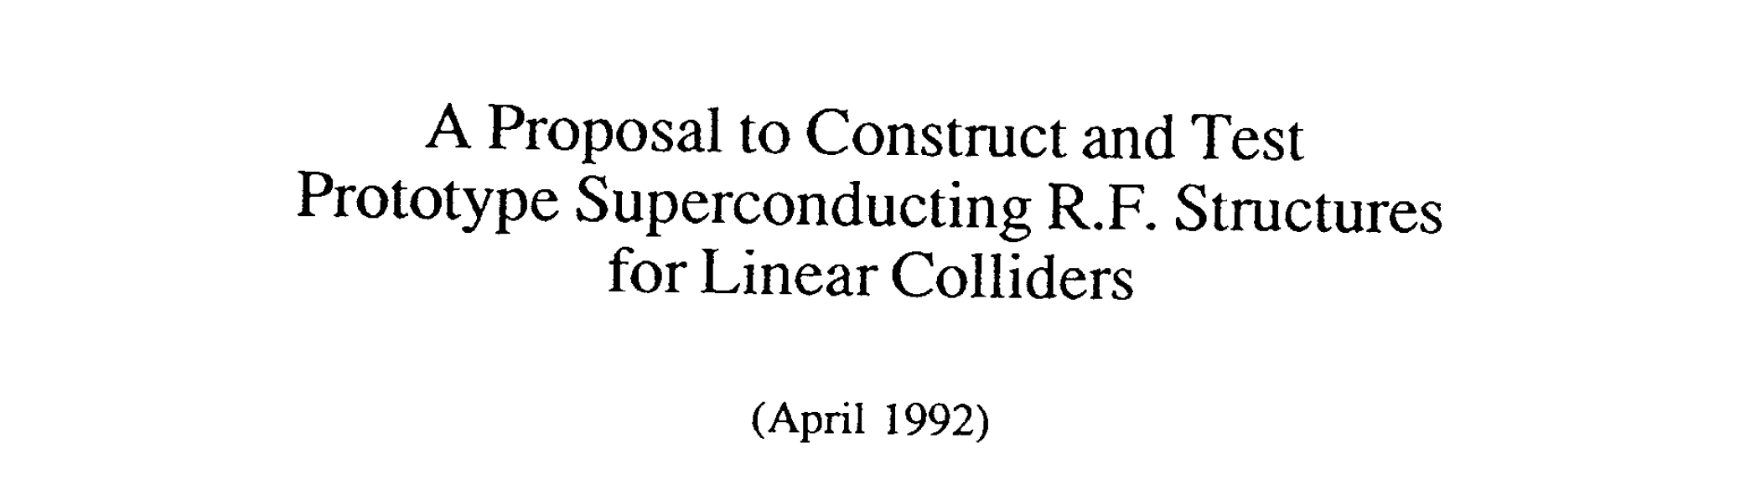
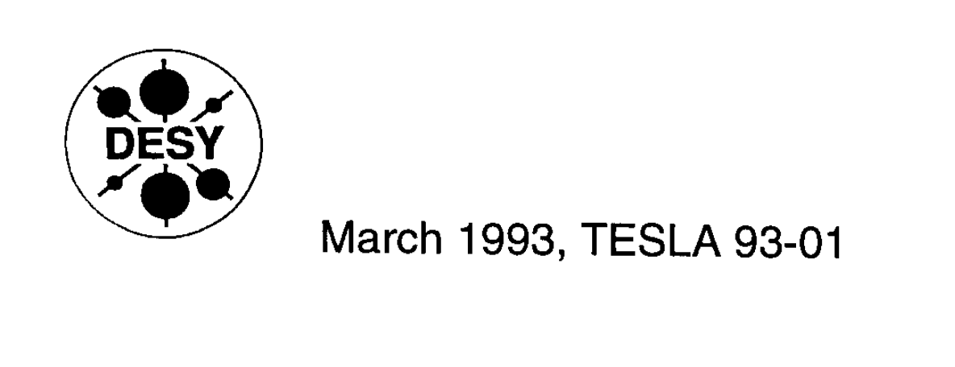
The origin of TTF: TESLA Test Facility

Slide 19
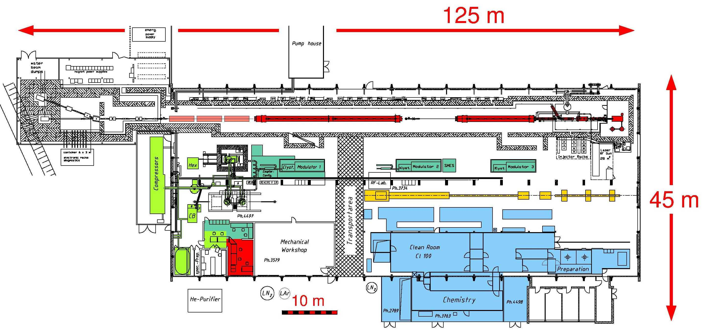
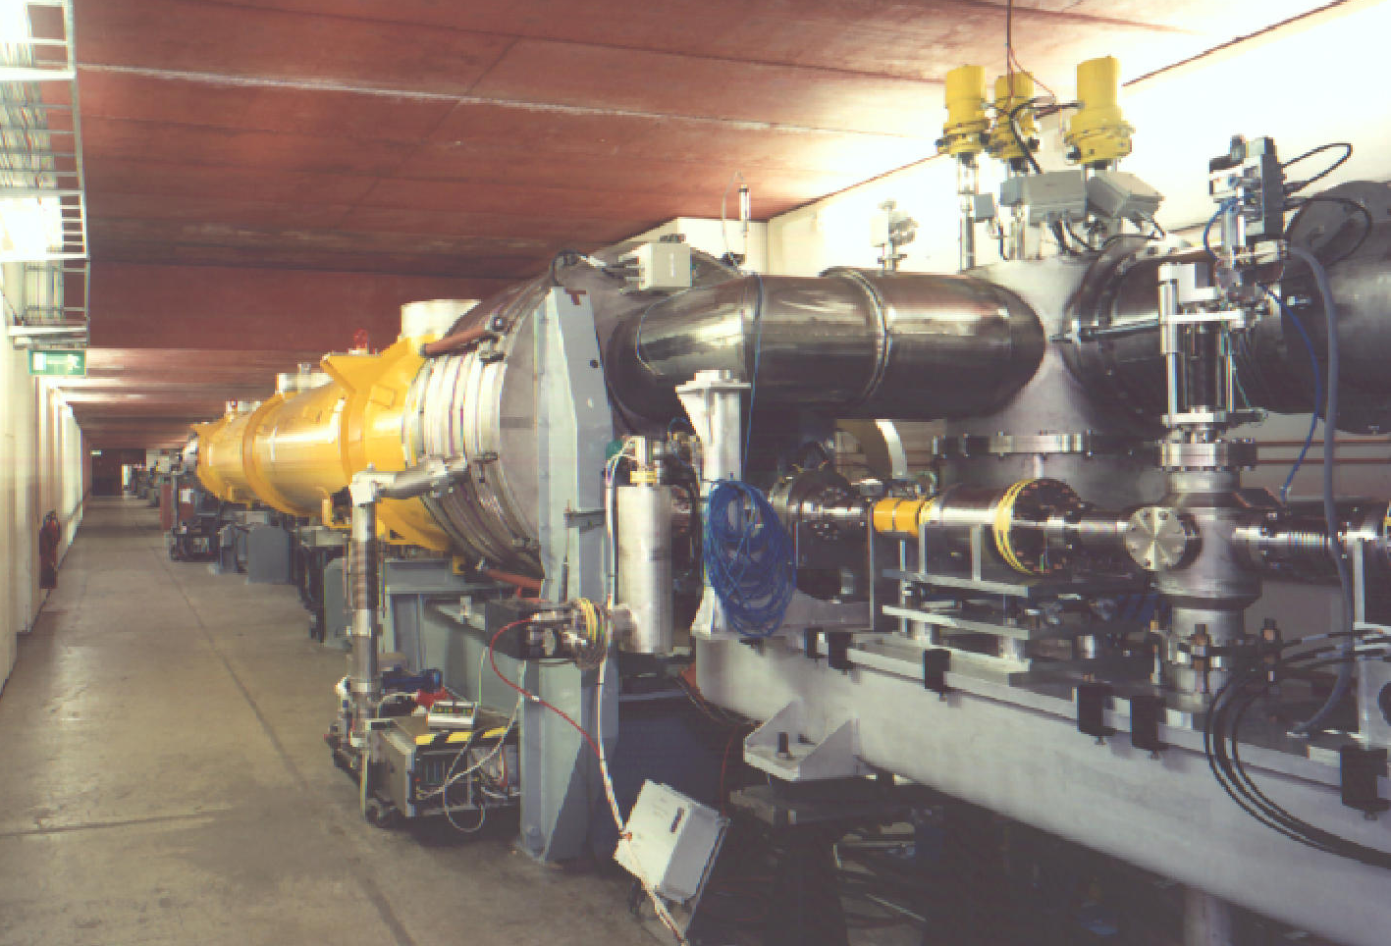
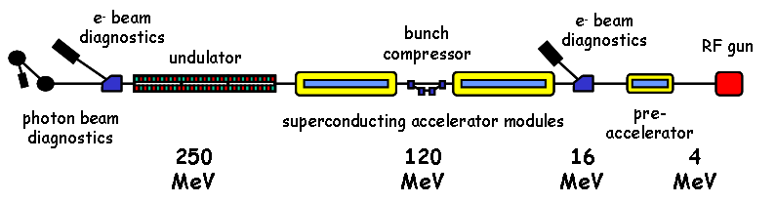
TTF: a new infrastructure at DESY
TTF as operated for SASE FEL

Slide 20
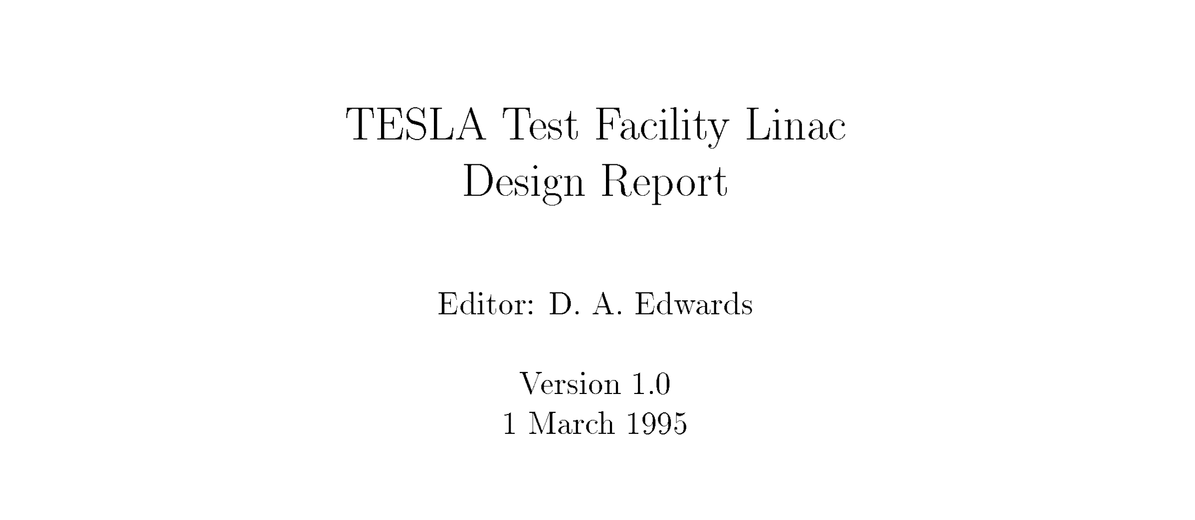
The TTF Design Report

Slide 21




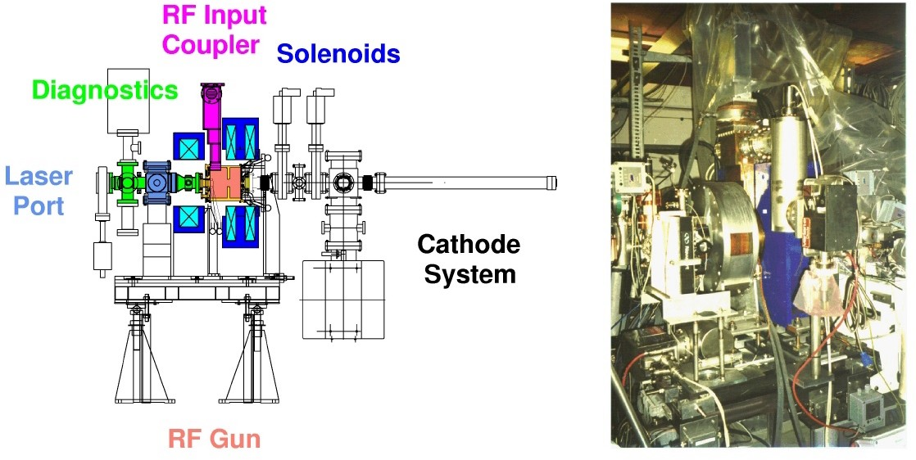
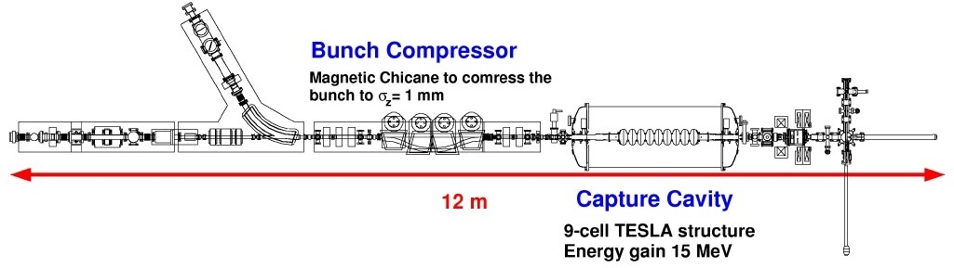
TTF: the RF Gun based Injector
CEA/DSM DAPNIA, Saclay IN2P3/LAL, Orsay IN2P3/IPN, Orsay
Max-Born Inst., Berlin DESY Hamburg
INFN LASA, Milano INFN Frascati
INFN and Univ. Roma 2
Fermilab, Batavia Rochester Univ. UCLA, Los Angeles ANL, Argonne

Slide 22






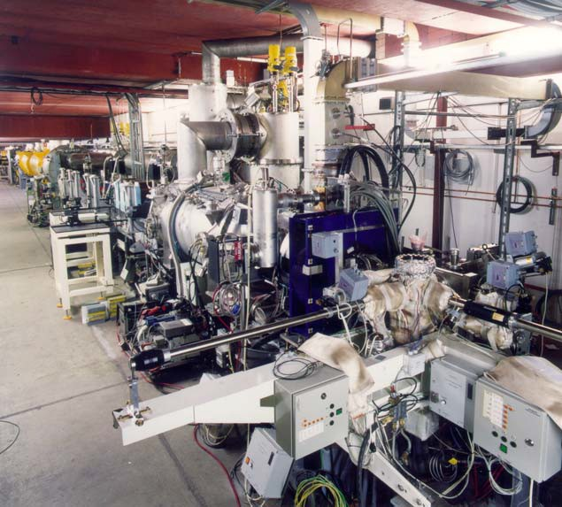
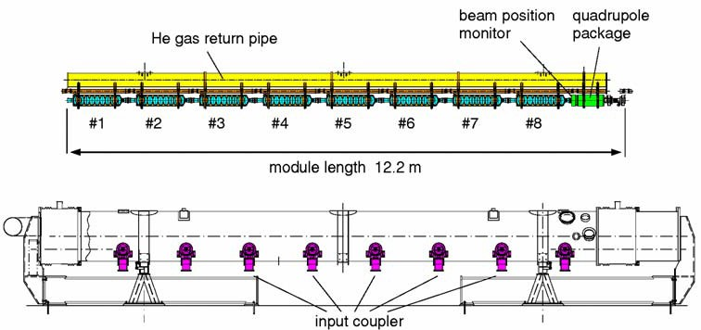
TESLA Test Facility Linac (TTF 1)
laser driven electron RF gun
beam diagnostics
bunch compressor
photon beam diagnostics
undulator
sc pre- accelerator
4 MeV
superconducting accelerating modules
120 MeV 250 MeV
16 MeV

Slide 23

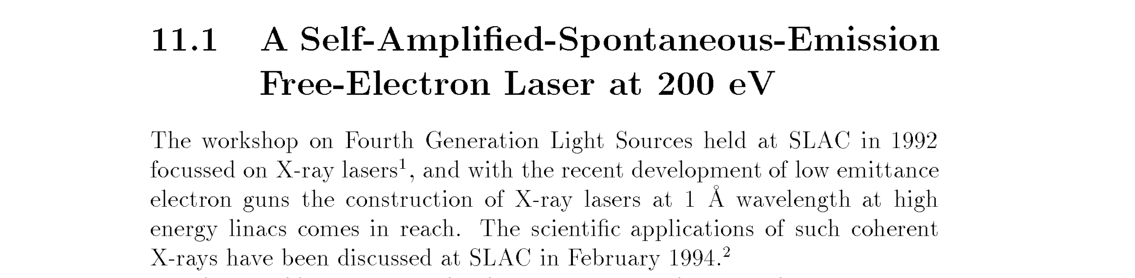
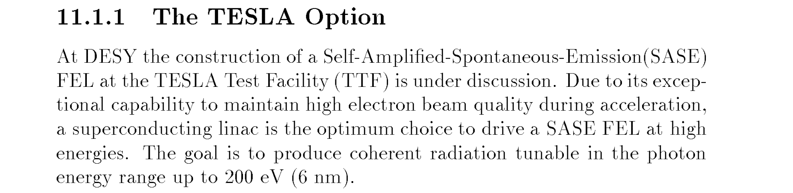
FEL is the 1° potential application

Slide 24
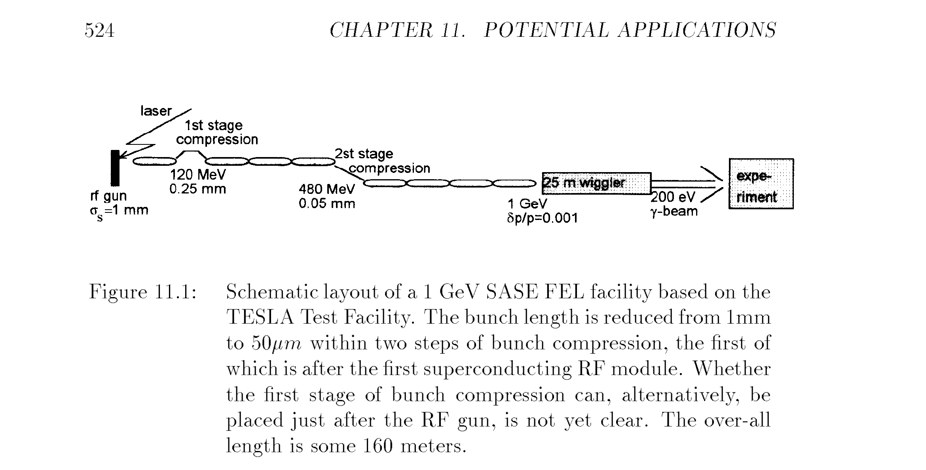
Schematic Layout of SASE FEL @ TTF

Slide 25
Why TESLA and XFEL developed together?
    With the enormous support from the HEP community TESLA was develloping an accelerator to efficiently produce an high energy electron beam of unprecedented quallity, high brightness and low emittance, i.e. the ideal beam for a Free-Electron Laser
    This effort sustained by an international scientific community and with the interested collaboration of industry because of the perspective of the realization of a huge scientific infrastructure led to the parallel developments of all the accelerator subcomponents: RF, cryogenics, electronics, etc.
    The required development of a TESLA Test Facility to combine the different components and experimentally qualify all the hardware and beam theory, created the condition of having an unique infrastructure for FEL experiments and applied physics.
    Finally, the existance at DESY of a consistent community of photon scientist at Hasylab, suggessted the dual use of TTF, so extending the scientific interest for the TESLA mission

Slide 26
Emittance ad Brightness drive Luminosity
C. Pagani - ISLC08 - Lecture 1
Oak Brook, October 20, 2008
L = Luminosity
N_{e} = # of electron per bunch
σ_{x,y} = beam sizes at IP
IP = interaction point
n_{b} = # of bunches per pulse
f_{rep} = pulse repetition rate
P_{b} = beam power
E_{c.m.}= center of mass energy
Parameters to play with
Reduce beam emittance (ε_{x} .ε_{y} ) for smaller beam size (σ_{x}.σ_{y} )
Increase bunch population (N_{e} )
Increase beam power
Increase beam to-plug power efficiency for cost

Slide 27
The Luminosity Issue: Aiming for 2x10³⁴
Collider luminosity [cm⁻² s⁻¹] is
approximately given by
where:
  n_{b} = bunches / train
  N = particles per bunch
  f_{rep} = repetition frequency
  A = beam cross-section at IP
  H_{D} = beam-beam enhancement factor
For a Gaussian beam distribution
luminosity is usually written

Slide 28
The Luminosity Issue: RF Power - 1
Introducing the
centre of mass energy, E_{cm}
Is the RF to beam Power Efficiency
i.e. for a given E_{cm}
Luminosity is proportional to the RF Power

Slide 29
The Luminosity Issue: RF Power - 2
Using some rough ILC numbers
E_{cm} = 500 GeV
N = 2 x 10¹⁰
n_{b} = 3000
f_{rep} = 5 Hz
Taking into account conversion efficiencies
It turns out that ~ 70 MW of average AC Power are required to accelerate the 2 beams to 250 GeV, achieving Luminosity
P_{beam} ~ 2 x 10 MW
~ 60% (SCRF)
~ 50%

Slide 30
The Luminosity Issue: LEP vs ILC
LEP f_{rep} = 44 kHz
ILC f_{rep} = 5 Hz
(power limited)
⇒ factor 8800 in L already lost!
Must push very hard on beam cross-section at collision:
LEP: σ_{x}σ_{y} ≈ 130×6 μm²
ILC: σ_{x}σ_{y} ≈ 500×(3-5) nm²
factor of 10⁶ gain!
Needed to obtain high luminosity of a few 10³⁴ cm⁻²s⁻¹

Slide 31
Luminosity: Beam Size & Beam Power
f_{rep} . n_{b} tends to be low in a linear collider
The beam-beam tune shift limit is much looser in a linear collider than a storage rings → achieve luminosity with spot size and bunch charge
  Small spots mean small emittances, ε_{x,y} and small β-functions, β_{x,y}
 | L [cm⁻² s^{_1}] | f_{rep} [s⁻¹] | n_{b} | N [10¹⁰] | σ_{x} [μm] | σ_{y} [μm]
ILC | 2.10³⁴ | 5 | 3000 | 2 | 0.5 | 0.005
SLC | 2.10³⁰ | 120 | 1 | 4 | 1.5 | 0.5
LEP II | 5.10³¹ | 10,000 | 8 | 30 | 240 | 4
PEP II | 1.10³⁴ | 140,000 | 1700 | 6 | 155 | 4

Slide 32
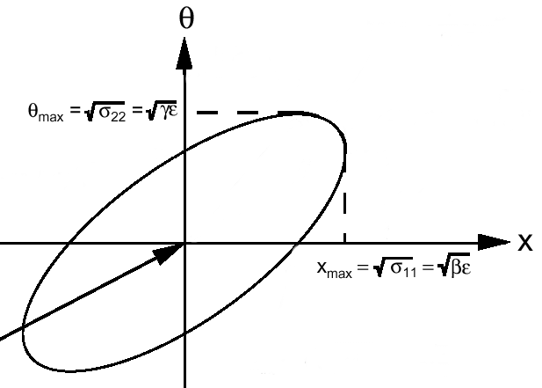
Emittance and Phase Space
Beta function β characterize optics
Emittance ε is phase
space volume of the
beam – optics analogy
is the wavelength
Tilt is parameterized with α
Beam size: (ε β)^{1/2}
Divergence: (ε /β)^{1/2}
Squeeze on beam size → increase angular divergence
Beam emittance is not conserved during acceleration → normalized emittance should be γε

Slide 33
Drawback: all Linear Colliders are pulsed
All the LCs must be pulsed machines to improve efficiency. As a result:
duty factors are small
pulse peak powers can be very large
C. Pagani - ISLC08 - Lecture 1
Oak Brook, October 20, 2008
<1 µs-1ms
<10-200 ms
RF Pulse
100 m - 300 km
Bunch Train
……
1-300 nsec
…………………....
gradient
with further input
Beam Loading
without input
accelerating field pulse:
filling
loading

Slide 34

TTF 1 Operational Statistics
Operated 7 days per week, 24 hours per day, since 1997
15,000 hours of beam delivered since November 2002
About 50 % of the time was allocated to FEL operation including a large percentage of user time.
beam uptime
operational uptime (users or acc.studies)
100%
OFF DOWNDOWN 6%
8%
OFF 8%
80%
DOWN 6%
TUNING
60%
19%
USERS 63%
TUNING 25%
STUDIES 61%
STUDIES
4%
40%
Week 3/2002
FEL
Operation
Week 7/2002
Accelerator Studies
20%
2001
2002
35
40
45
50
5
10
week

Slide 35







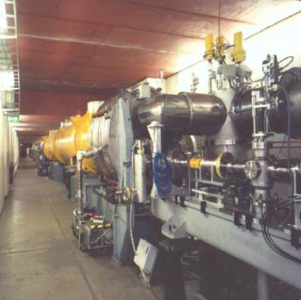
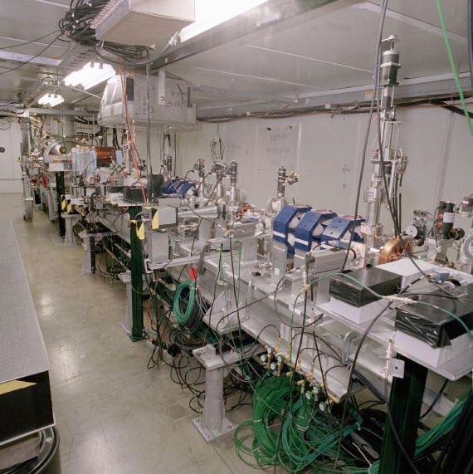
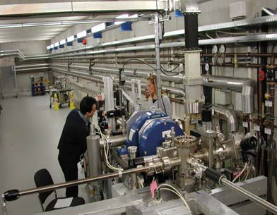
GAN: TTF Practiced Remote Operation
Home, Office
Roma/ Frascati
Milano
Paris
Batavia
Hamburg
Berlin
INFN
BKR
CEA Saclay
Fermilab
PITZ
TTF
TTF @ DESY
Photoinjector @ Fermilab
PITZ @ Zeuthen

Slide 36
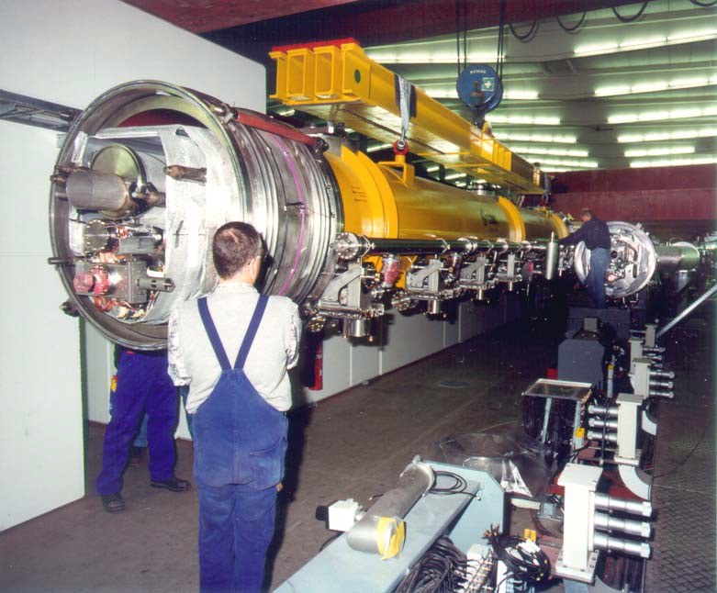
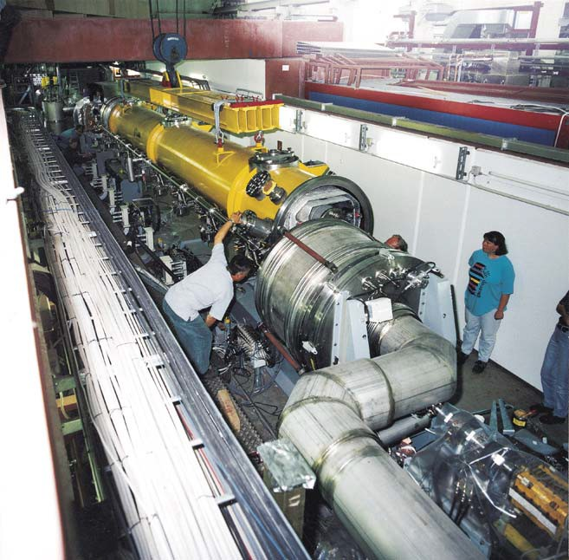
From TTF1 to TTF2/FLESH

Slide 37
Contents
The TESLA Collaboration Framework
TTF and the Free-Electro Laser
Parallel Development of TESLA and XFEL
XFEL Approval and TESLA going to the ILC

Slide 38


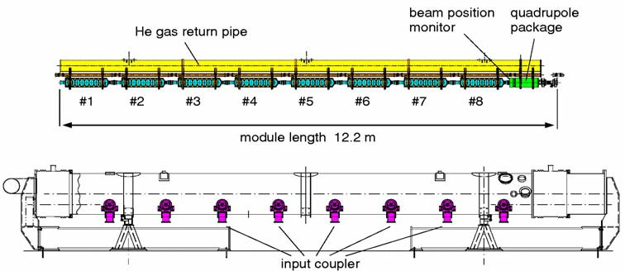
TTF2 as XFEL Injector Prototype
e⁻ beam
BC3 BC2
RF-GUN
ACC5 ACC4 ACC3 ACC2 ACC1
500 MeV

Slide 39
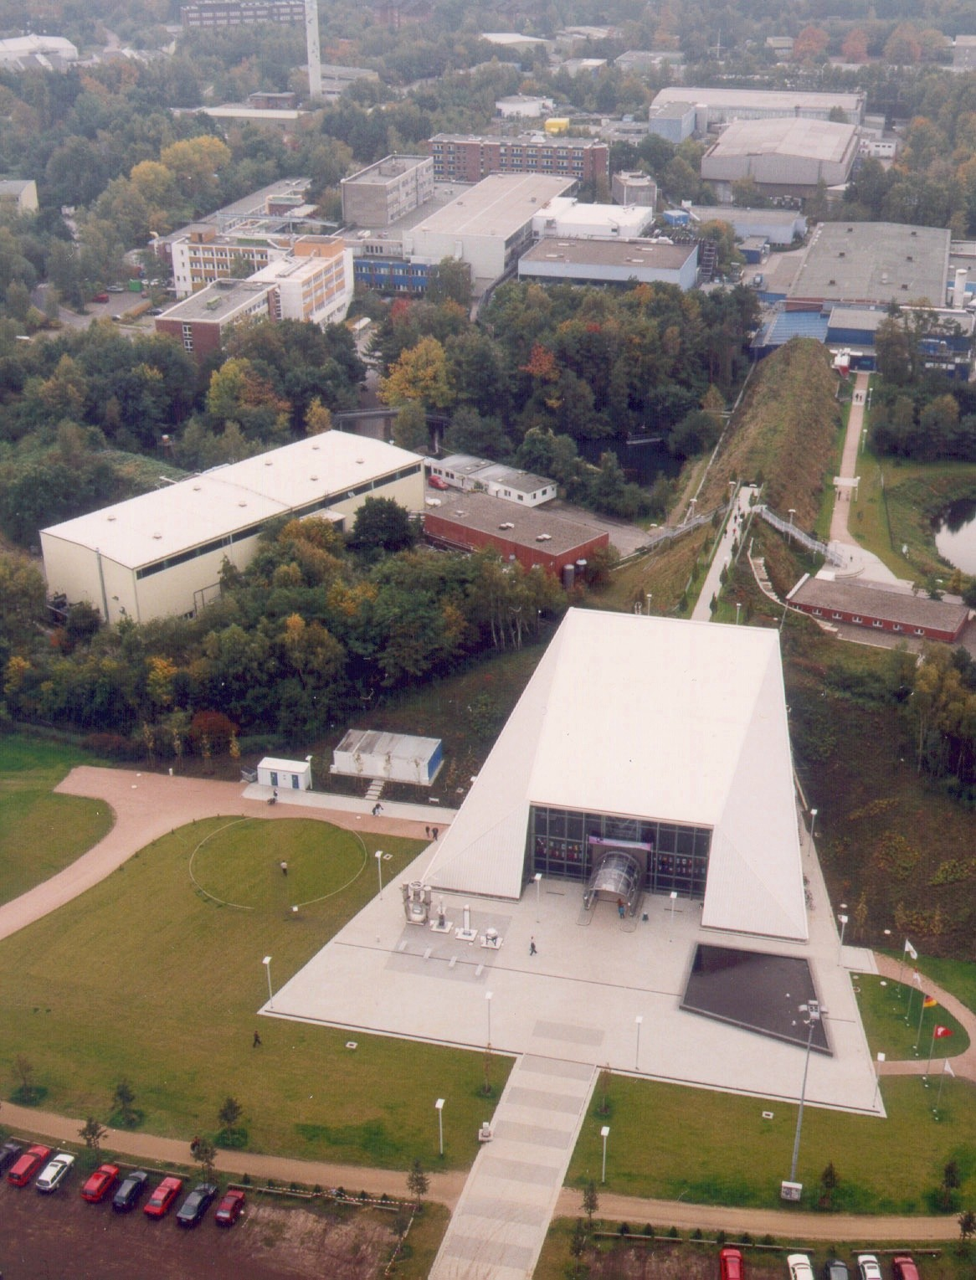
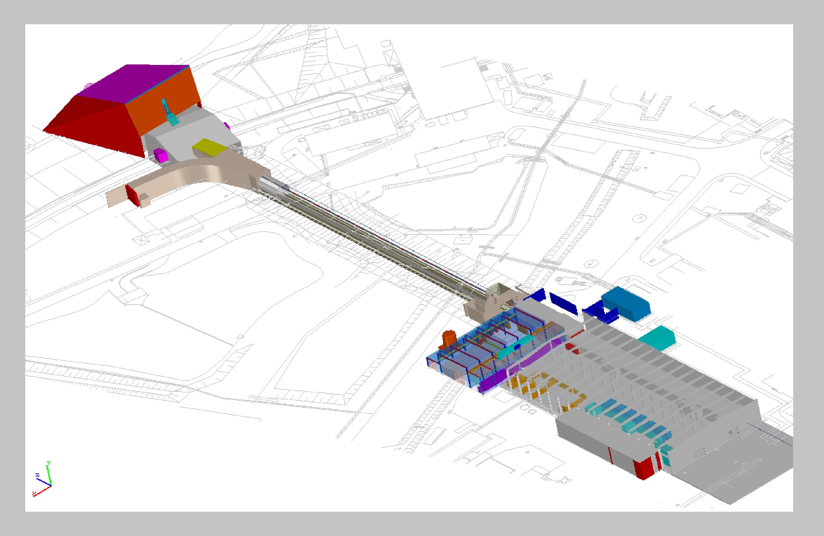
TTF2: SASE FEL @ TTF

Slide 40
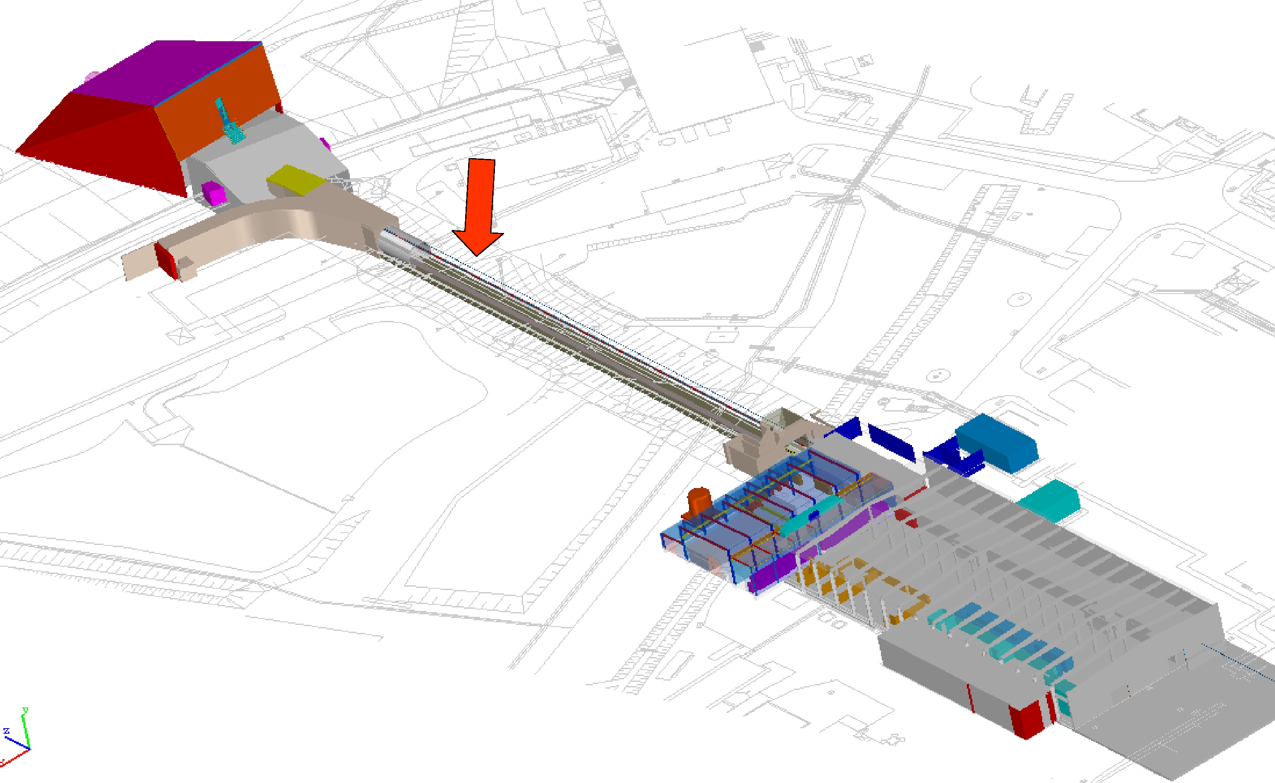
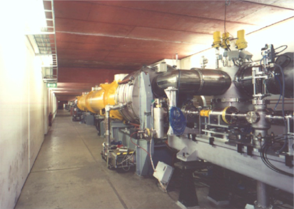
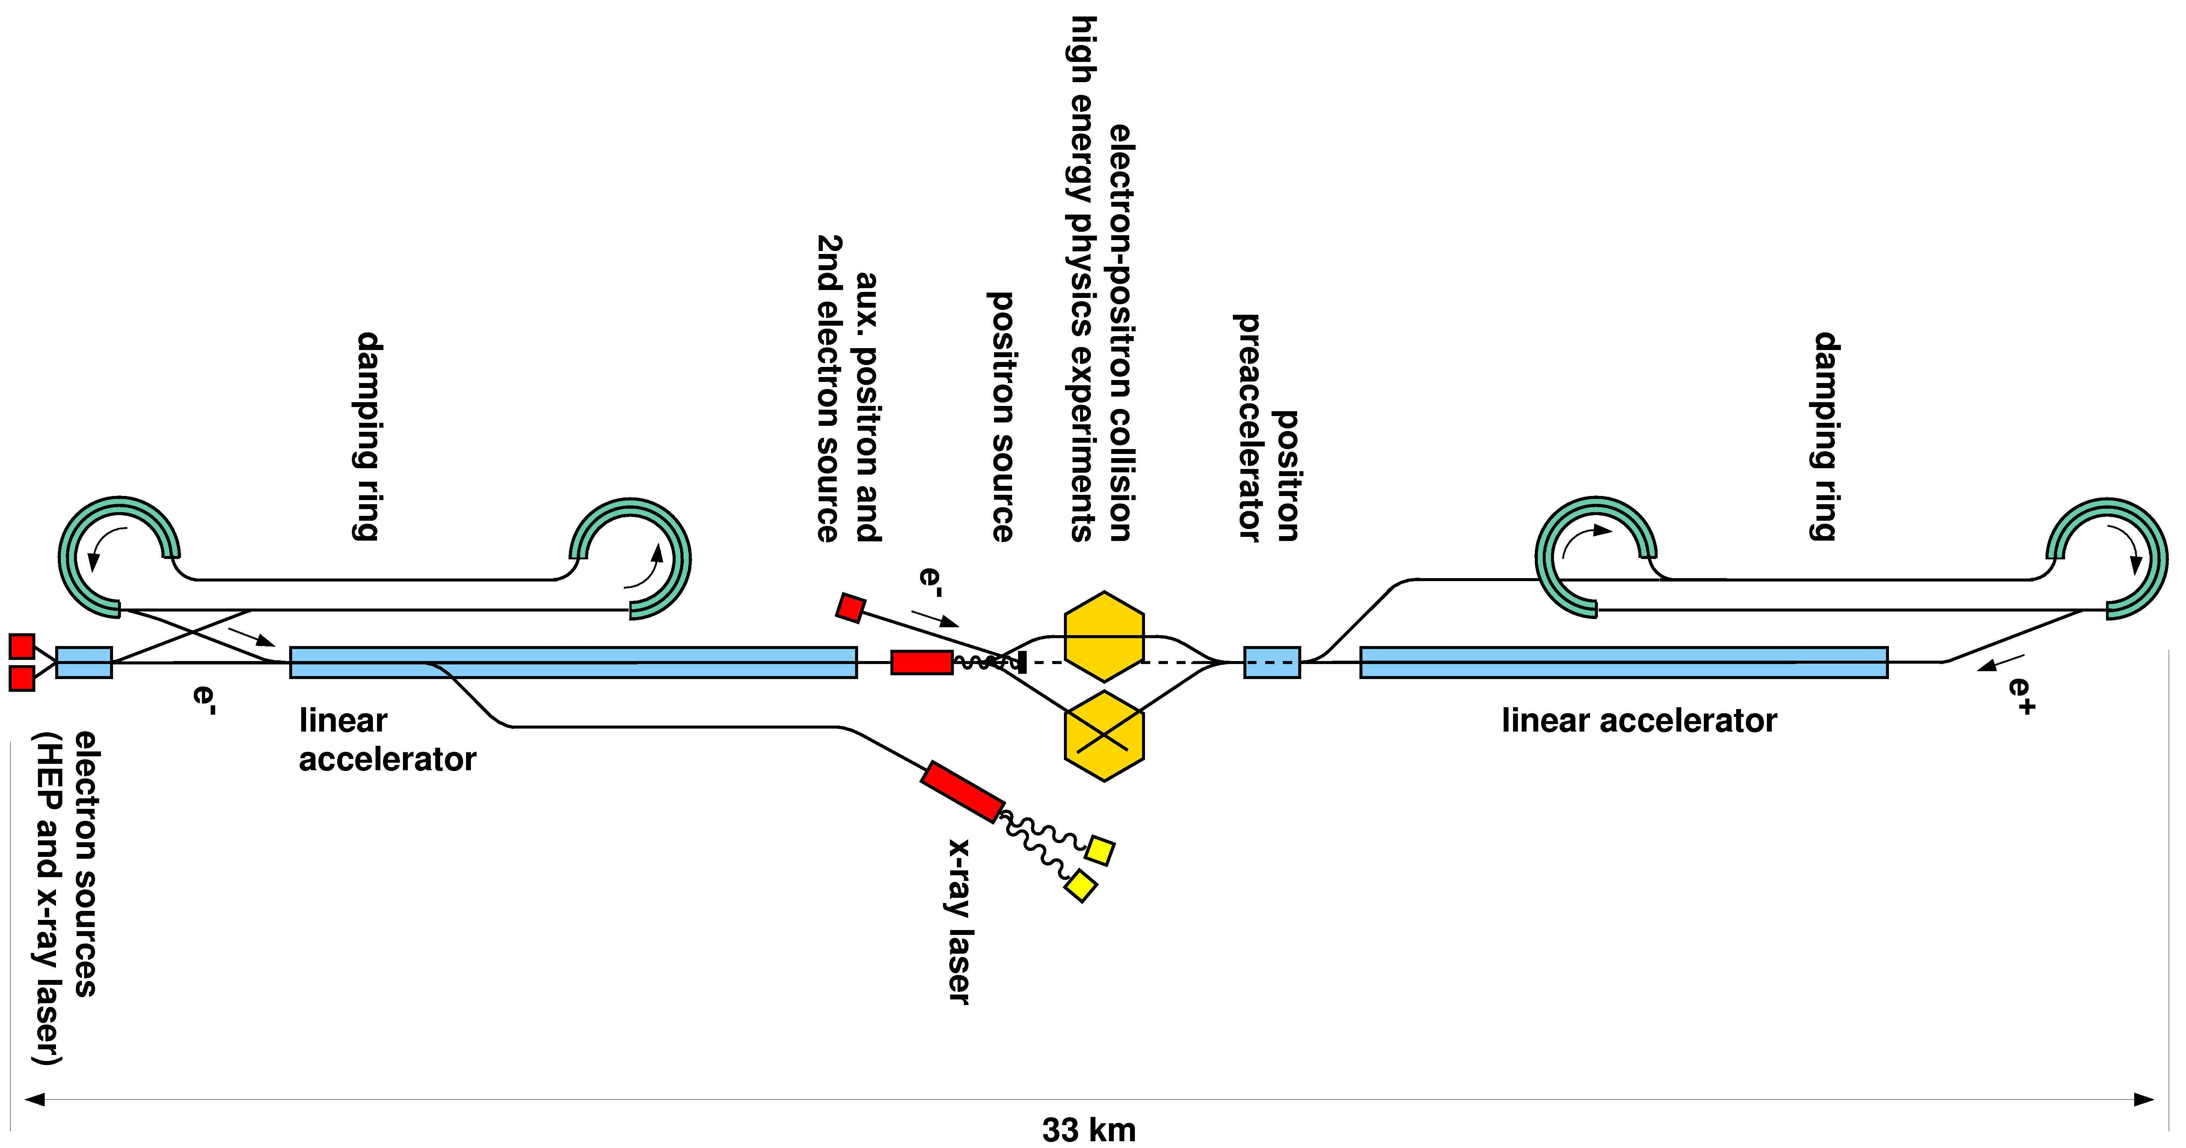
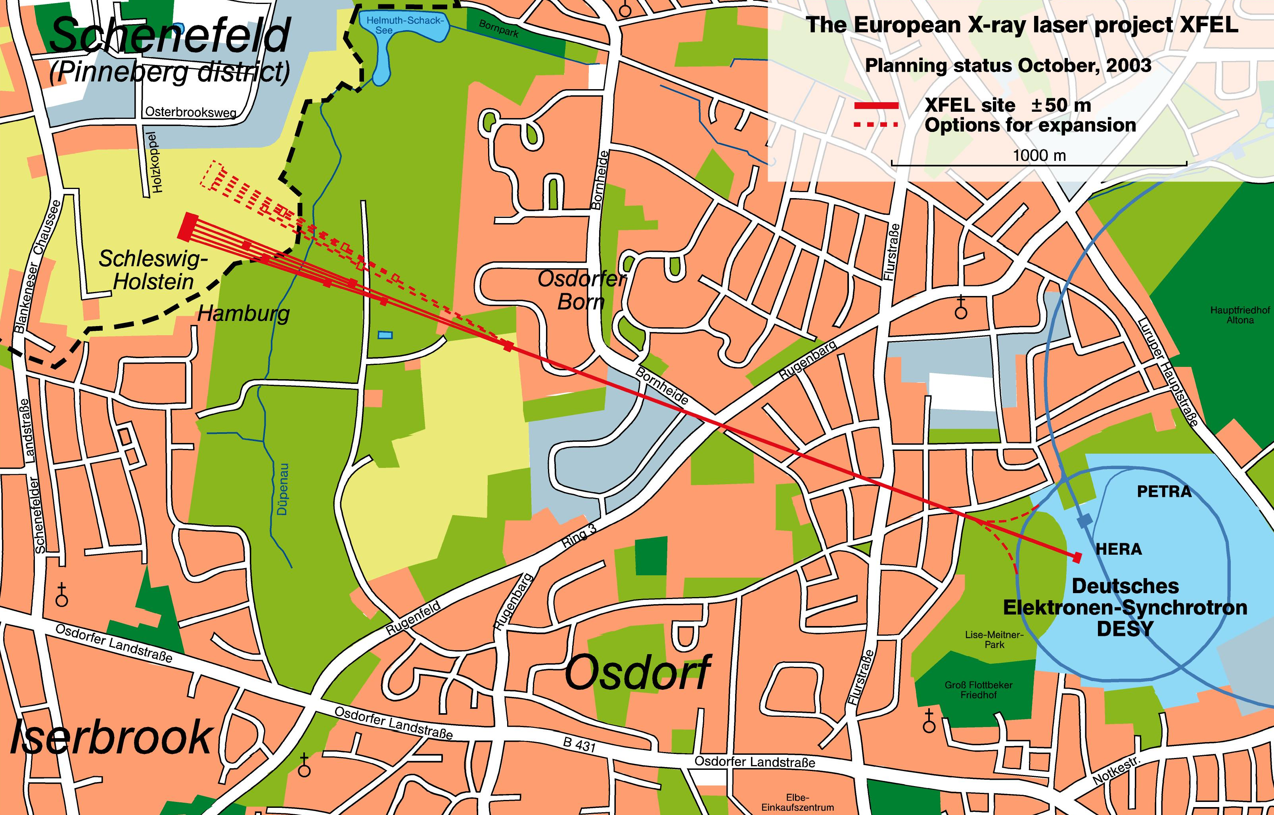
TESLA/XFEL Milestones
July 1990 – 1° International TESLA Workshop @ Cornell University
February 1992 – 1° TESLA Collaboration Board Meeting @ DESY
March 1993 - “A Proposal to Construct and Test Prototype Superconducting RF Structures for Linear Colliders”
March 1995 -TESLA Test Facility Linac Design Report
SASE FEL included in TESLA → TTF 2
May 1996 – first beam at TTF1
March 2001 – TESLA Technical Design Report with XFEL. First SASE-FEL Saturation at TTF
July 2002 – from the German Science Council: Two independent projects: TESLA X-FEL and TESLA LC
February 2003 –TESLA X-FEL proposed as an European Facility, 50% funding from Germany
June 2004 – TTF II: First beam accelerated
August 2004 – TESLA Technology chosen for ILC
June 2007 – European XFEL Project Starts
Infrastructure
@ DESY in Hall 3
TTF I
TTF II
TESLA Collider
TESLA X-Ray FEL

Slide 41
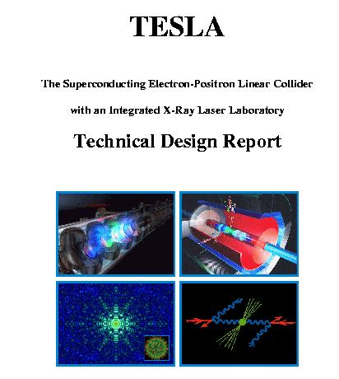
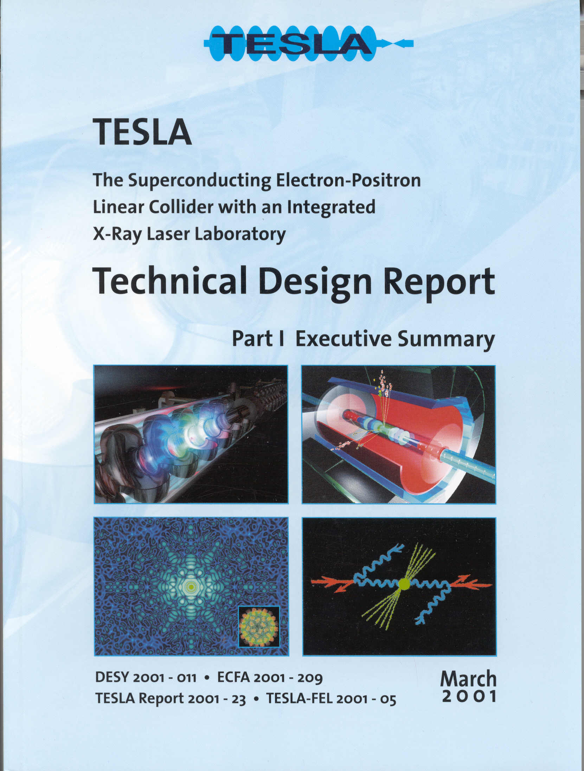
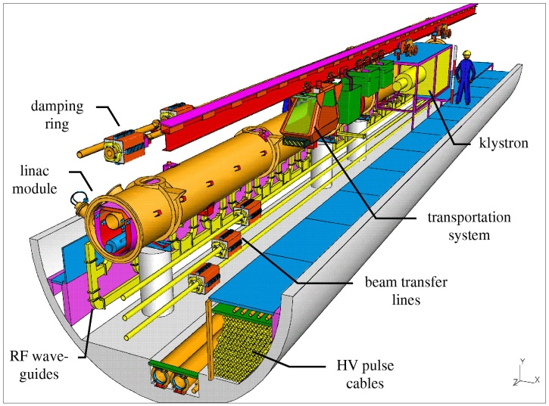
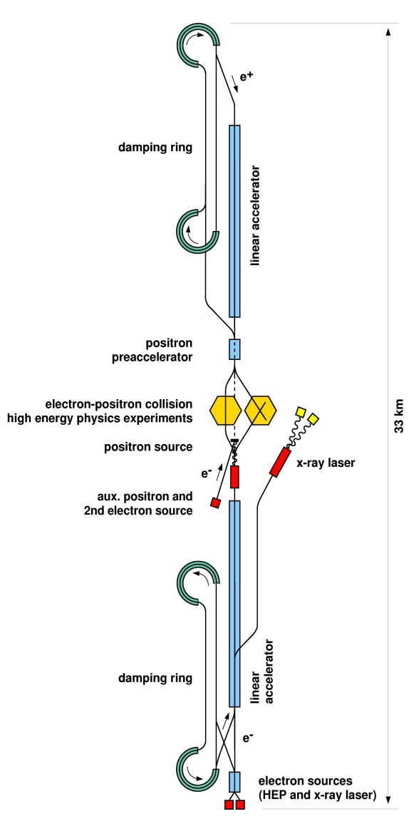
TESLA Technical Design Report 2001
As in the TDR
Updated tunnel cross section

Slide 42
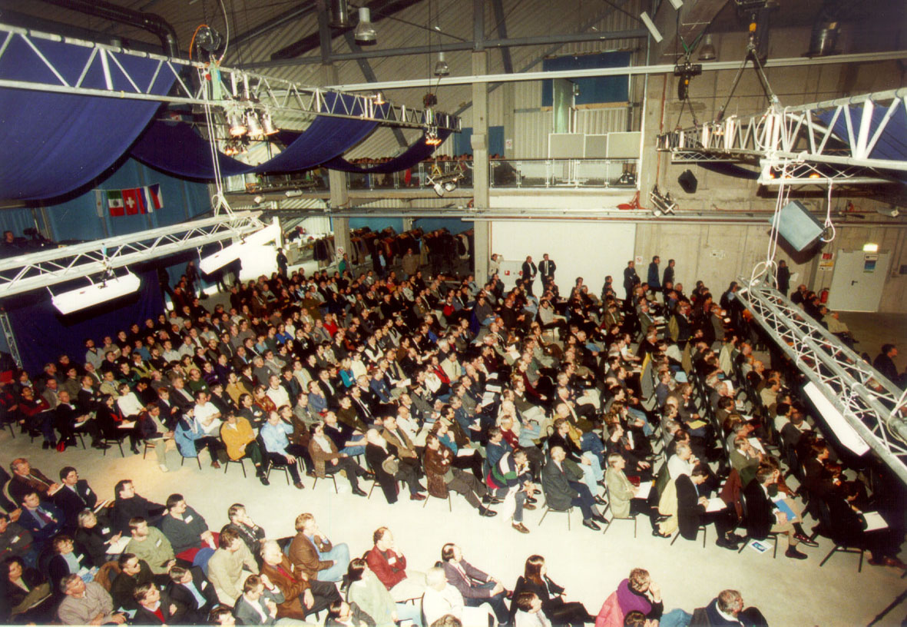
TESLA TDR: Presentation and Reactions
TESLA TDR kick-off meeting March 2001
Cold reaction from German Government to the proposal to host the TESLA inear collider
Insufficient momentum from the HEP international community, inspired by CERN
Understanding of the potentiality opened by the TESLA driven SRF technology
Endorsement of the science prospectives coming from the realization of an X-Ray Free-Electron Laser
Interest for a stand alone X-Ray FEL
1000 participants, 40% from abroad

Slide 43
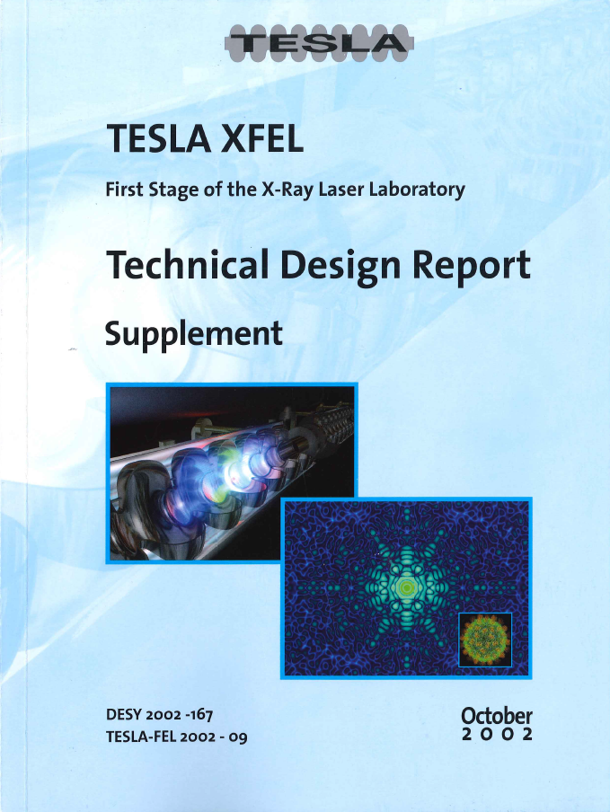
From TESLA TDR to an independent XFEL
Feb 2003 - Decision by German Government:
Germany will cover half of the cost of the free-electron laser facility proposed by DESY, which has to be realized in a European collaboration.
Stand alone facility
Huge international collaborative effort involving
1100 scientists from 36 countries
On request of German Science Council

Slide 44
TESLA package in 2003
In 2003 TESLA is the combination of: 3 independent Projects: C. Pagani: TCM May 2003
TESLA LC, TESLA X-FEL and TTF2
All based on the outstanding SC linac technology
Created by the TESLA Collaboration effort
TESLA LC is one of the two remaining competitors for the next HEP large accelerator facility
TESLA X-FEL is the core of a proposal for an European Laboratory of Excellence for fundamental and applied research with ultra-bright and coherent X-Ray photons
TTF2 will be the first user facility for VUV and soft x-ray coherent light experiments with impressive peak and average brilliance.
It will be also the test facility to further implement the TESLA SC Linac technology in view of the construction of a large and reliable accelerator

Slide 45
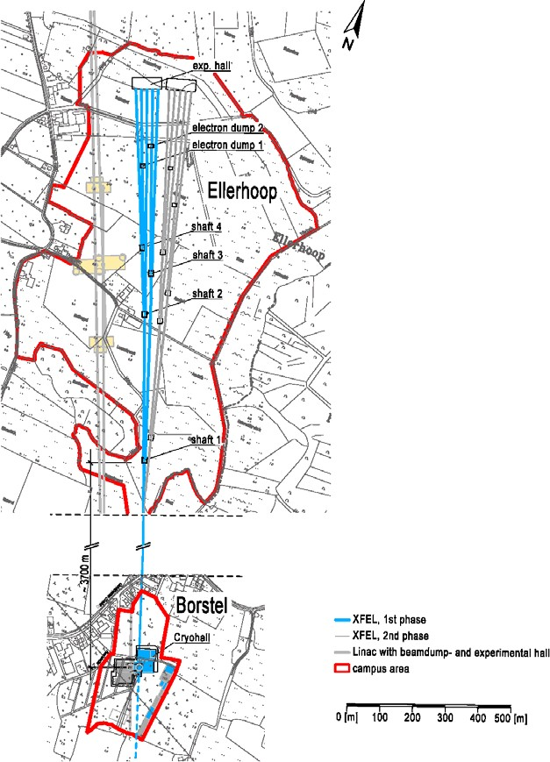
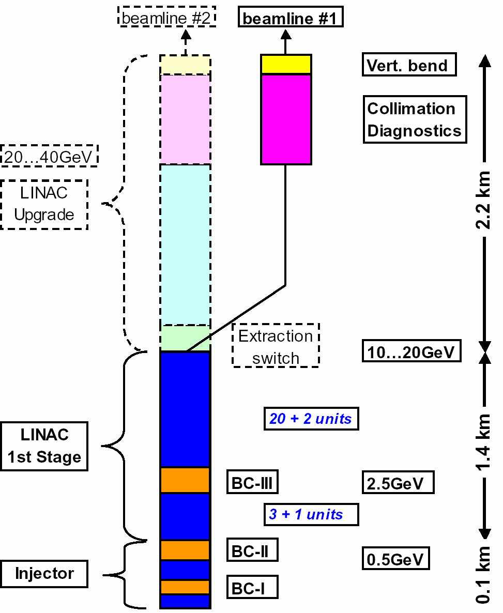
TDR Update 2002: XFEL Layout
3.9km

Slide 46
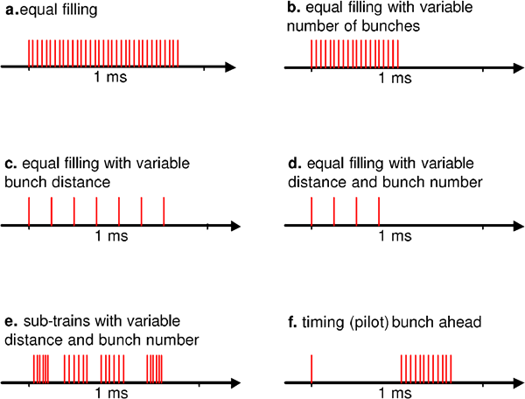



Parameter Flexibility and Limitations
Some flexibility aloowed on bunch distribution inside the 1 ms macropulse
Macropulse reprate and linac enegy limited by the existing DESY cryoplant

Slide 47
Contents
The TESLA Collaboration Framework
TTF and the Free-Electro Laser
Parallel Development of TESLA and XFEL
XFEL Approval and TESLA going to the ILC

Slide 48








Path to the European XFEL
2001 – TESLA Proposal and Science Council Eval.
Oct. 2002 – X-ray FEL with 20 GeV superconducting accelerator (TESLA-technology)
Feb. 2003 - Approval by Federal Government as European project
Nine countries signed MoU for the Preparatory Phase of the XFEL in January 2005
July 2006 – Technical Design Report
July 2006: Plan Approval Process completed
Sept/Nov 2009: XFEL Construction Starts
A. Wagner, Jan 2009

Slide 49
DESY Role in the XFEL
Central Element of DESY Strategy: Participation in all phases of the XFEL (construction, operation, science und development)
DESY leads the international accelerator consortium for the construction of the SC accelerator and its infrastructure, delivering the majority of components and technical systems as in-kind contributions
  Up to 300 FTEs from DESY will work on the XFEL
DESY is ready to operate the accelerator system on behalf of the XFEL GmbH
DESY will develop the XFEL further, together with the XFEL GmbH
A Centre for FEL science has been established together with MPG und Uni HH to become a main user of the XFEL
A. Wagner, Jan 2009

Slide 50
Also TESLA is growing
The International Linear Collider Steering Committee (ILCSC) selected the twelve members of the International Technology Recommendation Panel (ITRP) at the end of 2003:
Asia:
G.S. Lee
A. Masaike
K. Oide
H. Sugawara
Europe:
J-E Augustin
G. Bellettini
G. Kalmus
V. Soergel
North America:
J. Bagger
B. Barish (Chair)
P. Grannis
N. Holtkamp
Mission: one technology by end 2004
The 3 Project Leaders were asked to follow the ITRP process as “Technology Experts”: Dave Burke (NLC), Kaoru Yokoya (GLC) & Carlo Pagani (TESLA)
Result: recommendation on 19 August 2004
Cold that is TESLA like

Slide 51


Start of the Global Design Initiative in 2004
~ 220 participants from 3 regions
most of them accelerator experts

Slide 52

ILC RDR, Feb 2007
The 4 Volumes of the ILC Reference Design Report
Executive
Summary
Physics
at the
ILC
Accelerator
Detectors

Slide 53








XFEL / ILC Accelerator Shared Components
cavities
Cryomodule
TESLA Technology
coupler
Tuners
LLRF
RF
HOMs

Slide 54



XFEL–ILC Shared High Power RF Systems
XFEL
ILC
XFEL needs
31 RF stations
10 MW peak
150 kW average.
3.9 MW are needed for the beam at 20 GeV and nominal current.
5.2 MW. Including waveguide losses (6%) and regulation reserve (15%)
Minor Differences
XFEL has 32 cav. per klystron, ILC 26.
Due to the higher gradient, the ILC beam absorbs 7.6 MW instead of 3.9 MW. A margin of ca. 30 % is still available for wave guide and regulation reserve.
The XFEL will install the klystrons in the tunnel while ILC has chosen to put the klystrons & modulators in the 2nd tunnel.
Toshiba E3736

Slide 55
XFEL Low Level RF taken from TTF
XFEL needs on RF
0.01% amplitude stability
0.01° phase stability!!!
Challenging phase and amplitude stability required by the FEL process Successful tests already performed at TTF/FLASH.
The ILC numbers are more relaxed: 0.35% amplitude and 0.07° phase stability. XFEL development will be beneficial in any case
The operational requirements are probably different but similar to handle. Here the number of spare RF stations as well as the aimed up-time defines the ‘rules of the game’.

Slide 56
Coclusions
Pro
The European XFEL, EuXFEL, is based on the achievements of the big international effort established through the TESLA Collaboration to develop the best possible linear collider for particle physics.
The success of the TESLA Mission made the realization of the EuXFEL smooth, being all the competences available for the task.
Scientists and technicians were available and trained.
Industrial partners already qualified and prepared for the series production thank to the prototypes successfully built already.
Cons
No further improvements allowed. All major components based on the last design of the prototypes developed for TTF.
Pulsed beam mandatory because at the basis of the TESLA design
Maximum energy and duty cycle limited by the existing Cryo-plant at DESY

Slide 57


Thank you for your attention

