Slide 1


INFN4LS -27 Settembre 2024, Roma
LS in CSN5:
Status and News
Alberto Quaranta & Emanuele Scifoni

Slide 2
Outline
Brief Intro: CSN5 scope and mission
Life Science focused Current and New projects in CSN5
  Radiopharmaceuticals
  BNCT/Proton/hadron therapy
  Radiation Protection
  Imaging
  Medical Detectors and Accelerators
Some further news from CSN5

Slide 3

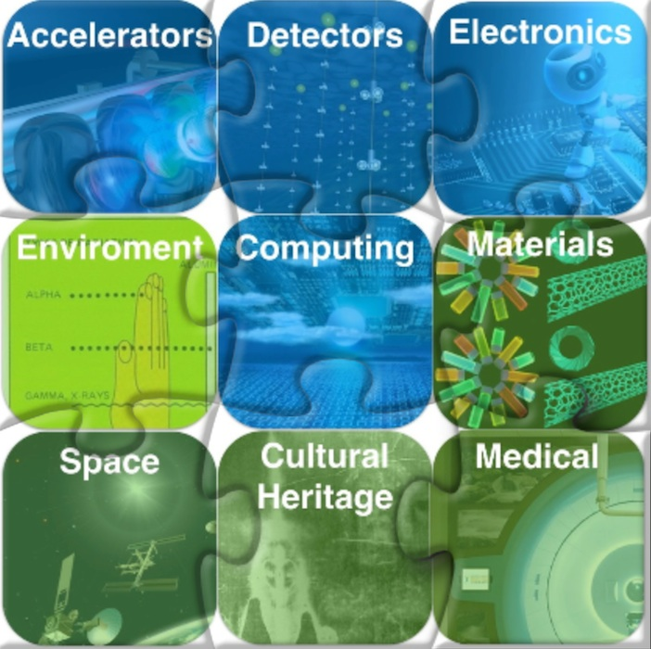
CSN5: what’s that?
Advanced Detector Technologies for Physics Experiments.
  Innovative detection methods for HEP experiments.
  Novel micro-nano architectures.
Advanced Technologies and Methods for Particle Accelerators.
  Magnetic superconductors.
  RF technologies.
  Laser-plasma acceleration technologies.
Quantum Technologies.
  Quantum sensing and metrology.
  Quantum Computation.
Life Science.
  Advanced radiotherapy methods, hadrontherapy, BNCT
  Radioisotopes & Radiopharmaceutics
  Radiation biophysics and Biophysical modeling
  Radiation dosimetry and Computational dosimetry
  Diseases diagnostic tests, monitoring and mapping.
Advanced Calculus.
  AI – ML and MC for experimental and interdisciplinary physics.
Others…
  Electronics.
  Cultural Heritage.
  Environmental monitoring.

Slide 4
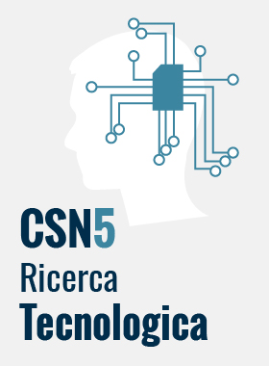
Experiment cathegories
Sigle Standard: progetti di 2-3 anni a budget medio-basso (∿ 50k€/y).
  Incubatori di attività e idee promettenti e interessanti per l’Ente.
  Supporto ad attività di più ampio respiro di altre commissioni.
  Possono avere livelli di rischio elevati.
Grant Giovani: Esperimenti (max 75k€/y) di 2 anni per giovani (PhD ≤ 6y). Viene finanziata l’attività sperimentale e l’AdR del PI.
  ﻿Supporto per giovani ricercatori che presentino idee originali.
  ﻿Supporto all’autonomia scientifica e alle capacità direzionali.
Call: Progetti ad alto budget e ampio network ( ∿1M€ max su 3y da bando).
  Supporto alla formazione di network ampi per progetti di frontiera su argomenti strategici.
  Finanziamento di Assegni di Ricerca.

Slide 5
Life Science focused Current and New projects in CSN5
(limited to projects active in 2025)

Slide 6
CSN5 projects with major focus on LS (alive in 2025)
New Radiotherapies
FRIDA(Call)
MIRO
BioHot
In Vivo Imaging & Dosimetry
pRAD
ARTEMIS
TEMPURA*
Radiopharms
ADMIRAL
CUPRUM-TTD
Computational (µ)dosimetry
Geant4INFN
Radiosensitizers
SEGNAR
AURORA
(Virtual/AI aided) Imaging
AIM_MIA*
AI_INFN
VI_HI
VITA5*
Medical Accelerators
SIG (Call)
Radioprotection
DISCOVER22
MOZART*
Medical Detectors
TIMEPIX4*.
PROVIDE*
SHINE
Space Radiation prot.
SPRITZ*
*=New

Slide 7
New Radiotherapies
FRIDA(Call) – FLASH Radiotherapy
MIRO – Minibeam Radiotherapy
BioHot – Helium and Oxygen beam Therapy

Slide 8

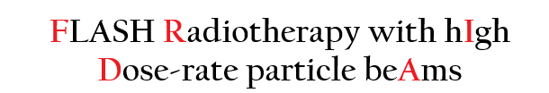
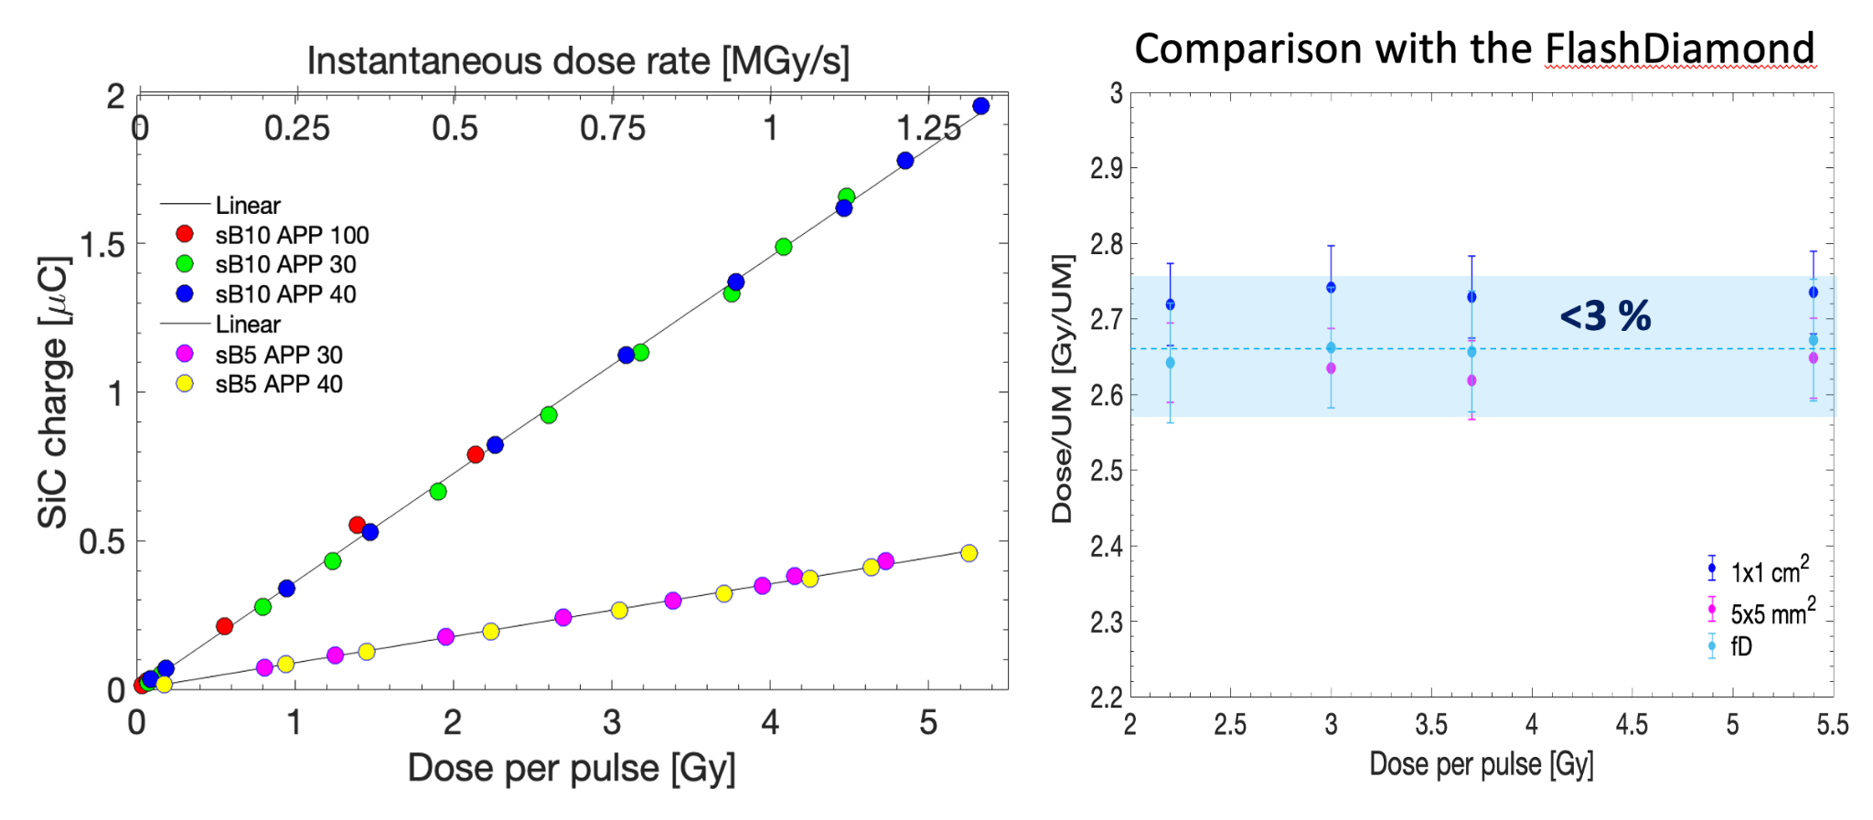
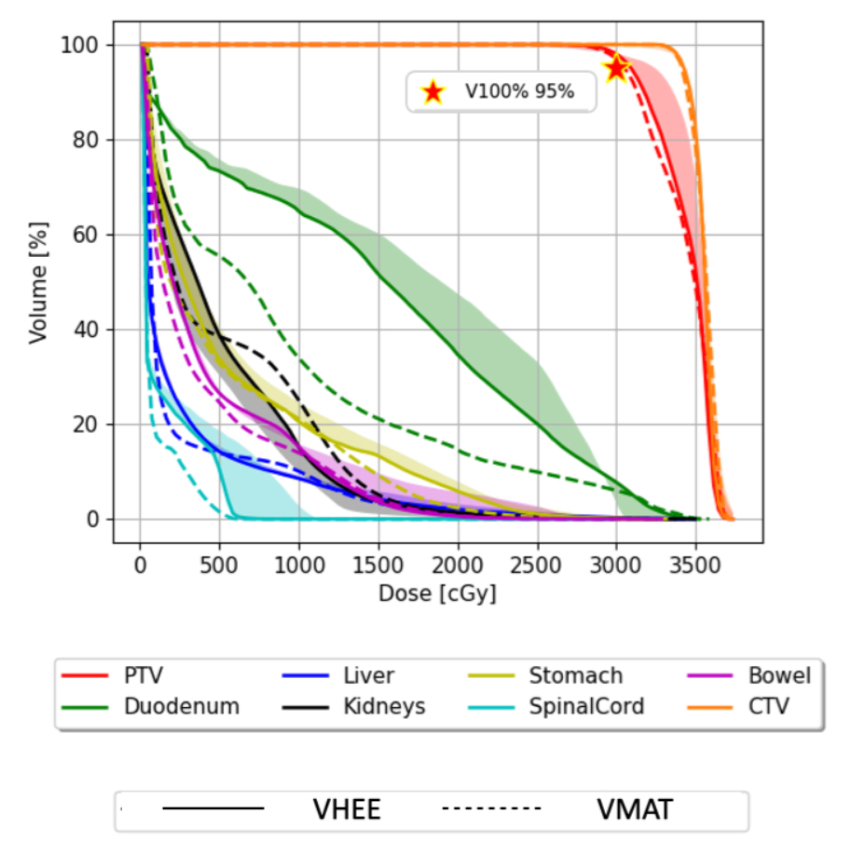
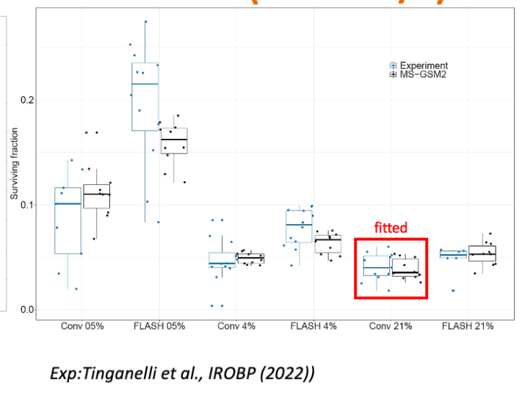
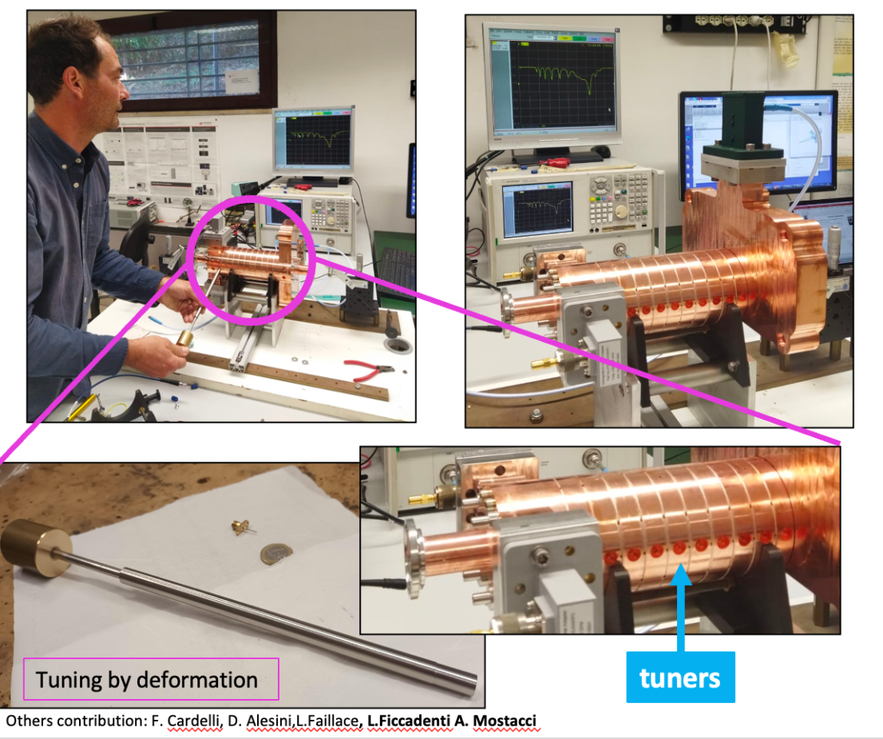
FRIDA
INFN-CSNV Call 2022-2024
Coordination
A. Sarti
Some recent highlights from:
The FLASH mechanism
Beam delivery
Beam/dose monitoring
Treatment planning
WP1
WP2
WP3
WP4
E. Scifoni (modeling)
G. Forte (bio experiments)
A. Mostacci (e-)
G. A. P. Cirrone (p)
A. Vignati (Beam monitoring)
G. Bisogni (Dose monitoring)
A. Schiavi (Dose sim/optim.)
M. Schwarz (Treatment planning)
-Reproduction of In vitro UHDR data over broad parameters range
-C-band compact accelerating structure and Pulse Compressor
Ready for testing
-Extended linearity of response
tested for novel SiC devices
-Evaluation of e-FLASH plans on pancreas cancer
Battestini et al. subm. to PNAS
G. Milluzzo et al., Medical Physics (2024)
Franciosini et al. subm. to IJROBP

Slide 9

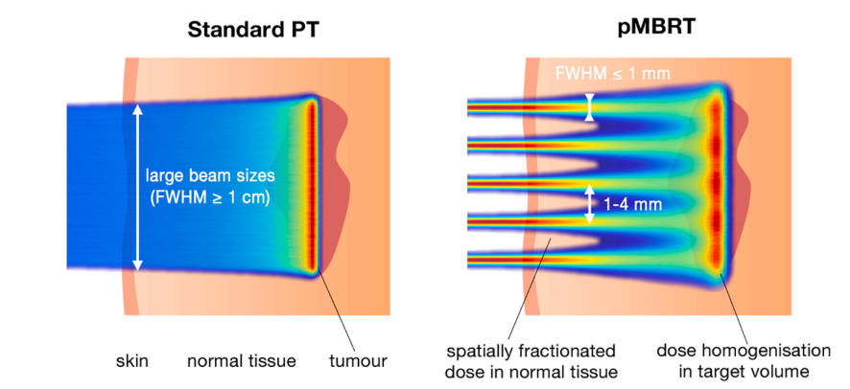
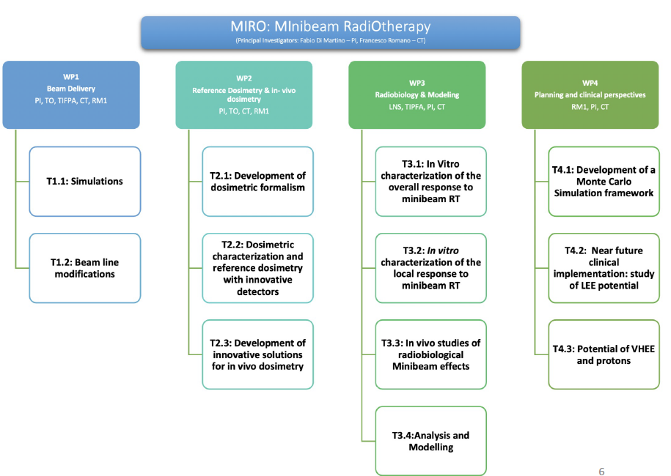
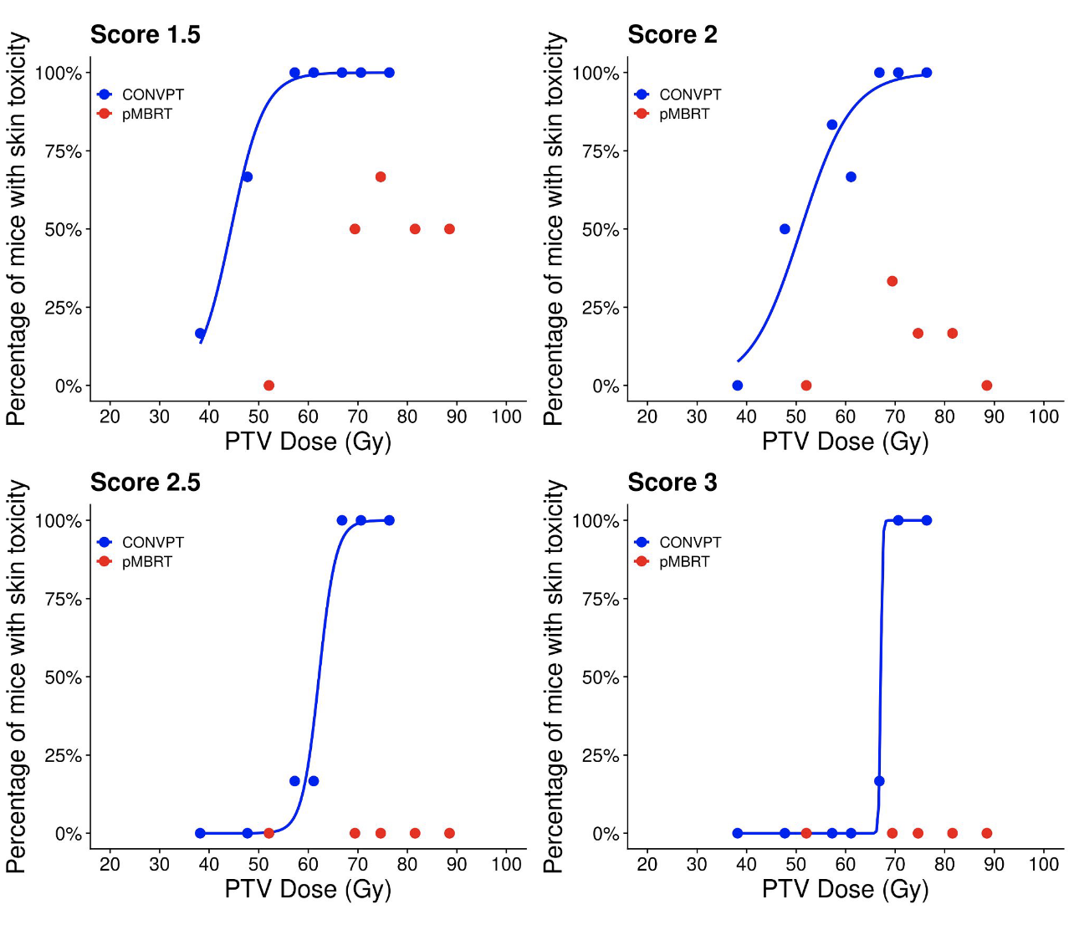
Exploiting Spatial Fractionation of
particle beams
2024-2026
RN: F. Romano/F. Di Martino
Courtesy of N. Bassler
PTCOG 2024,
subm . Nature Comm.

Slide 10
Radiosensitizers
SEGNAR – Gold Nanoparticles dose enhancement
AURORA – ROS enhancement and monitoring

Slide 11
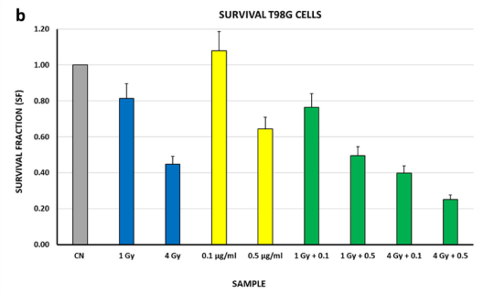
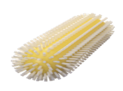
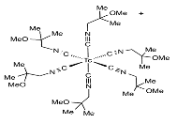

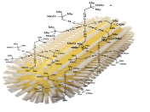
SEGNAR Synergic Effects of Gold Nanorods And Radiopharmaceuticals
Theoretical and modeling studies to highlight possible synergistic effects of modified AuNRs-TAT and radiopharmaceutical based on ^{99m}Tc-sestaMIBI
Preparation and preliminary structural characterization of modified AuNRs-TAT and AuNRs-⁹⁹Tc-sestaMIBI and AuNRs-TAT-⁹⁹Tc-sestaMIBI and stability studies
Structural and diagnostic characterization of AuNRs and AuNRs-TAT modified systems and their conjugates with ⁹⁹Tc-sestaMIBI and AuNRs-TAT-⁹⁹Tc-sestaMIBI
In vitro evaluation of cytotoxicity in human tumor cells induced by the three different AuNRs configurations without and with irradiation together with the assessment of AuNR suspension stability
In vitro study of metabolic profile before and after irradiation in human tumor cells by magnetic resonance spectroscopy after incorporation of the AuNRs in the three different configurations (AuNRs, AuNRs-TAT and AuNRs-TAT-⁹⁹Tc-sestaMIBI)
Ultrastructural studies to evaluate the distribution in cell compartments of AuNRs and morphological changes induced by them, in the three different configurations before and after irradiation
Preliminary evaluation with test in vitro using AuNRs-TAT-^{99m}Tc-sestaMIBI
AuNR TAT sestaMIBI
blue histograms (only γ-rays),
yellow histograms (only AuNRs)
green histograms (γ-rays + AuNrs)
L. Binelli et al, Nanomaterials 2023

Slide 12
Radioprotection
DISCOVER22 – Low Radiation Environment Effects (@LNGS)
MOZART* - Novel technique for Environmental dosimetry

Slide 13

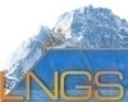

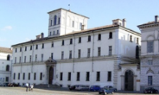
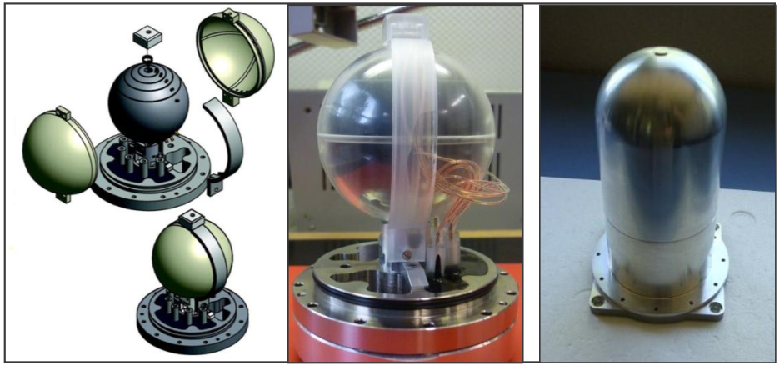
DISCOVER22
Responsabile Nazionale: A. Sgura
(Università di Roma 3 – INFN-RM 3)
“DNA Damage and Immune System COoperation in VEry low Radiation environment (2022)”
INFN-LNGS
Istituto Superiore di Sanità
To address the issue of immune-response modulation at LDR, the Discover22 project will take advantage of both the experimental characterisation of the LNGS radiation field by means of microdosimetry, and of the development of radiation biophysical models.
INFN Pavia
4. Microdosimetry becomes very important. This is a well-established theoretical and experimental methodology and it is focused in the stochastic aspects of energy deposition by single events at low doses.
5. Biophysical radiation model development can help to understand response mechanisms and identify even subtle changes in the behavior of biological systems, as can be expected following exposure to LDR.
The EUTEPC of LNL. A schematic view (left) and pictures of the internal sensor (centre) and external case
(right)

Slide 14
Space Radiation protection
SPRITZ* - Space Radiation &Carcinogenesis

Slide 15
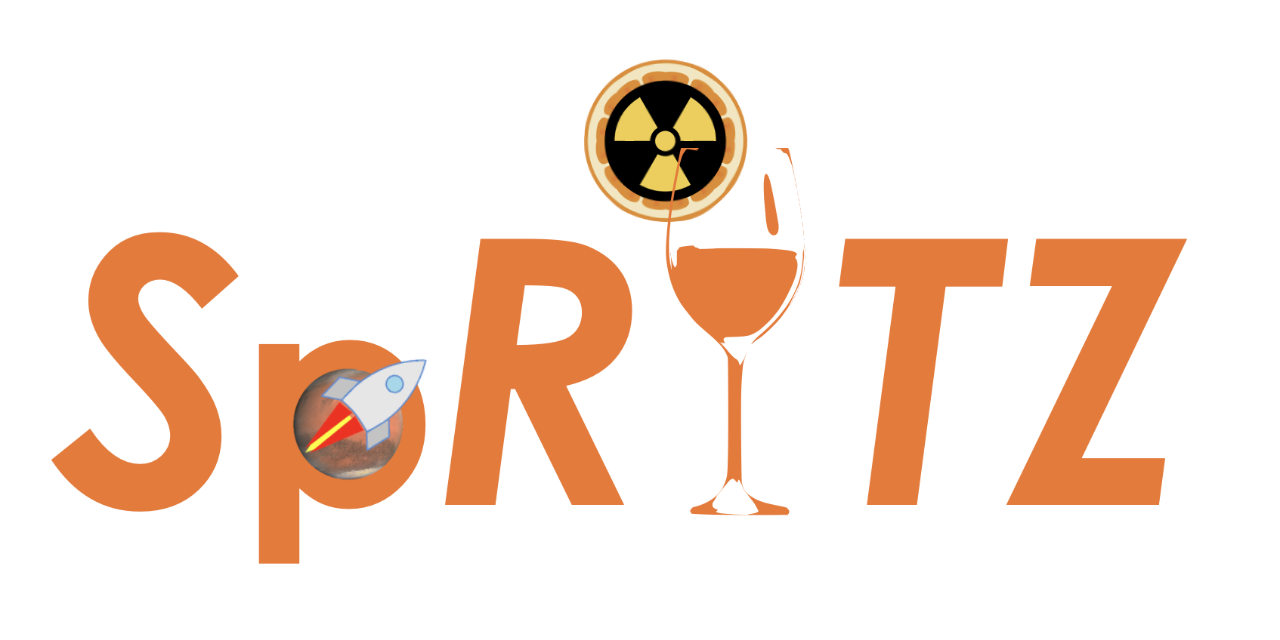
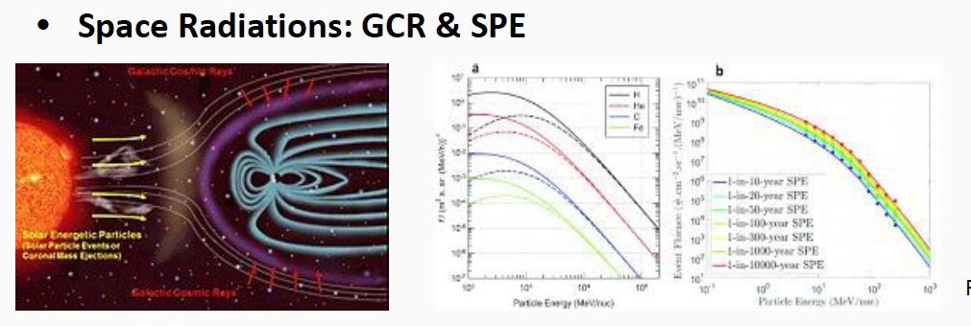
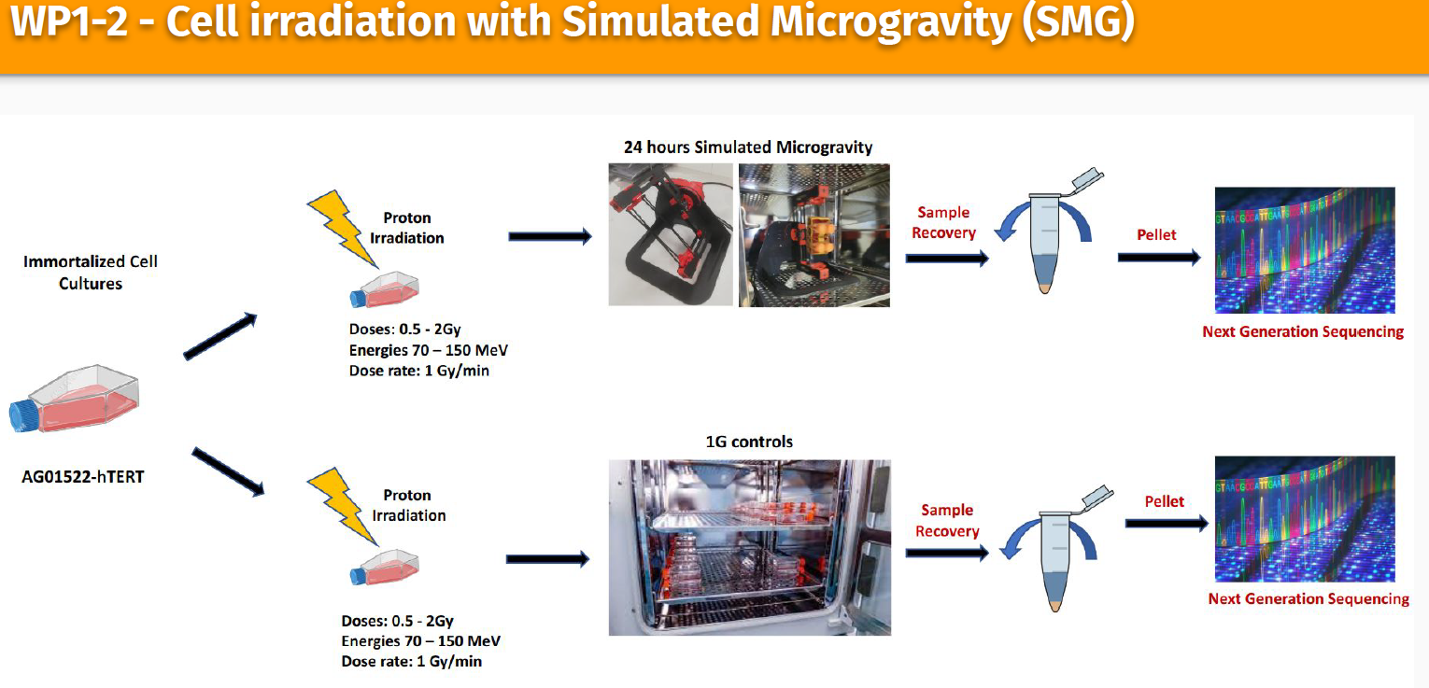
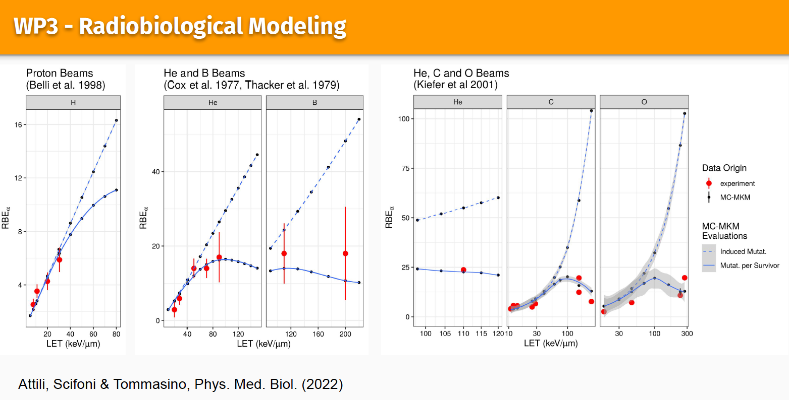
“Space Radiation Induced Tumorigenesis by high Z particles: modeling and experimental studies”
RN: A. Attili (RM3),
whole-genome sequencing (WGS) and mFISH to characterize the genomic impact of different particles (proton, 4He, 12C) of space environment
simulated microgravity (SMG) impact
microdosimetric based model of cancer induction

Slide 16
In Vivo Imaging & Dosimetry
pRAD - proton radiography
ARTEMIS - AI aided in vivo dosimetry
TEMPURA* - Subcellular Temperature measurements

Slide 17
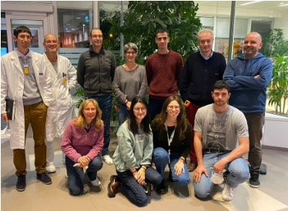
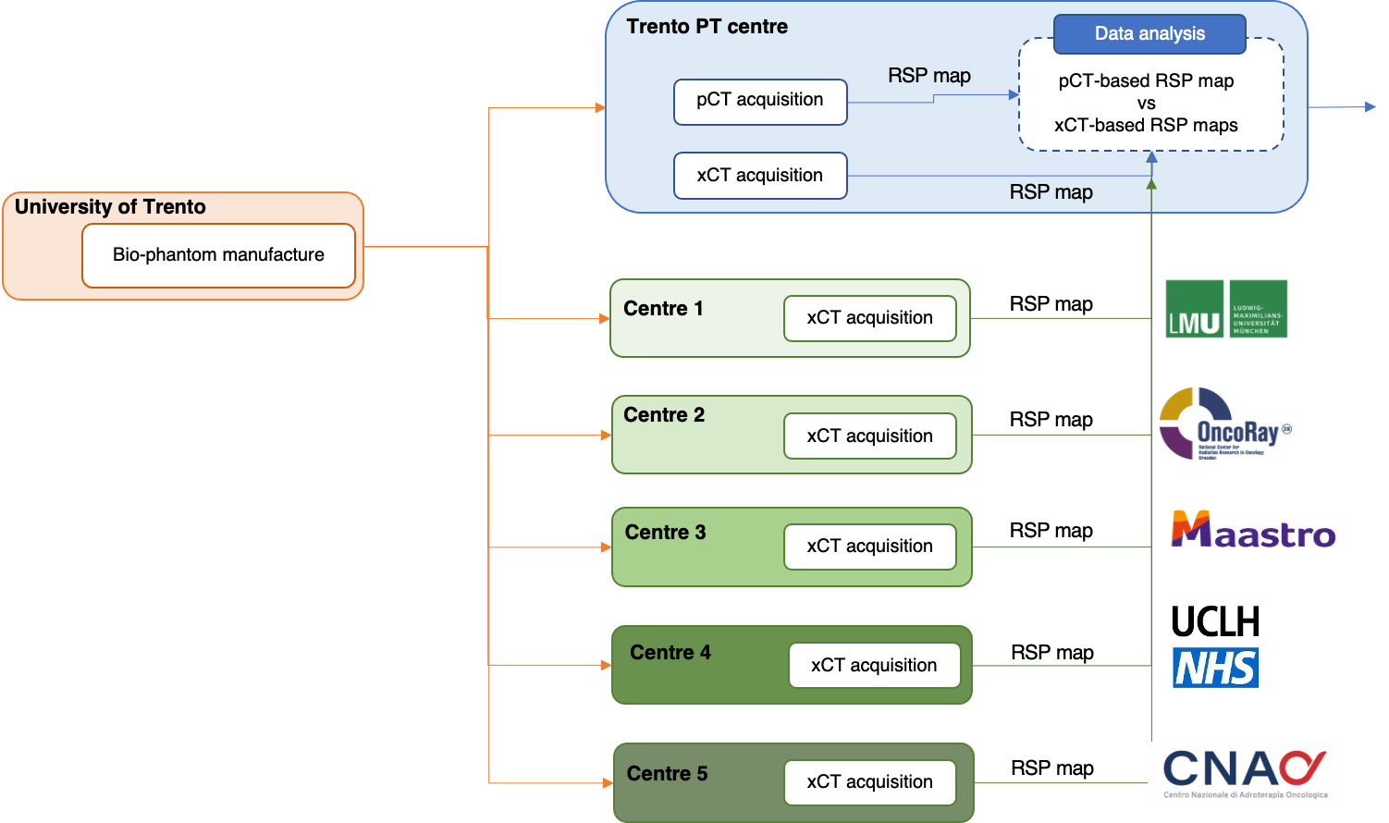
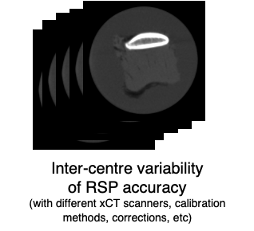




Proton Radiography (pRad) 2024-26
Three WPs:
pRad system in treatment room
pCT of metal implants
European survey on RSP accuracy (TIFPA main activity 2024)
WP1: calorimeter upgrade from YAG to EJ-200 for faster response
WP2: direct measurement of RSP on real patient prosthesis to build a library to be used in TPS
Courtesy
Elena Fogazzi

Slide 18
(Virtual/AI aided) Imaging
AIM_MIA* (AI driven Multi-input imaging analysis)
AI_INFN (AI foundational dev. Including medical app.)
VI_HI (Virtual Histology)
VITA5* (Virtual Clinical Trials)

Slide 19
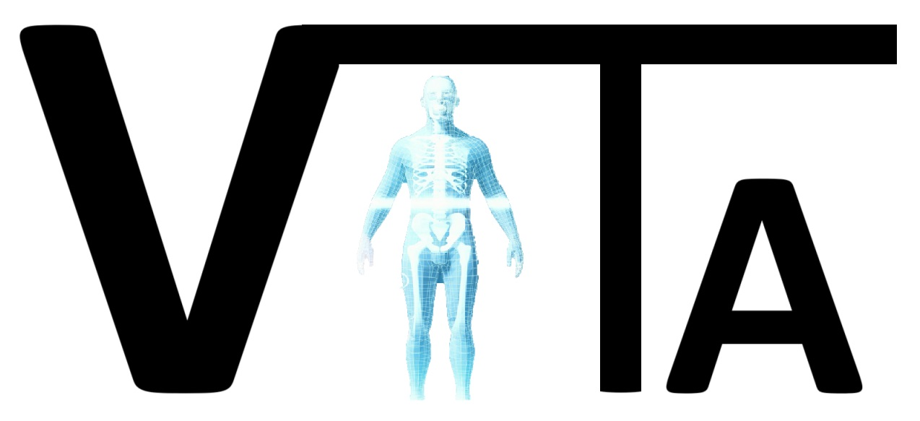


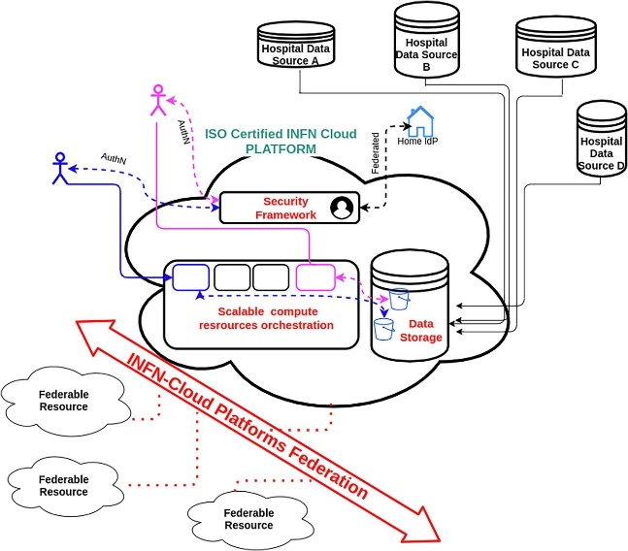


Virtual Imaging TriAls in medicine
verso la realizzazione, tramite una stretta collaborazione tra i maggiori enti di ricerca del campo (INFN, AIFM, ISS), di un archivio che comprenda sia risorse computazionali, hardware e software, che database (dati generati e dati raccolti da diversi centri) accessibile a livello nazionale.
Responsabile Nazionale
Giovanni Mettivier
RL: Annalisa Trianni (APSS)
Sezioni Coinvolte
Napoli, Roma1, Bologna, Trieste, Padova, Torino, Catania, CNAF, TIFPA

Slide 20
Radiopharmaceuticals
ADMIRAL – Ag111 radbio exploitation
CUPRUM-TTD – Cu67/64 Medical Translation

Slide 21
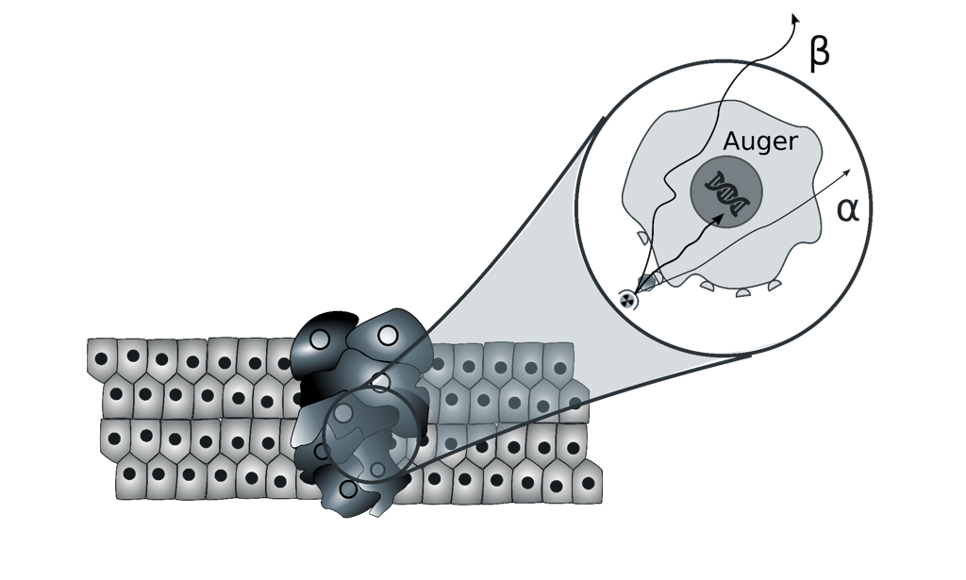
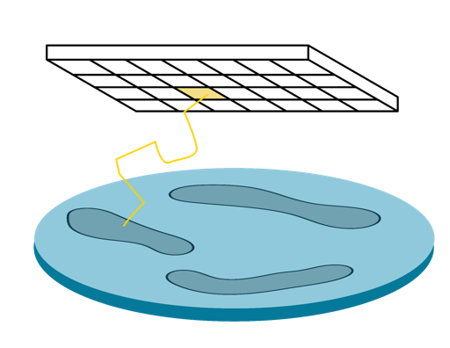
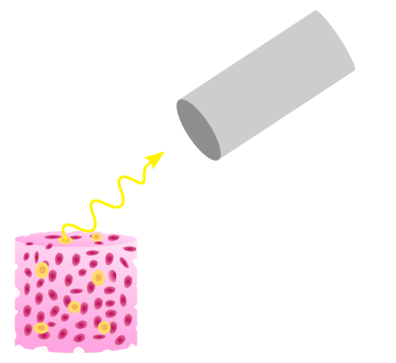
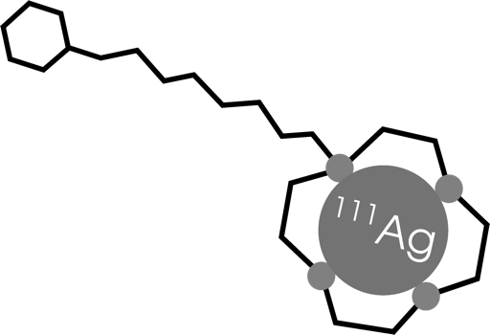
ADMIRAL Advanced Dosimetry Methods and In-vitro Radiobiology of Ag-111 Labeled radiopharmaceuticals
PI: Alberto Andrighetto (INFN LNL) – Local Coordinator: Devid Maniglio
AIMS of the project:
To design advanced methods for reducing the number of in- vivo experiments
To verify the active targeting of the radiopharmaceutical molecule
Explore the possibility of using ¹¹¹Ag γ-emission for SPECT imaging
Validate the radiotherapeutic effect
WP1
Radiopharmaceutical
WP2
WP3
WP4
β-imaging
γ-imaging
Targeted Radiobiology
Production of Ag-111 at the LENA facilities, purification and quality control
Radiochemistry of Ag-111
Pharmacology
Bioengineering of 3D scaffolds
Mechanics & electronics design
Monte Carlo simulations for mechanics and detector design
Detector characterization and tests with fluorescence
Monte Carlo simulations for detector design
Planar imaging detector construction for Ag-111 γ detection
Characterization and test of the planar system
Cell survival tests in 2D
Cell survival tests in 3D scaffolds
Comparison between different Monte Carlo codes
Dose computation in cell cultures

Slide 22
Medical Detectors
TIMEPIX4* - Sensors for advanced dosimetry
PROVIDE* - Perovskite det. Applications in dosimetry
SHINE- 3D printable detectors
RIPTIDE – Neutron detector

Slide 23
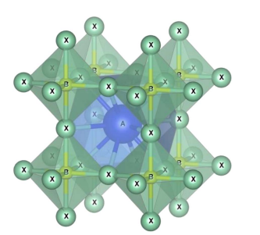
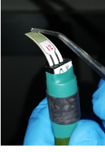
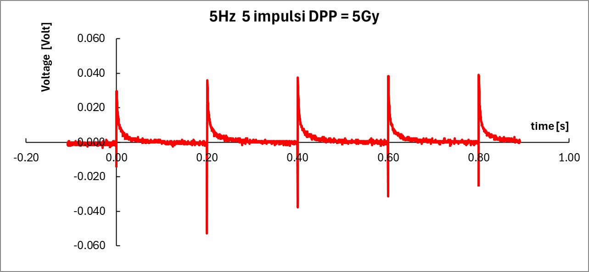
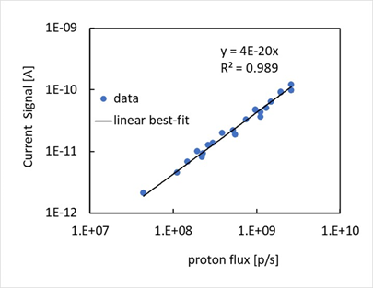
PROVIDE - PeROVskIte DEtectors for innovative strategies in radiation therapy and diagnostics
NEW!
Durata proposta 3 anni - Area di ric. Rivelatori
Responsabile nazionale: Mara Bruzzi
INFN-FI Unità partecipanti BO – FI – LE - PI - TIFPA
STATE OF THE ART Knowledge n Expertise with 3+ CSN5 projects. PEROV, PERO2, ANEMONE.
ABX3 PEROVSKITI:
Booming material with notable PROs:
⧫ High eff. low noise. High sensitivity.
⧫ Developm. driven by solar panels business.
⧫ Low cost, easy manufactoring, direct electrodes deposition.
PROJECT GOALS:
1-Optimize perovskite detectors  Geometry-planar electrode in resistive configuration  Time resolution: first thin-film perovskite schottky diode detectors  First single-event detectors based on perovskite films  First matrices of pixelated detectors 2D/3D mapping dose distributions.
2-Explore novel functionalities  flash radiotherapy  flexible in-vivo and transmission modalities  Advanced imaging for X-ray diagnostics.
3-Investigate long-term stability and durability of Halide Perovskite detectors under prolonged radiation exposure
Bruzzi et al. (19): Perovskite film CsPbBr₃ 1um thick L = 10um
Test beam at Pisa Hospital LINAC 9 MeV Electrons Flash Therapy
Trento PTC linearity tests with 70-228MeV Protons: Bruzzi et al. Front. Phys. 2023, 11, 51.

Slide 24
Medical Accelerators
SIG (Call) – Superconducting Ion Gantry

Slide 25

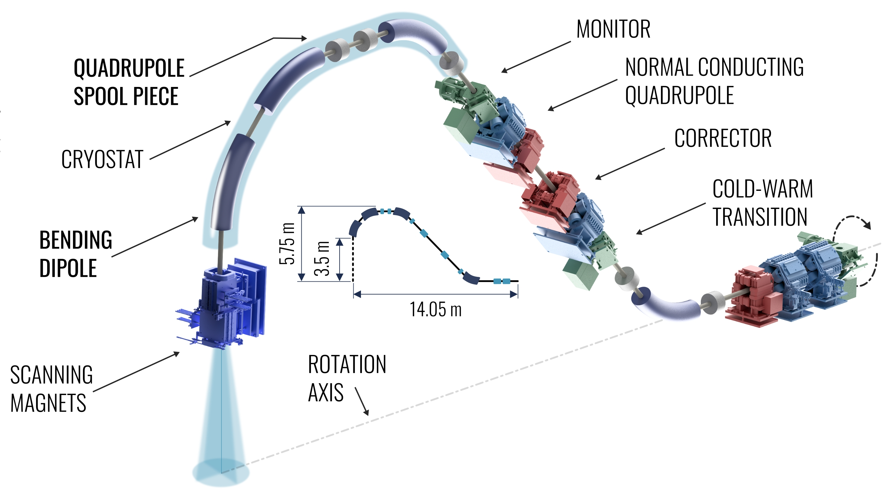
SIG - Superconducting Ion Gantry - Call
Scope: study and development in 4 years of the key technologies for the next generation ion gantry of “only” 50 tons. This R&D of SIG will enable non-coplanar ion irradiation, greatly increasing the quality of the cancer treatment.
Gantry key features and technologies
Particles up to a rigidity of 6.6 Tm (430 MeV/u carbon ions), 14 m long, ~50 tons weight
Technologies:
4 T curved superconducting dipoles
(WP2 – M. Prioli - MI)
Downstream scanning magnet system
(WP3 – L. Sabbatini - LNF)
Dose Delivery System (DDS)
(WP4 - S. Giordanengo - TO )
Range Verification System (RVS)
(WP5 - E. Fiorina - TO )
WP1: Project coordination – Principal Investigator: M. Prioli

Slide 26
Computational (µ)dosimetry
Geant4INFN

Slide 27
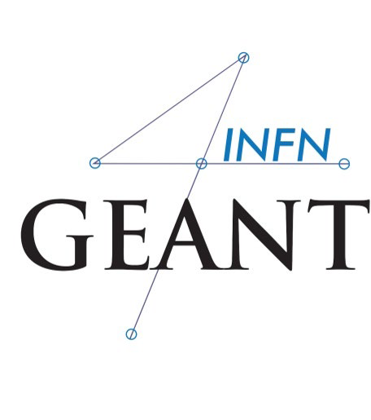
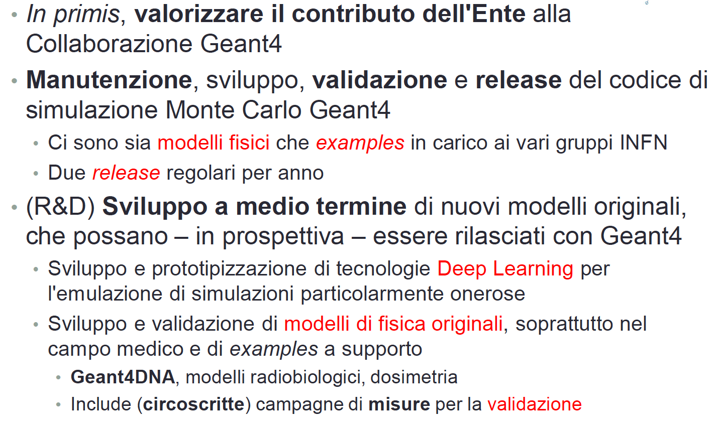
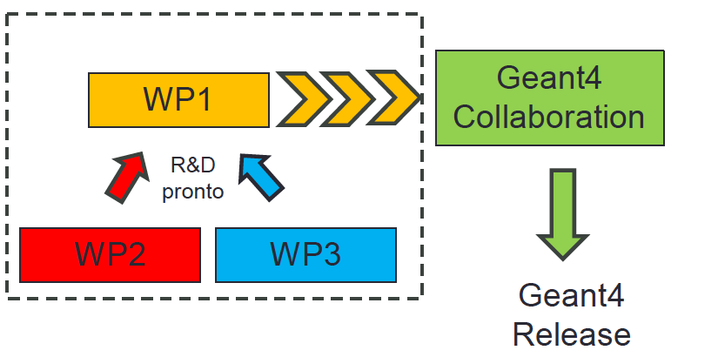
obiettivi generali
interfaccia con la Collaborazione Internazionale

Slide 28
Some further news from CSN5…

Slide 29
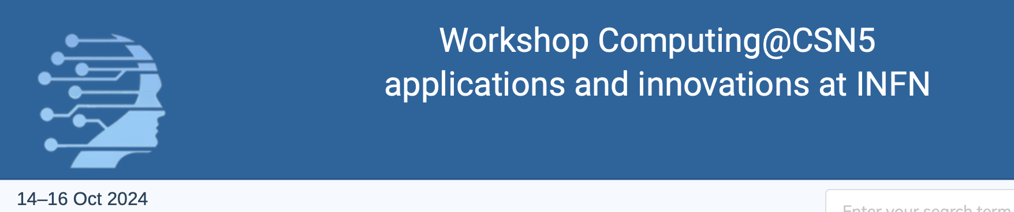
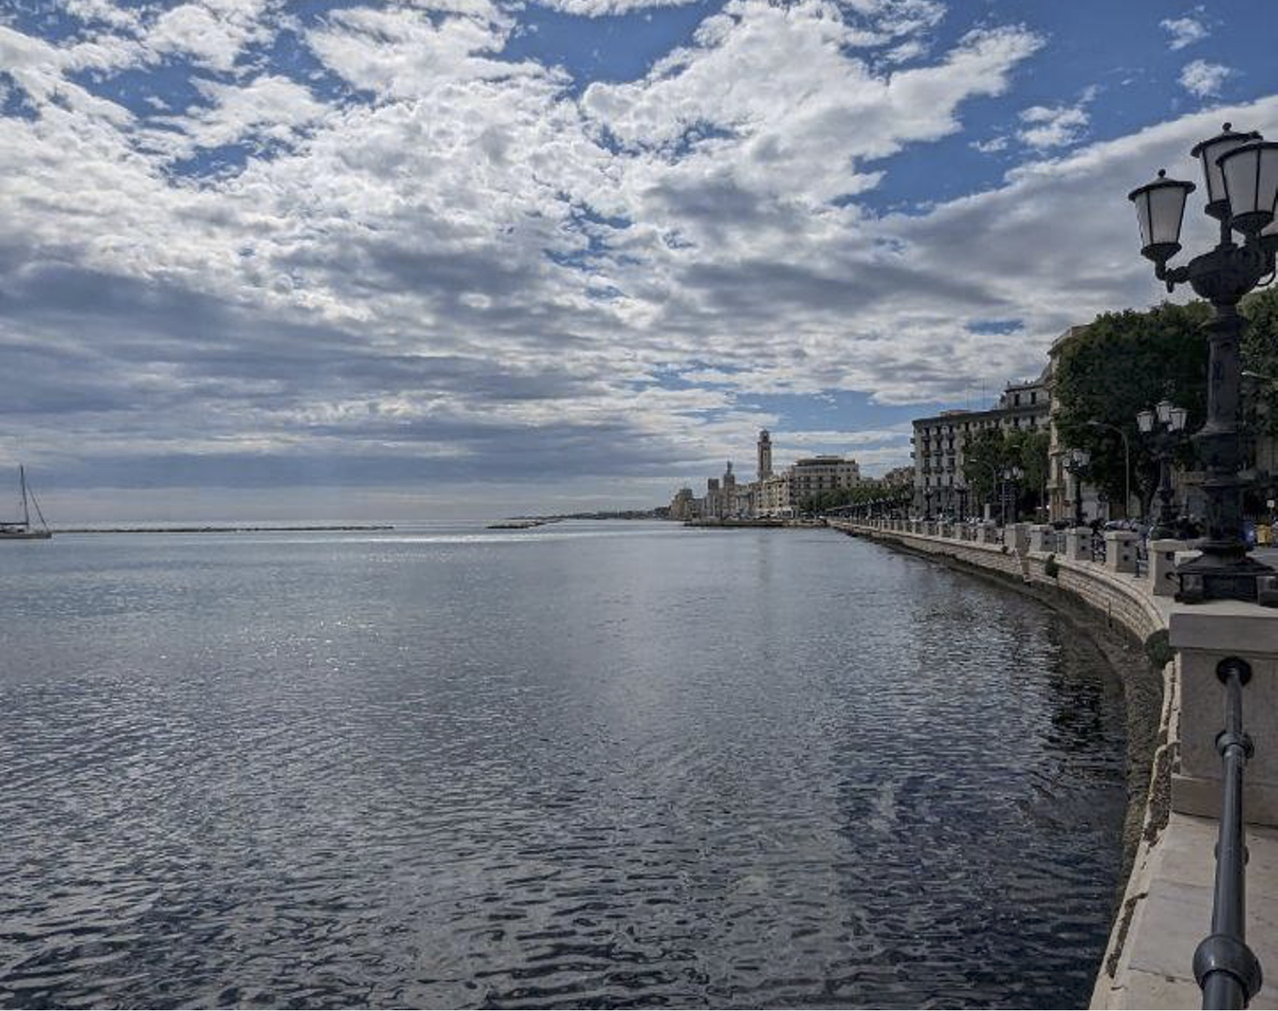
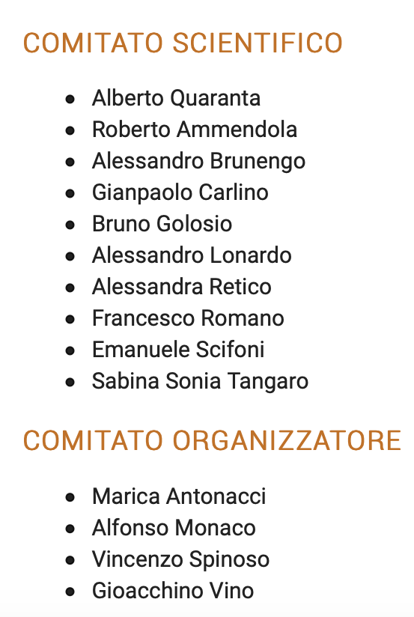
Bari
https://agenda.infn.it/event/42127/
24. HPC
Piero Vicini (Istituto Nazionale di Fisica Nucleare)
14/10/2024, 14:30
keynote
2. ReCaS
Domenico Di Bari (Istituto Nazionale di Fisica Nucleare)
14/10/2024, 15:15
3. PNRR Data cloud for medical applications
Barbara Martelli (Istituto Nazionale di Fisica Nucleare)
14/10/2024, 15:30
4. PNRR FAIR (spoke 8): GPU demanding tasks in medical imaging applications
Francesca Lizzi (Istituto Nazionale di Fisica Nucleare)
14/10/2024, 16:00
5. Applicazioni PNRR - FAIR - brain simulation with HPC
Pier Stanislao Paolucci (Istituto Nazionale di Fisica Nucleare)
14/10/2024, 16:45
6. Applicazioni PNRR - High-speed networks for HPC
Andrea Biagioni (Istituto Nazionale di Fisica Nucleare)
14/10/2024, 17:15
11. GPU for analytical and Montecarlo calculations in Treatment planning
Prof. Angelo Schiavi (La Sapienza - INFN Roma 1)
15/10/2024, 12:00
12. Geant4 Monte Carlo simulations and computational challenges for FLASH Radiotherapy and novel irradiation modalities
Giuliana Giuseppina Milluzzo (Istituto Nazionale di Fisica Nucleare)
15/10/2024, 12:30
23. GPU-accelerated dose engine for adaptive particle therapy
Cosimo Galeone
15/10/2024, 12:45
27. Dedicated infrastructure for systematic physics model validation for medical application: the G4Med international project
15/10/2024, 14:30
keynote
13. PNRR-THE: multi-scale modelling for simulation of the intra-cell dynamics following FLASH irradiation
Valentina Tozzini (Istituto Nazionale di Fisica Nucleare)
15/10/2024, 15:15
14. AI driven and mechanistic Biophysical modeling
Francesco Giuseppe Cordoni (Istituto Nazionale di Fisica Nucleare)
15/10/2024, 15:45
28. next_AIM: overview and challenges in medical image analysis

Slide 30


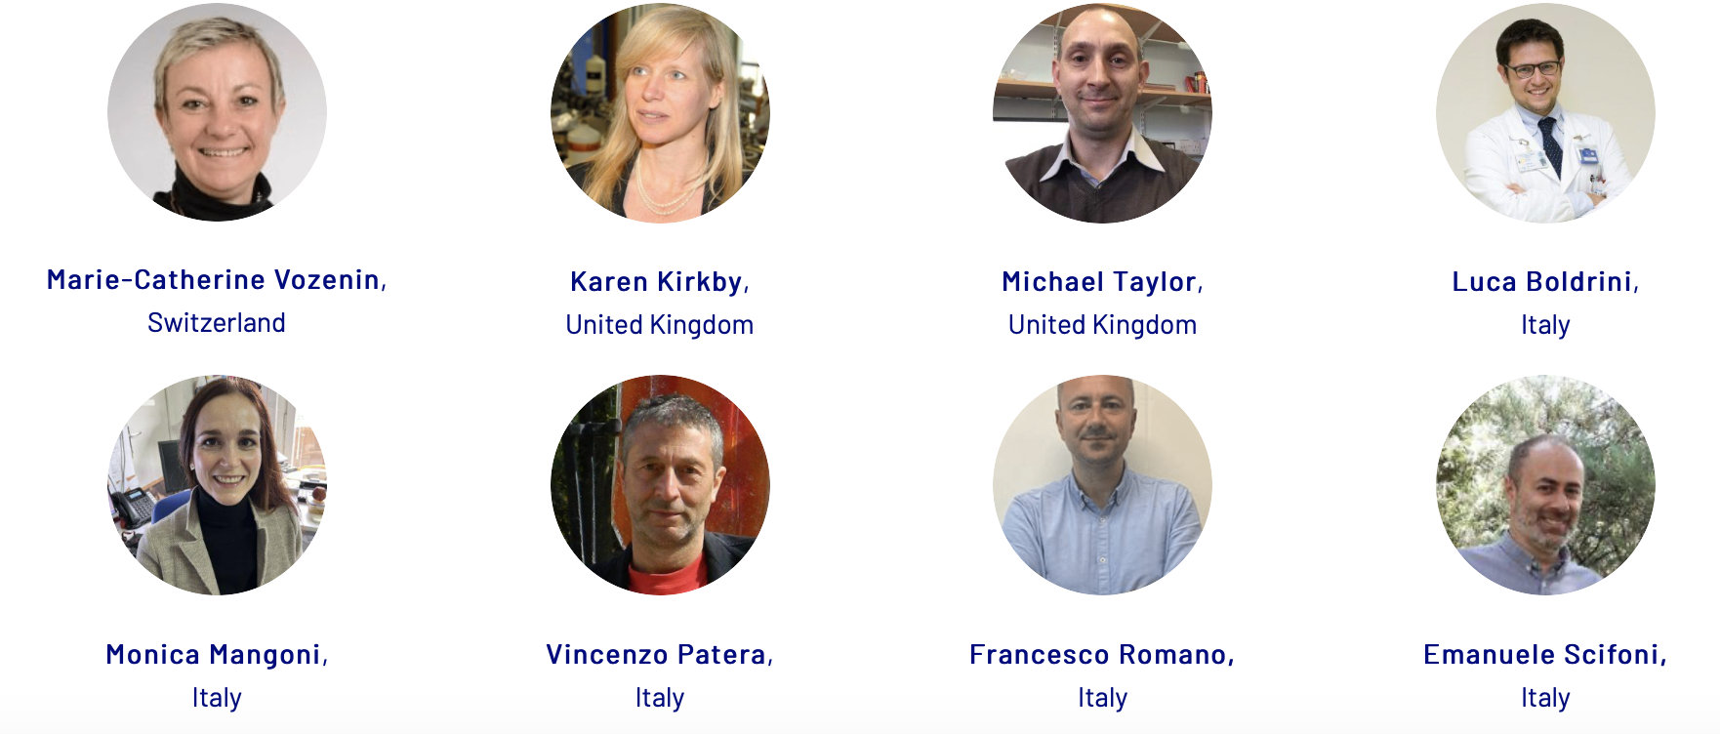
FLASH Radiotherapy& Particle Therapy 2024 conf. in Rome
Exploiting many CSN5 topics:
Detectors for UHDR Radiation
Accelerator techniques for UHDR beams
Experimental and Theoretical Radiobiology
Advanced Computing for TPS
Over 1000 participant expected

Slide 31
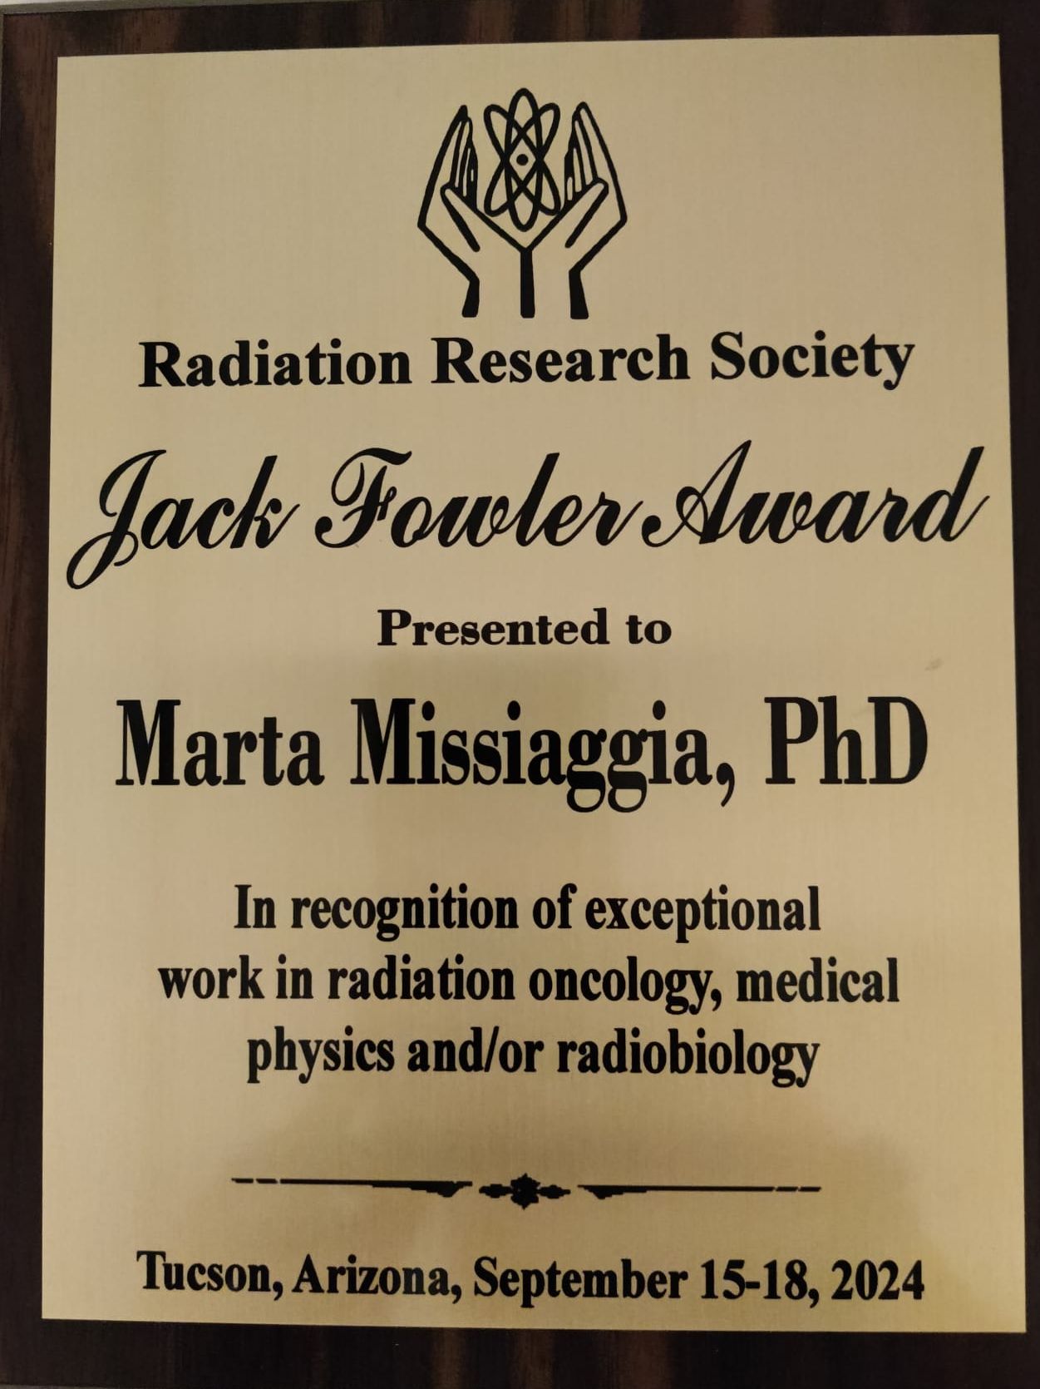

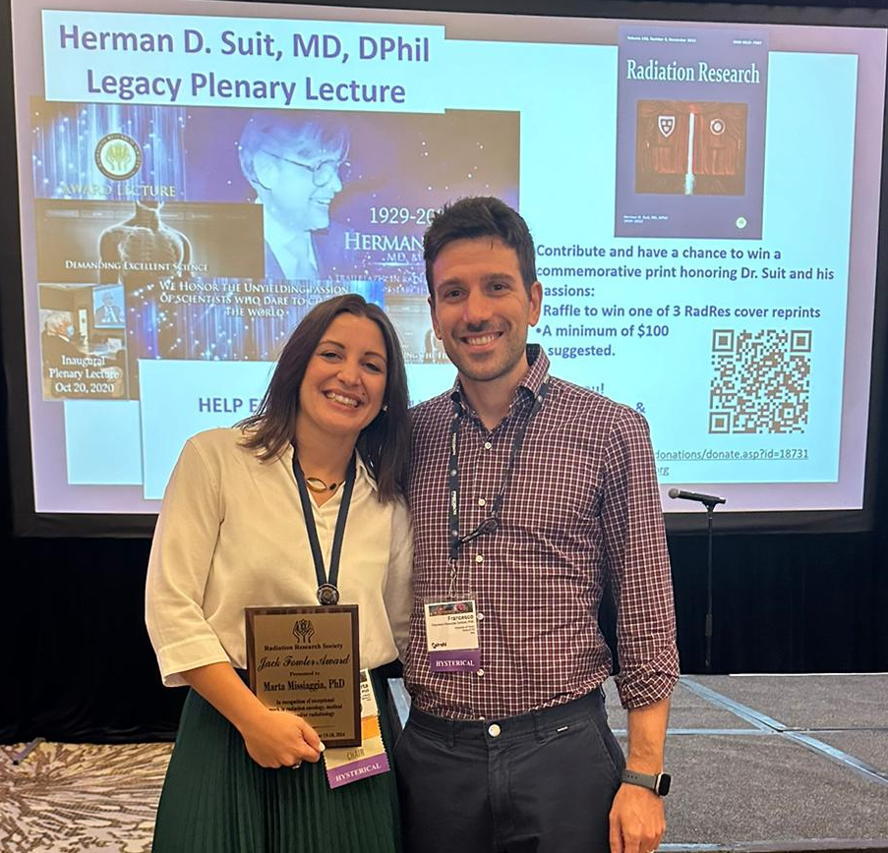
Jack Fowler Award 2024 to Marta!
The JFA by the RRS recognizes yearly an ”outstanding junior investigator/faculty for exceptional work in radiation oncology, medical physics, and/or radiobiology”
This year’s recipient is
MARTA MISSIAGGIA (from TIFPA-BiMeR now at Uni Miami) for her experimental and theoretical work on microdosimetry, mostly done in CSN5 (MICROBE-IT Exp)
-Already awarded with Resmini 2023 by CSN5

Slide 32
Summary
LS activities in CSN5 are steadily growing and diversifying….
Impacting not only the traditional “Interdisciplinary” sector, but also “Detectors” (for medical detectors), “Accelerators”(medical accelerators) and “Computing” (AI, MC, TPS, etc.)
Many contacts with local and national hospitals and sanitary structures have been established in this context
INFN4LS Role may be crucial in :
  Fostering these connections
  Spreading National and International initiatives in the sector
  Information flow is essential (ML, Website, OpenMeetings))

Slide 33
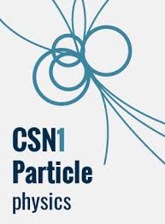

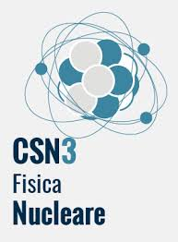

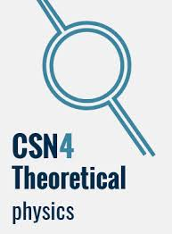





A Disney view
of INFN
Thanks!
Slides Courtesy of:
All the CSN5 Coordinators, and National Responsibles

