Slide 1


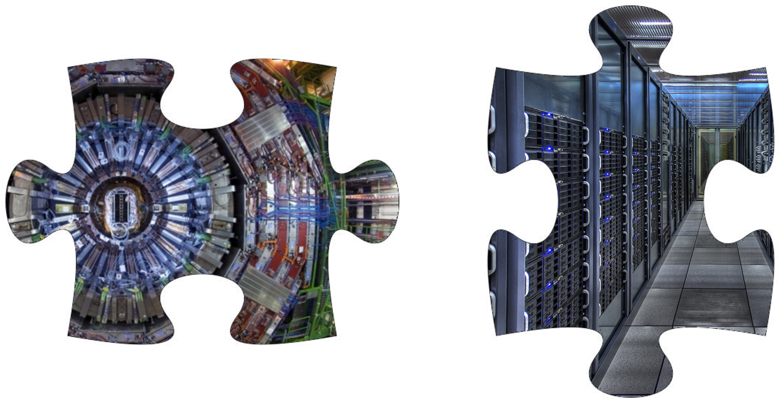


EUCAIF WG2-CODESIGN
Meeting 2025/2
T. Dorigo, P. Vischia
18/6/2025

Slide 2
Today’s Proposed Agenda
- Initial reflections on Co-design
A look at the demographics and input from members
- Identifying co-design examples for white paper and demonstration/benchmarking
1) innovative calorimetry?
2) co-design of muon tomography applications?
3) other bottom-up suggestions?
White paper organization
Grant application possibilities
Your proposed discussion topics
AOB

Slide 3
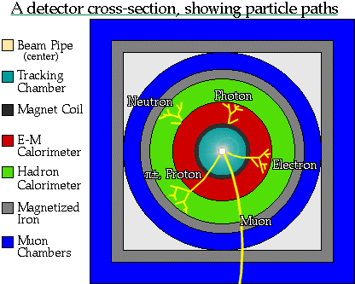
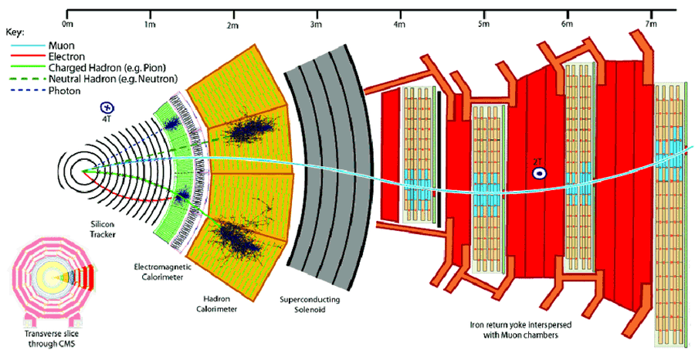
1989
We Are Successful Detector Builders…
In the past 60+ years our community established robust design paradigms, while pushing technologies to their bleeding edge
Some of those deeply ingrained paradigms are not necessarily as motivated today as they once were
- track first, destroy later (dichotomic!)
- redundancy (the opposite of optimality!)
- symmetric layouts (but the relevant physics is not!)
The design space of the biggest projects has grown to transcend our understanding – we cannot think in 10⁵ dimensions
Our demands (luminosity, resolution) are also on the rise, as is the size of the viable technological solutions space (e.g. 3D printing)
2010
2050?
?

Slide 4
We Are Successful Detector Builders…
1989
In the past 60+ years our community established robust design paradigms, while pushing technologies to their bleeding edge
Some of those deeply ingrained paradigms are not necessarily as motivated today as they once were
- track first, destroy later
- redundancy
- symmetric layouts
The design space of the biggest projects has grown to transcend our understanding – we cannot think in 10⁴ dimensions
Our demands (luminosity, resolution) are also on the rise, as is the size of the viable technological solutions space (e.g. 3D printing)
2010
2050?
?

Slide 5
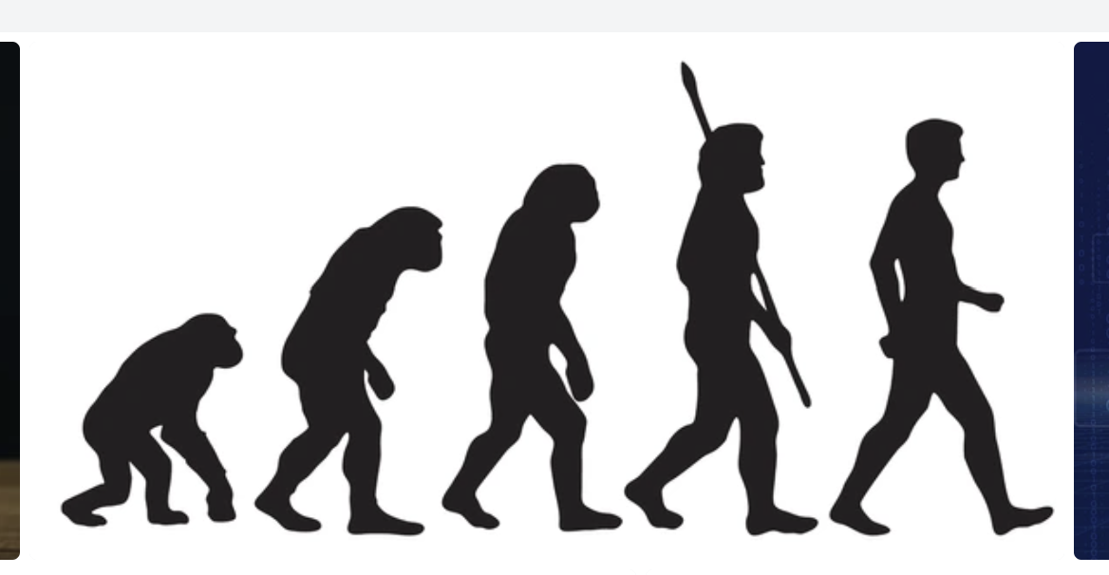

The (non-)Evolution of Detectors
1989
2010
2050?
DO’H!
Who’re you gonna call?
CO-DESIGN!

Slide 6
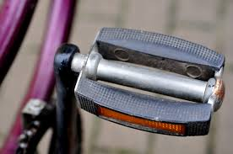
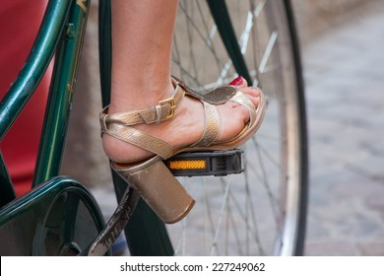
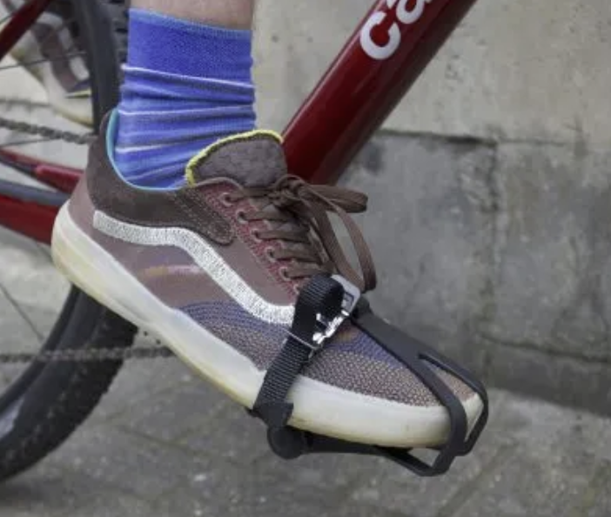
What is Co-Design?
Realizing that the achievement of a goal may require to tailor each part of a system to all others: synergy
Enabling the simultaneous optimization of all parts, to maximize a global utility in a high-dimensional design space: holistic optimization
Bringing together diverse components, technologies, or expertise to create a unified and cohesive system, ensuring seamless interoperability and coordination: integration

Slide 7
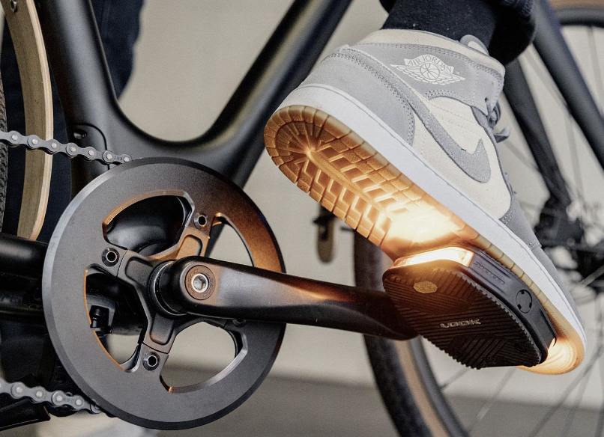
What is Co-Design?
Realizing that the achievement of a goal may require to tailor each part of a system to all others: synergy
Enabling the simultaneous optimization of all parts, to maximize a global utility in a high-dimensional design space: holistic optimization
Bringing together diverse components, technologies, or expertise to create a unified and cohesive system, ensuring seamless interoperability and coordination: integration

Slide 8
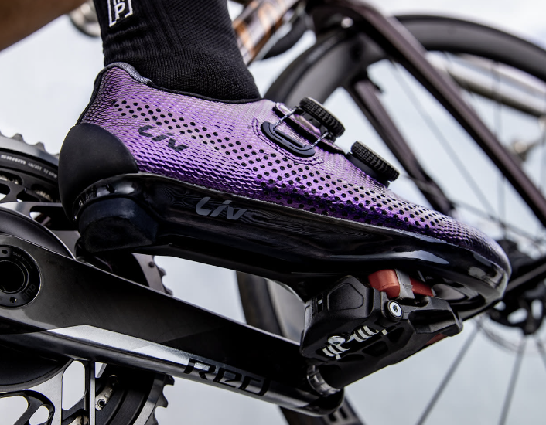
What is Co-Design?
Realizing that the achievement of a goal may require to tailor each part of a system to all others: synergy
Enabling the simultaneous optimization of all parts, to maximize a global utility in a high-dimensional design space: holistic optimization
Bringing together diverse components, technologies, or expertise to create a unified and cohesive system, ensuring seamless interoperability and coordination: integration

Slide 9
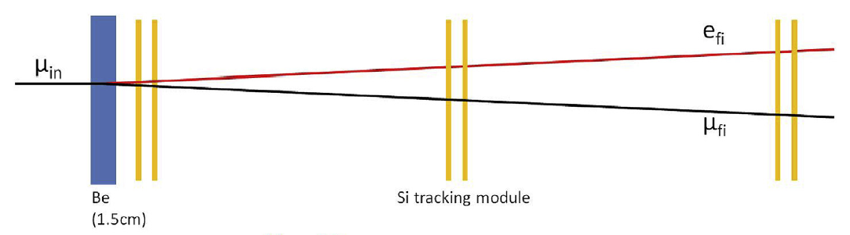
On Co-Design of experiments
Despite the flourishing of (very nice!) examples of hardware optimization (and software optimization) in various areas, I have not yet seen a convincing case of co-design carried out in full.
My only proto-example is an old and a bit too simple one: the MuOnE experiment (next slides).
Optimization efforts of the hardware H of an experiment may fix the software producing inference from the collected data, or consider a few possible choices for it
In other efforts the software (pattern reconstruction, dim. Reduction) is optimized end to end by considering a fixed detector, or maybe a few possible configurations
The full space is only accessible if you consider every parameter together
Beam
Above: layout of one of 40 1m-long MUonE stations, as per original design proposal

Slide 10
On Co-Design of experiments
Despite the flourishing of (very nice!) examples of hardware optimization (and software optimization) in various areas, I have not yet seen a convincing case of co-design carried out in full.
My only proto-example is an old and a bit too simple one: the MuOnE experiment (next slides).
Optimization efforts of the hardware H of an experiment may fix the software producing inference from the collected data, or consider a few possible choices for it
In other efforts the software (pattern reconstruction, dim. Reduction) is optimized end to end by considering a fixed detector, or maybe a few possible configurations
The full space is only accessible if you consider every parameter together
Design space
Software methods and parameters
Hardware components and parameters

Slide 11
On Co-Design of experiments
Despite the flourishing of (very nice!) examples of hardware optimization (and software optimization) in various areas, I have not yet seen a convincing case of co-design carried out in full.
My only proto-example is an old and a bit too simple one: the MuOnE experiment (next slides).
Optimization efforts of the hardware H of an experiment may fix the software producing inference from the collected data, or consider a few possible choices for it
In other efforts the software (pattern reconstruction, dim. reduction) is optimized end to end by considering a fixed detector, or maybe a few possible configurations
The full space is only accessible if you consider every parameter together
Design space
Software methods and parameters
Hardware components and parameters

Slide 12
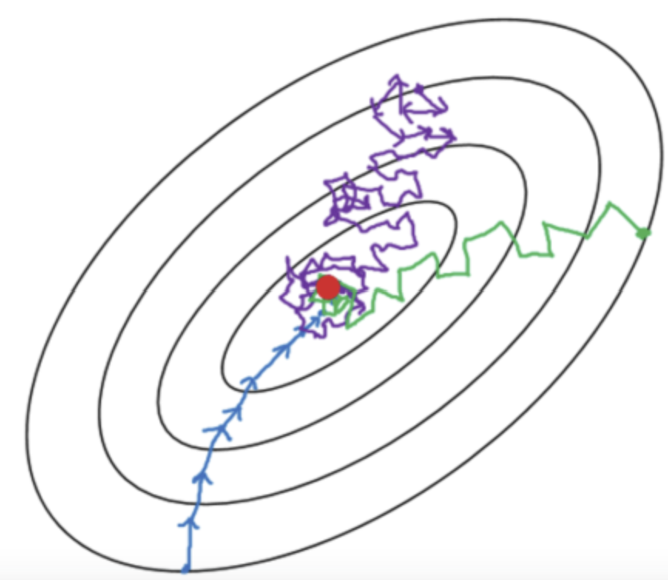
On Co-Design of experiments
Despite the flourishing of (very nice!) examples of hardware optimization (and software optimization) in various areas, I have not yet seen a convincing case of co-design carried out in full.
My only proto-example is an old and a bit too simple one: the MuOnE experiment (next slides).
Optimization efforts of the hardware H of an experiment may fix the software producing inference from the collected data, or consider a few possible choices for it
In other efforts the software (pattern reconstruction, dim. reduction) is optimized end to end by considering a fixed detector, or maybe a few possible configurations
The full space is only accessible if you consider together all parameters. Depending on the breadth of methods and parameter space considered, this scans (a subset of) the full dimensionality available
Design space
Software methods and parameters
Hardware components and parameters

Slide 13
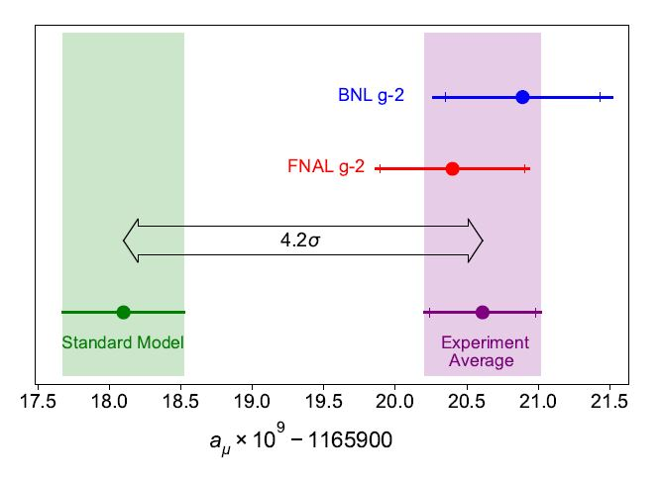
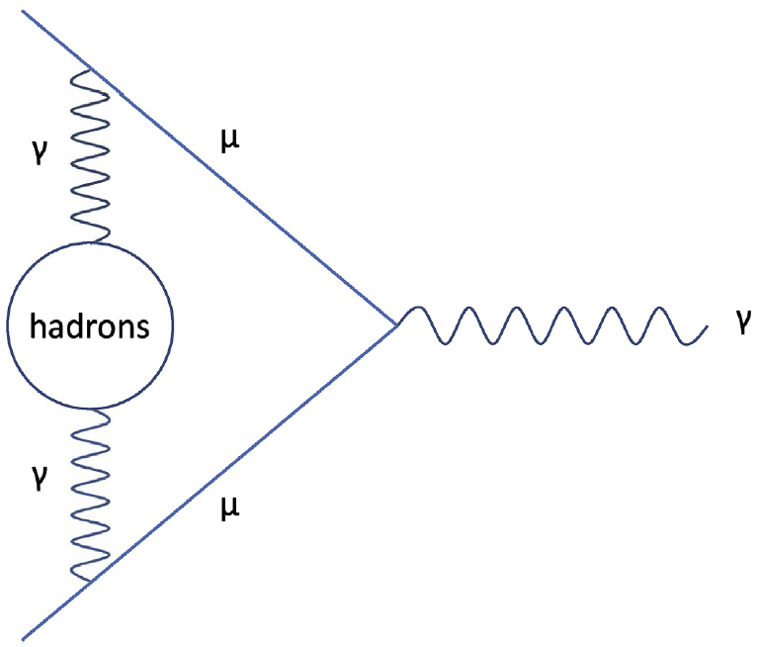
One Example of Geometry Optimization: MUonE
MUonE aims to determine with high precision the probability of elastic muon-electron scattering, as this number may reduce the theory systematics of the g-2 muon anomaly
The experiment must be sensitive to the rate of interactions as a function of momentum transfer, with 10⁻⁴ precision
Above: a long-standing anomaly in the Standard Model, the muon g-2 value
Below: a muon-photon interaction,
with a hadronic quantum loop
Beam
Above: layout of one of 40 1m-long MUonE stations, as per original design proposal

Slide 14
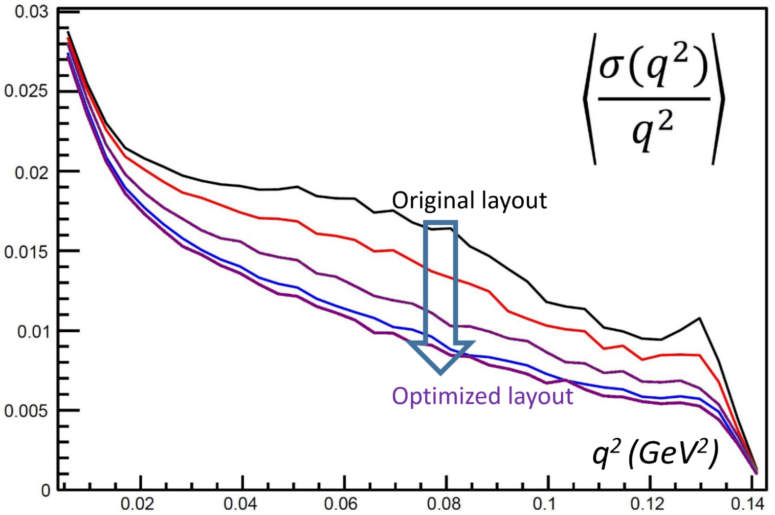
MUonE Optimization
Relevant figure of merit: relative resolution on momentum transfer q²
The original design of the MUonE stations was good, but it failed to use the constraining potential of the 3-particle vertex (a co-design exploitable!) and the strong dependence on geometry of q² resolution (the relevant metric)
A factor of two (!) gain was achieved by discrete optimization scans
Region sensitive to hadronic loop
contributions
Above: relative resolution in event q² for different configurations (the higher, black line is the original proposal by the MUonE coll.)
T. Dorigo, Geometry Optimization of a Muon-Electron Scattering Experiment,
Physics Open 4 (2020) 100022.

Slide 15
WG2 Composition and Survey(s)
As of today, the WG2 mailing list includes a total of 52 members
In order to organize group activities we tried to launch a quick survey last November, but it failed – too few answers to make sense
In the next slide I quote useful input from those who responded to it

Slide 16
Meaningful comments/input from 1st survey*
Goals:
- Inform the ESPP process, steer the design of future instruments
- Create collaborations for the R&D of innovative instruments
Produce scientific publications in specific topics connected to stated goals
Create collaborations for R&D
Advise design of future instruments
Wish list / comments:
Differentiable surrogates of Geant4, Corsika, Fluka would be useful
WG2 seen as an open forum rather than a group organizing activities
* Some longer comments reported later

Slide 17
A second (simpler) survey
We tried again to elicit input from ML members a month ago, by asking you for one line of input in a google doc table. So far got 15 answers.
Please add your own here: https://docs.google.com/document/d/123N3q8m5dgJR66L2jLAyspHNhK_Msg3BrJoNmGgLZFk/edit?tab=t.0
Summary of interests as declared:
Calorimeter optimization (9 answers)
Muon tomography (4 answers)
Hadrotherapy/pCT (4 answers)
Neuromorphic computing (4 answers)
Astrophysics experiments (2 answers)
Neutron tomography (2 answers)
Beamline design for fixed target (1 answer)
What should be the aim of the WG?
Sharing of knowledge
Coordination/synchronization of existing efforts
Collaborate to demonstrate scope and benefits
Forum for expert feedback on co-design
Foster networking for funding applications
Collaboration and training
Identify common examples to showcase idea
Develop demonstrators, guidelines, or frameworks for co-design
Define benchmarks for model testing

Slide 18
Comments and other input from 2nd survey
Tobias Golling:
1) We should develop well-documented staged benchmarks (open-ended, adding realism and complexity as we proceed) with clearly defined performance metrics, validation and monitoring code and plots and with a focus on interpretability and explainability. This should be available for the whole community to contribute to and compare with. Use as a set of challenges, present to AI community as an AI design demonstrator. Start a dialog with hardware community to find efficient and acceptable ways to have AI in the loop with humans. As part of these studies, investigate also extreme highly innovative designs. This would complement nicely the classic/standard research on detector design and has potential for greater leaps in design progress.
2) Come up with a common strategy together with WG1 on foundation models. The community is diverse - we should address the full spectrum of interested parties. Some already have a concrete goal in mind. Defining a clear and alive vision for WG2 is crucial which shows how the various efforts fit into the bigger picture, and always be open for new parties to join. Would be also good to reward people who contribute actively to minimize “dead wood”, i.e. people who on the paper are part of the effort but who have no active contribution.
Luigi Favaro:
skeptical that collaborative original research work would coalesce sufficient critical mass given the heterogeneity of topics; but may join small teams within WG2 on topics relevant to my research.
Karolos Potamianos:
1) The ability to quickly and accurately simulate the response of an in-design detector would be useful for my research activities, as it would significantly cut down iteration times to determine the optimal design. (The idea would be that we could define analysis strategies for processes of interest and run a “grid scan” on detector layouts and resolution.)
2) Not being sure how much effort interested parties could devote to these endeavours, in the context of limited funding and thus ability to dedicate postdoc, PhD or other student effort on these tasks, the organisation shouldn’t be too heavy so we can focus on getting things done rather than attend or present at meetings. i.e. keep a lightweight touch.
Pietro Vischia:
I suggest keep it [EUCAIF-WG2] a strategy body, in line with the idea of EUCAIF and with the other WGs (e.g. produce reports / strategic opinions, not research on the topics.
Andrea Giammanco:
My main hesitation comes from the thematic overlap with MODE, which creates potential confusion. If we stick to the principle that this WG does not do research, while MODE does, then maybe this mitigates the confusion.

Slide 19
Proposed activities for 2025
We need to aggregate researchers interested in developing co-design solutions to future experiments in some focused projects that can be pilots and later grow into flagship activities and prototype demonstrations of the power of simultaneous optimization of hardware and software
What can be your motivation to participate?
Become authors of papers resulting from the work activities → we need to be inclusive, but recognize merit and leading efforts
By taking part, you become an actor and a potential PI of future grant applications to, e.g., the EIC or the MSCA of the EC
If you are a PhD student or young post-doc, seniors in the group may support you for reference letters, and may be able to open positions for overperformers
If you are a senior, the group will be an excellent place to invest personpower (your students, to which you can offer topics that they will then develop)

Slide 20
Areas of activity of particular interest
An area where there is a whole lot of gain possible from co-design activities is hadron calorimetry
High granularity/precise timing: particle ID limits? Particle flow gains?
Neuromorphic readout with photonics: fast preprocessing / dim. reduction
Hybridization of tracker and calorimeter
Special geometries for special situations
Another area of co-design studies where there is high potential for improvements, as well as possibilities of industry engagement, is muon tomography

Slide 21
What can we deliver?
Eucaif working groups must have deliverables, as any self-respected WG. Otherwise we would have called them fora or committees.
However, seniors in this group are all overcommitted / can devote only small FTE fraction “for free” to extra activities
But: we can still, with young colleagues’ help (e.g. Masters theses, or starting Ph.D. burn-in projects):
Produce innovative papers - an incentive to collaboration
Contribute to improve our own experiment
Enhance visibility of research we are already carrying out
Establish benchmarks and challenges characterizing solutions to typical problems

Slide 22
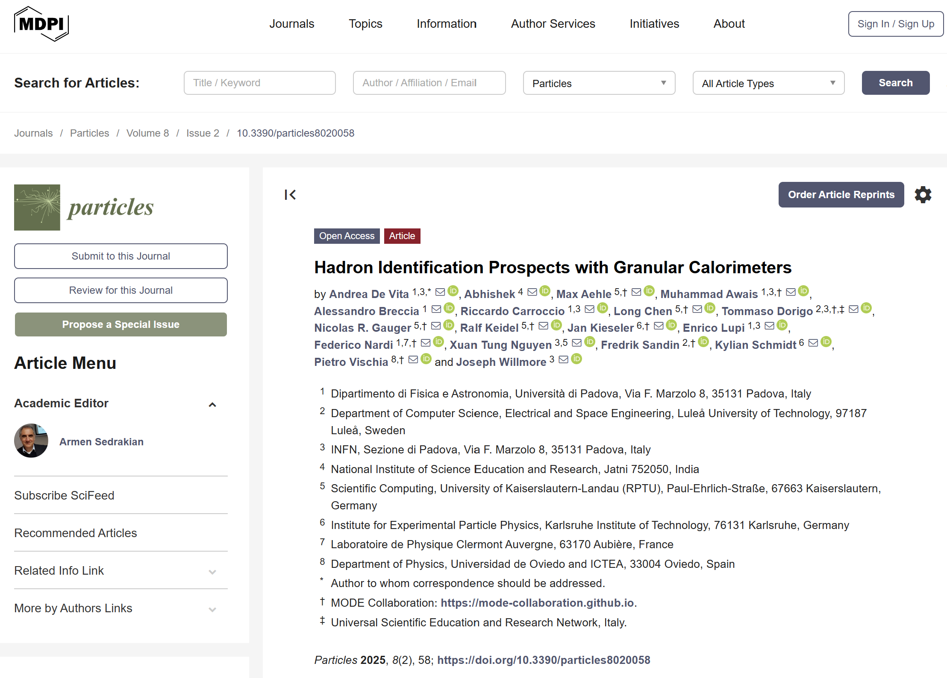
Calorimetry studies
High granularity / precise timing pursued ubiquitously. However, unclear what are the gains. Can you do particle ID? With what accuracy?
This becomes an input to co-design of advanced particle flow methods leveraging PID, when an automated loop can scan the full solution space
We started to explore p/k/π discrimination as a function of cell size in very-high-granularity, homogeneous PbWO4 calorimeter
Published preliminary study
We need to extend it – complete to fully characterize extractable information vs geometry, and build co-design model on it.
Currently involved: 3 seniors, 2 pre-PhD students
Profile sought: anybody interested, but in particular young contributors who can help with existing analysis (easy learning curve).
Possible involvement: producing large simulations; developing discriminating features; run trainings on large computing clusters; produce results for different PID discrimination tasks and detector geometries; editing manuscript of final publication
A.De Vita et al., Particles 2025, 8(2),58;
https://doi.org/10.3390/particles8020058

Slide 23
Sample results: p/π discrimination (presented by Abhishek at MODE workshop 10/6/2025)
Calorimetry studies
Below: discrimination at different energies as a function
of the number of cells segmentation of the detector
Above: discrimination for 25 GeV particles, full
granularity of PbWO4 homogeneous calorimeter

Slide 24
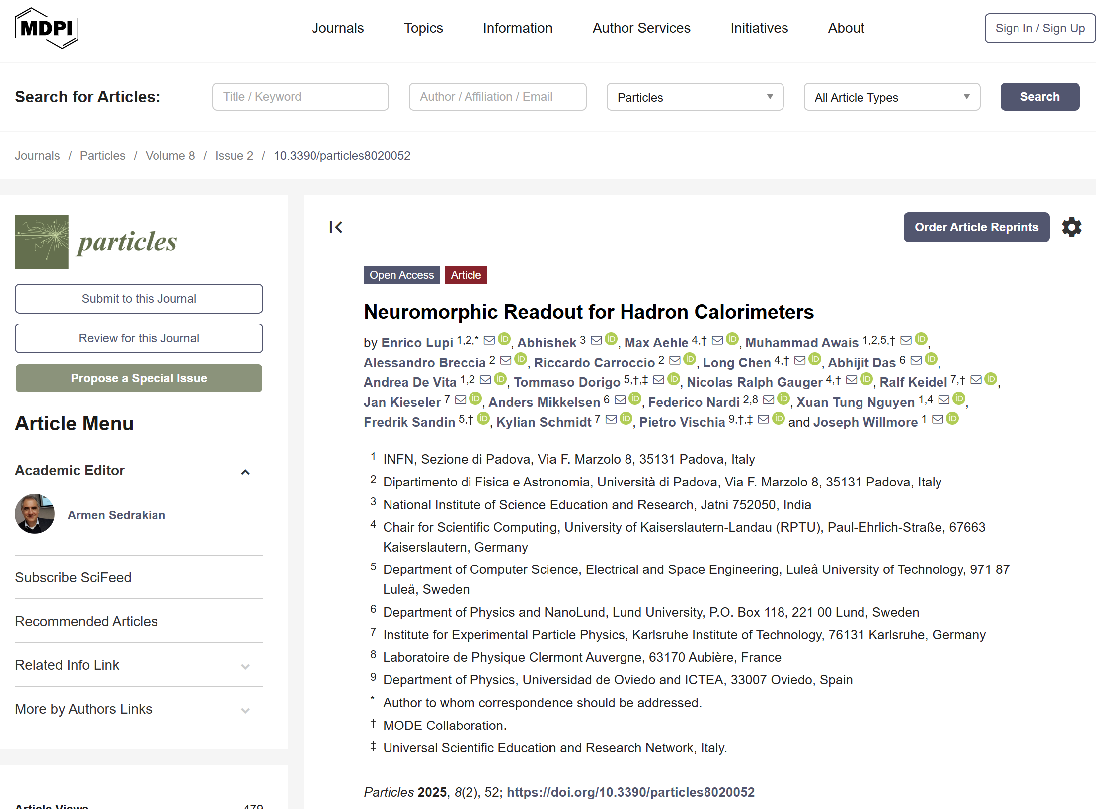
Calorimetry studies / 2
Neuromorphic computing and photonics-based localized preprocessing may be key to dramatically reduce data throughput, do faster readout and on-site dimensionality reduction, offering potential benefit of partly removing need of high granularity
→Studied SNN-based regression of energy, energy xyz centroid, and dispersion in PbWO4 cube where main interaction took place
Preliminary work published (see poster by E. Lupi).
Much to explore in near future! At least a couple of publications foreseen
  One on hardware implementation with nanowires
  One on co-design optimization of design of neuromorphic system
Currently involved: 3 seniors, 1 PhD student, 2 pre-PhD, one bachelor student + advisory at nanoLund
Profile sought: anybody interested. Also hardware experts to explore implementation/prototyping with AI
Possible involvement: explore SNN architecture; optimize layout of neurons for automated dimensionality reduction with generative models; conceive hardware parameter space and proceed to co-design whole system
E. Lupi et al., Particles 2025, 8(2), 52;
https://doi.org/10.3390/particles8020052

Slide 25
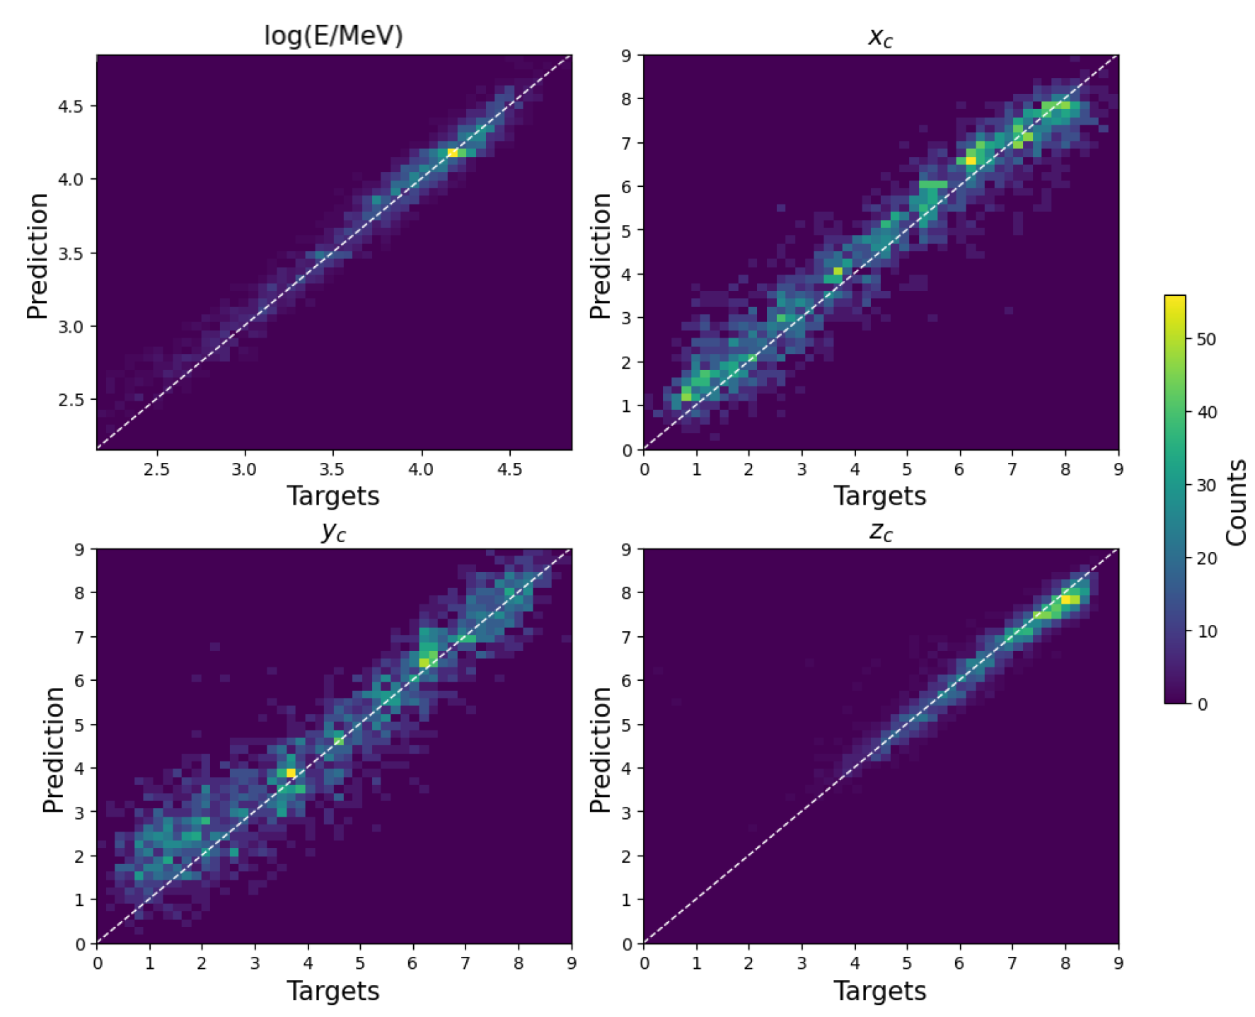
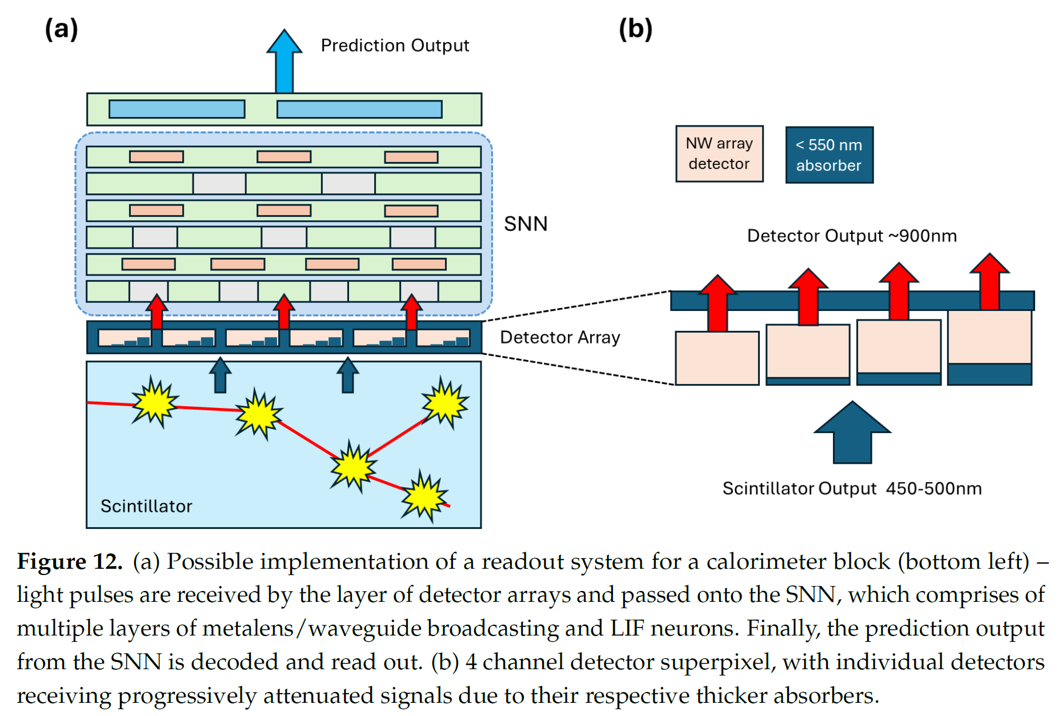
Example from publication:
Regression E+ E centroid x,y,z – see also poster by E. Lupi
Calorimetry studies / 2

Slide 26
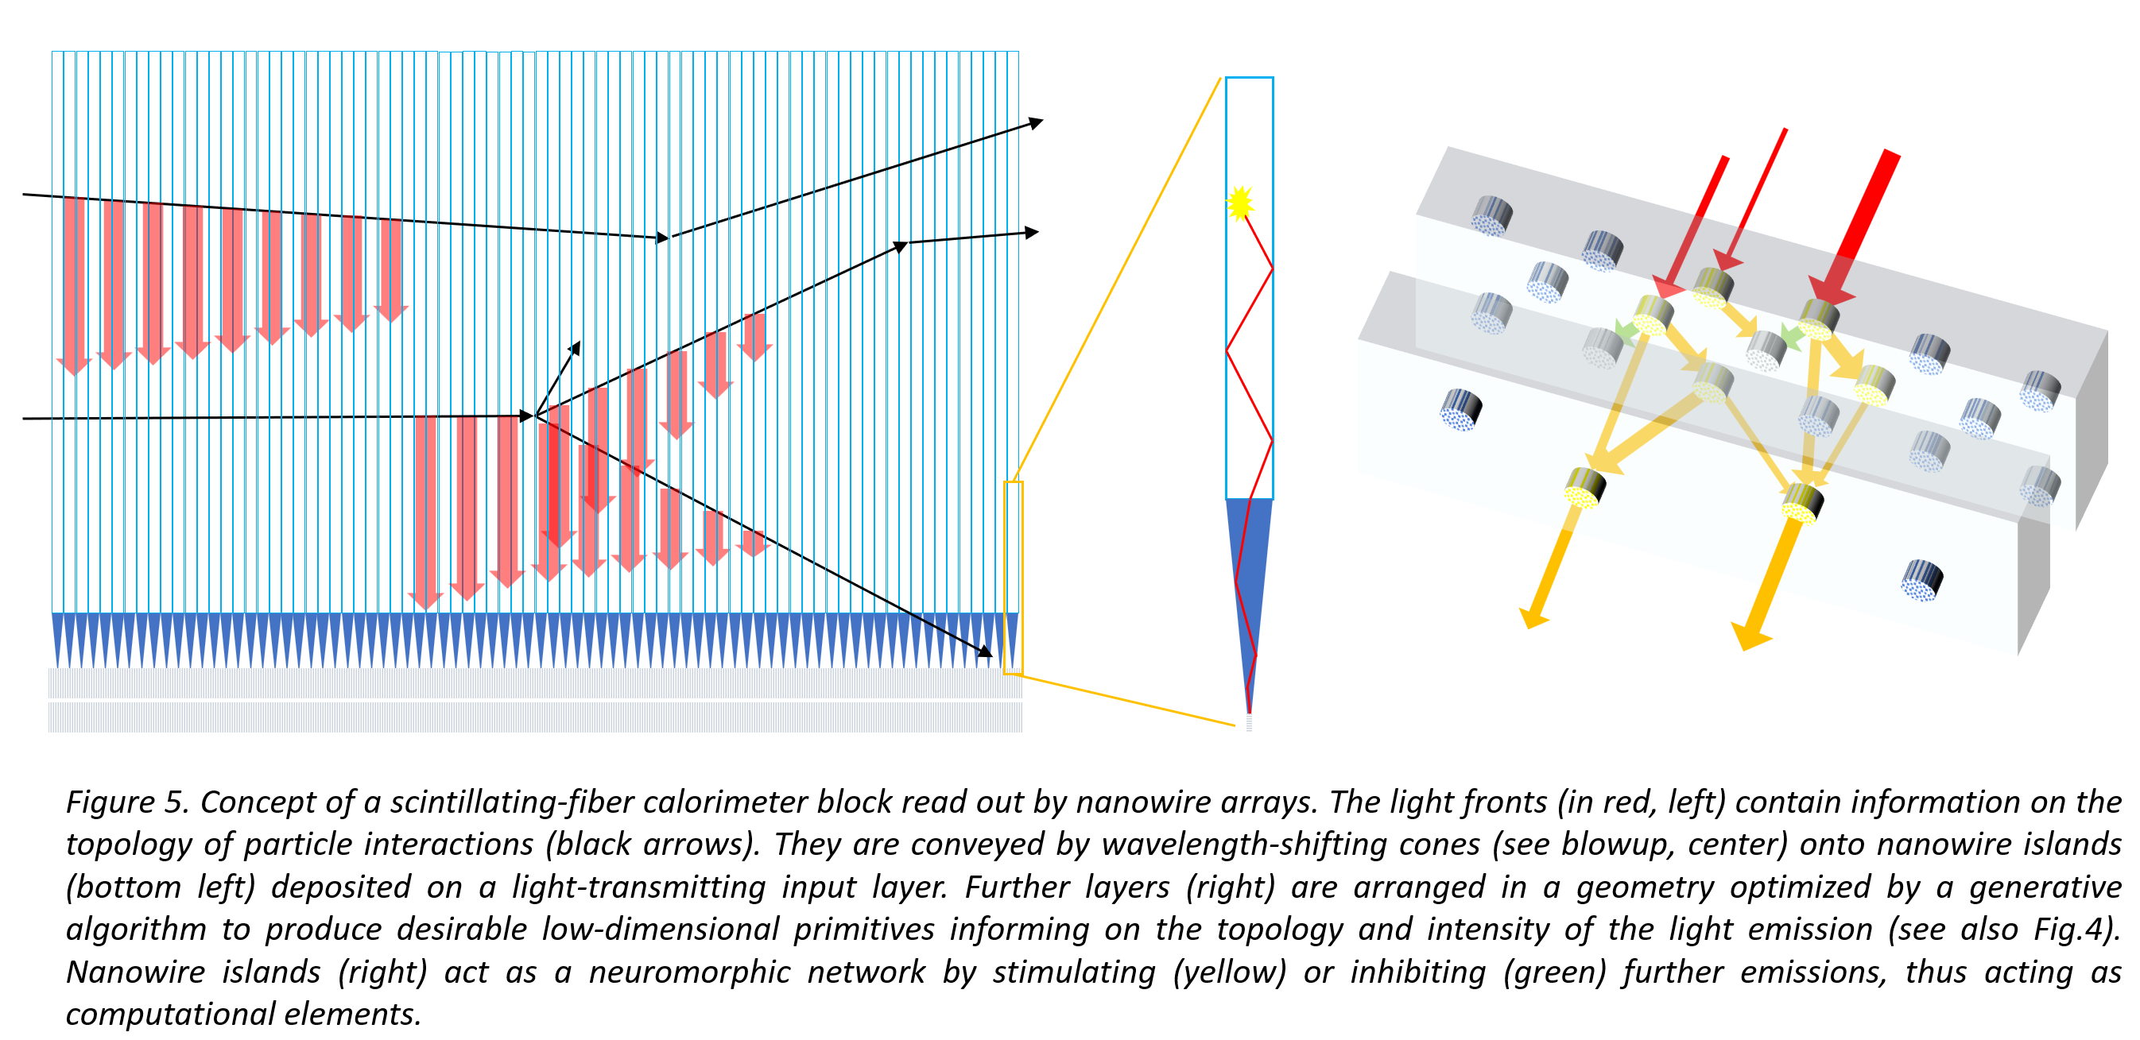
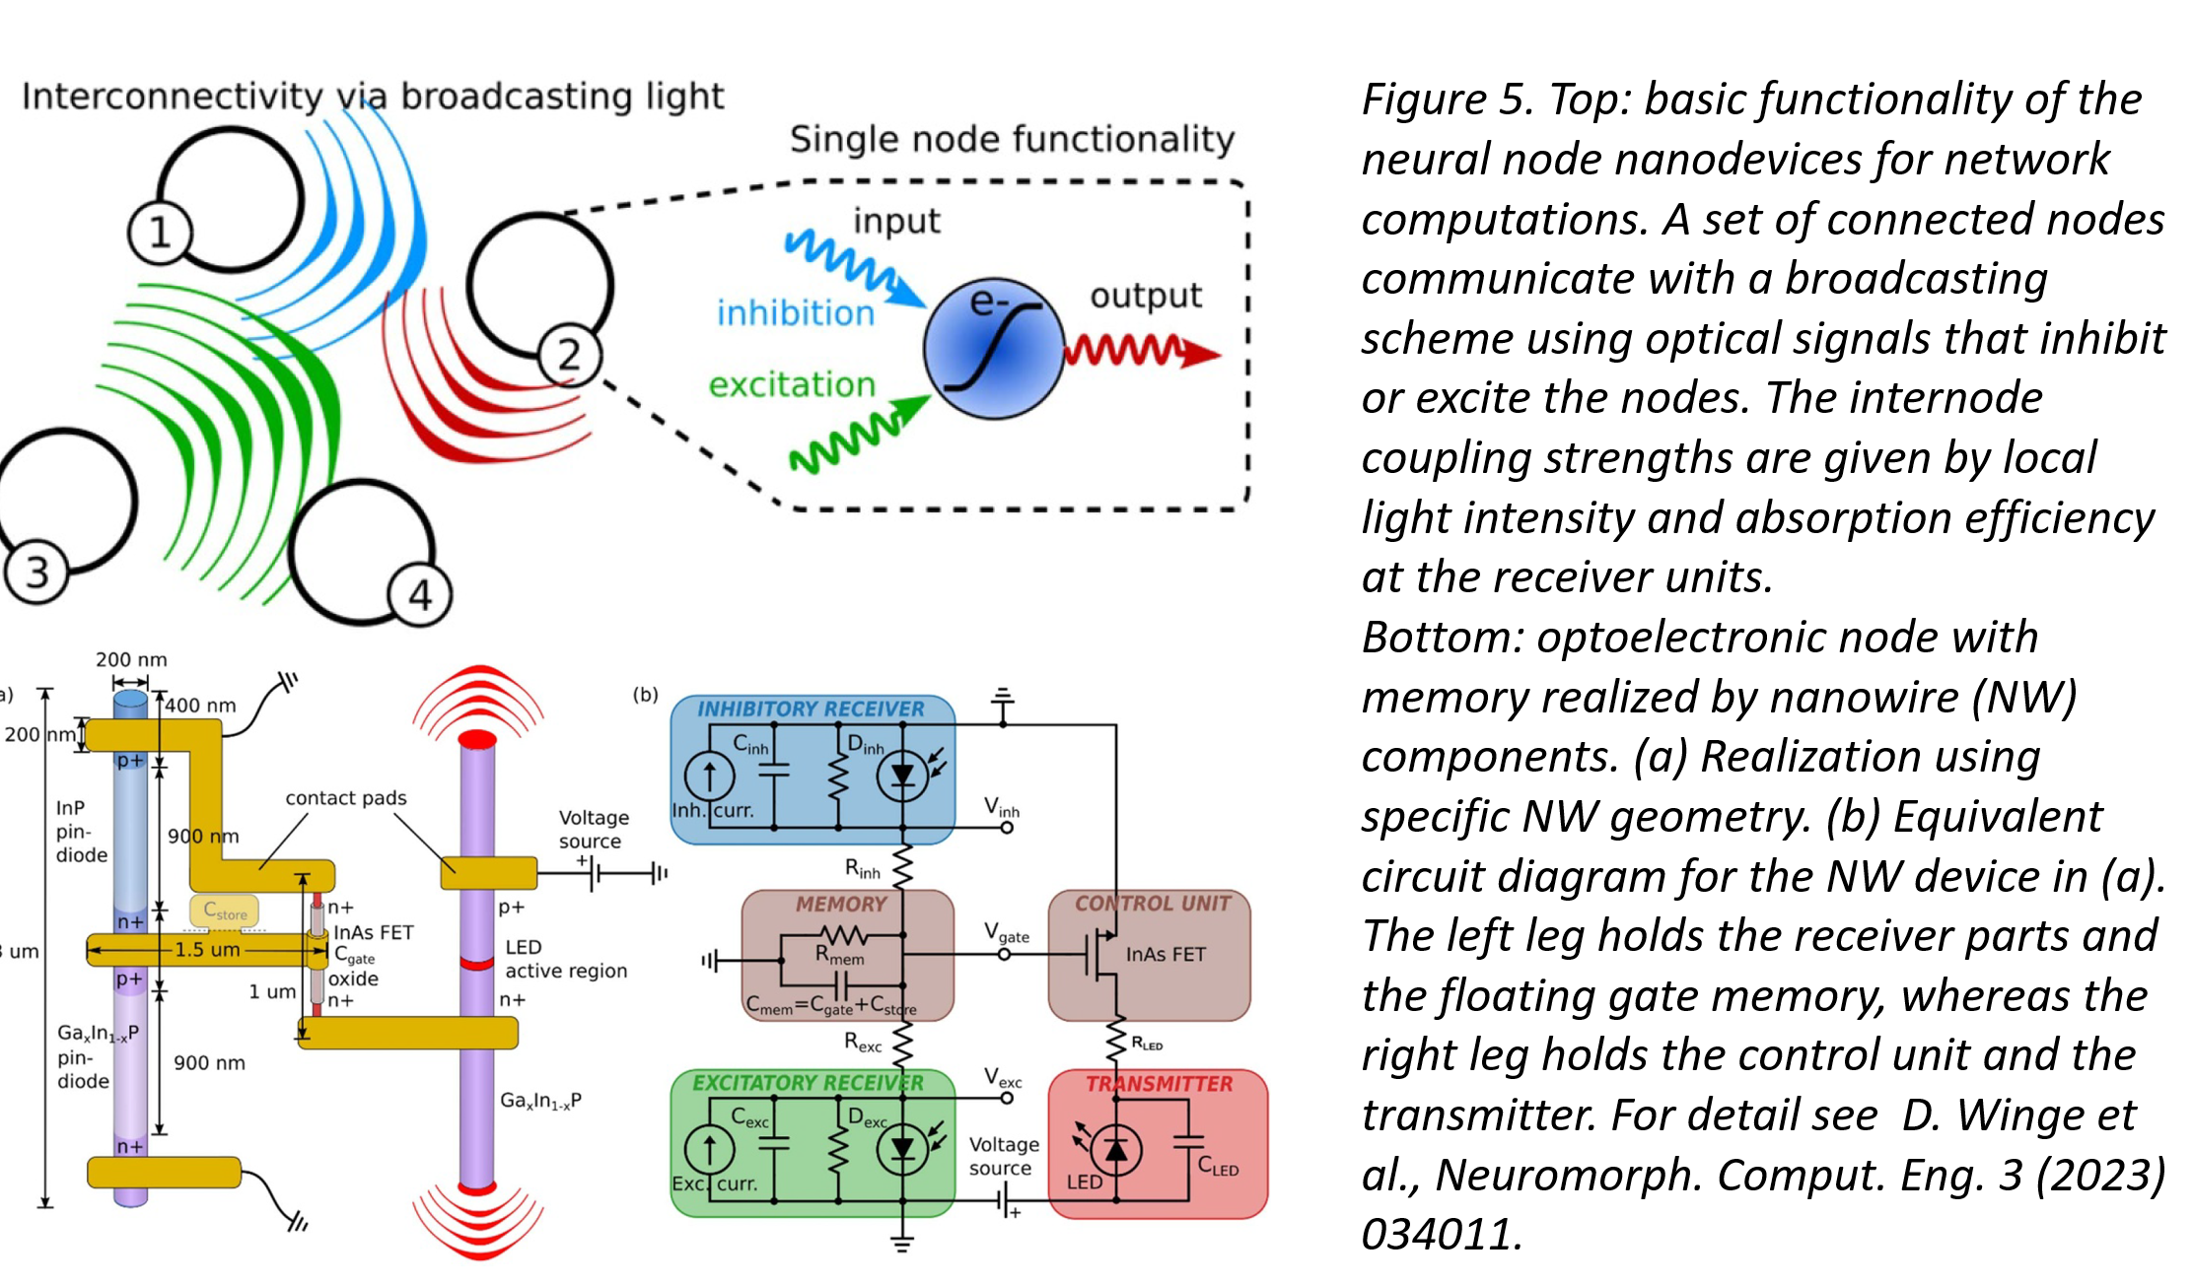
Neuromorphic computing calorimeter readout with nanophotonics
An idea for future development:
Using scintillating fibers coupled to nanowires, and a generative model to learn 3D geometry of NC system made of light-emitting nanowire “neurons” in a photonic network, we can produce ultrafast, low-throughput dimensionality reduction of calorimeter signals
Subject of Pathfinder proposal, in evaluation

Slide 27
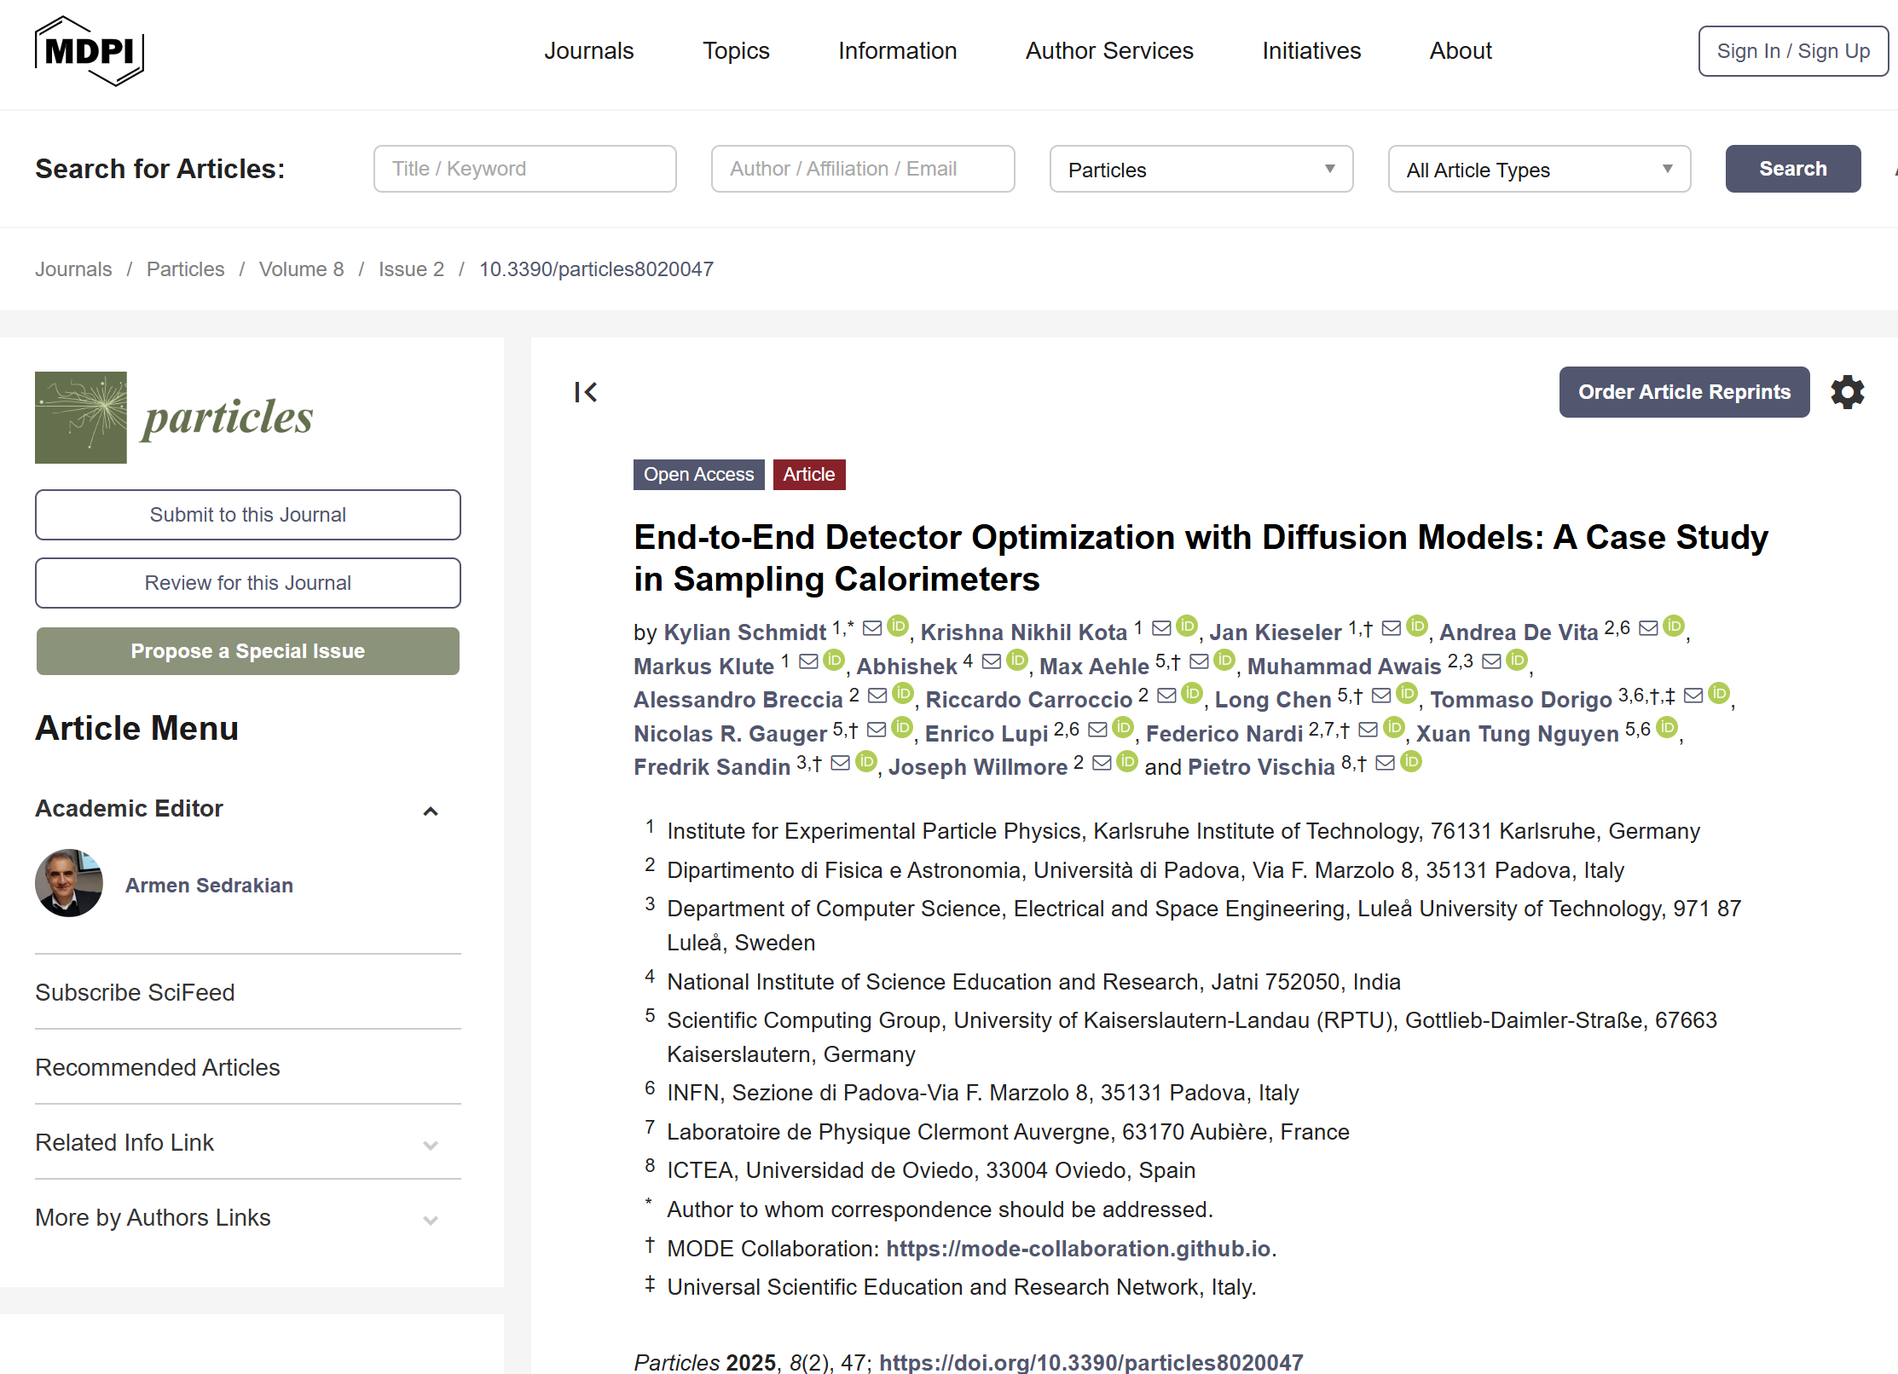
Calorimetry studies / 3
A lot can be explored in hybridization of tracking and calorimetry. Why density 0 → density 1? There must be a better solution.
We have started to prepare software that will explore these possibilities (AIDO) – an end-to-end pipeline that generates new G4 data at every epoch, and approximates with a diffusion model the full data chain. Best example of co-design in place so far.
Proof of principle paper published in MDPI.
Lots of possible questions to ask to the software & new papers to produce
Currently involved: seniors + 3MS + 1BA
Profile sought: TBD – happy to enlarge group
Possible topics: extension to handle tracking layers, study of different loss functions; coupling to different software reconstructions and co-design
K. Schmidt et al., Particles 2025, 8(2), 47;
https://doi.org/10.3390/particles8020047

Slide 28
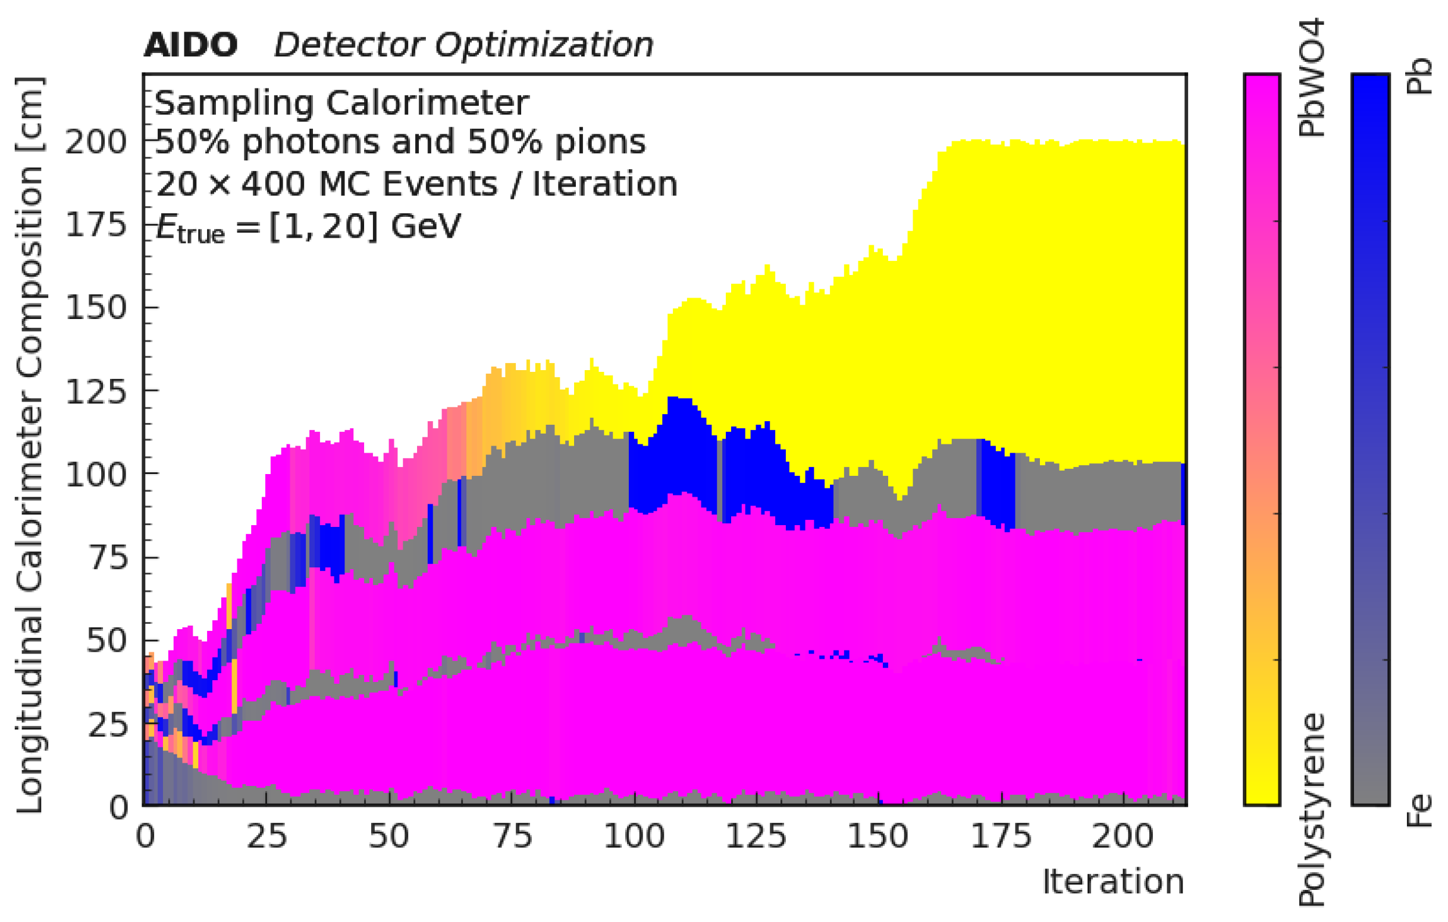
Money plot from paper: evolution of sampling calorimeter during learning
Calorimetry studies / 3

Slide 29
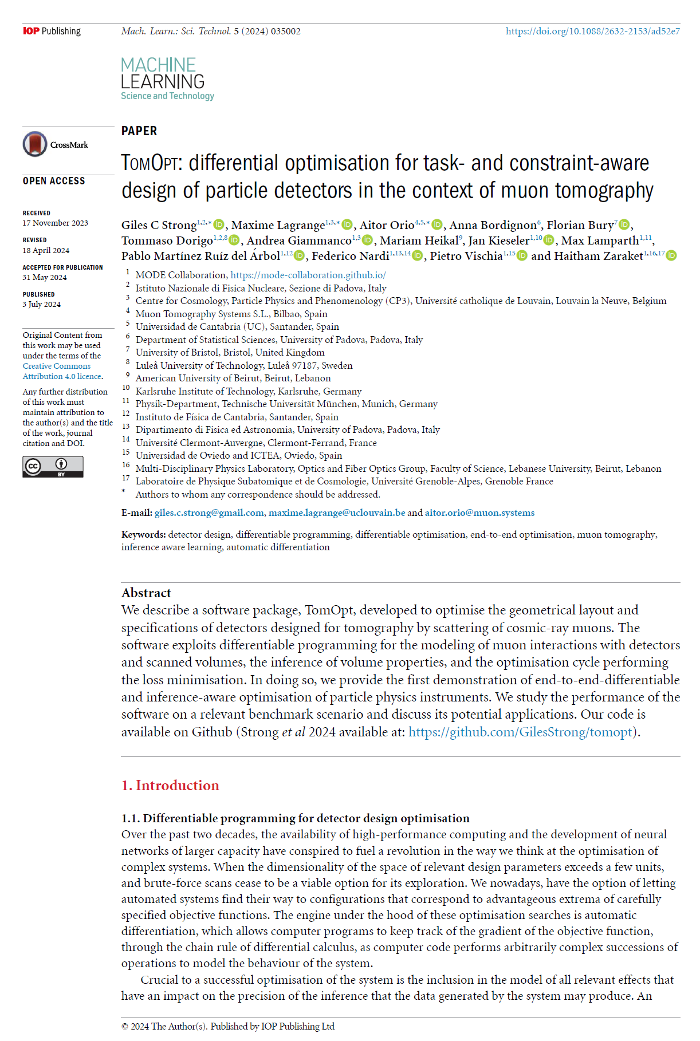
Muon tomography detector
optimization: TomOpt
Muon scattering tomography could be excellent co-design benchmark: setup simple to define, clear task, customizable benchmarks
An end-to-end pipeline for optimization of detector geometries and components has been developed by INFN+UCL+UOV (main developer G. Strong)
→ PyTorch software available at https://github.com/GilesStrong/tomopt
The software works, but can be extended in many ways.
TomOpt could be basis for co-design, by extending it to handle different inference techniques in pipeline
→ Current effort: seniors + 2 PhD + others
Happy to accept new contributors
Probably lowest-hanging fruit for a proof of co-design:
  Establish baseline result from human-conceivable design
  Show improvement from hardware optimization
  Show improvement by software optimization on top of that
  Show result achievable from combined optimization
G. Strong et al 2024 Mach. Learn.: Sci. Technol. 5,
035002, https://doi.org/10.1088/2632-2153/ad52e7

Slide 30
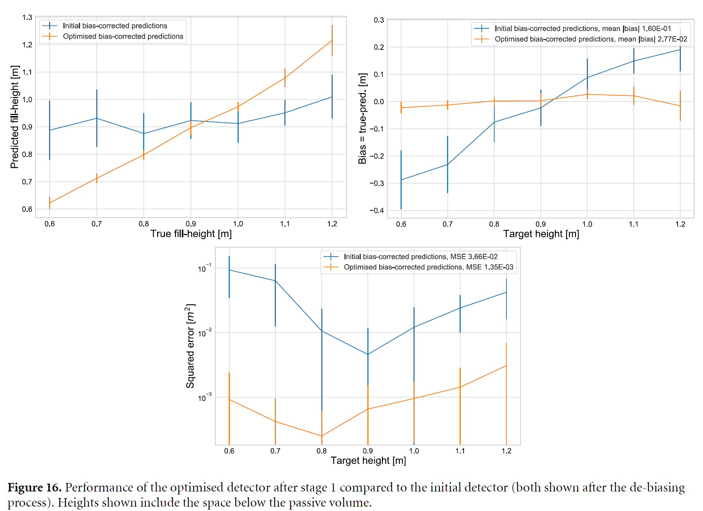
Example from article: improvement in linearity of metrics and squared error of prediction, for industrial application
Muon tomography detector
optimization: TomOpt

Slide 31
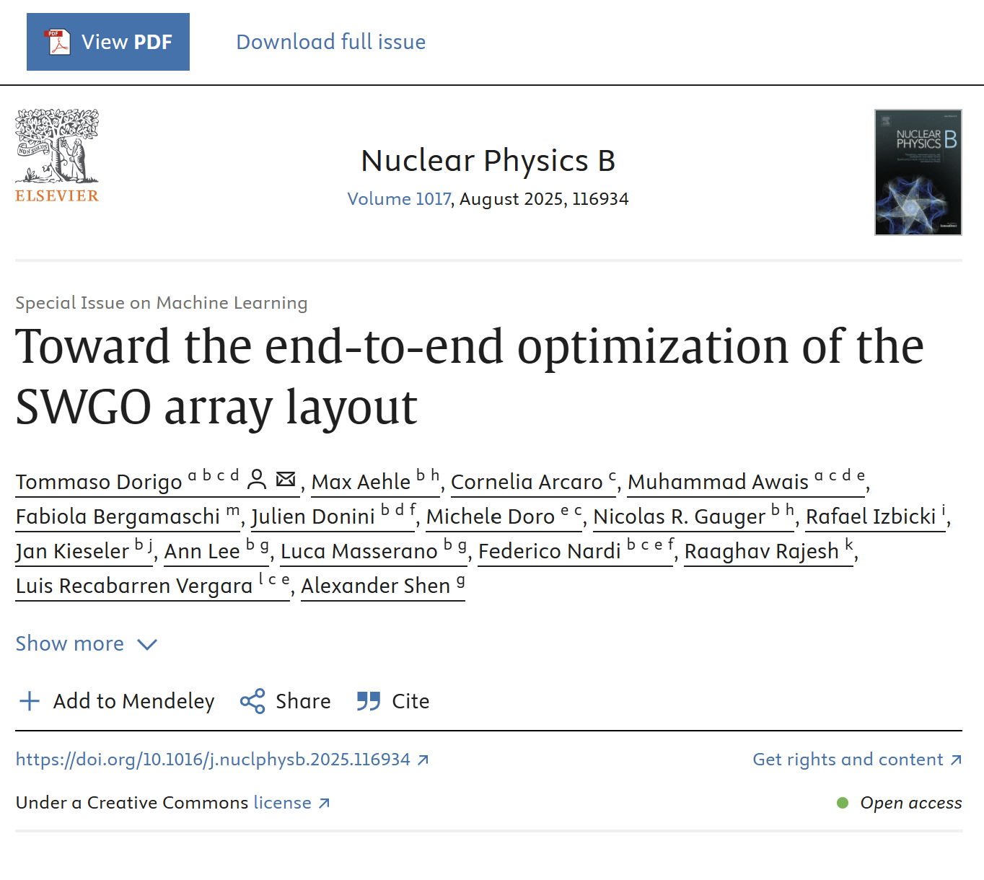
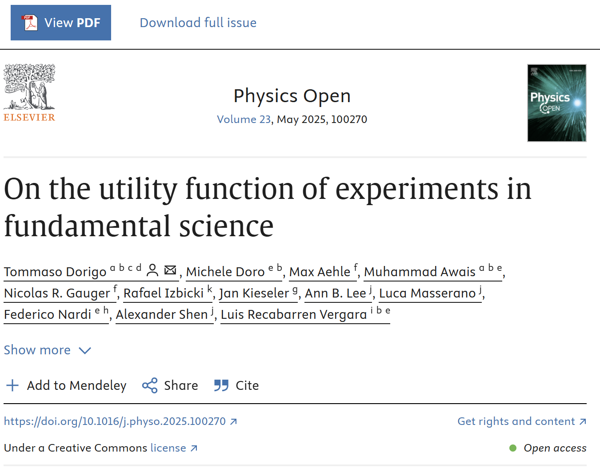
SWGO layout optimization
Two recently published papers: one on the software (https://doi.org/10.1016/j.nuclphysb.2025.116934), another discussing Pareto front (https://doi.org/10.1016/j.physo.2025.100270).
C++ software available on GitHub
(https://github.com/tdorigo/SWGOLO)
Now re-developed pipeline in PyTorch
Current involvement: 2 seniors, 1 PhD, 2 master students
Future developments: extend surrogate model of showers to lower energy, develop set of reconstruction models, co-design system
→ One or more papers expected
→ Possible impact in real experiment
Happy to collaborate with anybody interested!

Slide 32
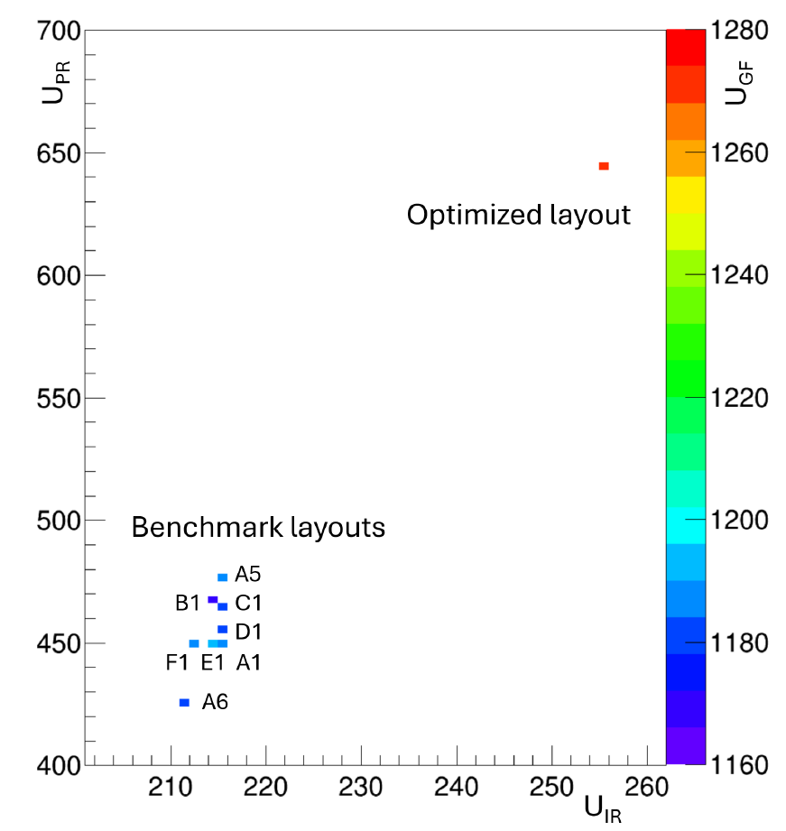
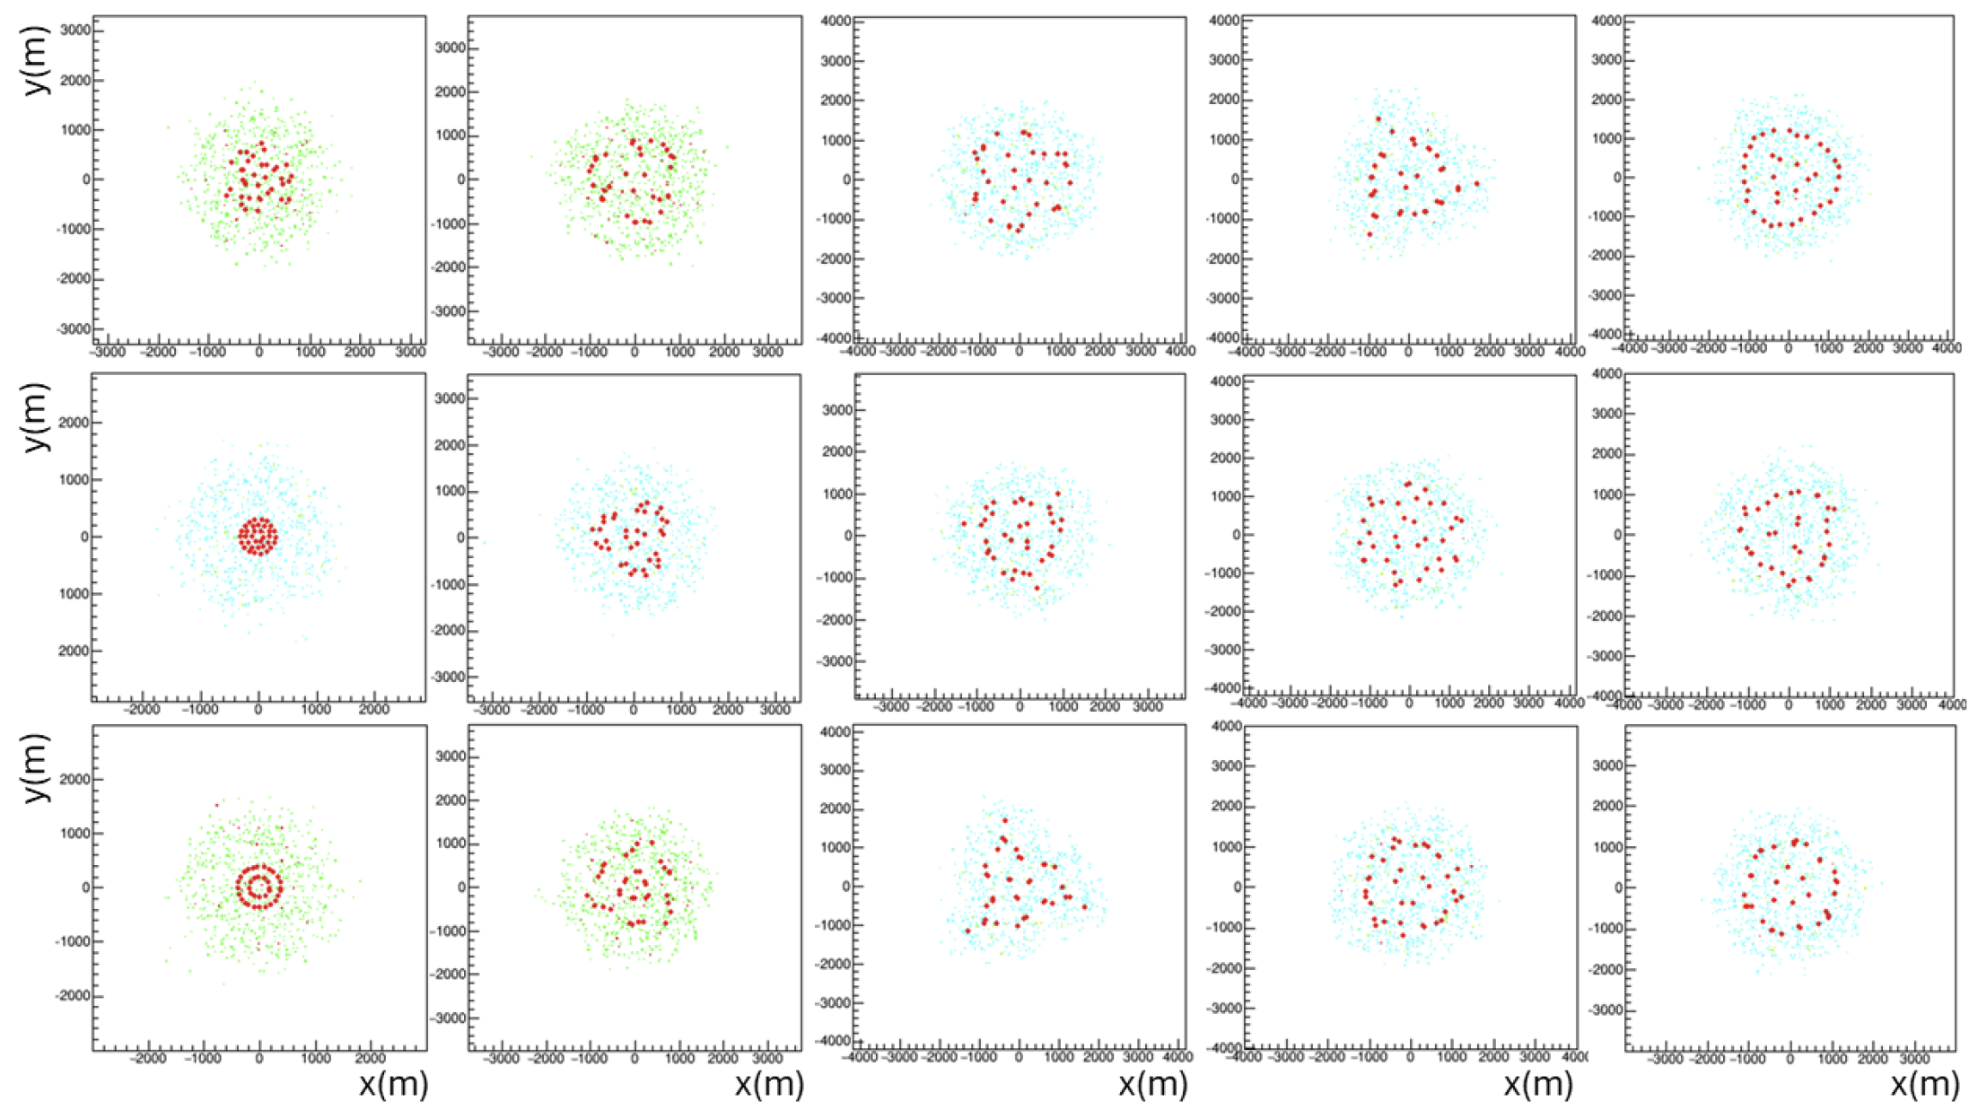
Sample results
Comparison of 3-component
utility function among 8
benchmarks proposed by SWGO
and optimization result
Epoch 1 epoch 20 epoch 50 epoch 100 epoch 400
Different initial layouts converge to same optimal configuration

Slide 33
Other possible crusades to embark on?
A number of planned experiments are toying with co-design ideas.
E.g. in astrophysics (neutrino expts: RNO-G, IceCube-Gen2, TAMBO)
This is your chance to advocate for focusing on your use case!
Suggestions?

Slide 34
White paper organization
Proposal: write a lean document (15-20 pages) where we describe use cases where co-design is expected to produce significant gains
Editors: conveners (both HEP) + one editor per other macro-area of EuCAIF interest [Astro-HEP/Nuclear-neutrino/Grav.waves]
→ Volunteer by email to tommaso.dorigo@gmail.com and pietro.vischia@cern.ch
Authors: sign up by adding name/affiliation to overleaf project; authors are expected to propose a use case in their domain or contribute to its exploration. No freeloaders please.
Target: arxiv submission + tier-1 journal
Timeline: March 31 2026 for preprint delivery

Slide 35
Possible structure of White Paper
Introduction: a critical survey of existing efforts of experiment optimization, highlighting where they fail to classify as co-design
Methods: a discussion of SoTA AI methods for successful end-to-end modeling including software exploration in the loop, and their points of strengths/ criticalities
Use cases: two or three use cases (ideally one per macro-area of JENAA) where possible structure of a modeling pipeline is described and discussed
Future studies: discussion of possible foundation models for co-design, integrating hardware and software modeling

Slide 36
What objectives could we set to ourselves in 2025?
White paper production – most of the work done by EoY
Progress in collaborative activities?
How do we get organized in practice?
Propose a 1h fortnightly meeting (find time/date by poll); cancel when no progress/no reports, but have slot in our calendars!
Common repositories (already in place for some of the activities)
Let us discuss…

Slide 37
AOB
Synergy with WG1 (Foundation models) ?
Grant applications ?

Slide 38

THANK YOU FOR TAKING PART!

