Slide 1
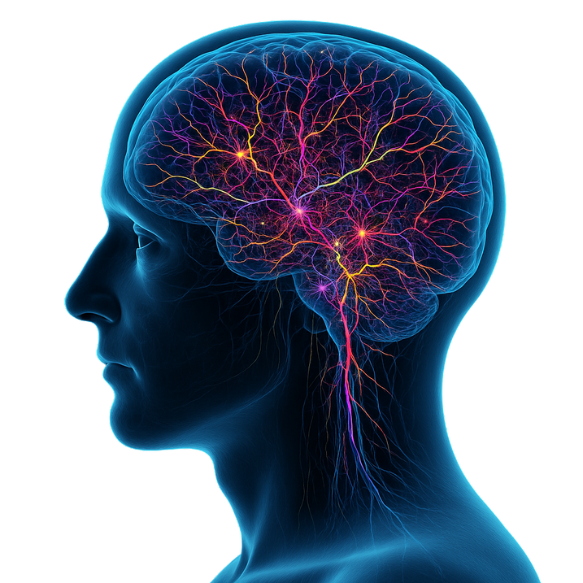
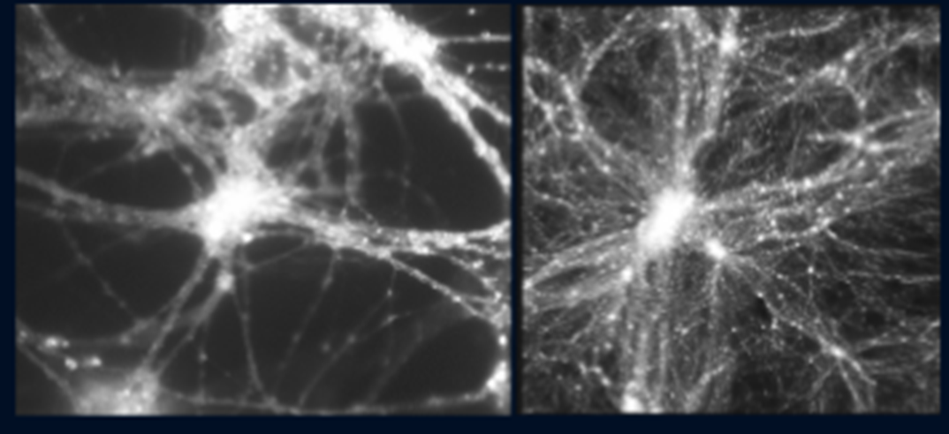
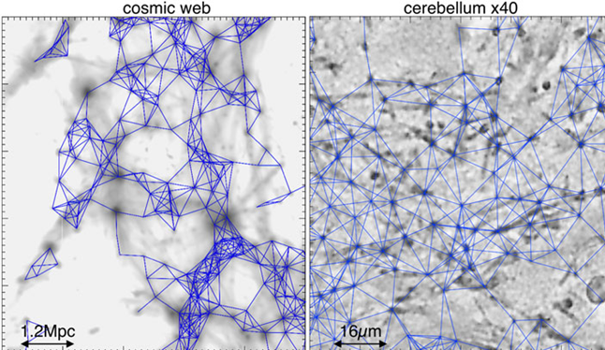
AI-Based Geometric Analysis
of Cultured Neuronal Networks:
Suggestive Parallels with the Cosmic Web
Danny Baranes,
Ariel University, Ariel, Israel
Wolfgang Kurz,
TUM, Munich, Germany
Neurons? Cosmic web?
Neurons
Cosmic web simulation

Slide 2
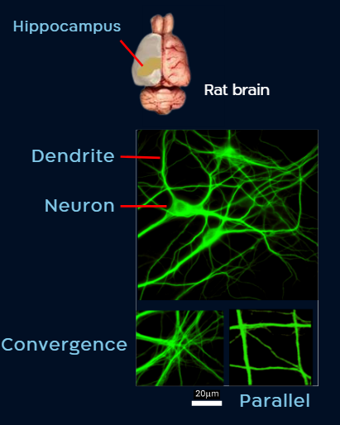
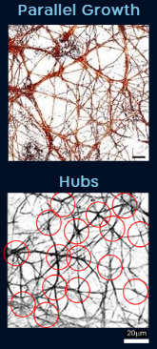
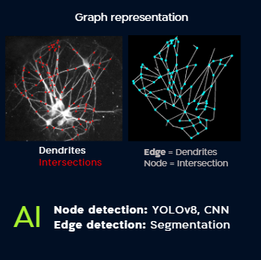
Neuronal Culture
Dendritic Lattices
AI-based Lattice Graphing
Parallel Growth
Hubs & Voids
Key Findings on Dendritic Lattices
Dendritic lattices are shaped by non-random wiring rules (32 rules were identified).
The lattices form hub-like configurations interspersed with large voids.
The dendritic lattice patterns and strengthens synaptic connectivity.

Slide 3
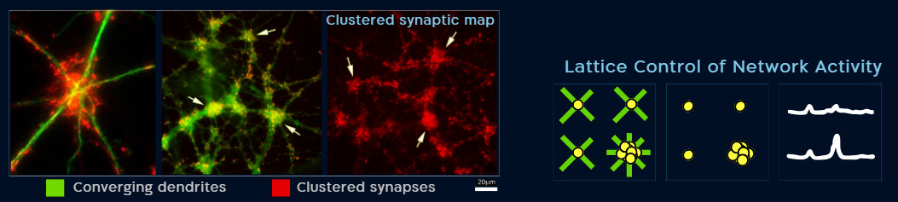
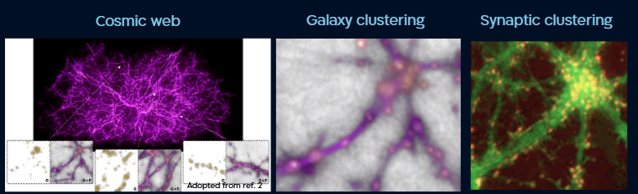
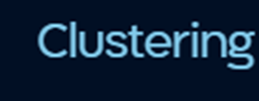
Dendritic Lattice–Guided Synaptic Mapping vs. Cosmic Structure Maps
Parallels with the Cosmic Web
Edges = dendrites / cosmic filaments
Nodes = sites of edge convergence
Synapses / Galaxies
  Distributed along edges
  Clustered and strengthened (synapses) / brightened (galaxies) at nodes
Voids exist in both systems between edges and clusters

Slide 4

Synaptic and Galactic Strength Share Spatial Patterns
Suggestions
Dendrites ~ cosmic filaments
Synaptic connections ~ Galaxies
Synaptic strengthening ~ Galaxies brightening
We welcome collaborations to explore dendritic lattices, their relation to the cosmic web, and their potential links to fundamental physics.
dannyb@ariel.ac.il / wolfgang.kurz@tum.de
Thank you
References
[1] Vazza, F. & Feletti, A. (2020). Frontiers in Physics, 8, 525731. https://doi.org/10.3389/fphy.2020.525731
[2] Joseph, J., Courtois, H. M., Pomarède, D., et al. (2020). The Astrophysical Journal Letters, 903(1), L32. https://doi.org/10.3847/2041-8213/abb9f1
[3] Springel et al., (2005) arXiv preprint astro-ph/0504097, 2005‏•arxiv.org

