Slide 1
ANTIDEUTERONS IN COSMIC RAYS
Low kinetic energy range -> Dark Matter antideuterons can be distinguishable from collisional background
Higher kinetic energy range -> Collisional antideuterons dominate the primary component
WHY ANTIDEUTERONS IN COSMIC RAYS ARE INTERESTING?
They don’t have any astrophysical origin
They can be produced only in collisions in the Galaxy between propagating Cosmic Rays (projectiles) and the Interstellar Medium (target)
Any excess observed in Cosmic Rays data can be a signal of new physics (such as Dark Matter)
Serksnyte et al. Phys. Rev. D 105, 083021 (2022)
Francesco D’Angelo – EiCAIFCon 2025, Cagliari – Flash Talk

Slide 2
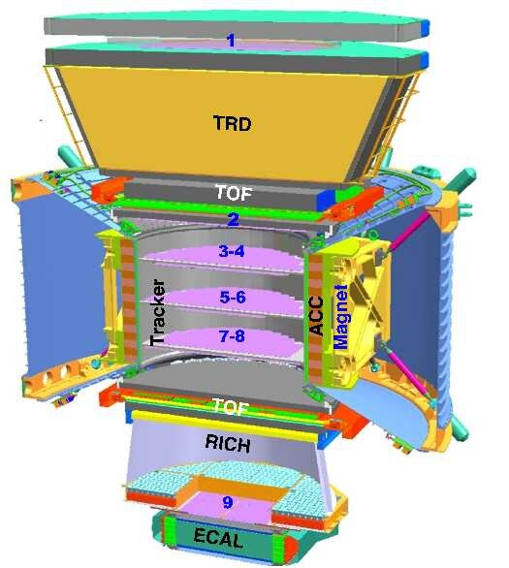
SEARCHING FOR ANTIDEUTERONS IN AMS-02 WITH MACHINE LEARNING
Antideuterons are very rare particles in Cosmic Rays (we expect to see in AMS-02 only few events).
More abundant particles can mimic an antideuteron signal in the AMS-02 experiment. We are using classifiers to reject al these backgrounds up to the precision required.
p
p
$$\overline{p}$$
n
$$\overline{p}$$
$$\overline{n}$$
$$\overline{p}$$
$$\overline{p}$$
$$\overline{n}$$
$$\overline{n}$$
Antideuterons can be misidentified protons
(required 1 over ${10}^{9}$ identification power)
Antideuterons can be misidentified deuterons
(required 1 over ${10}^{7}$ identification power)
Antideuterons can be misidentified antiprotons
(required 1 over ${10}^{4}$ identification power)
Francesco D’Angelo – EiCAIFCon 2025, Cagliari – Flash Talk

Slide 3
I’M WAITING FOR YOU.
COME AND SEE MY POSTER IN POSTER SESSION B!
IF YOU HAVE ANY QUESTION, FEEL FREE TO ASK ME!!
francesco.dangelo13@unibo.it
Francesco D’Angelo – EiCAIFCon 2025, Cagliari – Flash Talk

