Slide 1
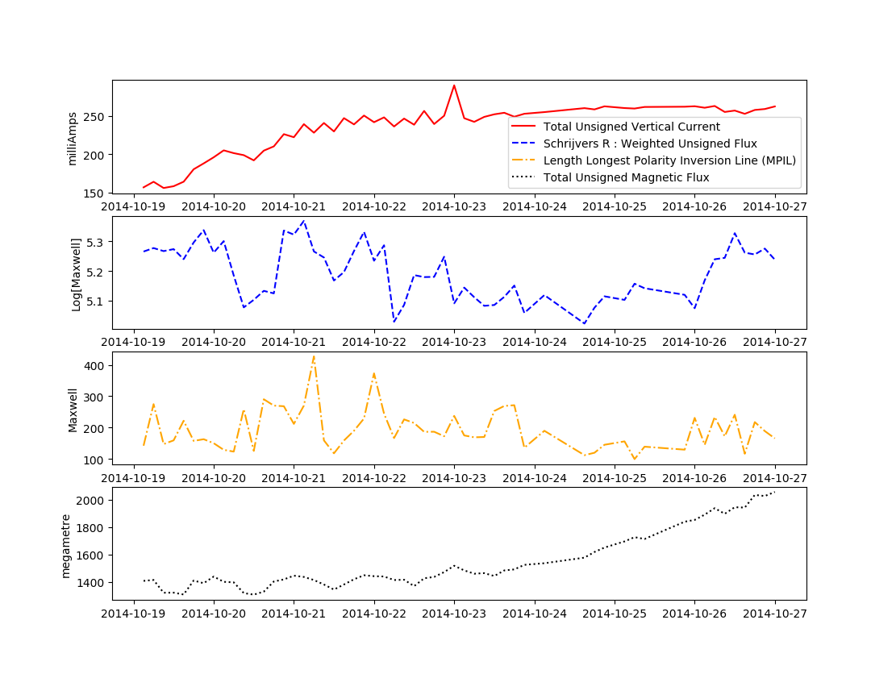
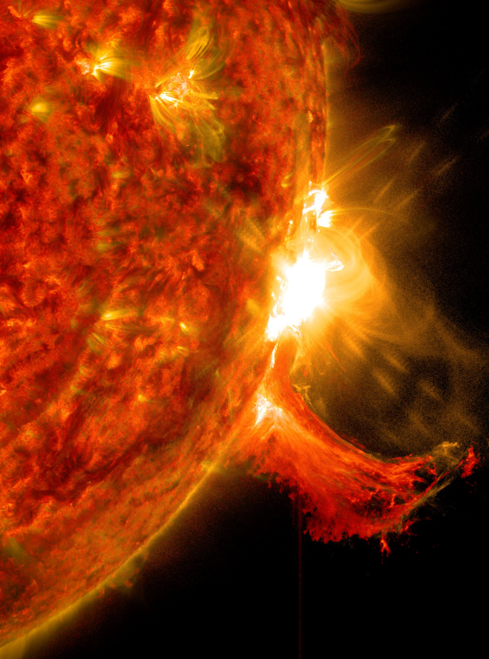
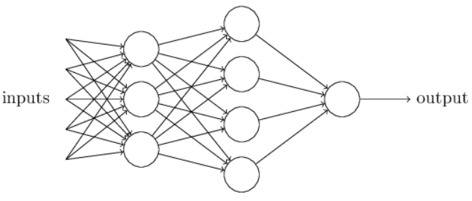
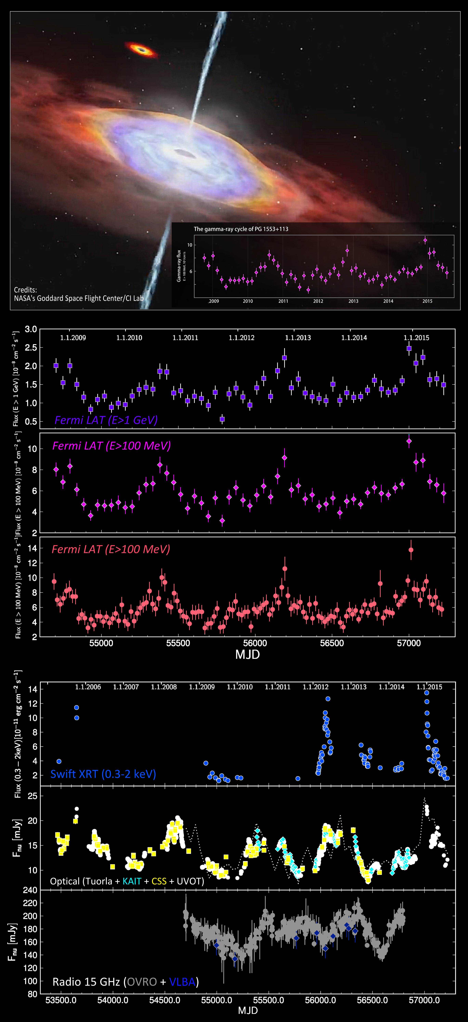
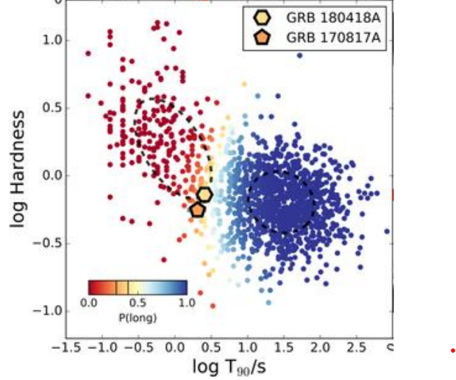
Cause-mic Universe : Causal Approaches Probing Solar and Astrophysical Variability
Physics Drivers
Solar Outbursts
Competing mechanisms (variables) driving variability
Their sequence via lags
Transient classes (progenitors)
Statistical Learning or Inference
y^{n:0}i-1
y^{n:0}i
y^{n:0}i+1
X-class flares
Time
Forecasts
Extragalactic Sources (transients)
Machine (Deep) Learning
Solar outbursts impact space weather
Feature-set for timely and precise ML-based forecasts (Met-Office)
Bayesian Networks
Nachiketa Chakraborty (University of Reading) [EuCAIF, 2025] n.chakraborty@reading.ac.uk
GRBs : Escorial et al., 2021
with Matthew Owens, Harriet Turner, Matthew Lang, Peter Jan van Leeuwen, Amy Lien

Slide 2
Generalised, Hierarchical Information Graphs
Solar Outbursts
cause y^{n:0}i-1
Limitations
y^{n:0}i-1
yi-1
yi
Effect variable
Non-linearity, non-Gaussianity
No consensus on classes
Black box ML/DL
Ceiling in forecast performance
y^{n:0}i
cause y^{n:0}i
target x^{n+m:m}
y^{n:0}i+1
yi
yi+1
yi-1
yi+1
X-class flares
yi-1
yi
yi+1
cause y^{n:0}i+1
Time
Causal variables
cause z^{n:0}i
Information Theoretic Entropic Measures
Van Leeuwen et al., 2021, Chaos, Chakraborty et al., 2022, Phys. Review R. (Non-linear Lags)

Slide 3
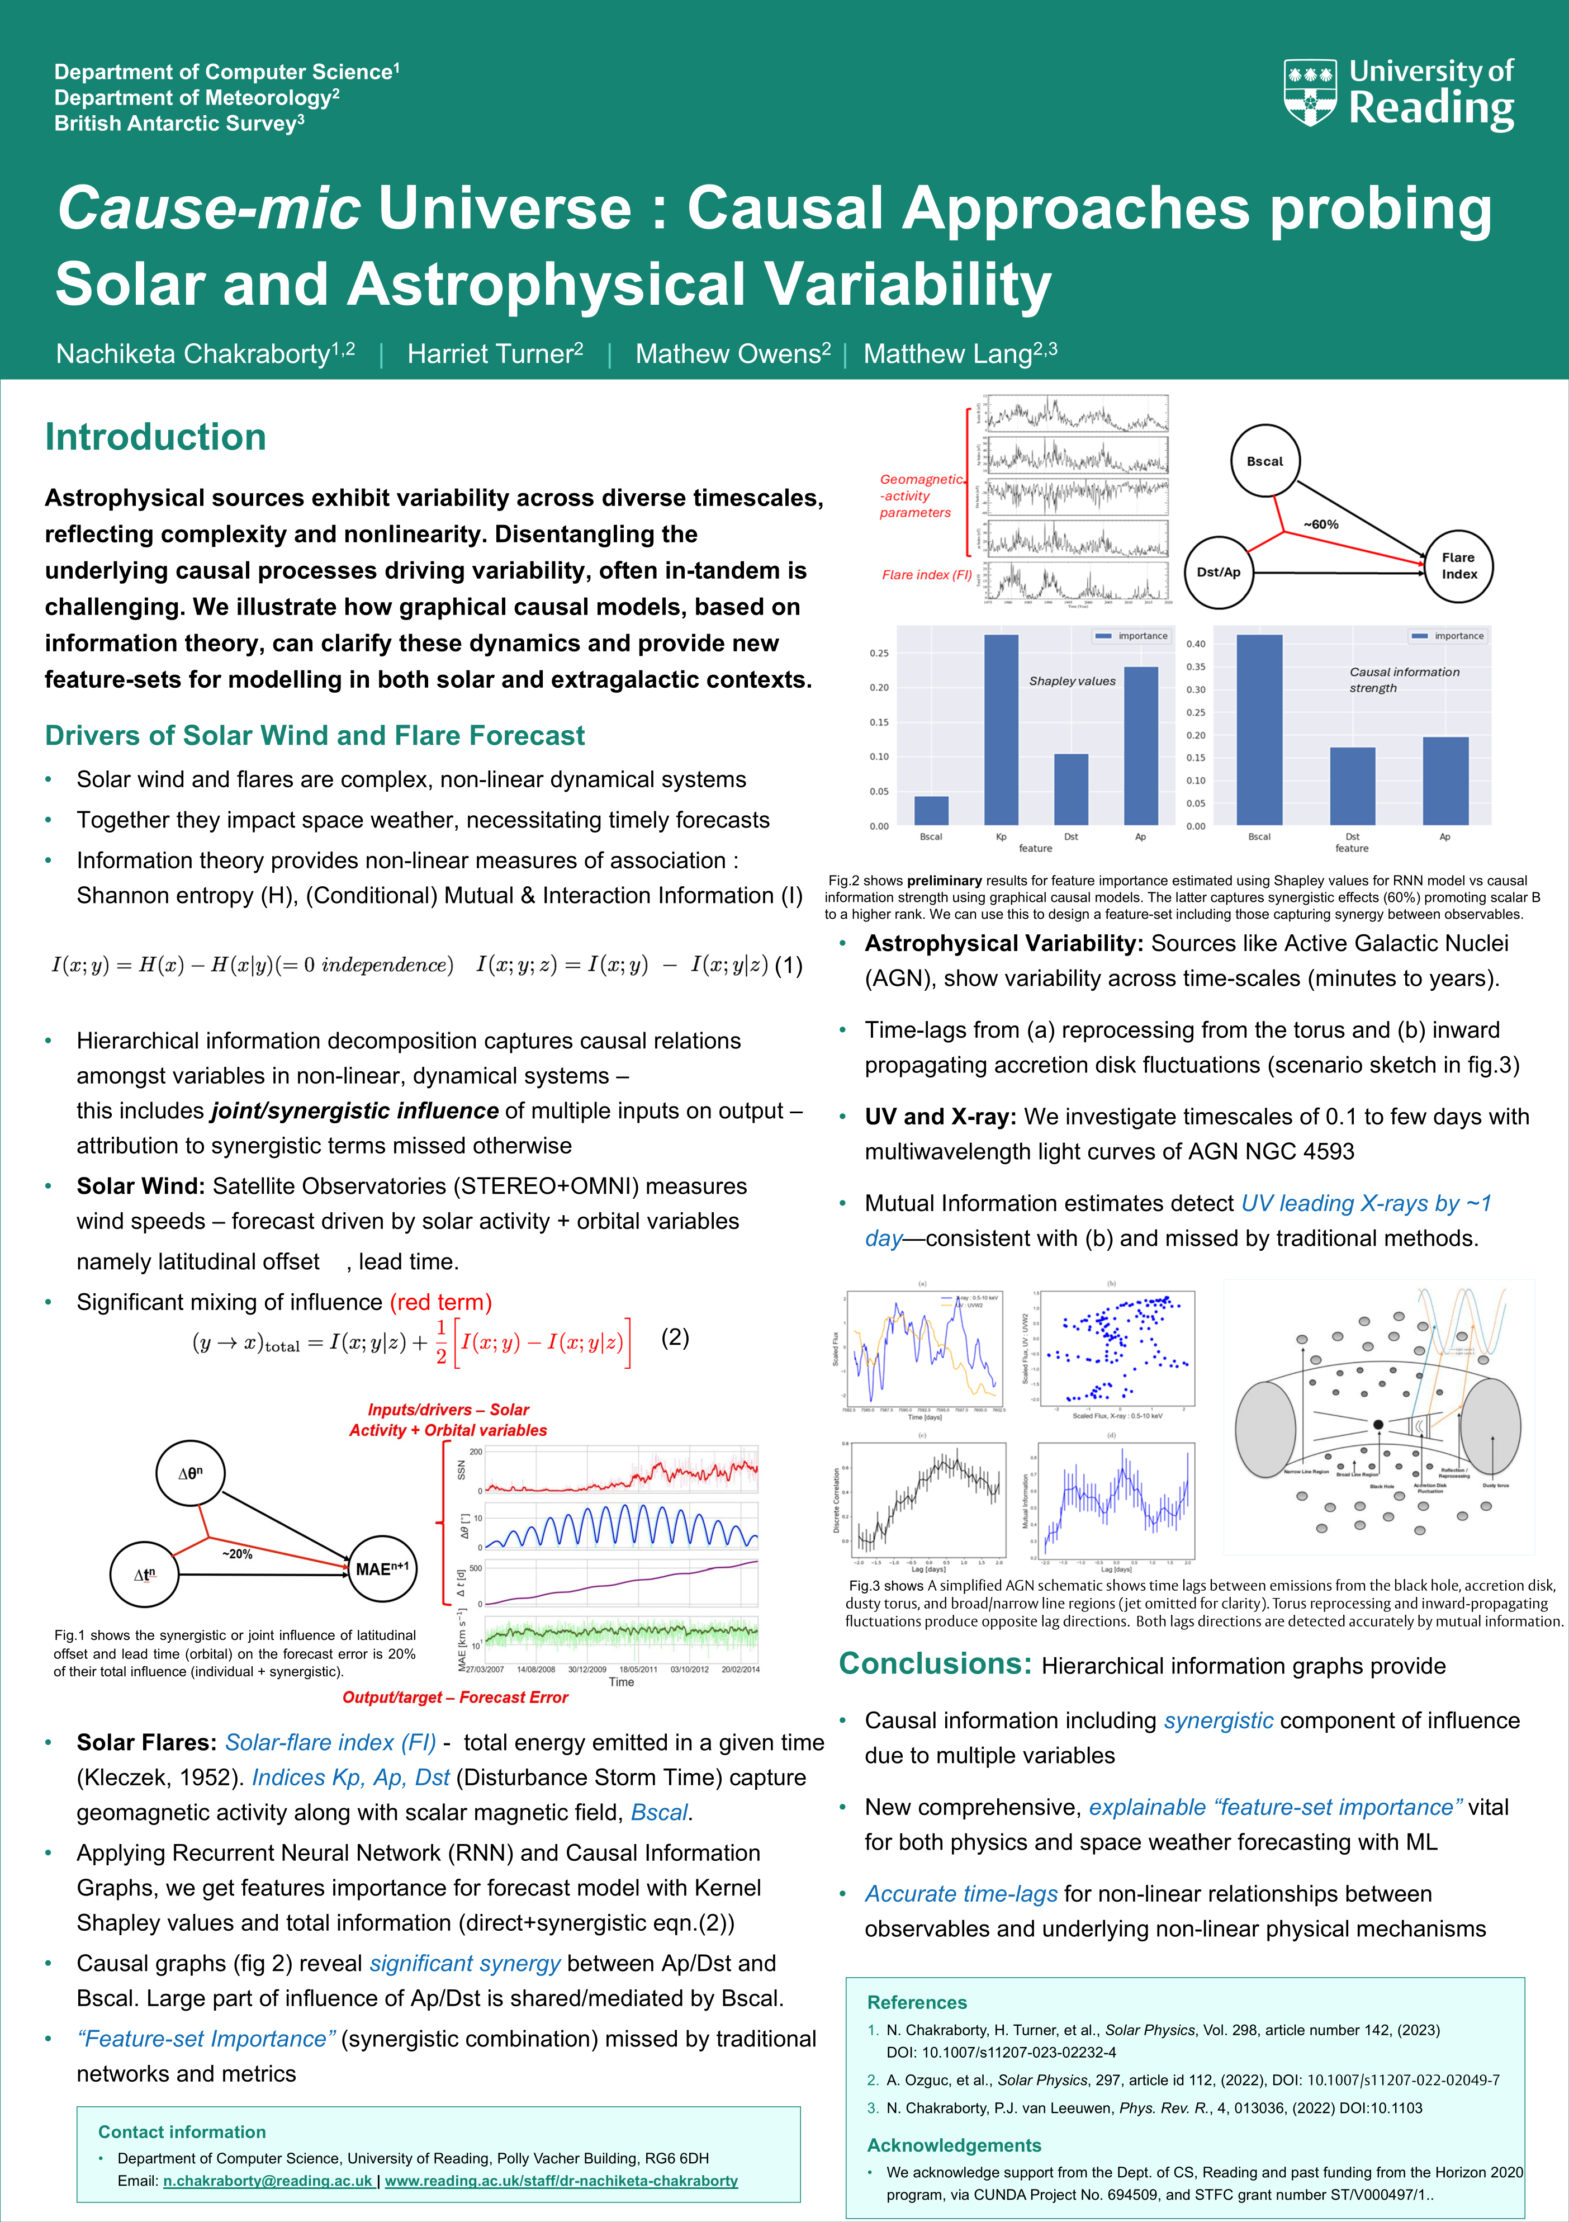
Conclusions: Hierarchical information graphs provide
Standalone inference or diagnostics for ML/DL
Causal information including synergistic influence due to multiple variables
New comprehensive, explainable “feature-set importance” vital for both physics and space weather forecasting with ML
Accurate time-lags for non-linearity
Poster Id : 63 (T1c)
Session A (Wednesday 12:00 - 15:00)
n.chakraborty@reading.ac.uk

