Slide 1
Enabling the compute continuum at ICSC: A solution based on interLink.
L. Anderlini, D. Ciangottini, D. Spiga, T. Boccali, D. Gasparrini, P. Lubrano, A. Troja, F. Fanzago, M. Sgaravatto, T. Tedeschi, G. Bianchini
110°Congresso della Società Italiana di Fisica (SIF 2024) “Emerging data and computing technologies for frontier physics” Symposium
September 10th, 2024
ICSC Italian Research Center on High-Performance Computing, Big Data and Quantum Computing
Missione 4 • Istruzione e Ricerca

Slide 2
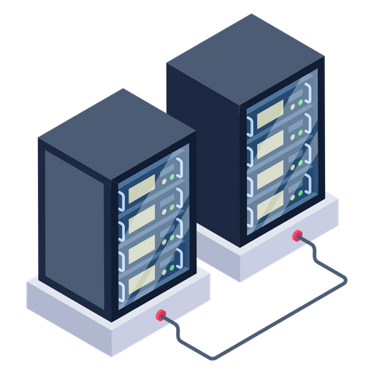
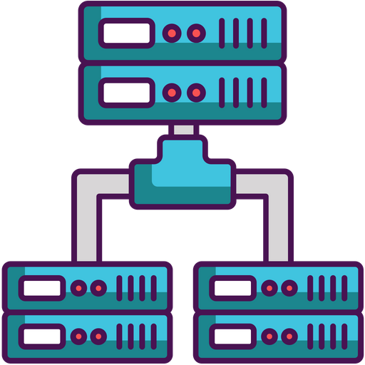
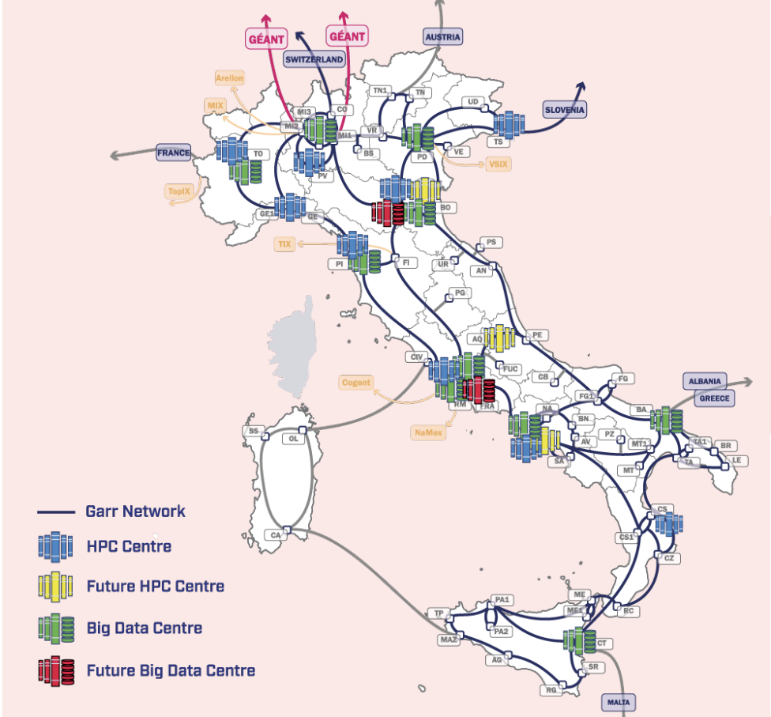
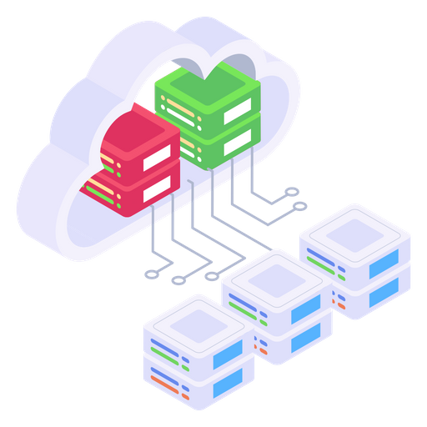
ICSC and Terabit: towards a highly heterogeneous, geographically distributed computing infrastructure
Cutting-edge computing infrastructure connecting highly specialized centers (HPC, BigData and Cloud) providing a comprehensive overview of the existing resources and integrating emerging technologies.
HPC
HTC
Cloud
High-Performance Computing (HPC), High-Throughput Computing (HTC), and Cloud computing … different resource providers, different backends, different authN/Z workflows, different network policies…
Scope: Support complex workflows by distributing payloads throughout the network of computing centers, effectively mapping resource requests to compute backends while hiding the underlying heterogeneity and complexity from the user.

Slide 3
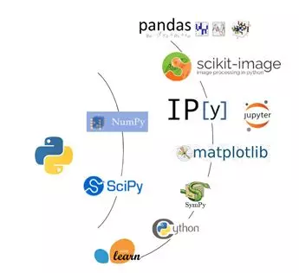
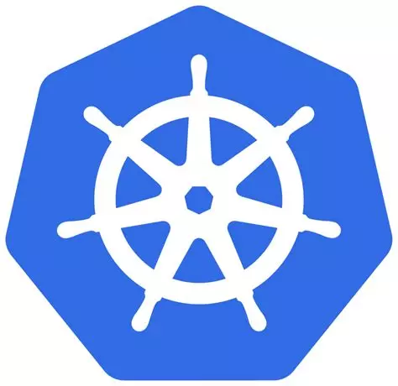
Kubernetes as the emerged standard for distributed applications (cloud-native)
As Python+NumPy emerged as de facto standard for Data Science applications in early 2000s,
the Kubernetes APIs have been emerging as the standard for distributed applications.
pip install
helm install
Kubernetes is an open-source system for automating deployment, scaling and management of containerized applications on multiple nodes.
The Cloud Native Computing Foundation (CNCF) supports and coordinates the development of 200 k8s applications in more than 850 git repositories.
To benefit of K8s for compute-intensive applications, tasks can be organized in job queues and submitted to HPC/HTC centers.

Slide 4
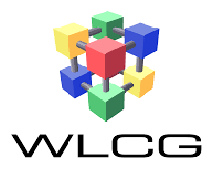
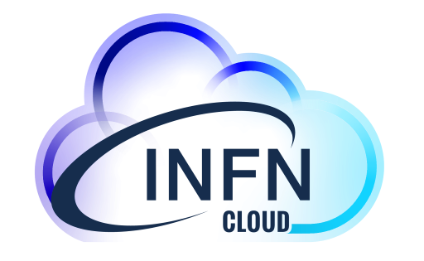
A typical workflow, offloaded
K8s-powered workload manager
Data reduction
or
Serialization
GPU-accelerated statistical data analysis
Interactive data analysis and visualization
Reporting/logging
results
HTC
CNAF-T1
HPC
Cloud
Cloud@CNAF

Slide 5
A typical workflow, offloaded
K8s-powered workload manager
Data reduction
or
Serialization
GPU-accelerated statistical data analysis
Interactive data analysis and visualization
Reporting/logging
results
HTC
HPC
Cloud

Slide 6
A typical workflow, offloaded
K8s-powered workload manager
Data reduction
or
Serialization
GPU-accelerated statistical data analysis
Interactive data analysis and visualization
Reporting/logging
results
Submission of simple containerized applications.
Requirements: scaling to thousands of jobs.
HTC
HPC
Cloud

Slide 7
A typical workflow, offloaded
K8s-powered workload manager
Data reduction
or
Serialization
GPU-accelerated statistical data analysis
Interactive data analysis and visualization
Reporting/logging
results
Submission of GPU-accelerated, highly configurable payloads
Requirements: large I/O sandboxes.
HTC
HPC
Cloud

Slide 8
A typical workflow, offloaded
K8s-powered workload manager
Data reduction
or
Serialization
GPU-accelerated statistical data analysis
Interactive data analysis and visualization
Reporting/logging
results
Interactive, web access (Jupyter/VSCode…).
Requirements: network proxing, multisite file system
HTC
HPC
Cloud

Slide 9
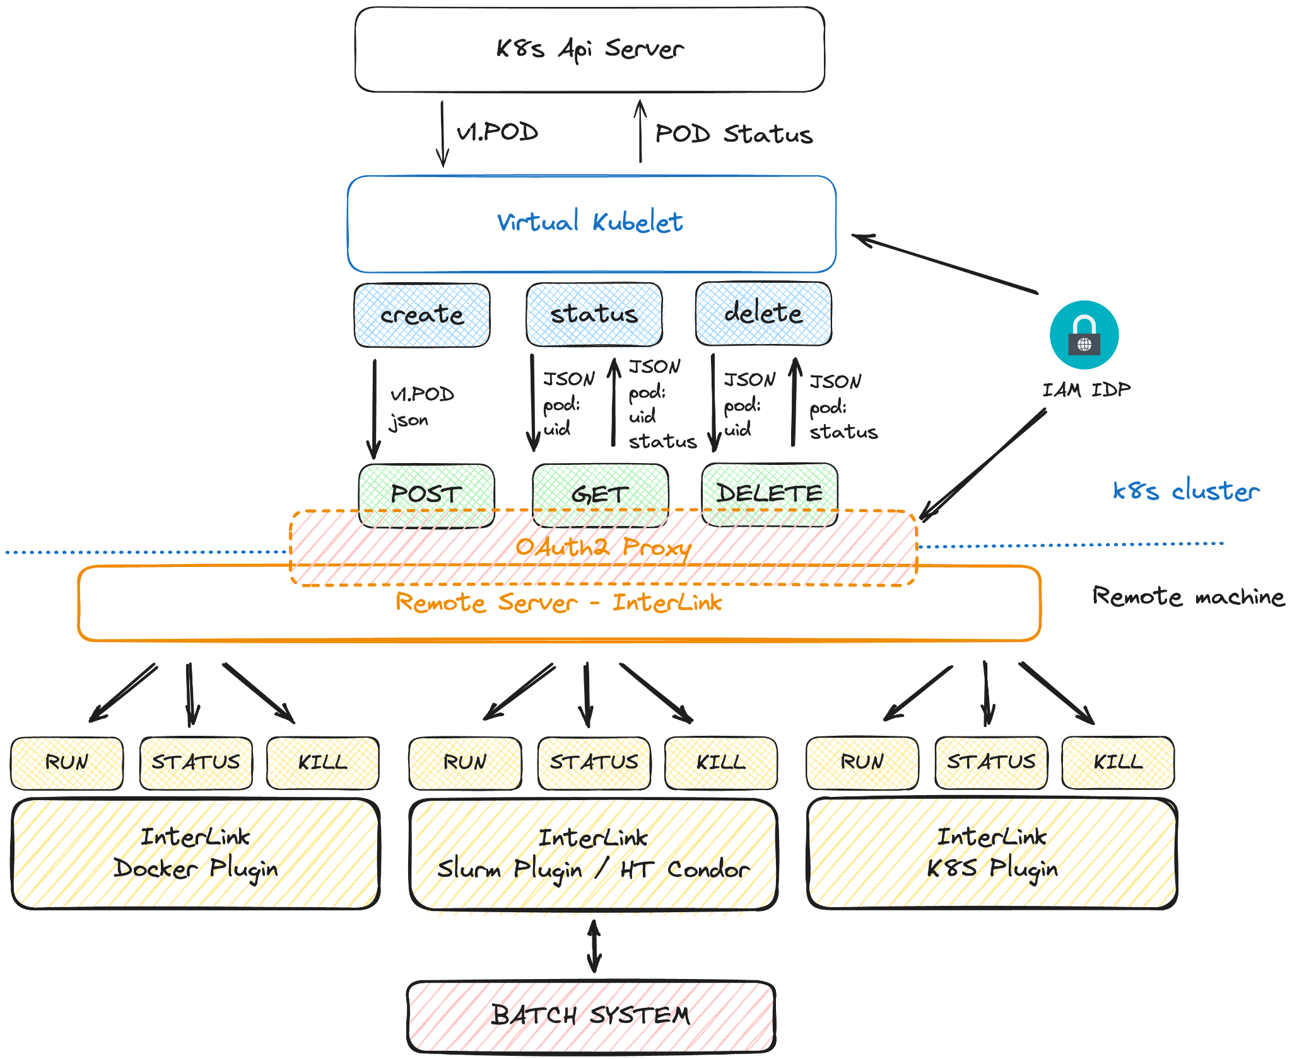
How does it work?
Virtual Kubelet is an open-source project providing an interface between Kubernetes and serverless container platforms.
Interlink abstracts the interaction with the remote container runtime to few REST APIs: create, status, delete.
Backend-specific plugins are developed to translate API calls into the “proper language” for each backend (CLI, REST, gRPC…).
OAuth2 and OpenID Connect are used to authenticate the Virtual Kubelet towards the remote backend.
The user submitting the job to the Kubernetes Workload manager is propagated as meta-data.
Data, accessed with remote protocols, can be cached locally by the compute backend (e.g. cvmfs)

Slide 10
Status of the development
 | HTC | HPC | Cloud
Submission of self-contained applications | Supported | Supported | Supported
Remote volumes for I/O sandboxes | PoC | PoC | Supported
Network proxying for Jupyter access | Supported | Supported | Supported
Generic network proxying | Ongoing
Multisite filesystem (e.g. for scripts and notebooks) | Tech. Tracking
Monitoring and observability | Supported

Slide 11
Scientific use-cases and their workflows
Flash Simulation for High Energy Physics experiments.
Workflow: Train models (HPC), Deploy models in grid-like simulation (HTC), Statistical validation (Cloud)
Quasi-interactive HEP data analysis for Analysis Facilities.
Workflow: An interactive application (Cloud) controls parallel, distributed data processing (HTC) and statistical interpretation (HPC)
Interactive GPU algorithm optimization for astrophysical data analysis.
Workflow: optimize code for astrophysical tasks on GPUs directly through interactive notebook sessions hosted on HPC.

Slide 12
Summary and next steps
Kubernetes is the standard for distributed applications, including workload managers.
Offloading compute-intensive containerized workloads to remote dedicated compute backends with a serverless-computing approach enables complex workflows combining:
custom services (cloud)
High Throughput Computing (data reduction and grid-like jobs)
High Performance Computing (statistical data analysis and machine learning)
Interlink is being deployed as part of the Integration PoC of ICSC and TERABit to integrate:
INFN Cloud instances (docker, Kubernetes)
CINECA Leonardo (slurm)
HTC resources at CNAF (HTCondor)
Development is progressing fast and use-cases have been identified in the context of ICSC-Spoke 2 and ICSC-Spoke 3 as demonstrators
ICSC Italian Research Center on High-Performance Computing, Big Data and Quantum Computing
Missione 4 • Istruzione e Ricerca

