Slide 1
Adopting RUCIO for the Italian datalake
National experience and perspectives
A. Troja, M. Biasotto, D. Ciangottini, M. Delli Veneri, F. Fanzago, A. Italiano, N. Marcelli, L. Morganti, A. Rendina, M. Sgaravatto, D. Spiga, B. Spisso, S. Stalio, M. Verlato
??/??/2024
7° Rucio Community Workshop

Slide 2
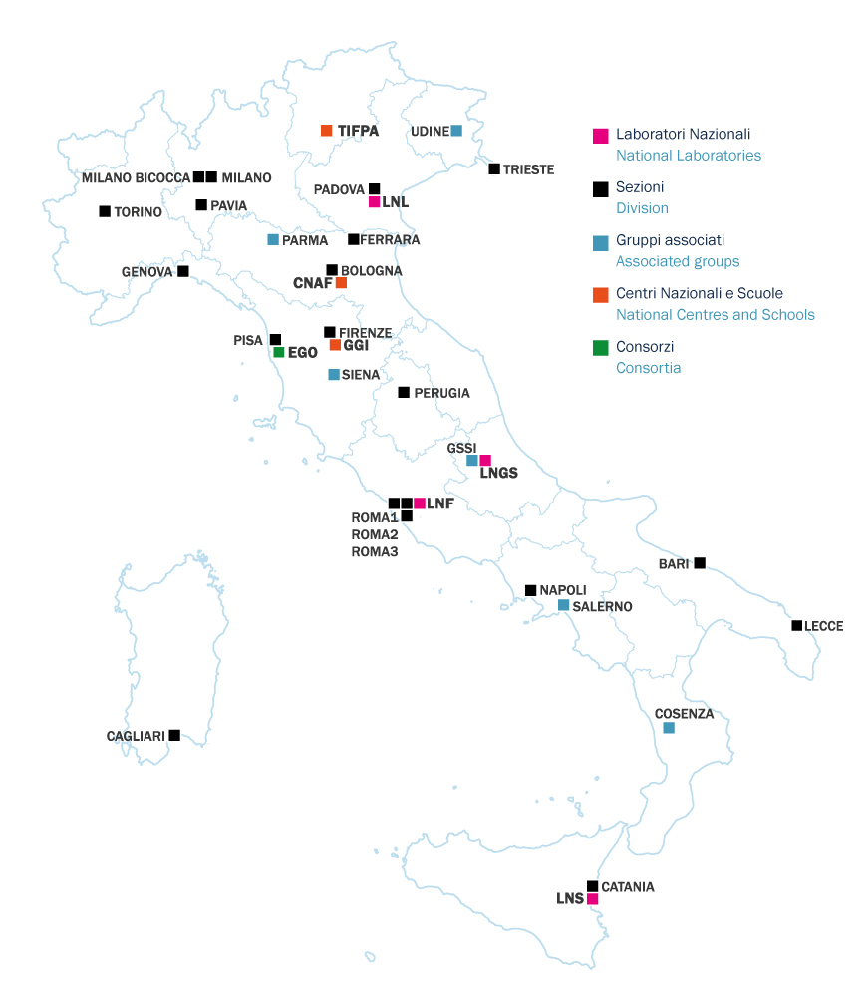
The National Institute for Nuclear Physics (INFN)
INFN is the Italian research agency dedicated to the study of the fundamental constituents of matter and the laws that govern them.
It consists of:
4 National laboratories;
20 Division;
6 Associated groups;
3 National centers.

Slide 3
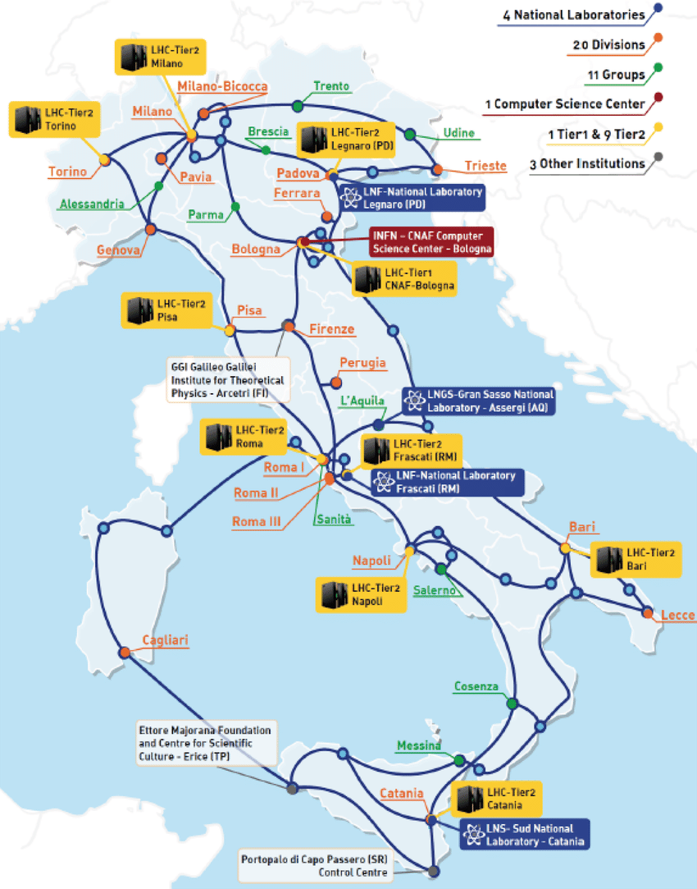
INFN Computing infrastructure
Distributed computing infrastructure:
1 WLCG Tier-1 @ Bologna-CNAF;
9 WLCG Tier-2 spread throughout Italy.
Resources:
200k CPU cores;
250PB disk storage;
200PB tape storage;
More than 100 international scientific collaborations served.

Slide 4
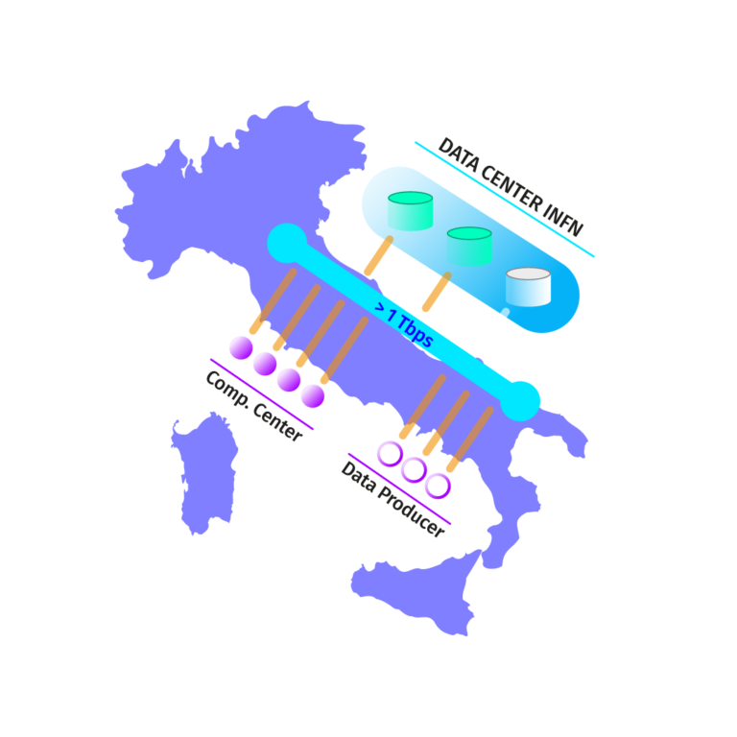
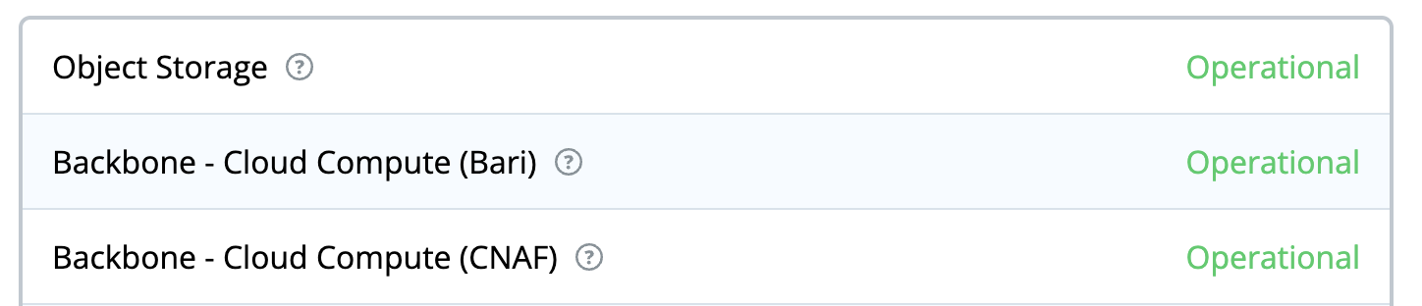
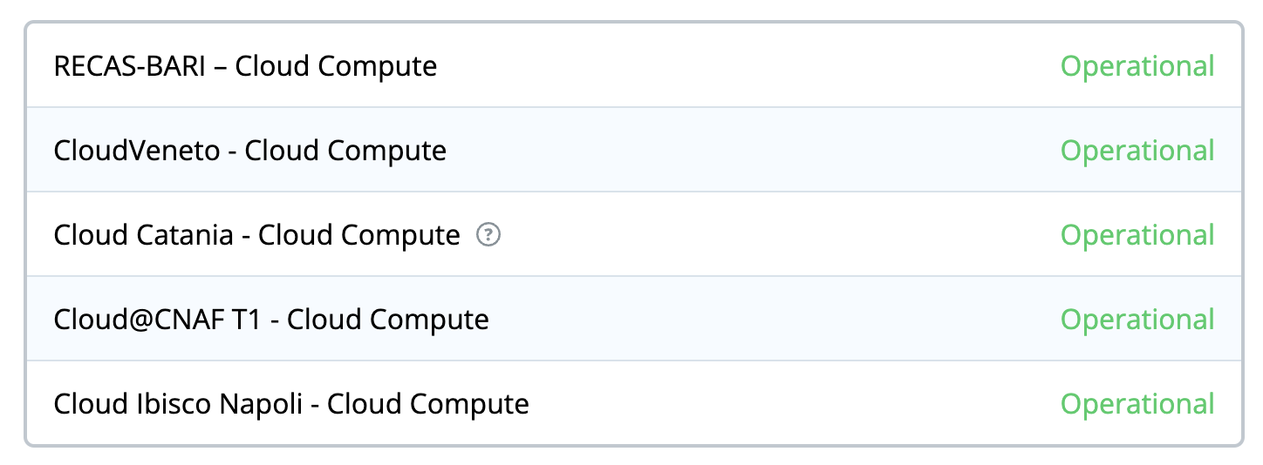
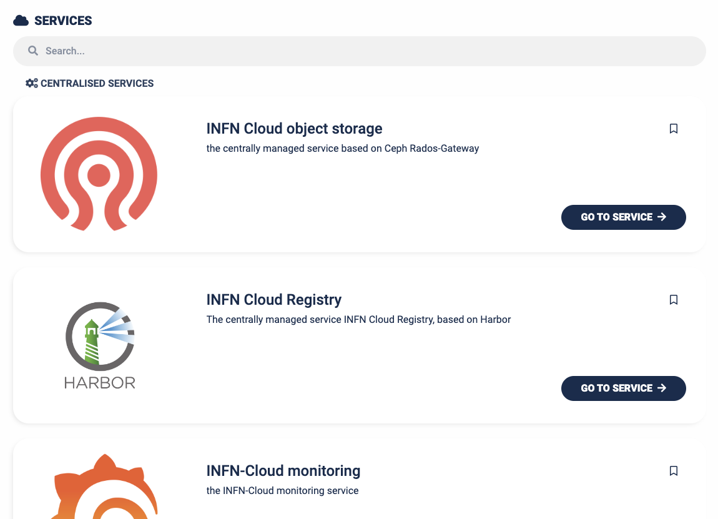
Cloud resources
While some of the computing resources are integrated in the worldwide Grid infrastructures, other resources are exposed through Cloud interfaces.
A Cloud backbone connects the two main INFN computing sites (CNAF and Bari), hosting core services and automated replication of object storage date across the two sites.
In addition, 6 cloud infrastructure hosted at INFN centers are federated to the Cloud infrastructure.
Cloud services are offered to users through a dedicated INFN Cloud infrastructure:
Based on modular component;
Spanning IaaS, Paas, Saas models;
Available via an easy-to-use WebUI or via CLI.

Slide 5
The TeRABIT project
The Terabit network for Research and Academic Big data in Italy (TeRABIT) envisions the creation of a a distributed, hyper-connected, hybrid HPC-Cloud environment that offers services designed to meet the evolving needs of research and innovation.
The environment will federate and strengthen the three existing research infrastructures GARR-T, PRACE-Italy and HPC-BD-AI (HPC-Big Data-Artificial Intelligence), leveraging their existing of connections to other national and European research infrastructures and data spaces through the GÉANT backbone.
Main objectives:
Enable widespread data transfer, up to Terabits per second, and services on a national scale in Italy, connected to Europe;
Innovate the central HPC node of PRACE-Italy;
Innovate the HPC services offered to researchers, beyond the centralized calculation model, adding distributed “HPC-Bubbles”

Slide 6
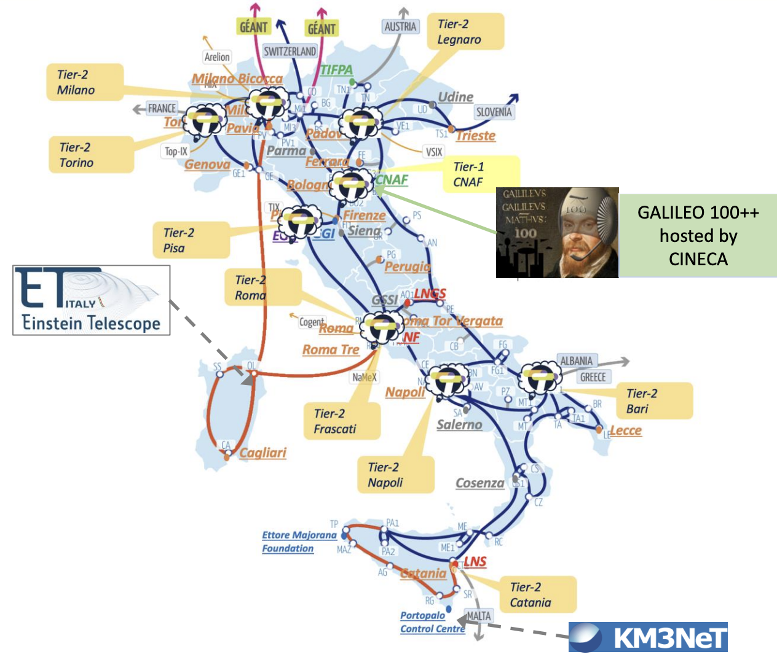
TeRABIT final infrastructure
The image shows the overlap of the expected combined final physical topologies of all three Research Infrastructures:
GARR-T with the new fibres (in red);
HPC-BD-AI with the HPC Bubbles locations (with TeRABIT logo);
PRACE-ITALY with the updated GALILEO100 hosted at CINECA;
Planned infrastructures (dashed grey).

Slide 7
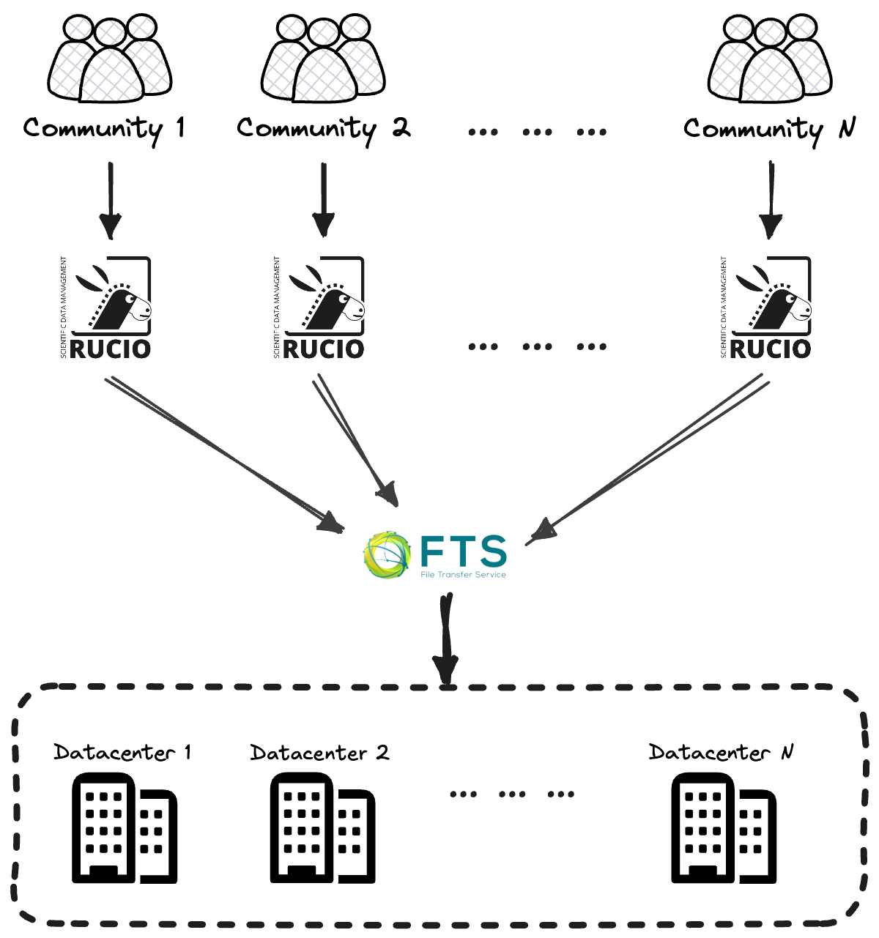
Data-centric model and the National datalake
The actual (and the future) infrastructure federates physical storages no matter their implementation, with data distributed among them.
We aim to the creation of a National datalake where users are allowed to access and manage data from any federated node. The underlying infrastructure must be transparent to them.
Each community would interact with its Rucio instance, which in turn connects to a single FTS server centrally managed. TCP are performed among the federated datacenter.
Federation will include INFN facilities as well as external ones, just like CINECA Prace-Italy HPC.

Slide 8
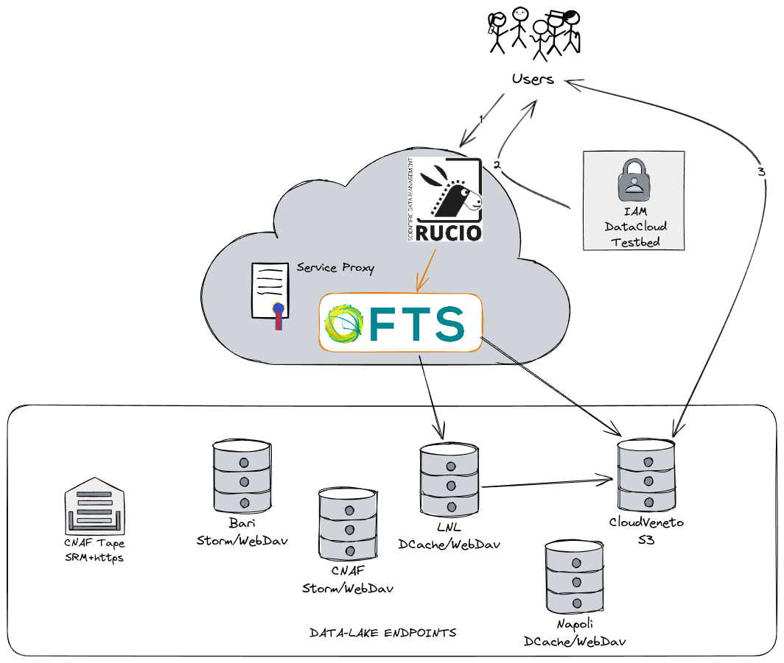
Our experience with Rucio
In order to test the federation of geographically distributed, etherogeneous INFN storages, we deployed a datalake testbed, on which we tested and validated several configurations.
We deployed Rucio on a K8s cluster on Almalinux9 VM, hosted in INFN Cloud machines. Same goes for the FTS server.
INDIGO IAM is used to AuthN/Z, and a centrally managed high-availability PostgreSQL database is attached to Rucio.
RSEs abstract six INFN storage systems, with different QoS, implementation and protocols.
We use Flux to manage the infrastructure.

Slide 9
AuthN model
We tested several authorization models on the data:
Group-based policies: group A users won’t be
allowed to interact data from group B, while it can
perform any action on group A data (even deletion);
Scope-based policies: scopes are defined within the
IAM, and passed to Rucio through the token.
Scopes give user permission to certain action
on certain area in the storages. As an example,
we implemented user isolation (e.g., each user can read everything but only write in his/her own designated area).

Slide 10
User registration
A particular case study is the EPIC Cloud (Enhanced PrIvacy and Compliance Cloud) developed and managed by CNAF to fulfill the requirements of projects and experiments dealing with clinical, biomedical and genomic data. EPIC Cloud must be compliant with relevant laws and regulations on privacy (like GDPR, Italian Data Protection Authority, European Data Protection Board, etc.), forbidding the use of scopes like scim:read.
That’s the reason why we developed a user registration layer, put in front of the data management infrastructure.
A user that wants to create an account in Rucio, must authenticated through OAuth2 on the WebUI developed specifically for the user registration. Upon accepting the terms, a Rucio account is created, along with:
User IAM identity attached;
Quota assigned;
User-owned scope crated.

Slide 11
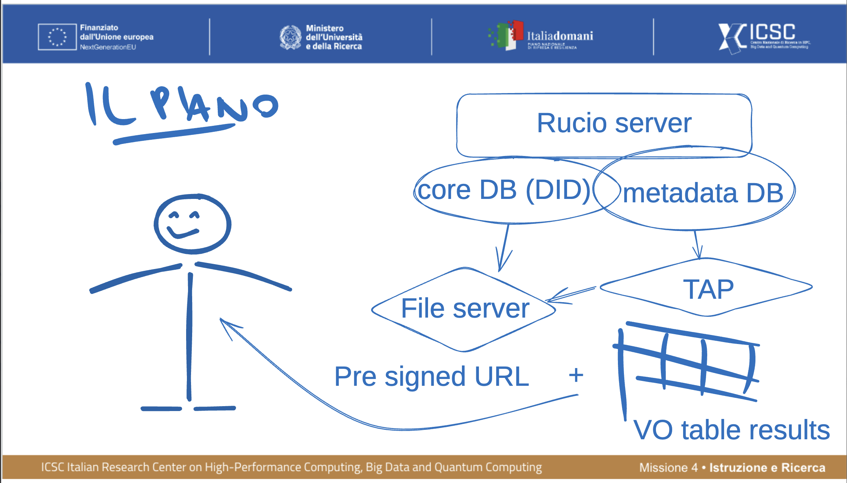
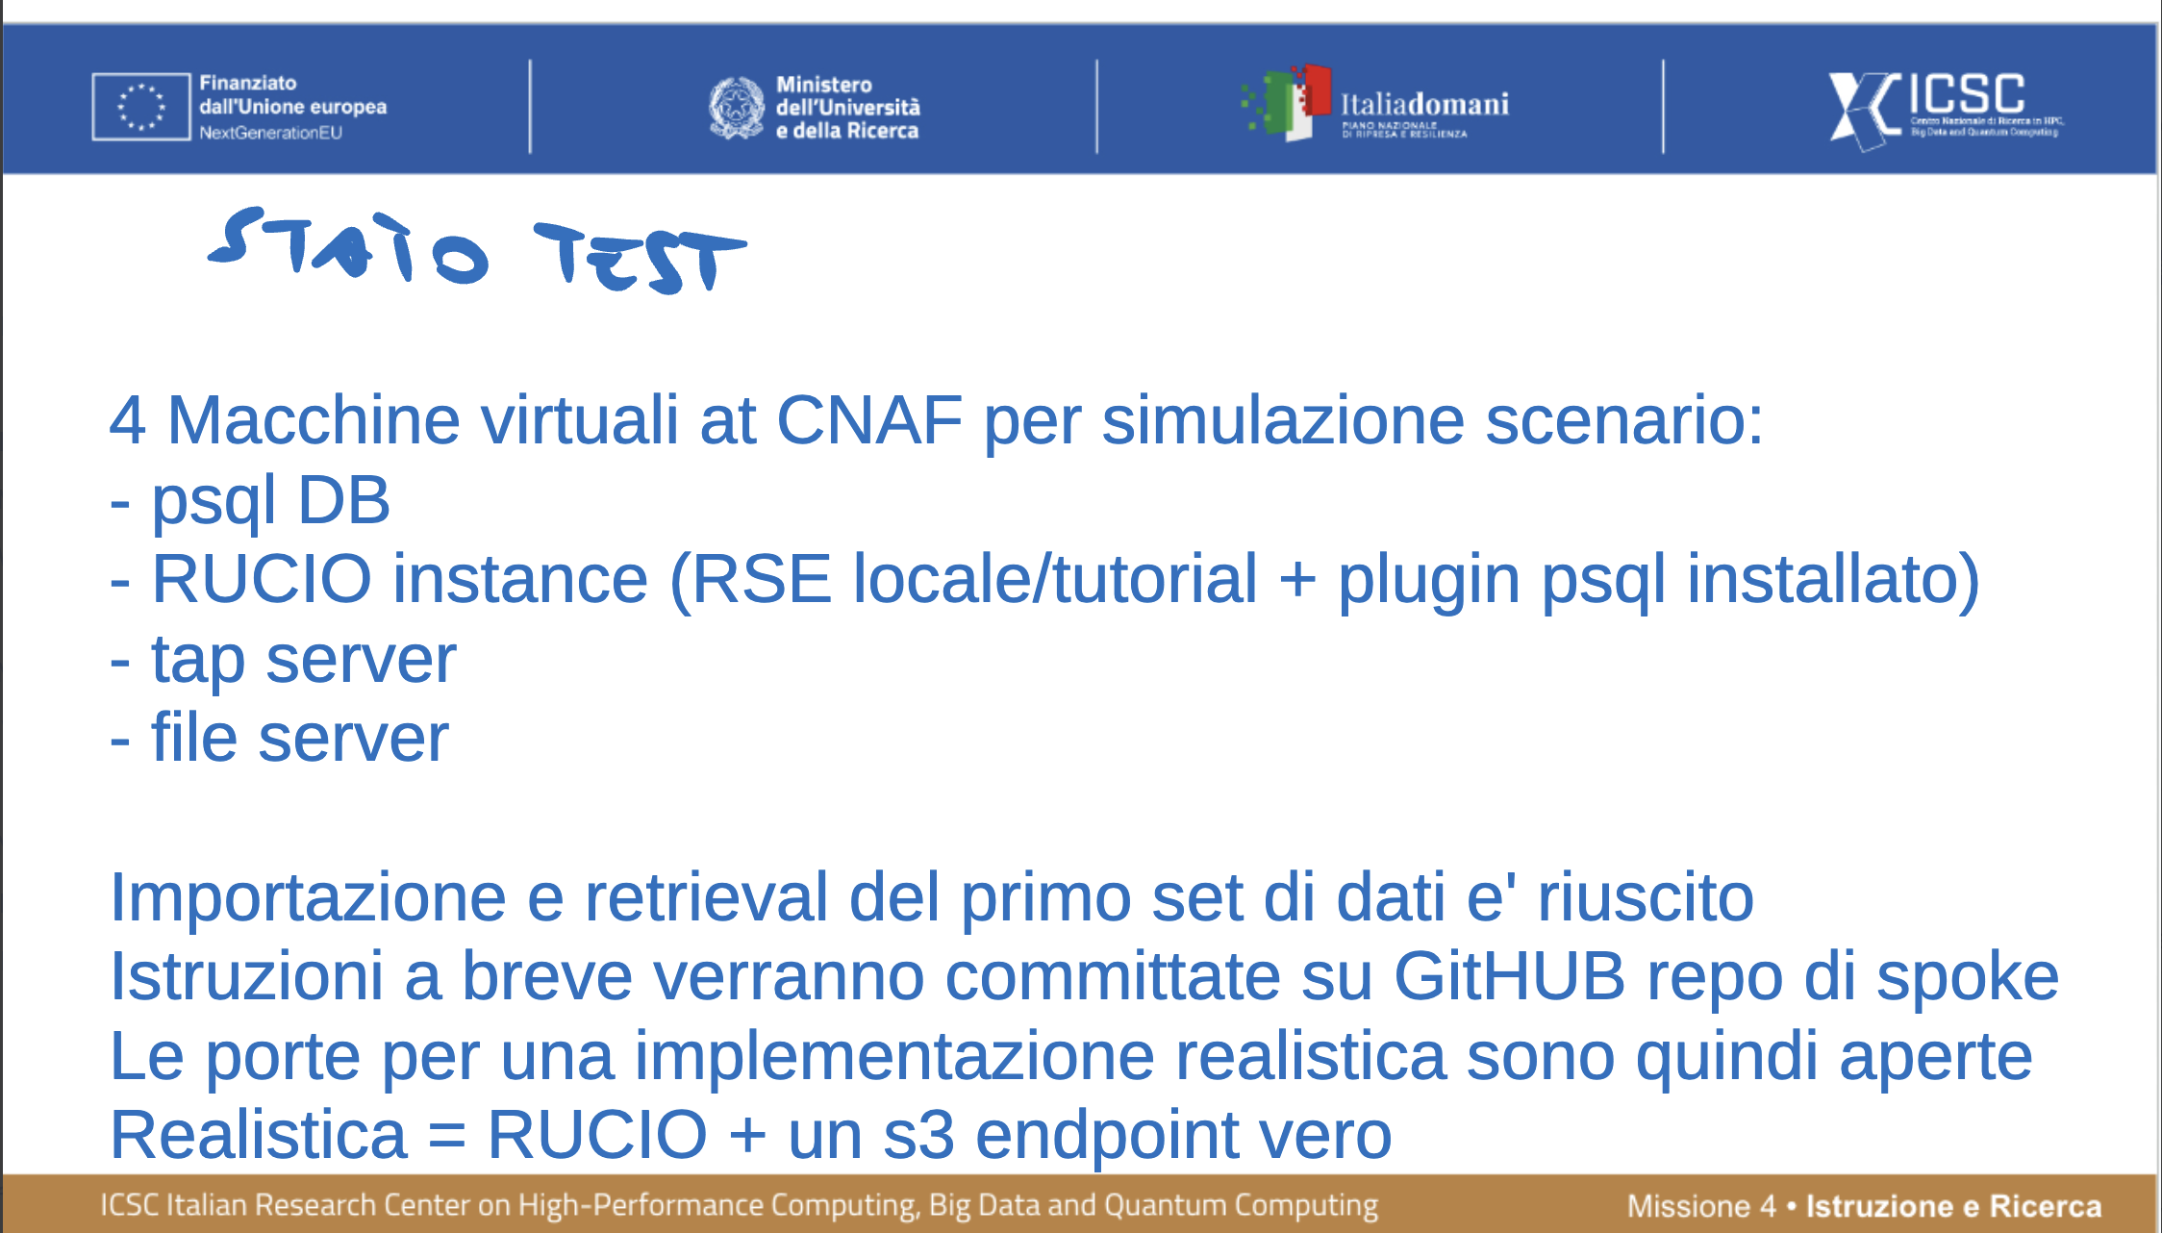
External Metadata catalog

Slide 12
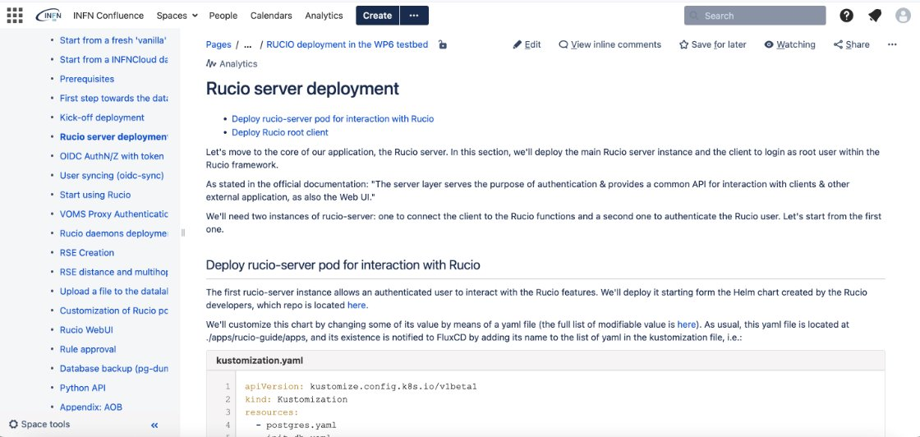
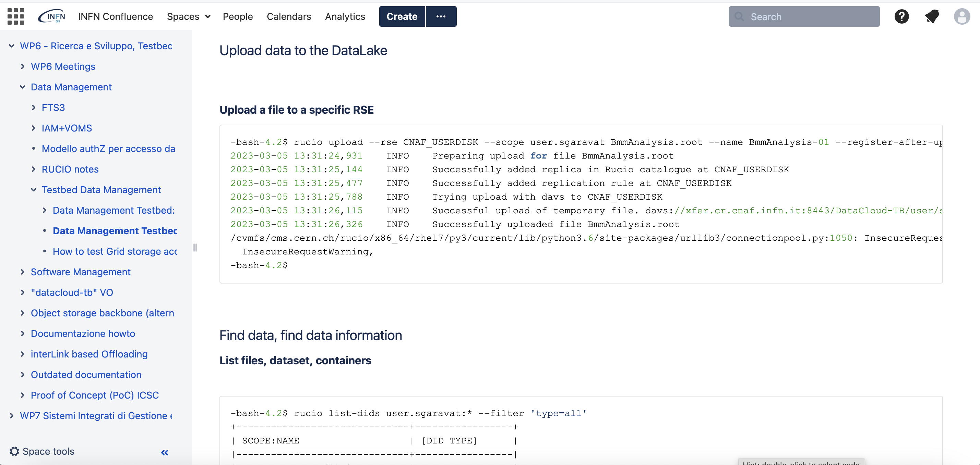
Documentation
We have produced documentation for both Rucio users and operators on INFN Cloud.
This documentation allows any user to replicate the DM system anytime is required, without major effort.

Slide 13
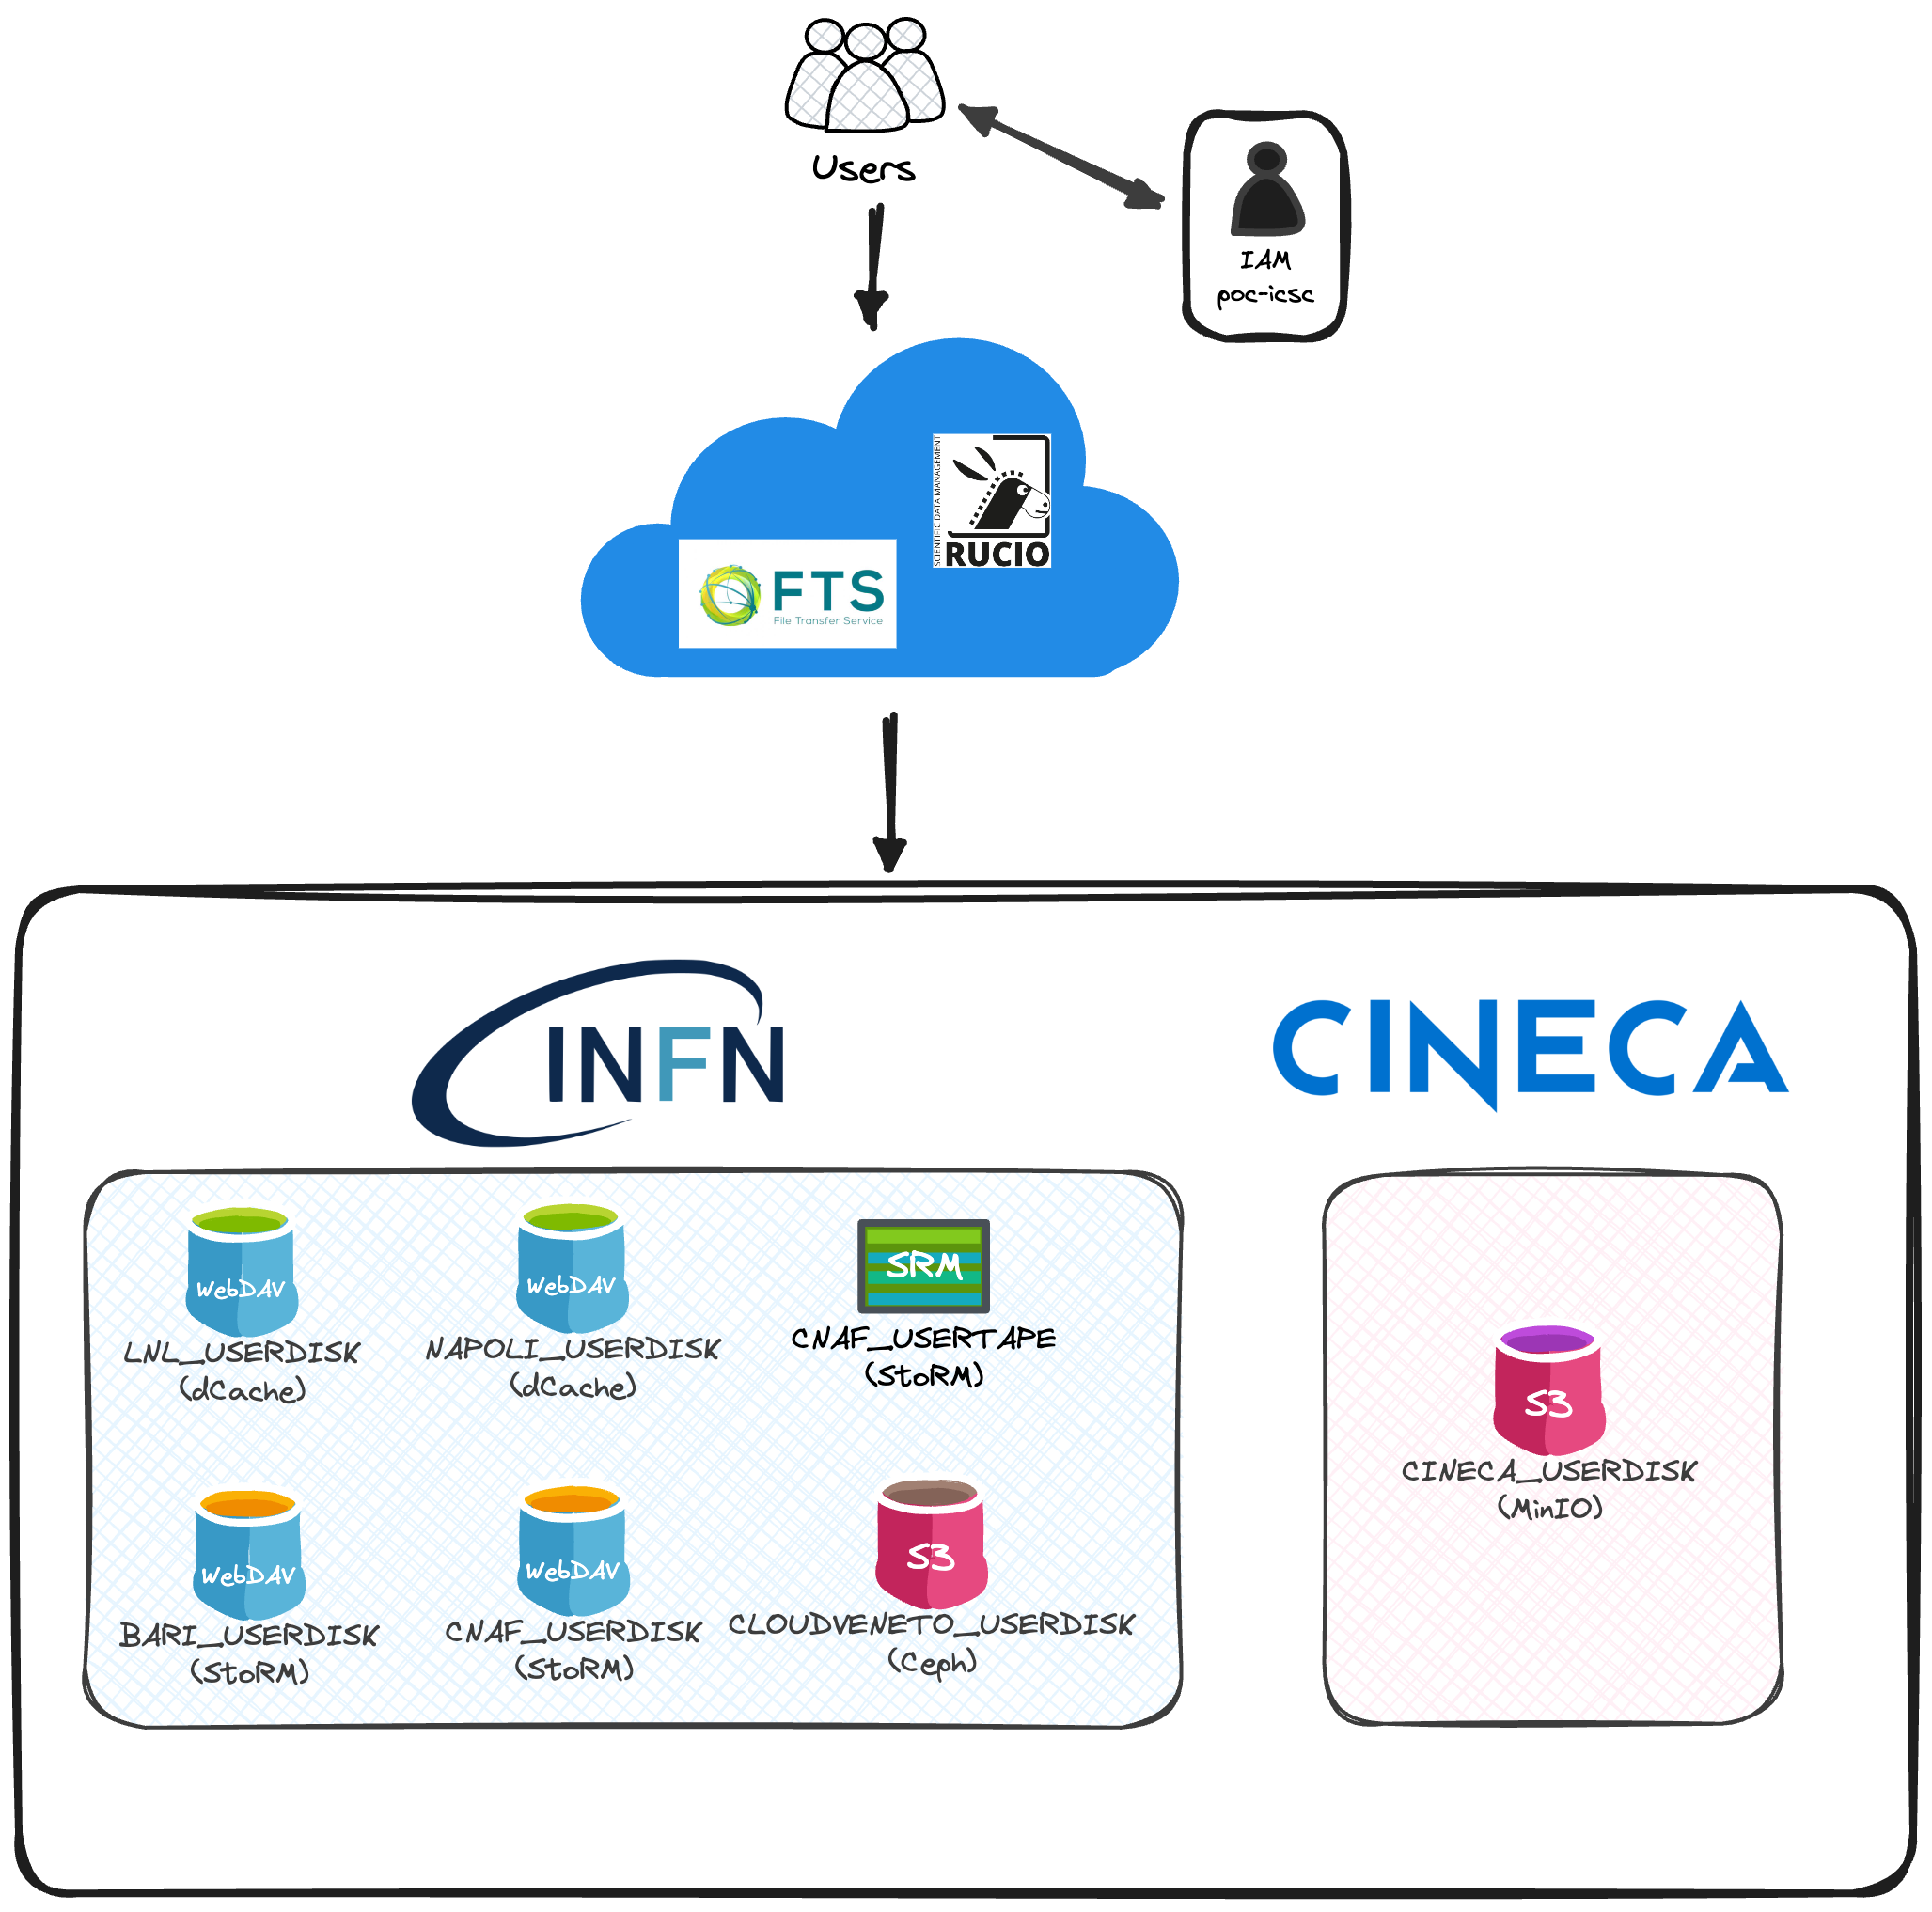
Federation with external storages
The first application of our infrastructure is in the Proof of Concept (PoC) implementation of a federation of storages involving both INFN and PRACE-Italy CINECA storages.
The implementation is pretty similar to the testbed one.
While the PoC is still ongoing, the data management infrastructure is already properly working.

Slide 14
Scientific communities onboarding
We’re already supporting scientific communities that decided to adopt Rucio (and also act as beta testers):
Cygno is an experiment on dark matter detectors. Data produced are stored in the INFN Cloud Backbone, analyzed and then moved to tape storage (and deleted from disks). We completed the implementation of the the Rucio infrastructure early this year;
DarkSide: research on direct evidence of dark matter from 2013 to 2020. They are developing the Rucio infrastructure by themselves, following the documentation we wrote;
DAMPE: research on indirect detection of dark matter signature. We’re setting up an infrastructure that allows interaction between Tier-1 storage at INFN and data center located in China;
Euclid Italy: The INFN contribution in the Euclid space mission is remarkable, but it lacks of a way to manage data. The process of developing a Rucio instance started with a kick-off meeting early September.

Slide 15
Rucio as a Service for communities
We aim to add Rucio as a a service in the portfolio of INFN Cloud applications.
A community will be able to instantiate a Rucio by simply triggering its deployment from the INFN Cloud dashboard:
Rucio community-specific, managed by them;
INDIGO IAM IdP community-specific, managing users and policies;
Centrally managed database in high-availability;
Centrally managed multi-VO FTS;
Federation of pledged storages.

Slide 16
Rucio as a Service for users
We can also add Rucio as a service for single users, who can take advantage of a federation of storages created specifically for this purpose.
A single user will be able to use Rucio to manage «personal» data, with a single interface in front of several storage systems → makes it simple.
Rucio centrally managed;
INDIGO IAM IdP centrally managed;
Centrally managed database in high-availability;
Centrally managed multi-VO FTS;
Federation of dedicated iNFN storages.

Slide 17
Conclusions and future perspectives
The INFN computing infrastructure and its Cloud resources represent a technological excellence in the Italian scientific research panorama.
The TeRABIT project will improve this infrastructure, making it ready to tackle the upcoming research and innovation challenges.
We decided to develop a data management infrastructure with Rucio as its core, federating the heterogeneous storage systems distributed across Italy.
We tested and validated several configuration and we already started onboarding scientific communities, in view of the forthcoming deployment of a National datalake.

Slide 18
Thank you!
antonino.troja@pd.infn.it

