Slide 1
Tofprad update

Slide 2
Tofprad rationale
Goal: proton-radiography with time of flight detection exploiting plastic scintillator
Rationale of proton-radiography
Detector inherited from FOOT (ST, TW + low intensity beam monitor)
Ekin measured from ToF
Time resolution < 100ps/m
Ideal rate capability ~MHz
monochromatic p beam
p beam with energy modulation due to different absorption
object
tracker2
stop
2m
start
tracker1

Slide 3
Optional implementation 2 in 1
tracker2
stop
0.5-1 cm
2m
start
tracker1
Std option:
Beam monitor + ST (FOOT)
Monolithic
TW-like
Few number of channel (4-8)
Easier hardware
“Guaranteed” time resolution
Spatial resolution???
Number of channel (~20)
Easier hardware
Time resolution??
Spatial resolution 0.5-1cm/ sqrt(12) ~ 2-4 mm
Requirements:
Spatial resolution ~few mm
Time resolution ~100ps (p @ 220 MeV)

Slide 4
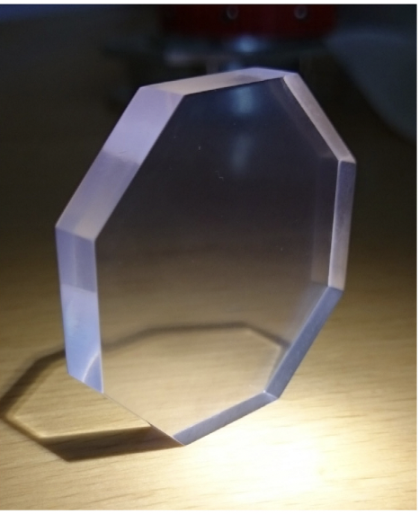
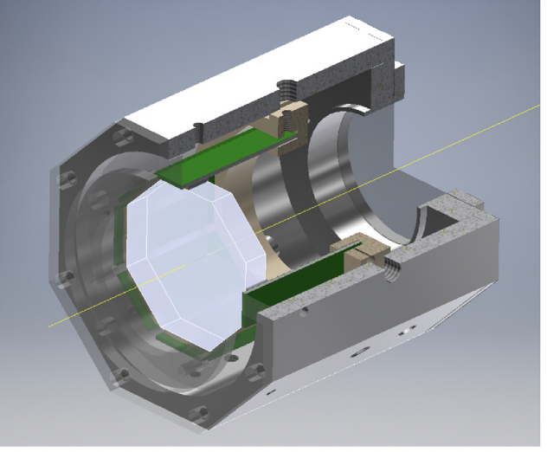
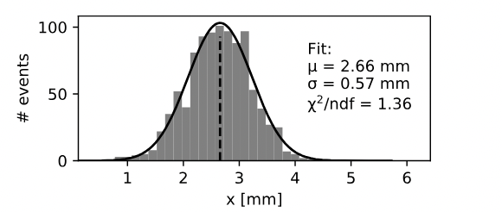
Monolithic scintillator
Noi
Loro
2 mm EJ232
p @ 220 MeV
Eloss ~ 880 keV (FLUKA)
8 channel (6 SiPM 3x3 mm² per channel)
Quadrato lato 7cm
6 mm EJ200
e- @ 850 MeV
Eloss 1.2 MeV (paper)
16 channel (2 SiPM 6x6 mm² per channel)
Ottagono lato 1.5 cm
Conti a mano:
Fattore ~4 meglio in luce totale raccolta
Fattore ~2 meglio in luce su singolo canale
Loro

Slide 5
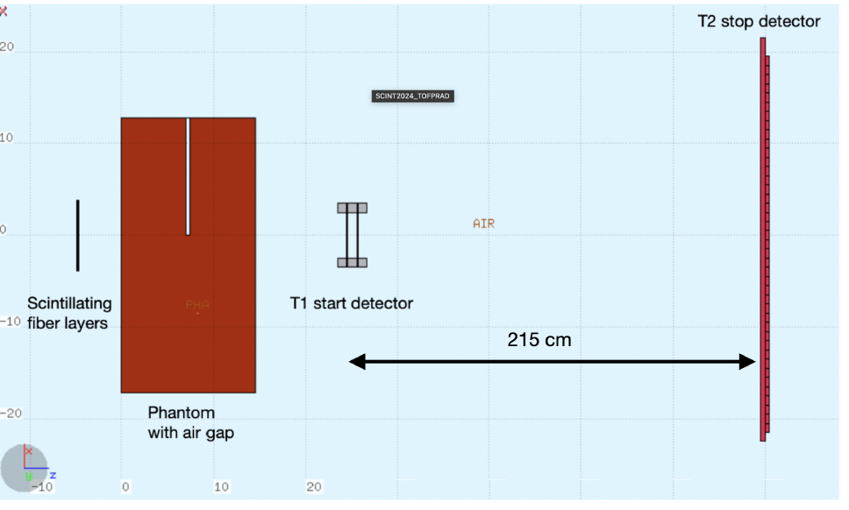
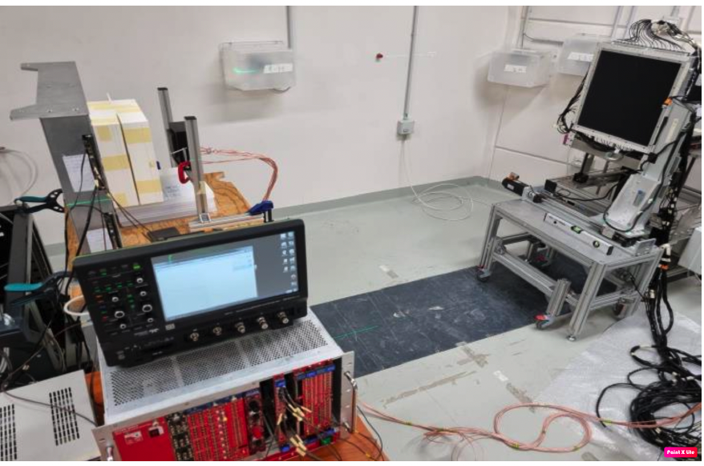
(Noi )FOOT ST (thickness 2mm)
beam
σ ~ 1.5cm

Slide 6
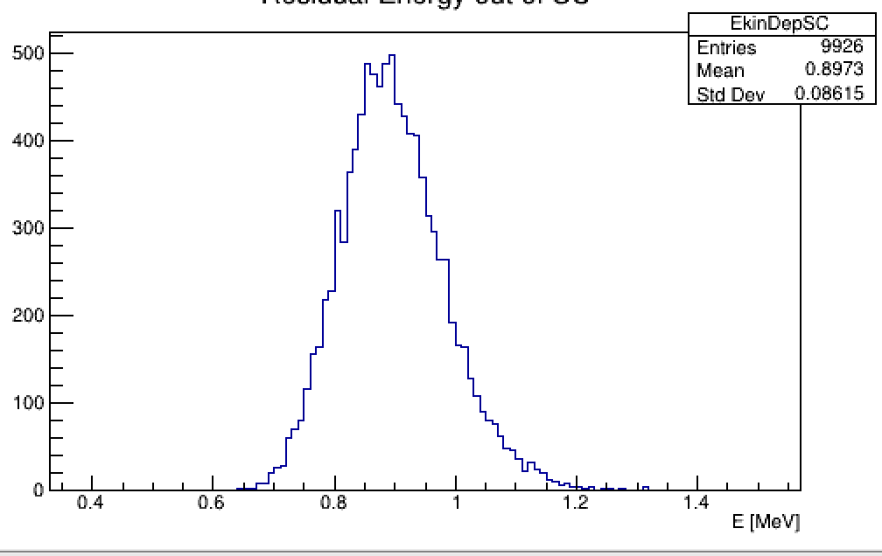
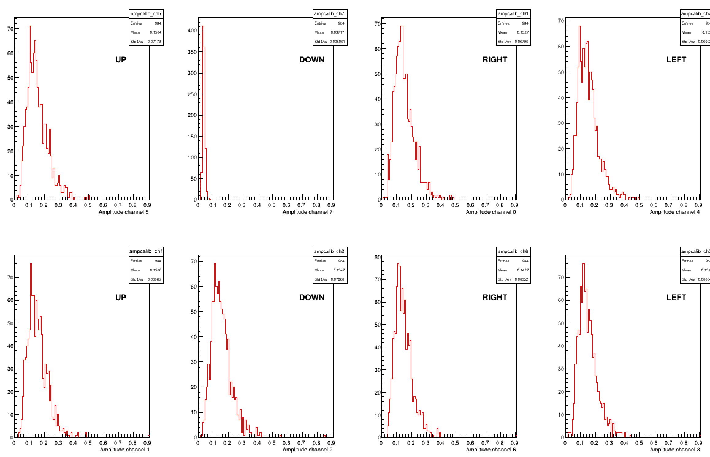
Detector response
MC
~ 30-35% statistical fluctuation

Slide 7
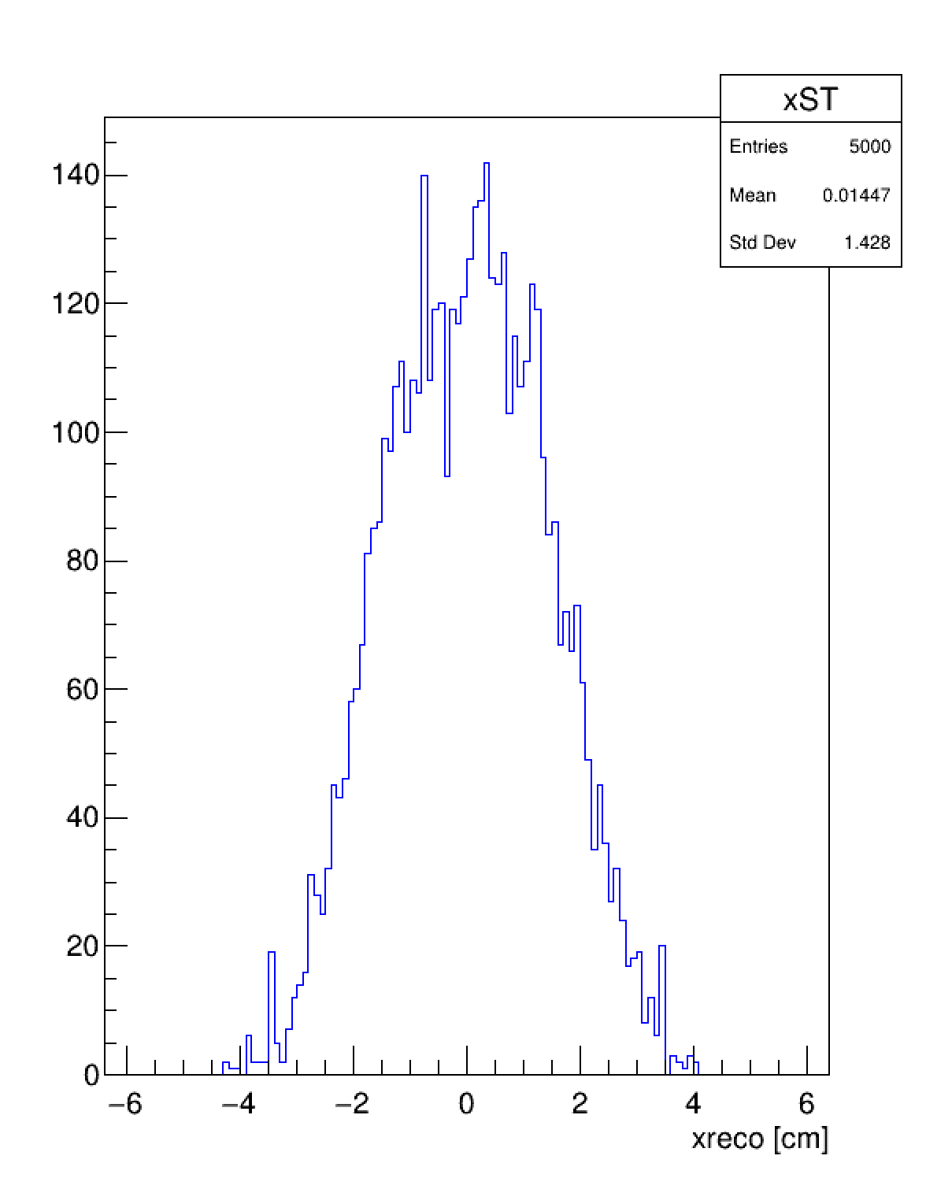
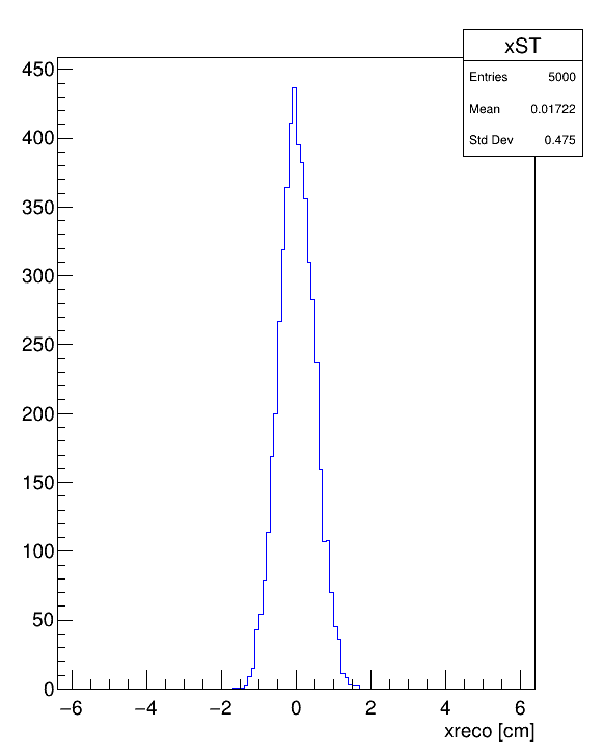
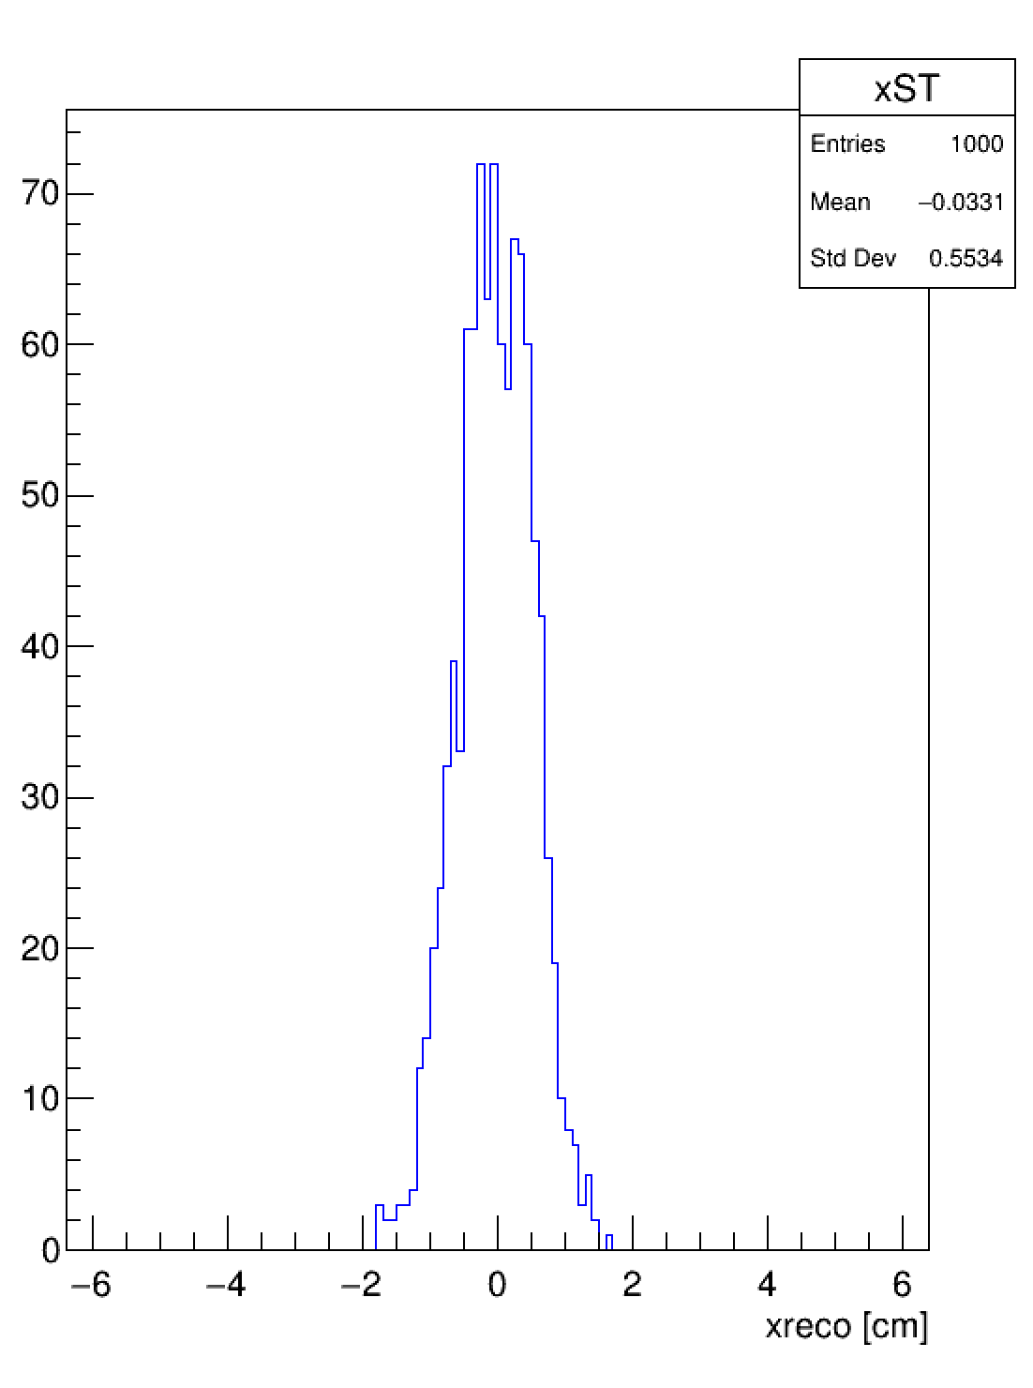
Toy MC
8 sides, 20x20 cm2 with 10%reso
Data-like(35%reso)
7x7 cm2 with 10%reso

Slide 8
Spatial resolution

