Slide 1
INFN LNL 26/11/2024

Slide 2
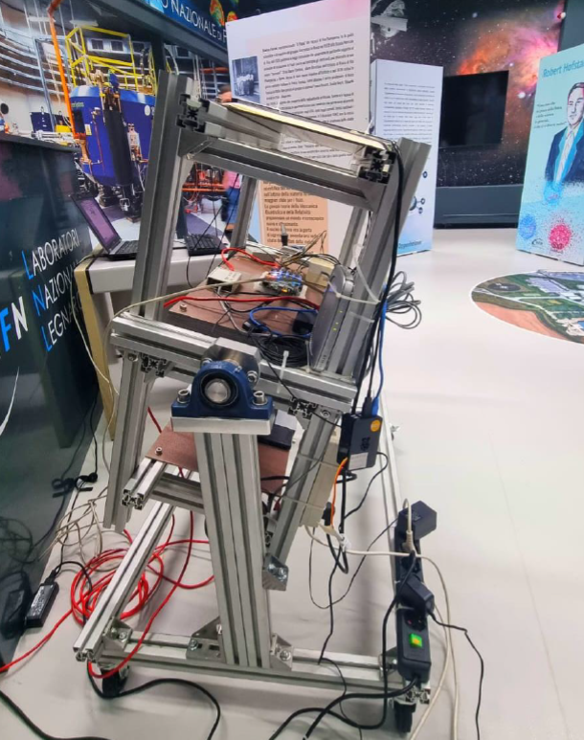
Measurement of muon flux as a function of the zenit angle
Our measures
y = 70 * cos²(x+1°)

Slide 3
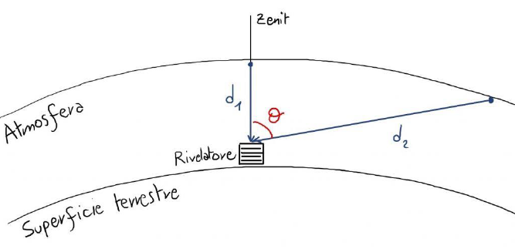
Measurement of muon flux as a function of the zenit angle
Our measures
y = 70 * cos²(x+1°)

Slide 4
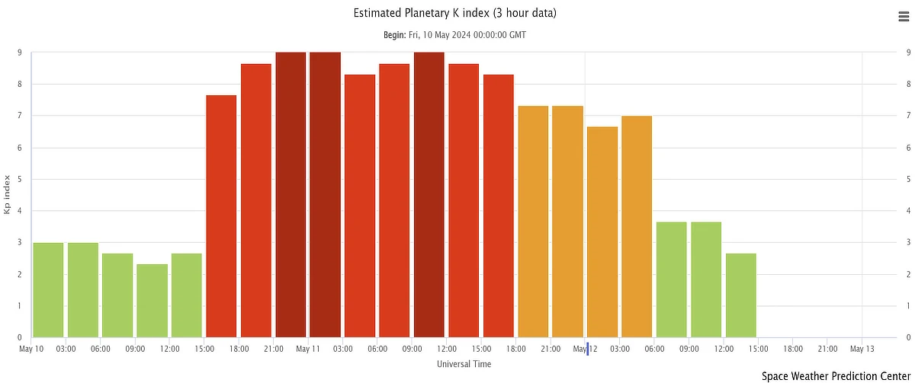
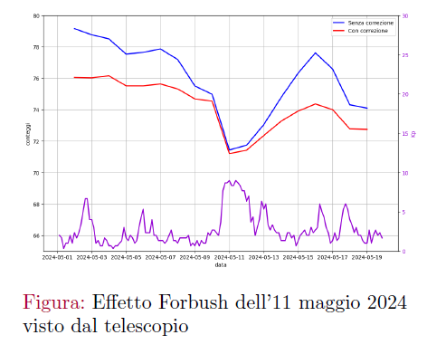
Forbush effect in May 2024
Data corrected for pressure and temperature effects

Slide 5
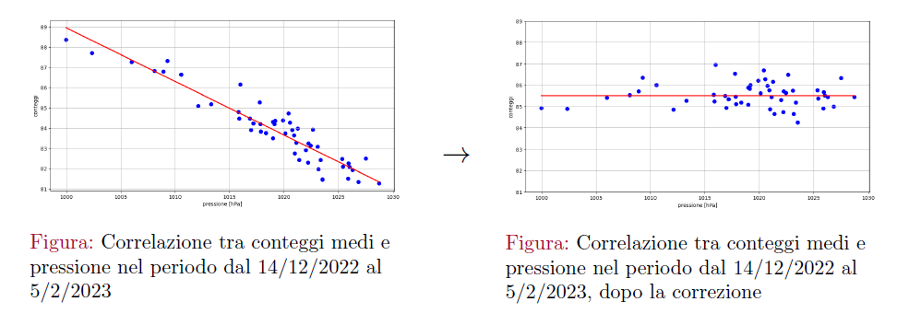
Measurement of muon flux as a function of the zenit angle

