Slide 1
DCH FEE
TDR contents discussion

Slide 2
Outline
Design goals
Requirements
  Specification for charge measurement based DAQ
    dE/dx & time measurements : resolution, dynamic range and linearity
  Cluster Counting option
    dE/dx measurements : resolution, dynamic range and linearity
DCH front-end system: block diagram
ON DETECTOR electronics
    Preamplifiers
    dE/dX based on charge measurements
    dE/dX based on Cluster Counting
Cabling
HV Distribution
    dE/dX based on charge measurements
    dE/dX based on Cluster Counting
OFF DETECTOR electronics
  Triggered Data Path
    Digitizing Modules
        dE/dX based on charge measurements
        dE/dX based on Cluster Counting
OFF DETECTOR electronics
  Triggered Data Path
      Concentrators Modules
    UnTriggered Data Path
      Option #1 - Concentrators Modules
      Option #2 – See Trigger Section
Radiation Environment Policy
Grounding and shielding ….
Conclusion
Questionnaire

Slide 3
Design goals

Slide 4
Design goals
SuperB Drift Chamber (DCH) front-end electronics is designed to extract and process the 8056 (to be finalized) sense wire signals to:
measure the electron drift times to the sense wires for tracking purpose (momentum of charged particles)
Measure the energy loss of particles per unit length, dE/dx (particle identification)
provide hits information to the trigger system (trigger primitives)
Measurement of the energy loss of particles per unit length, dE/dx (particle identification) can be implemented by
Measuring the charge collected on the sense wire (discarding high values to remove Landau fluctuations)
Counting the number of cluster generated by the particle crossing the cell
Decision : within the first half of 2012

Slide 5
Requirements

Slide 6
Specifications for charge measurements
dE/dx Goal: measure particle energy loss with precision of the order of 7.5% (BABAR) despite large fluctuations involved in single measurement (“truncated mean” method)
Resolution
Overall expected single cell σ_{E} ≈ 30 % (dominated by chamber contribution)
  Electronic contribution must be enough low to make it negligible. E.g.: σ_{EL}= 15% of σ_{E} (4.5%) → sqrt(σ_{E}² + σ_{EL}² ) ≈ σ_{E}
Assuming ≈ 50 fC the charge released from a mip (gas gain=10⁵) , σ_{EL} = 5% → single channel ENC ≈ 50 fC * 0.05 ≈ 2.5 fC
Dynamic range
σ_{E} dominated by gas amplification effects:
  Lower range: σ_{EL} (2.5 fC ) (could be 3σ_{EL})
  Higher range: ≈ 500 fC (BaBar experience)
Linearity
Linearity of the order of 2% matches system requirements

Slide 7
Specifications for time measurements
Particle tracks reconstruction based on (ionized) electrons drift time toward the sense wire
Resolution
Overall expected σ_{S} ≈ 130μm → dominated by chamber contribution
  σ_{S} limits: statistics of primary ionization, electrons diffusion, electronic
  Chamber contribution (σ_{SC} ) raw estimation ≈ 440/sqrt(N_{P}) ≈ 110 μm for a 90/10 He/Iso gas mixture
  σ_{EL} ≈ sqrt(σ_{S}² - σ_{SC}² ) ≈ 70 μm → σ_{S} ≤ 1.5 ns ( 3 * 16 μm/ns drift velocity)
    Main error sources are jitter (time walk + noise) and TDC (digitizing noise)
    Jitter
    Noise: Δt = σ_{N}/ (dV/dt) ≈ σ_{N}* τ/V_{max} (τ = peaking time)
      Assuming σ_{N} = 4 mV rms, V_{max} = 30 mV, τ = 4 ns → σ_{EL} ≈ 0.5 ns
    Time walk contribution: assuming τ = 4 ns a time walk of the order of 1.5 ns with 20 dB input signal dynamic is obtained → quite high → possible (partial) compensation using FADC sampled values
      Digitizing noise ≈ Δ/sqrt(12) with Δ ≈ 1 ns → ≈ 0.3 ns
→ Time resolution is dominated by signal time walk
Dynamic range
TDC range depends on gas mixture drift velocity and cell size → SuperB DCH max drift time ≈ 600 ns → TDC range ≈ 1us
Linearity
A linearity of ≈ 1% fulfill measurement requirements

Slide 8
Cluster Counting option
Pros & Cons
Pros
  Particle identification improvement
  Dedicated time measurement not required
  Possible improvement in spatial resolution
Cons
  High sampling frequency digitizers
  Fast processing
  Wide bandwidth and high power requirement front-end (environment noise sensitivity increase)
  Good cables for on-detector → off-detector connection required (bigger size)
  Termination resistor required (system noise baseline) with dedicated PCB
Resolution
FADC resolution is a function of the lowest sampled signal and system noise
  6 fC wire signal (gas gain 3x10⁵), 10 mV/fC shaper-amplifier, safety factor = 2 → 30 mV signal
  If we consider only the contribution of termination resistor (bottom limit – peaking time = 3 ns – gain = 10 mV/fC ) we get about 2 mV rms
Dynamic range and linearity
Total ionization in 1.2 cm high cell (average) ≈ 30e (90/10 – He/Iso)
Each electron correspond to a different level in output voltage → 3 bits/electron → 8 bits FADC
Linearity ≈ 2%

Slide 9
DCH front-end system: block diagram

Slide 10
DCH Front-End system: Block diagram
ON-DETECTOR ELECTRONICS
DCH BACKWARD END-PLATE
8056 chs
OFF-DETECTOR ELECTRONICS
12 cores Fiber Optical Cable patch-panel
#16
DAQ
16 OL @ 2Gbits/sec
173 OL
12→1
DAQ
DIOM
16 (12 cores) OL
12→1
ECS
ECS
16 OL @ 2Gbits/sec
#173 (48 chs)
#1152 (8 chs)¹
< 5 m
cables
Data Conversion
Trigger Primitive Generation
Boards
Pre-HV boards
#16
12→1
TRIGGER
TIOM
173 OL
16 (12 cores) OL
or Copper Links
64 OL @ 1.2Gbits/sec
or Copper Links
1 = Cluster Counting option
Trigger option 1: Data Conversion generates trigger primitives
Trigger option 2: Data Conversion board host a Trigger Mezzanine board for partial superlayer tracks reconstruction

Slide 11
DCH Front-End system: Block diagram
ON DETECTOR electronics

Slide 12
ON DETECTOR electronics - #1
Preamplifier
Front End Boards contain HV blocking capacitors, protection networks, preamplifiers and (eventually0 shapers.
Boards are located on the backward end-plate to maximize S/N ratio and are connected to the Data Conversion boards (located on external crates) through coaxial or twisted pairs cables (Cluster Counting = coaxial)
The end-plate will be divided in (sub)sectors → more cells will be grouped in a single multi-channel preamplifier-shaper board
dE/dx based on charge measurement
Wire signal is used both for charge and time measurement → preamplifier should not worsening too much signal time information (rise time).
Because gas mixture slow drift velocity and moderate detector parasitic capacitance a 80/100 MHz bandwidth transimpedance preamplifier match system requirements
Channel density is not so high and circuit design not so complex → approach based on SMT technology possible → profiting of high bandwidth, low noise SiGe devices developed for mobile-phone applications
dE/dx based on Cluster Counting
Preamplifier output must reflect as much as possible the wire current input signal, then current amplifier based on fast circuit topologies with low sensitivity to detector capacitance must be used (for example circuits based on current conveyor topology)

Slide 13
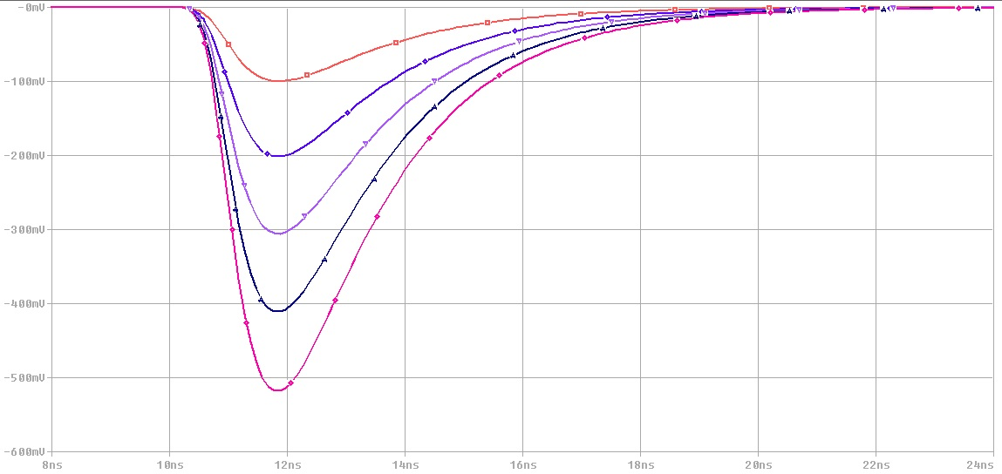
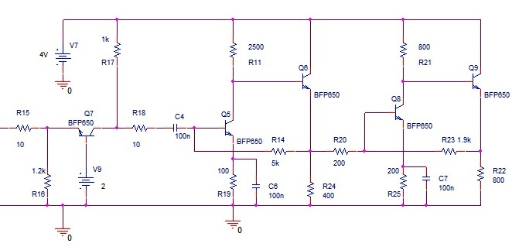
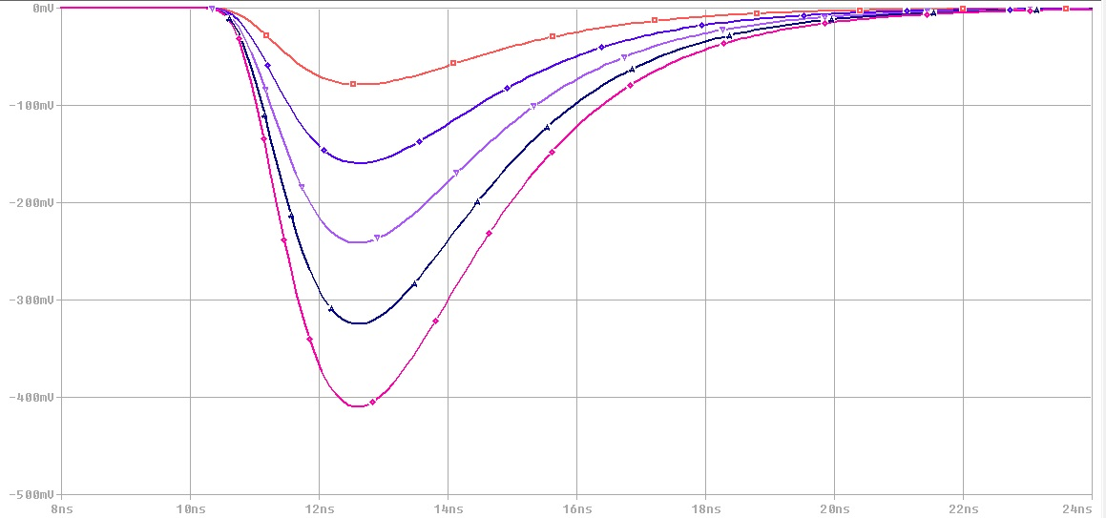
ON DETECTOR electronics - Preamplifier for charge measurements
0 mV
100 mV
200 mV
10 fC
300 mV
400 mV
C_{DET} = 0 pF
50 fC
0 mV
100 mV
200 mV
10 fC
P_{D} < 30 mW @ 4V
300 mV
400 mV
50 fC
C_{DET} = 24 pF
8 ns
10 ns
12 ns
14 ns
16 ns
18 ns
20 ns
22 ns
24 ns

Slide 14
ON DETECTOR electronics - #2

Slide 15
Cabling

Slide 16
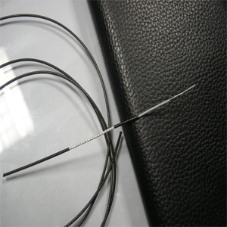
Cabling - Signal #1
dE/dx based on charge measurement
ON DETECTOR electronics will provide good amplification, but signal levels are still quite low.
Micro-coaxial cables or shielded twisted cables must be used to minimize noise environmental pickup
  Problem can arise due to the cable jacket. Many halogen free cable are quite rigid (large bending radius)
Braid shield twisted pairs offer a good compromise between cost, noise environmental shielding and bandwidth. Nevertheless shielded connectors could be a problem in the ON DETECTOR side
Both micro-coaxial and braid shielded twisted pairs are available in round and flat assembling. Flat assembling is (generally) better for ON DETECTOR front end boards connection, while round cables are better for routing and Digitizing Boards connections.
  Decision will follow the technique adopted for dE/dx measurement
Micro-coax: 50 Ω / 0.83 – 1.3 mm diameter

Slide 17
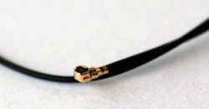
Cabling – Signal #2
dE/dx based on Cluster Counting
Besides considerations for dE/dx based on charge measurements cables for Cluster Counting must features high bandwidth, low losses and controlled impedance (Shielded Controlled Impedance)
There are several assemblies available. Cost is a function of modularity, type of connector and type of cable, but is generally higher than solution for charge measurement because the BW requirement.
  Again, decision on type of cable will follow the technique adopted for dE/dx measurement
1.88 mm diameter
Our Price: $1.83
Vol. Pricing: Quantity:25+50+100+Price:$1.67$1.52$1.38
Stock: 65
Mated height: 1.4 mm (55.12 mil)
Cable diameter: 0.7 mm (27.6 mil)
Length: 5.9" (150 mm)
Connectors: Super micro plug
Frequency: DC-7GHz
VSWR: 1.4:1 max
Standard lead time: 4 weeks ARO

Slide 18
HV Distribution

Slide 19
HV distribution
General considerations
Enough modularity to avoid too many dead channels in case of single chamber channel problem
Modularity is function of the distance from inner layer (example: 2 boards in inner layer – 5 boards in outer layer)
Good feedback of the current dragged by the inner layers (≈ 1 nA) and by the outer layers (≈ 10 nA)
HV Distribution – dE/dx by means of charge measurement
Distribution Board
[number of boards is a function of chamber layer]
Filter Box
[Outside Detector]
10MΩ
Ch 1
CH1
1MΩ
1MΩ
BOARD #1
2.2 nF
500 pF
10MΩ
Ch 8
Main
Power Supply
10MΩ
Ch 1
1MΩ
BOARD #N
500 pF
10MΩ
Ch 8

Slide 20
HV distribution
HV Distribution – dE/dx by means of Cluster Counting
Distribution Board
[number of boards is a function of chamber layer]
Filter Box
[Outside Detector]
10MΩ
R_{T}
Ch 1
CH1
1MΩ
1MΩ
500 pF
BOARD #1
2.2 nF
500 pF
10MΩ
R_{T}
Ch 8
Main
Power Supply
500 pF
10MΩ
R_{T}
Ch 1
1MΩ
500 pF
BOARD #N
500 pF
10MΩ
R_{T}
Ch 8
500 pF

Slide 21
Triggered Data Path
Digitizing Modules

Slide 22
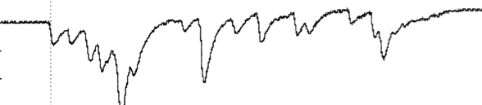
Triggered Data Path : Digitizing Modules - Latency (pre-FEX) buffers
Data continuously digitized and readout ONLY if L0 Trigger is delivered
First electron(s) cluster arrival time
dE/dx by means of wire signal charge measurement or Cluster Counting
Feature Extraction ON BOARD
dE/dE by means of charge measurement – Latency buffers (pre-FEX)
< 1 μs
32 samples (8 bits) @ 28 MHz ≈ 35.7 ns sampling period
≈ 1ns time resolution over-threshold TDC values
Single event buffer size : 32 x 8 bits
32 x 8 x 6 ≈ 6.8 μs latency time
  Separated FADC and TDC buffers
LPF
FADC
DISCR
TDC
dE/dE by means of Cluster Counting – Latency buffers (pre-FEX)
< 1 μs
1000 samples (8 bits) @ 1 GHz
Single event buffer size = 1000 x 8 bits
1000 x 6 = 6 μs latency time
Buffer
FADC
6 events buffer looks enough for trigger decision processing

Slide 23
Triggered Data Path : Digitizing Modules - Event Buffers
16/32 data path
Trigger Latency Time + n samples (Dual-port memory)
32 word (16 bits) block data readout
Event RO buffer
(Derandomizer)
Data RO Buffer
Over-Threshold data (from comparator)
n
2
1
0
DATA RO SM
(FEX)
Pushing mode
Ev7
Ev6
Ev5
Ev4
Ev3
Ev2
Ev1
Ev0
Ev3
Ev2
Ev1
Ev0
Concentrator board
Sampled data
n
2
1
0
(counter value @ L1) - Latency
ADDR
Read ADDR
Data Stream Example (10 bytes)
Sampling clock
Digitizer Module Address (2 Bytes)
Flag (1 Byte)
Trigger Tag (1 Byte) – 5 bits in BaBar
Counter (1 Byte)
Charge (2 Bytes)
Time (2 Bytes)
ADC sample @ Time
COUNTER (0 – n)
≈ 72 ns (Dead Time)
56 MHz x 4 clk
16 bits bus
≈ 50 ns (Dead Time)
56 MHz x 6 clk
16 bits bus
ADDR
FiFO Empty
L1 (synchronized by sampling clock)
L1 FIFO
FiFO Read
Data (counter value @ L1)
BW requirements = 8056 (N. channels) x 10% (occupancy) x 20 (bytes) x 8 (bits) x 150 kHz ≈ 19 Gbits/sec (foreseen: 16 fibers @ 2 Gbits/sec = 32 Gbits/sec)
NB: we have used 20 bytes in calculation instead of 10 (safety factor)
NB: Higher transfer rates are possible but as Digitizer Modules SHOULD use Rad Tol components. Then we can not use high performances SRAM based FPGAs.
Es : ACTEL ProAsic max internal frequency ≈ 350 MHz

Slide 24
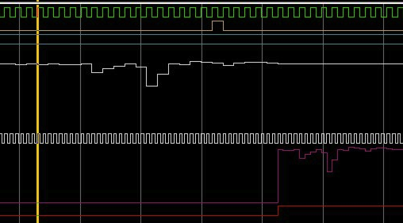
Triggered Data Path : Digitizing Modules – Event Readout
SAMPLING CLK
L1
SAMPLED DATA
READOUT CLK
READOUT ADC DATA

Slide 25
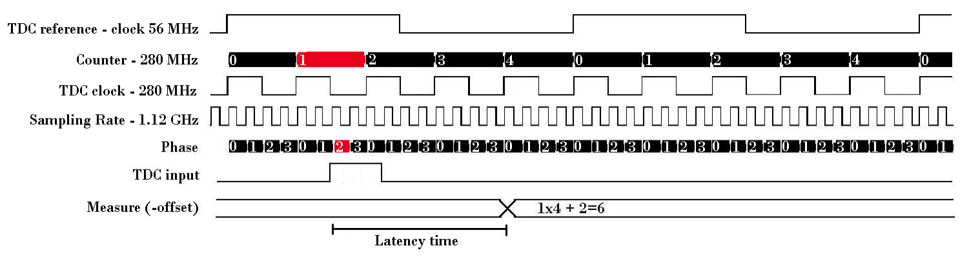
Triggered Data Path: TDC Implementation
Simulations show it is possible to implement a 4xOversampling – 1ns time resolution TDC in a ACTEL ProAsic3 device
Caveat
  No radiation mitigation technique can be applied to PLLs and (probably) to the high frequency section of 4xOversampling TDC
  FPGA internal resources could be not enough to manage data conversion & feature extraction for an acceptable number of channels.
  At the moment no Ser-Des are available

Slide 26
Triggered Data Path : Digitizer Modules – CC
Assuming FEX implemented on Digitizing Board
After FEature Extraction (primary cluster detection): 30 words (16 bits) containing time arrival information (worst case)
BW requirements = 8056 (N. channels) x 10% (occupancy) x 32 (words) x 16 (bits) x 150 kHz ≈ 62 Gbits/sec
(foreseen: 16 fibers @ 2 Gbits/sec = 32 Gbits/sec)

Slide 27
Triggered Data Path : Concentrators
12 cores Fiber Optical Cable Splitter
CONCENTRATORS
Data
DAQ section
12 chs connector
DAQ section
DAQ
Data Conversion boards
@ 48 CHS
DATA
CONVERSION
BOARD 12
OL @ 2Gbits/sec
ECS
ECS section
12 chs connector
ECS section
ECS
DATA CONVERSION CONCENTRATORS/OL
Data Conversion OL (576 channels): 48 (chs) x 12 (Data Conversion) x 0.10 (occupancy) x 20 (bytes) x 8 (bits) x 150 kHz ≈ 1.4Gbits/sec
Total amount of DATA CONCENTRATORS OL : 14 (foreseen 16)
Total amount of ECS CONCENTRATORS OL : 14 (foreseen 16)

Slide 28
UnTriggered Data Path – Option #1
Trigger Concentrators
12 (number of boards) x 48 (number of chs per board) x 7 MHz (Channel sampling frequency) ≈ 4 Gbits/sec
Trigger Concentrators : 14 – Trigger OL : 56 (foreseen 64)
12 cores Fiber Optical Cable Splitter
Data Conversion Boards
@ 48 CHS
≈ 1 Gbits/sec
Data Conversion
Board #3
TRIGGER
Data Conversion
Board #3
Data Conversion
Board #3
≈ 1 Gbits/sec
OL @ 1.2Gbits/sec
Data Conversion
Board #3
Data Conversion
Board #3
OL @ 1.2Gbits/sec
Data Conversion
Board #3
TRIGGER CONCENTRATOR
TRIGGER
≈ 1 Gbits/sec
OL @ 1.2Gbits/sec
Data Conversion
Board #3
Data Conversion
Board #3
Data Conversion
Board #3
OL @ 1.2Gbits/sec
≈ 1 Gbits/sec
Data Conversion
Board #3
Data Conversion
Board #3
Data Conversion
Board #3

Slide 29
Radiation Environment Policy
ON DETECTOR electronics
Only qualified components will be used. Anyway SiGe HBT transistors technology is inherently radiation hard
OFF DETECTOR electronics - NO CC
Only Rad Tol components will be used in Data Conversion and Concentrators Boards
  We have already shown it is possible to implement a ≈ 1 ns resolution TDC and FADC readout by means of (lash-ROM based) Rad Tol FPGA (Actel ProAsic)
OFF DETECTOR electronics - CC
Cluster Counting requires lots high performances FPGA → NO Rad Tol
  People think to to use neutron shielding (pure polyethylene ..)

Slide 30
SuperB Integration Questionnaire - #1
Author: G.Felici, G. Finocchiaro, M. Roney - 31-10-2011 - v1.0
Number of channels
8056 (to be finalized according to minimum allowed inner DCH radius)
ON DETECTOR - Power dissipation per channel - Preamplifier Boards
Standard dE/dx by means of charge measurement: 30 mW/ch - BW ≈ 80/100 MHz
Cluster Counting: 100 mW/ch - BW ≈ 250MHz
OFF DETECTOR - Power dissipation per channel - Data Conversion Boards (contribution to Feature Extraction to be checked)
Standard dE/dx: 0.9 W/ch (48 chs/board – 43W/board) ≈ 7.3kW total could be 0.7 W/ch (64 chs/board - 45 W/board) due to improvement in component power requirements ≈ 5.7 kW total
Cluster Counting: 5 W/ch (8 chs boards – 40W/board) ≈ 41kW could be 2.5W/ch (16 chs/board – 40W/board) due to improvement in component power requirements ≈ 20kW total
OFF DETECTOR - Power dissipation per channel - Concentrators
Assuming the same number of concentrators for both options (Feature Extraction on Data Conversion boards): 70 mW/ch (Concentrators boards must be located in non hostile environment): 650W

Slide 31
SuperB Integration Questionnaire - #2
OFF DETECTOR - Trigger - Primitives Generation
Option1: Off-Detector electronics generates only primitives à power requirement already considered in Data Conversion board
Option2: Off-Detector electronics includes electronics for partial super-layer track reconstruction → Off-Detector power and housing requirement would (slightly) change. The option is under study.
ON DETECTOR - Volume occupied by the electronics (drawings of electronic modules – non available yet)
HV distribution boards on forward endplate - Preamplifier boards on backward endplate. Position (both boards): 2-3 cm from endplate. Height (board + support) 8-10 cm → Nitrogen gas enclosure volumes are being determined ????
OFF DETECTOR - Volume occupied by the electronics (drawings of electronic modules – non available yet)
HV: 2 Crates 19"- wide, 8U-high Euro-mechanics rack (Ref: CAEN SY1527LC)
Standard dE/dx - 48 chs/board - 16 boards/crate: 173 boards (according to superlayer geometry) à 11 VME crates 19" x 8U (6+2) enclosure (Ref : CAEN VME8100 ) 64 chs/board - 16/boards/crate - 132 boards → could be 9 VME crates 19" x 8U (6+2) enclosure (Ref : CAEN VME8100)
Cluster Counting - 8 chs/board - 16 board/crate: 63 VME crates 19" x 8U (6+2) enclosure (Ref : CAEN VME8100 ) 16 chs/board - 16 bards/crate → could be 32 crates VME crates 19" x 8U (6+2) enclosure (Ref : CAEN VME8100)

Slide 32
SuperB Integration Questionnaire - #4
OFF DETECTOR - Number and size of Read-out cables or fibers
Data Conversion à Trigger (option 1): 64 fibers (150 kHz trigger rate - 10% occupancy - 20% safety - 1.2 Gbits/s link) Data Conversion à Trigger (option 2): partial super-layer track reconstruction in Data Conversion Board : 48 chs/board → 173 links - 64 chs/board → 132 links
Number and size of slow control cables
16 fibers
Minimum bending radius
Fibers: depends on assembly. Single fiber: 2 in; bundle: 15 times external bundle diameter. Waiting for ETD decision
ON-DETECTOR LVPS cables: depends on the assembling. Assuming a round shielded (aluminum foil) bundle of 12 cables à 12 x cable diameter (12 conductors – 1.5 mm^2 size à outer diameter ≈ .520 in ≈ 13.2 mm
ON-DETECTOR HV cables: depends on the assembling. Assuming a shielded (aluminum foil) bundle of 12 cables à 12 x cable diameter (12 conductors overall cable diameter ≈ 9 mm)
ON-DETECTOR Signal cables [Very Preliminary] Standard dE/dx: assuming a flat assembly of 12 cables à 24 x cable diameter (micro-coax cable diameter ≈ 0.5 mm - aluminum foil shielding)
ON-DETECTOR Signal cables [Very Preliminary] Cluster counting: assuming a flat assembly of 12 cables à 12 x cable diameter (RG178 cable diameter ≈ 1.8 mm)

Slide 33
SuperB Integration Questionnaire - #3
Max tolerable distances between the detectors to the electronic modules:
ON-DETECTOR – OFF-DETECTOR ≈ 5 m
Access frequency on the external electronic per year
12 access/year (after debug)
Frequency access on the detector per year
1-2 access/year (after debug) (including HV)
Modularity of the electronic unit (housing racks)
200 cm (45 rack units)
ON DETECTOR - Number and size of power cable
Preamp LV power cables: 12 chs/board modularity → 768 cables – 1.5 mm^2 size
HV cables: less than 100
OFF DETECTOR - Number and size of Read-out cables or fibers
Data Conversion à Concentrators: 168 fibers
Concentrators à DAQ: 16 fibers

Slide 34
SuperB Integration Questionnaire - #5
Shielding requirements (thermal and electrical)
Thermal: NO Electromagnetic: if cluster counting will be implemented some shielding could be useful. For standard approach (dE/dx by means of charge measurement) the magnetic field return iron should be enough May be SVT shielding required ??
Information drawings on the cable distribution on the detector geometry: non available yet
Only preamplifiers should be installed on backward-end plate. Connection to off-detector electronics will be implemented by coax cables (Cluster Counting) or coax/twisted cables (standard dE/dx). Cables should leave the detector along the outer diameter
Requirement of cooling system - Backward Endplate - flow, temperature and type of fluid
Standard dE/dx: 300W → air flow cooling should be enough to provide good air exchange ≈ 1000 m^3/h - coarse calculation: (3.16 x Watt) /(Dt*0.589) à Dt = 4 (!), degrees, PD = 300W → 500 m^3/h) Cluster counting: 1 kW → liquid cooling required
Requirement of cooling system - Allowed detector temperature variations: backward end-plate
4 degrees (????)
Size of the chiller
ON DETECTOR + OFF DETECTOR electronics ??

Slide 35
SuperB Integration Questionnaire - #6
Cooling pipes distribution at sub detector ends (drawings)
Not available yet
Describe other requirements that have an impact of the space available like auxiliary equipment, minimum space for accessibility, etc
1.5 mt in front of racks 0.5/1 mt behind racks Full access to end-plates (backward and forward) during detector access OPTIONAL : electronics for local debug (table, PC etc.)
Describe other requirements that have an impact of the space available like space for the commissioning operations and assembly
Full access to end-plates (backward and forward) during detector access

Slide 36
Conclusions
Design goals have been defined
Two different implementation of dE/dx measurements have been evaluated and will be reported in TDR. Measurements on Cluster Counting are going on and final decision about the technique that will be used to measure dE/dx will be taken within the first half of 2012
The technique used for dE/dx measurement has a NOT minor impact on number of boards, power requirement, interconnections cables, HV distribution boards and grounding (shielding).
HV distribution modularity will follow the chamber layer (less cells for the internal layers, more cells for the external ones)
Only Rad Tol components will be used in front-end boards (NO CC). If selected components has no qualification they will be qualified.
Grounding/shielding policy has not been defined yet
Probable (!!!) number of (optical) links : 16 for DATA, 16 for ECS and 64 (173) for TRIGGER
    Board design will start after the decision on dE/dx technique to be used

