Slide 1
ROM

Slide 2
ROM functionalities.
ROM boards has to provide data format conversion.
Event fragments, from the FE electronics, enter the ROM as serial data stream; they have to be forwarded to the HLT cluster, according to industrial standard format and protocol.
ROM boards could also perform event (fragments) processing, before the transmission to the HLT cluster takes place.

Slide 3
Additional considerations.
Latency for data processing and format conversion at the ROM stage is not a constraint.
Data processing can be effectively performed by means of CPU cores.
Would let us to cope with unforeseen changes.
PCIe seems to offer wide enough bandwidth to feed CPU and transmit data later on.
Use of commodity of PC-motherboards requires:
The design of the input optical to PCIe interface.
Validate the data transfer procedure to move data from the input board to the PC RAM for processing and formatting.
Perform effective data transmission with commodity network cards.

Slide 4
DAQ
In case of L1 yes
trigger info
Trigger
ROM
10 GbE connections
output to the Switch
1
PC
ROM
Main
Network
Switch
FE boards
5
1
10 GbE connections
input to the Switch
n. of PC depends on the
processing latency of
the selection algorithms
n. cores ~1500.
FE boards
50
ROM
PC
50 ROM boards

Slide 5
ROM blocks
Otical
Input
Interface
Event
Fragments
Processing
Formatting
and
Transmission
data output
< 10 GB/s
data input
10 GB/s
FCTS
Interface
?
Powering
Configuration
and
Control
?
What information do we get at this
stage from the Fast Control System ?
Severe limit: number of bits available
to transmit information to subsystems.
To be kept in mind…

Slide 6
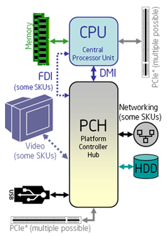
ROM bit more in detail
PCIe Chipset
Otical
Input
Interface
Data Input
PCIe
Interface

Slide 7
ROM Block Diagram

Slide 8
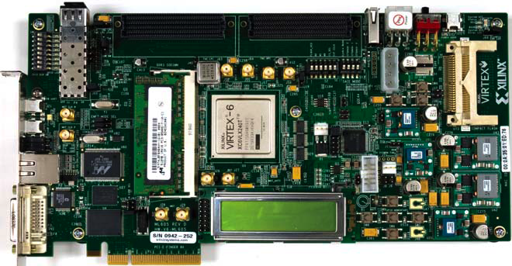
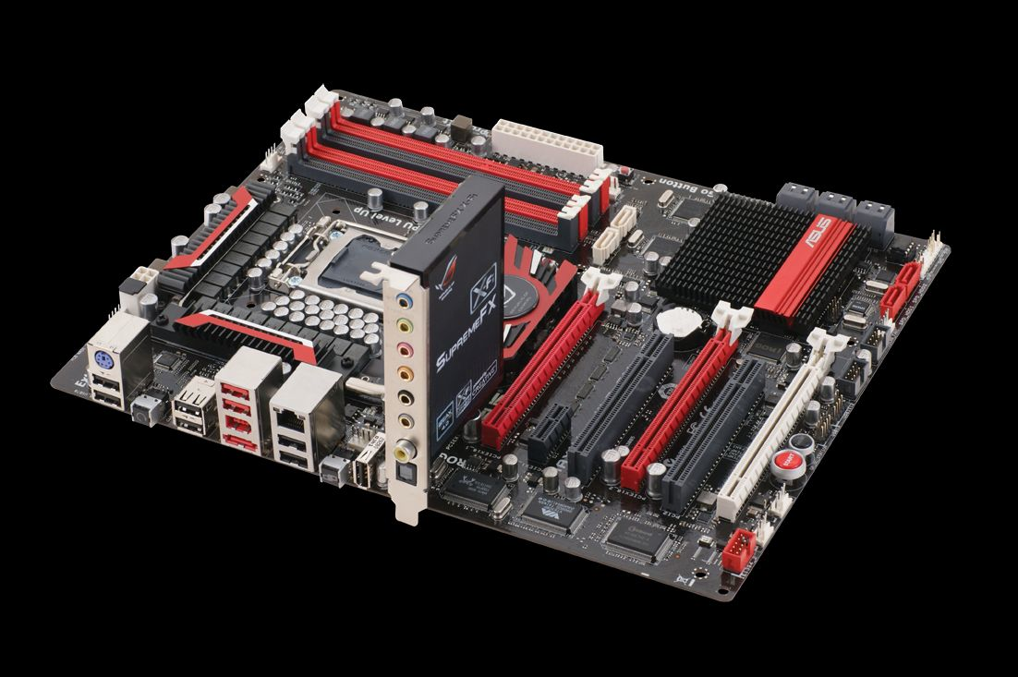
Electronics
To begin playing with PCIe, to inject data into the PC.
Xilinx ML605 evaluation board including Virtex-6 is a good tool to start with.
In order to test PCIe feauture/performances we need to develop the Linux driver; it is not only matter of implementing the PCIe protocol on the FPGA.
Motherboard equipped with PCIe chipset and quad-core CPU at 500 Euro.
8x lanes PCIe Gen2
4 GB/s
Performance in performing data
transfer depends on the DMA (chipset).

Slide 9
Pros
COTS PC architecture used as Read-out carrier
Low cost, field upgradable
Reuse of common services
Event builder interface, slow control
Move custom parts in a dedicated PCIe card
Exploit high bandwitdh PCIe to/from microprocessor(s) for:
Feature extraction
L2/L3 trigger
Unforeseen changes

Slide 10
Cons
Space:
Limited: 1U/2U servers support of PCIe slots
Cooling:
Adequate ventilation requires well designed chassis.
Power:
Good quality power supplies must be selected.

Slide 11
Two solution evaluated for the ROM project: board+PC, board stand alone: board+PC implementation data goes from the interface board to the PC through PCIe.
Main assumption in both cases: the ROM output rate ~ 10 Gb/s.
SuperB entire data flux can be estimated to be 600 Gb/s, so we’ld need ~60 ROM each one handling therefore ~10 kB.
Solution based on the board+PC approach aims to provide SuperB wit some computing capabilities for pre-processing of the event fragments. Tested using an evaluation board: Bologna-Padova collaboration.
What data pre-processing you may want at this stage?
Solution based on standalone board entirely relies on FPGA to get and transmit data through 10 GbE: the transmission protocol would be implemented on the FPGA.
ROM system can fit in one crate.
In Bologna two engineers can work and are working on this solution.
Cost evaluation for comparison not ready yet

Slide 12
ROM as standalone board acts as format converter, do not perform “complex” data processing.
Preprocessing can be easily postponed: the PC running the trigger will receive all the fragments (~60) and as a first step perform the pre-processing then run the trigger algorithm.
Data transmitted as IP packets, using for instance UDP/IP.
LHCb developed its own protocol based on IP.
Any processing postponed to the farm node in charge of performing the trigger algorithm.
Network is small: 60 input (ROM) and 100 output ports to the farm.
In LHCb we measured a percentage of packet loss in the network at the level of ~10⁻¹⁰
ROM as standalone board can be hosted in a VME crate for mechanics and powering.

Slide 13
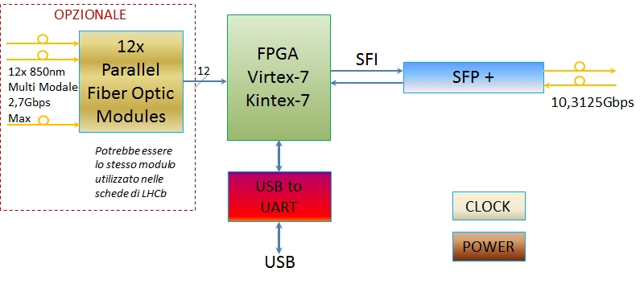
Board / FPGA implementation
Optical interface
New FPGAs host transceiver GTX arunning at 12.5Gbps (up to 28Gb/s vertion GTZ).

