Slide 1
Unfolding Particle Detector Effects in HEP with Generative AI
Yaohang Li and the A(I)DAPT Collaboration
Department of Computer Science
Old Dominion University
Norfolk, Virginia 23529
yaohang@cs.odu.edu
12/17/2024 @ Digital Twins for Nuclear and Particle
Physics - NPTwins 2024

Slide 2
Agenda
Initial Attempt in Exclusive Electron-Proton Scattering
  FAT-GAN
  Conditional GAN
Unfolding Smearing Effects
  Electron-Proton Scattering
  CLAS Exclusive 2π photoproduction
Unfolding Acceptance Effects
  Single-pion photoproduction reaction
Conclusion and Future Work

Slide 3
2019-2020 Jefferson Lab LDRD Project: Universal Monte Carlo Event Generator (Wally, Sato)
Simulate Physics Events with Machine Learning
  Data-Driven: directly learning from event samples
Machine Learning-based Event Generators (MLEGs)
  Data preservation (JLab in a jump drive)
    Compactified data storage utility
    Derivation of physics properties
  Faithful Representation of Nature
    Model independent
    Agnostic of theoretical assumptions about the microscopic nature of particle reactions
    Accurately mapping out the underlying probability distributions
  Much faster than MCEGs
    Simulation of the complete pipeline of particle experiment can take minutes to generate an event
    MLEGs can generate millions of events
Advantages of MLEGs
  Much faster than MCEGs
    Simulation of the complete pipeline of particle experiment can take minutes to generate an event
    MLEGs can generate millions of events
  Agnostic of theoretical assumptions
    Explore the true underlying probability distributions governing the particle spectra
Notes:
MCEGs simulate physics events from first principles while MLEGs directly learn from event samples. As an alternative approach of physics event generation, MLEGs have the advantages of much faster generator and agnostic of theoretical assumptions.

Slide 4
Initial Attempt: Electron-Proton Scattering
Direct Simulation Generative Adversarial Networks (GAN)
Training Events
  Pythia Events with Center-of-mass energy of 100 GeV
Inclusive Simulation
  Only trained on the momenta of the final state electrons
Alanazi et al., IJCAI 2021.

Slide 5
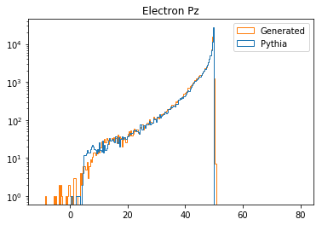
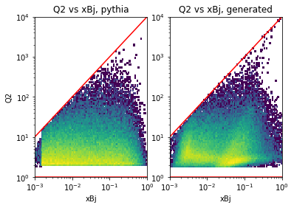
Results of Director Simulation GAN
Unphysical Events
E_{b} = 50GeV
χ² = 118.29

Slide 6
Challenges in GAN Training
Training a GAN is notoriously difficult
  Perfect Discriminator
  Mode Collapse
  Non-convergence
  Imbalance Generator and Discriminator Training
  Model parameter oscillation
  Destabilization
  Vanishing gradient
Additional Requirements for Physics Event Generation
  Precise Event Feature Distributions
    Replicate the nature of particle reactions faithfully
  Obeying the Fundamental Physics Laws
    Energy Conservation
    Momentum Conservation

Slide 7
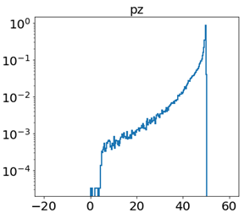
Features Transformation
Conversion to eliminate sharp edges
Guarantee no generation of non-physical electrons
Alanazi et al., IJCAI 2021.

Slide 8
Features Augmentation and Transformation GAN (FAT-GAN)
Features Transformation
Features Augmentation
Alanazi et al., IJCAI 2021.

Slide 9
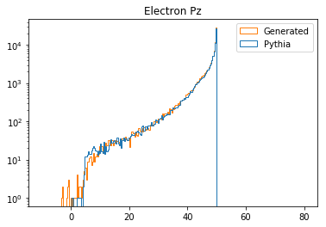
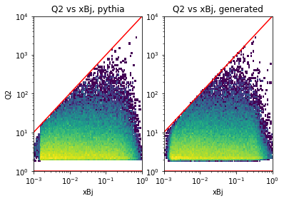
Results of FAT-GAN
No more non-physical events
with p_{z} > 50 GeV
Good approximation of Q² and x_{Bj} correlation with χ² = 1.52
Alanazi et al., IJCAI 2021.

Slide 10
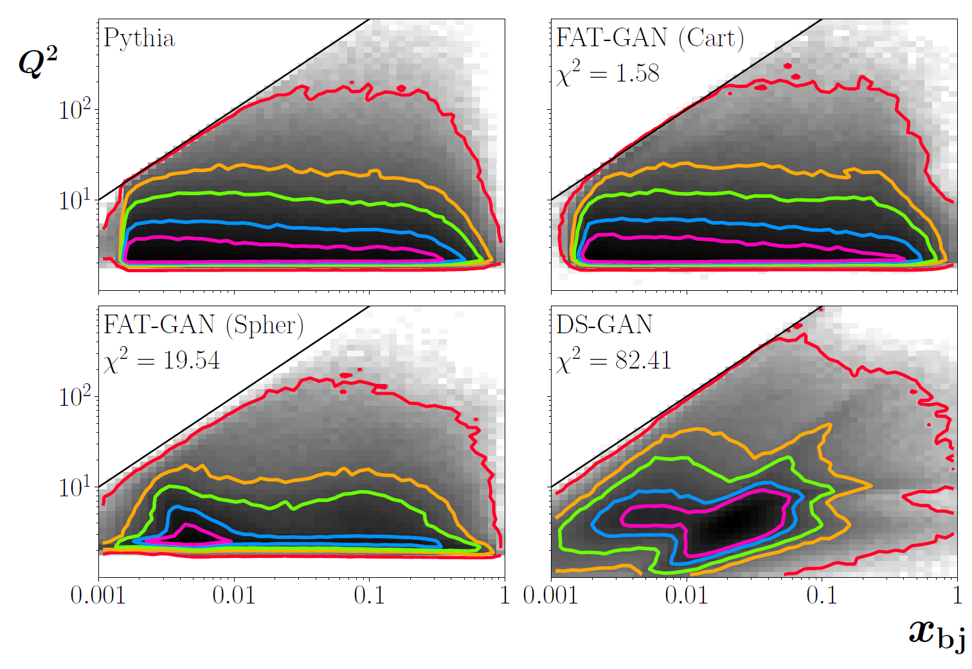
Distributions of Generated Physical Properties
Joint distributions of Q² and x_{bj}
Distributions of Distributions of physical properties of the scattered electron, p_{x}, p_{y}, p_{z}, E, p_{T} , x_{bj} and Q²
Alanazi et al., IJCAI 2021.

Slide 11
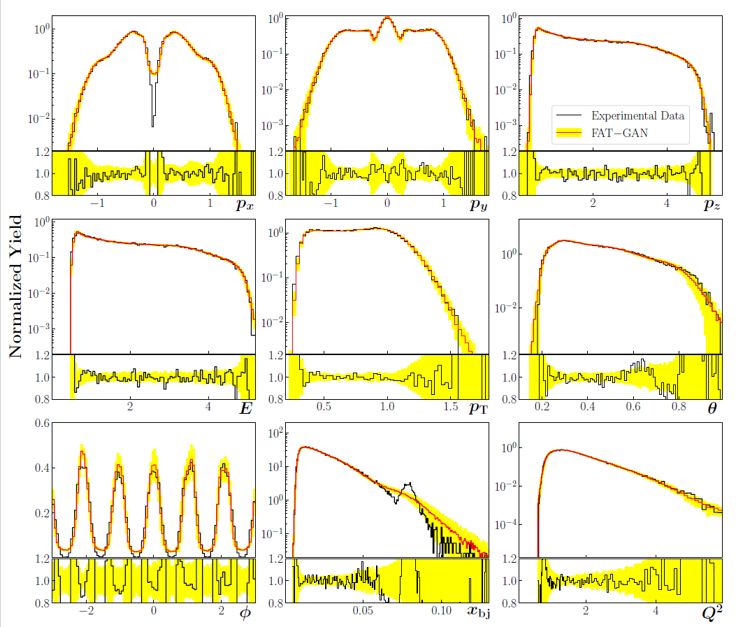
FAT-GAN on experimental electron-proton scattering data
Alanazi et al., IJCAI 2021.

Slide 12
Conditional GAN
A GAN-based Event Generator w.r.t. Beam Energy Input
Velasco et al, ICMLA 2020

Slide 13
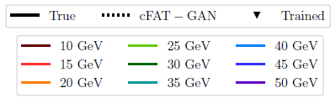
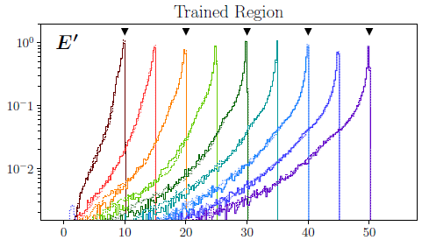
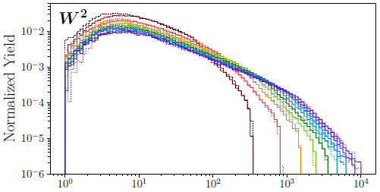
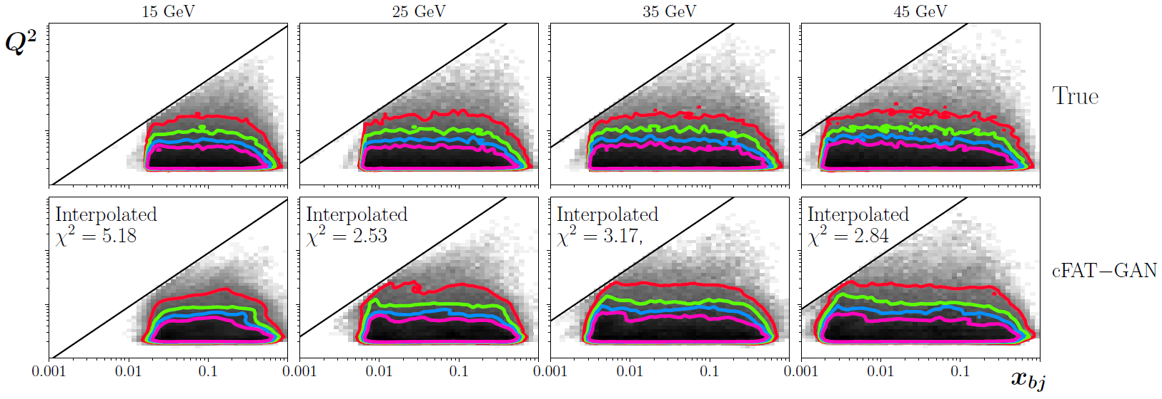
Interpolation

Slide 14
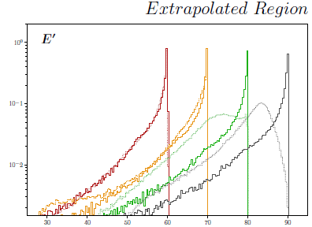
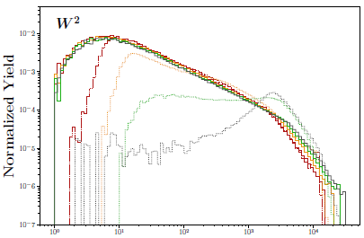

Extrapolation
Velasco et al, ICMLA 2020

Slide 15
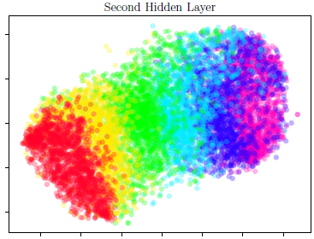
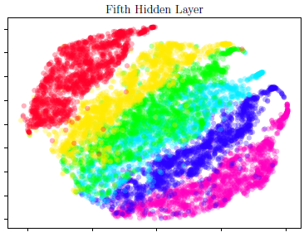
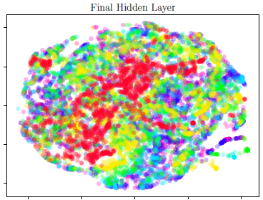

Latent Space
Velasco et al, ICMLA 2020

Slide 16
Agenda
Initial Attempt in Exclusive Electron-Proton Scattering
  FAT-GAN
  Conditional GAN
Unfolding Smearing Effects
  Electron-Proton Scattering
  CLAS Exclusive 2π photoproduction
Unfolding Acceptance Effects
  Single-pion photoproduction reaction
Conclusion and Future Work

Slide 17
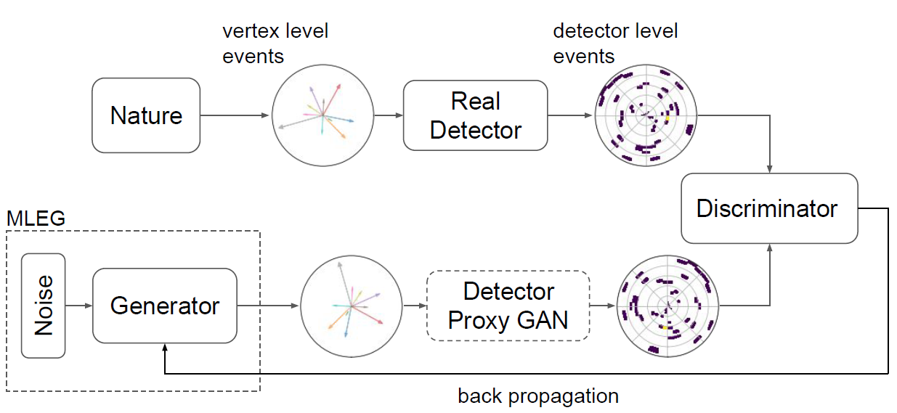
Unfolding Vertex-level Events from Detector-level Events
MLEG
  Transform noise into vertex-level simulated events
Detector Proxy (Surrogate) GAN
  Detected simulator
  Mimic synthetic detector-level events
Discriminator
  Differentiate detector-level events

Slide 18
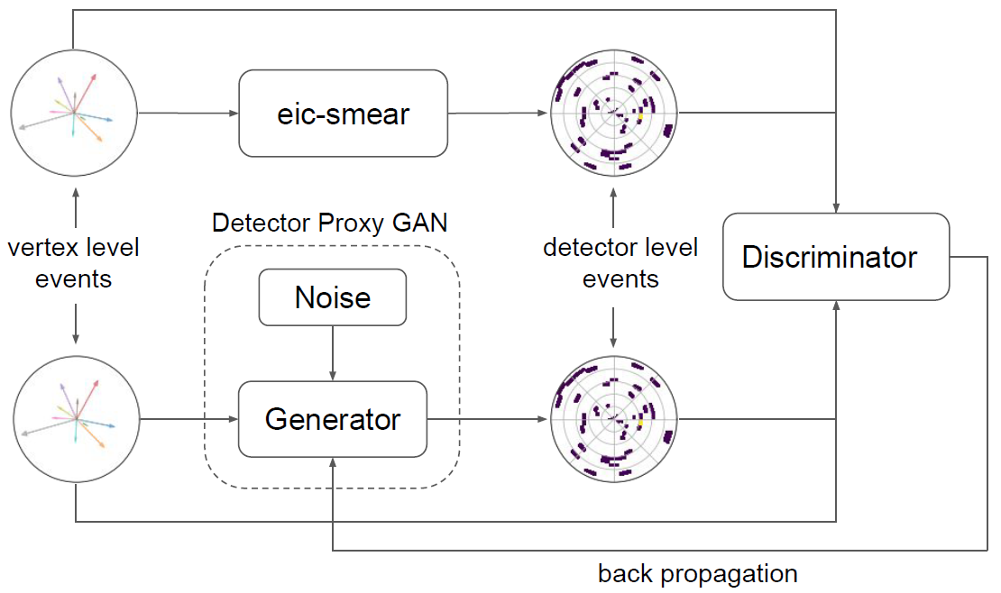
Detector Surrogate
Detector Proxy GAN
  Conditional GAN
  Training samples
    From guessed vertex-level samples and corresponding detector-level samples using a detector simulator
Alanazi et al., Phys. Rev. D 106, 096002, 2022

Slide 19
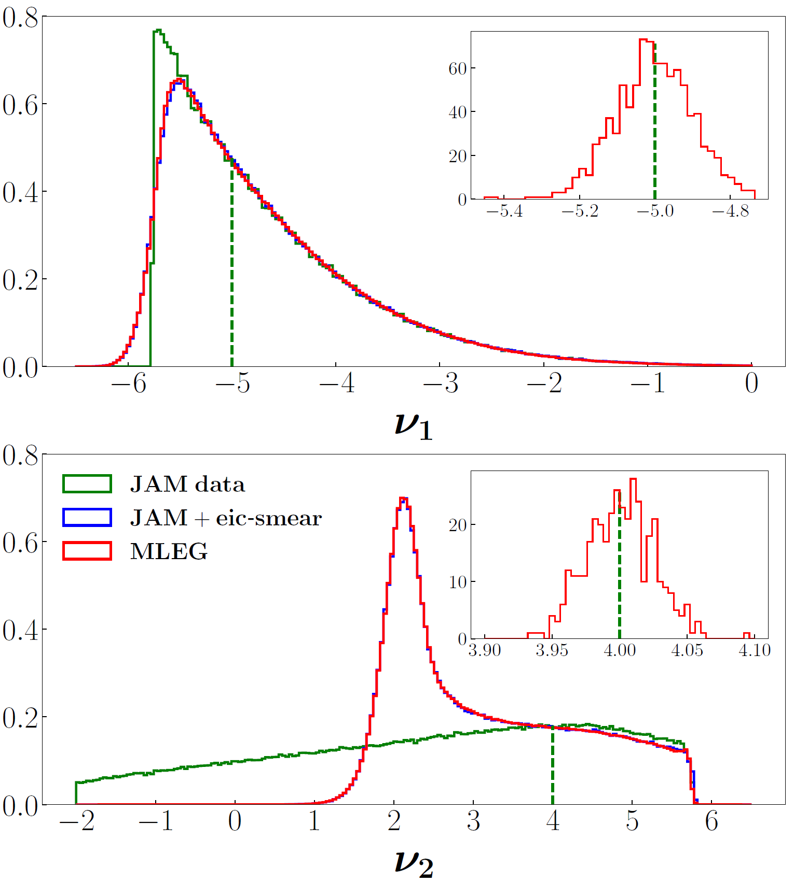
Detector Surrogate for Electron-Proton Scattering
Detector Surrogate
  Conditional GAN Architecture
  Translate vertex-level events to detector level events
  Trained by detector parametrization provided by the eic-smear.
Vertex-level events
  JAM global QCD analysis
Detector-level events
  Simulated by EIC-smear
  Vertex- and detector-level distributions for ν1 and ν2, where significant distortions are observed
Comparison of training features at the vertex level (generated, green histograms) and detector level (smeared, blue histograms) with the MLEG generated synthetic data (red histograms). The insets illustrate the local smearing effect at the points indicated by the green vertical dashed lines.
Alanazi et al., Phys. Rev. D 106, 096002, 2022

Slide 20
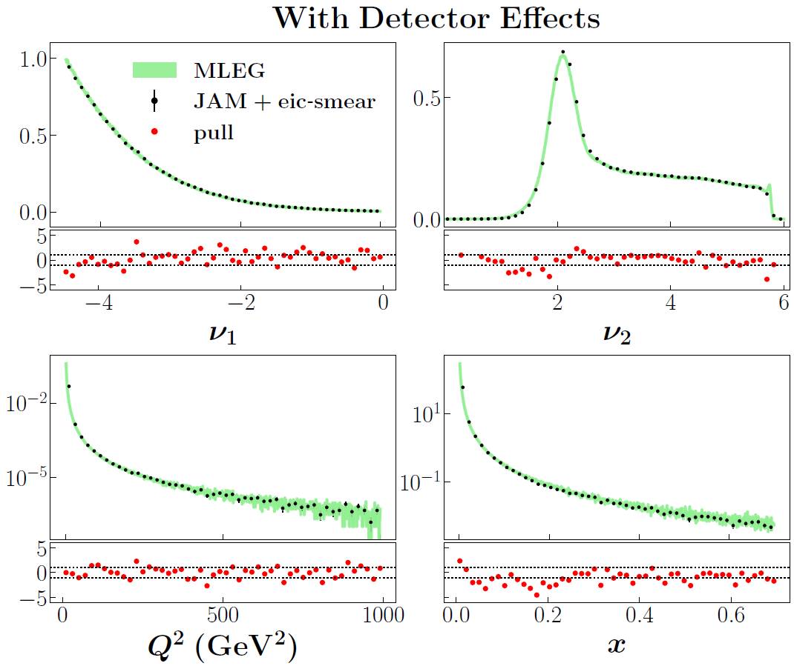
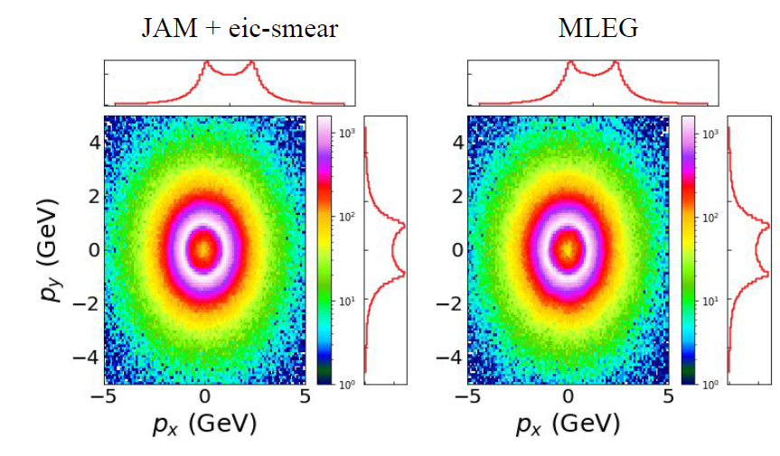
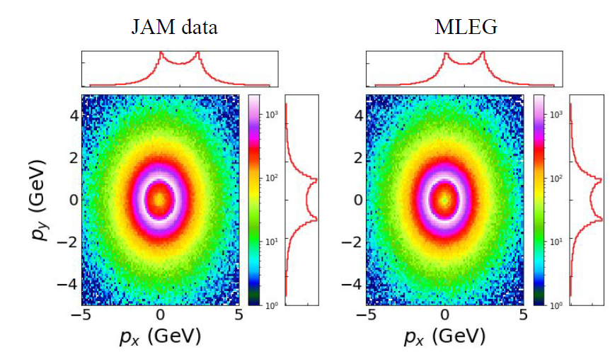
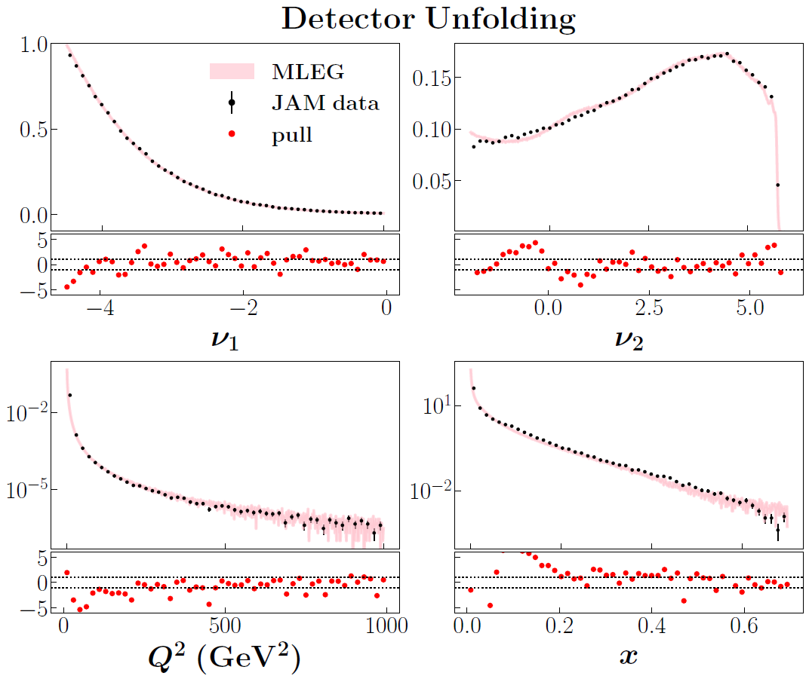
Unfolding Results
Alanazi et al., Phys. Rev. D 106, 096002, 2022

Slide 21
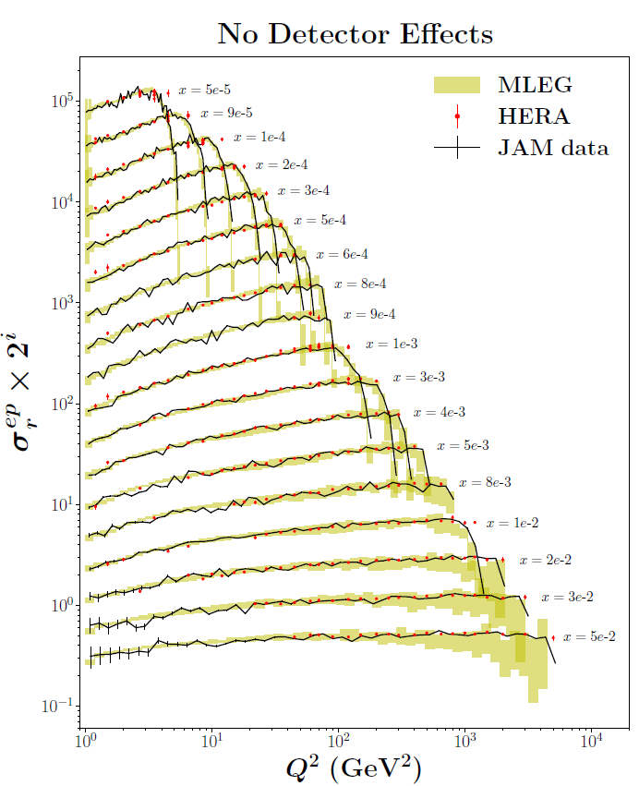
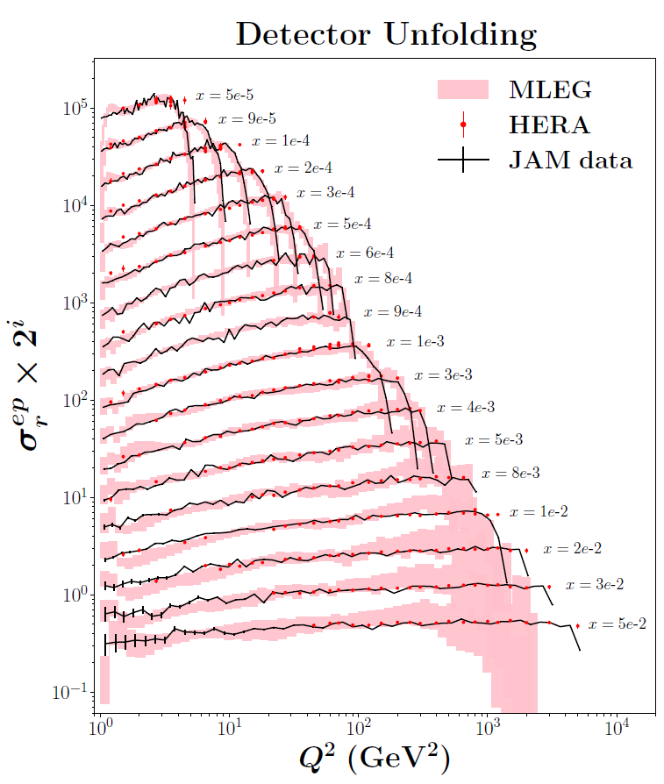
HERA
Alanazi et al., Phys. Rev. D 106, 096002, 2022

Slide 22
Agenda
Initial Attempt in Exclusive Electron-Proton Scattering
  FAT-GAN
  Conditional GAN
Unfolding Smearing Effects
  Electron-Proton Scattering
  CLAS Exclusive 2π photoproduction
Unfolding Acceptance Effects
  Single-pion photoproduction reaction
Conclusion and Future Work

Slide 23
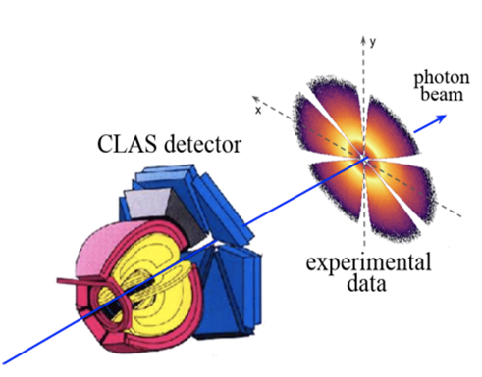
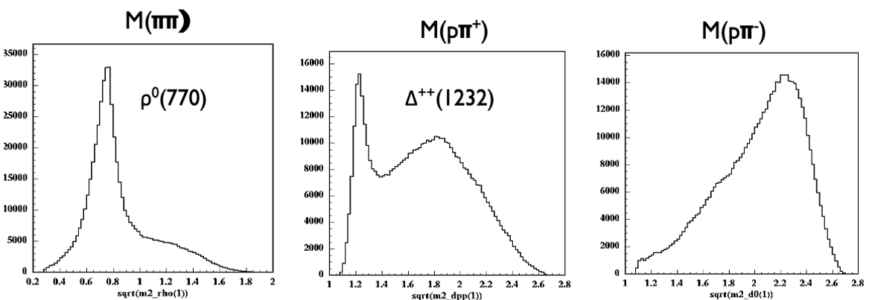
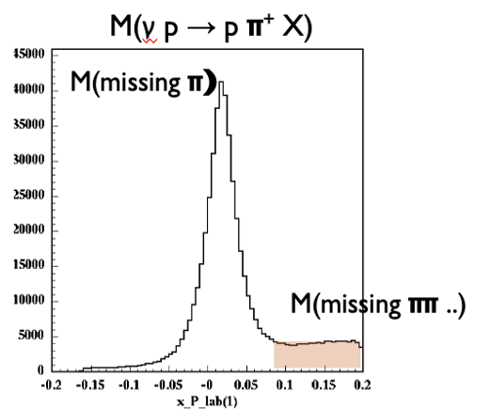

CLAS Exclusive 2π photoproduction
CLAS g11 kinematics
  Dataset used by CLAS Collaboration
    M. Battaglieri et al. (CLAS Collaboration) Phys. Rev. Lett. 102, 102001
    M. Battaglieri et al. (CLAS Collaboration) Phys. Rev. D 80, 072005
  Focus on $γp→pπ^{+} (π^{−})$
  Fiducial cuts $(p, θ, φ)$ are used
  Final exclusive $2π$ state identified by missing mass technique
    Variables are reconstructed by energy/momentum conservation

Slide 24
Unfolding Detector Effect for CLAS Exclusive 2π photoproduction
Two main components:
  Detector Simulation GAN (DS-GAN): Simulate the smearing detector effects
  Unfolding GAN (UNF-GAN): Reconstruct the vertex-level events.
MC-Phase Space Events
Vertex-level
DS-GAN
Detector-level
    MC-Realistic Events
Vertex-level
UNF-GAN
Detector-level
Alghamdi et al., Phys. Rev. D 108, 094030, 2023

Slide 25
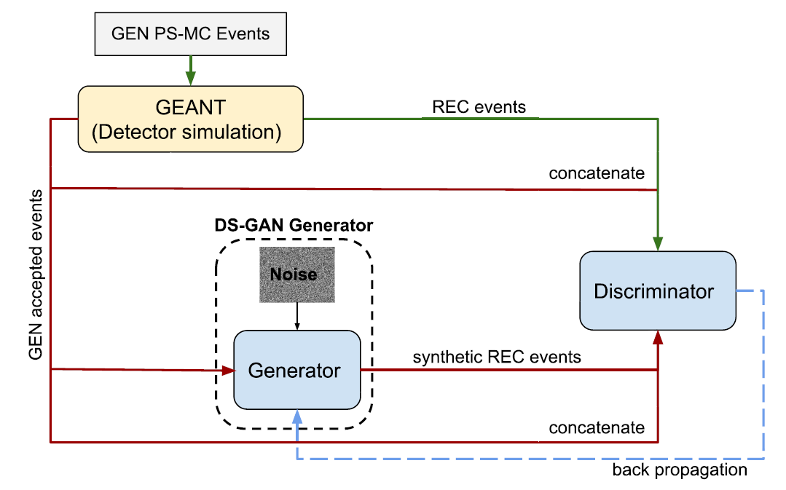
Detector Simulation GAN (DS-GAN)
Schematic view of DS-GAN
  Generator converts input GEN vertex-level events features and noise into REC detector-level events.
  The training is performed on PS-MC pseudodata passed through the GEANT simulation.
  Synthetic REC and REC pseudodata are concatenated with GEN PS-MC events and fed to the discriminator.
Alghamdi et al., Phys. Rev. D 108, 094030, 2023

Slide 26
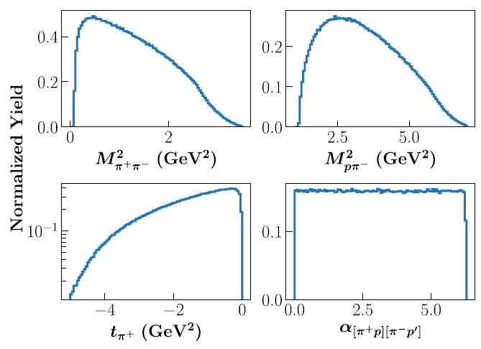
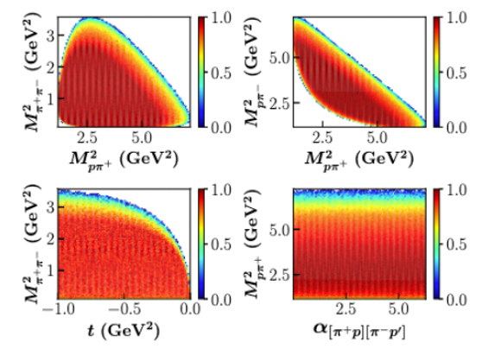
Phase Space (PS-MC) Event Generator
Distribute final-state events according to the $π^{+} π^{−}p$ phase space
1D-Projection
2D-Distribution
Alghamdi et al., Phys. Rev. D 108, 094030, 2023

Slide 27
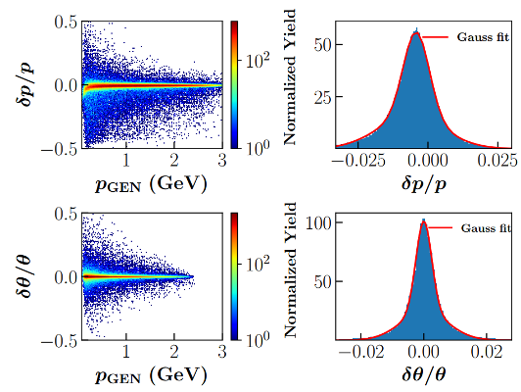
GSIM-GEANT for Detector Simulation
Apply detector simulation package GSIM to simulate detector effects (acceptance and resolution) based on GEANT3
Alghamdi et al., Phys. Rev. D 108, 094030, 2023

Slide 28
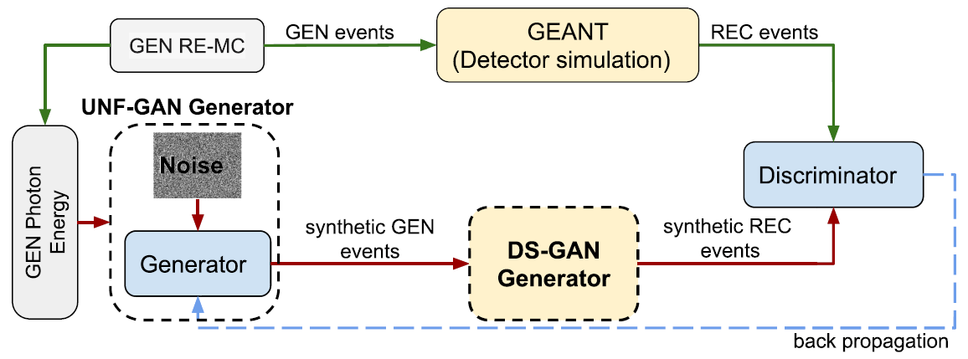
Unfolding GAN (UNF-GAN)
UNF-GAN framework
  Generator converts a GEN photon energy and random noise into synthetic GEN event features
  DS-GAN introduces simulated detector effect and converts synthetic GEN events into synthetic REC event features.
  Discriminator compares the features of the synthetic REC events and the REC events through GEANT.
Alghamdi et al., Phys. Rev. D 108, 094030, 2023

Slide 29
2π Photoproduction Closure Test
Generate events with a realistic MC (RE-MC) 2π Photoproduction model
Apply detector effects with GSIM-GEANT
Train a DS-GAN to learn detector effects using PS-MC + GSIM-GEANT
Deploy the UNF-GAN that includes the DS-GAN, trained with RE-MC REC events
Compare UNF-GAN GEN-SYNT events to RE-MC GEN events
Alghamdi et al., Phys. Rev. D 108, 094030, 2023

Slide 30
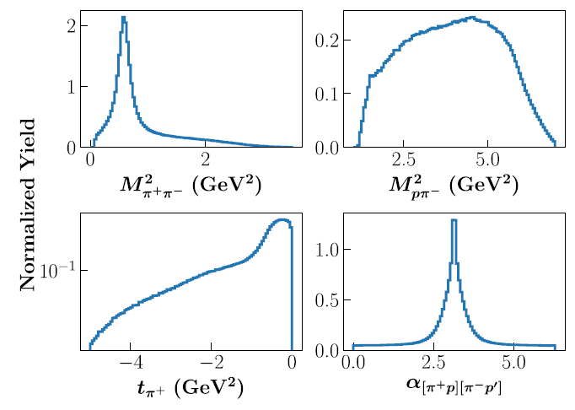
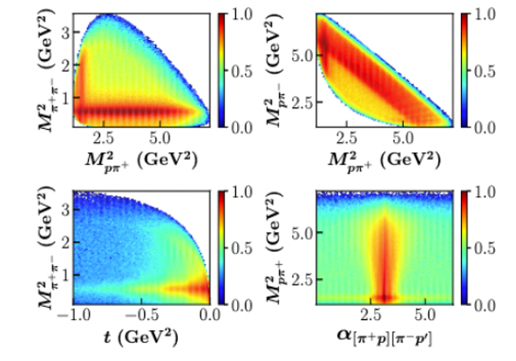
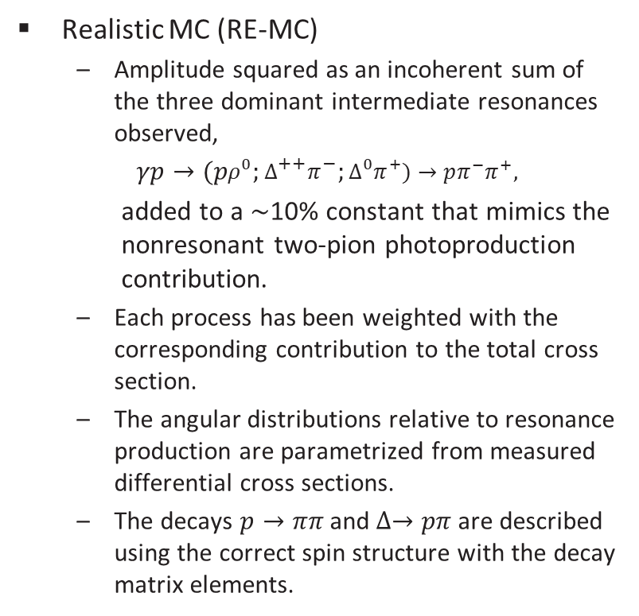
Realistic MC (RE-MC)
Realistic MC (RE-MC)
  Amplitude squared as an incoherent sum of the three dominant intermediate resonances observed,
  $γp→(pρ^{0};∆^{++}π^{−};∆^{0}π^{+})→$ $pπ^{−}π^{+},$
    added to a ∼10% constant that mimics the nonresonant two-pion photoproduction contribution.
  Each process has been weighted with the corresponding contribution to the total cross section.
  The angular distributions relative to resonance production are parametrized from measured differential cross sections.
  The decays $p→ππ$ and $∆→pπ$are described using the correct spin structure with the decay matrix elements.
1D-Projection
2D-Distribution
Alghamdi et al., Phys. Rev. D 108, 094030, 2023

Slide 31
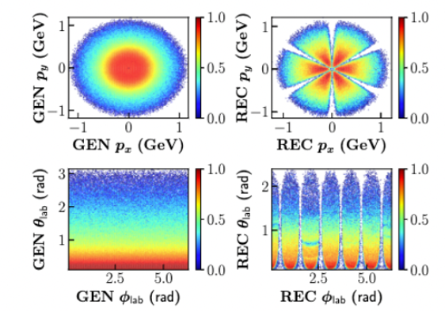
Detector Effects on RE-MC Events
The $π^{+}$ kinematic variables in the laboratory reference frame as GENerated with RE-MC (left) and REConstructed by CLAS (right)
Alghamdi et al., Phys. Rev. D 108, 094030, 2023

Slide 32
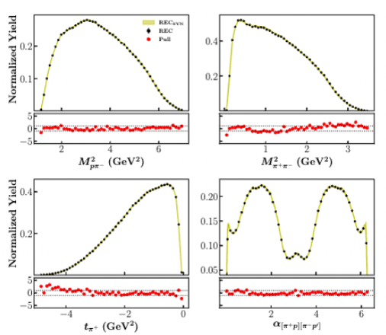
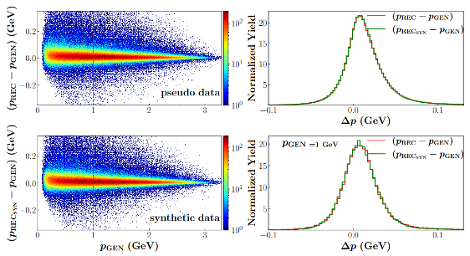
DS-GAN Results
DS-GAN can learn the CLAS detector effect
MC REC events vs DS-GAN synthetic events
CLAS Resolution
Alghamdi et al., Phys. Rev. D 108, 094030, 2023

Slide 33
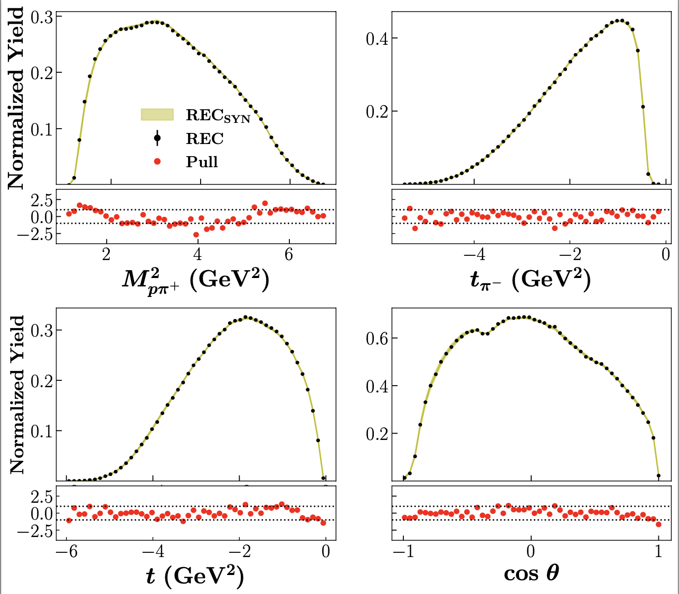
DS-GAN Results on Derived Variables
Derived Variables (not used in training)
Alghamdi et al., Phys. Rev. D 108, 094030, 2023

Slide 34
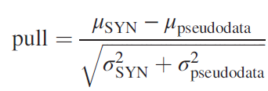
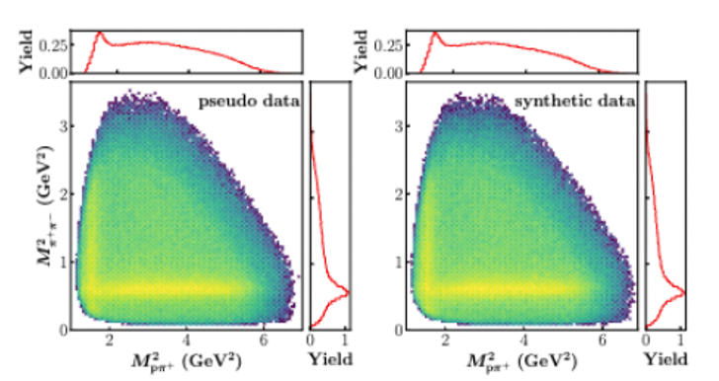
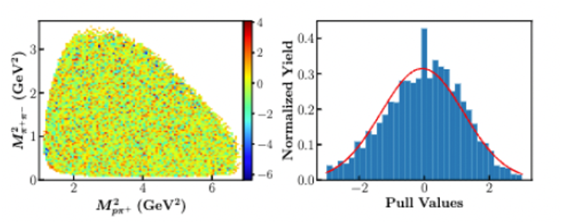
UNF-GAN Results (Unfolding Results)
RE-MC GEN
events
UNF-GAN SYN
events
2D Pull
Alghamdi et al., Phys. Rev. D 108, 094030, 2023

Slide 35
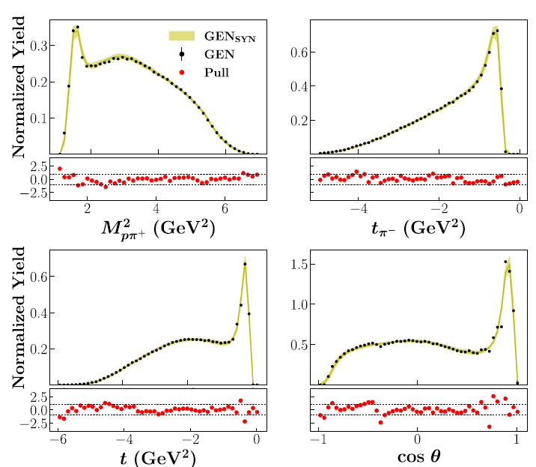
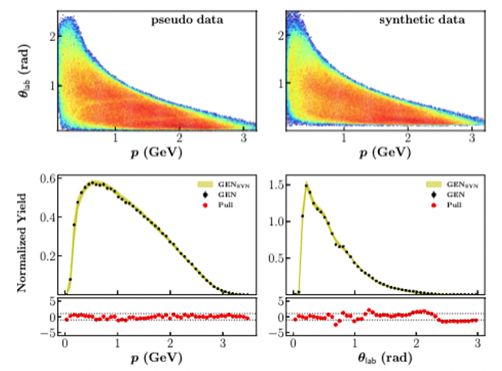
UNF-GAN Results on Derived Variables
Derived Variables (not used in training)
CM Frame
Lab Frame
Alghamdi et al., Phys. Rev. D 108, 094030, 2023

Slide 36
Agenda
Initial Attempt in Exclusive Electron-Proton Scattering
  FAT-GAN
  Conditional GAN
Unfolding Smearing Effects
  Electron-Proton Scattering
  CLAS Exclusive 2π photoproduction
Unfolding Acceptance Effects
    Single-pion photoproduction reaction
Conclusion and Future Work

Slide 37
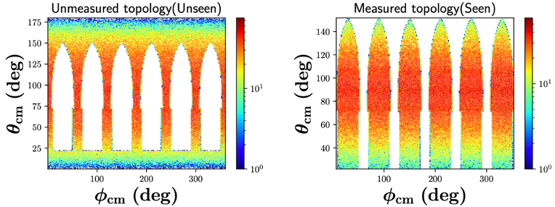
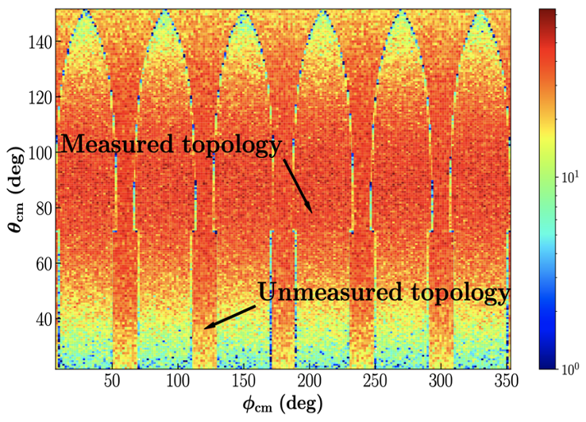
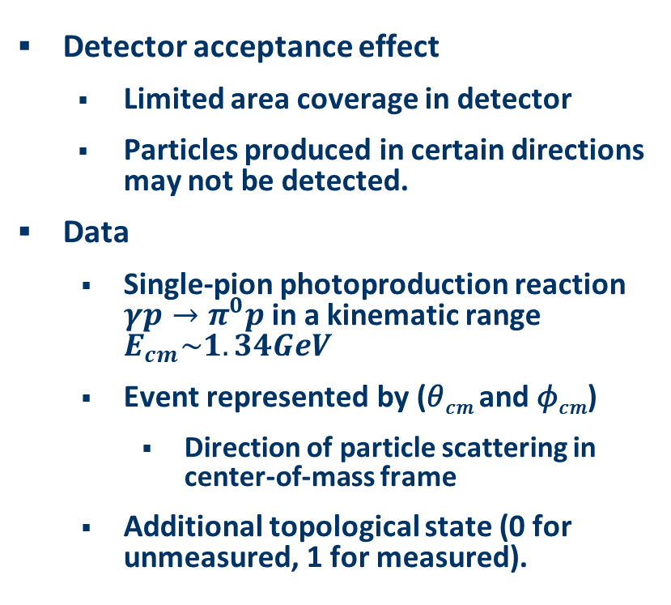
Unfolding Detector Acceptance Effects
Detector acceptance effect
    Limited area coverage in detector
    Particles produced in certain directions may not be detected.
Data
  Single-pion photoproduction reaction $γp→π^{0}p$ in a kinematic range $E_{cm}\sim 1.34GeV$
  Event represented by (𝜃_{𝑐𝑚} and 𝜙_{𝑐𝑚})
    Direction of particle scattering in center-of-mass frame
  Additional topological state (0 for unmeasured, 1 for measured).

Slide 38
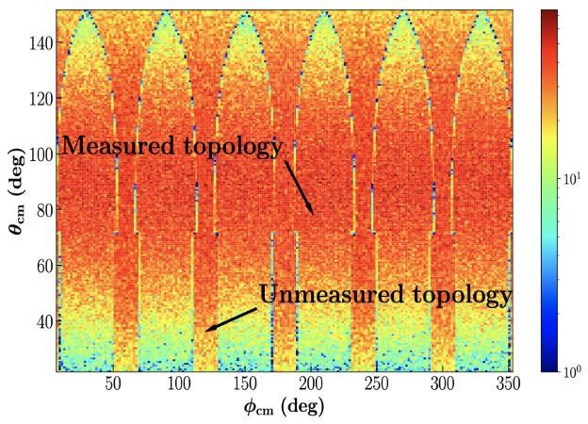

Classifier for Acceptance Effect
(𝜃_{𝑐𝑚}, 𝜙_{𝑐𝑚})
Classifier
Measured or unmeasured

Slide 39

GAN Architecture for Unfolding Acceptance Unfolding
Key Feature: a custom, physics-informed penalty term in the generator loss
  Penalize discrepancies between generated and true unmeasured topology event distributions.
Alghamdi et al., ITCAI 2024

Slide 40


Results
Entire Phase Space
Alghamdi et al., ITCAI 2024

Slide 41



Results of Unfolding Acceptance Effect
Entire Phase Space
Unmeasured topology
Measured topology
Alghamdi et al., ITCAI 2024

Slide 42

Summary
Development of ML-based event generator is still in its infant toddler stage
  Many Challenges in GAN
  Normalizing Flow or Diffusion Models have further advantages
  Incorporating physics into Machine Learning models is the KEY
Current/Future Research
  Uncertainty Quantification
  Unfolding Detector Acceptance + Smearing + Inefficiency Effect
  Multiple Topologies (Tommaso)
  Extracting Physics from ML
    Extract Amplitude (Gloria)
    Extract Resonance (Marco)

Slide 43
Acknowledgements
A(I)DAPT Collaboration
INFN Sezione di Genova (INFN GE)
We thank Jianwei Qiu for helpful discussions.
This work was supported by the LDRD project No. LDRD19-13 and No. LDRD20-18.

