Slide 1



Laboratori Nazionali di Legnaro – INFN
Study of cellular S-values variations in relation to cellular model eccentricity using Geant4
Giulia Saveria Valli
October 4th, 2024

Slide 2
Outline
Ag-111 radionuclide
The MIRD schema
Simulations with Geant4
Results for Ag-111
Other nuclides: I-125 and Lu-177
Notes:
2

Slide 3
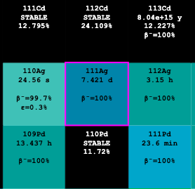
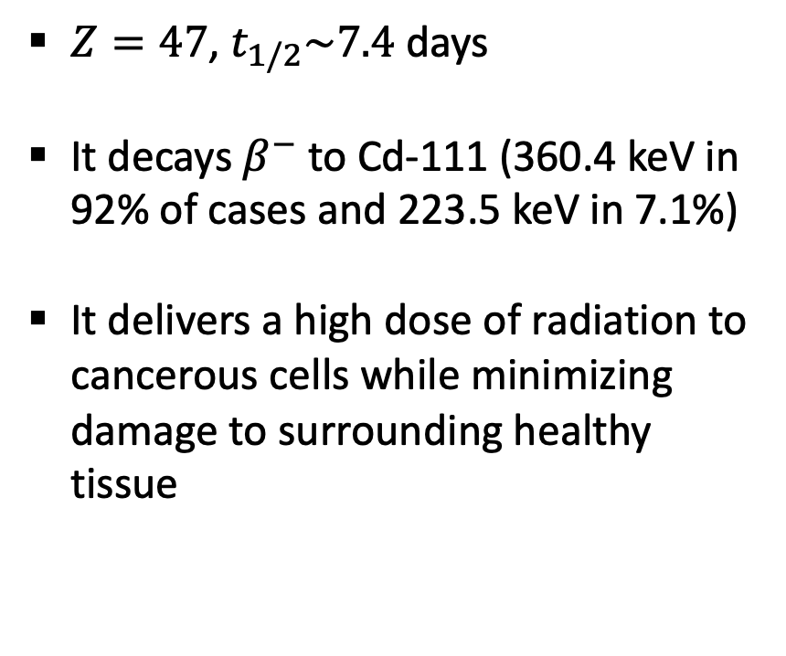
Ag-111 radionuclide
$Z=47$, $t_{1/2}\sim 7.4$days
It decays $β^{−}$ to Cd-111 (360.4 keV in 92% of cases and 223.5 keV in 7.1%)
It delivers a high dose of radiation to cancerous cells while minimizing damage to surrounding healthy tissue
Notes:
3

Slide 4
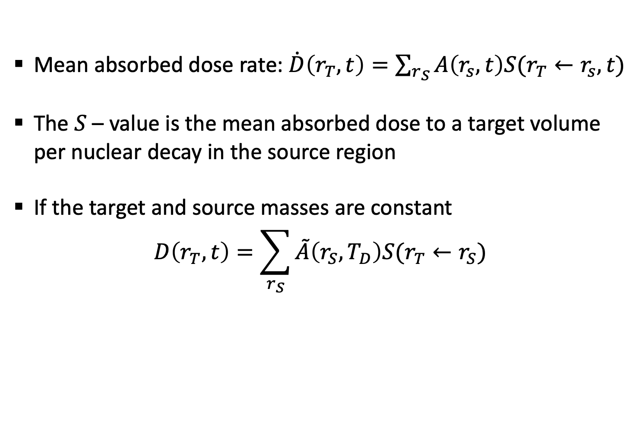
The MIRD schema
Mean absorbed dose rate: $\dot{D}\left(r_{T},t\right)=\sum_{r_{S}}{A\left(r_{s},t\right)S(r_{T}←r_{s},t)}$
The $S$– value is the mean absorbed dose to a target volume per nuclear decay in the source region
If the target and source masses are constant
$$D\left(r_{T},t\right)=\sum_{r_{S}}{\tilde{A}\left(r_{S},T_{D}\right)S(r_{T}←r_{S})}$$
Notes:
4

Slide 5

Geant4
Toolkit for the simulation of the passage of particles through matter
Physics list:
  G4EmStandardPhysics_option3
  G4DecayPhysics
  G4RadioactiveDecayPhysics
Notes:
5

Slide 6
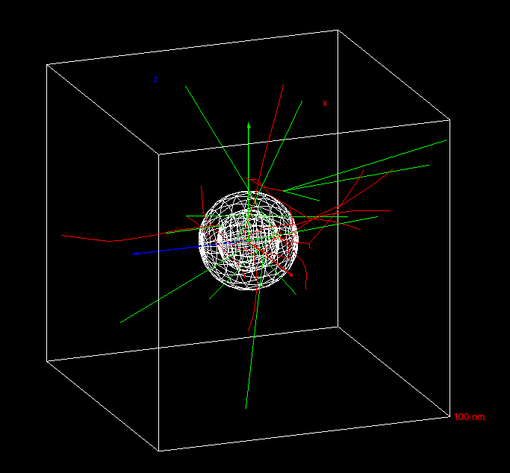
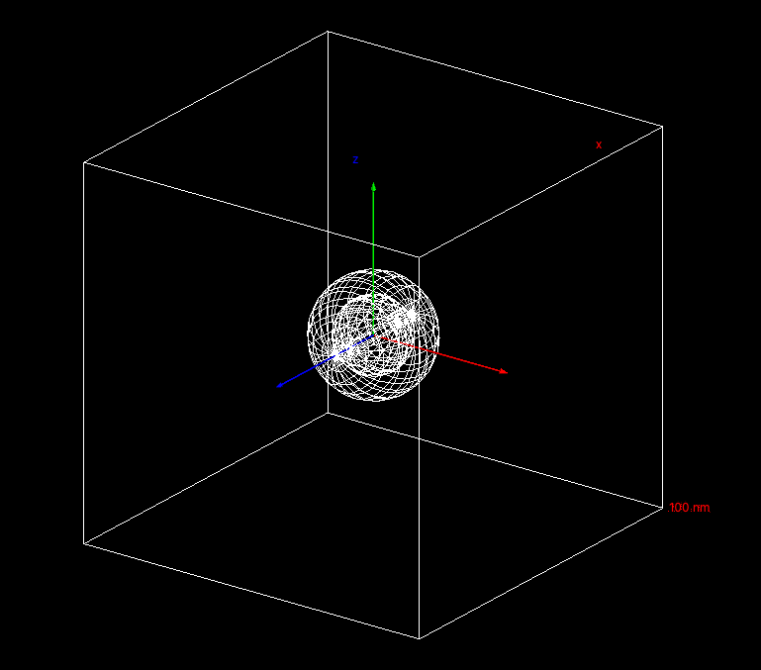
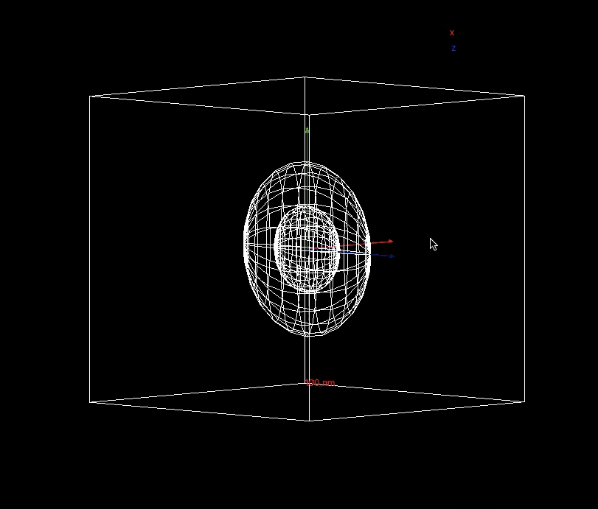
Simulations
Notes:
6

Slide 7
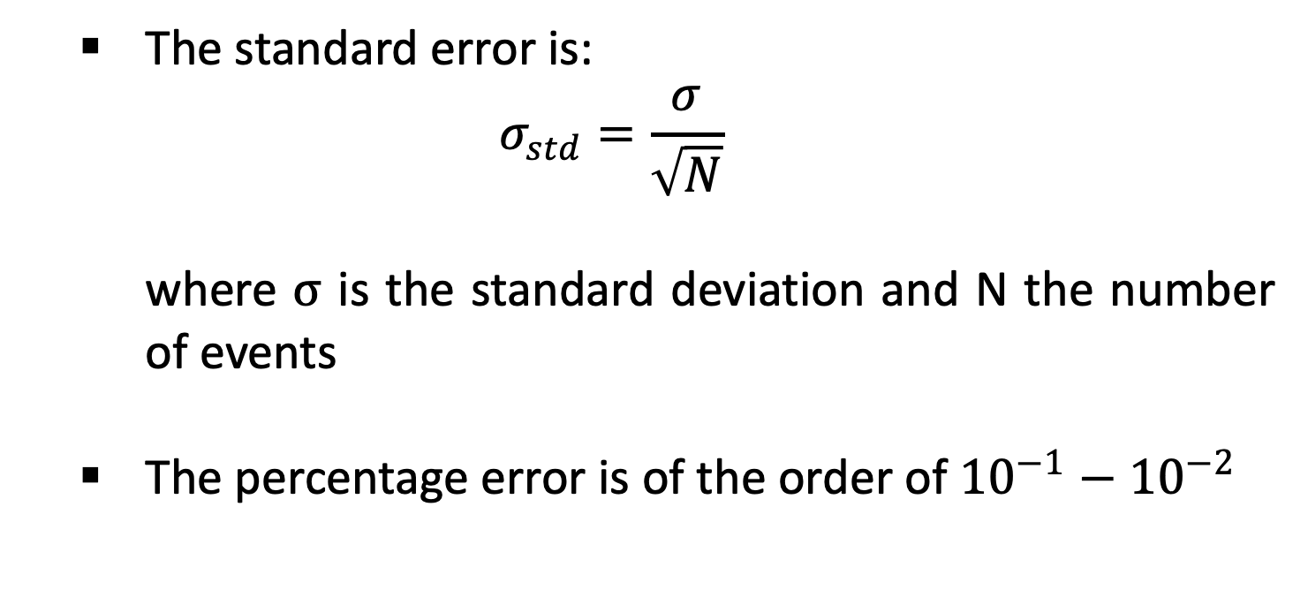
Standard error
  The standard error is:
  $$σ_{std}=\frac{σ}{\sqrt{N}}$$
  where $σ$ is the standard deviation and N the number of events
  The percentage error is of the order of ${10}^{−1}−{10}^{−2}$
Notes:
7

Slide 8
Results for Ag-111
The absorbed dose per event absorbed in the nucleus increases with eccentricity
Notes:
8

Slide 9
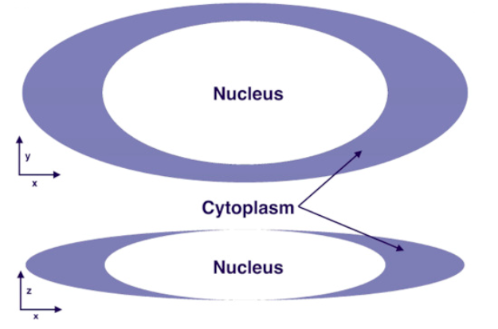
Results for Ag-111
Absence of cytoplasm near the two poles touching the nucleus
The radiation coming from the membrane near the nucleus is greater as it enters the nucleus without losing energy previously
Notes:
9

Slide 10
Other nuclides
I-125: uses in biological assays, nuclear medicine imaging and in radiation therapy
Lu-177: uses in targeted radionuclide therapy for treating neuroendocrine tumours and prostate cancer
Notes:
10

Slide 11
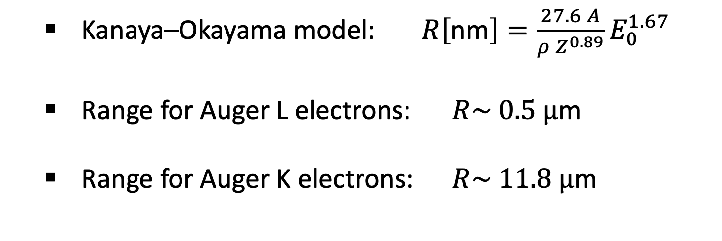
Range of electrons
  Kanaya–Okayama model: $R\left[\text{nm}\right]=\frac{27.6 A}{ρ Z^{0.89}}E_{0}^{1.67}$
  Range for Auger L electrons: $R\sim 0.5 μ$m
  Range for Auger K electrons: $R\sim 11.8 μ$m
Notes:
11

Slide 12
Results
Notes:
12

Slide 13
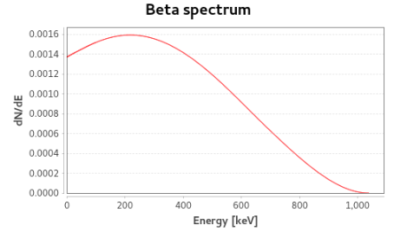
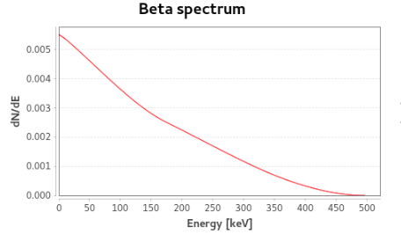

$β$-spectra
Ag-111
Lu-177
Notes:
13

Slide 14
Conclusions
  For Ag-111 the dose increases for increasing values of eccentricity
  The contribution from the radiation coming from the membrane near the nucleus is greater as it enters the nucleus without losing energy previously
  For I-125 and Lu-177 the dose has the same trend
Notes:
14

