Slide 1
ePIC Streaming DAQ / Computing Overview
Jeff Landgraf

Slide 2
Outline
Brief Overview of DAQ
Development Milestones
Status of Data Reduction in the Streaming DAQ
Data Transfer Between Streaming DAQ and Computing
Streaming Data Structure

Slide 3
ePIC DAQ uses streaming architecture
DAQ
Definition of streaming is “No L0 trigger”
All data is zero suppressed by the front end electronics
No system wide deadtime in normal operation
Collaboration should have the full ability to make data selection cuts on the widest possible criteria
Flexible event selection, data selection and background characterization
But subject to an overall throughput budget of ~100Gb/sec
ePIC Streaming will include
Capabilities for hardware and firmware based triggering
Capability for flow control
Zero suppression & aggregation within data packets
Greater sensitivity to noise
Greater sensitivity to backgrounds
Computing
Definition of streaming is “Process data as it arrives”
Fast Analysis (~3 weeks not months or years) using automation of calibration and reconstruction.
Requires some overlap between DAQ/computing
Automation of calibrations
Mapping calibration dependencies
Mapping application of calibrations
Mapping evolution of calibrations
QA and monitoring can make use of full offline structure
Consistent schemes and language for data/metadata
Event selection / tagging / and accounting

Slide 4
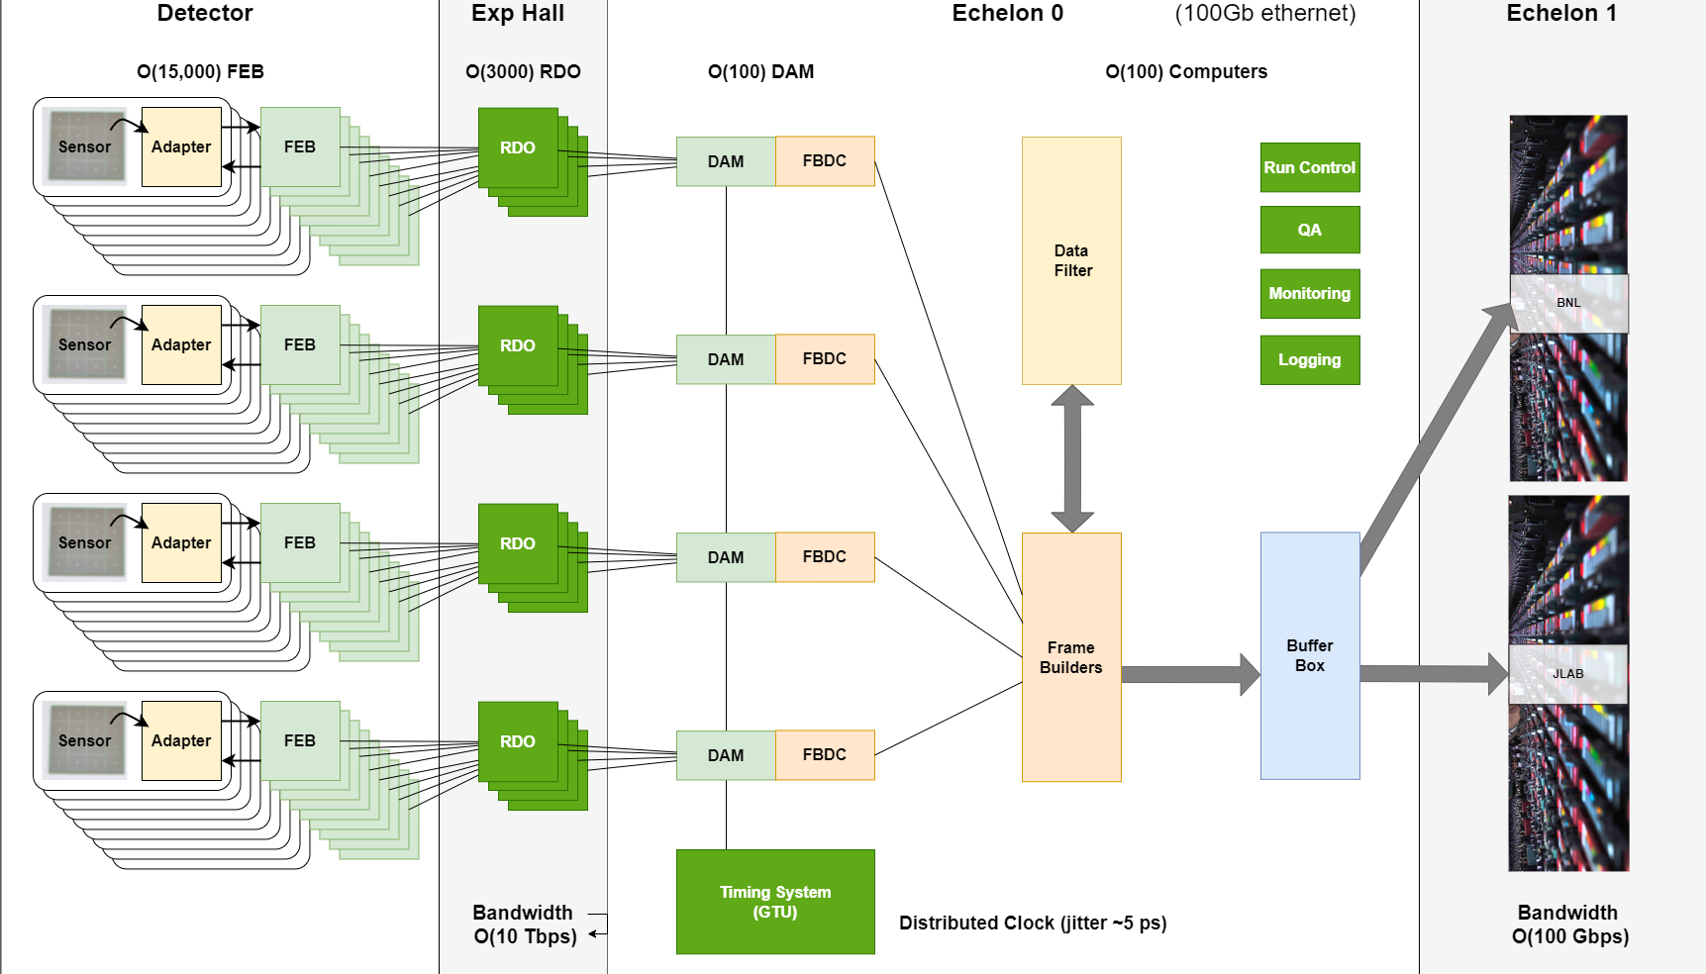
EIC Streaming DAQ/Computing Architecture
Collider Characteristics
1260 Bunches arriving at 98.5Mhz (10.15ns bunch separation)
1.015us abort gaps (100 bunches)
$\sqrt{s }$ ⇒ 20 – 141 GeV
𝓛_{max} ⇒ 10³⁴ cm⁻² s⁻¹
Electron, proton, and light nuclei beams can be polarized
Each bunch can have different polarization states
DAQ must tag data to specific bunch crossings
Need to track luminosity for each bunch crossing
Physics Performance
Maximum DIS rate ~500kHz
Large number of Channels
Low occupancy

Slide 5
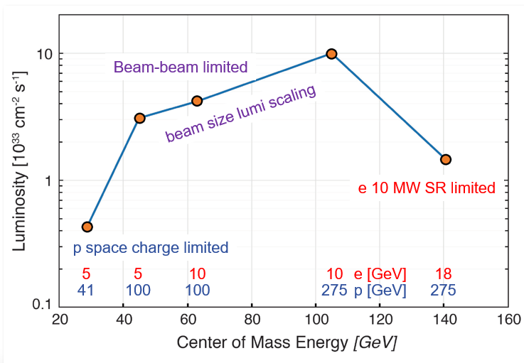
Summary Data Flow
Worst case Data Flow
“Worse Case Data Flow”
𝓛_{max} ⇒ 10³⁴ cm⁻² s⁻¹
10 x 275 GeV DIS
DIS rate ~500kHz
After 9 x 10⁹ (1-MeV n_{eq} / cm²) delivered fluence
300kHz DCR in dRICH
200x rate with no damage
At Worse Case
Need a factor of 20 reduction
PCI/Eth
Eth
Detector
FEB
Copper
RDO
Fiber
DAM
Readout Computer
Aggregate | 2.0 Tb/sec
Noise | 1.6 Tb /sec
Signal from Physics + Background | 400 Gb / sec
Aggregate | 109 Gb/sec
Collision Signal | 62 Gb/sec
Synchrotron Rad | Under design
Electron Beam | 4.5 Gb/sec
Hadron Beam | 1.0 Gb/sec
Noise | 41 Gb/sec
Aggregate | 2.0 Tb/sec
Per RDO (Avg) | 0.7 Gb/sec

Slide 6
ePIC Readout Chain (role in data reduction)
Global Timing Unit (GTU)
- Interfaces to Collider
Run Control & DAM
- Config & Control
- Clock & Timing
(BNL)
On Detector
SMT BGA
(JLAB)
Name
Design
Sensor
Detector Specific
Adapter
Detector Specific
Front End Board
(FEB)
Detector Specific
Readout Board
(RDO)
Few Variants
Data Aggregation Module (DAM)
Common
Echelon 0
Computing
Common
Echelon 1
Computing
Common
COTS
Type
Custom Electronics
Custom Electronics
Custom Electronics
FPGA
Large FPGA / SoC
COTS
Role
Aggregation
High Level Trigger
Data Reduction Processing
High Level Trigger
Data Reduction Processing
Data Reduction

Slide 7
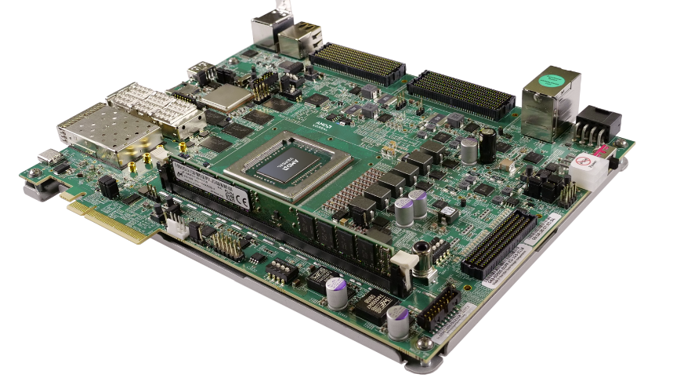
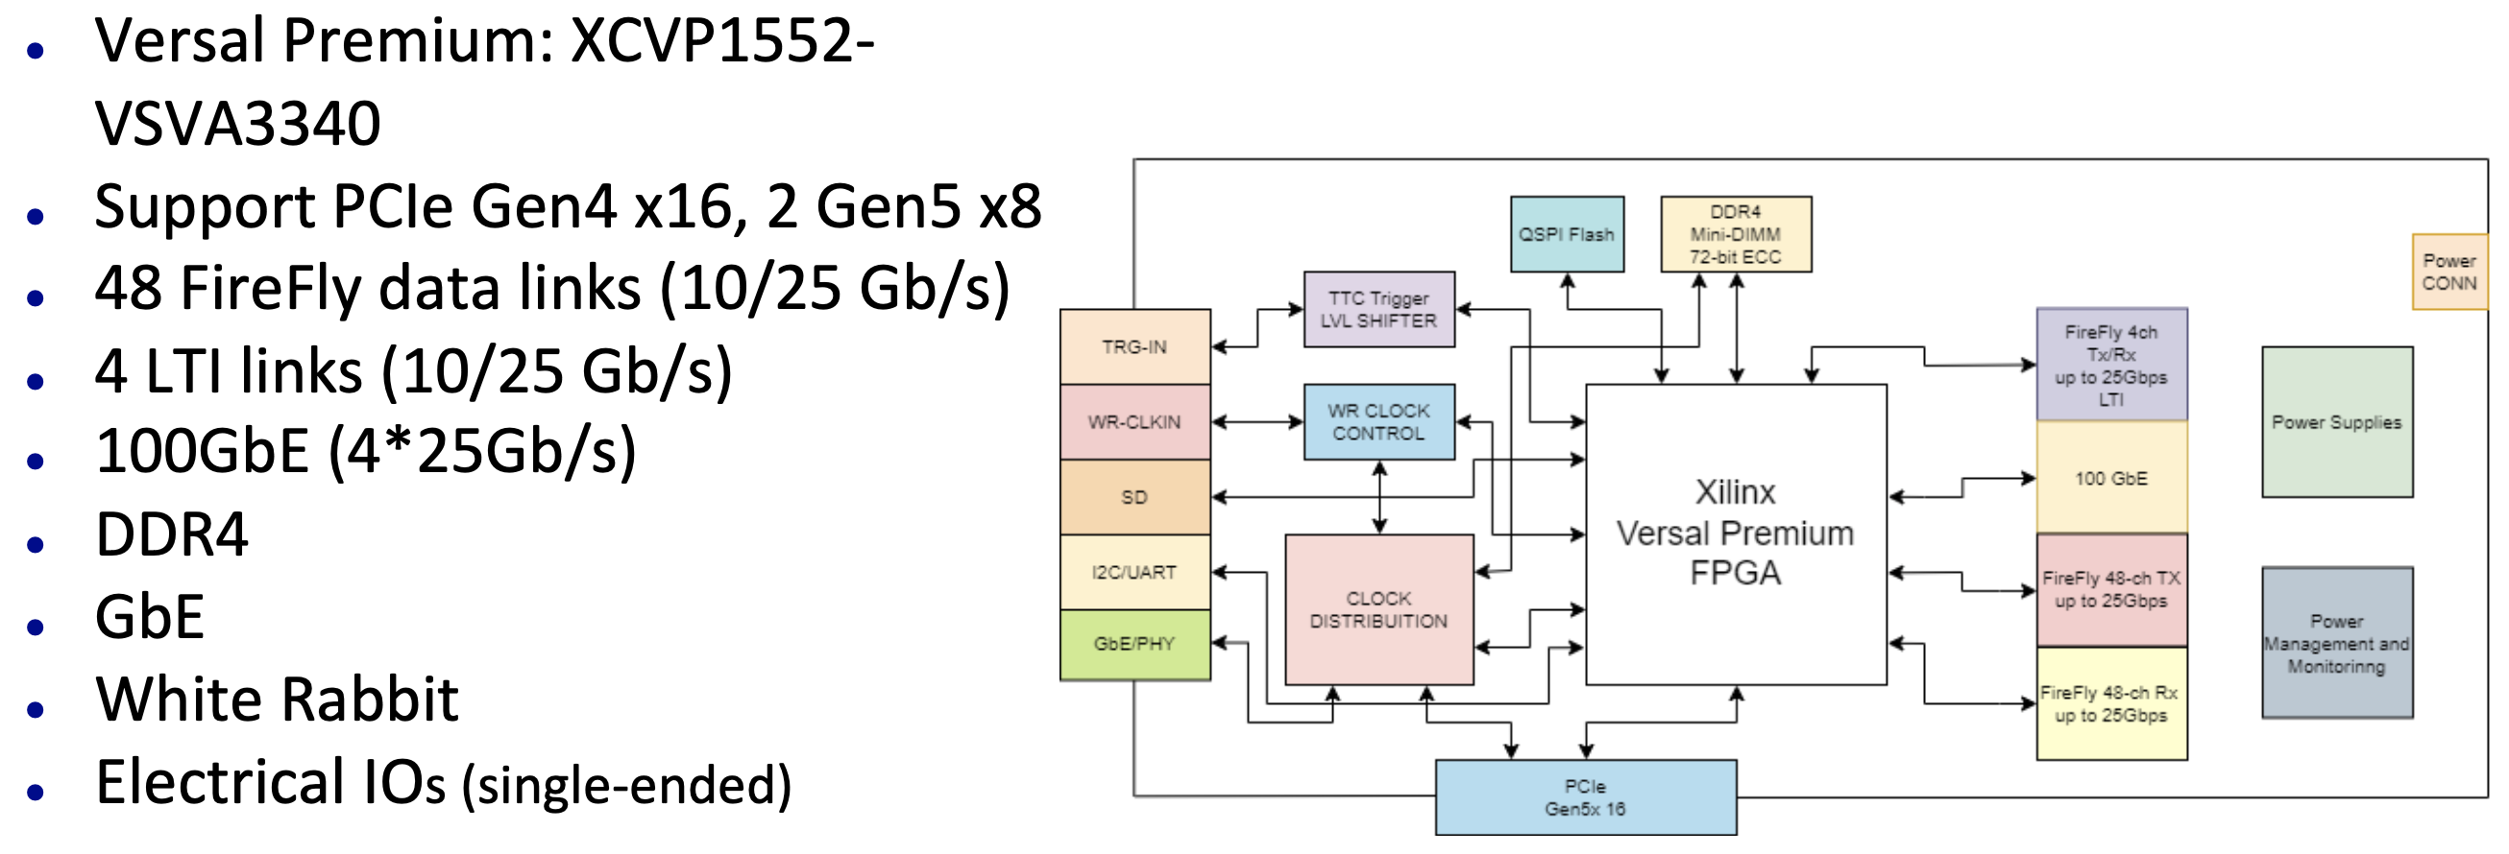
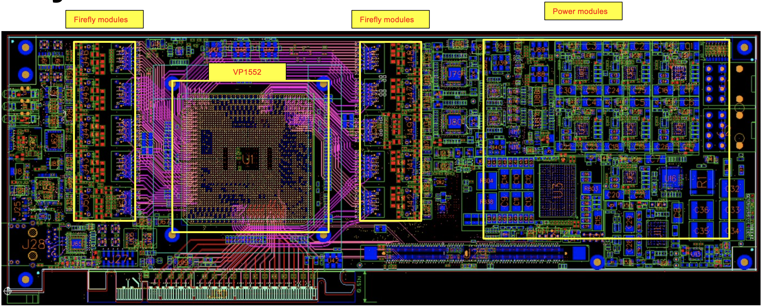
DAM Board – FLX-155
FELIX (Front-End Link Exchange) hardware for future ATLAS experiments at HL-LHC is being developed at BNL (Omega Group)
Long term support is insured. Development timelines are compatible with EIC.
ePIC is collaborating with Omega to use this design as our DAM board.
First boards under evaluation at BNL by Omega group
We expect to get 4 boards this spring
Note: 4 fiber LTI Link supports receiving either reconstructed or a direct clock
Versal FPGA is a SoC (Dual Core ARM) and can operate either standalone or in a Server

Slide 8
Streaming DAQ Milestones
Detector Install: FY29Q2 - FY31Q2
Cosmics: FY31Q3
Early CD-4: FY32Q4
DAQ Releases:
PicoDAQ FY26Q1
Readout test setups
MicroDAQ: FY26Q4
Readout detector data in test stand using engineering articles
MiniDAQ: FY28Q1
Readout detector data using full hardware and timing chain
Full DAQ-v1: FY29Q2
Full functionality DAQ ready for full system integration & testing
Production DAQ: FY31Q3
Ready for cosmics
PDR1
PicoDAQ
MiniDAQ
Production
DAQ
PDR2
MicroDAQ
Full DAQ-V1
PDR3

Slide 9
Streaming DAQ Milestones
Common Definition for all DAQ Releases
Tagged GIT release for all software and firmware so that a collaborator can retrieve and compile
Written manual to describe use
Definition of supported hardware
Echelon 1/2/3 – SRO
Consider links to DAQ releases today!
Should support DAQ releases
Should be supported by DAQ releases
Detector Install: FY29Q2 - FY31Q2
Cosmics: FY31Q3
Early CD-4: FY32Q4
DAQ Releases:
PicoDAQ FY26Q1
Readout test setups
MicroDAQ: FY26Q4
Readout detector data in test stand using engineering articles
MiniDAQ: FY28Q1
Readout detector data using full hardware and timing chain
Full DAQ-v1: FY29Q2
Full functionality DAQ ready for full system integration & testing
Production DAQ: FY31Q3
Ready for cosmics
PDR1
PicoDAQ
MiniDAQ
Production
DAQ
PDR2
MicroDAQ
Full DAQ-V1
PDR3

Slide 10
Streaming DAQ Milestones
“PicoDAQ” - Readout Test Setups
Communicate, program, access features: “Hello data”
Supporting:
FLX-155
DAM substitutes (2-port VD100, 48 port VMK180)
RDO articles (TBD)
GTU article
Detector Install: FY29Q2 - FY31Q2
Cosmics: FY31Q3
Early CD-4: FY32Q4
DAQ Releases:
PicoDAQ FY26Q1
Readout test setups
MicroDAQ: FY26Q4
Readout detector data in test stand using engineering articles
MiniDAQ: FY28Q1
Readout detector data using full hardware and timing chain
Full DAQ-v1: FY29Q2
Full functionality DAQ ready for full system integration & testing
Production DAQ: FY31Q3
Ready for cosmics
No direct connection to DAQ at this stage
Can have independent prototyping on same time scale
PDR1
PicoDAQ
MiniDAQ
Production
DAQ
PDR2
MicroDAQ
Full DAQ-V1
PDR3

Slide 11
Streaming DAQ Milestones
Detector Install: FY29Q2 - FY31Q2
Cosmics: FY31Q3
Early CD-4: FY32Q4
DAQ Releases:
PicoDAQ FY26Q1
Readout test setups
MicroDAQ: FY26Q4
Readout detector data in test stand using engineering articles
MiniDAQ: FY28Q1
Readout detector data using full hardware and timing chain
Full DAQ-v1: FY29Q2
Full functionality DAQ ready for full system integration & testing
Production DAQ: FY31Q3
Ready for cosmics
“MicroDAQ” – Readout detector data in test stand w engineering articles
Stand alone FEB -> RDO -> DAM implementation using DAQ protocol
Single RDO, DAM
Emulation of GTU in DAM
Echelon 0 still not developed at this point, so no interface to Echelon 1!
Will be creating “real” detector data
PDR1
PicoDAQ
MiniDAQ
Production
DAQ
PDR2
MicroDAQ
Full DAQ-V1
PDR3

Slide 12
Streaming DAQ Milestones
Detector Install: FY29Q2 - FY31Q2
Cosmics: FY31Q3
Early CD-4: FY32Q4
DAQ Releases:
PicoDAQ FY26Q1
Readout test setups
MicroDAQ: FY26Q4
Readout detector data in test stand using engineering articles
MiniDAQ: FY28Q1
Readout detector data using full hardware and timing chain
Full DAQ-v1: FY29Q2
Full functionality DAQ ready for full system integration & testing
Production DAQ: FY31Q3
Ready for cosmics
First stage where integrated tests can start
DAQ will still be stressing electronics
Development of QA/Calibrations should be in full swing
“MiniDAQ” – Readout detector data using full hardware and timing chain
As above, with GTU echelon 0
Still single stream
PDR1
PicoDAQ
MiniDAQ
Production
DAQ
PDR2
MicroDAQ
Full DAQ-V1
PDR3

Slide 13
Streaming DAQ Milestones
Detector Install: FY29Q2 - FY31Q2
Cosmics: FY31Q3
Early CD-4: FY32Q4
DAQ Releases:
PicoDAQ FY26Q1
Readout test setups
MicroDAQ: FY26Q4
Readout detector data in test stand using engineering articles
MiniDAQ: FY28Q1
Readout detector data using full hardware and timing chain
Full DAQ-v1: FY29Q2
Full functionality DAQ ready for full system integration & testing
Production DAQ: FY31Q3
Ready for cosmics
“FullDAQ-v1 – Full functionality DAQ ready for system integration
Includes run control, capability for merging streams from separate DAM boards, and interface to echelon 1
All components should exist. This is when detectors are installed and integration testing begins. The streaming readout is still being debugged, but is a tool for the collaboration at this point
PDR1
PicoDAQ
MiniDAQ
Production
DAQ
PDR2
MicroDAQ
Full DAQ-V1
PDR3

Slide 14
Data Reduction
General Principles
Don’t remove any information unless required by throughput / storage requirements
If any information is removed, write out a fraction of data without removing the information (in conjunction with the reduced data)
Any filtering / data reduction code needs to be documented and available for access by the collaboration
Additional Distinctions
There are several distinct reasons to avoid un-recoverable early analysis, but not a strong enough case to be dogmatic!
If reduction is done after storage of raw files, then if a problem in the method is found the analysis can’t be repeated
This is an unavoidable point, but note that the same is true of a streaming reconstruction. Our proposed streaming model is broken if repeated reconstruction must be performed due to bugs.
If the analysis is done early (e.g. traditional trigger) quality is suspect because one doesn’t have full information available
In the streaming concept the full information is available in the echelon 0 computing
There is the potential for much larger analysis farms in the computing facilities which can do more sophisticated analysis

Slide 15
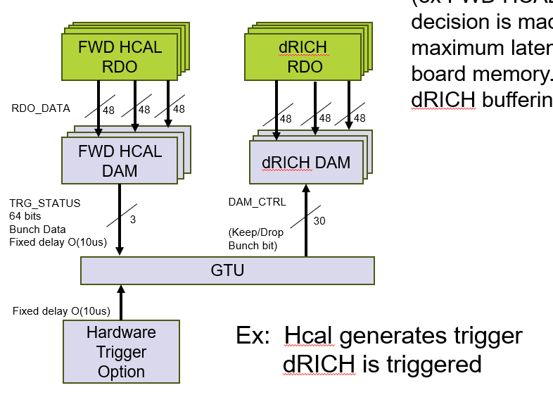
Data Reduction Particulars
Non-destructive reduction techniques:
Compression (Standard or ML techniques)
Reduction of ASIC data inefficiencies (e.g. unhit channels that are read out due to segmentation)
Aggregation of headers
Techniques that drop information:
(1-d) cluster finding for ADC data
SALSA / Discrete readouts (although feature finding might be built in)
(2-d) cluster finding
Feature finding
Convert CALOROC (ADC sequence,TOA,TOT) → (TOA, ADC_{eq} )
High Level Noise Rejection
The plan for the dRICH at high DCR rates is to implement this at the DAM level
Cross-Detector evaluation to select BX ranges to readout dRICH Hits
ML analysis to select real hits
High Level Noise Reduction (Like firmware trigger)

Slide 16
Data Reduction Particulars (2)
Averages / Histograms
Luminosity detectors have about 100 channels of data to be read out at 197MHz
Pure stream of hits @ ~160Gb/sec.
Handle this in DAM board
Sum and write out sum each BX (1.6Gb/sec)
Sum each beam bucket and write out each channel sum every Time Frame (40 Mb/sec)
Simple Analysis
An example might be the SciFi Barrel Ecal which obtains positions by subtracting times from readouts on each end. This subtraction could change 2 hits to 1 effective hit
Arbitrary Deadtime
This is the worst / last-ditch method for reducing data volumes
Typically to be exercised for short periods when electronics modules are misbehaving or for uncontrolled beam backgrounds
Will be initiated when data on RDO path must be truncated.

Slide 17
Data Transfer to Echelon 1
Principles
Equal transfer to both echelon 1 facilities (Both receive copies of data)
The desired transfer time to the echelon 1 is O(seconds) for fast feedback
Buffering for up to several days is available in Echelon 0
Details not yet fully defined
Data transfer mechanisms are under discussion
Orchestration is under discussion
Are reconstructions done twice or are they split between echelon 1 facilities?
How is QA organized
Some QA needed in echelon 0
Physics based QA expected at echelon 1
SDCC
IP-6
BNL ePIC
Echelon 1
ePIC DAQ
Echelon 0
DAQ
ROOM
400Gbps
4Tbps
400Gbps
ESNET
To JLAB ePIC
Echelon 1

Slide 18
Streaming Data Structure
Time Frames are unit of building data within DAQ system
At most 2¹⁶ bunch crossings (660 us)
O(5MB)
Time frames will contain data from all detectors
Time frames are not tied to revolutions of the beam
Do not want persistent effects due to time frame borders being correlated with spin states
Super Time Frames are unit of management of data within S&C
And extended number of Time Frames O(1000)
Time Ordered
Dense (non-overlapping)
ePIC State Machine
Will have continuously running subsystems (24/7) [scaler / luminosity ]
Will have subsystems turned on/off and set to different modes at different times [beam sensitive detectors / detectors with complex configuration / calibration]
Will have subsystem failures (down to RDO level at least), and also intend to have capability for auto-recovery of electronics where possible.
Will have low level failures / timeouts / overruns. The strategy is to mark effected channels and write out unaffected channels

Slide 19
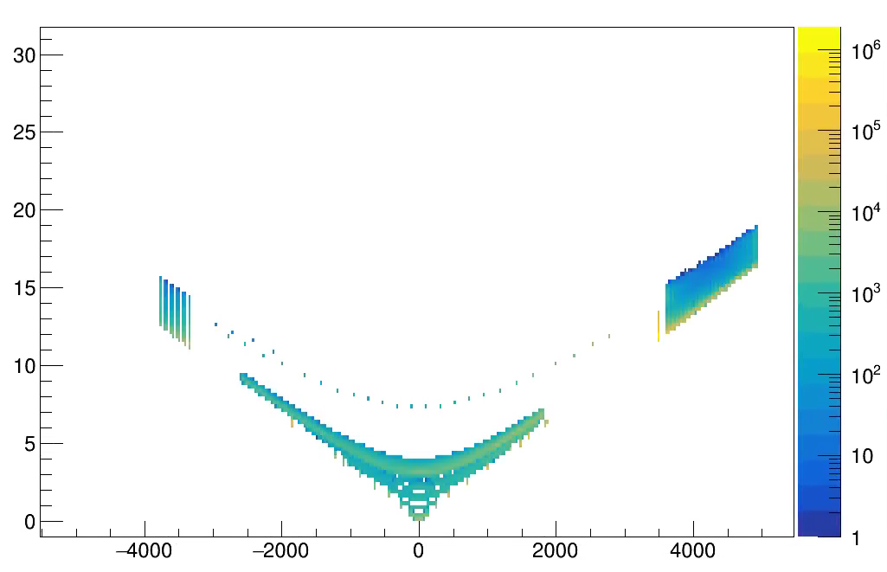
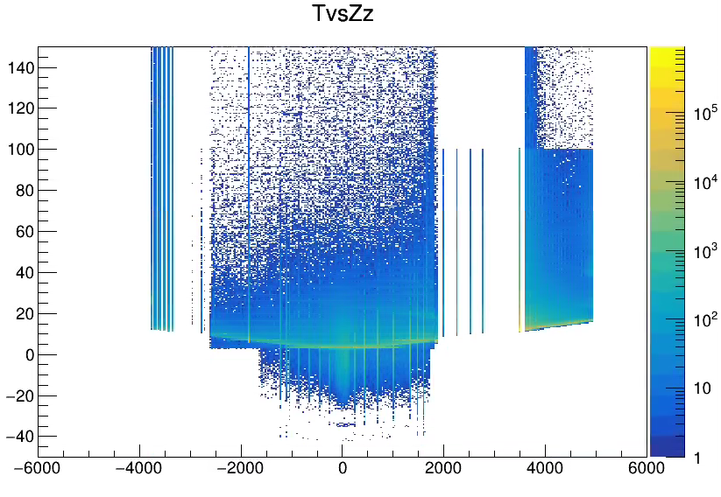
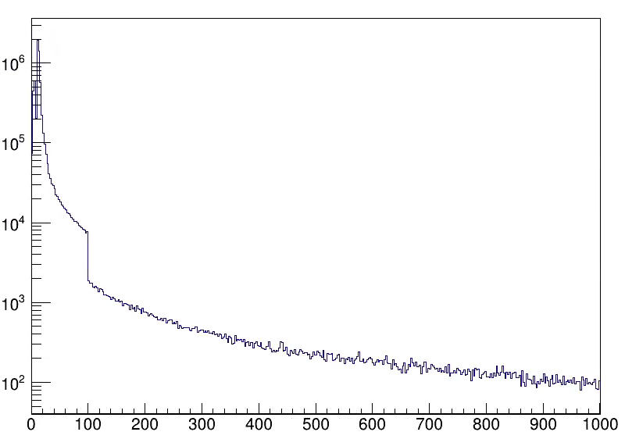
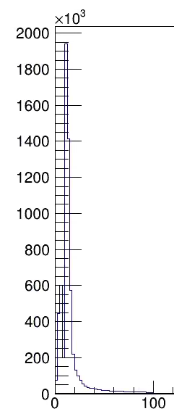
Time Frames (Hit Structure)
Produced Particles
At speed of light
ePIC hits will be marked by a time, not by any association to physics event.
Meaning of times varies by detector
2-8 us resolution for MAPS
25-30 ps resolution for AC-LGAD
Precision doesn’t necessarily match up (e.g. MAPS time value will be quantized at 2-8 us values)
Time storage may differ from presentation (40Mhz / 100MHz)
Time referenced to absolute time of hit, not in any way to the event. Hits from same event have significantly different time values!
Electronics Time Jitter and drift will be low < O(10ps), but must be calibrated to obtain absolute synchronization at this level.
T (ns)
Z (mm)
Simulated

Slide 20
Time Frame (Physical Structure)
The assumption is that time frames can easily be read into memory (2-10 MB / time frame), and so random access is efficient
Physical Structure will reflect convenience and efficiency of DAQ processing
Buffers following structure of data producers
To degree possible buffers are handled as containers (with sub-buffers)
More advanced levels of DAQ do have capability of manipulating sub-buffers (e.g. adding to stream, or removing them from the stream, but not modify them*)
DAM 1
RDO 1
RDO 2
…
RDO N
DAM 2
RDO 1
RDO 2
…
RDO N
DAM 3
RDO 1
RDO 2
…
RDO N
DAM 4
RDO 1
RDO 2
…
RDO N
Time
Frame
DAM “N”
RDO 1
RDO 2
…
RDO N
SC
Echelon 0 Additions

Slide 21
Summary
My goal here was to give enough of an overview of our current plans for DAQ to have a common starting point for these discussions we want to have today (even for newer collaborators)
Overview of the ePIC DAQ
Development Milestones
Status of Data Reduction in the Streaming DAQ
Data Transfer Between Streaming DAQ and Computing
Streaming Data Structure
Questions or Comments?

Slide 22
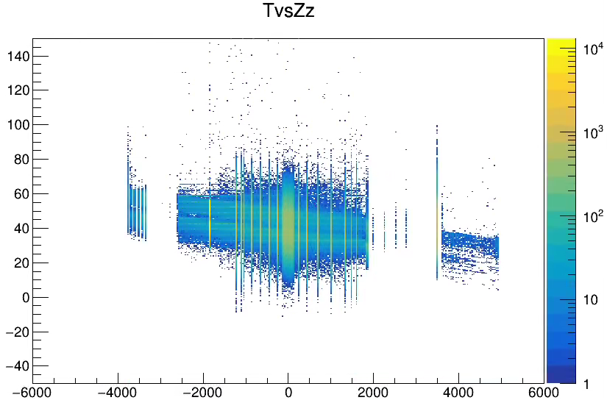
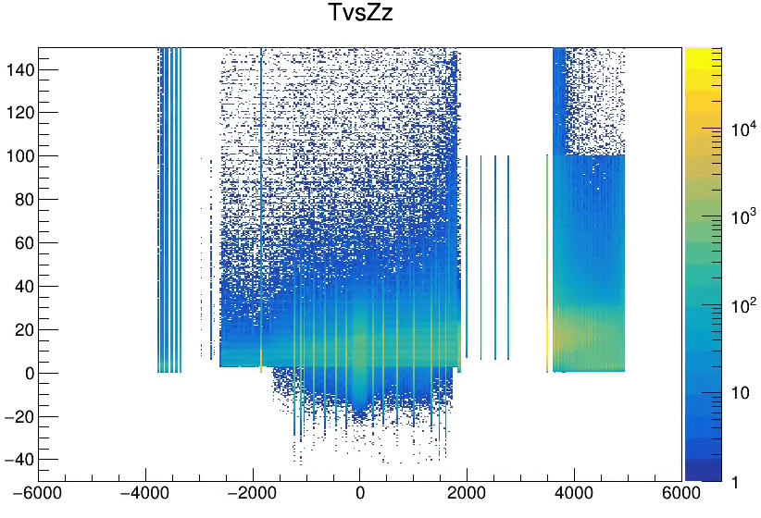
Event Timing
Electron Beam Gas
Simulation (RecHits)
DIS
Proton Beam Gas

Slide 23
Recommendations from PDR 1
Given the requirement for a backup triggered readout for RICH, it is necessary to carefully define the physics trigger rate, trigger conditions, and trigger latency in order to facilitate design of the RICH front-end.
ePIC depends upon a flexible scheme in which sufficient bandwidth is available for data to the dRICH DAM in the worst case. (> 4x safety). The selecting detectors (ex FWD HCAL) generate information characterizing beam in O(10us). The decision is made by the GTU and returned to DAM boards with fixed latency. The maximum latency is orders of magnitudes less than available buffering in DAM board memory. A hardware trigger is supported by the GTU but uses the same dRICH buffering scheme and delays as the firmware trigger option.
FWD HCAL RDO
FWD HCAL RDO
FWD HCAL RDO
FWD HCAL RDO
FWD HCAL RDO
FWD HCAL RDO
FWD HCAL RDO
dRICH
RDO
RDO_DATA
48
48
48
48
48
48
FWD HCAL DAM
dRICH DAM
FWD HCAL DAM
dRICH DAM
Activitiy | Notes
Data Arrives at DAM | <=10us from Bunch Crossing
Data Evaluation (DAM) | 100ns
TRG_STATUS to GTU | Data transmitted to GTU after fixed delay from source crossing O(10us)
Trigger Evaluation on GTU | Fixed Latency O(100ns)
Keep/Drop Bit to DAM | Fixed Latency O(40ns)
Drop data / forward data | Drop Forward after fixed time O(11us)
DAM Buffer | 16GB
Buffer Time available | 2.6 seconds
FWD HCAL DAM
dRICH DAM
TRG_STATUS
64 bits
Bunch Data
Fixed delay O(10us)
DAM_CTRL
3
(Keep/Drop
Bunch bit)
30
GTU
Fixed delay O(10us)
Hardware Trigger Option
Ex: Hcal generates trigger
dRICH is triggered

