Slide 1
ToF
Status on Simulations and Reconstruction Software
Kentaro Kawade
Shinshu Univ. on behalf of the ePIC ToF simulation team

Slide 2
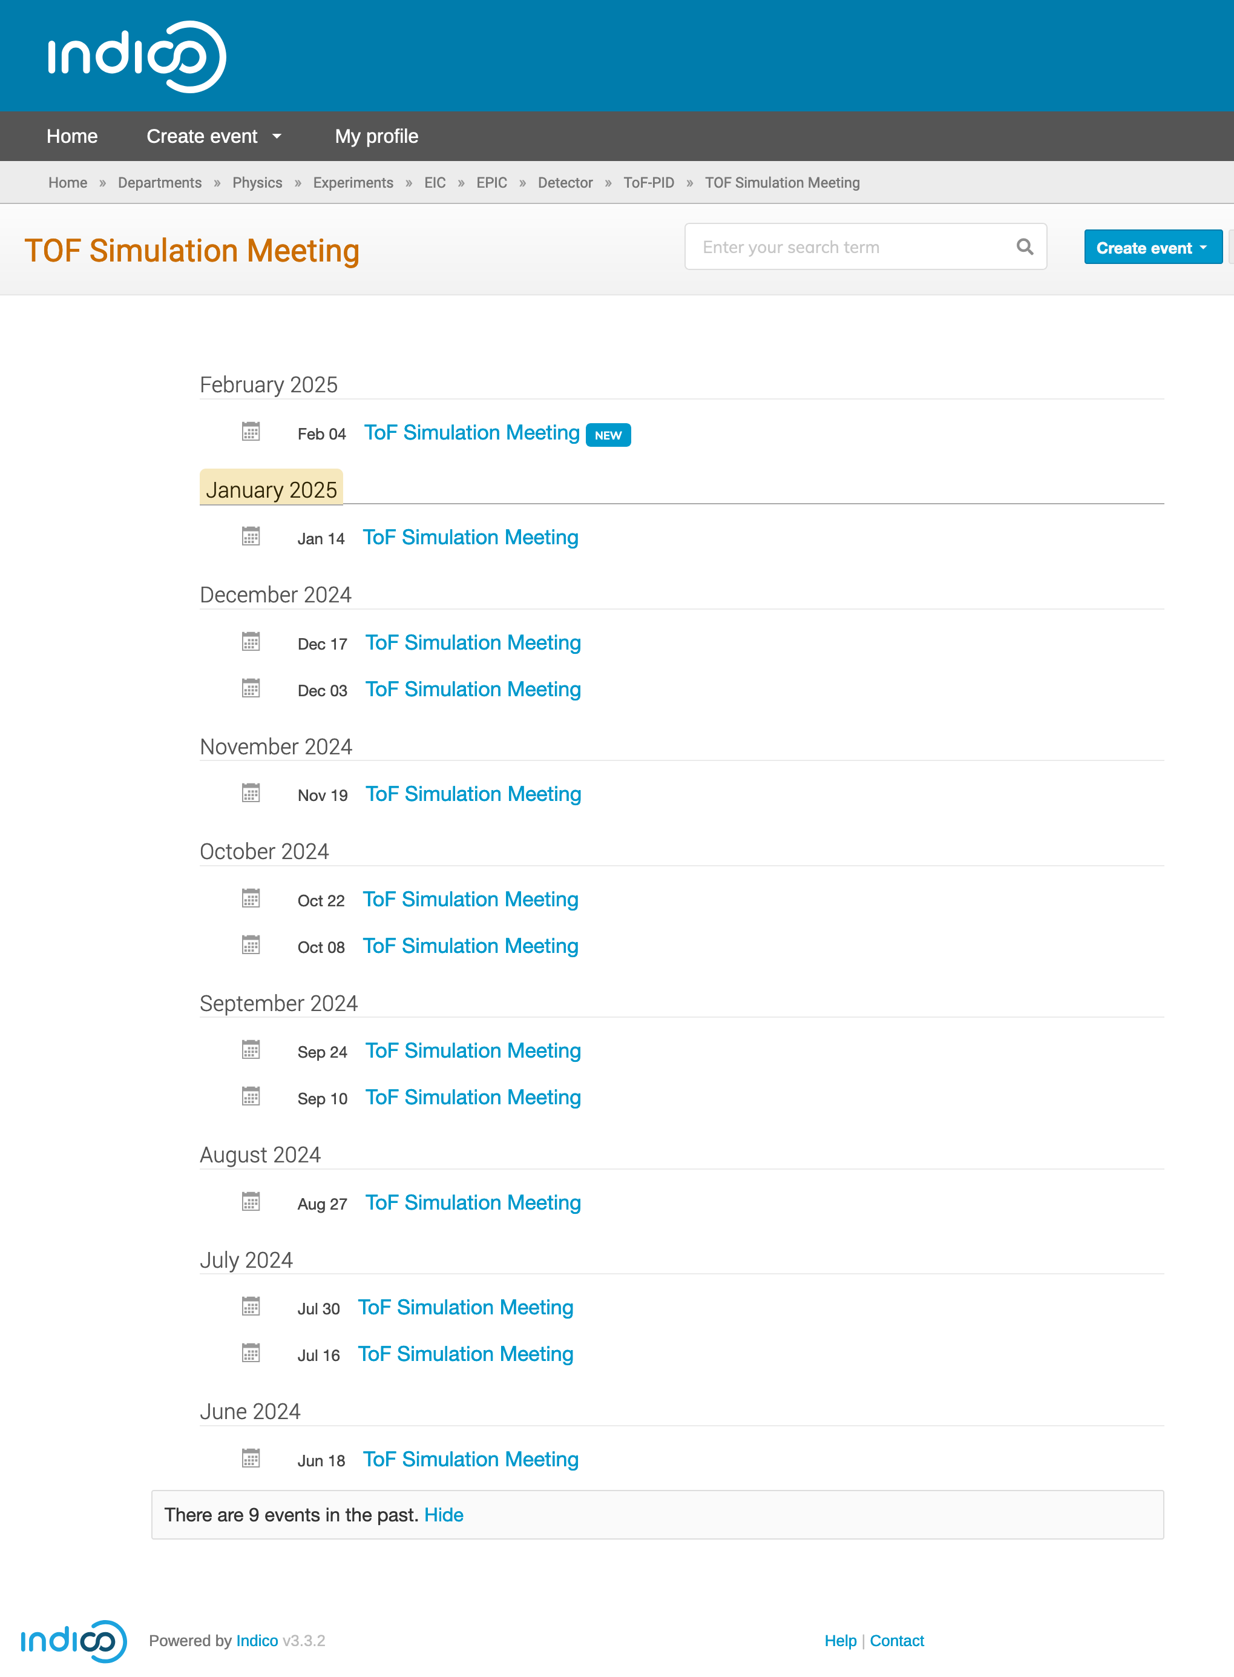
ToF Simulation Working Group
https://indico.bnl.gov/category/569
Leader
  Kentaro Kawade, Tommy Tsang Chun Yuen
Holding biweekly meeting since June 2024
Activities
  Tommy Tsang Chun Yuen (KSU)
    Digitization for BToF
    Implement new ToF geometry/design
  Honey Khindri (IIT Madras)
    Digitization for EToF
  Shunichiro Muraoka (Hiroshima U)
    Impact of ToF material budgets on hpDIRC resolution
  Kyohei Ono (Shinshu U)
    Evaluate PID performance under proton background environment

Slide 3
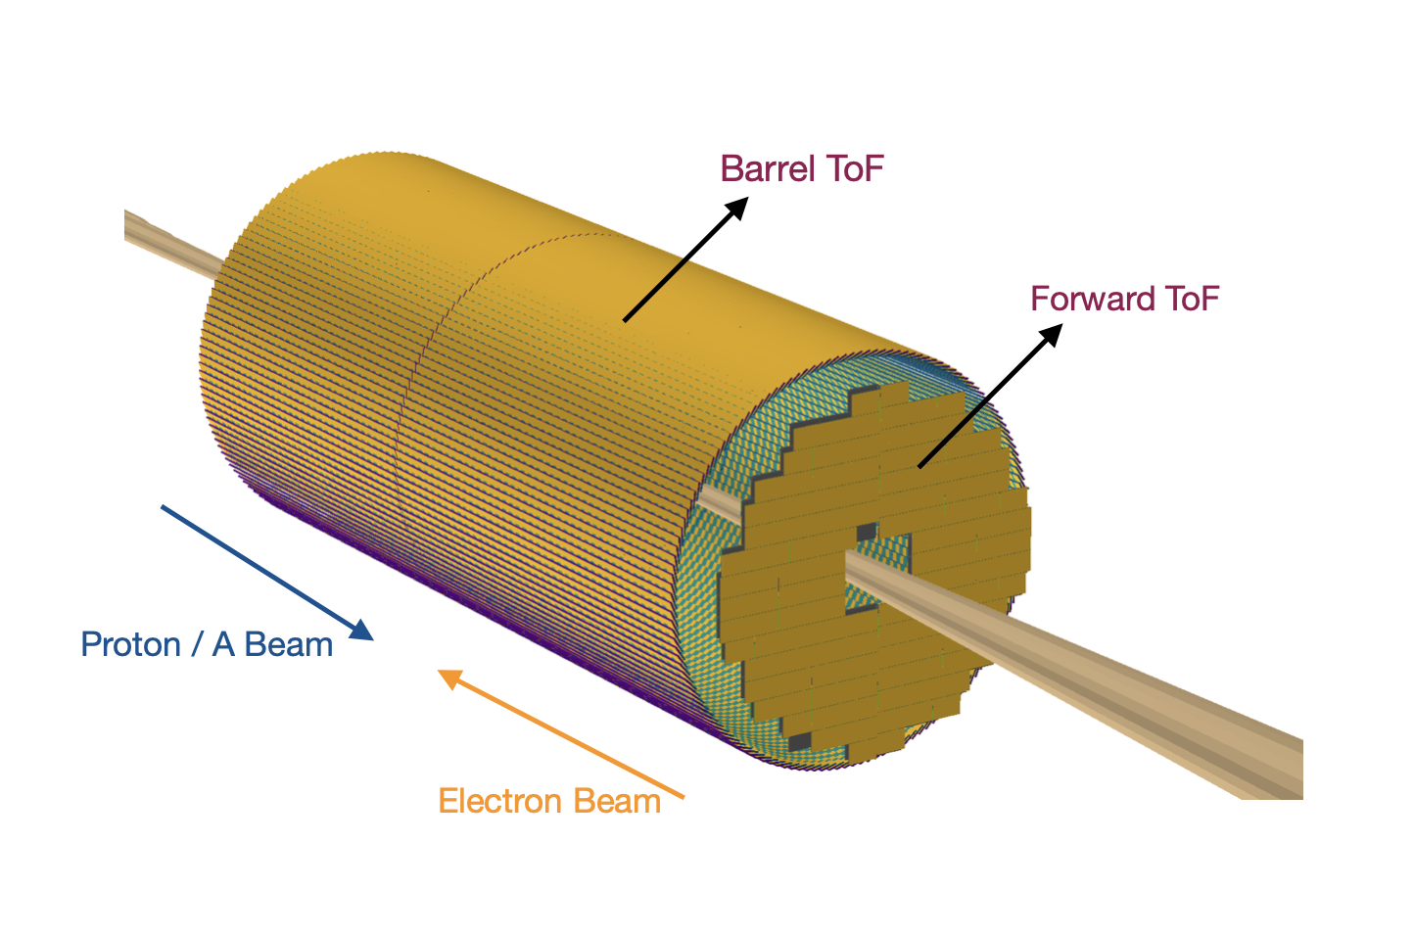
ToF Digitization
Thanks to Tommy and Honey

Slide 4
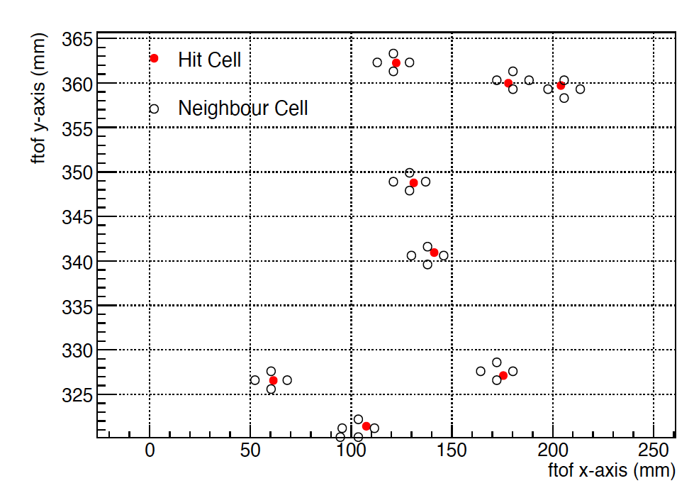
Digitization work-flow
Start
Geant hits
Charge sharing
E_{dep} in cells
Pulse Generation
V vs t for all cells
Pulse Digitization
ADC and TDC
Charge sharing
Find neighboring sensors and sensor boundaries
Distribute energy deposition according to 2D Gaussian

Slide 5
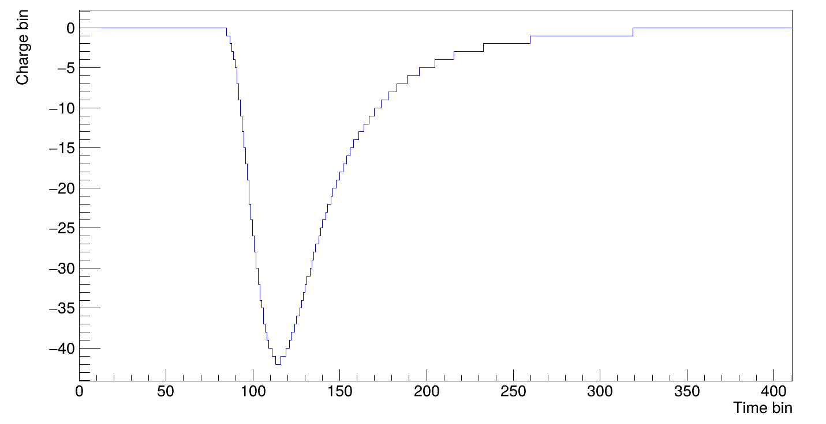
Digitization work-flow
Start
Geant hits
Charge sharing
E_{dep} in cells
Pulse Generation
V vs t for all cells
Pulse Digitization
ADC and TDC
Pulse Generation
Collect all hits within 0 < t < 25 ns
Convert hits to digitize pulses
Add all pulses in the same strip for the final pulse
rise time = 0.45 ns
0.1 MeV/2⁸ ADC counts

Slide 6
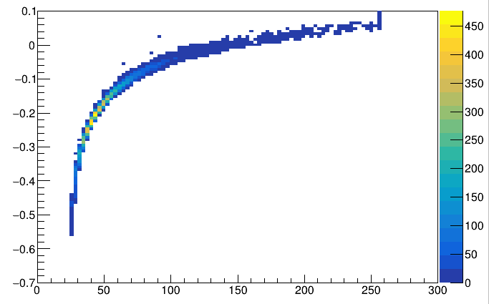
Digitization work-flow
Start
Simt – Calibrated TDC
Geant hits
Charge sharing
E_{dep} in cells
Pulse Generation
V vs t for all cells
Pulse Digitization
ADC and TDC
Max(ADC)
Pulse digitization
Time when Charge value crosses a threshold
→ TDC value
Max(Min) pulse height
→ ADC value
Threshold
ADC value = -42
TDC value = 100

Slide 7
Geometry updates in EPIC simulation

Slide 8
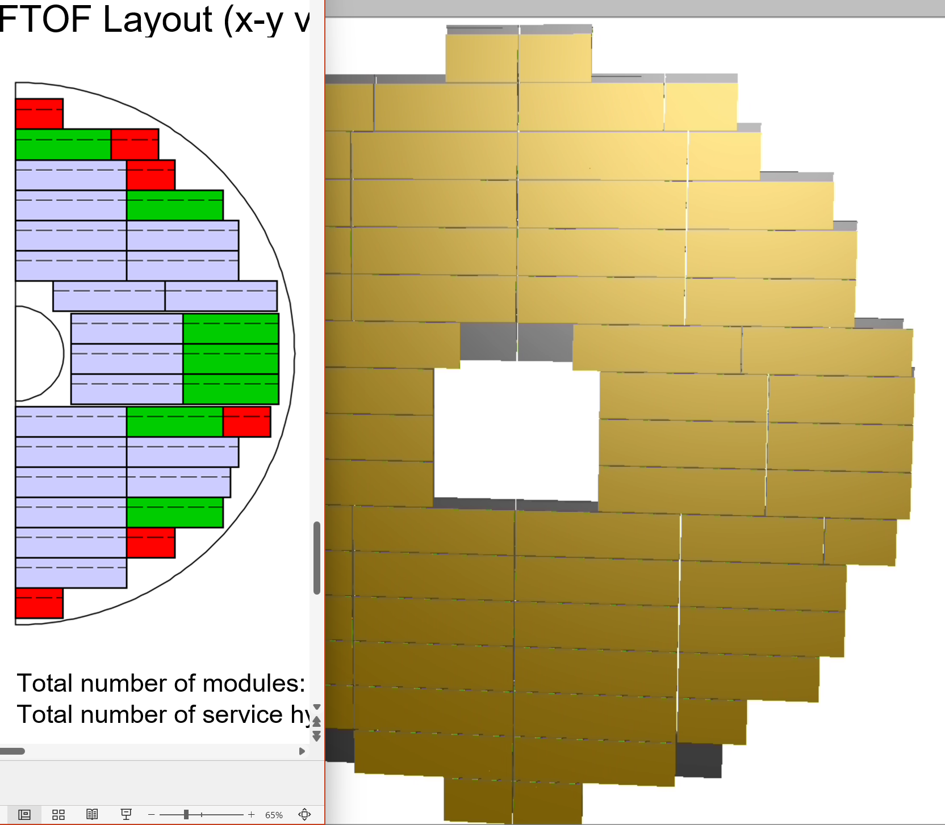
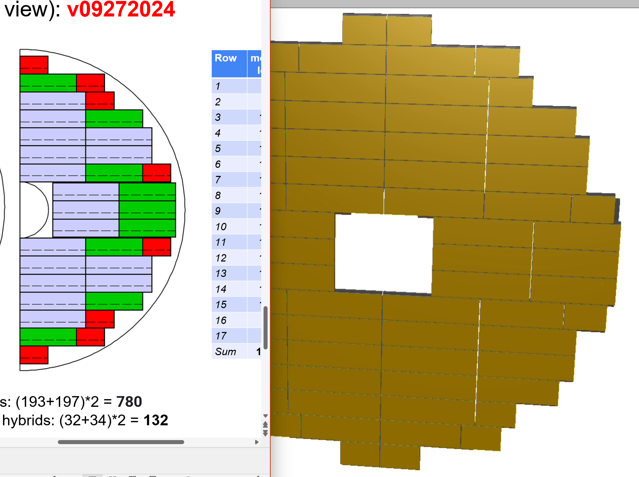
Updated ETOF geometry ①

Slide 9
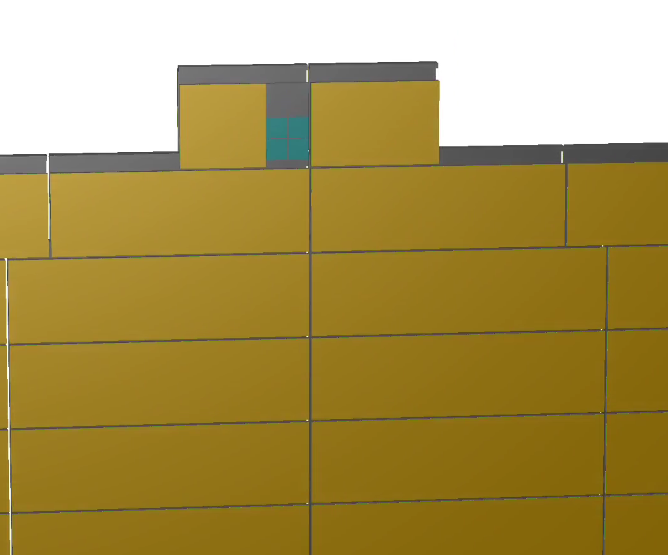
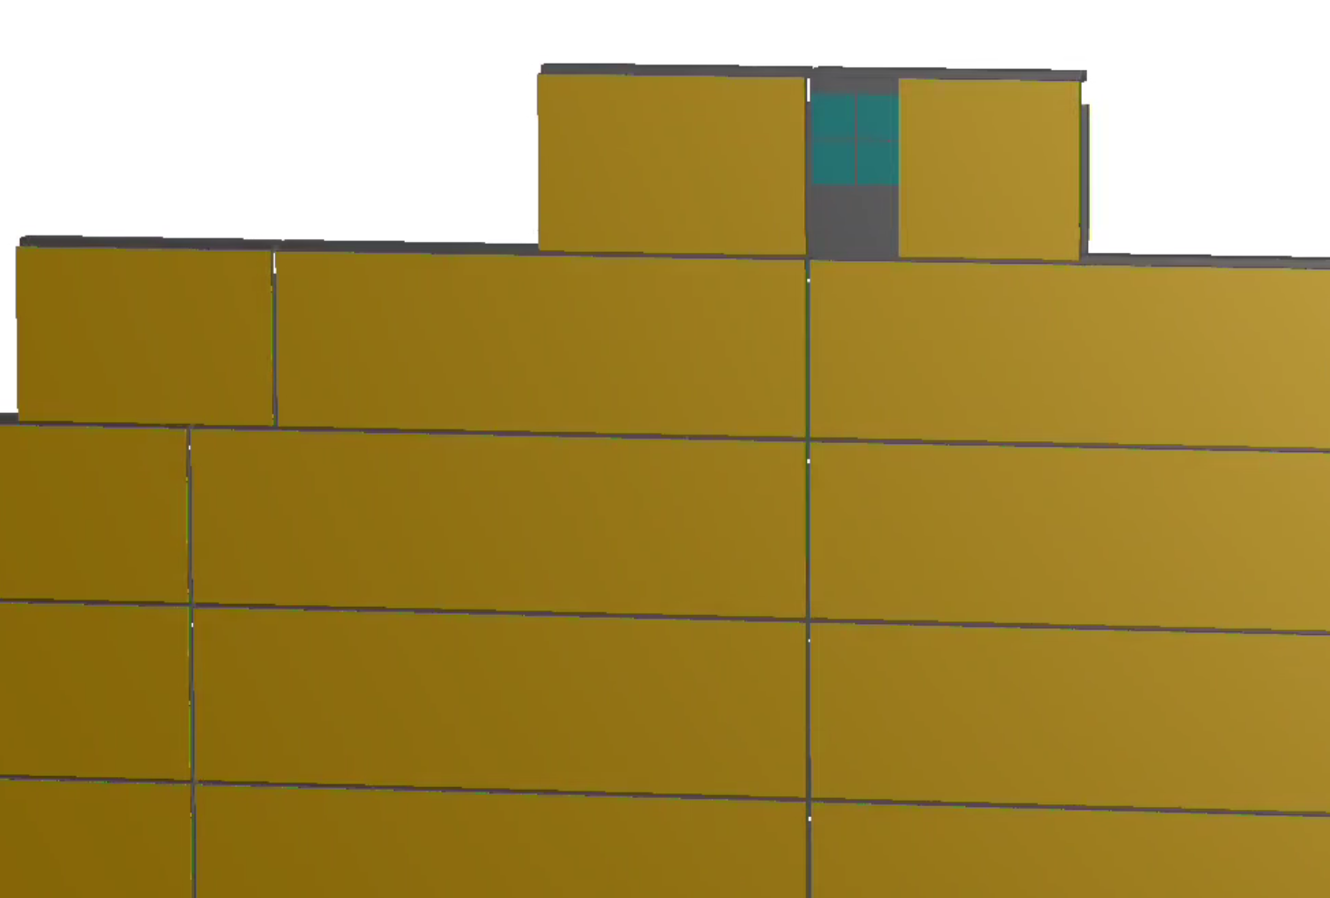
Updated ETOF geometry ②
PCB removed Blue squares are individual sensors

Slide 10
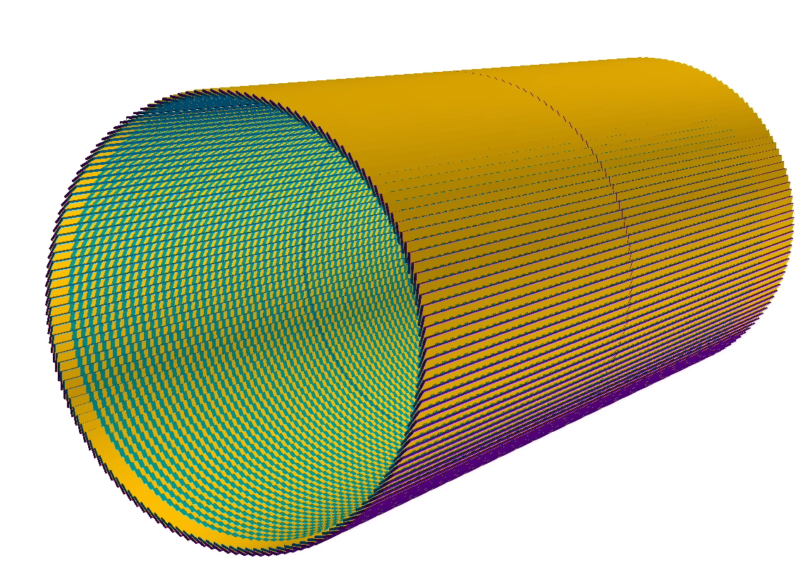

Updated BToF geometry ①
Implemented double sided sensors, gap for engagement ring and half sensors near the gap

Slide 11
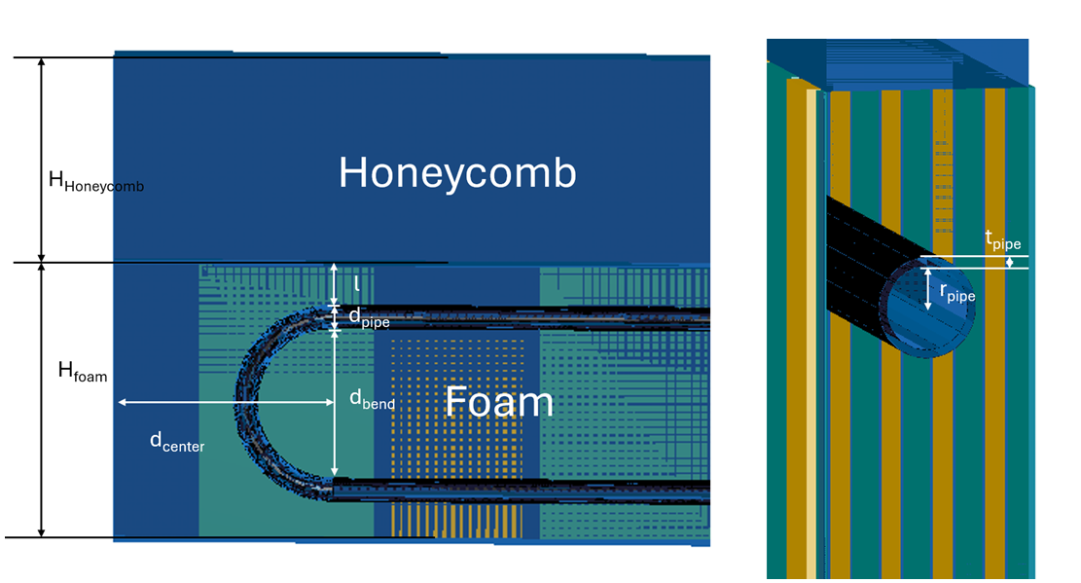
Updated BToF geometry ②
Cooling tubes for BTOF in simulation (work in progress)

Slide 12
Material Budget
Thanks to Shunichiro

Slide 13
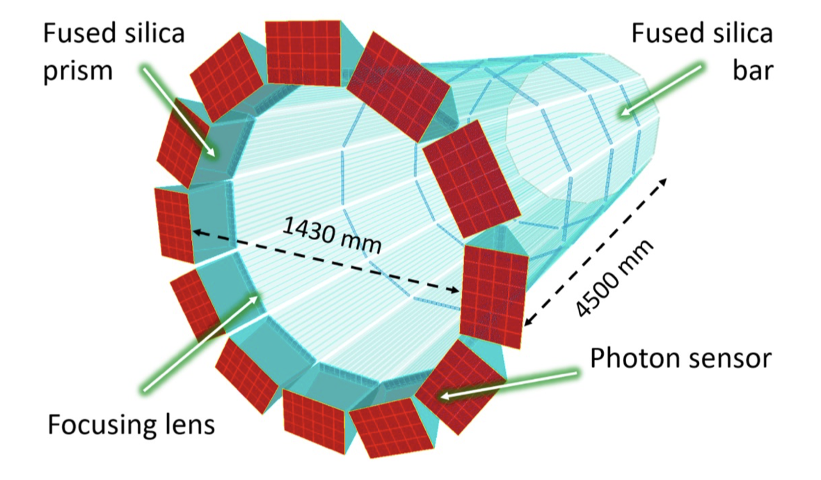
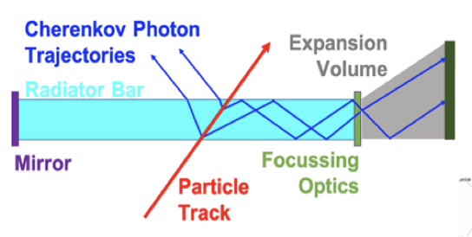
Motivation of this study
TOF (64cm)
Outer MPGD (72.5cm)
DIRC (75.5cm)
Estimate the impact of BTOF material budgets on the outer hpDIRC angular resolution
  To optimize the BTOF design and performance
  Crucial inputs for sensors, structures and readout PCBs
  to relax the tight requirement (1% X₀)
hpDIRC is a Cherenkov particle identification detector
  → Angular resolution at the surface is important
    Requirement (6 GeV/c): Δθ = 0.5 [mrad]
  Material budget of BTOF
  → Affects on angular resolution due to multiple scattering effects
  Determine the upper limit of the BToF material budget
hpDIRC:
high performance Detection of
Internally Reflected Cherenkov light

Slide 14
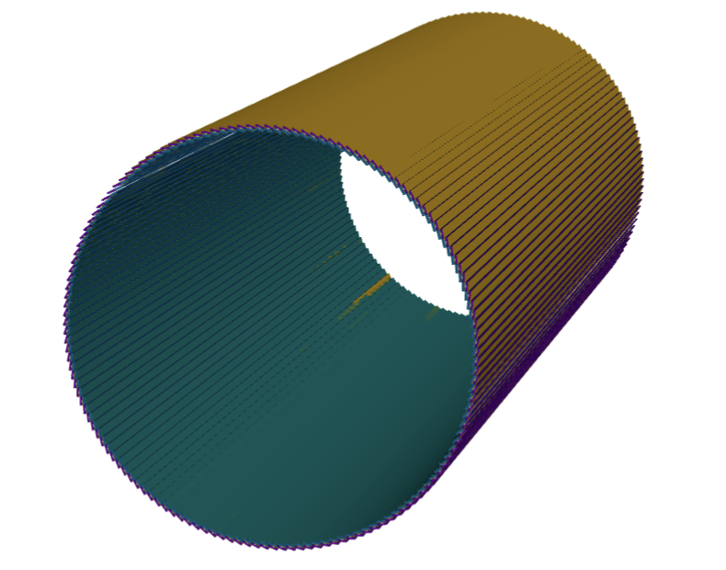
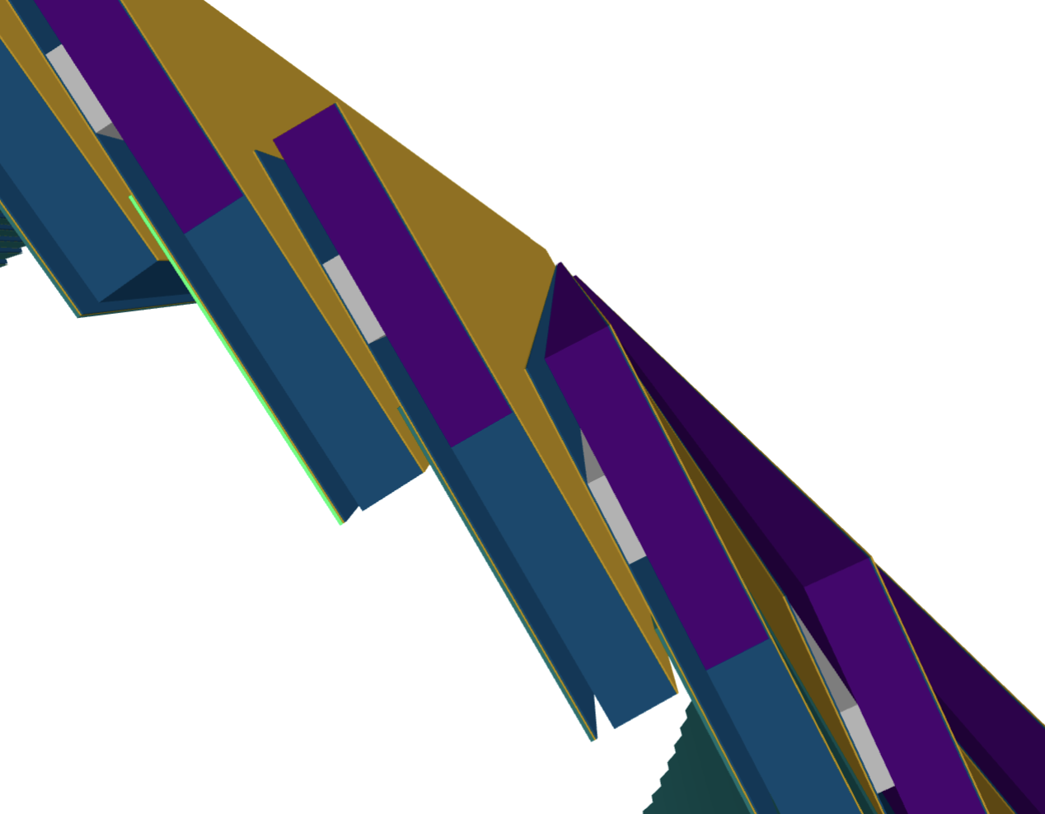
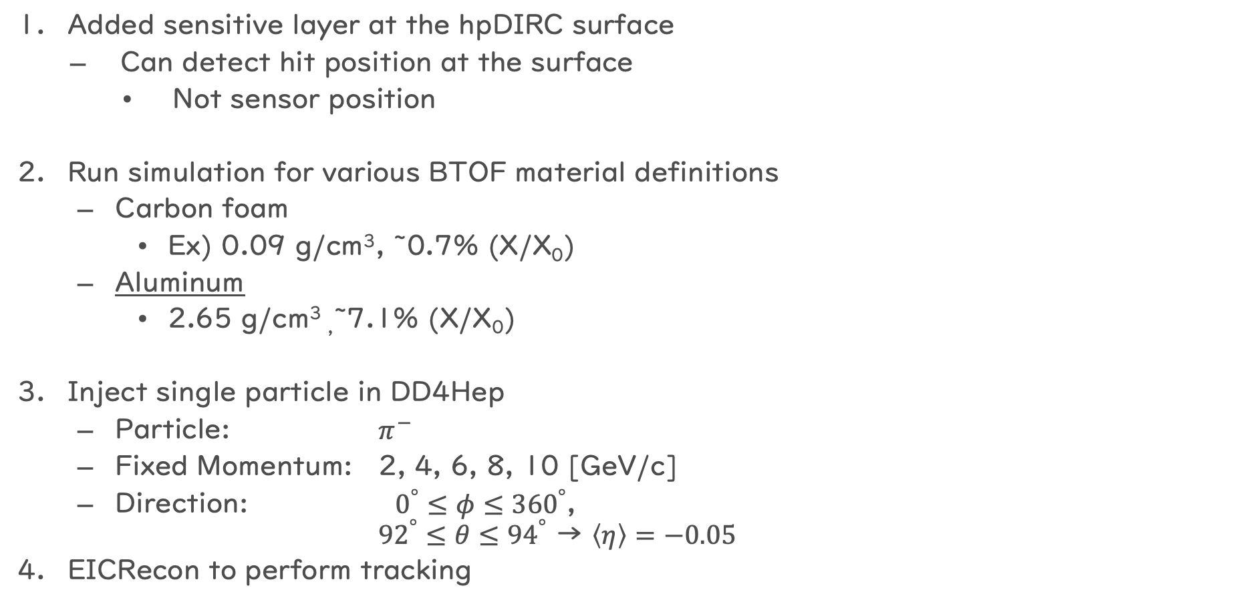
Simulation
Original sensor position
Added sensitive layer at the hpDIRC surface
  Can detect hit position at the surface
    Not sensor position
Run simulation for various BTOF material definitions
  Carbon foam
    Ex) 0.09 g/cm³, ~0.7% (X/X₀)
  Aluminum
    2.65 g/cm³ ,~7.1% (X/X₀)
Inject single particle in DD4Hep
  Particle: $π^{−}$
  Fixed Momentum: 2, 4, 6, 8, 10 [GeV/c]
  Direction: $0^{°}≤φ≤{360}^{°}$,
  ${92}^{°}≤θ≤{94}^{°}$ → $\left\langle η\right\rangle =−0.05$
EICRecon to perform tracking
New definitoin
BToF Support structure 5.8 mm

Slide 15
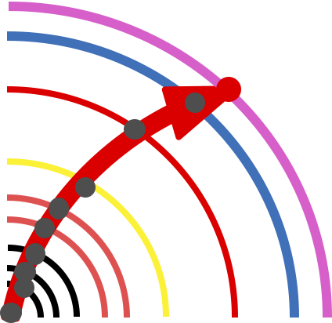
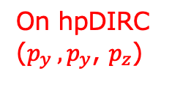
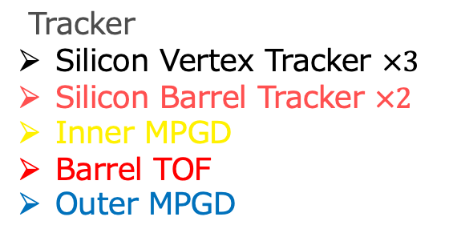
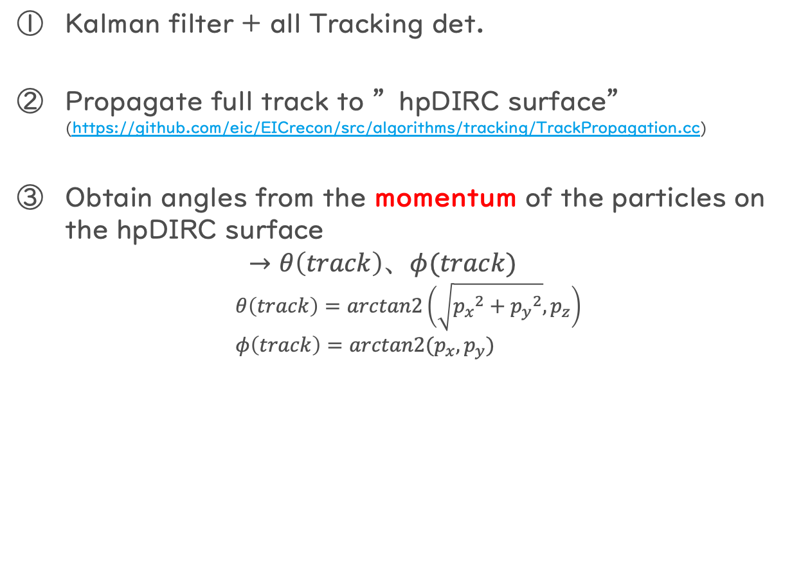
Tracking detail ① Full reconstruction
Kalman filter + all Tracking det.
Propagate full track to ”hpDIRC surface”
(https://github.com/eic/EICrecon/src/algorithms/tracking/TrackPropagation.cc)
Obtain angles from the momentum of the particles on the hpDIRC surface
  $$→θ\left(track\right)、φ(track)$$
$$θ\left(track\right)=arctan2\left(\sqrt{{p_{x}}^{2}+{p_{y}}^{2}},p_{z}\right) \\ φ\left(track\right)=arctan2(p_{x},p_{y})$$
On hpDIRC
($p_{y} ,p_{y}$, $p_{z}$)
Tracker
Silicon Vertex Tracker $×3$
Silicon Barrel Tracker $×2$
Inner MPGD
Barrel TOF
Outer MPGD

Slide 16
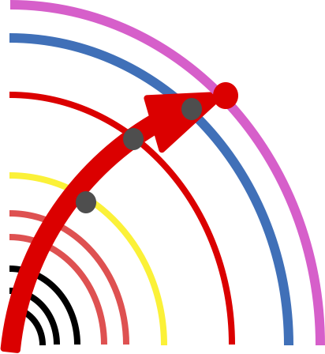
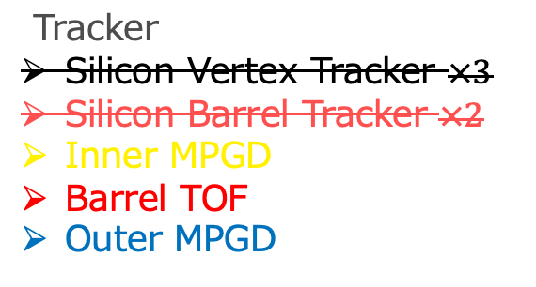
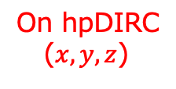
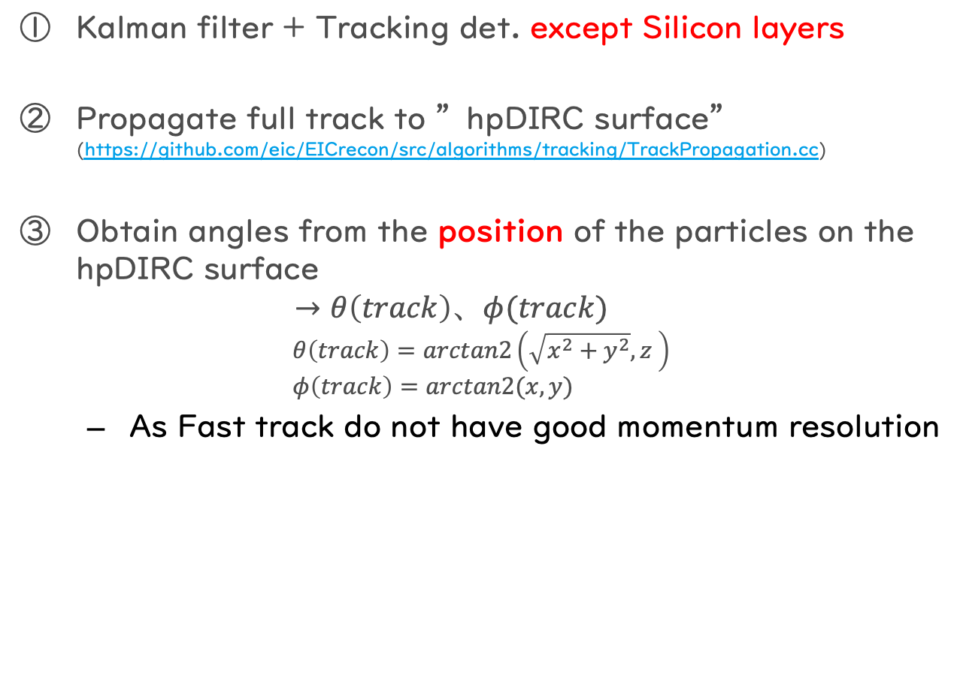
Tracking detail: ② Fast reconstruction
Kalman filter + Tracking det. except Silicon layers
Propagate full track to ”hpDIRC surface”
(https://github.com/eic/EICrecon/src/algorithms/tracking/TrackPropagation.cc)
Obtain angles from the position of the particles on the hpDIRC surface
  $$→θ\left(track\right)、φ(track)$$
$$θ\left(track\right)=arctan2\left(\sqrt{x^{2}+y^{2}},z \right) \\ φ\left(track\right)=arctan2(x,y)$$
  As Fast track do not have good momentum resolution
On hpDIRC
($x,y,z$)
Tracker
Silicon Vertex Tracker $×3$
Silicon Barrel Tracker $×2$
Inner MPGD
Barrel TOF
Outer MPGD

Slide 17
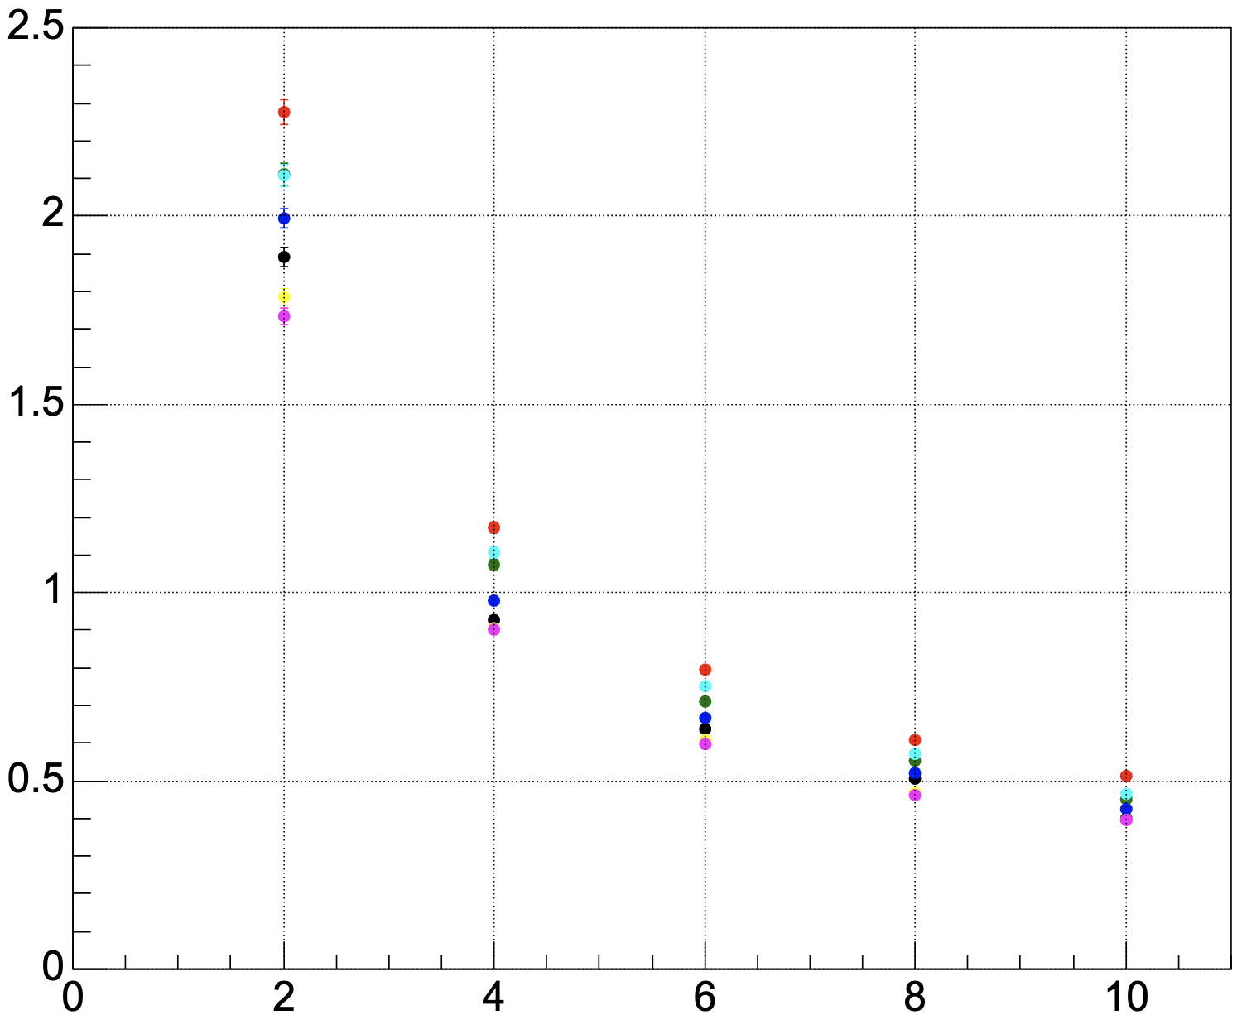
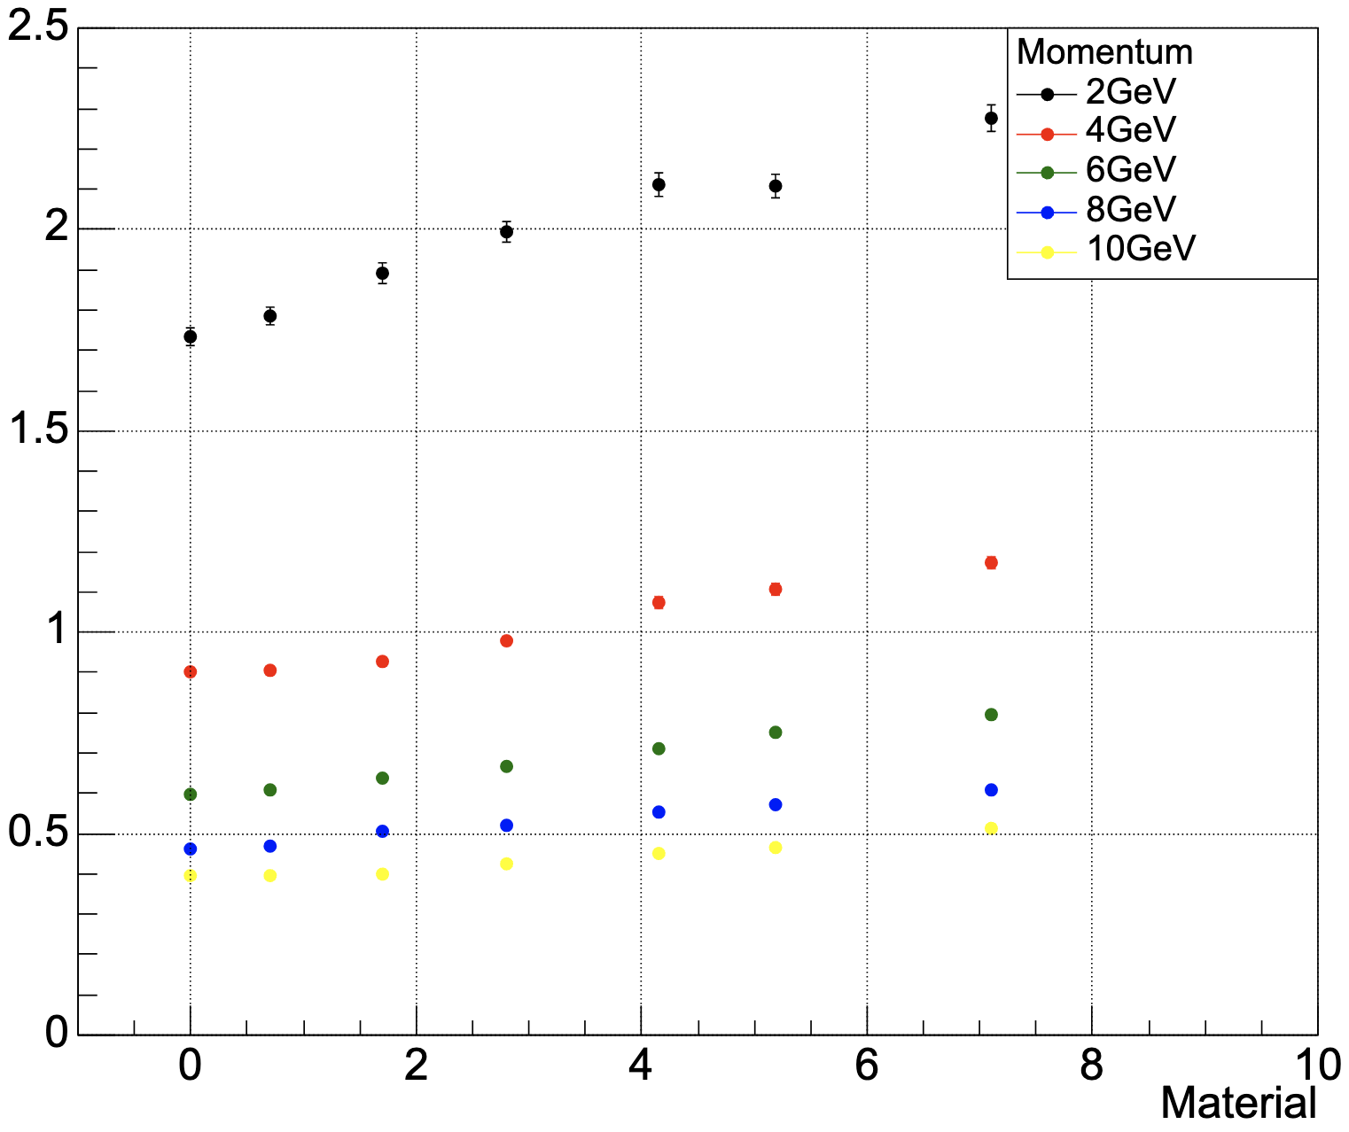


Results: Angular resolution w/ full track
Angular resolution for various BTOF material
  The BToF material budget seems to not have a drastic effect
[$Δφ$vs Momentum] (92 < θ < 94 )
[$Δφ$vs Material] (92 < θ < 94 )
Aluminum [X/X₀ ~ 7.1%]
pyrexGlass [X/X₀ ~ 5.2%]
BoronOxide[X/X₀ ~ 4.2%]
CarbonFiber[X/X₀ ~ 2.8%]
CarbonFiber(50)[X/X₀ ~ 1.7%]
CarbonFoam[X/X₀ ~ 0.7%]
noBTOF material [X/X₀ ~ 0%]
Angular resolution [mrad]
Angular resolution [mrad]
Momentum [GeV]
[X₀/X]

Slide 18
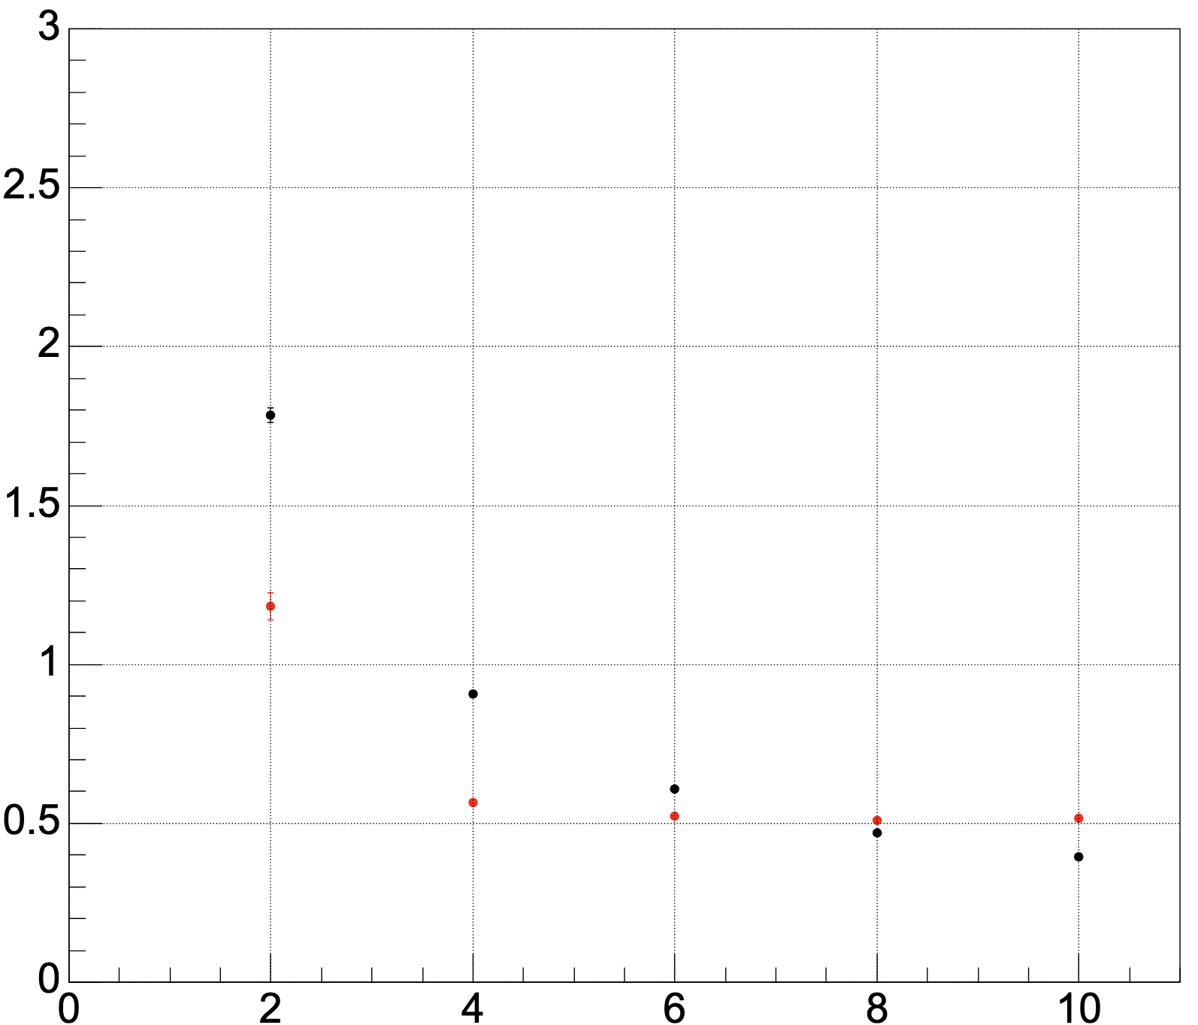
Comparison of reconstructed full track & fast track
Fast tracking showed better angular resolution at the lower momentum region
  While full tracking showed better results at higher momentum region
Neither method satisfy the hpDIRC requirement (0.5 mrad for 6 GeV/c)
[$Δφ$vs Momentum] (6GeV, 92 < θ < 94 )
Using Reconstructed Fast Track
Using Reconstructed Full Track
Momentum [GeV]

Slide 19
Material budget study: Summary
Simulation study is ongoing to determine the upper limit of the material budget of BTOF and optimize detector design
Angular resolution using Reconstructed Full Track
  Slightly failed to meet the requirement of hpDIRC 0.5 mrad for 6 GeV/c particles
Angular resolution using Reconstructed Fast Track
  showed better results in the low momentum region
  Still not satisfy the hpDIRC requirement
  Possibility to improve the angular resolution by making use of Tracklet
    Tracklet: calculate the angle from only MPGD and BTOF hits
    → Study ongoing
Angular resolution is not very sensitive to the BToF material budget

Slide 20
TOF PID performance in Pythia DIS sample
Thanks to Kyohei

Slide 21
Motivation of this study
Confirm early estimation of the PID performance using recent simulation software
  For the moment, we are still using simulation before include digitization
  Once well establish the method, we go to up-to-date software
Check the PID performance even in the background rich environment
  → Using Pythia to simulate ep collision

Slide 22
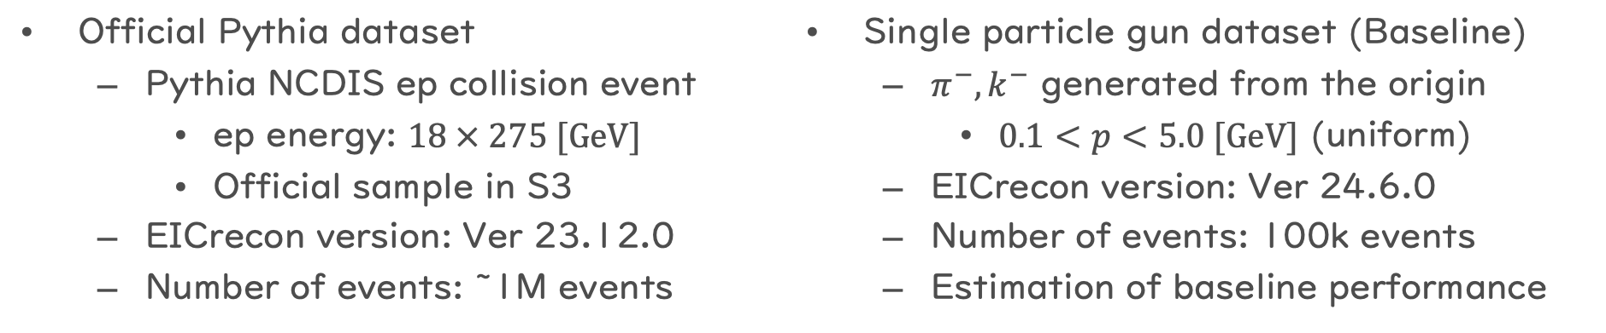
MC Simulation Configuration
Official Pythia dataset
  Pythia NCDIS ep collision event
    ep energy: $18 × 275 [GeV]$
    Official sample in S3
  EICrecon version: Ver 23.12.0
  Number of events: ~1M events
Single particle gun dataset (Baseline)
  $π^{−},k^{−}$ generated from the origin
    $0.1<p<5.0 [GeV]$ (uniform)
  EICrecon version: Ver 24.6.0
  Number of events: 100k events
  Estimation of baseline performance
Run Full detector simulation through DD4HEP
and full event reconstruction using EICRecon including ACTS tracking
  → EICRecon output
Same analysis procedures are applied for both samples
  Adding gaussian smearing to T₀ (σ=15 ps) and T_{ToF} (σ=25 to 35 ps) values

Slide 23
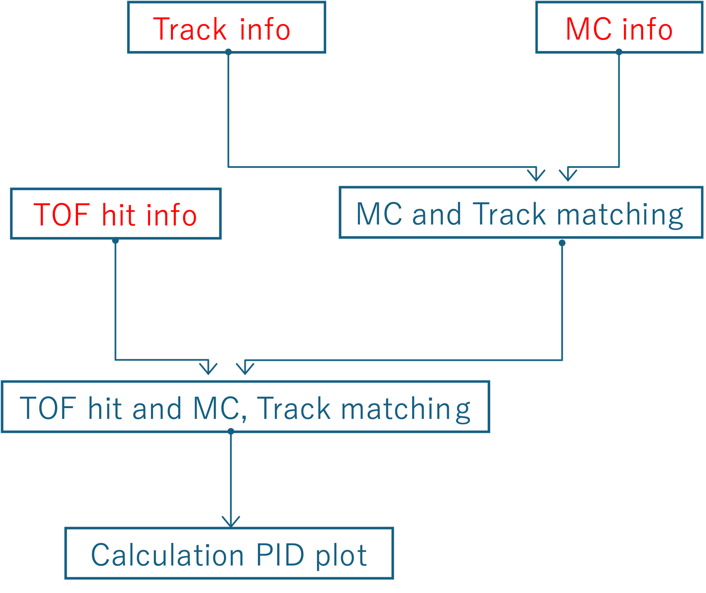
Analysis workflow
Connects these branches (info)
  Tracking information
    Determine track length, momentum
    also needed to match truth particle
  MC (Truth) information
    give PID flag to matched tracks
  TOF hit information
    Timing to calculate velocity
    hit position to match tracks

Slide 24









Reconstruction of particle masses
Particle masses can be derived from
  velocity: $β= \frac{track length @ ToF}{Time measured by ToF}$
  Track momentum taken by ACTS Tracking: $P_{Track}$
$$m_{reco} = \frac{P_{Track}\sqrt{1−β^{2}} }{β }$$
Pythia DIS data
Slice at 1 GeV
$k$
$p$
$π$
$k$
$π$
$p$
$$1/β$$

Slide 25
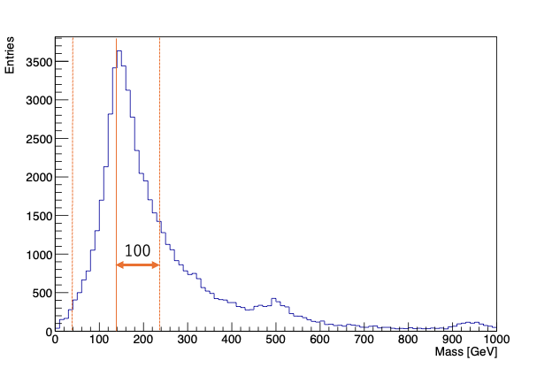

Definition: PID performance
To compare single particle case, we define following probability:
$$p= \frac{Number of events within specific mass range}{Total number of events}$$
=
Mass distribution of reconstructed 𝜋
← Reconstructed mass distribution of truth pion
selected by using PDGID

Slide 26
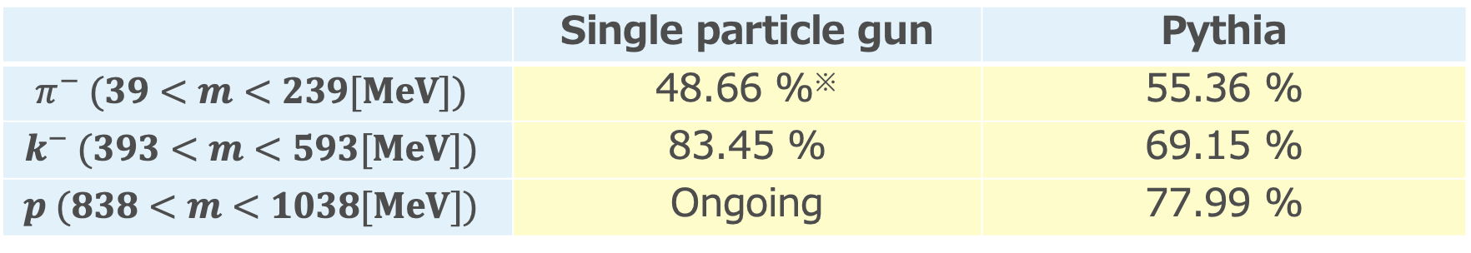


Results: Single particle vs Pythia
Compare PID probabilities
Pythia DIS
Single particle $(π^{−})$
$$\text{Single} \text{particle}\text{ (}k^{−})$$
 | Single particle gun | Pythia
$$π^{−} (39<m<239[MeV])$$ | 48.66 %※ | 55.36 %
$$k^{−} (393<m<593[MeV])$$ | 83.45 % | 69.15 %
$$p (838<m<1038[MeV])$$ | Ongoing | 77.99 %

Slide 27
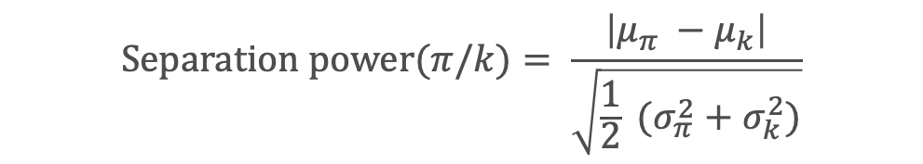



results: 𝜋/𝑘 separation power
This study
$3σ π/k$ separation for $ptrack<1.15 GeV$
  Slightly lower than ePIC requirement※
※Requirements for ePIC
$3σ π/k$ separation for $ptrack<1.2 GeV$
$$Separation power(π/k)= \frac{\left|μ_{π} −μ_{k}\right|}{\sqrt{\frac{1}{2} (σ_{π}^{2}+σ_{k}^{2})}}$$
Separation power($π/k$ ) vs reconstruction momentum
3$σ$
$P_{Track}$[GeV]

Slide 28









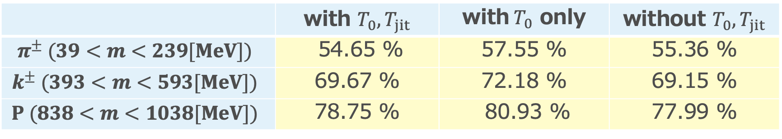
Effect of timing resolution
Check the PIC performance with or without including timing smearing
  As a fast look, no strong effects from smearing?
with $T_{0}, T_{jit}$
with${ T}_{0}$ only
without $T_{0}, T_{jit}$
$$1/β$$
$$1/β$$
$$1/β$$
$P_{Track}$[GeV]
$P_{Track}$[GeV]
$P_{Track}$[GeV]
 | with $T_{0}, T_{jit}$ | with${ T}_{0}$ only | without $T_{0}, T_{jit}$
$$π^{±} (39<m<239[MeV])$$ | 54.65 % | 57.55 % | 55.36 %
$$k^{±} (393<m<593[MeV])$$ | 69.67 % | 72.18 % | 69.15 %
$$P (838<m<1038[MeV])$$ | 78.75 % | 80.93 % | 77.99 %

Slide 29
Summary
https://indico.bnl.gov/category/569
Simulation working group started June 2024
  Main activities
    Tommy Tsang Chun Yuen (KSU)
      Digitization for BToF
      Implement new ToF geometry/design
    Honey Khindri (IIT Madras)
      Digitization for EToF
    Shunichiro Muraoka (Hiroshima U)
      Impact of ToF material budgets
      on hpDIRC resolution
    Kyohei Ono (Shinshu U)
      Evaluate PID performance under
      proton background environment
  A lot of ongoing works, but started showing
  good results
Please join the meeting if you interested

