Slide 1
(Angular Resolutions via Hit Extrapolation) Effect of the ToF material budget on the hpDIRC resolution Kentaro Kawade Shinshu Univ. on behalf of the ePIC ToF simulation team

Slide 2
This study was done by Shunichiro Muraoka, a student at Hiroshima University

Slide 3
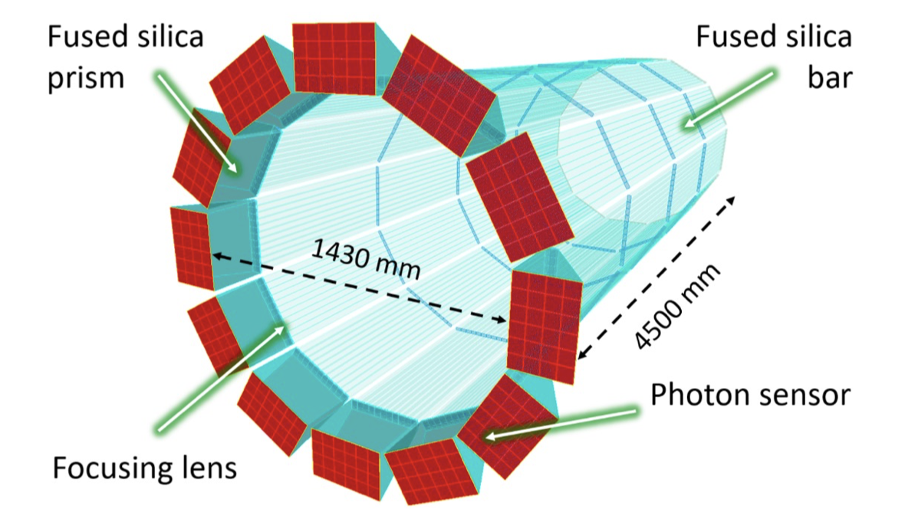
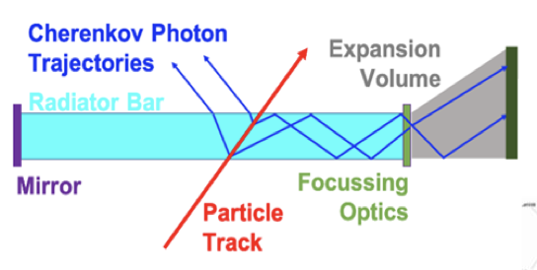
Motivation of this study
TOF (64cm) Outer MPGD (72.5cm) DIRC (75.5cm)
Estimate the impact of BTOF material budgets on the outer hpDIRC angular resolution
To optimize the BTOF design and performance
Crucial inputs for sensors, structures and readout PCBs to relax the tight requirement (O(1%) X/X₀)
hpDIRC is a Cherenkov particle identification detector
→ Angular resolution at the surface is important
Requirement (6 GeV/c): Δθ = 0.5 [mrad]
Material budget of BTOF → Affects on angular resolution due to multiple scattering effects Determine the upper limit of the BToF material budget
hpDIRC: high performance Detection of Internally Reflected Cherenkov light

Slide 4
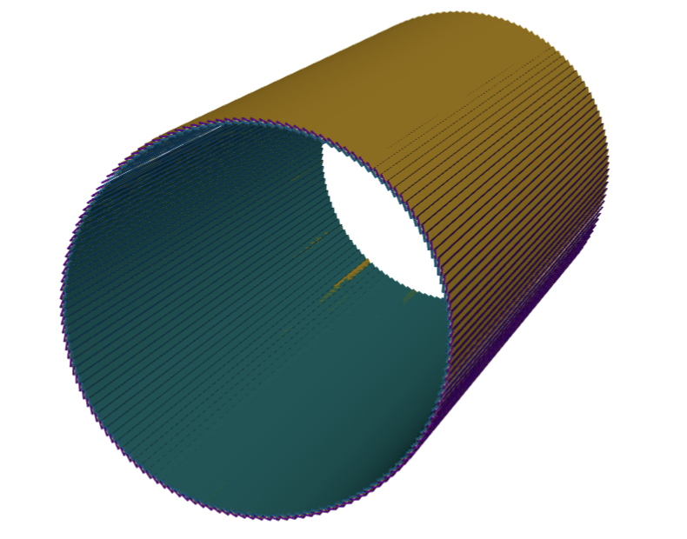
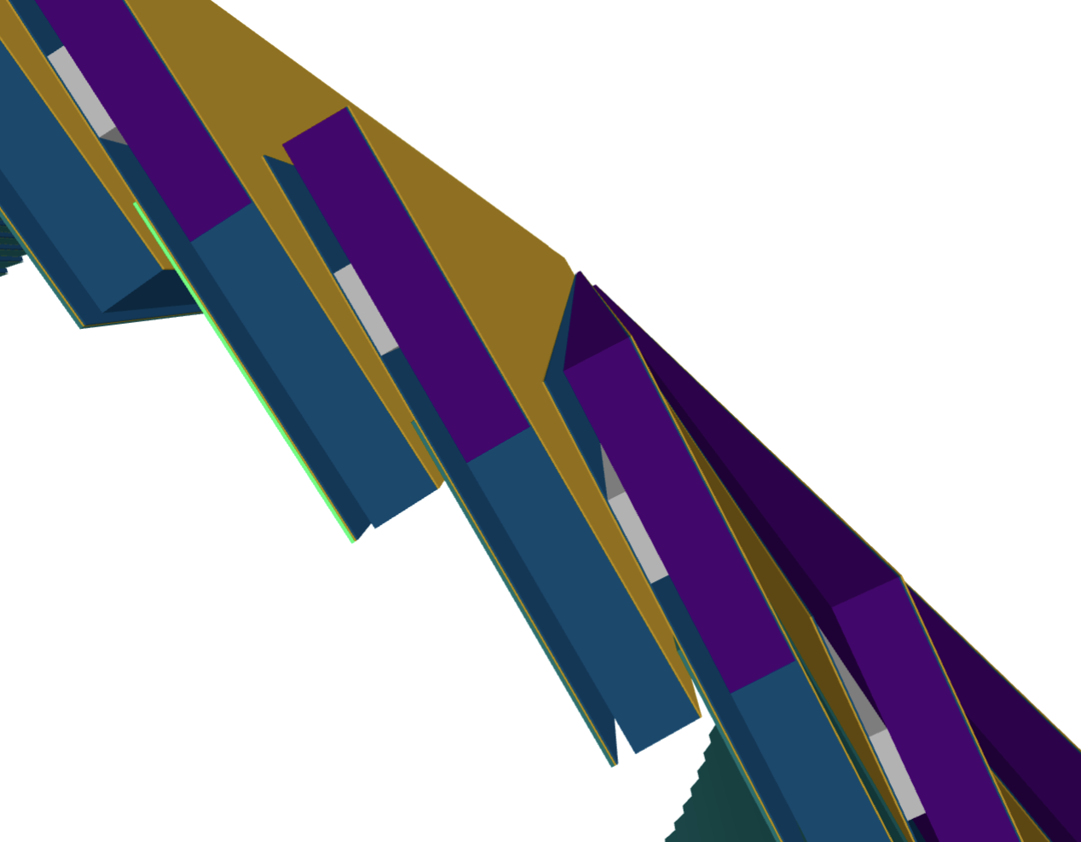
Simulation
Original sensor position
Added sensitive layer at the hpDIRC surface
Can detect hit position at the surface
Not sensor position
Run simulation for various BTOF material definitions
Carbon foam
Ex) 0.09 g/cm³, ~0.7% (X/X₀)
Aluminum
2.65 g/cm³ ,~7.1% (X/X₀)
Inject single particle in DD4Hep
Particle: $π^{−}$
Fixed Momentum: 2, 4, 6, 8, 10 [GeV/c]
Direction: $0^{°}≤φ≤{360}^{°}$, ${92}^{°}≤θ≤{94}^{°}$ → $\left\langle η\right\rangle =−0.05$
EICRecon to perform tracking
New definitoin
BToF Support structure 5.8 mm

Slide 5
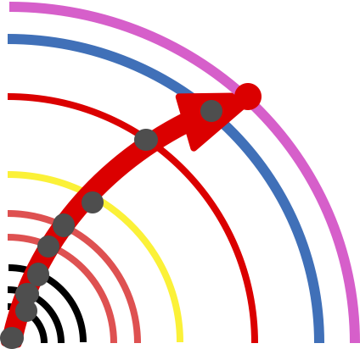
Tracking detail ① Full reconstruction
Kalman filter + all Tracking det.
Propagate full track to ”hpDIRC surface” (https://github.com/eic/EICrecon/src/algorithms/tracking/TrackPropagation.cc)
Obtain angles from the momentum of the particles on the hpDIRC surface
$$→θ\left(track\right)、φ(track)$$
$$θ\left(track\right)=arctan2\left(\sqrt{{p_{x}}^{2}+{p_{y}}^{2}},p_{z}\right) \\ φ\left(track\right)=arctan2(p_{x},p_{y})$$
On hpDIRC ($p_{y} ,p_{y}$, $p_{z}$)
Tracker
Silicon Vertex Tracker $×3$
Silicon Barrel Tracker $×2$
Inner MPGD
Barrel TOF
Outer MPGD

Slide 6
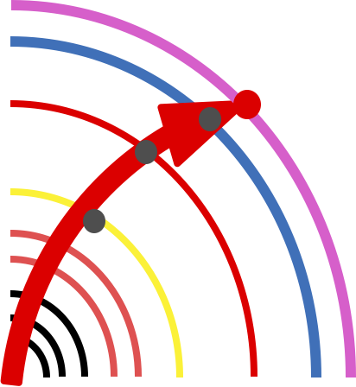
Tracking detail: ② Fast reconstruction
Kalman filter + Tracking det. except Silicon layers
Propagate fast track to ”hpDIRC surface” (https://github.com/eic/EICrecon/src/algorithms/tracking/TrackPropagation.cc)
Obtain angles from the position of the particles on the hpDIRC surface
$$→θ\left(track\right)、φ(track)$$
$$θ\left(track\right)=arctan2\left(\sqrt{x^{2}+y^{2}},z \right) \\ φ\left(track\right)=arctan2(x,y)$$
As Fast track do not have good momentum resolution
On hpDIRC ($x,y,z$)
Tracker
Silicon Vertex Tracker $×3$
Silicon Barrel Tracker $×2$
Inner MPGD
Barrel TOF
Outer MPGD

Slide 7
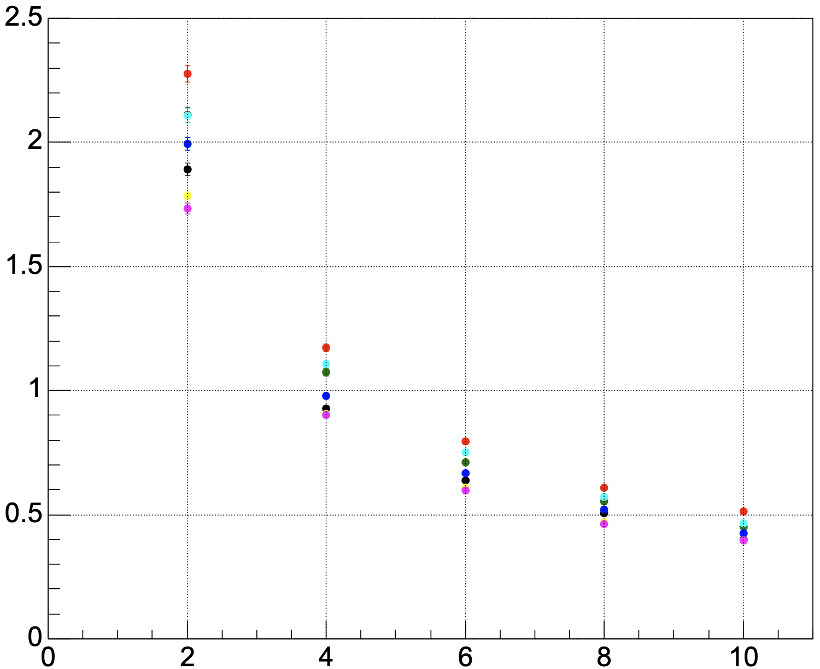
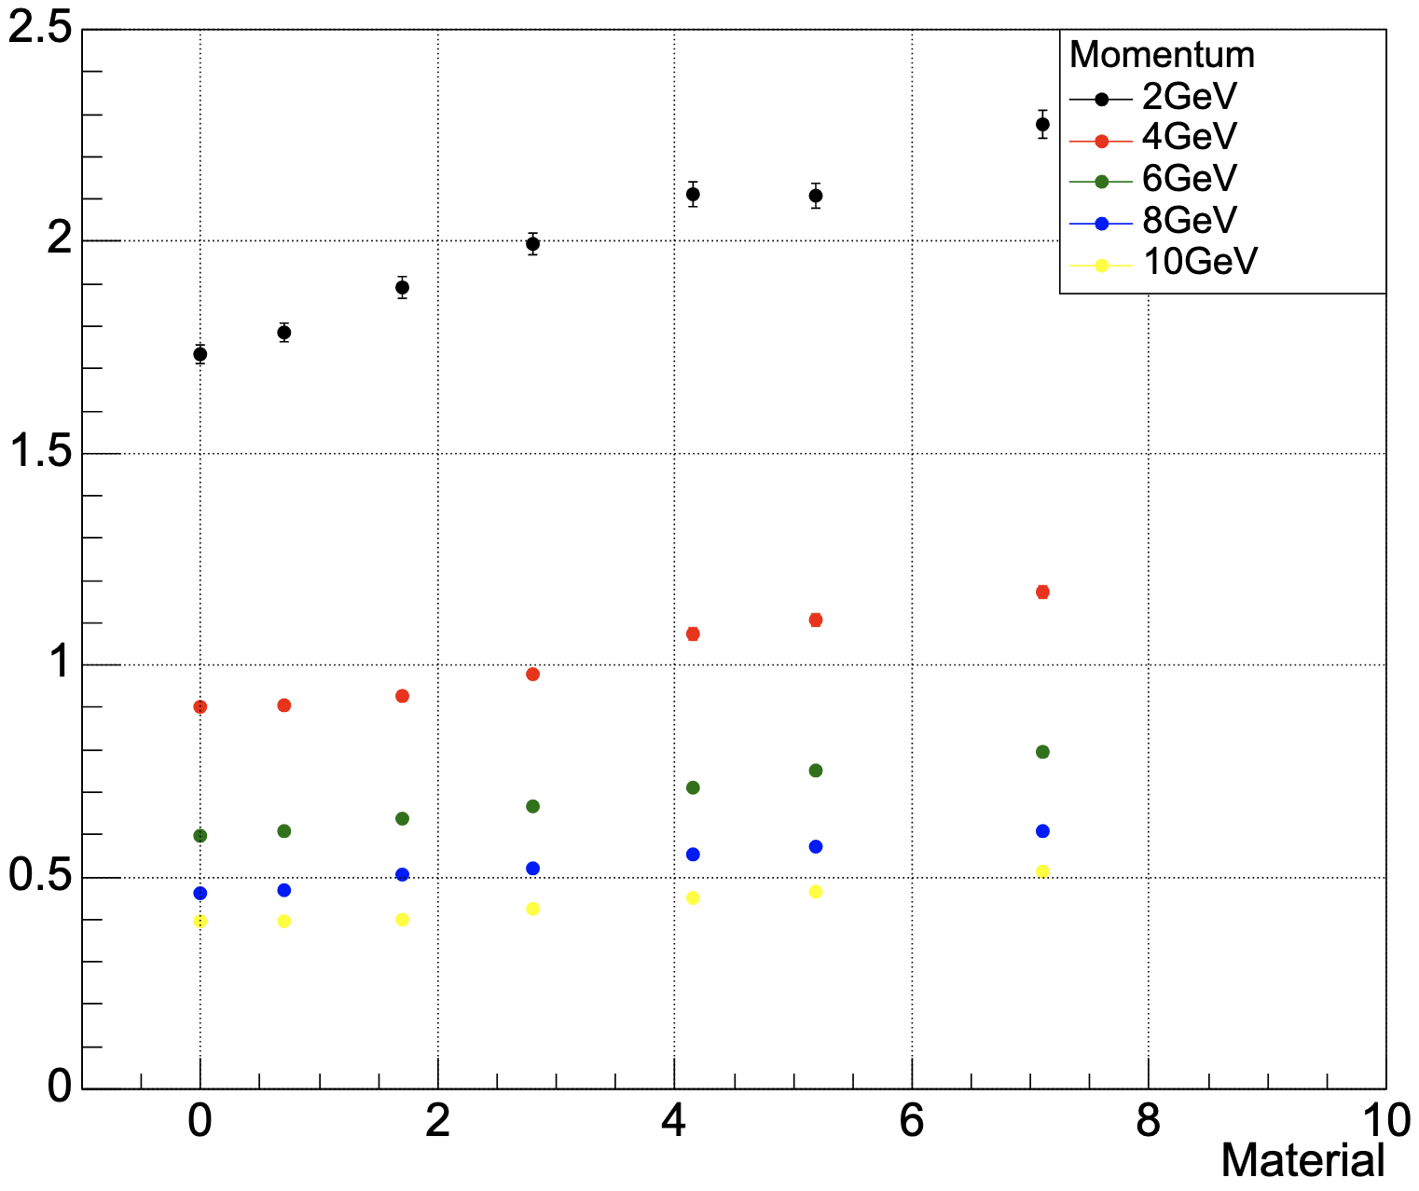
Results: Angular resolution w/ full track
Angular resolution for various BTOF material
Tentative Conclusion: The BToF material budget does not have a drastic effect
[$Δφ$vs Momentum] (92 < θ < 94 )
[$Δφ$vs Material] (92 < θ < 94 )
Aluminum [X/X₀ ~ 7.1%]
pyrexGlass [X/X₀ ~ 5.2%]
BoronOxide[X/X₀ ~ 4.2%]
CarbonFiber[X/X₀ ~ 2.8%]
CarbonFiber(50)[X/X₀ ~ 1.7%]
CarbonFoam[X/X₀ ~ 0.7%]
noBTOF material [X/X₀ ~ 0%]
Angular resolution [mrad]
Angular resolution [mrad]
Req. 0.5 mrad for 6 GeV/c
Req. 0.5 mrad for 6 GeV/c
Momentum [GeV]
[X₀/X]

Slide 8
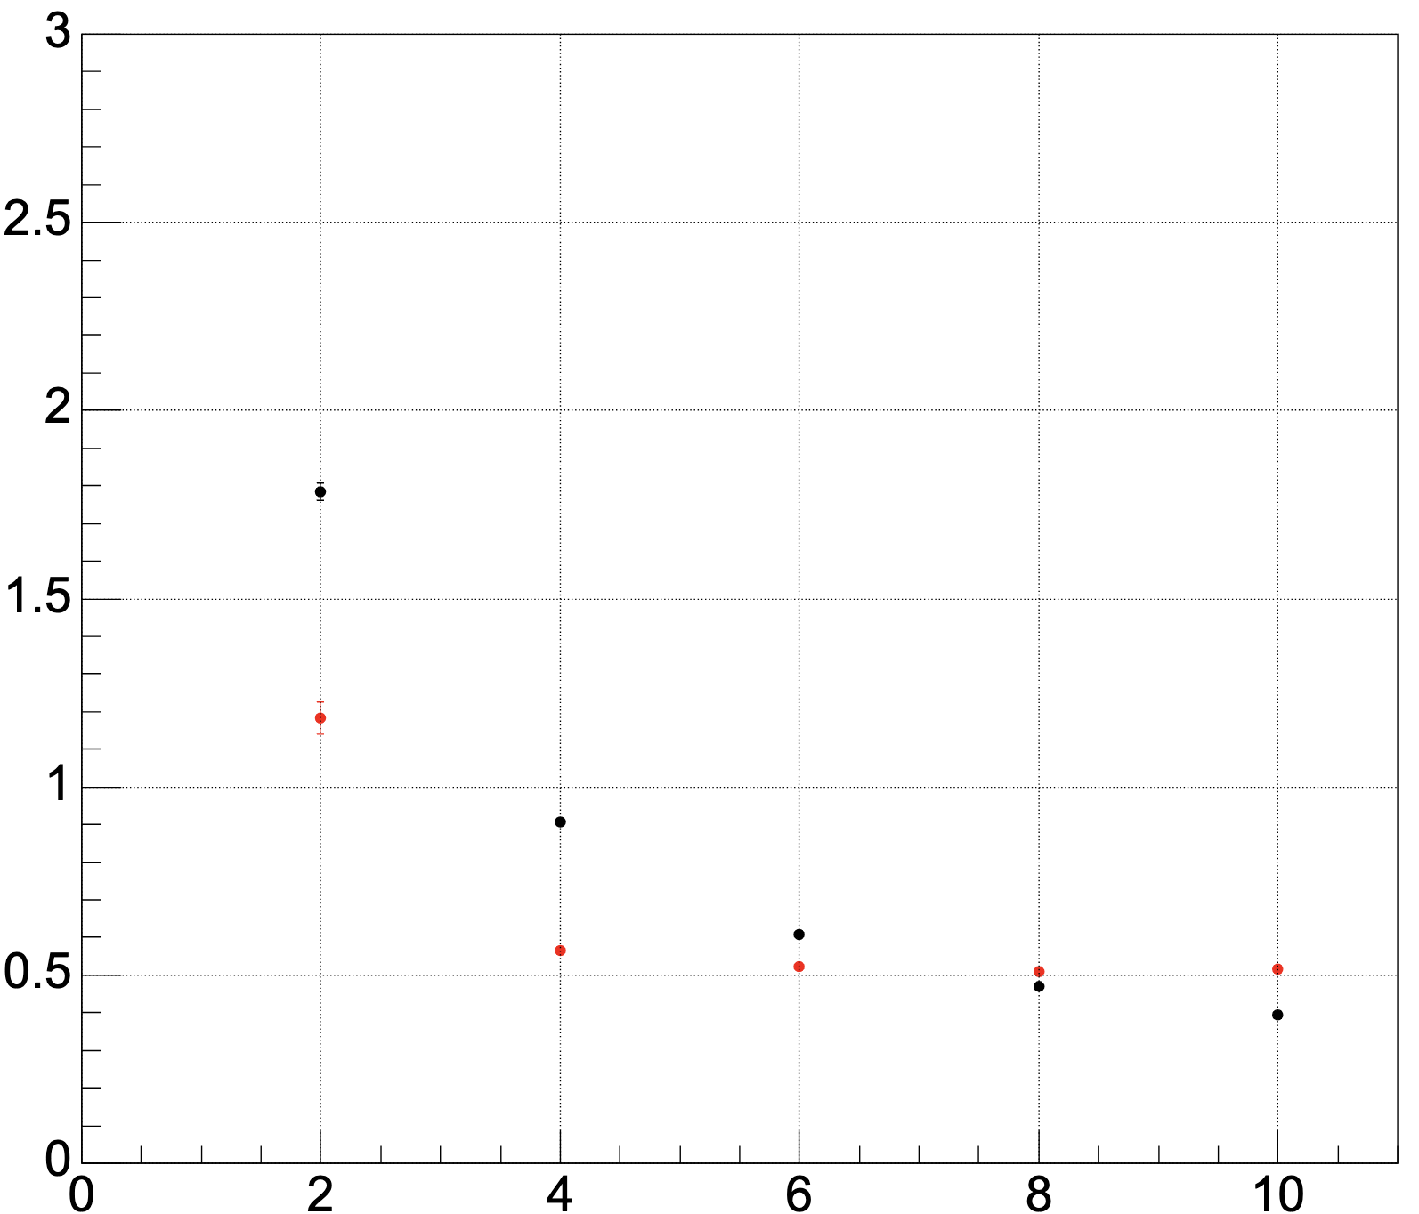
Comparison of reconstructed full track & fast track
Fast tracking showed better angular resolution at the lower momentum region
While full tracking showed better results at higher momentum region
Neither method satisfy the hpDIRC requirement (0.5 mrad for 6 GeV/c)
[$Δφ$vs Momentum] (6GeV, 92 < θ < 94 )
Using Reconstructed Fast Track
Using Reconstructed Full Track
Momentum [GeV]

Slide 9
Summary
Simulation study is ongoing to determine the upper limit of the material budget of BTOF and optimize detector design
Angular resolution using Reconstructed Full Track
Slightly failed to meet the requirement of hpDIRC 0.5 mrad for 6 GeV/c particles
Angular resolution using Reconstructed Fast Track
showed better results in the low momentum region
Still not satisfy the hpDIRC requirement
Possibility to improve the angular resolution by making use of Tracklet
Tracklet: calculate the angle from only MPGD and BTOF hits → Study ongoing, any comments or suggestions are highly welcome!
Angular resolution is not very sensitive to the BToF material budget

Slide 10
Backup slides

Slide 11
PID detectors and coverages

