Slide 1
MOSAIX CHARATERIZATION – FOCUS ON WAFER PROBING
Ivan Amos Cali, Leyre Flores, Gian Michele Innocenti, Anhelina Kostina, Lukas Tomasek
ePIC collaboration meeting Frascati
21/01/2025

Slide 2
GENERAL CONSIDERATIONS

Slide 3
SVT CONSIDERATIONS
The SVT WP2 group has established a direct collaboration with the ITS3 team to co-develop all the tools needed to characterize MOSAIX
Wafer probe-based characterization has emerged as the most efficient testing strategy for both SVT and ITS3
→ SVT has developed valuable experience for this technology
→ providing essential contributions to the overall MOSAIX testing project

Slide 4
WHY WAFER-PROBE TESTING?
It makes the characterization process faster and more effective
Reduces the time needed for prototyping and development
→ Electrical QA/QC run at high-speed
Reduces the time needed for testing of large volumes of sensors
→ It is effectively the only viable solution for the SVT (~200 wafers to test)
What are the technical requirements?
→ Develop a wafer-probe system that runs at high frequency for 12 inches thin sensors
Dedicated wafer probe machine for 12 inch sensors
Optimized for thin sensors (dedicated micro-vacuum chuck)
Low-impedance/resistance probe cards, allowing the use of the high-frequency links that equip MOSAIX

Slide 5
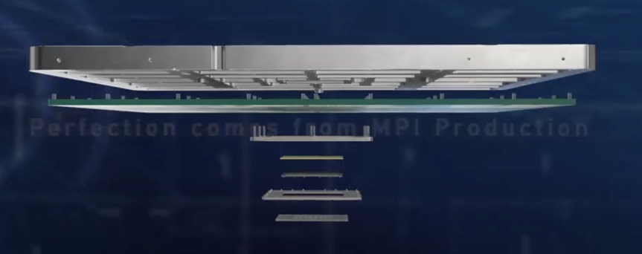
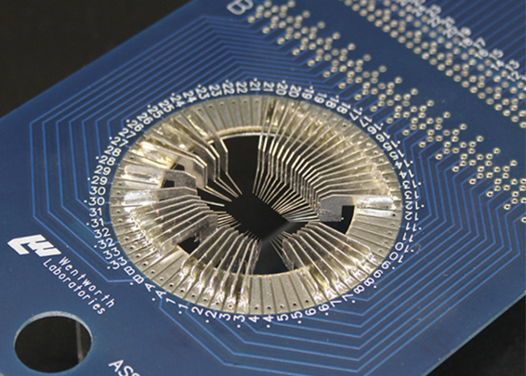
HIGH-SPEED AND LOW SPEED WAFER TESTS
Develop general purpose HW that can be used in several wafer probing sites and with different level of performance:
High-speed: RF Vertical probing 300 mm machines
Low-speed: cantilever technology
ITS3 is developing a probe card with cantilever technology while SVT (MIT) is developing a probe card with vertical probing and both will be used in common for MOSSAIX testing
VERTICAL PROBE CARD
CANTILEVER PROBE CARD

Slide 6
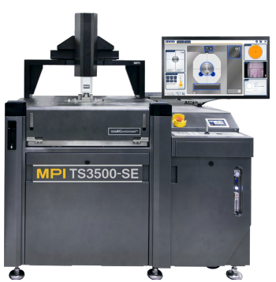
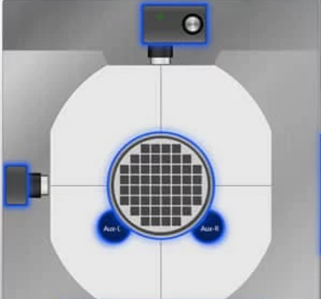
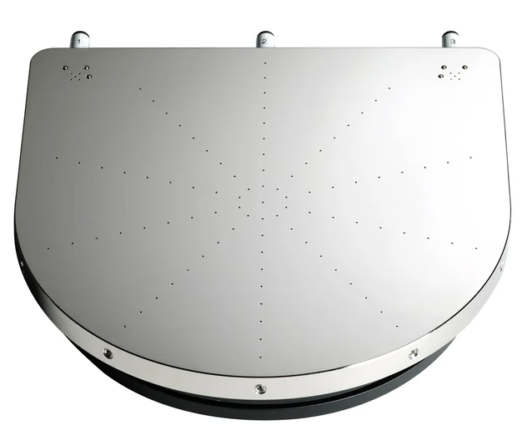
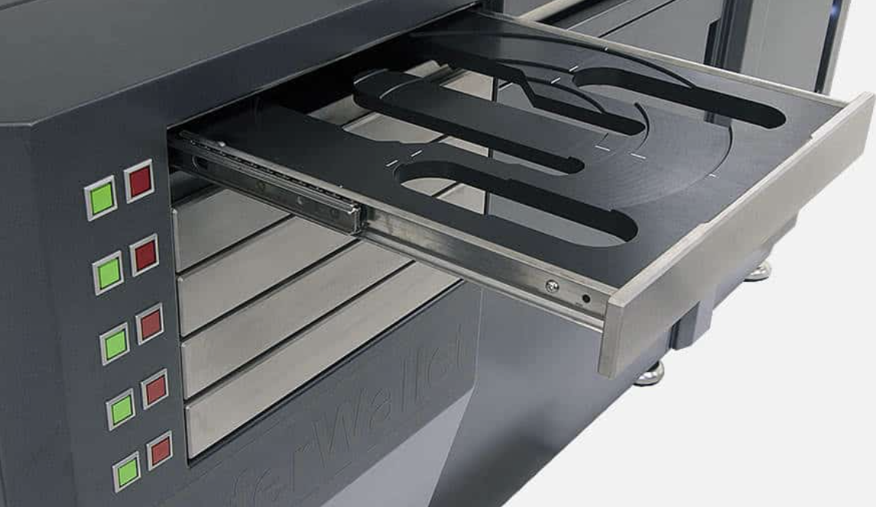
A DEDICATED WAFER PROBER @ CERN
MPI TS-3500 SE
Installed at the DSF lab
Wafer wallet for fully automatized testing
Multiple cameras available
Must for vertical probing
Capable to load 300 mm wafers
Micro-holes for accurate placing of ultra thin wafers

Slide 7
COMMISSIONING AND FIRST TEST IN “NON-AUTOMATISED” MODE

Slide 8
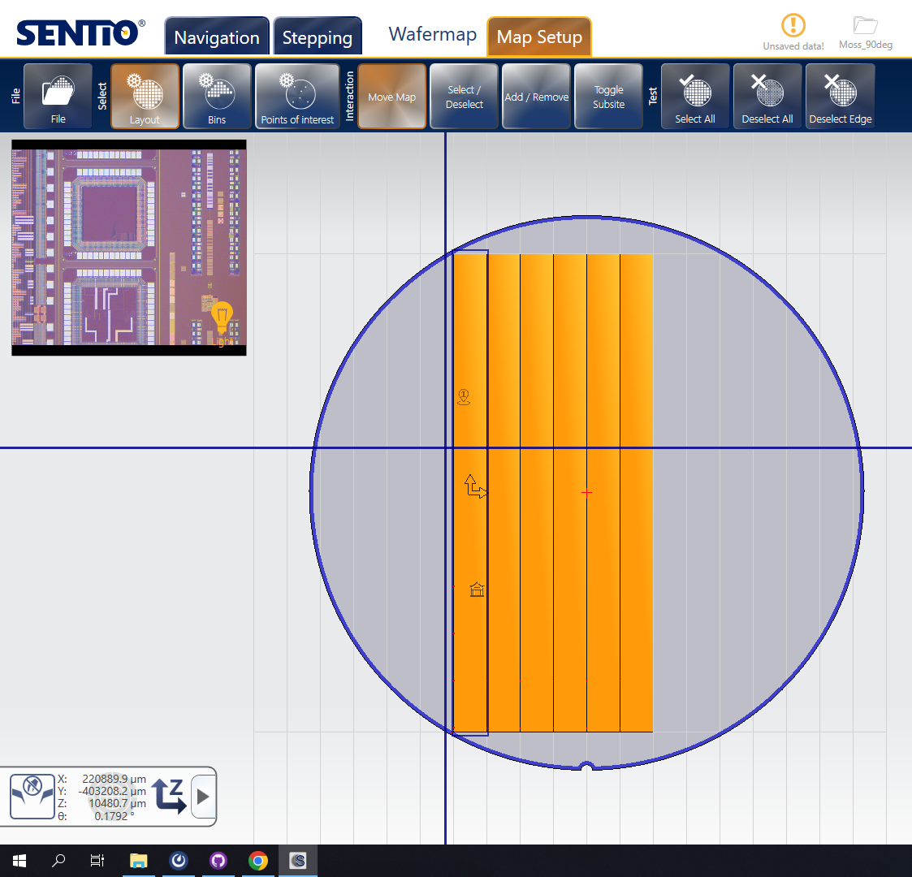
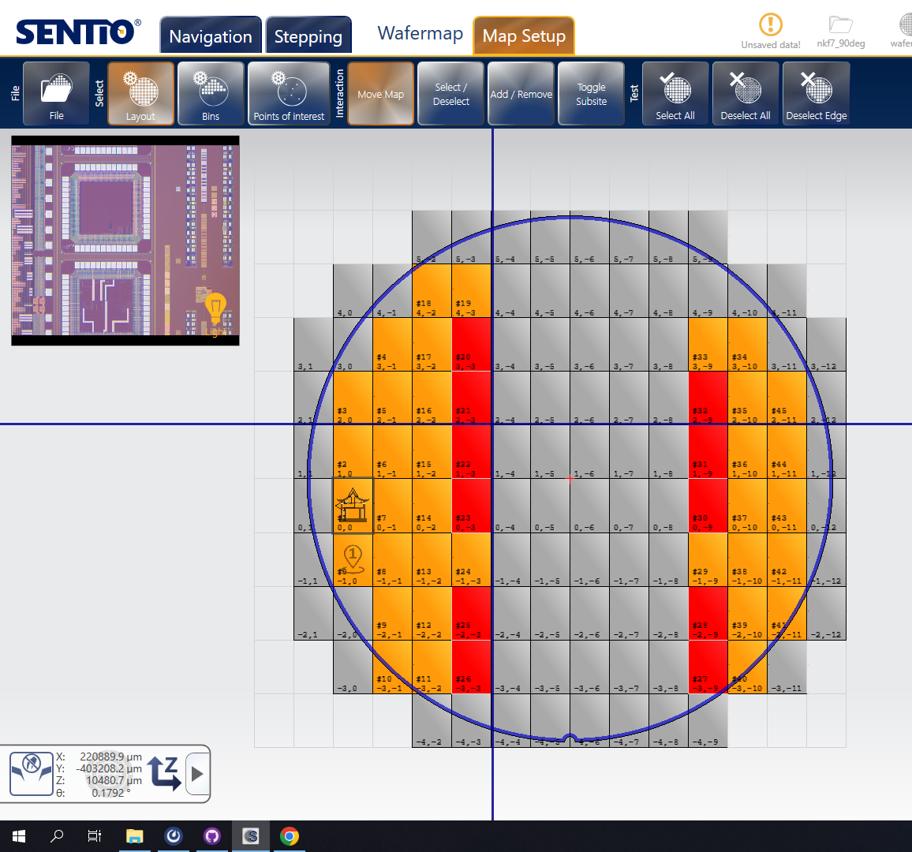
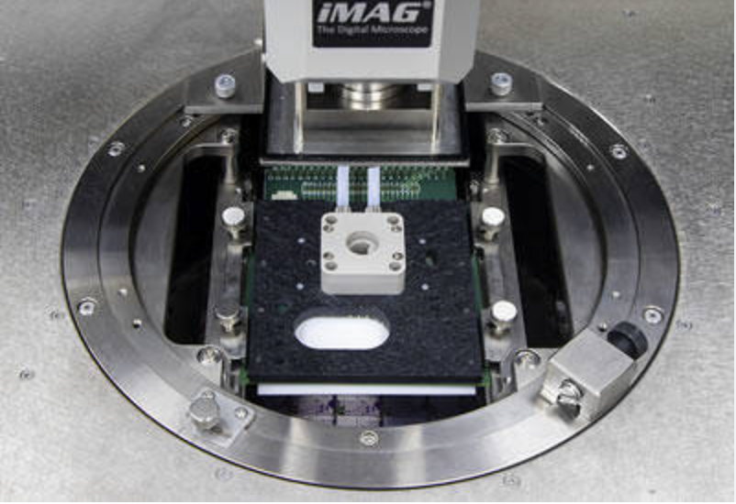
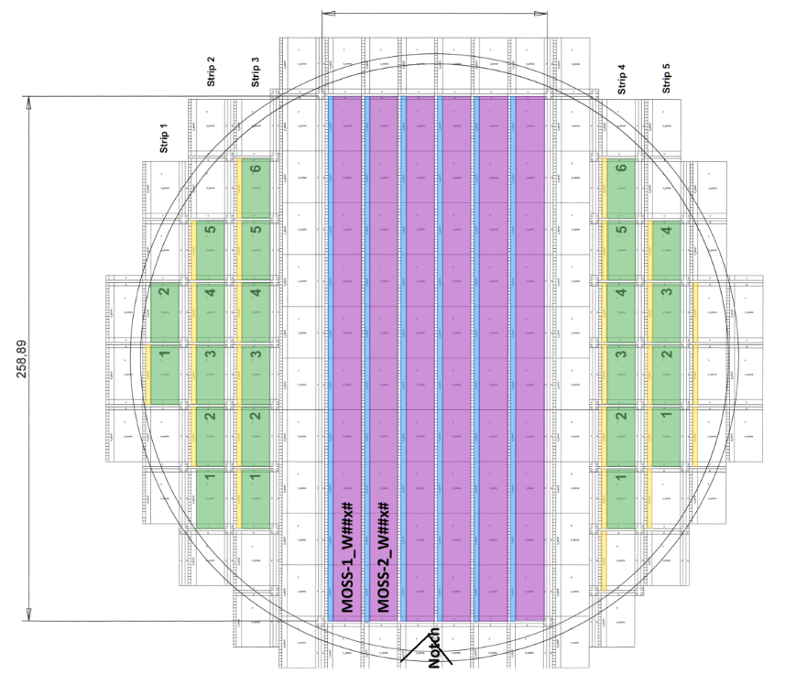
PROBE CAR SETUP AND WAFER MAP GENARATION
Wafer map generation
Probe card holder and alignment
Inclination adjust wheel
Screws for z position
Rails for X and Y

Slide 9
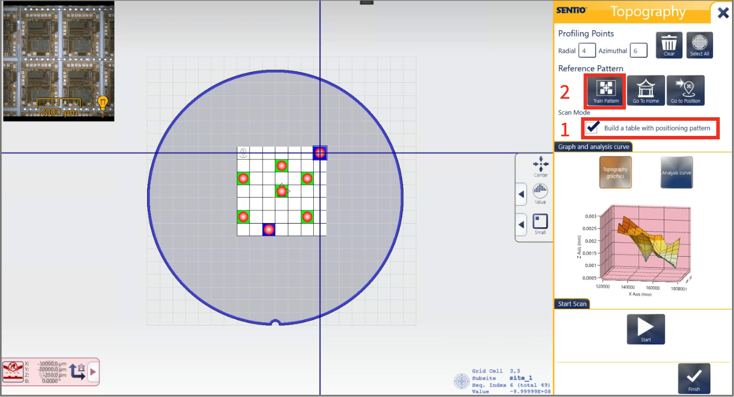
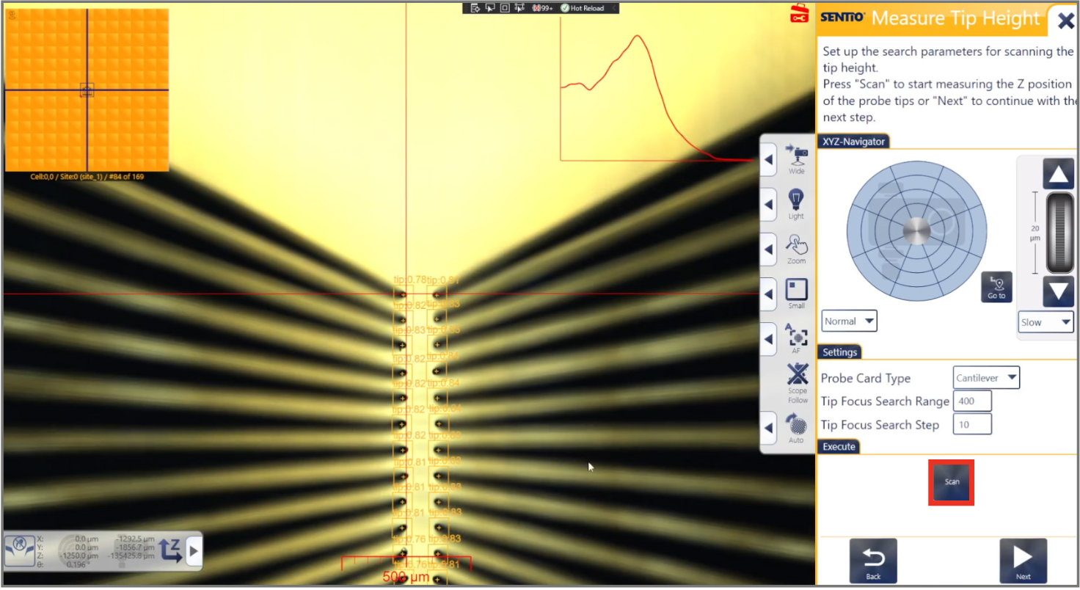
PROBE TO PAD ALIGNMENT
Topography maps
Pobe To Pad Alignment training (PTPA)
Uses light reflection to calculate the differences in heights across the wafer using the specified dies
Training procedure using marker, pads and tips to align needles to pads in X, Y and Z

Slide 10
DEVELOPMENT OF NEW SOFTWARE TOOLS FOR FAST CHARACTERIZATION

Slide 11
DEVELOPING AUTOMATIC TESTING
Goal of sharing the projects and scripts with all the institutes involved in wafer probing testing
Github repository: https://github.com/SVT-WP2/MITWP1/tree/main
Currently to main folders:
Python projects: Sentio Software Remote commands scripts to operate the WP
Scripts: Bash scripts that allow to test a full system including DAQ, PS and WP commands
All the automatization process has been done using the features of vertical probing
Code snippet from the Scripts

Slide 12
WORKFLOW WAFER PROBE TESTING
~ 30 MIN
per wafer family
Wafer_name_project
Few min to load wafer
+ few sec per die
Probe card adjustments
WP remote control
New wafer installation
Manual Sentio Project Setup
Automatization scripts
Electrical Tests
MANUAL SETUP ONLY ONCE PER WAFER TYPE
AUTOMATIC TESTING
Readout and control HW
Analysis of results
Wafer alignment
Wafer map generation
PTPA training
Topography
Includes PS control
Wafer_name_project

Slide 13
ALICE ITS ER1 WAFER PROBER CHARCTERISATION RESULTS

Slide 14
ALICE ITS ER1 CHARACTERISATION WITH SVT PROBER
SETUP DESCRIPTION
The machine validation was done following the presented workflow with ALICE ITS ER1 wafers
Cantilever prober card (used as vertical probe card)
Used ER1 readout system as DAQ and HW control as well as for analysis
Used automatization software tools presented above

Slide 15
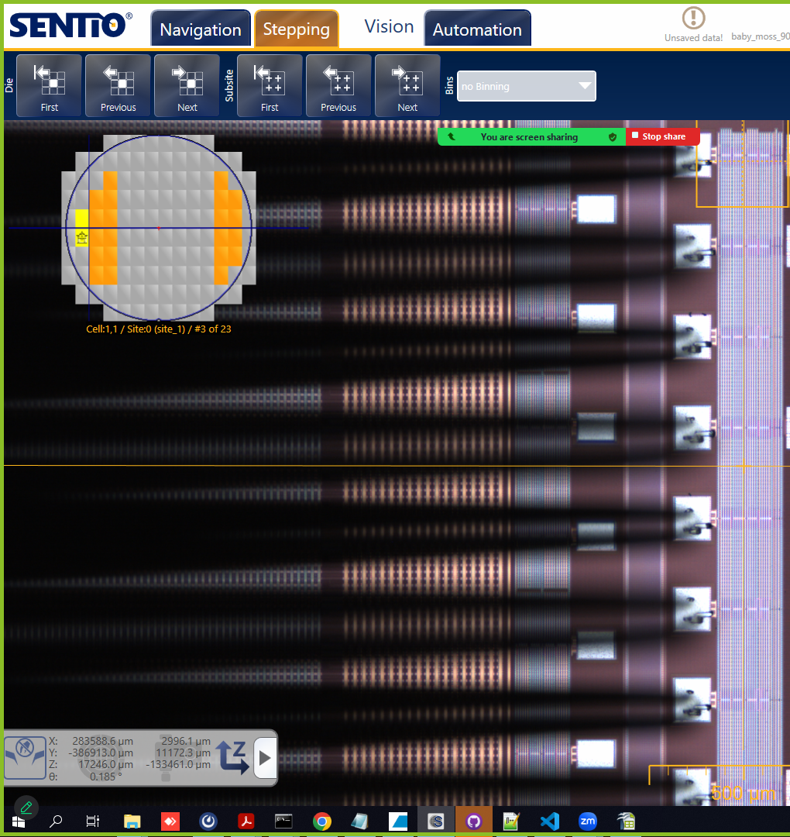
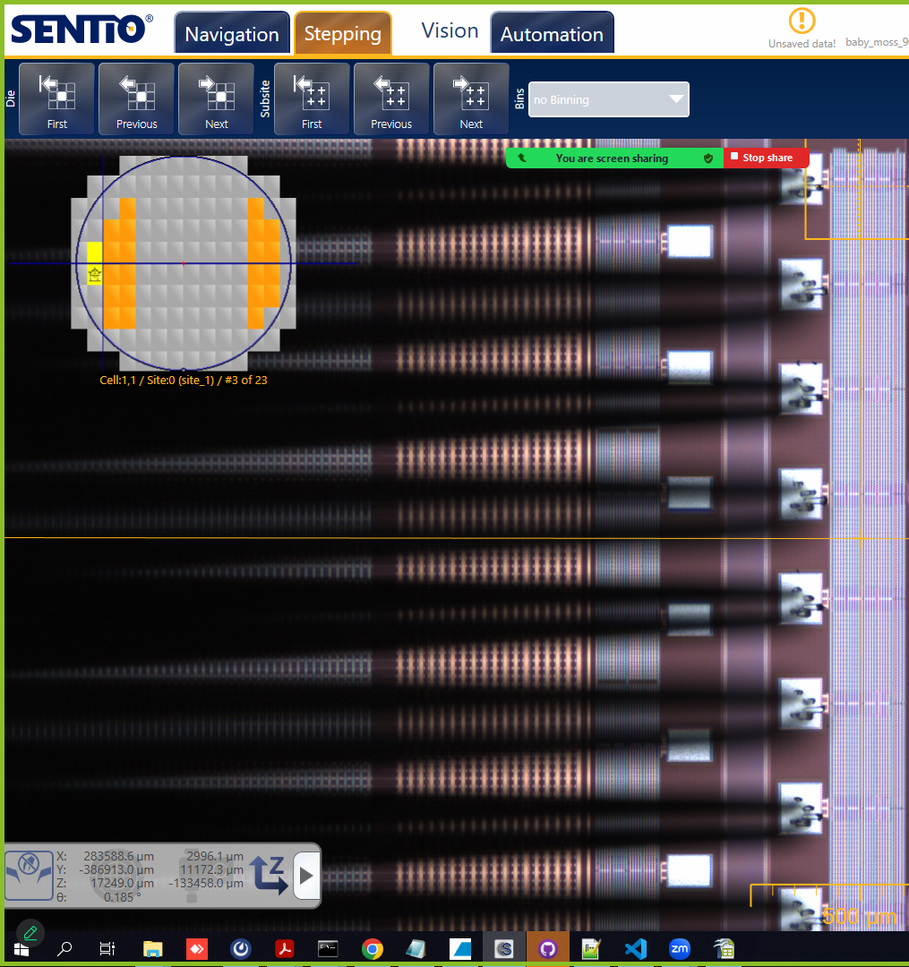
PRECISE ELECTRICAL CONTACT
Demonstrated ability to position needles with μm precision in both XYZ with automatic features and have good electrical contact
ITS3 PROBE MARKS
SVT + ITS3 PROBE MARKS
New contact created beside ALICE ones
ePIC Collaboration Frascati 2025

Slide 16
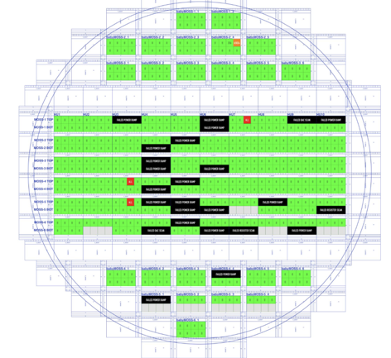
ELECTRICAL TESTS RESULTS OF BABY MOSS
Tested all 25 babyMOSS top unit in the wafer in 25 minutes with ~identical results to ALICE
Electrical tests as Digital Scan, PowerOnTest, Registers scan
Goal for ER2 is 30 mins/wafer with high-speed probe card and high-speed readout
ALICE ITS3 RESULTS
SVT RESULTS
W124A 3-1 HIT MAP
W124A 3-3 NOISY PIXELS
ePIC Collaboration Frascati 2025

Slide 17
NEXT STEPS: NKF7 FIRST VERTICAL PROBE CARD BENCHMARK

Slide 18
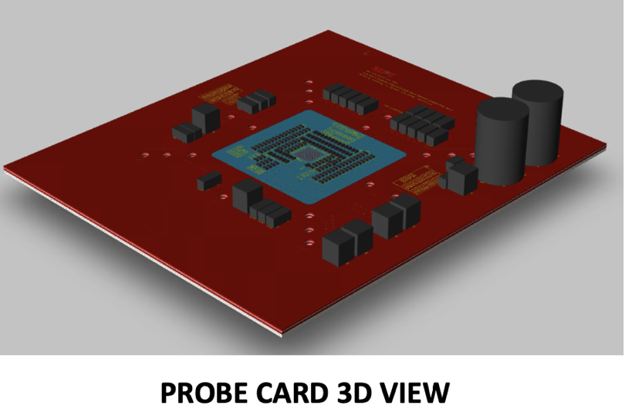
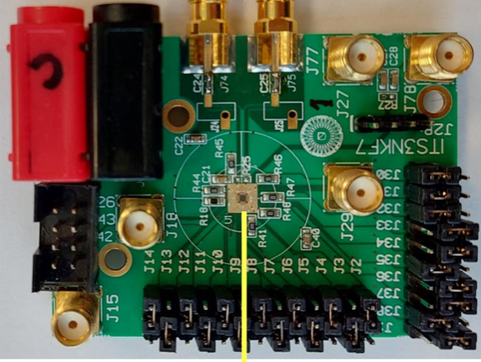
NKF7 VERTICAL PROBE CARD
First prototype of vertical probe card
It will be shipped to CERN before the Chinese NY
Main design specifications:
High-speed material laminates: Megtron6
Careful layout of high-speed traces
Decoupling capacitance network and pull up and pull down resistors
Orientation of the MLO and probe card
Layer stack-up
Goal is to use vertical probing probing technique to achieve a data rate of 10 Gbps
NKF7

Slide 19
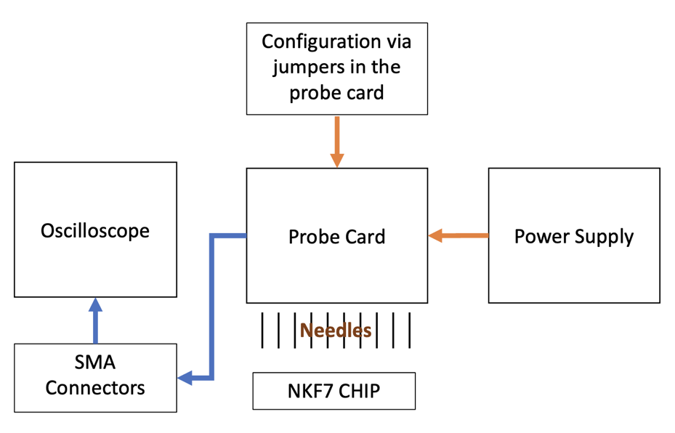
NKF7 TESTING SETUP
NKF7 testing does not require of an FPGA for the data acquisition system
Check that pattern sent via jumpers is received in the scope
This project will be used to benchmark the system and getting ready to test the MOSAIX and LAS in the future
Vertical probing automatization
High-speed data taking from needles

Slide 20
MOSAIX AND LAS PROBE CARDS AND CHARACTERISATION

Slide 21
MOSAIX AND LAS PROBE CARD
Probe card using vertical probing single point for MOSAIX ER2 + readout via Enclustra/KCU10x
Foreseen a multipoint version for MOSAIX ER2 or 3
LAS is expected to have a similar interface of MOSAIX with just suppression of some signals
Best Case scenario: same pinout
Middle case scenario: similar pinout
A multipoint probe-card for LAS should be considered to speed up significantly the testing

Slide 22
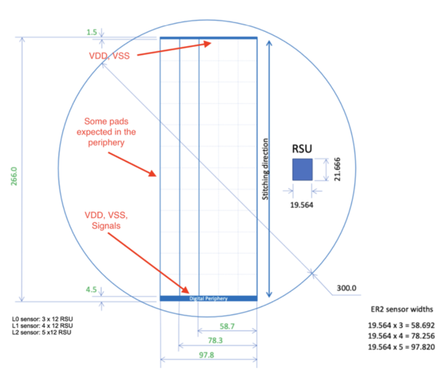
PROBE CARD OPTIONS
Option 1: Probe card with needles only on the left endcap
Option 2: Probe card with needles in both right and left endcap
Right endcap is for powering and it has some test out pins
Option 3: Multi-point probe card to test several sensors at once
ITS3 carrier card can be used as a starting point
PCB could be adapted with minor changes
Redistribution layer will need to be designed
In process of getting some quotes for the various options from MPI

Slide 23
MOSAIX CARRIER BOARD DESIGN
Compatibility with wafer probers in the collaboration needs to be verified
It allows irradiation and thermal camera studies
It limits the re-use of the same modules for multipoint
ePIC Collaboration Frascati 2025

Slide 24
MOSAIX CARRIER BOARD DESIGN
Compatible with all the WP with standard probe card holder
Does not allow irradiation with source (needed for ER2 studies)
It can be easily extended to multipoint
ePIC Collaboration Frascati 2025

Slide 25
BEFORE MOSAIX IS SUBMITTED...

Slide 26
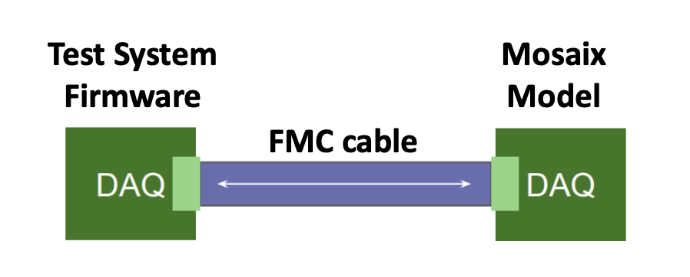
MOSAIX EMULATOR TESTS
WP2 members currently contributing to the ITS3 system tests
Testout readout of tiles at 160 Mbps
Hardware used: Enclustra boards with Intel Arria 10 FPGA with the ST1+ board
Firmware development tools
Quartus as design suite
Altec Riviera Pro used for simulation
Cocotb for verification (https://docs.cocotb.org/en/stable/index.html)
While design is not submitted working on an emulator system that includes MAPS RTL

Slide 27
WRAPING IT UP

Slide 28
CONCLUSIONS
First validation of the machine WP successfully completed
Tested all the babyMOSS top unit of ALICE ER1 wafer W12A6 obtaining same results as them
25 minutes to finish a wafer
First version of automatization software tools available in Github for anyone interested
SW and FW for MOSAIX readout is ongoing for single MOSAIX and we are part of team
Extension to multiple MOSAIX/LAS needs to be designed
NKF7 vertical probe card prototype will arrive very soon
First real benchmark of testing capabilities
MOSAIX vertical probe card agreement with ALICE ITS
Waiting for initial quotes

Slide 29
BACK UP

Slide 30
MOSAIX CARRIER BOARD DESIGN
It can be adapted from the ALICE ITS3 carrier board card
Design files available
Technical specifications:
12 layers design
Rogers 4350B high-speed laminate used
Data at 10 Gbps
6 voltage planes
6 conductor layers
Multipoint Probe card: It could be a combination of LECs and RECs probe cards with a mechanical structure
Left endcap needles
Right endcap needles

Slide 31
PROBE CARD OPTIONS
Probe card LEC: Only needles for the Left Edge
Probe card REC: Needles for Right Edges
Multipoint Probe card: It could be a combination of LECs and RECs probe cards with a mechanical structure

Slide 32
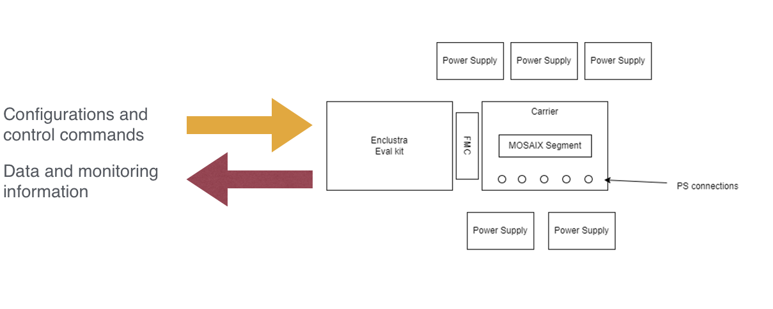
TEST SYSTEM HW CONCEPT ITS3 (MOSAIX ER2)
System for 1 MOSAIX
Enclustra Evaluation Kit + FMC and Power supplies are off the shelf commercial components
The Enclustra Eval kit acts as control and readout system
The Enclustra FW is being developed by the ITS3 team in collaboration with some SVT members
Probe Card being developed by MIT and Korea University (parallel approach)
Carrier board is being developed by CERN ITS3 team
WAFER PROBER TEST SYSTEM
WIRE BONDED TEST SYSTEM

Slide 33
PLANS AND MILESTONES FOR WP2
ER2/ER3 MOSAIX testing:
DAQ setup developments at software/hardware and firmware levels
SVT requires unique SW/HW features, beyond what used by ITS3 (backup)
Unique contributions to exploit the new technology for large area detectors
Develop a new a high-frequency testing system with wafer probe
It will be tested very soon on the NKF7 serializer prototype
Testing and characterization:
performed with wafer probe/DAQ setup
characterization of the EIC-specific blocks
EIC Large Area Sensors:
Adapt the reading/testing setup developed to the LAS
Extensive tests using wafer probes, DAQ setup before and after irradiation
Dedicated irradiation studies needed for LAS sensor, support chip, COTS, optic cables, FPC, …
Large scale tests of LAS sensors and corresponding ancillary blocks for LAS V1 and production LAS sensors

Slide 34
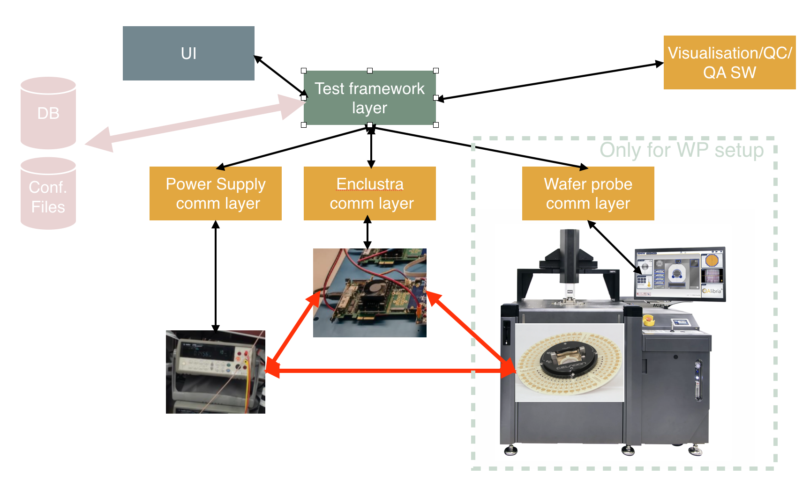
GENERAL CONCEPT TEST SYSTEM SOFTWARE

Slide 35
WP2 SW Considerations
With O(10) institutes interested to characterization/test we need to create self contained packages with minimal manual intervention required by the users
User and expert mode should be available
Any test and any configuration should be recorded (automatically) to allow repeatability and experts intervention
Scripting could be a day0 approach but not maintainable on the longer term considering the scale of the project.
For the final experiment or further in the process we will have DQM and UI but most probably we’ll need to develop our own tools in the meantime
Tools that should be anyway re-designed in the SVT framework are:
Data visualization/QC/QA should anyway be re-designed in the SVT framework
Database for sensors characterization and production
User interface

Slide 36
WP2 SW Considerations
During the meeting was clarified that we should re-use as much as possible from ITS3
But at the moment we should consider to don’t have access to any ITS3 SW
At present ePIC doesn’t not have active global groups taking care of global User Interface or global DQM/QC/QA framework
A document was produced globally by Prakhar Gang collecting info also from SVT (Nikki) about Detector HW construction DB:
Presentation: https://indico.bnl.gov/event/23086/contributions/90436/attachments/54156/92649/TIC_DB_04292024.pdf
Document: https://docs.google.com/document/d/1ow1nfy8dsrI1CfTBkG6kUJ0Oy2MZONhAktLy-zevJ1E/edit
Main requirement for the WP2/Construction SW:
User interface that would allow also not experts to operate the test system (“clicking” buttons may be easier than running scripts)
Reproducibility of the test configuration (no parameters need to be changed by the final user if not in expert mode)
Clear history of the sensors during the various step of production, constrictions and final commissioning

Slide 37
ITS2/MVTX approach to Testing/DCS
UI (WinCC) /FSM
SCADA Layer
The SCADA layer:
Allows macro instructions (e.g. configure detector, perform TH scan, etc.)
Info on detector and services stored to the DB
The APP Layer:
Perform constant monitoring of the detector (e.g. T, configuration status, etc.)
Retrieves from the DB the HW (electronics + detector) configuration
Performs automatic testing and scans
WinCC Dist 0
…
WinCC Dist. N
ITSComm 0
…
ITSComm N
APP Layer
ALF 0
…
ALF N
Services 0
CRU/Felix 0
…
CRU/Felix N

Slide 38
NKF7 serializer
Full presentation: https://www.dropbox.com/scl/fo/v41zz5ib4ghk3xi9tsjrc/h?rlkey=32vxzrr5msu39nudo5n1khg0j&dl=0

Slide 39
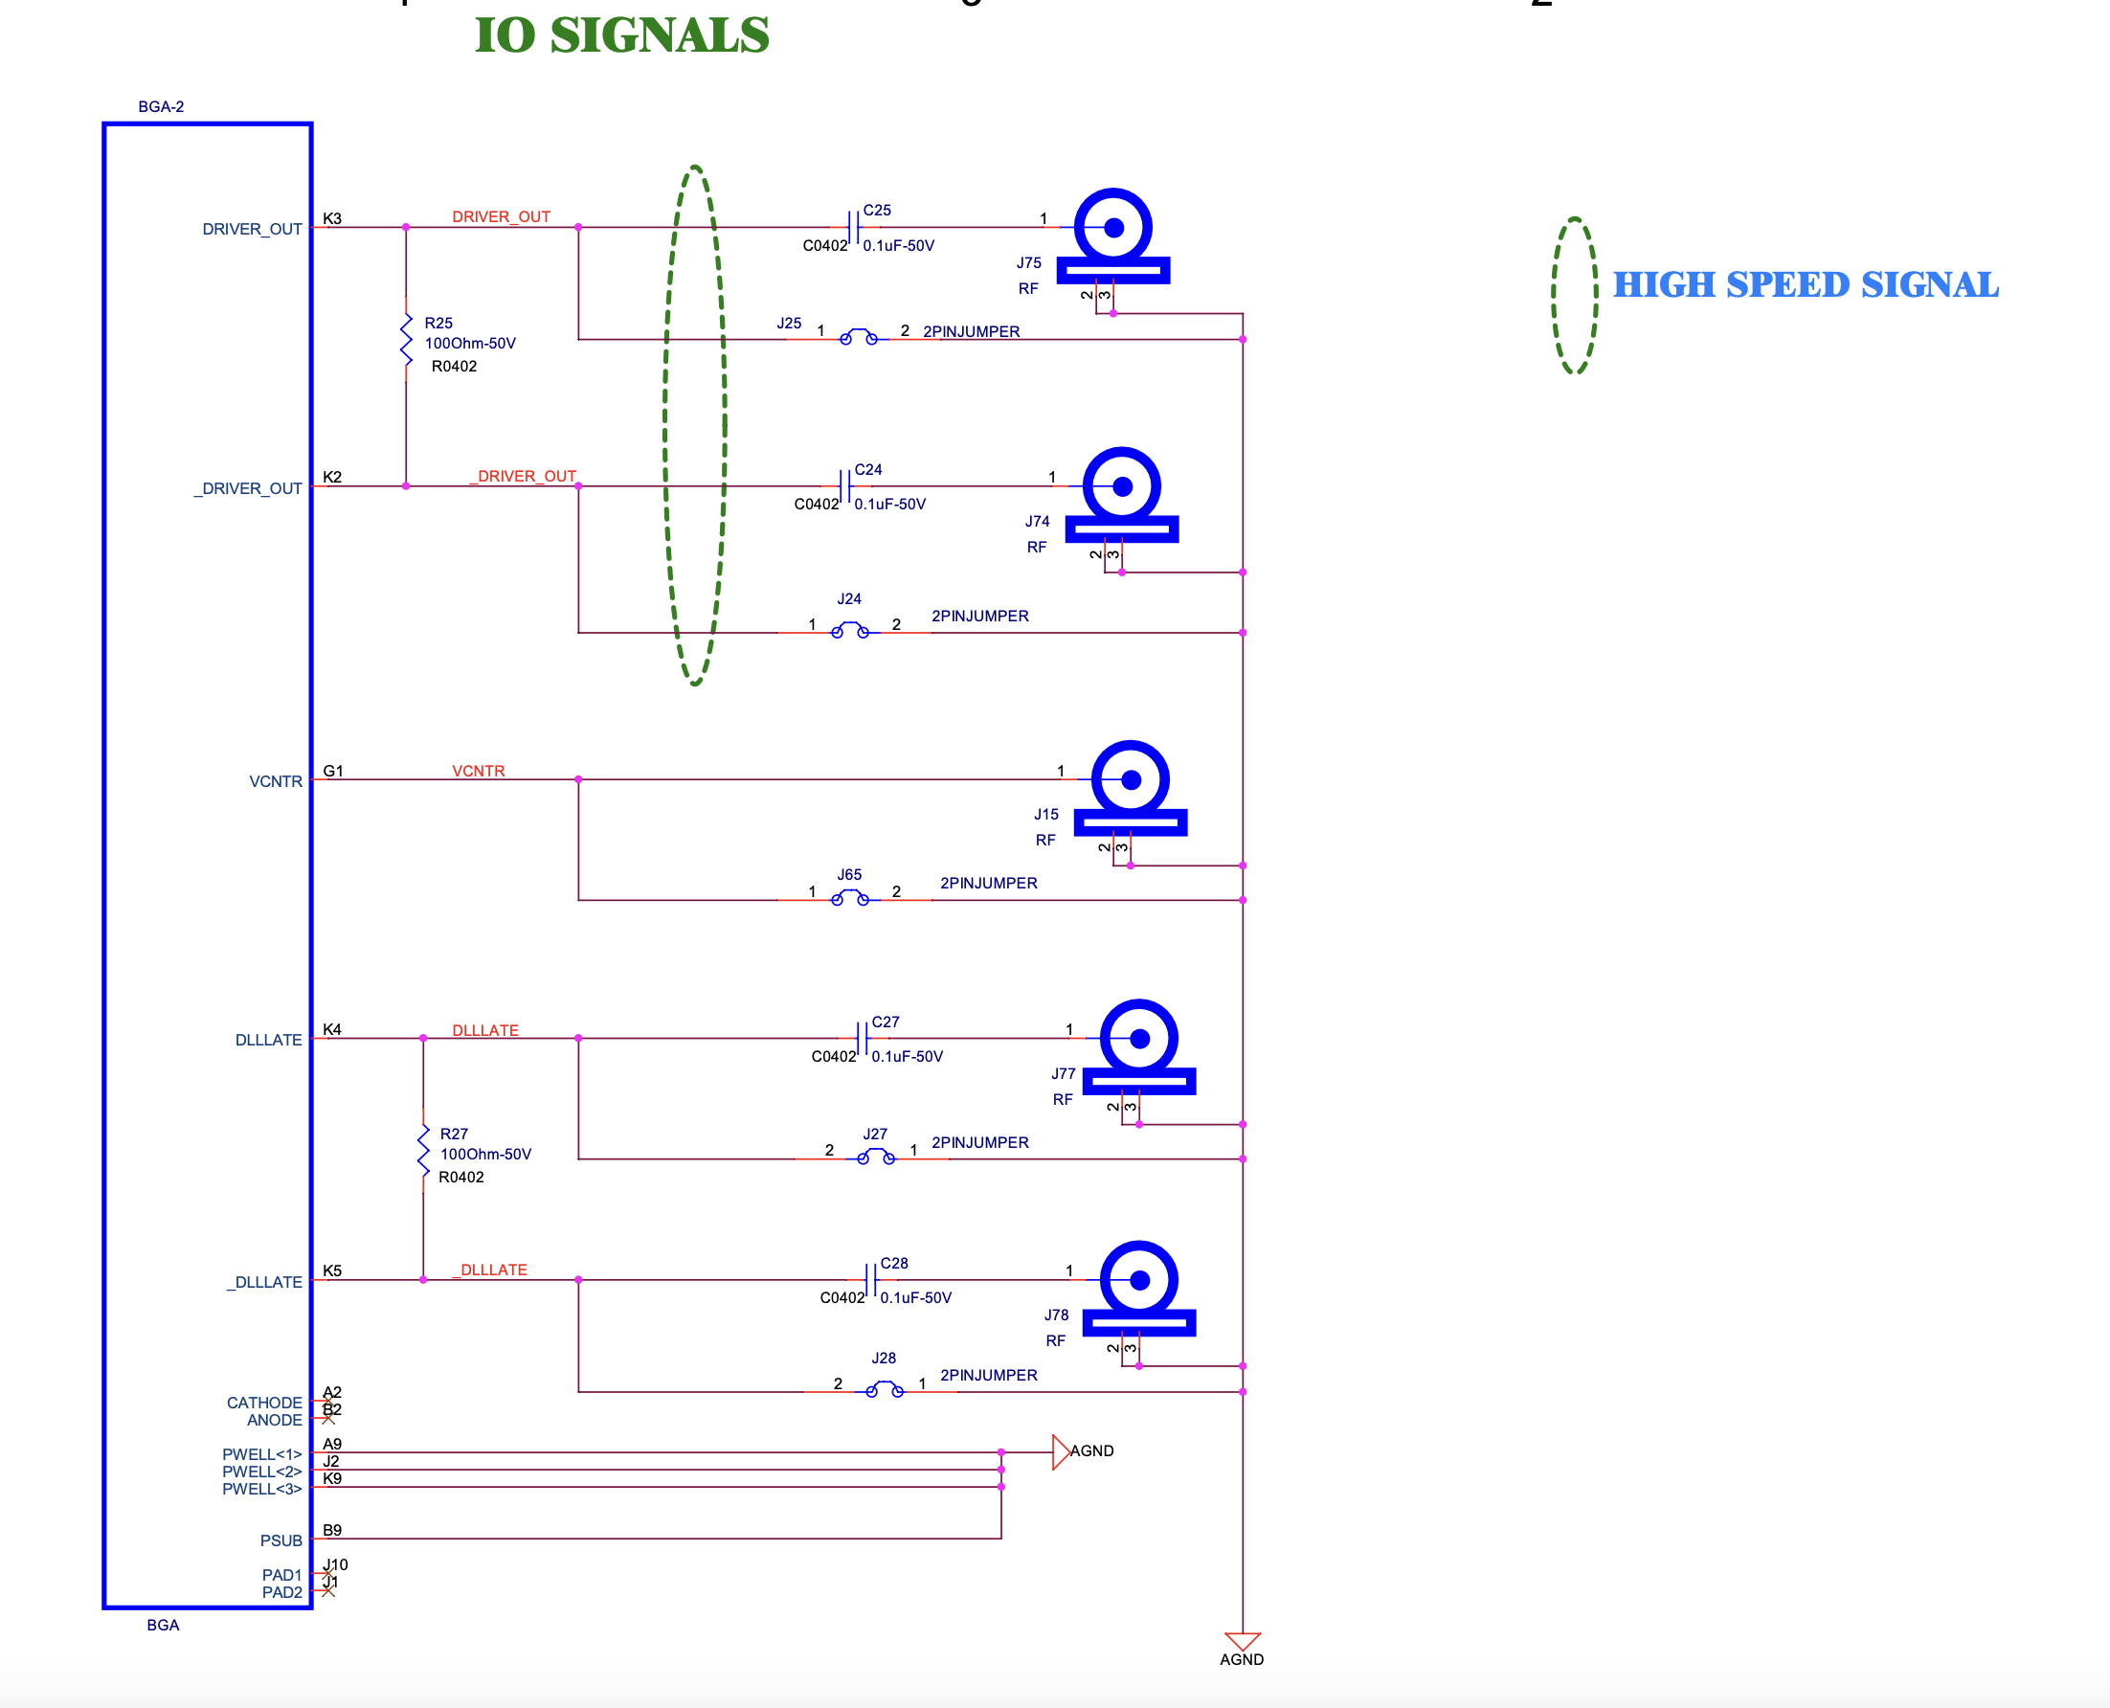
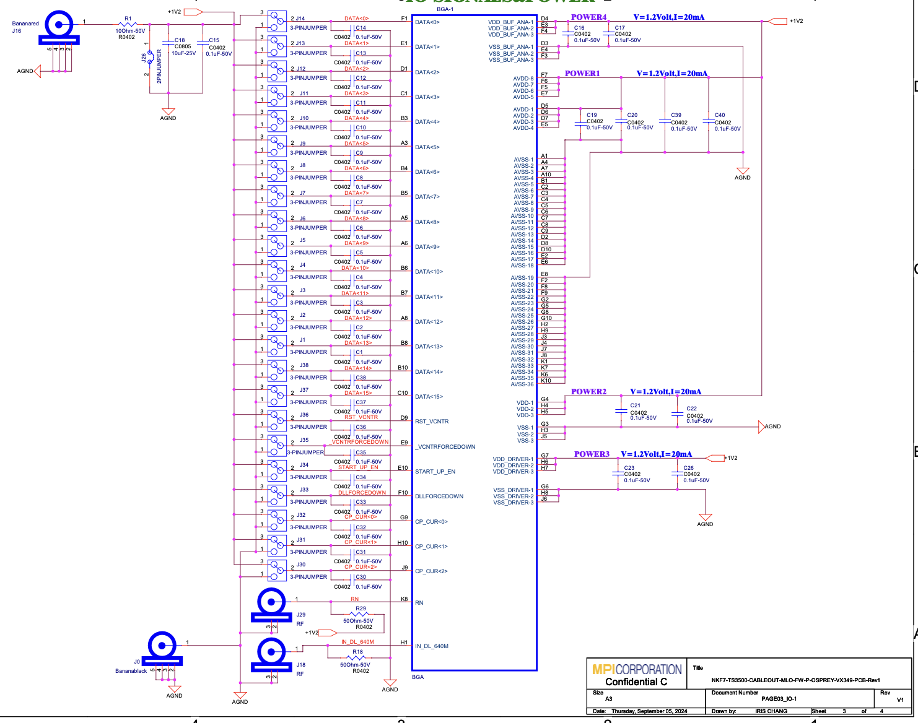
NKF7 probe card schematics
Termination resistors not mounted as using scope termination

Slide 40
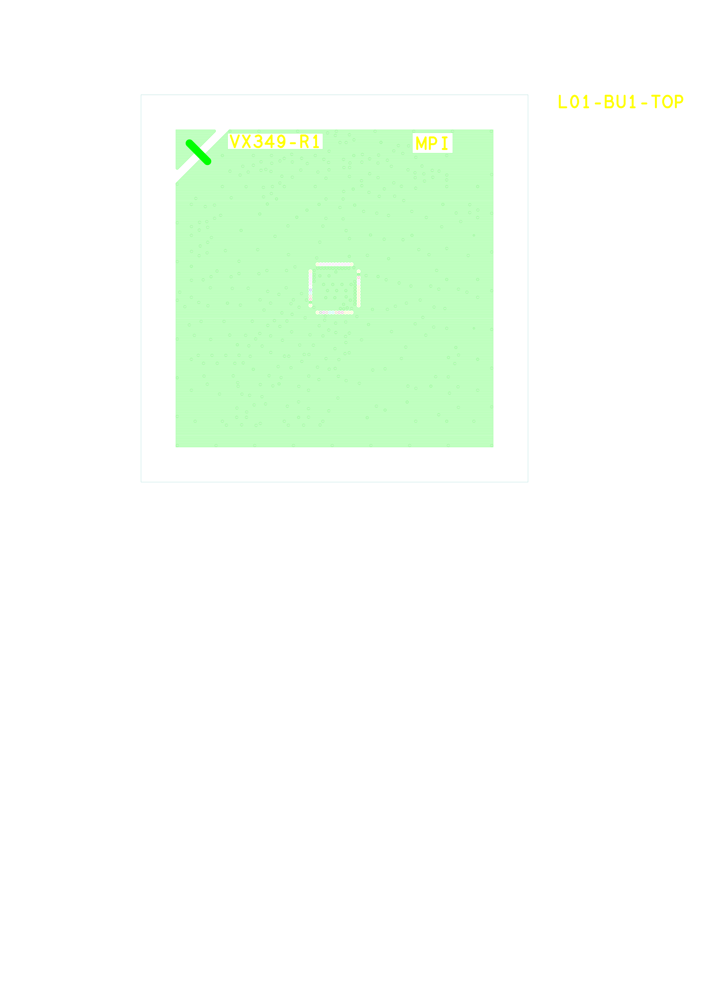
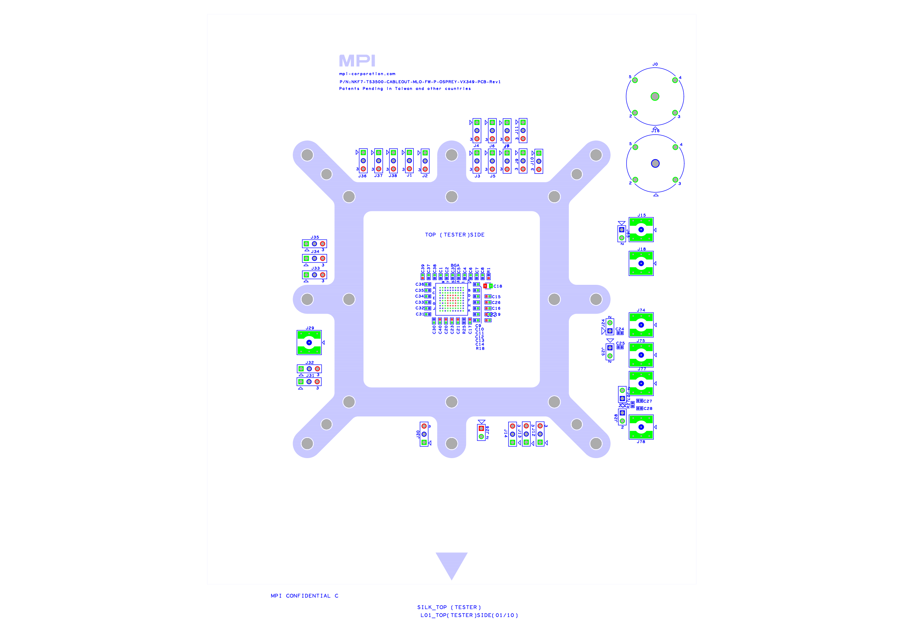
NKF7 probe card PCB and MLO

Slide 41
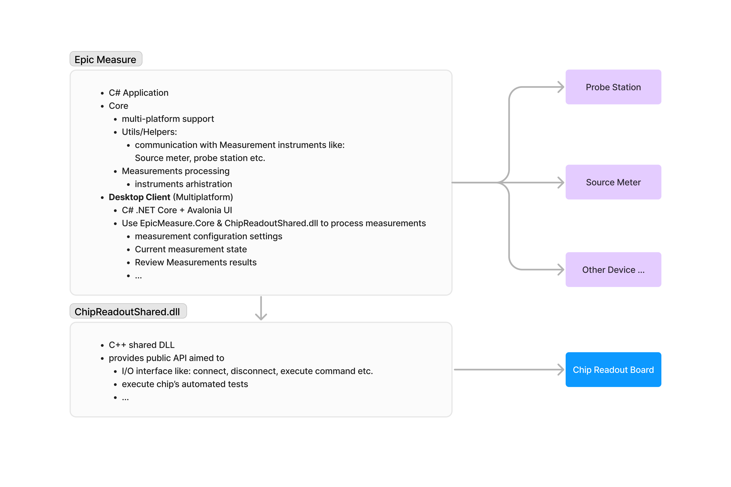
Possible Architecture for SVT
COPY OF THE SLIDE SHOWN
AT THE WP2 SW MEETING
This block could replace the SCADA and be used as core for visualization (waiting for DQM/QA/QC)
C# is being proposed but Avalonia UI could be as well a possible candidate
Any other ideas are more than welcome
An adjusted ITSComm/ITS3 API could be used for this block.
Common DB/repository is mandatory considering the amount of sensors/people involved in the SVT sensors characterization
O. Korchak
Strategy will be defined at the WP2 SW Meeting

Slide 42
Questions
Which User Interface do we want to use/design?
Which visualization tools we want to use?
Which “database” we want to use? How do we want to store configurations and results?
How do we plan to share the software between the various institutes?
Personal interests to the various activities?
What people already did in the SW land?
What else ?
General considerations:
With O(10) institutes interested to characterization/test we need to create self contained packages with minimal manual intervention required by the users
User and expert mode should be available
Any test and any configuration should be recorded (automatically) to allow repeatability and experts intervention
Scripting could be a day0 approach but not maintainable on the longer term considering the scale of the project.
For the final experiment or further in the process we will have DQM and UI but most probably wei’ll need to develop our own tools in the meantime

Slide 43
ITSComm
ITS3 is planning to start from the ITSComm to derive an API for the test system
C++ based code
Automatic configuration and monitoring functions available already in ITSComm
Geometry definition mechanism already implemented
ALF is a diver layer wanted by ALICE that is not needed in general.
The Communication Layer ALF can be easily replaced directly with the driver layer
The driver layer for the FELIX board is already available (MVTX)
Commands
Response + Status
DATA
DIM
DB
Communication Layer
Application layer
Conf.
Files
Communication Layer ALF
DIM

Slide 44
ITS3 system plans (M. Keil)

Slide 45
Introduction
SW Subgroup mandate
Create the general testing framework used to include each subcomponent’s testing software. The framework should be designed to be easily extended to the production software.
Develop the needed control/test software for each subcomponent
Develop analysis tools for each step of the characterization
Assist the Readout and General Strategy task force.
Interact with the WP responsible for the final software integration.

Slide 46
Disclaimer
This set of slides are supposed to help the discussion on general WP2 SW/HW strategy. Details needs to be discussed further during the meeting/s
The informations reported about ITS3/MVTX represent what known at the moment and changes in strategy can/will be applied
After the SW meeting some information were collected about the ePIC wishes/plan. Informations are still quite scattered and scarse.

Slide 47
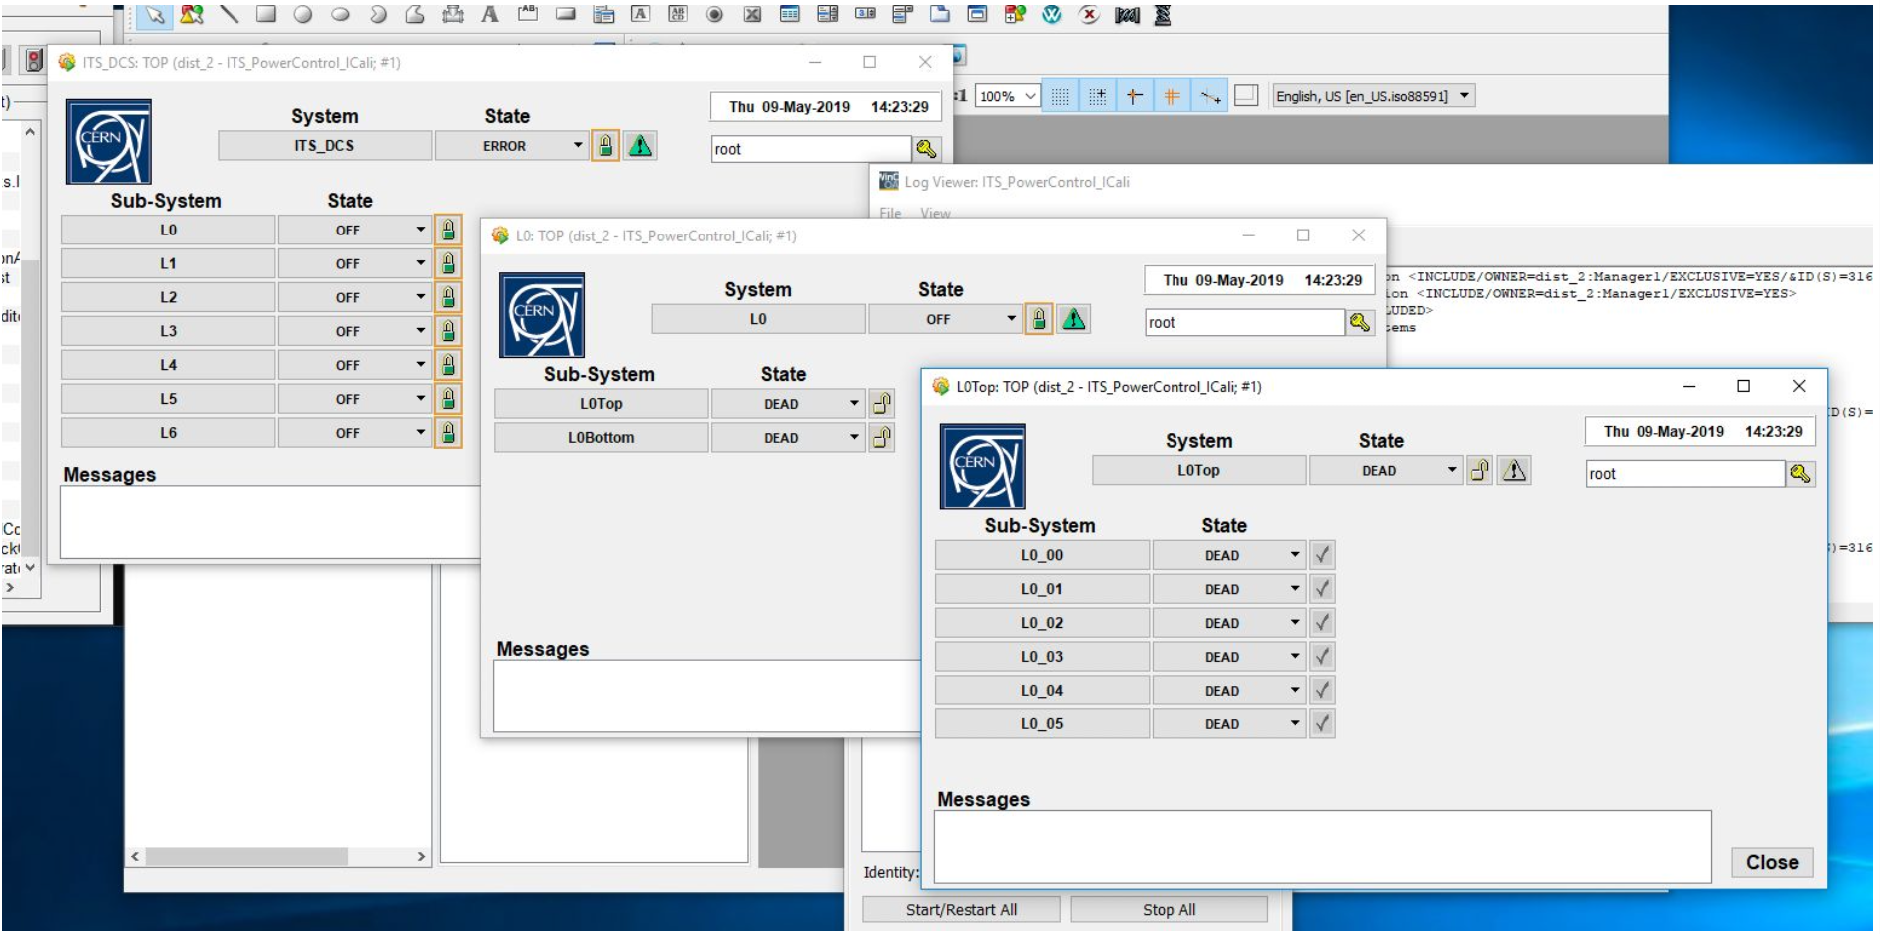
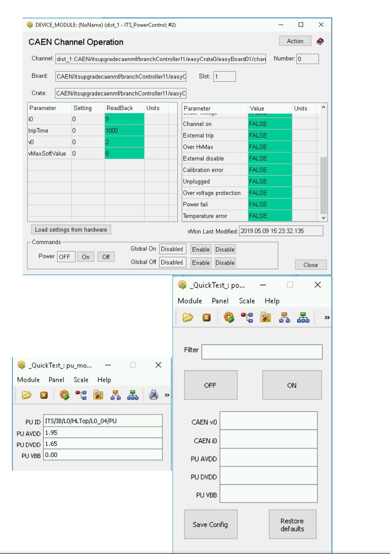
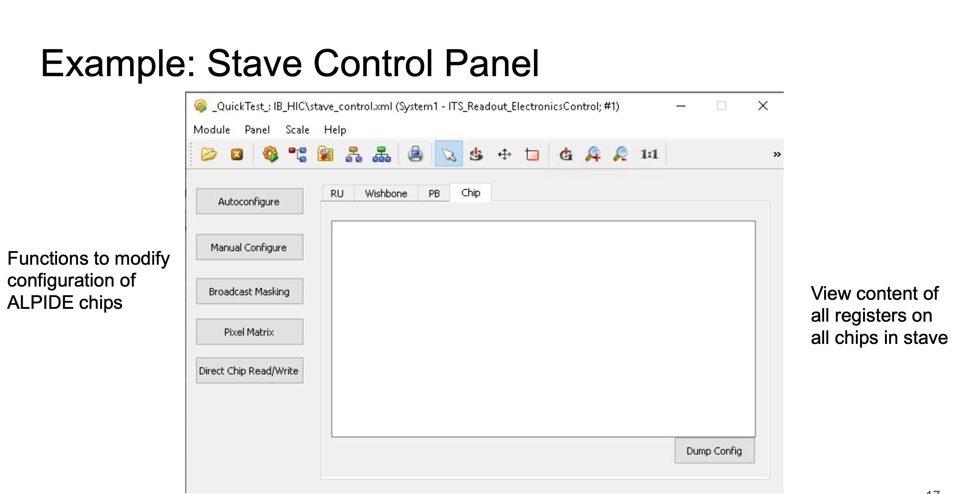
WinCC look&feel

Slide 48
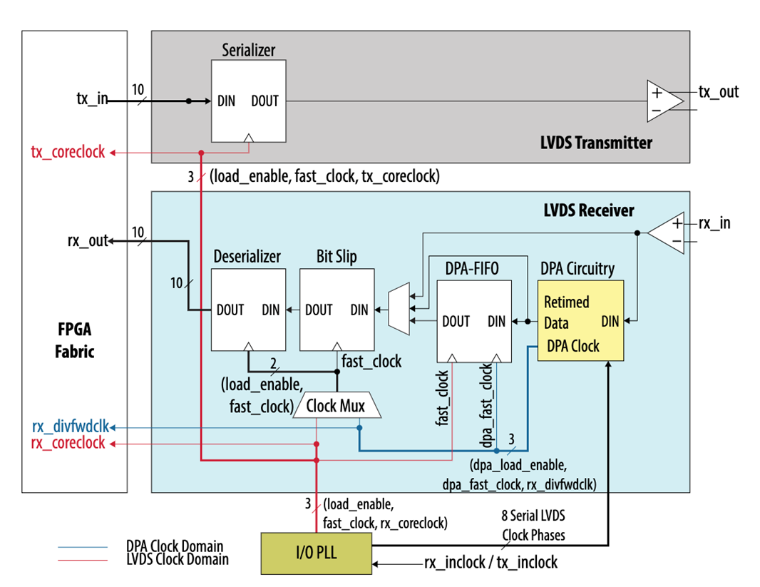
MOSAIX SYSTEM TESTS

Slide 49
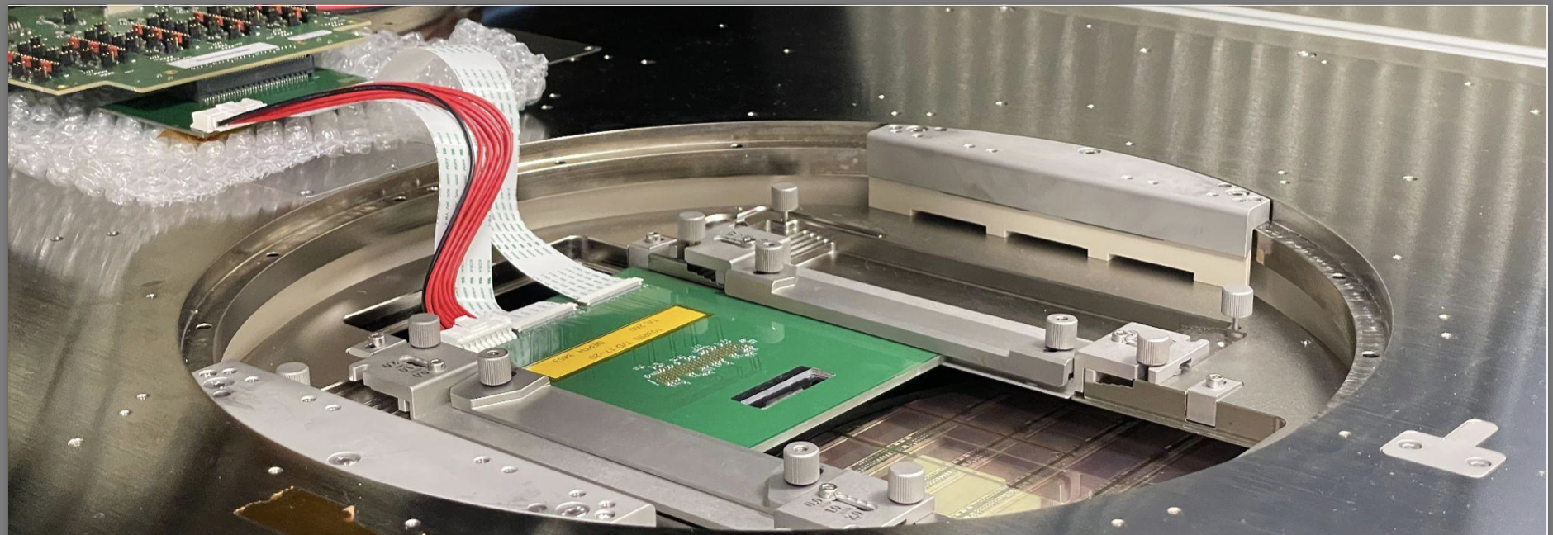
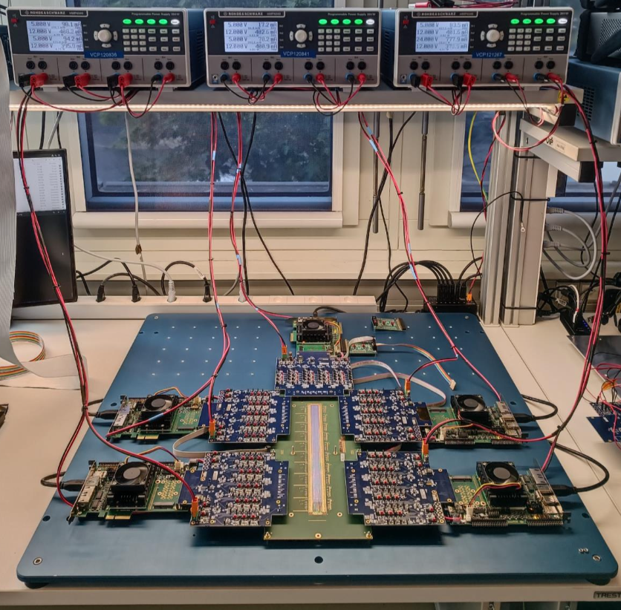
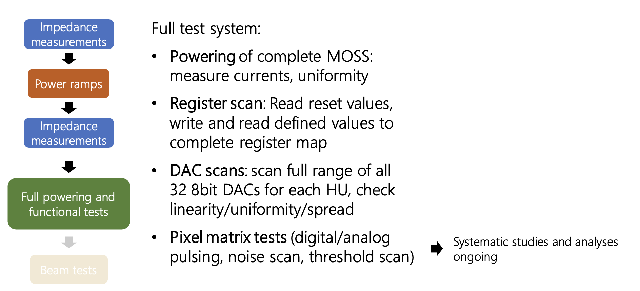
Status of ER1 testing
Enclustra Evaluation board
Breakout board
MOSS carrier board
On the wafer probe: the wafer probe would be used only for basic functionality test and scan could be performed at 160 Mbps
Test card: The characterisation of the serializer and the high speed link could be done wire bonding a small fraction of the sensors to a test card.
5 Enclustra boards are used to configure and read-out the MOSS. Powering is provided via lab PS and power regulator on breakout boards

Slide 50
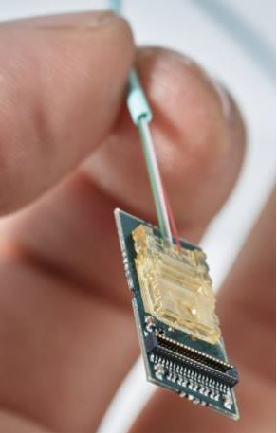
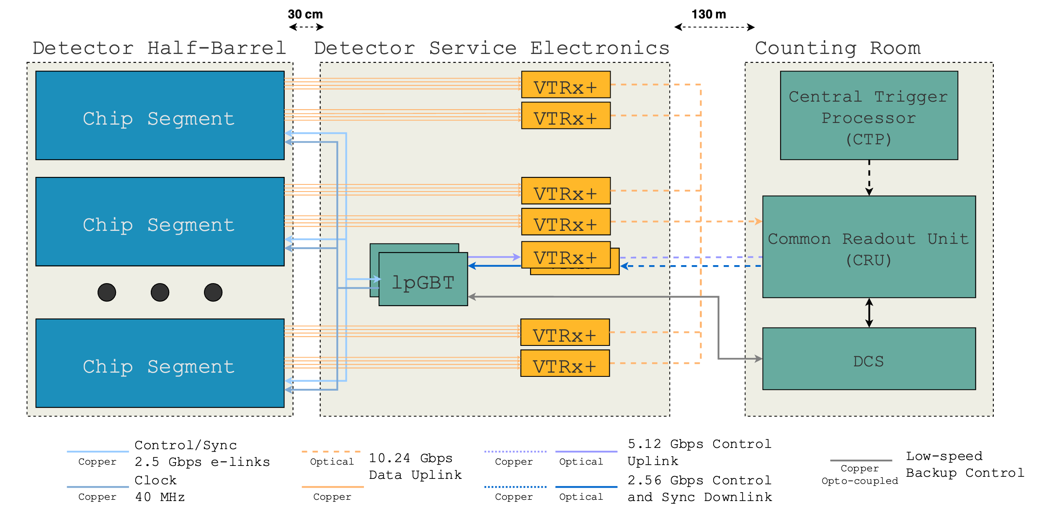
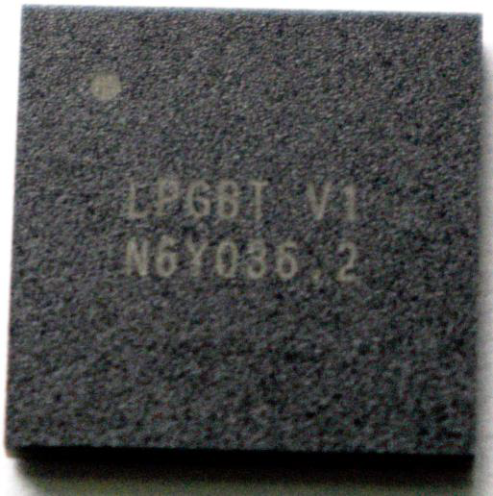
Detector Electronics – Data & Control for ER2

Slide 51
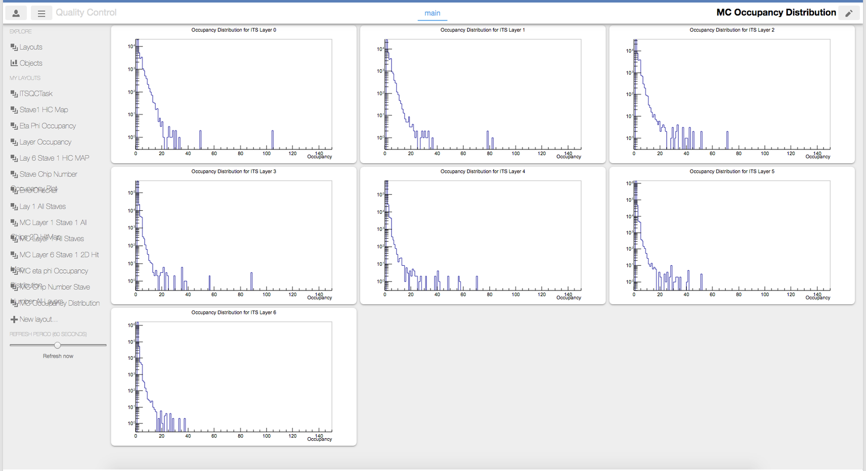
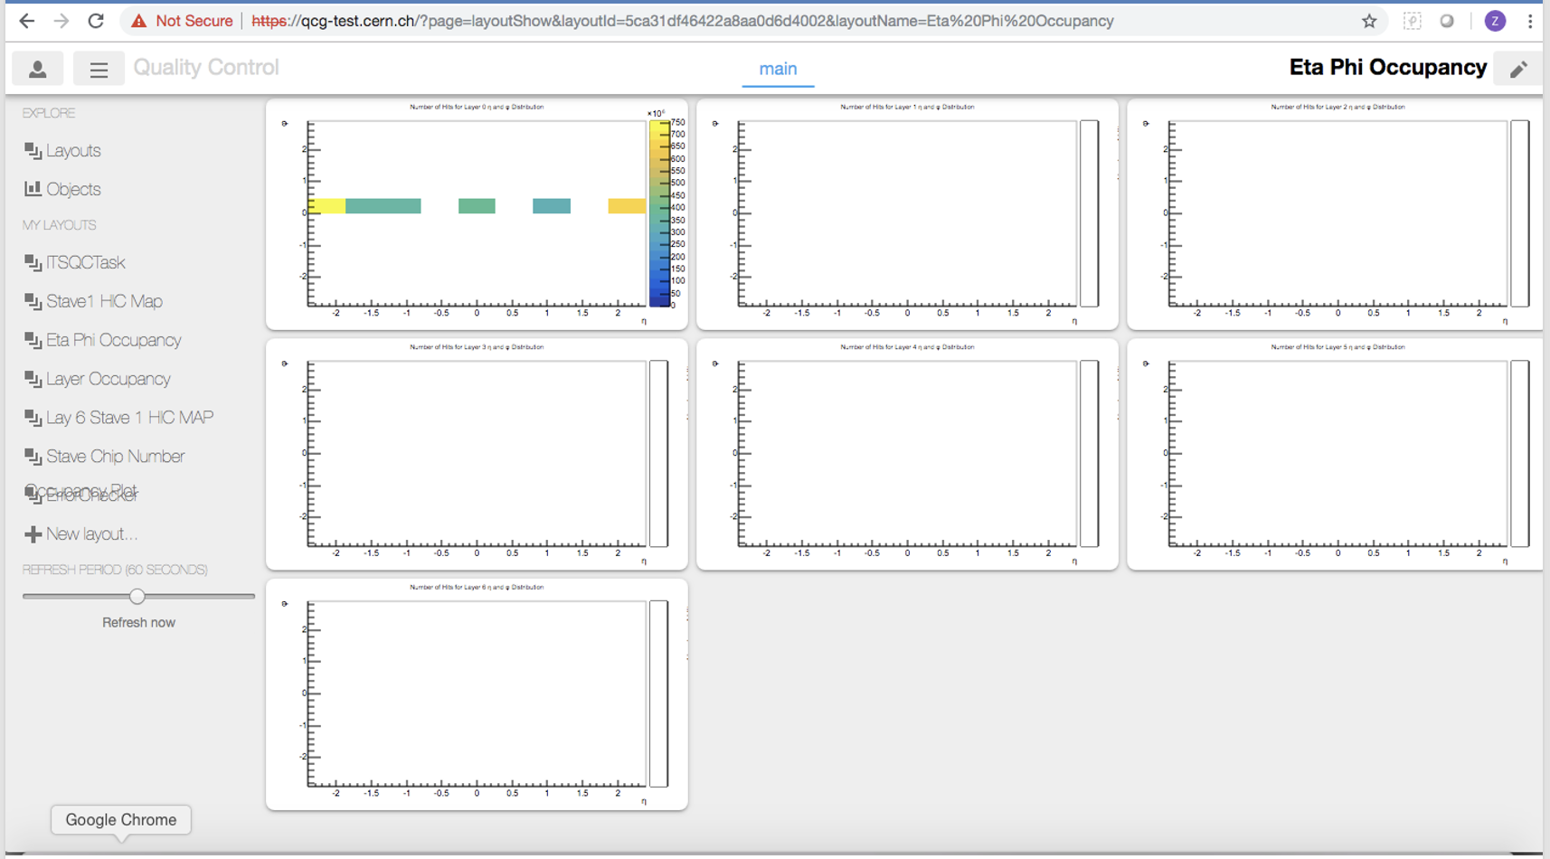
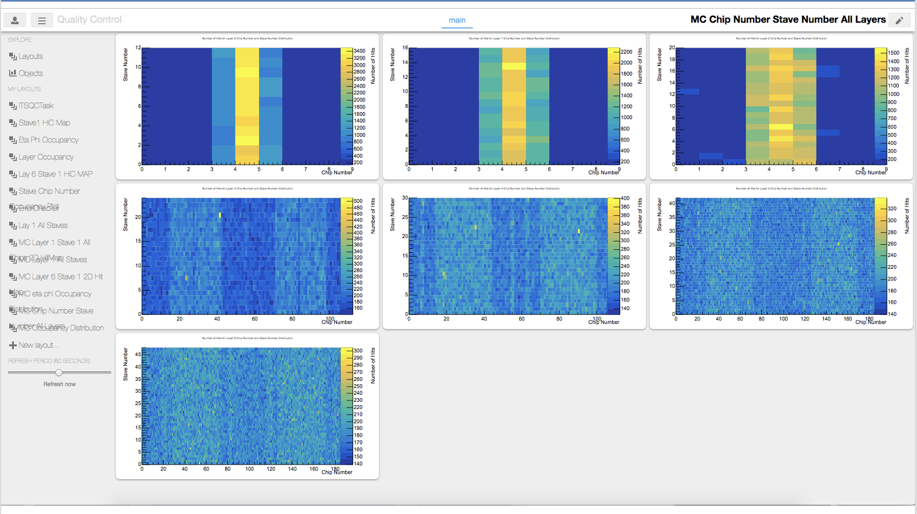
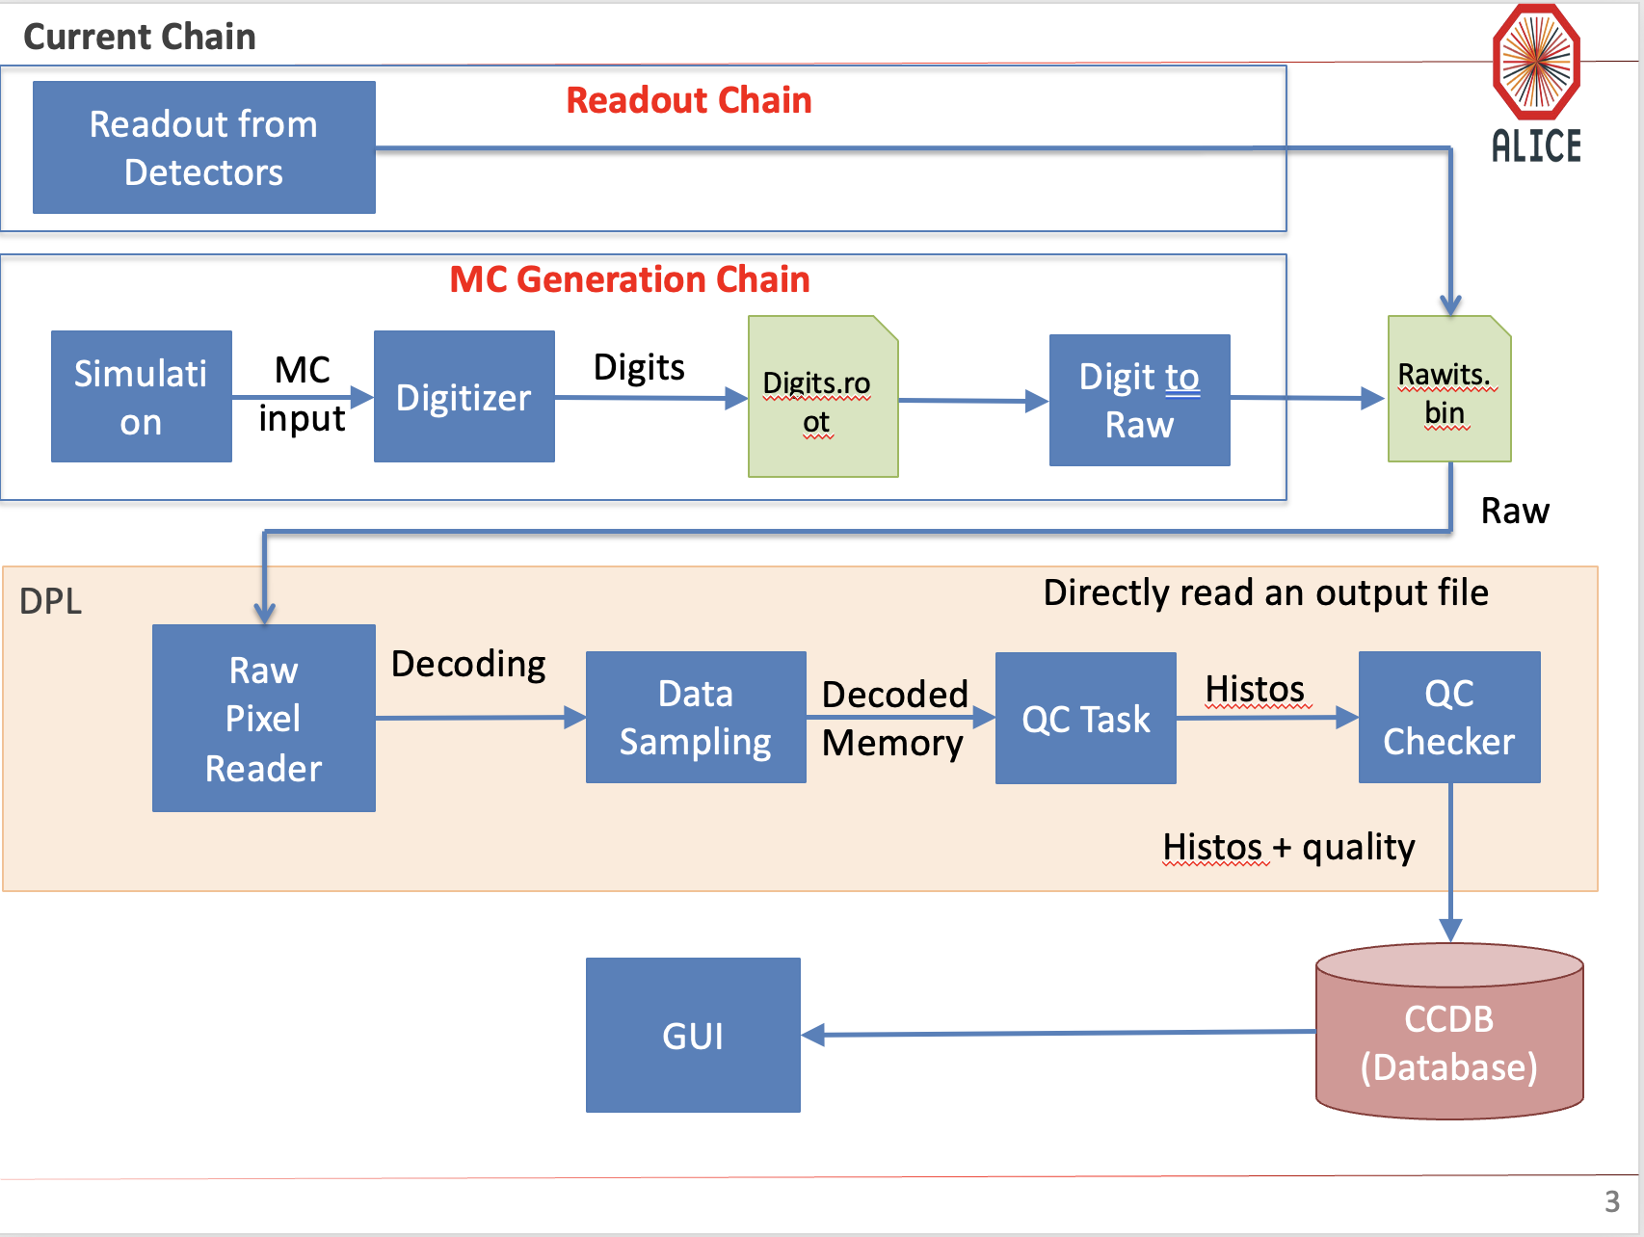
Visualization examples

Slide 52
ITS2 DCS

Slide 53
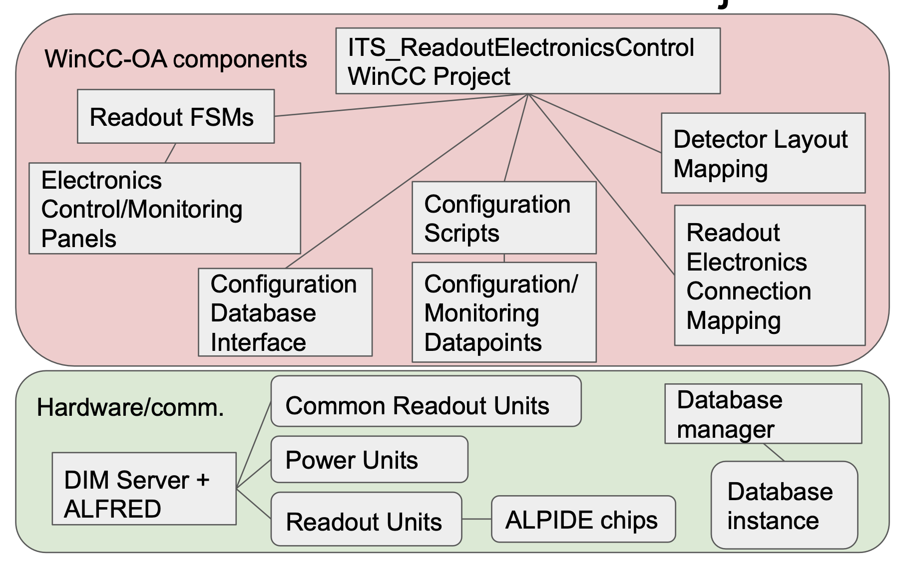
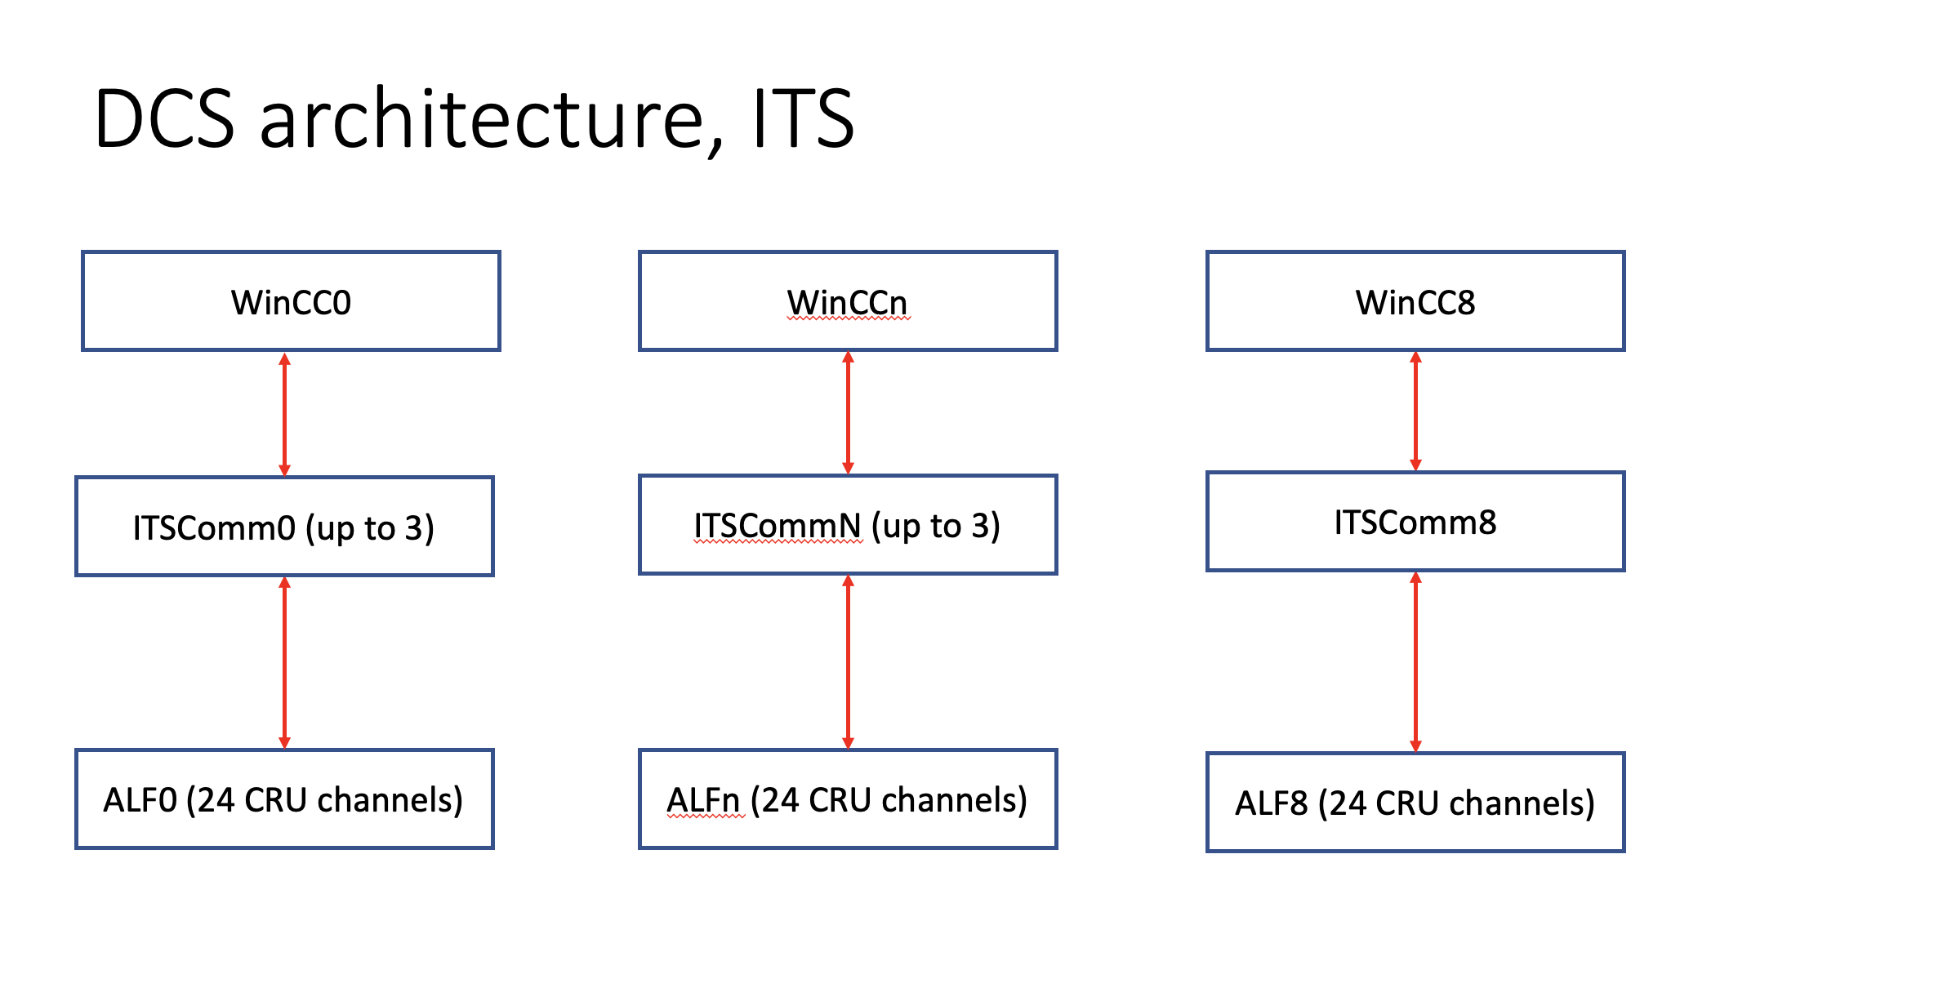
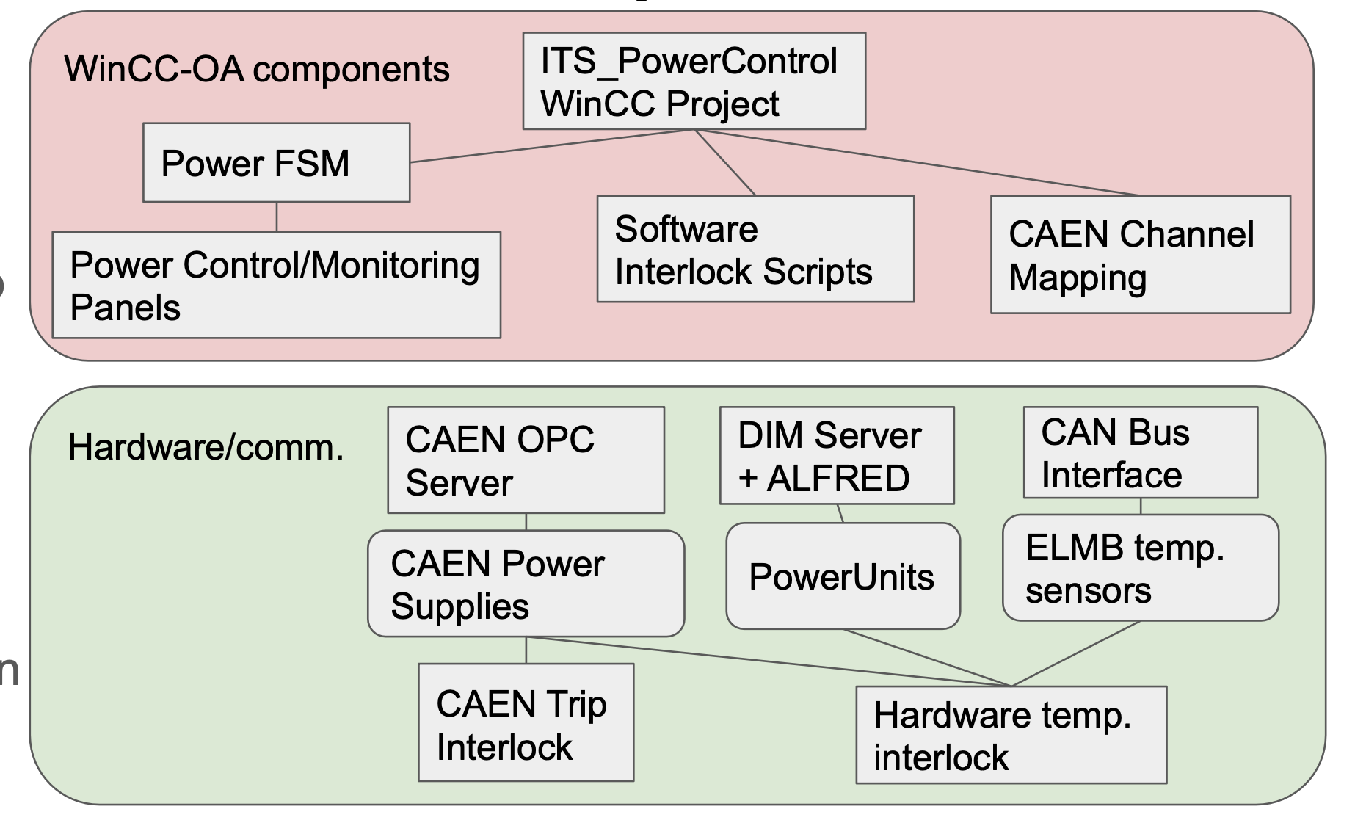
ITS2 DCS

