Slide 1

AncASIC – Ancillary ASIC for power, bias and slow-control management in serially powered OB layers and disks
- functionality
- fabrication process
- plans and schedules
Common design efforts of RAL, BNL and LBL within WP1
G.W. Deptuch on behalf of WP1
ePIC Collaboration meeting 20-24 January 2025

Slide 2
Design Team
BNL:
Dominik Gorni, Syed Hassan, Arif Iqbal, Joao de Melo, Soumyajit Mandal, Prafull Purohit, Sergio Rescia, Nicholas St. John, Grzegorz W. Deptuch
RAL:
Iain Sedgwick, Roy Wastie, Jaya John John
LBL:
Amanda Krieger

Slide 3
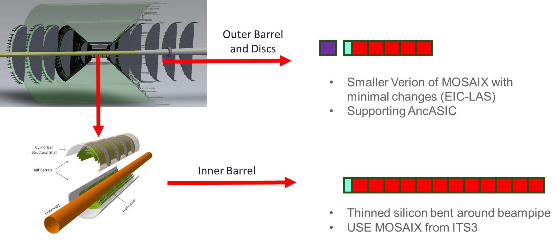
Background
ITS3 to ePIC
  ALICE are currently developing a chip (MOSAIX) to be used in the ITS3 upgrade.
  Since performance is similar, ePIC (the EIC detector) would like to use this chip for its inner layers.
  For the outer layers a smaller version is needed (yield and coverage)
AncASIC
  Since MOSAIX was designed for inner layers, it has features which make it unsuitable for the outer layers:
    Point-to-point powering
    Point-to-point slow control
  Idea is to design an Ancillary ASIC (AncASIC) to interface to MOSAIX
    Serial powering
    Slow control multiplexing
    Negative Voltage Generation

Slide 4
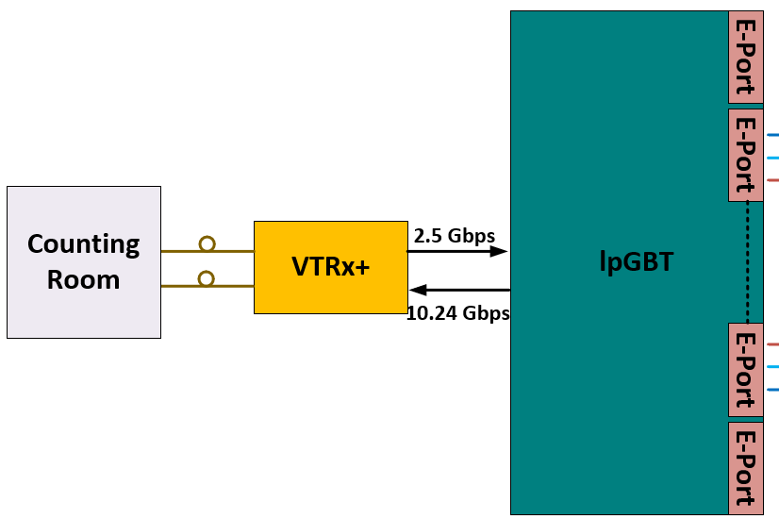
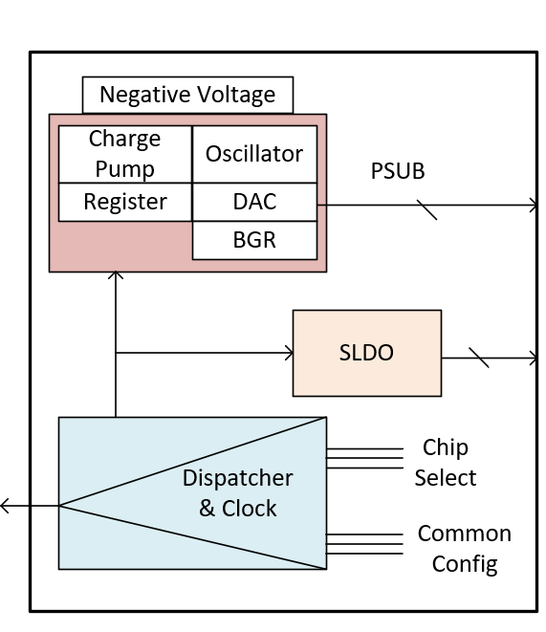
Functionality
MOSAIX / EIC-LAS interface
AncASIC
MOSAIX (all diff. CLPS):
Clock - input
Reset - input
Sync - input
2× slow control – input/output
Services management
Core management
1× reserved
– +HS Data (all differential):
8× high-speed channels
(4 top, 4 bottom)
slow control downlink
40, 160 or 320 Mbps ?
5-10 Mbps
MOSAIX interface needs to be fomrlaized

Slide 5
Fabrication Process XFAB XT011 Platform
Automotive quality compliant with extended temperature range -40°C …. 175°C
(Bipolar, CMOS, and DMOS)-on-SOI 110nm technology 1.5V/5V with Cu Back End of Line (metal stack) and HV devices up to 85V
TOX for 1.5V transistors: 3.5 nm / 3.5 nm and good value resistors: rnw 1.17 kΩ/sq
Floating capacitors mosvcti/mosvc: 9.8 fF/um² – 10.8 fF/um²
Digital 244 kGE/mm² (kilo gate equivalent/mm²)
3,740 nm
4.5 mΩ/*
400 nm
62 mΩ/*
400 nm
62 mΩ/*
400 nm
62 mΩ/*
400 nm
62 mΩ/*
Suitable for high current application in voltage regulation
400 nm
62 mΩ/*
400 nm
62 mΩ/*

Slide 6
Selection of Process Features
process modules selected:
ALUCAP, COPTHK, DTI, LVT, METAL1, METAL2, METAL3, METAL4, METAL5, MOS5, MOSLP, PSUB Æ only 31-mask layer set
(it is the ‘1157’ option settings)
rejected DEPL, NHVA, PHVA, DIODEA, NVM, OTPF – HV layers.
number of thin metals: 5 metal layers, (no point to impose restriction to default 3 metal layers)
XFAB provides pricing (and delivery time) based on modules selected for both options:
  MPW Æ $22.5k per 10 mm^2 (minimal chip size with 45 die delivered)
  engineering/production run Æ $177.2k per with minimum 3 wafers delivered
  2-MLM mask-set option used
Wafer thickness (725 µm +/- 15 µm) delivered unlapped; thinning can be ordered 250 µm.
XFAB Foundry Facility in France in Corbeil – Essonnes
Less frequent and longer delivery than other mainstream foundries
Purchase Order dispatched by BNL for AncASICXT011_P1 (first 10 mm² prototype)

Slide 7
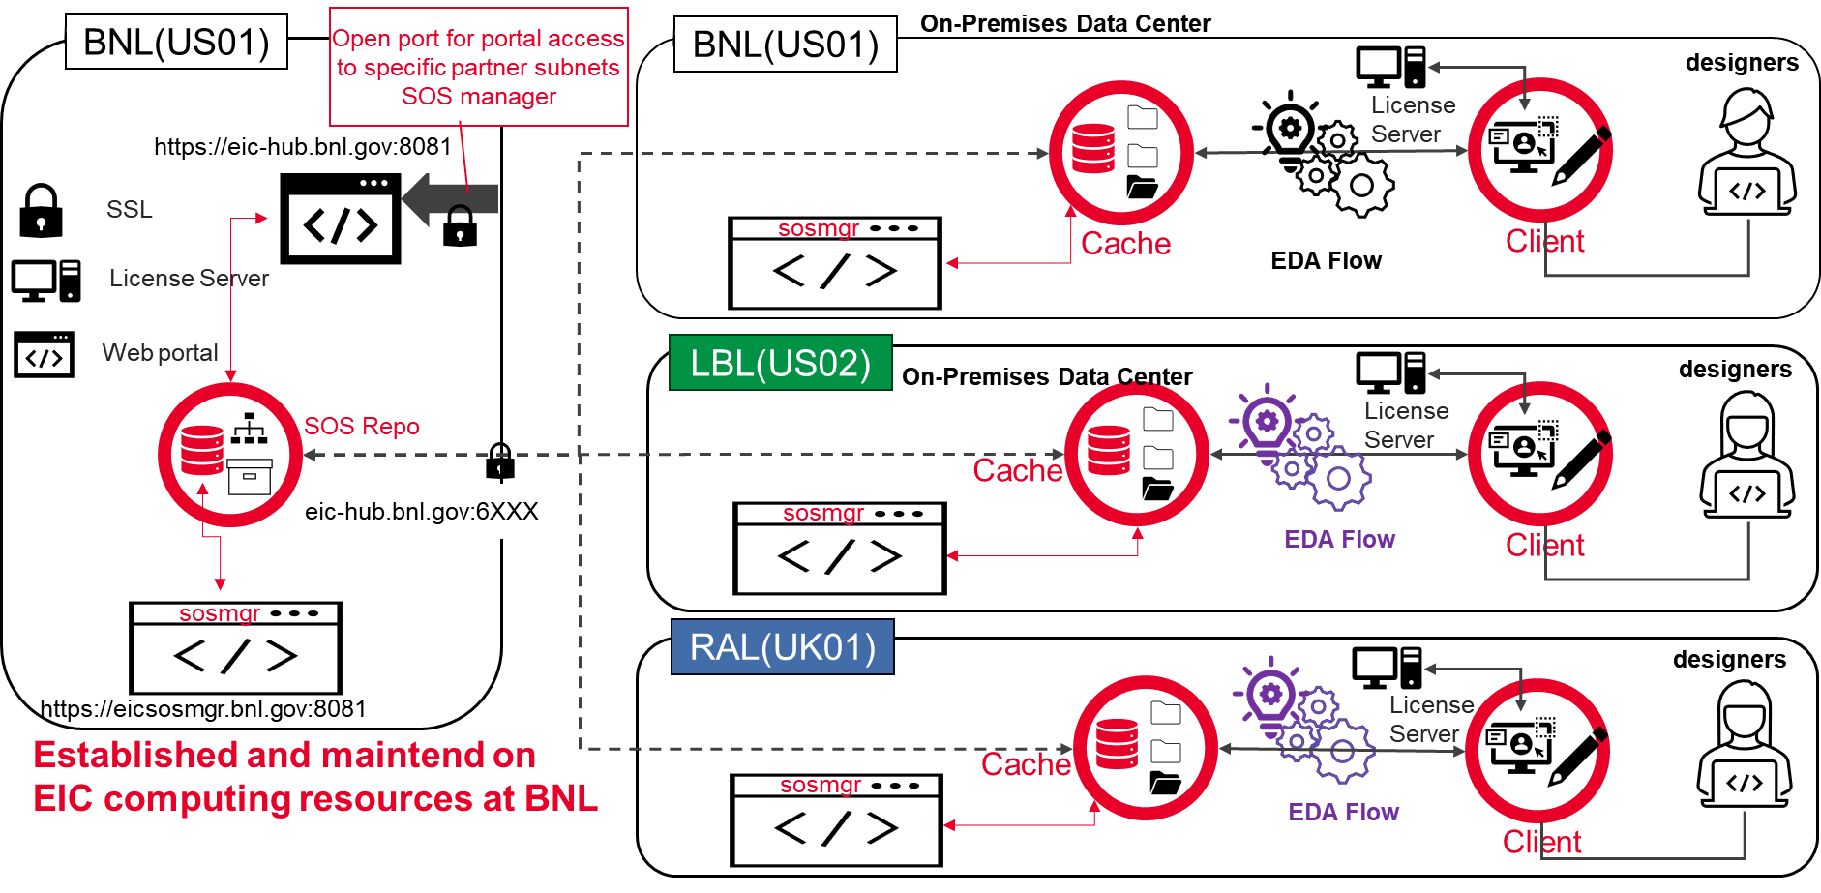


Common Design Repository
Design Management Software (SOS and IP-HUB by Keysight – formerly Cliosoft)
Check-out, check-in process allows synchronized design within the design team
AncASICXT011_P1
AncASICXT011_P2
AncASICXT011_F1
AncASICXT011_E1
EIC_LASTPSCo_P1
EIC_LASTPSCo_P2 EIC_LASTPSCo_F1
EIC_LASTPSCo_E1
EIC_LASTPSCo_M1
Courtesy of
Sharing agreement RAL ÆÆÆUS institutions needs to be completed

Slide 8
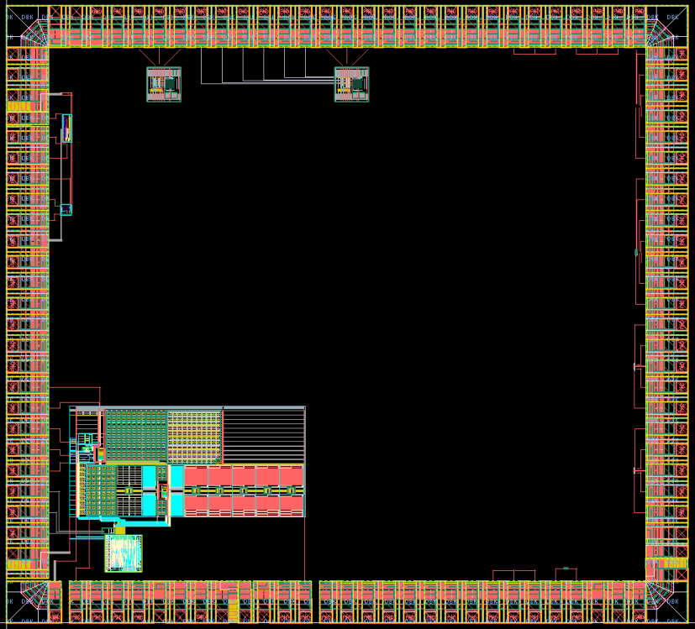
Plans and Schedule (AncASICXT011_P1)
includes:
  NVBG first prototype (w/o DAC.ADC for setting/monitoring)
  SLDO preregulator stages
  TX/RX stages for DC-coupling demo
  transistor test structures for irradiations
  Cross chip transmission line for HS demonstration
next steps:
  Complete NVBG and SLDO stages
  Selection of size and aspect/form factor ratio
  Mounting on FPC (wire, TAB or bump bonding)
  Implement Anc Brain
  Development of software (digital-twin) and hardware (FPGA emulator) mockups
3.2 mm
CML transceiver
SLDO pre-regulator from LBL
Test devices
2.9 mm
Negative Voltage Generator

Slide 9
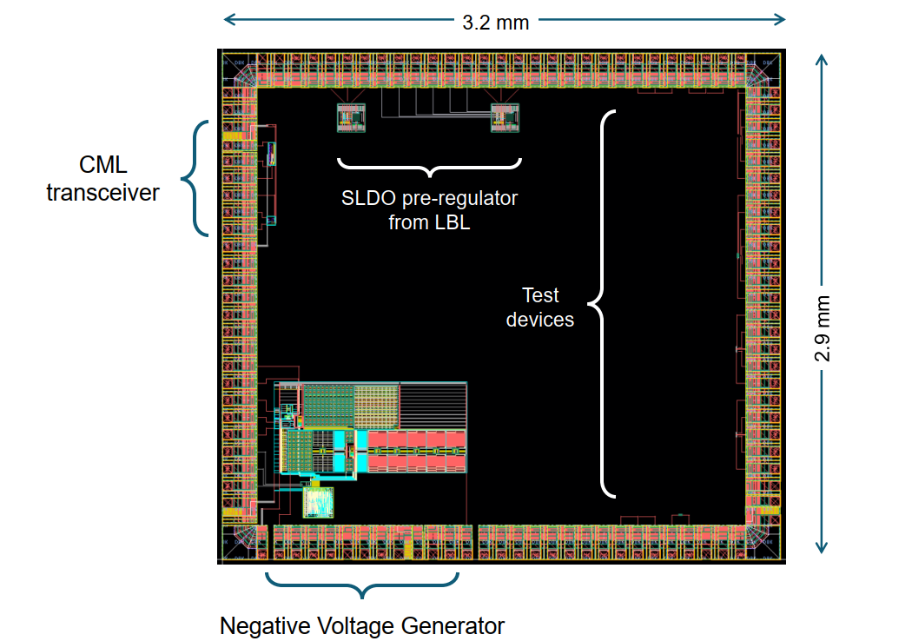
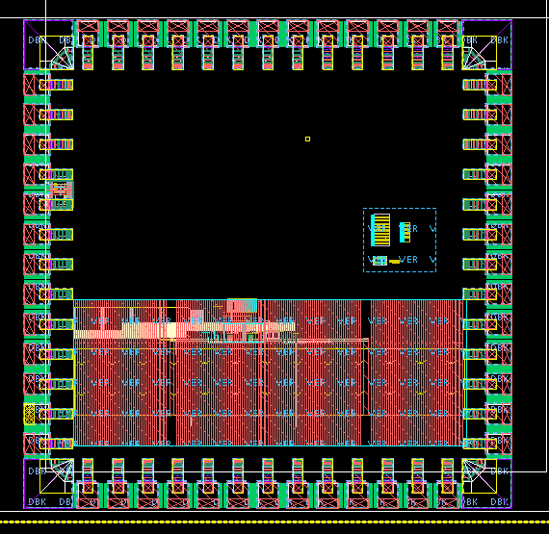
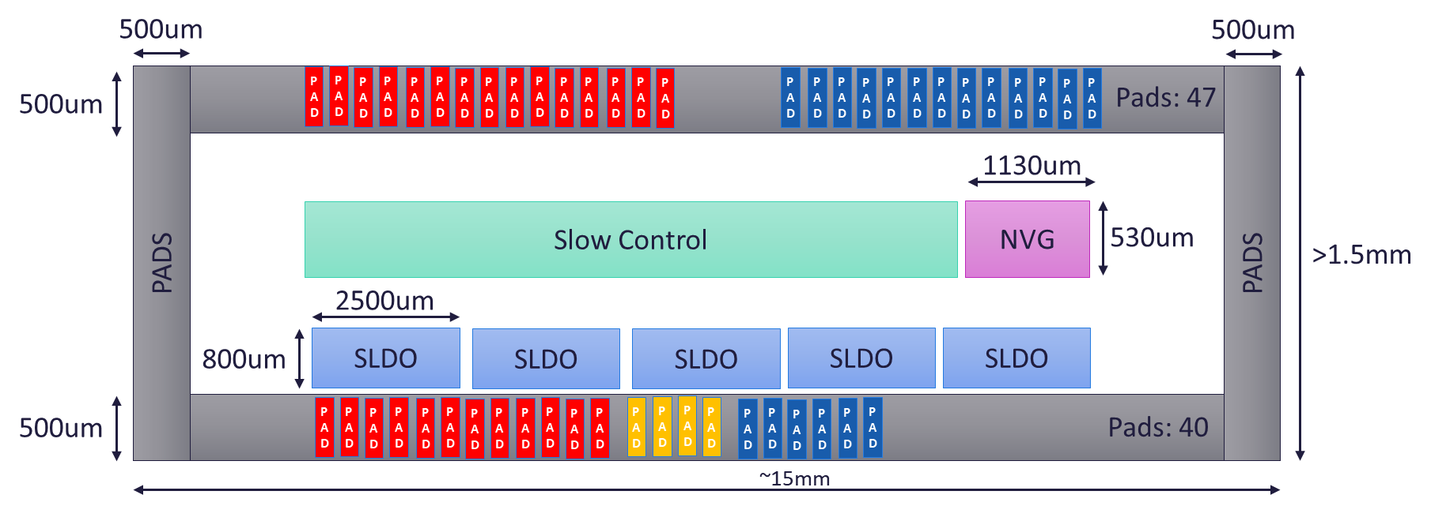
AncASIC - MPWs
MPW1
MPW2
MPW3
AncASICXT011_P1
AncASICXT011_F1
AncASICXT011_F1
NVG, Transistor Test Structures, CML, SLDO Pre-reg
Complete SLDO
Complete AncASIC
Complete NVBG
  Selection of size and aspect/form factor ratio
  must happen
Pads 52x52 um
Pads 125x150 um
MPW2 may be two ASIC
If there is no DSA

Slide 10

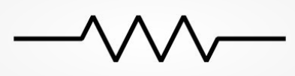
AncASIC Size and Pads
4x 100nF (sub-divided?)
500um
3 pads
GAVDD
7 pads
GDVDD
1 pad GSVDD
3 pads TXVDD
1 pad
PSUB
32 pads Slow Control
500um
500um
PAD
PAD
PAD
PAD
PAD
PAD
PAD
PAD
PAD
PAD
PAD
PAD
PAD
PAD
PAD
PAD
PAD
PAD
PAD
PAD
PAD
PAD
PAD
PAD
PAD
PAD
PAD
PAD
Pads: 47
1130um
Slow Control
NVG
530um
>1.5mm
PADS
PADS
2500um
800um
SLDO
SLDO
SLDO
SLDO
SLDO
500um
PAD
PAD
PAD
PAD
PAD
PAD
PAD
PAD
PAD
PAD
PAD
PAD
PAD
PAD
PAD
PAD
PAD
PAD
PAD
PAD
PAD
PAD
Pads: 40
~15mm
15 pads IIn
15 pads IOut
2 pads
SCin
2 pads
SCout
2 pads
CL_in
FPC Trace
FPC Trace
4x 1-100k
Preliminary – Treat as fully subject to change
4 pads R3
AC-coupling caps?
10µF

Slide 11
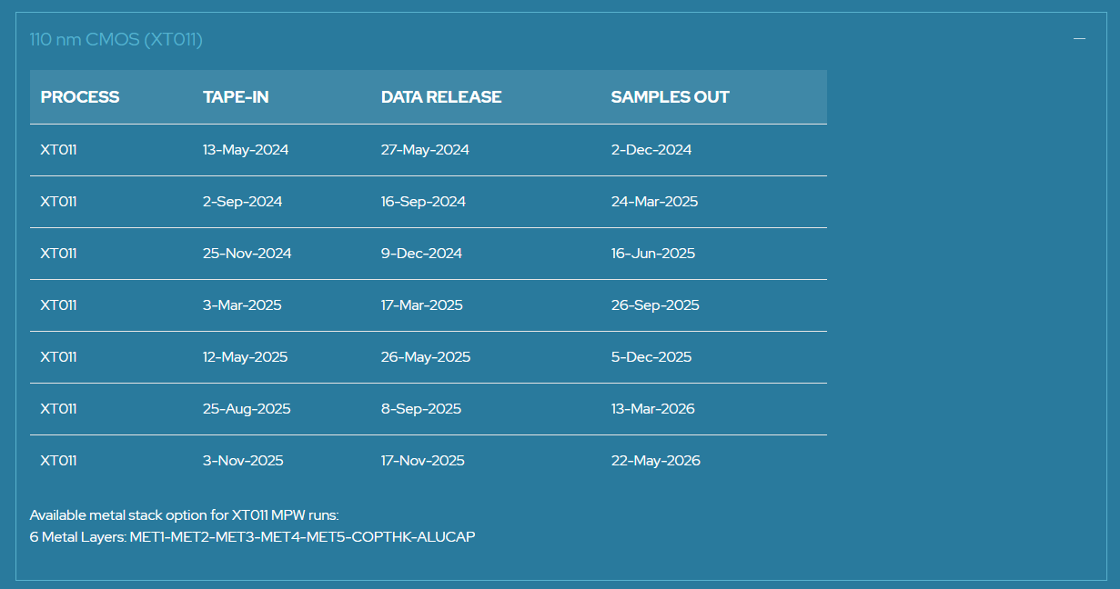
Plans and Schedule
initial plan: part of NVBG (open loop) + transistors test structures for irradiations
Å
È
closed loop of NVBG + SLDO preregulation + test structures + CML TX/RX + trline
Å
canceled with potential of delay
È
Å
closed loop of NVBG + complete SLDO + test structures + CML TX/RX + trline+ NVBG monitoring ADC
Å
Full AncASIC with AncBrain
Q1 CY 2026: Engineering Run
If no sharing
agreement
RAL: separate SLDO submission

Slide 12
Evolving Schedule
02/09/2024
25/11/2024
3/3/2025
12/05/2025
25/08/2025
Tape-In Date
Out-of-Fab Date
24/03/2025
16/06/2025
26/09/2025
05/12/2025
13/03/2026
Fab Time – MPW 1
Fab Time – MPW 2
MPW 3???
MPW3 date uncertain due to lack of knowledge of MOSAIX Slow Control
  INITIAL:
  NOT MORE ON THE TABLE

Slide 13
Evolving Schedule
02/09/2024
25/11/2024
3/3/2025
12/05/2025
25/08/2025
Tape-In Date
Out-of-Fab Date
24/03/2025
16/06/2025
26/09/2025
05/12/2025
13/03/2026
Procurement issues
Fab Time – MPW 1
No DSA – reduced effort
Fab Time – MPW 2
MPW 3???
  Intermediate

Slide 14
Evolving Schedule
02/09/2024
25/11/2024
3/3/2025
12/05/2025
25/08/2025
Tape-In Date
Out-of-Fab Date
24/03/2025
16/06/2025
26/09/2025
05/12/2025
13/03/2026
Run Cancelled
Fab Time – MPW 1
MPW2 Risks
Still no DSA
Trying other route, but risk of procurement failure
Fab Time – MPW 2
MPW 3???
MPW3 Risks
Still no DSA
Funding delays
May realistic now other runs have moved up?
  Assumes Complete NVBG and SLDO achieved in one shot

Slide 15
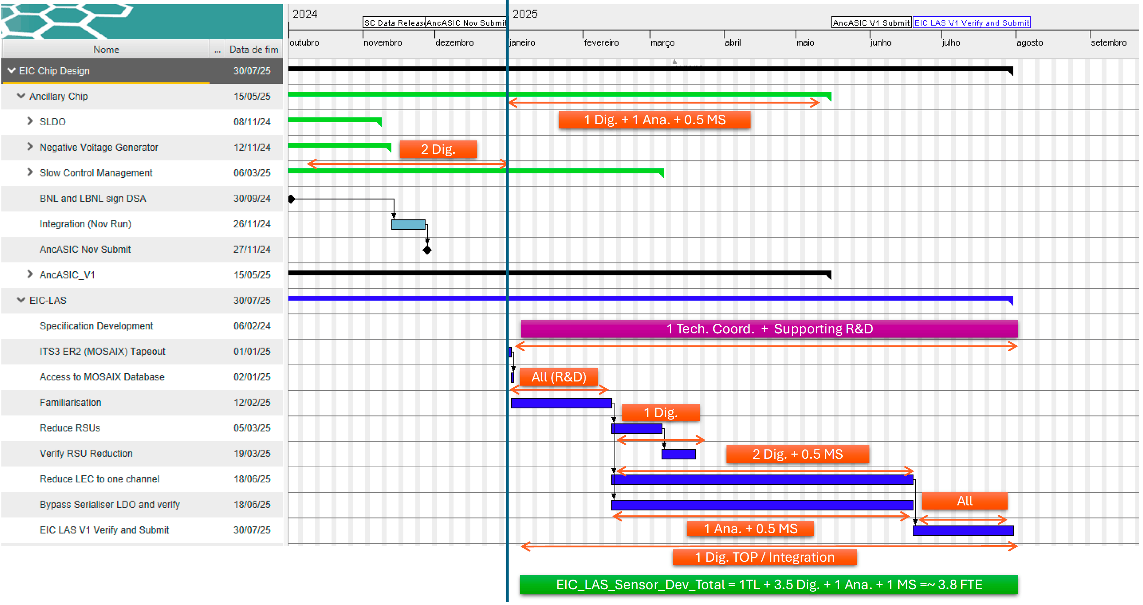
Plans and Schedule
this schedule/manpower planning requires adjustments
Support of manpower may be limiting progress

Slide 16
Mockups efforts planned in eRD113 to reduce risks

Slide 17
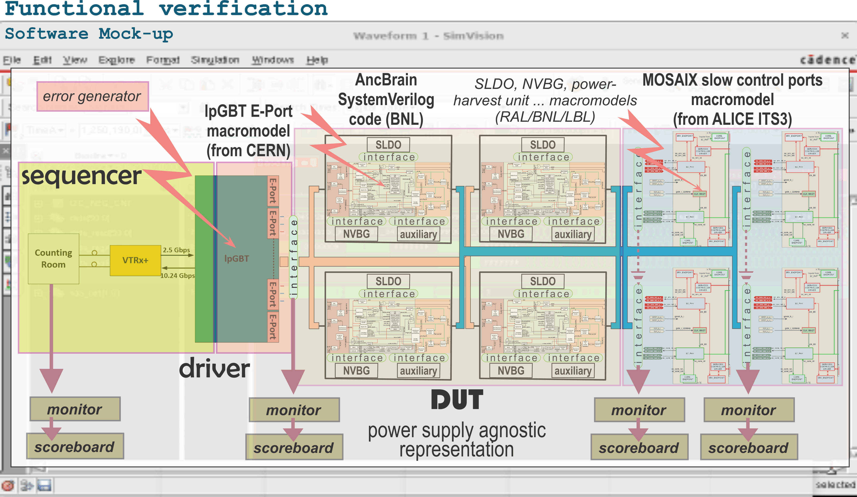
Design Verification – digital twin

Slide 18
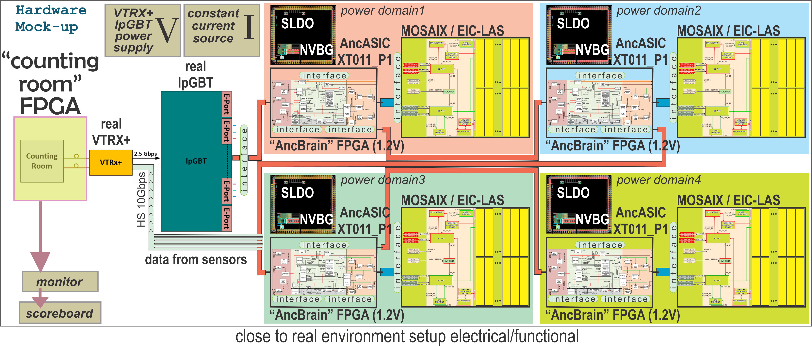
Design Verification – hardware emulation
Software Mockup (BNL) – needed for functional verification before implementation
  to verify code coverage, find exceptional situations, and reduce risks Æ single step implementation.
Hardware mockup (LBL)– needed to perform verification in experiment like environment
Both included in FY25 eRD113’s deliverables

