Slide 1
Configuration and Capabilities for the Phase-1 EIC
E.C. Aschenauer (BNL)
Co-Associate Directors for the Experimental Program
ePIC Collaboration Meeting
January 20 - 24, 2025

Slide 2
Lessons from recent other colliders

Slide 3
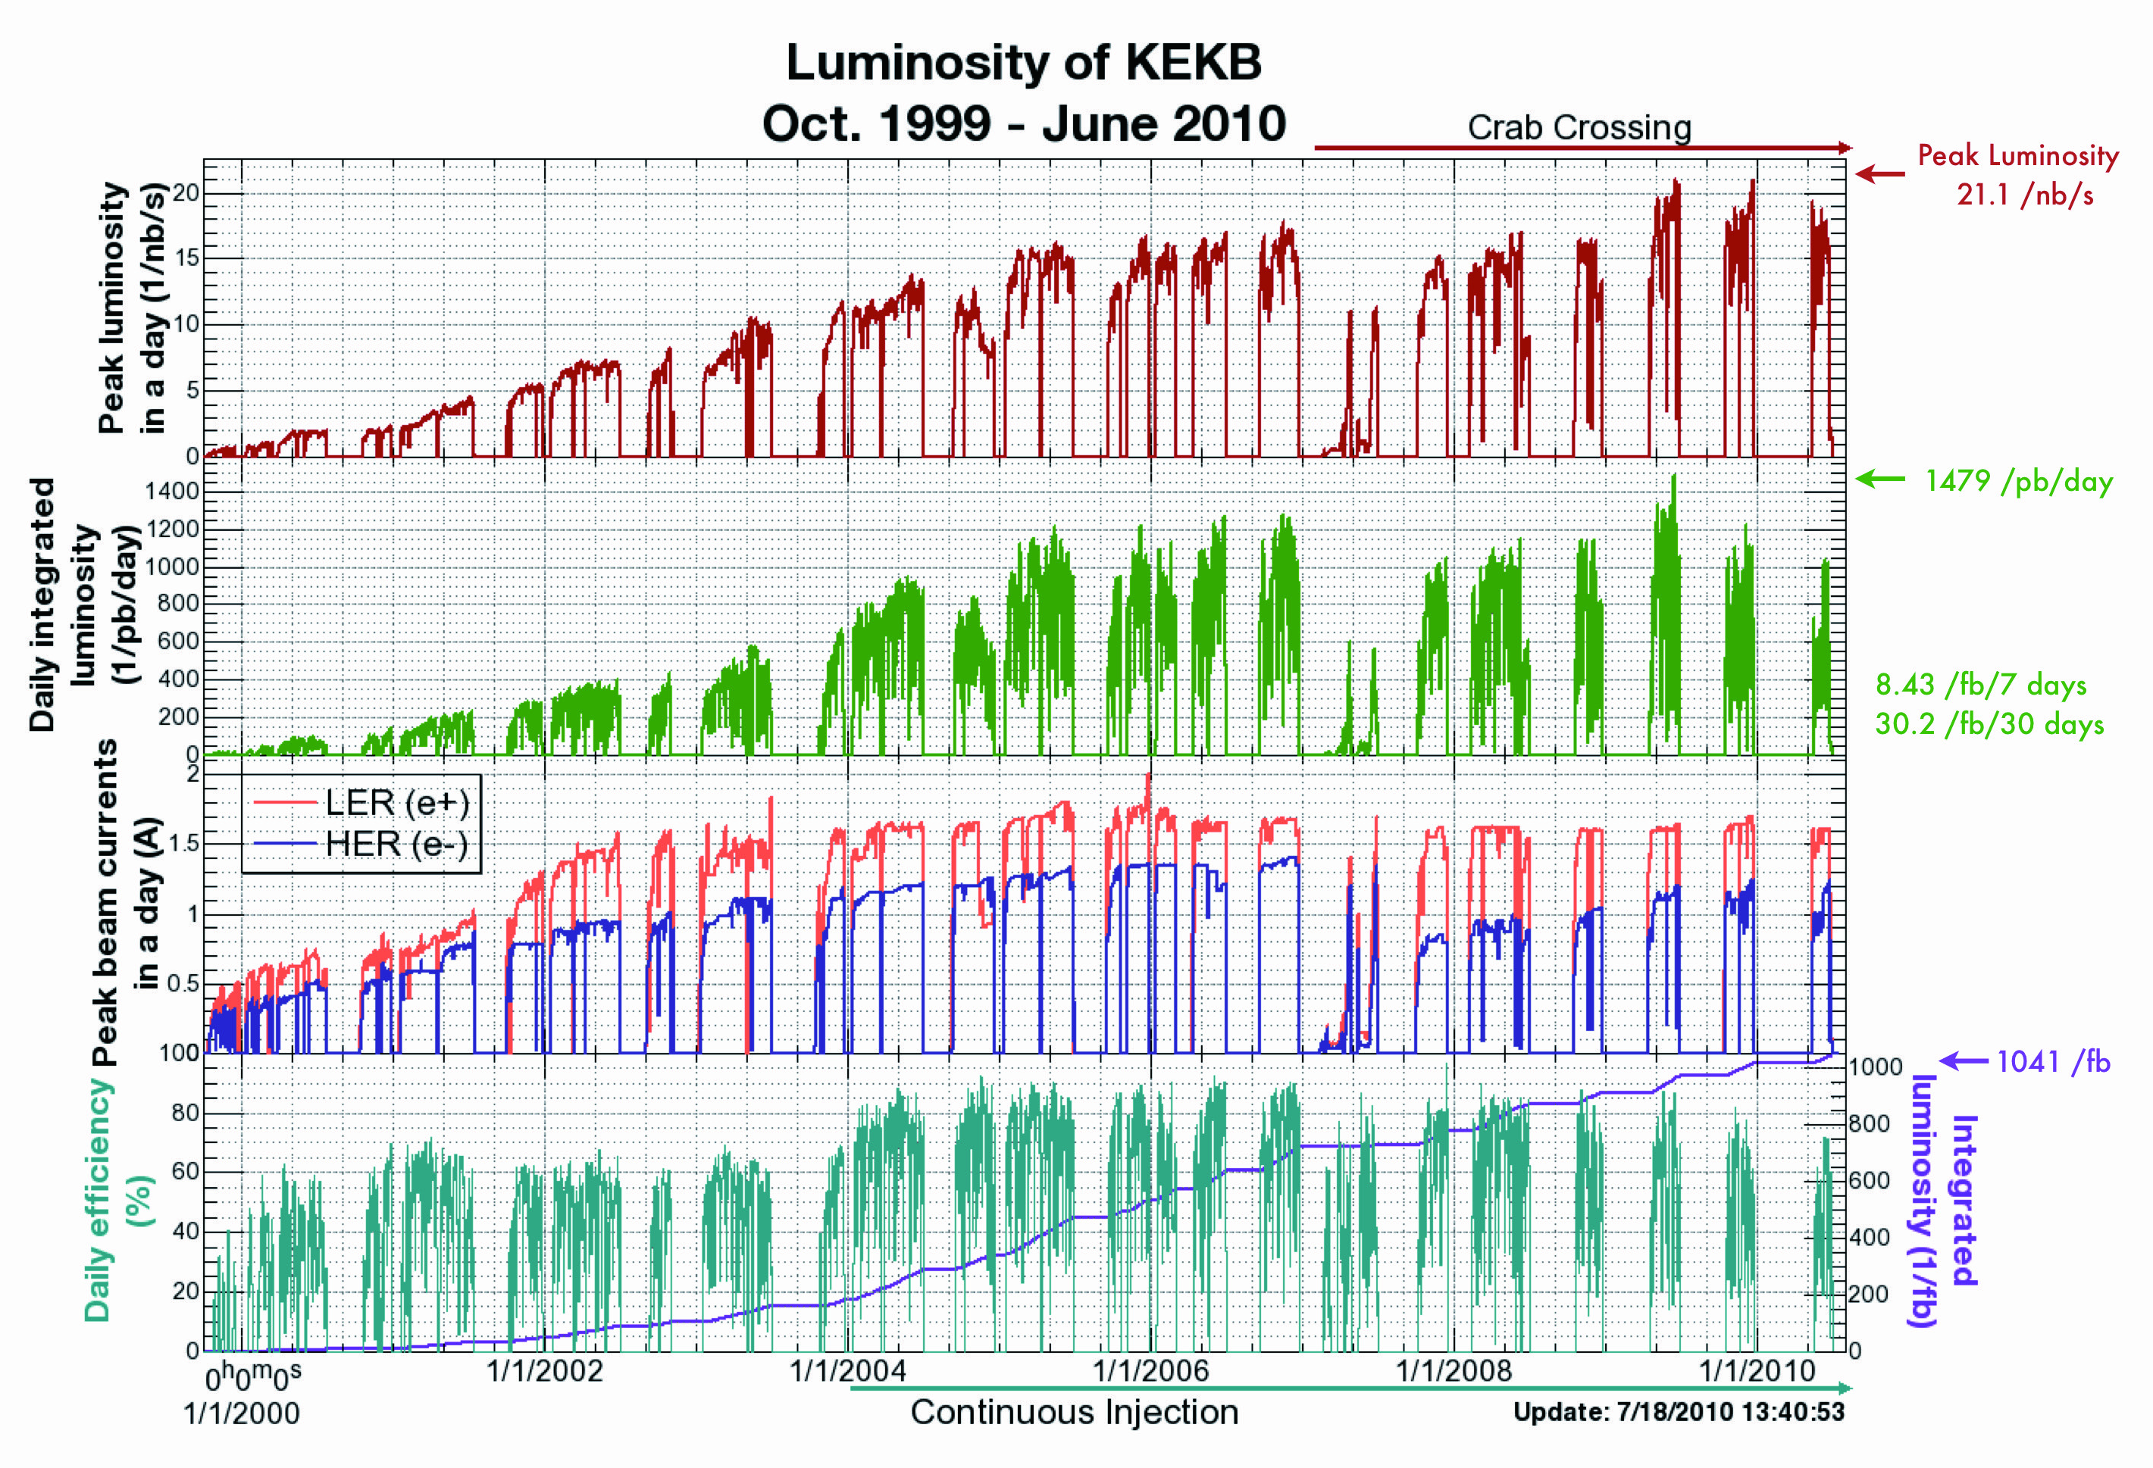
Experience ramping up KEKB and SuperKEKB
KEKB took ~5 years to reach design luminosity
SuperKEKB has not yet reached design luminosity
> 20 below goal
operating since 2019
Several reasons, beam instabilities and beam backgrounds

Slide 4
Lessons from HERA II upgrade
HERA performed an upgrade to increase luminosity by a factor of 5
  Mainly by squeezing the beam more at the IP by redesign of the IR
The upgrade increased backgrounds dramatically → Several month shutdown to implement improvements
Electron beam polarization never reached HERA-I levels, H1 and Zeus solenoids (~1T) not well compensated
Main culprits:
  no careful simulations prior to the upgrade
  Proton beam-gas interactions most severe background
    Needed an extremely good vacuum to mitigate this
  Synchrotron radiation background
    Background to detectors
    Excess heating of beam pipe
      Can damage flanges, etc.
      Can heat beam pipe, decreasing vacuum
  Electron beam-gas

Slide 5
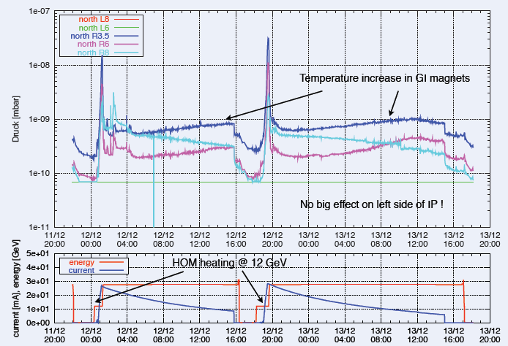
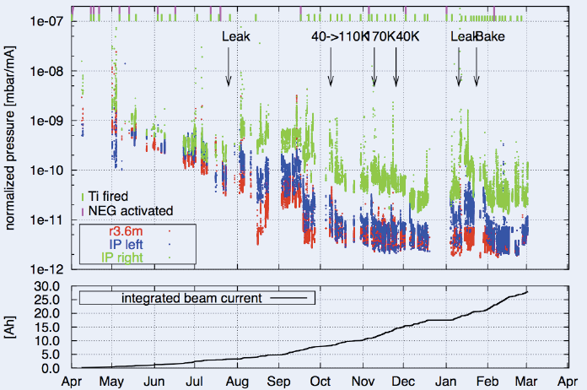
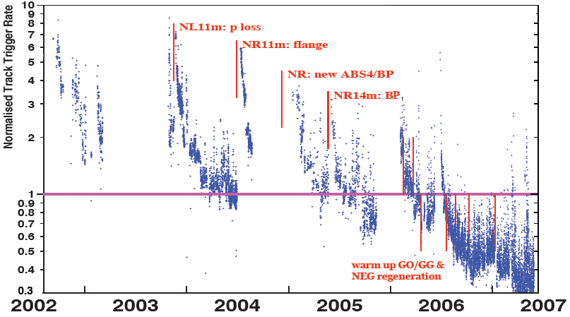
Lessons from HERA II upgrade
Dynamic pressure increase due
to thermal and photo desorption
Pressure vs. integrated electron
current 2002 - 03
Proton Beam Gas Background
Two time constants for vacuum
conditioning
Short term after leaks 20 – 30 days
Long term 600 days

Slide 6
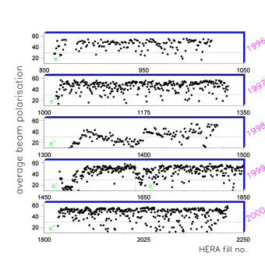
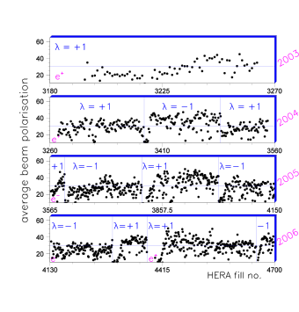
Lessons from HERA II upgrade
Electron polarization through Sokolov Ternov
Luminosity and Polarization have been strongly anti-corelated

Slide 7
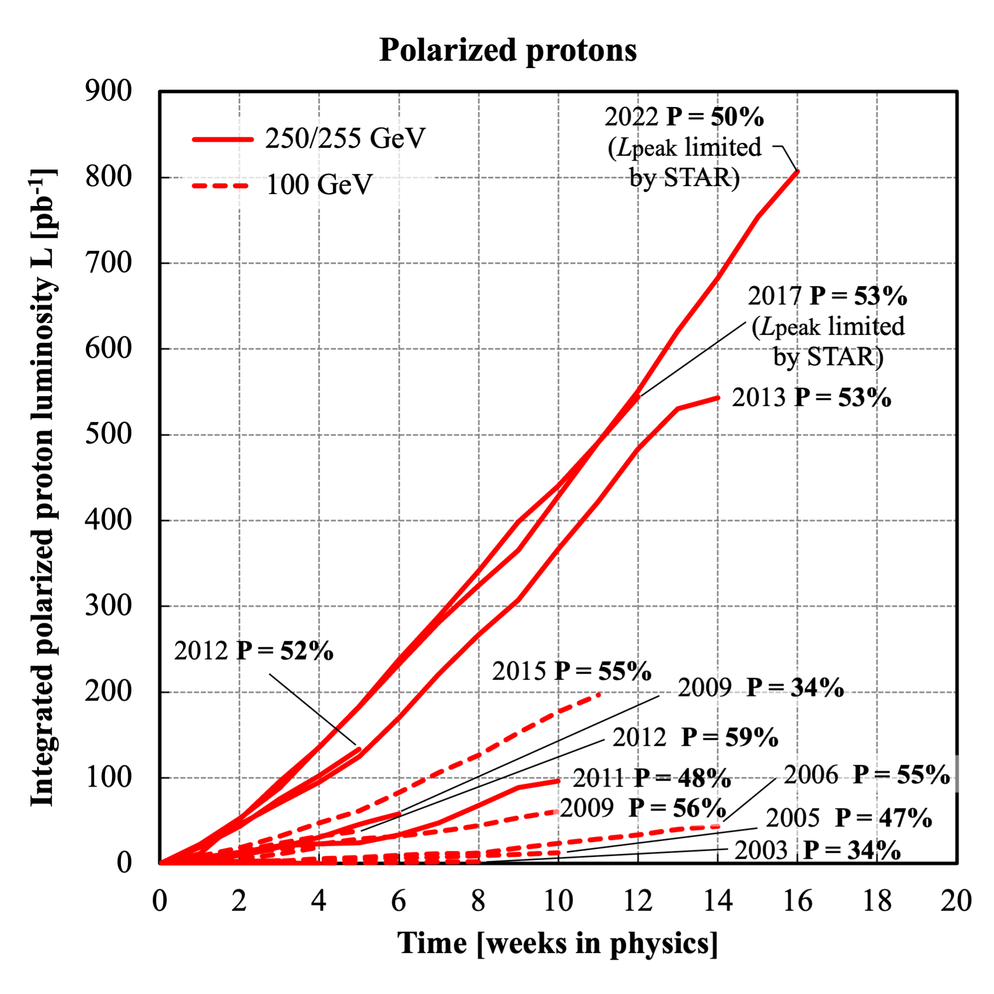
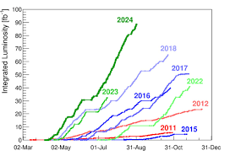
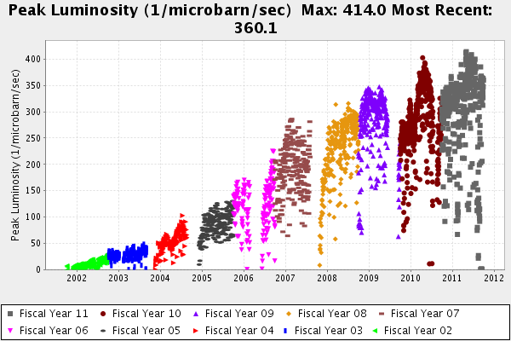
Lessons learnt from pp Colliders
Tevatron
LHC
RHIC
The pbar electron cooler was added in July of 2005. The initial luminosity increased by ~50% at first and then it took many years to take advantage of the cooler by optimizing the store length, beam-beam interactions, etc.
First beam September 10th, 2008, malfunction 9 days later no beam for experiments till 2010, March 19th, 2010 collisions at 7 TeV
Design Lumi was reached June 2016
13.6 TeV reached April 2022
First Beam in 2000
Polarization and Luminosity often anti-corelated.
Took in 2015 in one year the integrated luminosity from all the years before at √s=100 GeV and for √s=250 GeV in 2017

Slide 8
Ramping up EIC performance

Slide 9
EIC and Subprojects
Early
Science
EIC
Full Capabilities
Detector + IR – Subproject 2
+
+
Accelerator, … – Subproject 4
Collider (ESR + HSR) – Subproject 1
Electron Injector – Subproject 3
All the scope needed for
mission need
All the scope needed to
reach full EIC capabilities

Slide 10


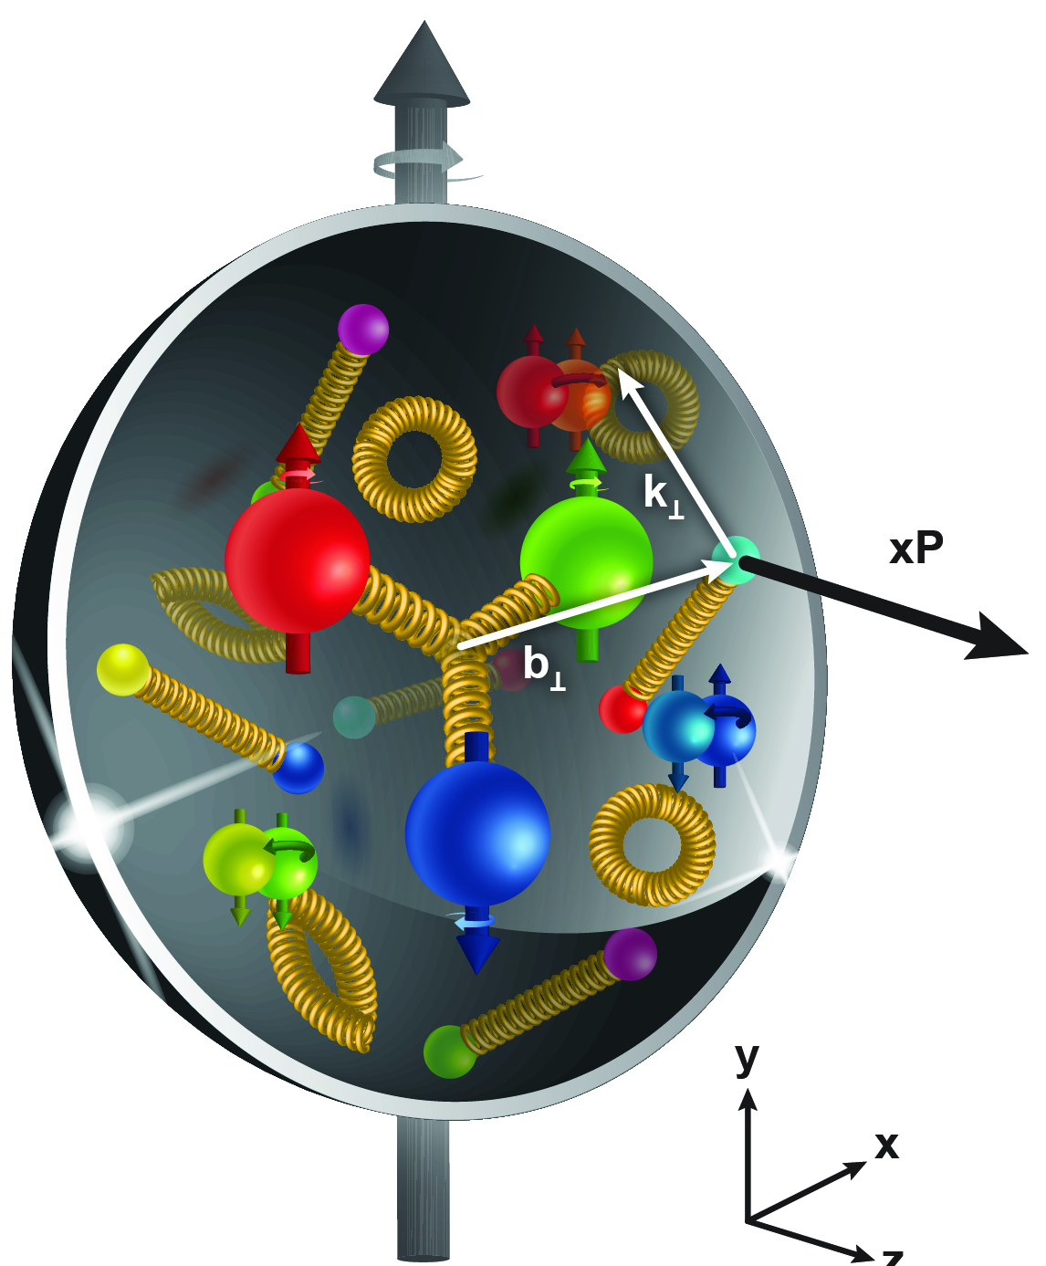
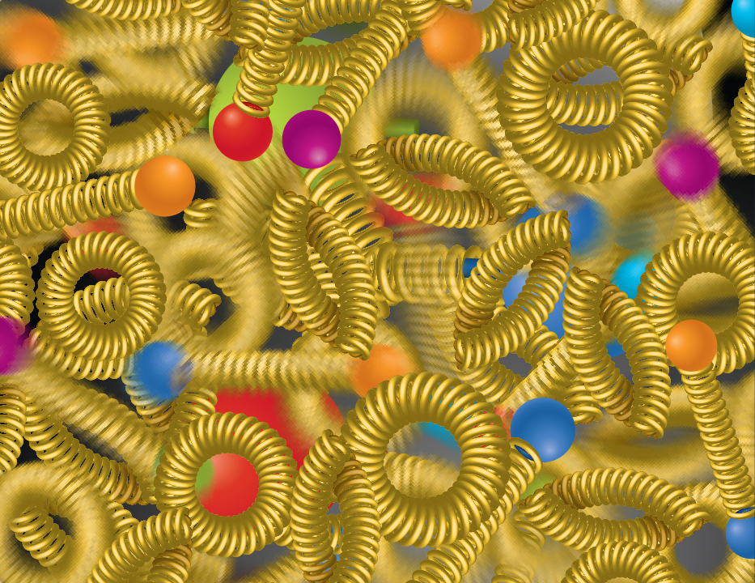
EIC NAS Science Pillars
The EIC will unravel the different contribution from the quarks, gluons and orbital angular momentum
SPIN is one of the fundamental properties of matter.
All elementary particles, but the Higgs carry spin.
Spin cannot be explained by a static picture of the proton
It is the interplay between the intrinsic properties and interactions of quarks and gluons
Does the mass of visible matter emerge from quark-gluon interactions?
Atom: Binding/Mass =
0.00000001
Nucleus: Binding/Mass =
0.01
Proton: Binding/Mass =
100
For the proton the EIC will determine an important term contributing to the proton mass, the so-called “QCD trace anomaly
How can we understand their dynamical origin in QCD?
What is the relation to Confinement
How are the quarks and gluon distributed in space and momentum inside the nucleon & nuclei?
How do the nucleon properties emerge from them and their interactions?
How do the confined hadronic states emerge from quarks and gluons?
Is the structure of a free and bound nucleon the same?
How do quarks and gluons, interact with a nuclear medium?
How do the quark-gluon interactions create nuclear binding?
What happens to the gluon density in nuclei? Does it saturate at high energy?
How many gluons can fit in a proton?
How does a dense nuclear environment affect the quarks and gluons, their correlations, and their interactions?
?
gluon
splitting
=
gluon
recombination

Slide 11
Accelerator at Day One and Ultimate
Early Science Program
Full EIC Capabilities
RCS:
7nC / bunch Add an accumulation ring to reach 28 nC / bunch
5 – 10 GeV polarized e- and add RF to accelerate to 18 GeV electrons
ESR:
7nC / bunch Add more RF cavities to operate at 18 GeV electrons
5 – 10 GeV polarized e- and 28 nC / bunch
HSR:
100 – 250 GeV polarized p Update PS to reach 275 GeV protons and 110 GeV/u nuclei
100 GeV/u nuclear beams add 41 GeV bypass to get full HSR beam energy capabilities
cooling at injection energy
Proposal for the Day-One Physics and the initial years of science is driven by
  Start of the promised NSAC/NAS science program
  Alignment with expected order in commissioning the collider and ramp up of performance that comes with gain of operational experience
  Having access to new physics results early to get high impact publications, i.e. PRLs, ……

Slide 12
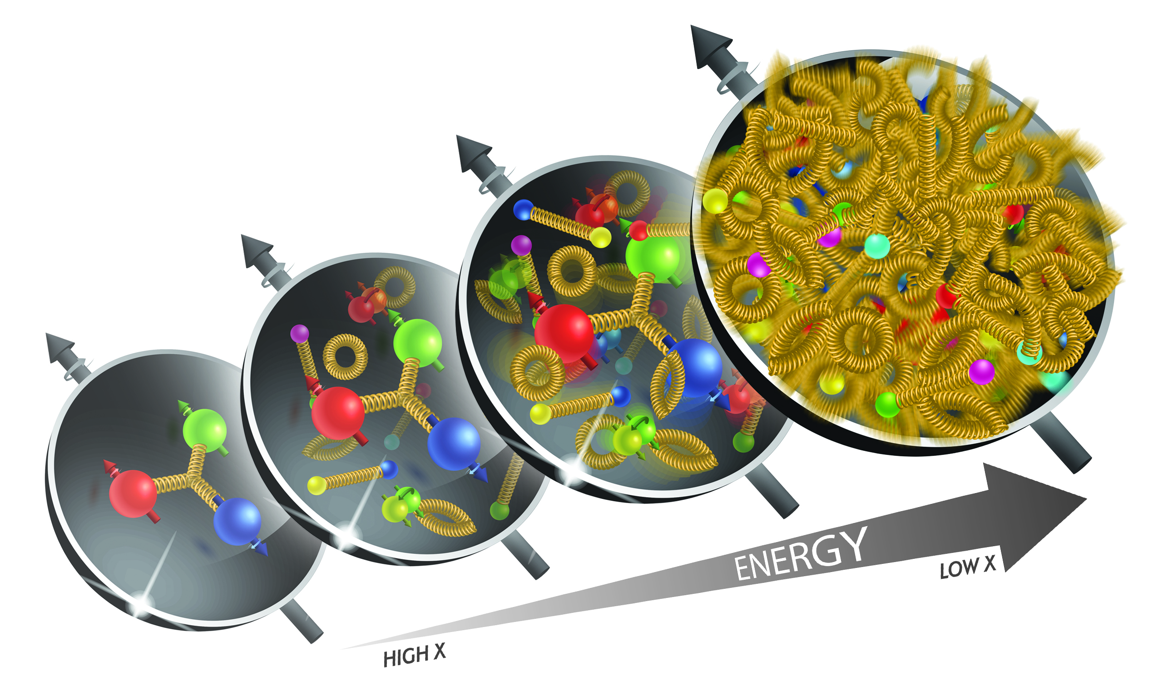
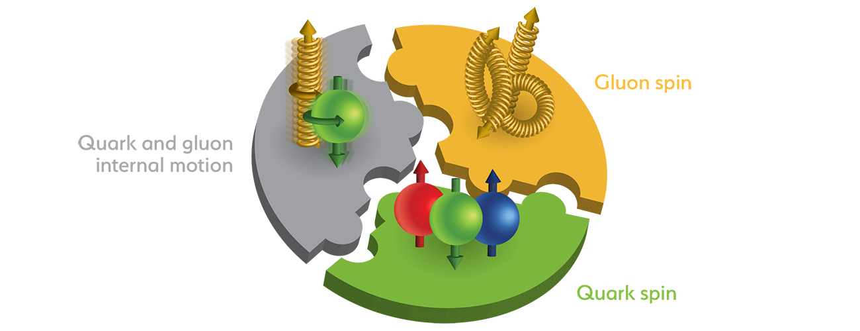
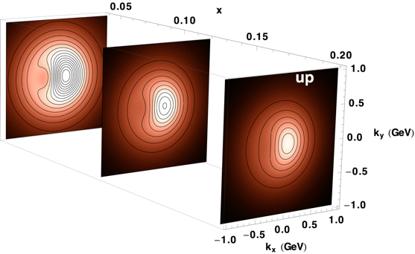
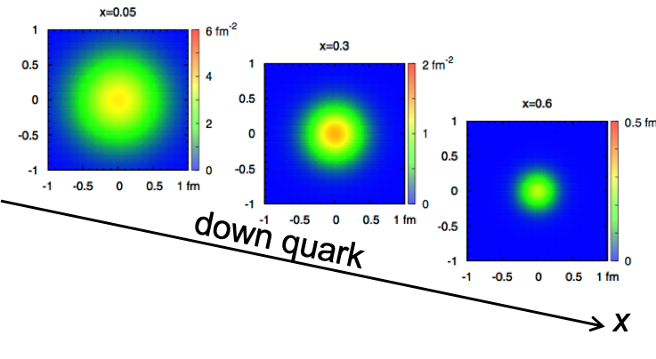
Accelerator Performance for NAS Science
map the out nucleon and nuclei structure from high to low x
span center-of-mass energy √s: 45 – 100 GeV
wide center-of-mass energy: √s: 30 – 140 GeV
access to spin structure of nucleons and nuclei
Spin vehicle to access the spatial and momentum structure of the nucleon in 3d
quark – gluon structure of light nuclei
polarized electron and hadron (p, He-3) beams
accessing the highest gluon densities → saturation
How quarks and gluons interact with a nuclear medium
nuclear beams: d to Pb at √s: 45 – 63 GeV
nuclear beams: d to Pb at √s: 30 – 90 GeV → access to highest & lowest x
mapping the spatial and momentum structure of nucleons and nuclei in 3d
high luminosity ≤10³³ cm⁻²s⁻¹
large acceptance in p_{T} (0.2 – 1.3 GeV) through forward focusing IR magnets
access to rare probes, i.e. Ws and BSM Physics
precision mapping the spatial and momentum structure of nucleons and nuclei in 3d
high luminosity: > 10³³ cm⁻²s⁻¹
EIC Mission Need
& Early science program
Full EIC capabilities
gluon emission
gluon recombination
?
=

Slide 13

What will be installed for the early science program
Goal:
central ePIC has all subsystems installed
Ancillary detectors all supports are installed, but some of the detector packages are not installed for safety reason for year 1.
ZDC and Lumi-detector are fully installed
Off-Momentum detectors should be in save position, so they can be used if beam is stable
Roman Pots will not be installed
low Q2 Tagger should be discussed
hadron and electron polarimetry will be installed from day-1 operating EIC
Hadrons
Ring Inside
Electrons
Photon
Beam
pC Hadron
Polarimeter
Rear
SC Magnets
B0 Magnets
& Detectors
Far Forward
SC Magnets
Luminosity
Monitor
Dipoles
Hadron Storage Ring
Electron Storage Ring
Low Q²
Taggers
Off Momentum
Detectors
Roman
Pots
Zero Degree
Calorimeter
Ring Outside

Slide 14
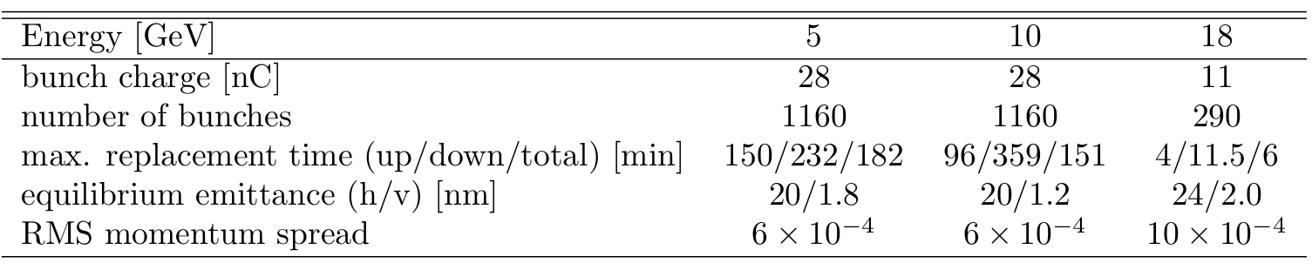
What do we need to commission
RCS:
  operate the RCS
  get polarization in the RCS
  swap out of electron bunches in the ESR
ESR:
  operating with spin rotator to get longitudinal polarization
  swap out of electron bunches to preserve polarization, needed because Sokolov Ternov depolarizes ”up” spin direction
HSR:
  operating beams off center
  transverse and longitudinal beam polarization (needs spin rotator) for protons and He-3
  pre-cooling of hadron beams
  operating with crab cavities
Maximum replacement times (= max. allowable storage times in ESR) are based
on 85% injected polarization and 70% time averaged polarization

Slide 15
Beam Energy and Average Orbit Radius in the HSR
3He
p
20 mm
130 GeV
100 GeV
store
275 GeV
70 mm $∅$ beam pipe
Since the electron revolution frequency is fixed, the hadron orbit must be adjusted with energy to keep the collisions in sync.
Zr
d
Au,
p
U
Ru
Cu
Prefer ~130 GeV/u, which corresponds to a ‘centered’ hadron beam (path length difference ΔR ~ 0, this is achieved for a beam where Z ~ 0.5A) → Ru, Cu, Ag, …..
Do not want to exceed the present RHIC maximum dipole fields (corresponds to 250 GeV protons or 833 T-m)

Slide 16
EIC Science Program in the early Years of EIC
Proposal to bring EIC online got feedback from
ePIC Leadership June 2024
Detector Advisory Committee Meeting June 2024
Users during EIC-UG/ePIC Summer Meeting July 2024
EIC Project Strategy Workshop August 2024
EIC@JLab Friday meeting September 2024
ePIC dedicated meeting on early science September 2024
Machine Advisory Committee Meeting September 2024
EIC CD-3B and Status Directors review October 2024
EIC RRB Meeting November 2024
EIC DOE OPA CD-3B LLP Review January 2025

Slide 17
Proposal for EIC Science Program in the First Years
Year - 1
Year - 2
Year - 3
Year - 4
Year - 5
Start with Phase 1 EIC
New Capability:
Commission electron polarization in parallel
Run:
10 GeV electrons on 115 GeV/u heavy ion beams (Ru or Cu)
Physics:
Add your preferred science topic
Phase 1 EIC
+ long. electron polarization
New Capability:
Commission proton polarization in parallel
Run:
10 GeV long. polarized electrons on 130 GeV/u Deuterium
Physics:
Add your preferred science topic
Run:
Last weeks 10 GeV long. polarized electrons and 130 GeV polarized protons
Physics:
Add your preferred science topic
Phase 1 EIC
+ long. electron polarization
+ proton polarization
New Capability:
Commission running with hadron spin rotators
Run:
10 GeV long. polarized electrons on 130 GeV transverse polarized protons
Physics:
Add your preferred science topic
Run:
Last weeks switch to longitudinal proton polarization
Physics:
Add your preferred science topic
Phase 1 EIC
+ long. electron polarization
+ proton polarization
+ operation of hadron spin rotators
New Capability:
Commission hadron accelerator to operate with not centered orbits
Run:
10 GeV long. polarized electrons on 100 GeV Au
Physics:
Add your preferred science topic
Run:
10 GeV long. polarized electrons on 250 GeV transverse and longitudinal polarized protons
Physics:
Add your preferred science topic
Phase 1 EIC
+ long. electron polarization
+ proton polarization
+ operation of hadron spin rotators
+ operation of hadron beams with not centered orbits
Run:
10 GeV long. polarized electrons on 100 GeV Au
Physics:
Add your preferred science topic
Run:
10 GeV long. polarized electrons on 166 GeV transverse and longitudinal polarized He-3
Physics:
Add your preferred science topic
Time to install additional ESR RF and HSR PS to
reach design Current and max. Energies

Slide 18
Proposal for EIC Science Program in the First Years
Year - 5
Year - 6
Year - 7
Phase 1 EIC
+ long. electron polarization
+ proton polarization
+ operation of hadron spin rotators
+ operation of hadron beams with not centered orbits
Run:
10 GeV polarized electrons on 100 GeV Au
Physics:
Add your preferred science topic
Run:
10 GeV long. electrons on 166 GeV transverse and longitudinal polarized He-3
Physics:
Add your preferred science topic
Phase 1 EIC
+ long. electron polarization
+ proton polarization
+ operation of hadron spin rotators
+ operation of hadron beams with not centered orbits
New Capability:
Commission ESR & HSR at max. energy and beam currents
Run:
18 GeV long. polarized electrons on 275 GeV/u polarized (longitudinal & transverse) proton beams
Physics:
Add your preferred science topic
Phase 1 EIC
+ long. electron polarization
+ proton polarization
+ operation of hadron spin rotators
+ operation of hadron beams with not centered orbits
+ operation of ESR & HSR at max. energy and beam currents
New Capability:
Operate HSR with 41 GeV bypass
Run:
5 GeV long. polarized electrons on 41 GeV transverse polarized proton beams
Physics:
Add your preferred science topic

Slide 19
Assumptions and Luminosity Calculation
7 nC electron bunch charge compared to 28 nC (CDR)
Constant proton beam IP divergencies are maintained throughout the store by gradual increase of proton IP beta-functions as the beam emittance increases.
The electron IP beta-functions are adjusted accordingly to match electron and proton transverse beam size.
Ion beam is cooled at low energy (24 GeV/u) but no stochastic cooling is used in the store
1 Run is ½ year operation at 80% uptime
2 h store turnaround time
30 min at the beginning of the store is taken by the ESR fill and detector turn-on
Not yet included a ramp of of luminosity through the Run
→ at RHIC: 1st week 25% of projected lumi / week
2nd week 50% of projected lumi / week
3rd week 75% of projected lumi / week
4th week to X week 100% of projected lumi / week
→ First guess for EIC early years
1st week 10% of projected lumi of the run / week
increase by 10% every → 10 weeks to reach projected lumi / week

Slide 20
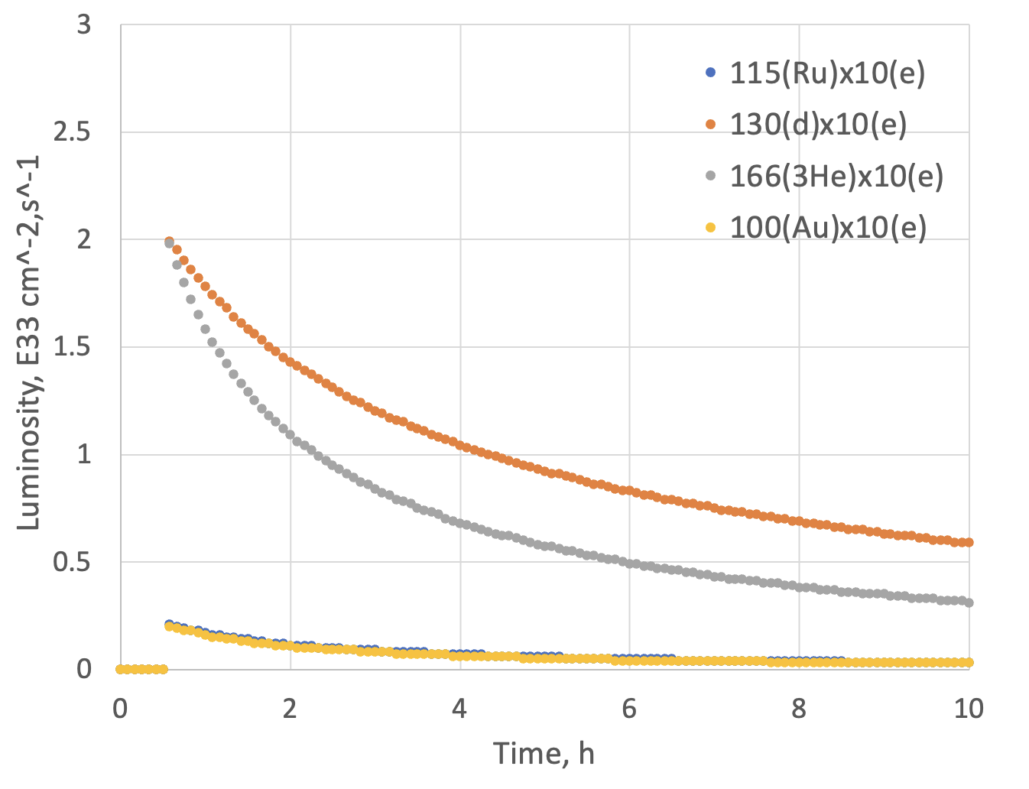
Assumptions and Luminosity
Possible Beam energies:
electron: 5 GeV, 10 GeV and ultimately 18 GeV
proton: 41 GeV, 100 GeV to 255 GeV ultimately 275 GeV
Au: 41 GeV, 100 GeV to 110 GeV ultimately
A: 41 GeV, 100 GeV to Max ~255 / (A/Z) ultimately ~275 / (A/Z)
eA luminosities for Phase-I
 | Lumi per Fill (5 h) | Lumi per Year
10 GeV e x 115 GeV Ru | 1.3 pb⁻¹ | 0.9 fb⁻¹
10 GeV e x 100 GeV Au | 1.2 pb⁻¹ | 0.84 fb⁻¹
10 GeV e x 130 GeV d | 16 pb⁻¹ | 11.4 fb⁻¹
10 GeV e x 166 GeV ³He | 12 pb⁻¹ | 8.65 fb⁻¹
Note:
eA luminosity is per nucleon

Slide 21
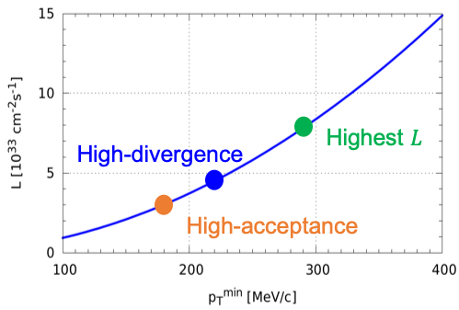
ep Luminosity for Phase-1
High Divergence | Lumi per Fill (5 h) | Lumi per Year
5 GeV e x 250 GeV p | 9.26 pb⁻¹ | 6.48 fb⁻¹
10 GeV e x 250 GeV p | 13.12 pb⁻¹ | 9.18 fb⁻¹
5 GeV e x 130 GeV p | 6.3 pb⁻¹ | 4.36 fb-1
10 GeV e x 130 GeV p | 7.6 pb⁻¹ | 5.33 fb⁻¹
Low Divergence | Lumi per Fill (5 h) | Lumi per Year
5 GeV e x 250 GeV p | 6.81 pb⁻¹ | 4.78 fb⁻¹
10 GeV e x 250 GeV p | 8.8 pb⁻¹ | 6.19 fb⁻¹
5 GeV e x 130 GeV p | 5.8 pb⁻¹ | 4.1 fb⁻¹
10 GeV e x 130 GeV p | 7.1 pb⁻¹ | 4.95 fb⁻¹
Compare to HERA integrated luminosity 1992 – 2007: 0.6 fb⁻¹
Remember:
high divergence: higher lumi, but reduced acceptance
for low forward particle p_{T}^{min}
low divergence: lower lumi, but increased acceptance
for low forward particle p_{T}^{min}
→ important for exclusive processes
Illustration
Low-divergence

Slide 22
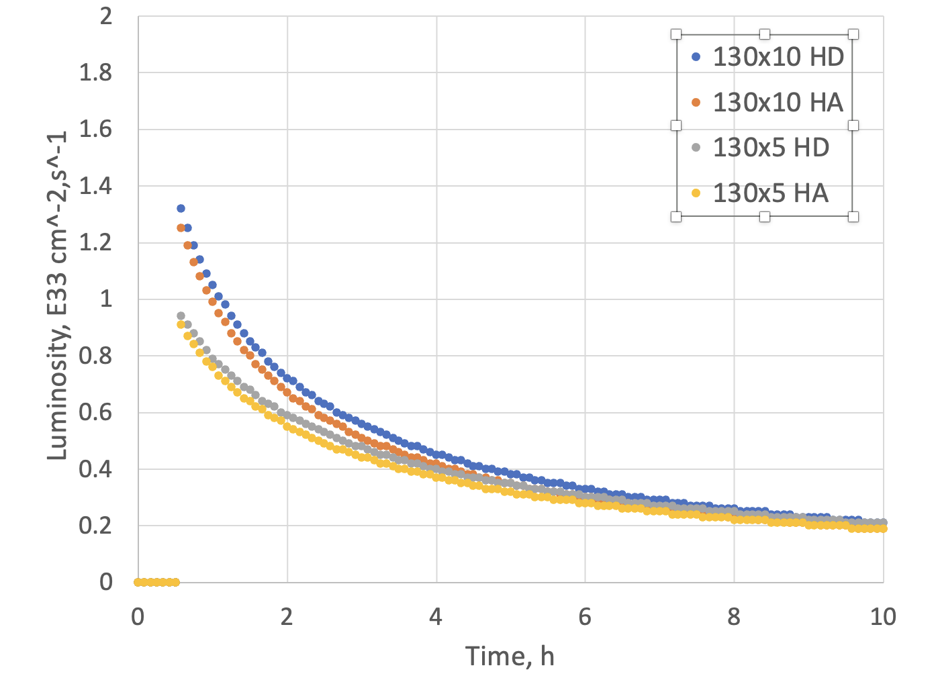
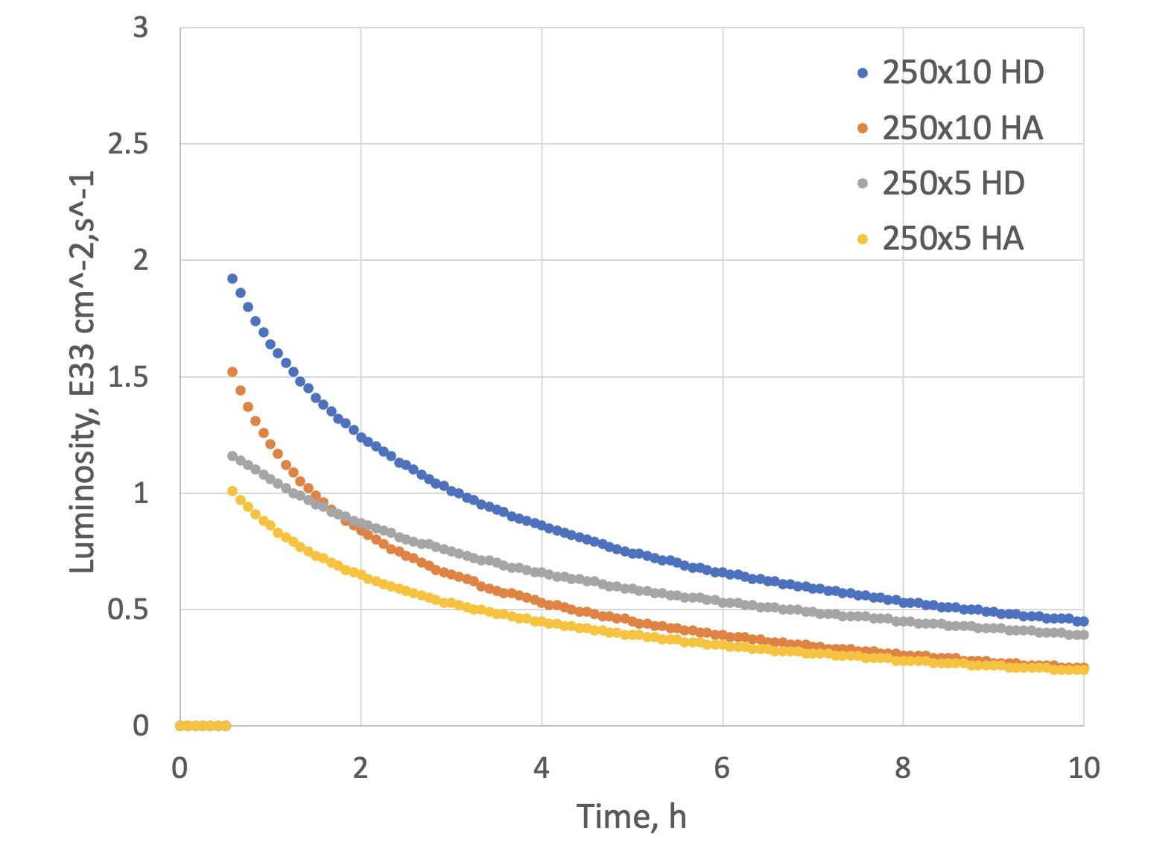
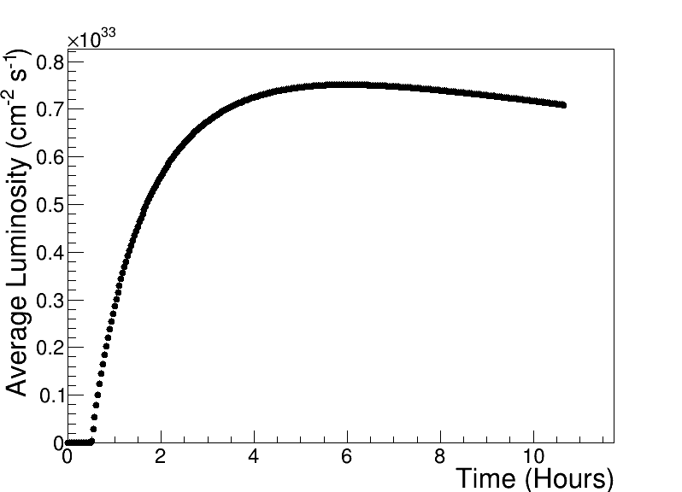
Luminosity ep for Phase-1
Compare to HERA peak luminosity
of 5x10³¹cm⁻²sec⁻¹
Max average luminosity without SHC: 0.8 x 10³³ cm⁻² s⁻¹ with 5.9 hr store
250 GeV x 10 GeV

Slide 23


Slide 24


Slide 25
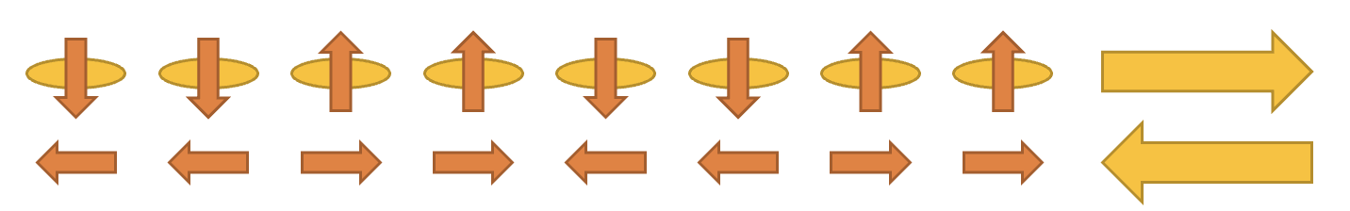
Initial thoughts on the EIC Commissioning Strategy
Science Requirement for Polarisation:
need high polarization (~70%) → experimental uncertainties proportional to 1/(P_{e}²P_{A}²L) or 1/(P_{e/A}²L) depending on measurements (single or double spin dependent observables)
if electron polarization is required, it needs to be always longitudinal → requires ESR spin rotators
to limit systematics → optimum would be to have arbitrary spin patters for both HSR and ESR
HSR: have trains of 4 bunches with the same spin direction​
ESR: using RCS allows for arbitrary spin patters in the ESR through replacements
Running at 5 and 10 GeV electrons:
we want polarization as early as possible,
depolarization is small → max allowable replacement time for 10 GeV 360 mins (85% → 70%) for the preferred polarization state and 96 mins for opposite direction
→ proposal run only the preferred spin state per fill → backup to swap out option in case backgrounds at detector
would be high
  Consequence: need to flip the ESR spin rotators between fills to keep systematics small → possible; optics does not depend on spin rotator polarity and in the shadow of filling the HSR we change spin rotator polarity in ESR
Maximum replacement times (= max. allowable storage times in ESR) are based
on 85% injected polarization and 70% time averaged polarization

