Slide 1
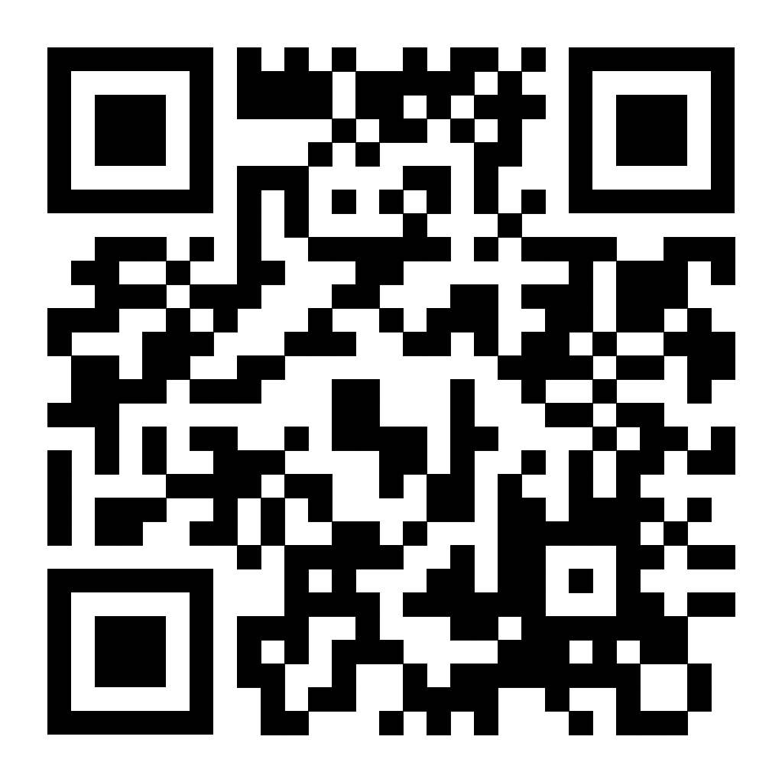
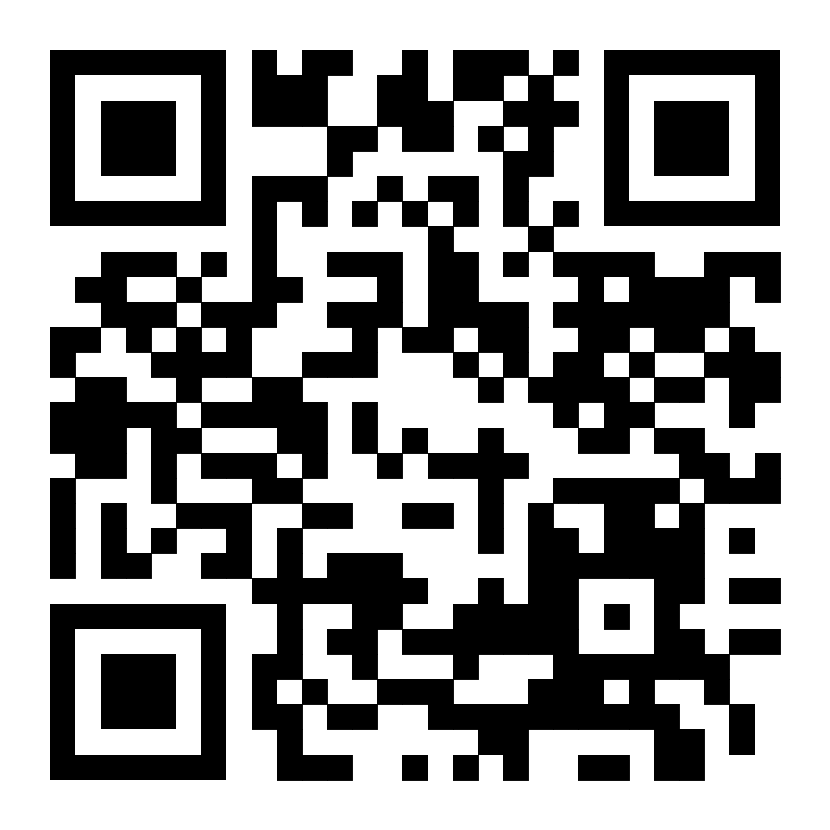
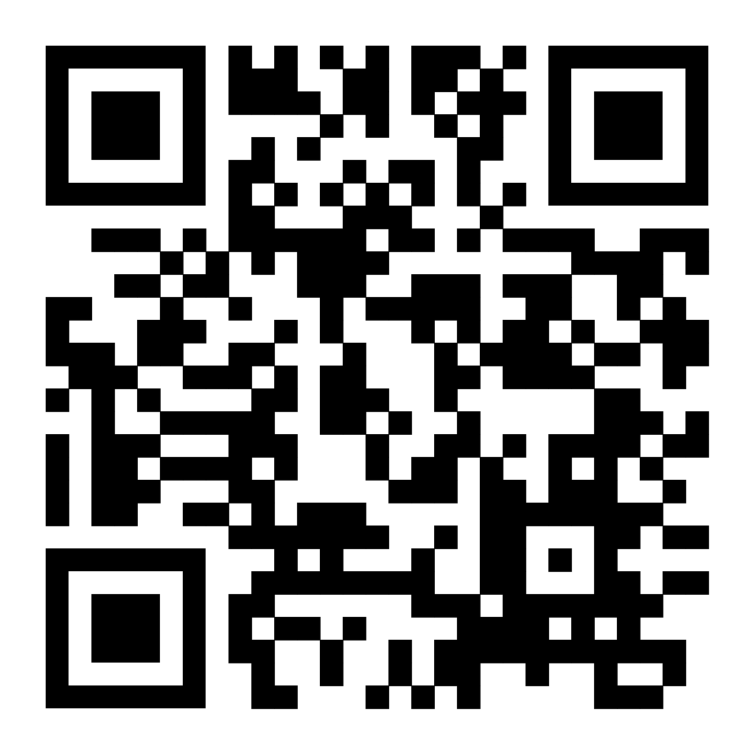
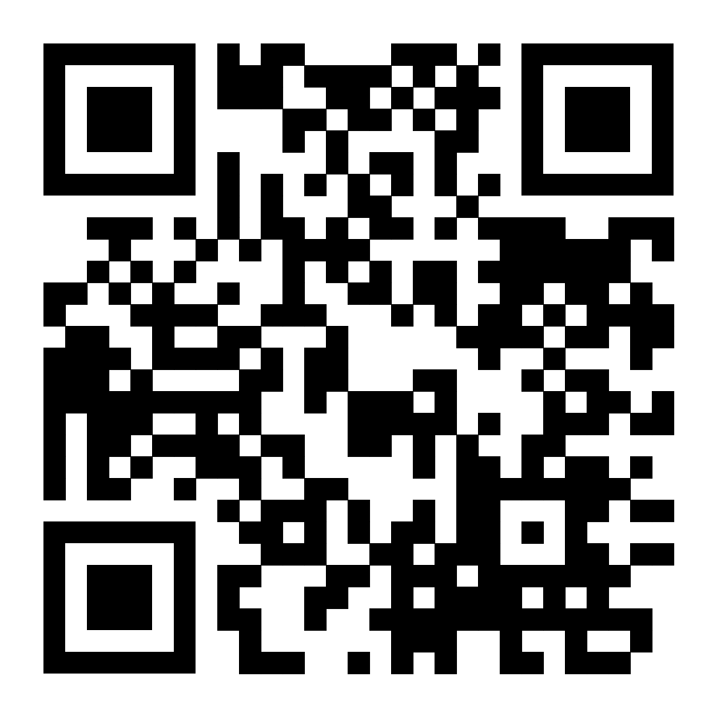
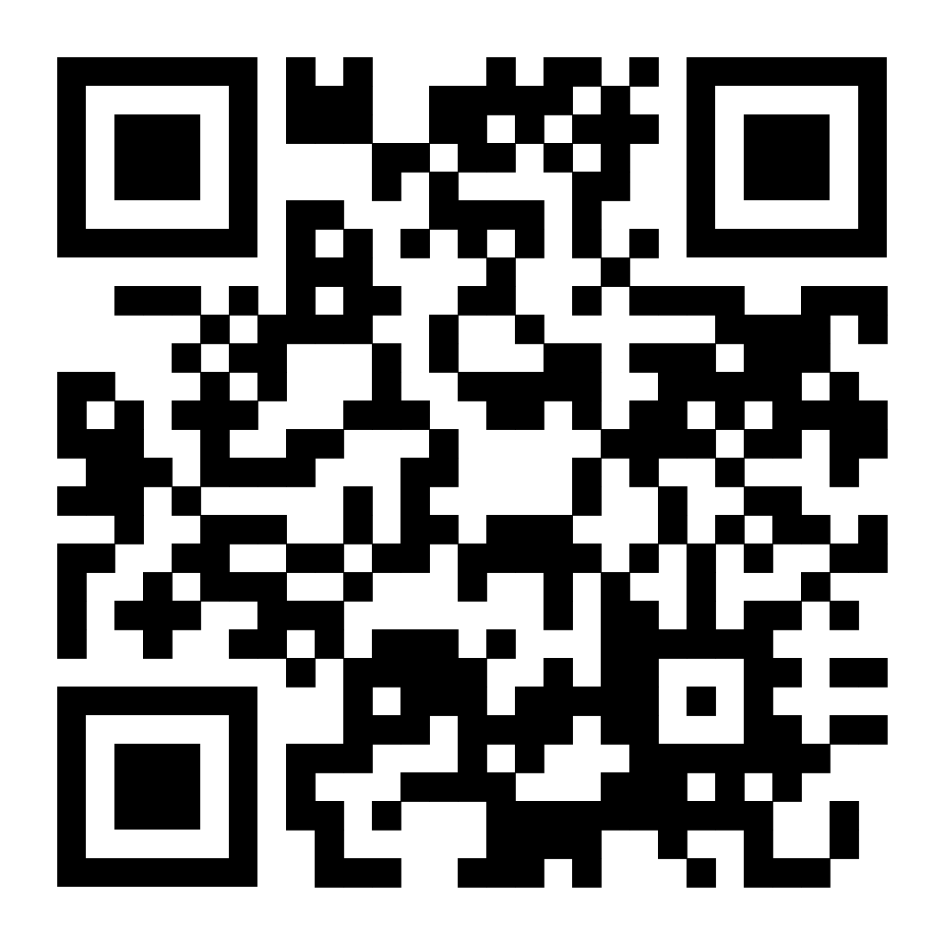
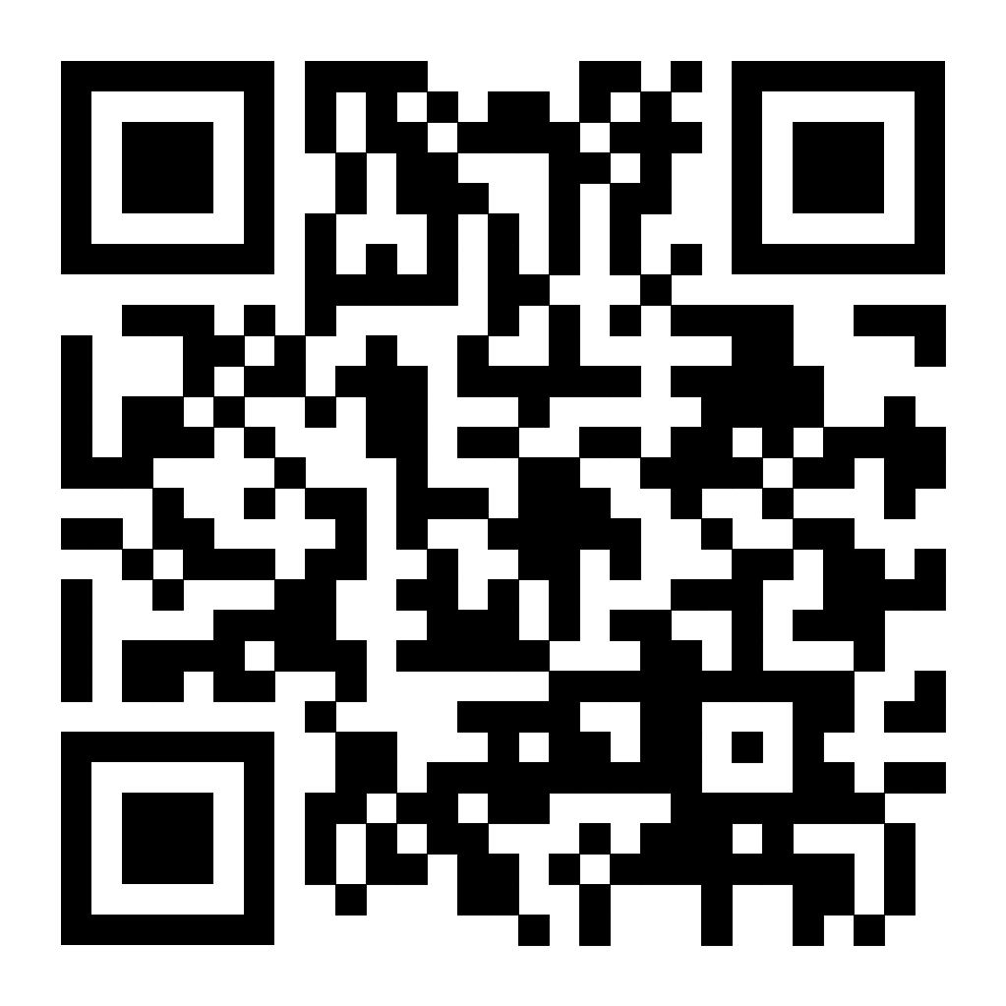
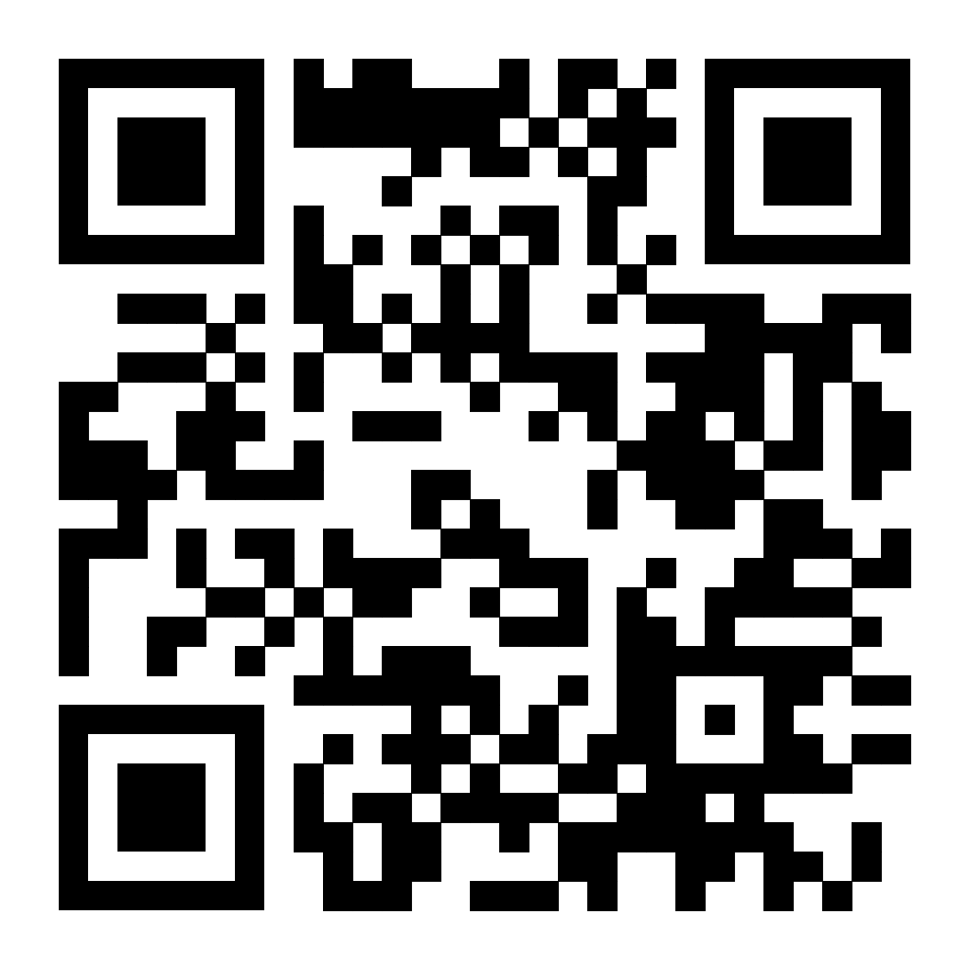
Links to Google Docs
Group #1
Group #2
Group #3
Group #4
Group #5
Group #6
Group #7 (Zoom)

Slide 2
Links to Group Google Docs
Group #1: https://shorturl.at/6OSa1
Group #2: https://shorturl.at/ovgE4
Group #3: https://shorturl.at/0i4NH
Group #4: https://shorturl.at/pdMcH
Group #5: https://tinyurl.com/ye257ysk
Group #6: https://tinyurl.com/3v2ffnwy
Group #7 (Zoom): https://tinyurl.com/n8962w4x

