Slide 1
ePIC Collaboration Status
J. Lajoie, S. Dalla Torre
January 20, 2025

Slide 2
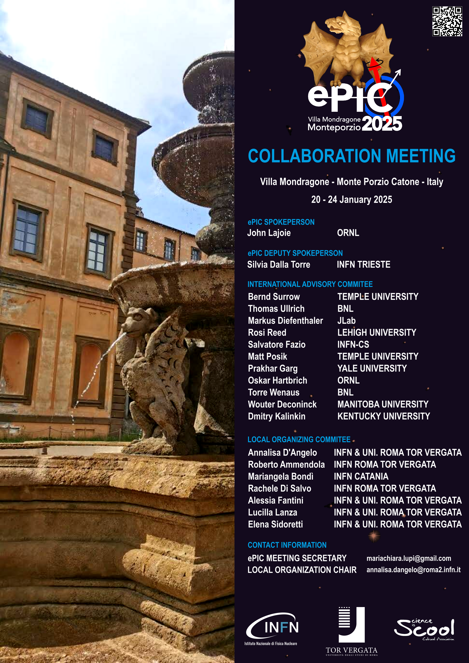
Welcome to Frascati!
Hosted by University of Rome Tor Vergata & INFN
January 20-24th, 2025
Via Frascati (Roman Hills)
https://agenda.infn.it/event/43344/
224+ registered participants (170 in person)

Slide 3
January 2025 Collab. Meeting Plan
Monday
Jan. 20th
Tuesday
Jan. 21st
Wednesday
Jan. 22nd
Thursday
Jan. 23rd
Friday
Jan. 24th
Plenary 1
Parallel/ Workfest 1
Early Science
Parallel/ Workfest 3
Parallel/ Workfest 4
Morning
Plenary 2
(incl. Contributed)
Parallel/ Workfest 2
Excursion
Collaboration Council
Plenary 3
Afternoon

Slide 4
Theme of the Collaboration Meeting
The Jan 2024 meeting at ANL established the goals and priorities for the collaboration for the coming year.
At the Summer 2024 meeting at Lehigh we took stock of where we were on the roadmap, made adjustments, and began the early science discussions.
The meeting in Frascati in Jan 2025 will come immediately after the EIC Project CD-3B review. We will again discuss the goals and set priorities for the collaboration in the coming year.

Slide 5
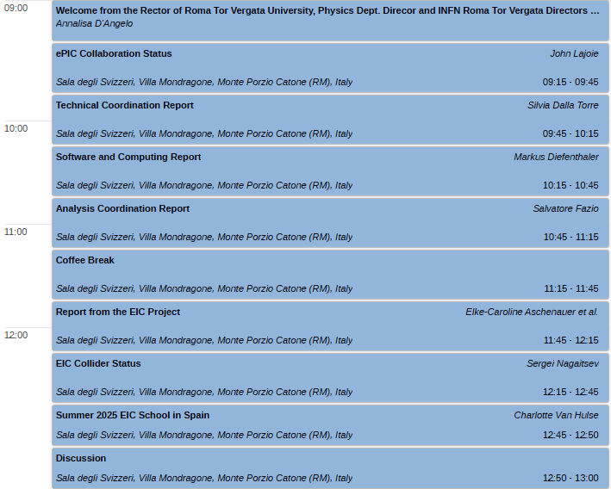
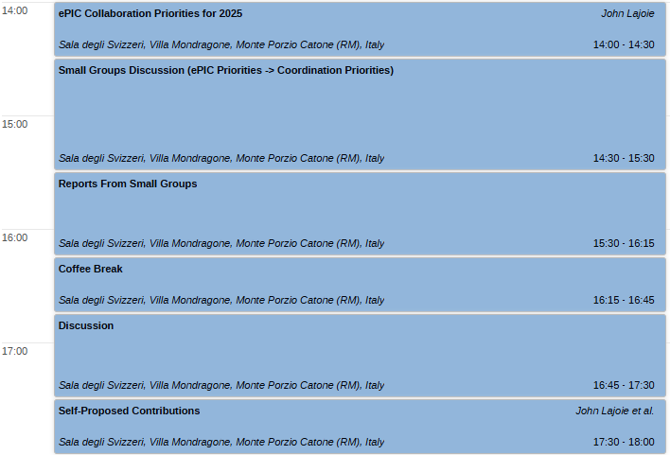
Agenda – Monday, Jan. 20th
The discussions on Monday afternoon will be extremely important! Come with your thoughts and ideas.
We’ll follow up with presentations from the coordinators and more discussion in Friday’s plenary session.

Slide 6
Early Science with ePIC
From Elke’s talk @ Strategy Workshop
At the summer EICUG/ePIC meeting, the discussion of what phasing the EIC might mean to an early science program was initiated.
This starting point has generated a growing discussion within the collaboration - the collaboration is motivated to define a meaningful and impactful early science program within the EIC.
This led to an ePIC Early Science Workshop in September, 2024.

Slide 7
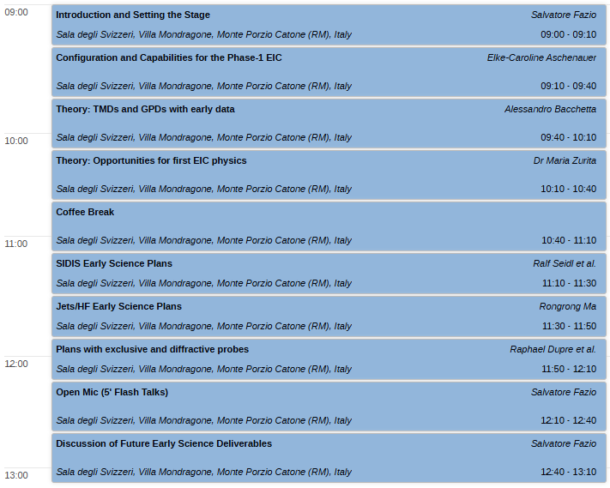
Early Science – Wednesday, Jan 22nd
Early Science Workshop organized by Salvatore Fazio and Rosi Reed.
Two invited theory talks!
Contributions welcome!! Contact Rosi and Sal

Slide 8
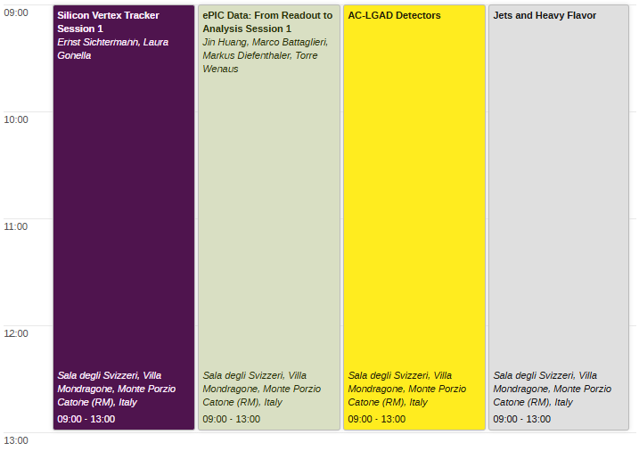
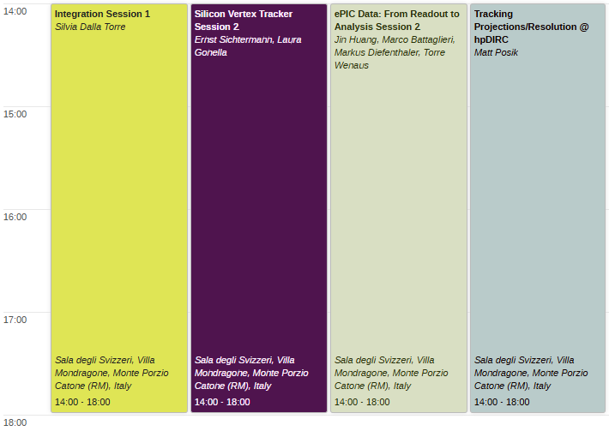
Workfests – Tuesday, Jan. 21st
Workfest descriptions at:
https://agenda.infn.it/event/43344/page/9444-workfest-descriptions

Slide 9
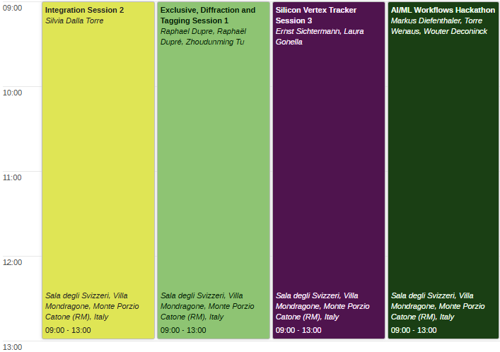
Workfests – Thursday Jan. 23rd
Collaboration Council Meeting
Thursday afternoon.
Conference dinner Thursday evening “will be enriched with high quality wines”

Slide 10
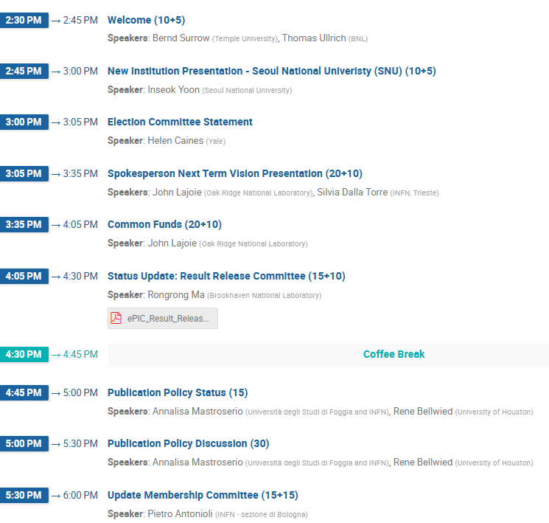
CC Meeting – Thursday Afternoon Jan 23rd
The CC meeting is open to the whole collaboration (with exception of closed session).
There will be important discussions of the Results and Publications policies and an update on the Membership Survey.

Slide 11
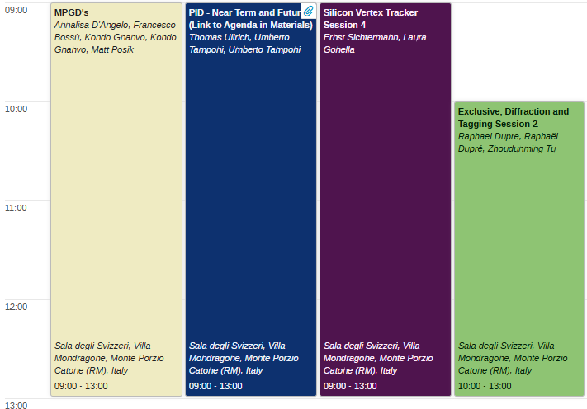
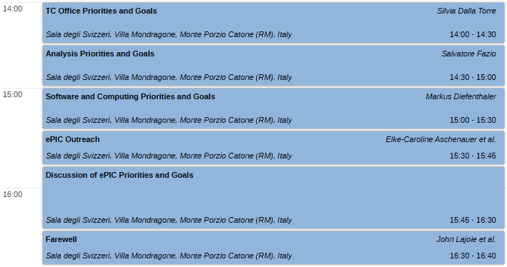
Agenda Friday, Jan. 24th
On Friday afternoon, we will return to the discussion of priorities and goals.
No workfest summaries! We’ll schedule a special online session for workfest summaries in the weeks following the collaboration meeting (split between TIC and General Meetings).

Slide 12
ePIC Contests
Several contests are ongoing:
ePIC Photo Contest:
Organized with the support of the ePIC-EICUG outreach group
Contact Marta Ruspa (ruspa@to.infn.it)
ePIC Poster Contest:
Organized by the ePIC Early Career Group with Elke

Slide 13
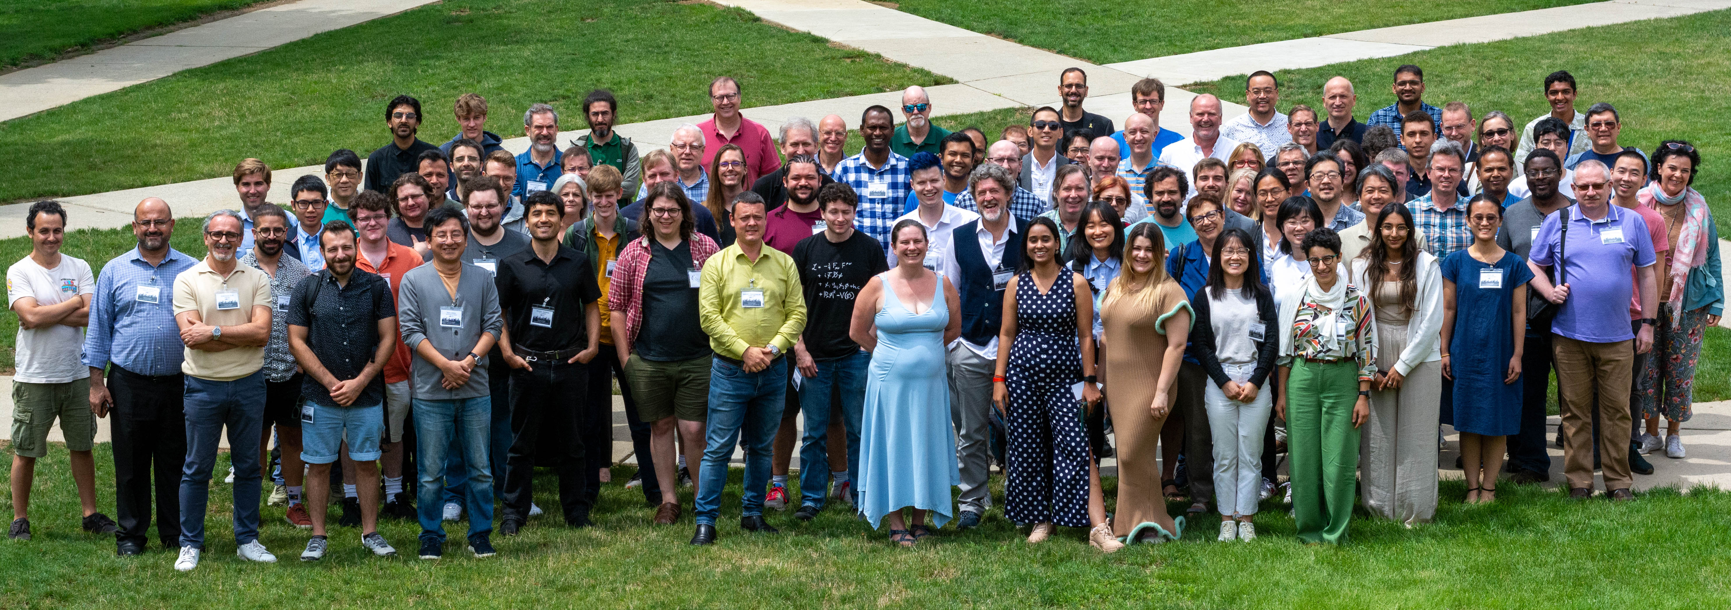
The Collaboration
ANL, Jan 2024
EICUG/ePIC Meeting – Lehigh, July 2024

Slide 14
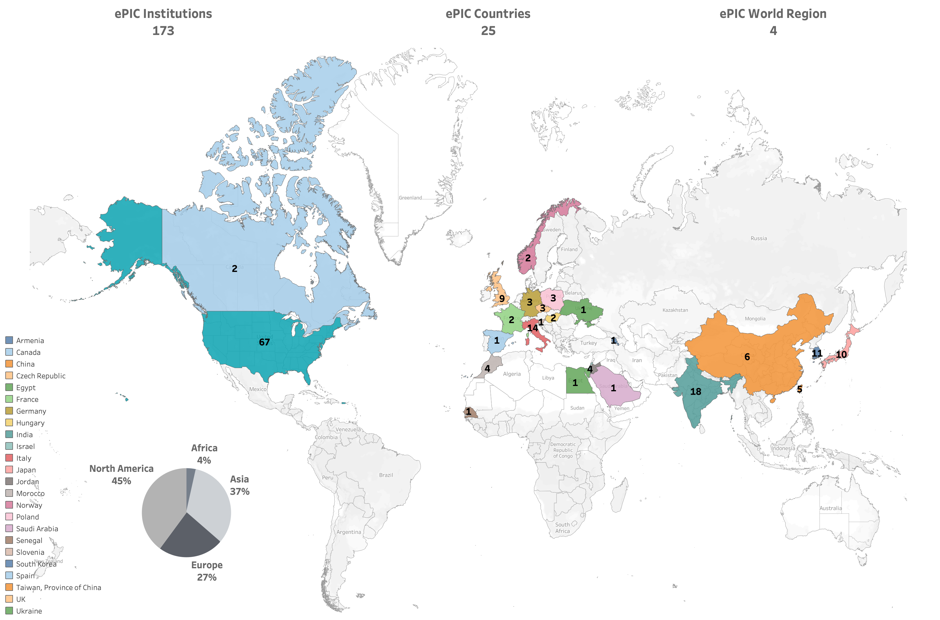
International
178
New Institutions Joining ePIC in 2024:
Univ. of Texas at Austin
Univ. Mohammed V in Rabat
Univ. Ibn Tofail in Kénitra
Univ. Mohammed Premier in Oujda
Tohoku University
Univ. Mohammed VI in Bengurir
Kent State Univ.
Laboratoire Leprince-Ringuet (LLR)
American University in Cairo
Central University of Haryana
Indian Institute of Technology Mandi
UPES
ePIC Initiated in July 2022
Currently:
897 collaborators (from 2024 Institutional Survey)
2025 collaboration survey ongoing

Slide 15
2024 -2025
PLUS:
18 General Meetings
39 TIC Meetings
100’s of DSC and WG Mtgs
Test beams, etc.
ePIC draft pre-TDR Version 1.0 December 6, 2024
3rd EIC-Asia Workshop Jan 29-31st
BIC Workshop May 14-17th
FDR: Magnet Flux Return Steel October 16, 2024
EIC Strategy Mtg August 21st
ePIC Early Physics Workshop Sept. 13, 2024
4th EIC-Asia Workshop July 1-5th
ePIC Software and Computing Review Sept. 26-27th
ePIC Software and Computing Meeting @ CERN– Apr 22-26th
9th Detector Advisory Committee R&D Meeting
August 28-28th
EIC Project CD-3B/Status Review January 7-9th, 2025
hpDIRC Annual Meeting May 16-22nd
PDR: Integration, Installation
and Infrastructure July 15th
Recognized Experiment
INFN ePIC Meeting June 27-28th
ePIC Collab. Jan 9-13
2024
2025
ePIC/EIC Det. R&D Day March 25th
PDR2: IR Integration and Auxiliary Detectors – Feb 12th
PDR2: Electronics & DAQ
FDR for VTRx+/lpGBT June 10-11th
Frascati
Jan 20-24,2025
3rd EIC RRB Meeting May 6-7
EICUG/ePIC Collab. Mtg. July 22-27
EIC “Host” Lab User Experience Workshop
August 26th
PDR2: Barrel EMCal
September 19th
4th EIC RRB Meeting Nov 12-13
PDR1: Tracking Detectors March 20-21st
EIC-France Meeting Oct 9th
8th Detector Advisory Committee June 21st
BNL Off-Project Dep. Review Experimental Program Aug 22-23
FDR: Magnet Power Supply May 28th
ePIC draft pre-TDR Version 0.1 Sept. 30, 2024
Directors Review for CD-3B/Status Review
October 22-24

Slide 16
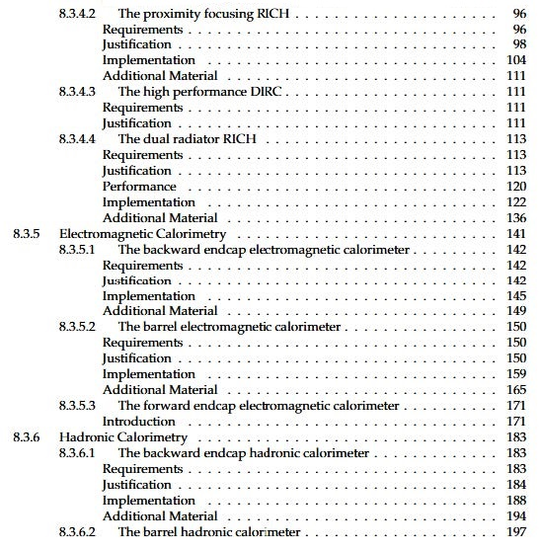
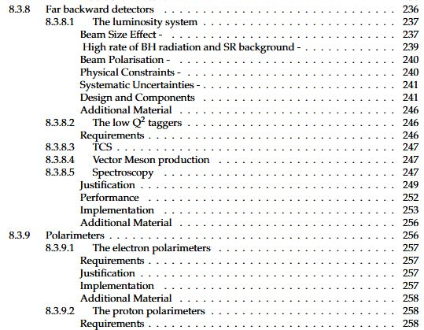
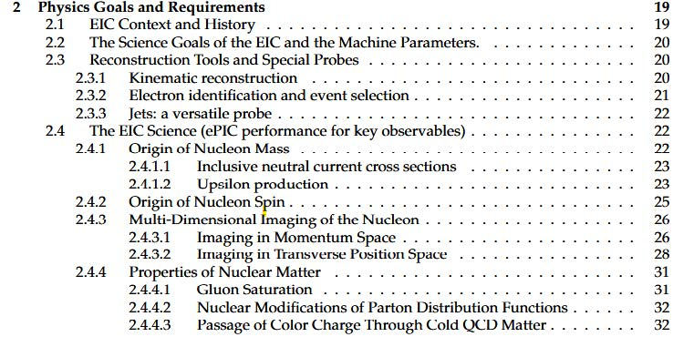
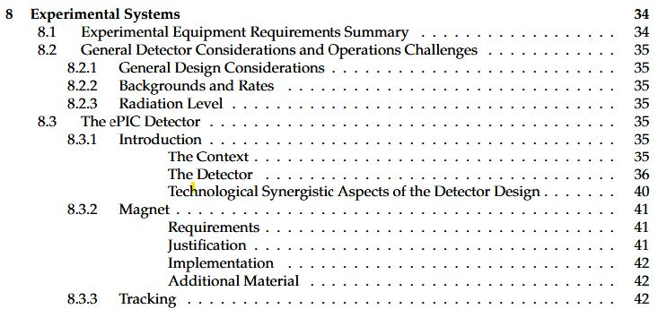
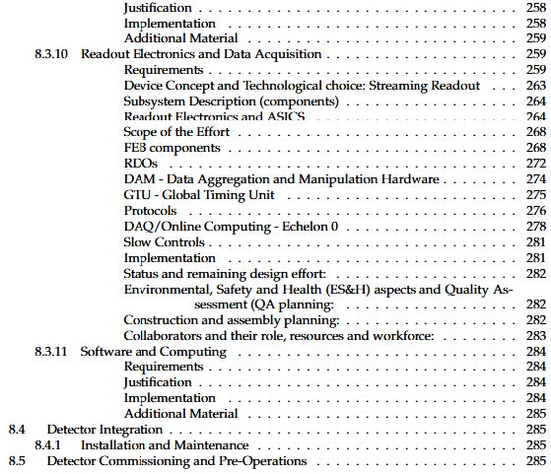
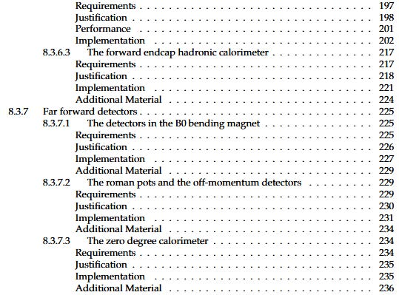
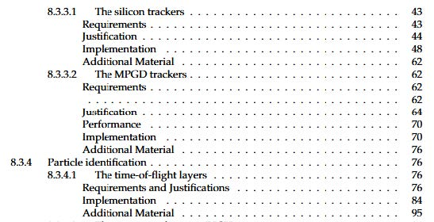
preTDR Version 1.0!
Executing the plan from the Jan. 2024 Collaboration Meeting:
More in the Coordinator reports – this was a coordinated effort!
process design phase
structuring the
effort
draft ePIC pre-TDR
ePIC pre-TDR (CD-2)
writing
(TDR/notes)
Internal Review
(October)
Preparing papers for
publication
Mid Jan.24
381 pages, 290 figures
Mid Mar.24
Early 2025
Version 0.1
Sept. 30, 2024
Version 1
Dec. 6, 2024
If you think about how the landscape had changed since the ANL collaboration meeting it really is quite stunning. Despite all this the collaboration set a goal and worked steadily towards that goal all year.
Version 1.0 has been made available to the CD-3B/Status Review Committee.
Congratulations and thank you to all those involved in preparing the pre-TDR this year!

Slide 17
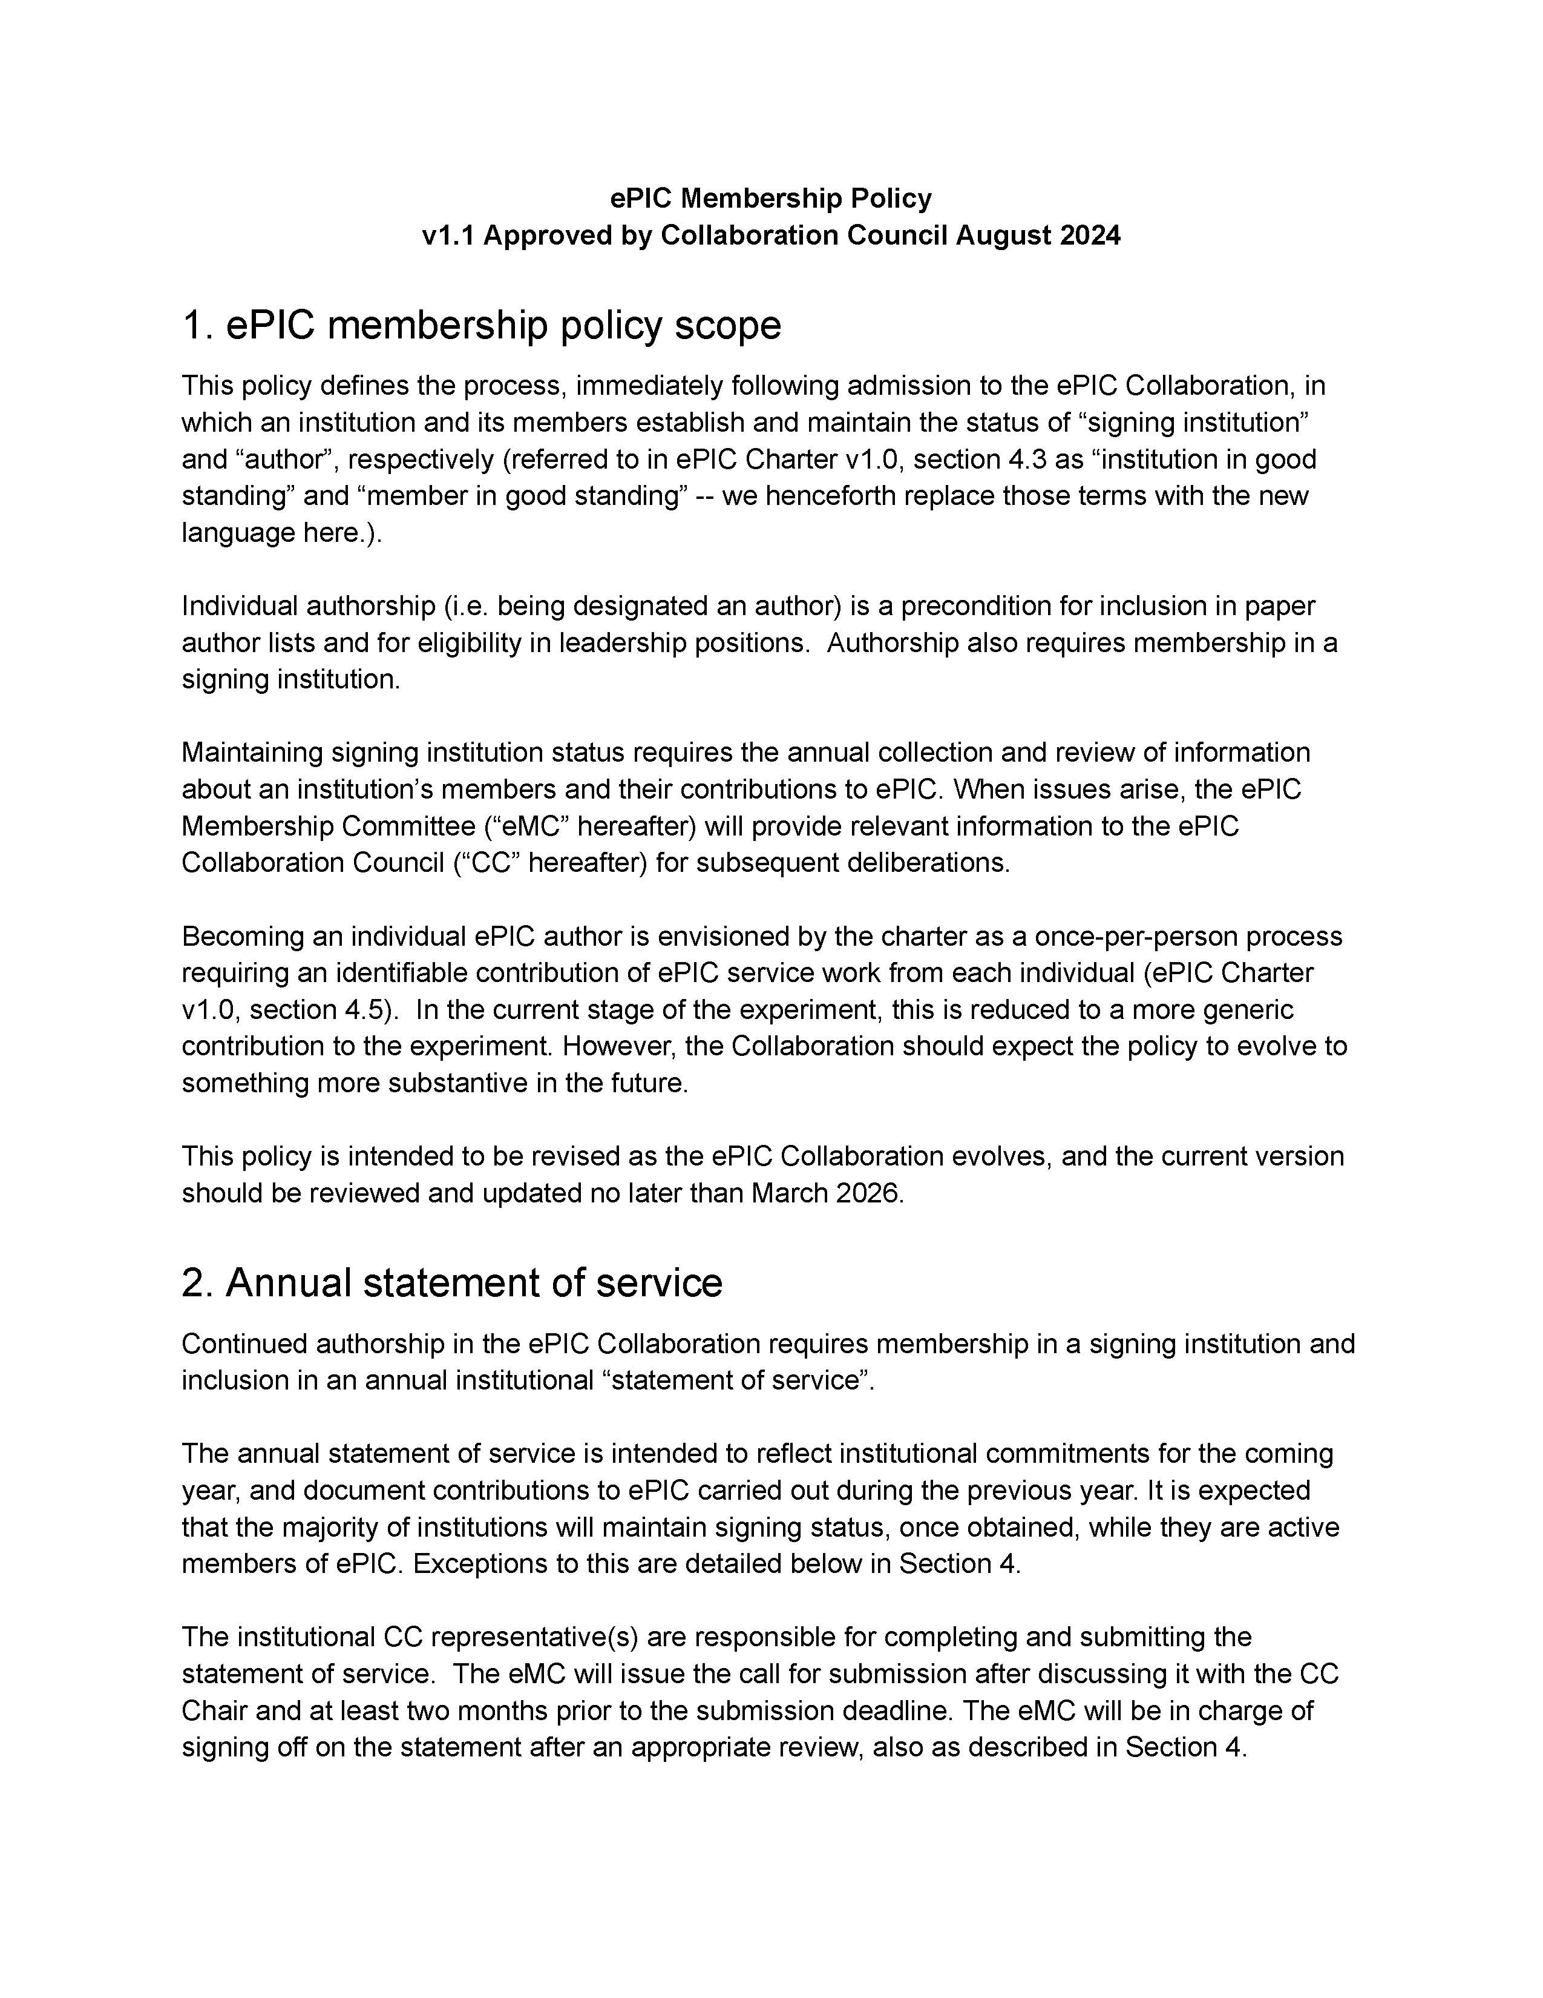
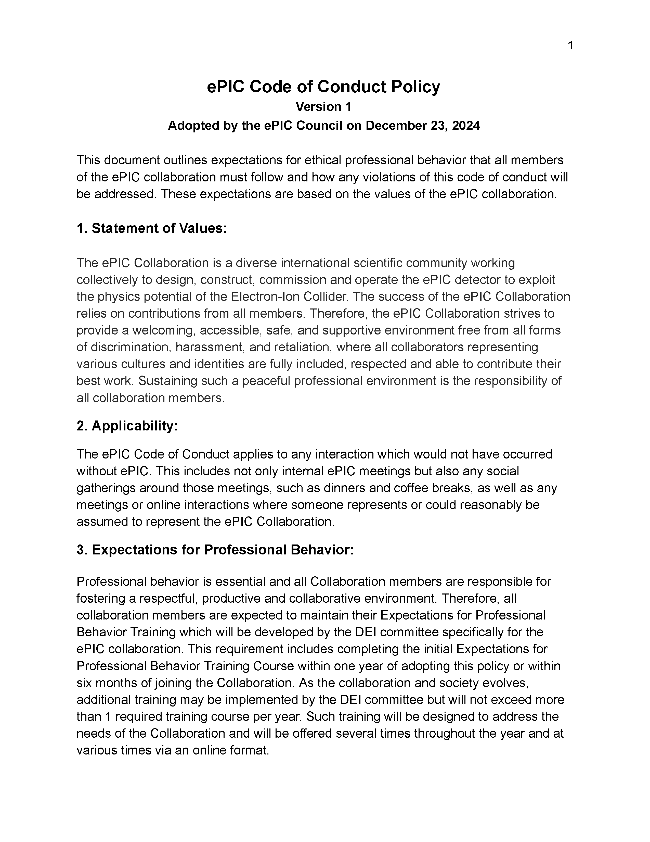
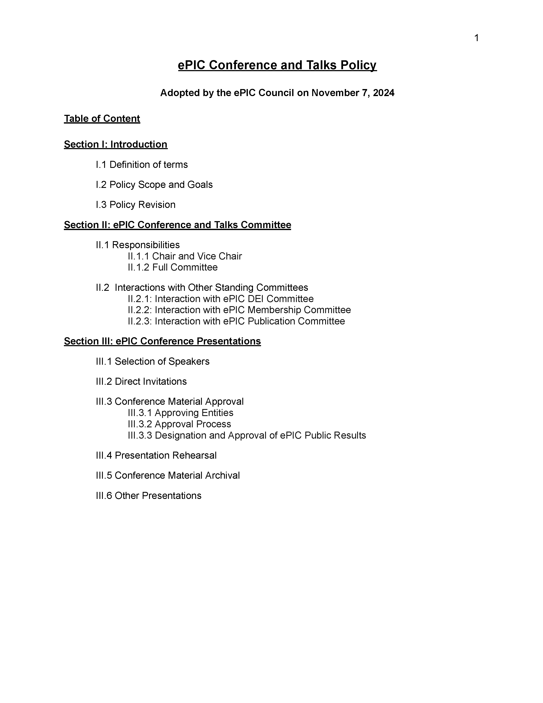
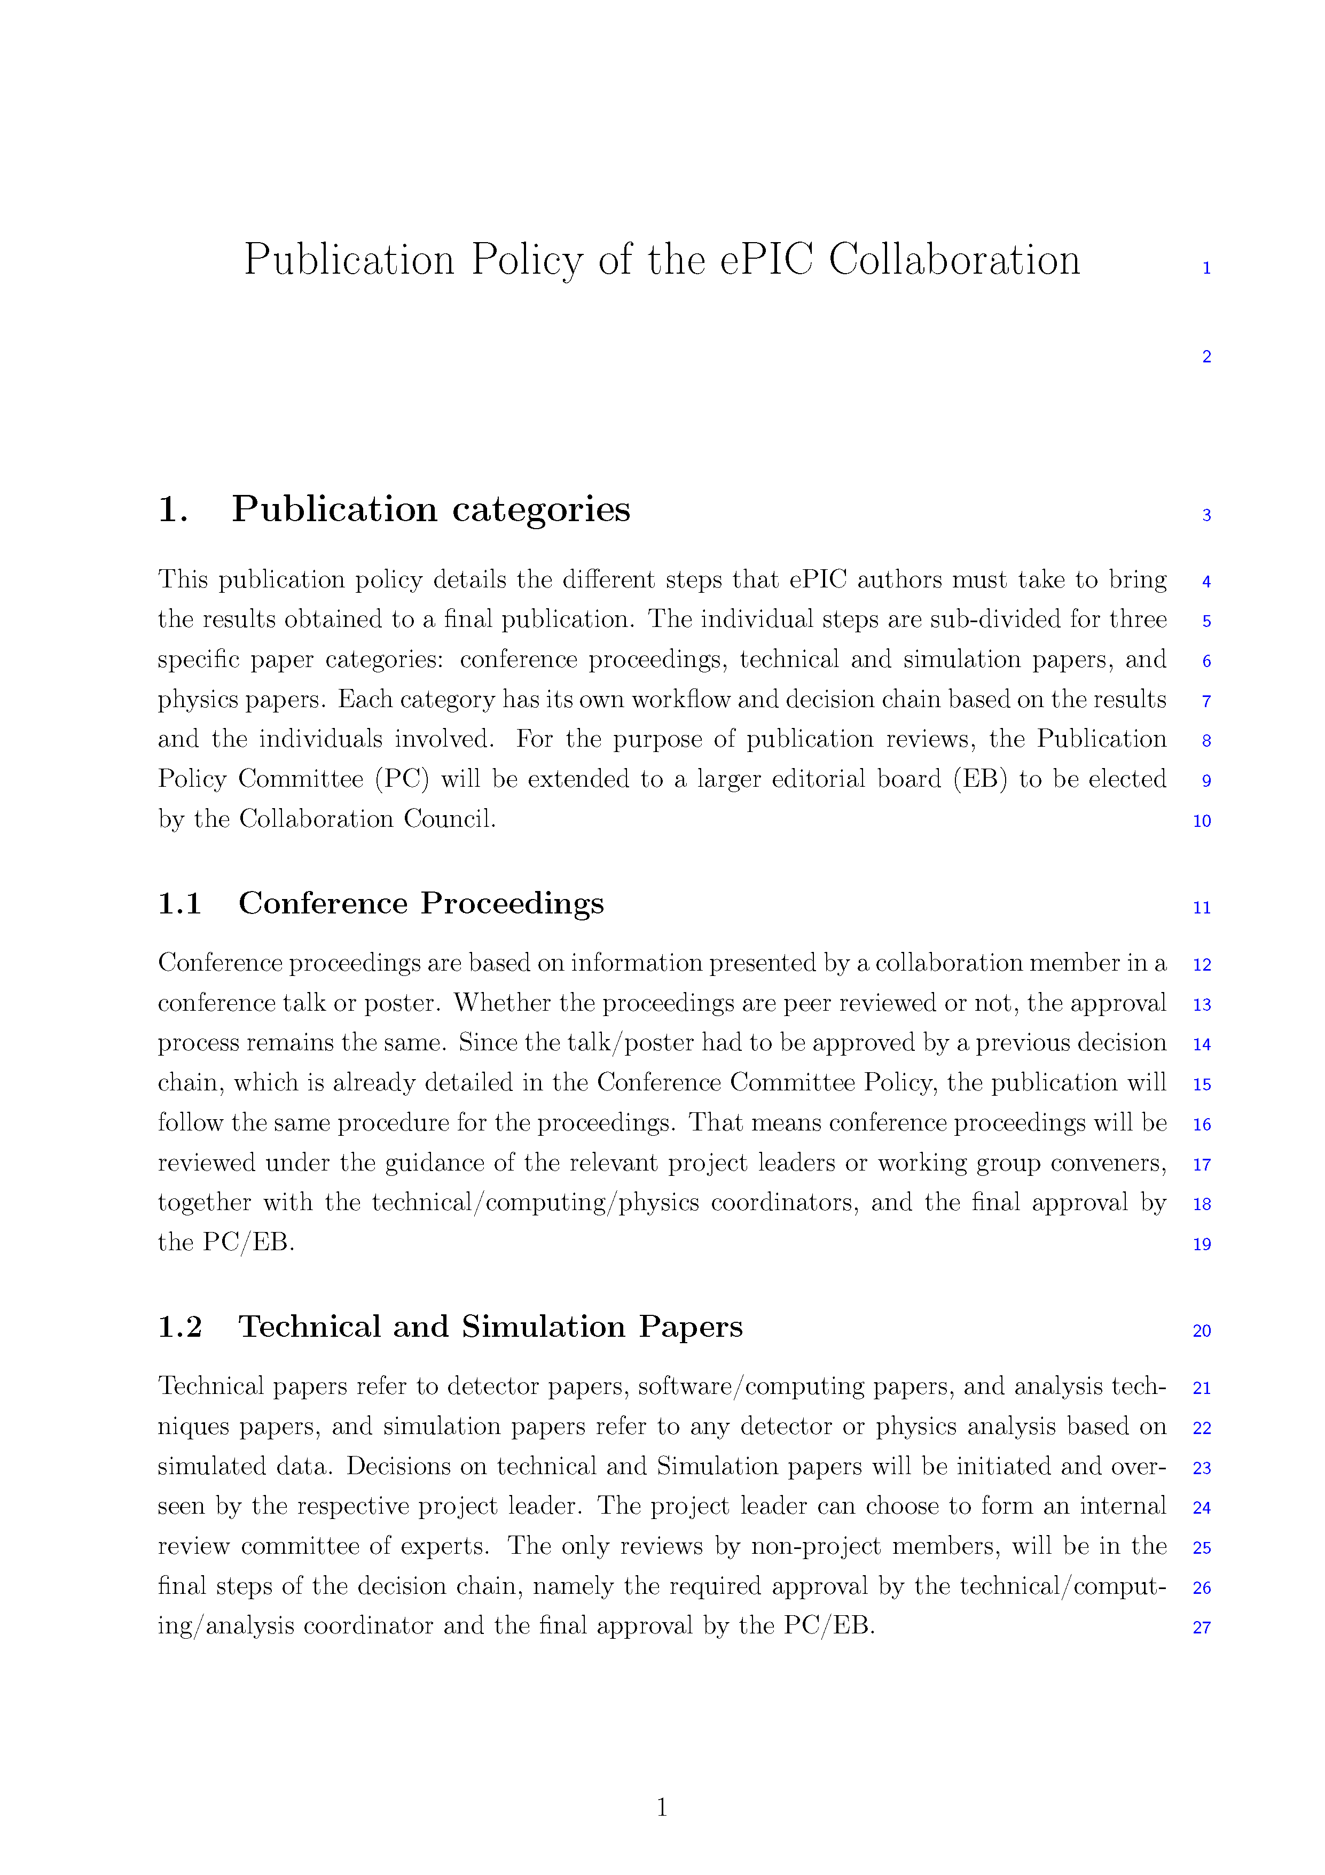
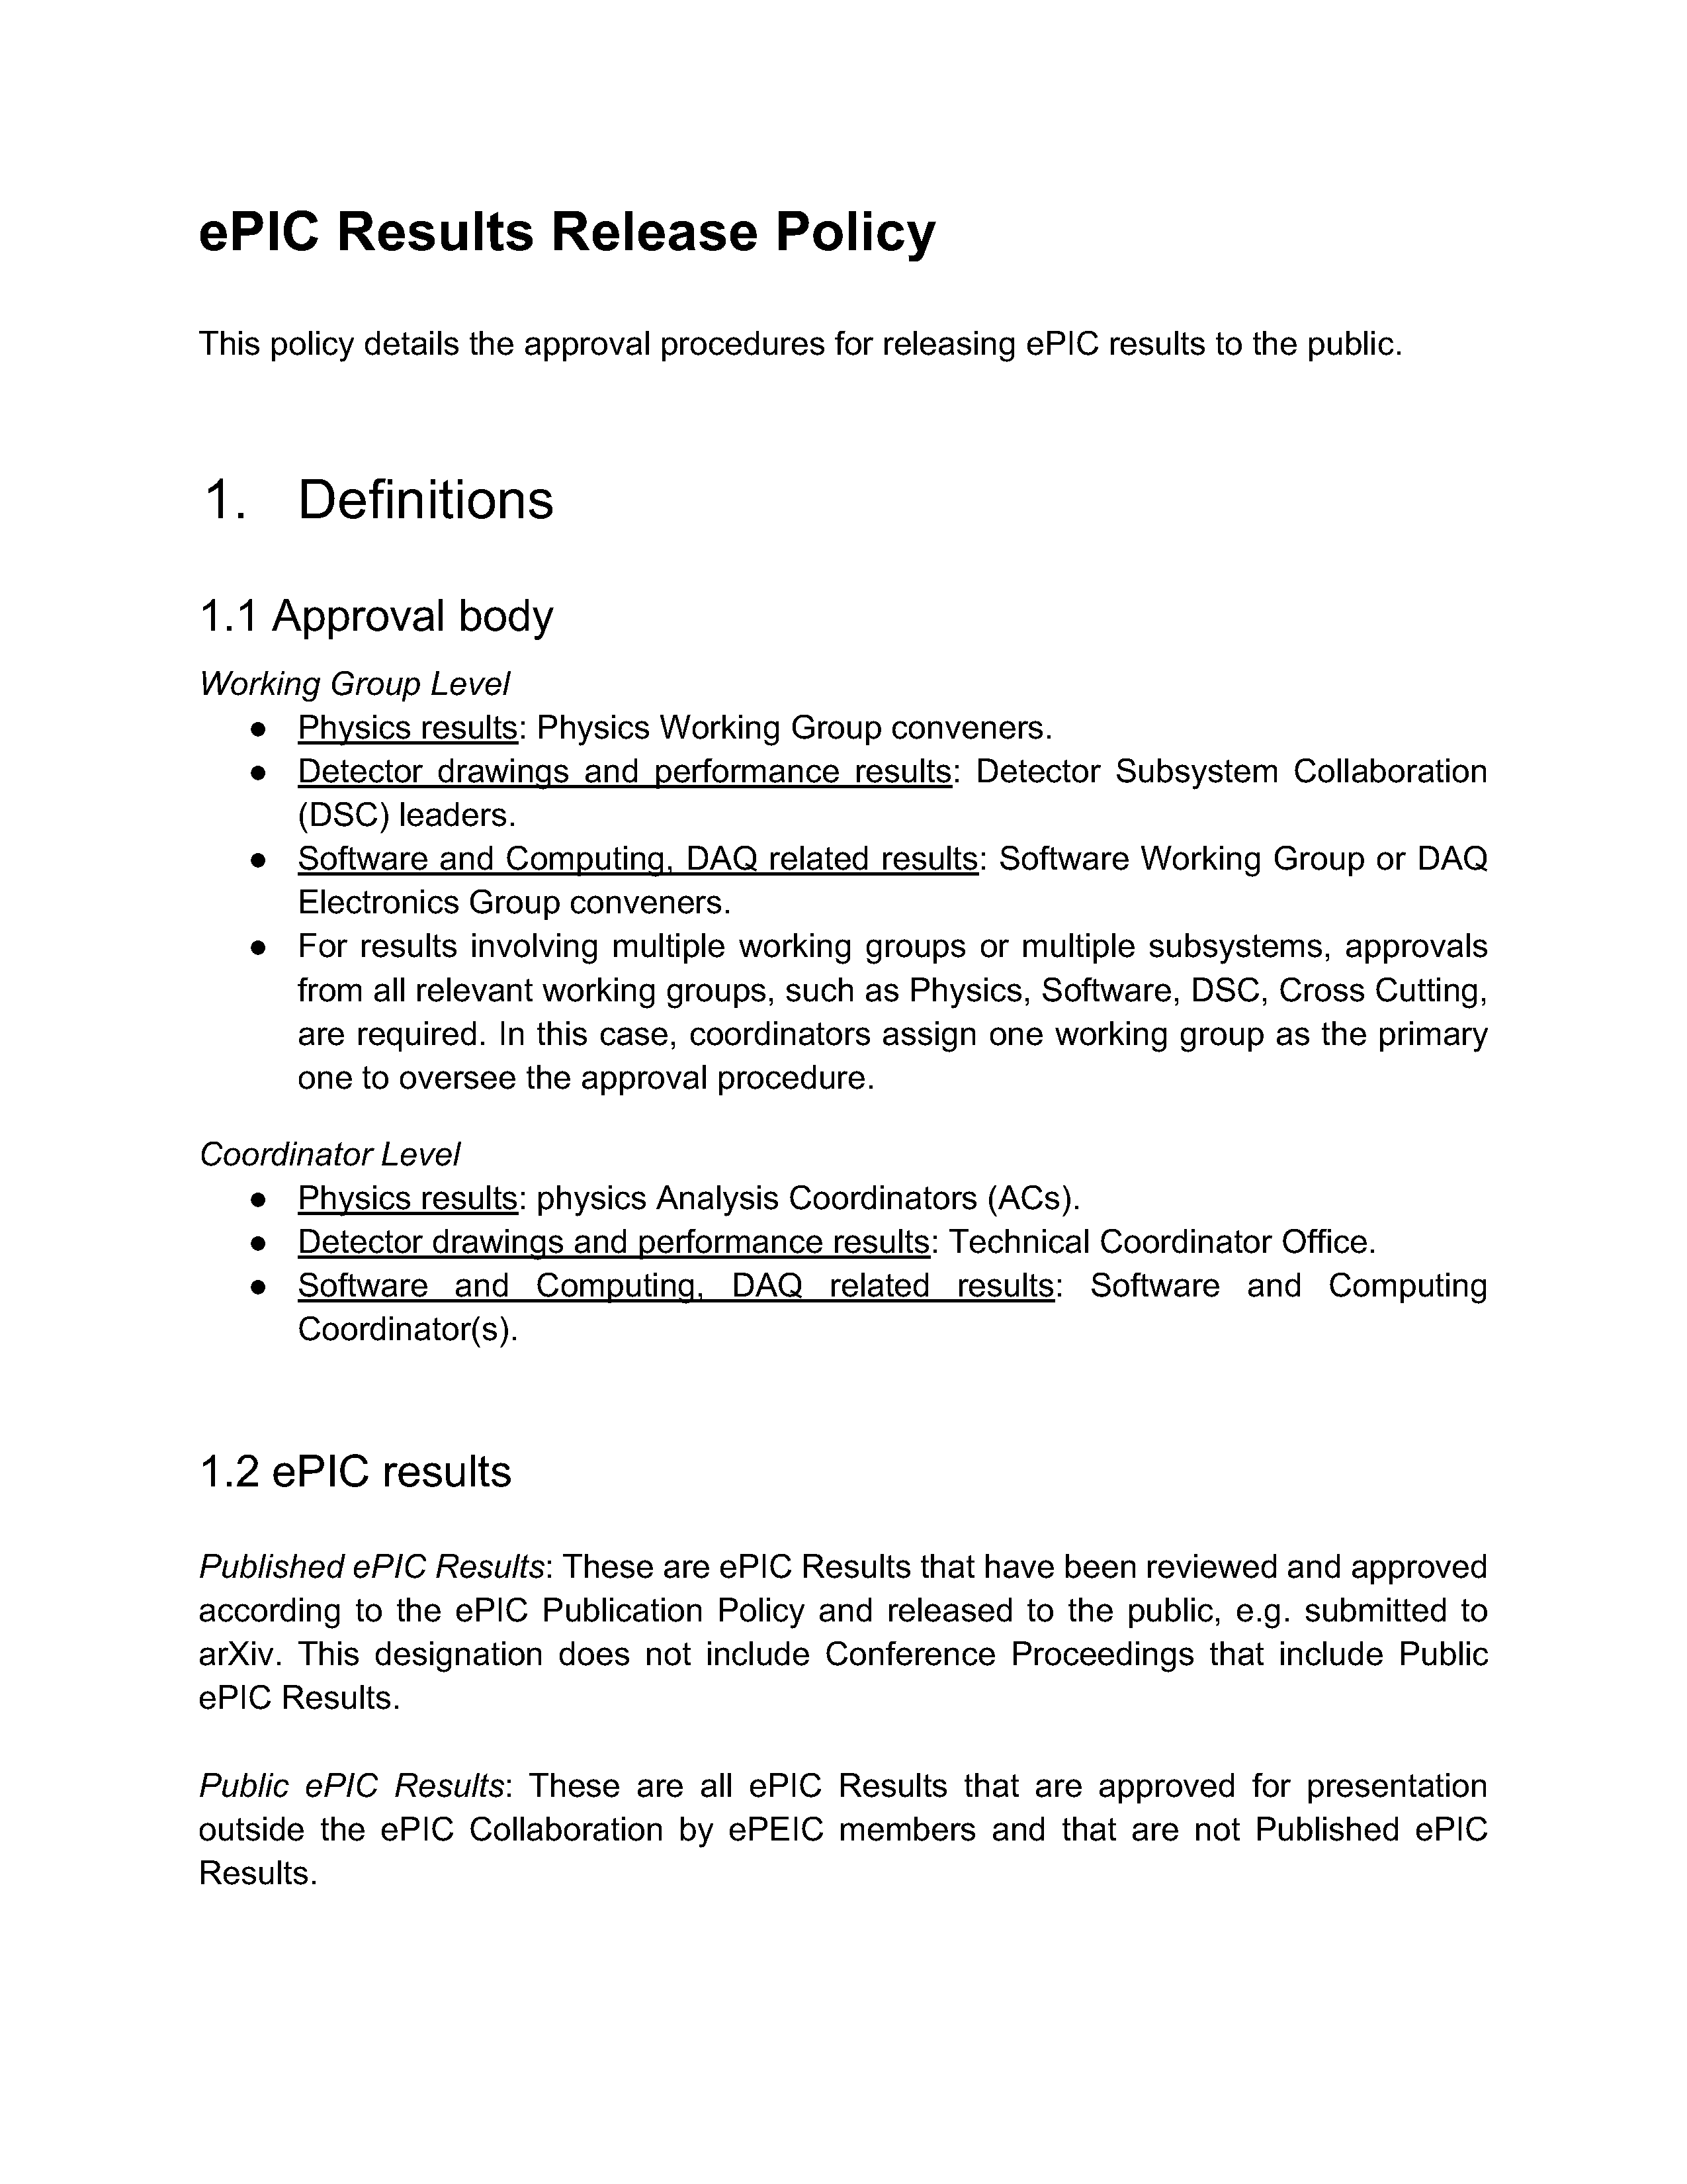
ePIC Committees
August 2024
Membership Committee:
Chair: Peter Steinberg (BNL)
Vice-Chair: Pietro Antonioli (INFN-Bologna)
Friederike Bock (ORNL), Helen Caines (Yale), Doug Higinbotham (JLab), Bedhanga Moharty (NISER), Silvia Niccolai (IJCLAB), Marzia Rosati (ISU)
APPROVED
Collaboration Council
Institutional Representatives
DE&I Committee:
Chair: Megan Connors (GSU)
Vice-Chair: Christine Nattrass (UTK)
Francesco Bossù (CEA-Saclay), Wouter Deconinck (University of Manitoba), Narbe Kalantarians (Virginia Union University) , Iris Ponce Pinto (Yale University) , Maya Shimomura (Nara Women’s University) , Allison Zec (University of New Hampshire)
Standing Committees
DE&I
Conferences and Talks
Membership
Elections
Publications
Ad-Hoc Committees
APPROVED
November 2024
Conferences and Talks:
Chair: Maria Zurek (ANL)
Vice-Chair: Brian Page (BNL)
Barbara Jacak (Berkeley), Daniel Brandenburg (OSU), Dmitry Kalinkin (Kentucky), Nick Zachariou (York), Xuan Li (LANL), Nicola Rubini (Bologna), Wouter Deconinck (Manitoba)
APPROVED
December 2024
Publications Committee:
Chair: Rene Bellwied (U. Houston)
Vice –Chair: Annalisa Mastroserio (INFN Bari)
Lokesh Kumar (Panjab U.), Michela Chiosso (Torino), Prithwish Tribedy (BNL), Markus Diefenthaler (JLab), Sevil Salur (Rutgers),
ex-officio w. Conferences and Talks Committee: Daniel Brandenburg (OSU)
Thursday’s CC Mtg
Elections Committee:
Chair: Helen Caines (Yale)
Vice-Chair: Ken Barish (UCR)
Past-Chair: John Arrington (LBNL)
Maria Stefaniak (OSU), Domenico Elia (INFN)
DRAFT
DRAFT

Slide 18
ePIC Statements of Service 2025
From the ePIC Membership Policy:
Continued authorship in the ePIC Collaboration requires membership in a signing institution and
inclusion in an annual institutional “statement of service”.
The annual statement of service is intended to reflect institutional commitments for the coming
year, and document contributions to ePIC carried out during the previous year. It is expected
that the majority of institutions will maintain signing status, once obtained, while they are active
members of ePIC.
The 2025 commitments will be reviewed in ~1 year as part of the 2026 survey process. The ePIC Membership Policy requires a 0.15 FTE group member average to maintain “signing institution” status. Commitments to ePIC strengthen the collaboration both internally and in our standing with funding agencies and the community.
In addition, the form includes a request for non-binding projections out to 2034. This information will help the SP Office understand workforce in ePIC and allow informed discussions with funding agencies.
Report from Peter and Pietro in Thursday’s CC Meeting

Slide 19
Regular Cadence Collaboration Governance
Collaboration Council Vice-Chair Elections:
Thomas Ullrich (BNL) elected
Physics Working Group Convener Rotations
PWG Co-conveners serve staggered two-year terms
New PWG conveners submitted for CC endorsement at July collaboration meeting, endorsed and active
Spokesperson election in February 2025
Open call for nominations went out Oct. 25th
Candidate presentation at Thursday’s CC Meeting
Election results at February 2025 CC Meeting

Slide 20
Looking Forward to 2025+
ePIC faces significant challenges in the coming years:
External Challenges:
New US Administration with new programs and priorities
The EIC project has made design changes for the electron injector complex and is reorganizing the project plan around subprojects – schedule is an issue
Funding and support for groups working in the EIC/ePIC
…
Internal Challenges:
Engagement and workforce continue to be issues
Detector integration and performance
Still an enormous amount of work to do to reach 90% design maturity
…

Slide 21
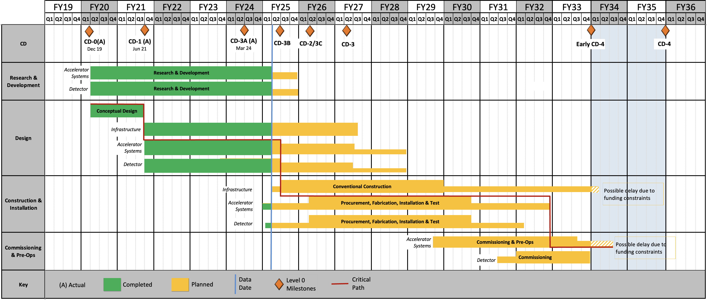
Schedule
From L. Lari CD-3B Plenary Presentation
Notional – project plan to be defined and reviewed in 2025
Under finalization; Mostly Technically Driven after FY2027
CD2/3
SP1
CD2/3
SP2
CD2/3
SP3
The Sub-Projects (SP) delivery strategy is planning to help the start the Early Science program @ Early CD-4 timeframe
RHIC Operations is planned for the end of CY2025
Since CD-1, the critical path is on the Accelerator systems.

Slide 22
European Particle Physics Strategy
https://europeanstrategy.cern/
Mandated and organized by the CERN council
Seeks broad consultation with the grass-roots European community

Slide 23
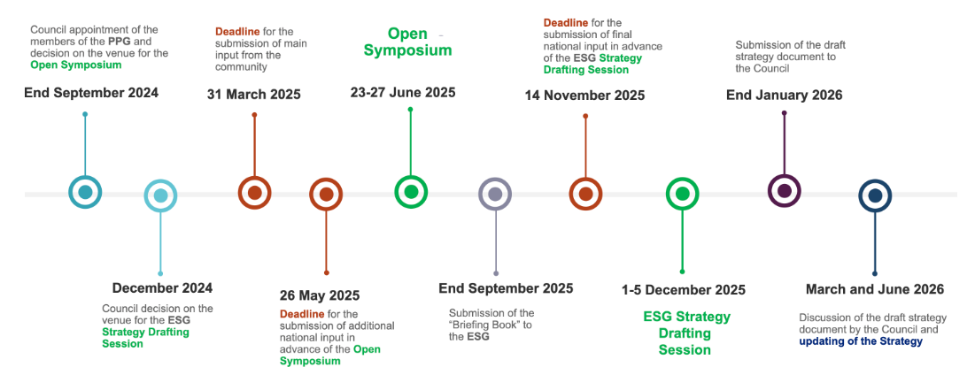
EPPSU Timeline
Contributions emphasizing the EIC/ePIC are due here.
ePIC is working on two contributions:
Detector Technologies and R&D (TC Office)
Physics Synergies Update (EICUG/Analysis)

Slide 24
The Status of the Collaboration
The ePIC Collaboration is strong, active and growing!
The collaboration has made excellent progress on contributions to the EIC preTDR
International participation is key to the success of ePIC
International collaborators play key roles in collaboration leadership
10/12 new institutions added in 2024 were international
ePIC is now a CERN Recognized Experiment
ePIC is engaged in developing the Early Science program at the EIC
Very successful review of ePIC Software and Computing
Collaboration committees are fully formed, ePIC policies nearing completion
The collaboration has established a regular election schedule and convener rotation
Developing contributions to the European Particle Physics Strategy Update
Very productive Collaboration Meetings with strong participation
ePIC is ready to face the challenges of 2025 (and beyond)!

Slide 25
Meeting Sticker
By request we also have a reprint of the “standard” ePIC sticker as well.

Slide 27
ePIC Resources
Public Website - https://www.bnl.gov/eic/epic.php
Mailing Lists – https://lists.bnl.gov/mailman/listinfo
Indico Agenda - https://indico.bnl.gov/category/402/
ePIC Software and Computing: https://indico.bnl.gov/category/435/
Wiki - https://wiki.bnl.gov/EPIC
ePIC Software Training:
Landing Page: https://eic.github.io/documentation/landingpage.html
Tutorials: https://eic.github.io/documentation/tutorials.html
Mattermost: https://chat.epic-eic.org
ePIC Zenodo Community: https://zenodo.org/communities/epic

Slide 28
EICUG Membership
The EICUG is a vital organization to promote the interests of the EIC community!
Without the EICUG we would never have gotten far enough to form ePIC!
Please register your institution!
Check with your EICUG IB representative to get registered as a member
https://www.eicug.org/content/join.html

