Slide 1





Radiation resistance properties of electronic devices interacting with different radiation sources
Beatrice D'Orsi
Final seminar – PhD in Accelerator Physics XXXVI cycle
Advisors:
Prof. Patrizio Antici
Prof. Mauro Migliorati
Co-advisor:
Dr. Alessia Cemmi
Rome, September 30th, 2024

Slide 2



Summary of the presentation
Part 1 Introduction
Experimental results
Part 2 Results elaboration
Results comparison
Part 3 Other activities

Slide 3
Part 1

Slide 4
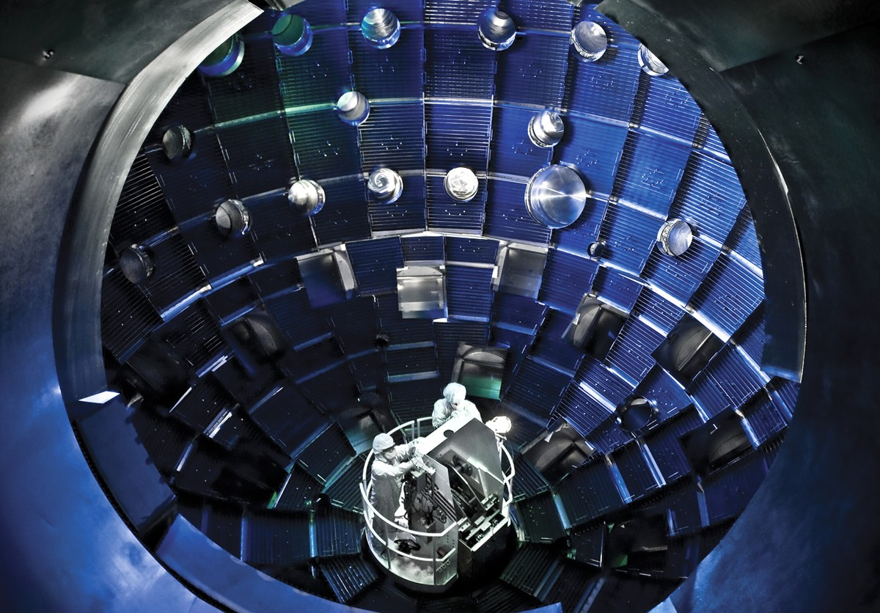
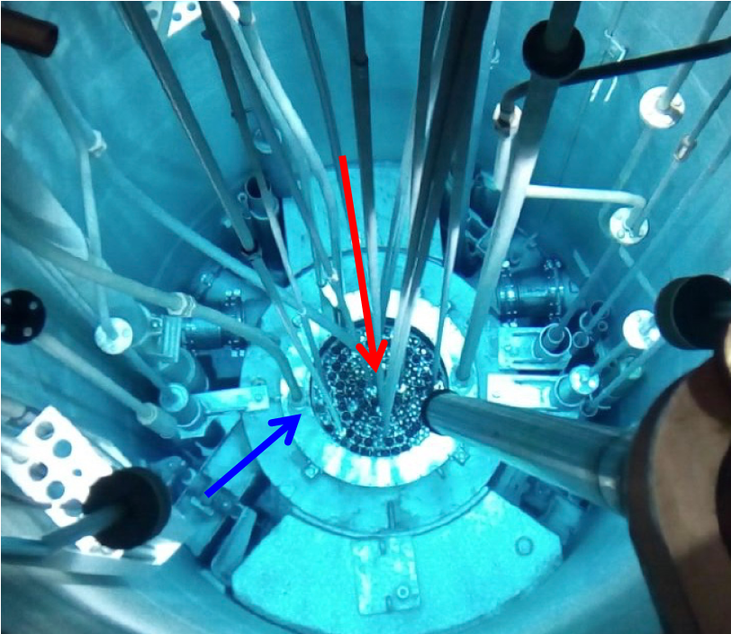
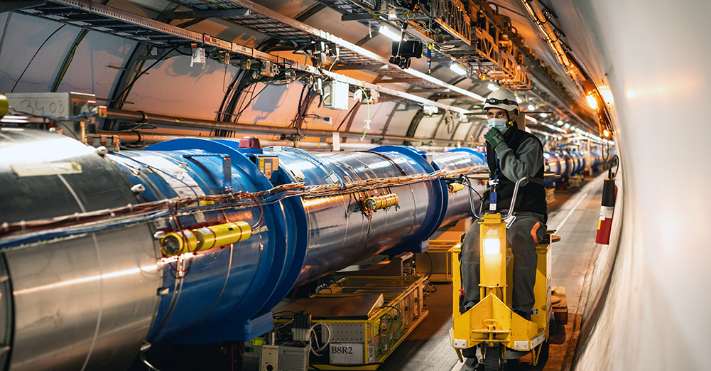
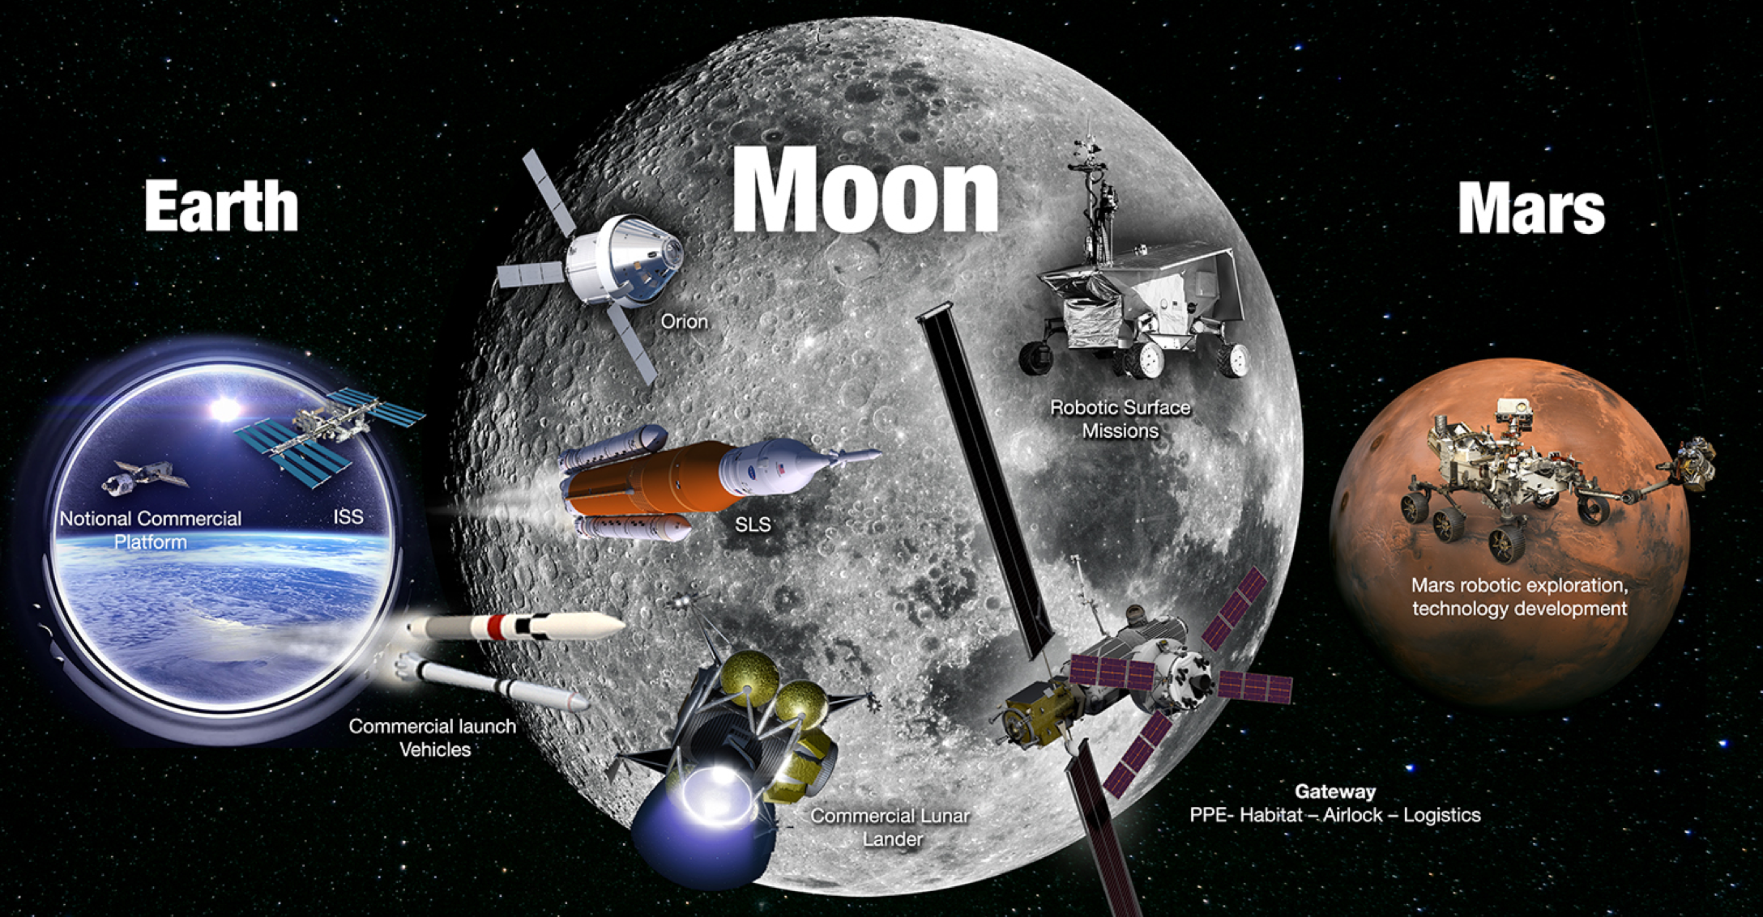
Aim of the work
Electronic devices
Irradiation
Study of radiation effects
Commercial
Radiation tolerant
Radiation hardened
Photons
Protons
Electron
Neutrons
Heavy ions
Etc.
Electronic measurements
Data analysis (stress testing optimization)

Slide 5


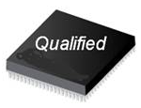


PhD research
Electronic devices
2 $
80 $
Commercial Off-the-Shelf (COTS)
Radiation tolerant
Study of
radiation effects
Irradiation
Gamma rays
Neutrons
Protons (innovative and conventional sources – stress testing method validation)
Radiation resistance testing of specific electronic devices
Investigate different irradiation methods for optimization of stress testing

Slide 6
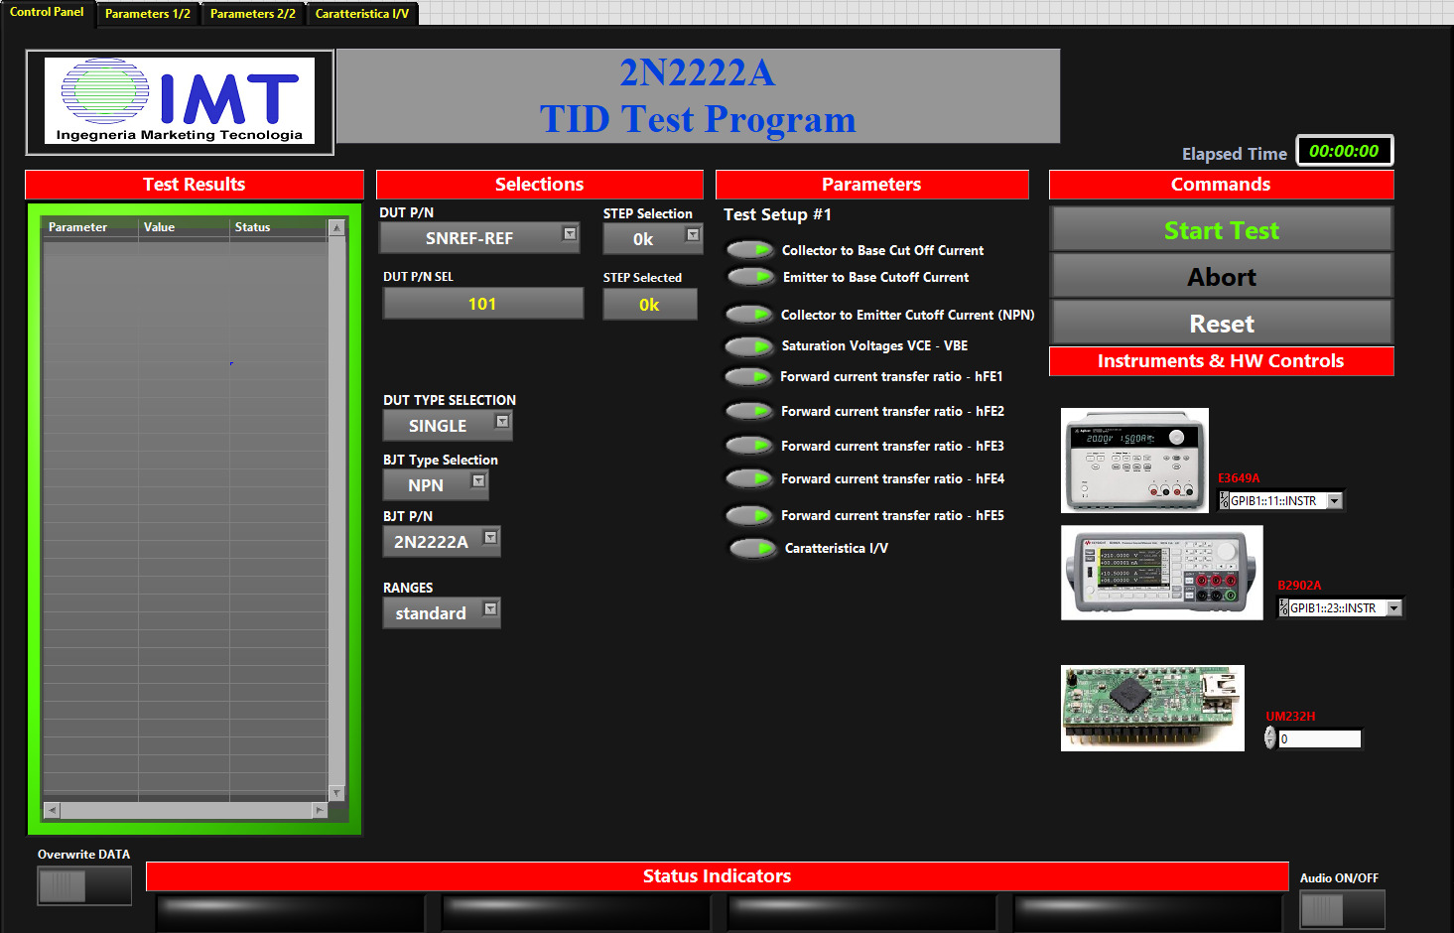
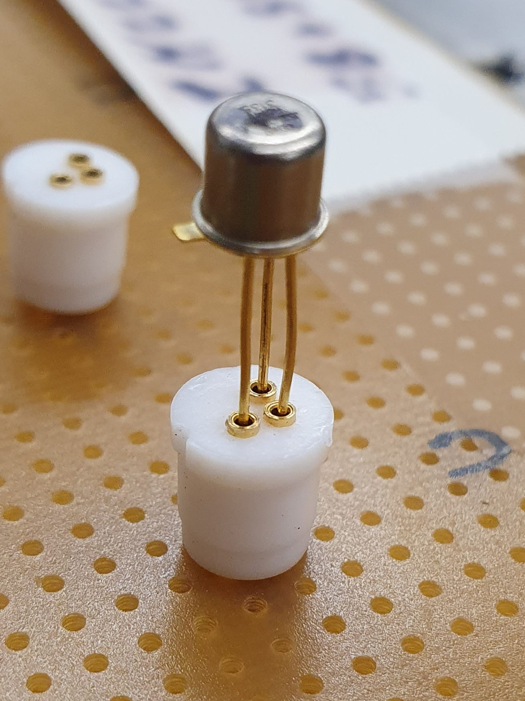
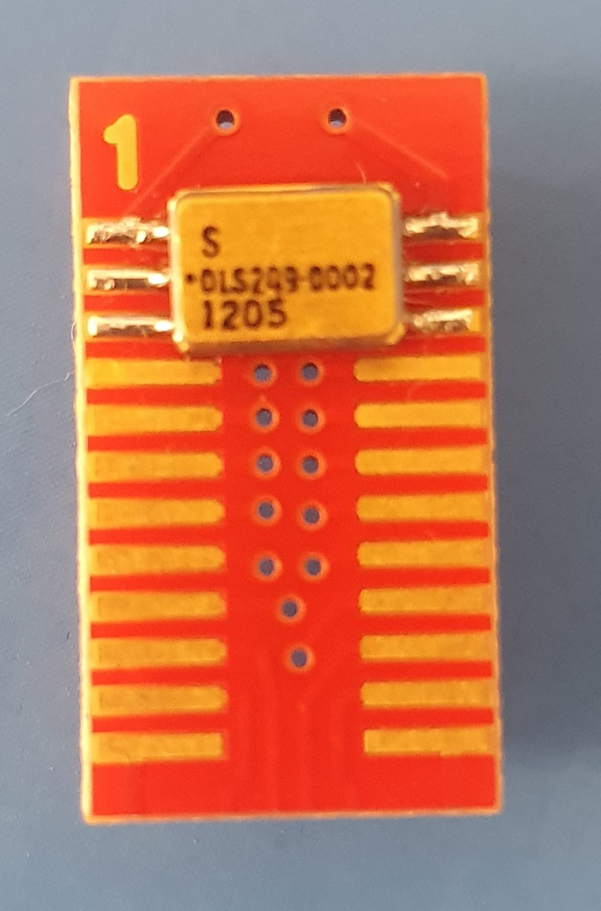
Electronic components characterization before and after irradiation
Tested components
COTS NPN and PNP Bipolar Junction Transistors (BJTs)
Radiation tolerant opto-isolator
2 cm
https://www.imtsrl.it/
2 cm
Many parameters (currents, voltages and gain) were evaluated before and after the irradiation tests.
Not reported here
Microsemi. TECHNICAL DATASHEET – 2N2222A NPN silicon switching transistor.
Microsemi. TECHNICAL DATASHEET – 2N2907A PNP small signal silicon transistor.
Skyworks. TECHNICAL DATASHEET - OLS249: Radiation-Tolerant Phototransistor Hermetic Surface-Mount Optocoupler.
6

Slide 7

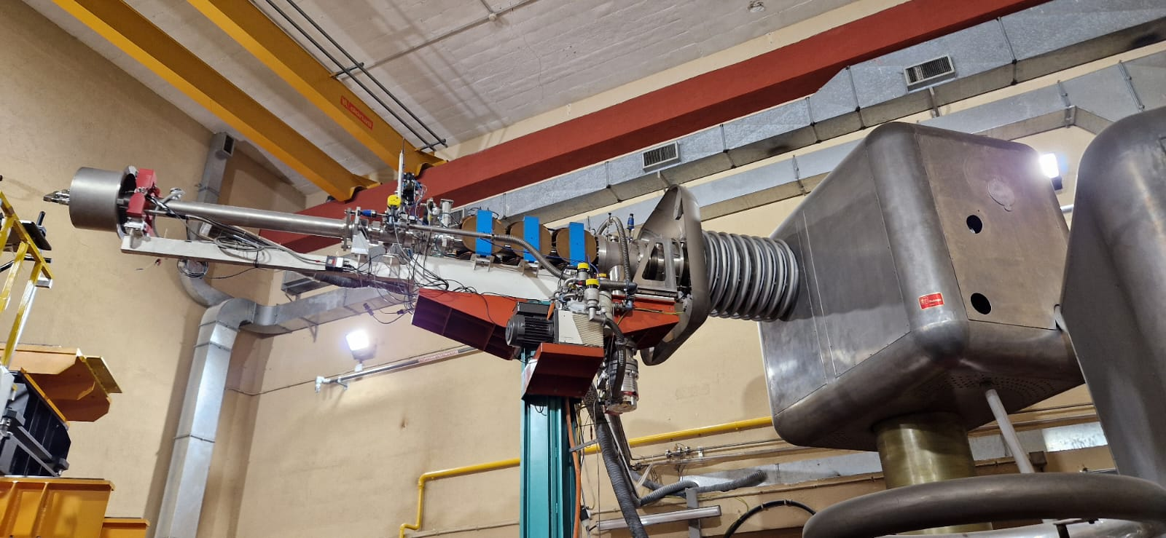
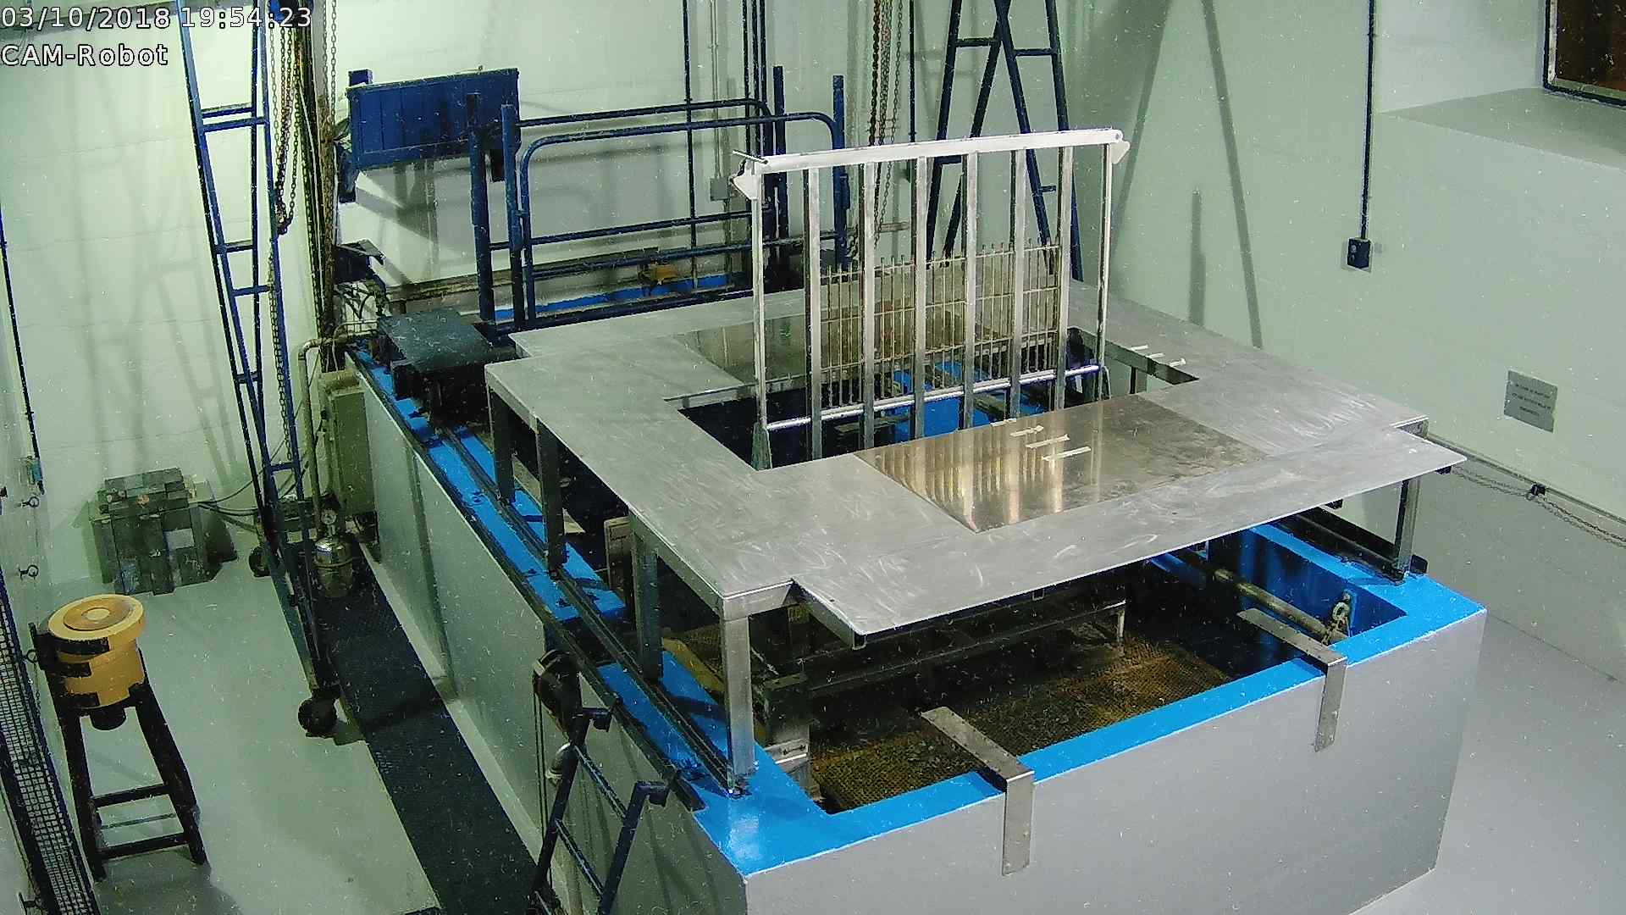
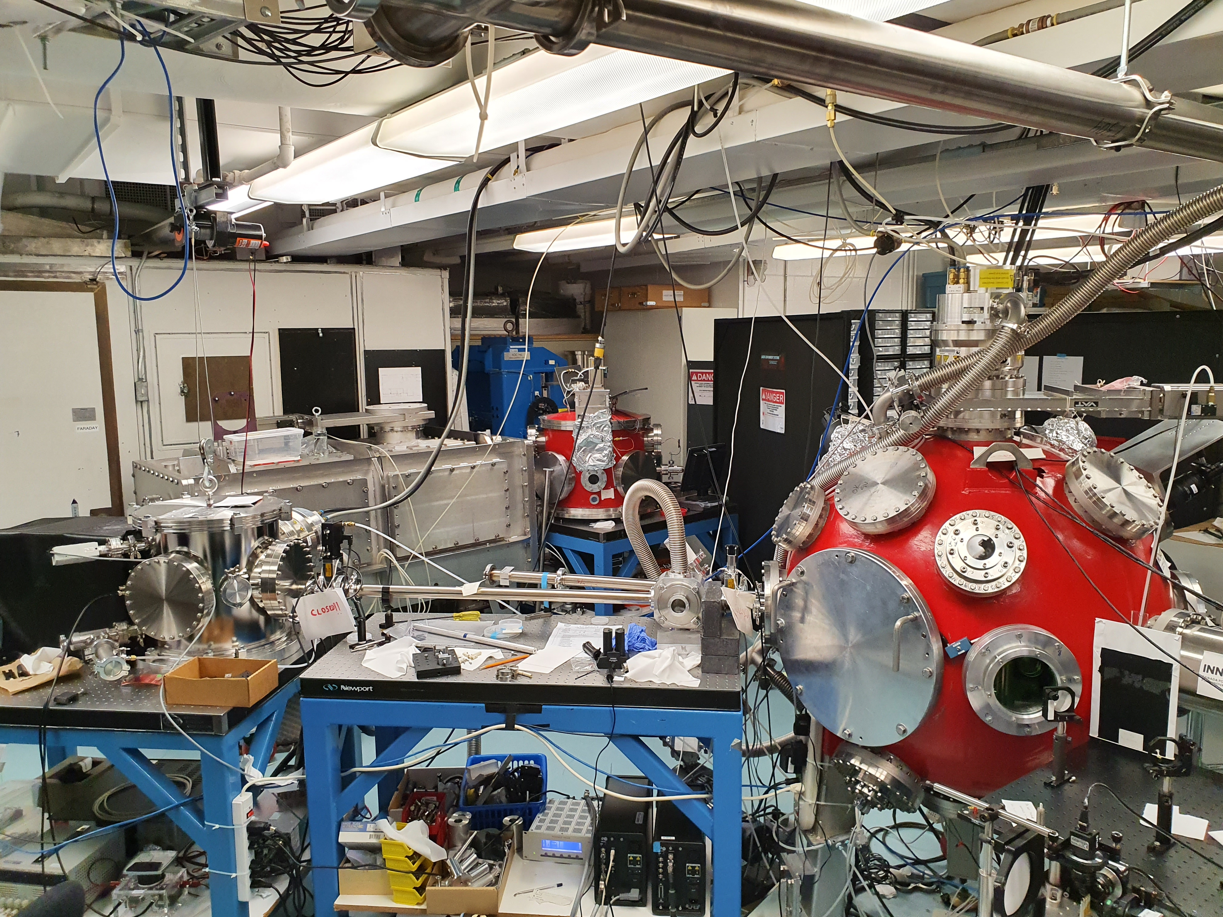

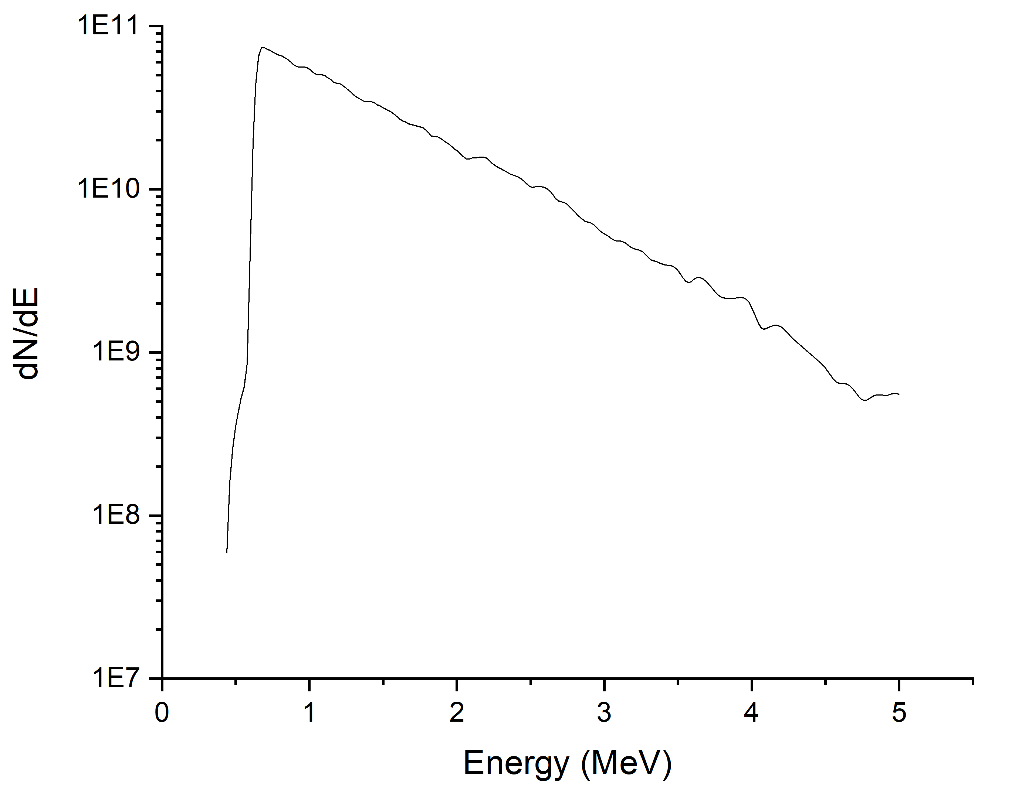
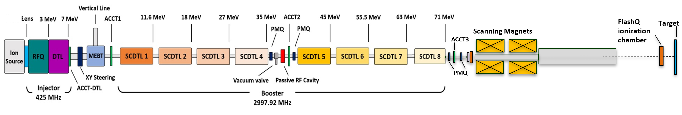
Irradiation facilities: Italy and Canada
Innovative radiation source for stress testing
Conventional radiation sources for stress testing
Gamma irradiation
Calliope facility at
ENEA Casaccia R.C.
(Rome, Italy)
⁶⁰Co gamma photons
(mean energy 1.25 MeV)
Proton irradiation Advanced Laser Light Source (ALLS) ion beamline at INRS-EMT (Varennes, Québec, Canada)
14 MeV
neutrons
Dosimetric laboratory available
Neutron irradiation Frascati Neutron Generator at ENEA Frascati R.C. (Frascati, Italy)
Ultra-intense ultra-short laser pulse is focused on a thin target
Target Normal Sheath
Acceleration
(TNSA) mechanism
Laser-driven protons (from few keV up to 5MeV)
Proton irradiation TOP IMPLART at ENEA Frascati R.C.
(Frascati, Italy)
Proton acceleration
2.8 MeV conventional protons

Slide 8
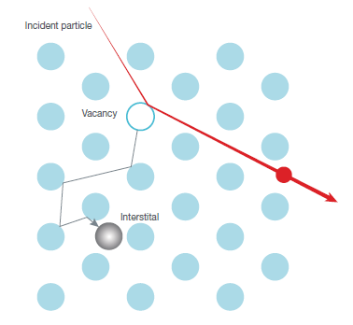
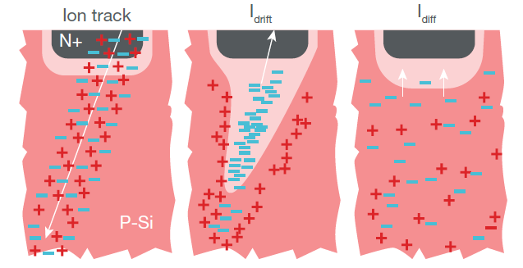
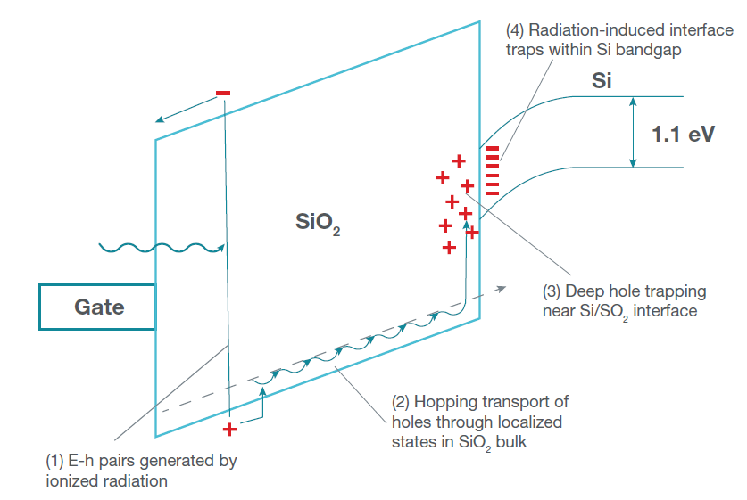
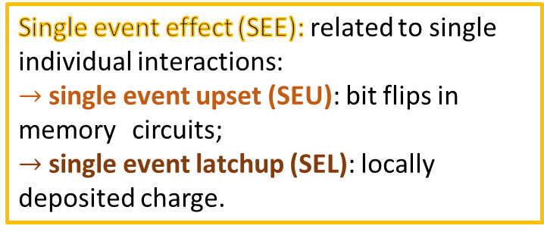
Possible radiation effects on electronics
The active material of electronic devices is often made of silicon.
Energy loss by ionization: interactions of atomic particle which result in the excitation or emission of atomic electrons
Non Ionizing Energy Loss (NIEL) processes: interactions in which the energy imparted by the incoming particle result in atomic displacement.
Single event effect (SEE): related to single individual interactions:
$→$single event upset (SEU): bit flips in memory circuits;
$→$single event latchup (SEL): locally deposited charge.
Total Ionizing Dose (TID) damage
Displacement Damage (DD) dose
Single interaction
Surface damage
Bulk damage
Incident particle
Interface traps within Si bandgap
V
Cumulative effects
I
Hole trapping near Si/SiO₂ interface
V: vacancy
I: interstitial
Holes transport through localized state in SiO₂ bulk
e-h pair generation
Radiation Handbook for electronics, Texas Instruments (2018) www.ti.com/radbook
Leroy C, Rancoita PG. Particle interaction and displacement damage in silicon devices operated in radiation environments. Reports Prog Phys. 2007;70(4):493–625

Slide 9
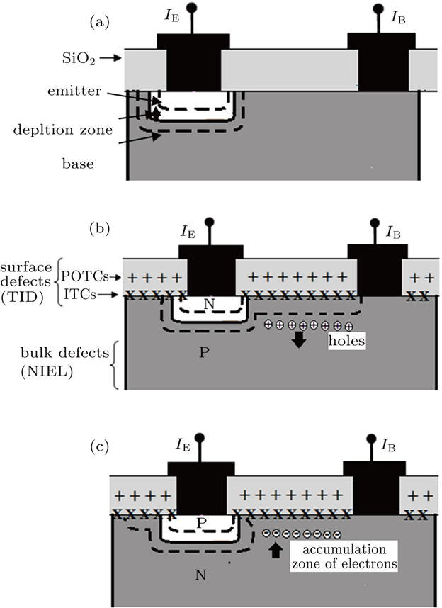
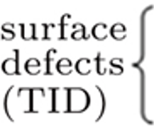
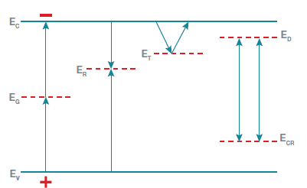
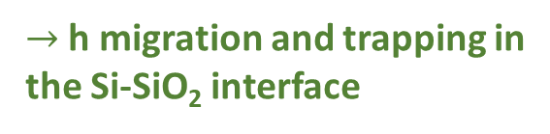

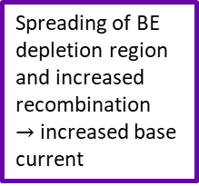
Typical radiation effects on BJTs
Base Emitter (BE) junction of NPN BJTs
AFTER IRRADIATION
BEFORE IRRADIATION
Metal contact
SiO₂
SiO₂
emitter
depletion zone
base
Si
Interstitials-vacancies creation
Spreading of BE depletion region and increased recombination
$→$ increased base current
These effects translate in BJTs current gain degradation
e⁻-h creation and separation
$→$e⁻ drift outside the oxide
Reduction of minority carriers lifetime (increased recombination)
$→$ h migration and trapping in
the Si-SiO₂ interface
J Assaf 2018 Chinese Phys. B 27 016103
Radiation Handbook for electronics, Texas Instruments (2018) www.ti.com/radbook

Slide 10
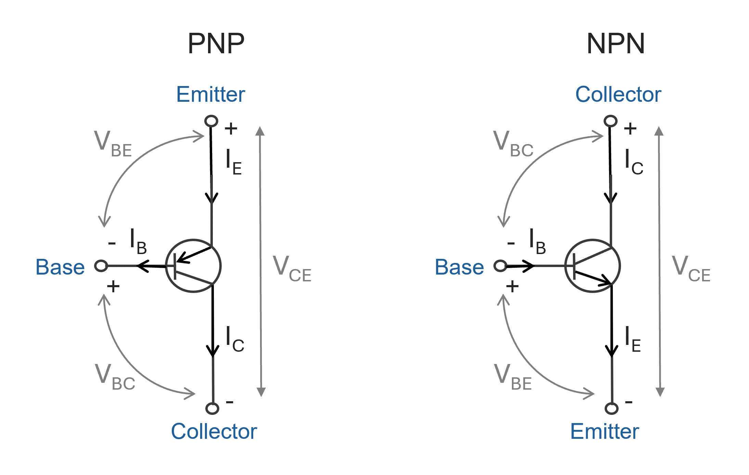
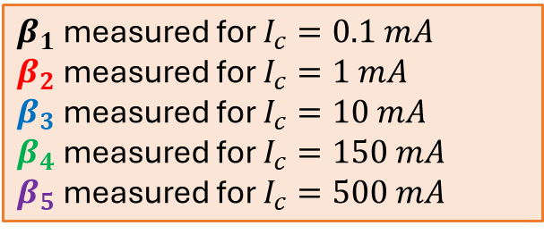
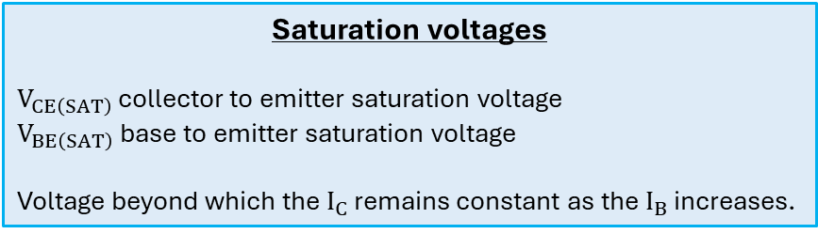
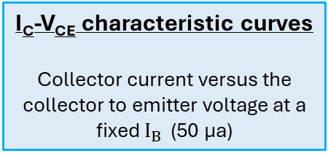
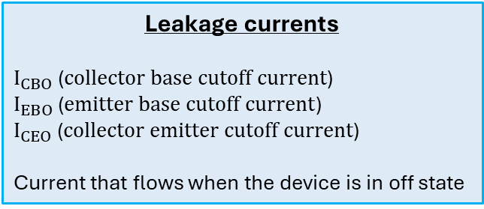

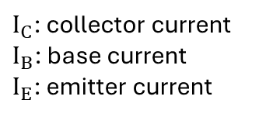
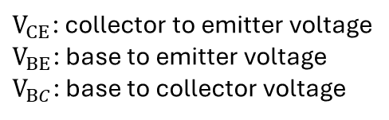
COTS BJTs:
Radiation effects evaluation
To evaluate the radiation effect, the $β$ parameter, corresponding to the transistor current gain, the leakage currents and saturation voltages were measured.
$β_{1}$measured for $I_{c}=0.1 mA$
$β_{2}$measured for $I_{c}=1 mA$
$β_{3}$measured for $I_{c}=10 mA$
$β_{4}$measured for $I_{c}=150 mA$
$β_{5}$measured for $I_{c}=500 mA$
NPN
PNP
Gain
Saturation voltages
$V_{CE\left(SAT\right)}$ collector to emitter saturation voltage
$V_{BE\left(SAT\right)}$ base to emitter saturation voltage
Voltage beyond which the $I_{C }$remains constant as the $I_{B }$increases.
Other measured parameters
$$I_{c}=βI_{B}$$
Leakage currents
$I_{CBO }$($collector base cutoff current$) $I_{EBO }$($emitter base cutoff current$)
$I_{CEO }$($collector emitter cutoff current$)
Current that flows when the device is in off state
I_{C}-V_{CE} characteristic curves
Collector current versus the collector to emitter voltage at a fixed $I_{B }$ (50 µa)
$I_{C}$: collector current
$I_{B}$: base current
$I_{E}$: emitter current
$V_{CE}$: collector to emitter voltage
$V_{BE}$: base to emitter voltage
$V_{BC}$: base to collector voltage

Slide 11
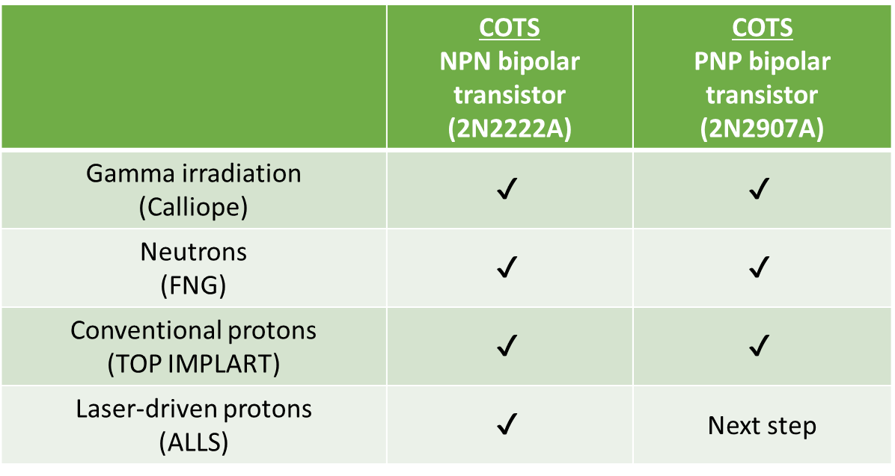
COTS BJTs:
Summary of performed irradiation tests
The components were characterized before and after irradiation.
 | COTS NPN bipolar transistor (2N2222A) | COTS PNP bipolar transistor (2N2907A)
Gamma irradiation (Calliope) | $$\text{✔}$$ | $$\text{✔}$$
Neutrons (FNG) | $$\text{✔}$$ | $$\text{✔}$$
Conventional protons (TOP IMPLART) | $$\text{✔}$$ | $$\text{✔}$$
Laser-driven protons (ALLS) | $$\text{✔}$$ | Next step

Slide 12
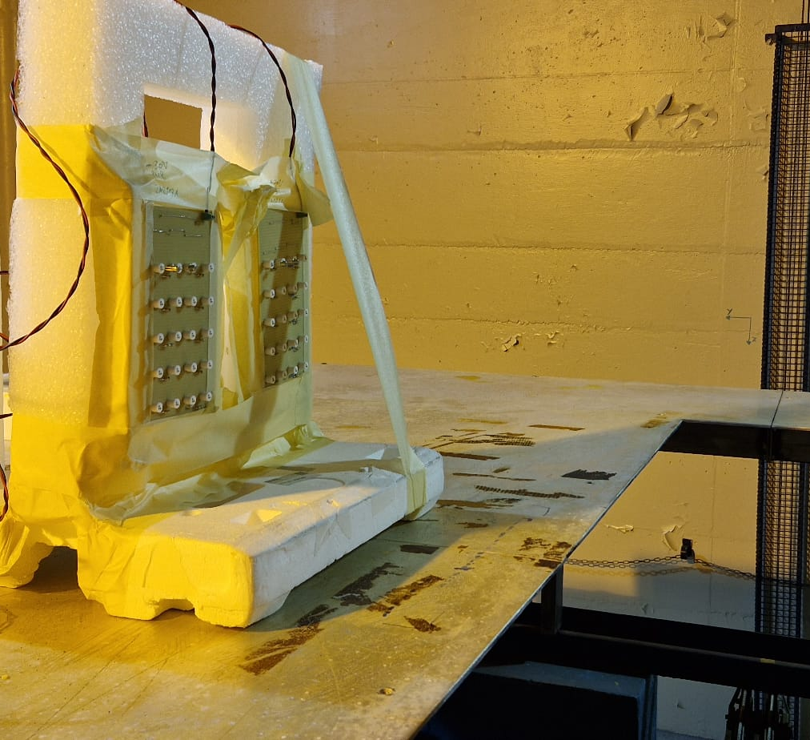
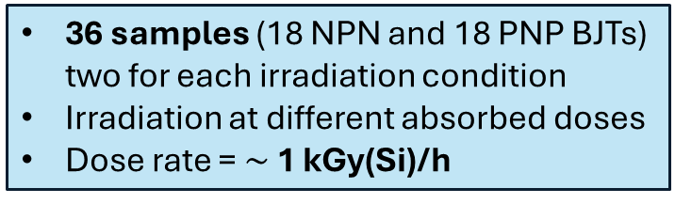
COTS BJTs: gamma irradiation tests and measurements - 1
⁶⁰Co gamma radiation
COTS
Irradiation test | Total absorbed dose (kGy)
1 | 1
2 | 2.3
3 | 26
4 | 72
5 | 120
6 | 240
7 | 320
8 | 420
9 | 515
36 samples (18 NPN and 18 PNP BJTs) two for each irradiation condition
Irradiation at different absorbed doses
Dose rate = $\sim$ 1 kGy(Si)/h
Irradiation setup
All samples were biased
during irradiation (+30 V).
Irradiation tests:
Irradiation at room temperature and parametric tests after irradiation
Annealing followed by parametric tests:
-24 hours at room temperature
-168 hours at 100 °C
1 kGy(Si): 1 kGy absorbed dose in silicon. All reported doses are referred to silicon.

Slide 13
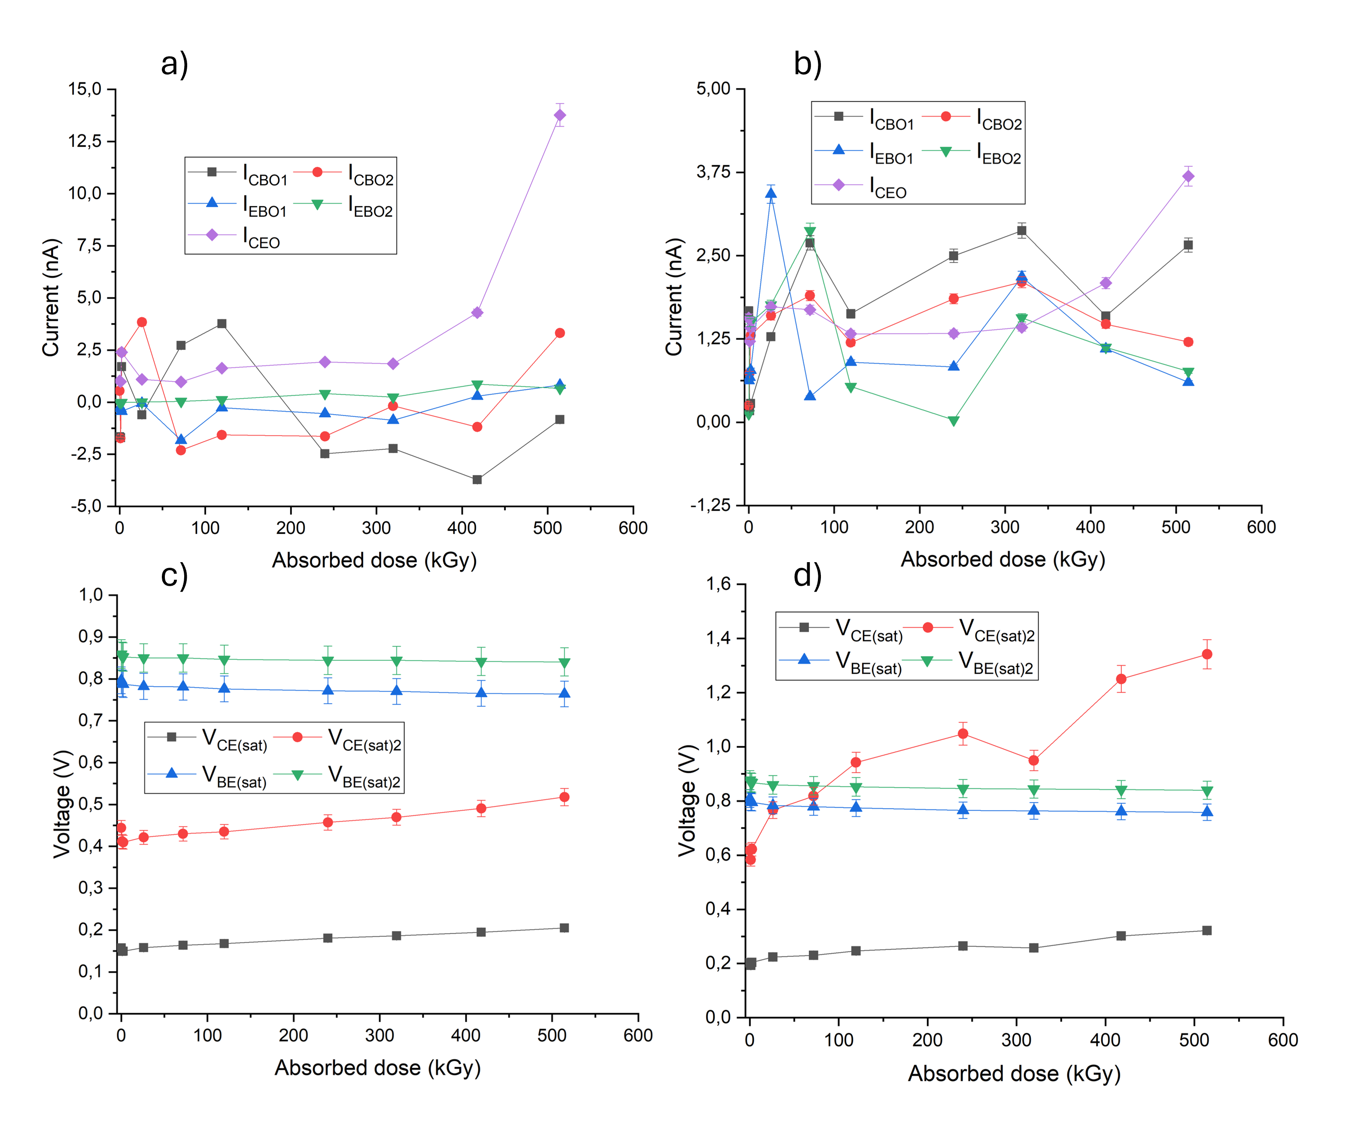
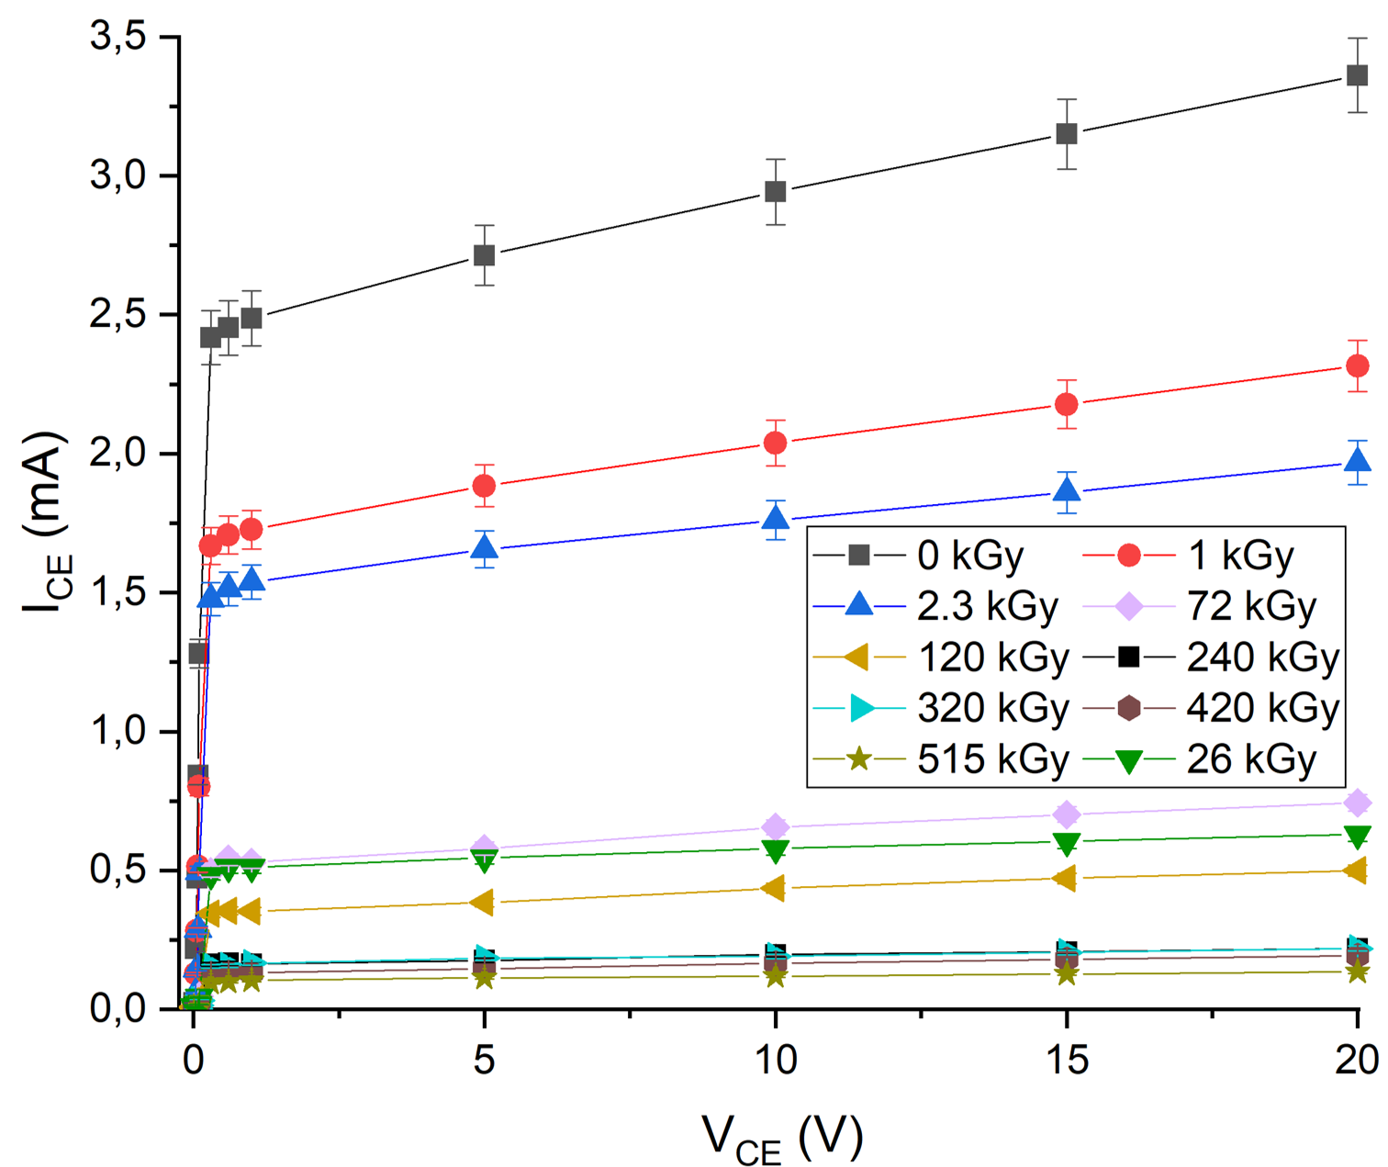
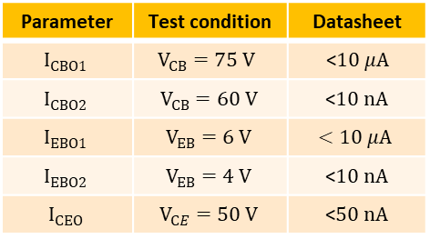
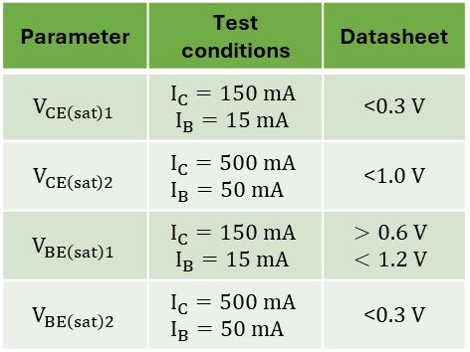
COTS BJTs: gamma irradiation tests and measurements - 2
⁶⁰Co gamma radiation
PNP
Leakage currents
I_{C}-V_{CE} characteristics
Parameter | Test condition | Datasheet
$$I_{CBO1}$$ | $$V_{CB}=75 V$$ | <$10 μA$
$$I_{CBO2}$$ | $$V_{CB}=60 V$$ | <$10 nA$
$$I_{EBO1}$$ | $$V_{EB}=6 V$$ | $$<10 μA$$
$$I_{EBO2}$$ | $$V_{EB}=4 V$$ | <$10 nA$
$$I_{CEO}$$ | $$V_{CE}=50 V$$ | <$50 nA$
fluctuations
Saturation voltages
Parameter | Test conditions | Datasheet
$$V_{CE\left(sat\right)1}$$ | $$I_{C}=150 mA \\ I_{B}=15 mA$$ | <$0.3 V$
$$V_{CE\left(sat\right)2}$$ | $$I_{C}=500 mA \\ I_{B}=50 mA$$ | <$1.0 V$
$$V_{BE\left(sat\right)1}$$ | $$I_{C}=150 mA \\ I_{B}=15 mA$$ | $$>0.6 V \\ <1.2 V$$
$$V_{BE\left(sat\right)2}$$ | $$I_{C}=500 mA \\ I_{B}=50 mA$$ | <$0.3 V$
I_{C} decreases with increasing dose
No modification except for V_{CE(sat)2}

Slide 14
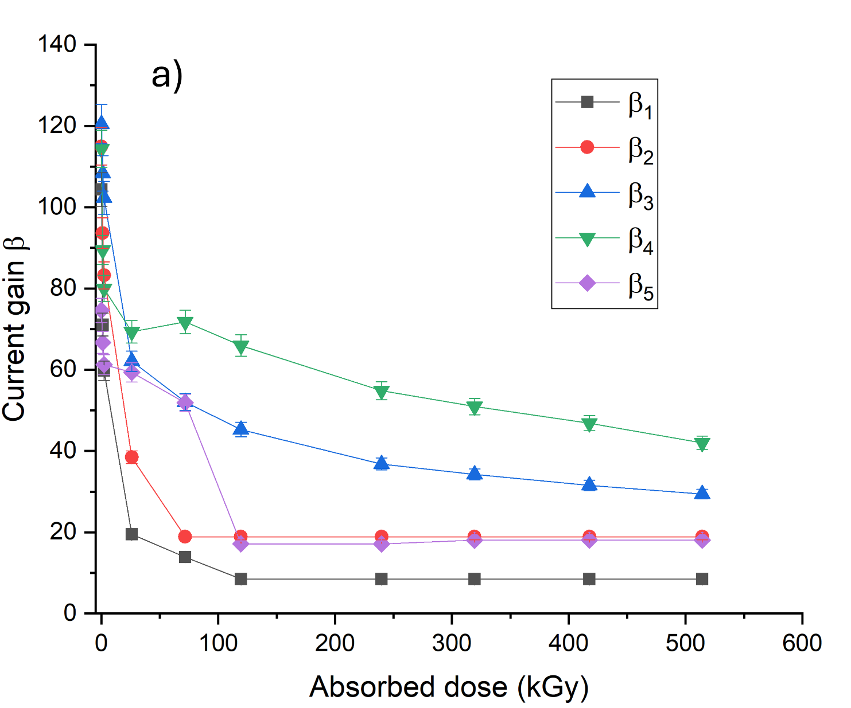
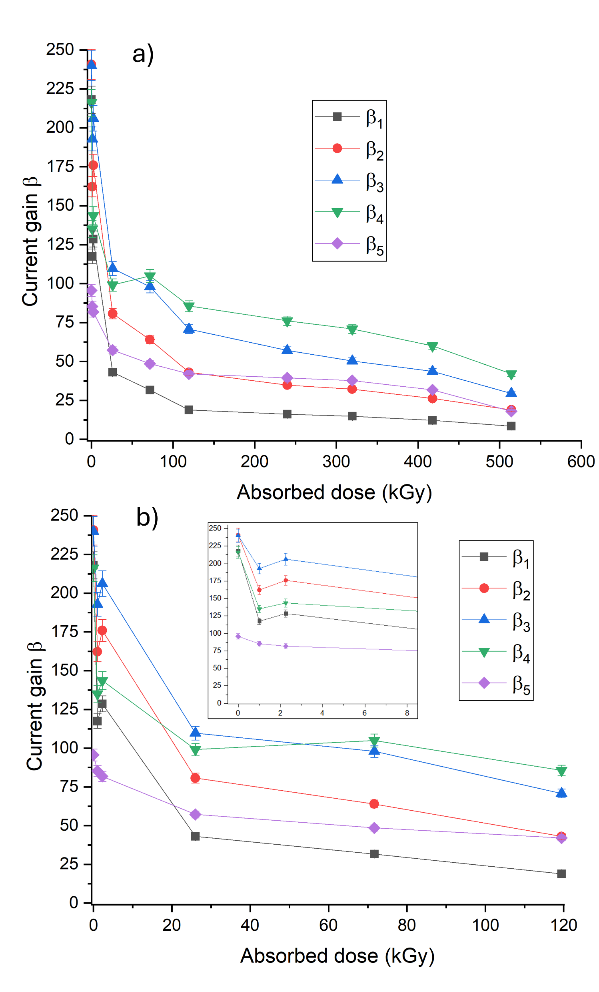
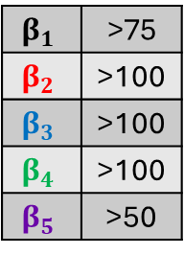
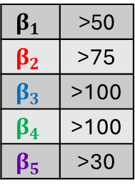
COTS BJTs: gamma irradiation tests and measurements - 3
⁶⁰Co gamma radiation
NPN
Datasheet allowed values
HEAVILY damaged after:
PNP
Datasheet allowed values
HEAVILY damaged after:
$$β_{1}$$ | >50
$$β_{2}$$ | >75
$$β_{3}$$ | >100
$$β_{4}$$ | >100
$$β_{5}$$ | >30
8 kGy
7 kGy
3 kGy
0.6 kGy
100 kGy
$$β_{1}$$ | >75
$$β_{2}$$ | >100
$$β_{3}$$ | >100
$$β_{4}$$ | >100
$$β_{5}$$ | >50
15 kGy
20 kGy
35 kGy
20 kGy
70 kGy
Out of
range
Out of
range

Slide 15
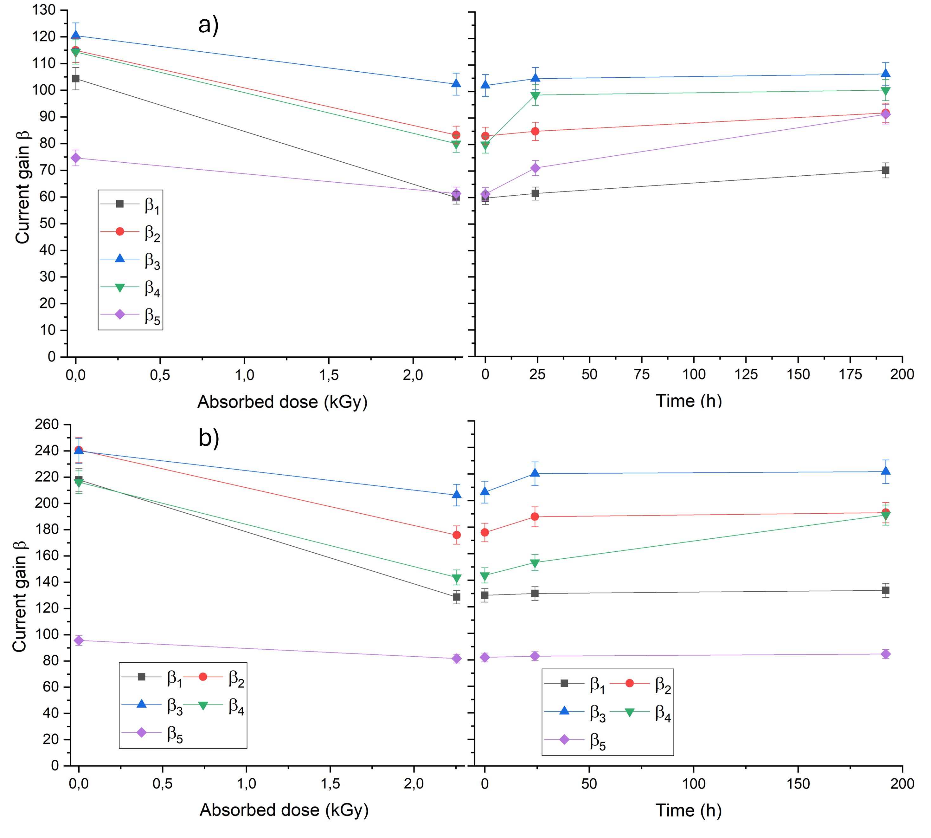
COTS BJTs: annealing tests and measurements - 4
⁶⁰Co gamma radiation
After irradiation, two annealing tests were performed in order to evaluate the recovery of the parameters.
NPN
End of irradiation
No recovery of the heavily damaged samples after the annealing tests
Annealing step:
25 °C for 24 hours.
Recovery
Parametric test
Annealing step:
100 °C for 168 hours.
PNP
Slight recovery of the samples irradiated up to 2.3 kGy(Si) after the annealing tests
Parametric test
End of test
Recovery

Slide 16
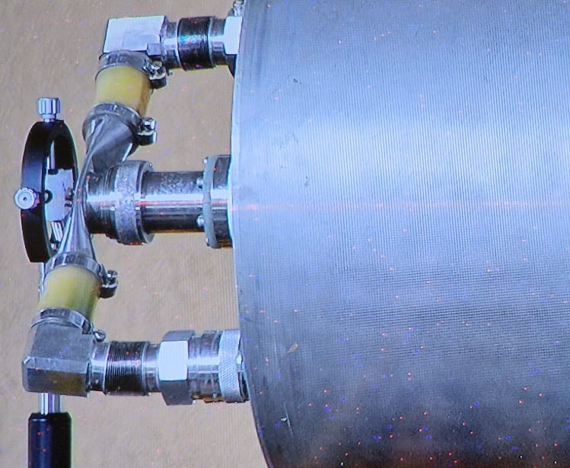
COTS BJTs: neutron irradiation tests and measurements - 1
14 MeV
neutrons
COTS
20 samples (10 NPN and 10 PNP BJTs) two for each irradiation condition
Irradiation up to different neutron fluences (14 MeV neutrons)
Irradiation test | Neutron fluence
1 | 2 ּ 10⁹ n/cm²
2 | 2 ּ 10¹¹ n/cm²
3 | 2 ּ 10¹² n/cm²
4 | 1 ּ 10¹³ n/cm²
5 | 2 ּ 10¹³ n/cm²
All samples were unbiased
during irradiation.
Irradiation setup
Irradiation tests:
Irradiation at room temperature and parametric test after irradiation
Annealing followed by parametric tests:
-24 hours at room temperature
-168 hours at 100 °C
ASTM E722-19: Standard Practice for Characterizing Neutron Fluence Spectra in Terms of an Equivalent Monoenergetic Neutron Fluence for Radiation-Hardness Testing of Electronics
https://www.sr-niel.org/index.php/sr-niel-web-calculators/niel-calculator-for-neutrons-using-astm-standards/neutrons-niel-calculator

Slide 17
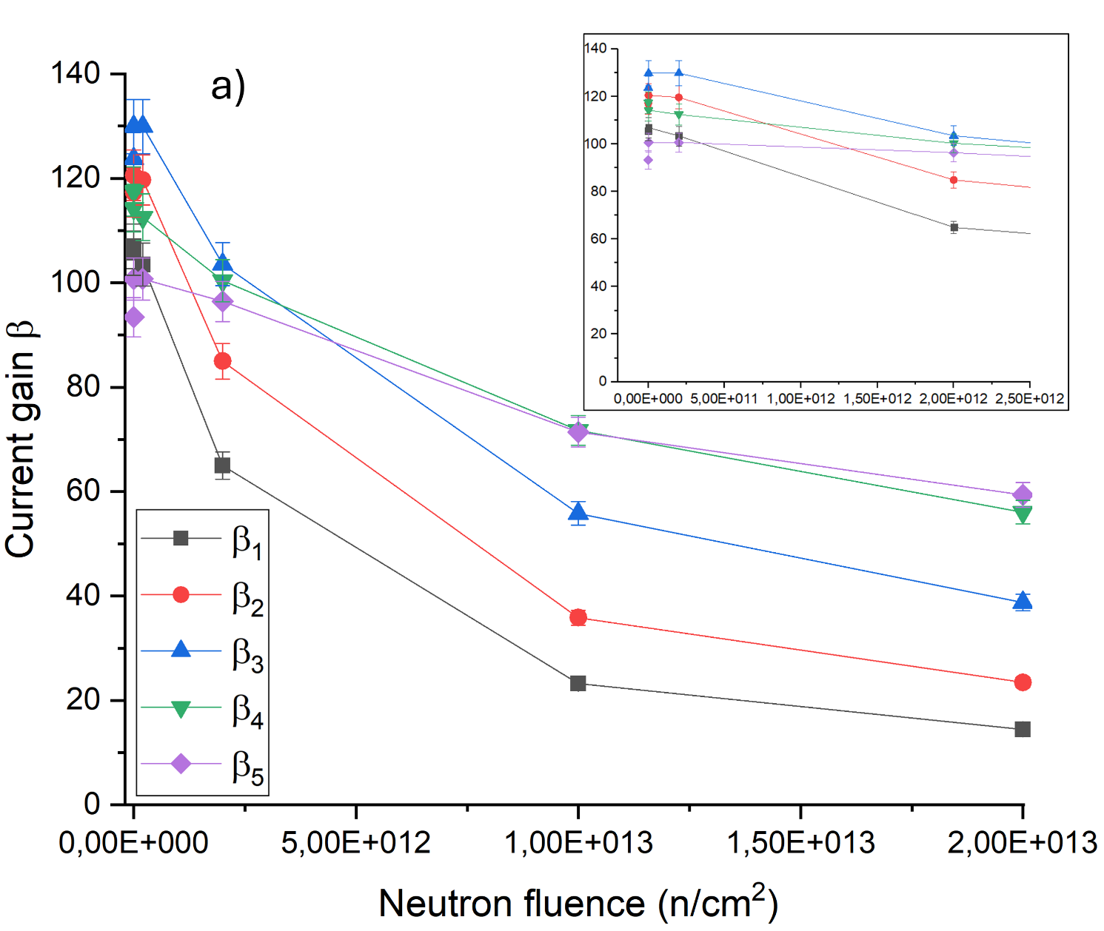
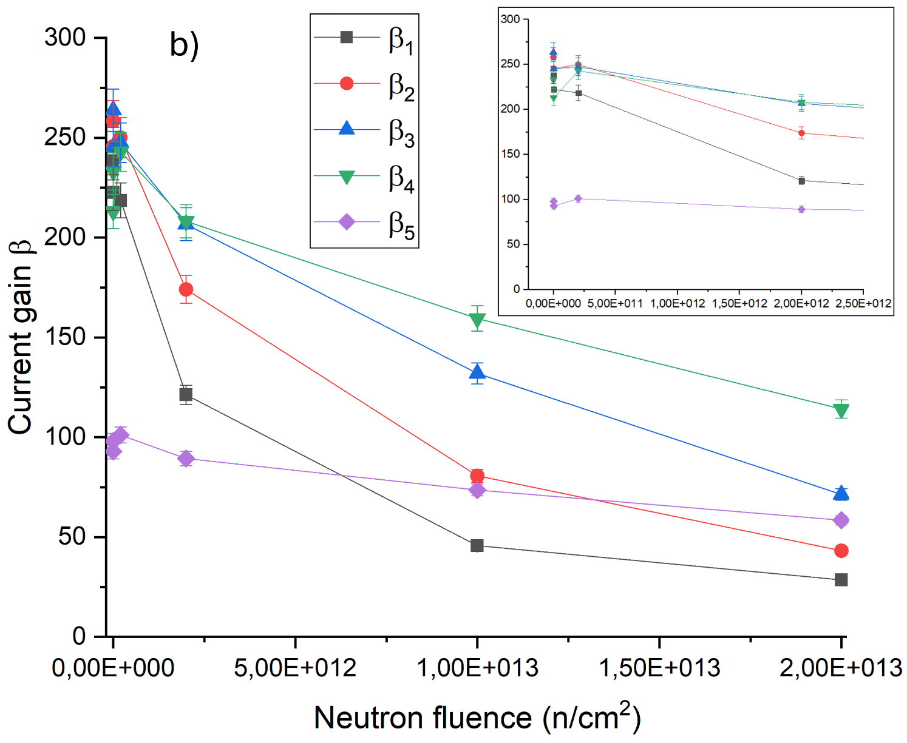
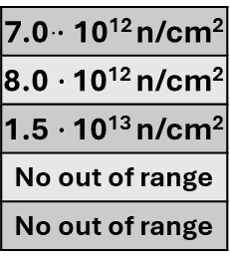
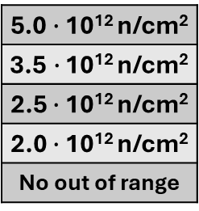
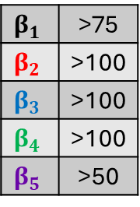
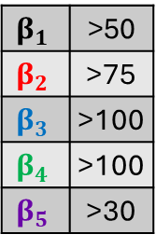
COTS BJTs: neutron irradiation tests and measurements - 2
14 MeV
neutrons
NPN
HEAVILY damaged after:
PNP
HEAVILY damaged after:
$$β_{1}$$ | >50
$$β_{2}$$ | >75
$$β_{3}$$ | >100
$$β_{4}$$ | >100
$$β_{5}$$ | >30
5.0$∙$ 10¹² n/cm²
3.5$∙$ 10¹² n/cm²
2.5 $∙$ 10¹² n/cm²
2.0 ּ$∙$ 10¹² n/cm²
No out of range
$$β_{1}$$ | >75
$$β_{2}$$ | >100
$$β_{3}$$ | >100
$$β_{4}$$ | >100
$$β_{5}$$ | >50
7.0ּ$∙$ 10¹² n/cm²
8.0$∙$ 10¹² n/cm²
1.5$∙$ 10¹³ n/cm²
No out of range
No out of range
Datasheet
Datasheet
No recovery after annealing tests

Slide 18
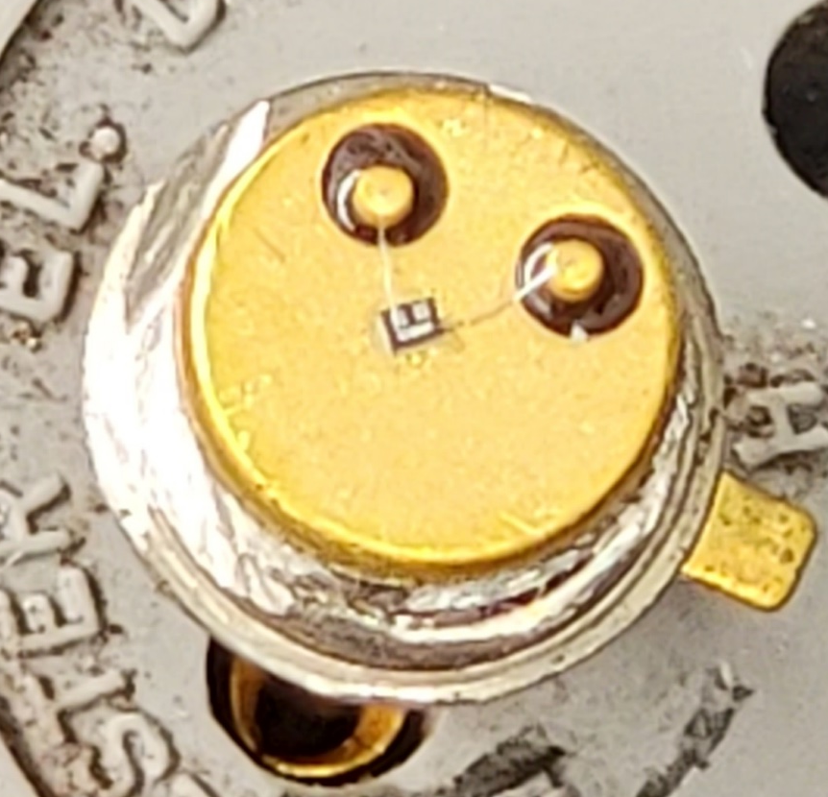
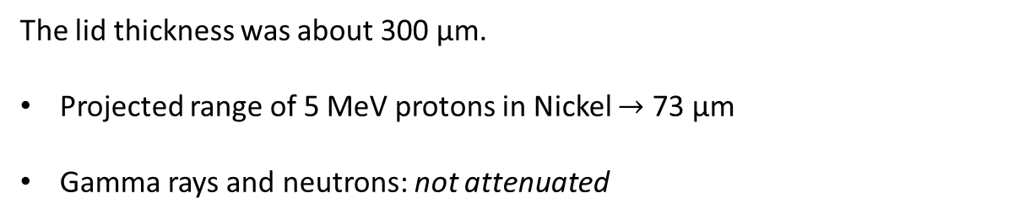
COTS BJTs: samples preparation for proton irradiation (TOP IMPLART and ALLS)
For proton irradiation tests the BJTs were decapped.
SEM analysis
The lid was removed
6 mm
Magnitude 66X
Magnitude 400X
The lid thickness was about 300 µm.
Projected range of 5 MeV protons in Nickel $→$ 73 µm
Gamma rays and neutrons: not attenuated

Slide 19


COTS BJTs: proton irradiation (TOP IMPLART) and measurements - 1
Conventional protons
COTS
12 decapped samples (6 NPN and 6 PNP BJTs) two for each irradiation condition
Irradiation up to different proton fluences (2.8 MeV protons)
Irradiation test | Proton fluence
1 | 3.38 ּ 10⁹ p/cm²
2 | 3.38 ּ 10¹⁰ p/cm²
3 | 2.5 ּ 10¹¹ p/cm²
Irradiation setup
All samples were unbiased
during irradiation.
Irradiation tests:
Irradiation at room temperature and parametric test after irradiation
Annealing followed by parametric tests:
-24 hours at room temperature
-168 hours at 100 °C
ASTM E722-19: Standard Practice for Characterizing Neutron Fluence Spectra in Terms of an Equivalent Monoenergetic Neutron Fluence for Radiation-Hardness Testing of Electronics
https://www.sr-niel.org/index.php/sr-niel-web-calculators/niel-calculator-for-neutrons-using-astm-standards/neutrons-niel-calculator

Slide 20







COTS BJTs: proton irradiation (TOP IMPLART) and measurements - 2
Conventional protons
HEAVILY damaged after:
HEAVILY damaged after:
NPN
PNP
$$β_{1}$$ | >50
$$β_{2}$$ | >75
$$β_{3}$$ | >100
$$β_{4}$$ | >100
$$β_{5}$$ | >30
1.2$∙$ 10¹¹ p/cm²
0.8$∙$ 10¹¹ p/cm²
0.5 $∙$ 10¹¹ p/cm²
0.4 ּ$∙$ 10¹¹ p/cm²
1.8 ּ$∙$ 10¹¹ p/cm²
$$β_{1}$$ | >75
$$β_{2}$$ | >100
$$β_{3}$$ | >100
$$β_{4}$$ | >100
$$β_{5}$$ | >50
2.1$∙$ 10¹¹ p/cm²
2.5$∙$ 10¹¹ p/cm²
No out of range
No out of range
No out of range
Datasheet
Datasheet
No recovery after annealing tests

Slide 21

COTS BJTs:
proton irradiation tests (ALLS) and measurements - 1
Laser-driven protons
6 decapped samples (NPN BJTs)
Irradiation at different number of shots
COTS
Irradiation test | Number of shots
1 | 1
2 | 5
3 | 50
4 | 100
5 | 250
6 | 400
Irradiation setup
All samples were unbiased
during irradiation.
Irradiation tests:
Irradiation at room temperature and parametric test after irradiation
Annealing followed by parametric tests:
-24 hours at room temperature
-168 hours at 100 °C

Slide 22


COTS BJTs:
proton irradiation tests (ALLS) and measurements - 2
Laser-driven protons
NPN
HEAVILY damaged after:
Zoom in:
1-5 shots
$$β_{1}$$ | >50
$$β_{2}$$ | >75
$$β_{3}$$ | >100
$$β_{4}$$ | >100
$$β_{5}$$ | >30
4 shots
3 shots
2 shots
2 shots
No out of range
Datasheet
No recovery after the annealing tests

Slide 23
Part 2

Slide 24

Dose deposition study – 1
To compare different stress testing methods the Dose_{TOTAL} due to each radiation source was investigated.
Fluences and number of shots were transformed into Dose_{TOTAL} values
$${Dose}_{TOTAL}= Dose_{TID}+Dose_{NIEL}$$
TID:
Surface damage
NIEL:
Bulk damage
For each radiation source Dose_{NIEL} contribution to
Dose_{TOTAL} was evaluated
TID depends on radiation type and irradiation conditions
NIEL dose proportional to the number of created bulk defects independently of the radiation type
Leroy C, Rancoita PG. Principles of Radiation Interaction in Matter and Detection. WORLD SCIENTIFIC (2016).

Slide 25



Dose deposition study – 2
⁶⁰Co gamma photons
⁶⁰Co gamma radiation
D_{TOTAL} deposited by gamma radiation is provided by the facility (dosimetric systems)
⁶⁰Co photons directly induce only TID damage but can create Compton electrons responsible of DD.
D_{NIEL} evaluation:
MCNP simulation
ASI sr-niel calculator
Sample geometry
Sample position inside the irradiation cell
Irradiation conditions (dose and dose rate)
After one hour of irradiation:
Dose_{TOTAL} = 1 kGy
Dose_{NIEL} = 8ּ$∙$ 10⁻³ Gy
Sample
γ
⁶⁰Co source
The electron spectrum after one second of gamma irradiation at 1 kGy/h
https://www.sr-niel.org/index.php/sr-niel-web-calculators

Slide 26





14 MeV
neutrons
Dose deposition study – 3
Neutrons
Neutrons D_{TOTAL} evaluation:
The kerma K can be obtained using the kerma coefficient k:
$$k=\frac{K}{Φ_{n}} [rad cm^{2}]$$
The International Commission on Radiation Units and measurements (ICRU). Fundamental quantities and units for ionizing radiation (Report No. 85), volume 11. Oxford University Press, 2011.
Neutrons D_{NIEL} evaluation:
ASI sr-niel calculator
R.S. Caswell, J.J. Coyne, and M.L. Randolph. Kerma factors of elements and compounds for neutron energies below 30 MeV. The International Journal of Applied Radiation and Isotopes, 33(11):1227–1262, 1982.
For a fluence $Φ_{n}$ = 2 $∙$10¹² n/cm²:
Dose_{TOTAL} = 25 Gy
Dose_{NIEL} = 1.2 Gy
https://www.sr-niel.org/index.php/sr-niel-web-calculators

Slide 27





Conventional protons
Dose deposition study –4
Conventional protons
Conventional protons D_{TOTAL} evaluation:
2.8 MeV protons are completely absorbed by the silicon depth.
$$D_{TOTAL}=\frac{dE}{dx}{\left.​\right|}_{2.8 MeV}∙Φ_{p}∙1.6∙{10}^{−10}$$
Proton stopping power
Conversion factor
Proton fluence
Conventional protons D_{NIEL} evaluation:
J.F. Ziegler. SRIM - The Stopping and Range of Ions in Matter. http://www.srim.org/.
ASI sr-niel calculator
For a fluence $Φ_{p}$ = 3.38 $∙$10⁹ p/cm²:
Dose_{TOTAL} = 48 Gy
Dose_{NIEL} = 1.33 $∙$ 10⁻² Gy

Slide 28







Laser-driven protons
Dose deposition study – 5
Laser-driven protons
Laser accelerated protons D_{TOTAL} evaluation (MATLAB simulation)
$$\sim 200 μm$$
y
Without the lid
[°C]
Laser accelerated protons D_{NIEL} evaluation
ASI sr-niel calculator
Dose_{TOTAL} $\sim c_{p}ΔT$
$$\sim 265 μm$$
For each shot:
Dose_{TOTAL} = 3.5 Gy
Dose_{NIEL} = 2.5 $∙$ 10⁻³ Gy
Simon Carrier-Vallieres. PhD Thesis - Towards reliable, intense and high repetition-rate laser-driven ion beamlines. Université de Bordeaux; INRS (2020)

Slide 29




Results summary
The results obtained after irradiation of BJTs and the results of the dose deposition study were merged.
NPN
PNP
Doses/fluences causing gain to exit allowed ranges
 | Gamma | Neutrons | Conventional protons | Laser-driven protons
$$β_{1}$$ | 8 kGy | 5.0$∙$ 10¹² n/cm² | 1.2ּ$∙$ 10¹¹ p/cm² | 4 shots
$$β_{2}$$ | 7 kGy | 3.5$∙$ 10¹² n/cm² | 0.8$∙$ 10¹¹ p/cm² | 3 shots
$$β_{3}$$ | 3 kGy | 2.5 $∙$ 10¹² n/cm² | 0.5 $∙$ 10¹¹ p/cm² | 2 shots
$$β_{4}$$ | 600 Gy | 2.0 ּ$∙$ 10¹² n/cm² | 0.4 ּ$∙$ 10¹¹ p/cm² | 2 shots
$$β_{5}$$ | 100 kGy | / | 1.8 ּ$∙$ 10¹¹ p/cm² | /
 | Gamma | Neutrons | Conventional protons
$$β_{1}$$ | 15 kGy | 7.0ּ$∙$ 10¹² n/cm² | 2.1ּ$∙$ 10¹¹ p/cm²
$$β_{2}$$ | 20 kGy | 8.0$∙$ 10¹² n/cm² | 2.5$∙$ 10¹¹ p/cm²
$$β_{3}$$ | 35 kGy | 1.5$∙$ 10¹³ n/cm² | /
$$β_{4}$$ | 20 kGy | / | /
$$β_{5}$$ | 70 kGy | / | /
All the values were transformed into absorbed doses
NPN
 |  | Gamma | Neutrons | Conventional protons | Laser-driven protons
$$β_{1}$$ | Dose_{TOTAL} | 8 kGy | 62.5 Gy | 2.05 kGy | 13.6 Gy
 | Dose_{NIEL} | 0.06 Gy | 3.0 Gy | 0.46 Gy | 0.01 Gy
$$β_{2}$$ | Dose_{TOTAL} | 7 kGy | 43.8 Gy | 1.37 kGy | 10.2 Gy
 | Dose_{NIEL} | 0.06 Gy | 2.1 Gy | 0.31 Gy | 0.01 Gy
$$β_{3}$$ | Dose_{TOTAL} | 3 kGy | 31.3 Gy | 856 Gy | 6.8 Gy
 | Dose_{NIEL} | 0.02 Gy | 1.5 Gy | 0.24 Gy | 5.0 $∙$ 10⁻³ Gy
$$β_{4}$$ | Dose_{TOTAL} | 600 Gy | 25 Gy | 685 Gy | 6.8 Gy
 | Dose_{NIEL} | 5.0 $∙$ 10⁻³ Gy | 1.2 Gy | 0.14 Gy | 5.0 $∙$ 10⁻³ Gy
PNP
 |  | Gamma | Neutrons | Conventional protons
$$β_{1}$$ | Dose_{TOTAL} | 15 kGy | 87.5 Gy | 3.02 kGy
 | Dose_{NIEL} | 1.2 $∙$ 10⁻¹ Gy | 4.3 Gy | 0.83 Gy
$$β_{2}$$ | Dose_{TOTAL} | 20 kGy | 100 Gy | 3.6 kGy
 | Dose_{NIEL} | 1.6 $∙$ 10⁻¹ Gy | 5 Gy | 1 Gy

Slide 30


Results comparison
 |  | Gamma | Neutrons | Conventional protons | Laser-driven protons
$$β_{1}$$ | Dose_{TOTAL} | 8 kGy | 62.5 Gy | 2.05 kGy | 13.6 Gy
 | Dose_{NIEL} | 0.06 Gy | 3.0 Gy | 0.46 Gy | 0.01 Gy
$$β_{2}$$ | Dose_{TOTAL} | 7 kGy | 43.8 Gy | 1.37 kGy | 10.2 Gy
 | Dose_{NIEL} | 0.06 Gy | 2.1 Gy | 0.31 Gy | 0.01 Gy
$$β_{3}$$ | Dose_{TOTAL} | 3 kGy | 31.3 Gy | 856 Gy | 6.8 Gy
 | Dose_{NIEL} | 0.02 Gy | 1.5 Gy | 0.24 Gy | 5.0 $∙$ 10⁻³ Gy
$$β_{4}$$ | Dose_{TOTAL} | 600 Gy | 25 Gy | 685 Gy | 6.8 Gy
 | Dose_{NIEL} | 5.0 $∙$ 10⁻³ Gy | 1.2 Gy | 0.14 Gy | 5.0 $∙$ 10⁻³ Gy
NPN
Gamma radiation highest required absorbed dose
Neutrons Dose_{NIEL} contribution to Dose_{TOTAL} is the largest in percentage -> lower Dose_{TOTAL} required
Conventional protons require two orders of magnitude higher than neutrons for similar effects
Laser-driven protons lowest required dose
Different kind of damage induced by ionizing and non-ionizing dose.
Two orders of magnitude difference in total absorbed dose for conventional protons and laser-driven protons
Similar energy ranges
Approximately the same amount of protons
A significant distinction lies in the total irradiation time:
Conventional: pulse length $\sim 15 μs →\sim$ 400 s to deliver 10¹¹ protons
Laser-driven: pulse length $\sim 13 ns →\sim$6 s to deliver 10¹¹ protons
Therefore laser-driven protons require two order of magnitude less time to deliver the same amount of protons.

Slide 31

Conclusion
In this work, the effects of conventional and innovative radiation sources on electronics were compared to validate innovative sources for stress testing and to propose alternative, advantageous methodologies.
Gamma radiation, neutrons, conventional protons and laser-driven protons require different dose levels (ionizing and NIEL dose) to cause the same damage:
  Gamma radiation requires the highest total absorbed dose (Dose_{TOTAL} $\sim$ 10⁶ Dose_{NIEL});
  Neutrons have the largest NIEL dose contribution to the total dose leading to a lower required dose (Dose_{TOTAL} $\sim$ 10 Dose_{NIEL});
  Conventional protons require a dose two orders of magnitude higher than neutrons to achieve similar effects (Dose_{TOTAL} $\sim$ 10³ Dose_{NIEL});
  Laser driven protons require the lowest dose (Dose_{TOTAL} $\sim$ 10³ Dose_{NIEL}).
Conventional protons require a dose two orders of magnitude higher than laser-driven protons to induce similar damage. This effect lies in the time needed to deliver the same amount of protons:
  Laser-driven protons can induce intense damage within an extremely short timeframe making them a promising tool for stress testing.

Slide 32
Part 3

Slide 33






Calliope and REX dosimetric intercalibration
To identify suitable electron irradiation conditions for electronics, experimental dosimetric measurements were performed at the REX facility (ENEA Frascati R.C.)
Removable Electron to X-ray target
ESR alanine spectrum
Dosimetric systems
Fricke solution
(primary dosimeter)
Alanine
(secondary)
The REX facility is based on a S band 5 MeV electron linac equipped with a removable beta-gamma conversion unit for secondary X-Ray emission.
Alanine Electron Spin Resonance (ESR) dosimeters
$$h_{pp}$$
40cm x 40cm x 80cm irradiation chamber
REX
Calliope
Alanine dosimeters were irradiated at different positions within the REX chamber.
Low dose range calibration
High dose range calibration
Equation: y = A + Bx
A: 0,021
B: 0,0037
Equation: y = A + Bx + Cx² + Dx³
A: -12.36
B: 0,0092
C: -6.73· 10⁻⁷
D: 3.43 · 10⁻¹¹
e⁻

Slide 34











Other activities
Scintillators studies (PbF_{2,} LYSO)
Components for ITER detector
Cultural Heritage characterization
Optical spectroscopic analysis
Radiation resistance tests
Optical spectroscopic analysis
Reflectance measurements
Fluorescence measurements
Neutron and gamma radiation resistance tests
EPR analysis
FTIR/ATR analysis
UV-Vis measurements
Raman
Colorimetric
Viscosimetric

Slide 35
















Scientific production: papers and conferences
F. Addesa, M. Campana, A. Cemmi, I. Dafinei, I. Di Sarcina, B. D’Orsi et al, Optical spectroscopic characterization of LYSO crystals at the Calliope facility (ENEA Casaccia R.C.), RT/2020/15/ENEA. ISSN/2499-5347
A. Cemmi, I. Di Sarcina, B. D’Orsi et al, Radiation study of Lead Fluoride crystals, JINST 17 (2022) T05015. doi: 10.1088/1748-0221/17/05/t05015
F.M. Addesa, M. Campana, A. Cemmi, I. Dafinei, I. Di Sarcina, B. D’Orsi et al, Comparative characterization study of LYSO:Ce crystals for timing applications, JINST 17 (2022) 08028. doi: 10.1088/1748-0221/17/08/p08028
A. Cemmi, B. D’Orsi et al, Le radiazioni ionizzanti in ‘soccorso’ dei beni culturali, ENEA magazine 1/2022. doi: 10.12910/EAI2022-032
A. Cemmi, I. Di Sarcina, B. D’Orsi, Gamma radiation-induced effects on paper irradiated at absorbed doses common for cultural heritage preservation, Radiation Physics and Chemistry 202 (2023) 110452.
A. Cemmi, A. Cirigliano, I. Di Sarcina, B. D’Orsi et al, Calliope gamma irradiation facility for Cultural Heritage: the PERGAMO project challenges, ENEA - Ricerca, sviluppo e applicazioni per i Beni Culturali Dai risultati del progetto VADUS alle future collaborazioni, C.R. ENEA Frascati 9 - 10 May 2023
A. Cemmi, A. Cirigliano, I. Di Sarcina, B. D'Orsi et al, Gamma radiation effects on Cultural Heritage artifacts at Calliope facility (Enea Casaccia R.C. - Rome, Italy), Proceeding of AIES XIV International Conference, 2023
B. D’Orsi, R. Carcione, I. Di Sarcina, G. Ferrara, J. Scifo, A. Verna, A. Cemmi, Optimization of paper characterization procedures for cultural heritage, RT/2024/2/ENEA (2024).
B. D’Orsi et al, Gamma irradiation for Cultural Heritage conservation: comparison of the secondary effects on new and old paper, under review at Journal of Cultural Heritage (2024).
A. Cemmi, B. D’Orsi, E. Di Meco, I. Di Sarcina et al, The CRILIN calorimeter: gamma radiation resistance of crystals and SiPMs, Accepted for publication in JINST (2024).

Slide 36

CALLIOPE
Thank you for your attention!
beatrice.dorsi@inrs.ca
beatrice.dorsi@uniroma1.it

Slide 37
Backup slides

Slide 38



Calliope gamma irradiation facility at the ENEA Casaccia R.C.
(Rome, Italy)
Pool-type irradiation facility equipped with a ⁶⁰Co gamma source in a large volume (7×6×3.9 m³) shielded cell.
Dosimetric and characterization laboratories are available.
Mean energy:
1.25 MeV
Cherenkov effect around the 25 source rods in the plane rack (activity of around 70 kCi)
Maximum available dose rate (April 2024):
6.2 kGy/h
Maximum allowed activity:
3.7x10¹⁵ Bq (100 kCi)
Irradiation tests at different dose rates, atmospheric and temperature conditions and under bias.
Simulation of the gamma field by Fluka/MCNP code (irradiation cell and irradiated samples).
Online tests and remote acquisition.
ISO 9001 – ISO 17025 (by 2024)
Activities (research & qualification):
Space, Nuclear, High Energy Physics, environment, radiobiology, Cultural Heritage, agrifood, medicine…
https://www.enea.it/it/seguici/pubblicazioni/pdf-opuscoli/calliope.pdf

Slide 39

Frascati Neutron Generator at the ENEA Frascati R.C.
(Frascati, Italy)
The Frascati Neutron Generator (FNG) is a medium intensity neutron source housed in a large shielded cell (11.5×12×9 m³).
It consists of a linear electrostatic accelerator of D+ ions up to 270 keV and 1 mA.
Research activities:
Benchmark experiments, detector calibration, detector development, Space, Nuclear, Biology, High Energy Physics, environment…
Target | Neutron energy | Maximum neutron flux
Tritiated | 14 MeV (T(d,n)⁴He) | 5 ּּ 10⁹ n/cm²/s
Deuterated | 2.45 MeV (D(d,n)³He) | 5 ּּ 10⁷ n/cm²/s
Simulation of the neutronic field by MCNP code
Test with high flux, on bias and online data acquisition from the Control Room
M. Martone, M. Angelone, M. Pillon, The 14 MeV Frascati Neutron Generator (FNG), Journal of nuclear materials, Volume 212-215 Part II, pp. 1661-1664 (1994)

Slide 40


TOP IMPLART at the ENEA Frascati R.C.
(Frascati, Italy)
Intensity Modulated Proton Linear Accelerator for Radiotherapy TOP IMPLART Technology demonstrator of a pulsed, fully linear machine for proton therapy developed at ENEA Frascati Research Centre in collaboration with the Italian Institute of Health (ISS) and the Oncological Hospital Regina Elena-IFO.
protons
Horizontal line (high energy)
Beam Energy | 71 MeV
Energy spread | 0.6 MeV
Pulse duration | 2.5 µs
Repetition rate | 25 Hz
Beam size at SCDTL exit | <3 mm
Vertical line (low energy)
Beam Energy | 1-6 MeV
Energy spread | 0.2 MeV
Pulse duration | 15-60 µs
Repetition rate | 25 Hz
Typical beam spot | 16 mm
Research activities:
Radiobiology, Space, Dosimetric characterization of proton pulsed beams, High Energy Physics…
C. Ronsivalle, M. Carpanese, C. Marino, G. Messina, L. Picardi, et al. The TOP-IMPLART project. The European Physical Journal Plus, Volume 126, pp. 1–15 (2011)
Notes:
It comprises a commercial injector, by ACCSYS-Hitachi, and 8 Side Coupled DTL structures (SCDTL), patented by ENEA, accelerating the proton beam to a maximum energy of 71 MeV and maximum intensities of 4.5 10⁸ protons per pulse.
The TOP-IMPLART (Oncological Therapy with Protons - Intensity Modulated
Proton Linear Accelerator for Therapy) facility at the ENEA Frascati Research Center
is equipped with a multipurpose Radio Frequency (RF) proton linear accelerator,
developed by ENEA in collaboration with the Italian National Institute of Health
(ISS) and the Regina Elena National Cancer Institute (IFO) of Rome [127, 128]. It
was designed for proton therapy applications, it boasts features that enable precise
control of the intensity and energy released from pulse to pulse.
Situated within a bunker measuring 27 meters in length and 3 meters in width, the
TOP-IMPLART facility is depicted in Figure 3.16.
The TOP-IMPLART linac consists of a 7 MeV commercial injector (Duoplasmatron
Source, Radio Frequency Quadrupole (RFQ), and Drift Tube Linac (DTL)) produced
by ACCSYS-Hitachi (PL7 model) operating at 425 MHz, and a high-frequency linear segment is composed of Side Coupled Drift Tube Linac (SCDTL) structures up to
71 MeV.
Exiting the injector, there is a low-energy vertical extraction line with an energy
range of 1 to 6 MeV. The minimum energy is obtained by powering only the RFQ
and transporting the beam through the DTL. Intermediate energies (1 to 6 MeV) are
achieved by varying the relative phase and/or the input RF power level of the DTL.
These energies are selected using a 90° dipole magnet that acts as a spectrometer.
The effective energy on a target placed outside the 50 μm Kapton window is in the
1 to 6 MeV range. The beam spot size is 16 mm in diameter with a homogeneity of
The resultant beam, characterized by an energy spread (FWHM of the Gaussian
energy distribution) of 600 keV, is bunched into pulses lasting 2.5 μs, each containing
approximately 3 ・ 108 protons, operating at a repetition frequency of 25 Hz. The
number of pulses can be selected based on the desired proton fluence. The beam spot
diameter is less than 3 mm at the exit of the last SCDTL structure, but it increases
to 17 mm FWHM at the end of the beam high energy transport line. Utilizing a
pair of X-Y scanning magnets, it becomes feasible to irradiate samples over an area
of up to 10 x 10 cm2 at a nominal target distance of 2.60 m from the linac exit. The
homogeneity on the target is a function of the spot mesh resolution: the higher the
number of spots, the higher the homogeneity. The main parameters of the horizontal
and vertical extraction lines of the TOP-IMPLART accelerator are summarized in
Table 3.2 and Table 3.3, respectively.

Slide 41



ALLS facility at INRS-EMT
(Varennes, Québec, Canada)
At the Institut National de la Recherche Scientifique in Québec (Canada), laser-accelerated protons with a broad energy spectrum are available at the ALLS (Advanced Laser Light Source) laboratory.
Titanium-Sapphire laser
Proton axis
The most powerful available in Canada
Laser beam peak power | 750 TW
Central wavelength | 800 nm
Pulse repetition rate | 2.5 Hz (5 shots each 2 seconds)
Energy per pulse | Up to 13 J
Pulse duration | 17 fs
Beam diameter | 170 mm
Picosecond contrast | $$\text{1}\text{x}\text{10}\text{−12}$$
Thomson Parabola with a MicroChannel Plate (allows high repetition-rate shots) as ion detector.
Boule rouge: multiple target holder (800 targets that can be shot automatically),
proton source, optics, samples
Mini-chamber e.g. for laser-PIXE experiments.
https://alls.inrs.ca/beamlines-endstations
Notes:
The beam has a peak power of 750 TW and can be focused on targets with an extremely high-field intensity. In such conditions, the laser-matter interactions lead to the generation of secondary sources. The ion acceleration beamline (laser-irradiation of solid targets via the Target Normal Sheath Acceleration mechanism) features a multiple target holder with 800 targets that can be shot automatically. The 100 mm-wide laser beam is focused down to an intensity of 1.3 x 1020 W/cm². The main ion detector is a Thomson Parabola with a MicroChannel Plate that enables high repetition-rate shots. On the proton axis, a mini-chamber allows experiments interacting with the protons, e.g. for laser-PIXE experiments.

Slide 42

ALLS facility at INRS-EMT :
TNSA mechanism and proton spectrum
Thin target irradiation by an intense laser pulse:
Laser beam is focused down to an intensity of 1.3x10²⁰ W/cm²
Target Normal Sheath
Acceleration
(TNSA) mechanism
Routinely available proton spectrum at ALLS
Ion acceleration
Preplasma creation at the front side of the target
Main high-intensity laser pulse interaction with the plasma
Hot electrons acceleration and propagation through the target
Dense sheath generation at the rear side of the target
Electric field creation
Ionization of target rear surface and ions acceleration
M. Roth and M. Schollmeier. IonAcceleration – Target Normal Sheath Acceleration. In CAS - CERN Accelerator School: Plasma Wake Acceleration, pages 231–271, Geneva, 2016.CERN.
Notes:
When a Thin target irradiated by an intense laser pulse, a preplasma is created at the front side of the target by the laser prepulse. Thus, the main high-intensity laser pulse interacts with the plasma and accelerates hot electrons, mainly in the forward direction. The electrons propagate through the target.
When the electrons leave the target, generate a dense sheath at its rear side and, as a results of the charge separation, an electric field is created.

Slide 43


REX facility
Electron linac and X-ray
Removable Electron to X-ray target
The REX test facility is based on a S band 5 MeV electron linac equipped with a removable beta-gamma conversion unit for secondary X-Ray emission.
Electron linac and X-ray production
Activities (research & qualification):
Space components, life science, structural defects of crystals and minerals, polymers treatment, controlled damage of materials for nuclear fusion, microbiology of biodeteriogens, cultural heritage…
40cm x 40cm x 80cm irradiation chamber
Vadrucci, M., Borgognoni, F., Campani, L., Ferrari, P. (2019) doi: 10.1016/j.nima.2019.02.066.

Slide 44








REX facility
Main parameters and dosimetric systems
Pulse length | 3 µs
Pulse current (max) | 150 mA
Electrons per pulse (max) | 2.95 ·10¹²
Pulse Repetition Frequency (max) | 20 Hz
Average current (max) | 9 µA
Electrons per second (max) | 5.6·10¹³
Dosimetric systems
REX
main
parameters
Radiochromic
films
HD-V2 gafchromic for electrons spectrum measurements
Alanine-EPR
dosimeters
Spectrum (MeV⁻¹)
Markus
ionization
chamber
Energy (MeV)
Linac extraction point

Slide 45




Alanine dosimeter
The irradiation of
alanine amino acid
($CH_{3}−CHNH_{2}−COOH$) induces the formation of
$CH_{3}−CH−COOH$
free radicals.
Alanine
EPR spectrum
$$h_{pp}$$
Intensity (a.u.)
$\sim$4 mm
EPR Bruker e-scan spectrometer:
X-band
frequency of 9.4 GHz
microwave power of 0.14 mW
magnetic field in the range 3350–3650 G
Magnetic Field (G)
Alanine powder substrate pressed into pellet shape.
Practice for use of the alanine-EPR dosimetry system ISO/ASTM 51607:2012(E)

Slide 46



CALLIOPE facility - alanine dosimeters calibration
By using the absolute Fricke dosimeter, calibration curves for the alanine dosimetry system were obtained:
$$h_{pp}$$
Low dose range calibration
High dose range calibration
Intensity (a.u.)
Equation: y = A + Bx
A: 0.021 ± 0.023
B: (3.72 ± 0.04) · 10⁻³
Equation: y = A + Bx + Cx² + Dx³
A: -12.4 ± 7.0
B: (9.3 ± 3.1) · 10⁻³
C: (-6.7 ± 3.8) · 10⁻⁷
D: (3.4 ± 1.3) · 10⁻¹¹
Magnetic Field (G)
Gamma radiation

Slide 47




REX - alanine irradiation
Alanine dosimeters were irradiated under different conditions.
Distance (cm)
20
30
40
5 MeV electrons
Irradiation setup
Pulse Repetition Frequency (PRF):
15 Hz
e⁻
$\sim$1 cm
$\sim$20 cm
Alanine holder

Slide 48


REX beam characterization
EPR spectrum acquisition after irradiation
9.49 kGy
Low dose range calibration curve
8.96 kGy
The value $h_{pp}$/m (mg⁻¹) is reported in the calibration curve made at Calliope to get an equivalent dose (kGy)
High dose range calibration curve
2402 mg⁻¹
2545 mg⁻¹
Dose per pulse at centre (Gy/pulse)
25.8
10.5
6.6
Distance (cm) | h_{pp}/m (mg⁻¹) | Absorbed dose (Gy) | Irradiation time (s) | Dose rate (Gy/s)
20 | 4235 | 17436 | $\sim$ 45 | 387.5
30 | 2545 | 9488.1 | $\sim$ 60 | 158.1
40 | 2402 | 8958.6 | $\sim$ 90 | 99.54
17.4 kGy
4235 mg⁻¹

Slide 49




REX – gafchromic film vs alanine
A comparison between gafchromic film HD-V2 (measured data in the plots) and alanine measurements was performed.
d = 30 cm
d = 40 cm

Slide 50


Typical radiation effects on opto-isolators
Radiative recombination
Radiation effects on opto-isolator are mainly due to:
Space charge zone
Opto-isolator component | Main degradation mechanism
LED | DD
Phototransistor | TID, DD
Coupling medium | TID
An opto-isolator consists in a LED optically coupled to a phototransistor.
Light Output
(HIGH)
Radiative recombination (LOW)
Space charge zone
Light Output
(LOW)
Non radiative recombination
Non radiative recombination
centres
Mukherjee, Bhaskar & Simrock, Stefan, Application of low cost GaAs LED as neutron kerma dosimeter and fluence monitor at FLASH (2007)
Reed, Robert., Guideline for Ground Radiation Testing and Using Optocouplers in the Space Radiation Environment (2007)
A. Cemmi et al, Optical characterization and irradiation tests at ENEA Calliope lab, 17th B2GM ECL meeting (2014)
Notes:
LEDs produce light by means of radiative recombination of injected minority charge carriers with majority carriers in the depletion region. As such, any damage that decreases the efficiency of radiative recombination or introduces competing processes will degrade device performance. Irradiation by heavy particles such as protons and neutrons can displace nuclei from the crystalline lattice, causing DDD. These defects can serve as sites for nonradiative recombination, decreasing the efficiency of the light source

Slide 51

Radiation tolerant opto-isolators: gamma irradiation tests and measurements - 1
Three samples (optoisolators OLS249)
Different steps of irradiation up to 300 Gy(Si) absorbed dose
Dose rate = 3.3 Gy(Si)/h
Radiation-tolerant
3
Irradiation step | Absorbed dose per step (Gy) | Total absorbed dose (Gy)
1 | 56.7 | 56.7
2 | 74.3 | 131.0
3 | 19.1 | 150.1
4 | 68.6 | 218.7
5 | 74.6 | 293.3
1
4
PHOTOTRANSISTOR
6
5
LED
2 cm
Irradiation tests according to ESCC Basic Specification No. 22900 (Issue 5):
Irradiation at room temperature and parametric tests after each step of irradiation
Annealing followed by parametric tests:
-24 hours at room temperature
-168 hours at 100 °C
All samples were biased
during irradiation.
Skyworks. TECHNICAL DATASHEET - OLS249: Radiation-Tolerant Phototransistor Hermetic Surface-Mount Optocoupler.
Notes:
Chiedi foto irraggiamento
Anche nelle missioni unbiased e biased perché se un componente è spento è unbiased
Controlla carattere titolo e aggiungi box con radiation tolerant
Optoelectronic components are the most sensitive devices of systems exposed to radiation environments

Slide 52







Radiation tolerant opto-isolators: gamma irradiation tests and measurements - 2
PHOTOTRANSISTOR
To evaluate the radiation effect, the $V_{CE\left(SAT\right) }$voltage, defined as the $V_{CE}$ when the transistor is in saturation mode, i.e. $I_{C}$ is maximum and does not depend on $I_{B}$, was measured.
LED
C
B
$$V_{CE}$$
E
Opto-isolators
The value of $V_{CE\left(SAT\right)}$ increased after each step of irradiation.
Other measured parameters:
Leakage currents (Current that flows when the device is in off state)
$I_{CBO }$($collector base cutoff current$) $I_{CEO }$($collector emitter cutoff current$)
Breakdown voltages (Threshold voltage at which breakdown occurs)
$V_{brCEO }$(collector to emitter breakdown voltage)
$V_{brCBO }$(collector to base breakdown voltage)
(V)
SLIGHTLY damaged
Datasheet
$$V_{CE\left(SAT\right)}<0.3 V$$
No modifications
Notes:
Prima di iniziare l’irraggiamento sono state effettuate le misure di alcuni parametri caratteristici del componente elettronico. Tali misure sono state ripetute dopo ogni step di irraggiamento per valutare l’andamento dei parametri.
Quando il transistor è in saturazione la Vcesat è definite come la differenza tra la tensione di collettore e quella di emettitore per una specifica corrente di collettore (massima)
, it is defined as the collector to emitter voltage $V_{CE}$ when the transistor is in saturation mode, i.e. $I_{C}$ is maximum and does not depend on $I_{B}$.

Slide 53


Radiation tolerant opto-isolators: gamma irradiation tests and measurements - 3
Annealing tests
End of irradiation
End of irradiation
Annealing step at room temperature
(V)
Parametric test
Annealing step at 100 °C (biased)
Parametric test
End of test
All samples recovered the original value of $V_{CE\left(SAT\right)}$ after the second step of annealing.
After the last irradiation step
24 h at room temperature + 168 h at 100 °C
24 h at room temperature
Notes:
VCEsat viene impostata una corrente I_F vengono polarizzati diodo con 30mA e Ic 1mA in uscita VCE
tensiona di polarizz della giunzione CE e questa tensione si abbassa fino ad un certo punto e questo deve stare sotto un certo valore
Il valore della dose dipende dall’orbita della missione, a seconda dell’altezza il campione è più sensibile ad una certa radiazione e ad una determinate energia (dipende dall’orbita del satellite)

