Slide 1
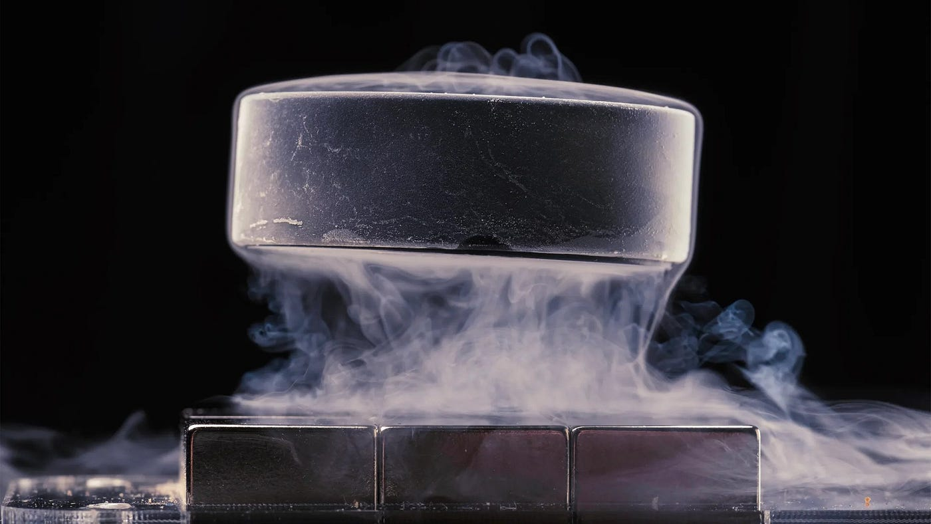

Superconductivity
Alessio Rettaroli Alessandro D’Elia
Corso Nazionale di Criogenia e Vuoto
5-8 Novembre 2024

Slide 2
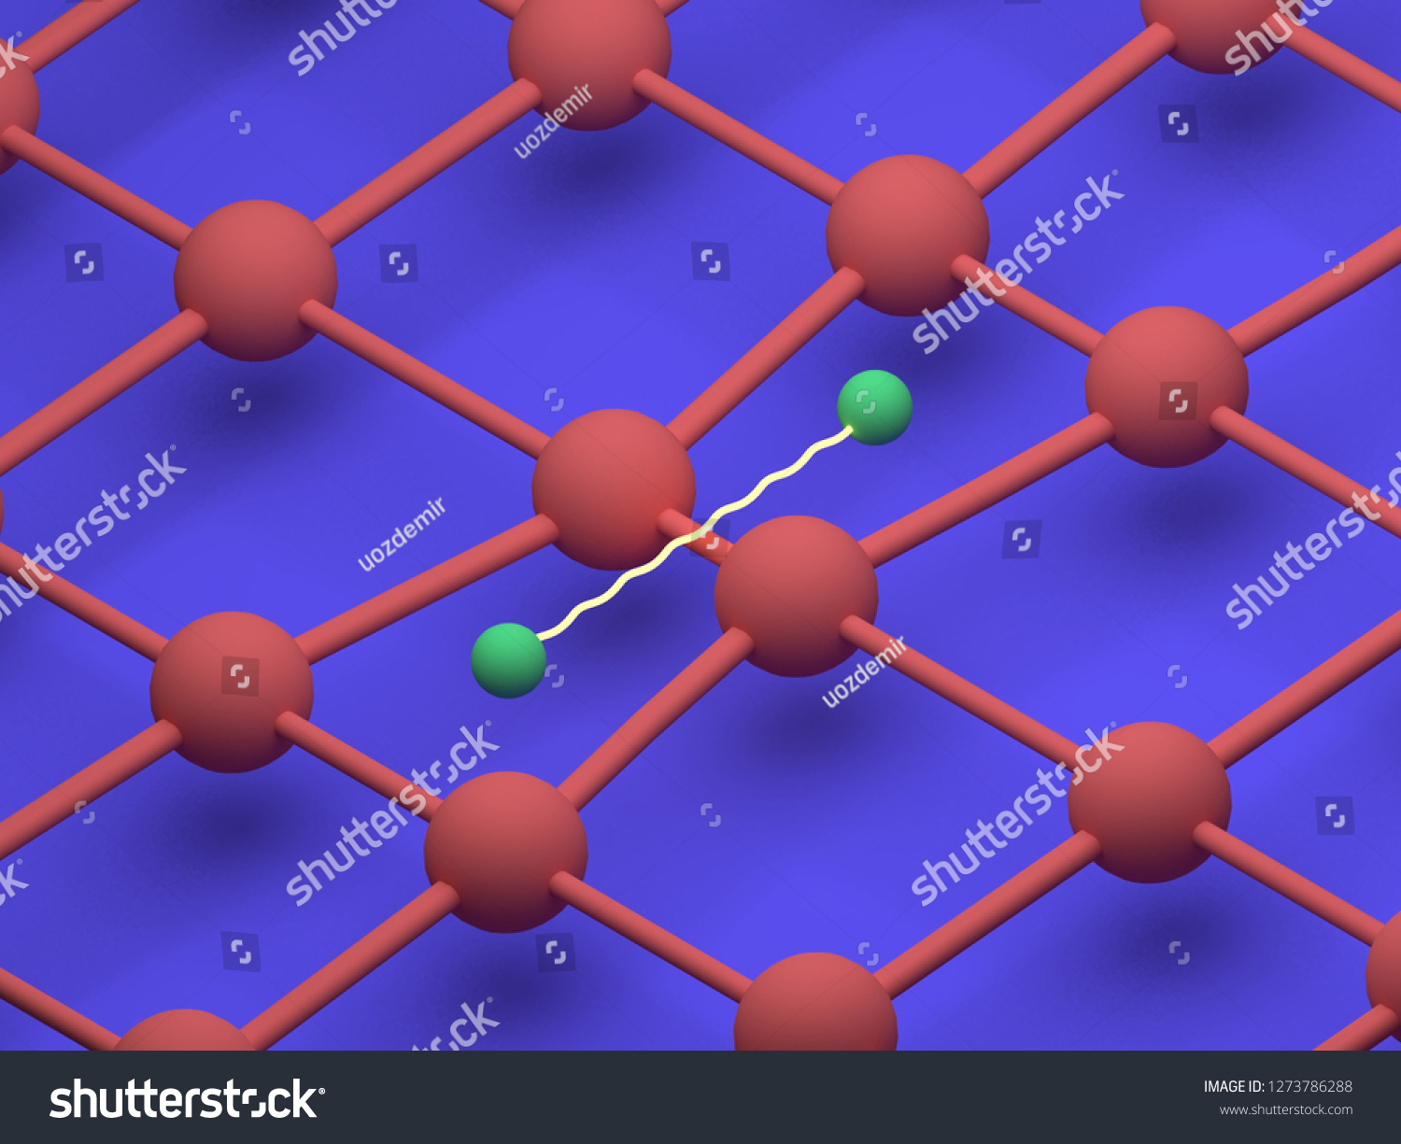
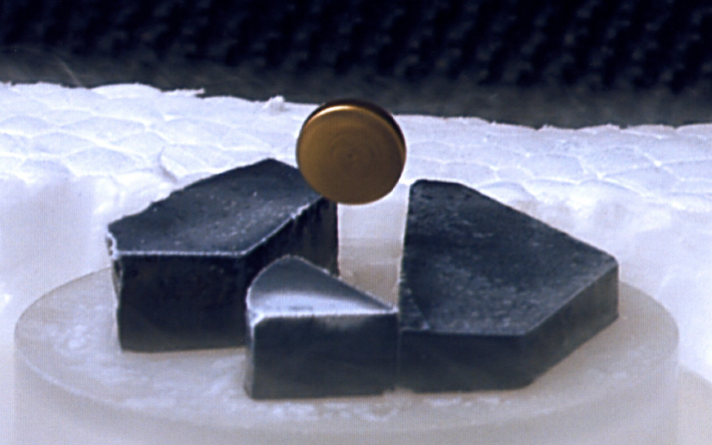
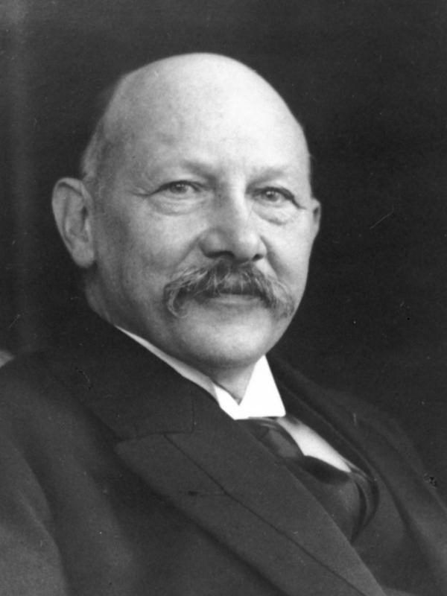
What is superconductivity
It is a state of matter in which electrons behave differently with respect to normal conductors.
Superconductors have peculiar electrical and magnetic properties
Discovered by Heike K. Onnes in 1911 in its cryogenic laboratory

Slide 3
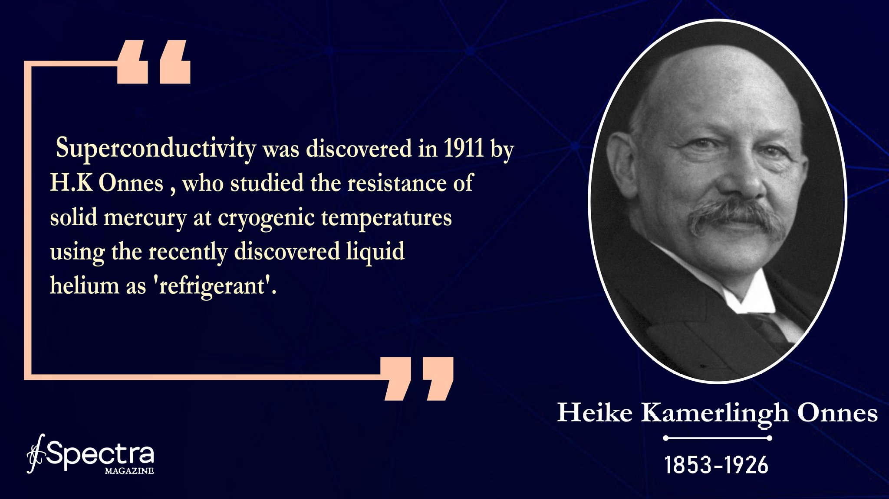
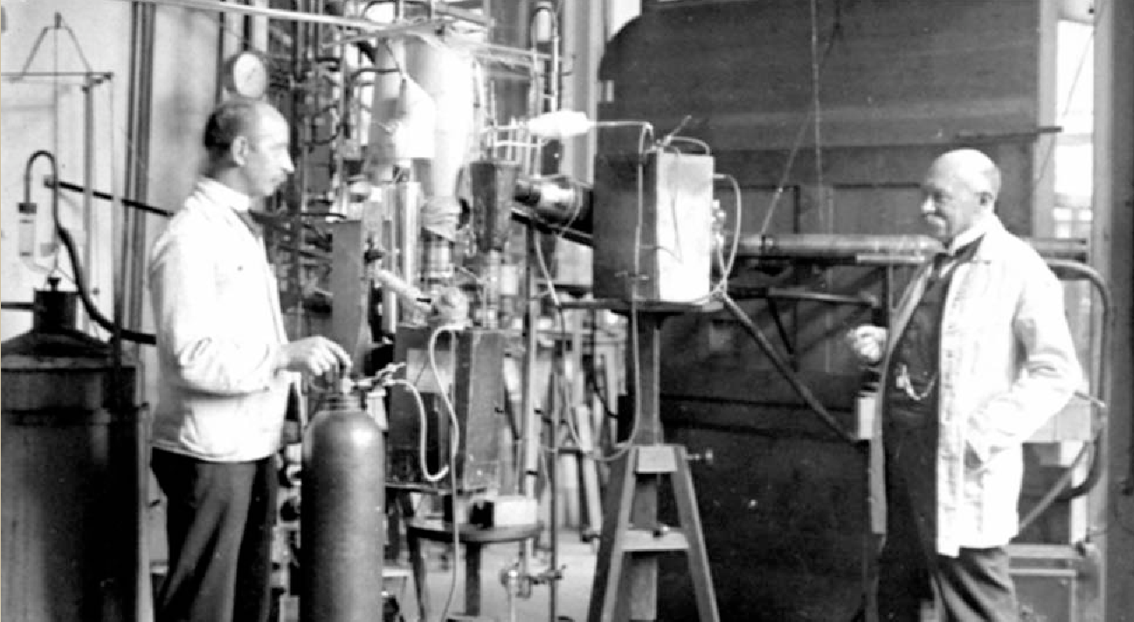
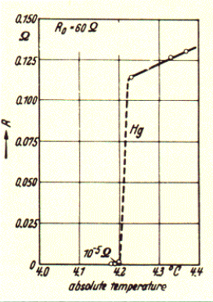
Introduction
1900
1911
1933-35
1950
1957
1962
2000
1908: Liquefied Helium for the first time (4.2 K)
1911: discovered that at 4.2 K the Mercury showed zero resistance

Slide 4
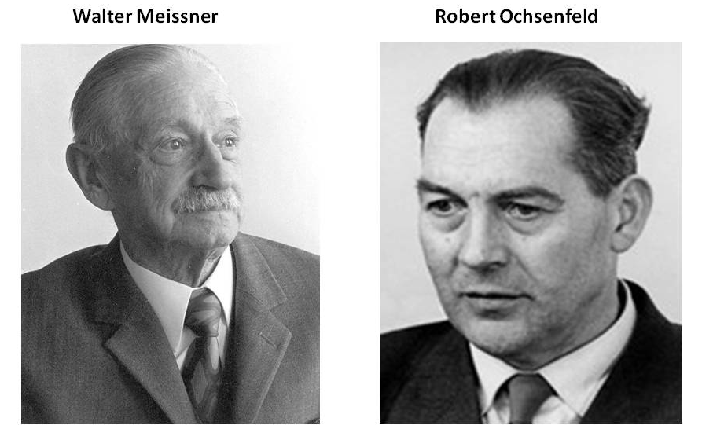
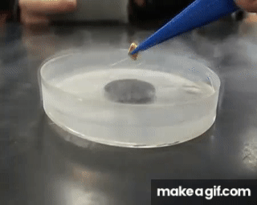
Introduction
1900
1911
1933-35
1950
1957
1962
2000
1933: Meissner and Ochsenfeld discovered the so-called Meissner effect: expulsion of magnetic field from superconductors
1935: The Meissner effect was explained by Fritz and Heinz London with the London equations

Slide 5
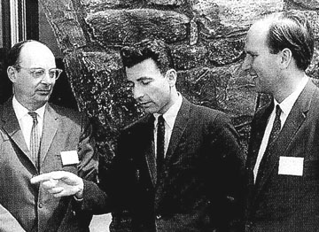
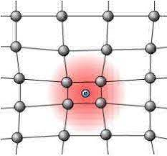
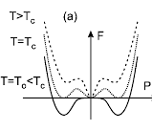
Introduction
1900
1911
1933-35
1950
1957
1962
2000
1950: Ginzburg-Landau theory, a phenomenological explanation of superconductivity
1957: BCS theory (after Bardeen, Cooper, Schrieffer), a microscopic explanation of SC

Slide 6
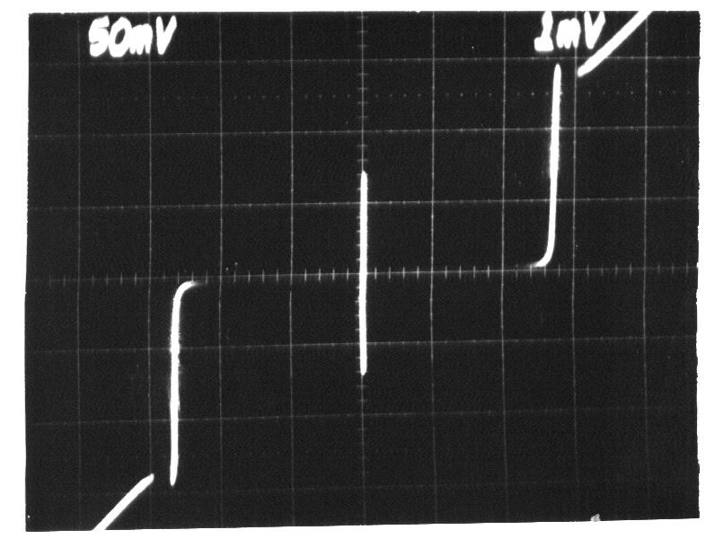
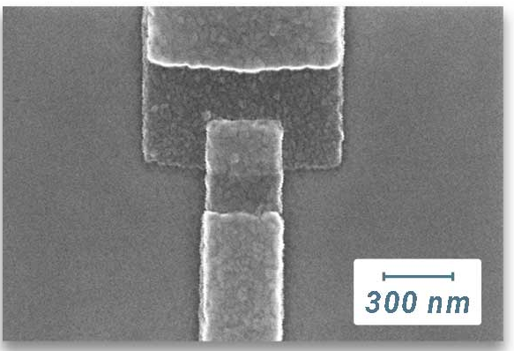
Introduction
1900
1911
1933-35
1950
1957
1962
2000
1962: B. D. Josephson predicted the Josephson effect: a tunneling process at the base of electronic devices mainly used in research

Slide 7
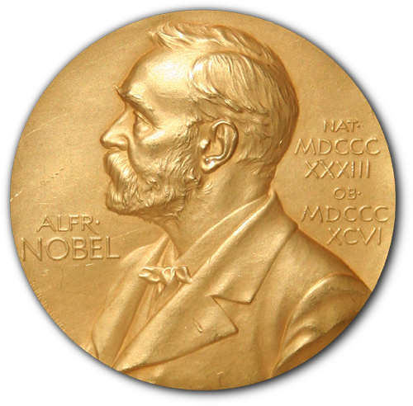
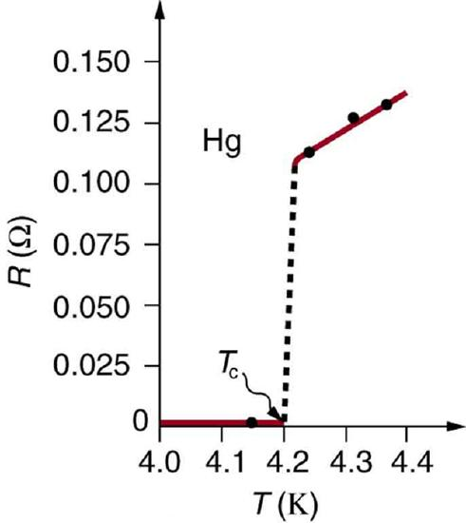
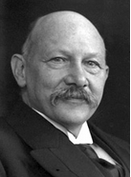
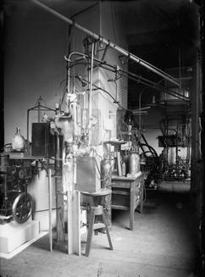
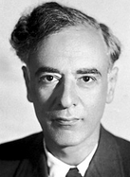
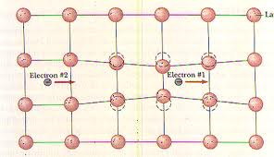
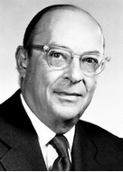
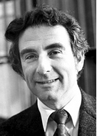
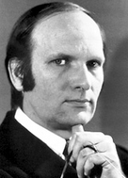
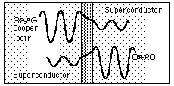
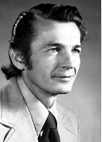
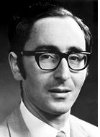
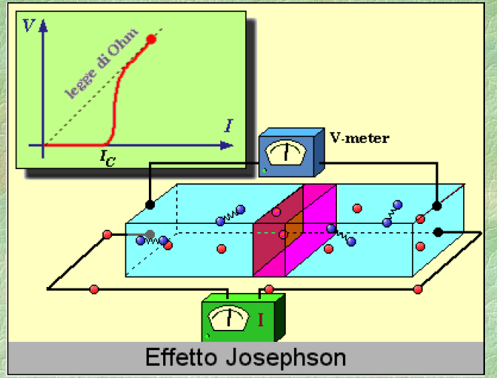
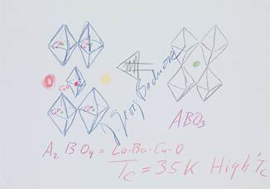

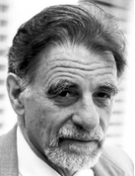
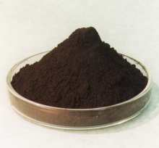
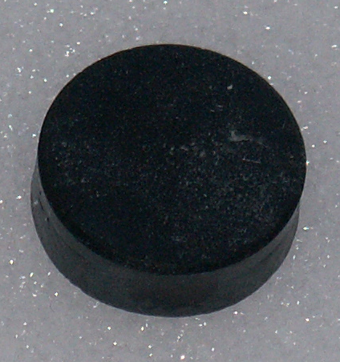
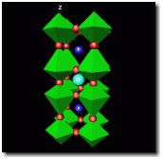
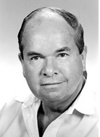
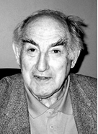
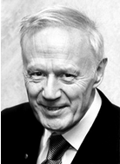
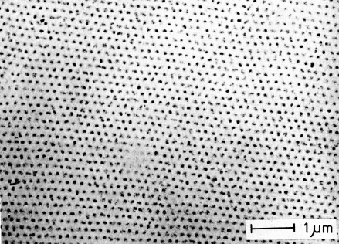
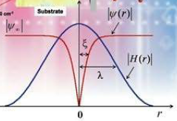
Nobel prizes for superconductivity
Kamerling Onnes (1913)
For his research on the properties of matter at low temperatures which also led to the production of liquid helium
Lev Davidovich Landau (1962)
For pioneering theories on condensed matter, especially liquid helium
J. Bardeen, L.N. Cooper, J.R. Schrieffer (1972)
For their jointly developed theory of Superconductivity, known as BCS theory
I. Giavier, B.D. Josephson (1973)
For the experimental discovery regarding the tunneling phenomenon in superconductors and the theoretical prediction of the properties of a supercurrent through a tunnel barrier (Josephson effect)
J. G. Bednorz, K.A. Muller (1987)
For their important success in the discovery of superconductivity in ceramic materials
A. A. Abrikosov, K.L. Ginzburg, A.J. Leggett (2003)
For pioneering contributions to the theory of superconductivity and superfluidity

Slide 8
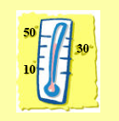

Macroscopic properties
Certain materials become superconductors below their critical temperature Tc.
Tc is usually very small.
1) Superconductivity is a phenomenon happening at low temperatures

Slide 9
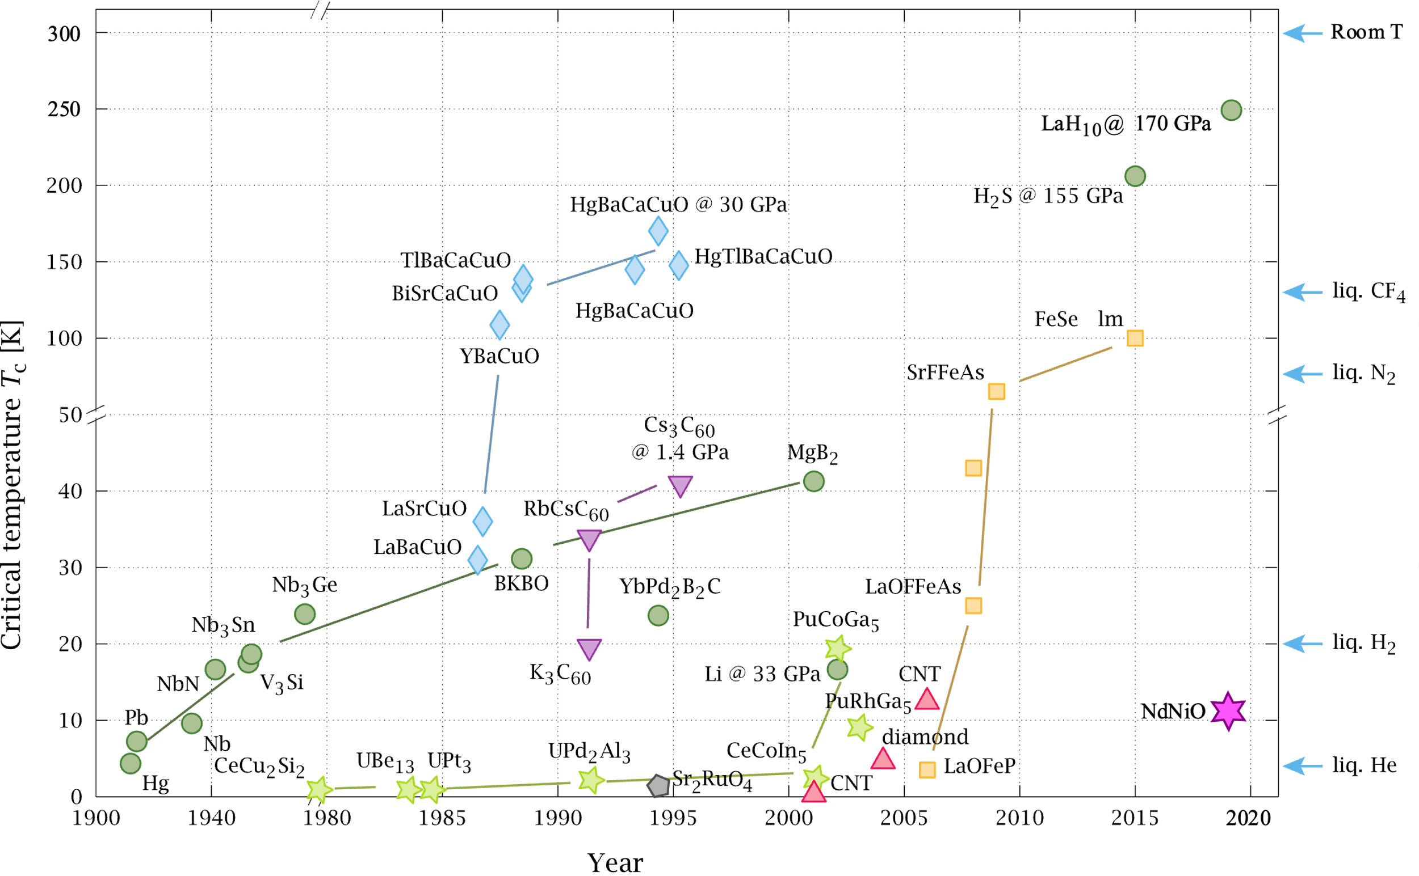
Temperature: how low?
100 K dark side of the moon
Typical materials are:
Ceramic materials
Iron based
Metallic alloys
Elements
40 K Pluto surface
4 K Mercury,
the first discovered
By PJRay - CC BY-SA 4.0, https://commons.wikimedia.org/w/index.php?curid=46193149

Slide 10
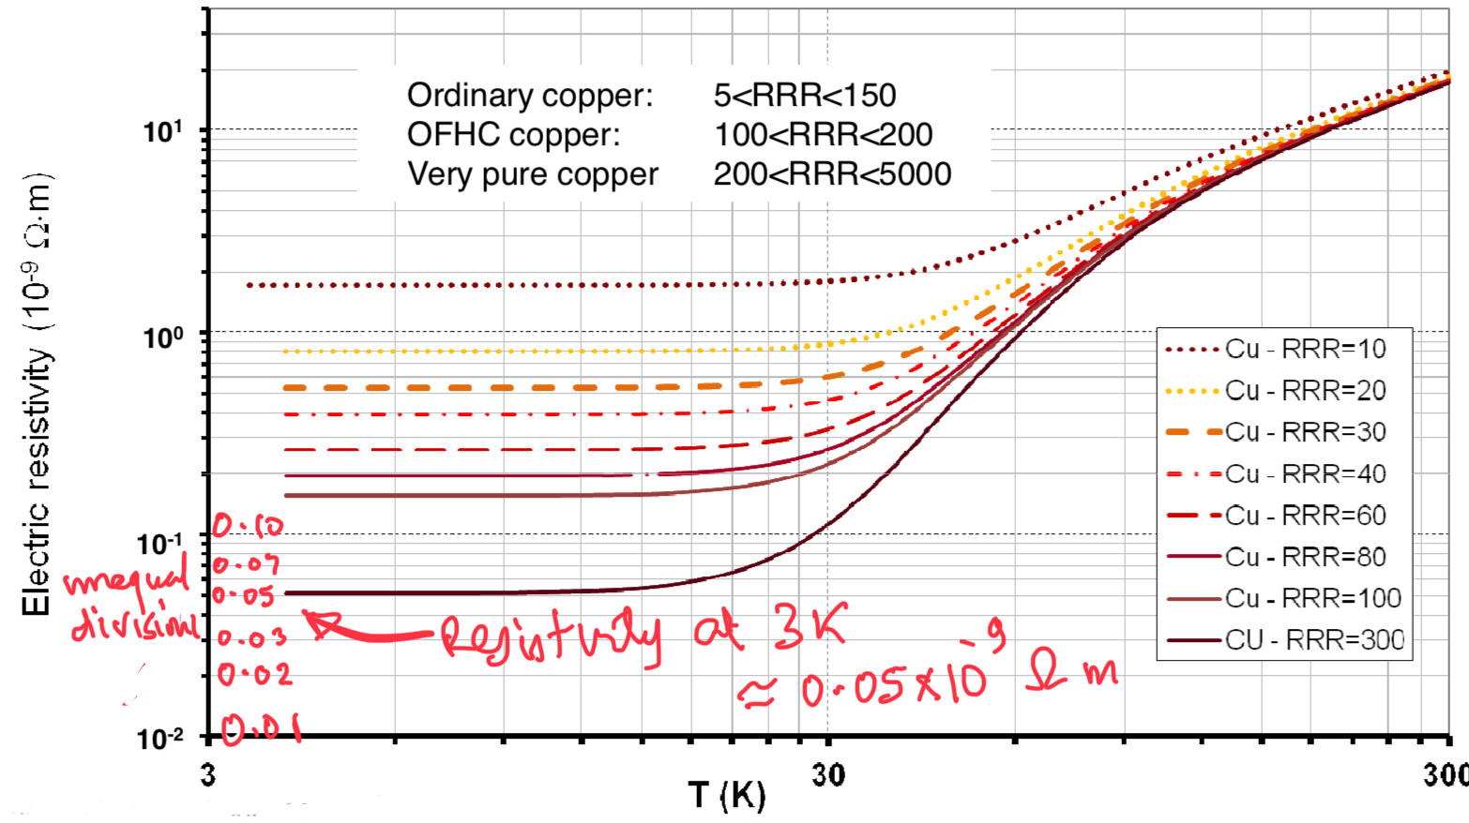
Macroscopic properties
Normal conductors: residual resistivity
Onnes observed an abrupt decrease in electrical resistivity of Mercury
2) Zero electrical resistivity
Electrical current can endlessly flow in a superconducting circuit (called supercurrent), until a critical current Ic.

Slide 11
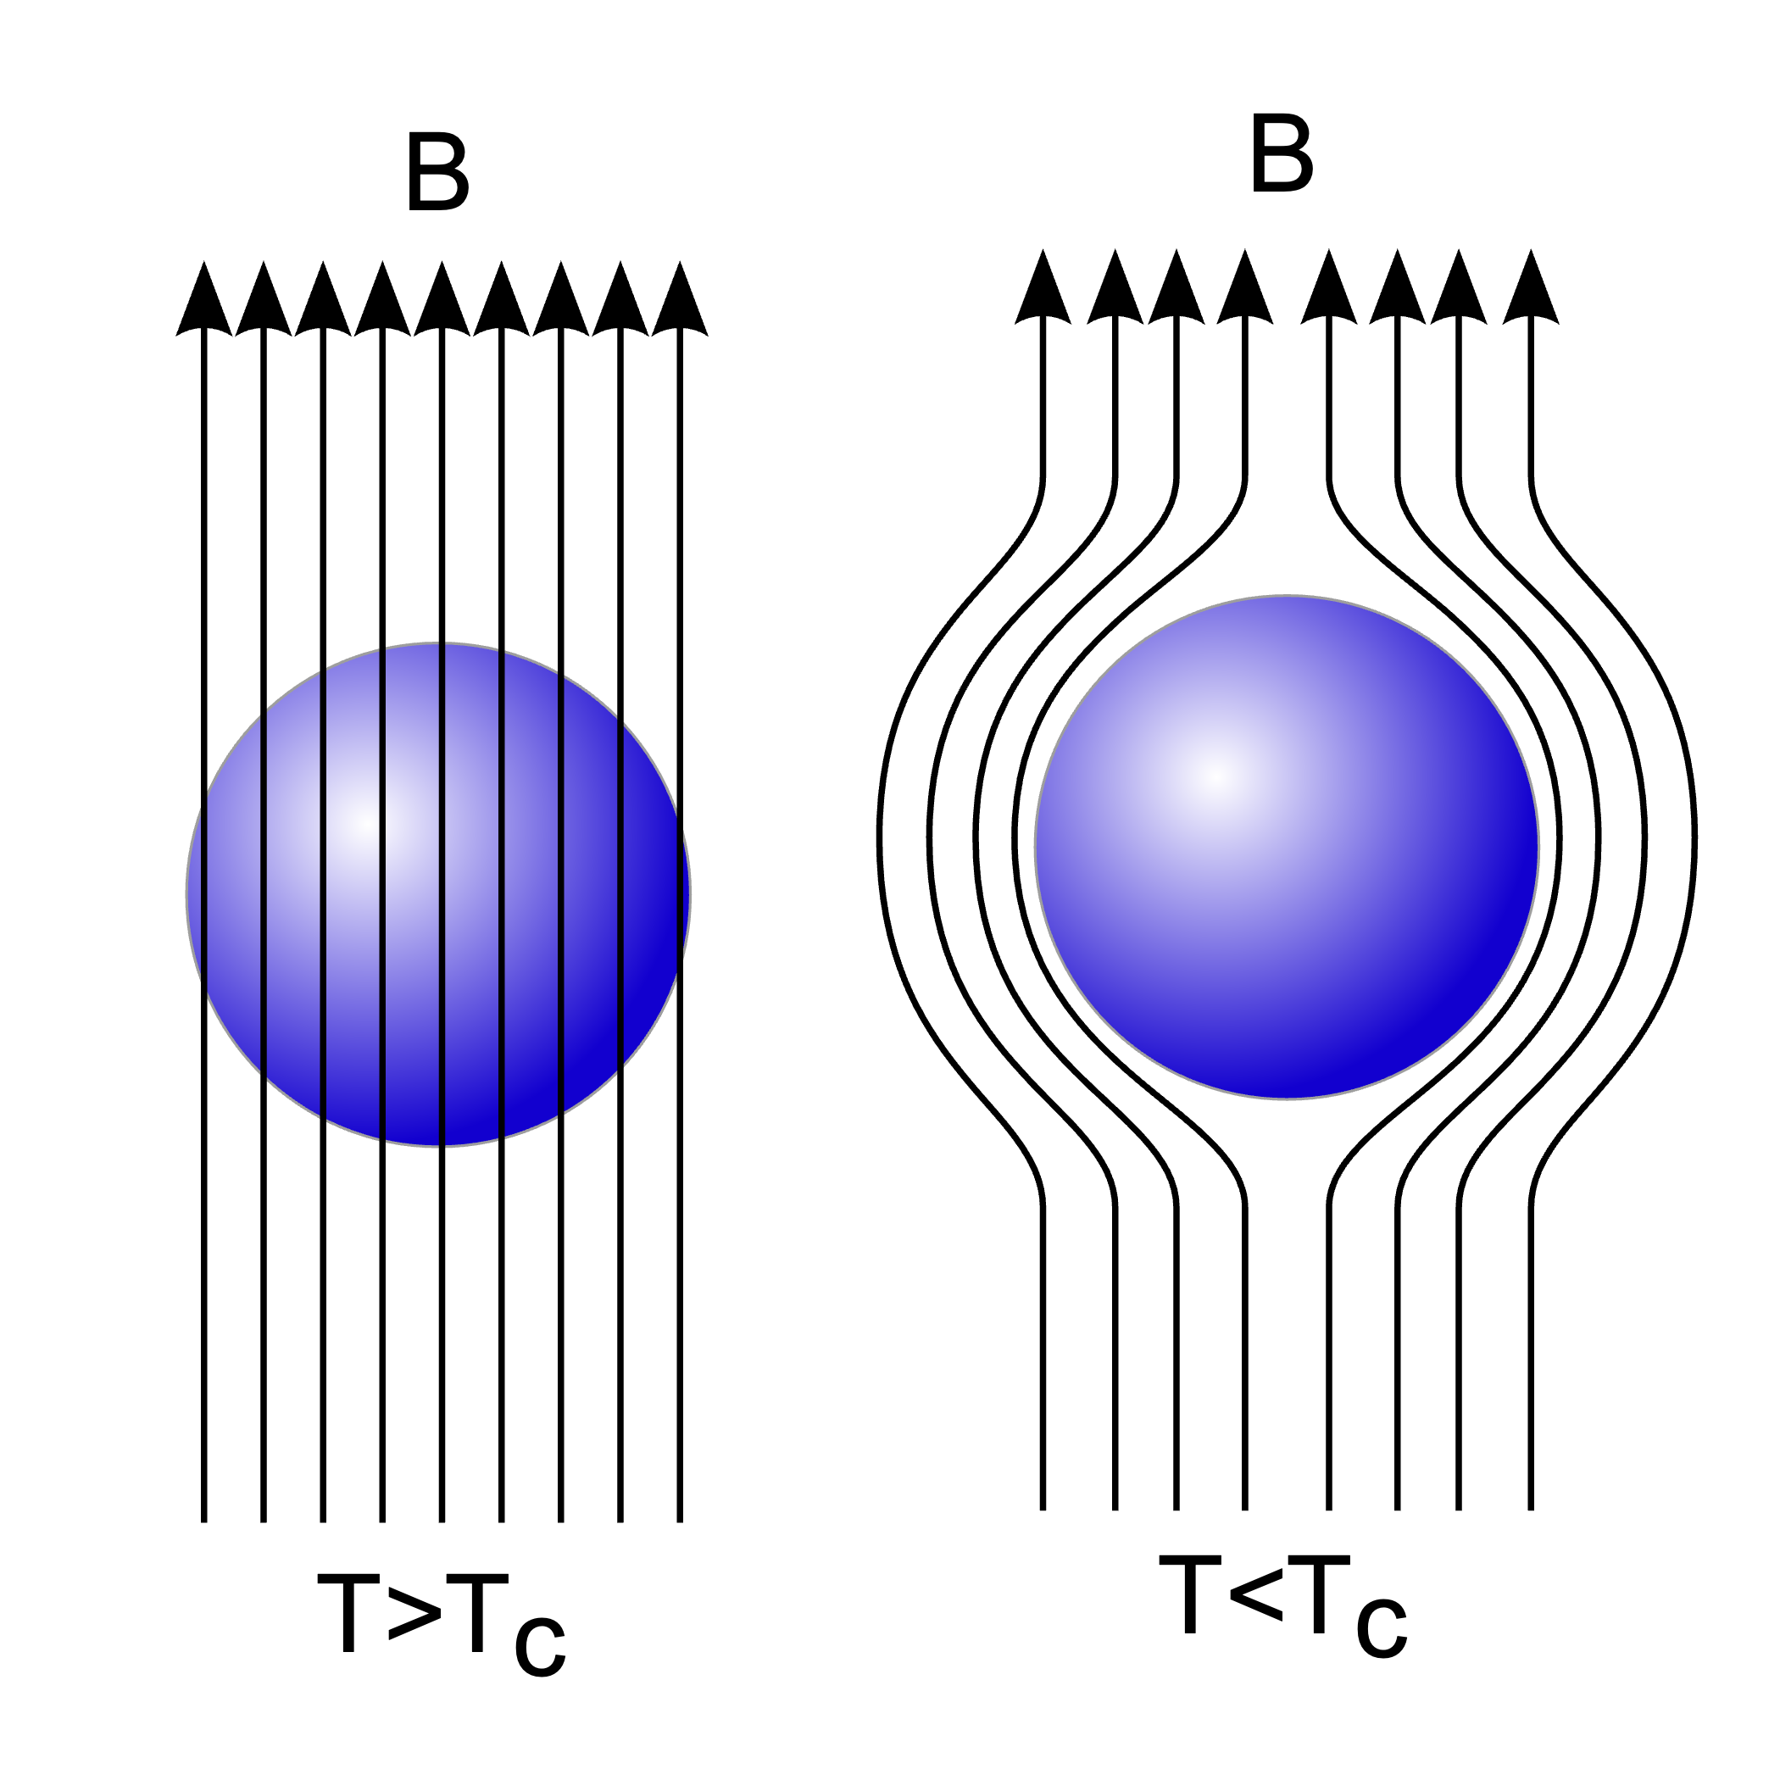
Macroscopic properties
3) Magnetic field is expelled
(Meissner effect - 1933)
Magnetic field is expelled until a critical fiel Bc is reached, above which the SC is back to normal conductor
Di Piotr Jaworski, PioM EN DE PL; POLAND/Poznań - Inspiration: Image:EXPULSION.png, Public domain, https://commons.wikimedia.org/w/index.php?curid=325237
Notes:
Spiegato poi nel 1935 da equazioni di London

Slide 12
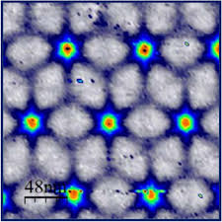
Macroscopic properties
Superconductivity cannot be explained by classical physics
4) It is exclusively a Quantum Effect
Notes:
Spiegato poi nel 1935 da equazioni di London

Slide 13

Summarizing
1) Low temperatures
Critical temperature Tc
R(Ω)
2) Zero electrical resistivity
Critical current Ic
T(K)
3) Magnetic field is expelled
Critical field Bc

Slide 14
Some theory: BCS

Slide 15
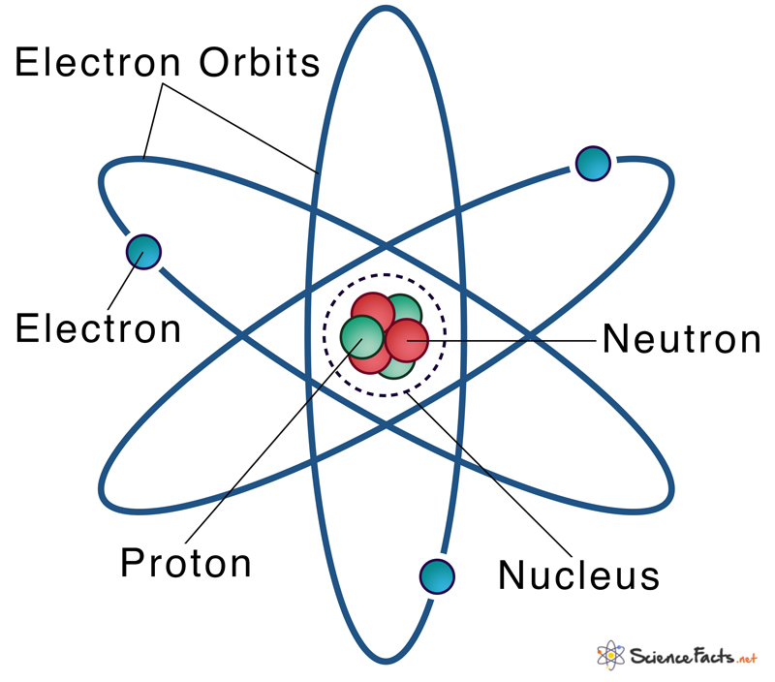
Atoms
Electrons move around the atomic nucleus on discrete orbits (like the planets in the solar system)

Slide 16
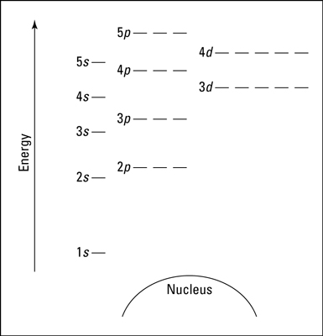
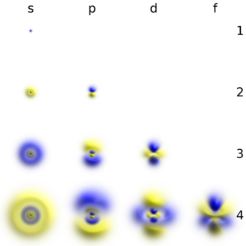
Atoms
Each «orbit» has different dimension, shape and energy. In quantum mechanics they are called orbitals.

Slide 17
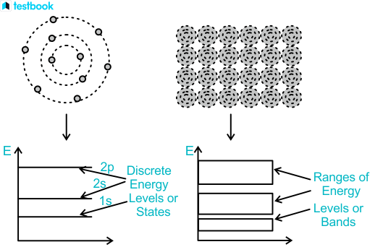
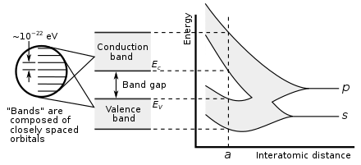
From atoms to solids
Atoms closely packed form a crystalline lattice. The orbitals of the different atoms mix, forming electronic bands of allowed energy where the electrons can exist.

Slide 18
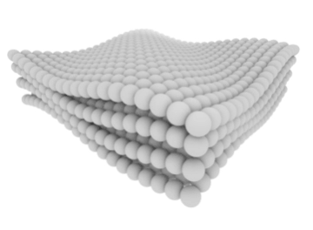
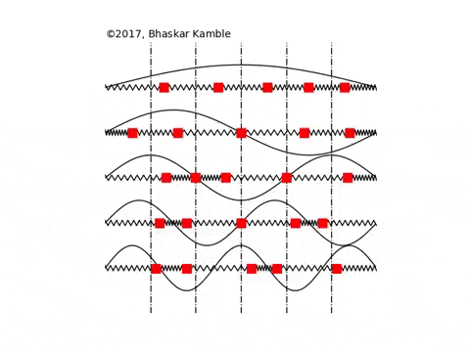
From atoms to solids
The crystalline lattice vibrates creating collective wave-like motion
The frequency and amplitude of these vibrations, depend on multiple frequencies, most importantly the temperature

Slide 19
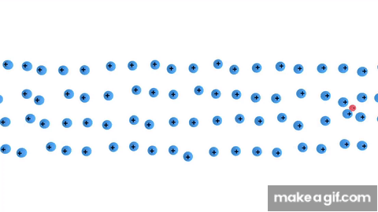

Cooper pairs formation
At low temperature the lattice vibrations become negligible. The negative charge of an electron generates a deformation of the lattice creating a cloud of positive charge that will attract a second electron. These couple of electrons are called Cooper pairs, and are the main charge carriers in a superconductor.

Slide 20


Electrons vs Cooper pairs
Electrons must be in separate states because of Pauli exclusion principle. Cooper pairs are Bosons that condensate in the lowest energy level.
Electrons moving in a lattice scatter with the atomic nuclei. This reducs their mobility and is the first source of electrical resistance in a metal
Cooper pairs, travel to the lattice without scattering => no electrical resistance
Normal metal
Superconductor

Slide 21
Classification by critical temperature
Historically, 30 K is considered as the threshold between:
Low temperature SC
Tc < 30 K
High temperature SC
Tc > 30 K
30 K
Liquid N2 77 K
Absolute zero 0 K
-273.15 °C
Room temp. 300 K

Slide 22
Classification by critical temperature
High
Low

Slide 23


Low temperature superconductors
Usually metals or simple alloys
Al Tc=1.2 K
«Conventional» conduction mechanism
Not very high H_{c2} (with some exceptions)

Slide 24

High temperature superconductors
High temperature superconductors are complex oxides. In contrast to most of the low T_{c} superconductors, at room temperature they show a ceramic (insulating) behaviour.
In these materials the cooper pairs conduction happens in the CuO₂ planes (usually insulating at room temperature)
In addition to having a high Tc, these class of materials also exhibits extremely high H_{c2} and critical current, making them extremely appealing for multiple allications (e.g. super high intensity magnets).
YBa₂Cu₃O₇ Tc=92.6 K
YBCO

Slide 25



Cryogenic techniques
Dilution refrigerator
10 mK
Liq. Helium (He4) 4.2 K
Liq. Nitrogen (N2) 77 K
The most used liqud gases are the Liquid Nitrogen (cheapest) and the Liquid Helium (coldest)
Dilution refrigerators use the thermodynamic properties of a mixture of liquid He3 and He4

Slide 26

Classification by magnetic properties
Type I superconductors
Perfect diamagnetism (Meissner effect)
Magnetic field B
The magnetic field is completely expelled, because the SC creates an equal and opposite field inside
I_{s}
Superconductor
Meissner state
normal
SC
For T < Tc
and B < Bc
By Frederic Bouquet (user:Fbouquet),Julien Bobroff (user:Jubobroff) LPS, Orsay, France, CC BY-SA 3.0

Slide 27


Classification by magnetic properties
Type II superconductors
For magnetic fields Bc1 < B < Bc2 there is an intermediate state (Mixed state) in which part of the magnetic flux lines can penetrate.
Small paramagnetic behaviour
normal
Mixed SC
SC
For T < Tc
and Bc1 < B < Bc2

Slide 28


Classification by magnetic properties
Type II superconductors
Picture of the Abrikosov lattice, with increasing B field.
These regions are cylindrical, and made out of a normal core. The cylinders contain the magnetic flux lines.

Slide 29



Classification by magnetic properties
Type II superconductors
The amount of magnetic field entering these cores is quantized. Only integer multiples of the flux quantum $φ_{0}$ enter the superconductor
$$φ_{0}=\frac{h}{2e}≃2×10^{−15} Wb (Tesla⋅m^{2})$$
These cores are called fluxons, or magnetic vortices.
On the border a supercurrent flows like in a vortex.

Slide 30
Type II superconductors – energy dissipation
B
Fluxons are like ’’charges’’ in the superconductor, so they are subject to a Lorentz force due to the external magnetic field
A Lorentz force implies a movement: fluxons move inside the SC (flux flow)

Slide 31

Type II superconductors – energy dissipation
B
Fluxons have a normal core, meaning that they contain electrons
Electrons moving in a material dissipate energy = the material have a resistivity.
$⟹$ Type II SC have a small resistivity
Notes:
Esistono comunque modi per limitare la dissipazione

Slide 32


Applications in research
Josephson junctions
Macroscopic effect of a quantum phenomenon
Based on Quantum tunneling
A supercurrent can flow without applied voltage, by the effect of Cooper pairs tunneling through the insulator

Slide 33




Applications in research
SQUID: Superconducting QUantum Interference Device
Two Josephson junctions in loop.
The concatenated magnetic flux is quantized $⟹$ the current is proportional to the flux quanta
SQUIDs are powerful magnetometers:
Half flux quantum detectable:
$\frac{1}{2}φ_{0}≃10^{−15} T⋅m^{2}$
Minimum magnetic field detected:
$$5×10^{−14} T$$
(The Earth magnetic field is $5×10^{−6} T$)

Slide 34

Quantum technologies

Slide 35

Qubit
Qubits exploits the states superposition to increase calculation power
A two level quantum system is required
By Abhishek Dubey
JJ provide a solid state system that mimics the features of an artificial atom with discrete energy levels

Slide 36

Transmon
The transmon is the most simple qubit
It is composed by a Josephson junction shunted by two capacitors
Superconductive circuits are the most promising candidates for large scale scalability!

Slide 37


Transmon
In quantum emchanics, the measurements of a quantum states, makes the wave function collapse destruction of the states superposition
A resonant cavity is necessary to read the qubit in a non-destructive way

Slide 38



Applications in everyday life
Powerful magnets
Superconducting wires are used to build powerful SC magnets, because SC wires do not have resistance --> no heating due to Joule effect
Medical use.
MRI, 0.2 – 7 T
Nuclear fusion.
ITER tokamak has11.8 T
Accelerators.
LHC has 8.3 T magnets

Slide 39




Applications in everyday life
SC Maglev
Niobium-Titanium SC magnets are also used to develop frictionless Maglev trains
Levitation
Guidance
Propulsion
Central Japan Railway Company

Slide 40

Applications in everyday life
Magnetoencephalography (MEG)
Array of SQUIDs as magnetometers used in neuroscience to detect the small magnetic fields of the brain activity
The brain cortex can be seen, because the skull is magnetically transparent
Magnetic field of human brain: $10^{−13}−10^{−12} T$

Slide 41





Applications in COLD lab
$$\{$$
Resonant cavities coated with superconductors
Parametric amplifiers
Superconducting magnet (9 T)
Josepshon junctions and SQUIDs as single-photon detectors
Qubits as single-photon detectors
CryOgenic Laboratory for Detectors

Slide 42
Thank you for your attention

