Slide 1

CMS at LNF group activities
Davide Piccolo
for the LNF CMS group

Slide 2
Outline
LHC and CMS in 2011
The Muon system and CMS LNF group
RPC detector and trigger performance
Physics analysis and plans for 2012
Plans for CMS Upgrade
Conclusions

Slide 3
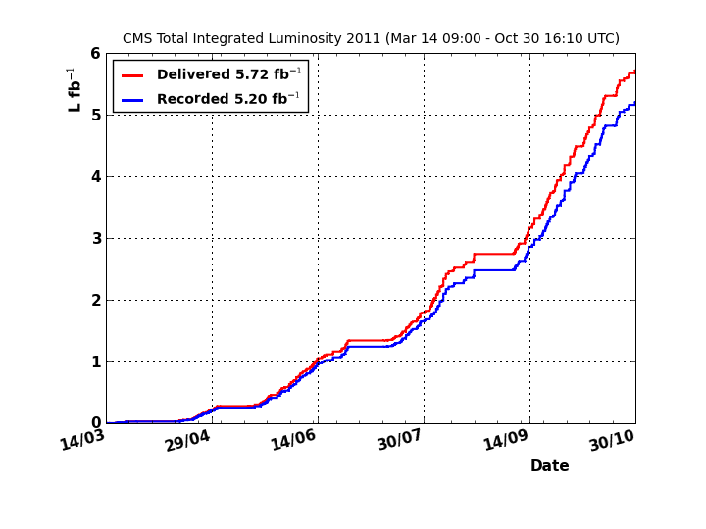
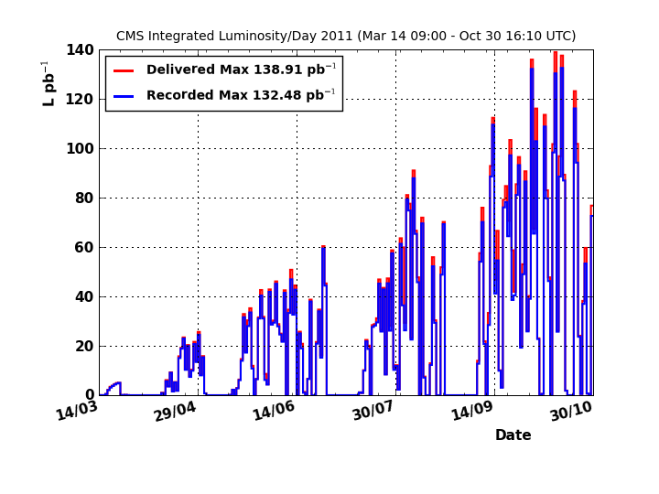
LHC performance in 2011
Record instantaneous luminosity: 3.54x10³³ cm⁻²s⁻¹
5.72fb⁻¹ delivered and 5.20fb⁻¹ recorded by CMS: 91% efficiency.
Excellent performance.

Slide 4
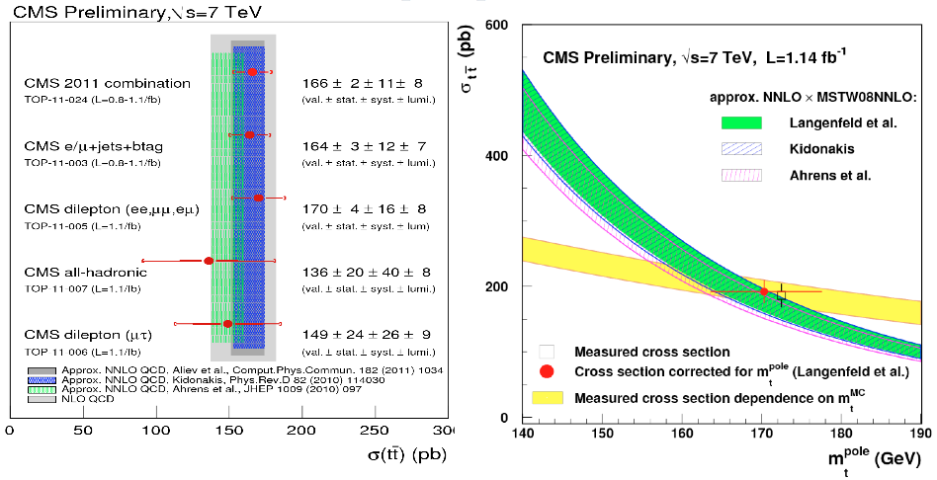
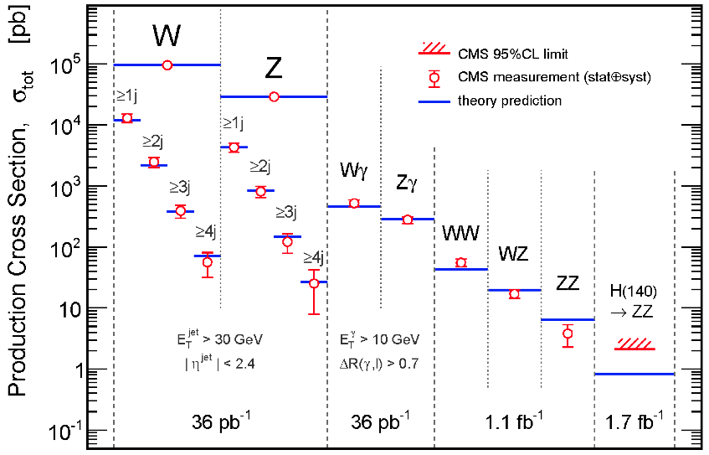
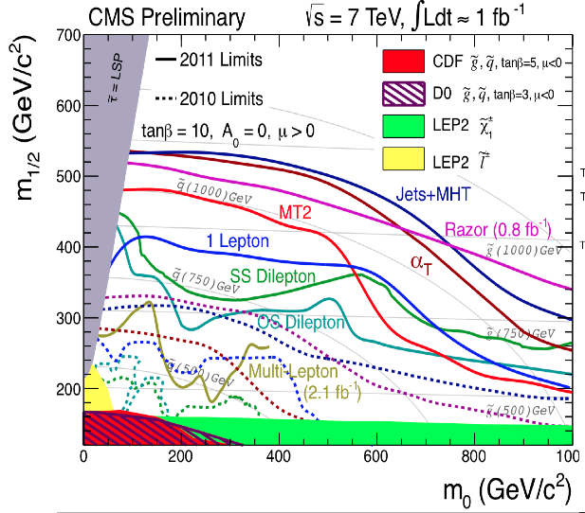
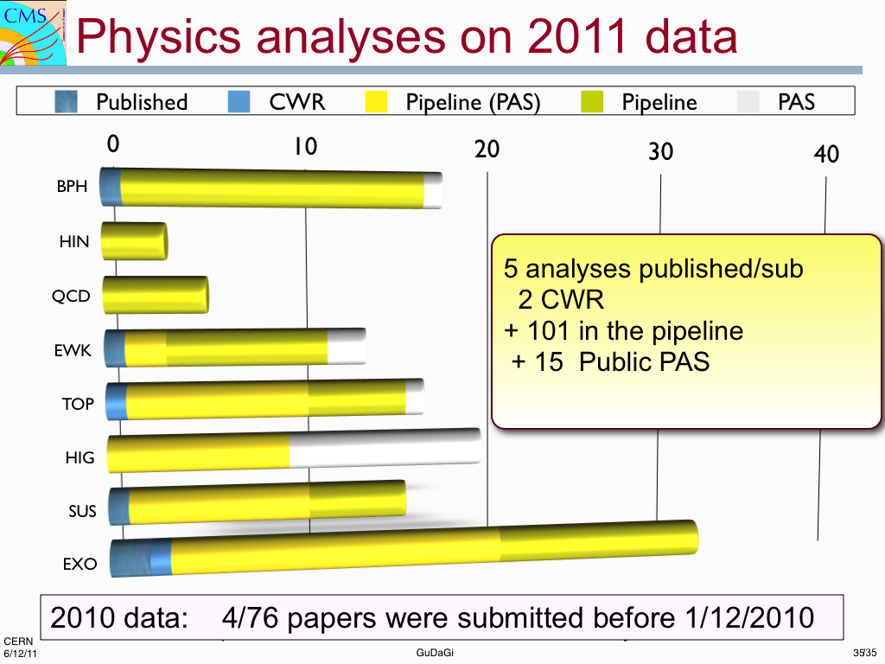
Main CMS Results
Top quark results
EWK results
SUSY results

Slide 5
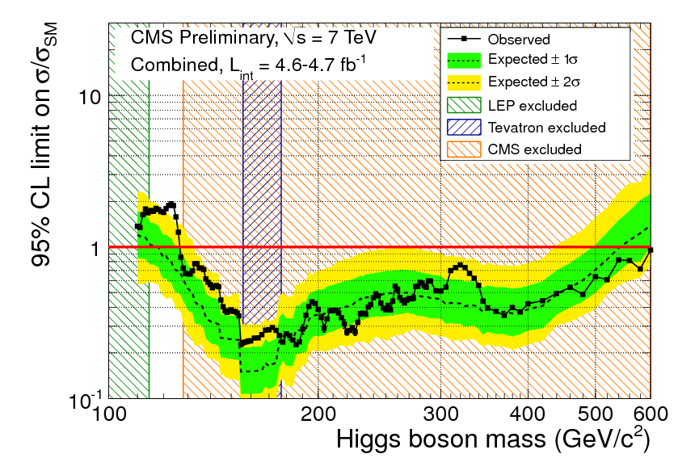
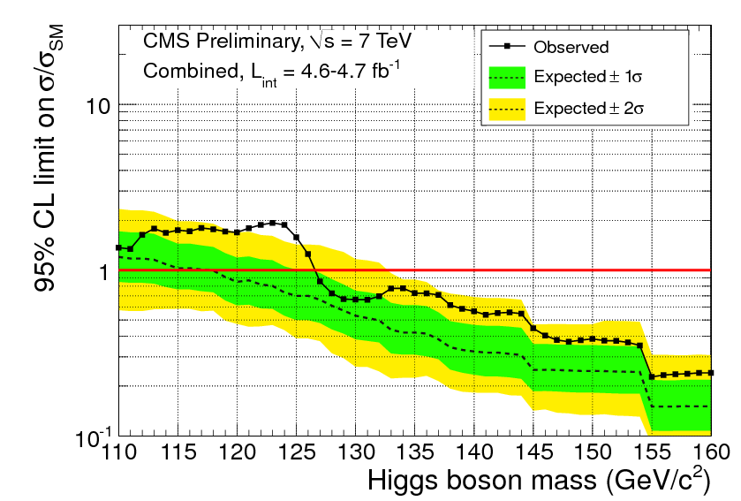
Higgs search in CMS
SM Higgs excluded in the range 127 – 600 GeV at 95% confidence level,
and 128 – 525 GeV at 99% confidence level.
Small excess in 5 different channels in the range 115 – 127 GeV
Most compatible with a SM Higgs of 124 GeV at 1.9 σ (taking into account LEE effect)
More data to be collected in 2012, will help ascertain the origin of the excess

Slide 6
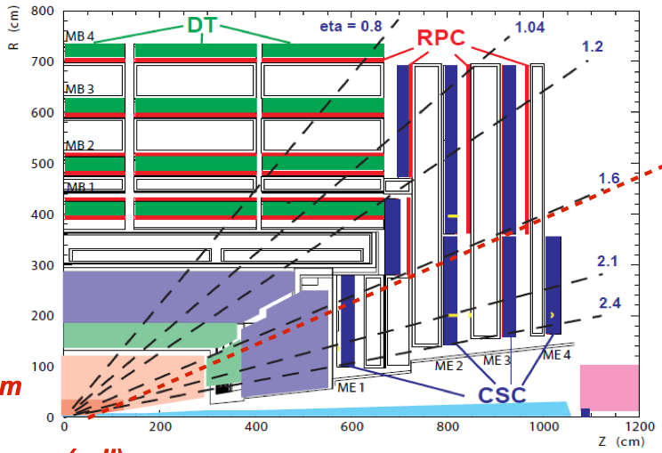
The CMS detector and the Muon system
With 6 layers in Barrel and 3 in Endcaps, RPCs
partecipate in both trigger and muon reco
LNF group involved in RPC Muon System

Slide 7
CMS Frascati group 2012
Staff Physicists: L.Benussi^{a,100%}, S.Bianco^{a,100%,P.I.}, D.Piccolo^{a,100%}
Staff Engineer: G.Raffone^{a,30%}
Associate Engineers: M.A.Caponero^{b,60%,} F.Felli^{c,100%}, G.Saviano^{c,100%}
Grad. Students (Engineering): S.Colafranceschi^{c}, C.Vendittozzi^{c}
Senior associates: F.L.Fabbriª, M.Giardoniª,M.Pallottaª
In collaboration with technicians L.Passamonti^{a,} D.Pierluigiª, A.Russoª
and SPECAS and Computing center personnel
ªLaboratori Nazionali di Frascati dell’INFN, Italy
^{b}Laboratori Nazionali di Frascati dell’INFN and ENEA Frascati, Italy
^{c}Laboratori Nazionali di Frascati dell’INFN and Facolta’ di Ingegneria Roma1, Italy
^{d}Laboratori Nazionali di Frascati dell’INFN and Scuola di Ingegneria aerospaziale Roma 1, Italy

Slide 8
CMS Frascati group responsibilities
L2 responsibility: RPC Run Coordination (2011-12): Luigi Benussi
L2 responsibility: RPC Detector Performance Group convener (2010-11): Davide Piccolo
L3 responsibility: RPC GGM responsibility: Stefano Bianco
PRIN2008: development of optical sensors for detection of contaminants in CMS RPC gas.

Slide 9
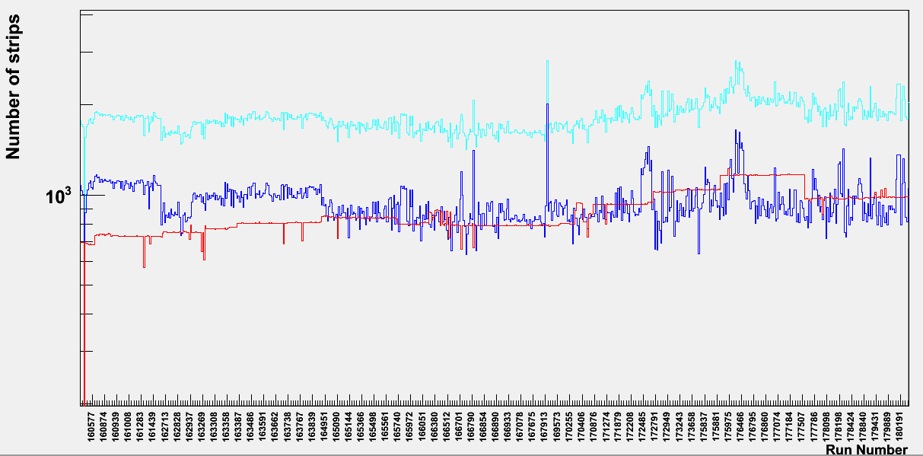
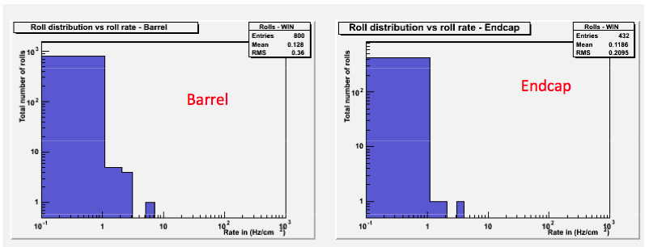
RPC Detector Operations
Inactive channels (dead+masked)
dead channels
Masked channels
Inactive channels: ~1.6%‐1.7%
(~0.9% masked strips,
~0.7% dead strips)
• Active electronic channels stable:
~98.3%‐~ 98.4 %
Excellent performance of RPC system
Thanks to the work of the Operation Team
Coordinated by Run Coordinator (Luigi Benussi)
Averge noise
Rate 0.1 Hz/cm2
Averge noise
Rate 0.1 Hz/cm2
According to specifications

Slide 10
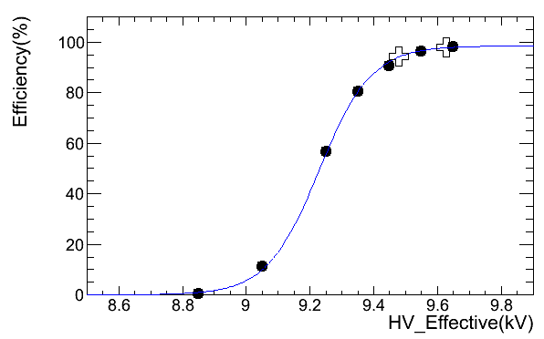
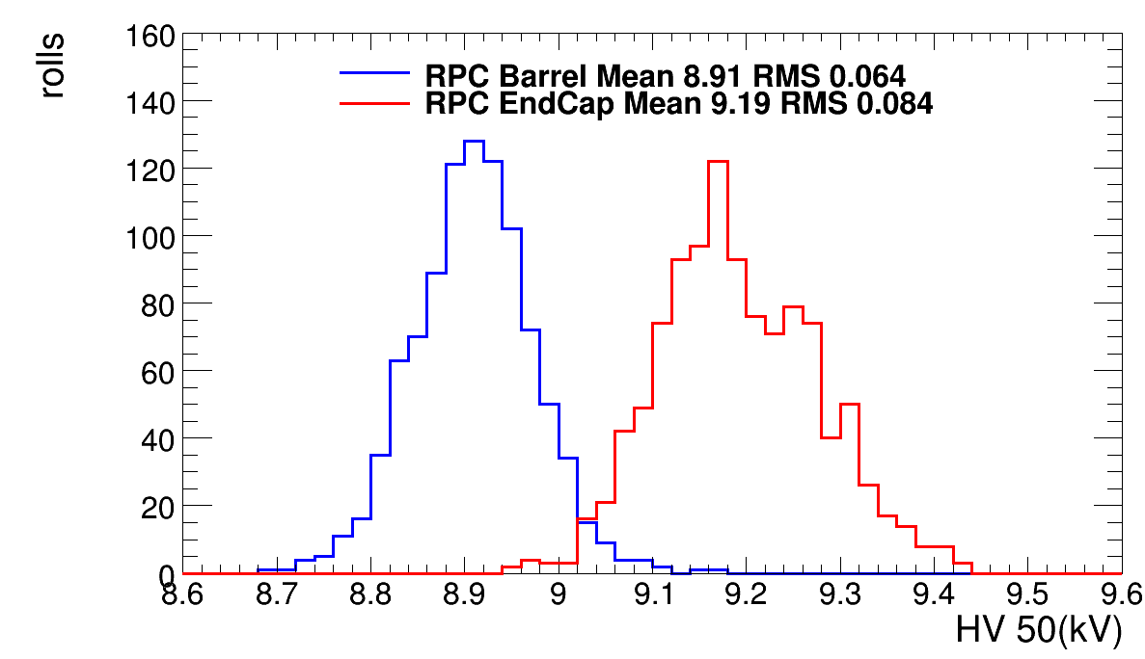
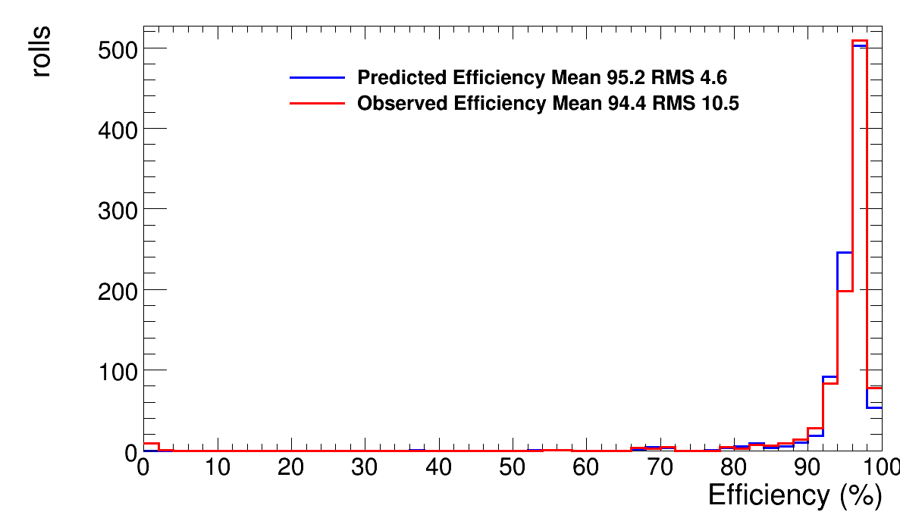
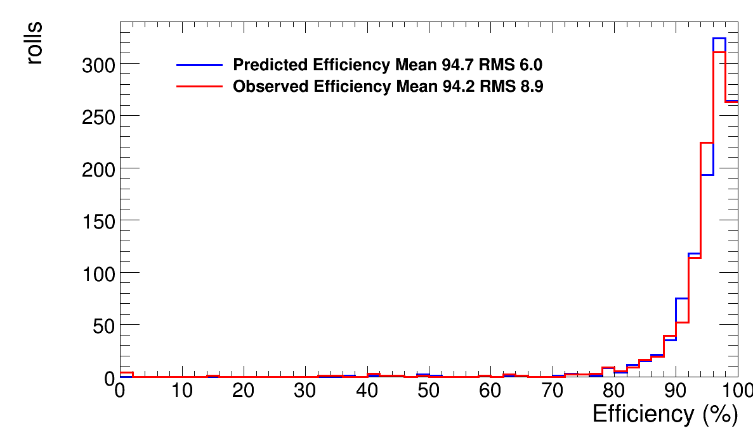
RPC HV scan
CMS preliminary 2011
HV scan campaign at beginning of 2011
during LHC Low Luminosity Runs
(To be repeated in 2012)
“knee”
2316 plateau
of RPC DoubleGaps measured
Working
Point
HV AT 50%
barrel
endcap
EFFICIENCY
EFFICIENCY
According to specifications
Different HV point for barrel and endcap
(different construction techniques)

Slide 11
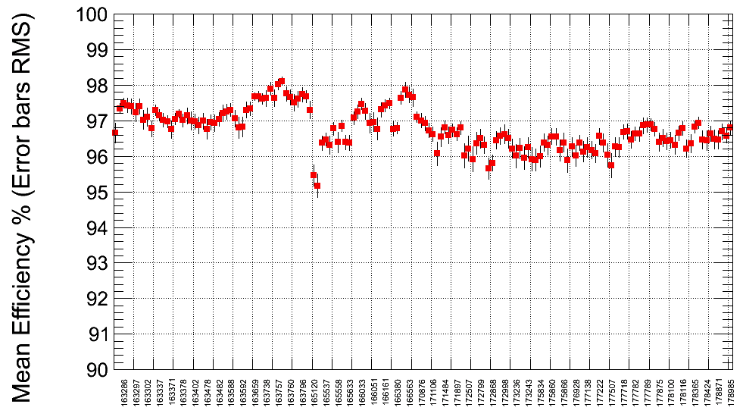
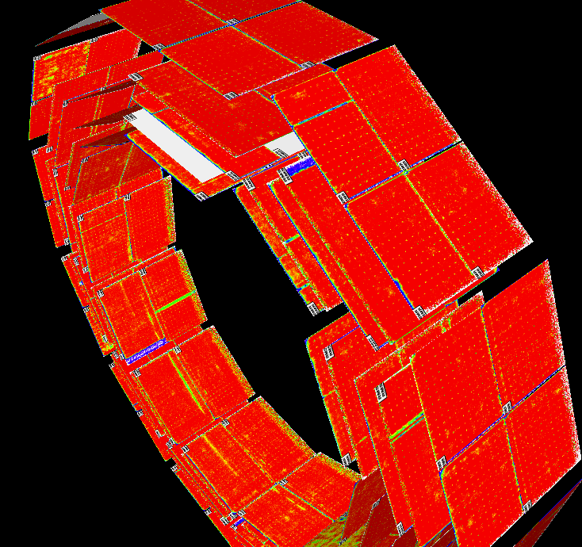
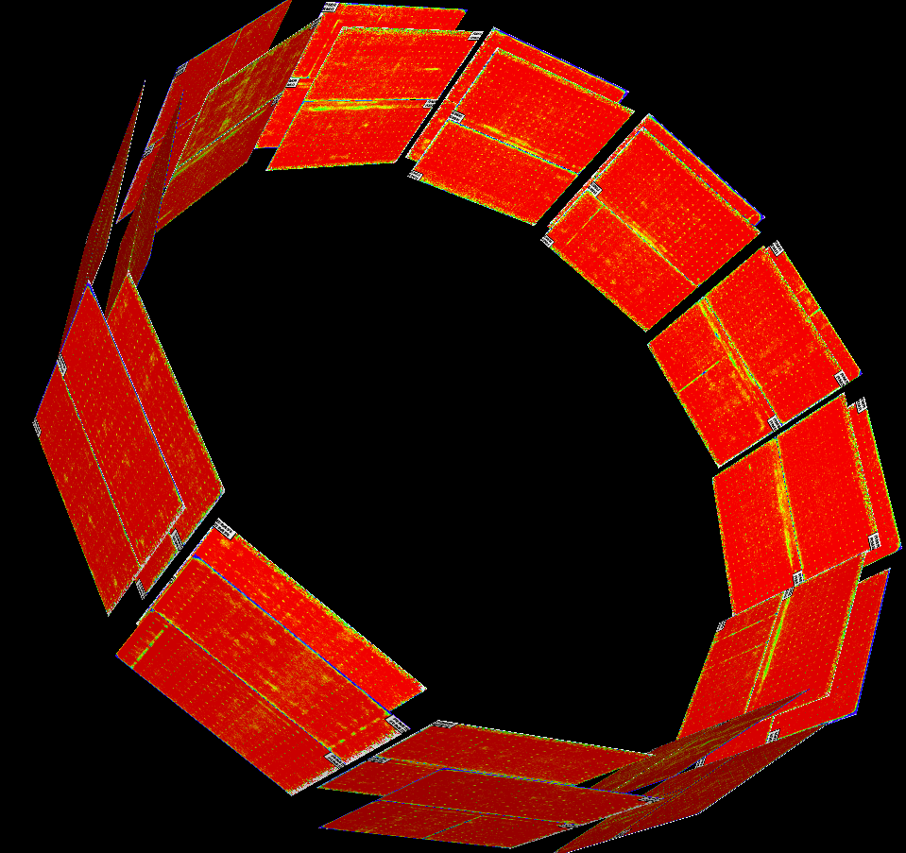
RPC Performance
2011 Average
Barrel RPC efficiency
HV corrected for
Pressure variations
Precise Efficiency map
Chamber by chamber

Slide 12
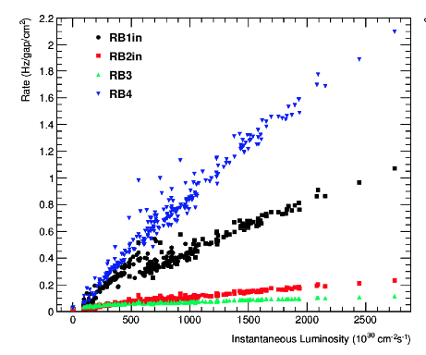
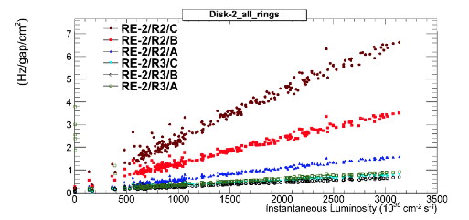
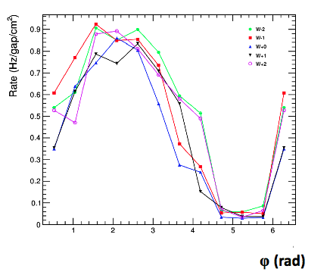
LHC background measured by RPCs
OuterMost layer
InnerMost ring
Mainly neutron
Background
InnerMost layer
Mainly punch through Background
Very nice correlation between LHC luminosity
And Background rate seen by RPCs
Clear correlation with RPC Geometry
Extrapolation to 10³⁴ cm⁻² s⁻¹ not an issue
Screen of Floor
Outermost
layer

Slide 13
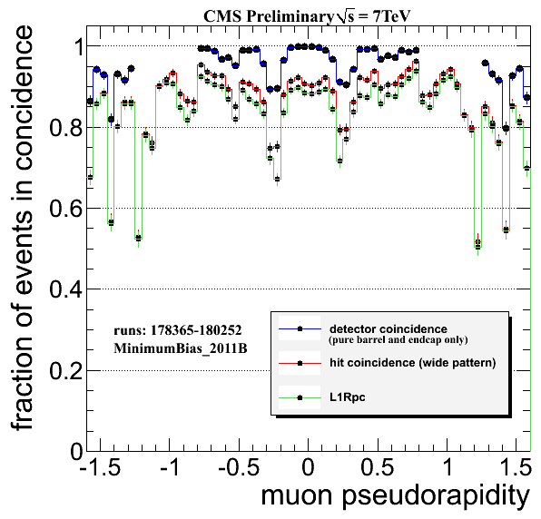
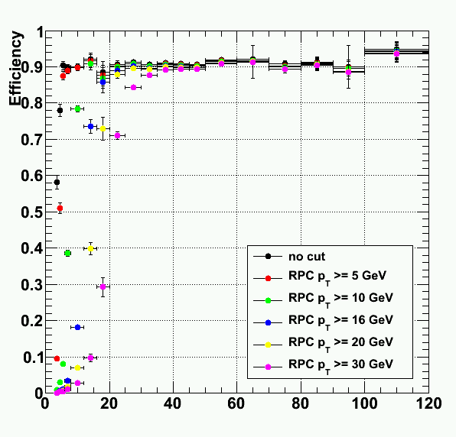
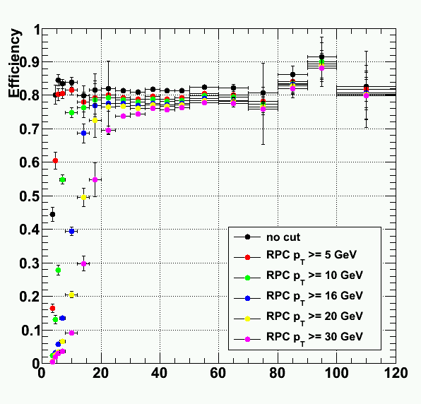
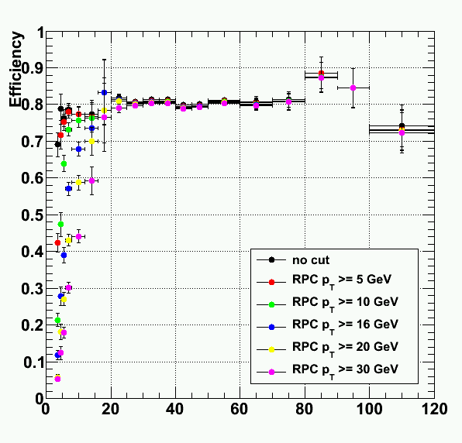
RPC Trigger Efficiency
J/ψ + Z events
Barrel Region
Pt (Gev/c)
Pt (Gev/c)
According to specifications
J/ψ + Z events
J/ψ + Z events
Overlap Region
Endcap Region
Pt (Gev/c)
Pt (Gev/c)

Slide 14
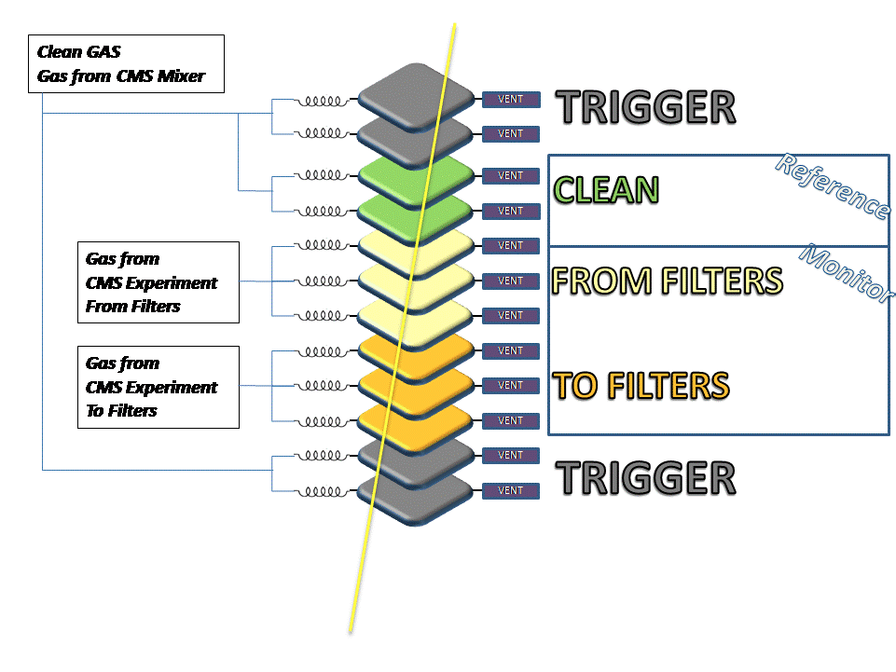
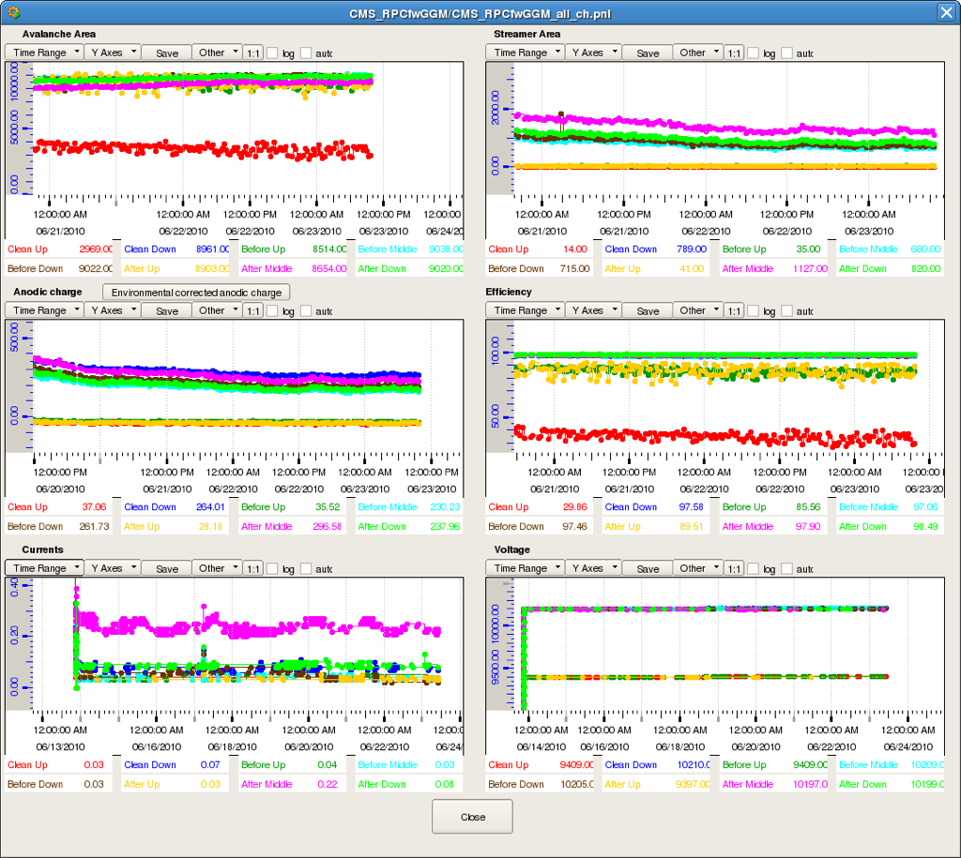
Gas Gain Monitor (GGM) system
Streamer charge
Avalanche charge
Efficiency above th.
According to specifications
μ
Monitoring of working point for changes due to
differences among clean, after-purifiers, before-purifiers
gas mixtures.
Monitoring of charge ratios
(afterPurifiers/clean, beforePurifiers/clean) allows
cancellation of p,T,H effects

Slide 15
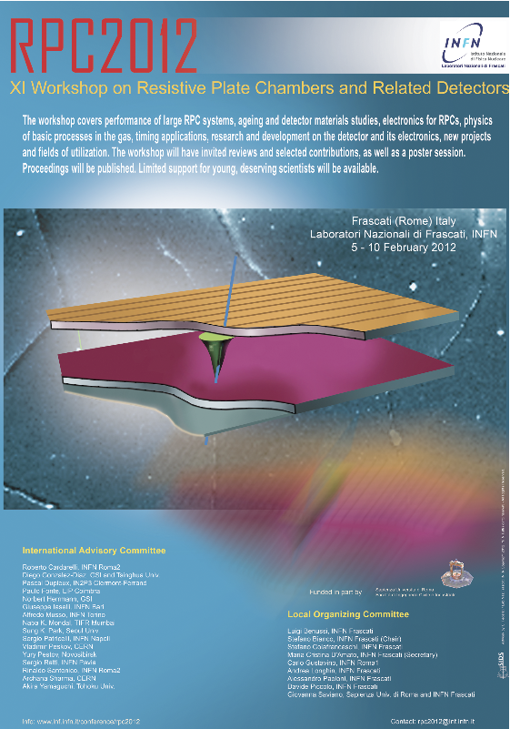
RPC2012 conference at LNF
5-10 February 2012 at LNF
Luigi Benussi, INFN Frascati (CMS) Stefano Bianco, INFN Frascati (chair) (CMS) Stefano Colafranceschi, INFN Frascati (CMS now at CERN) Maria Cristina D'Amato, INFN Frascati (secretary) Carlo Gustavino, INFN Roma1 (Opera) Andrea Longhin, INFN Frascati (Opera) Alessandro Paoloni, INFN Frascati (Opera) Davide Piccolo, INFN Frascati (CMS) Giovanna Saviano, Sapienza Univ. di Roma and INFN Frascati (CMS)
Many contributions from CMS:
4 talks on CMS RPC system performance
4 talks on plans fo upgrade
4 poster on specific RPC CMS activities

Slide 16
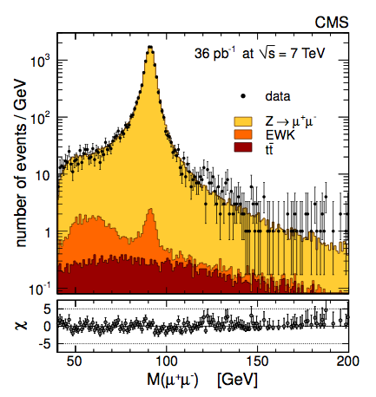
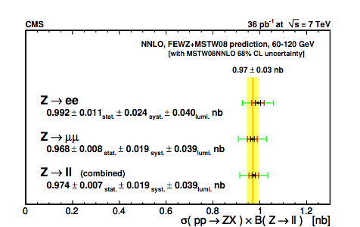
Analysis activities at LNF
Z → μ⁺μ⁻ cross section
Contribution in collaboration with Napoli group in the development of the tools for data driven methods of Reco/selection/trigger Efficiency and production yield
Published on 27 October 2011
On JHEP10 (2011) 132

Slide 17
Plans for Analysis in 2012
LNF group of Physicists (3) mainly involved in detector activities up to now
  Many contributions in detector operations, performance, Muon Reco and trigger activities
People involved in detector tasks will concentrate in Analysis during 2012
  DPG coordination terminated in 2011
  GGM system is working smoothly (Vendittozzi and Colafranceschi will take care)
We have re-hiterated the request for an Assegno di ricerca to be devoted mainly to Physics Analysis
  We have good possible candidates
We are exploring possible physics channels in which to be involved
  Discussion for cooperation with other Italian groups already started
  Possible involvement in single top Analysis (see next slide)

Slide 18
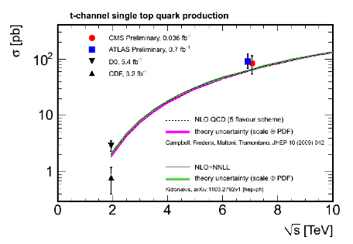
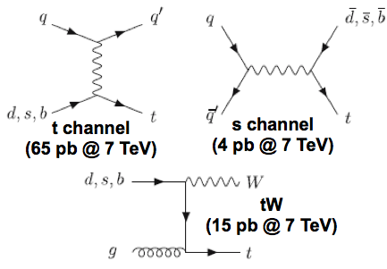
Plans for Analysis in 2012 (2)
Single top production xSection
Toward 2012 single top Analysis
Analysis of the differential cross section
in the t channel related to new physics,
and constraints to Vtb vertex
s channel sensible to the exchange of
exotic W’.

Slide 19
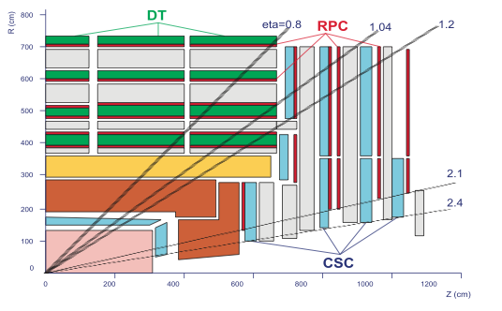
CMS upgrade activities
Upgrade phase I (2013-14)
Upgrade phase II
(2017-18)
LNF group involvement in phase I
Readout boards production for Disk 4
Temperature sensors with Fiber Bragg Grating
(FBG) technology (Enea and Roma1 engeneer)
Simulation studies for mechanical design
(SPECAS)
Interest in GEMs for high eta
region (phase II)

Slide 20
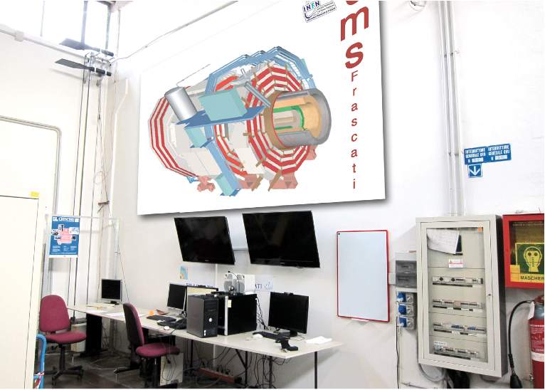
LNF CMS center
CMS center financed with INFN funds:
Under study remote shift possibility
Used for outreach (event display real time, webcam on CMS control hall)

Slide 21
List of publications and Conference contributions of LNF people in 2011
Many CMS articles
    Conference contributions
S.Bianco, SUSY and New Physics from CMS & ATLAS, LC11 Trento September 2011
S.Bianco, Conference Experimental summary, HADRON11 Munich June 2011.
S. Colafranceschi, ICATP -13th ICATPP Construction and Performance of full scale GEM prototypes for future upgrades of the CMS forward Muon system COMO, Italy. October 2011
S.Colafranceschi, IEEE2011 - 2011 IEEE, Test beam results of the GE1/1 prototype for CMS high-muon system future upgrade Valencia, Spain October 2011
M.Caponero, A novel sensor for T monitoring in gases – TIPP Chicago, June 2011
G.Saviano, Monitoring of environmental parameters via FBG sensors, ICTS Auckland Nov 2011
M.Parvis, Modified POF sensor for gaseous Hydrogen Fluoride monitoring in the presence of ionizing radiations IEEE TNS 2011.
  Technical publications
A new approach in modeling the response of RPC detectors, published on NIM A661(2012)
Study of gas purifiers for the CMS RPC detector, published on NIM A661(2012)
Characterization of GEM Detectors for Application in the CMS Muon Detector System arXiv:1012:3675
Construction of the first full-size GEM-based prototype for CMS high-eta muon system arXiv:1012:1524

Slide 22
Conclusions
Excellent performance of LHC and CMS
Many Physics Results
  Higgs excluded in the mass region 127-600 GeV
  Small excess in the mass region 115-127 GeV
During 2010 and 2011 the LNF group was heavily involved in detector (RPC) activities:
  DPG coordination
  Run coordination
  Gas Gain Monitor responsibility
Excellent performance of RPC system
Z→ μ⁺μ⁻ analysis published
Plans for involvements in single top analysis for 2012
More involvement in physics analysis for 2012; Assegno di ricerca requested and strongly needed

Slide 23
Backup

Slide 24
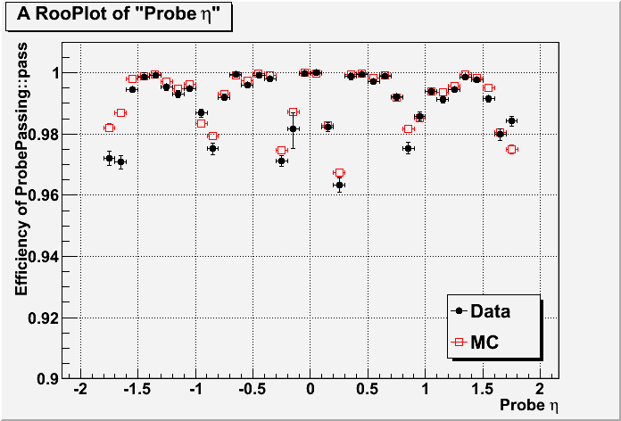
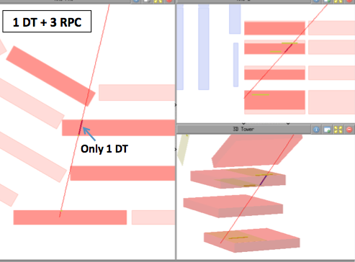
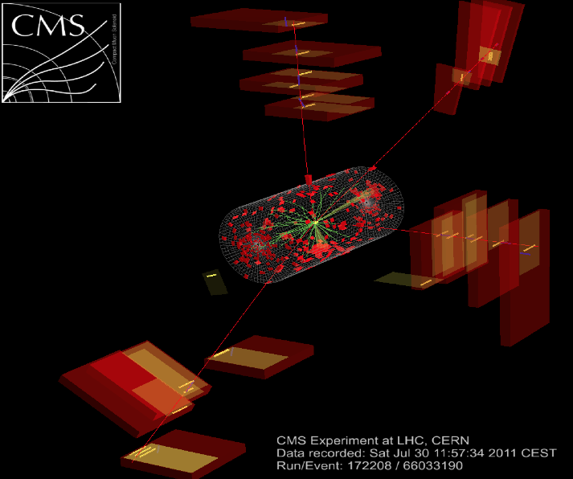
RPC hits in Muon Reconstruction
Contribution of RPCs
In specific Eta Regions
4 muons Event
Every contribution to the efficiency
can help
All the interesting events have been
carefully debugged

Slide 25
LNF CMS computing
Contribution to the project for the LNF scientific computing center in the working group (LNF report LNF-10/5(IR) )
For our need mainly used CERN resources and minimal internal facilities

