Slide 1
Phenomenology and experimental flavour physics
The study of quark and lepton transitions
Prof. Angelo Carbone
Prof. Maximiliano Sioli
Department of Physics and Astronomy

Slide 2
Introduction
The course is divided into two modules:
Module 1: Weak interactions in the quark sector and CP violation prof. Angelo Carbone (16/09/2024 – 24/10/2024)
Module 2: Flavour physics in the leptonic sector prof. Maximiliano Sioli (4/11/2024 – 12/12/2024)
Detailed description of the course can be found at the following link

Slide 3
The Teacher #1 prof. Angelo Carbone
I’m a researcher in High Energy Physics
I carry on my research activities at the Large Hadron Collider (LHC) at CERN (Geneve), namely in the LHCb experiment
I do research aiming to understand the origin of the matter anti-matter asymmetry present in the Universe
Office: Dep. of Physics and Astronomy, Via Irnerio, 46, room 88
Office hours: by appointment sending an e-mail to angelo.carbone@unibo.it
LHC is a proton-proton collider built close to Genève
The LHCb detector taking data at CERN

Slide 4
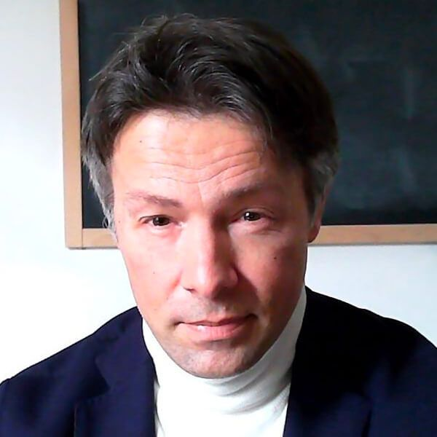
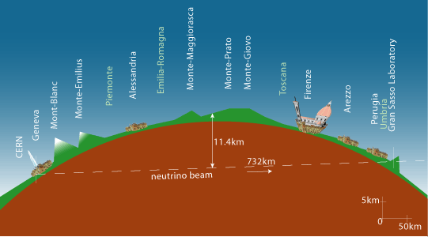
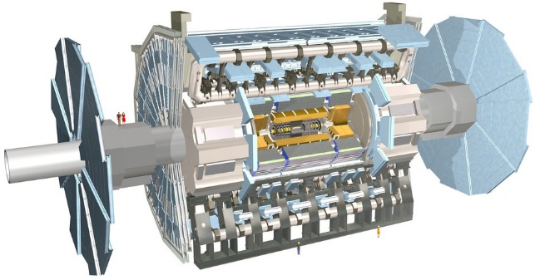
The Teacher #2 prof. Maximiliano Sioli
I’m a researcher in High Energy Physics
Currently I work at CERN's LHC, as a member of the ATLAS Collaboration, looking for new physics beyond the Standard Model.
My research activity started in the mid 90’s, when I was a master student, studying high energy hadronic interactions in underground experiments at Gran Sasso
Then I moved to neutrino physics, for about 15 years: atmospheric neutrinos at the beginning, participating in the discovery of neutrino oscillations in 1998, and artificial neutrino beams later (CERN-to-Gran Sasso beam)
Now I’m still studying neutrinos at the LHC collider, searching for the mechanism which generates neutrino masses at large energy scales
I coordinate the ATLAS Bologna group and – at DIFA – the group of Nuclear and Subnuclear Physics

Slide 5
Reading and assessment methods
Module 1: Suggested book are for insights. Slides and notes will be distrubuted during the course
Text 1: “CP violation”, I. I. Bigi and A. I. Sanda
Text 2: “CP violation”, G.C.Branco, L.Lavoura and J.P.Silva
Text 3: Modern Particle Physics, Mark Thomson, chapters 1, 2, 11, 12 and 14
Module 2: Also here books are for in-depth reading. A suggested comprehensive text on neutrinos is:
Fundamentals of Neutrino Physics and Astrophysics, Giunti and Kim, 2007
For the rest (e.g. charged lepton physics) slides and notes will be provided

Slide 6
Assessment
The exam will be written for both modules.
Each of the two modules will have five questions, one of which is more detailed.
It is possible to agree on a possible oral exam (optional and can be done only once for each written exam), if the written exam is passed.
In agreement with the University regulations, it is possible to refuse the final grade only once.
It is also specified that the grade of the last written piece is valid and not the best.
During the exams, it is not possible to consult texts and notes. A calculator is allowed.

Slide 7
Objectives
Provide general overview of phenomenological and experimental aspects of Flavour Physics, concentrating on the most influential and/or recent measurements from colliders and neutrino experiments

Slide 8
What Flavour Physics means
Flavour physics: is the description of effects related to the change of quark and lepton flavours.
In this course we restrict ourselves to quark and leptons transitions
Since the top quark does not form bound states we will not discuss it

Slide 9
Module #1
Quantum mechanic oscillations in the K, D, and B meson systems and experimental results.
CP violation in the K, D, and B meson decays and experimental results.
The Unitarity Triangle of the CKM matrix and the current experimental knowledge.
Rare K, D, and B decays and experimental results.
The indirect search for New Physics with the flavour physics experiment.

Slide 10
Module #2
Charged and neutral leptons in the Standard Model.
Physics of massive neutrinos.
Mechanisms of neutrino mass generation.
Neutrino cross sections.
Experimental searches in the framework of seesaw mechanisms (colliders, beam dumps).
Neutrinoless Double Beta Decay.
Flavor mixing and CP violation in the neutral sector.
Short/medium/long baselines (accelerators and reactors).
Connection with Cosmology. Leptogenesis.
Dark sector.
Flavor violation in the charged sector.
Electron and muon magnetic dipole moments.

Slide 11
prof. Angelo Carbone and prof. Maximiliano Sioli
Dipartimento di Fisica e Astronomia
angelo.carbone@unibo.it
maximiliano.sioli@unibo.it

