Slide 1
International Master on
Advanced Methods in Particle Physics
Second year, first semester @Bologna
prof. Angelo Carbone

Slide 2
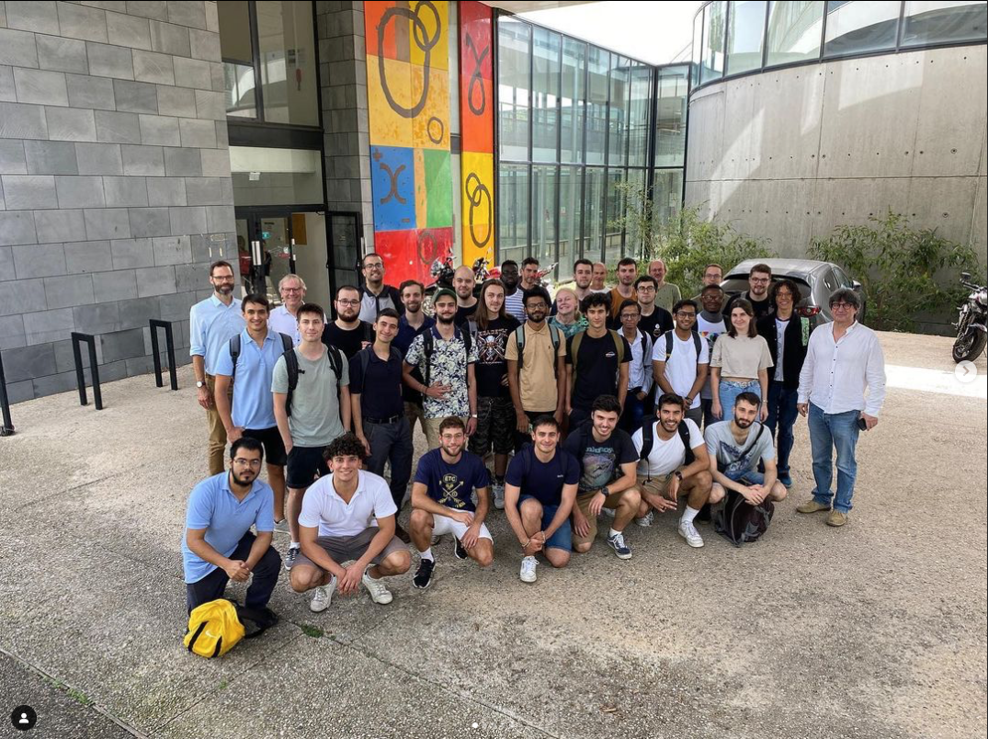
Welcome!!!

Slide 3
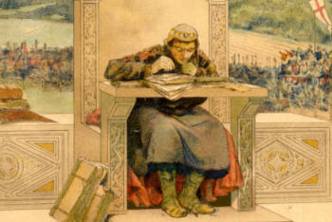
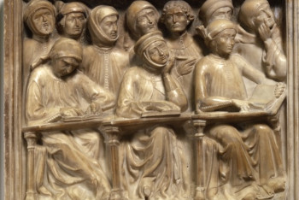
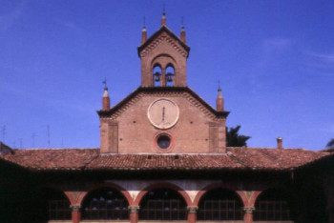
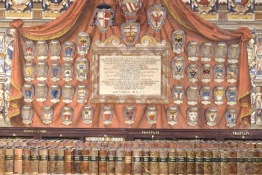
History – Alma Mater Studiorum - UNIBO
The University of Bologna is considered to be the oldest university in the Western world
Founded in 11th-12th centuries - The birth of the Studium and the Commune
It was the outcome of the spontaneous and informal initiative of a few students
A long history over Nine centuries
In the 21st century, UNIBO set up the first Multicampus scheme in Italy

Slide 4
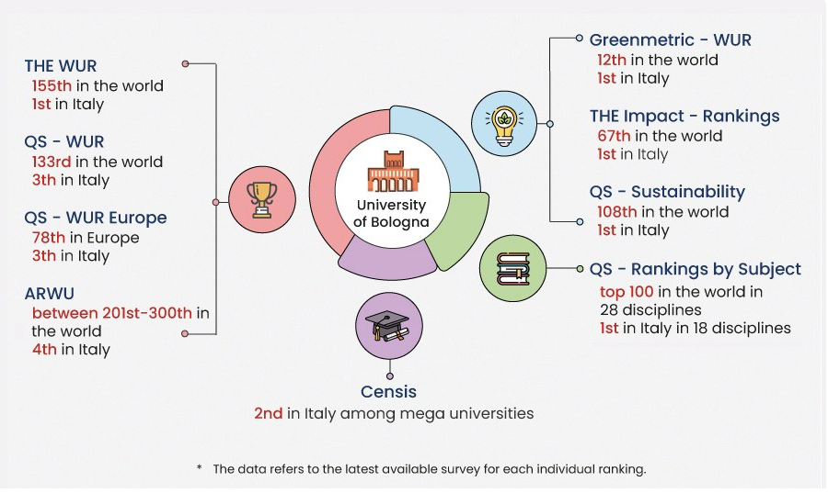
Ranking
QS: Physics & Astronomy 90th place tied

Slide 5
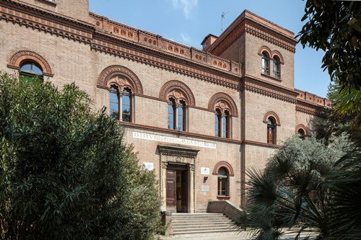
The University today: numbers and innovation
The University of Bologna is made up of 31 Departments
One is the Department of Physics and Astronomy ”Augusto Righi”
It is located in the city-centre of Bologna
96,984 students chose the University of Bologna (A.Y. 2022/2023), including 8,526 international students
6,617 people are part of the university community, including teachers (3,382 ) and professional staff (3,235)
107 international Degree Programmes, of which 89 are held in English.
51 PhD Programme Degrees (A.Y. 2022/2023)

Slide 6
The Italian University system
High school
I Level: Bachelor Degree (Laurea)
3 years, 180 academic credits
1st level masters
II Level: Master Degree (Laurea Magistrale)
2 years, 120 academic credits
2nd level masters
III Level
PhD (Dottorato di Ricerca)
Graduate Schools

Slide 7
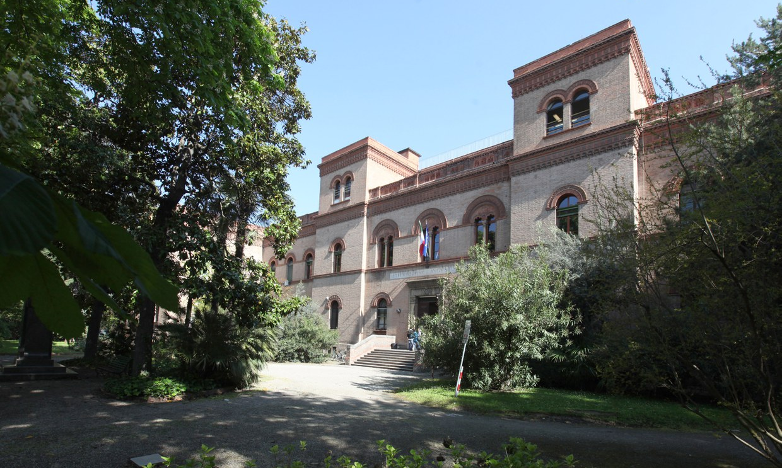
Department of Physics and Astronomy (DIFA)
Via Irnerio 46
Historical building

Slide 8
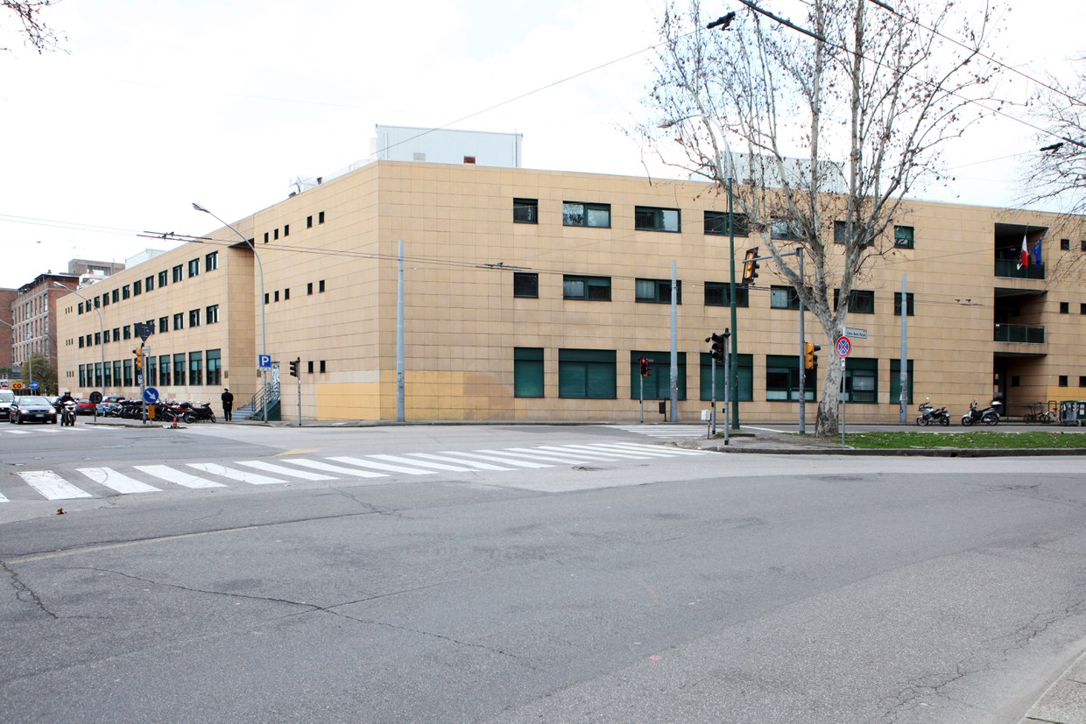
Department of Physics and Astronomy (DIFA)
Viale B. Pichat 6/2
Headquarter

Slide 9
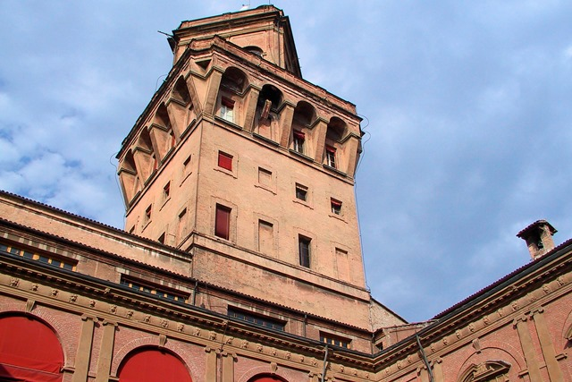
Department of Physics and Astronomy (DIFA)
Via Zamboni 33
Specola tower
Specola Museum of Astronomy
Museum of Palazzo Poggi
Free admission for UNIBO students

Slide 10
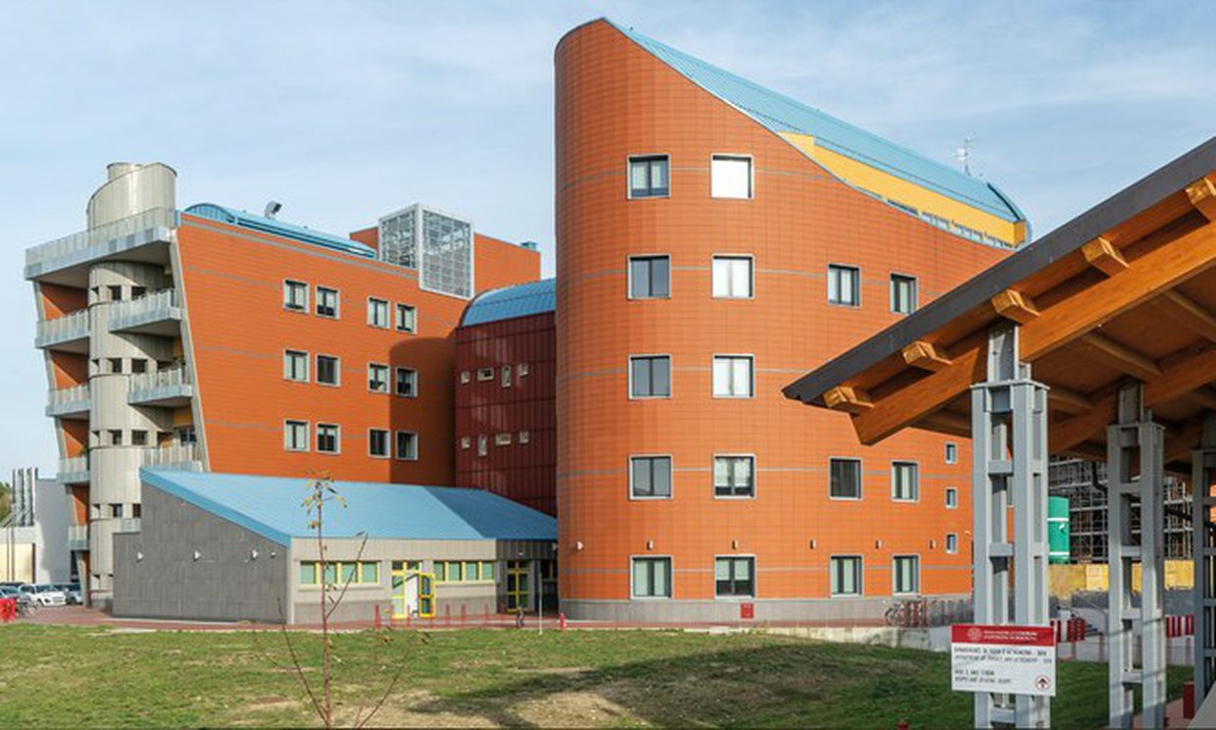
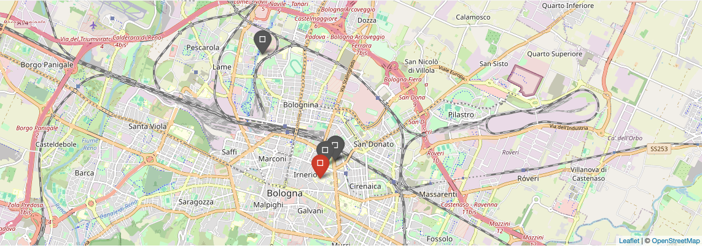
Department of Physics and Astronomy (DIFA)
Via Gobetti 9/3
Navile-branch
Astrophysics section

Slide 11
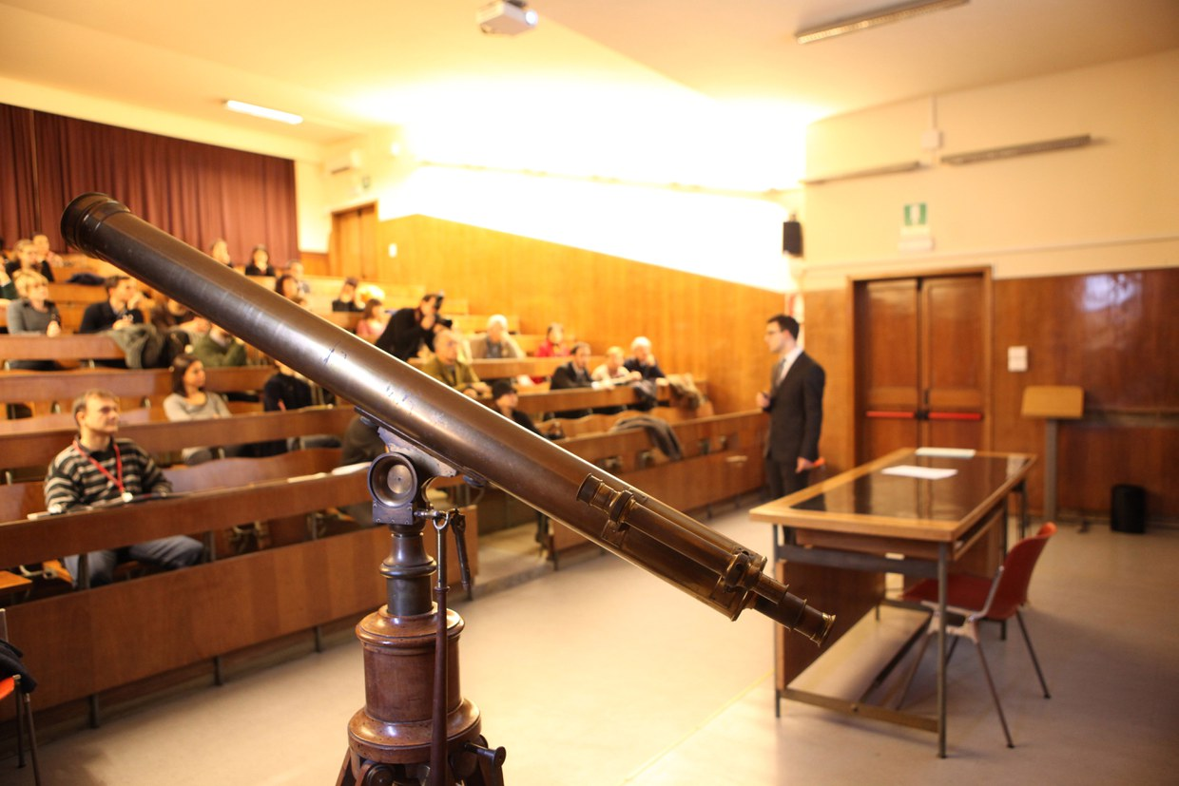
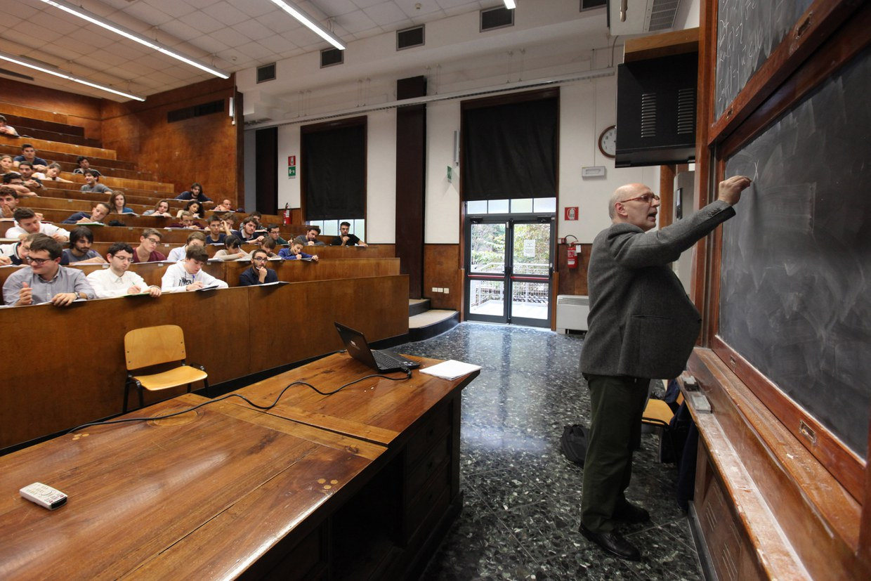
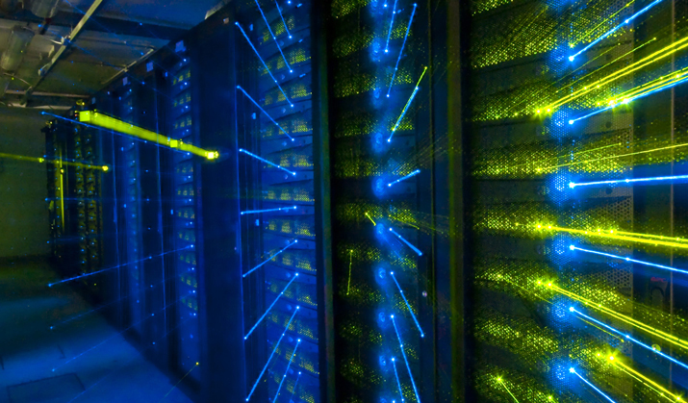
Department of Physics and Astronomy (DIFA)
DIFA is a significant structure integrated with almost 500 researchers achieving a level of excellence in Research and Teaching
DIFA area hosts researchers, laboratories and infrastructures of
Istituto Nazionale di Fisica Nucleare (Bologna's branch of INFN)
INFN's Centro nazionale tecnologie informatiche (CNAF)
CNAF- Particle physics computing centre

Slide 12
Research areas

Slide 13
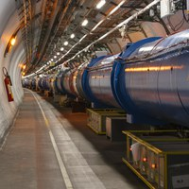
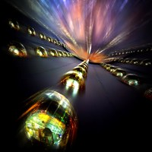
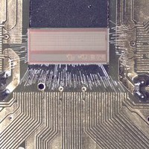
Research areas in particle physics
High Energy Particle Physics with accelerators
ATLAS, ALICE, CMS, LHCb
Nuclear Physics
FOOT, FAMU, n_TOF, NUCL-EX
Neutrino Physics
CUORE, ENUBET, NU@FNAL
Astroparticle Physics and Cosmology
AMS, DarkSide, EUCLID, KM3, LVD, XENON
Detector R&D, Technology Transfer and Computing

Slide 14
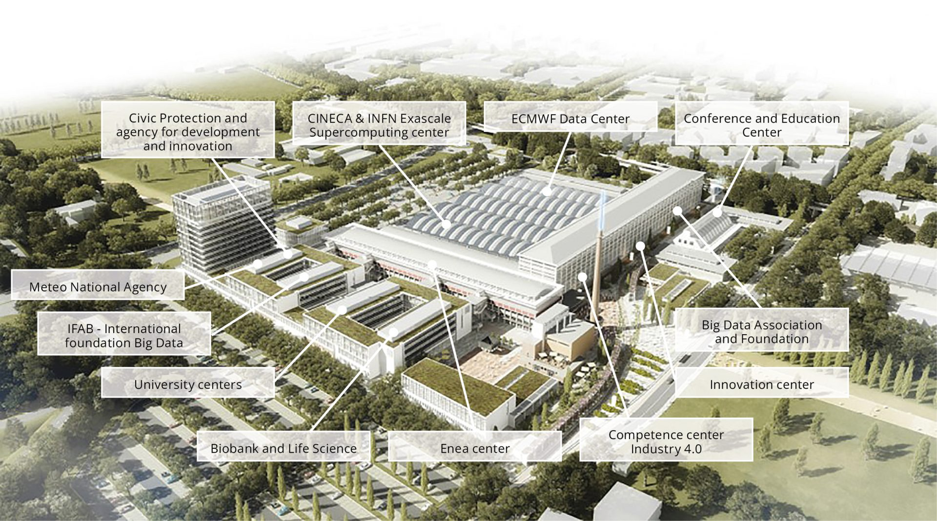
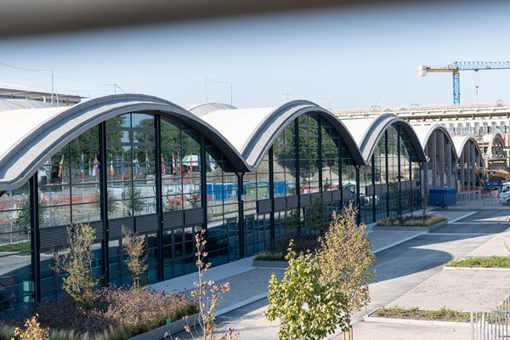
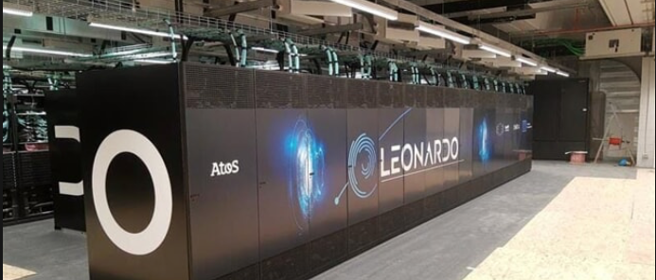
Bologna, in the heart of Data Valley
Bologna hosts 70% of Italian computing and storage capacity at the European research hub: the Big Data Technopole
Leonardo: one of the most powerful supercomputer in the world

Slide 15
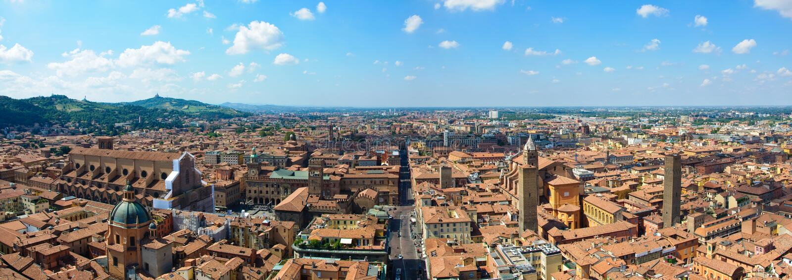
The semester in Bologna
First semester – second year
Introduction day in Bologna: 13th September 2024
Courses start in Bologna: 16th September 2024
Courses end in Bologna: 19th December 2025
Exam period: January-February 2025 (possible end of December 2024)
Focus: Particle Physics and Computer Science

Slide 16
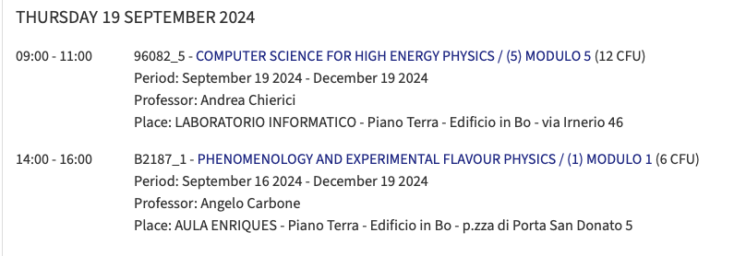
Course timetable
Available at the following link: https://corsi.unibo.it/2cycle/ParticlePhysics/timetable?anno=2&curricula=
Not for now

Slide 17
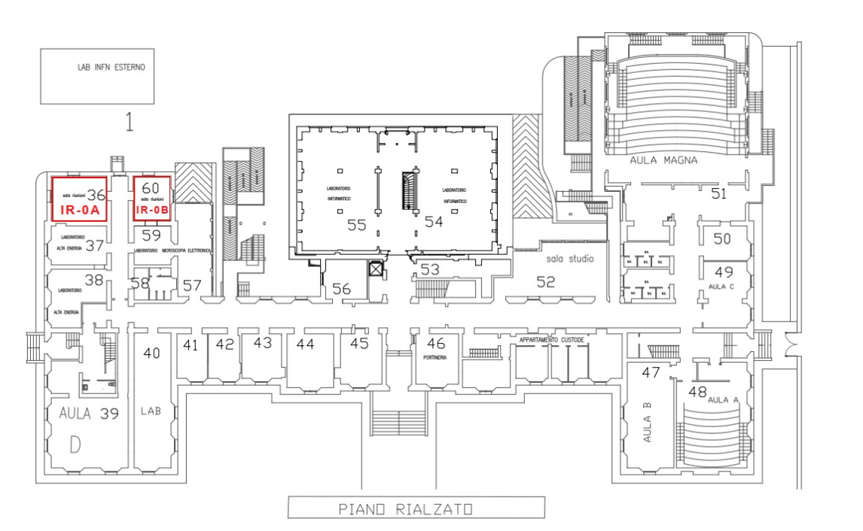
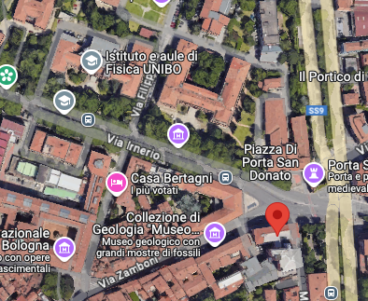
IMAPP Class Room
Aula A → where we are today
Aula D → Along the corridor opposite side from Aula A
Informatic lab → “Laboratorio di Informatica”
Aula Enriques → Matematic Department Piazza Porta San Donato 5
Aula III → Dip. Ciamciam Via F. Selmi 2
Aula Enriques

Slide 18
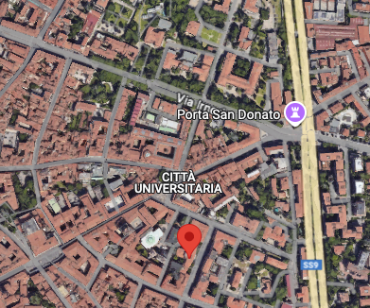
IMAPP Class Room
Aula A → where we are today
Aula D → Along the corridor opposite side from Aula A
Informatic lab → “Laboratorio di Informatica”
Aula Enriques → Matematic Department Piazza Porta San Donato 5
Aula III → Dip. Ciamciam Via F. Selmi 2
Aula III
mezzanine floor

Slide 19
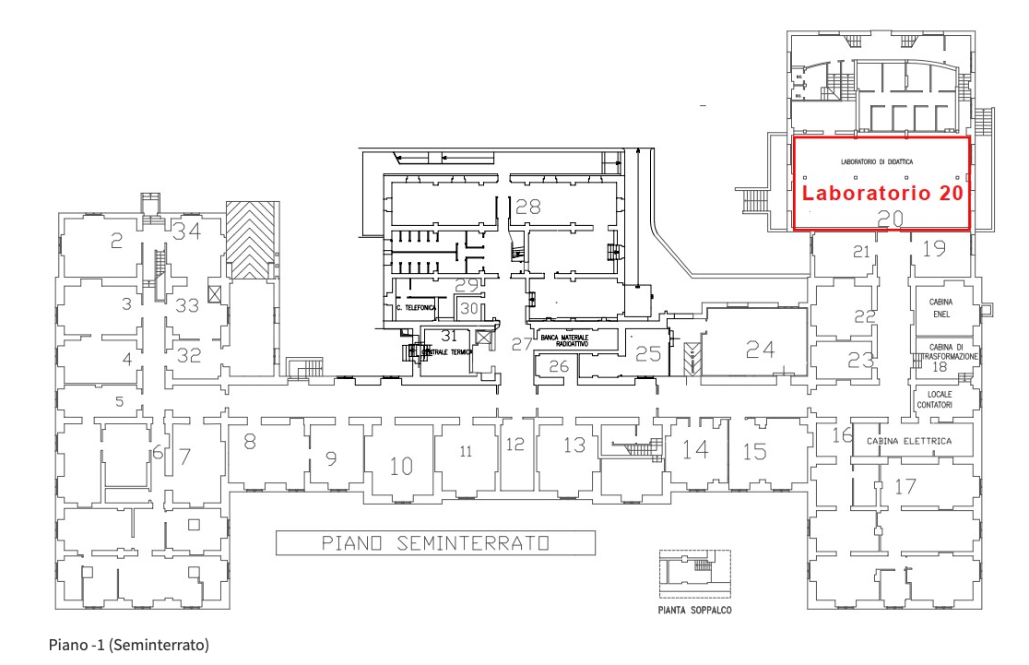
Study rooms
You have access to several study room visit: https://www.unibo.it/en/study/life-at-university-and-in-the-city/libraries-digital-resources-and-study-rooms
In this building two rooms: “sala studio”,
Basement
mezzanine floor

Slide 20
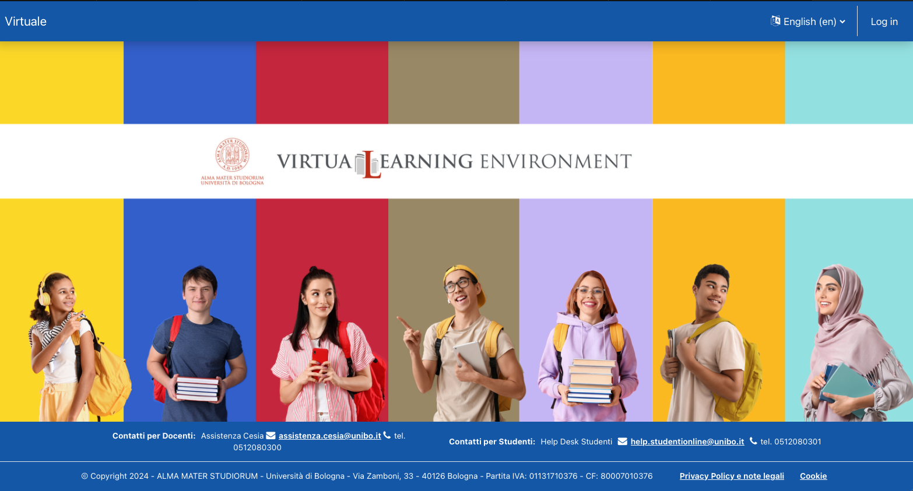
“Virtuale” VirtuaLearningEnviroment
“Virtuale”: is the moodle platform of the Bologna University: https://virtuale.unibo.it
Every course will add material on the “virtuale” space if needed, and professors will inform you
You have access to the UNIBO credential

Slide 21
Study grants and subsidies
Visit the following page to be updated on UNIBO initiative:https://www.unibo.it/en/study/study-grants-and-subsidies
In principle, you should have access to all the initiatives, except for what is offered by “ERGO” which is dedicated only to students who pay fees directly to UNIBO
YOU HAVE NOT TO PAY ANY FEE TO UNIBO → you have already paid the fee to Dortmund, which will transfer a quote to UNIBO. In case you get automatic request on that, please ignore it

Slide 22
Sport
UNIBO has an important sport association, “CUSB”: https://cusb.unibo.it/en
A lot of courses offered → they are not for free but the prices are pretty competitive

Slide 23
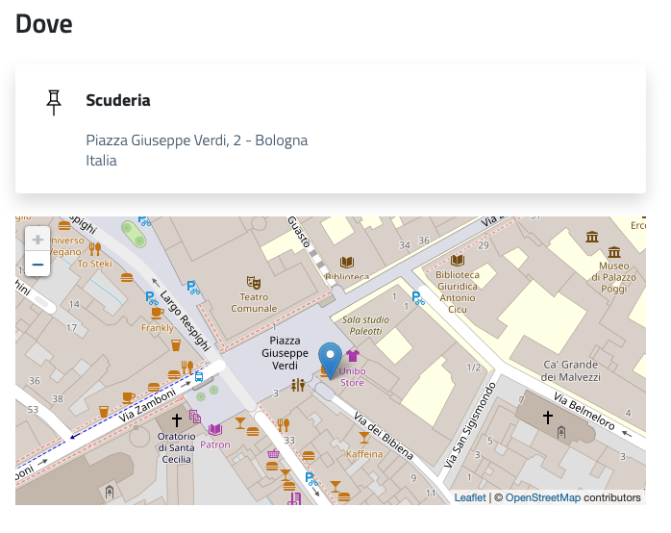
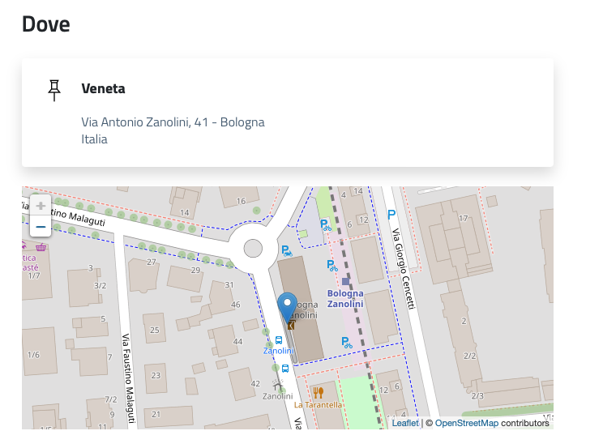
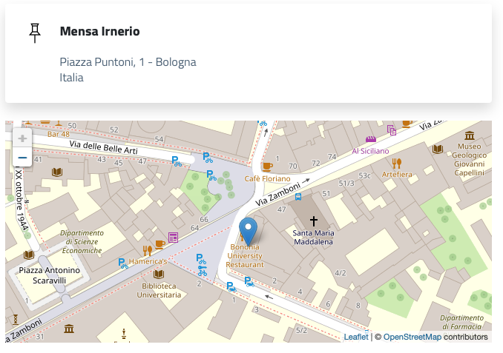
University canteens
University canteens are places where you can stop for a full meal for lunch or dinner : https://www.er-go.it/esplora-i-benefici/benefici-erogati-da-er.go/ristorazione/bologna (web site in Italian, ask to Italians to help you)
Discount for students
Visit for other info: https://www.unibo.it/en/study/life-at-university-and-in-the-city

Slide 24
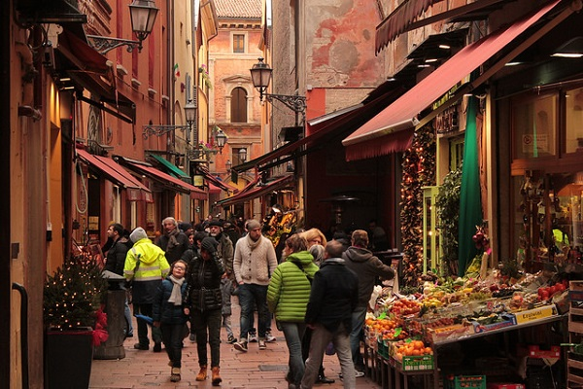
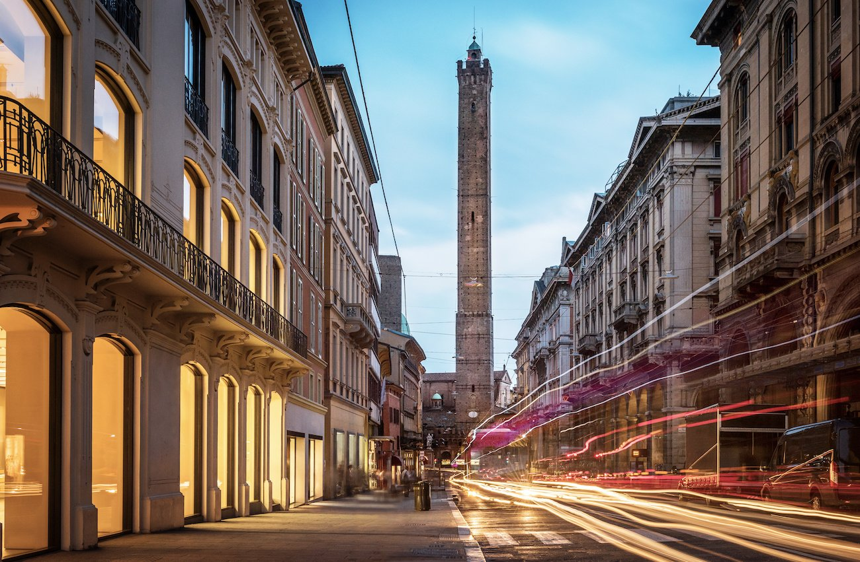
Bologna’s life
Bologna is an important agricultural, industrial, financial, and transport hub, where many large mechanical, electronic and food companies have their headquarters as well as one of the largest permanent trade fairs in Europe
Famous for nicknames
“the learned one” (la dotta), hosting thousands of students
“the fat one” (la grassa), referring to its rich cuisine
Bologna is a lovely place to live for numerous reasons.

Slide 25
Open issues
Everyone who still has open issues is kindly invited to speak with me at the end of the afternoon → I will take note and try to follow up and solve the problem
Visa? Accommodation? Account?

