Slide 2
Contents
Introduction
To the TESLA Cryomodule Design Concept
From Cry 1, the Prototype, to Cry 3
Main Features of the Cry 3 Reference Design
WPMs, Experience & Picture Gallery

Slide 3
Contents
Introduction
To the TESLA Cryomodule Design Concept
From Cry 1, the Prototype, to Cry 3
Main Features of the Cry 3 Reference Design
WPMs, Experience & Picture Gallery

Slide 4
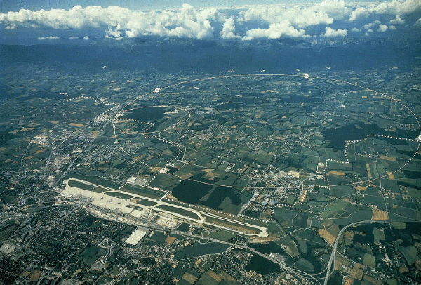
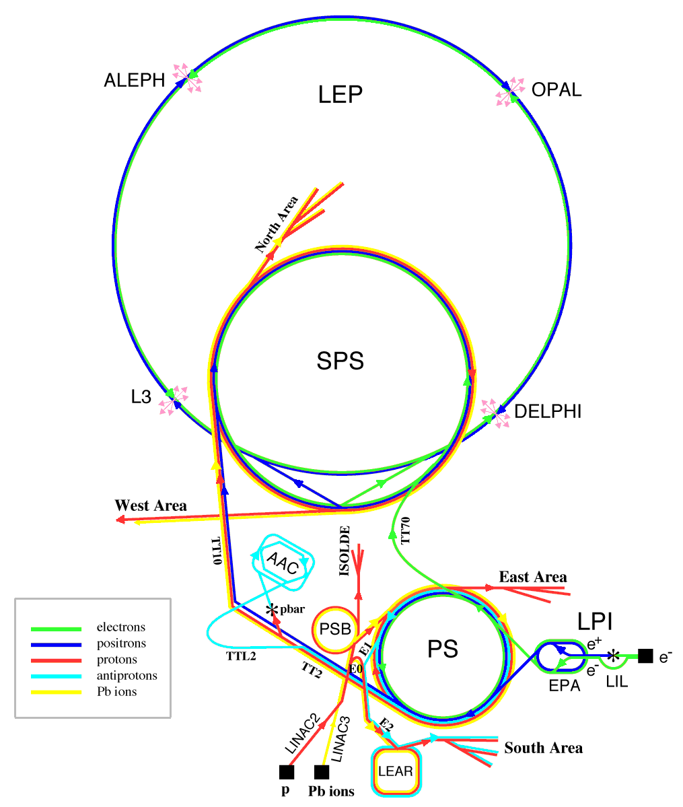
At the end of Eithies LEP-II was the King
Aerial view of the CERN site with an indication of the circular LEP tunnel
Linacs and synchrotrons were used to inject in the 28 km synchrotron where both electron and positrons were accelerated up to 100 GeV to collide with a centre of mass energy of 200 GeV
LHC was designed, prototyped, and ready to make use of the LEP 27 km tunnel and of most of its injection accelerator complex

Slide 5
A Great success for LEP-II
Accelerating Field Evolution with time
Final energy reach limited by
allowable cryogenic power
from G. Geschonke’s Poster for the ITRP visit to DESY
100 GeV: 3500MV
Mean Nb/Cu
6.9 MV/m
96 GeV:
Mean Nb/Cu
6.1 MV/m
104 GeV: 3666MV
Mean Nb/Cu
7.5 MV/m
design

Slide 6
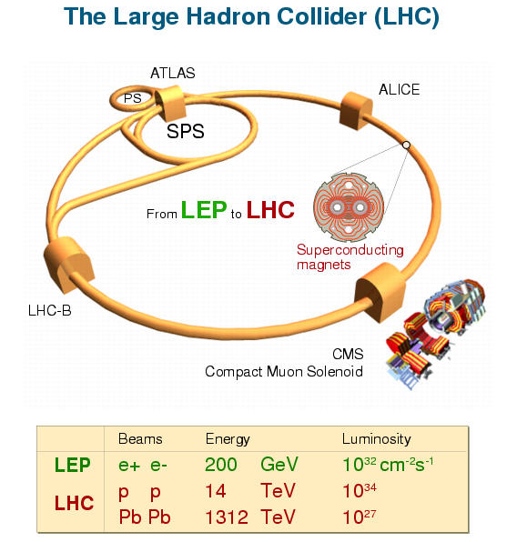
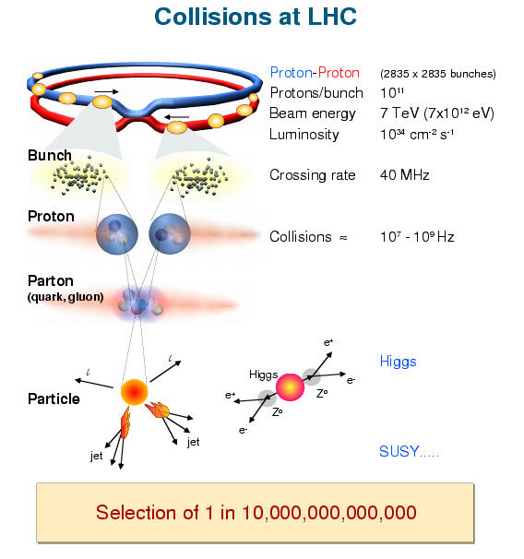
LEP-II success pushed for the LHC

Slide 7
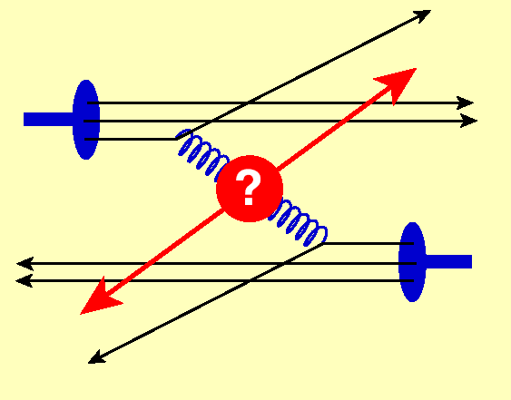
But Leptons needed to complement LHC
Leptons (e⁻, e⁺, μ⁻, μ⁺) are Fermions, i.e. matter constituents
e⁺
e⁻
E_{react.} = E_{c.m.} = 2 E_{beam}
Hadrons (p, , ions) are complex composite particles
Fighting for Luminosity
u
u
u
d
u
d
p
p
E_{react.} << 2 E_{beam}
Gluon-Gluon Collision
E_{react.} cannot be controlled and it is unknown

Slide 8
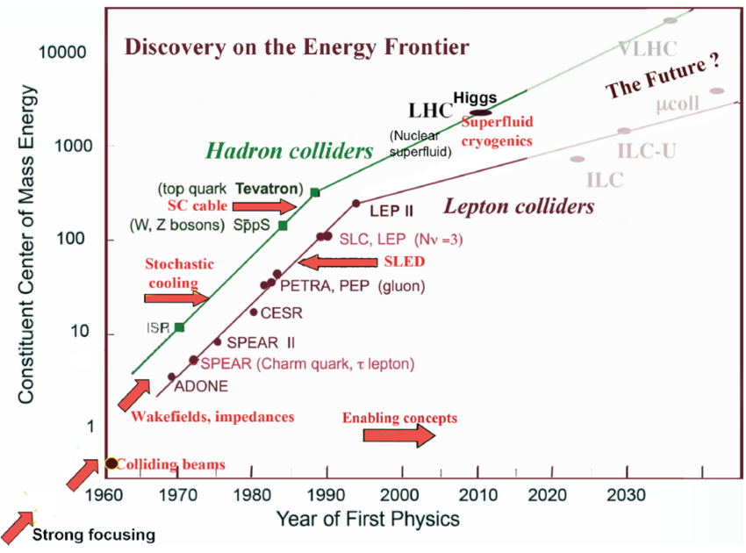
Livingston chart for Colliders
CEPC-hh
CEPC
K. Yokoya, 2014

Slide 9
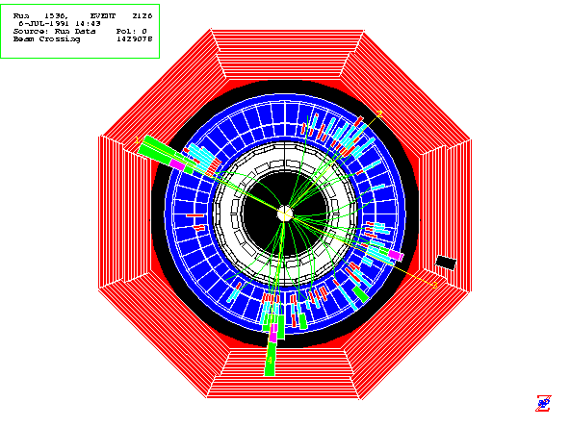
No Circular e⁺e⁻ Collider after LEP !
Synchrotron Radiation
From an electron in a magnetic field:
Final Focus
Demagnify and collide beams
Main Linac
Accelerate beam to IP energy without spoiling DR emittance
Bunch Compressor
Reduce σ_{z} to eliminate hourglass effect at IP
Damping Ring
Reduce transverse phase space (emittance) so smaller transverse IP size achievable
Positron Target
Use electrons to pair-produce positrons
Energy loss must be replaced by RF system
$ ∝ E_{cm}²
Electron Gun
Deliver stable beam current

Slide 10
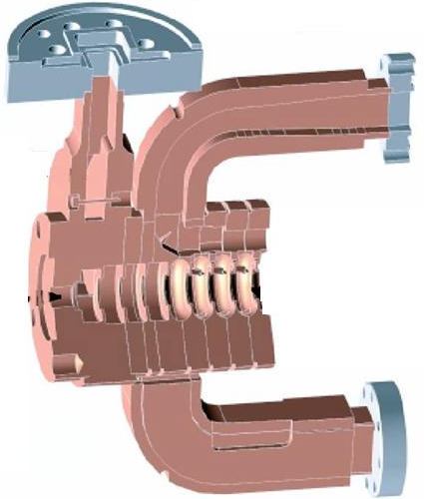


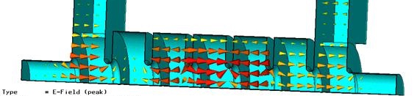
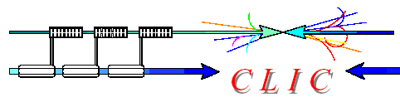
All competitors were Normal Conducting
NC Traveling wave
v_{ph} ≈ c and v_{g} < c Nornal Conducting
11.4 GHz
30 GHz

Slide 11
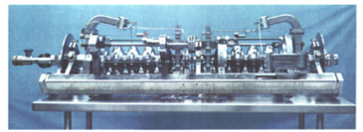
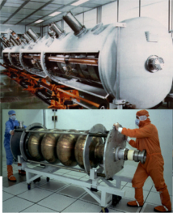
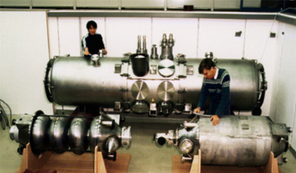
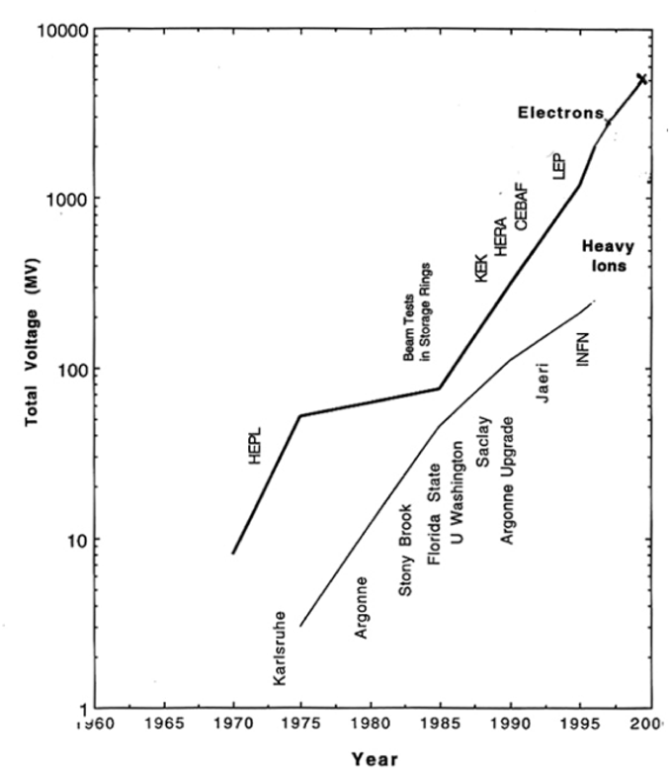
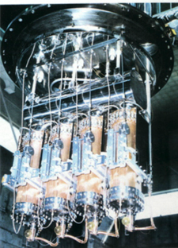
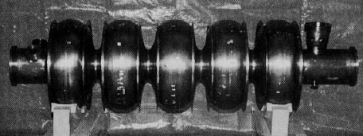
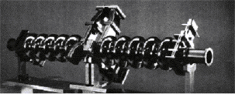
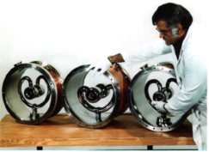
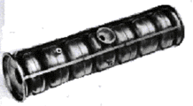
SRF in 1990, when TESLA was born
All SRF cavities operated in CW
“Livingston Plot” from H. Padamsee
CW = Continuous Wave

Slide 12
But… all Linear Colliders must be pulsed
All the LCs must be pulsed machines to improve efficiency. As a result:
duty factors are small
pulse peak powers can be very large
C. Pagani - ISLC08 - Lecture 1
Oak Brook, October 20, 2008
<1 µs-1ms
<10-200 ms
RF Pulse
100 m - 300 km
Bunch Train
……
1-300 nsec
…………………....
gradient
with further input
Beam Loading
without input
accelerating field pulse:
filling
loading

Slide 13
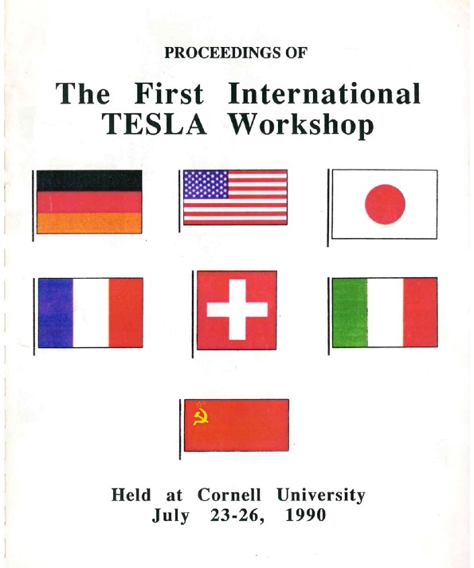
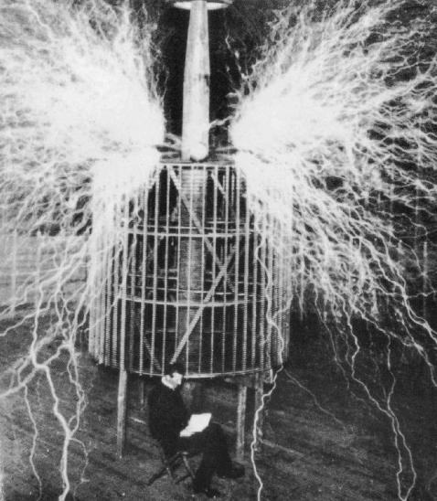
The Origin of TESLA (The SRF Linear Collider)

Slide 14
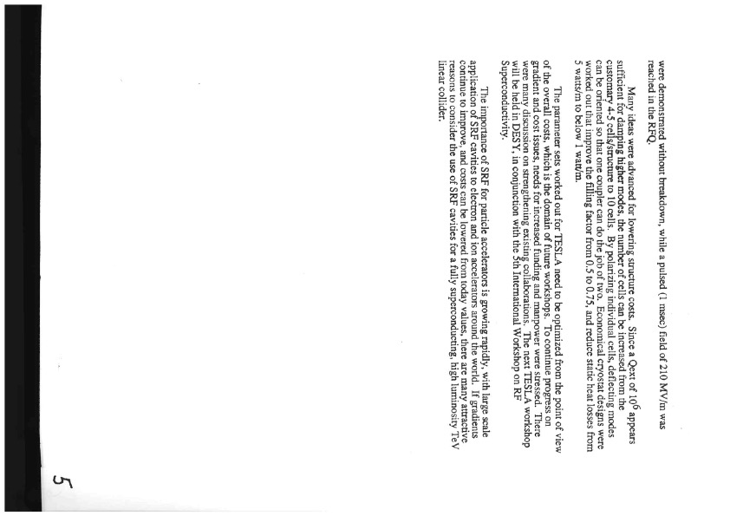
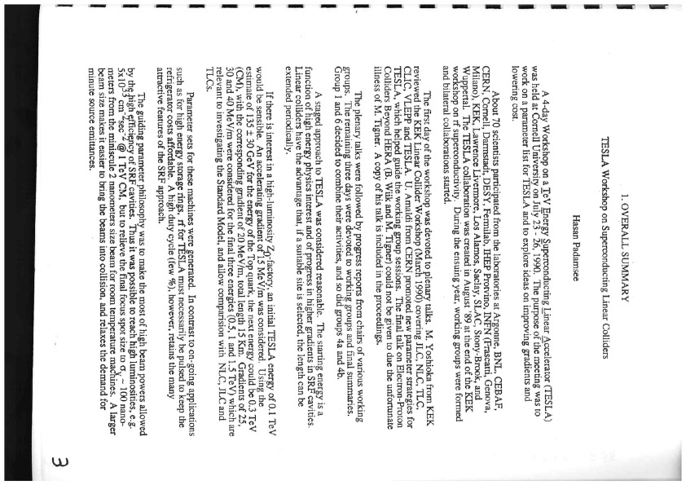
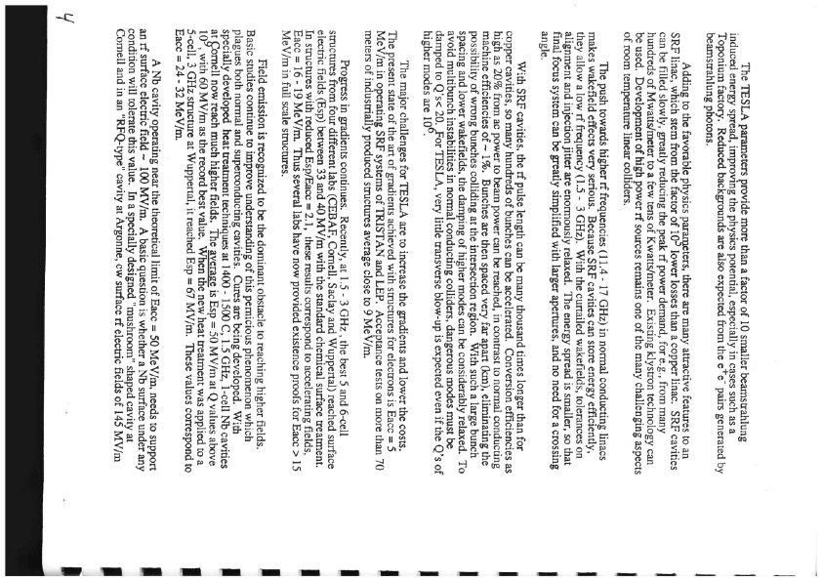
Ws Summary by Hasan Padamsee

Slide 15
From the H. Padamsee’ Summary - 1

Slide 16
From the H. Padamsee’ Summary - 2

Slide 17
From the H. Padamsee’ Summary - 3

Slide 18
What we need to use SRF
The power is deposited at the operating temperature of few K
We need to guarantee and preserve the 2 K environment
Cavity is sensitive to pressure variations; only viable environment is sub-atmospheric vapor saturated He II bath
We need a thermal “machine” that performs work at room temperature to extract the heat deposited at cold
The Thermal machine efficiency is just a fraction of the Carnot efficiency
Less favorable Geometrical Factor G

Slide 19
Contents
Introduction
To the TESLA Cryomodule Design Concept
From Cry 1, the Prototype, to Cry 3
Main Feature of the Cry 3 Reference Design
WPMs, Experience & Picture Gallery

Slide 20
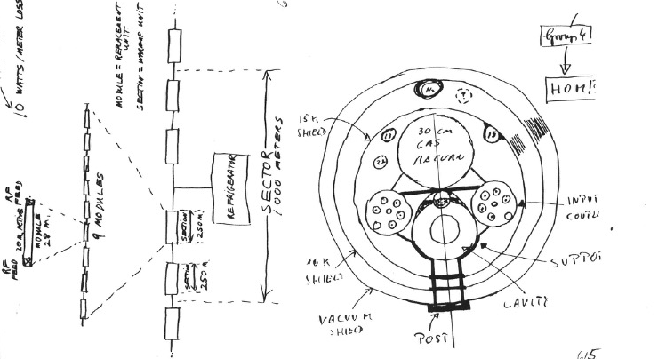
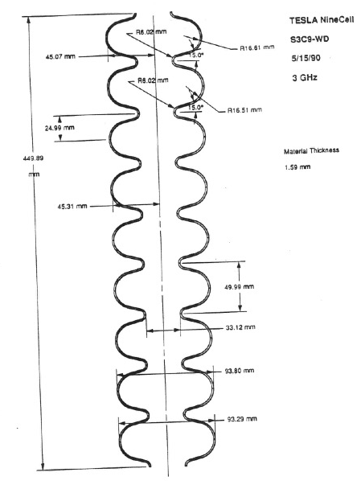
Cryomodule & Cavity Concept from Cornell
Support Posts, Gas Return Pipe, 2 Shields
2 Phase line, RF power via Coaxial cables
9-cell, 3 GHz

Slide 21
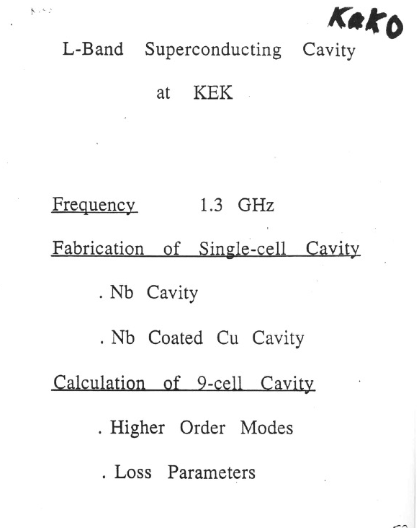
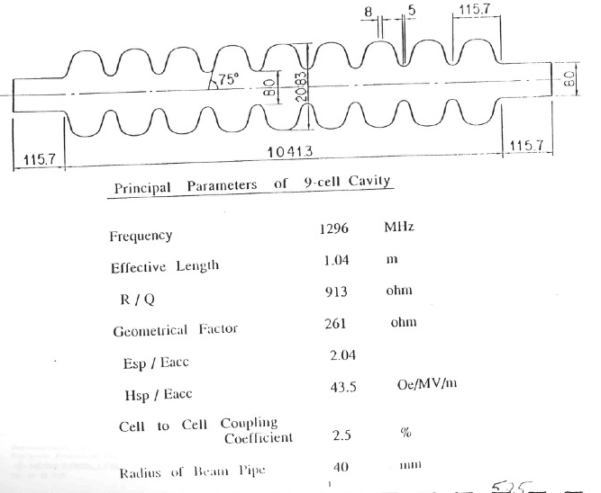
Memories from the Cornell Workshop

Slide 22
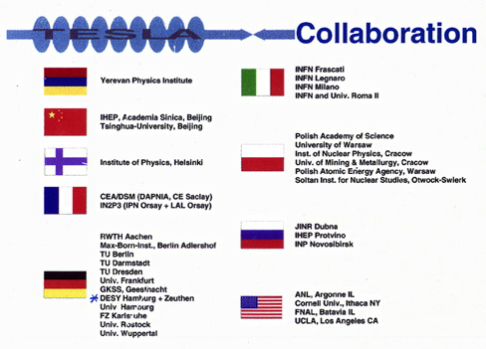
1992: DESY hosts the TESLA Collaboration
Develop SRF for a TeV Linear Collider
  Increase gradient by a factor of 5 (Physical limit for Nb at ~ 50 MV/m)
  Reduce cost per MV by a factor 20 (New cryomodule concept and Industrialization)
  Make possible pulsed operation (Combine SRF and mechanical engineering)
Major advantages vs NC Technology
  Higher conversion efficiency: more beam power for less plug power consumption
  Lower RF frequency: relaxed tolerances and smaller emittance dilution
as in 1992
Björn Wiik

Slide 23
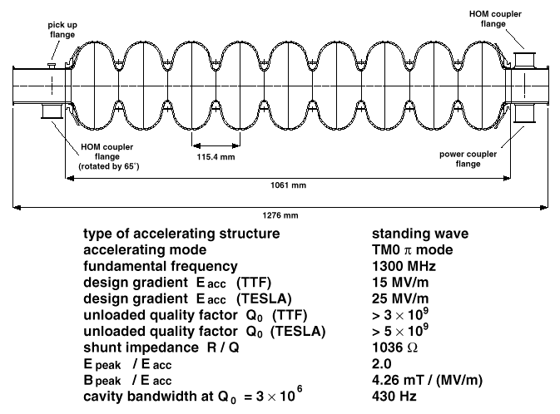
The TESLA SRF Cavity, 1.3 GHz, 9-cell

Slide 24
TESLA Cryomodule Design Rationales
High Performance Cryomodule was central for the TESLA Mission
More then one order of magnitude was to be gained in term of capital and operational cost
High filling factor: to maximize real estate gradient
Long sub-units with many cavities (and quad): cryomodules
Sub-units connected in longer strings
Cooling and return pipes integrated into the main cryomodule
Low cost per meter: to be compatible with a long TeV Collider
Cryomodule used also for feeding and return pipes
Minimize the number of cold to warm connections for static losses
Minimize the use of special components and materials
Modular design using the simplest possible solution
Easy to be alligned and stable: strict beam requirements: +/- 0.3 mm (rms)

Slide 25
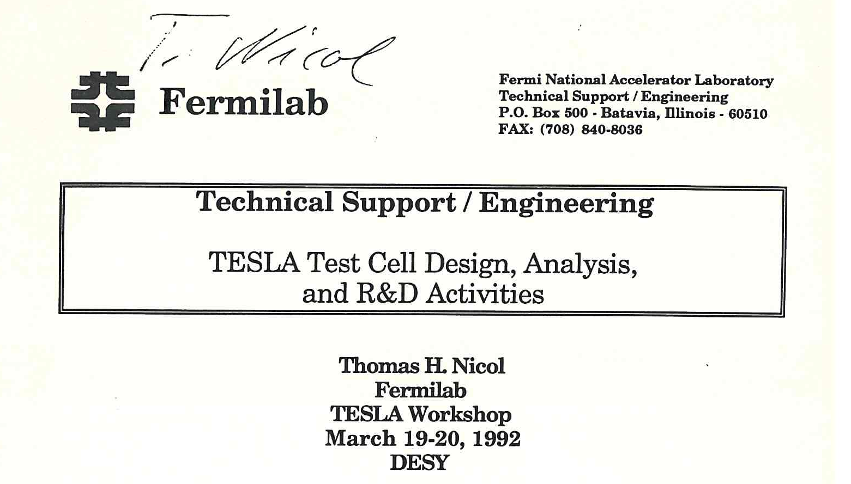
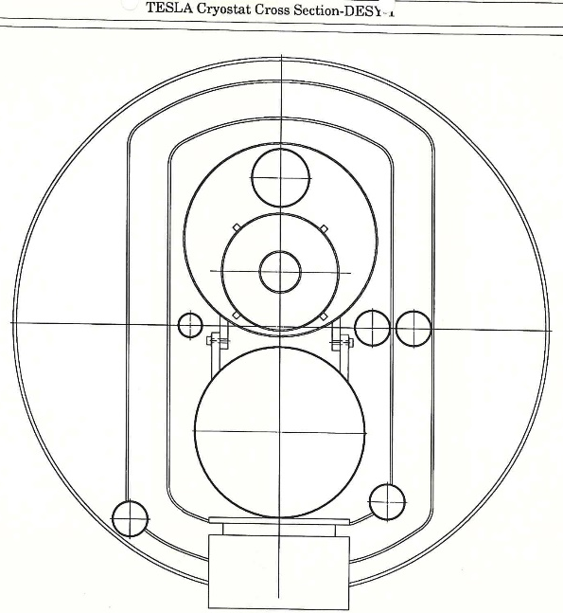
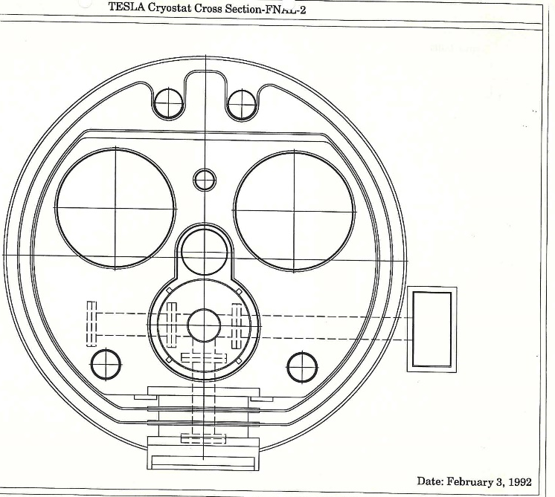
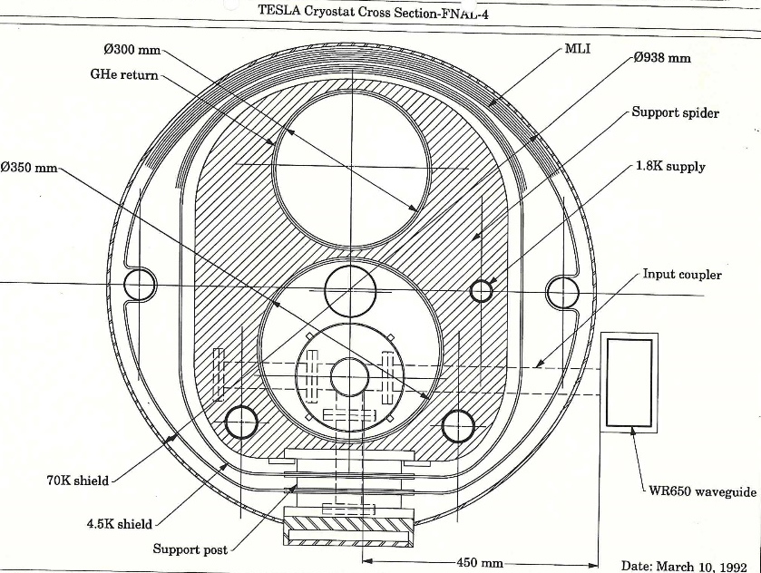
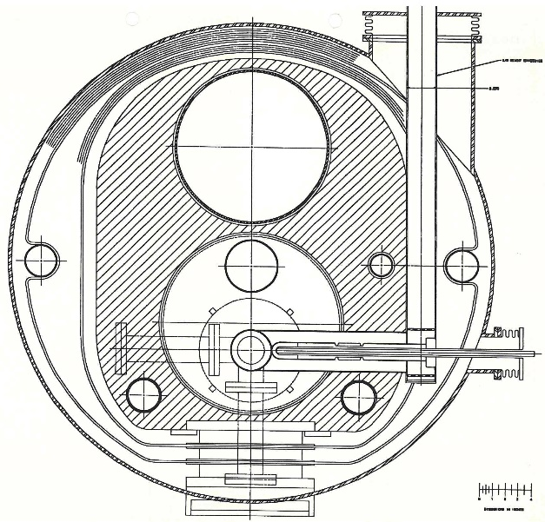
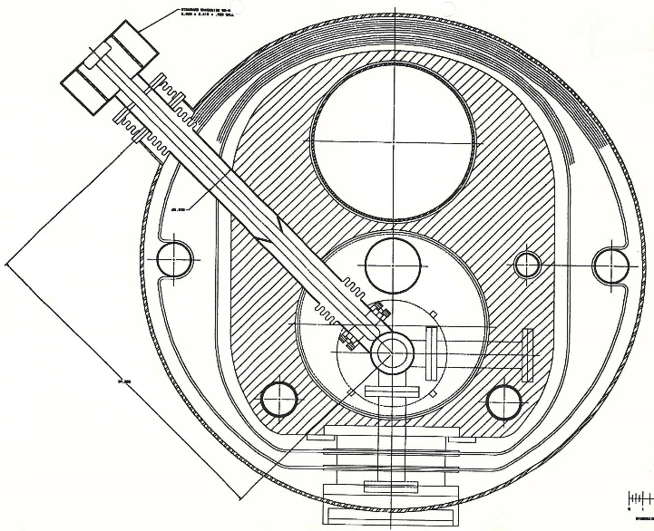
Cryomodule Evolution at Fermilab

Slide 26
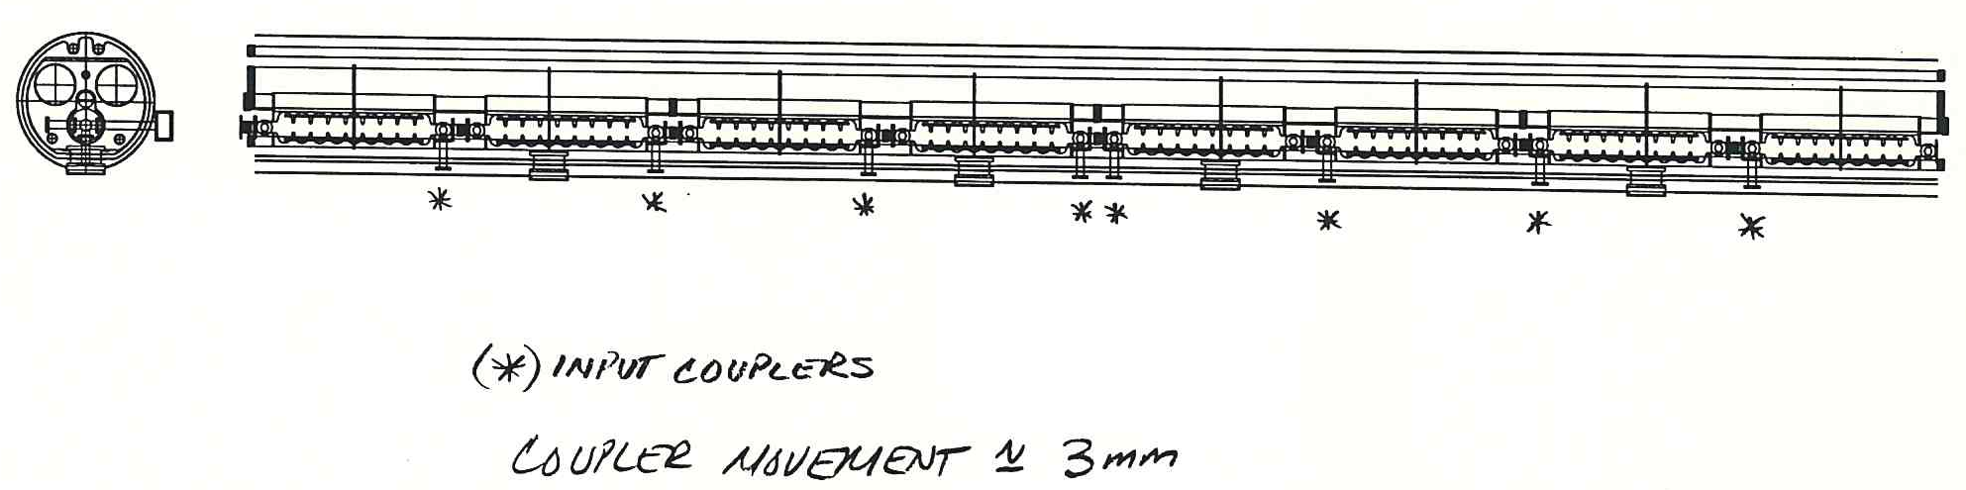
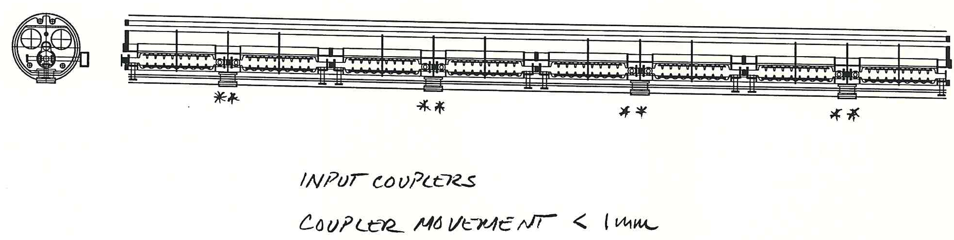
Schematic Longitudinal Layout

Slide 27
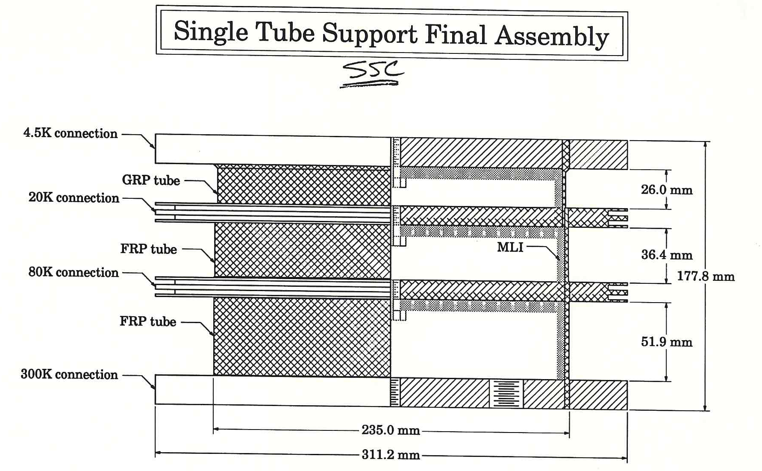
The Fermilab Support Post

Slide 28
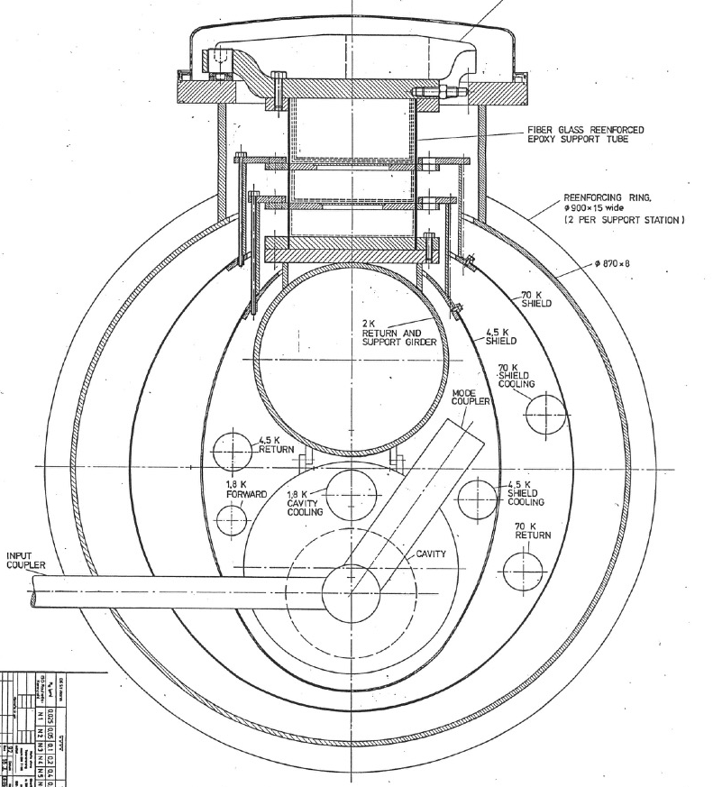
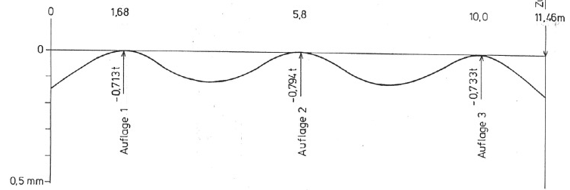
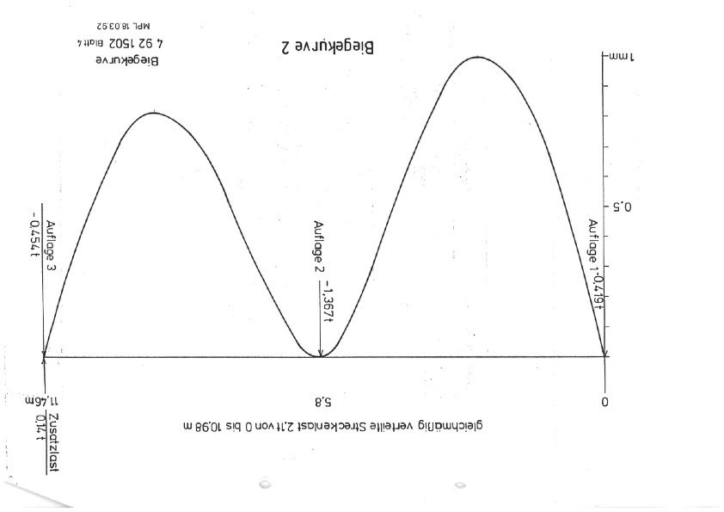
Design Review by DESY (and INFN)

Slide 29
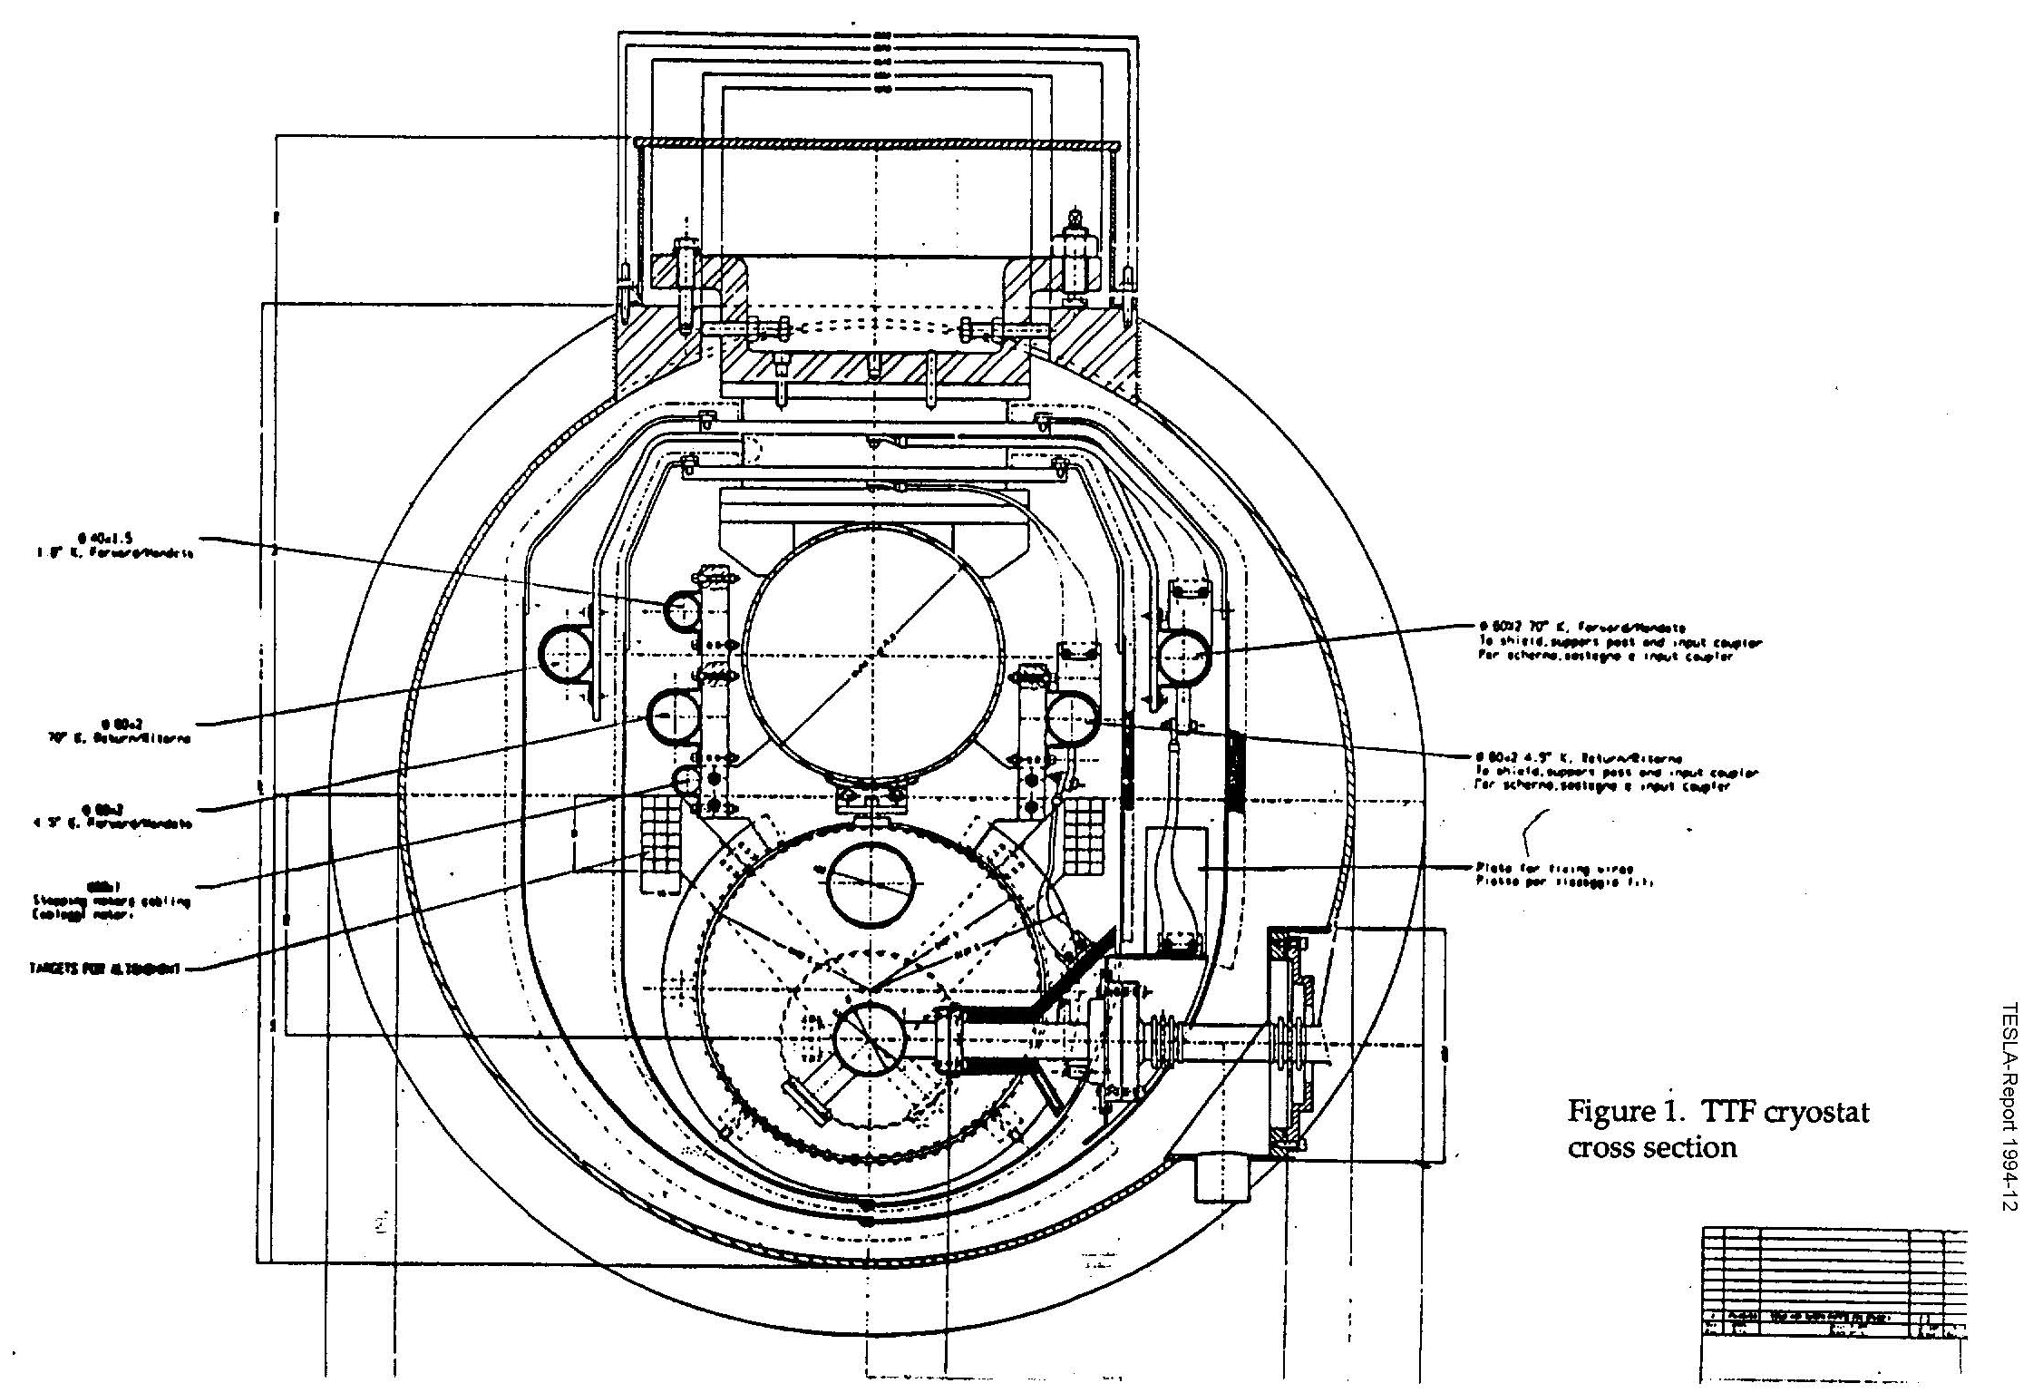
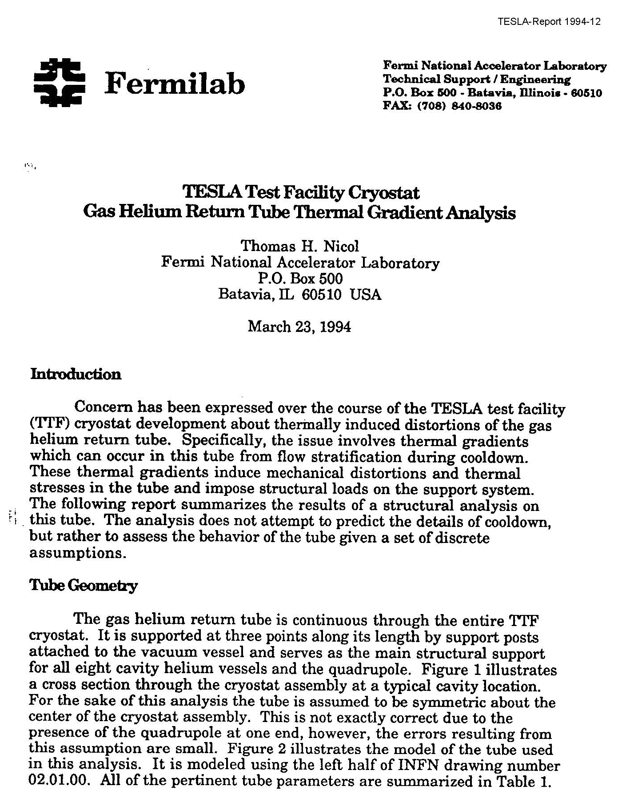
CRY 1 – Some new Hints from Fermilab

Slide 30
Contents
Introduction
To the TESLA Cryomodule Design Concept
From Cry 1, the Prototype, to Cry 3
Main Features of the Cry 3 Reference Design
WPMs, Experience & Picture Gallery

Slide 31
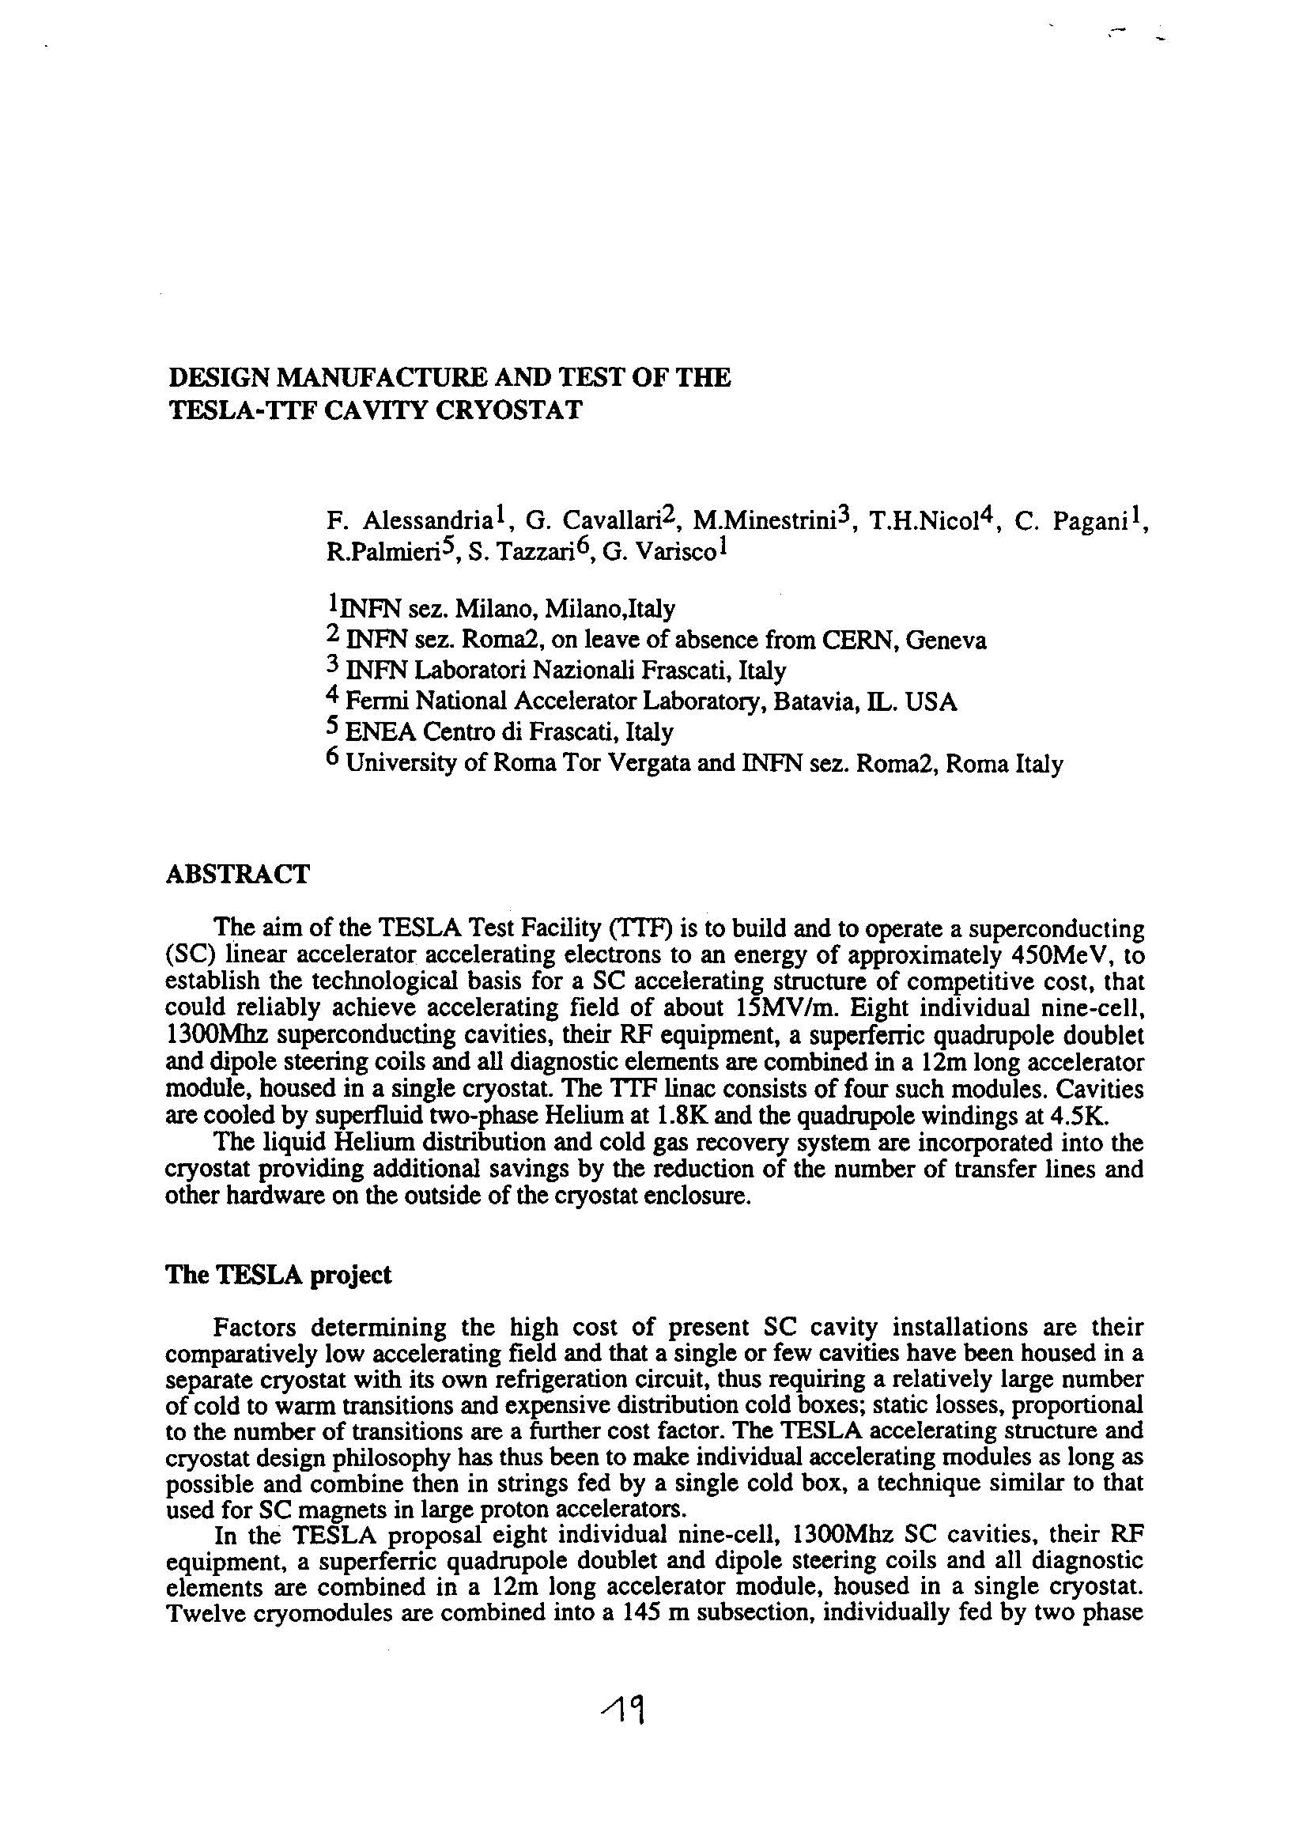
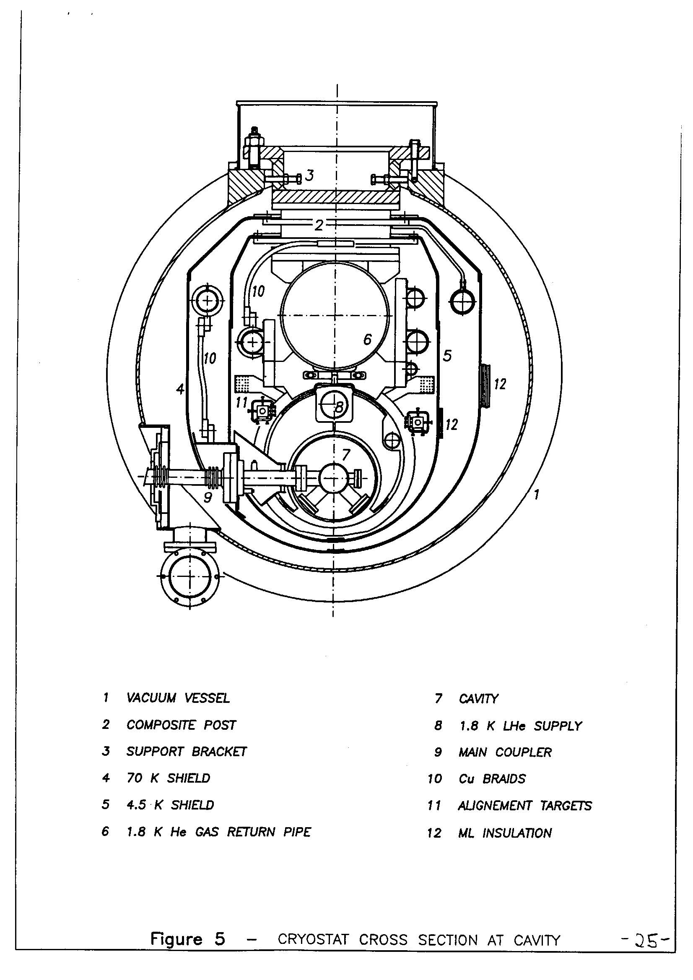
CFY-1: the FNAL-DASY-INFN Compromize

Slide 32
Support Posts (FNAL Design) - 1
Support Posts are the mechanical cryogenic connections of the HeGRP (He Gas Return Pipe) that supports all the active elements. FNAL Design
The insulating element is a fiberglass pipe dimensioned in order to keep the eigenfrequencies high
Stainless Steel and aluminum flanges are shrink-fitted for mechanical connection to GRP, thermal shields and room temperature support
Each support post has been tested by compression-tension cycles to verify the stiffness of the interference junction
A break test shown that the post break point is about 100 kN

Slide 33
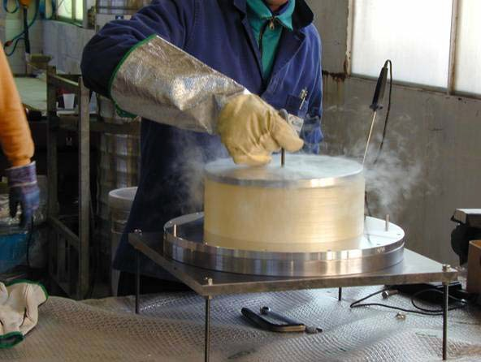
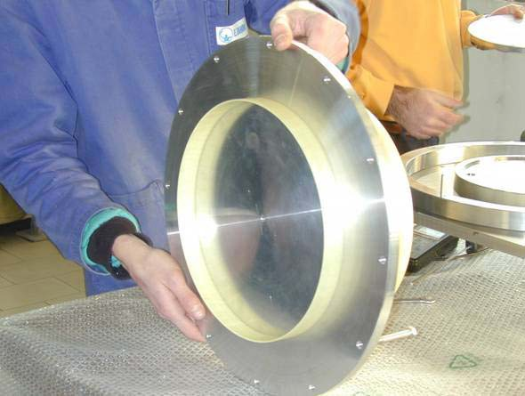
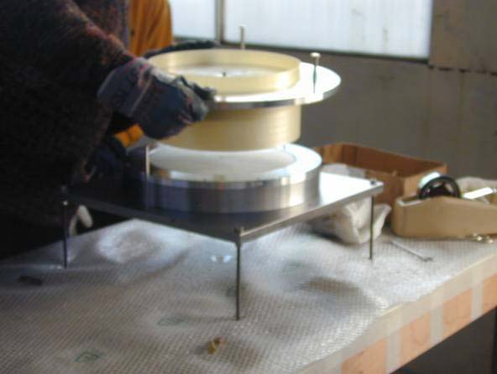
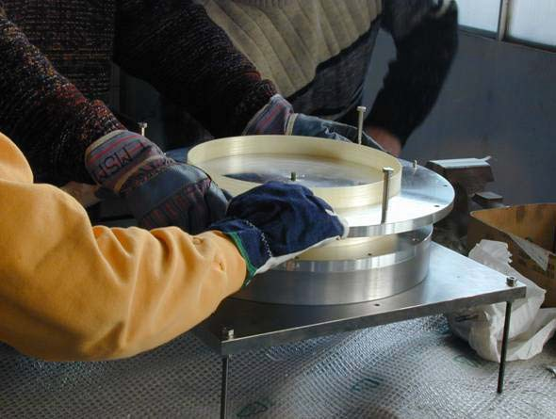


Support Posts (FNAL Design) - 2

Slide 34

CRY 2 , new shields and fabrication strategy

Slide 35


CRY 3, the reference for most projects

Slide 36


Cryomodule & Assembly as Crucial as Cavity
Three cryomodule generations to:
improve simplicity and performances
ensure precise alignment
minimize the cost
“Finger Welded” Shields
Reliable Alignment Strategy
Sliding Fixtures @ 2 K
Required plug power for static losses < 5 kW / (12 m module)

Slide 37











From Cry 1 Prototype to Cry 3
Extensive FEA modeling (ANSYS™) of the entire cryomodule
  Transient thermal analysis during cooldown/warmup cycles,
  Coupled structural/thermal simulations
  Full nonlinear material properties
Detailed sub-modeling of new components and Laboratory tests
  Finger-welding tests at ZANON
  Cryogenic tests of the sliding supports at INFN-LASA

Slide 38







The Three Generations in TTF
ACC 5
ACC 4
ACC 3
ACC 2
ACC 1
RF gun
800 MeV
400 MeV
120 MeV
4 MeV
Cry 1
Cry 2
Cry 3
1st Module in TTF I
Module 1 & 2 in TTF I Module 1, 2 & 3 in TTF II
Module 4 & 5 in TTF II

Slide 39







Cryoodules installed in TTF II
ACC 5
ACC 4
ACC 3
ACC 2
ACC 1
RF gun
800 MeV
400 MeV
120 MeV
4 MeV
ACC 4 & ACC 5
ACC 2 & ACC 3

Slide 40







2nd Generation TESLA Cryomodule
New strategy for tolerances and allignment

Slide 41

New Shield Connection by “Finger Welding”

Slide 42
Contents
Introduction
To the TESLA Cryomodule Design Concept
From Cry 1, the Prototype, to Cry 3
Main Features of the Cry 3 Reference Design
WPMs, Experience & Picture Gallery

Slide 43
3rd Generation TESLA Cryomodule
Reduce the Cross Section and use a standard “pipeline” tube
  Redistribute the internal components
  Reduce the distances to the minimum
Improve the connection of the active elements to the HeGRP
  Sliding fixtures to allow “Semi Rigid Coupler” and Superstructures
Reduce alignment sensitivity to the forces on the HeGRP edges
  Move the external posts closer to the edges
  Include the 300 mm bellow in the in the backbone referencing
Further simplify the assembling procedure
  Simplify coupler cones and braids
  Reduce by a factor two the shield components
System thought for mass production cost cutting
  Tolerances reduced to the strictly required ones
  Simpler components and standard tubes wherever possible

Slide 44


Cry2 & Cry3: Cross Sections
0
1 m

Slide 45


Cry3 Cross Section
Support Post
Pressurized He feeding
HeGRP & System backbone
Shield cooling return pipes
WPM
Shield cooling pipes
Thermal shields
Two phase line
Coupler port
Sliding support
Helium tank

Slide 46

Cry2 to Cry3: Diameter Comparison

Slide 47



Helium GRP, Posts & Invar Rod
Fixpoint Invar rod
C1
C2
C3
C4
C5
C6
C7
C8
magnet

Slide 48
C-Shaped Fixtures and Rolling Needles
Four C-Shaped stainless steel fixtures are used to define the position of each one of the thirteen active elements:
8 cavities and 1 quadrupole package. Each active element has four titanium pads welded to the helium tank
Each active element is independently referred to the module axis through screws and “belleville” pushers on both x and y directions of each of the four pads
Rolling needles reduce drastically the longitudinal friction
The longitudinal position of each active element is defined through a fixture to the reference Invar Rod. This makes its position independent from the elongation and contraction of the supporting HeGRP

Slide 49






Spring Washers
C-shaped support
Rolling needles
Pad
Runner

Slide 50



Finger-Welded Shield Behavior
Cooldown simulation of the 4.2 K and 70 K aluminum thermal shields.
We used a simultaneous 12 hour linear cooldown.
The maximal thermal gradient on the shields (upper left graph) is below 60 K, a safe value.
The temperature fields show that the gradient is concentrated in the welding region, where the fingers unload the structure
Maximum shield temperature
Temperature during cooldown
Maximum temperature gradient

Slide 51


Thermo-mechanical analysis of Shields
Applying the computed temperature field, deformations and stress distribution can be easily computed.
Maximum stresses are within acceptable limits
Maximum deformations due to asymmetric cooling are below 10 mm.
Maximum stresses during cool-down
Maximum shield displacement

Slide 52
From Prototype to Cry 3
Extensive FEA modeling (ANSYS™) of the entire cryomodule
  Transient thermal analysis during cooldown/warmup cycles,
  Coupled structural/thermal simulations
  Full nonlinear material properties
Detailed sub-modeling of new components and Laboratory tests
  Finger-welding tests at ZANON
  Cryogenic tests of the sliding supports at INFN-LASA

Slide 53
Contents
Introduction
To the TESLA Cryomodule Design Concept
From Cry 1, the Prototype, to Cry 3
Main Features of the Cry 3 Reference Design
WPMs, Experience & Picture Gallery

Slide 54
WPMs to qualify alignment strategy
WPM = Wire Position Monitor
On line monitoring of cold mass movements during cool-down, warm-up and operation
2 WPM lines with 2 x 18 sensors 4 sensors per active element
8 mm bore radius
1 WPM lines
1 sensors per active element 25 mm bore radius
1 WPM line
7 sensors/module 25 mm bore radius
Cry 1
Cry 2
Cry 3
1st Module in TTF I
Module 1 & 2 in TTF I Module 1, 2 & 3 in TTF II
Module 4 & 5 in TTF II

Slide 55

Large ammount of thermal sensors

Slide 56

Large Bending in First Cooldown (CRY 1)
New Cooldown procedure thanks to the WPM’s measurements during the first “fast” cooldown
The Big Banana

Slide 57


Safe Cooldown of ACC4 and ACC5

Slide 58





ACC4 & ACC5 Met Specs
Still some work at the module interconnection Cavity axis to be properly defined

Slide 59







WPM as Vibration Sensors
TTF2-ACC4
TTF2-ACC5
WPM1
WPM4
WPM7
WPM8
WPM11
WPM14
Post
V −V
V −V
Post
D =
B D
D =
A C
A WPM is a sort of microstrip four channel directional coupler. A 140 MHz RF signal is applied on a stretched wire placed in the center of the monitor bore.
A Wire Position Monitor (WPM) system has been developed for on-line monitoring of the cold mass during cooldown and operation.
The low frequency vibrations of the cold mass, amplitude modulate the RF signals picked up by the microstrips.
The microphonics (and the sub-microphonics) can be recovered de-modulating the microstrip RF signal.
x
V +V
y
V +V
B D
A C
x = a D + a D³ + a D D²
10 x 30 x 12 x y
y = a D + a D³ + a D²D
01 y 03 y 21 x y

Slide 60
TESLA Cryomodule Concept Peculiarities
Positive
  Very low static losses
  Very good filling factor: Best real estate gradient
  Low cost per meter in term both of fabrication and assembly
Project Dependent
  Long cavity strings, few warm to cold transitions Large gas return pipe inside the cryomodule
  Cavities and Quads position settable at ± 300 µm (r m s) Reliability and redundancy for long MTTR (Mean Time To Repair)
  Lateral access and cold window natural for the coupler
Constraints
  Long MTTR in case of non scheduled repair
  Moderate (± 1 mm) coupler flexibility required
ILC Acc. Workshop
Beijing, 16 August 2005

Slide 61

Module assembly picture gallery - 1

Slide 62

Module assembly picture gallery - 2

Slide 63

Module assembly picture gallery - 3

Slide 64

Module assembly picture gallery - 4

Slide 65

Module assembly picture gallery - 5

Slide 66

Module assembly picture gallery - 6

Slide 67

Module assembly picture gallery - 7

Slide 68

Module assembly picture gallery - 8

Slide 69

Module assembly picture gallery - 9

Slide 70

Module assembly picture gallery - 10

Slide 71
Design changes important for ILC
Move quadrupole to the center
Quad/BPM Fiducialization
High pressure rinsing and clean room assembly issues
Movers for beam based alignment? Why not if really beneficial
Short cavity design
Cutoff tubes length by e.m. not ancillaries (coaxial tuner)
Cavity inter-connection: Flanges and bellows (coating?)
Fast locking system for space and reliability (CARE activity)
Bellow waves according to demonstrated tolerances
Coaxial Tuner with integrated piezo-actuators
Parametric “Blade Tuner” or equivalent for real estate gradient
Integration of fast tuner (piezo actuated) underway
Longer module design: 10-12 cavities
ILC Acc. Workshop
Beijing, 16 August 2005

Slide 72






The INFN Cryomodule for XFEL & ILC

