Slide 1
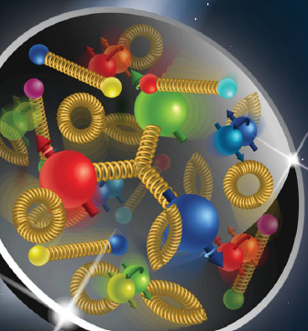
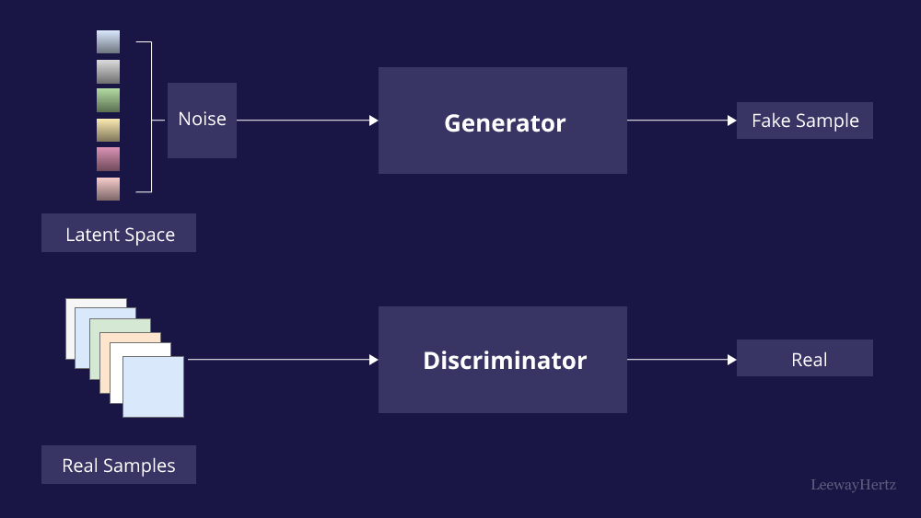
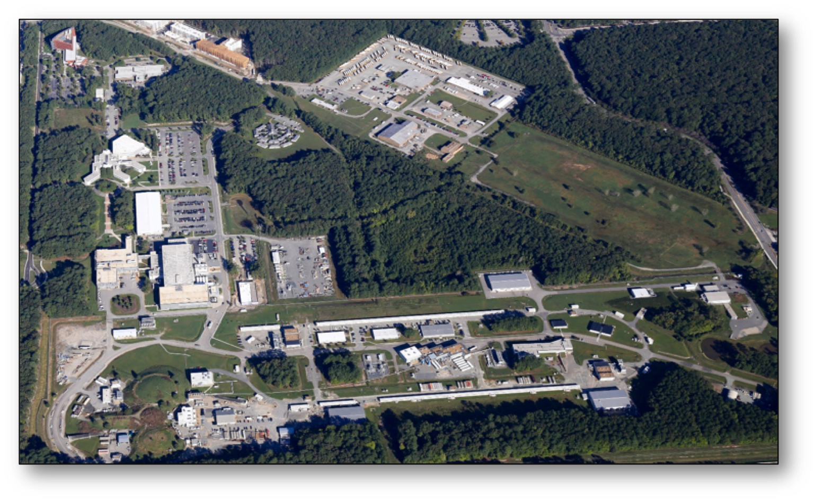
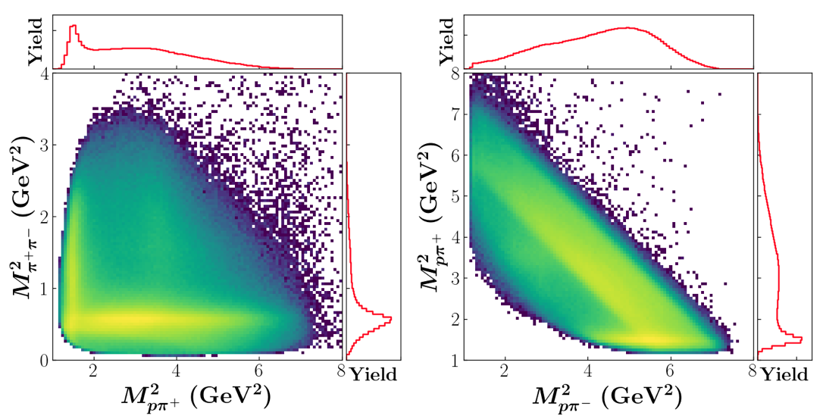
GANs for detector unfolding
Tommaso Vittorini
1 -

Slide 2
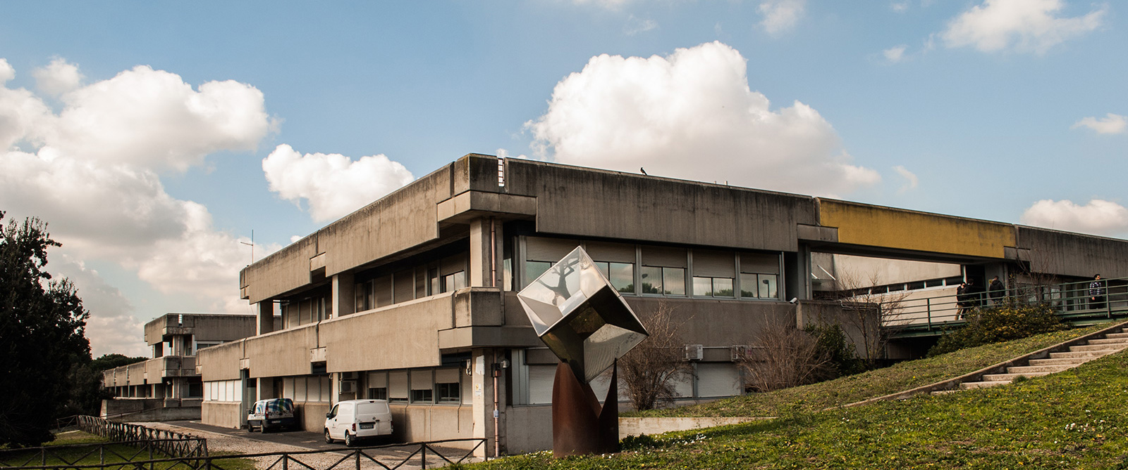
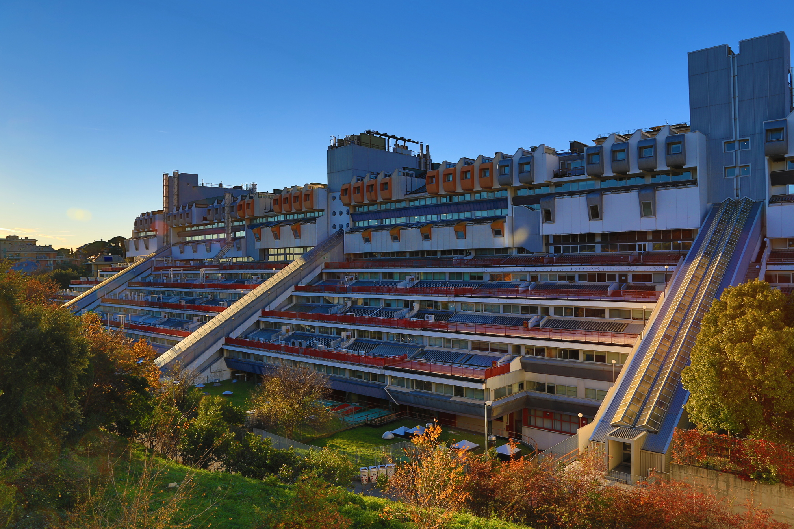
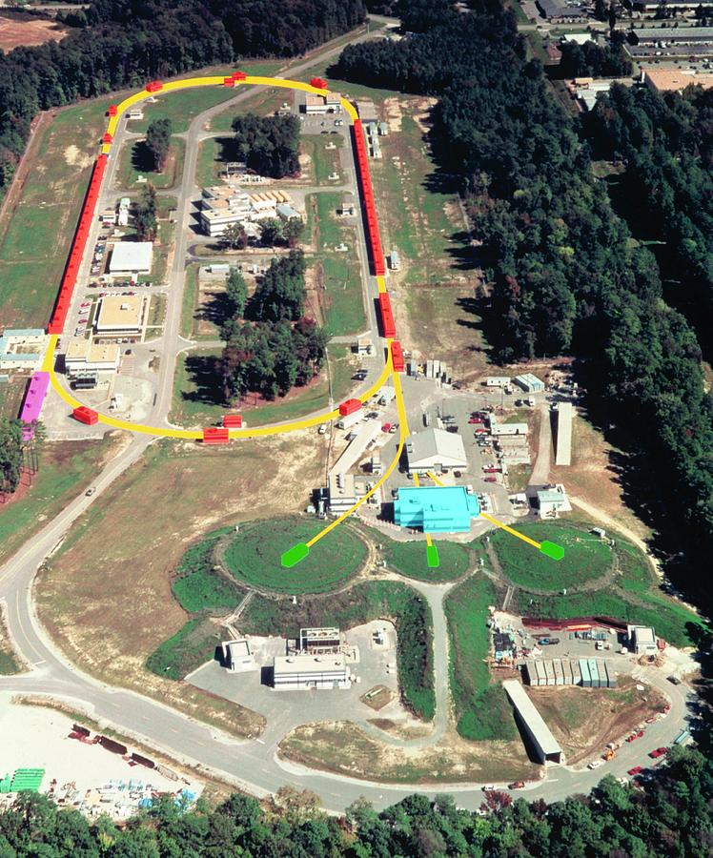
Who am I and what do I do?
Master degree in Roma Tor Vergata
Working on my PhD in Genova
Collaboration with Jefferson Lab
2 -

Slide 3
Outline
AI/ML fundamentals
AI basics
AI/ML algorithms
Linear regression
Minimization
Extrapolation vs. interpolation
Neural Networks
Generative models
An example: GAN to extract physics
3 -

Slide 4
Machine/Deep Learning

Slide 5
Machine/Deep Learning
Typical problem:
Data set with independent $(X_{i})$ and dependent $(Y_{i})$ variables
The model, function of variables $X_{i}$, and some parameters $W_{k}$
The cost (loss) function to judge how the model performs on observed $Z(X_{i},Y_{i})$ varying parameters $W_{k}$
How it works:
Split (randomly) the data set into 2 (independent) subsets training and test
(… better in 3: a small part of the test data set can be used for validation during trainig)
The model learns from the training data set
The performance of the model (changing $W_{k}$) is evaluated using the cost (loss) function
When the training is concluded, apply the resulting parameters to the the test data set
Some caveats
Fitting is not predicting (this is why we want to use a validation set during training)
Using a complex model may result in overfitting
Better to use the simplest model
Not different from a traditional fit …
Model selection
No free lunch theorem: there is no universally best model (All models are wrong, but some models are useful. — George Box)
Cross-validation to empirically select the best model for the specific problem
Data science is not an ’exact science’, data scientist’s experience is priceless …
4 -

Slide 6
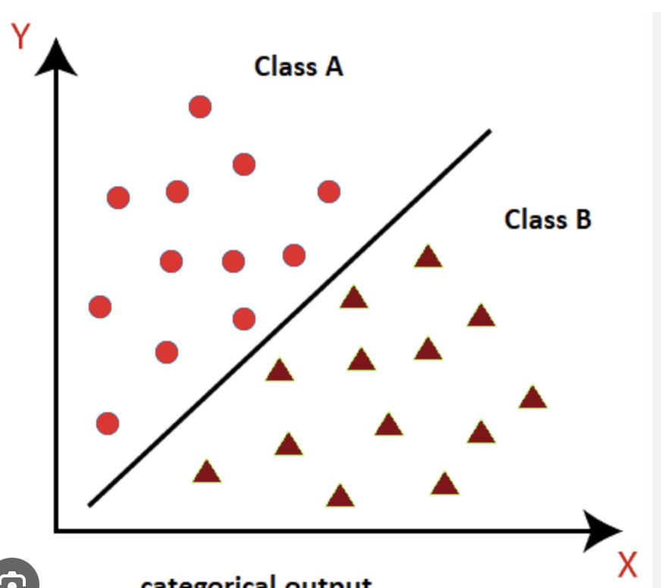
(Machine) learning algorithms
How do we learn from data?
Machine learning systems process data sets made by examples (a vector)
Examples are a collection of features (element of the vector)
The data set is divided into batches
Every run of the AI/ML algorithm over the training data set is called an epoch
In a HEP/NP scattering data set:
example = data entries (events)
features = 4-momentum components
Performance: the accuracy of the model is evaluated by measuring the error rate. Values can be 0/1 or log(Probability)
Unsupervised: the algorithm finds the underlying law by itself
Supervised: an instructor teaches the algorithm what to do
Reinforced learning: the algorithm may change in time interacting with the environment
An ML algorithm is a transformation that connects a set of features with an output variable(s)
Classification
Regression
ML algorithm is a function f: R^{n} →{1,…, k}
ML algorithm takes a vector x in R^{n} as input and produces a scalar y in R as output f: R^{n} → R
In a HEP/NP scattering data set:
separate signal from background
In a HEP/NP scattering data set:
fitting a model to data
5 -

Slide 7
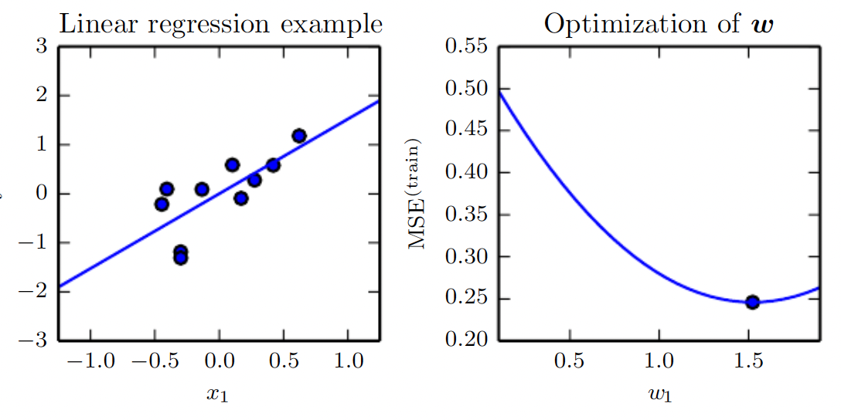
(Machine) learning algorithms
Linear regression
The output is a linear function of the input
w (weights) = parameters
P (Performance) = Mean Square Errors
The prediction matches the test value when the (Euclidean) distance between the predicted and the test sample decreases to zero
The ML algorithm should change w to minimize the MSE
Minimization can be done analytically or iteratively
A generalization of linear regression introduces an intercept (b = bias)
The cost function can be defined in different ways: e.g. LASSO (Least absolute shrinkage and selection operator)
The distance is defined including weight decay with a hyperparameter λ to select small weights (if w is big, the cost function gets bigger)
This a form of regularisation of the model
6 -

Slide 8
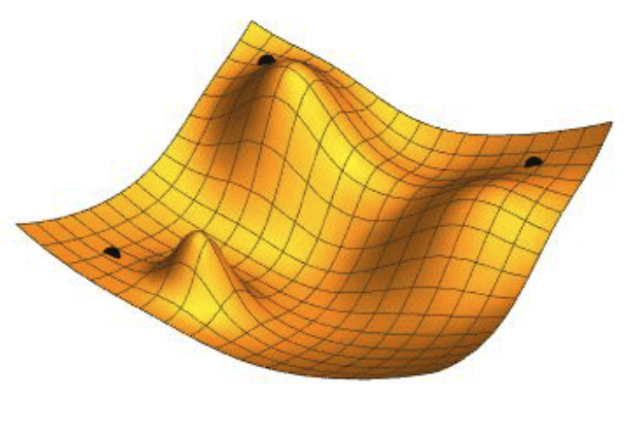
Cost function minimization
The model is fit to training data by minimizing the cost function,
… but there are practical issues that complicate life:
the cost function is not known at the ground truth
it is defined in a multi-d space
it may have multiple local minima
in modern ML algorithm you may have millions of parameters
Different methods to find the minimum:
Gradient Descent (GD)
ηt = learning rate
Gradient Descent with momentum
Gradient Descent with second momentum
RMSprop
ADAM
vt = ηt ∇θ E(θt)
θt+1 =θt -vt
learning rate decreases in directions where the gradient is large
Stochastic Gradient Descent (SGD)
vt = ηt ∇θ E^{MiniBatch} (θt)
θt+1 =θt -vt
chose randomly where to start to avoid local minima
7 -

Slide 9
Interpolation vs extrapolation

Slide 10
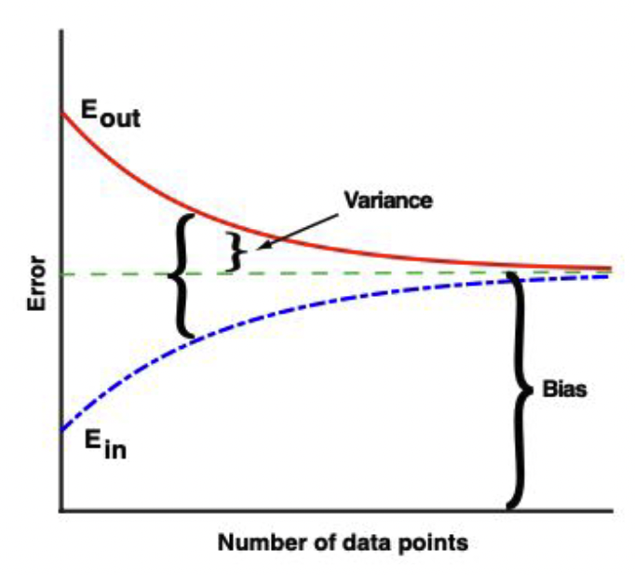
Fitting vs. predicting (interpolating vs extrapolating)
We would like the ML algorithm learns the underlying law from (training) data and not simply reproduces the (training) data set features (otherwise it will not be able to say anything about the test data set outside the training range)
In-sample error vs. out-of-sample error (aka: How could ML possibly work???)
We minimized the error in the training sample: what about the test?
Bias = difference between model and true
Variance = difference between in/out errors
Assuming that training and test samples are identically distributed
A more sophisticated (expressive) model can minimize the bias
Variance can be reduced by increasing statistics (train/test sample)
The model that provides the best explanation for the current dataset will probably not provide the best explanation for future datasets
The discrepancy between $E_{in}$, $E_{out}$ grows with the complexity of our data and of our model (increased model parameters, high dimensional space, curse of dimensionality)
For these reasons (and for complicated models), predicting and fitting can be different things. One needs to pay attention to out-of-sample performance.
Fitting existing data well is fundamentally different from making predictions about new data.
8 -

Slide 11
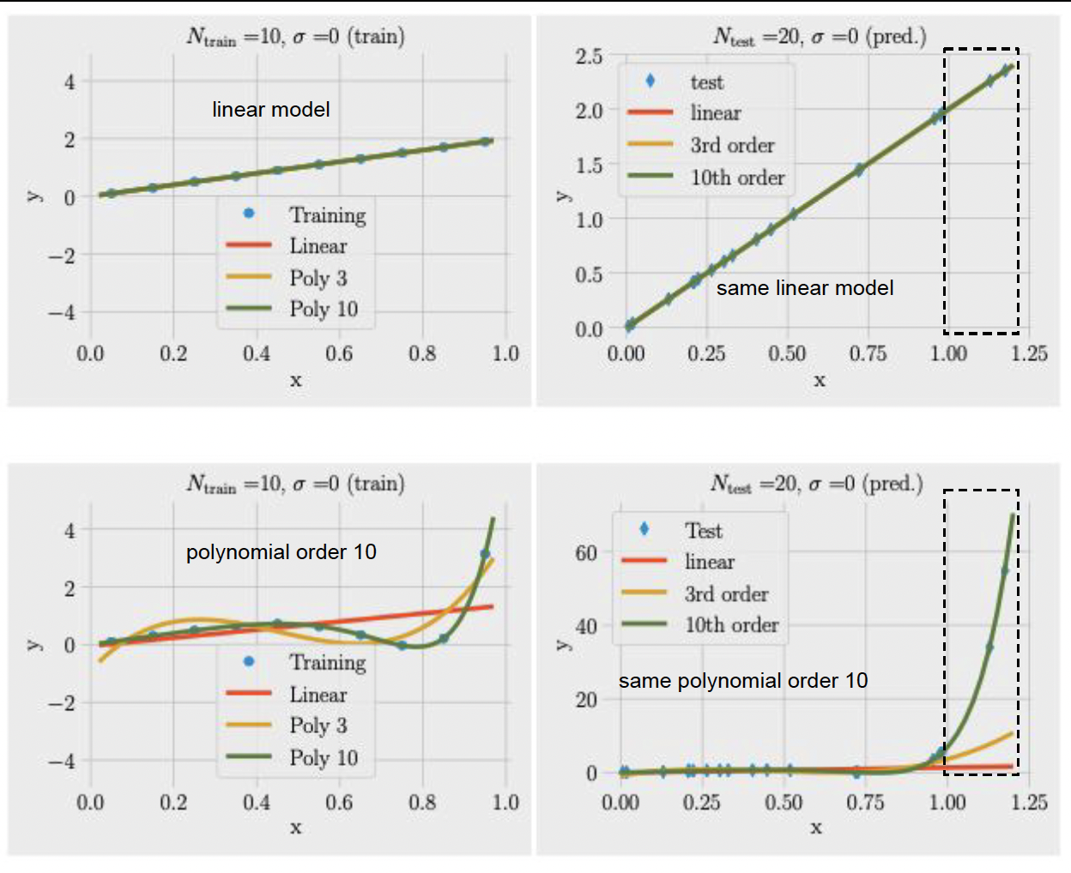
Fitting vs. predicting
Signal only
Traing interval [0,1.0]
Test interval [0,1.2] (larger than the training interval)
Data sampled from
f(x) = 2 x
f(x) = 2 x -10 x⁵ + 15 x¹⁰
If no noise, even with a small training set (Ntrain = 10 < Ntest = 20) the model class that generated the data provides the best fit and also the best out-of-the sample prediction.
9 -

Slide 12
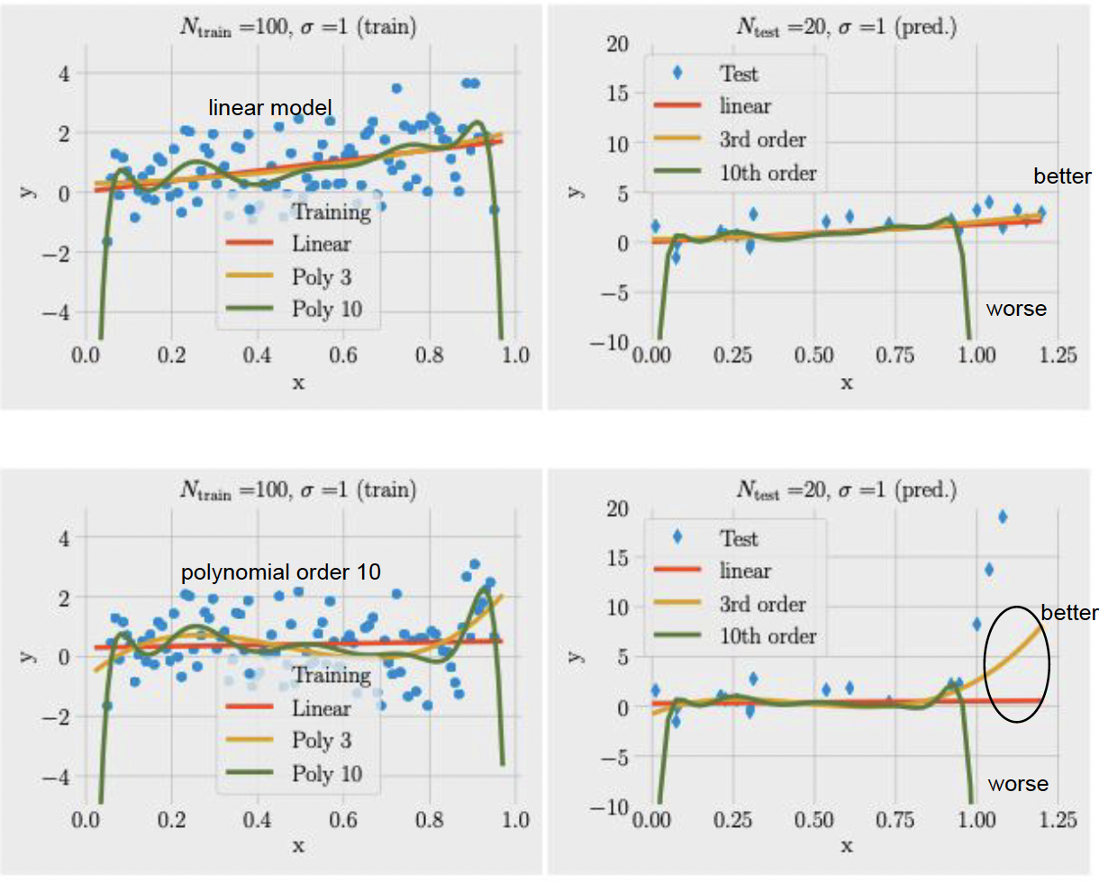
Fitting vs. predicting
Signal + noise
Traing interval [0,1.0]
Test interval [0,1.2] (larger than the training interval)
Data sampled from
f(x) = 2 x
f(x) = 2 x -10 x⁵ + 15 x¹⁰
Noise=1, larger training set (Ntrain = 100, Ntest = 20)
LINEAR provides better out-of-sample prediction for POLY10 too
10 -

Slide 13
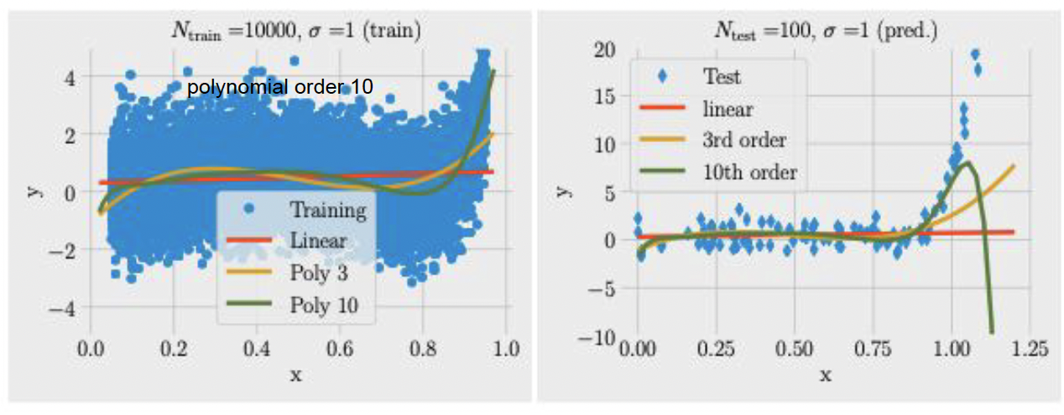
Fitting vs. predicting
Signal + noise with a larger training sample
Traing interval [0,1.0]
Test interval [0,1.2] (larger than the training interval)
Data sampled from
f(x) = 2 x
f(x) = 2 x -10 x⁵ + 15 x¹⁰
Noise=1, larger training set (Ntrain = 10000, Ntest = 100)
POLY10 provides the best fit and extrapolation close to the training interval but degrades quickly outside
Bias-variance tradeoff: with limited statistics, it is better to use less expressive (simpler) models (larger bias smaller variance)
11 -

Slide 14
Neural Networks

Slide 15
Neural networks
NNs are powerful supervised learning techniques
Since the ’80s, it became widely used today thanks to the progress in hardware (CPU, GPU, and now FPGA)
Several libraries are available to simplify custom implementation (PyTorch, Kera, TensorFlow, …)
The basic unit of a neural network is a stylized neuron i that takes d input features x = ( x1, x2, …, xd) and produces a scalar output ai(x)
The first layer is called the input layer, the middle layers are called the hidden layers, the final layer is the output layer
The exact function ai depends on the type of non-linearity used in the NN
It can be decomposed into a linear operation that weights the relative importance of the various inputs and a non-linear transformation σi(z) activation function
12 -

Slide 16
Neural networks
NNs are powerful supervised learning techniques
Since the ’80s, it became widely used today thanks to the progress in hardware (CPU, GPU, and now FPGA)
Several libraries are available to simplify custom implementation (PyTorch, Kerr, TensorFlow, …)
The basic unit of a neural network is a stylized neuron i that takes d input features x = ( x1, x2, …, xd) and produces a scalar output ai(x)
The first layer is called the input layer, the middle layers are called the hidden layers, the final layer is the output layer
The exact function ai depends on the type of non-linearity used in the NN
It can be decomposed into a linear operation that weights the relative importance of the various inputs and a non-linear transformation σi(z) activation function
The choice of the activation function is critical
NN is trained using a gradient descent method (a derivative of neural function as a function of weights w and bias b)
Derivative of step-function can be an issue (tanh and sigmoid were widely used in the past)
When w’s become large, some activation functions saturate and the derivative tends to zero (vanishing gradient).
ReLU and ELU are not vanishing even for large w’s (widely used today)
13 -

Slide 17
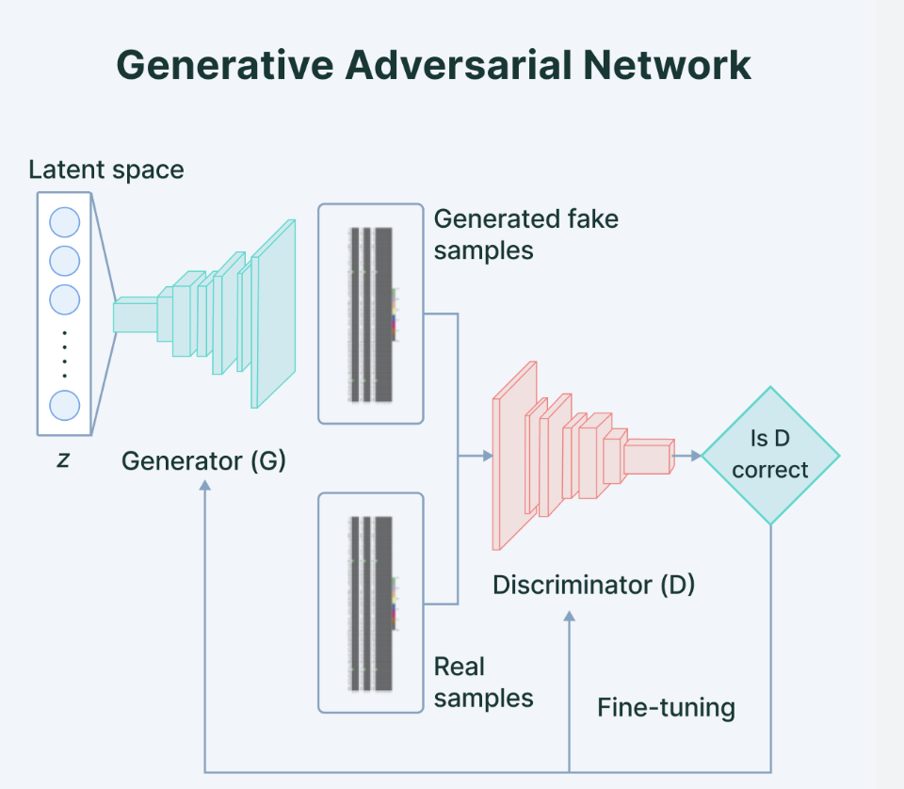
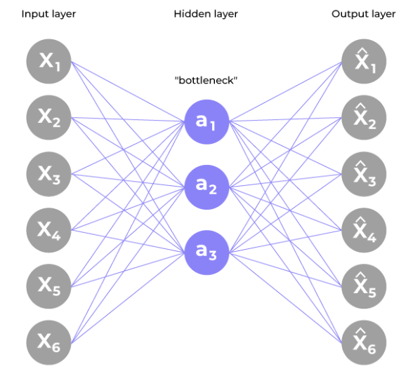
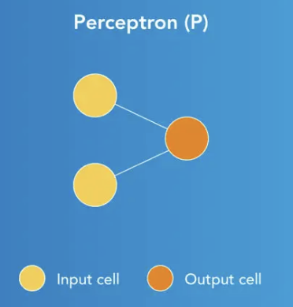
Neural networks in practice
Chose the NN architecture
Define your loss function
Regularize it
Prepare the data set
Train the network
Check results
have fun!
NN is more powerful than a simpler linear regression thanks to the inter-connections of weights and non-linearity introduced by the activation function
Universal approximation theorem: a neural network with a single hidden layer can approximate any continuous, multi-input/multi-output function with arbitrary accuracy
The more complicated a function, the more hidden units (and free parameters) are needed to approximate it
Adding hidden layers also allows neural nets to learn more complex features from the data.
Choosing the exact network architecture for a neural network remains an art
Define the NN type (Perceptron, Feed Forward NN, Multilayer perceptron, Convolutional NN, Encoders, …) and details of the network (how many nodes, how many layers, the activation function, …)
14 -

Slide 18
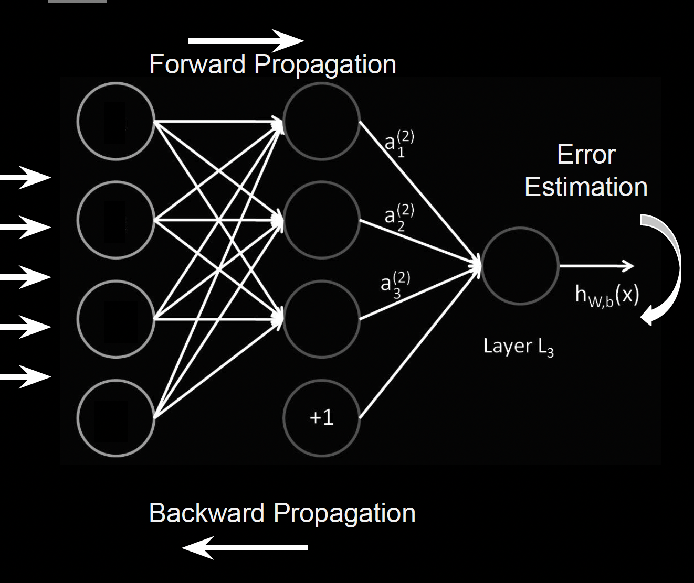
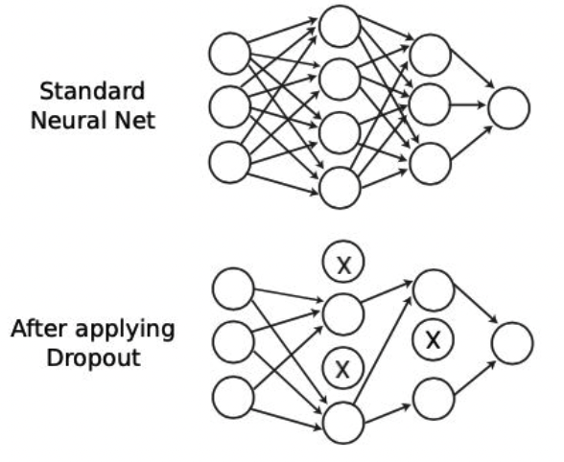
Neural networks in practice
Chose the NN architecture
Define your loss function
Regularize it
Prepare the data set
Train the network
Check results
have fun!
Deep Learning (adding more hidden layers) nets are good for learning non-linear functions (heavy processing tasks)
Backpropagation is the key in the training procedure (how the NN improves over time)
Regularisation (e.g. dropout) contributes to outperforming on new data (besides the training set)
Implicit regularization using Stochastic Gradient Descent: initialization, hyperparameter tuning, early stopping, .,..,
15 -

Slide 19
Generative models

Slide 20
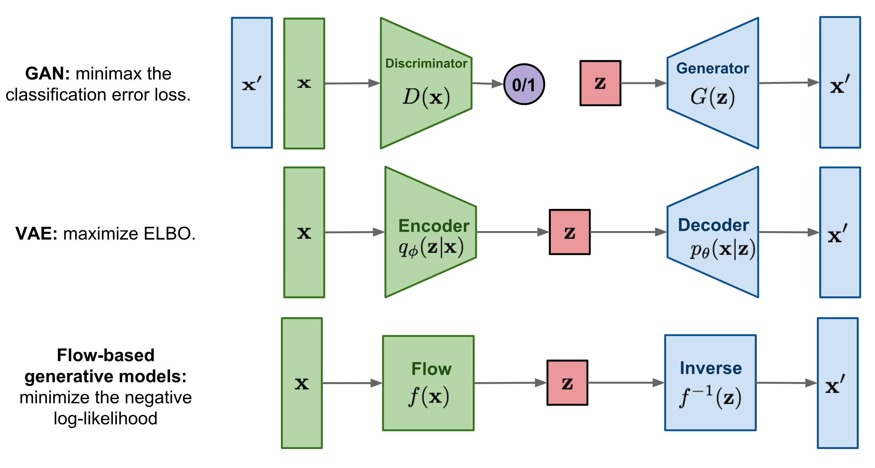
Generative models
Different generative model with different characteristics, structures, perks and disadvantages:
16 -

Slide 21
Generative models
Different generative model with different characteristics, structures, perks and disadvantages:
GANs
Pros:
Very high quality of the generated data
Really fast in the inference procedure
Flexible (applicable to different types of data)
Cons:
Hard to train
Convergence issues due to the need of a dynamical equilibrium
No pdf estimate
17 -

Slide 22
Generative models
Different generative model with different characteristics, structures, perks and disadvantages:
VAEs
Pros:
Latent space continuous and interpretable
Stable during training
Control over the generated samples
Cons:
Lower images quality wrt the GANs
The model is highly dependent on the choice of the distribution of the latent space
18 -

Slide 23
Generative models
Different generative model with different characteristics, structures, perks and disadvantages:
Flow-based generative models
Pros:
Invertible transformation
Explicit pdf estimate
Flexible (applicable to different types of data)
Cons:
Invertible transformations may be computationally expensive
Hard to train when dealing with high-dimensionality data
The design of these invertible transformations can be very complex
19 -

Slide 24
An example: GAN to extract physics

Slide 25
Who am I and what do I do?
Data collected by NP/HEP experiments are (always) affected by the detector’s effects
Before starting any phisics analysis the detector’s effect unfolding is required
Traditional observables may not be adequate to extract physics in a multi-dimensional space (multi-particles in the final state)
At High-inteisity frontiers, datasets are large and difficult to preserve/manipulate
Develop AI – supported procedures to:
Accurately fit data in a multi-D space
Unfold detector effects
Compare synthetic (AI-generated) to experimental data
Quantify the uncertainty
How can AI support NP/HEP extract physics from data in the most efficient way possible?
20 -

Slide 26
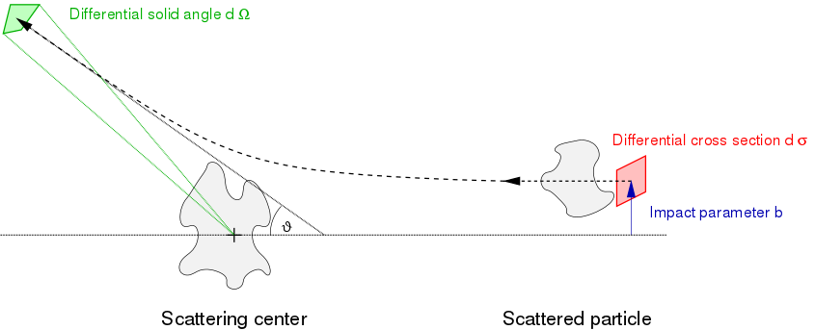
The cross section in particle physics
The cross section is related to the transition probability between an initial to a final state
In case of scattering, cross sections provides information about the elementary interaction
Cross section is expressed as squared sum of scattering amplitudes (complex functions) depending on the kinematic Lorentz-invariant of the problem and embedding the interaction properties
It is derived by measuring the momentum distributions of reaction particle (at different CM energy)
Correlations between particles in the final state reflects the underlying dynamics
Cross sections fully replaces the 4-mom data sample in a compact and efficient way
Cross section is the starting point for any higher level physics analysis
Traditional approach: particles (4-momenta) measured into the detector, extract the relevant observables, extract physics mechanisms
Cross section preserves this information as replacement for the original particle-by-particle scattering information
21 -

Slide 27
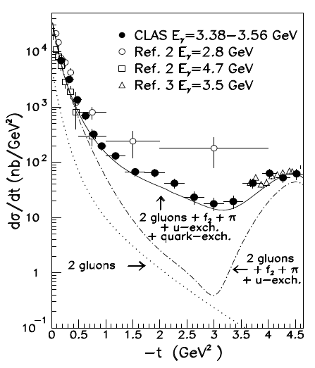
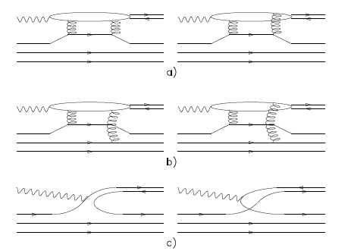
Exclusive reactions: 2 → 2
M. Battaglieri et al. (CLAS Collaboration) Phys. Rev. Lett. 90, 022002
JLab-CLAS g6 ω photo production at large momentum transfer
2 → 2 scattering (no polarisation)
Initial state: known
Final state: 2 x 3
Parameters: (2 x 3) - 4 = 2
Possible choice: -t and φ
the physics depends only on one variable (-t)
γ p → p ω
2-gluon exchange
It worked (and still works!) well if limited to channels with a single variable
Xsec, Polarization observables, angular distribution, decay matrix, …
Correlations
quark exchange
22 -

Slide 28
Exclusive reactions: 2 → 3
M. Battaglieri et al. (CLAS Collaboration) Phys. Rev. Lett. 90, 022002
2 → 3 scattering (no polarization)
Initial state: known
Final state: 3 x 3
Parameters: (3 x 3) - 4 = 5 (Eγ fixed)
Possible choice: M²ππ, M²pπ θπ, α, φ
It does not work (in practice) when you have several independent variables: multi-particle final states (spectroscopy) or multi-variable correlations (SIDIS)
In the integration to reduce to 1-dim all correlations are lost
AI may provide a new way to look at data and extract observables and physics interpretation
(on event by event base)
CLAS g11 2π photo production
Eγ = (3.0 - 3.8) GeV γ p → p π⁺ π⁻ exclusive reaction
data set analyses so far γ p → p π⁺ (π⁻) + small contamination of γ p → p π⁺ (more than a missing π⁻)
complicated dynamic for the overlap of (pπ) to form Δ baryon resonances and (ππ) to form meson resonances
Credit: Y.Alanazi Awadh, , P..Ambrozewicz, G. Costantini A.Hiller Blin, E. Isupov, T. Jeske, Y.Li, L.Marsicano W. Menlnitchouk, V.Mokeev, N.Sato, A.Szczepaniak, T.Viducic
23 -

Slide 29
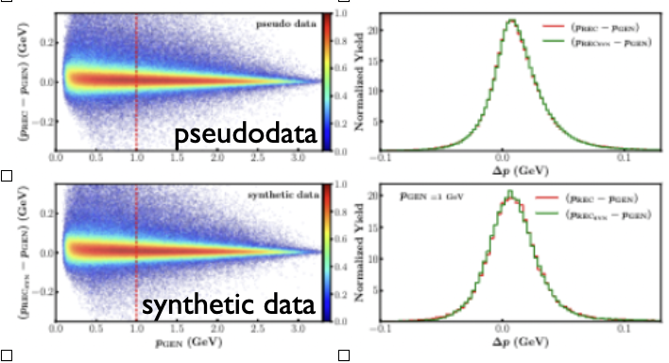
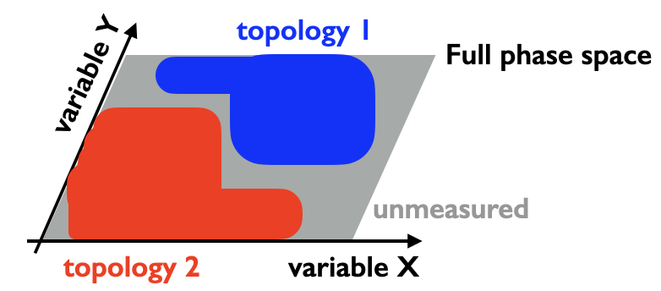
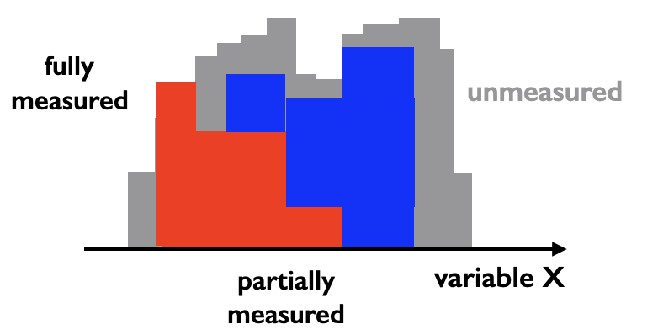
AI for Data Analysis and Preservation
Can AI help in recovering detectors effects?
Resolution of the CLAS detector learned by a GAN
All detectors introduce (at least) two effects in a measured data set:
smearing: the detector has a finite resolution making DETECTED ≠ TRUE
acceptance: every detector only covers a fraction (small/large) of the available phase space
Smearing (unfolding)
Fixable!
Train the ML algorithm with data passed through a proxy of the detector (GEANT-like) to learn the distortions
Use this knowledge to unfold detector distortion
Acceptance
More difficult to recover: the cross section (Probability Density Function) can not be constrained by general rules (other than being positive) since it reflects the underlying (a-priori unknown) physics
No PDF extrapolation outside detector acceptance is possible (based on measured phase space)
A possible approach is to impose conditions to the PDF via constraints on scattering aptitudes Ai (parity conservation, analiticity, unitarity, …)
Considering that:
XSec = ∑ |Ai|² Ai = ∑ (Scattering amplitude for each possible process)
Ai are difficult to constrain supervising on XSec
24 -

Slide 30
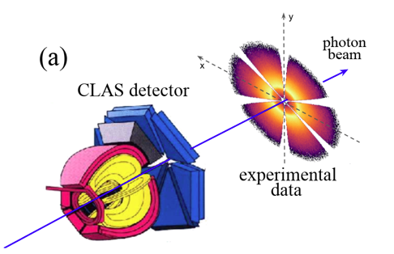
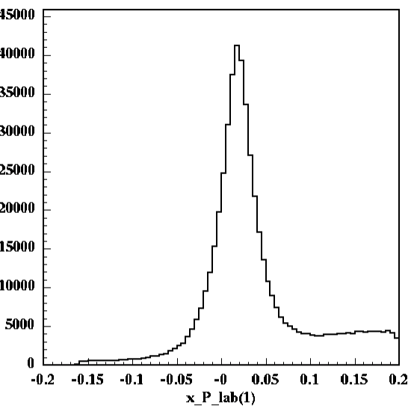
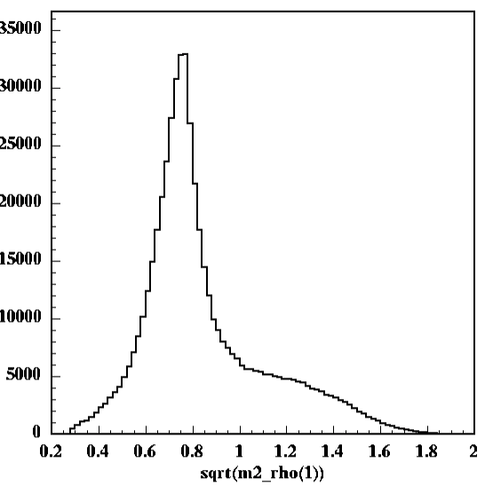
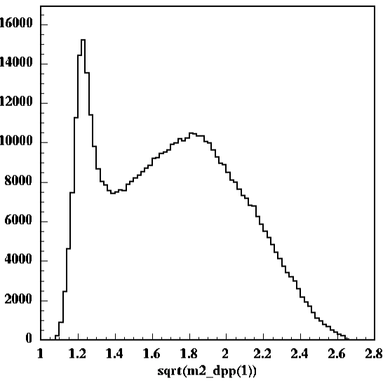
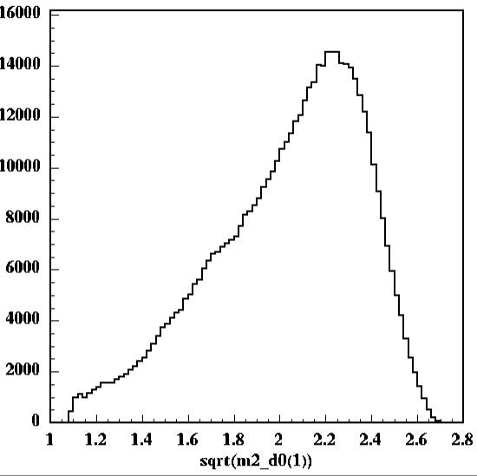
AI for Data Analysis and Preservation
M. Battaglieri et al. (CLAS Collaboration) Phys. Rev. D 80, 072005
M. Battaglieri et al. (CLAS Collaboration) Phys. Rev. Lett. 102, 102001
CLAS g11 kinematics
Dataset used by CLAS Collaboration for many publications
Fiducial cuts $(p, θ, φ)$ as used in published analyses
Focus on $γp→pπ^{+}\left(π^{−}\right)$
Final exclusive $2π$ state identified by missing mass technique (variables are reconstructed by energy/momentum conservation)
Multi-pion backgound comes from $γp→pω^{0}→pπ^{+}π^{−}π^{0}$
At $E_{γ}=\left(3−4\right)GeV$ reaction dynamics are dominated by $ρ^{0}$ photproduction through $γp→pρ^{0}$ and $Δ^{++}$ resonance excitation through $γp→Δ^{++}π^{−}$
$$M(γp→pπ^{+}X)$$
$$M(ππ)$$
$$M(pπ^{+})$$
$$M(pπ^{−})$$
$$M(missing π)$$
ρ⁰(770)
Δ⁺⁺(1232)
$$M(missing ππ…)$$
25 -

Slide 31
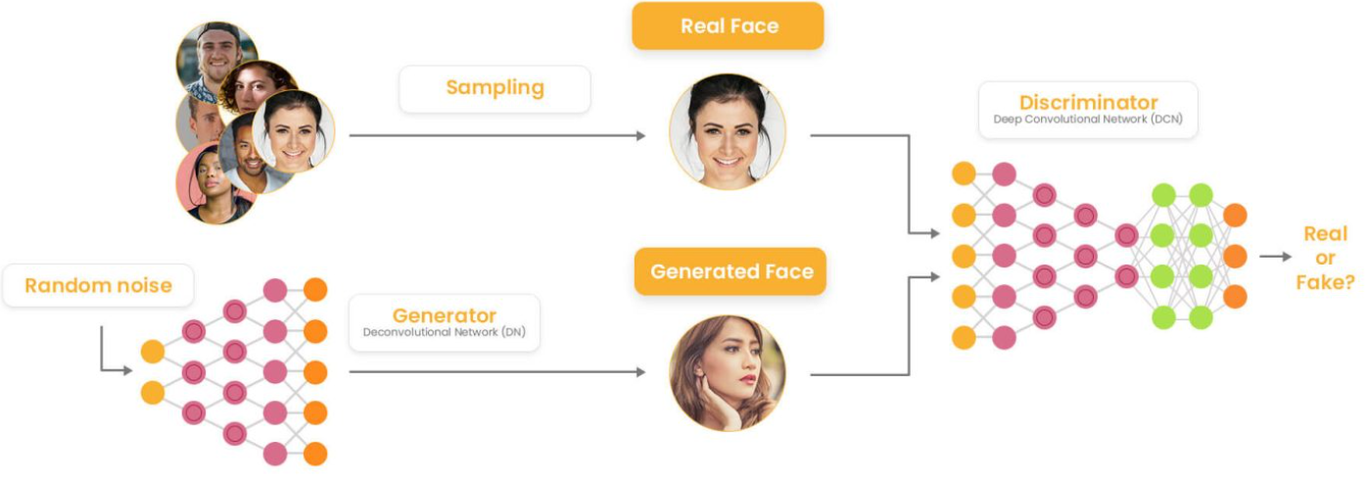
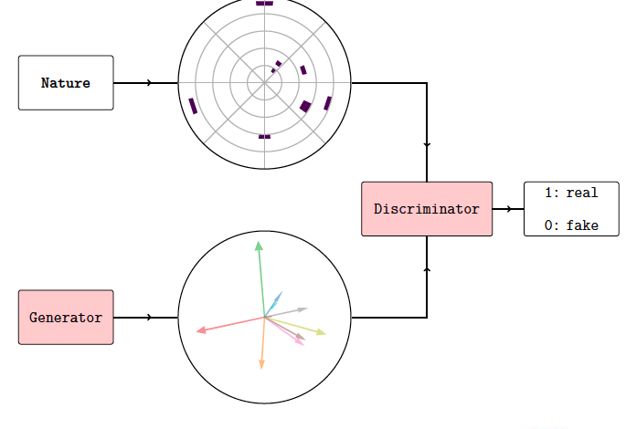
ML Event Generator GAN scheme
Generative model based on the competition between two sub-models
Discriminator is trained to distinguish between “real” (training) samples and “fake” (generated) samples
Generator returns “fake” samples and it’s trained to fool the discriminator
The Generator can be used as data compression tool
Typical size for the Generator: O(MB) - to be compared to NP/HEP experiments data set O(GB/TB)
Simple to distribute instead of events stored on tapes
26 -

Slide 32
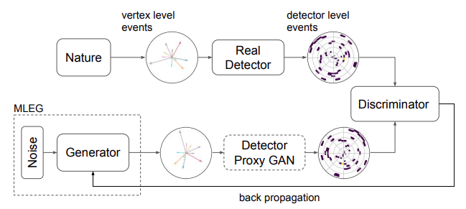
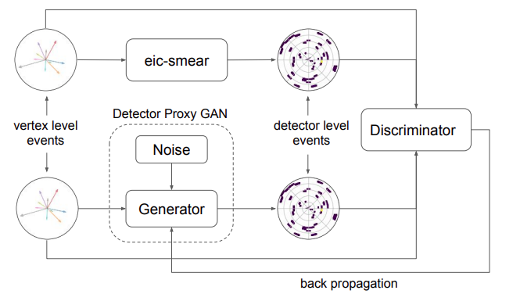
ML Event Generator GAN scheme
Develop an architecture capable of performing the unfolding procedure: removing detector effects as much as possible
Two separate networks:
Detector proxy GAN: removes the smearing due to the finite detector resolution
Outer GAN: Recover vertex level distribution from “experimental” data
Detector proxy
27 -

Slide 33
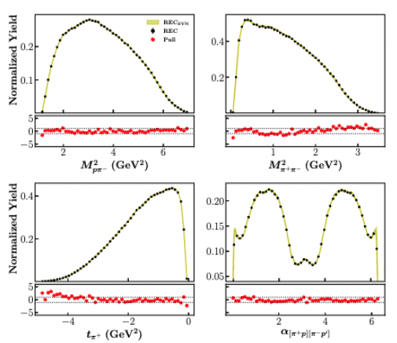
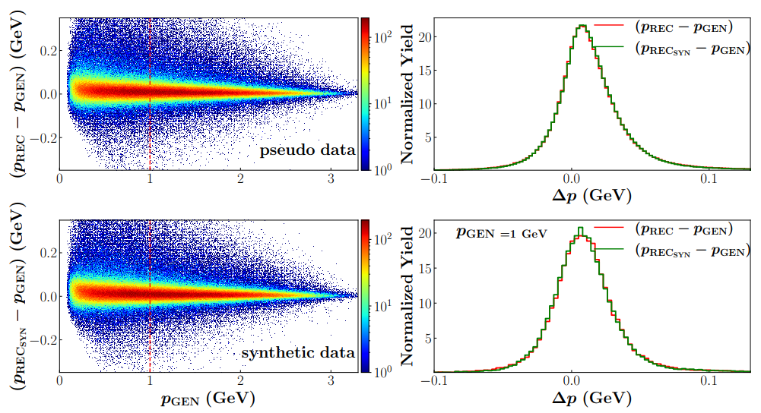
ML Event Generator GAN scheme : Detector proxy results
Develop an architecture capable of performing the unfolding procedure: removing detector effects as much as possible
Two separate networks:
MC REC pseudodata vs. DS-GAN synthetic data
Detector proxy GAN: removes the smearing due to the finite detector resolution
Outer GAN: Recover vertex level distribution from “experimental” data
Detector proxy
CLAS resolution
pseudodata
28 -
synthetic data

Slide 34
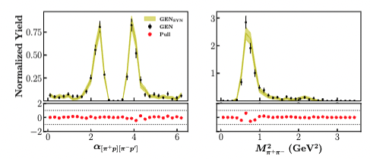
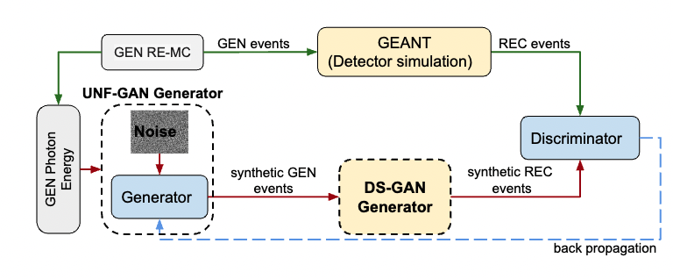
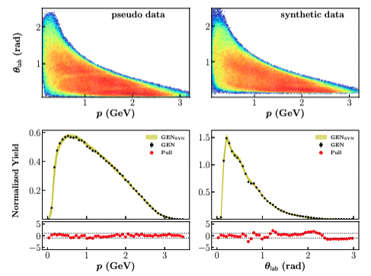
ML Event Generator GAN scheme : Outer GAN results
T.Alghamdi, M.Battaglieri, A.Golda, A. Hiller Blin, L.Marsicano, W.Melnitchouk, G.Montaña, E.Isupov, Y.Li, V.Mokeev, A.Pilloni, N.Sato, A.Szczepaniak, T.Vittorini, Y.Alanazi to appear in ArXiv
Distribution in 4D bins
UNF-GAN trained with RE-MC REC pseudodata (exp data proxy)
DS-GAN used to unfold CLAS detector effects (within acceptance)
UNF-GAN
RE-MC GEN pseudodata vs. UNF-GAN SYN data
Compare UNF-GAN GEN SYNT data to RE-MC GEN pseudodata
Good agreement (± 1σ) for lab variables and in 4D bins
29 -

Slide 35
ML Event Generator GAN scheme : Validating our results
T.Alghamdi, M.Battaglieri, A.Golda, A. Hiller Blin, L.Marsicano, W.Melnitchouk, G.Montaña, E.Isupov, Y.Li, V.Mokeev, A.Pilloni, N.Sato, A.Szczepaniak, T.Vittorini, Y.Alanazi to appear in ArXiv
Yellow band to quantify the generator systematic uncertainty through bootstrapping technique:
Training the full model on random subset of the initial training dataset
Perform this task 20 times with independently initialized GANs to minimize the initialization bias
The yellow band represents the average of the GAN results for that given bin and its width is associated with the uncertainty on the generation
30 -

Slide 36
ML Event Generator GAN scheme : Validating our results
T.Alghamdi, M.Battaglieri, A.Golda, A. Hiller Blin, L.Marsicano, W.Melnitchouk, G.Montaña, E.Isupov, Y.Li, V.Mokeev, A.Pilloni, N.Sato, A.Szczepaniak, T.Vittorini, Y.Alanazi to appear in ArXiv
Red dots represent a way to quantify the accuracy of the data reconstruction for that given bin – pull plots:
$$pulls=\frac{μ_{R}−μ_{G}}{\sqrt{σ_{R}^{2}+σ_{G}^{2}}}$$
Normalized difference between the real and generated values for each bin
The closer the pulls are to zero, the better the agreement
31 -

Slide 37
Brief exercise overview

Slide 38
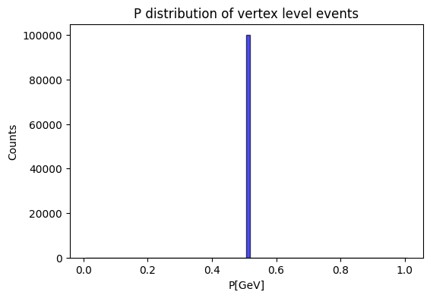
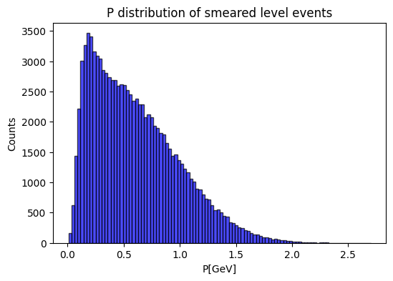
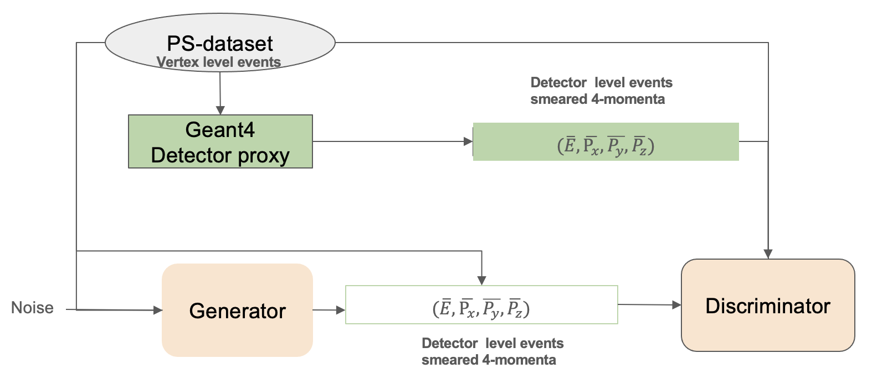
Brief exercise overview
Detector proxy GAN training:
Vertex level: (N, 4) $δ$-like input distribution
Detector level: Different Gaussian smearing for each component
Generator and Discriminator are both Deep NN:
Generator: MLP that generates detector level data from noise
Discriminator: Binary classifier to distinguish the two sets of data
Loss function: MSE
Optimizer: Adam
Performance: Comparison between generated and training sample distributions
32 -

