Slide 1

AI in Europe and WLCG vision
?
Tommaso Boccali (INFN Pisa)

Slide 2
outline
AI: The Europe Way
  initiatives
  AI Act
  Funding opportunities
Which forces on the table
  Resources
  Opportunities
  Infrastructures
Restricting to “our” field: AI for CERN/LHC/WLCG ….

Slide 3
Europe and AI
Fact: Europe is late in AI
Notes:
https://www.euractiv.com/section/tech/news/europes-ai-computing-plans-may-be-too-little-too-late/
https://currentaffairs.adda247.com/india-ranks-5th-in-countries-with-most-ai-investment/
https://www.thestack.technology/global-ai-index/
https://hbr.org/2023/12/charting-the-emerging-geography-of-ai
https://www.linkedin.com/pulse/divergent-paths-comparing-ai-regulation-us-eu-china-yannick-mah%C3%A9-ztlre/
https://www.voronoiapp.com/technology/Which-AI-Companies-Have-Acquired-the-Most-Funding-1006
https://www.reddit.com/r/europe/comments/11mqdld/private_investment_in_artificial_intelligence_2020/
https://digital-strategy.ec.europa.eu/en/policies/european-approach-artificial-intelligence
https://www.oecd-ilibrary.org/science-and-techno
logy/artificial-intelligence-in-science_d89b39b6-en
https://transcend.io/blog/ai-regulation

Slide 4
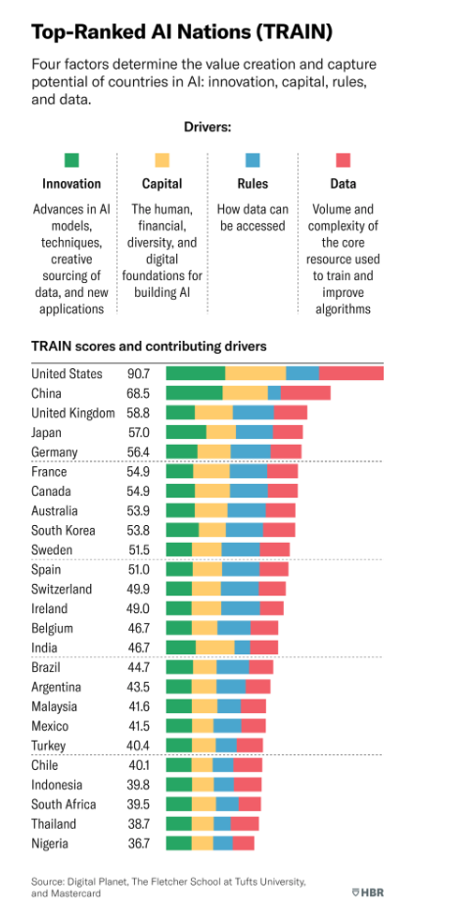
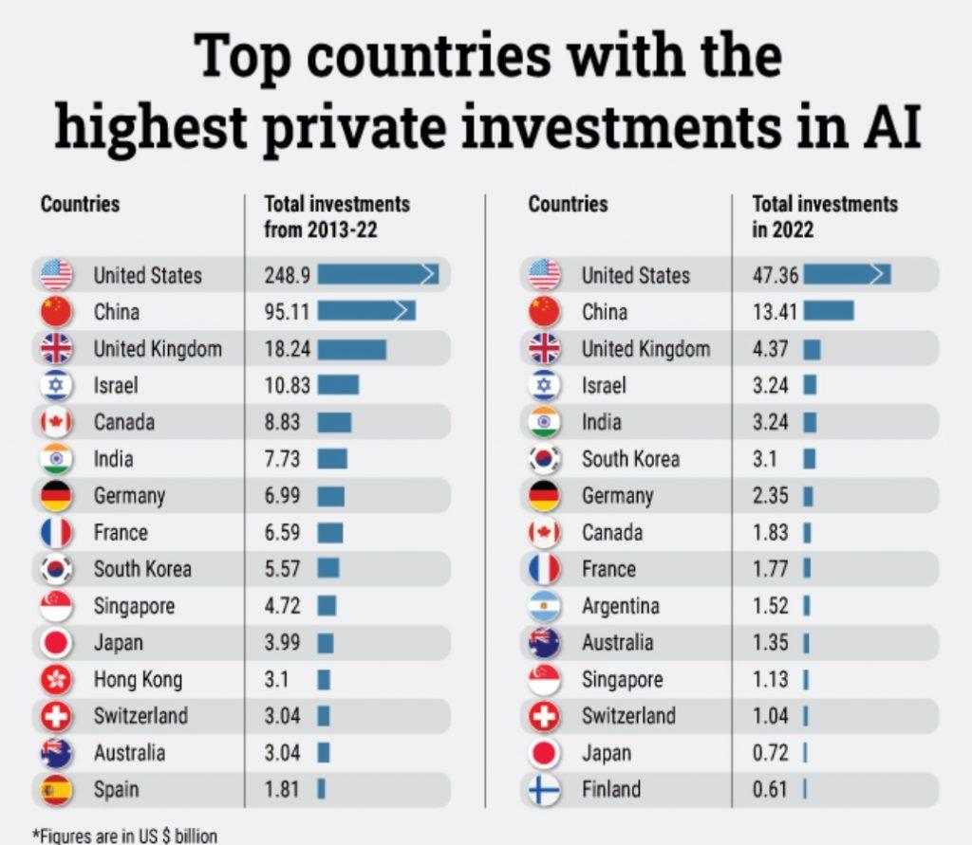
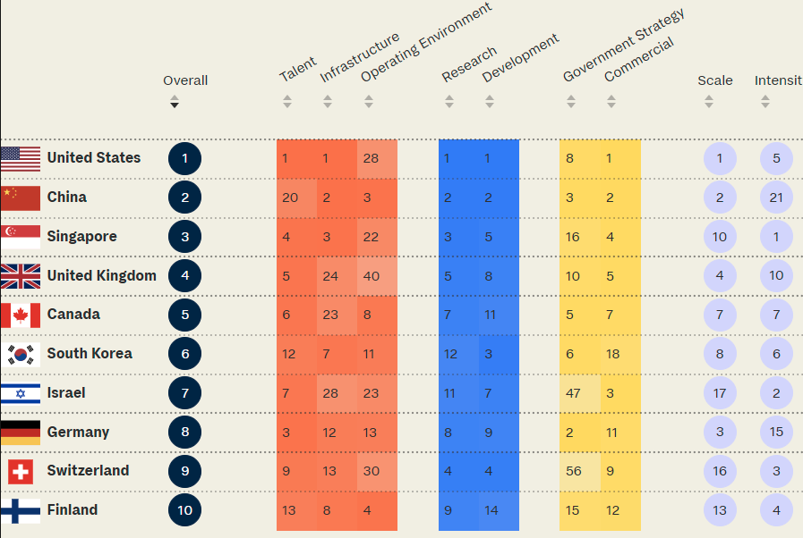
EU vs China vs US
EU started late
EU: more focus on regulation
EU: can count on a lower level of private fundings
Investment per Country (private)↑
← Country Ranking in AI per subitem
Country Ranking in AI per (other) subitems →

Slide 5
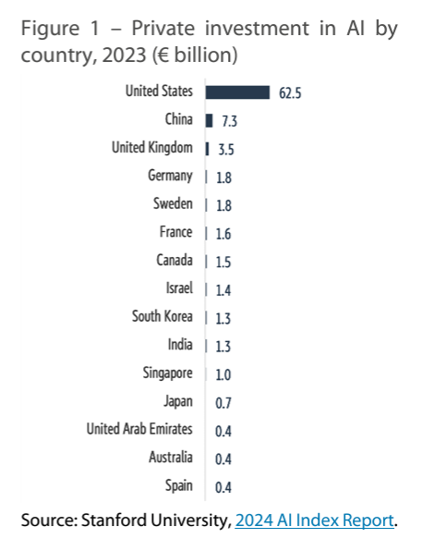
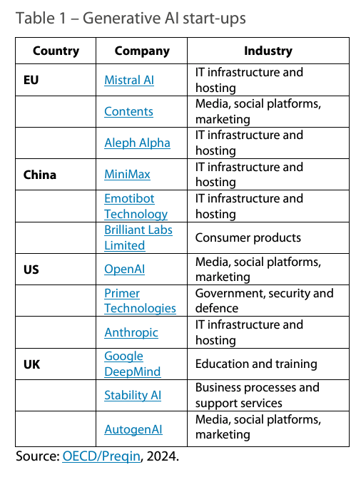
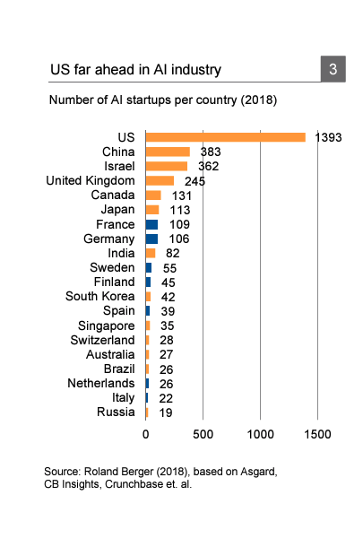
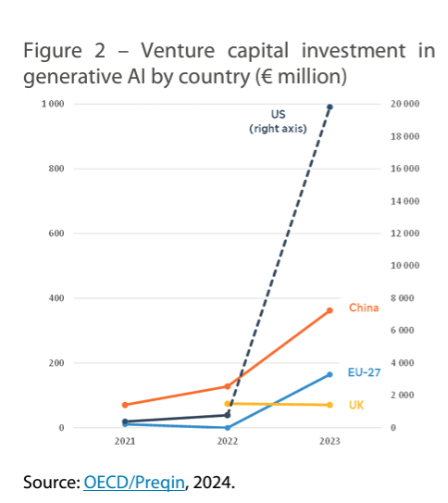
Notes:
https://www.europarl.europa.eu/RegData/etudes/ATAG/2024/760392/EPRS_ATA(2024)760392_EN.pdf
https://www.jsr.org/hs/index.php/path/article/download/1762/816/10694
https://itif.org/publications/2024/08/26/how-innovative-is-china-in-ai/
/https://www.dbresearch.com/PROD/RPS_EN-PROD/PROD0000000000505746/%28How%29_will_the_EU_become_an_AI_superstar%3F.pdf?undefined&realload=po8nZ8dM2IhIXQbzBvn76mE~fv14cny05JzSChAe4p07VMfXm0U6tncIApBDrr29

Slide 6
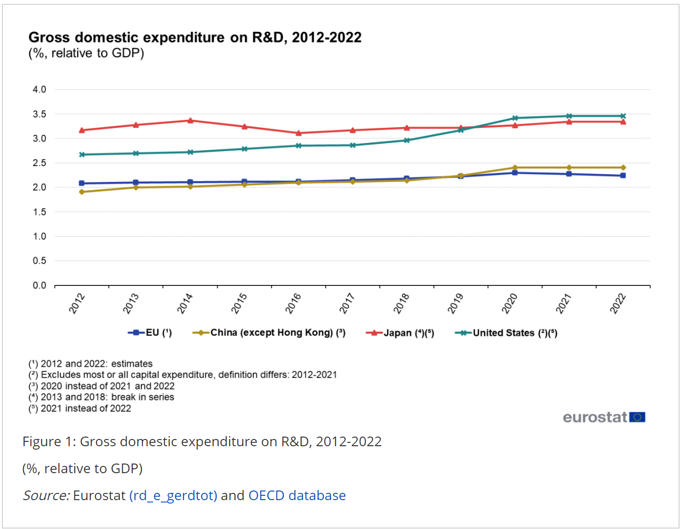
A general trend, not only AI

Slide 7
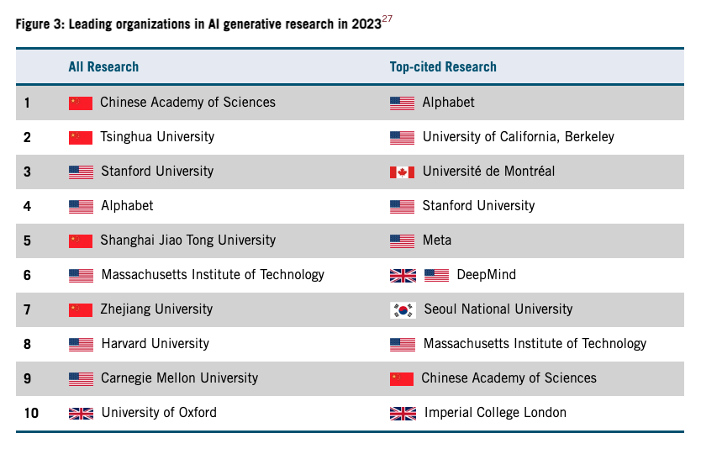

Slide 8

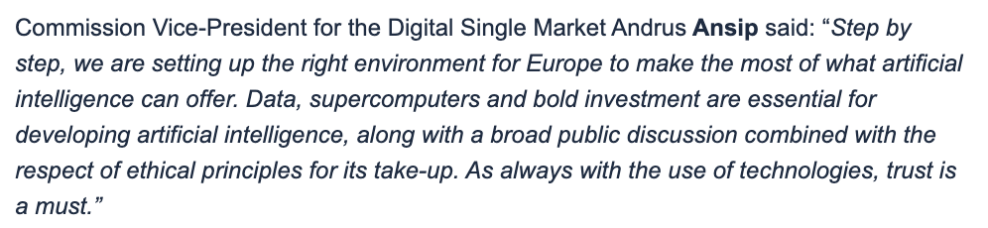
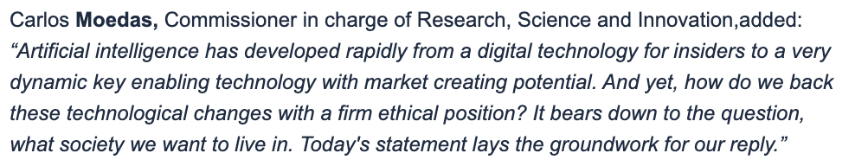
AI in Europe -- timeline
EU quite late in realizing the need to drive / push for AI, centrally.
A few landmarks
  2018: first real endorsement
From the start, a lot of focus on ethical points

Slide 9

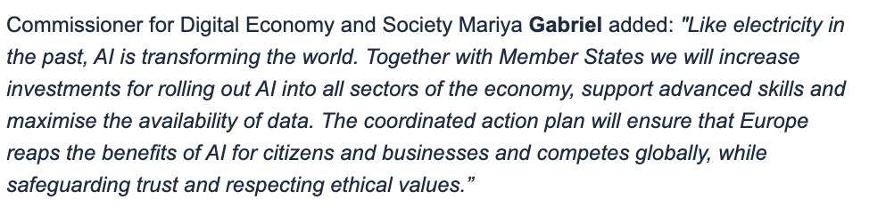
AI in Europe -- timeline
2019:

Slide 10
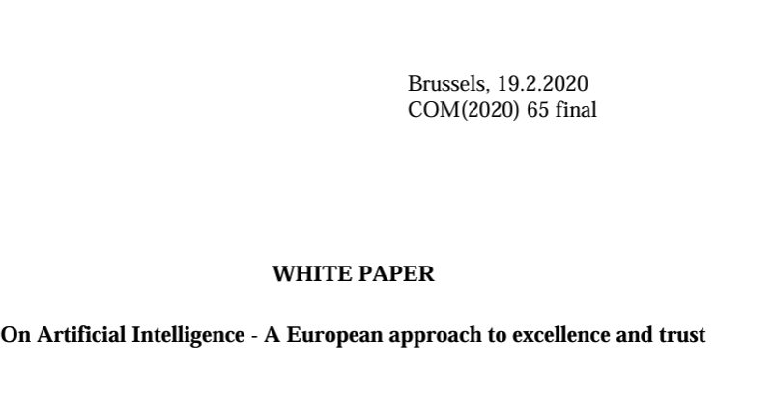
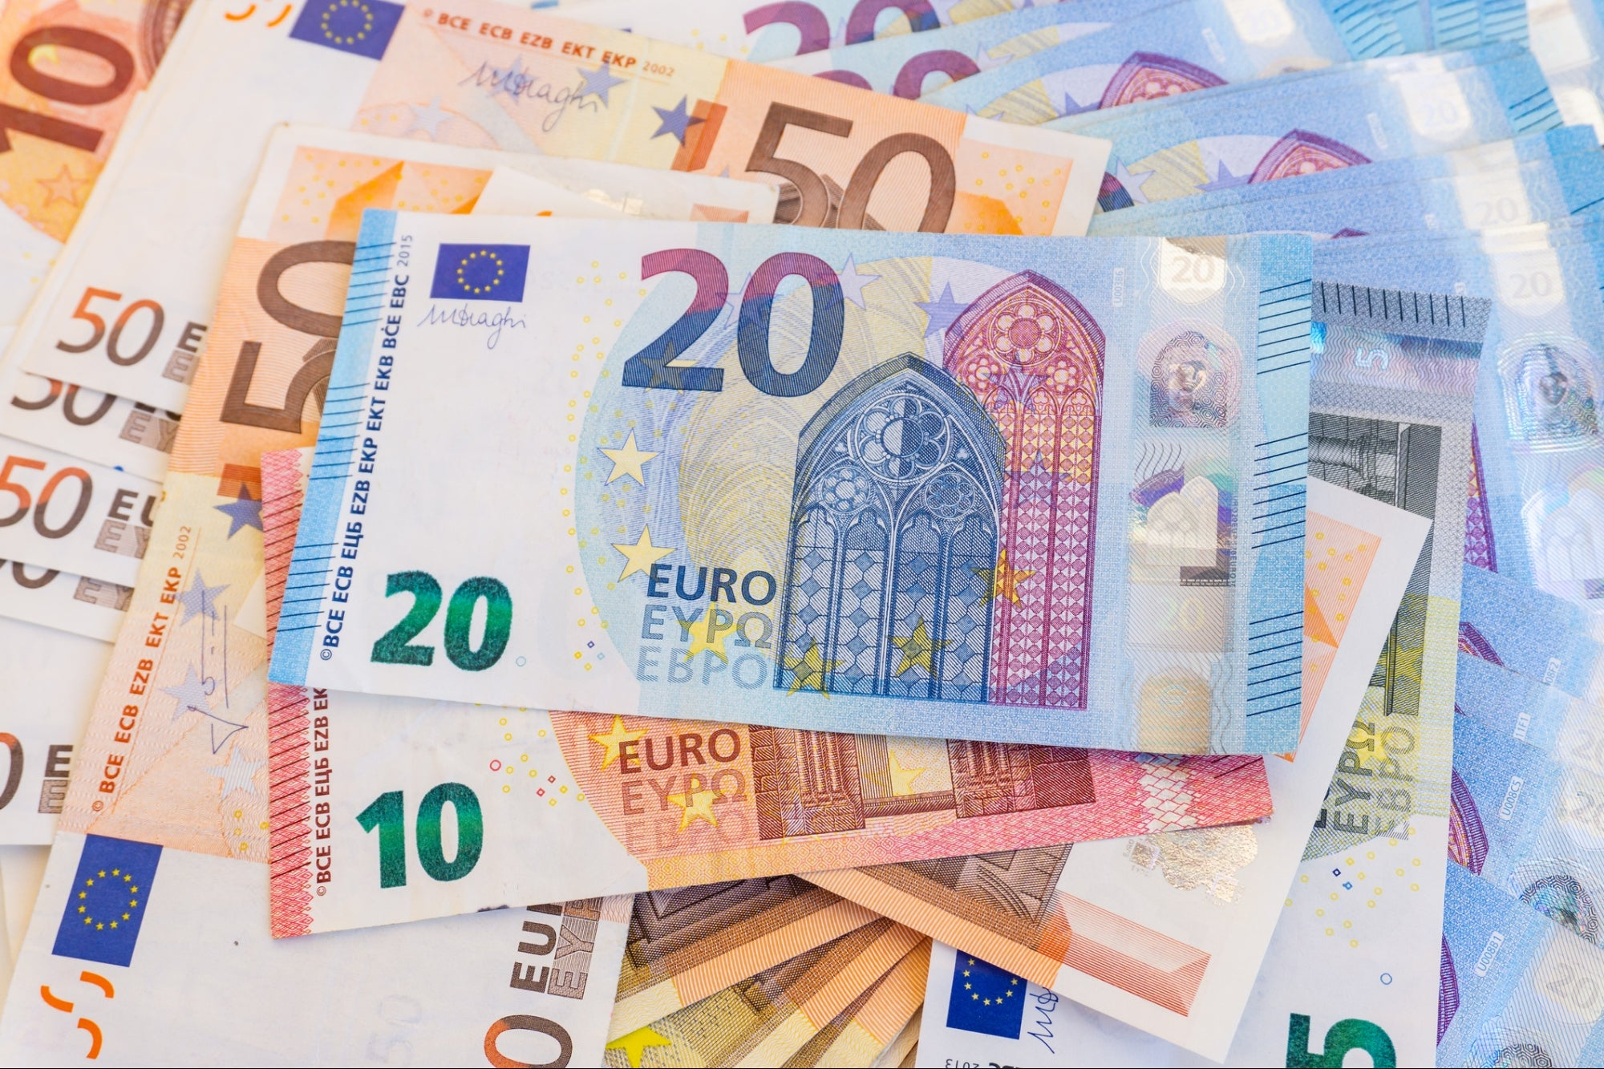
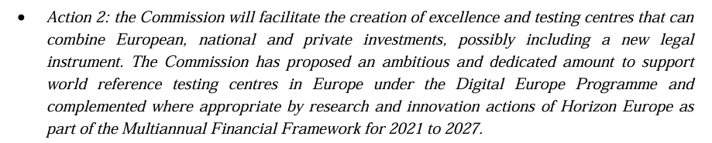
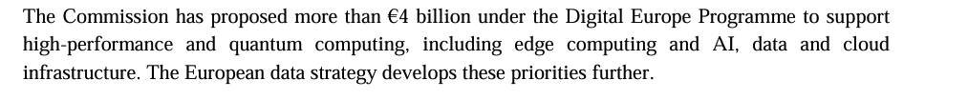
AI in Europe -- timeline
2020:

Slide 11

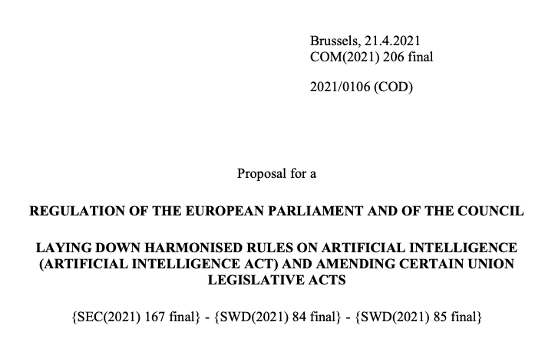
2021
First version of the AI act

Slide 12
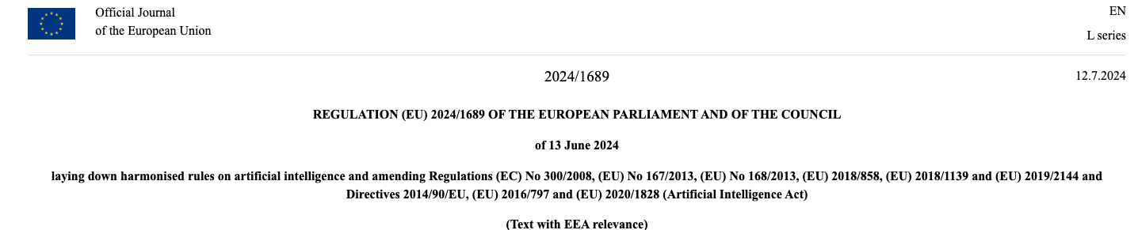
The EU AI ACT
Here, here
See F.Lizzi’s talk later
Notes:
https://eur-lex.europa.eu/legal-content/EN/TXT/HTML/?uri=OJ:L_202401689

Slide 13
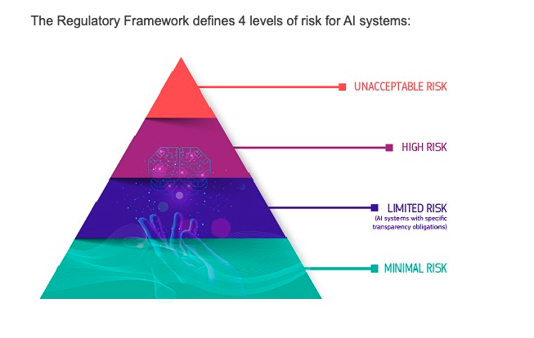
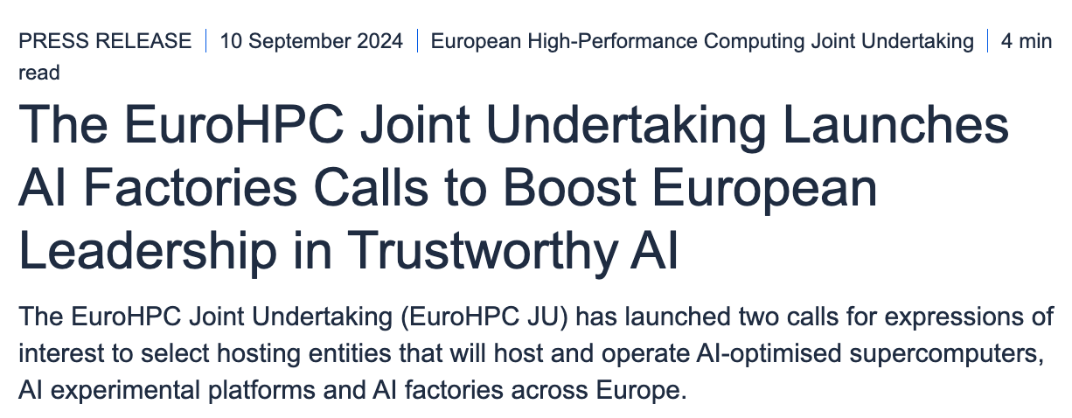
2024:
The AI act starts validity
Large (~ 1.6BEur) money for AI infrastructure

Slide 14
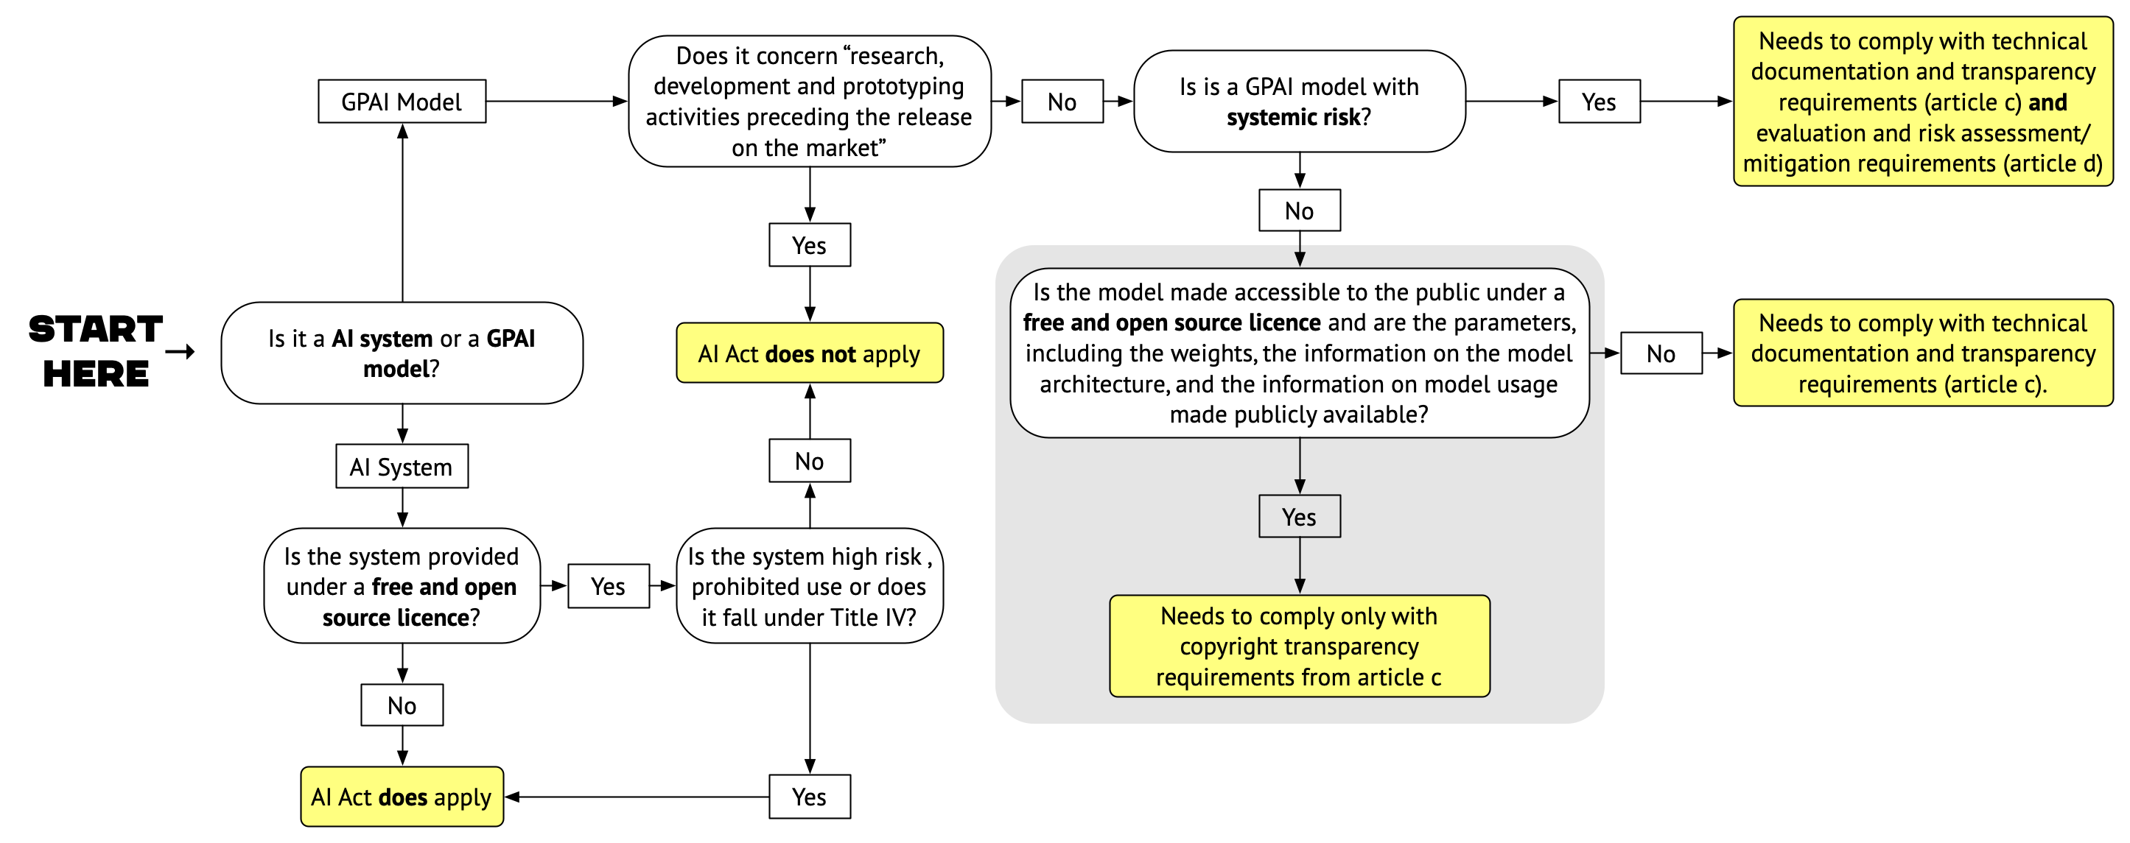
Notes:
https://openfuture.eu/blog/a-frankenstein-like-approach-open-source-in-the-ai-act/
https://scienceeurope.org/media/ulolndb2/science-europe-webinar-on-ai-report.pdf

Slide 15
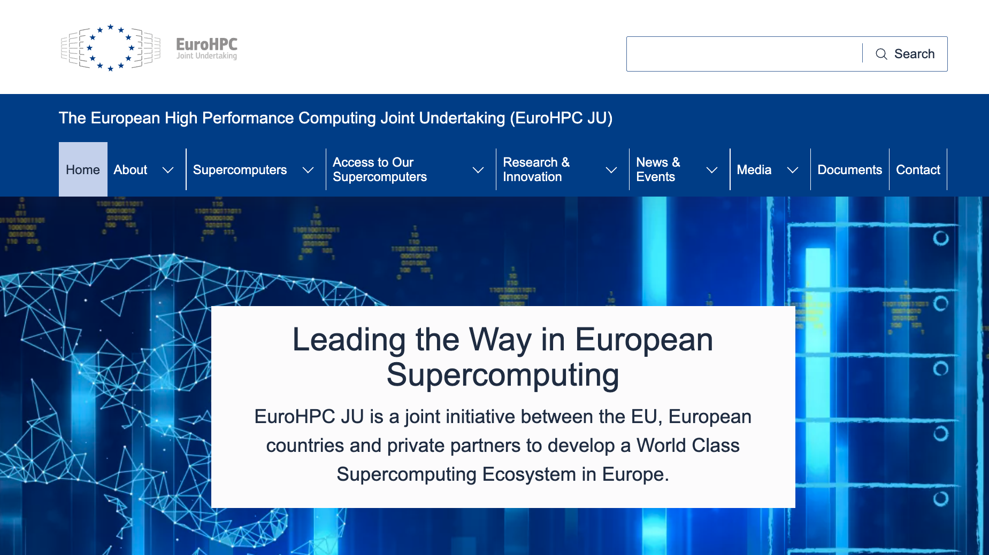
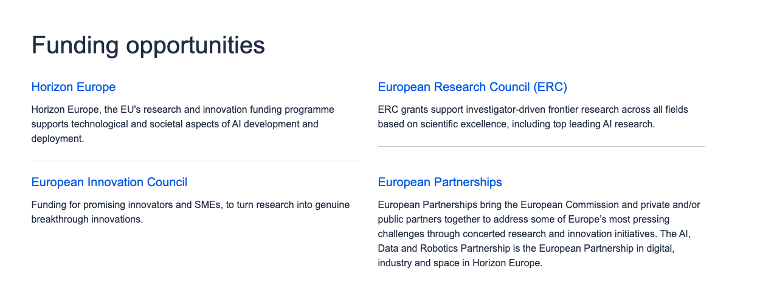

How does EC fund/governs AI?
2 streams
  The infrastructure / hardware side
    Quite advanced, mostly via EuroHPC (repurposed from generic computing)
    Preexascale: 120x3 (x2) Meur
    Exascale: 250x2 (x2) Meur
    AI factories: 200x4 (x2) MEur
  The application / foundational side
    A mess, many different funding streams
    No clue on how to get a number in Eur!!!
EuroHPC has taken to a large extent
the role of PRACE
ERC funds mostly individual foundational studies
Horizon Europe Institutional level projects
EIC is interested in startups and SME
European partnerships are large projects such as the EOSC
Notes:
https://research-and-innovation.ec.europa.eu/research-area/industrial-research-and-innovation/artificial-intelligence-ai-science_en

Slide 16

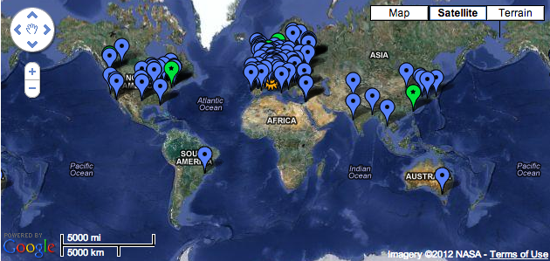
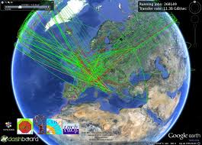
WLCG (what is it?)
The Worldwide Large Hadron Collider Computing Grid
  The computing system to collect / store / analyze the data from LHC Experiments
  Choice from late 1990s: implement as a distributed computing systems (compared to a single huge computing center @ CERN)
  A design choice which needed ~ 10 years of computing R&D
    The GRID, Authentican mechanisms, Tbps file transfers, …
  Today:

Slide 17
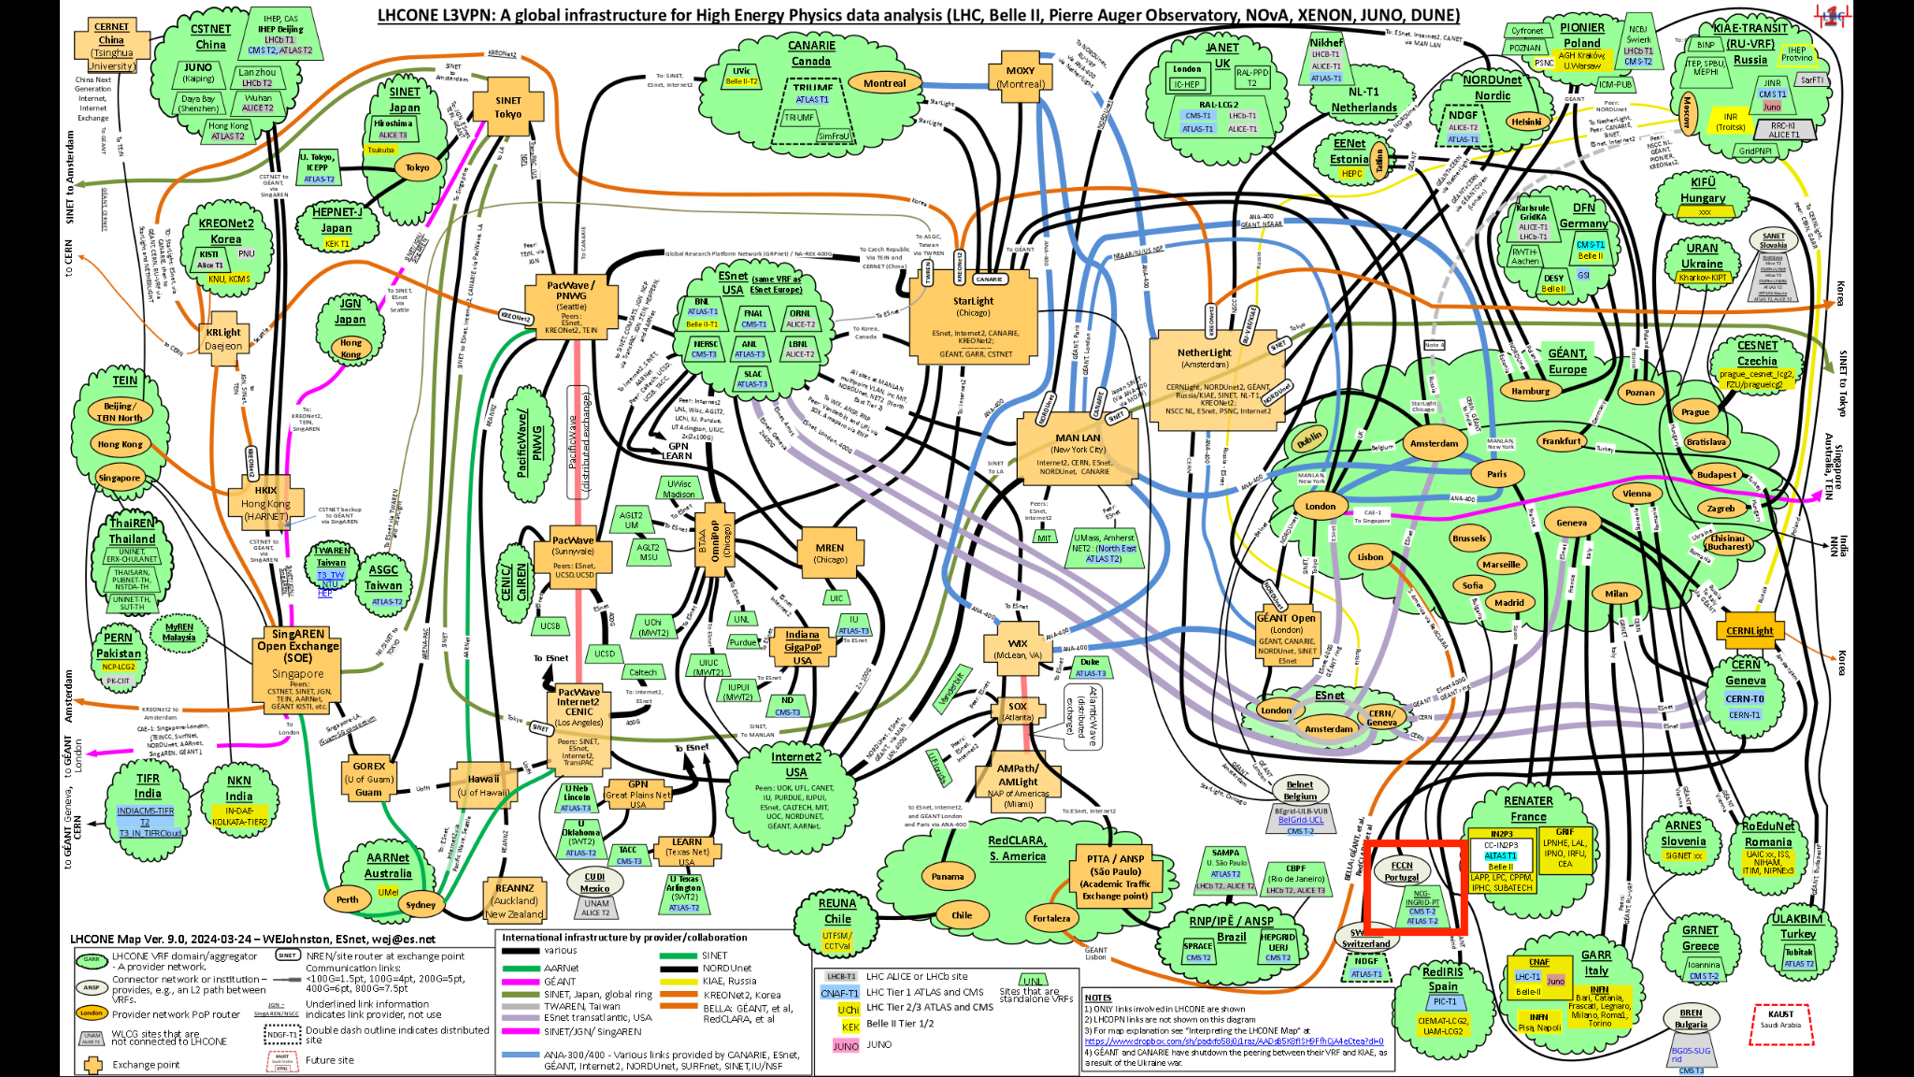


WLCG Computing (not so much about AI … yet)
Active since 2009 (data challenges since 2004)
200 Computing centers
  ~ 1.5 M CPU cores
  ~1.5 EB of disk
  ~2.5 EB of tape
  GPUs starting to appear
  (not mainstream atm)
Global Data Management System (using RUCIO+FTS)
Accessing HPC resources as “site extensions”
Data more critical than computing … is this going to be the case also for large scale AI?
2 VPNs (L2 and L3) deployed; > 2 Tbps sustained

Slide 18
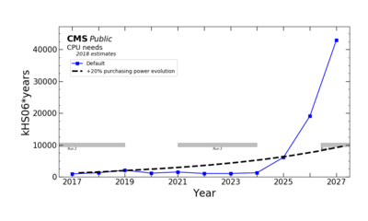
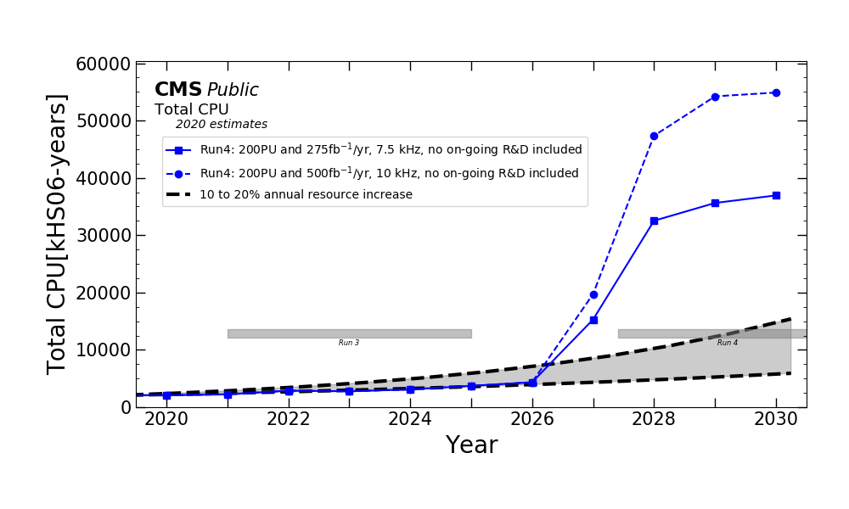
Computing and AI for CERN/LHC/WLCG ….
WLCG (CERN computing infrastructure for LHC data processing) has a Computing sustainability problem … does it?
Computing extrapolations for the High Luminosity LHC (2030-2041) are exploding wrt the current (already expensive) LHC Runs
Honestly, that is the problem for me. I care for AI if it is a solution to this problem (or in general to “doing better physics”)
Black line = flat budget
(you can buy more computers with the same money if you wait …)
2030 is the new 2026

Slide 19
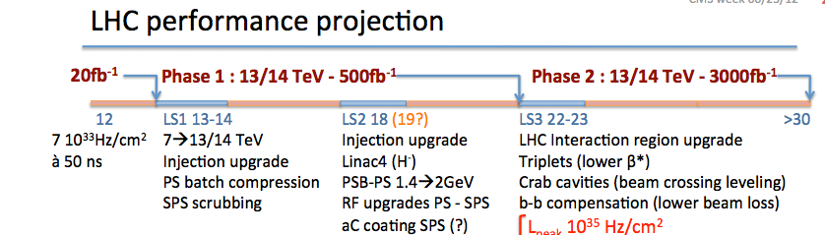
Why these numbers?
shutdown
run
Run 1
Run 2
Run 3
Unknown territory…
From 2017….
2015-2018: 13 TeV, ~2.5x in luminosity, up to 3x in hadronic events per collision
2021-2023: 13 TeV, again 2.5x in luminosity
2026+: the so-called HL-LHC (or SLHC)
2035+: the so-called HE-LHC @ 30 TeV
  Magnet for this simply do not exist at them moment, so wait and see
(2040+: at some point I will retire, so no more my problem…)
We are here

Slide 20
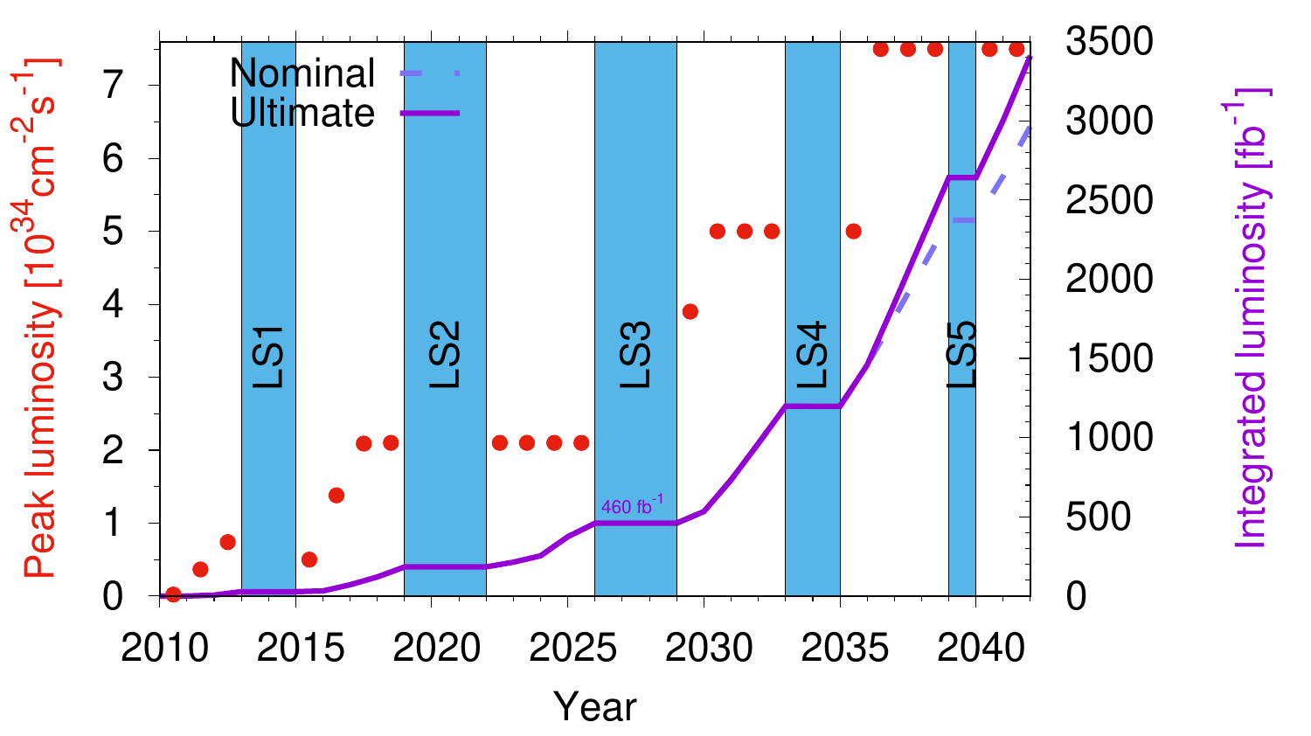
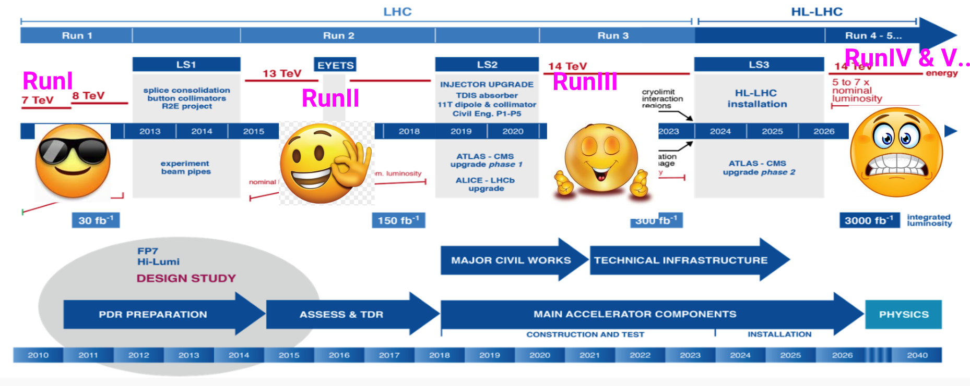

We collected by now ~ 15% of the total LHC luminosity
LHC is working at ~25% of its final performance

Slide 21
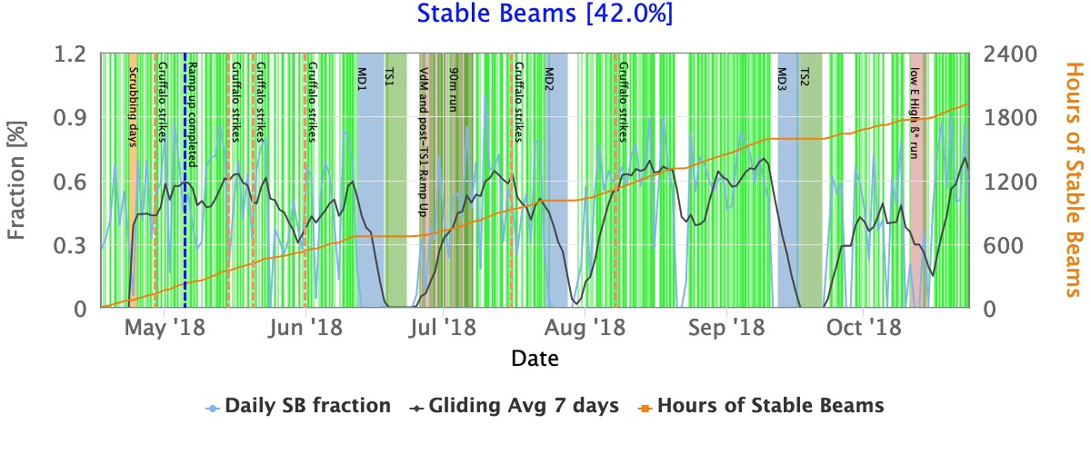
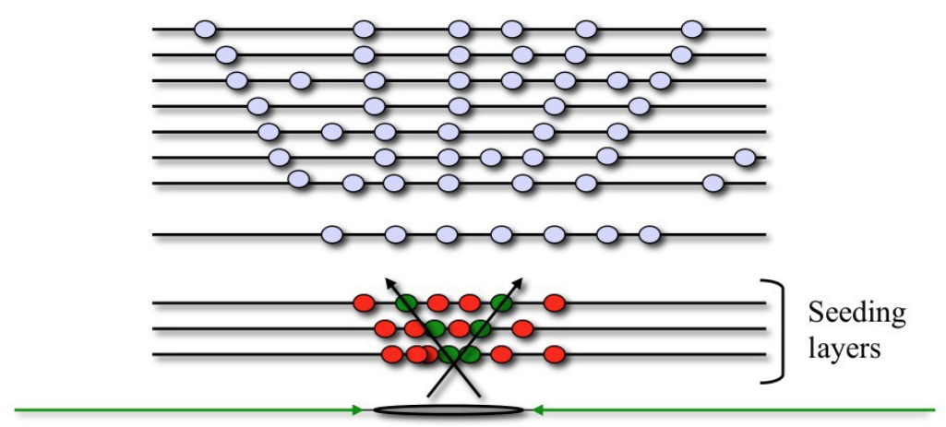
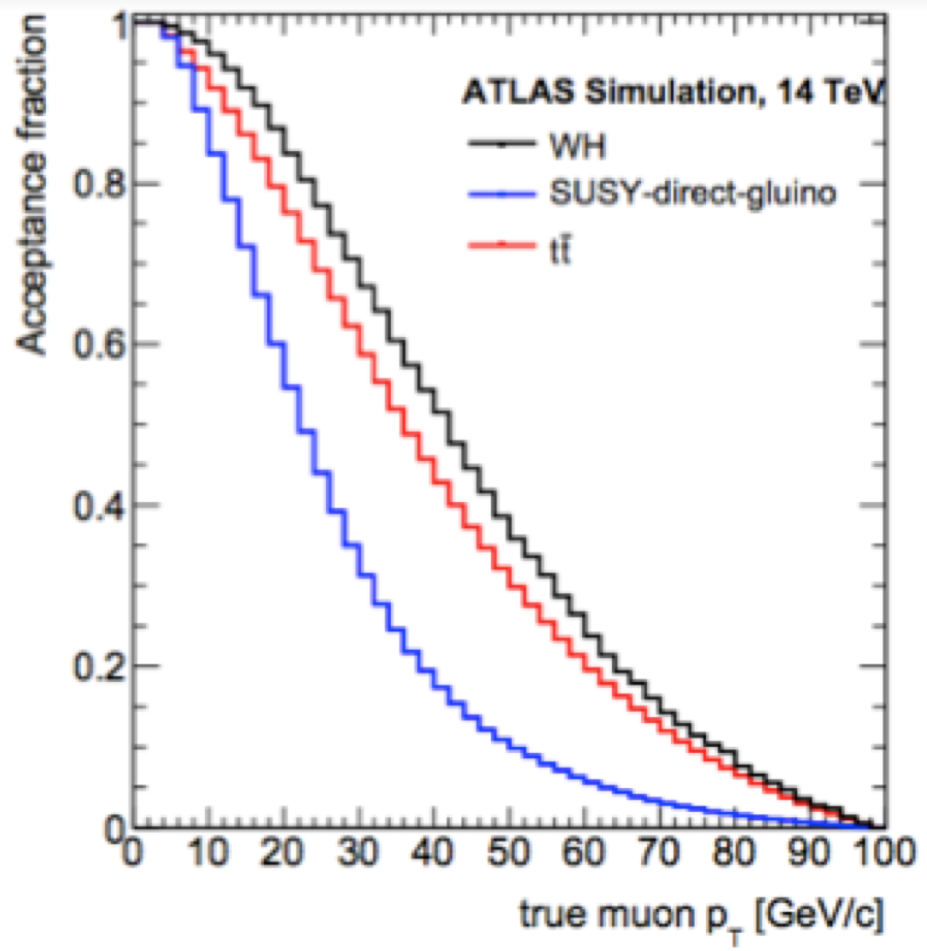
The scalings (trivialized …) in LHC → HL-LHC
Main Evolution of important computing parameters
  Live time cannot change much; if anything can go much below
  <PU> goes from 50 to 200 (~ instantaneous luminosity)
  Trigger rate 2 kHz → 7.5 kHz
HL-LHC / LHC = (7.5/2) * (200/50) = 15
This is optimistic!
  Triggers have to remain clean
  Assumes all is linear with <PU>, while reconstruction has at least a superlinear component
  Upgraded detectors, more DAQ channels
A more realistic educated guess is ~50x keeping all the rest constant
Trigger rate scales at best with ℒ for
Same physics
Clean triggers
Difficult to do better than this

Slide 22
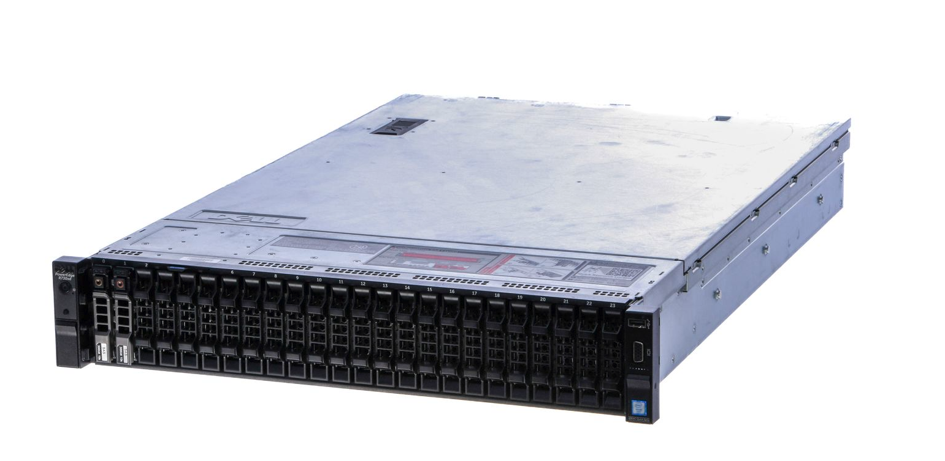
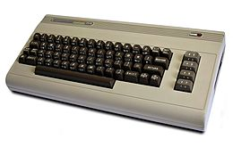
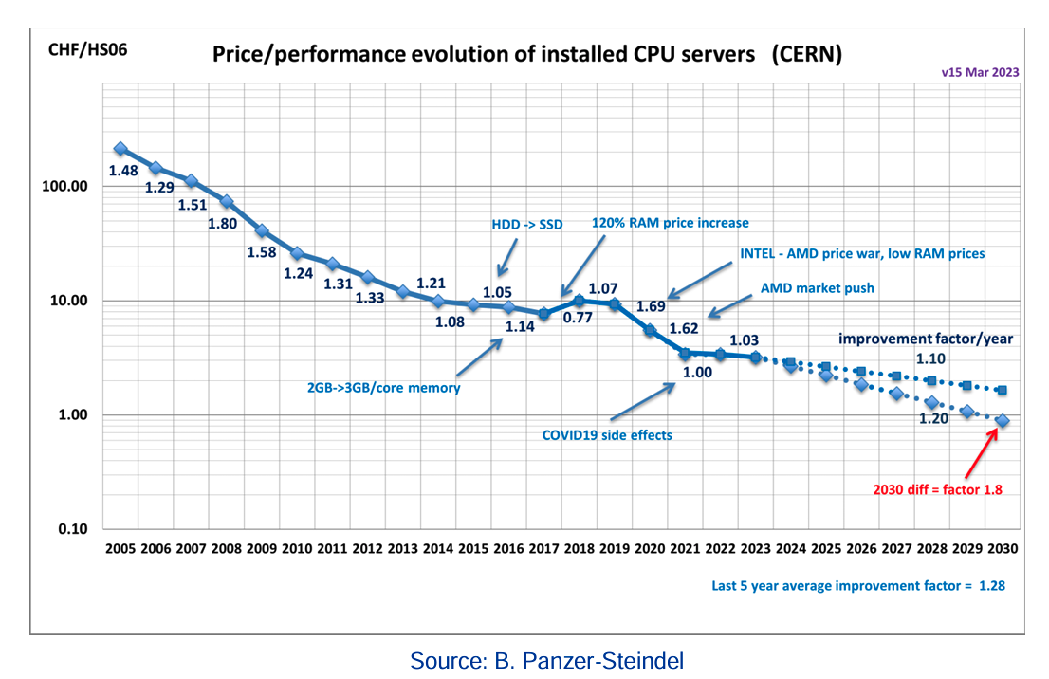
Do we need 50x more money for WLCG computing?
Well, partially:
  Moore’s law: resources cost less year over year
    A rack server today is ~ 5e12 Operations per second, a Commodore 64 was 4e2 Operations per second … and obviously there is not a factor 1e12 in the price!
  Prices go down … in the timescale now-2030 we can expect up to (1.2)^6 = a factor 3x
  Same for storage, network, …
So 50x → 15x ….

Slide 23
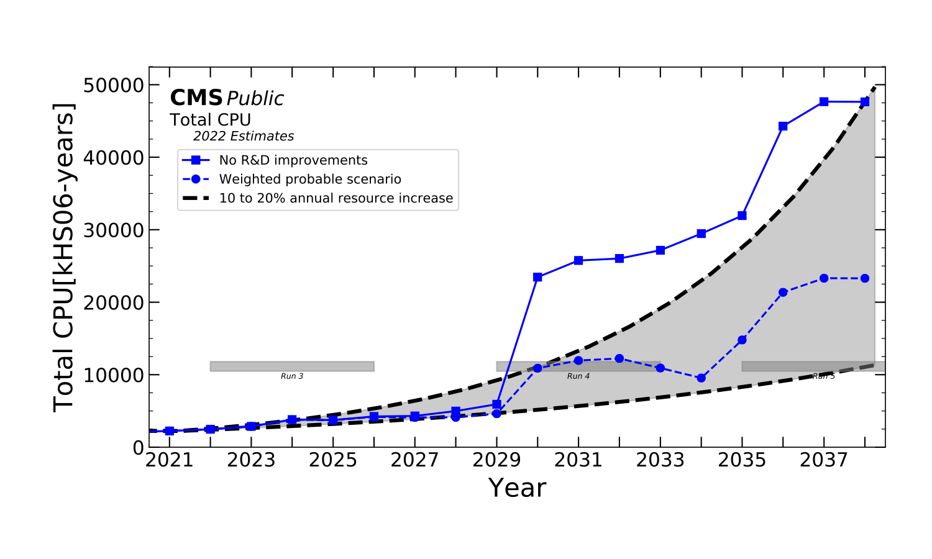
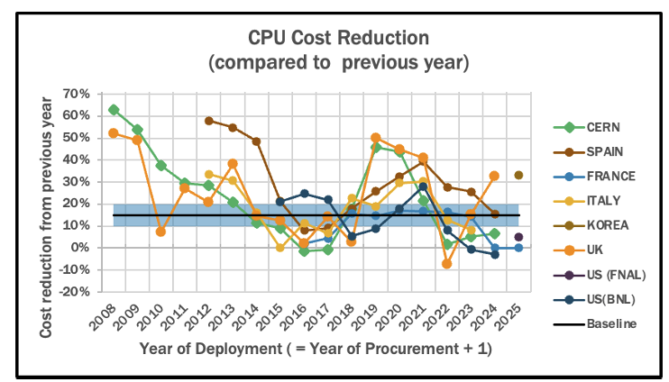
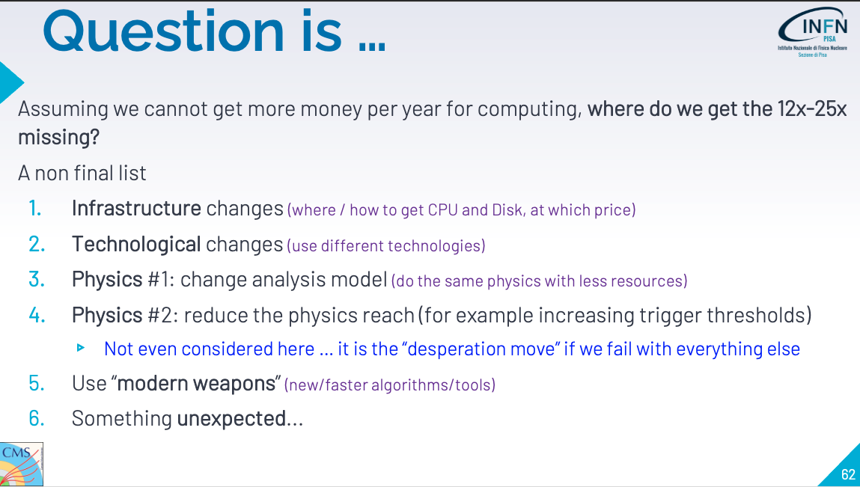
This obviuosly triggered some “panic” (which we call R&D). But, which are the ways to decrease the computing needs for an High Energy Physics Experiment?
From CERN/FNAL School 2021

Slide 24
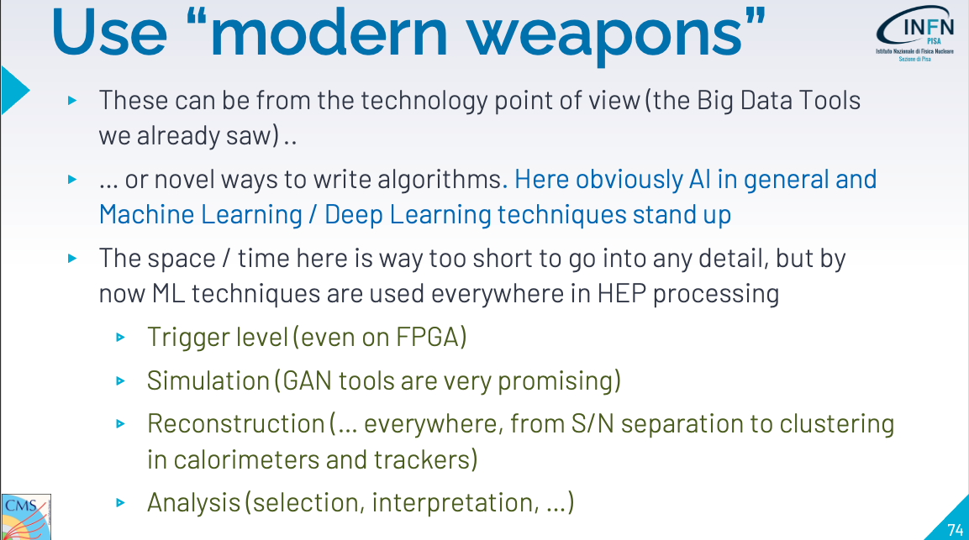

Slide 25
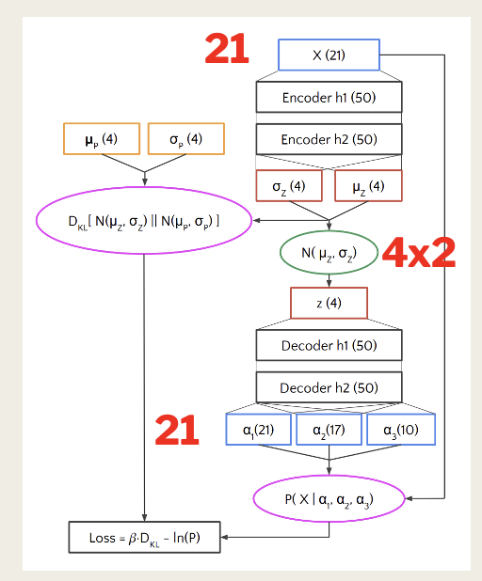
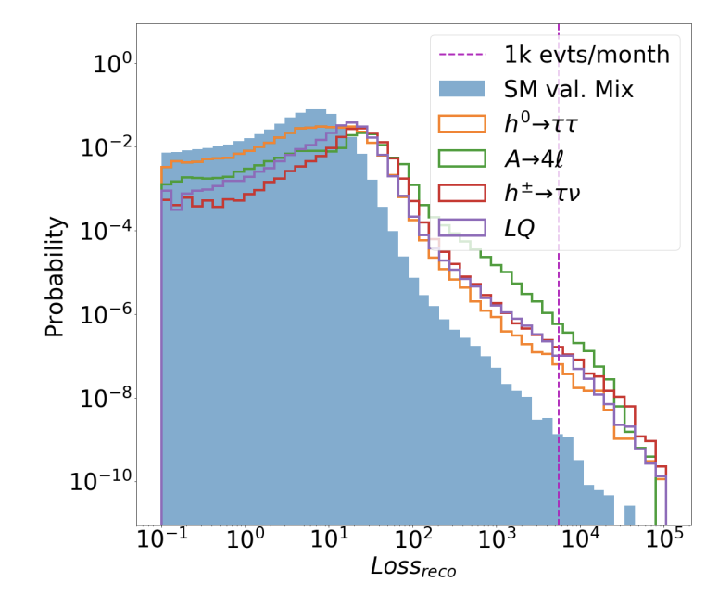
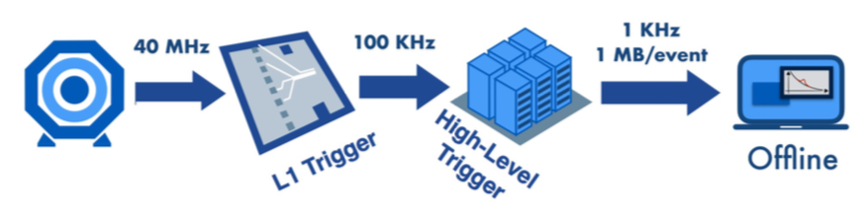
Pervasive ML in HEP [1/3]
Autoencoder with 21 inputs/outputs, and dimension 8 in the latent space.
Trained on SM events (or in practice, all events since they are so much more abundant)
ML in data acquisition and trigger
  Bkg and trigger rate reduction
  Signal specific trigger paths
  Anomaly detection in data taking
  Unsupervised new physics mining
E.g. LHC experiments’ trigger is a strong “driver” for high-performances ML applications
  Next-gen trigger systems → real-time reconstruction → real time analysis
Challenge is the trade-off between algorithmic complexity and the performances achievable under severe time constraints in inference
Accept ~1000 events month to be better scrutinized. If NP, should be predominant
1000 SM events/month
@ 10³⁴
[ CMS - credits: M.Pierini ]

Slide 26
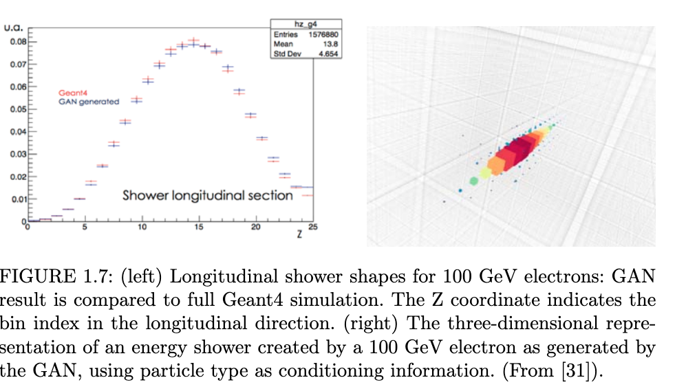
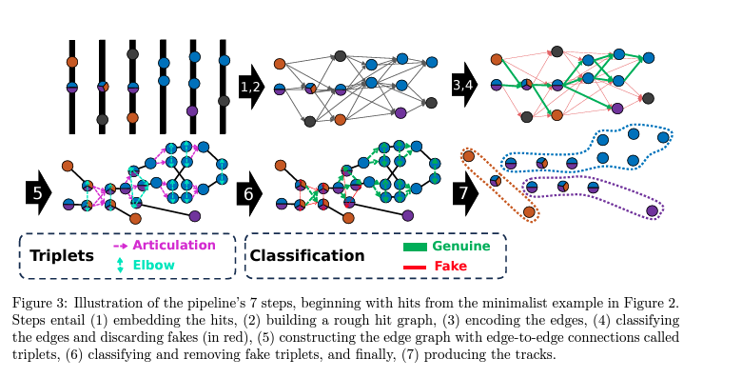
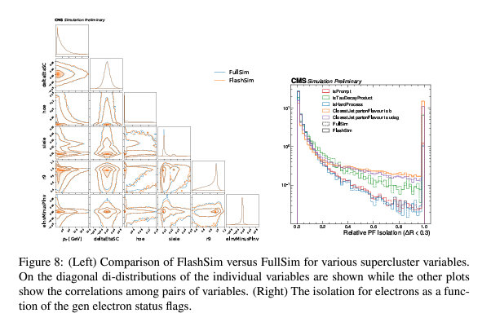
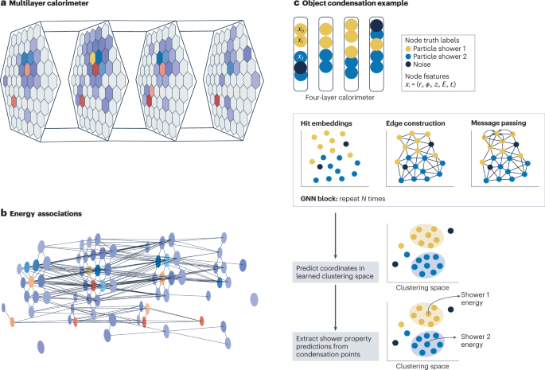
Pervasive ML in HEP [2/3]
ML in Event Simulation
The production of simulated events (full/fast simulation) is extremely intense from the computation standpoint (up to the point it might impact the physics reach of the experiments). ML can help to reduce such load
  Calorimeter shower surrogate simulator
  Analysis level simulator
  Pile-up overlay generator
  Monte Carlo integration
  ML-enabled fast-simulation
  Invertible full-simulation (probabilistic programming, …)
  …
ML in Event Reconstruction
Online/offline reconstruction might be partially replaced by surrogate models (approximate → faster) or by new algorithms (that might offer unprecedented performances)
  Charged particle tracking (GraphNN, vertexing, …)
  Calorimeter reconstruction (local, clustering, …)
  Particle flow (GraphNN, …)
  Particle identification (boosted jets, isolation, …)
  Pileup mitigation
  Energy regression (end-2-end, …)
  …

Slide 27
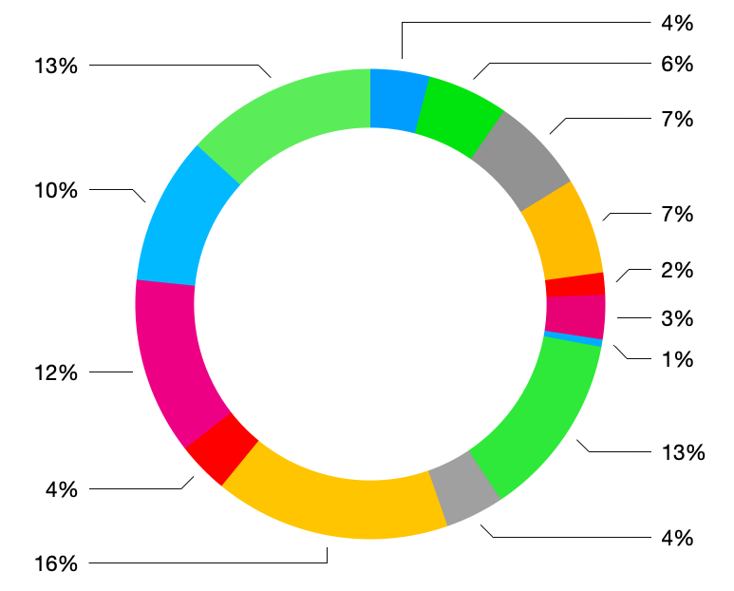
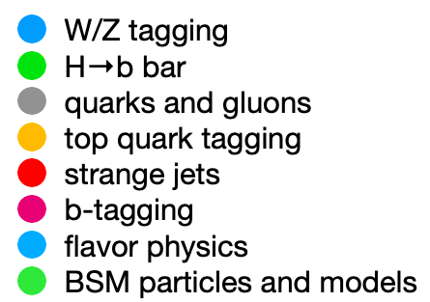

Pervasive ML in HEP [3/3]
ML in Data Analysis
ML in Computing Operations
Application of ML to non-collision (meta-)data might help to increase efficiency and reduce the need of person power in Ops, e.g. automating specific tasks, developing intelligent/adaptive systems, ultimately acting on the full chain - from data collection to data analysis - and make it more agile
  Detector control
  Data quality monitoring
  Operational intelligence
  Predictive maintenance
  …
Data: IML

Slide 28



ML/DL in HEP
“Traditional” ML
ML in HEP started by using domain knowledge to perform feature extraction/engineering
  HEP physicists design high-level features, and use ML in place of traditional (small → medium → large) algorithms

Slide 29


Particle id, energy resolution, and beyond ..
BDT used for learning energy correctionsin calorimeters usando tutte le info disponibili nei vari sensori calorimetri
  es. CMS: energy sum, bremsstrahlung reccovery, use of pre-shower… It is a regression!
LHCb uses NN trained on O(30) features → mis-ID bkg/particle reduced by ~3x
better
better
[ 2015 ECAL detector performance plots, CMS-DP-2015-057. Copyright CERN, reused with permission ]

Slide 30


ML for discovery and features of the Higgs
ML instrumental to the Higgs discovery (beyond the pre-LHC expectations)
  es. diphoton analysis in CMS, BDT used for regression and characterizations
  → sensitivity increased by ~50%
Higgs properties: 𝜏 leptons in
→ 40% better sensitivity wrt a non-ML approach
[courtesy M.Pierini]
[1] JHEP 04 (2015) 117

Slide 31

Test di alta precisione del MS
CMS and LHCb: rare decay B⁰s→𝜇⁺𝜇⁻
  E.g. BDT used to reduce the dimensionality in the feature space and for analysis
  → use of ML equivalent to a classical algorithms with 4x more statistics
Mass distribution of the selected B⁰ → μ⁺μ⁻ candidates with BDT > 0.5 [2]
[1] Nature 522 68–72 (2015)
[2] Phys.Rev.Lett. 118 (2017) 19, 191801
Notes:
(as rare as ~ 1 / 300 billion pp collisions..)

Slide 32
ML/DL in HEP
“Traditional” ML
Seeking DL solutions
Since some years, ML (DL) in HEP seeks for more advanced techniques, e.g. deep NNs
  Use all the features space at its full dimensionality to train deep NN - no more manual feature engineering
→ estract best from data, and do so by exploiting any architecture that might work for a given use-case (e.g. input from CV and NLP solutions..)

Slide 33


Convolutional Neural Networks (CNN)
CNNs offer translational-invariant feature learning, robustness against noise, versatility in application to a variety of domains
  Extremely vast zoo of architectures! Primary target: computer vision
  are based on sequences of convolutional and pooling layers, and
Industry:
Large adoption in computer vision applications (e.g., self-driving cars, ..)
HEP:
3D imaging in detectors, event classification, automation of hist checking (e.g. data quality), …
General tactics: (TPCs, CALOs..): represent your data as 2D/3D images (even 4D w/ timing info)
→ problem casting into a computer vision task

Slide 34


Deep learning in jet flavour identification
Esempio
The lower the better!
B-tagging
heavy-flavour (b/c quarks)identification in jets from pp collisions at 13 TeV
  DL version ~ 5x lower background at the same efficiency level, OR 20%better efficiency at the same background level
  (best algo vs best DL)
[1] JINST 13 (2018) P05011
[2] JINST 15 (2020) 12, P12012

Slide 35



Autoencoder (AE)
AE is a“data-specific” compression algorithm, able to reduce dimensionality and extract “the juice” of an input
  a feed-forward (un/self-supervised) NN capable to encode the input into a reduced-dimensionally representation (“latent space”) and decode it in output
AEs in Industry:
dimensionality reduction (like PCA), clustering, denoising, …
AEs in HEP:
anomaly detection (intestìni events are those whose decoding in output is dtstant from the input, according to a given metric
Potenziale strumento per scoprire nuova fisica in modo “unsupervised”

Slide 36


(V)AE per ”new physics mining” - at LHC and beyond
Esempio
A Variational AE has been proposed (CMS) for “new physics mining”
  Train on known SM processes, build threshold to identity “anomalous” (i.e. interesting: BSM?) events
  Treat them as outliers, save them (no trigger kill!), build a catalog for further inspection
  Model-independence: training not dependent from specific new physics signatures → assumptions-free
  Might be complementary to classical methods, i.e. model-dependent hypothesis testing
  Target: up to the trigger level..
Note: going from discriminative AI to generative AI …
[1] JHEP05 (2019) 036

Slide 37





Generative Adversarial Networks (GAN)
A generative algorithm, based on an architecture with 2 NNs, a generator G and a discriminator D, which compete
  G creates images from noise, D classifies them real vs fake
  Once trained one against the other, G pursues its goal which is to confuse D, and in the process it learns how to creare fake but very realistic images
Industry:
image editing, data generation, security, ..
HEP:
Simulate the detector response at reduced computational costs

Slide 38


Event simulation with GAN
Esempio
Fast and high-fidelity generative models can represent alternatives and learn from existing data samples → high-dimensional feature distribution sampling.
Early approaches show improvements in simulation speed by orders of magnitude compared to FastSim, from which all HEP experiments would benefit…
→ e.g., CaloGAN, a FastSim technique to simulate 3D showers in multi-layer ECAL systems using GANs, can learn and generate the reconstructed calorimeter image, bypassing the GEANT and RECO steps → 10k times faster than the default.
... but the accuracy still needs to improve (method limitations, training instability, etc.).”
Let me know if you'd like any clarifications!
CaloGAN composite generator (left) and discriminator (right)
[1] Phys.Rev.D 97 (2018) 1, 014021

Slide 39


Graph Neural Network (GNN)
Think of a CNN acting on its input features (pixels). Its power resides also on a “regular-array dataset” paradigm
  Data represented as sets of dense arrays/tensors, with intrinsic metrics
In a sparse representation, we need a metric that defines proximity in the abstract space of features
How? Migrating from“datasets” to “graphs”
  Connect elements of a dataset and train a NN to learn which are the relevant connections
GNN → build a data structure, (V,E) with V=vertex and E=edges, choose possible types of vertices (if no prior one builds a fully-connected graph), etc
GNNs start to be part of present/future of DL in HEP

Slide 40

ML/DL in HEP
?
“Traditional” ML
Seeking DL solutions
What next?
?
D. Bonacorsi

Slide 41
NaNatural Language Processing (NLP)
Important advances in the decade 2010-2020, thanks to deepNN (“Deep Learning”)
  Machine Translation → e.g. language A - Language B translation
  Text/Document Classification → e.g. doc clustering, sentiment analysis, ..
  Entity Extraction (a.k.a. Named Entity Recognition) → extracting relevant information from unstructured text (e.g. vital parameters of a patient from her/his medical record)
  Summarisation → e.g. generating concise summaries of docs
  Question-Answering → multi-domain and multi-language factual knowledge
  Digital Assistants → e.g., Amazon Alexa, Google Assistant, Apple Siri, ..
NLP “first generation” (2010 - ~2017):
  RNN, or Long Short-Term Memory (LSTM), trained on text corpus to learn the structure of language
    Handle text as a sequence of symbola (“token”), mapped to multidimensional vectors (“embedding”) and processed through a hierarchy of levels
But then.. a “second generation” came in..
BTW: is NLP relevant for HEP? → Yes.
D. Bonacorsi

Slide 42



“Attention is all you need”
Google (Brain), 2017: a new deepNN architecture called Transformer
  A native seq-2-seq, with a key element: the “attention” mechanism, that allows to pass the meaning of a token in the context of other tokens in the same text
  Soon became the reference model for language processing (see next)
Residual streams: info channel at high capacity (d=12288 in GPT-3). Attention and MLP modules can read/write from/to subspaces of residual streams w/o interference with message passing.
D. Bonacorsi

Slide 43
Language Models: from LM to LLM
“Second generation” → modern Language Models (LM): a class of probabilistic models that learn patterns in NL via more advanced methods
  Architetture change: from RNN to Transformer
  Tokenization → multi-language and multi-domain
  Training on extremely large text corpuses (incl. source code!)
Major players:
  GPT-3 (OpenAI, 2020) from which ChatGPT derived (OpenAI, 2022): trained on 45 TB of text (equiv. 2000x Wikipedia), Estimated training cost: 4.6 M$. GPT-4 (OpenAI, 2023). Estimate: 1 order of magnitude more params
  Bard/Gemini (Google), Claude (Anthropic), LLaMA (Meta)
Significant efforts into scaling LMs into Large LMs (LLM)
  → training bigger models on more data with greater compute
  → steady+predictable improvements in their ability to learn patterns
  This could be observed in improvements to quantitative metrics.. but also qualitative (!)
Before getting to this, some examples..
D. Bonacorsi

Slide 44

LLMs for Multimessenger Astronomy
Observations in astronomy:
[ credits: D. Kostunin, A. Alkan, A. Chaikova, V. Sotnikov et al. ]
44
D. Bonacorsi

Slide 45



LLMs for Multimessenger Astronomy
An example text based on ATel messages
(astronomerstelegram.org)
Goal is to build an information extraction system, i.e. recognize a list of predefined concepts (celestial objects, astronomical facilities, physical properties, people, organization etc.) from a text and produce LLM-generated event summaries based on the parameters of each event
From entity recognition…
… to semantic relationship extraction
[ credits: D. Kostunin, A. Alkan, A. Chaikova, V. Sotnikov et al. ]
D. Bonacorsi

Slide 46

A 7B LLM fine-tuned on Cosmology papers and textbooks
“Cosmosage”, a general-purpose AI-assistant specialised in answering questions about cosmology (based on Mistral-7B-v0.1)
  training dataset: arXiv papers, astro textbooks, physics textbooks, wikipedia
[ credits: Tijmen de Haan ]
D. Bonacorsi

Slide 47
A LLM-based AI-assistant for a CERN experiment
“ChATLAS” a prototype LLM project in a LHC experiment (ATLAS) at CERN (as of end 2023)
Data gathering part is interesting (data chunking and data retrieval not described here)
  Docs: twiki (>2k), sw docs (>500), e-groups/mails archive (>10k), indico meetings’ agendas incl. attached slides and minutes (>440k), Mattermost, Jira tickets, experiment’ papers and internal notes (>66k)
  Either HTML or scraped into markdown
Many open challenges:
  highly heterogeneous data
  ensure that collaboration DBs are accessible and exportable; websites should live on a git repo; pubs should be saved as latex, and compiled separately; discussion forums should have anonymisation options… Estimates indicate that this would have saved ~1 yr of data wrangling
  Hallucinations are a real problem
  Not many gpu-hrs, but many expert-hrs, needed for any high-quality fine-tuned AI assistant
[ credits: Cary Randazzo ]
D. Bonacorsi

Slide 48

What does a ML solution offer to HEP, overall?
Less computing resources for the same task
  Main outcome in this discussion! “Bring down the curves!”
But this is just to get budget under control, what is more interesting in the long run is ”getting better performance with a similar budget”
Large investment in experiments, and recognition from CERN as a “global topic” →
AI will be one of the topical discussion on Computing at the Upgrade of the European Strategy for Particle Physics (2025)

Slide 49

But … infrastructure?
WLCG has deployed a large infrastructure for its processing needs
  ~200 computing centers
  Good balance of Storage and CPUs
  Large and reliable networking
  Efficient access to data
… but a (very) low number of GPUs
Where do we execute ML training workflows (and eventually also inference?)

Slide 50
AI oriented Italian projects

Slide 51

The Italian Center for HPC, Big Data and Quantum Computing (with an AI focus)

Slide 52






ICSC – What is it?
ICSC: HPC, Big Data and
Quantum Computing
One of the 5 National Centers funded by NRRP (Italy’s Recovery and Resilience Plan – after COVID-19)
1.6 Beur In total, each center funded with 320 MEur for the period Sept 2022 – Dec 2025
1
Agricultural Technology
(Agritech)
2
3
Sustainable mobility
Drugs development with RNA
technology and gene therapy
4
5
Bio-diversity

Slide 53
Universities: 25
National Research Institutes: 12
Companies: 13

Slide 54
The idea behind ICSC
E-Infrastructure
Operate in Italy a powerful modern computing infrastructure
  HW, MW and reference use cases
  Prepare a cohort or researchers able to confront with the new technologies
  Long term plan: ICSC operational at least 10 years, beyond NRRP funds
Centers of Excellence
Links Academia – Productive system – Public administration
Training of data scientists – data stewards
Innovation and Dissemination
Synergy with other NRRP projects:

Slide 55



ICSC is not born in the vacuum!
It is based on 50+ years experience on Scientific Computing in Italy
Technological pillars:
  INFN and CINECA
Scientific Pillars
  Departments of Maths, Physics, Engineering, CS, … from the most important italian universities
INFN Computing centers
(pre –NRRP – dating back to 1962)
Tier1-Tier2s of WLCG (CERN) Computing
O(50) initiatives supported
The Bologna Technopolo (2022)
Hosting the largest CINECA and INFN facilities + meteo, energy, astrophysics , …
CINECA (funded in 1967)
Hosting HPC resources since 1969

Slide 56




0
SUPERCOMPUTING CLOUD INFRASTRUCTURE
0
SUPERCOMPUTING CLOUD INFRASTRUCTURE
SII
TRANSVERSAL RESEARCH GROUP on SOCIETAL IMPLICATIONS AND IMPACT
~ ½ of the budget in Infrastructure, ~½ supporting Thematich Spokes; provate companies linked via the Spokes.
Important focus on societal implications and impact

Slide 57





The infrastructure – the “hardware”
Tbps level networking between all centers (including islands via the sister project TeRABIT)
CINECA: Leonardo Extension (LISA) + a production quantum system in Bologna. A new HPC center in Naples
INFN: upgrade of the 10 computing centers and transition to the Cloud; implementation of a ICSC-wide datalake via a middleware layer merging logically all the centers
QC: 3 phases
100 qbit (analog / sim)
200 qbit (digital)
500 qbit (digital)

Slide 58
The Thematic Spokes
2000+ scientists involved (staff + hired + PhD)
2 “technological” spokes:
  Future HPC technologies:
    focus on Risc-V, energy, living labs, …
  Quantum Computing:
    Design of R&D machines with all the technologies
    Design of algorithms
8 scientific spokes
  Porting, desing and test of algorithms on the ICSC facilites
    AI is everywhere!

Slide 59

How to include the productive system?
Two channels:
  For the industries member of the center: 18 Meur “Innovation funds”
    “From research to industry”: test solutions from research on “low-medium” TRL industrial use cases; PoCs and testbeds
    Full list here; large interconnection matrix
  For external entities: 32 Meur on “open calls”
    Bottom up ideas to be tested on the ICSC infrastructure
In all cases: a Resource Allocation Committee

Slide 60
Getting to the AI oriented platform
AI as a tool: Most of the ICSC projects!
  “empower” users to a more advanced use of AI
    Better infrastructure
    Easier access via the datalake
    Training opportunities
  Most of the projects are AI based – even more the industrail ones
Some examples (from Spoke2, which I know better)
  ENI: use PIML for the simulation of deposits
  IntesaSanpaolo: anomaly detection from financial streams
  Leitha’: AI image analysis to correlate with financial data of agri companies
  LHC: Flash Simulation with GANs
  Astro: cosmological data analysis
  …
Infrastructure for AI:
  Thematic spokes: AI_INFN as a tool for fast AI-oriented R&D
  INFN-Cloud: access to O(300) PB of storage; deployment of NVMe caches close to compute nodes for AI training
  AI on FPGA testbed
Fast links between processing and data silos:
  INFN and CINECA (1.6 Tbps DCI)
  INFN and CERN (0.4 → 1.6 Tbps DCI)
  Inter ICSC, via GARR (backbone at multiple Tbps)
  Via GARR, 600 Gbps to Geant
  EuroHyperConn: additional connectivity between EU-level HPC centers and data silos expected

Slide 61



Slide 62
beyond
Internally:
Externally:
The ICSC is intended to be a durable infrastructure for the italian research and productive system
It merges and upgrades the largest HTC and HPC infrastructures in Italy, and deploys more systems
  Large scale HPCs (CINECA)
  Small HPC systems
  Large HTC infrastructures (INFN, INAF, …)
  Quantum production and R&D level hardware
The ICSC is already an active player (as umbrella entity for the affiliates):
  HORIZON-EUROHPC-JU-2022-TECH-03-01 (FPA) “Digital Autonomy for RISC-V in Europe” -- approved
  HORIZON-EUROHPC-JU-2024-DARE-SGA-04 (RIA) – submitted
  Call EUROHPC-2024-CEI-IND-01 – EuroHPC-Industrial-grade Supercomputer - approved
  Call DIGITAL-2024-AI-ACT-06-SANDBOX (CSA) “EUSAiR - Regulatory Sandboxes for AI” – submitted
ICSC / Quantum Basel collaboration agreement
ICSC / ICTP collaboration agreement

Slide 63




PNRR initiative of «Foundational AI»
  Application aspects not in the focus, directly
  INFN is the only «non CS» partner
3 aspects for INFN
  AI on Big data («reuse» on INFNCloud/AI_INFN solutions)
  AI in medical physics
  Brain Inspired AI
115 Meur total
budget

Slide 64
The resources …

Slide 65


Italy: current and next machine for large (as in LLM?) AI
Leonardo (current machine @ CINECA):
  Not designed for AI, but with standard HPC use cases (lattice QCD, Meteo, computational chemistry, …)
    Not al lof them can use GPUs → 2 partitions
  Leonardo Booster:
    3456 nodes, each 3xA100 and 32 CPU cores
  Leonardo GP:
    1536 nodes, each 112 CPU cores
  Fast interconnect between nodes and fast storage
INFN has a large quota; “ask us!”
“It happened” it is also a quite good machine for AI; not automatic!
#4, Fugaku, is a terrible AI machine: no GPUs, low RAM

Slide 66


Inauguration: Nov 24th 2022

Slide 67




Intermezzo
Next CINECA machine: LISA (Leonardo Improved Supercomputing Architecture)
More oriented towards AI:
  No CPU only nodes
  Very fat nodes with large interconnect (“to bring LLM training data to the system”)
  2x the GPUs per node
  Lots of fast local disks not to clog training
(from the tender)
Even too large for our uses … it starts smelling “LLM”

Slide 68


Future plans (in EU)?
EuroHPC plans was to have machines at the level of Leonardo (“pre exascale”, a fraction of a Exaflops; there are 3 of them) followed by exascale machines (~ 1 Exaflops; 2 machines) and then by “postexascale” machines (>2 Exaflops)
Only partially followed: exascale machines are being deployed (operational in 2025)

Slide 69

And then?
Postexascale delayed for the moment; momentum (after chatgpt and fiends) is for AI machines, and especially machines for LLMs
Funds (1,6 Beur) diverted for special ”AI Factories” (400 Meur/each)
Which is the effect on us? Which machines are we going to have?

Slide 70




Slide 71

The future is sad for the serial programming …
The typical AI-oriented (and even more, LLM oriented) system in the coming 2 years is this:
“Unlocking Real-Time Trillion-Parameter Models
GB200 NVL72 connects 36 Grace CPUs and 72 Blackwell GPUs in a rack-scale design. The GB200 NVL72 is a liquid-cooled, rack-scale solution that boasts a 72-GPU NVLink domain that acts as a single massive GPU and delivers 30X faster real-time trillion-parameter LLM inference.“
You can translate in:
“for ~ 8 Meur you get 36 CPUs and 72 GPUs”
“useless for you unless your models do not fit 4xNVidia B100”
“Only 90 Tflops/GPU in FP64, 40 Pflops in FP4” (no space for precision….)

Slide 72



“A CERN for AI”?
An idea since at least 2018
Not clear what it means?
  A physical place? (but why?)
  A collaboration of institutes?
  Just funding?
<no written comment>

Slide 73
Conclusions (?)
EU is late in AI, and is not getting better; we definitely miss private investments!
EU has way more focus on ethics, privacy and its citizens’ rights
  This is very good, but is eventually slowing down developments/startups/SMEs. All ok, but we have to be aware
On the infrastructure side, we are NOT in a bad position as academic
  We must be vigilant that there is no drift towards a predominant utilization from the industrial system!
  Or that LLMs become the only funded use case …

