Slide 1
First Studies For HIT2022 Analysis
Heidelberg data taking 2022
Lorenzo Pierfederici INFN-University of Pisa
Notes:
Today we would like to present some of the first results of the analysis on the HIT2022 campaign data, from the Heidelberg facility

Slide 2
Overview
This is an ongoing work, part of my MS thesis which aims to analyze the HI2022T data with the FOOT apparatus using helium beams
Up to now we are focusing on the ToF-Wall and Calorimeter data
Data decodification is done on the Tier-1 through the SHOE software and the analyses were done with custom ROOT macros.
The data are grouped according to run numbers, each characterised by the beam type and energy, the DAQ rate and number of events, the presence of a carbon target (for fragmentation runs) or its absence
The list of runs is available at Data location on Tier 1 · Wiki · Alessio Sarti / shoe · GitLab
Notes:
Notes

Slide 3
Runs
Energy [MeV/u] | Run numbers | Number of events (millions)
100 | 4766 | 1.03
140 | 4727, 4801, 4802 | 2.37
180 | 4725, 4726 | 0.47
200 | 4742, 4743, 4744, 4745 | 1.41
220 | 4828, 4830, 4832, 4833 | 1.91
Runs without target
ToF-Wall gain 2.5
MargaritaMajority trigger
Energy [MeV/u] | Run numbers | Number of events (millions)
100 | 4767, 4769 | 2.21
140 | 4805, 4806 | 2.11
200 | 4747, 4748, 4749 | 3.09
220 | 4838, 4840 | 2.24
Fragmentation runs
5 mm C target
ToF-Wall gain 2.5
MargaritaMajority trigger
Notes:
These are the runs that we are currently analyzing, summarized in two tables which distinguish between fragmentation runs (which foresee a 5 mm thick carbon target) and runs without a target (for calibration purposes).
Here we can see the ToF-Wall gain and the type of trigger (Minimum-Bias, issued whenever a minimum number of channels of the Start Counter, the first detector encountered by the particles, gives a signal)

Slide 4
ToF-Wall
The ToF-Wall consists of 40 bars arranged in 2 orthogonal layers(X the front horizontal layer and Y the rear vertical layer) of plastic scintillator bars, each being 44 cm long, 0.3 cm thick and 2 cm wide. It provides the ToF (Time of Flight), energy loss and charge of the impinging particles
Here are some of the quantities we have analyzed from the runs output:
Bar IDs (from 0 to 19 for each layer)of the bars hit in each event
The charge collected in each bar, defined as $Q=\sqrt{Q_{L}Q_{R}}$, $Q_{L(R)}$being the charge collected in the left (right) bar channel
The raw ToF values
Notes:
This is the ToF-Wall detector, which has already been thoroughly described yesterday
We have 2 layers with 20 bars per layer, each being labeled with a bar ID ranging from 0 to 19
The charge values correspond to raw energy value, defined with the sqrt so that it is roughly independent on the hit position

Slide 5
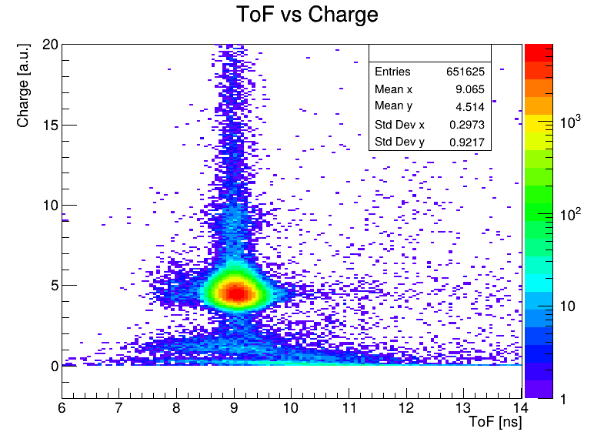
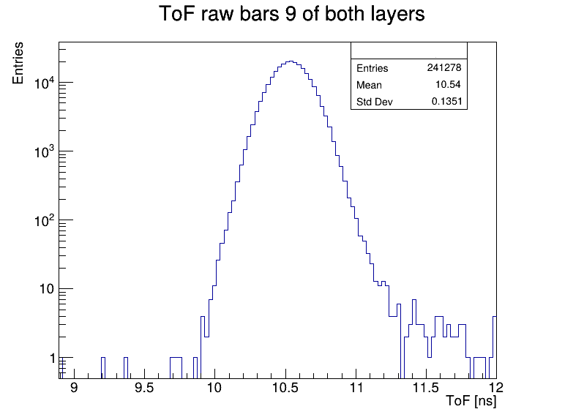
ToF-Wall: Some Plots From Targetless Runs
2D histogram of hit bar IDs when there’s only 1 hit both in the X and Y layers, for the 4744 run at 200 MeV/u beam energy.
2D histogram of charge values vs raw ToF values for the 4828 run at 220 MeV/u beam energy.
1D histograms of the ToF raw values considering only bars 9 of both layers, for the 4727 run at 140 MeV/u beam energy.
Notes:
Here we have some of the plots from the targetless runs

Slide 6
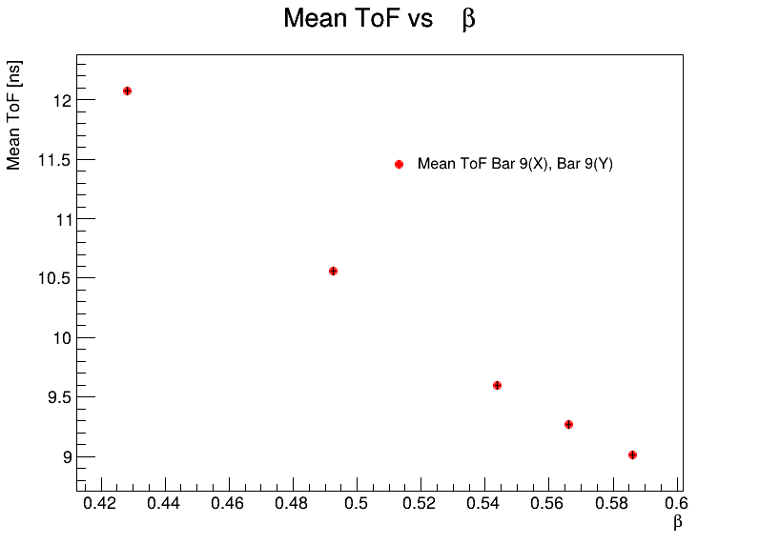
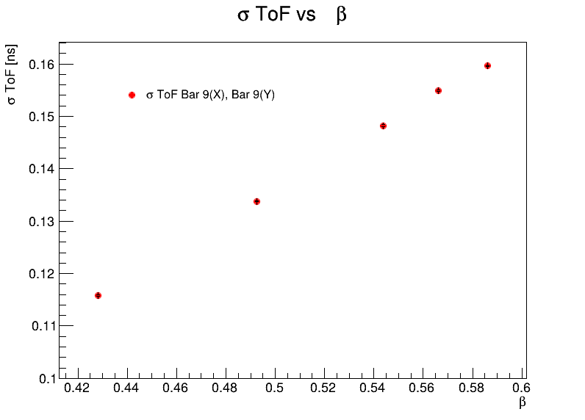
ToF, Targetless Runs
The run files with the same beam energy have been merged in order to add their respective histograms and improve statistics
The 1D ToF raw histograms were fitted with Gaussians, the mean and standard deviation values have been extracted
Mean and standard deviation ToF (when only bars 9 of each layer are hit) fit values vs β
Notes:
We have then performed the analyses by merging the run files with the same beam energy, in order to improve statistics
Here we have the mean and std deviation of the ToF histograms, filled when only bars 9 of each layer are hit

Slide 7
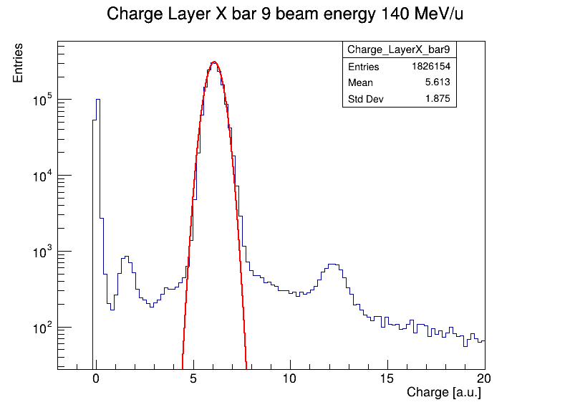
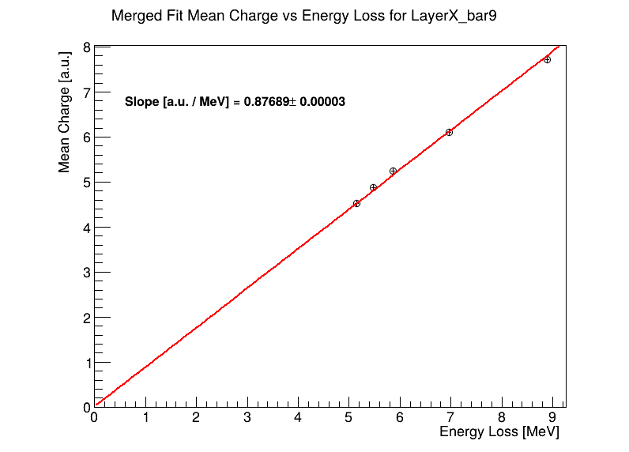
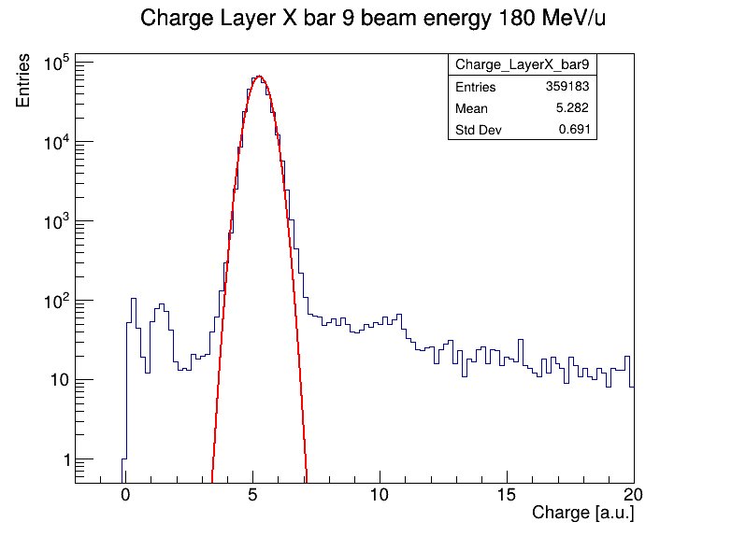
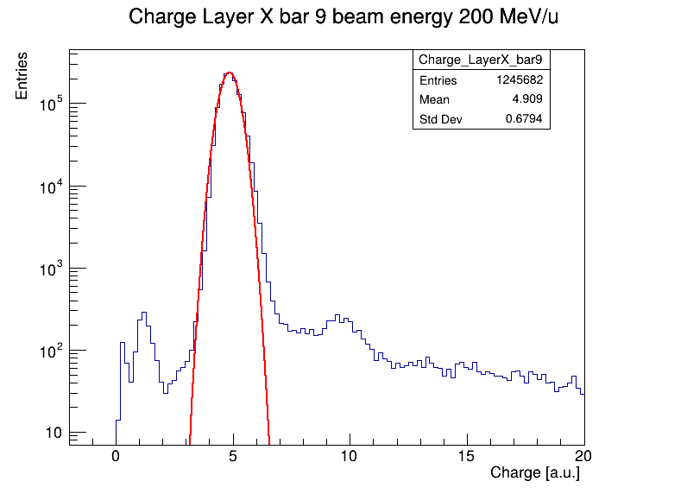
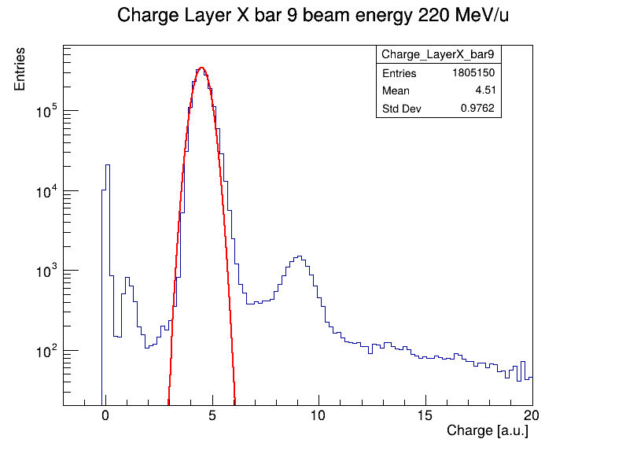
ToF-Wall Charge Calibration (no target)
Helium beam energies are converted to energy loss thanks to the PSTAR tables NIST_PSTAR considering a 3 mm thick plastic scintillator material ($ρ=1.023 g/cm^{3}$) and multiplying the results for protons by 4 ($Z^{2}$, $Z=2$)
$$ΔE\left(He\right)=4 ΔE\left(p\right)=4 {\left(\frac{dE}{ρdx}\right)}_{NIST}ρΔx$$
Pile-up events ?
The charge-energy loss calibration is carried out by performing a linear fit for every bar marked as available.
Notes:
We have then proceeded to perform the charge calibration for runs without target, by fitting the charge histograms for every bar showing enough statistics. The charge values for every bar have been plotted against the energy loss values (PSTAR) and a linear fit has been performed
Explain the PSTAR energy loss part

Slide 8
ToF-Wall Charge Calibration (no target)
Bar ID | Fit executed | Available for calibration
from 0 a 4 | No | No
5 | Yes, except for 200 MeV | Yes
6 | Yes, except for 100 and 180 MeV | Yes
from 7 to 11 | Yes, all the energies | Yes
12 | Yes, except for 100 MeV | Yes
13 | Yes, only for 100 and 140 MeV | (only 2 energies)
14 | No | No
15 | Yes, only for 100 MeV | No
from 16 to 19 | No | No
Front X horizontal layer
The merged run files have been analyzed to extract the charge histograms for each ToF-Wall bar
A fit with a Gaussian model has then been performed, in order to extract the charge as the mean value
Since there’s no target, the charge histograms of the central bars have more hits than the others: for each energy the fit is performed only to the histograms whose entries are at least 0.9% of the total events
A bar is marked as available for calibration if its charge histogram has been fitted for more than 2 energy values out of 5
Bar ID | Fit executed | Available for calibration
From 0 to 3 | No | No
4 | Yes, only for 100 MeV | No
5 | Yes, only for 140 MeV | No
from 6 to 12 | Yes, all the energies | Yes
13 | Yes, only for 140 MeV | No
from 14 to 19 | No | No
Rear Y vertical layer
Notes:
So here's the summary of what we have done. Obviously, since there's no target, the central bars will be the ones with the higher number of hits (bar 9 of both layers being the one with the highest number) while the other bars (off from the center) may not have enough statistics to perform the fit. Therefore a threshold on the histograms entries has been set for the charge fitting
This table summarizes the bars available for calibration, that is if the fit to the charge histogram has been performed for at least 2 energies out of the 5 available. Here we see that mainly the central bars are available for calibration (from 6 to 11), as expected

Slide 9
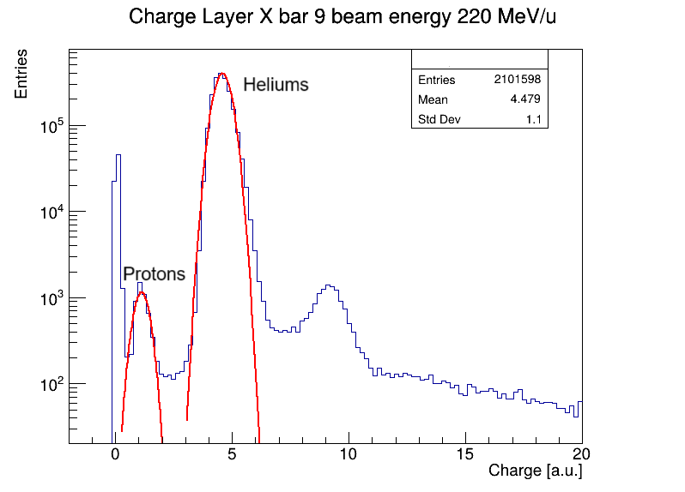
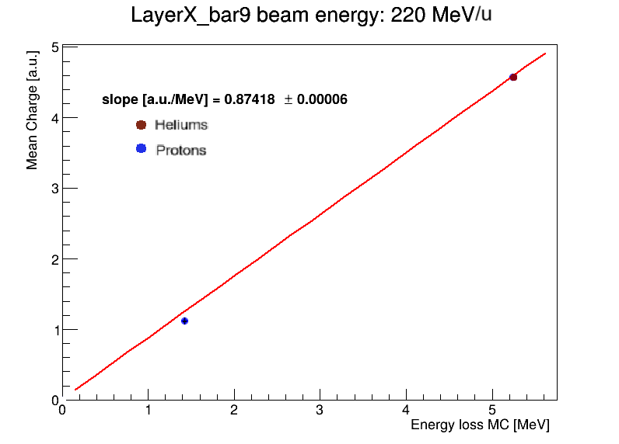
ToF-Wall Fragmentation Runs
The same charge calibration has been carried out for the merged fragmentation runs, only for bar 9 of the front layer (ongoing work towards the calibration of as many bars as possible)
For every beam energy, the charge histogram have been fitted with 2 Gaussian functions, one for the protons peak and one for the heliums peak
The extracted mean values (2 points per bar at each energy) have been plotted vs the energy loss values $ΔE$ given by MC simulations
A fit with a linear function has then been performed
Example of calibration of the front bar 9
At 220 MeV/u beam energy
Notes:
We plan to calibrate the ToF-Wall charge response even with fragmentation runs, by fitting every charge histogram of every bar with 2 separate gaussians (one for protons and one for helium). At the moment we have performed this calibration only for bar 9 of the front layer (work in progress)
For every bar and energy we plot the fit charge vs the energy loss (by MC) and we then perform a fit with a linear function (tried with Birks, but it didn’t show the expected results)

Slide 10
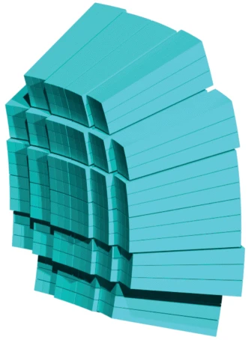
Calorimeter
Modules arranged in 3x3 BGO crystals. Here we will be focusing on 7 modules
This detector stops the impinging particles and measures their kinetic energy
Here we want to analyze the calorimeter charge response in relation to the beam energy, using targetless runs only
Notes:
We have also analyzed the data from the calorimeter, focusing on 7 modules out of 32
We want to analyze the detector charge response in relation to the beam energy, considering targetless runs only

Slide 11
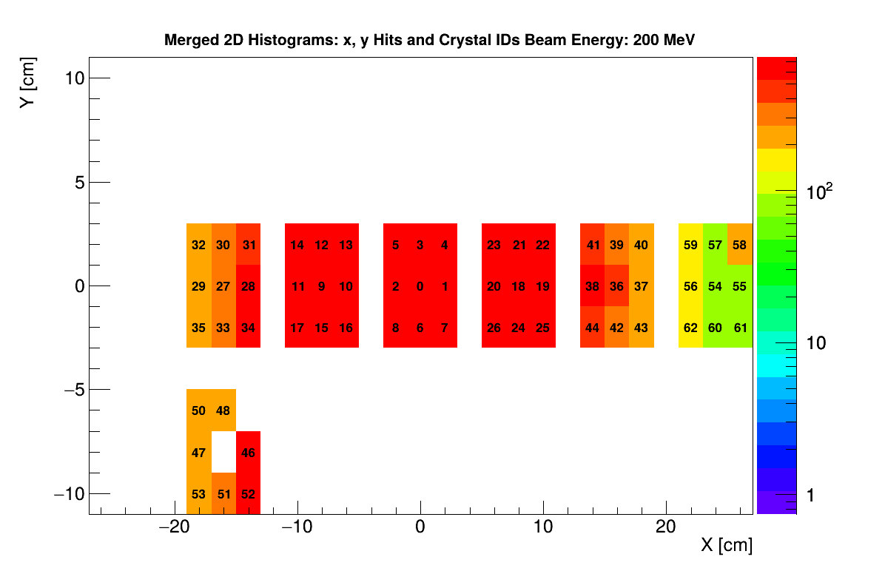
Calorimeter Modules
Modules disposition (from the HIT2022 ELOG)
Each module consists of 9 2x2 $cm^{2}$ crystals labeled with a crystal ID number, ranging from 0 to 62.
Here we will focus on the central module (number 4) whose crystal IDs range from 0 to 8.
Reconstructed 2D hit-map of the x and y hit position in the calorimeter (not to scale) for the merged run files at 200 MeV/u, with the crystal IDs superimposed.
Modules 7 and 1 seem to be out of the expected y position.
Notes:
Here we see the disposition of the 7 modules of interest, retrieved from the excel file in the elog, each module consists of 9 crystals labeled with a crystal ID number ranging from 0 to 62.
We will focus on the central module 4, with crystal IDs ranging from 0 to 8
Here we see the reconstructed 2D hit map of the x and y hit positions in the calorimeter for 200 MeV/u beam energy, with the crystal IDs superimposed. We noticed that modules 7 (rightmost side) and module 1 (lower part) seem to be out of the expected y position

Slide 12
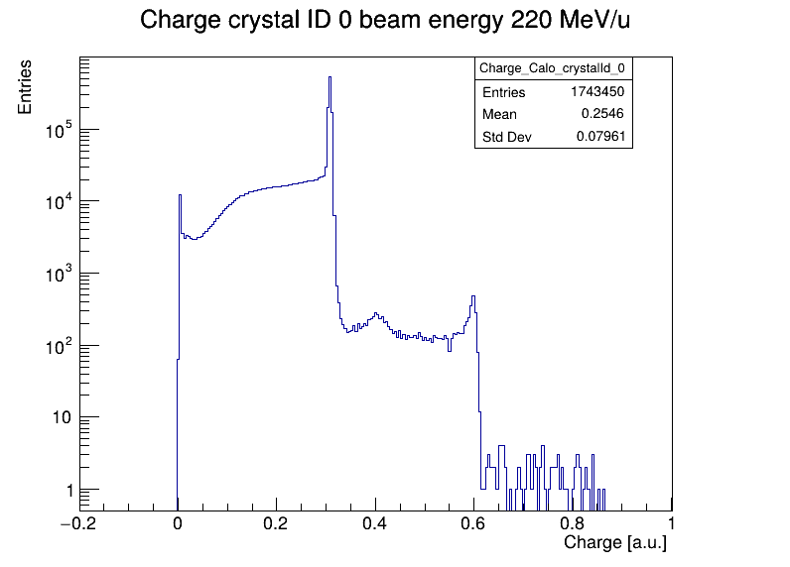
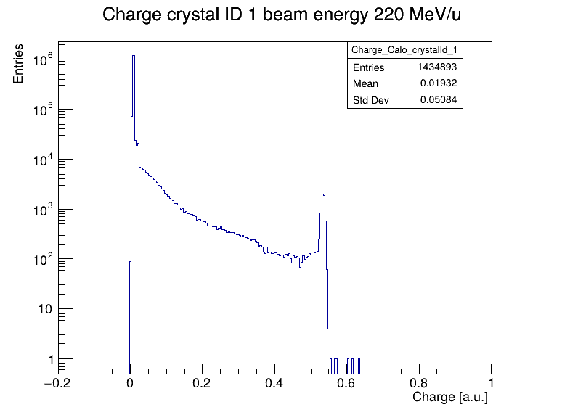
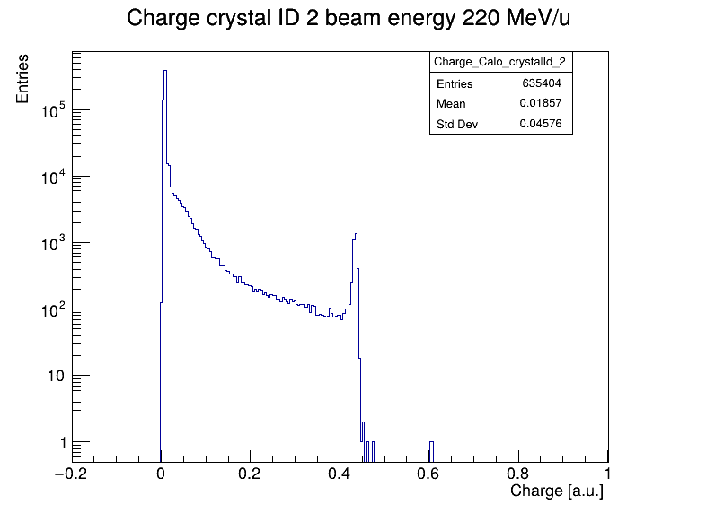
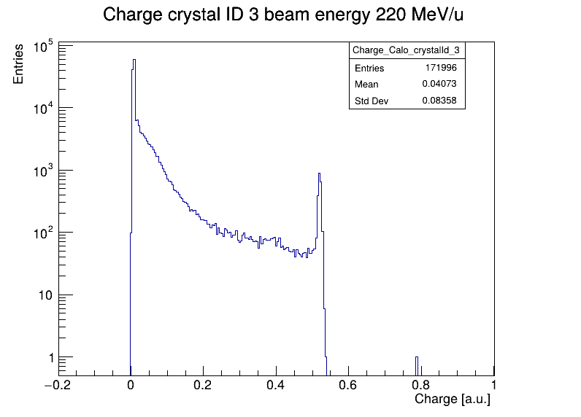
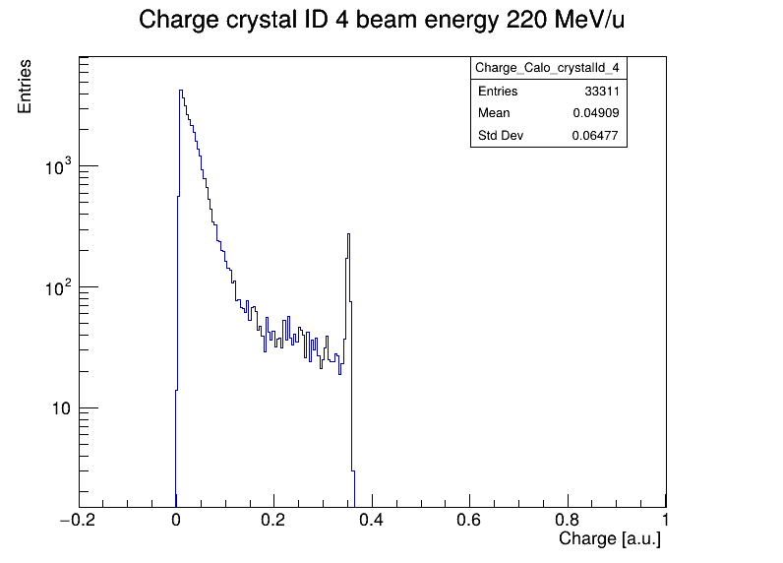
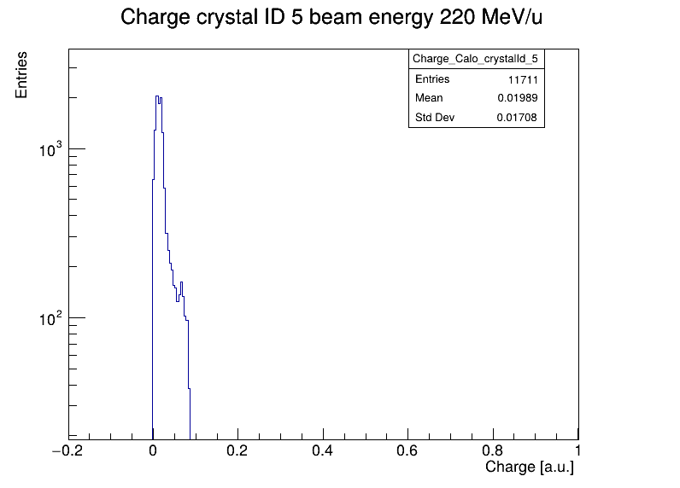
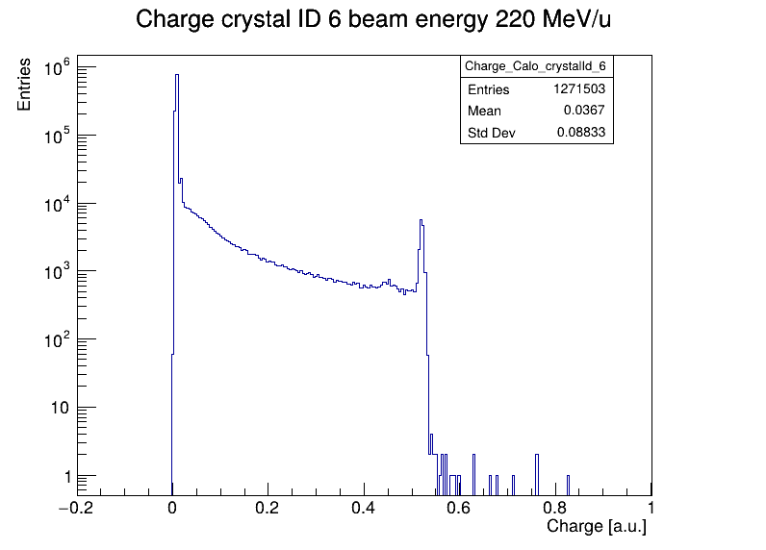
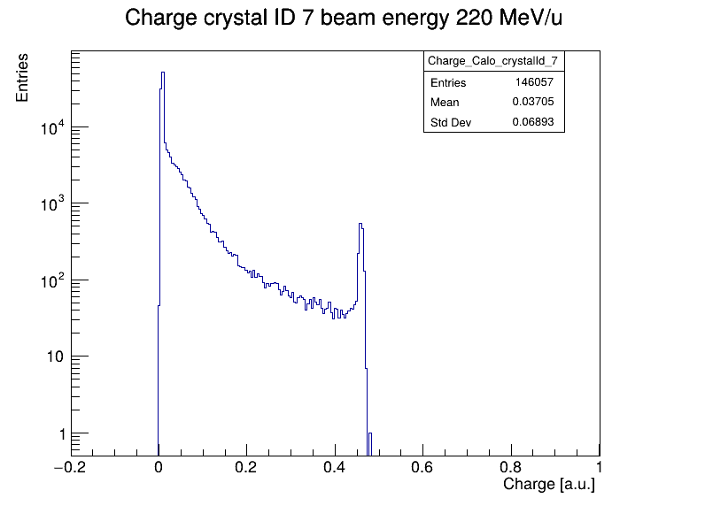
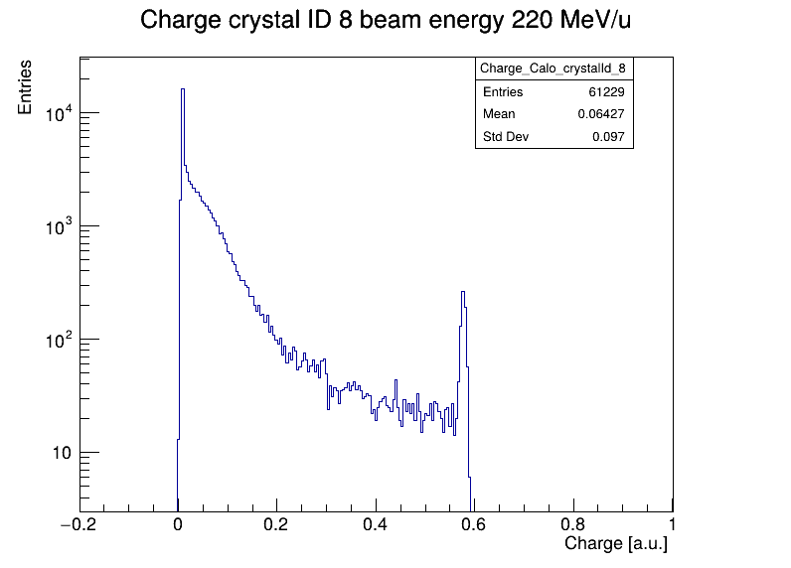
Calorimeter Crystal IDs Charge
The merged targetless run files, one for each beam energy value, have been analyzed to extract the charge histograms for every crystal of module 4
A fit with a Gaussian model has then been performed for every crystal (with the exception of crystal IDs 0 and 5), in order to extract the charge as the mean value
This process has been repeated for every energy, in order to perform the charge-energy calibration for each crystal
Crystal IDs:
0
1
2
3
4
Multiple peaks?
5
6
7
8
No noticeable peak to be fitted, for none of the analyzed energies
Notes:
A gaussian fit was performed for every crystal of module 4 (with the exception of crystal 0, with multiple peaks, and 5, with no peaks), this process has been repeated for every energy
Crystal 0 displayed multiple peaks, while crystal 5 showed no peaks, for none of the analyzed energies

Slide 13
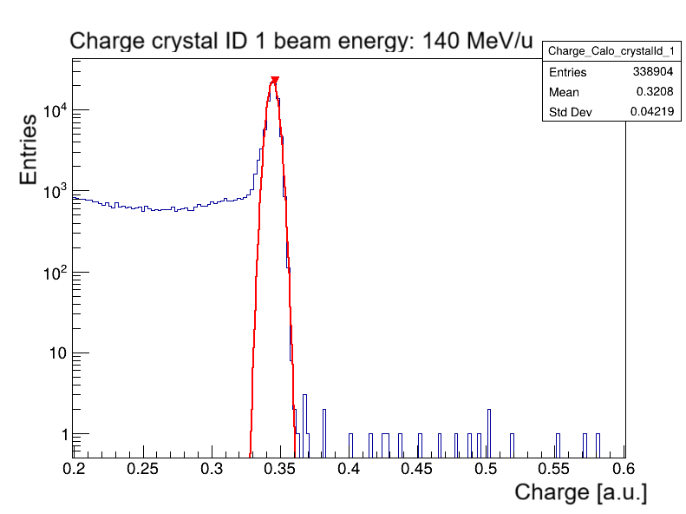
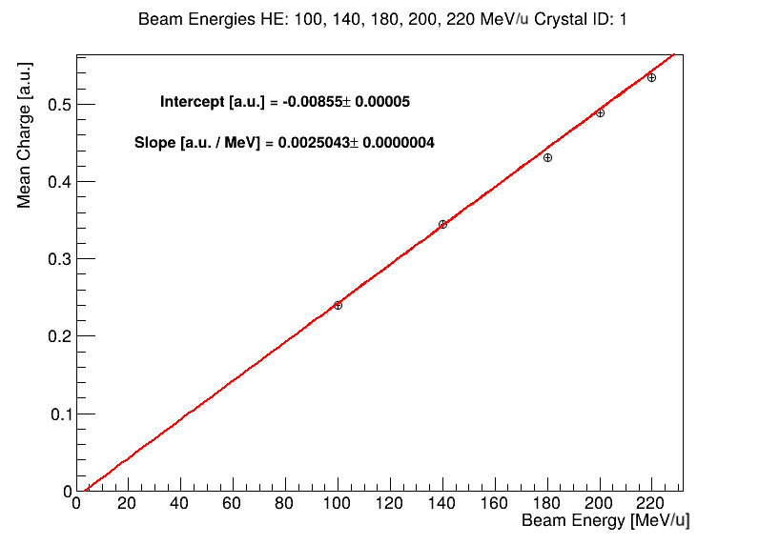
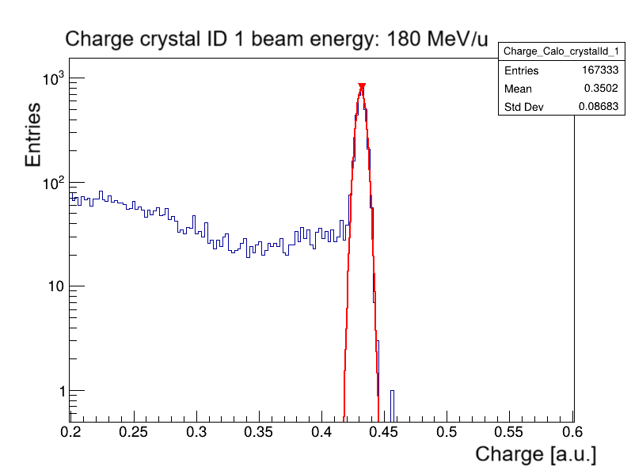
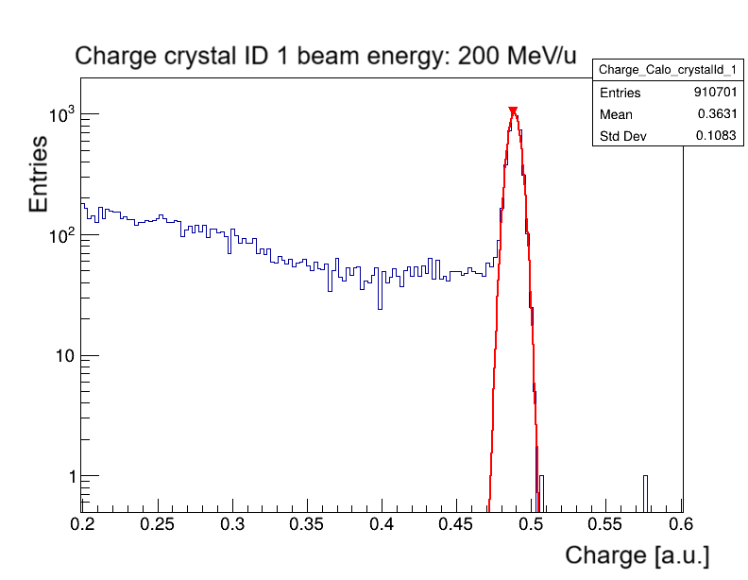
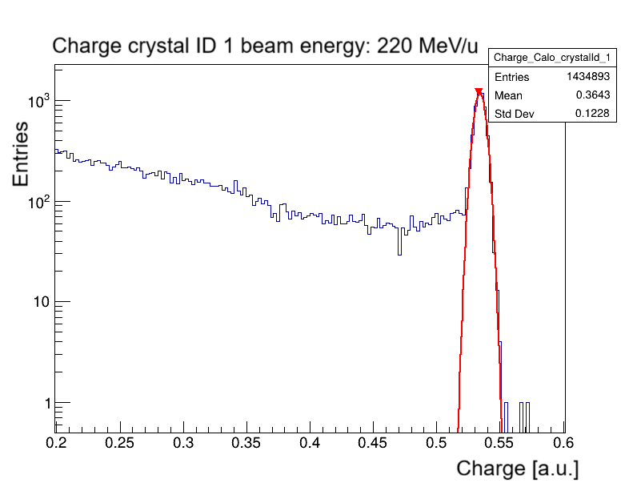
Calorimeter Charge Analysis (no target)
MeV/u*
Charge peak vs beam energy for crystal ID 1
Notes:
Here we have the fits performed to the charge histograms of crystal ID 1 at each energy and the distribution of the extracted fit means vs beam energy

Slide 14
To Do
Complete the analyses on the fragmentation runs for as many bars as possible
Analyze the calorimeter clusters by examining the charge collected in each crystal of the cluster size
Notes:
Here’s what we are planning to do in the near future

