Slide 1
Institute Board Meeting Report
Cherasco, 18 Dec 2024

Slide 2
Agenda
Communications
Next data takings; next requests
Rotation of charges
Authorship & Membership
Next meeting location
AoB

Slide 3
- Recruiting personnel
1. Comunications
3 people have been hired (NA, TO, BA) within the MAECI project. One will start on Jan 1°. Others (not italian) in march and hopefully in april. Problems to cover all the expenses on the MAECI project.
At least 3 new PhD (BO, TO, PG)
6 months bourse to be issued in jan/feb for a master’s degree (RM)

Slide 4
2. Next data takings; next requests
2025 CNAO 2025 (p, C), october-november
2026 GSI (Oxygen 500-1000 MeV/n)
→ several improvements expected (VTX, TW)
→ we need to write a proposal for the Bio-PAC (deadline mid-march 2025)
Discussion on the GSI proposal for wednesday
Coherent with the INFN 3 year plan

Slide 5
3. Rotation of charges
Physics Coordinator:
M. Toppi (jun 25)
Note that at the moment there is no «deputy» physics coordinator
Editorial Board:
A. Kraan (EB chair, jun 25), A. Lauria (jun 26), G. Traini (jun 25)
Software coordination:
C. Finck (dec 25), Y. Dong (deputy, jun 25)
Spokesperson:
M. Villa (dec 26), P. Cerello (deputy)

Slide 6
3. Rotation of charges
Physics Coordinator:
M. Toppi (jun 25)
Note that at the moment there is no «deputy» physics coordinator
Editorial Board:
A. Kraan (EB chair, jun 25), A. Lauria (jun 26), G. Traini (jun 25)
Software coordination:
C. Finck (dec 25), Y. Dong (deputy, jun 25), R. Zarrella (deputy, dec 26)
Spokesperson:
M. Villa (dec 26), P. Cerello (deputy)

Slide 7
3. Rotation of charges
Physics Coordinator:
M. Toppi (jun 25)
Note that at the moment there is no «deputy» physics coordinator
Editorial Board:
A. Kraan (EB chair, jun 25), A. Lauria (jun 26), G. Traini (jun 25)
Software coordination:
Y. Dong (dec 26), R. Zarrella (deputy, dec 26)
Spokesperson:
M. Villa (dec 26), P. Cerello (deputy)

Slide 8
3. Rotation of charges
Physics Coordinator:
M. Toppi (jun 25)
Note that at the moment there is no «deputy» physics coordinator
Editorial Board:
A. Kraan (EB chair, jun 25), A. Lauria (jun 26), G. Traini (jun 25)
Software coordination:
Y. Dong (dec 26), R. Zarrella (deputy, dec 26)
Spokesperson:
M. Villa (dec 26), P. Cerello (deputy)
Many thanks to Chris for all the efforts and results leading the software group during the «building» years

Slide 9
4. Authorship & Membership
Authorship
New institutes authoring papers after 6 months of visible work
For new collaborators (inside groups), team leaders decides on inclusions into (but also on removals from) the author lists. The general principle of 6 months of contribution to the FOOT activities still apply.
Membership
We’ve been contacted by a group of Aarhus (Denmark) interested in our activities and on cross sections for proton therapy. They have a proton therapy facility and they plan to submit for grant application (2 M€).
Join FOOT, common work, share information? A meeting will be held in the next weeks with them.

Slide 10
5. Next Meetings locations
2024: Napoli, Cherasco (CN)
2023: Bergamo, Trento
2022: Strasbourg, Perugia
2021: online, CNAO
2020: online, online
2019: CNAO, Rome
2018: Elba, Borgomale (CN)
2017: Napoli, Bologna
2016: Milano
2025: ?? Volunteers welcome!
a possibility for may/jun

Slide 11
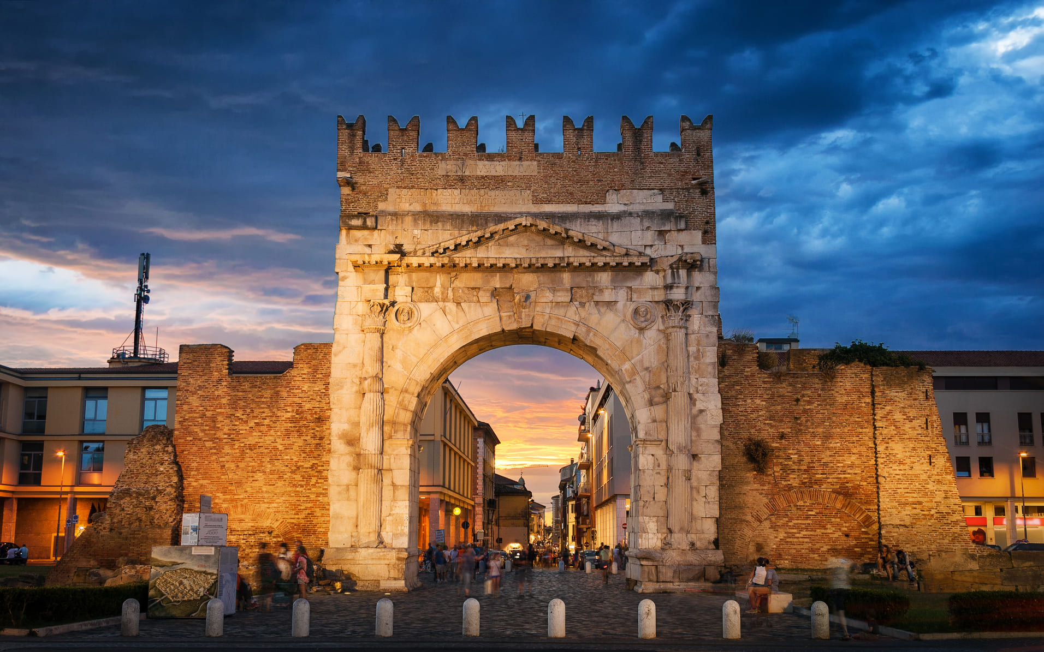
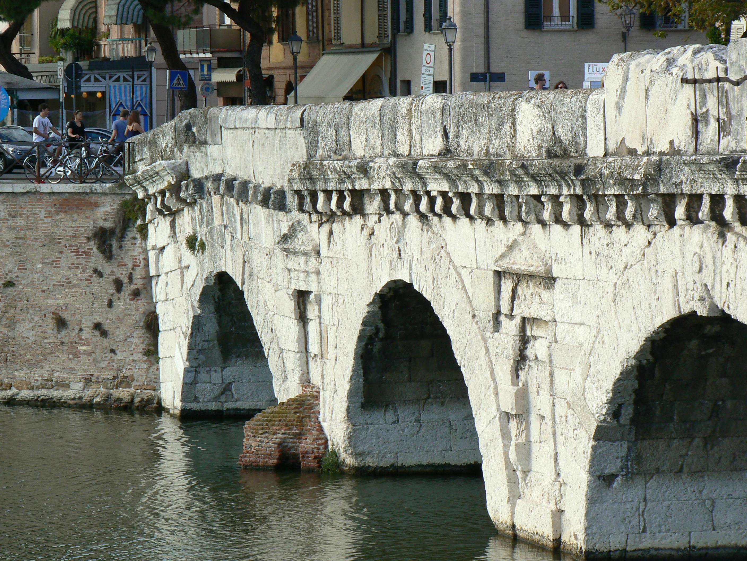
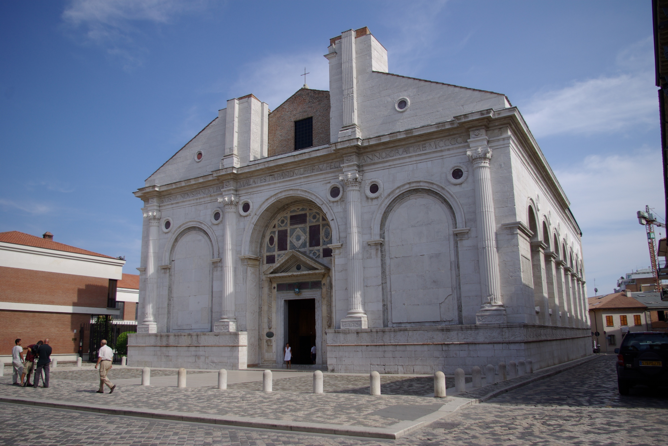
Rimini
Tiberius bridge
2000 years of history, still in use today
Roman history
Malatesta temple
IX secle;revised during
reinassance

Slide 12
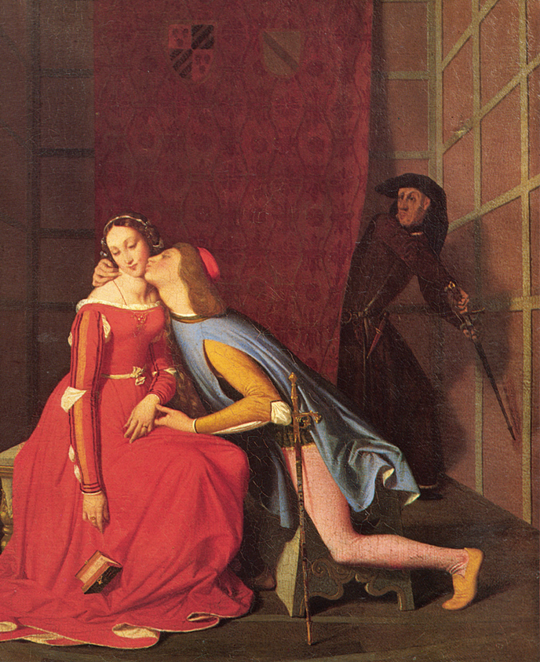
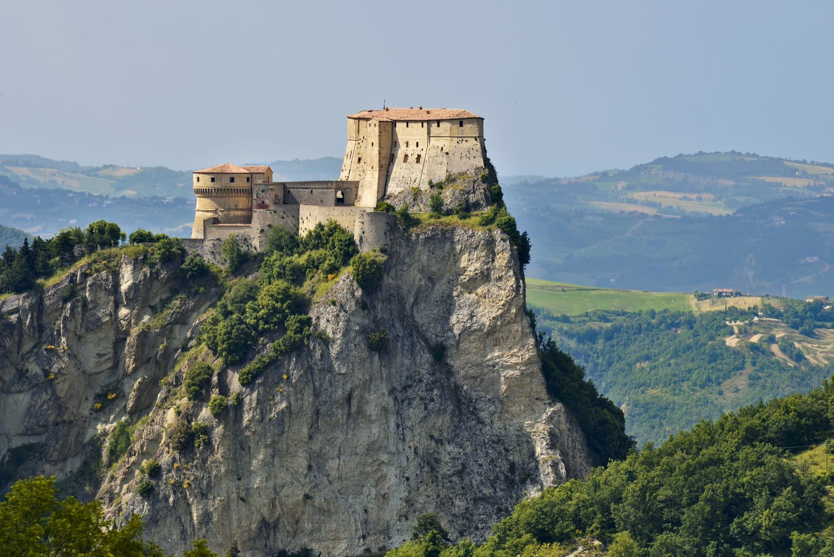
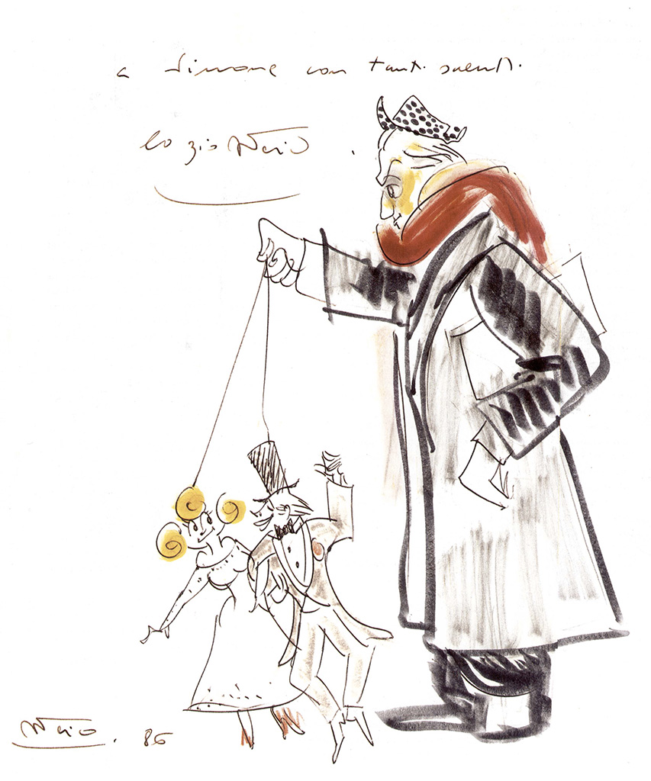
Interesting places nearby
Paolo (Malatesta) e Francesca (da Rimini) tragic affair …
San Leo – beautiful place
Rocca di Gradara
Fellini
Museum
Inside the
Malatesta castle
San Marino,
Oldest republic
in the world
1700 years of history

Slide 13
Formula: one place fits all
Just one hotel with
- rooms,
conference room
Fast connection
Restaurant
Swimming pool
Spa
Available periods:
26-28 may 2025
9-11 jun 2025
i.e. before the starting
of the summer season

Slide 14
Winter Meeting
Rome Tor Vergata voluntereed to held the meeting, with the help also of Rome La Sapienza
Exact place & location still to be decided ….

Slide 15
6. AoB

Slide 16
Have a safe return home
Best wishes to you
and your families

