Slide 1
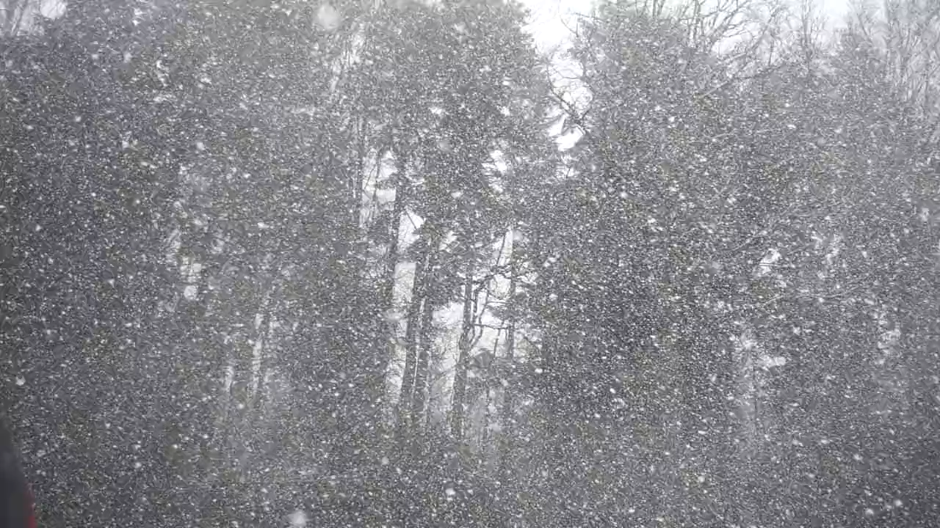

Slide 2
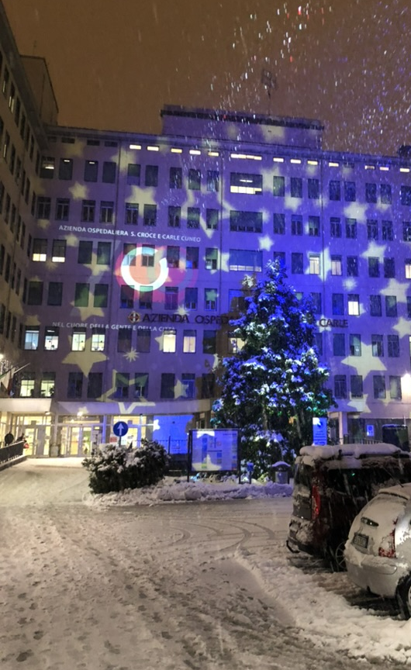
Physics research prospects in Nuclear Medicine
Stephane chauvie

Slide 3

Isotope Production
Image reconstruction
Radio-chemistry
Algorithms
Equipment

Slide 4
Isotope Production
Image reconstruction
Radio-chemistry
AI
Equipment

Slide 5
Isotope Production
Radio-chemistry

Slide 6
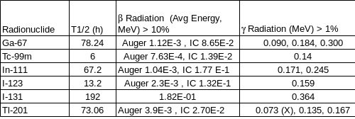
NUCLEAR MEDICINE IsOtopeS production
«Conventional» or «traditional» nuclear medicine
great contraction of traditional examination carried out with Ga67, Cr51, Tl201, In111

Slide 7
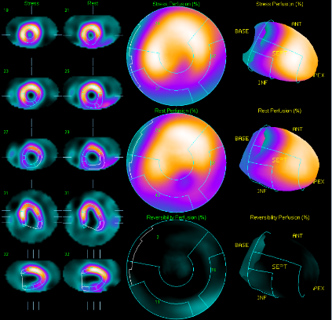
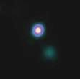
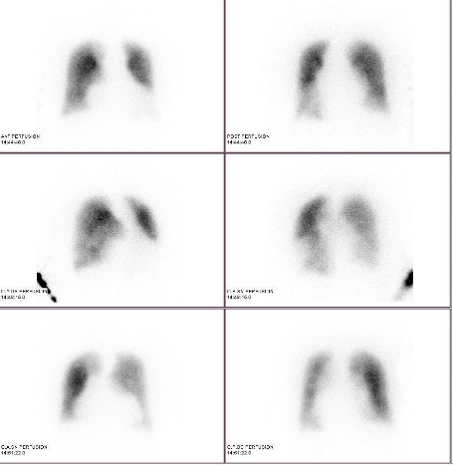
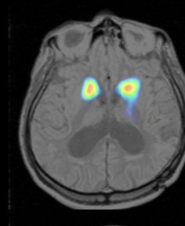
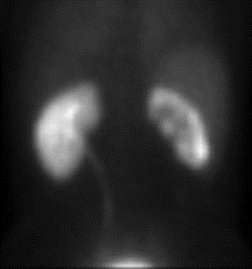
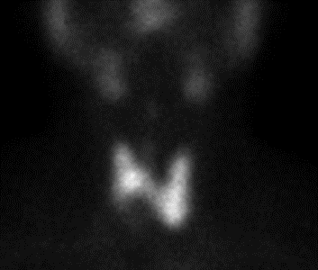
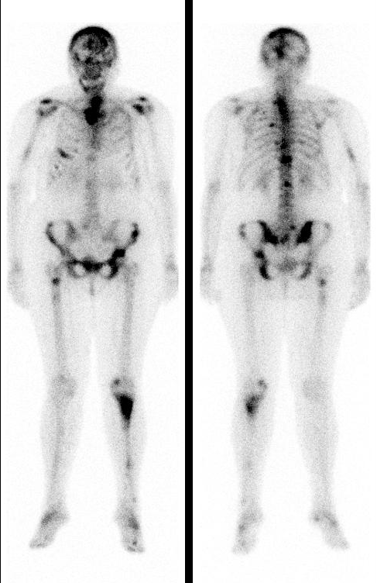
Common ^{99m}Tc scintigraphic procedure
Cardiac
Bone
Lymph
Lung
Thyroid
Kidney
Neurology (with ¹²³I)

Slide 8
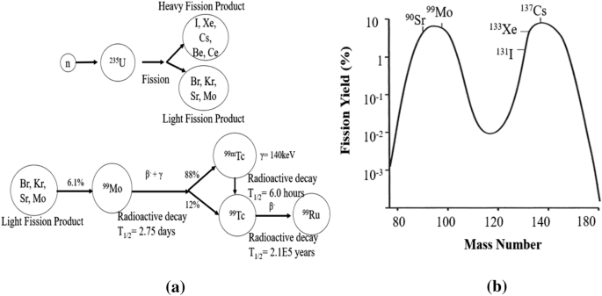
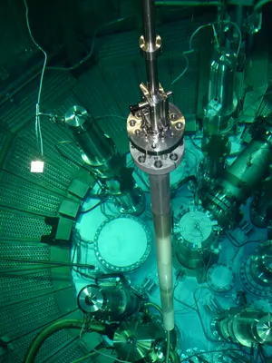
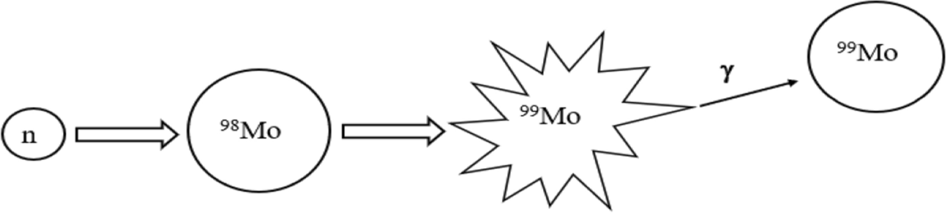
Molybdenum production
fission
Neutron activation

Slide 9
MolybdeNum production is critical
99Mo irradiation and processing is a recurring challenge;
securing irradiation capacities will remain a challenge if no new irradiation installations are available in Europe.
The current strong reliance on research reactors for 99Mo/99mTc production is an issue for the security of supply.
Production by fission is expected to remain the standard for at least one more decade; thus, securing LEU supply by a decade is a key challenge as US & EU supply is expected to run out in the 2030s at the latest.
Non-fission alternatives may remove the constraint of building new research reactors, yet enrichment considerations for 100Mo have to be solved (need for enrichment, processing and recycling)

Slide 10
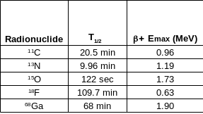
PET IsOtopeS production
PET or PET/CT- PET/MRI
Cyclotron produced
Iiquid vs solid target
⁶⁴Cu,
⁸⁹Zr

Slide 11
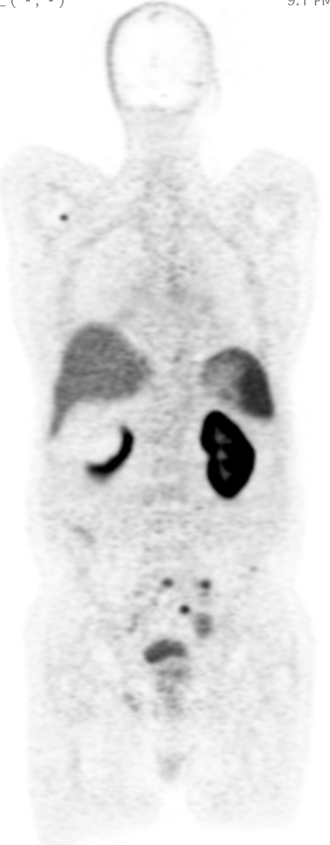
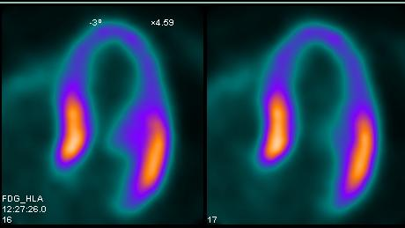
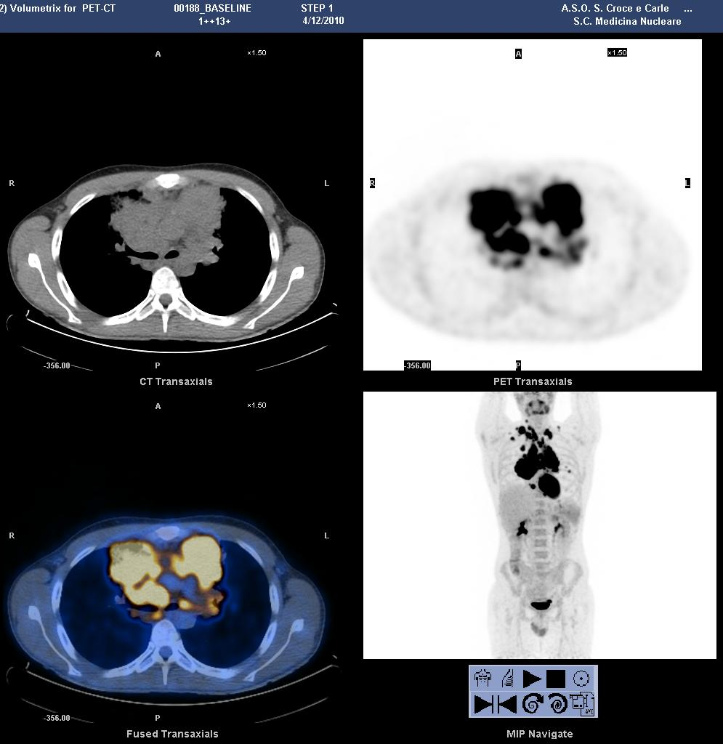
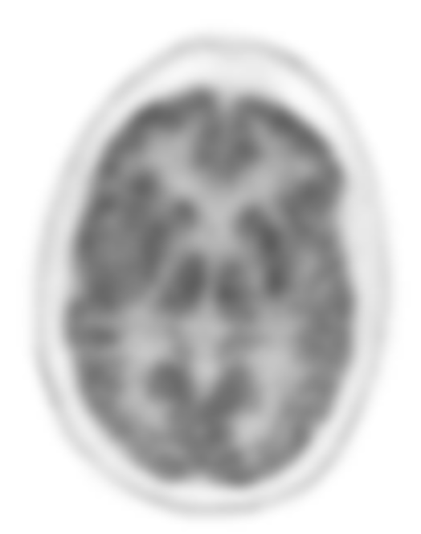
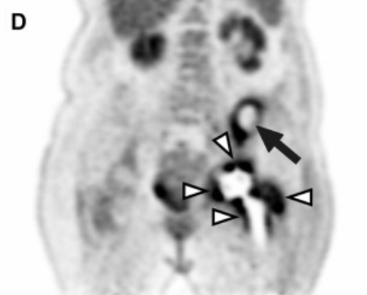
PET procedure
Cardiac
Oncology
Inflammation
Neurology

Slide 12
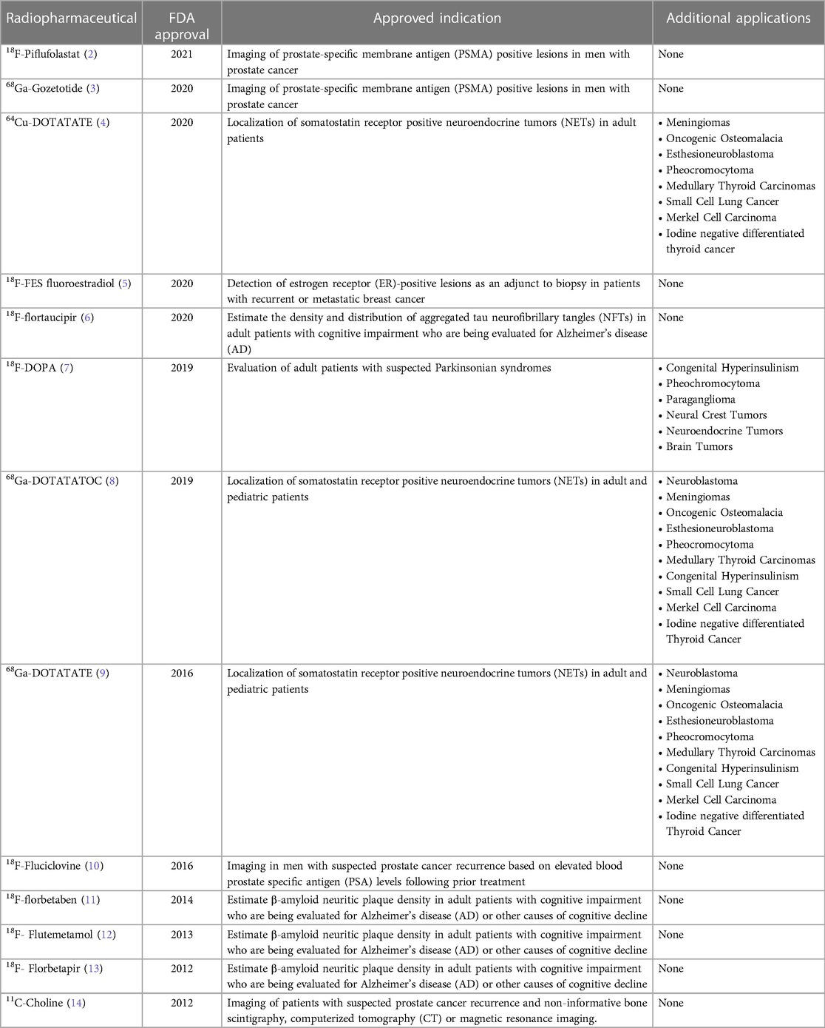
Future prospective in PET

Slide 13
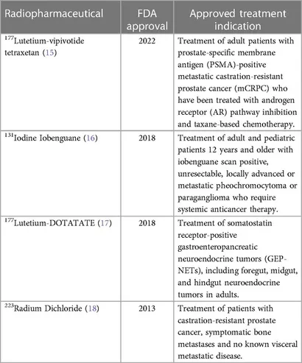
THERANOSTIC
Theranostics (ie, "therapy" + "diagnostics") is an innovative approach to personalized cancer care that involves the use of molecular imaging (eg, PET/CT and SPECT/CT) and radiopharmaceuticals to tailor treatments to an individual patient.
It involves the combination of one diagnostic radioactive drug to "see" the disease and a second therapeutic radioactive drug to deliver therapy to "treat" the disease.

Slide 14
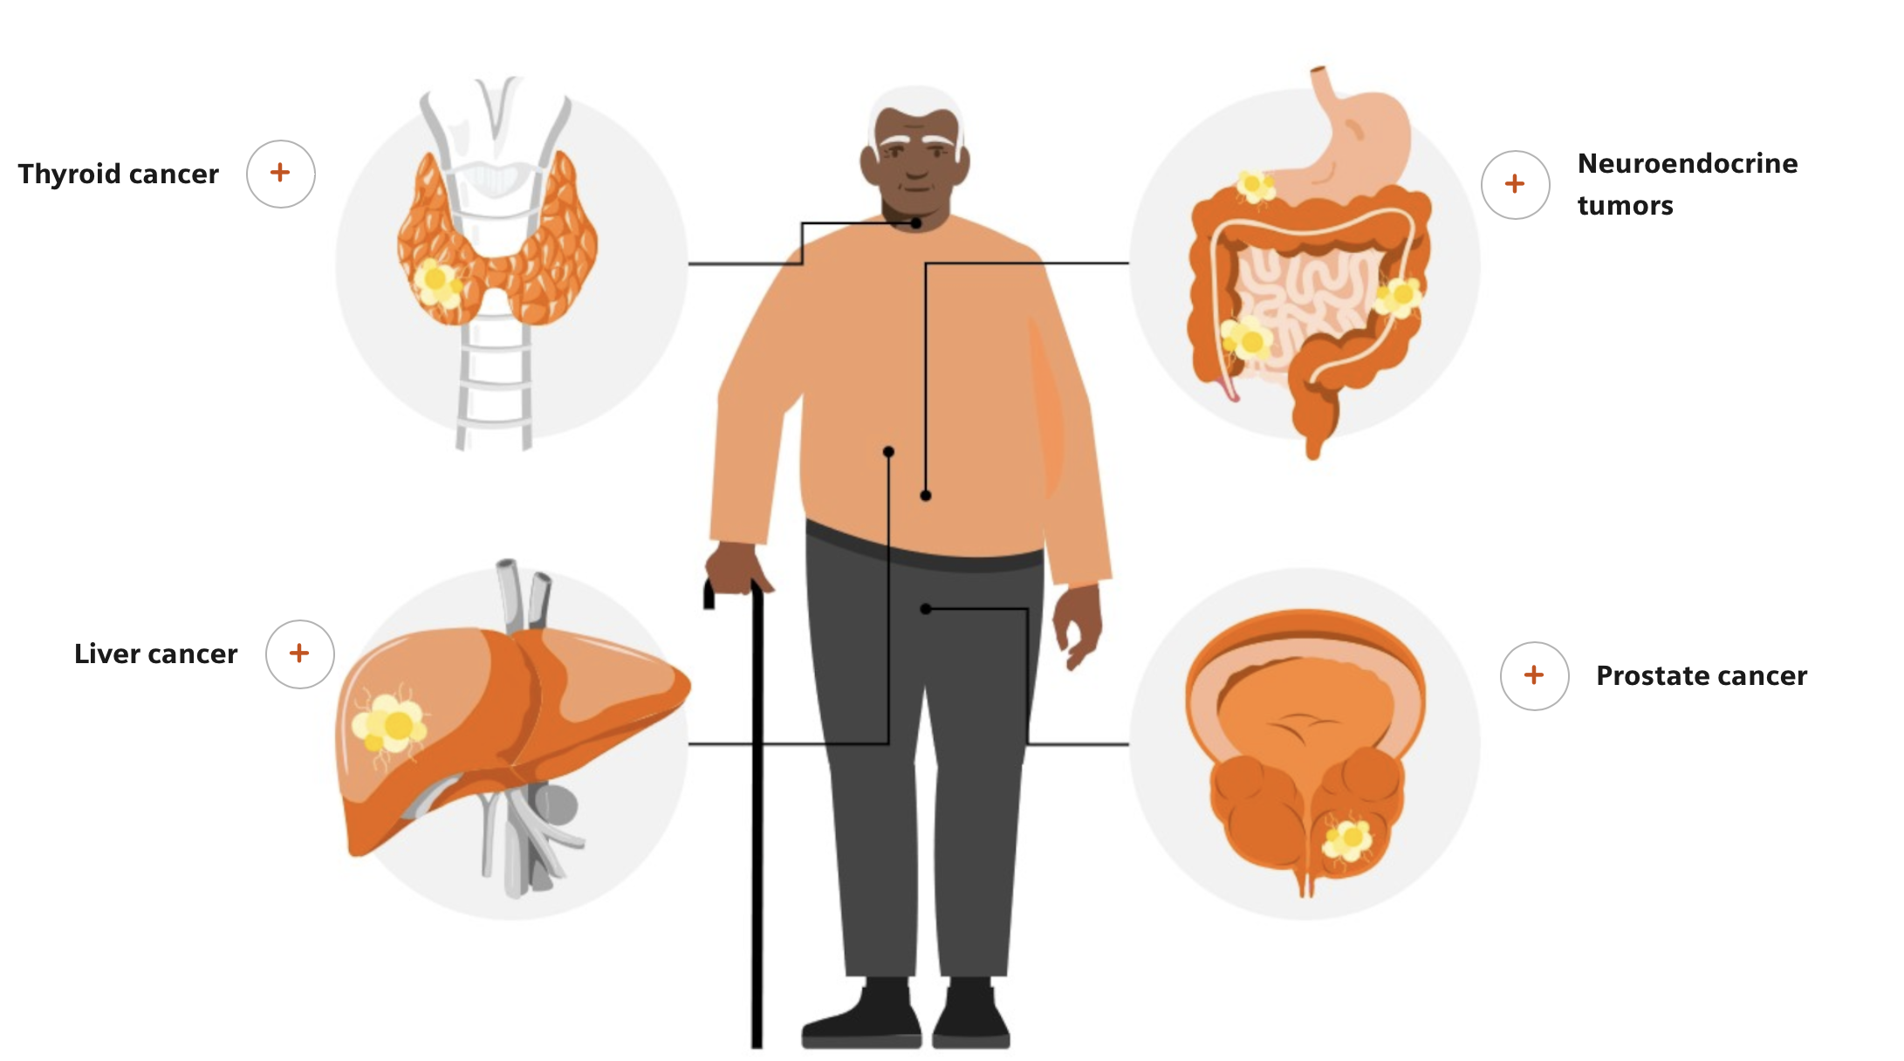
Type of treated cancer

Slide 15

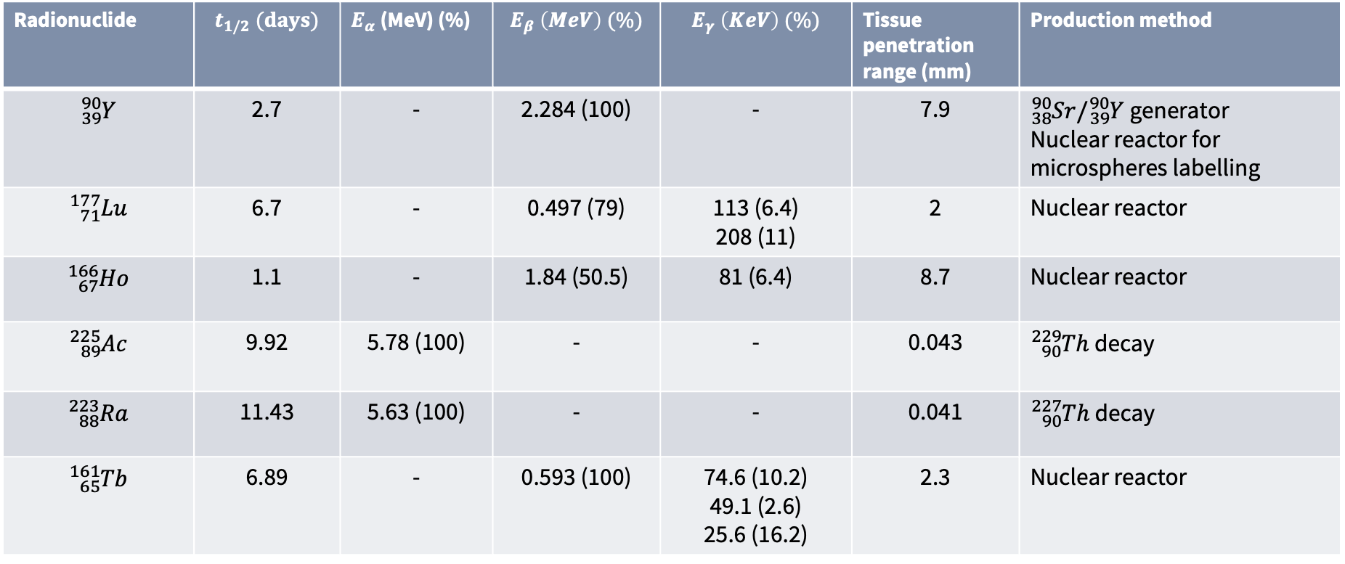
Therapy isotopes
Radionuclide | $$t_{1/2} (days)$$ | $E_{α}$ (MeV) (%) | $$E_{β} \left(MeV\right) (\%)$$ | $$E_{γ} \left(KeV\right) (\%)$$ | Tissue penetration range (mm) | Production method
$${}_{39}^{90}Y$$ | 2.7 | - | 2.284 (100) | - | 7.9 | ${}_{38}^{90}{Sr}/{}_{39}^{90}Y$ generator Nuclear reactor for microspheres labelling
$${}_{71}^{177}{Lu}$$ | 6.7 | - | 0.497 (79) | 113 (6.4) 208 (11) | 2 | Nuclear reactor
$${}_{67}^{166}{Ho}$$ | 1.1 | - | 1.84 (50.5) | 81 (6.4) | 8.7 | Nuclear reactor
$${}_{89}^{225}{Ac}$$ | 9.92 | 5.78 (100) | - | - | 0.043 | ${}_{90}^{229}{Th}$ decay
$${}_{88}^{223}{Ra}$$ | 11.43 | 5.63 (100) | - | - | 0.041 | ${}_{90}^{227}{Th}$ decay
$${}_{65}^{161}{Tb}$$ | 6.89 | - | 0.593 (100) | 74.6 (10.2) 49.1 (2.6) 25.6 (16.2) | 2.3 | Nuclear reactor
Note: $t_{1/2} \left(days\right), radioisotope half−life in days;E_{α}\text{ (}\text{MeV}\text{) (\%) }\text{energy} \text{of} emitted alpha particles \text{and} \text{respective} \text{decay} \text{abundance} \text{shown} \text{in} \text{parentheses};E_{β} \left(MeV\right) (\%)$ maximum energy of emitted beta particles and respective decay abundance shown in parentheses; $E_{γ} \left(KeV\right) (\%)$ gamma ray energy useful for imaging and respective abundance in total energy shown in parentheses; tissue penetration range(mm), maximum tissue penetration shown in millimeters

Slide 16
Lutetium production
Considering the significant increase in clinical use and the limited number of suppliers along with European irradiation capacity and lack of European enrichment for stable isotope (¹⁷⁶Yb), the ¹⁷⁷Lu supply should be closely monitored and direct actions taken in collaboration with the industry to work towards securing supply.
Enrichment of ¹⁷⁶Yb relies mostly on Russian enrichment units, and the growing demand already exceeds the offer.
Upscaling of both irradiation and processing capacities is key to meeting the projected radioisotope needs within the next 5 to 10 years.

Slide 17
Other isotope used in PET
1. Copper-64 (64Cu)
Half-life: 12.7 hours
neuroendocrine tumors and prostate cancers.
2. Zirconium-89 (89Zr)
Half-life: 3.27 days
antibody-based therapies due to its ability to track slow biological processes over a longer period
4. Scandium-44 (44Sc)
Half-life: 3.97 hours
47Sc theranostic pair.
5. Yttrium-86 (86Y)
Half-life: 14.7 hours
is used in conjunction with 90Y radioimmunotherapy. (lymphoma)
6. Gallium-68 (68Ga)
Half-life: 68 minutes
neuroendocrine tumors with somatostatin receptor targeting.

Slide 19
Image reconstruction
AI
Equipment

Slide 20
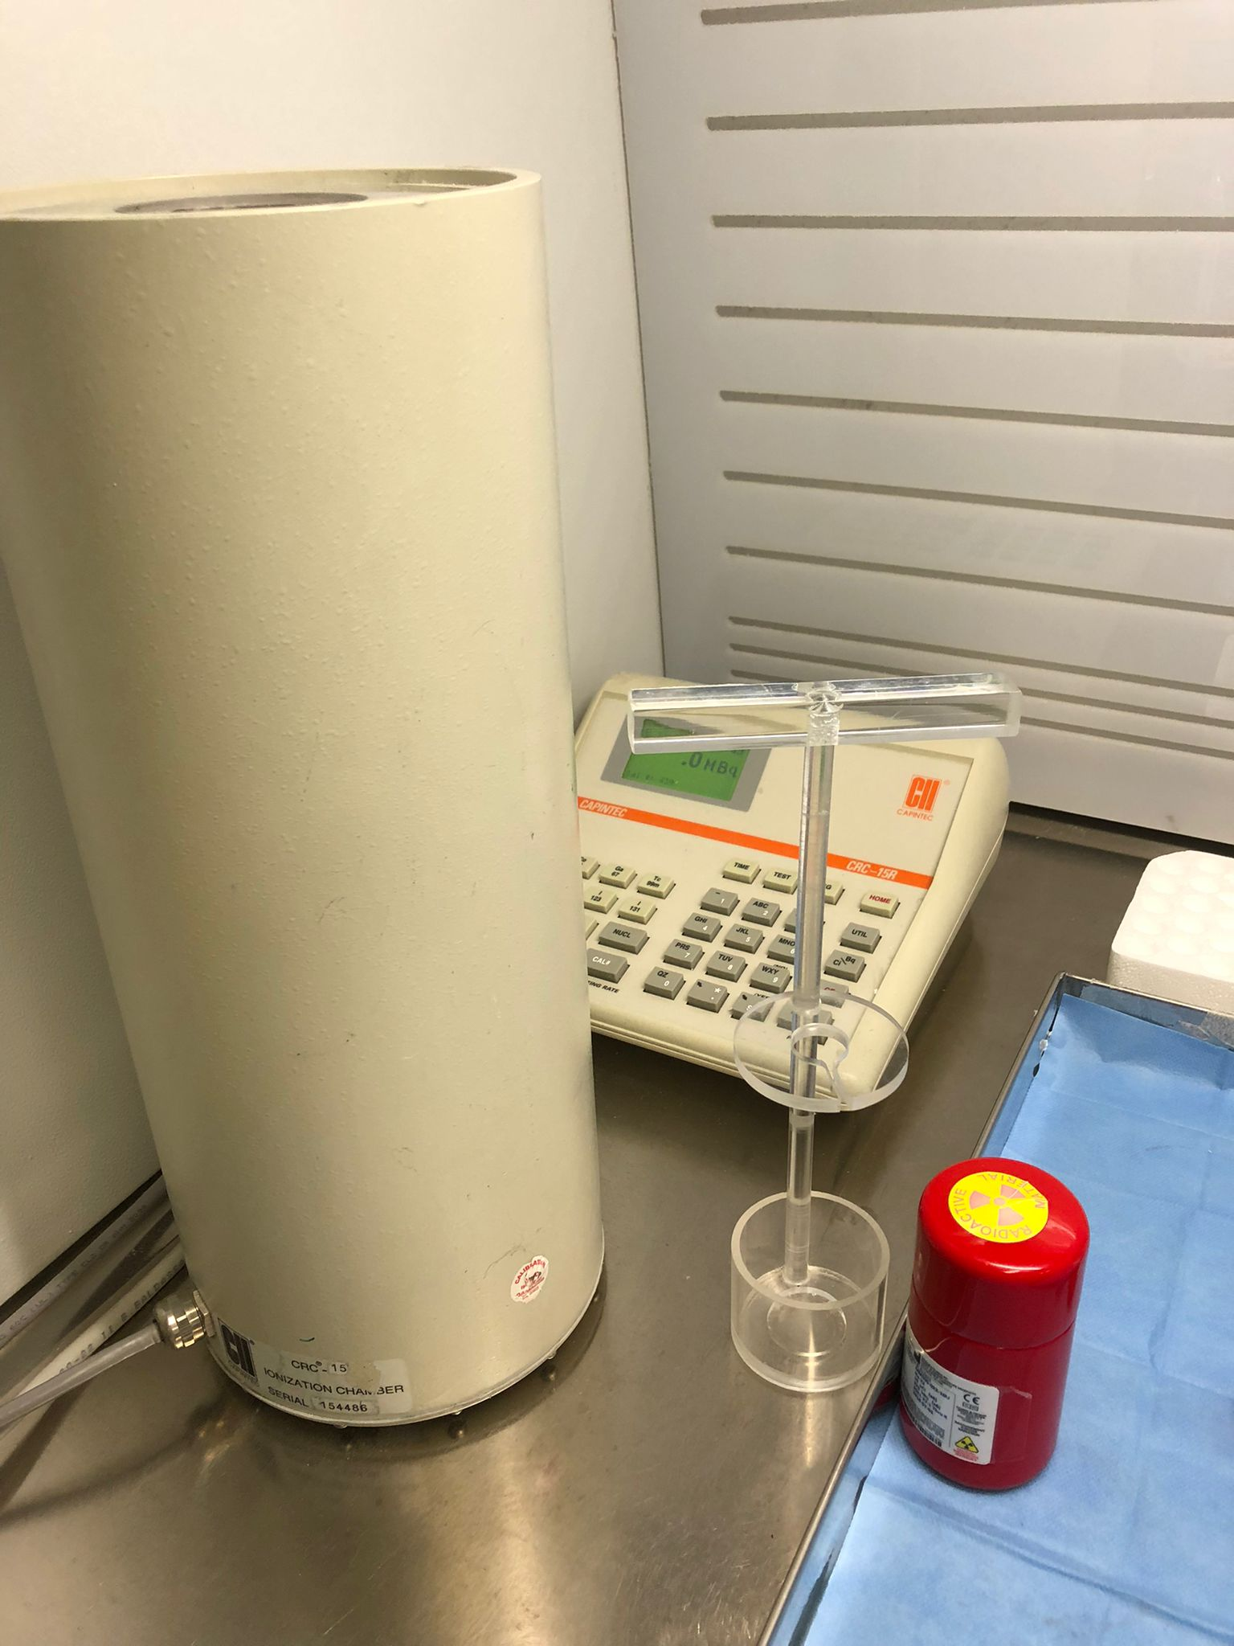
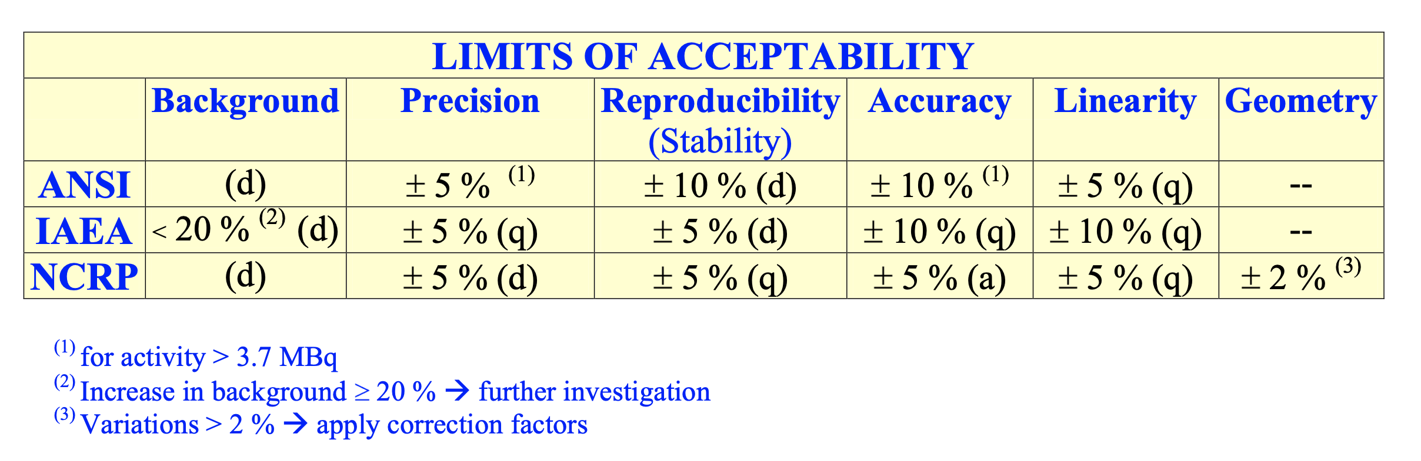
activemeter
Activemeter should be calibrated respect to a primary/secondary activemeter that has been calibrated respect to certified/traceable sources
Calibration coefficients convert pA in MBq
Calibration coefficients depends on radioisotope
Correction shall be applied locally depending on your environment (hot cell, etc…) and on your devices (vial, syringe, etc..)
  geometry (syringe/vial)
  volume of the source
  source position

Slide 21


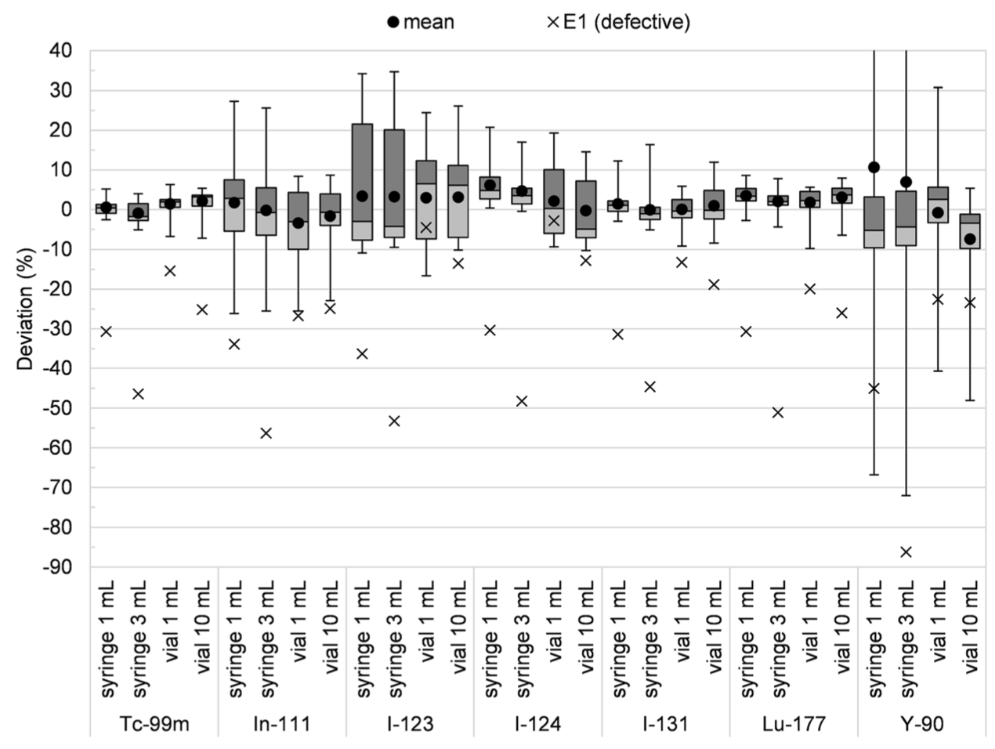
Activimeter: are they reliable?
1
Brazil
2
Europe
3
Switzerland
15 activemeter in 12 Rio de Janeiro hospital
32 activemeter in 8 uni-hospitals in Netherlands, Belgium, and Germany
13 activemeter in 13 hospitals in Switzerland
Iwahara et al, Saltirraga Varias et al. EJNMMI Physics, 2021

Slide 22
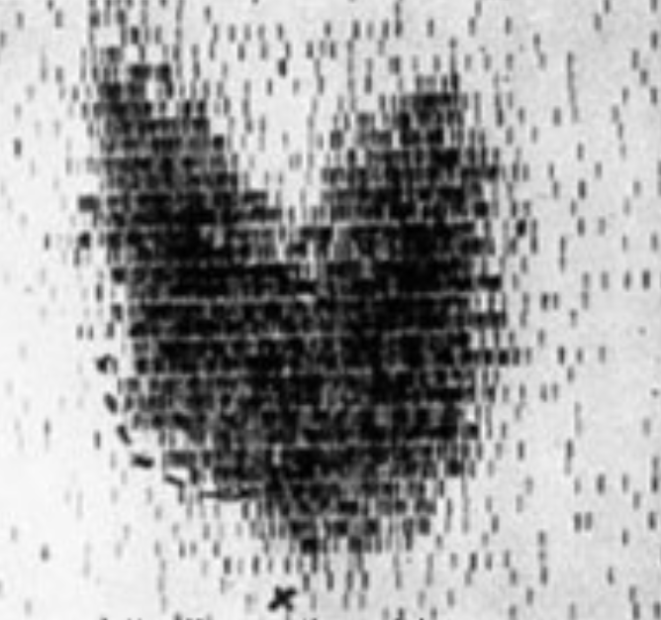
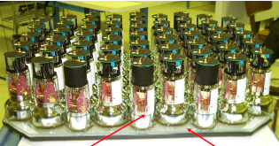
Gamma camera
Thyroid were already imaged from linear scanner since 1950 when Anger invented the scintillation camera in 1958 establishing its basic design:
  NaI(Tl) crystal
  PhotoMulTiplier (PMT) array
  Position weighted signals (Anger logic)

Slide 23
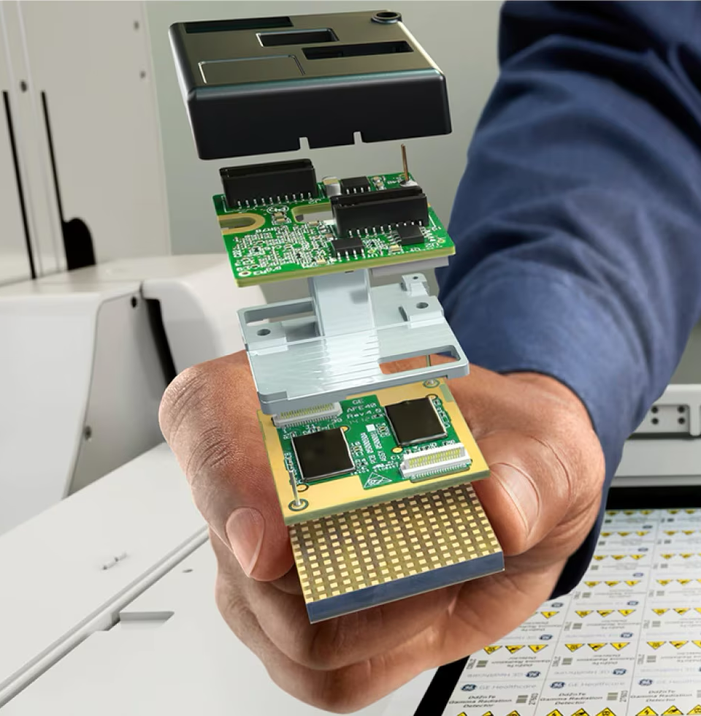
Cadmium Zinc Telluride scintillators
Direct conversion of scintillation photons into electric impulses without the need for PMT
the interaction of a gamma photon of 140 keV in CZT detectors produces approximately 30,000 electrons (20-fold more than that produced in a conventional NaI crystal) improving the energy resolution by a factor of 2;
much thinner and more flexible respect to NaI(Tl) crystal
possibility to design gamma cameras dedicated to cardiac imaging offering a larger surface for signal detection, which is focused on the heart region.

Slide 24
Quantitative use of SPECT
Besides dosimetry, nuclear medicine provides different quantitative measurements of physiological and pathological parameters, the so-called imaging biomarkers.
Imaging biomarker shall be produced by equipment verified for the quantitative.
An error propagation shall be thought when using the imaging bio-marker
While specific QA procedure does not exists several experience in clinical trial could be used(2)
1) O’ Connor et al. Nature Review Clinical Oncology, 2017, 2) Chauvie et al. Biomedicine 2018

Slide 25
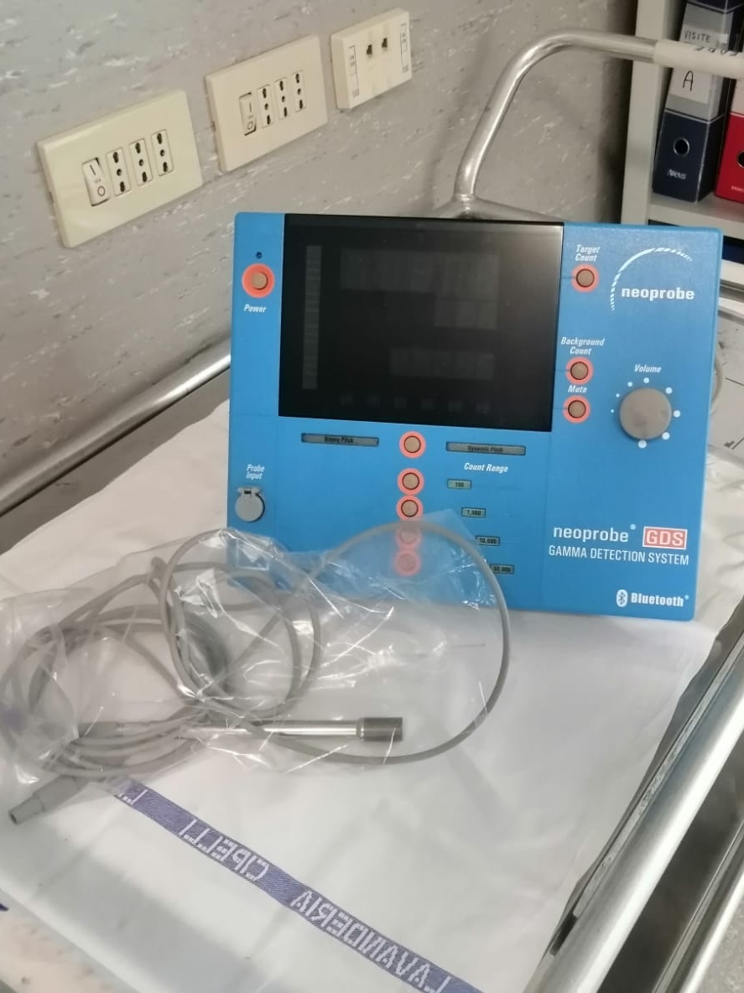
Sentinel lymph-node probe
Radioguided surgery procedures use hand-held intraoperative radiation detection probe systems, commercially available as certified medical devices.
The most relevant characteristics of these detectors are the energy resolution, the sensitivity, and the efficiency of collimation, the latter being aimed to grant a markedly unidirectional response.
Scintillation detectors in use were mainly NaI(Tl) and CsI(Tl), (BGO or LSO for 18F) now, the most diffused is a solid state CdTe or CZT semiconductor.

Slide 26
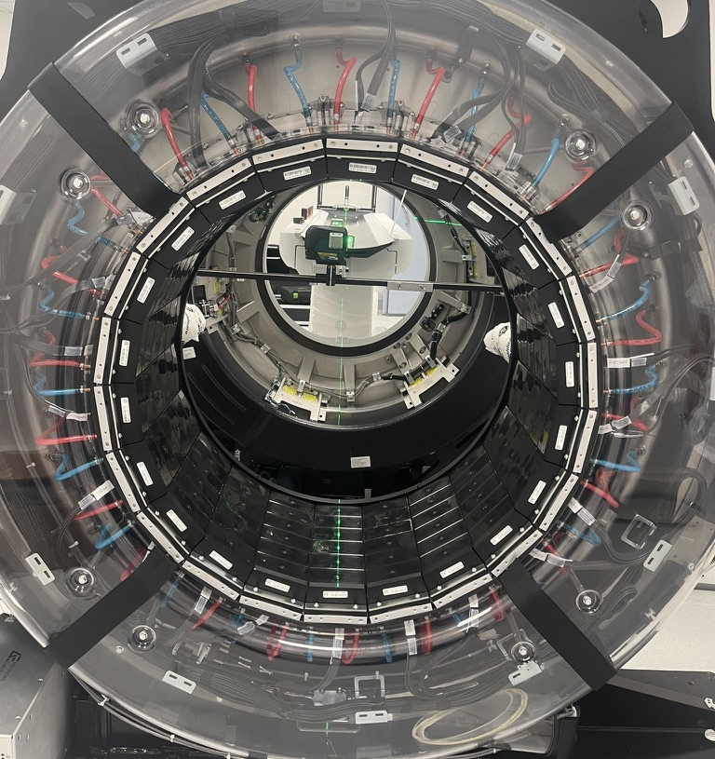
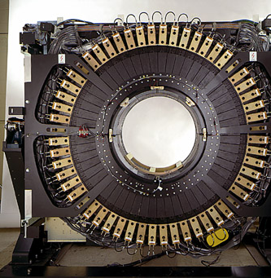
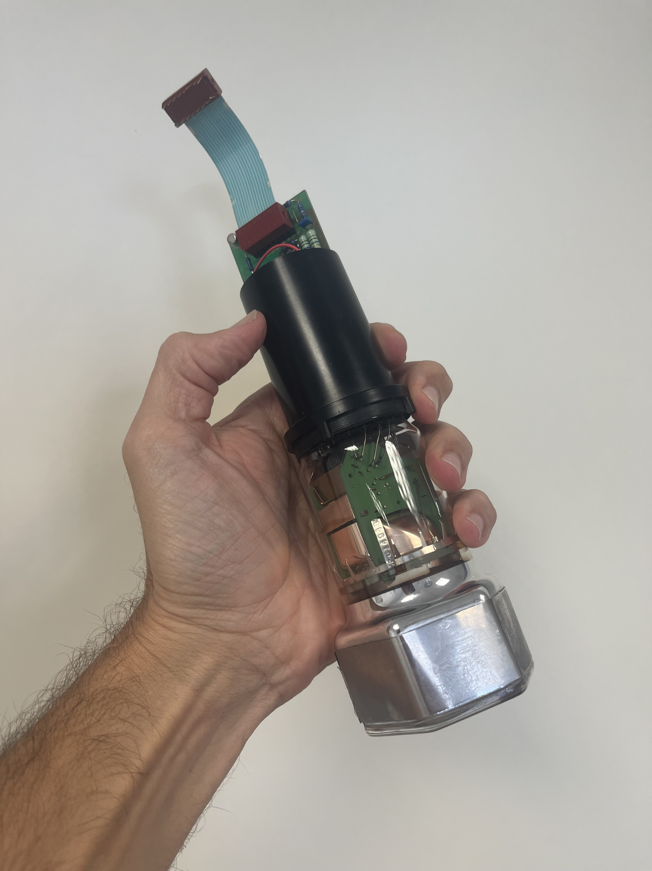
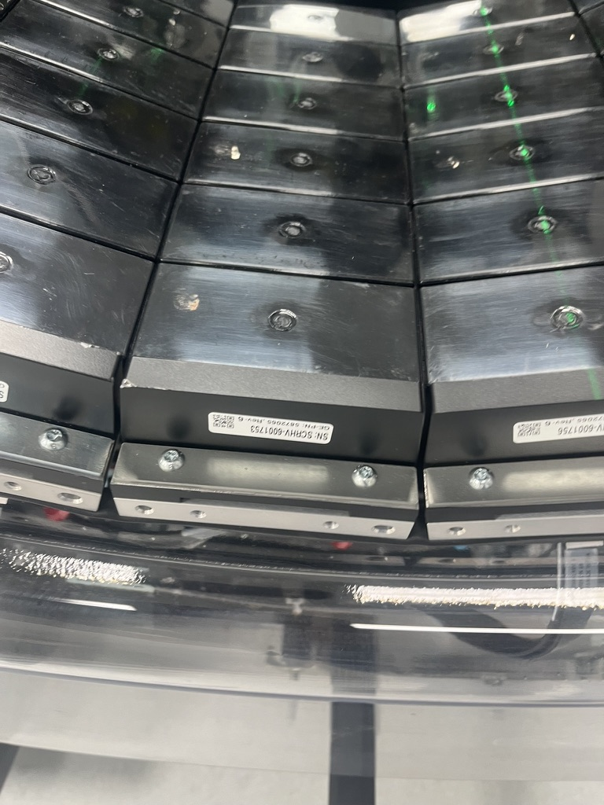
PET:
FROm
PMT
TO
SIPM

Slide 27
Time-OF-flight (TOF) PET “DIGITAL PET”: the silicon photomultipliers
 | PMT | APD
Amplification | 10⁶ | 10⁶
Electron transit time | 30 ns | 100 ps
Operational voltage | 800-1000 | 30-60

Slide 28
THE TWO trends in pet imaging

Slide 29
Time-OF-flight (TOF) PET
NON TOF | TOF | digital TOF
- | 495 ps | 225 ps
60 cm | 9 cm | 3.4 cm
The 10 ps challenge

Slide 30
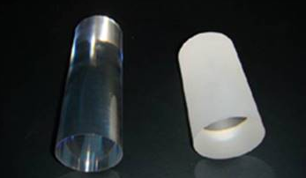
Improve sensitivity
Strategies to increase sensitivity:
  increase AFOV
  Increase AFOV and use BGO but neglect TOF
Sensitivity boost from 10 to 150 cps/kBq
Large axial FOV permits:
  Lowering the injected activity (immunoPET)
  Delayed imaging increasing biological T/B
  Clinical feasible dynamic imaging

Slide 31
Large Axial Field-Of-View (LAFOV) PET
Increase axial length permits:
  Lowering the injected activity (immunoPET)
  Delayed imaging increasing biological T/B
  Better temporal resolution
  Clinical feasible dynamic imaging

Slide 32
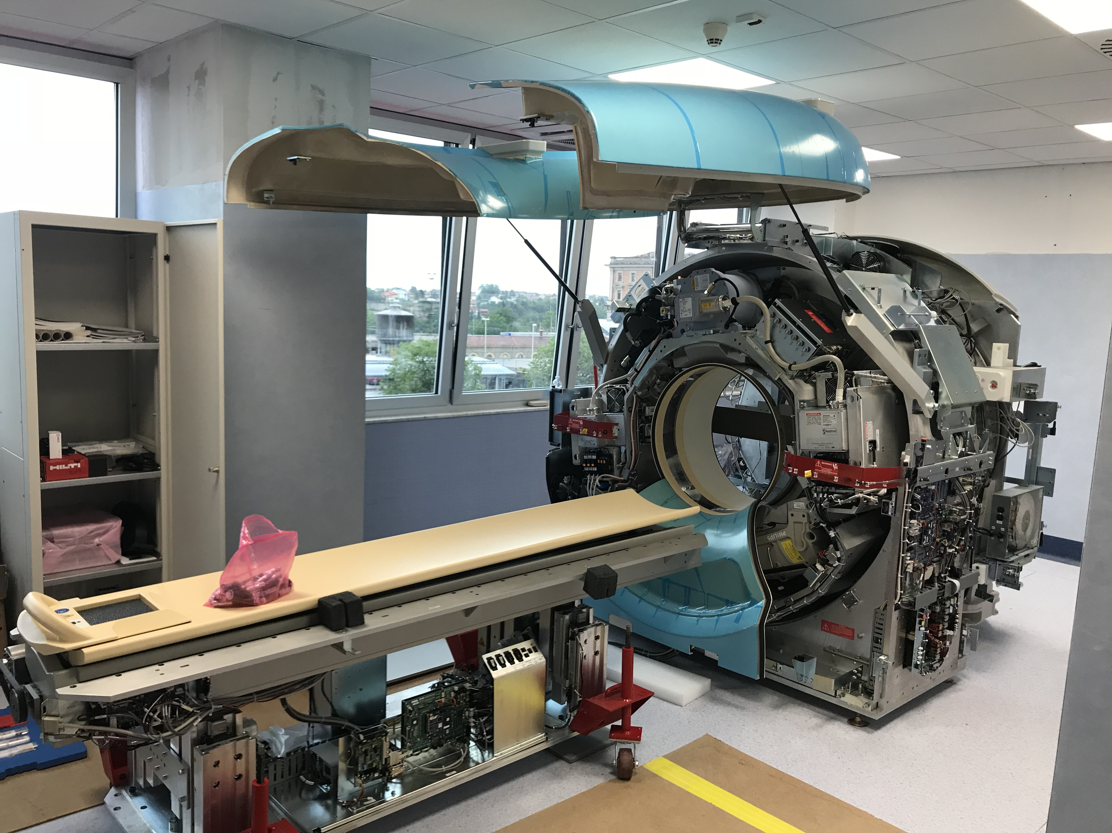
PERFORMANCE OF “CUNEO” PET SCANNERS
 | Advance NXi | Ingenuity TF | OMMI Legend 32
Installation date | 2002 | 2018 | 2024
Sensitivity (cps/kBq) | 6.5 | 7.4 | 46
Spatial resolution (cm) | 4.8 | 4.7 | 3.6 2.5 (with recon)
Axial FOV (cm) | 14.5 | 15 | 32

Slide 33
Walk-trough PET
1/3 cost with BGO

Slide 34
J-PET
In the tissue, positron-electron annihilation may proceed directly (e+e−→ photons) or via positronium (e+e−→ positronium → photons) (40% in PET scanning.
The positronium decays:
25% parapositronium (p-Ps) 2 photons in vacuum in 125 ps
75% orthopositronium (o-Ps) three photons in 142 ns,
The mean lifetime of o-Ps in a patient’s body varies from approximately 1.8 ns in water molecules to approximately 4 ns in skin cells (18).

Slide 35
FROM FILTERED BACK PROJECTION TO ITERATIVE RECONSTRUCTION
Noise modeling through convergence algorithm (BPL)
Iterative reconstruction (IR)
Acceleration
Prior knowledge
(PSF)
Scatter and random correction
TOF

Slide 36
Recovery coefficient curves
Represents the ratio among the measured and expected [A]
Different normalization:
  [A] = Activity measured on activemeter / volume of the phantom
  [A] of the larger sphere
Different metrics:
  Max in sphere/section
  Average value in the nominal sphere/section
  Average value in the 50% of nominal sphere/section
  Peak value (except last…)
NB: definition is different from the hot contrast in NEMA

Slide 37
IMAGE QUALITy
IR
TOF
TOF+PSF
Juweid

Slide 38
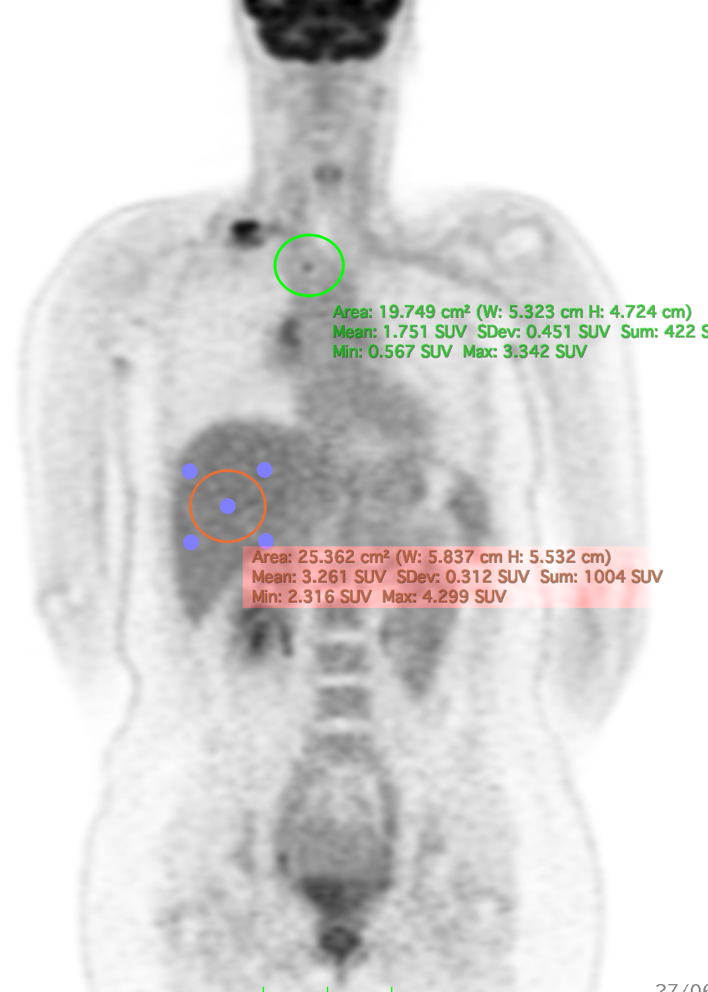
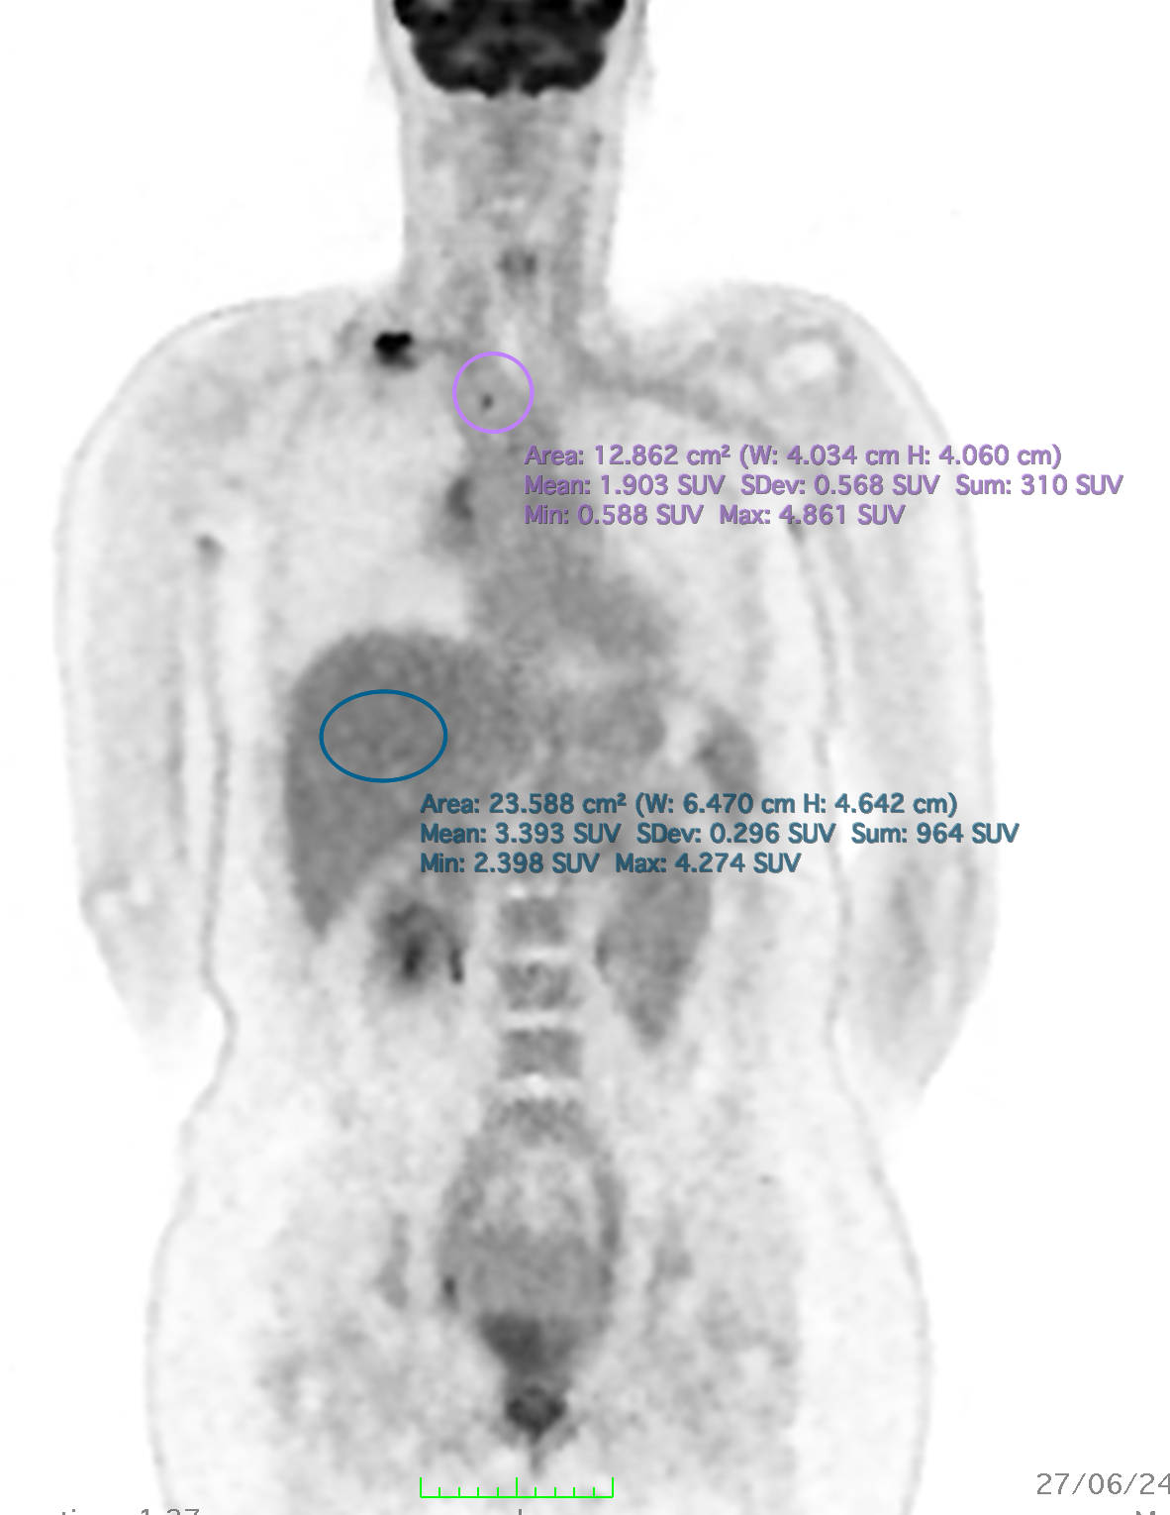
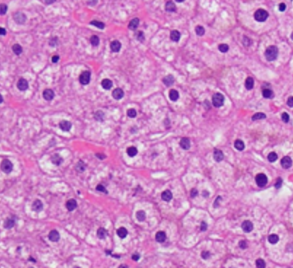
Quantification: suv convergence
Lesion
3.33 -> 4.86
Liver

Slide 39

Deep learning reconstruction

Slide 40
AI application in image reconstruction
Image correction
Iterative RECONSTRUCTION
Attenuation correction
Scatter correction

Slide 41
Full image recon-struction

Slide 42
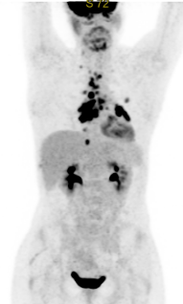
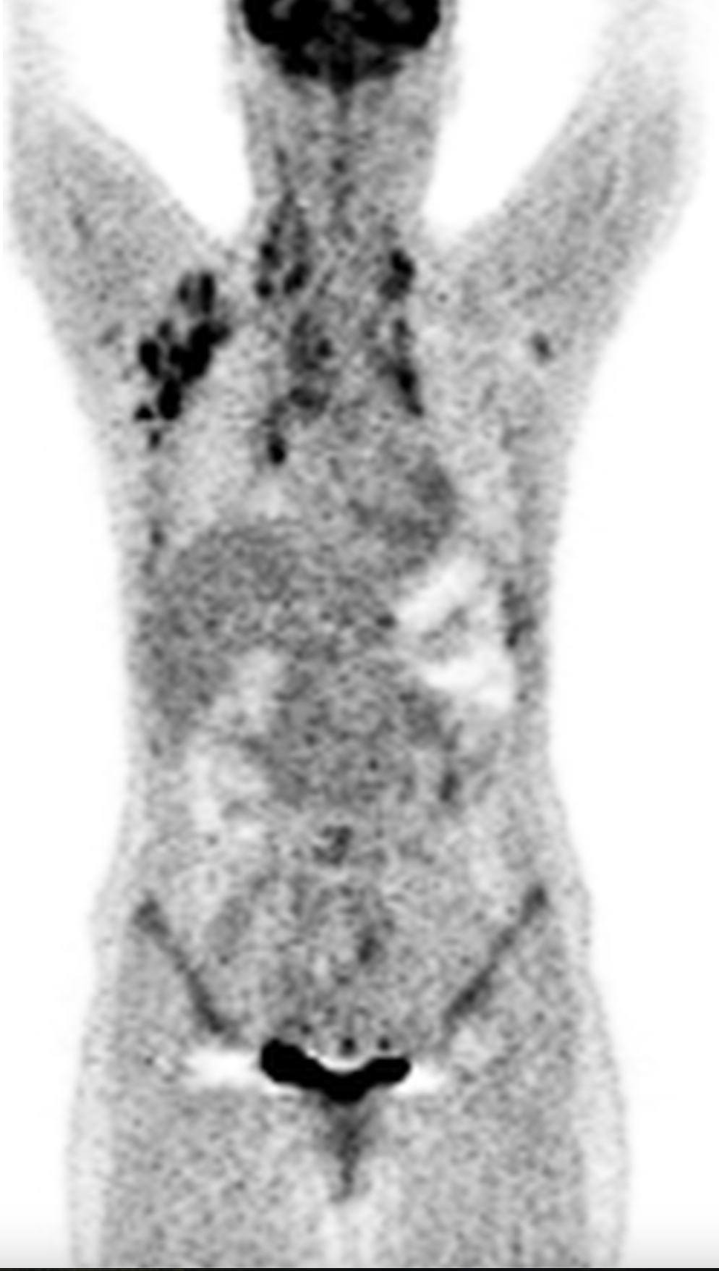
NOW AND THEN
Higher T/B
Higher sensitivity
Low noise
@ low dose
@ short time
quantitative...

Slide 43
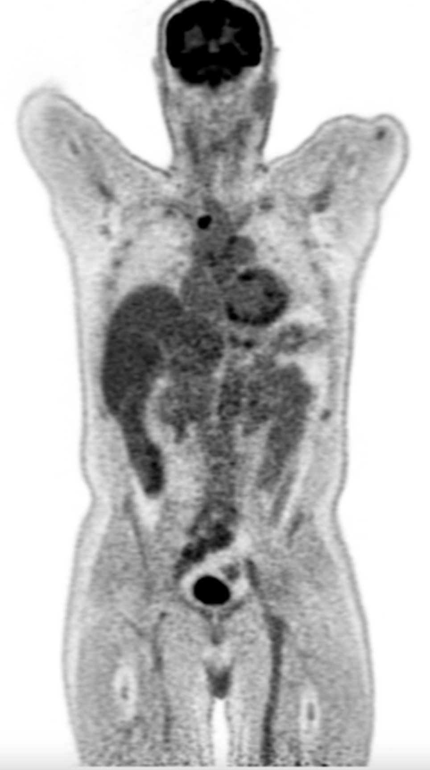

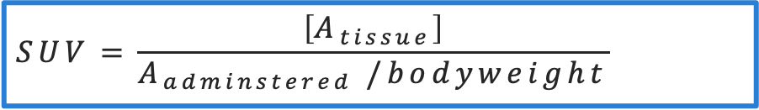
PET is intrinsically quantitative…
FDG
$$Sensitivity Factor= \frac{CPS}{Activity }$$
kBq/ml
Sensitivity permits to translate from counts to activity
SUV
Normalising to patient
CPS/voxel
PET measures the number of counts accumulated in a voxel
$$SUV=\frac{\left[A_{tissue}\right]}{A_{adminstered} /bodyweight}$$

Slide 44
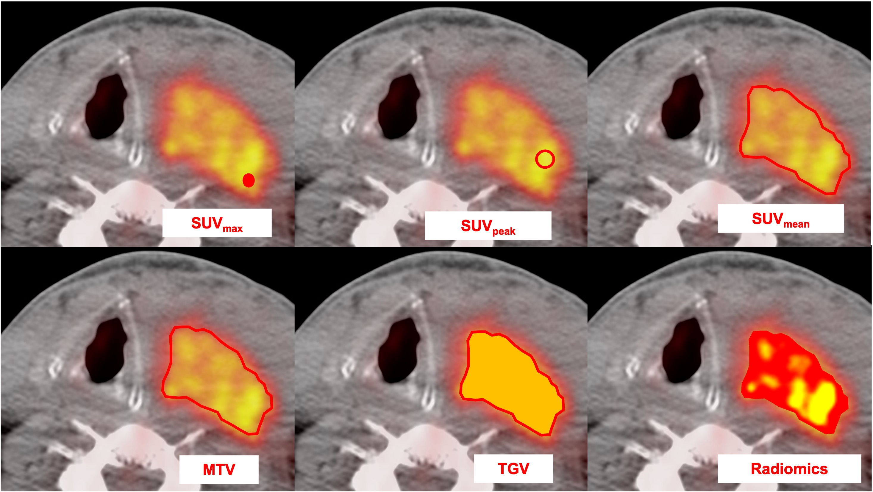
Which is THE representative metric?
  SUV_{max}, SUV_{peak}
  α
  most active tumor foci
  SUV_{mean}
  α
  tumor cell metabolic rate
  Metabolic Tumor Volume
  α
  number of viable tumor cells
  Total Glycolithic Volume
  =
  SUV_{mean}* MTV
Chauvie et al.

Slide 45
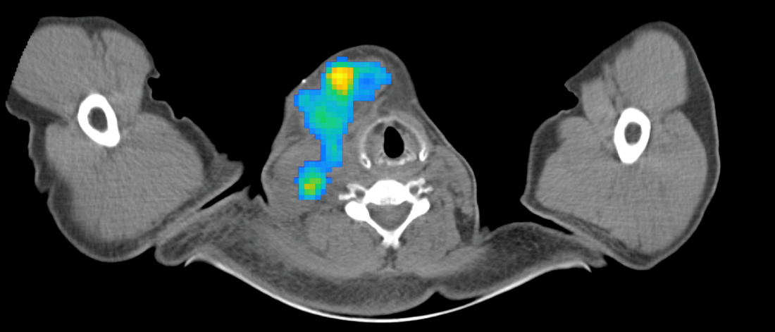
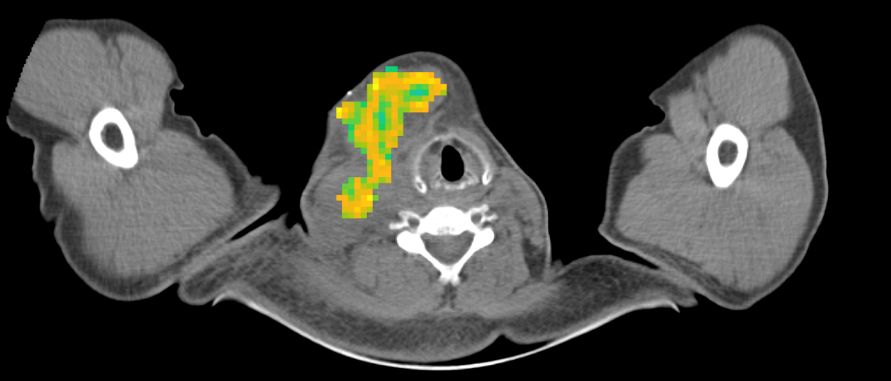
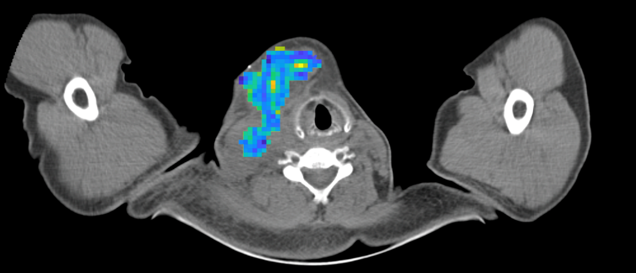
Radiomics to describe intratumor heterogeneity
basic biophysical parameters (e.g. blood flow, hypoxia, cell death)
underlying gene expression profiles
SUV
Contrast
Emphasis
intraPATIENT

Slide 46
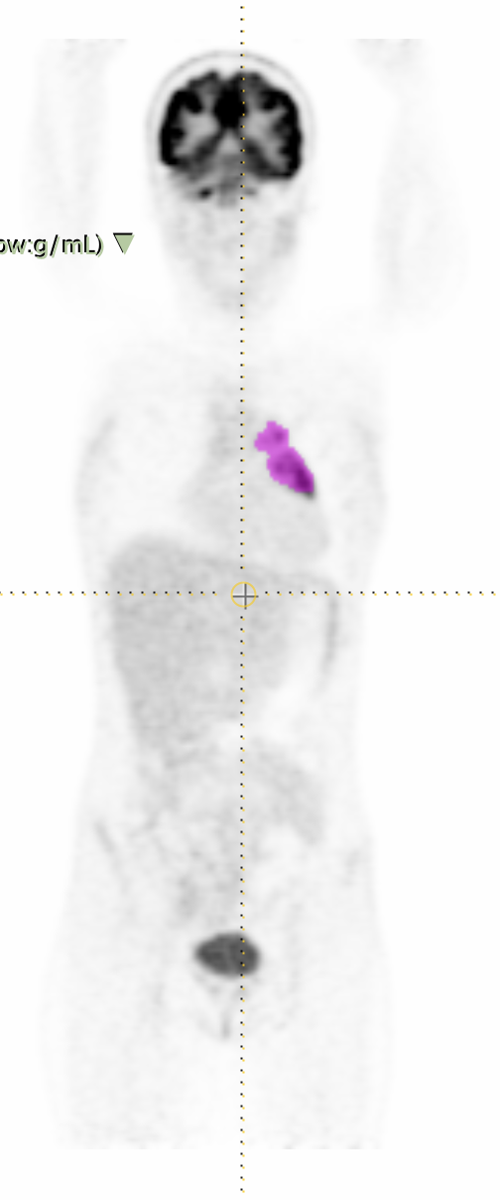
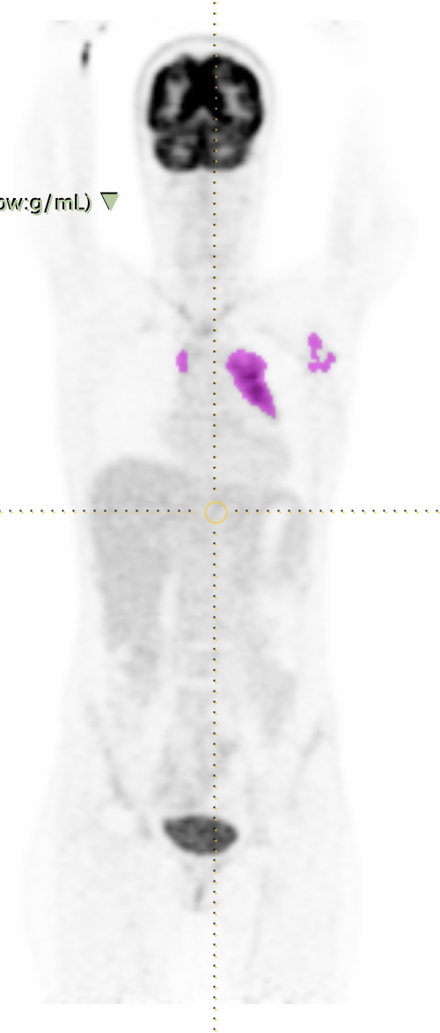
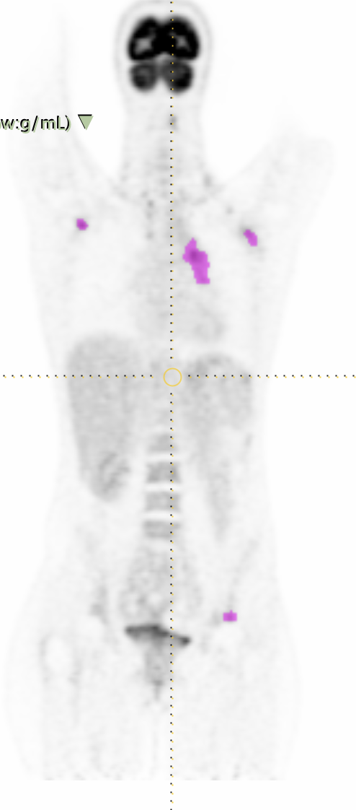




Slide 47


RADIOPROTECTIOn
It is usually seen as a professional skill, not too much science has been put on it. But it is needed!
InFra-structures
Real-time Radiation dosimeter

Slide 48

CONCLUSIONS
NM moved from gamma camera to PET
Many new tracers are nowadays used in clinical practice
Theragnostics would play a central role
Need for:
  isotope production
  quantitative imaging
  AI offers different solution but definitively need to be validated in research and clinical environment

Slide 49

Thanks fot the attention and Buna festa

