Slide 1
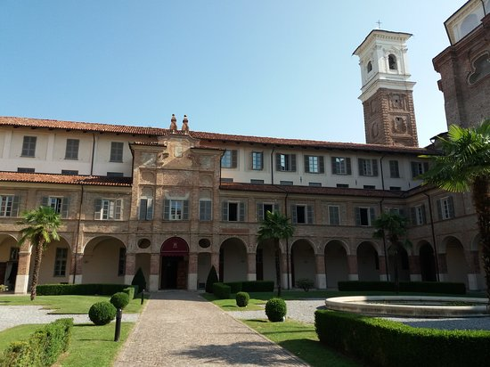
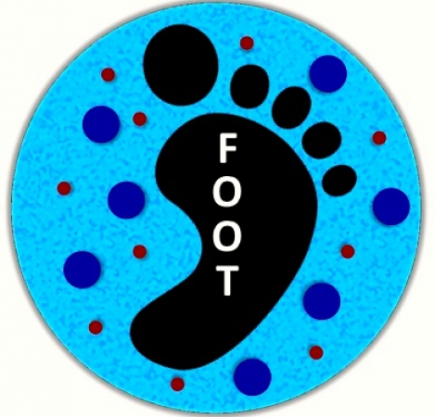
XVII FOOT General Meeting
Cherasco (CN), 16-18 Dec 2024
M. Villa
INFN Bologna & Unibo

Slide 2
Collaboration
Collaboration by numbers:
93 Authors, (TBU)
35 Institutions
7 countries (Italy, France, Germany, Japan, Cuba, USA, India)
3 continents (Europe, Asia, America)
About 54% of women (highest in CSN3)
Latest on board:
A group from LNGS (emulsions)
Calicut University, India (data analysis)
Other groups show interest to join/collaborate with us

Slide 3
Collaboration
Three new post doc bourses funded partly on the MAECI project won by people interested but not previously working in FOOT
At least three new PhD students on board
To all the new collaborators:
A warm welcome !!

Slide 4
The FOOT Physics Program
Specific measurements related with Particle Therapy & Radioprotection in Space
Using C, C₂H₄ ➔ cross sections on C and H
Using C, C₂H₄, PMMA ➔ cross sections on C, O and H
PMMA is a combination of C,O,H.
Phys | Beam | Target | Energy (MeV/u) | Inv/direct
Target Frag. PT | ¹²C | C, C₂H₄ | 200 | inv
Target Frag. PT | ¹⁶O | C, C₂H₄ | 200 | inv
Beam Frag. PT | ¹²C | C, C₂H₄, PMMA | 350 | dir
Beam Frag. PT | ¹⁶O | C, C₂H₄, PMMA | 400 | dir
Beam Frag. PT | ⁴He | C, C₂H₄, PMMA | 250 | dir
Rad. Prot.space | ⁴He | C, C₂H₄, PMMA | 700 | dir
Rad. Prot.space | ¹²C | C, C₂H₄, PMMA | 700 | dir
Rad. Prot.space | ¹⁶O | C, C₂H₄, PMMA | 700 | dir
open to other possible physics programs
E.g. C + C → 3α + X
4

Slide 5
Physics data taking done up to now
Beam | Target | Energy MeV/u | Statistics (millions) | Integral Differential elemental | Integral Differential isotopic | direct | inverse | Emulsions | campaign
O | C C2H4 | 200 400 | 0.06 | angle | NO | YES | NO | Yes Yes | GSI 2019 GSI 2020
O | C C2H4 C C2H4 | 200 200 400 400 | 14.2 12.2 5.5 6.5 | angle | NO | YES | NO | Yes | GSI 2021
He | C | 100 140 200 220 | 18.5 19.6 13.5 14.4 | angle | NO | YES | NO | No | HEID 2022
C | C | 200 | 4.1 | angle | NO | YES | NO |  | CNAO 2022
C | C C2H4 | 200 200 | 3.2 2.0 | Angle Energy | YES | YES | YES | Yes | CNAO 2023
C | C | 200 | Mostly tests VTX, IT, Calo, NIT | Angle | YES | YES | NO | NIT tests | CNAO 2024

Slide 6
The three year plan presented to CSN3
Beam | Target | Energy MeV/u | Integral Differential elemental | Integral Differential isotopic | Emulsions | Campaign
C | C, C2H4 | 100-200 | Angle Energy | YES | YES (NIT?) | CNAO 2025
O | C | 500-700 (?) | Angle Energy | YES | YES | GSI 2026
C | C, C2H4 | 200-300 | Angle Energy | YES | - | CNAO 2026
P | C | 100-220 | Angle Energy | YES | NIT | CNAO 2026
C | C, C2H4 PMMA | 320-400 | Angle Energy | YES | YES | CNAO 2027
He | C, C2H4 PMMA | 200-400(?) | Angle Energy | YES | YES | CNAO 2027

Slide 7
INFN Milestones
Year 2024 (all on 31st december)
Complete analysis of 2022 data campaigns (ongoing)
First results with NIT emulsions (ongoing)
First results on the full electronic set-up (2023 CNAO campaign, ongoing)
New CNAO campaign with both set-ups (2024 CNAO campaign, done!)
Year 2025 (all on 31st december)
Proceeding/article with preliminary results on CNAO 2023 (el. set-up)
Proceeding/article with preliminary results on CNAO 2023 (emulsions)
Beam test on the new vertex detector
Beam test on the new TofWall
Preparation of an instrumental article for FOOT
Proceeding/article on NIT

Slide 8
Detector status
Up and running (most of the time!)
Recent advances in understanding some detector features on
VTX
MSD
CALO
ST, BM, TW in the phase of continuous improvement
Improvements needed in the knowledge of IT and NIT emulsions

Slide 9
Tools
Monte Carlo:
Continuously evolving and following the different set-ups used in data takings or contributing to the definition of the set-ups!
Trigger and Data Acquisition:
Evolving with time and detectors on the beam line
More online controls; not yet finished!
Reconstruction software:
Shoe: continuous development. Not at all an easy task!
Tuning at each data taking (alignment, noise, detectors on the beam line….). Solving bugs/features of recent campaigns…(2022-2024!)
Computing farm
Moving from Tier3 to Tier1 (T3 accounts will be removed on 01/01/2025)
Tools are being used to get some physics!

Slide 10
Many calibration studies and analyses ongoing
Really too many to mention!
We’ll get the details in this meeting
Some «reference» papers have been published
Some papers are in the pipeline

Slide 11
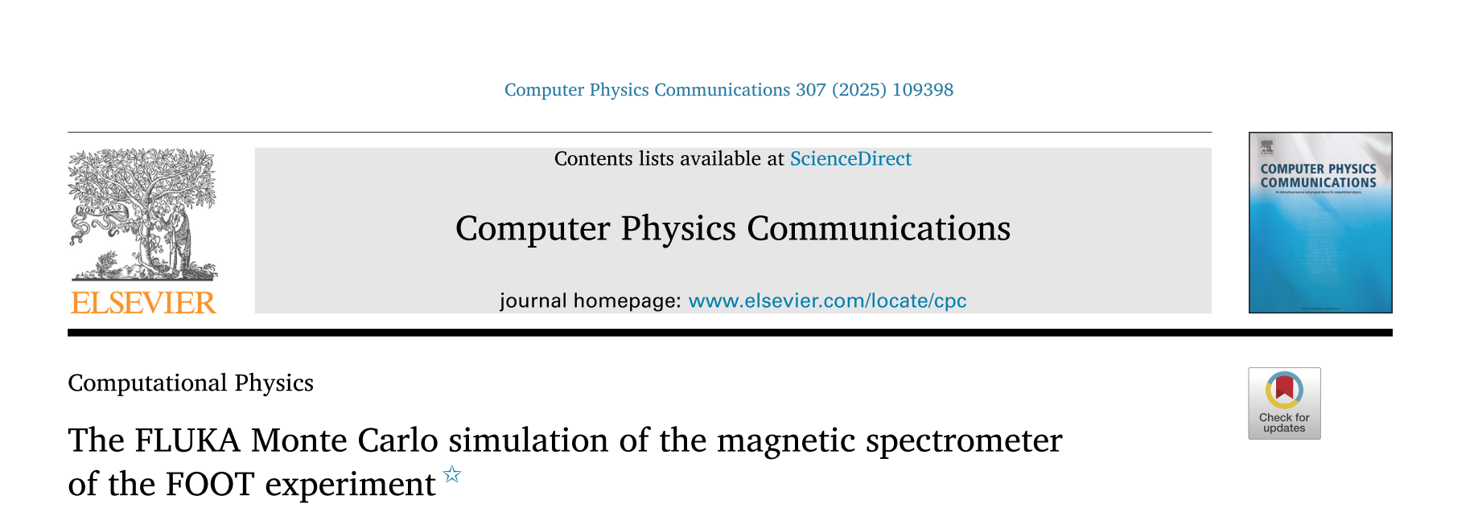
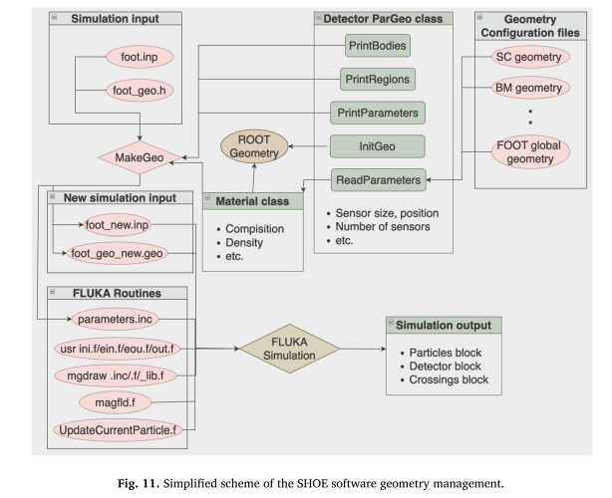
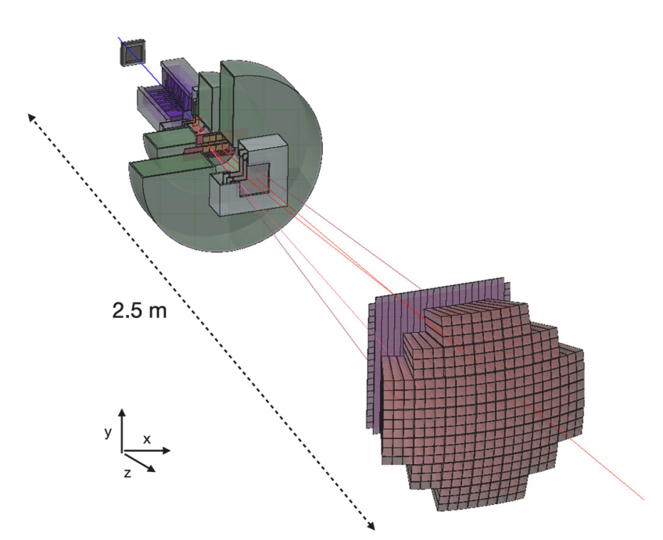
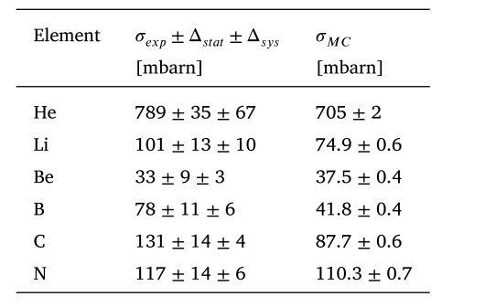
O+C, 400 MeV/N

Slide 12
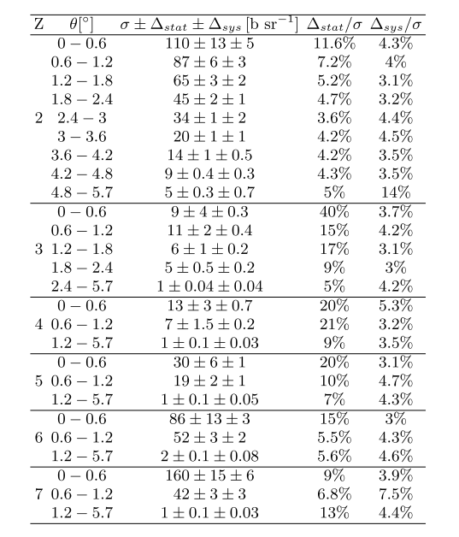
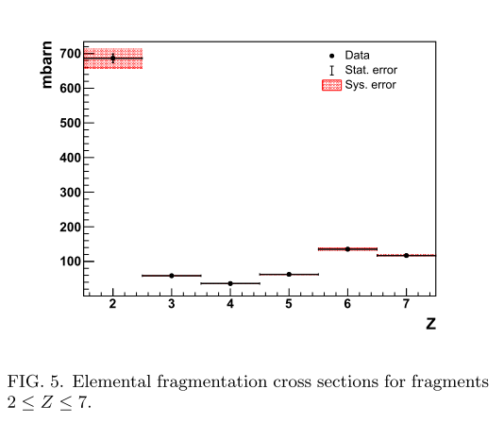
GSI 2021 sample

Slide 13
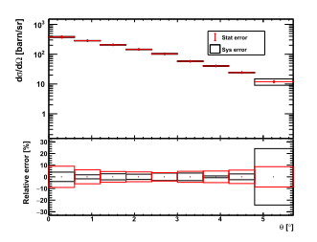
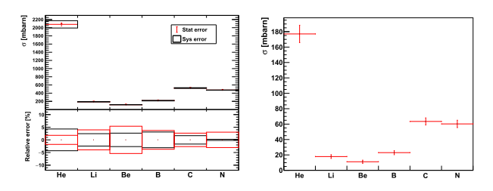
Very preliminary!!
GSI data: O+C and O+C2H4, 400 MeV/n
O+C2H4 -> Helium differential
O+C2H4 -> X, integral
p+C -> X, integral

Slide 14
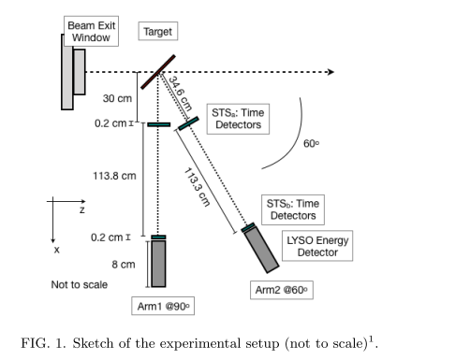
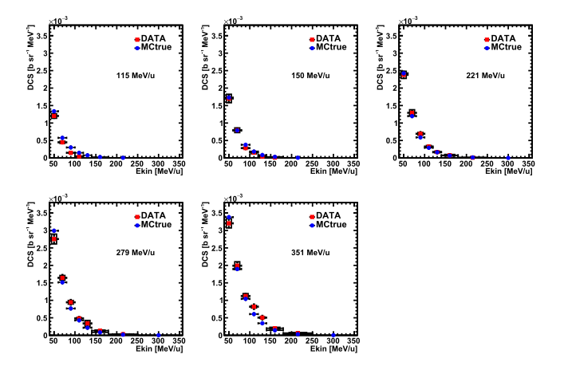
CNAO 2017, C on C, C9H10, PMMA; energy: 115-351 MeV/n
C+PMMA-> p + X at 90°
Differential cross sections

Slide 15
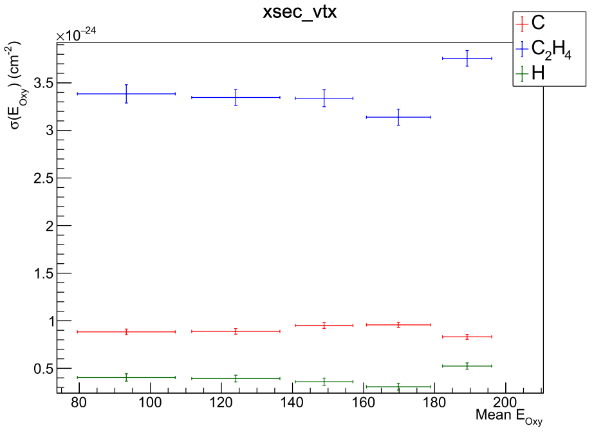
Emulsions: cross section measurements
GSI data: O+C and O+C2H4, 200 MeV/n
Analysis of ¹⁶O @ 200 MeV/n on C and C2H4 targets almost completed:
Improvements in data-driven effects added on Monte Carlo reconstruction (background, misalignments, local distortion due to chemical development…)
Evaluation of total and reaction cross sections
Paper on cross section measurements with ¹⁶O at 200 MeV/n on C, C2H4 and H in preparation

Slide 16
MAECI PROJECT: Measuring Oxygen Fragmentation For Improved Ion Therapy Strategies (MOFFIITS)
Decided to measure cross sections in the «high» energy range:
¹⁶O on C, CH₂, 32 h of beam, exact energy to be decided soon
Use of the Cave A – currently studing the optimal detector geometry
We need to submit a project to the bio-PAC for 2026, when an Oxygen beem will be available. Time scale: mid-jan to mid-march. (priority for beam?)
MAECI will end support on October 2025 !!

Slide 17
Time to start the meeting!
Please stay in the allocated time
Please upload your presentation as soon as possible
Have a fruitfull meeting!

Slide 19
FOOT impact on the community
Activities ongoing on several fronts:
- Many are involved in PRIN 2022 (9!) activities and
- in the MAECI Project
- Detector calibration & undestanding
- Analyses
Present at the Nuclear Physics Mid Term Plan &
Sesto Incontro Nazionale di Fisica Nucleare (Trento)
Paper and conference proceedings
Proposal writing
No proposal in writing or in the waiting stage at the moment.
Good: we’re fully booked till 2026!!
All these activities are are signs of a healthy
and active collaboration!

Slide 21
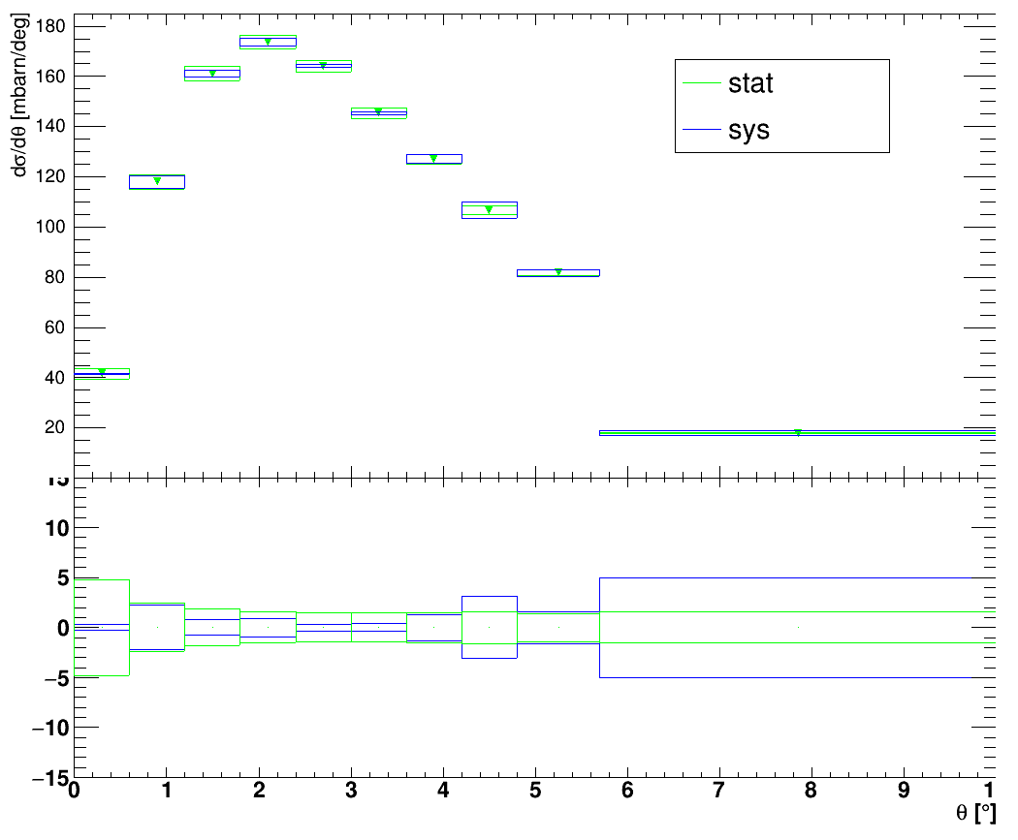
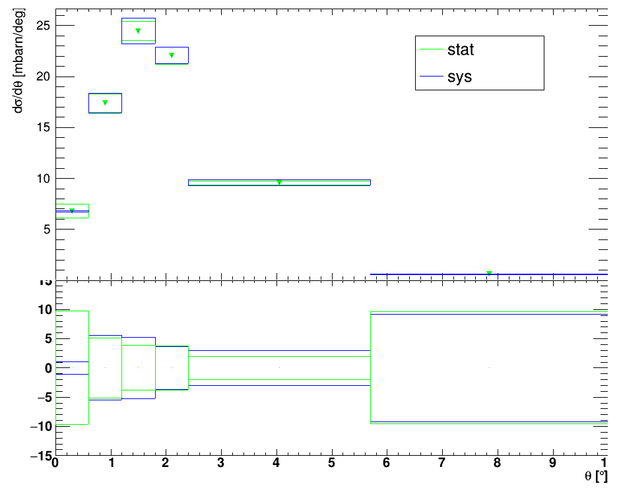
Results on GSI 2021 O+C, 400 MeV/N
$$σ_{frag}\left(Z\right) \frac{dσ_{frag}\left(Z\right)}{dθ} Z<8$$
Z=3
He
%
%
24

Slide 22
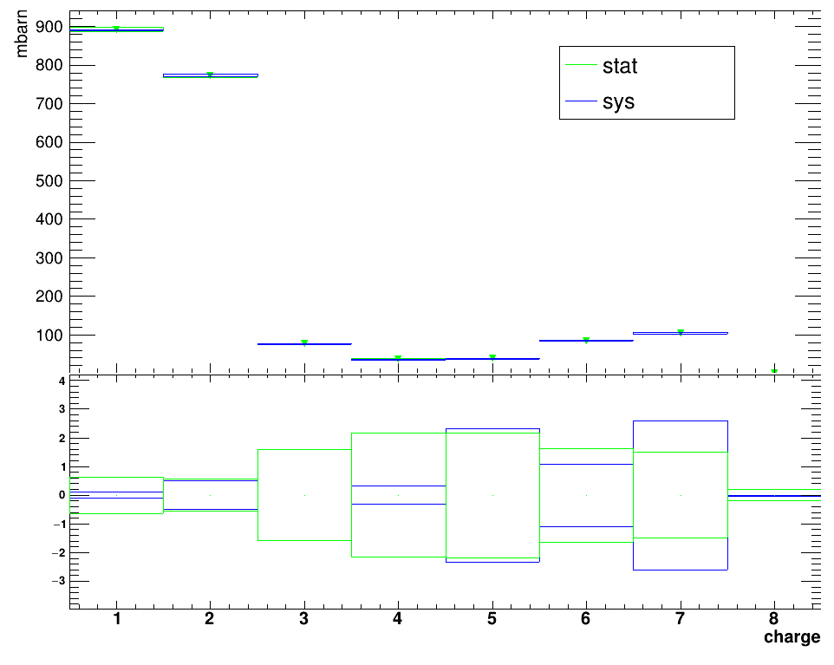
Integral cross section GSI 2021 – O+C 400 MeV
Paper in the writing stage
Uncertainties on cross sections
(much) lower than 5%
Analysis extension to the O+CH₂
And extraction of O+H cross section
Under way
%
27

Slide 23
Tools
Monte Carlo:
Continuously evolving and following the different set-ups used in data takings or contributing to the definition of the set-ups!
Trigger and Data Acquisition:
Evolving with time and detectors on the beam line
More online controls; not yet finished!
Reconstruction software:
Shoe: continuous development. Not at all an easy task!
Tuning at each data taking (alignment, noise, detectors on the beam line….).
Emulsions: properly running

Slide 24
A general comment
We have an abundance problem: too many data sets
Still working on data from 2021 and earlier, while we have two samples in 2022 and one «engineering run» (good for physics) in 2023.
I would welcome if more people decide to be involved in the analyses, but I also know duties and opportunities in other fields (i.e. calibration, prins, …)
The 2024 CNAO data taking will likely be detuned to be detector understanding only (or mostly). A physics data taking will come soon after.

Slide 25
Fragmentation cross sections ¹⁶O on ^{nat}C at 400 MeV/N kinetic energy
Relevant both for hadrontherapy and space radioprotection
$$\frac{dσ_{frag}\left(Z\right)}{dθ} 1< Z<8$$
$σ_{frag}\left(Z\right)$ [mbarn]
$$σ_{frag}\left(Z\right) 1< Z<8$$
$dσ_{frag}\left(Z\right)/dθ$ [mbarn/deg]
H
He
Li
Be
B
C
N
$∆σ/σ$ [%]
0
$θ$ [deg]
H
He
Li
Be
B
C
N

