Slide 1

Activities of the Theoretical Physics Group
A theoretical support for the planning and interpretation of experiments
Maria Colonna
Laboratori Nazionali del Sud (Catania)
LNS Annual Meeting 2024 - 30.9.2024

Slide 2
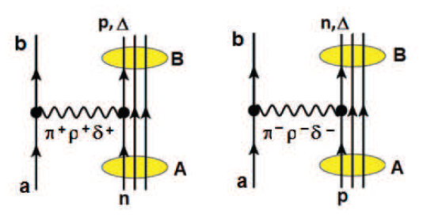

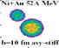


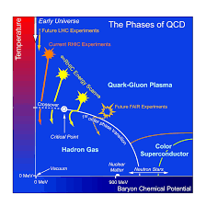
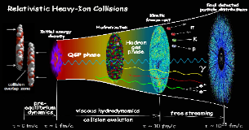
Research Projects - Theory Group@LNS
MONSTRE: MOdeling Nuclear STructure and REactions
SIM: Strongly Interacting Matter at high density and temperature

Slide 3

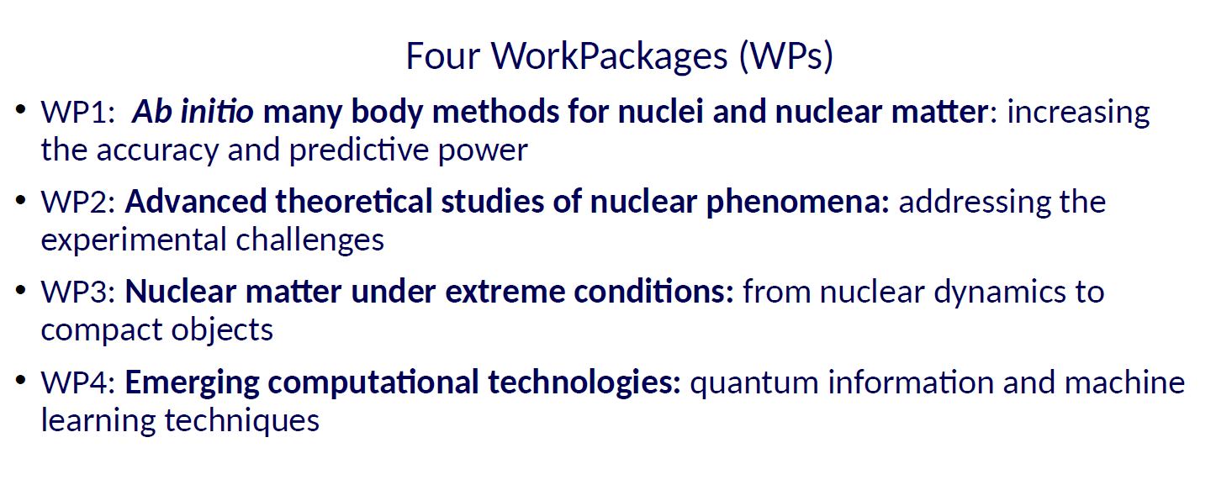
MONSTRE: MOdeling Nuclear STructure and REactions
National Coordinator: D.Gambacurta (LNS)

Slide 4

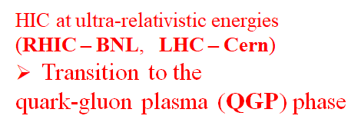
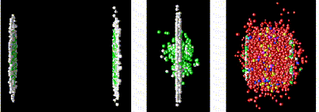
National Coordinator: A.Beraudo (INFN-TO), Local Coordinator: V.Greco
QGP phenomenology
Quark dynamics and hadronization mechanisms
Transport equations for partons (beyond hydrodynamics)
Dynamics of heavy quarks: charm and bottom
Early stage, non-equilibrium dynamics AA, pA and pp

Slide 5
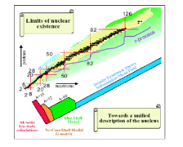
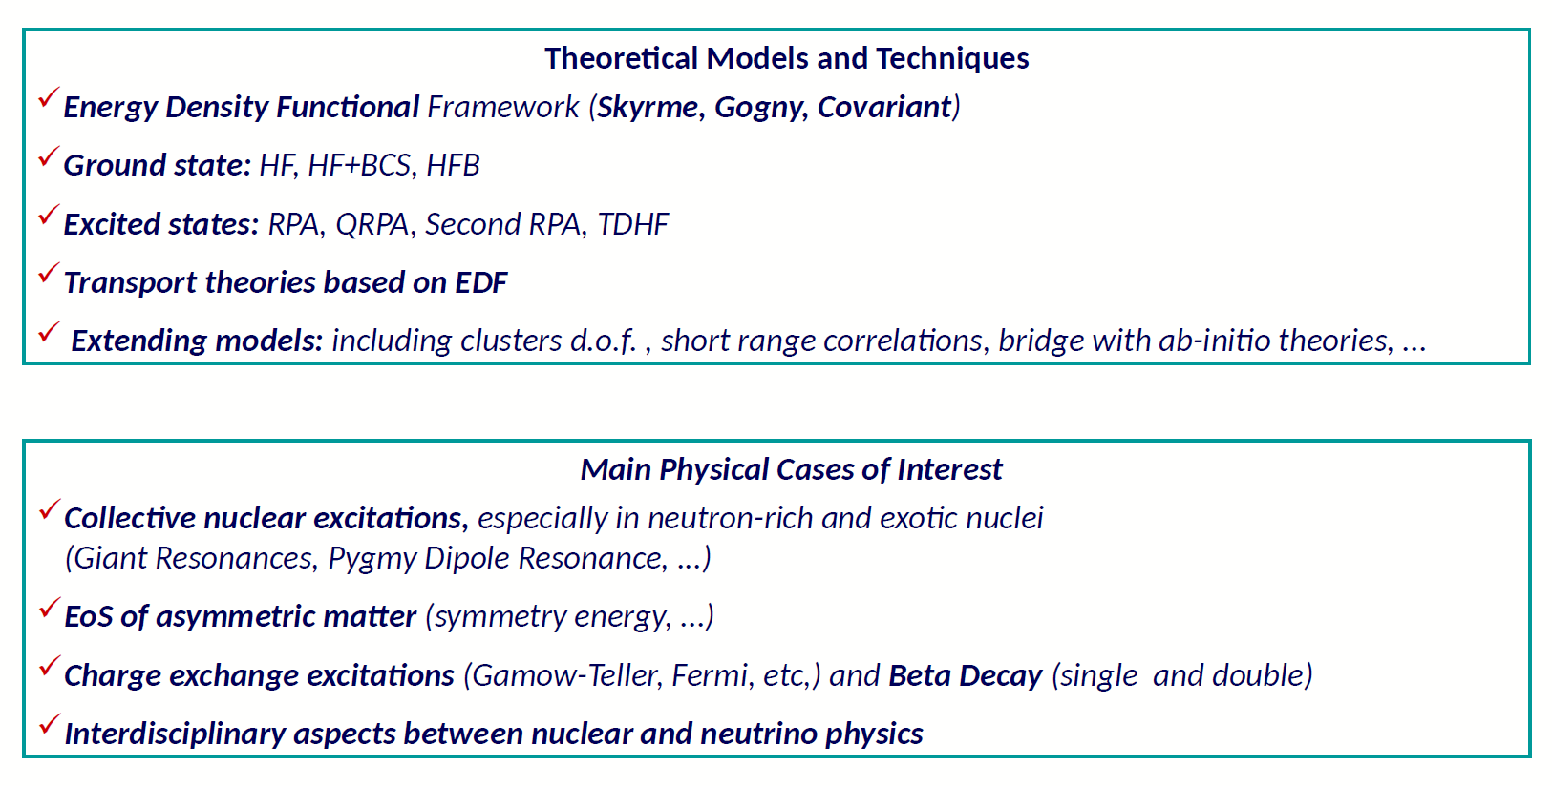
Nuclear structure

Slide 6
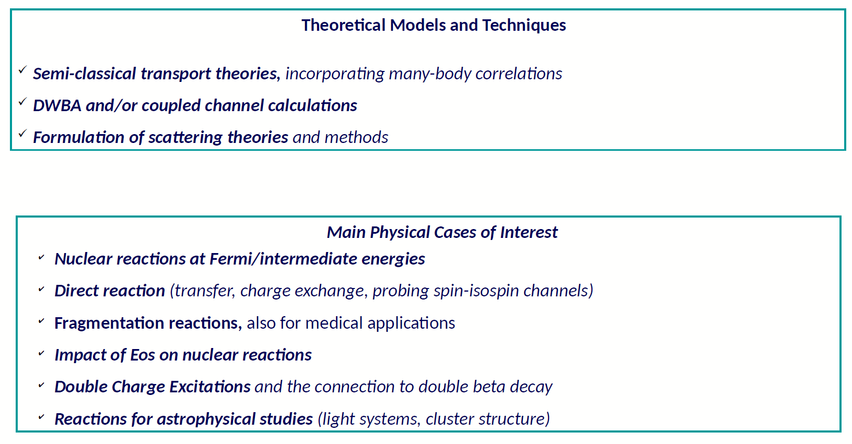
Nuclear reactions

Slide 7
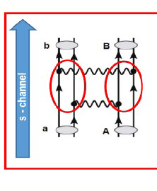
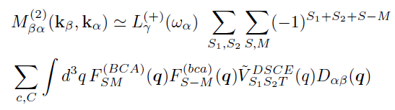

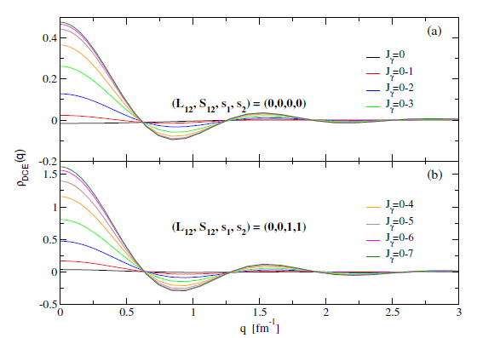
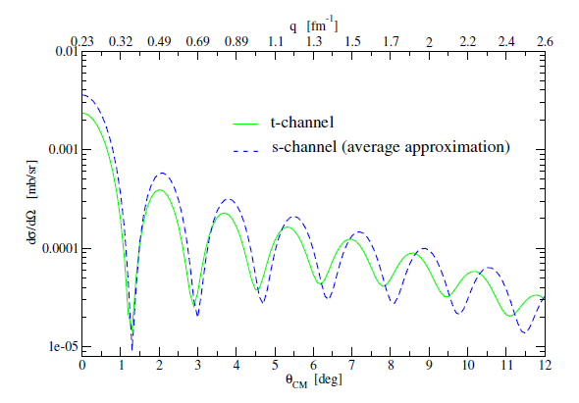
Double Charge Exchange (DCE) as a sequential two-step process (DSCE)
[H.Lenske et al., Universe 10, 93 (2024)
→ J.Bellone, M.Colonna, D.Gambacurta, H.Lenske, submitted]
TME
rank-2 NN interactions
DCE form factors
DCE Cross Section - ⁷⁶Se(¹⁸O,¹⁸Ne_{g.s.})⁷⁶Ge_{g.s.}
2BTDs ⁷⁶Se →⁷⁶Ge_{g.s.}
QRPA

Slide 8
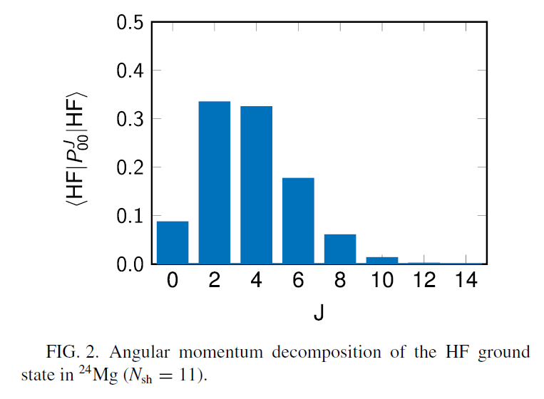

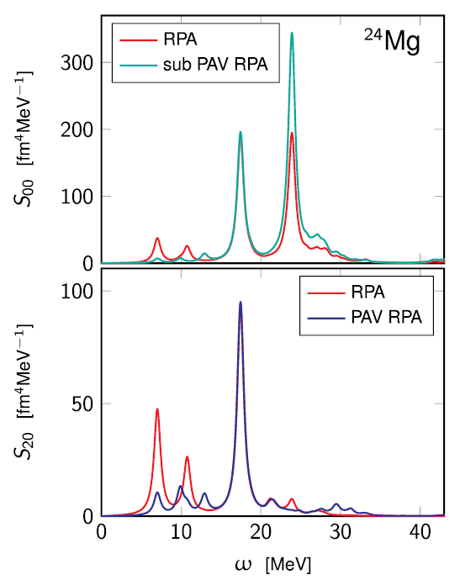
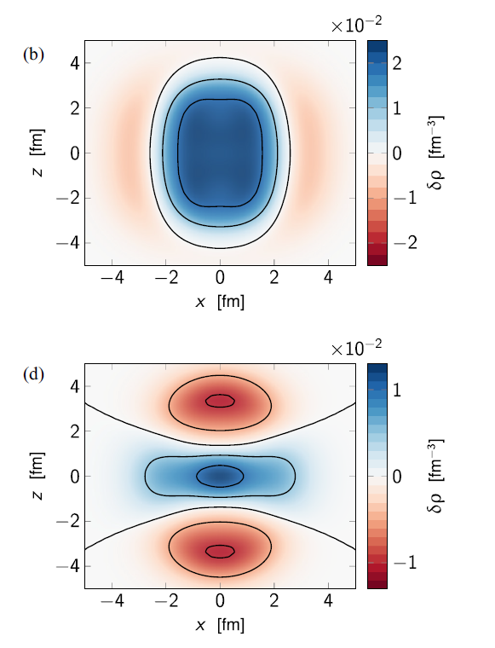
Collective excitations in deformed nuclei → extensions of QRPA calculations
²⁴Mg ground state
angular momentum
projection
PAV effects on:
monopole
oscillations
A.Porro, G.Colò, T.Duguet,
D.Gambacurta, V.Somà,
PRC 109, 044315 (2024)
quadrupole
oscillations

Slide 9
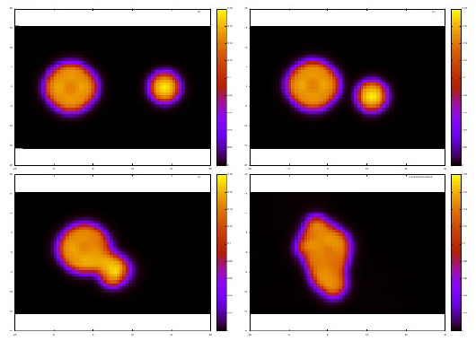
Collective excitations in deformed nuclei → extensions of QRPA calculations
²⁴Mg ground state
angular momentum
projection
PAV effects on:
monopole
oscillations
quadrupole
oscillations
Deformation and collective motion in TDHF dynamics
L.Shvedov et al., in preparation

Slide 10
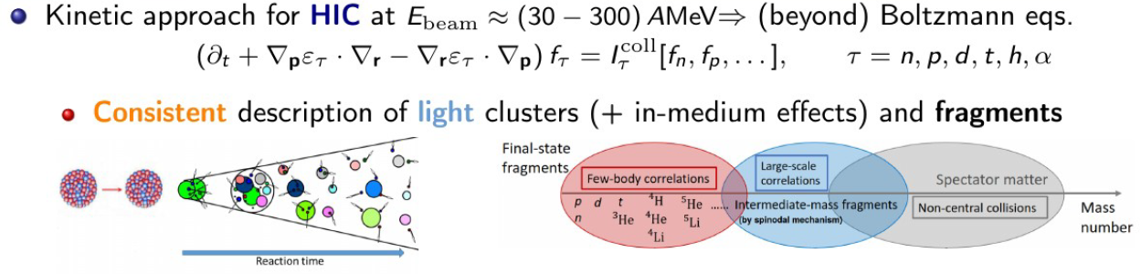
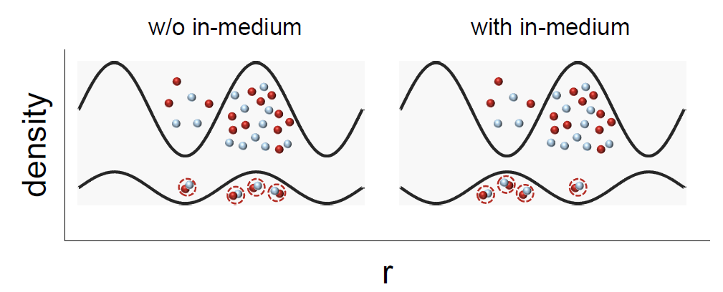
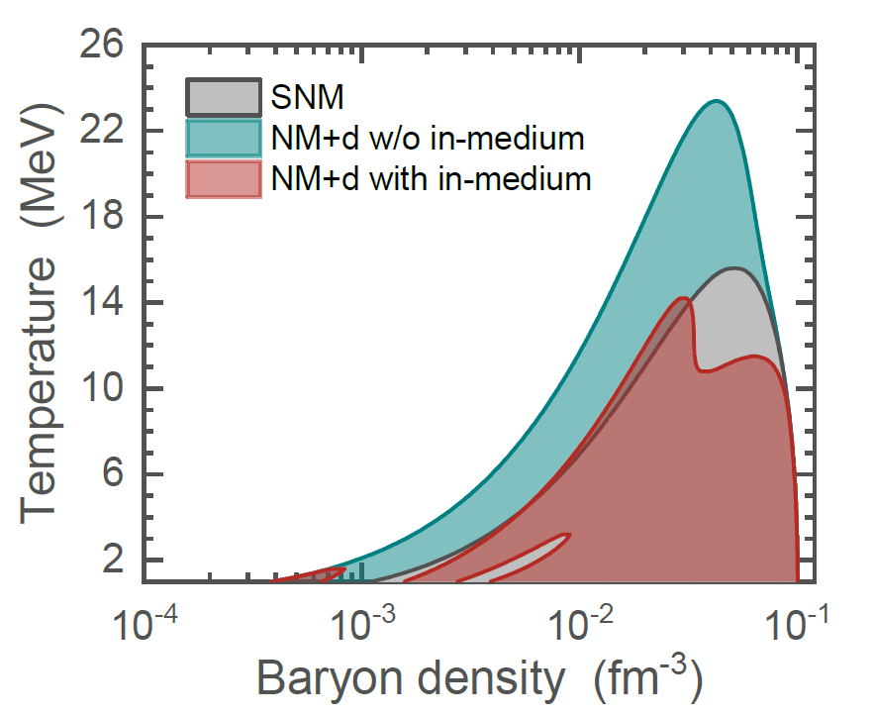
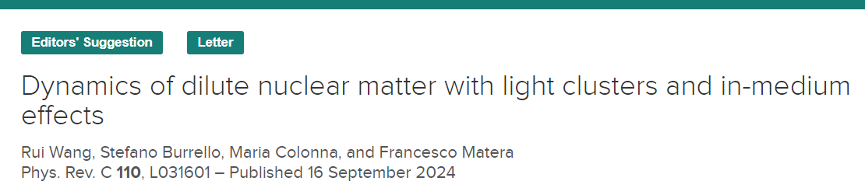
Improving models for Heavy Ion Collisions at intermediate energies
S.Burrello, S.Typel, EPJA 58,120 (2022)
Linear response analysis
→ Importance of in-medium effects
→ Unstable (spinodal) region
‘cooperation’
‘distillation’

Slide 11
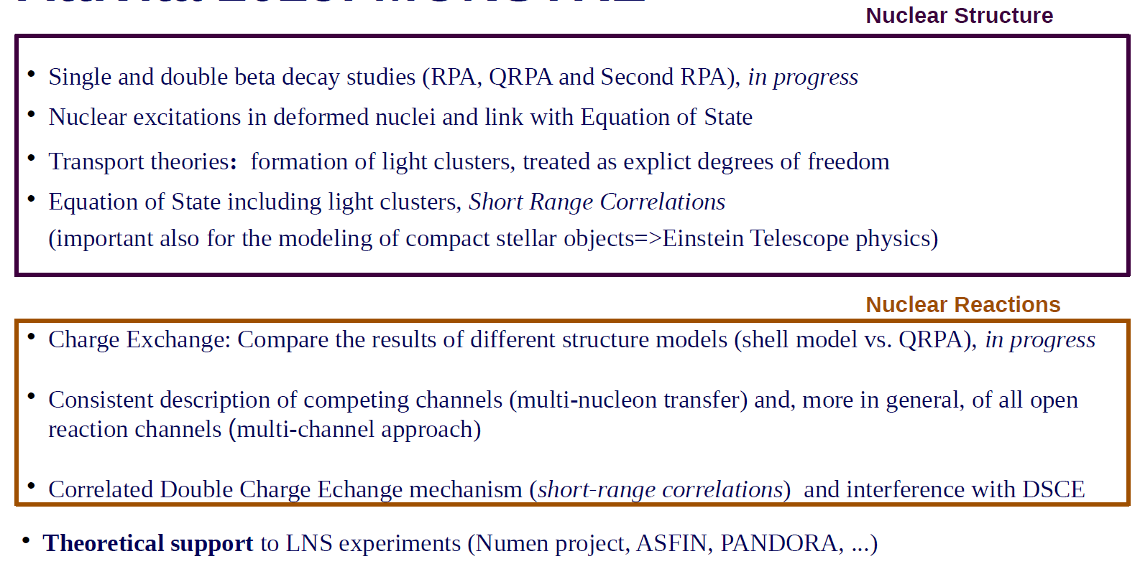
Ongoing and planned activities
NUMEN
FRAISE,
ET
(ET, Chimera, Asy-EOS @ GSI, INDRA/FAZIA, FRIB,…)

Slide 12

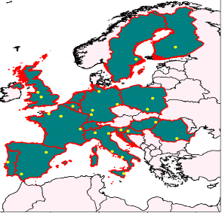
Horizon Europe call for Research Infrastructure (RI) services advancing frontier knowledge
HORIZON-INFRA-2021-SERV-01-07
Combined proposal – Nuclear and Particle Physics
EURO-LABS is a consortium of 39 Research Infrastructures:
15 for Nuclear Physics (NP)
24 for High Energy Physics (HEP) Accelerators + Detectors
→ twelve countries in Europe
From Finland (north) to Italy (south), from Romania (east) to Portugal (west)
Submitted on September 23rd, 2021
Evaluation report sent on January 18th, 2022
GA signed in April 2022
Project started September 1, 2022 (duration: 4 years)

Slide 13

WP2
Access to RI for Physics
Coordinator: Adam Maj
Paul Greenless JYFL
Task 1 | Stable Beam Facilities
ALTO Orsay, CLEAR (Debrecen, Lisbon, Seville) ,GANIL Caen, GSI/FAIR Darmstadt, IFIN-HH Bucharest, JYFL Jyvaskyla, LNL-LNS (Legnaro, Catania), NLC (SLCJ Warsaw & CCB Krakow)
new in TA/VA program
Iulian Stefan IJCLab
Task 2 | Radioactive Ion Beams
ALTO Orsay, GANIL Caen, GSI/FAIR Darmstadt, JYFL Jyvaskyla, ISOLDE CERN, LNL-LNS (Legnaro, Catania)
Marco Durante GSI
Task 5
Service Improvements
Streamlined procedures. +Remote access
Bio medical
Ion source improvements
Target developments
Traveling detectors (γ)
Alberto Mengoni ENEA/n-TOF CERN
Task 3 | Neutron Beam Facilities
ALTO Orsay, CLEAR (Seville, Debrecen), GANIL Caen,
n-ToF CERN, LNL (Legnaro)
Gert Aarts ECT*
Task 4 | Theoretical support for experiments (TA + VA)
LNS
ECT* FBK Trento
Theo4Exp VA (Krakow, Seville, Univ. Milano)
LNL
https://web.infn.it/EURO-LABS/

Slide 14
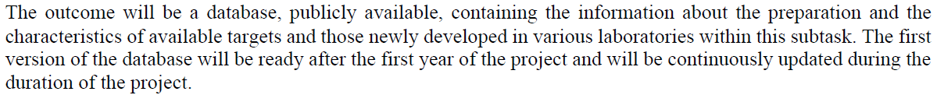
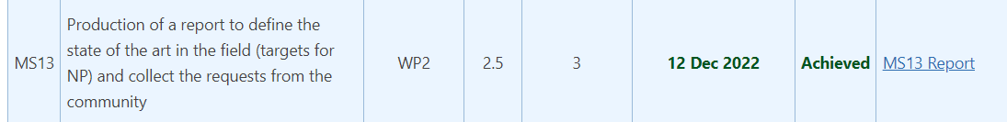
Targets for high intense beams
Coordination: M.Cavallaro
Budget: 1-year position (already filled) + travel budget
https://web.infn.it/EURO-LABS/results-milestones/

Slide 15
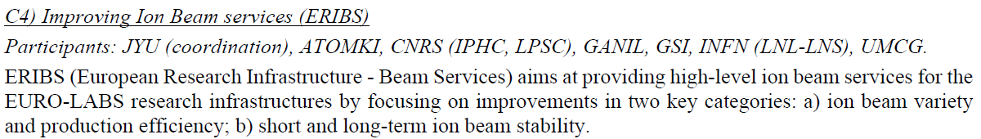
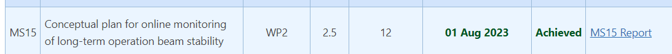
Improving Ion Beam services in variety and stability
Local coordination: D.Mascali
Budget: 2-year position (competition almost completed) + travel budget
https://web.infn.it/EURO-LABS/results-milestones/

Slide 16
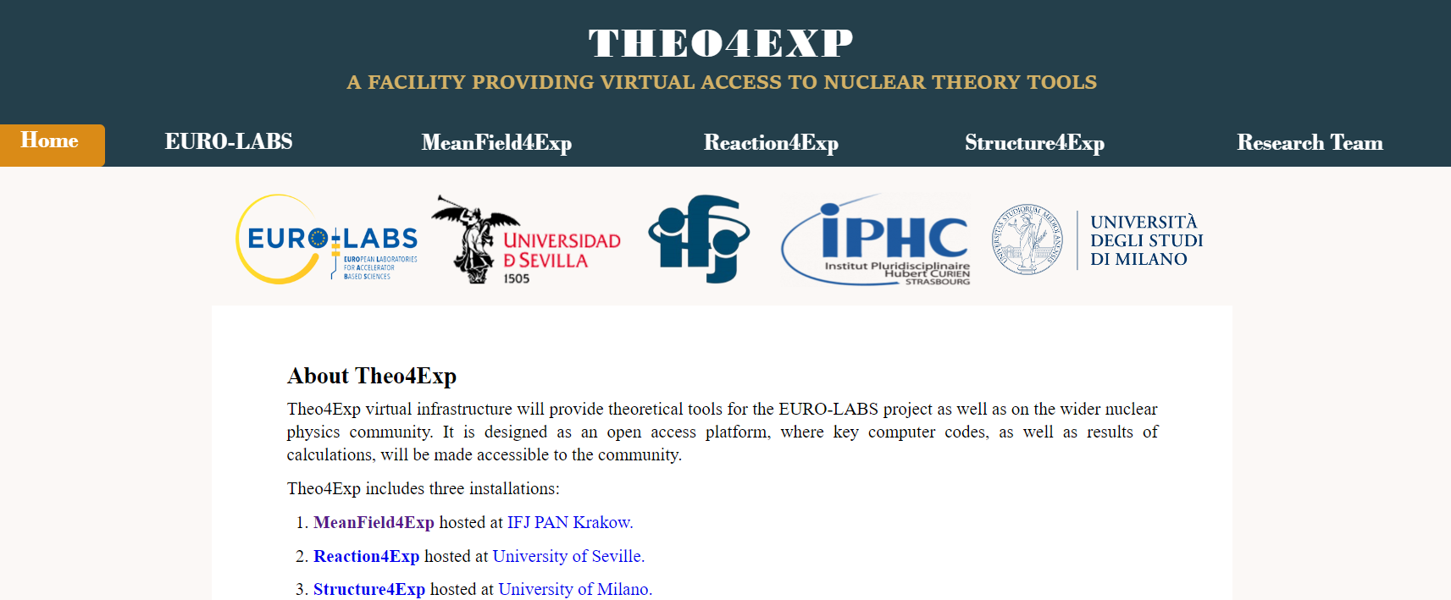
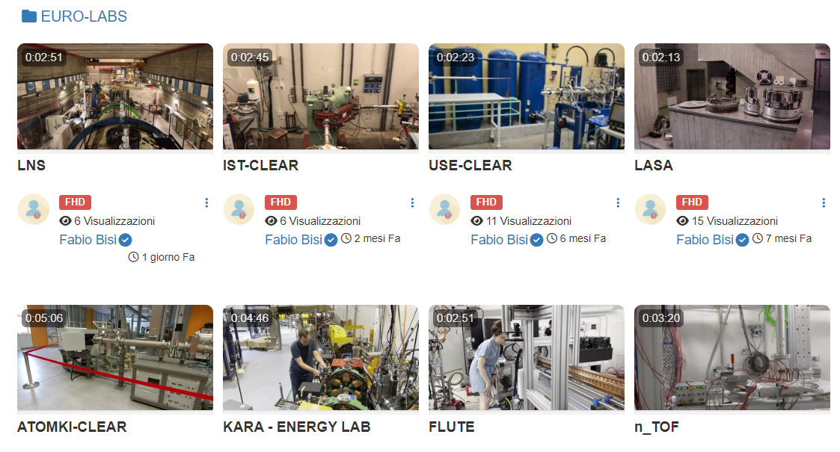
https://institucional.us.es/theo4exp/
Virtual Access
for theoretical tools
Videos of all EURO-LABS
facilities are available online
https://mediawall.infn.it/cat/euro-labs
https://web.infn.it/EURO-LABS/

Slide 17
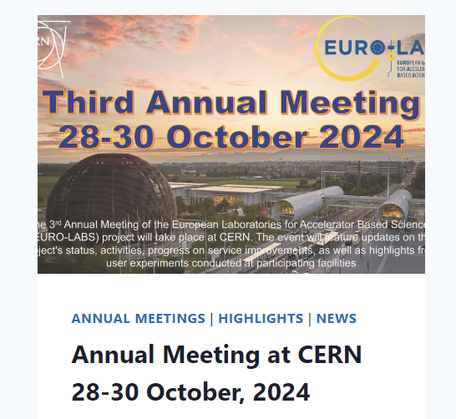
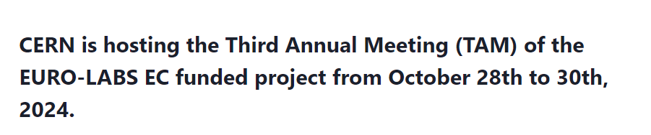
https://indico.cern.ch/e/euro-labs-tam
https://web.infn.it/EURO-LABS/

Slide 18
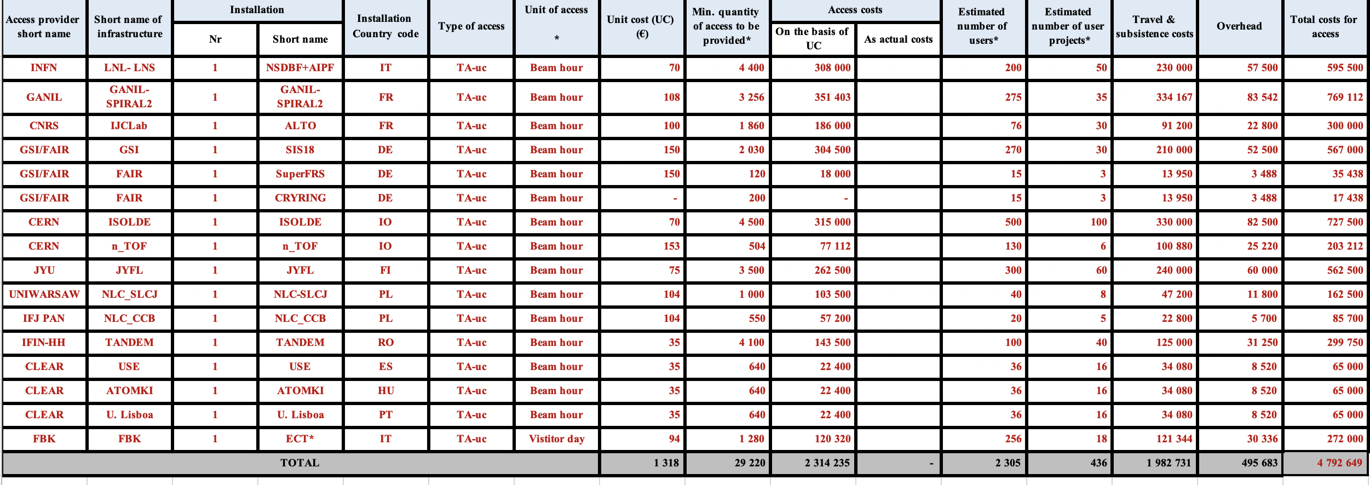
WP2 Access
+ 225 KE for VA

