Slide 1
An Update on the FOOT Experiment Programma anni futuri Richieste 2025 Sblocchi SJ
M. Villa (INFN Bologna)
05 September 2024

Slide 2
The FOOT Collaboration (2025)
93+6 Authors, 33+2 Institutions
Italy, France, Germany, Japan, Cuba, +India
3 Continents (Europe, Asia, America)
INFN:
12 units (Ba, Bo, LNF, LNGS, Mi, Na, Pg, Pi, Rm1, Rm2, TIFPA, To)
66 researchers & 13 technologists
28.9 FTE (25.5 researchers, 3.4 technologists)
2025:
LNGS : Preparation/development of nuclear emulsions
Calicut University (Kerala, India): participation to the analysis (MAECI - mobility of researchers)

Slide 3
Data taking campaigns already performed
Beam | Target | Energy MeV/u | Statistics (millions, electronic set-up only) | Integral Differential elemental | Integral Differential isotopic | direct | Inverse | Emul-sions | Campaign
O | C C2H4 | 200 400 | 0.06 | angle | NO | YES | NO | Yes Yes | GSI 2019 GSI 2020
O | C C2H4 C C2H4 | 200 200 400 400 | 14.2 12.2 5.5 6.5 | angle | NO | YES | NO | Yes | GSI 2021
He | C | 100 140 200 220 | 18.5 19.6 13.5 14.4 | angle | NO | YES | NO | No | HEID 2022
C | C | 200 | 4.1 | angle | NO | YES | NO |  | CNAO 2022
C | C C2H4 | 200 200 | 3.2 2.0 | Angle Energy | YES | YES | YES | Yes | CNAO 2023
Analysis status
published
In the pub phase
Only detector calib
Det calib.
Started

Slide 4
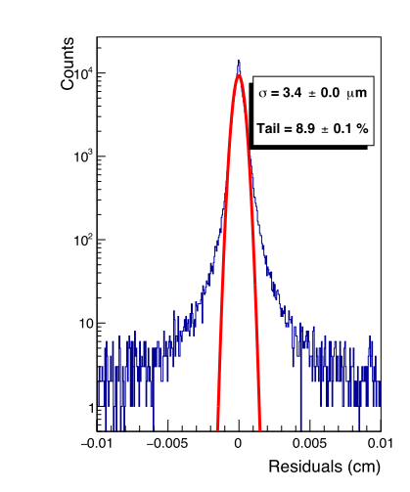
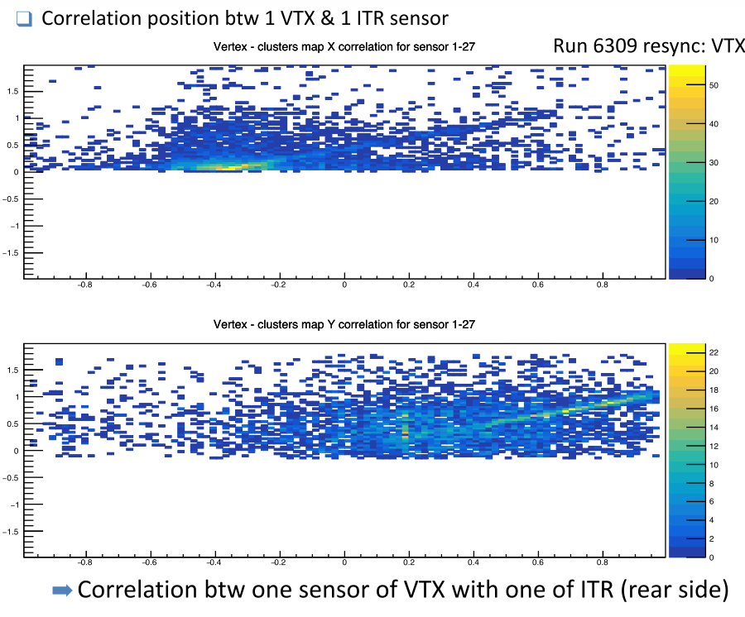
Vertex & Inner tracker – CNAO 2023
Vertex spatial resolutions

Slide 5
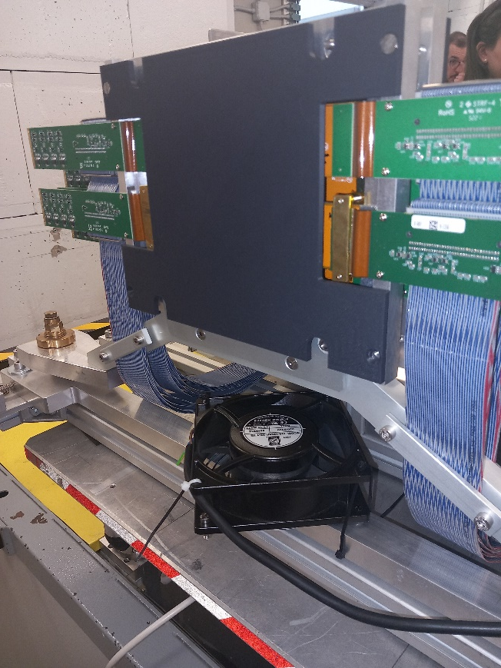
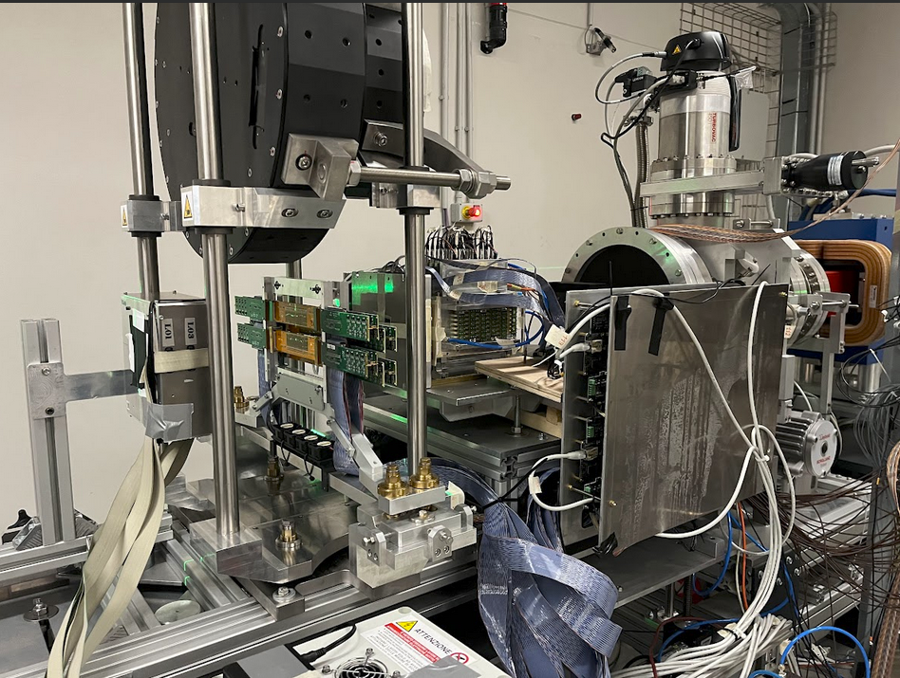
Magnet and Intermediate Tracker!
BTF test
CNAO set-up

Slide 6
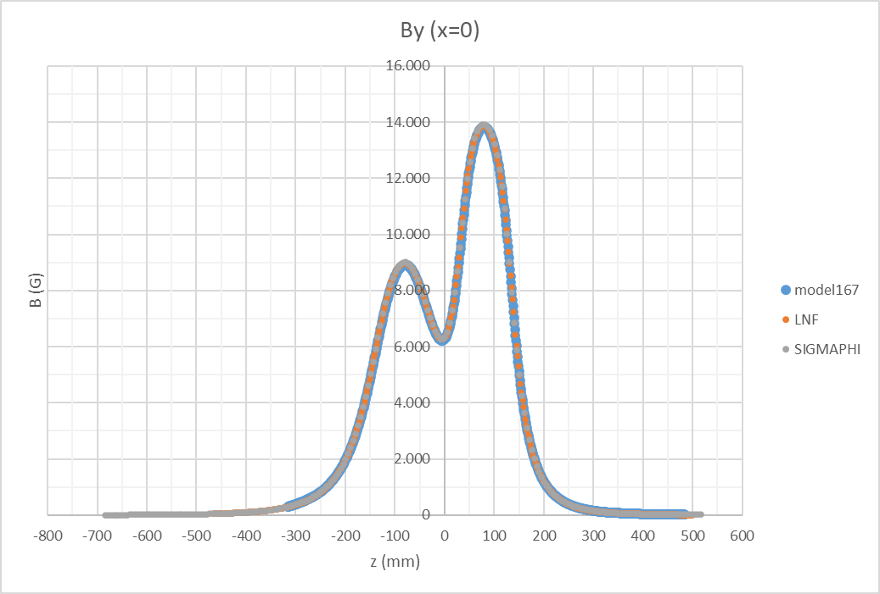
LNF measurements. 3D mechanical and magnetic model
Needed several iteration to get the real «as built»
Several tests for different «real positions» of M1 & M2
Permanent magnets BH curves from producer.
Max 2% disagreement.
<0.5% at B max

Slide 7
MSD status
A lot of effort to understand well the detector. W.r.t. the starting condition:
Changes in firmware to reduce induced noise in the strips
Optimized tracking of the pedestals (that might vary in a run)
Updated definition of hit clusters with two thresholds (Seed, signal)
Optimized spatial reconstruction, taking into account the eta-dependence
Energy deposition calibrated w.r.t. the eta-dependence
Checked all the samples from GSI 2021 to CNAO 2023

Slide 8
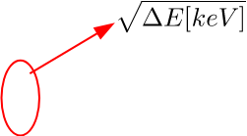
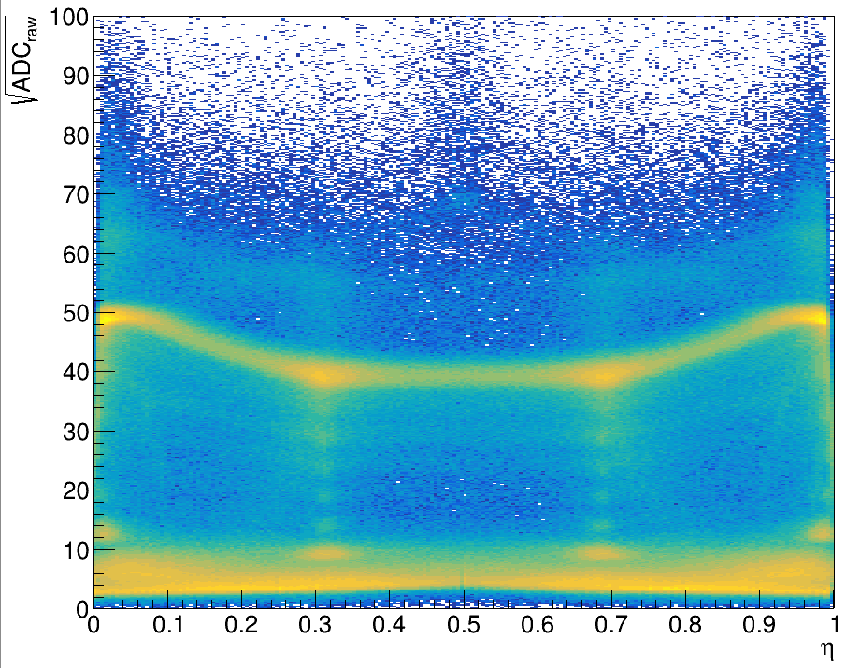
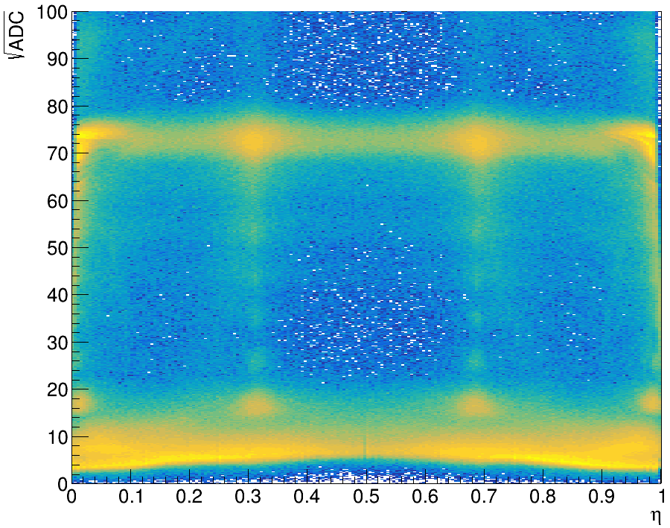
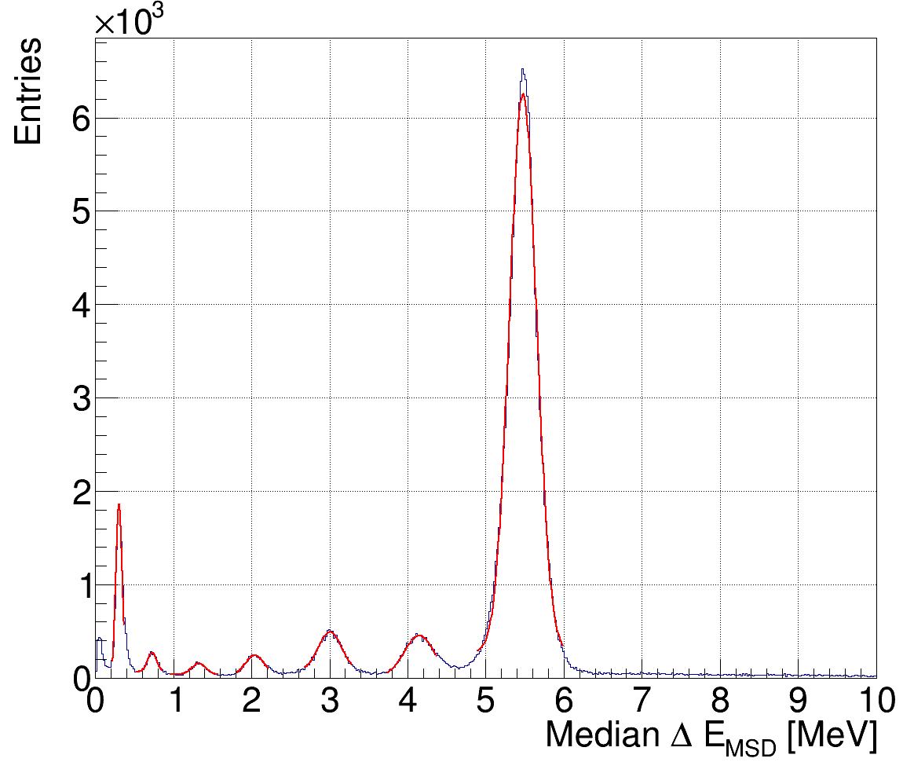
η correction: application to the energy release
Apply η-correction → Sensor response correctly flattened!!
$$\sqrt{∆E(keV)}∝Q$$
¹⁶O @ 400 MeV/u
5mm C target
¹⁶O
¹⁶O
¹⁶O
C
He
He
Be
C
Li
B
N
Median $ΔE$on a track
In-flight interations can be well identified if they happens after MSD

Slide 10
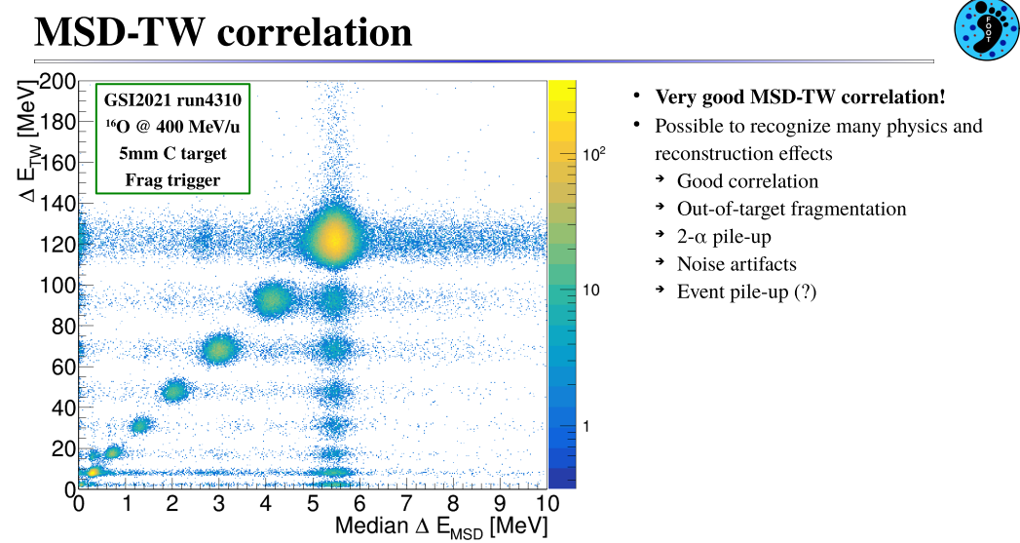

Slide 11
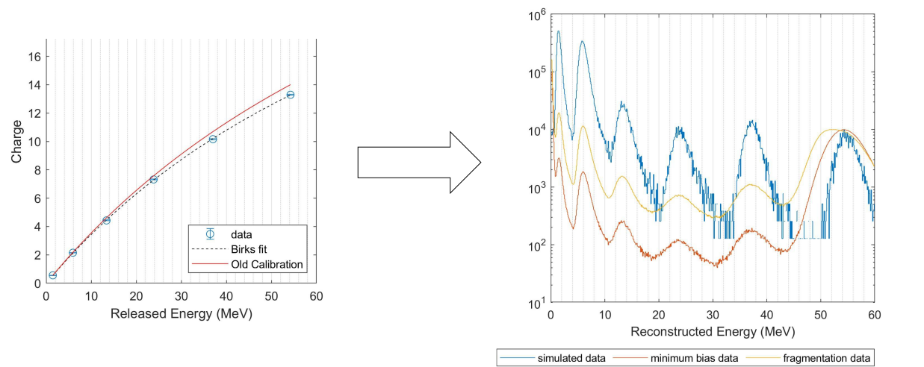
TOF Wall – Energy calibration – CNAO 2023
Routine calibration at each data taking: check of timings and energy deposits

Slide 12
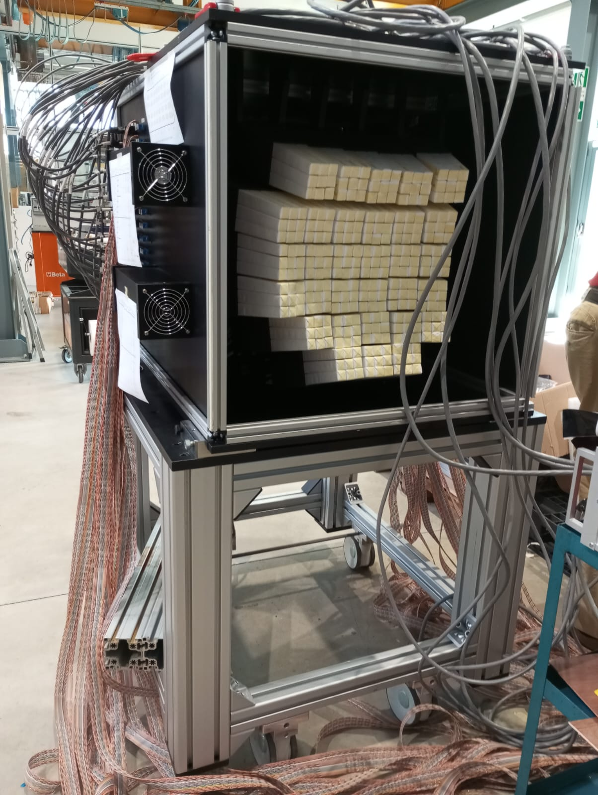
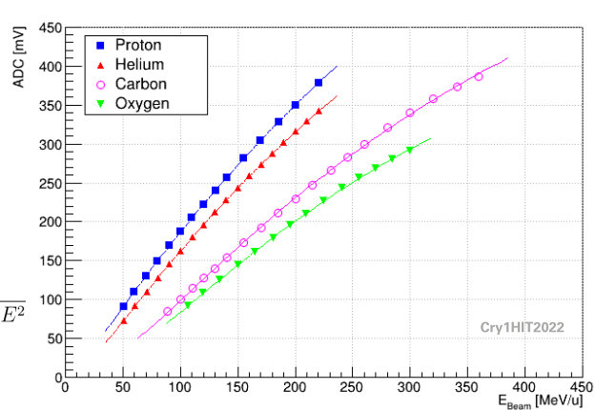
Calorimeter calibration
Set-up almost completed
Module holding mechanics to be substituted
HIT2022: few modules calibrated with p, He, C, O
CNAO2023: all modules calibrated with p & C

Slide 13
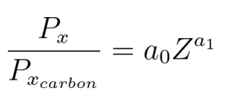
Charge dependence of the parametrization
HIT 2022
CNAO 2023

Slide 14
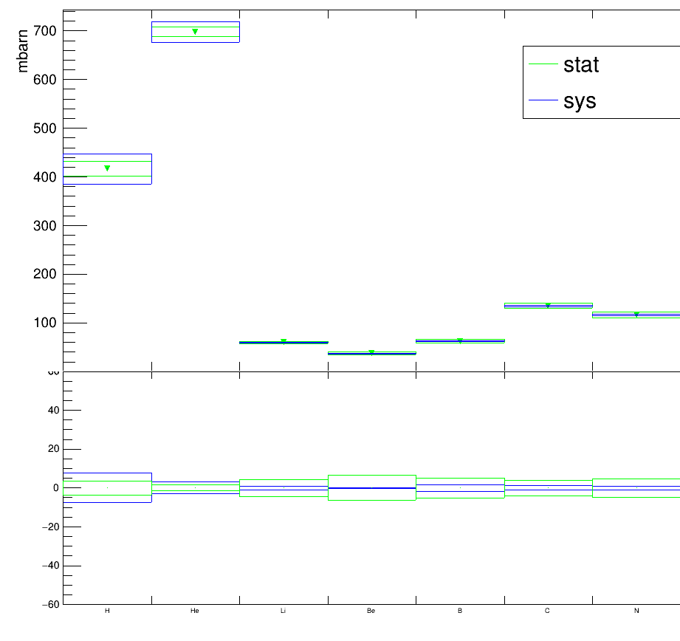
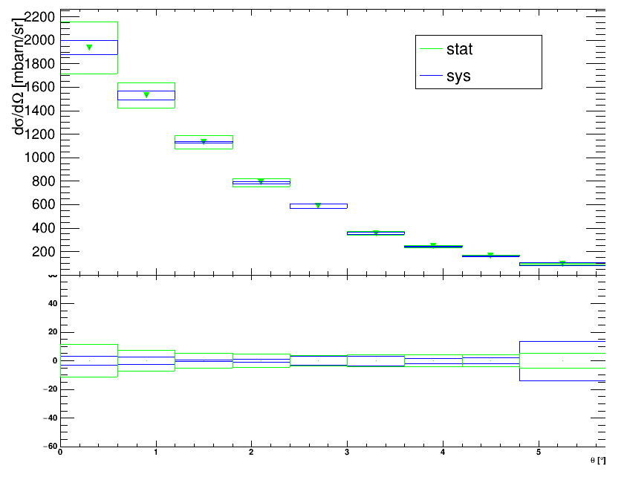
GSI 2021 analysis – electronic set-up – ¹⁶O+C, 400 MeV/n
Few detector elements: SC, BM, TW (no VTX, ITR, MSD, CALO)
«high» background from in-flight interactions
Full analysis chain; MC closure test OK;
Efficiencies validated for each detector
He
$$σ({}_{}^{16}O+C→Z+X)$$
$$\frac{dσ}{dΩ}(θ)$$
$$\frac{∆σ}{σ}(\%)$$
H
He Li Be B C N
1 2 3 4 5 θ [°]

Slide 15
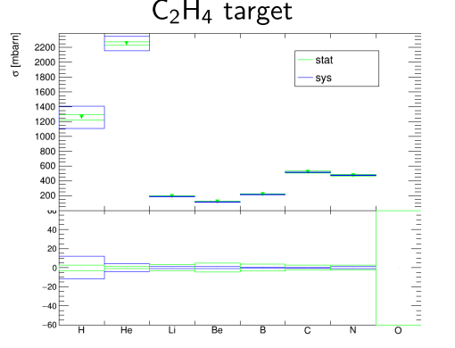
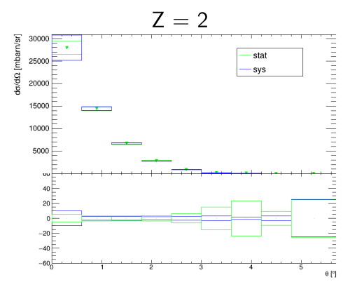
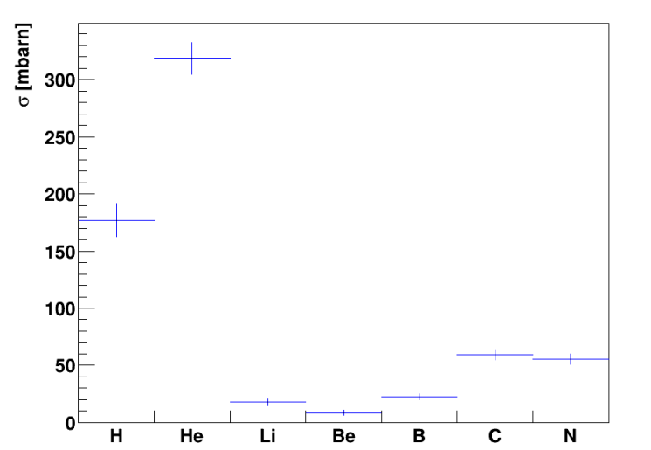
GSI 2021 analysis –
electronic set-up –
¹⁶O+C₂H₄, 400 MeV/n
$$σ({}_{}^{16}O+C_{2}H_{4}→Z+X)$$
Ongoing analysis of C2H4
Preliminary results
$$\frac{∆σ}{σ}(\%)$$
H
He Li Be B C N
He
$$\frac{dσ}{dΩ}(θ)$$
$$σ({}_{}^{16}O+H→Z+X)$$
$$\frac{∆σ}{σ}(\%)$$
1 2 3 4 5 θ [°]

Slide 16
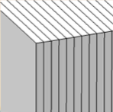
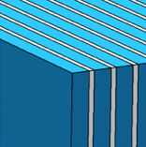
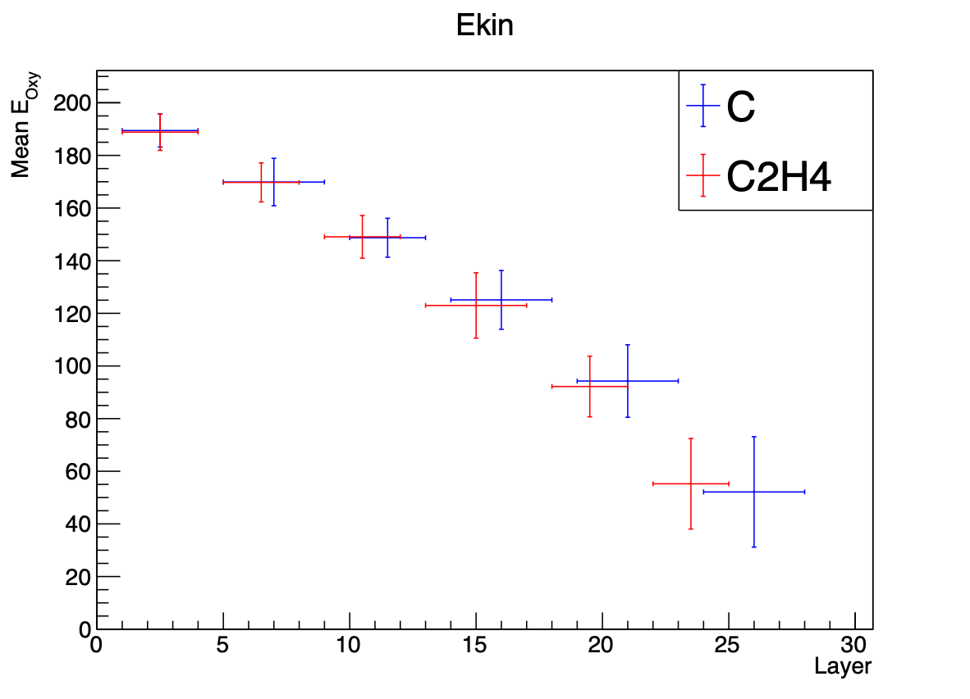
Emulsions: data analysis and cross section measurement
Emulsion film
Lexan
Tungsten
Tungsten
C (C2H4) layer
Lead
Analysis of ¹⁶O @ 200 MeV/n on C and C2H4 targets almost completed:
Improvements in data-driven effects added on Monte Carlo reconstruction (background, misalignments, local distortion due to chemical development…)
Evaluation of total and reaction cross sections
Evaluation of systematics effects by data-driven methods
Beam
S2: Charge identification
S3: Momentum
Paper on cross section measurements with¹⁶O at 200 MeV/n on C, C2H4 and H in preparation
S1: Vertexing
BEAM →
SC
BM
ECC
One beam energy, but
interactions at several energies…

Slide 17
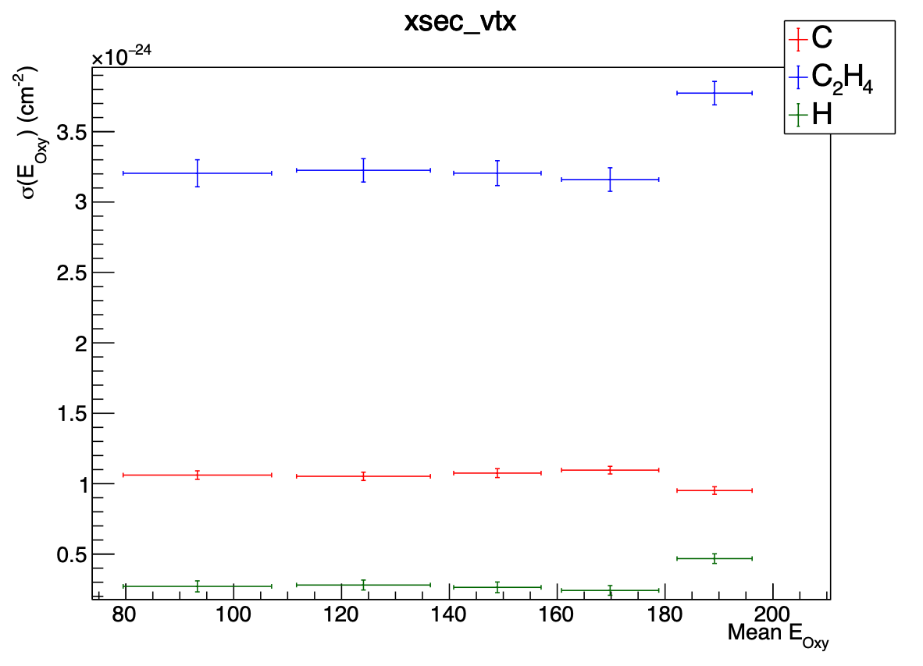
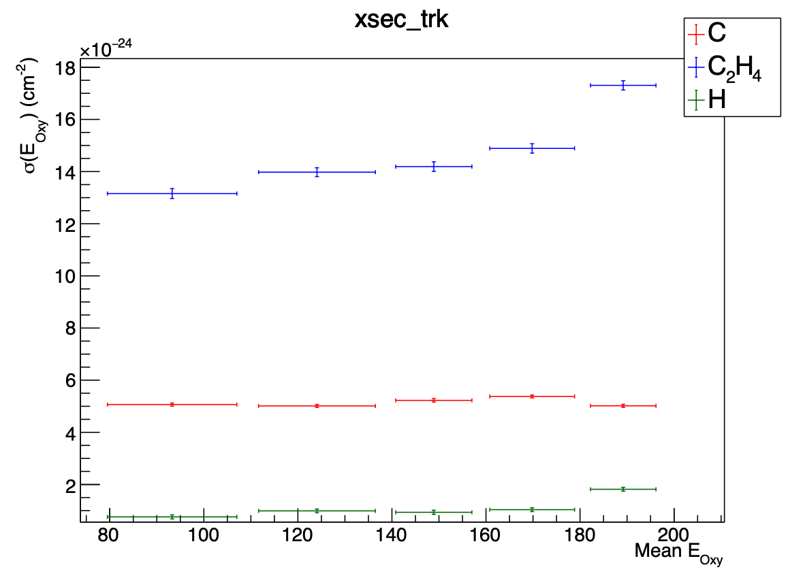
Integrated cross section H
Total reaction cross section
Total production cross section
PRELIMINARY
PRELIMINARY
$Y_{i}=$# of vertices
$Y_{i}=$# of fragments

Slide 18
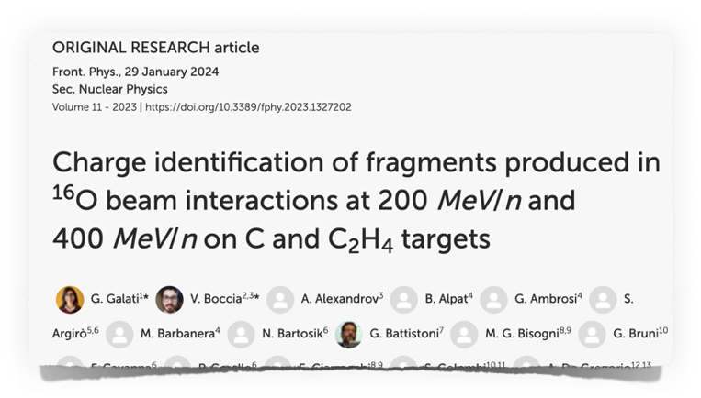
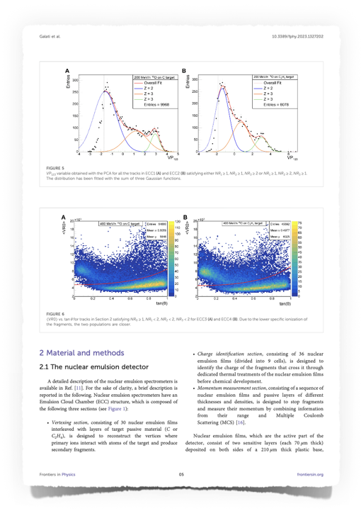
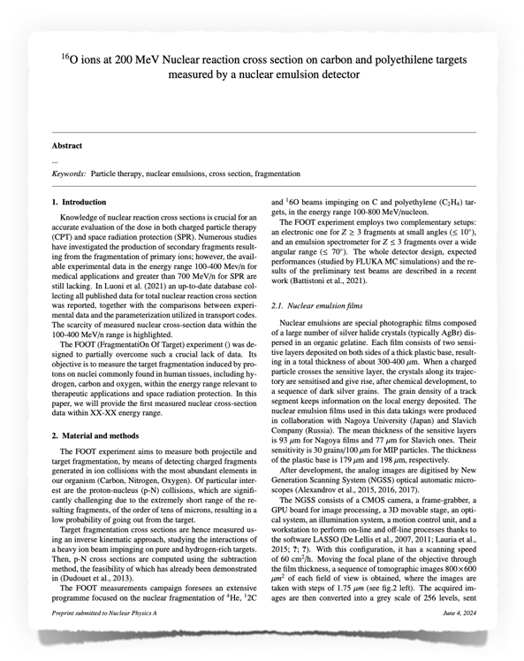
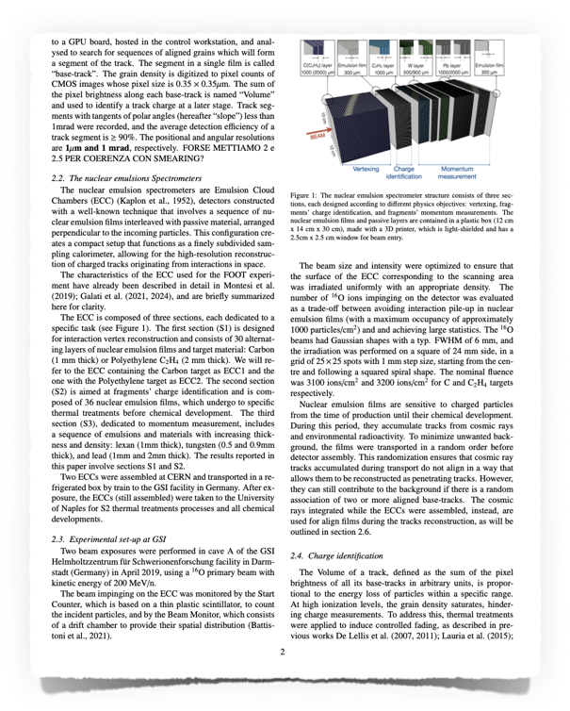
Publications and papers in preparation (emulsions)
Paper published on Charge identification of fragments produced in ¹⁶O at 200 MeV/n and 400 MeV/n on C and C2H4 targets
doi.org/10.3389/fphy.2023.1327202
Paper on cross section measurements with¹⁶O at 200 MeV/n on C, C2H4 and H in preparation

Slide 19
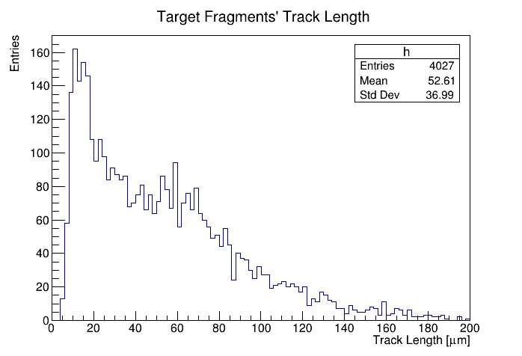
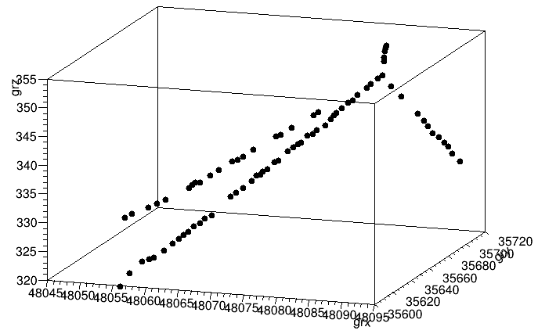
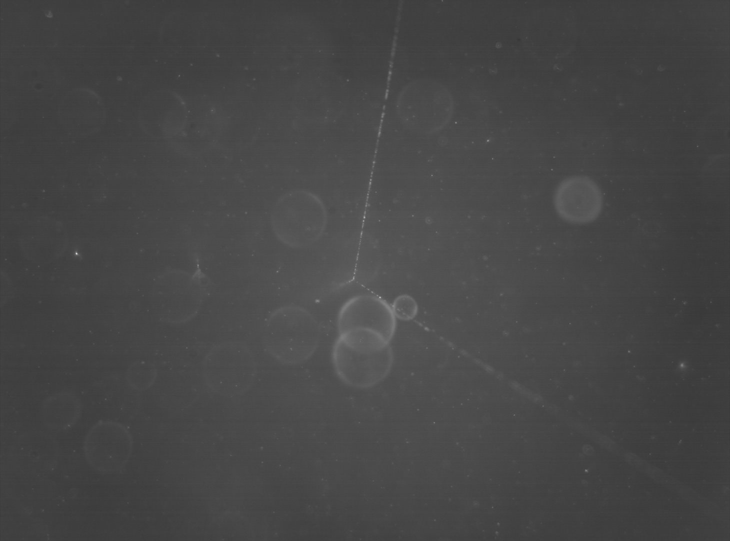
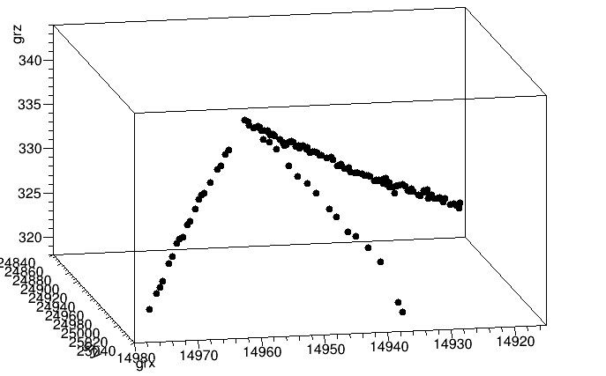
NIT emulsions first results
Access to the direct kinematics of p+C fragmentation cross sections
All the emulsions from the Pilot test have been scanned with the fast optical microscope
Developed a strategy to identify target fragmentation events: more than 1500 events reconstructed so far
Proton
3D displays of reconstructed events
Developments/problems:
Improved optics for the scanning microscopes
Tracks and interactions are clearly seen
Vertices can be easily reconstructed
Impinging proton track is weak
Emulsion preparation and development to be studied carefully
Proton
$$400 μm$$

Slide 20
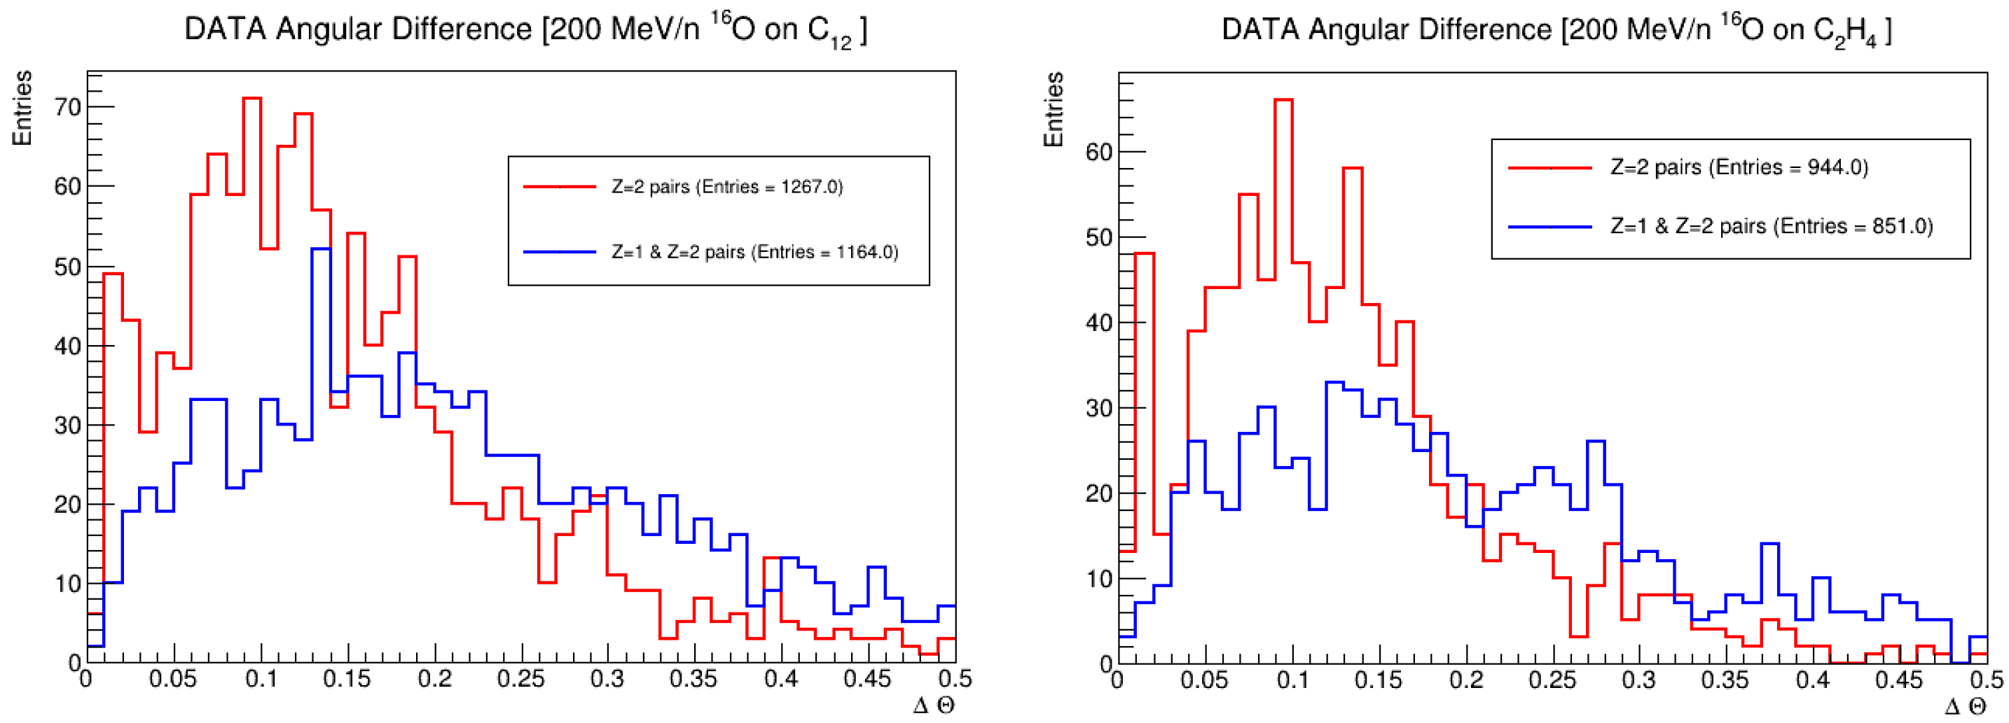
$α$ clustering physics with nuclear emulsions
Nuclear cluster structures can be probed by studying preferential dissociation channels (such as $^{16}O →4 α$)
$α$ clustering has not been thoroughly explored in the energy regime accessed by FOOT
Analysis on-going with 2019 FOOT emulsion DATA ($^{16}O @ 200 MeV/n$ on carbon and polyethylene targets)
The detection of correlated $He$ pairs (relative angle $<25 mrad$) is used to measure the production of$^{8}Be_{g.s.}$ in the fragmentation of the oxygen nucleus
Observed Production of$^{8}Be_{g.s.}$ in DATA

Slide 21
Future: 2025-2027
- At the moment there is no portable competing experiment with FOOT → no external improvements on cross section measurements.
- We are still working towards differential cross sections for hadrontherapy
- C+C, C+C2H4, O+C, O+C2H4 in different conditions at Ekin < 400 MeV/n
A lot of interest also for higher energies for radioprotection (O+C, O+C2H4 at > 500 MeV/n)
At CNAO there is a broad interest on 4He: both for therapy and for diagnostics
Far Future (>2027)
- O-O cross section (for space radioprotection) and Ca+C cross sections (for hadrontherapy) are also very interesting in their fields

Slide 22
Foreseen data taking campaigns
Beam | Target | Energy MeV/u | Integral Differential elemental | Integral Differential isotopic | Direct | inverse | Emul-sions | Campaign
C | C C2H4 | 100-200 | Angle Energy | YES | YES | YES | YES (NIT?) | CNAO 2025
O | C | 500-700 (?) | Angle Energy | YES | YES | YES | YES | GSI 2026
C | C C2H4 | 200-300 | Angle Energy | YES | YES | YES | - | CNAO 2026
P | C | 100-220 | Angle Energy | YES | YES | - | NIT | CNAO 2026
C | C C2H4 PMMA | 320-400 | Angle Energy | YES | YES | YES | YES | CNAO 2027
He | C C2H4 PMMA | 200-400(?) | Angle Energy | YES | YES | YES | YES | CNAO 2027

Slide 23
Richieste finanziarie 2025
Capitolo | Richieste (k€) | Voci principali
Inventariabile | 0 | Finanziati su PRIN/MAECI o altro
Consumo | 47 | NA: chim x emulsioni, LNF: mecc+schede,
Apparati | 0 | Finanziati su PRIN/MAECI o altro
Trasporti | 5 | BO, LNGS, MI, PI
Missioni | 144 | Tutti: prese dati a CNAO, meeting di collaborazione, tests, calibrazioni. NO GSI
Pubblicazioni | 0 | Finanziati su MAECI, principalmente
Totale | 195 | per una spesa pro capite di 6.7 k€/FTE
Storico richieste: 2017: 274 k€, 2018: 815k€, 2019: 868 k€, 2020: 545 k€, 2021: 389 k€
2022: 434 k€, 2023: 317 k€, 2024: 286 k€

Slide 24
Algoritmo missioni
Viaggio ITA (AR): 220€, viaggio EU (AR): 440€
Giorno ITA, giorno EU: 180€
2 Meeting di collaborazione ITA (per molti)
Presa dati 1-4 persone per sede
Trasporti per BO, LNF, MI, PI, TO (>1 m³, >200 kg, sicurezza)

Slide 25
Richieste consumo 2025
Sede | Richieste (k€) | Voci principali
BO, LNF, MI, PI, RM1, RM2, TIPFA, TO | 17 | Metabolismi laboratorio (2 k€/sede in media)
LNGS | 5 | Prodotti chimici per emulsioni / smaltimento
BO, LNF | 8 | Schede elettroniche (DAQ, Nuovo VTX)
LNF | 5 | Sensori MIMOSA di riserva
NA | 11,5 | Emulsioni e reagenti chimici
Totale | 46,5

Slide 26
Richieste addizionali & sblocchi
Nessuna richiesta addizionale! → In caso di necessità ci aiuteremo tra le sezioni
Prossime prese dati: CNAO – Novembre 2024 – (+BTF prenotata per fine novembre)
SJ totali: 70 k€ - Richieste sblocco 48 k€, restituzione di 22 k€
Richieste di sblocco | Richieste (k€) | Sezione/voci principali
SJ missioni x CNAO | 23.0 | Varie sedi coinvolte (non tutte)
SJ Bonus dottorandi | 24.5 | BO (da usare per il CNAO)

Slide 27
Milestones
Milestone | Data
Proceeding/articolo con risultati preliminari campagna 2023 set-up elettronico | 31-dic-2025
Proceeding/articolo con risultati preliminari emulsioni 2023 | 31-dic-2025
Test su fascio del nuovo rivelatore di vertice | 31-dic-2025
Test su fascio di un prototipo di nuovo TofWall | 31-dic-2025
Sottomissione lavoro strumentale FOOT | 31-dic-2025
Proceeding/articolo R&D su emulsioni NIT per FOOT | 31-dic-2025

Slide 28
Grazie per l’attenzione!

