Slide 1
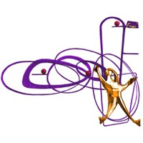
Full simulation study of a hadronic calorimeter for a future muon collider
110º Congresso Nazionale SIF
Bologna, September 9-13, 2024
Lisa Generoso
University and INFN Bari
On behalf of the IMCC Collaboration

Slide 2
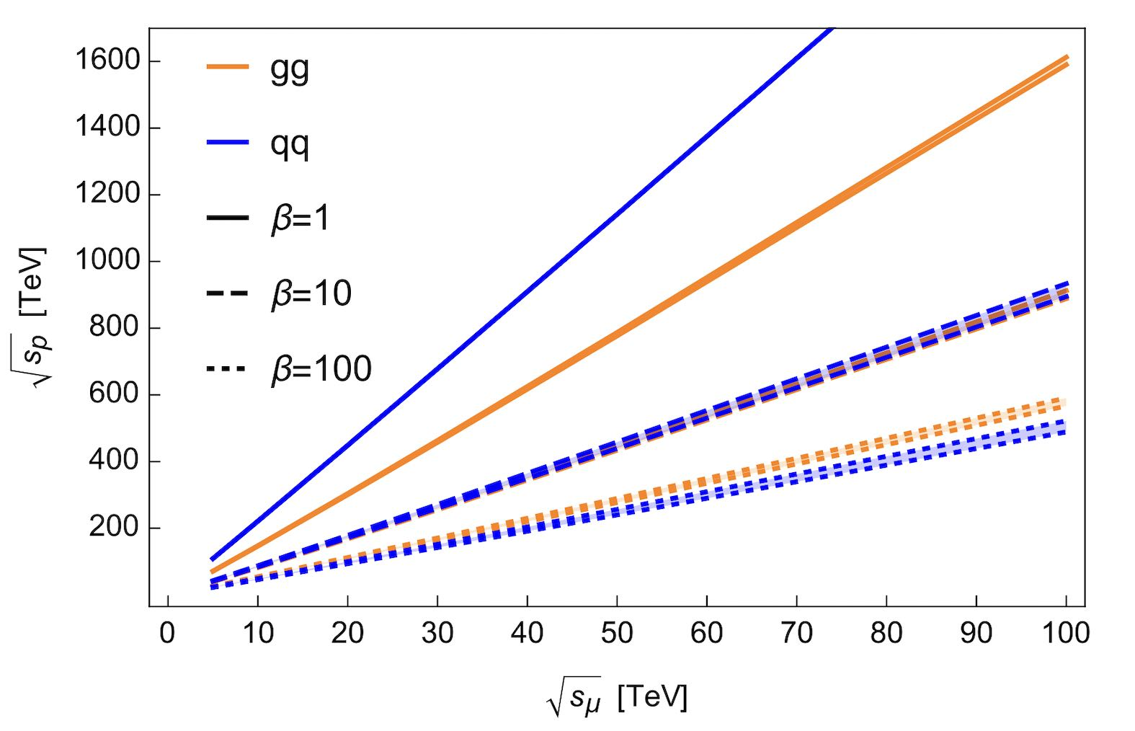
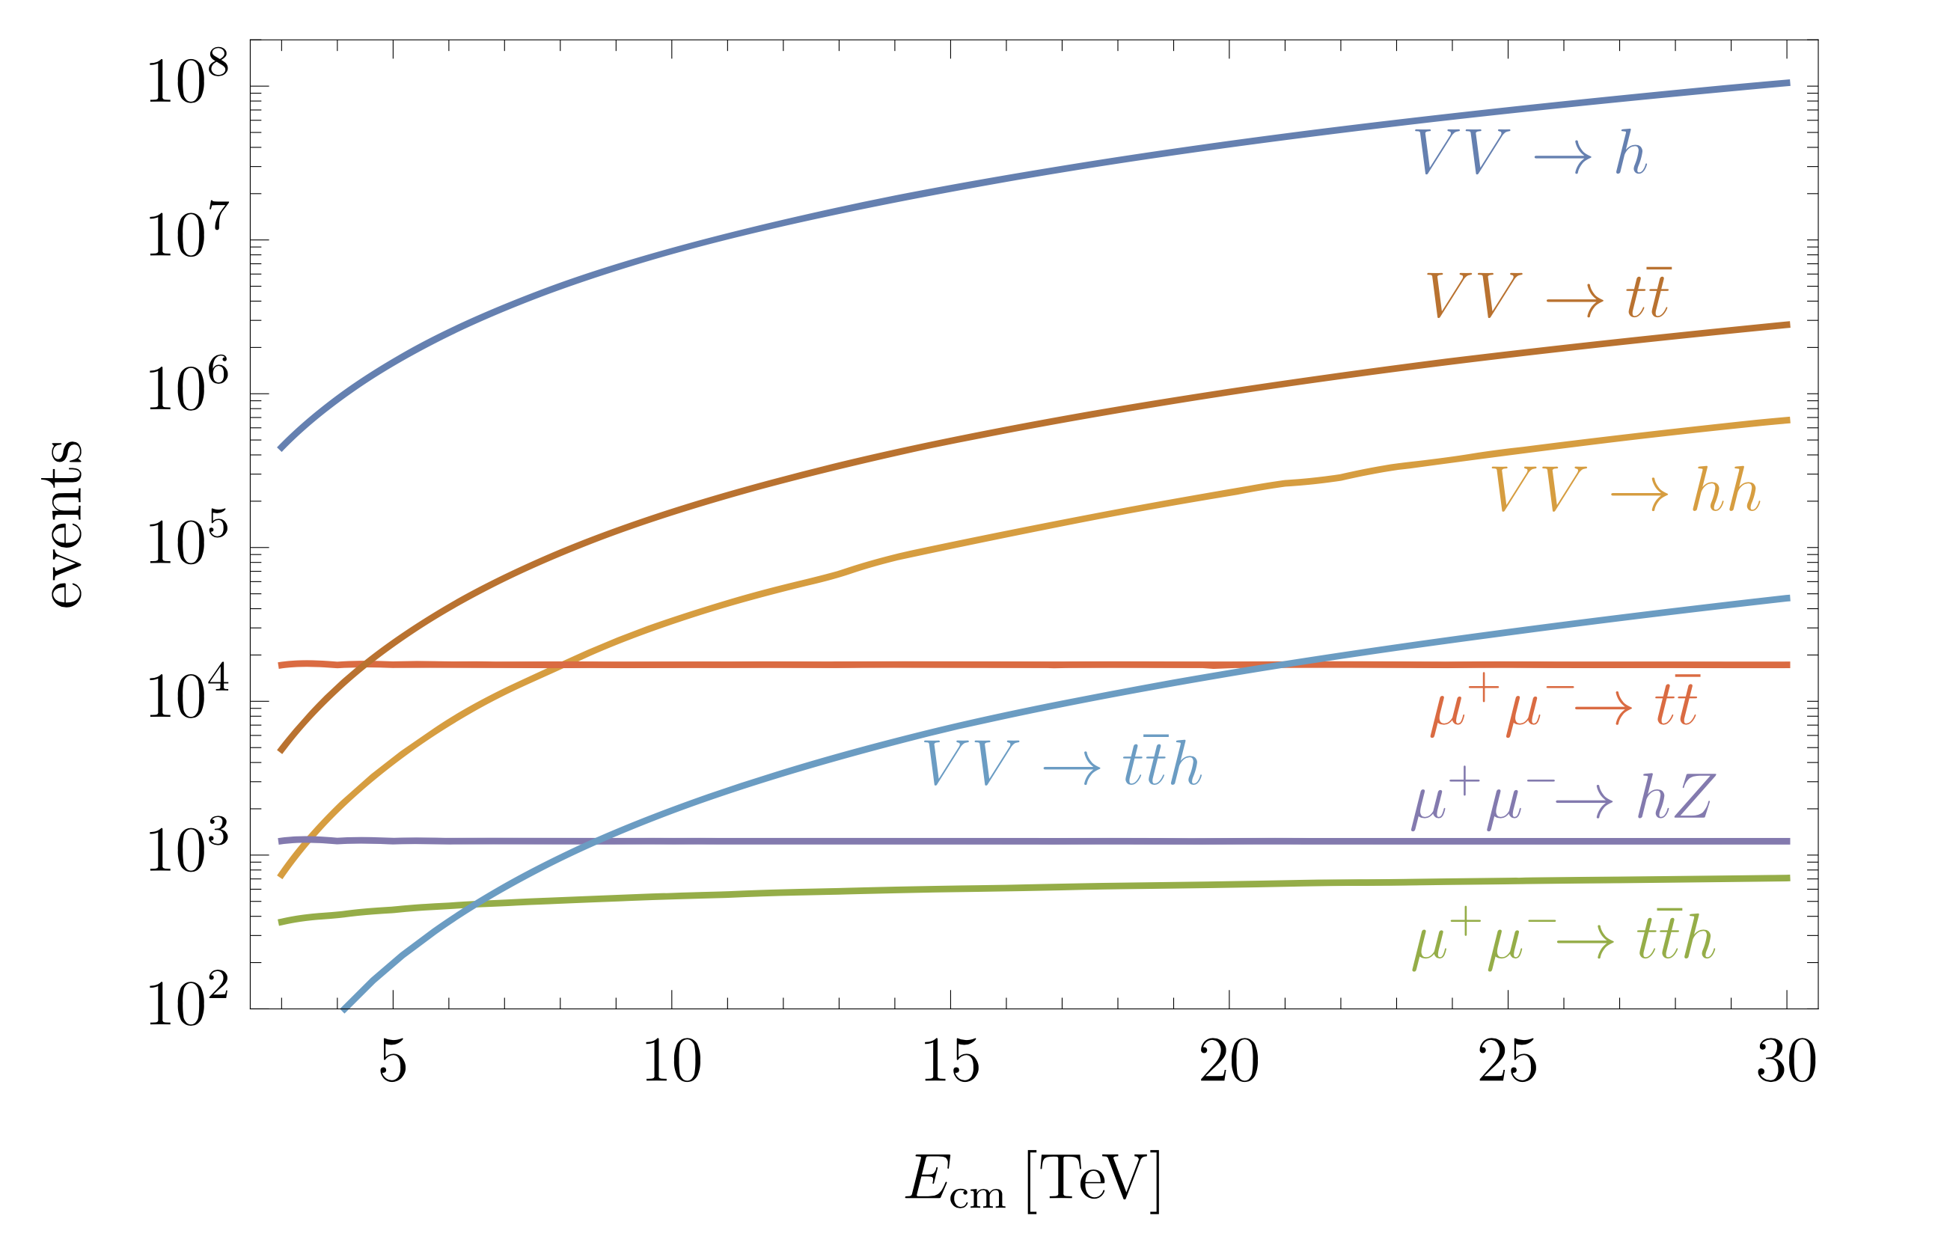
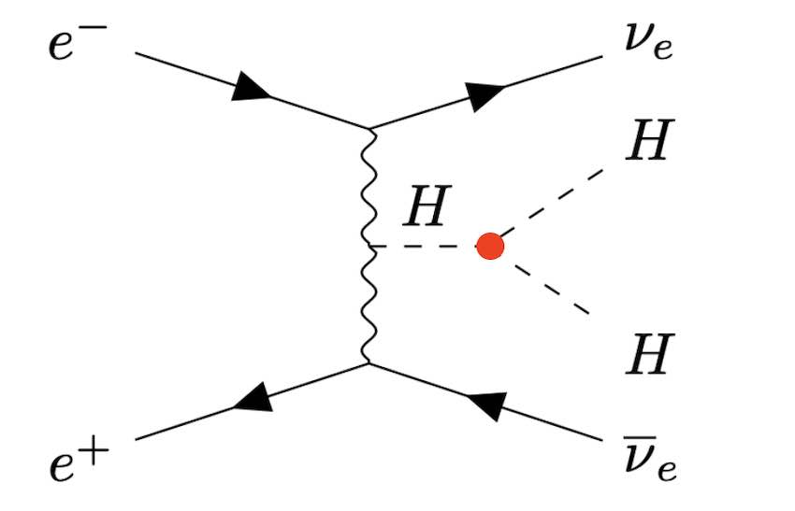
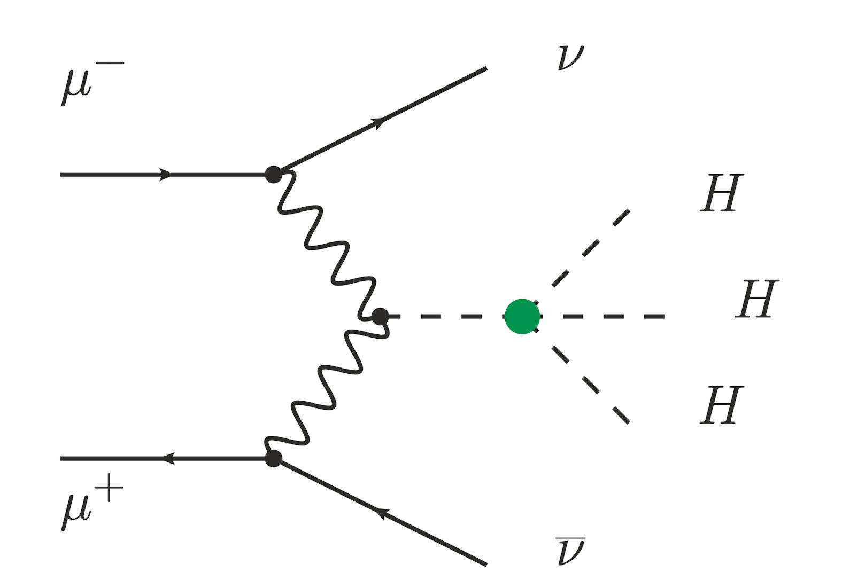
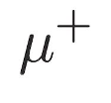
Why a multi-tev muon collider ?
https://arxiv.org/abs/2303.08533
Point-like particle
Clean collisions
Full CoM energy available for hard collisions
(as in e⁺e⁻ colliders)
$≈$ Proton collider of a much higher CoM energy
m$μ$ $≈$ 200m_{e}
negligible loss of the beam energy due to bremstrahlung
→ High energy frontier
(as in hadron colliders)
Vector Boson Fusion
→ Higgs Factory
https://arxiv.org/abs/2303.08533
Improve the precision of Higgs couplings to the per-mille level
Measure Higgs self-coupling constant
Observe trilinear and quartic coupling
5 years of operation
Ideal probe for Higgs physics
$$√s$$ | $$ℒint$$ | #Higgs
3 TeV | 1 ab⁻¹ | 5 x 10⁵
10 TeV | 10 ab⁻¹ | 1 x 10⁷

Slide 3
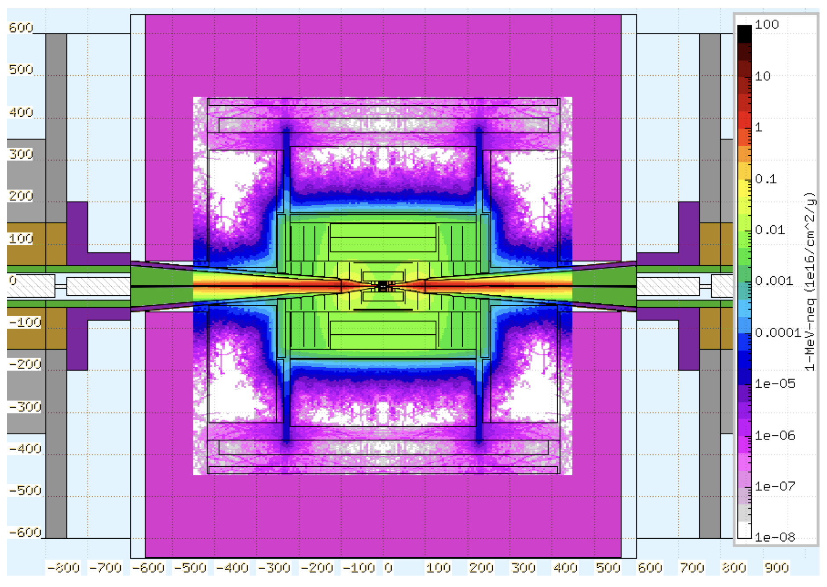
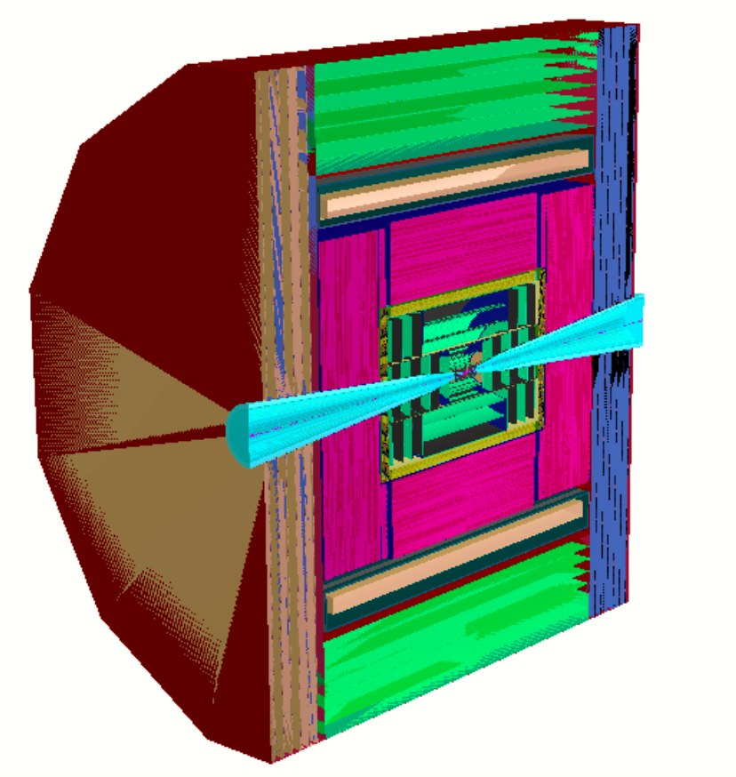
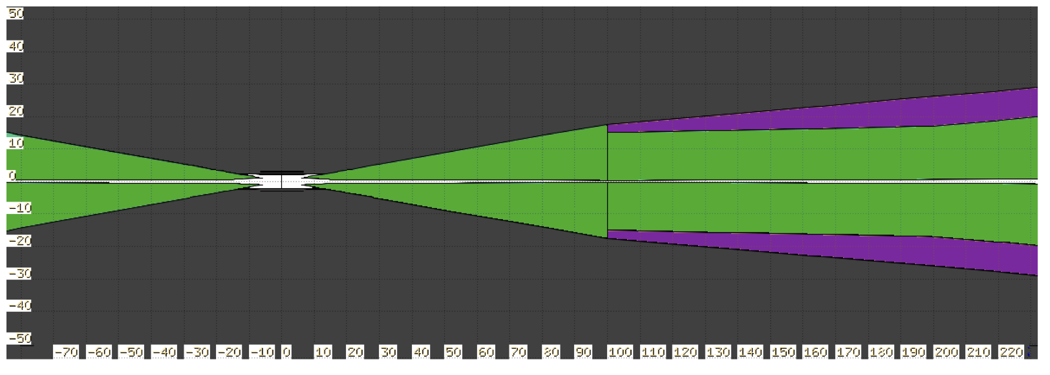
muon collider CHALLENGE
UNSTABLE NATURE OF MUONS
$μ^{+}$ → $e^{+}\overline{ν_{μ}}ν_{e}$
Beam Induced Background (BIB)
Muon decay products + interaction with the detector material (mostly photons and neutrons)
Asynchronous arrival time
DETECTOR :
Radiation hard technology
Good time resolution
MDI : shielding tungsten nozzles
y
DESIGN FOR A
3 TeV MUON COLLIDER DETECTOR
Tracking system
Calorimeter system
PbF₂ ECAL (CRILIN): new proposal from LNF-PD INFN
MPGD HCAL: new proposal and protptype developement from INFN Bari
3.6 T magnet yoke + muon system
ᵠ
z
x
https://arxiv.org/abs/2303.08533

Slide 4
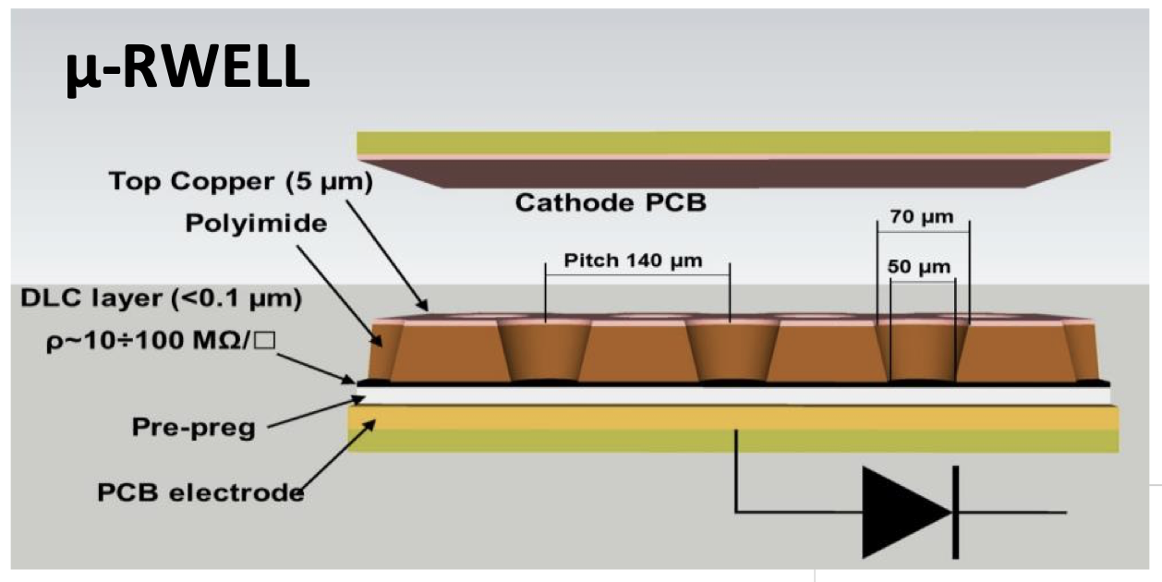
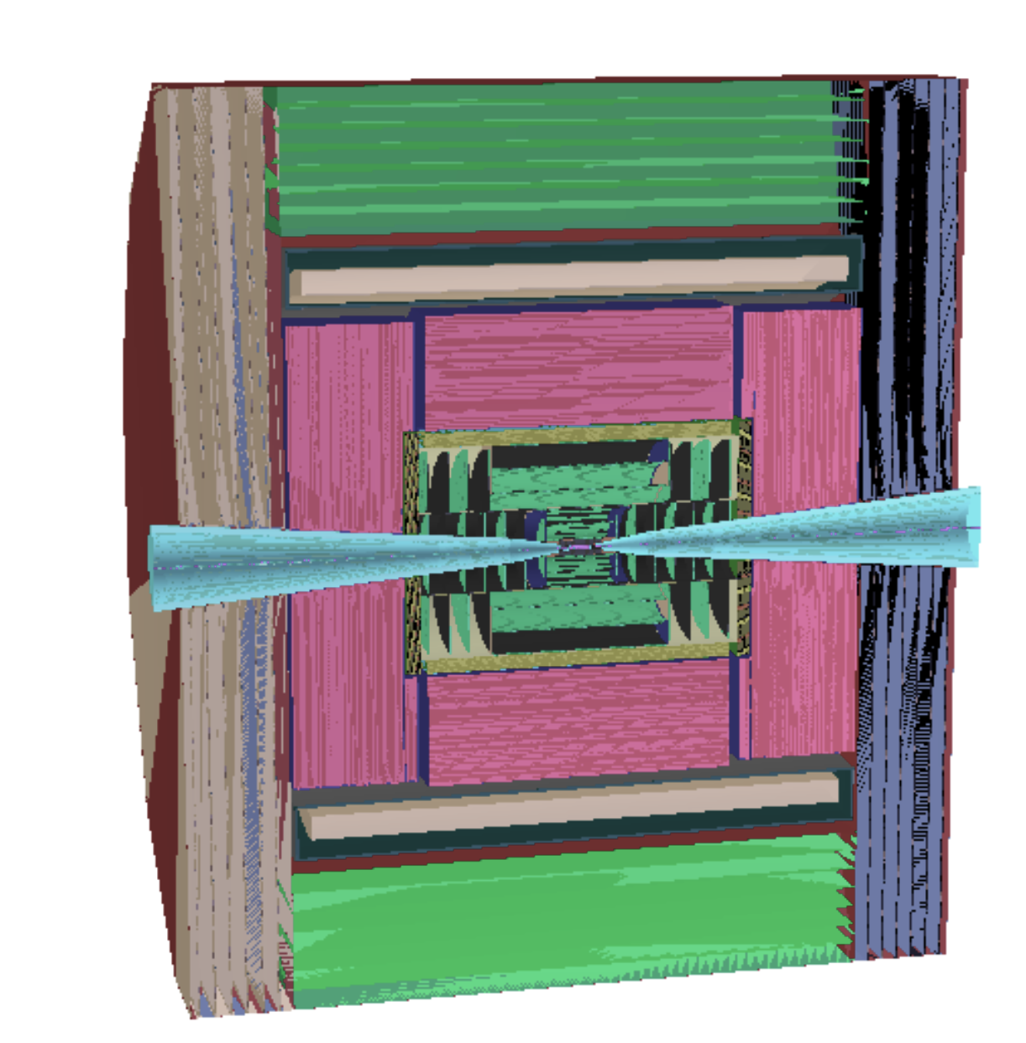
WHY AN MPGD-based HCAL?
HCAL requirements:
Radiation hard to withstand ~10⁻⁵ GRad/year
Time resolution of O(ns)
Energy resolution $≥$ 60% /√E
Fine granularity (1 – 3 cm²)
Longitudinal segmentation
Resistive Micro Pattern Gaseous Detectors
Satisfy all the previous requirements ✔️
+
High rate-capability O(MHz/cm²)
Cost-effective for large-area instrumentation
GEOMETRY OF THE CALORIMETER SYSTEM IMPLEMENTED IN THE FULL DETECTOR SIMULATION SOFTWARE (iLCSoft)
CRILIN ECAL
5-layer SEMI-HOMOGENEOUS CALORIMETER of PbF₂
Layer thickness: 4 cm - depth: 0.9 λI
HCAL LAYER COMPOSITION:
Iron (absorber) 20 mm
Argon (active material) 3 mm
Copper (RO electronics) 0.1 mm
PCB (RO electronics) 0.7 mm
Air (environment) 2.7 mm
MPGD-based HCAL
60-layer SAMPLING CALORIMETER
Layer thickness: 2.65 cm - cell: 1 cm²

Slide 5
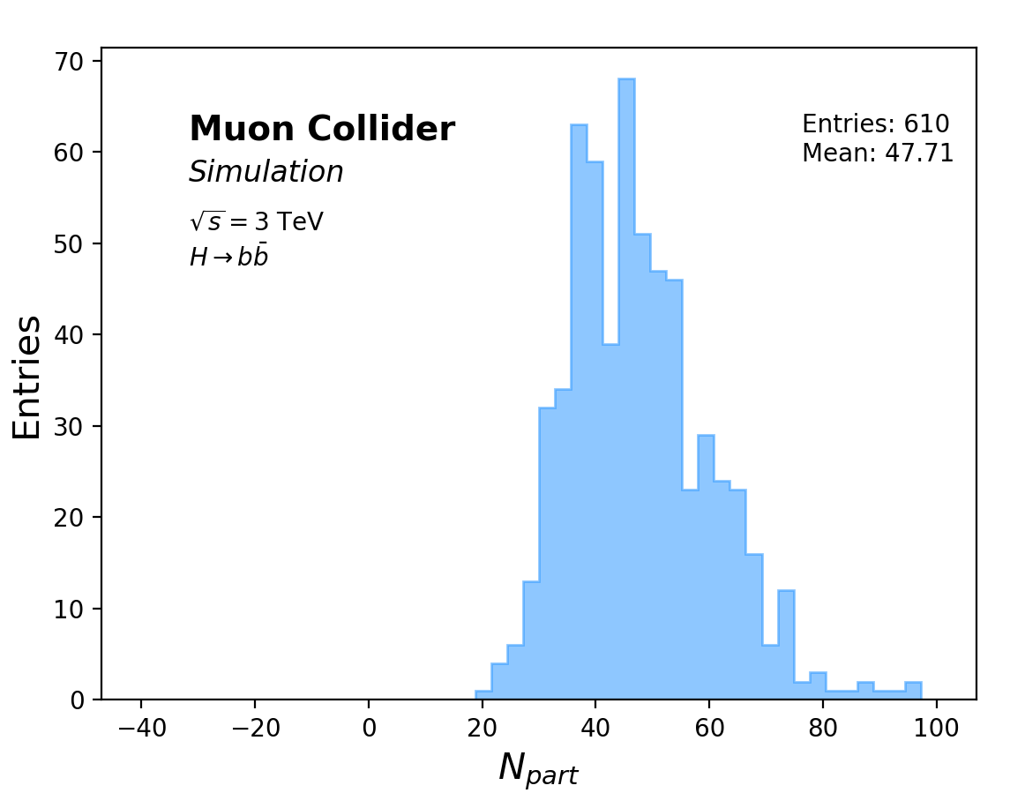
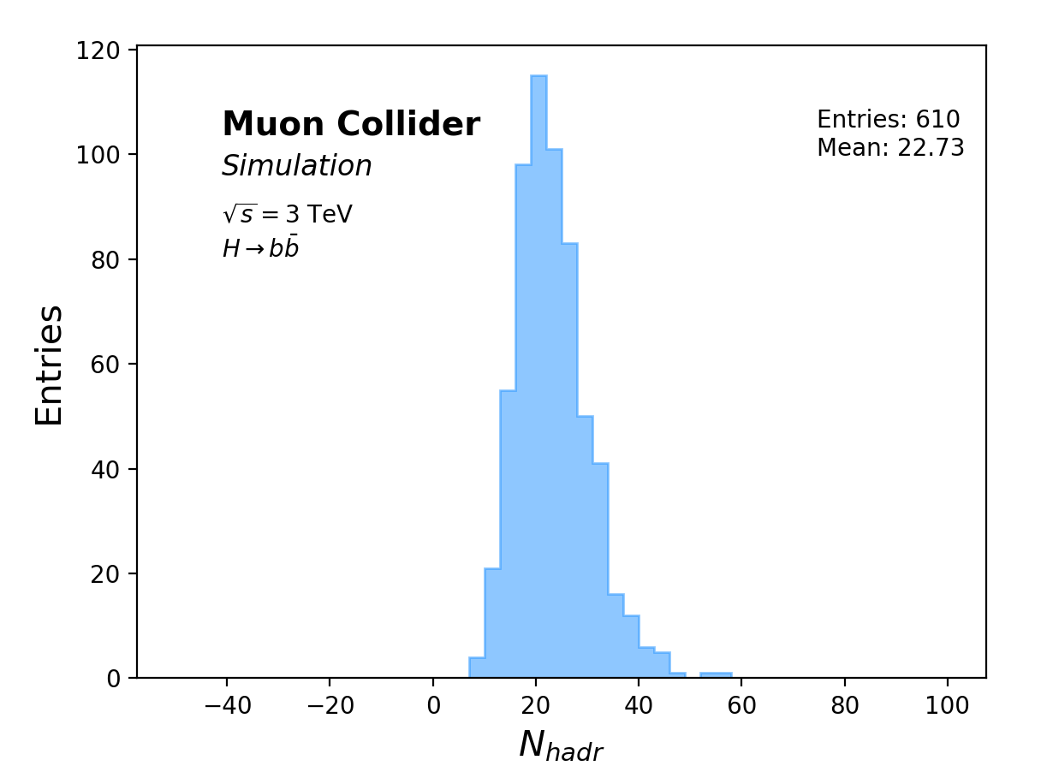
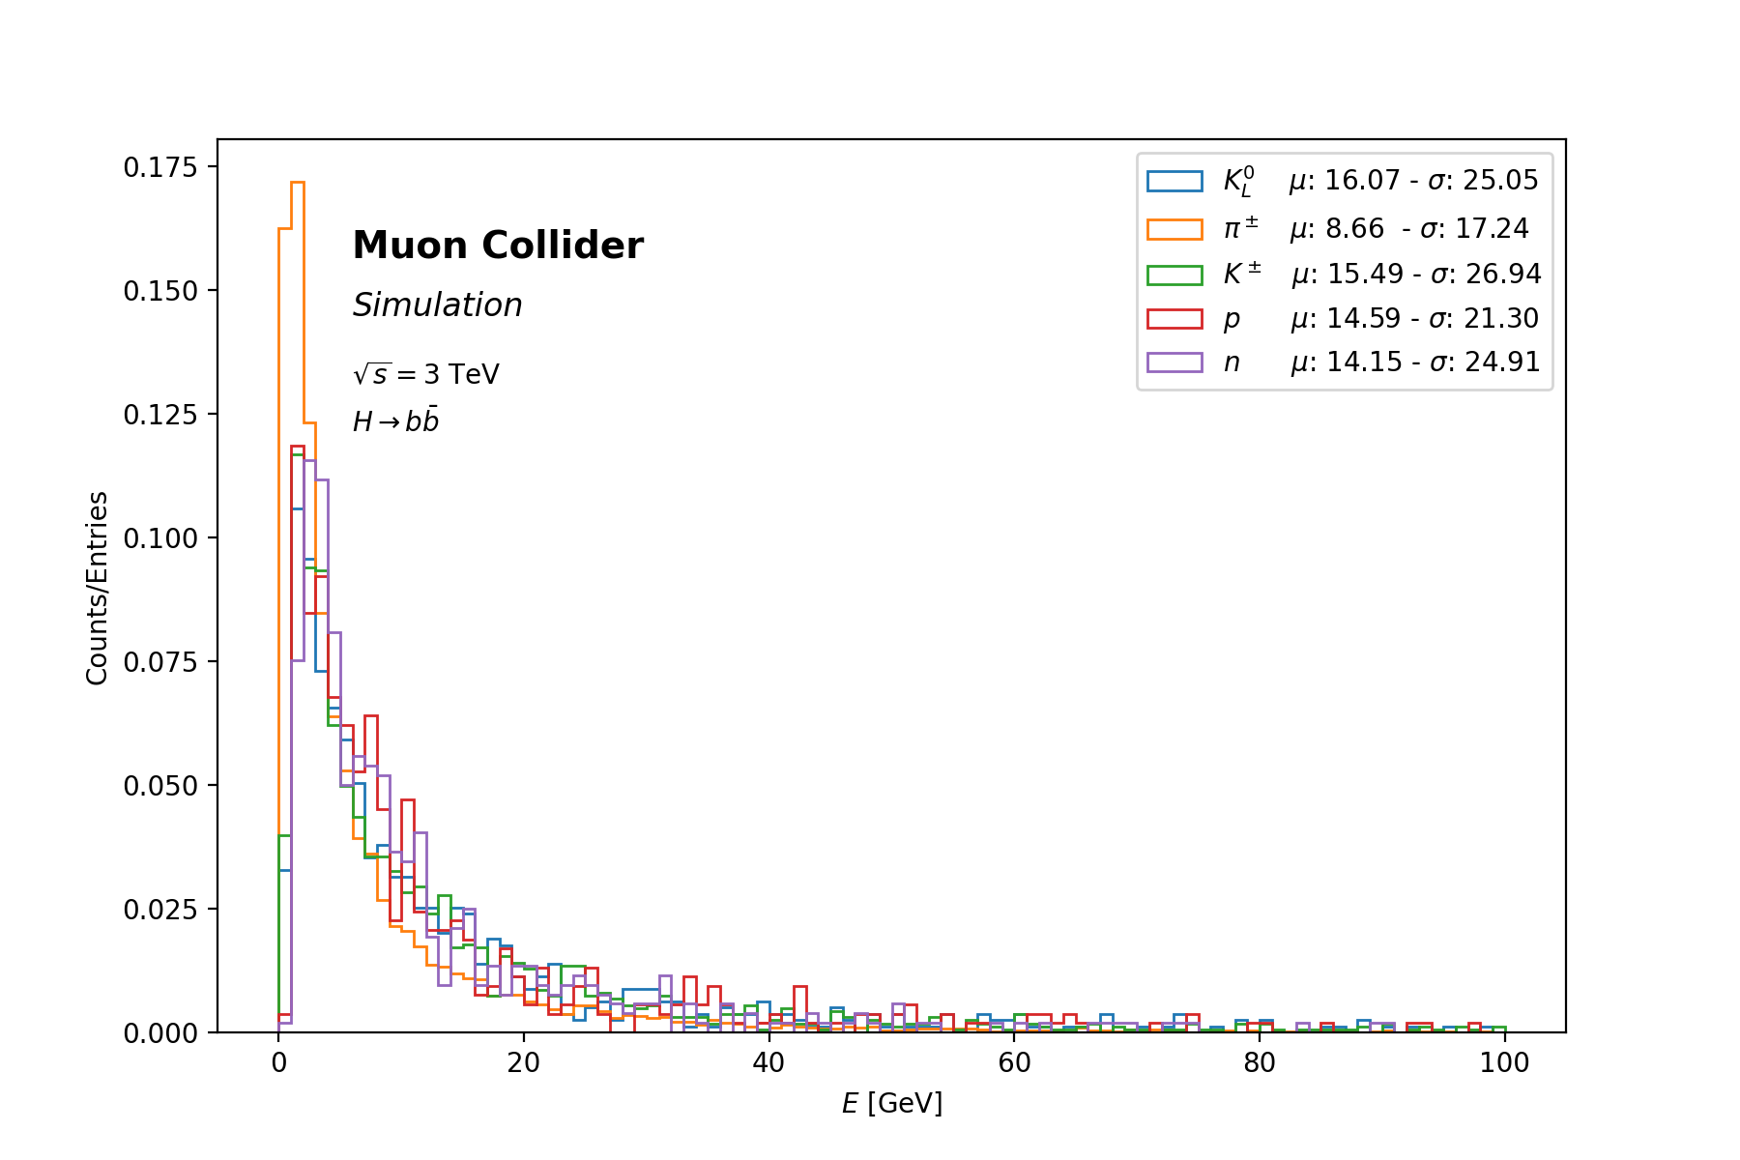
STUDY OF $μμ$ → H →$b\overline{b}$
#HADRONS PER EVENT
#PARTICLES PER EVENT
DI-jets event analysis
1000 events generated with Whizard at 3 TeV
On average :
~50 particles in each di-jet event
~10 hadrons per jet
mean energy : ~9 GeV for $π^{±}$ (~80% of the hadrons)
~15 GeV for p, n, $K^{±}$, $K^{0}$
~95% of particles below 20 GeV
Most of the particles produced at the interaction point convert their energy into hadronization processes
→ high particle multiplicity / low particle energy
Detector characterization with monochromatic $π^{±}$ guns with energy in the observed range 1.5-100 GeV

Slide 6
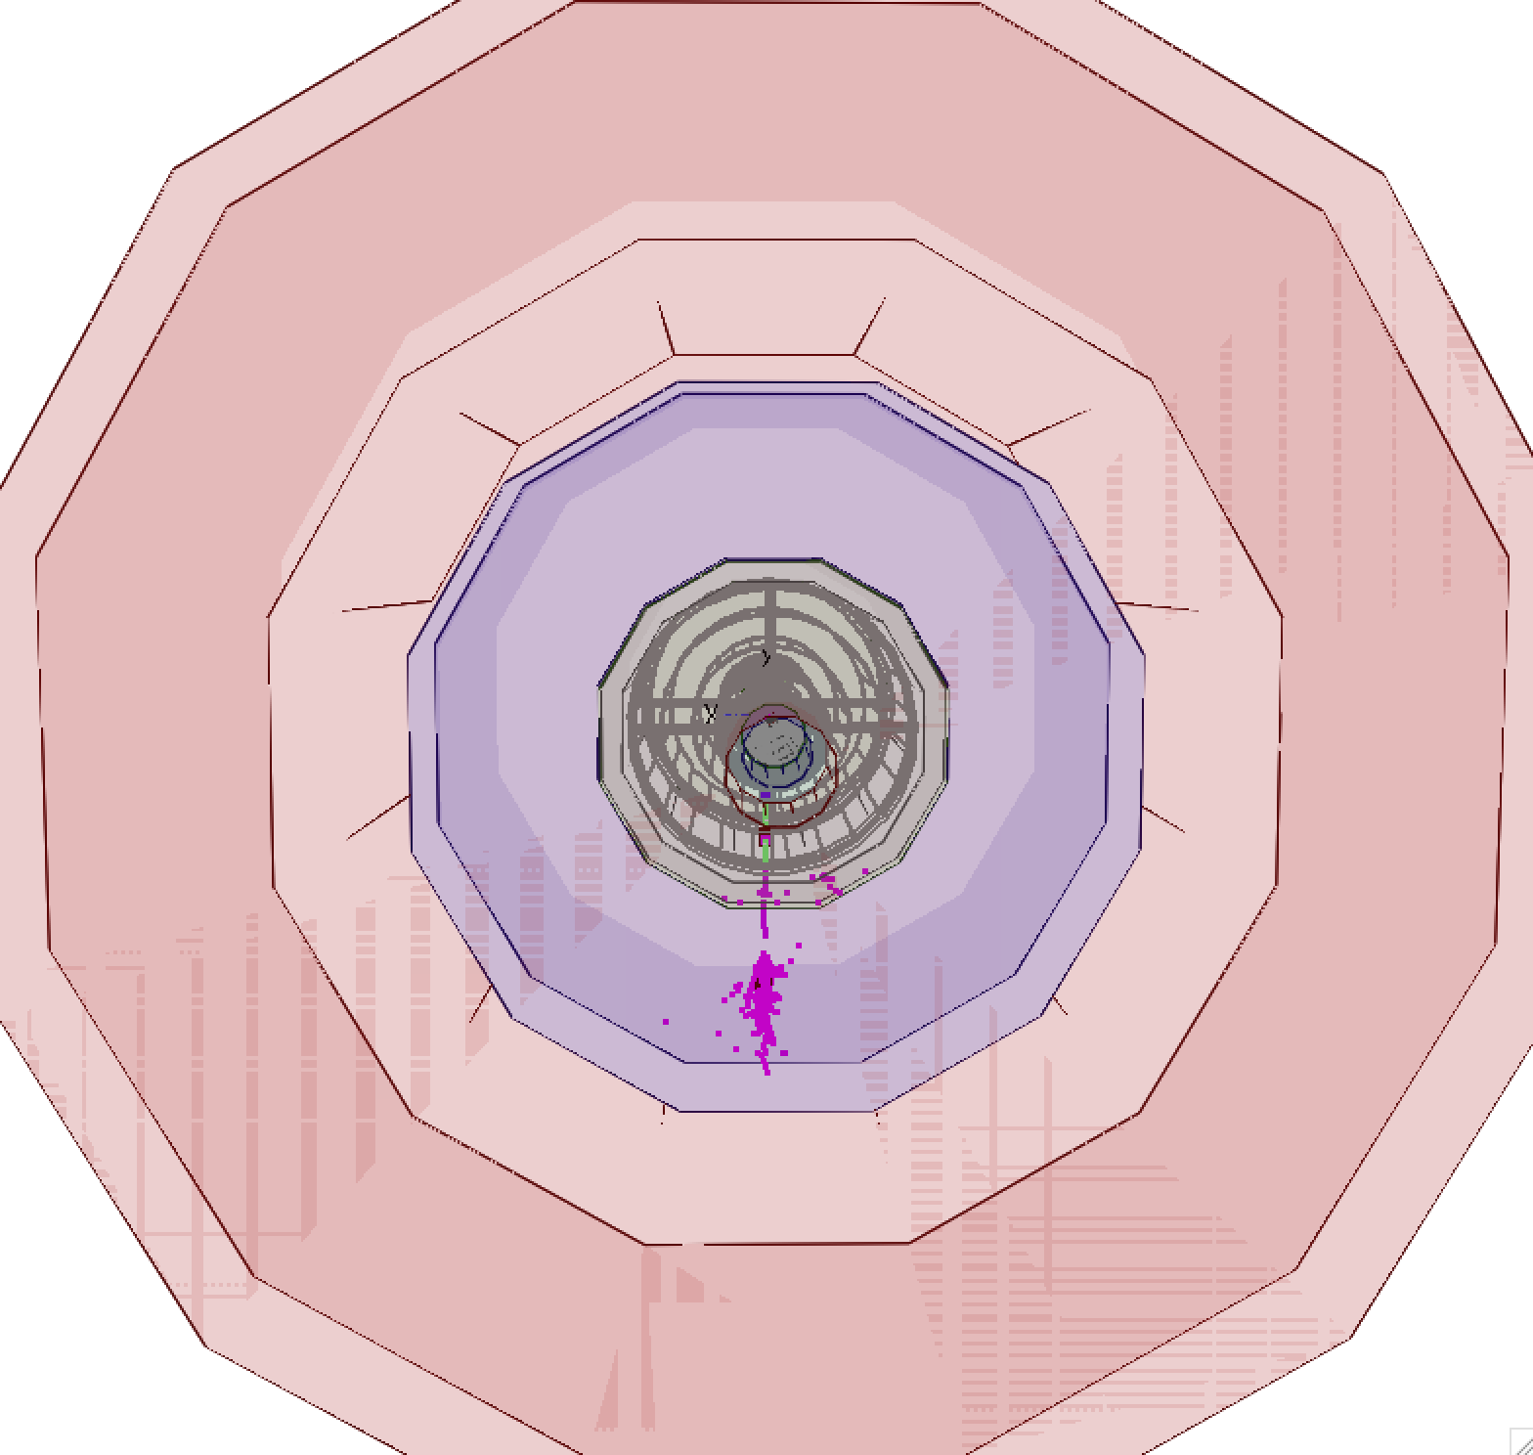
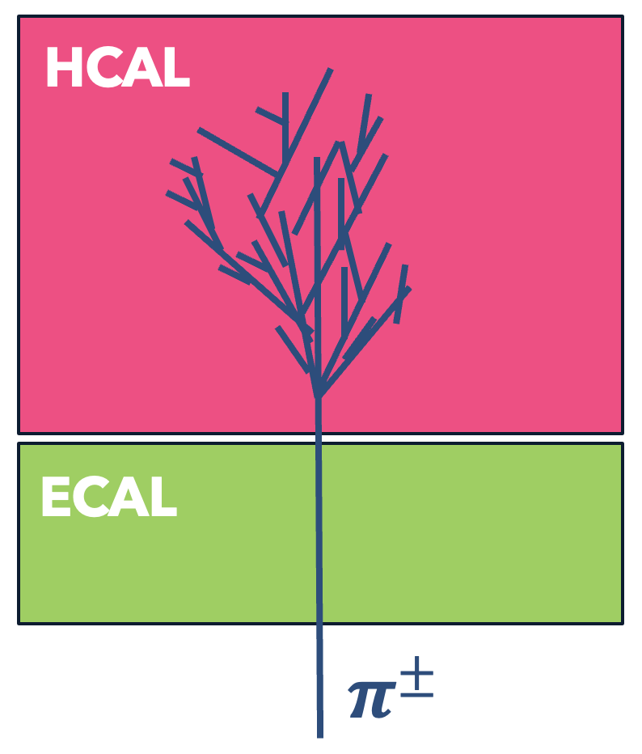
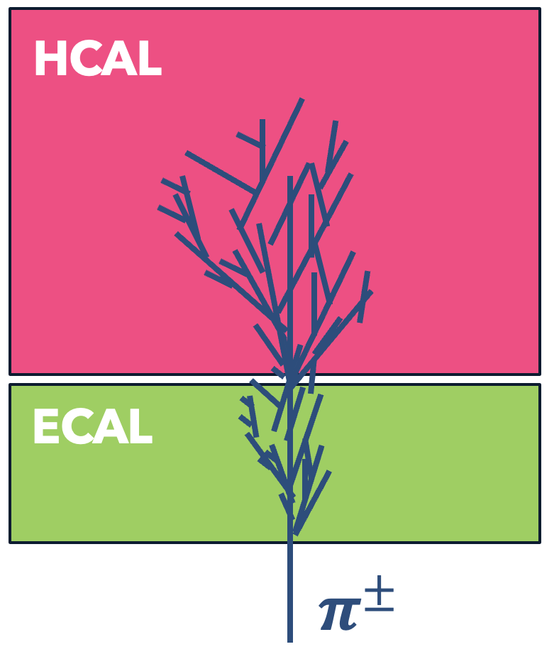
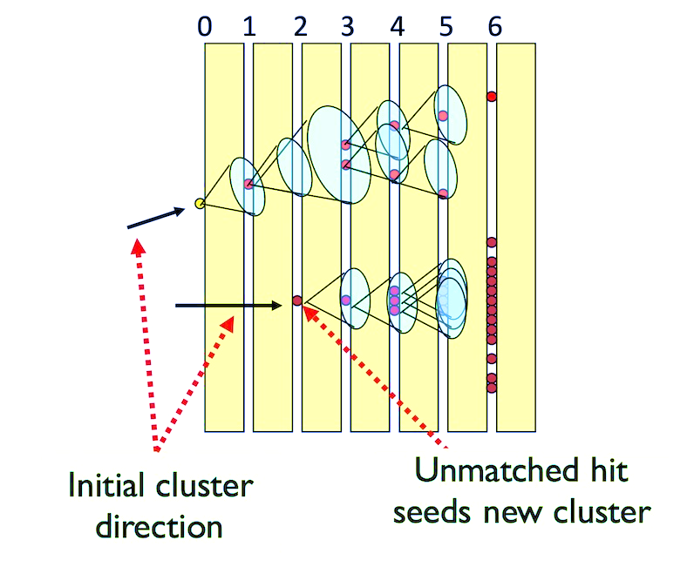
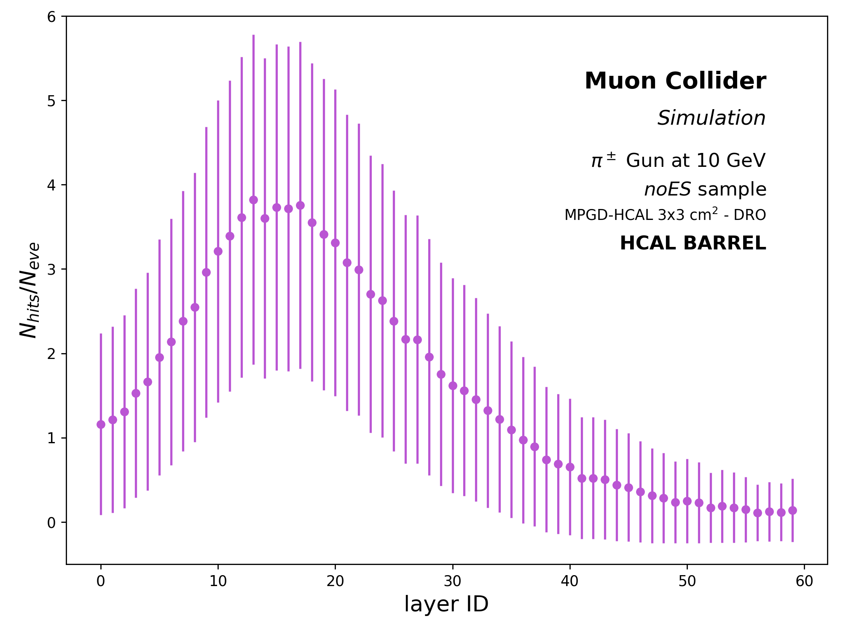
Calorimeter showers
Simulation of monochromatic $π^{±}$ guns performed through the DD4HEP package
Particles release energy deposits (HITS) in the calorimeter volume
noES Sample
MIP-like behaviour in ECAL
Shower starts in HCAL
Shower profile in HCAL
EH Sample
ECAL absorber ~ 1𝛌_{I}
Shower starts in ECAL
ECAL+HCAL
CLUSTER FORMATION
Pandora PFA
A cone-based forward projective clustering algorithm
grouping ECAL and HCAL hits into clusters
ENERGY RECONSTRUCTION OF CLUSTERS
ECAL HITS → ANALOG READOUT: E_{ECAL} $=\sum_{i=0}^{N_{EHit}}{E_{i}}$
HCAL HITS → DIGITAL READOUT: E_{HCAL}$=f(N_{HHit})$ $\sum_{i=0}^{N_{EHit}}{E_{i}}$
E_{raw} = E_{ECAL} + E_{HCAL}

Slide 7
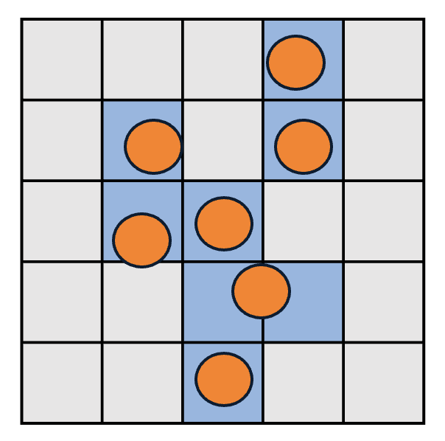
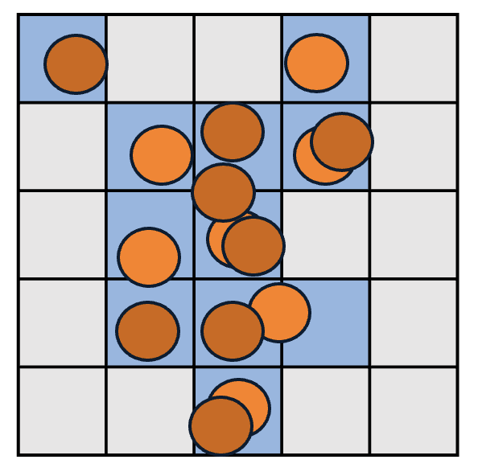
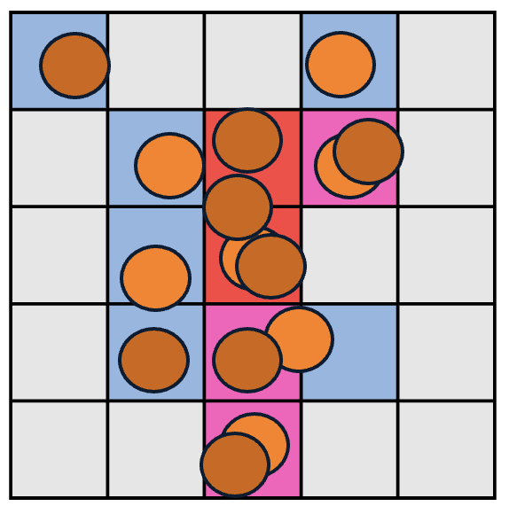
Cluster ENERGY - HCAL
Event digitization and reconstruction with Marlin through the DDMarlinPandora package
DIGITAL READOUT
SEMI-DIGITAL READOUT
LOW ENERGY
HIGH ENERGY
HIGH ENERGY
Set 3 energy thresholds: T₁ - T₂ - T₃
Count separately HCAL hits within the different energy ranges ($N_{1}$, $N_{2}$, $N_{3}$)
IMPROVEMENT
3 LEVEL DIGiTIZATION
The cluster energy is a weighted sum
E_{HCAL} =$αN_{1}+ βN_{2}+γN_{3}$
with $α$, $β$and $γ$ depending on N_{TOT}
To assess the best combination of T₁ - T₂ - T₃ : threshold scan based on the energy distributions of hits at different E_{MC} of the incoming $π^{±}$
→ Energy resolution as final the figure of merit :
0.2 – 4 – 12 keV
HCAL energy: increasing function of the total number of HCAL hits associated with the cluster
E_{HCAL} =$f$(N_{TOT})
At high E_{MC}, more shower particles might impinge on the same cell
Larger energy deposit in the cell, but one single hit is counted
→ Saturation of energy resolution at high energies

Slide 8
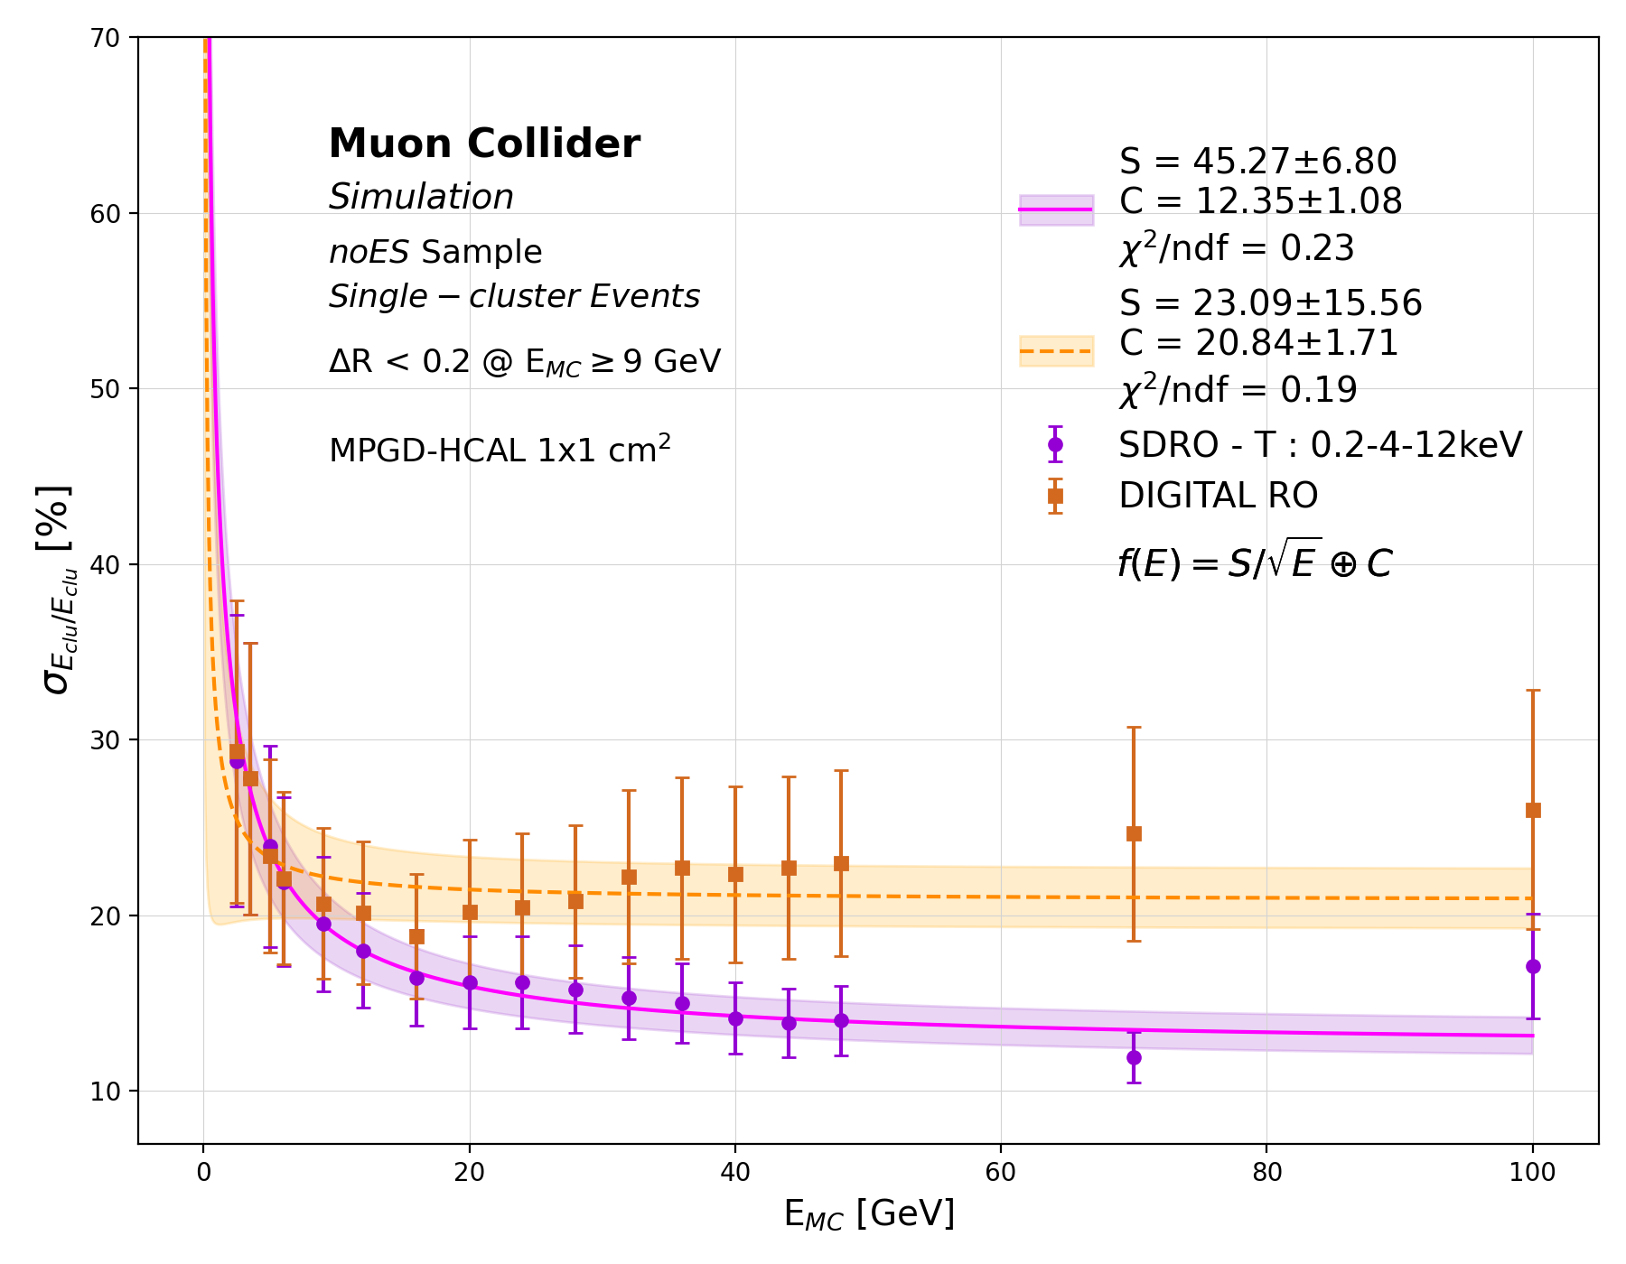
HCAL ENERGY RESOLUTION
Digital vs SEMI-DIGITAL READoUT (RO)
Reconstruction of the noES samples with Digital RO (DRO) and Semi-Digital RO (SDRO) Thr: 0.2-4-12 keV
Linear calibration of the energy spectra of clusters, accounting for energy underestimation due to invisible energy
Gaussian fit of the calibrated energy distributions
Extract the mean E_{clu} and the sigma $σ$
→ resolution points $σ$/E_{clu}
Fit function $f\left(E\right)=S/\sqrt{E}⊕C$
Comparable performances below 6 GeV
DRO: Saturation at high energies of the fit function with an evident increase in the experimental points
Better performances of the SDRO :
$σ$/E_{clu} = $45.27\%/\sqrt{E}⊕12.35\%$

Slide 9
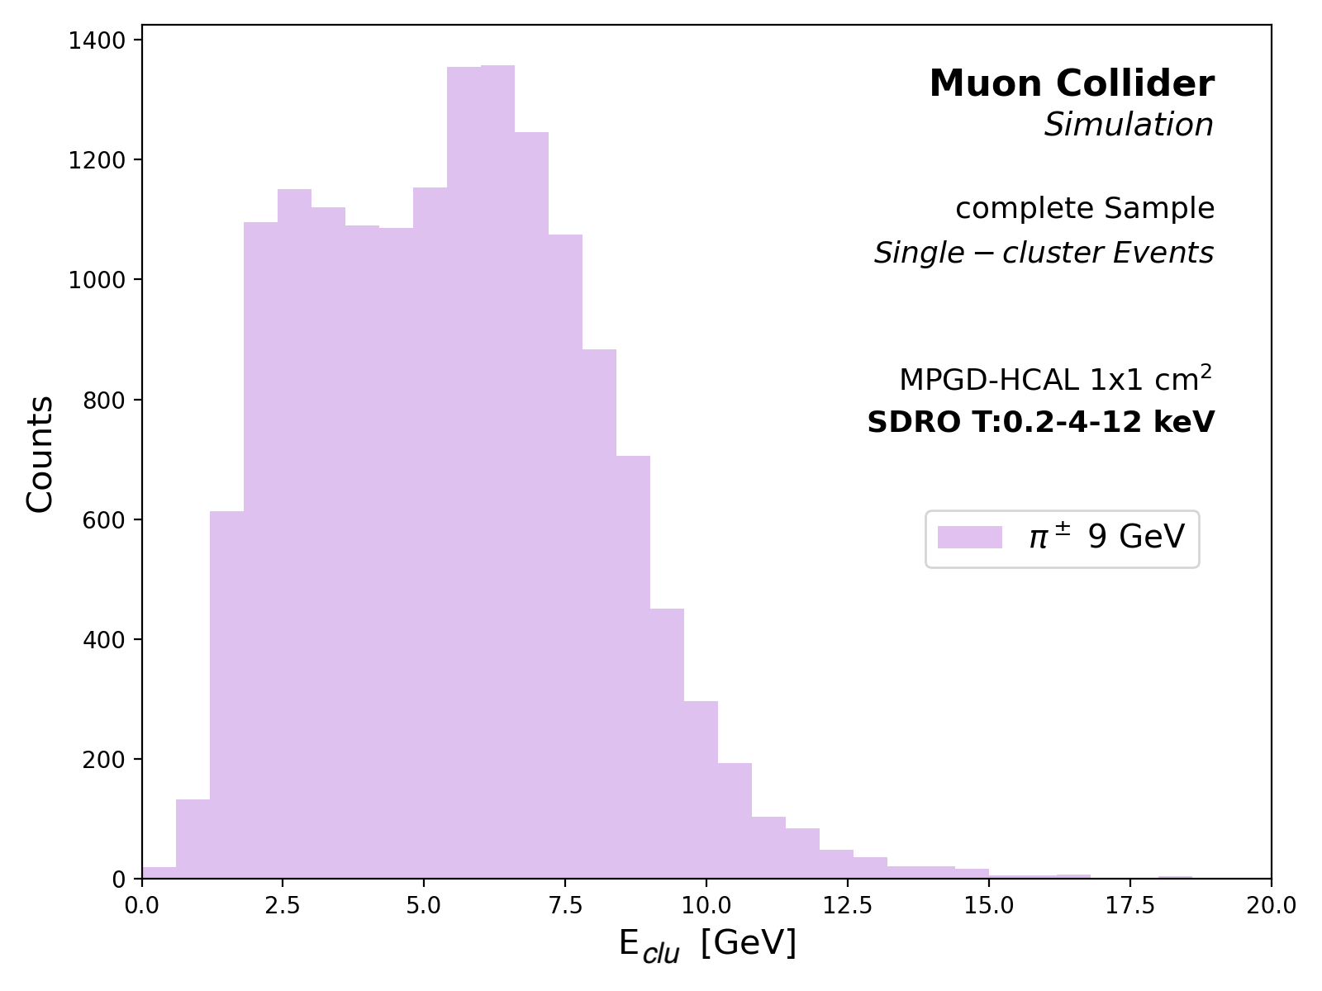
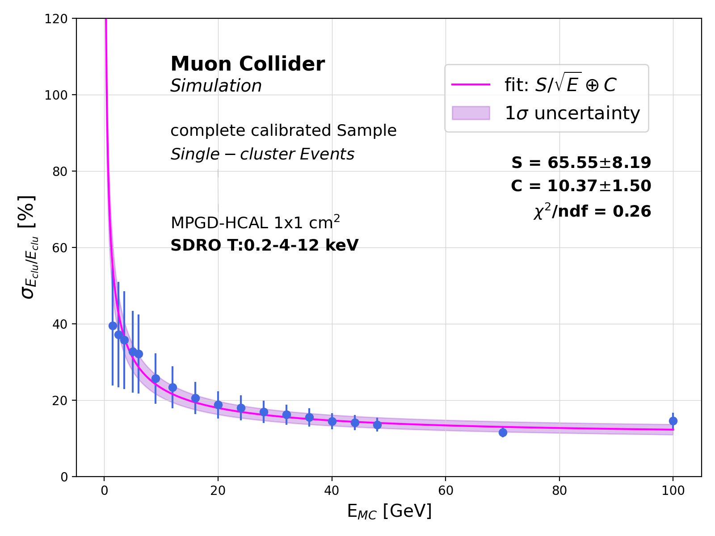
ENERGY RESOLUTION of the full calorimetric system
CRILIN ECAL + MPGD HCAL (SDRO)
$π^{±}$ guns with E_{MC} of 1.5-100 GeV noES + EH sample
Ad hoc calibration of the energy spectra accounting for different responses of ECAL and HCAL
Average resolution from the fit:
$σ$/E_{clu} = $65.55\%/\sqrt{E}⊕10.37\%$
With respect to the intrinsic HCAL resolution :
The constant term C slightly decreases → better reconstruction at high energies
The stochastic term S increases → fluctuations due to analog read out of the ECAL

Slide 10
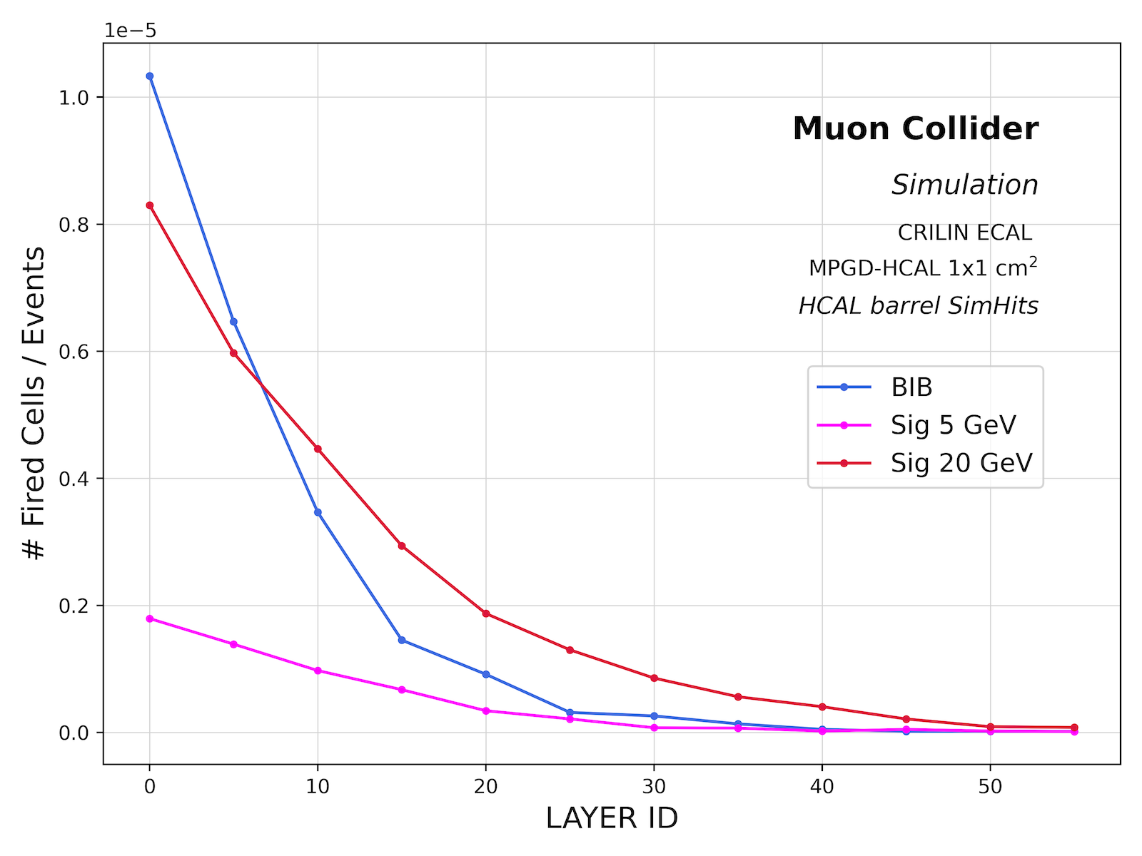
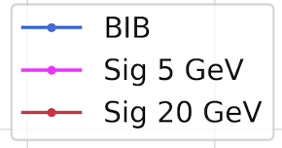
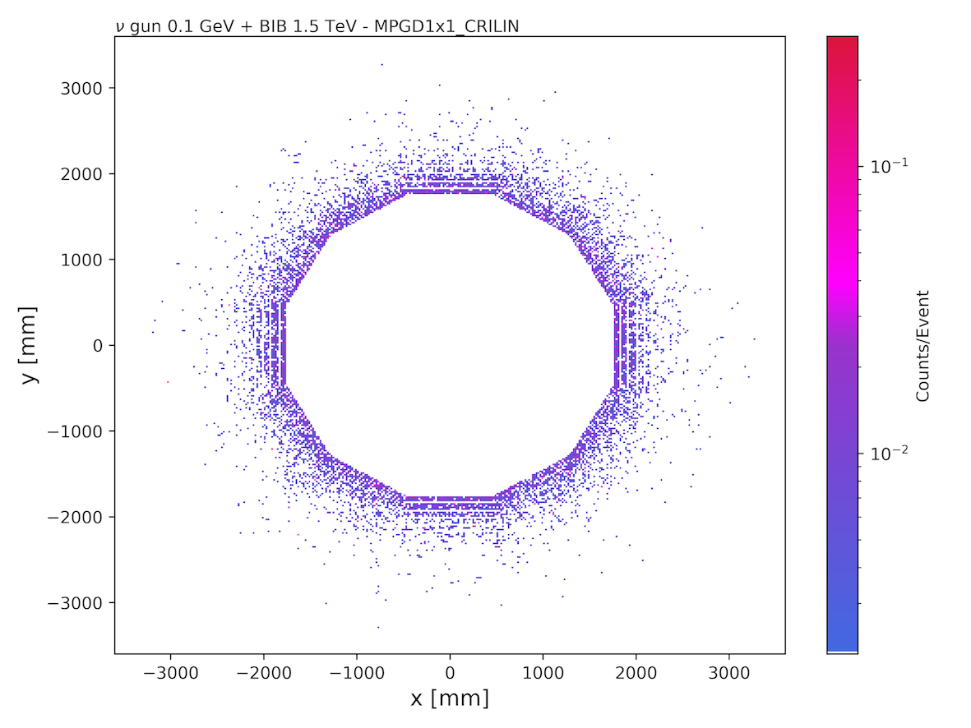
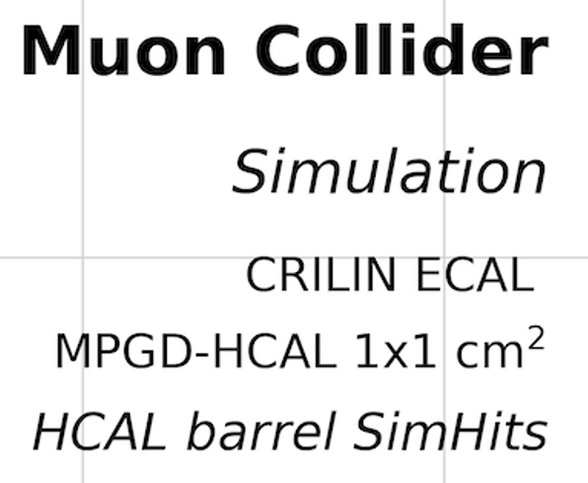
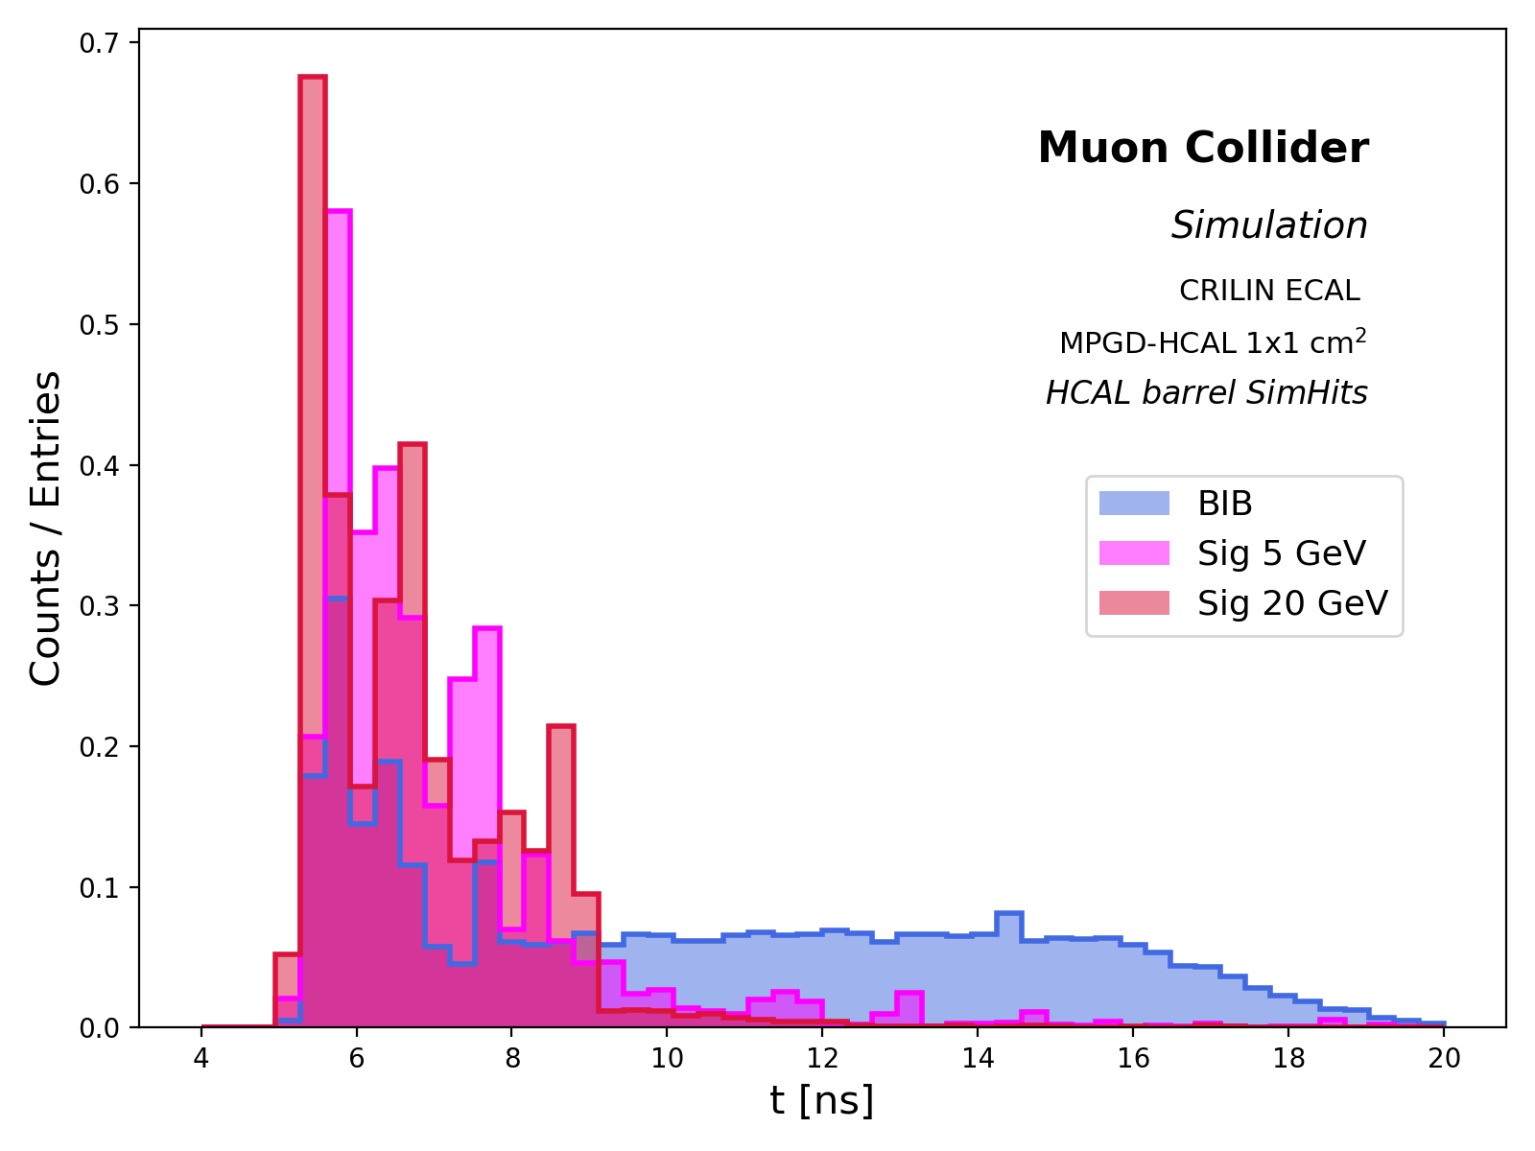
BIB IN HCAL
1500 events of BIB generated at the $\sqrt{s}=1.5 TeV$ Muon Collider in 1 BX : $μ^{+}$ → $e^{+}\overline{ν_{μ}}ν_{e}$
BIB containment within the first 20 layers of HCAL
Probability of a cell to be fired in the first layer :
BIB : ~ 1 x 10⁻⁵
$π^{±}$ 5 GeV : ~ 0.2 x 10⁻⁵
${ π}^{±}$ 20 GeV : ~ 0.8 x 10⁻⁵
potential problems for low energy pion reconstruction
ARRIVAL TIME
Arrival time distribution is uniform in the range 7-20 ns, while signal peaks at 6 ns
→ Cut at t > 10 ns ~50% BIB rejection

Slide 11
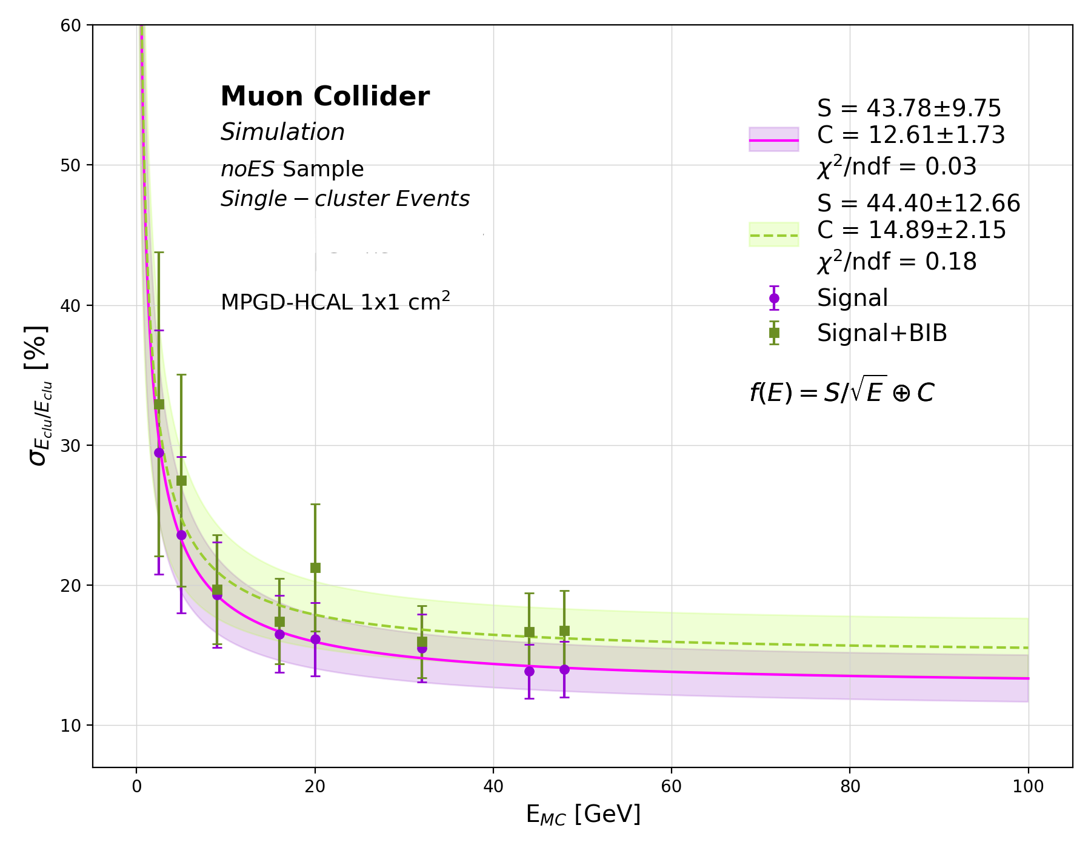
CLUSTER ENERGY RECONSTRUCTION with bib
BIB IMPACT ON ENERGY RESOLUTION
Reconstruction of the w/wo BIB noES samples with SDRO Thr: 0.2-4-12 keV
Compatible in resolution with BIB overlaid
However, the parameter S, accounting for uncertainties, remains below 60%
→ Satisfied the energy resolution requirements for an imaging HCAL in a multi-TeV Muon Collider
 | Signal | Signal+BIB
S [%] | 43.78 $±$ 9.75 | 44.40 $±$ 12.66
C [%] | 12.61 $±$ 1.73 | 14.89 $±$ 2.15

Slide 12
CONCLUSIONS
Characterization and optimization of the innovative MPGD-based HCAL for the Muon Collider in a full simulation of the detector environment
CLUSTER RECONSTRUCTION
Implementation of SDRO with the optimal threshold choice:
0.2-4-12 keV
HCAL intrinsic energy resolution :
$σ$/E_{clu} = 45.27%/$\sqrt{E}$ $⊕$ 12.35%
Significant improvement wrt DRO
Stochastic term below 60%, as required for imaging HCALs at Muon Colliders
In the innermost layers of HCAL, occupancy of the BIB hits comparable to that of the Signal
However, the energy resolution is negligibly affected by the BIB overlay
→ further improvement is expected for a cut on BIB hits
at arrival times > 10 ns provided the necessary electronics
FUTURE STEPS
Optimize Particle Flow event reconstruction to analyze energy of jets

Slide 13
THANK YOU
FOR THE ATTENTION

Slide 14
BACKUP SLIDES

Slide 15
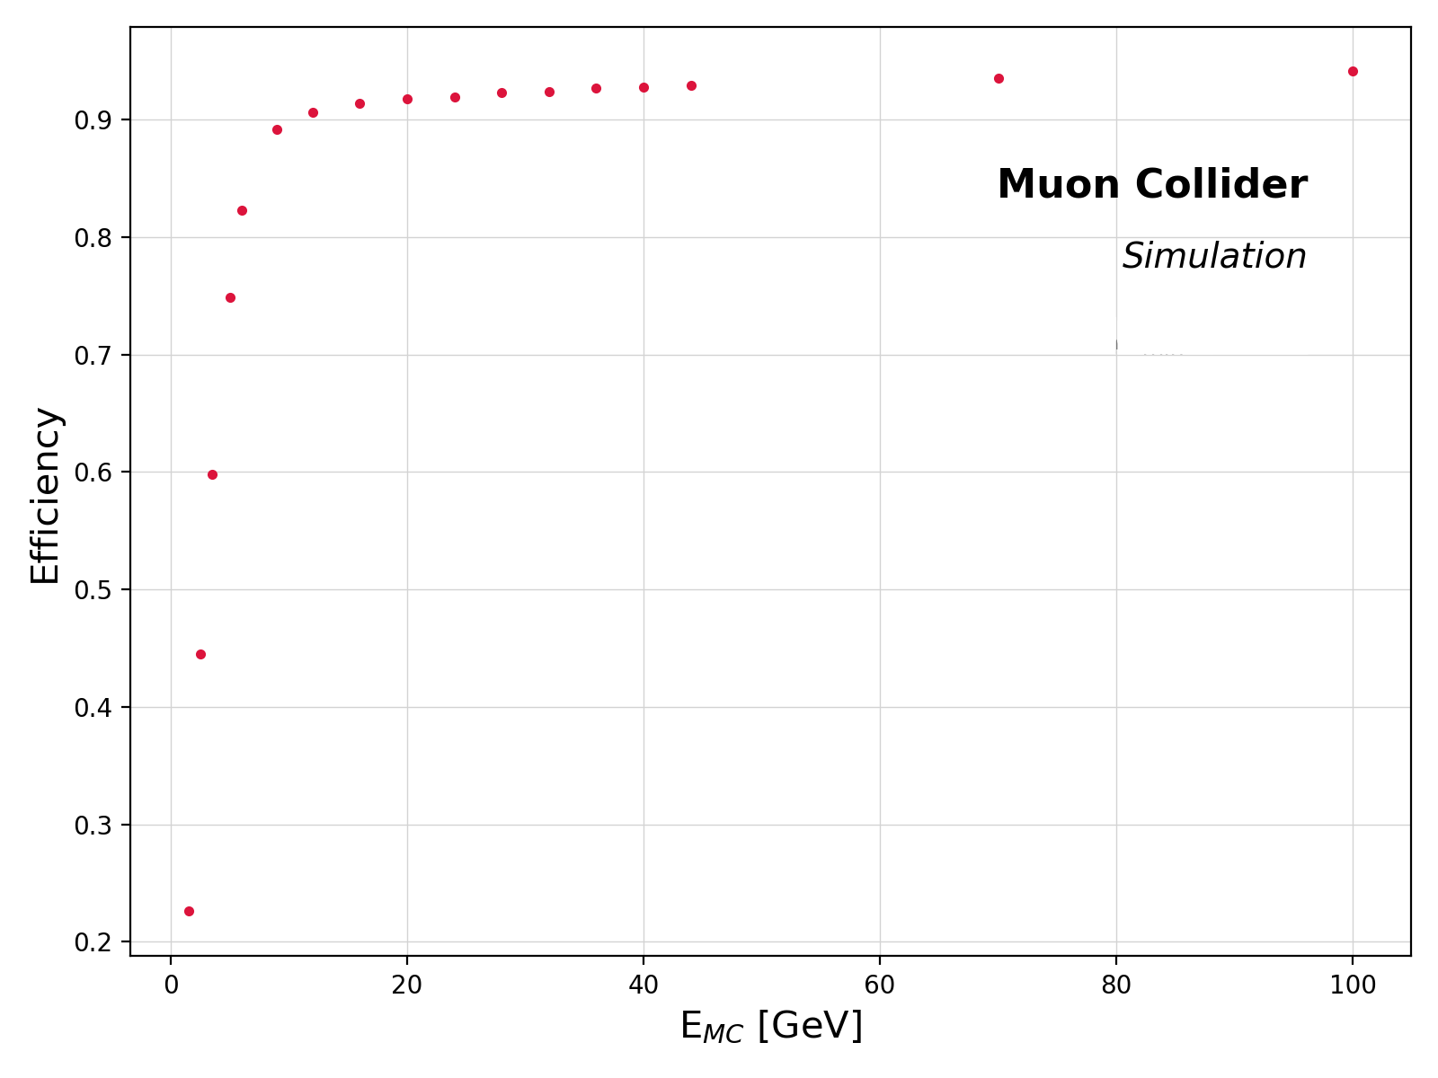
Clustering
ECAL+HCAL
Pandora Particle Flow Algorithm
Cluster = ECAL hits + HCAL hits
Cone-based forward projective clustering algorithm from the innermost to the outermost layer
Efficiency tested with 1 $π^{±}$ per event → expected 1 cluster per event
Detector efficiency = (nr. events with $≥$1 cluster) / (sample size )
Low energies E_{MC} → big fraction of zero-cluster events due to impossibility of finding and merging neighboring hits
low multiplicity of produced and reconstructed hits
For E_{MC} > 9 GeV, saturation at ~95%
BUT many MULTIPLE CLUSTERS → Discard all the multiple-cluster events and perform the cluster energy analysis with SINGLE CLUSTER events
Data

Slide 16
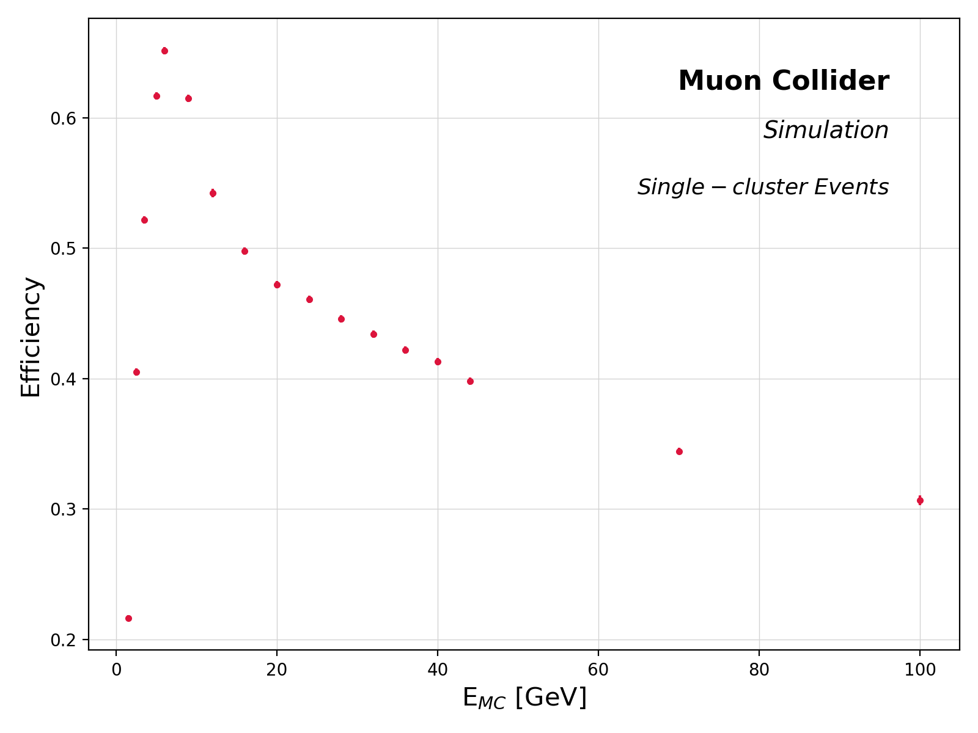
Clustering
Pandora Particle Flow Algorithm
Algorithm Efficiency tested with 1 $π^{±}$ per event → expected 1 cluster per event
Algorithm Effective efficiency is given by (nr. single-cluster events) / (sample size )
At low energies E_{MC} → dominates the fraction of zero-cluster events
For E_{MC} > 9 GeV, increasing number of MULTIPLE CLUSTERS
Algorithm logic:
→designed to rather separate true clusters than merge energy
deposits from multiple particles into a single cluster
→multiple clusters result from unmerged groups of hits, each
carrying a fraction of the true cluster energy
Discard all the multiple cluster events, and associate single clusters within a ΔR < 0.2 from the MC $π^{±}$

Slide 17
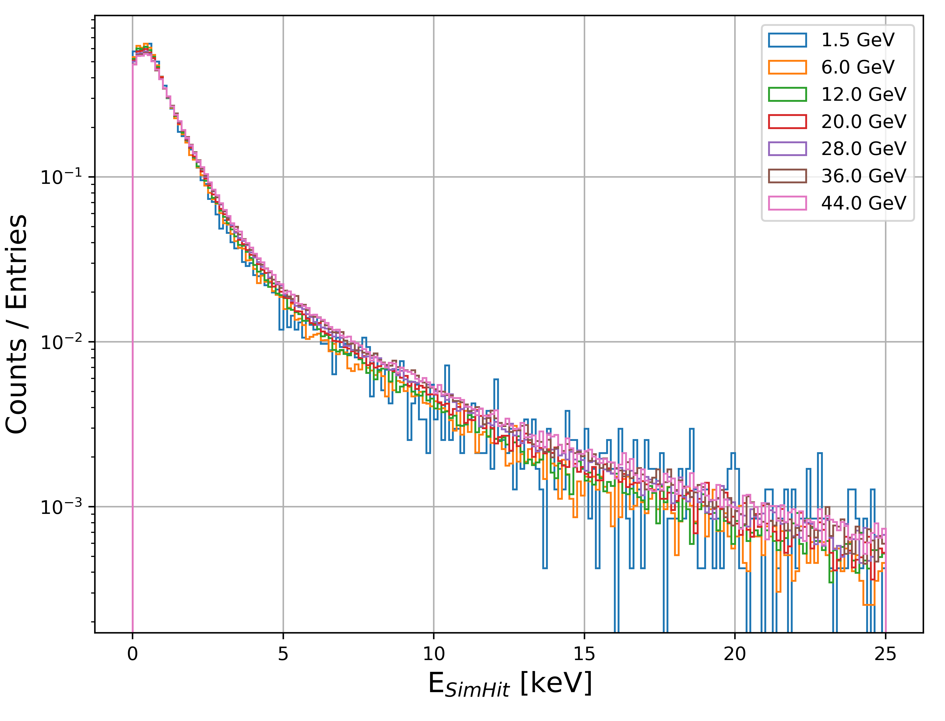
SEMIDIGITAL READOUT
THRESHOLD CHOICE
ENERGY DISTRIBUTIONS OF SIMHITS NORMALIZED BY THE NUMBER OF ENTRIES
The choice of T₂ and T₃ should be based on the E_{SimHit} values at which the difference between the curves is more evident :
From 0 to ~2.5 keV the curves are almost indistinguishable
After 2.5 keV, the tails tend to increase with E_{MC} → the probability of having larger energy deposits for high E_{MC} is higher
For E_{SimHit} $≥$ 10 keV, the curves feature significant fluctuations (especially at low E_{MC}) → the number of entries above a high threshold decreases significantly

Slide 18
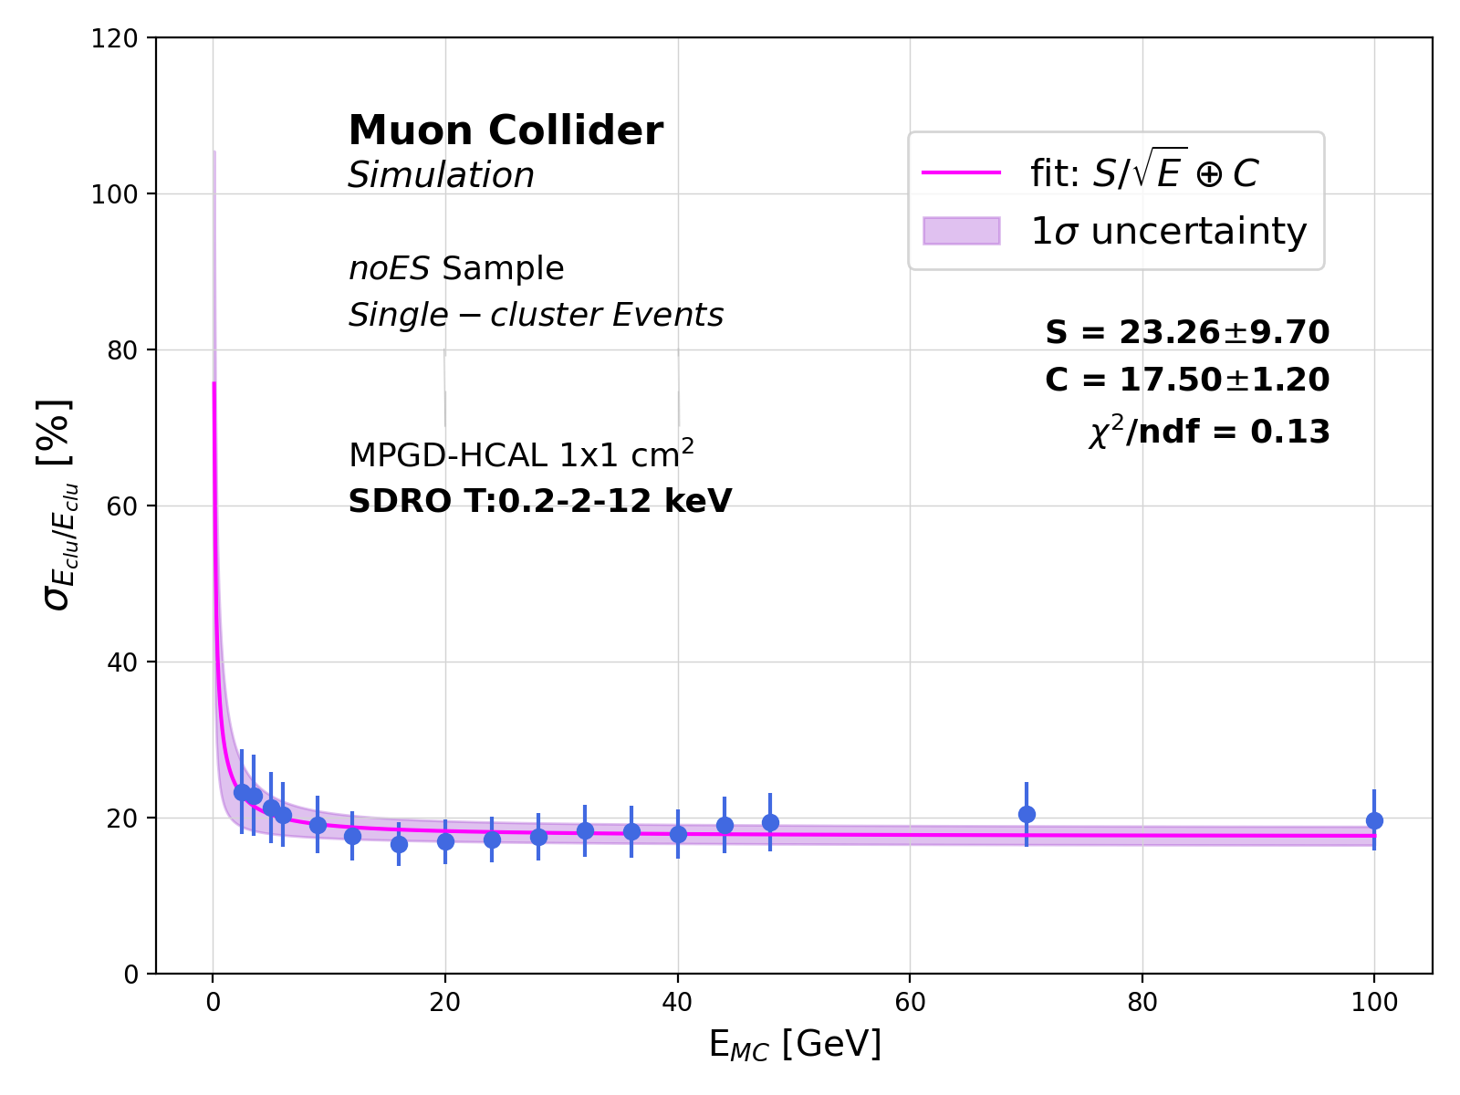
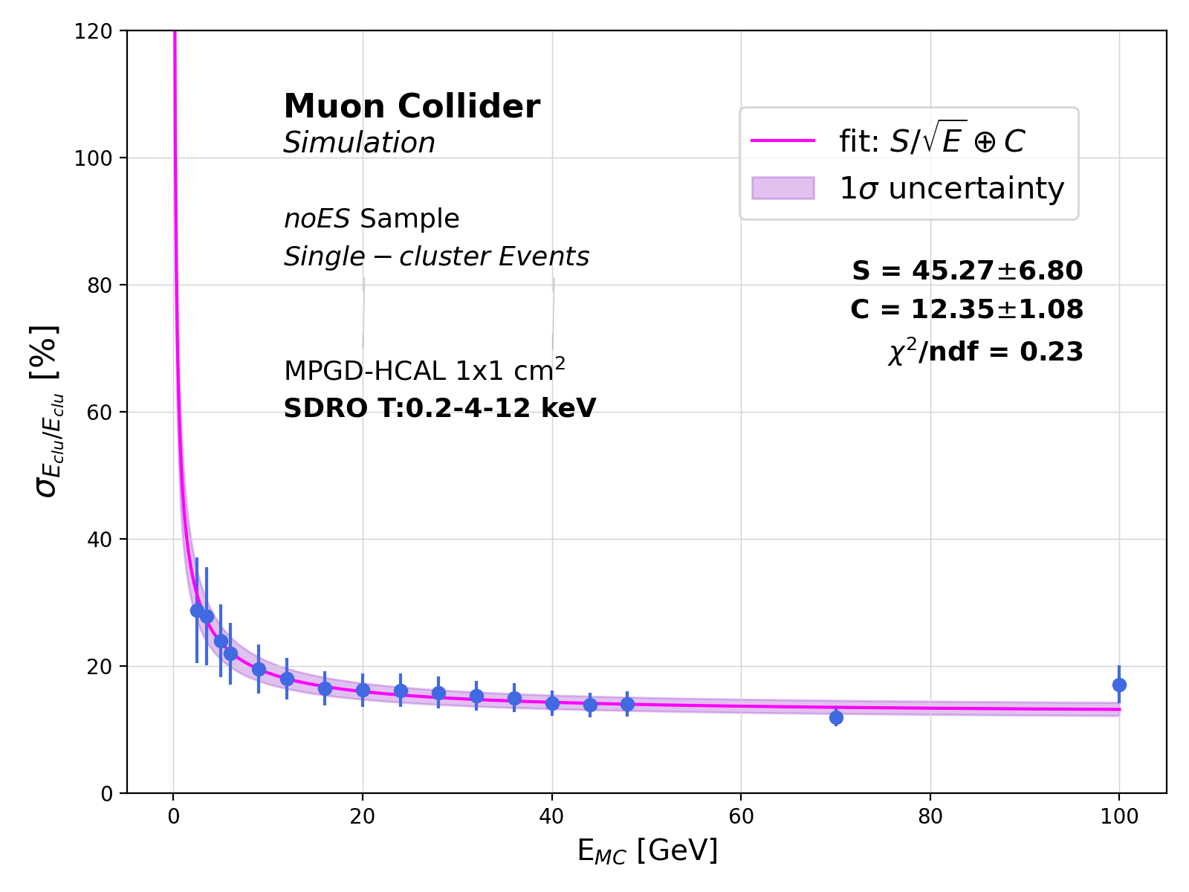
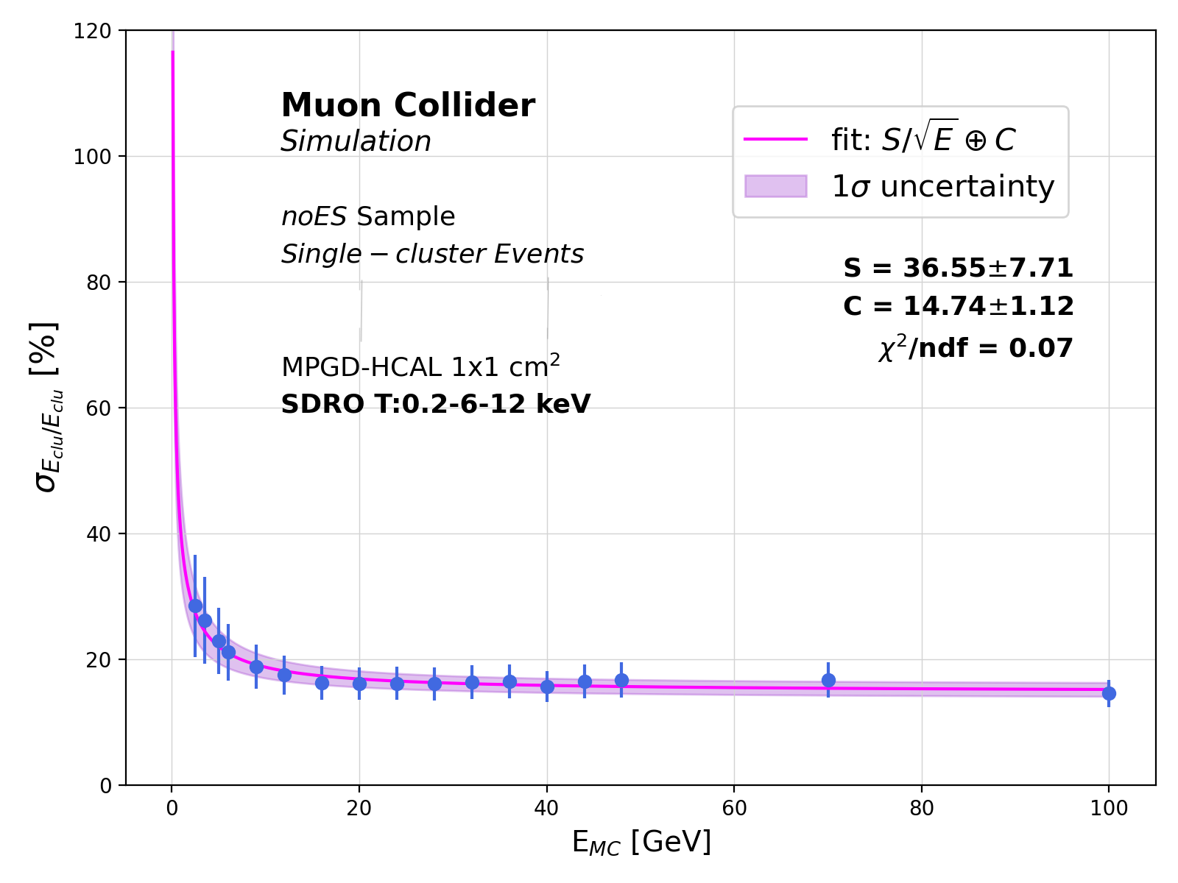
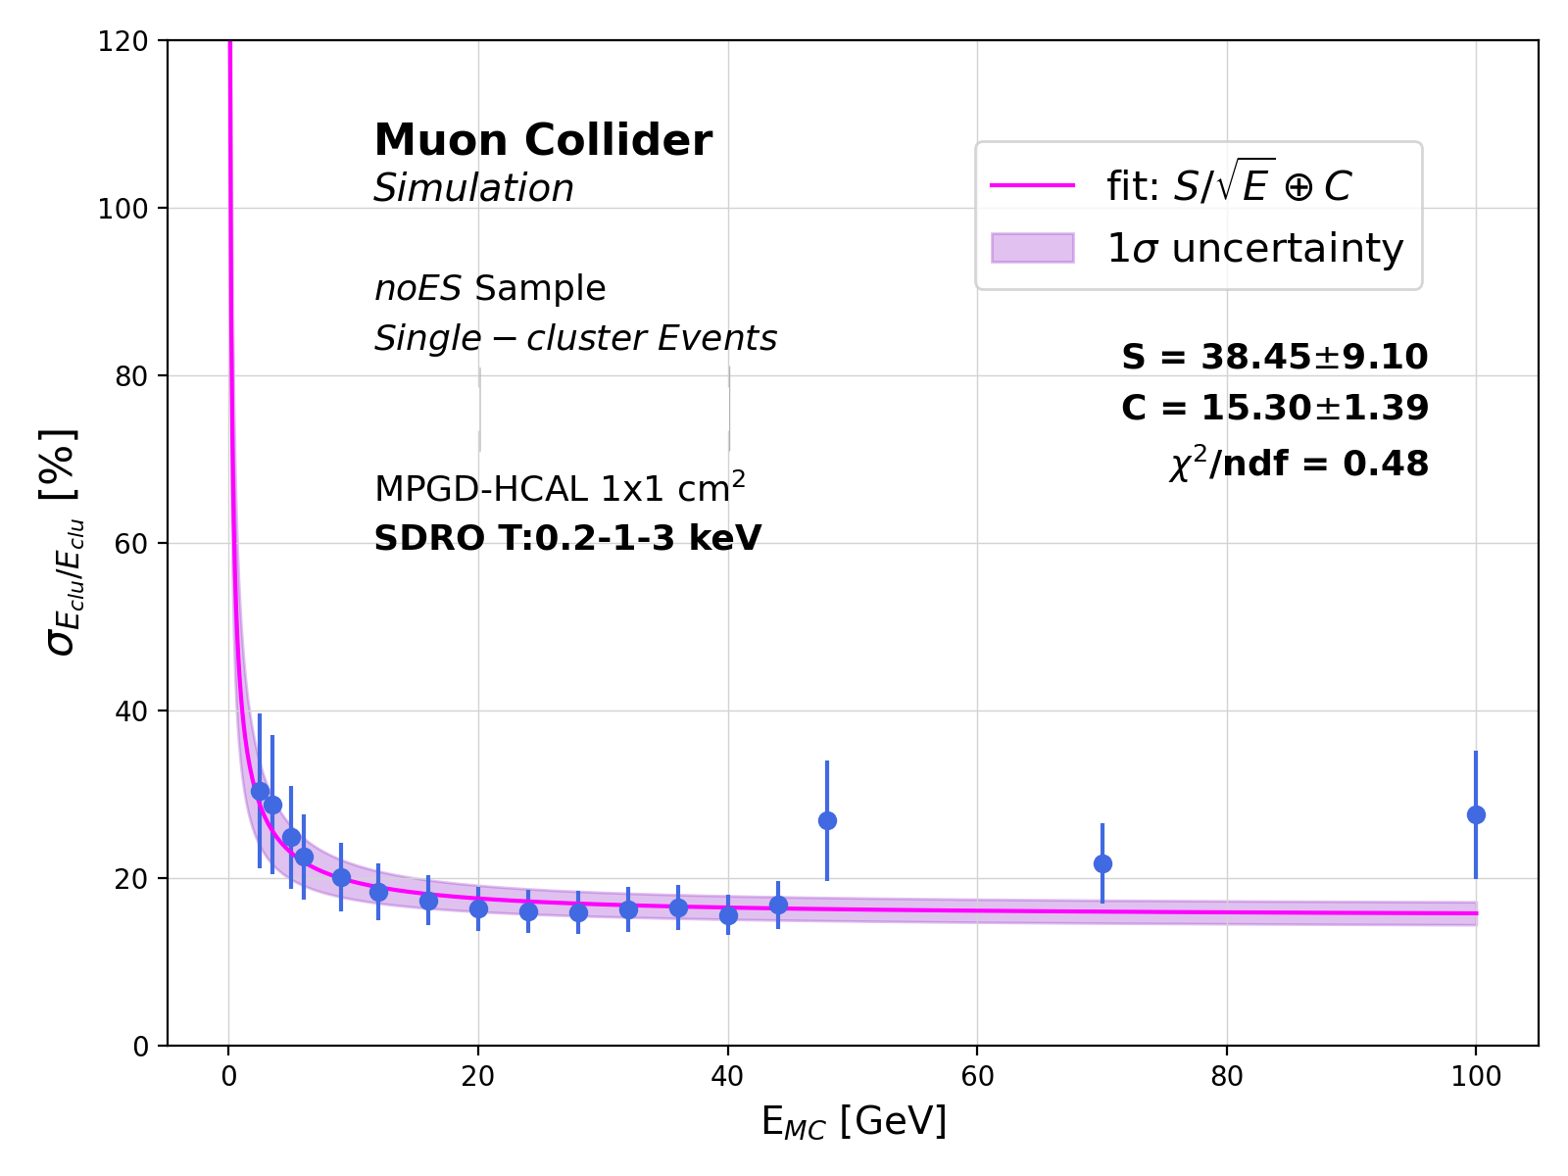
HCAL ENERGY RESOLUTION
SEMIDIGITAL RO - THRESHOLD CHOICE
Energy resolution as the figure of merit to assess the best threshold combination
A too-small T₃ (~3 keV) makes the resolution above 48 GeV worse
Comparable results obtained for fixed T₃ = 12 keV and varying T₂
→ The best combination is the one providing the minimum C parameter: 0.2-4-12 keV

Slide 19
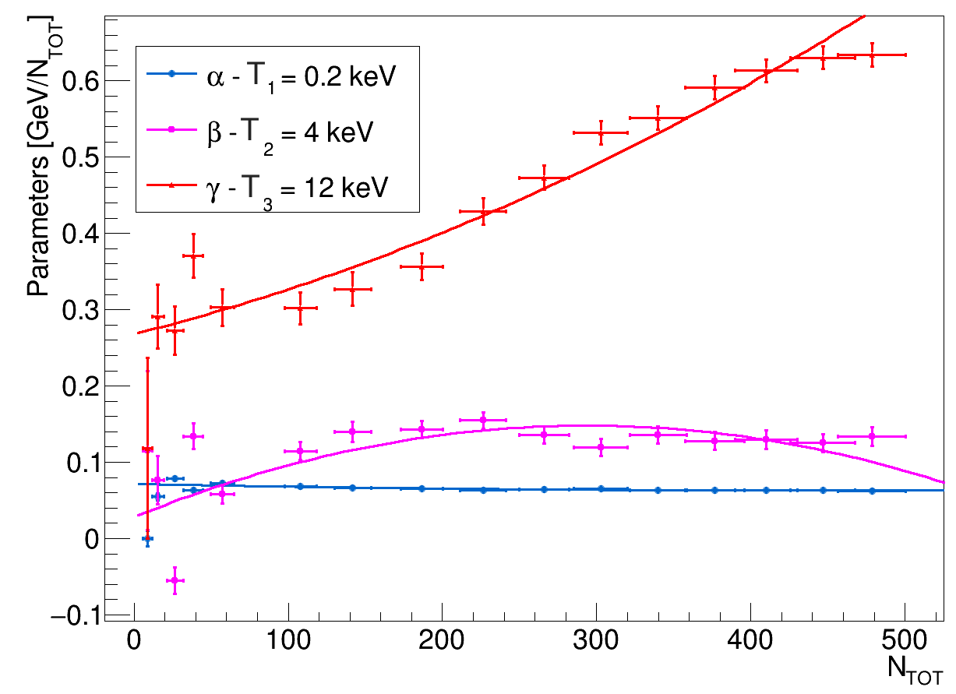
Cluster ENERGY - HCAL
SEMI-DIGITAL READOUT
ENERGY THRESHOLDS
T₁ = 0.2 keV : set by the sensitivity [10 fC] of the readout electronics
T₂ - T₃ : threshold scan based on the energy distributions of hits at different E_{MC}
→ Energy resolution as the figure of merit to assess the best combination :
0.2-4-12 keV
At each energy point E_{MC}, $α$, $β,$and $γ$ are obtained by a $χ^{2}$ minimization
$$\sum_{i}^{Neve}{\frac{{(E}_{MC}^{i}−E_{REC}^{i})2}{σ_{i}}}$$
The dependence of $α$, $β$and $γ$ on on N_{TOT} is obtained by a 2nd order polynomial fit

Slide 20
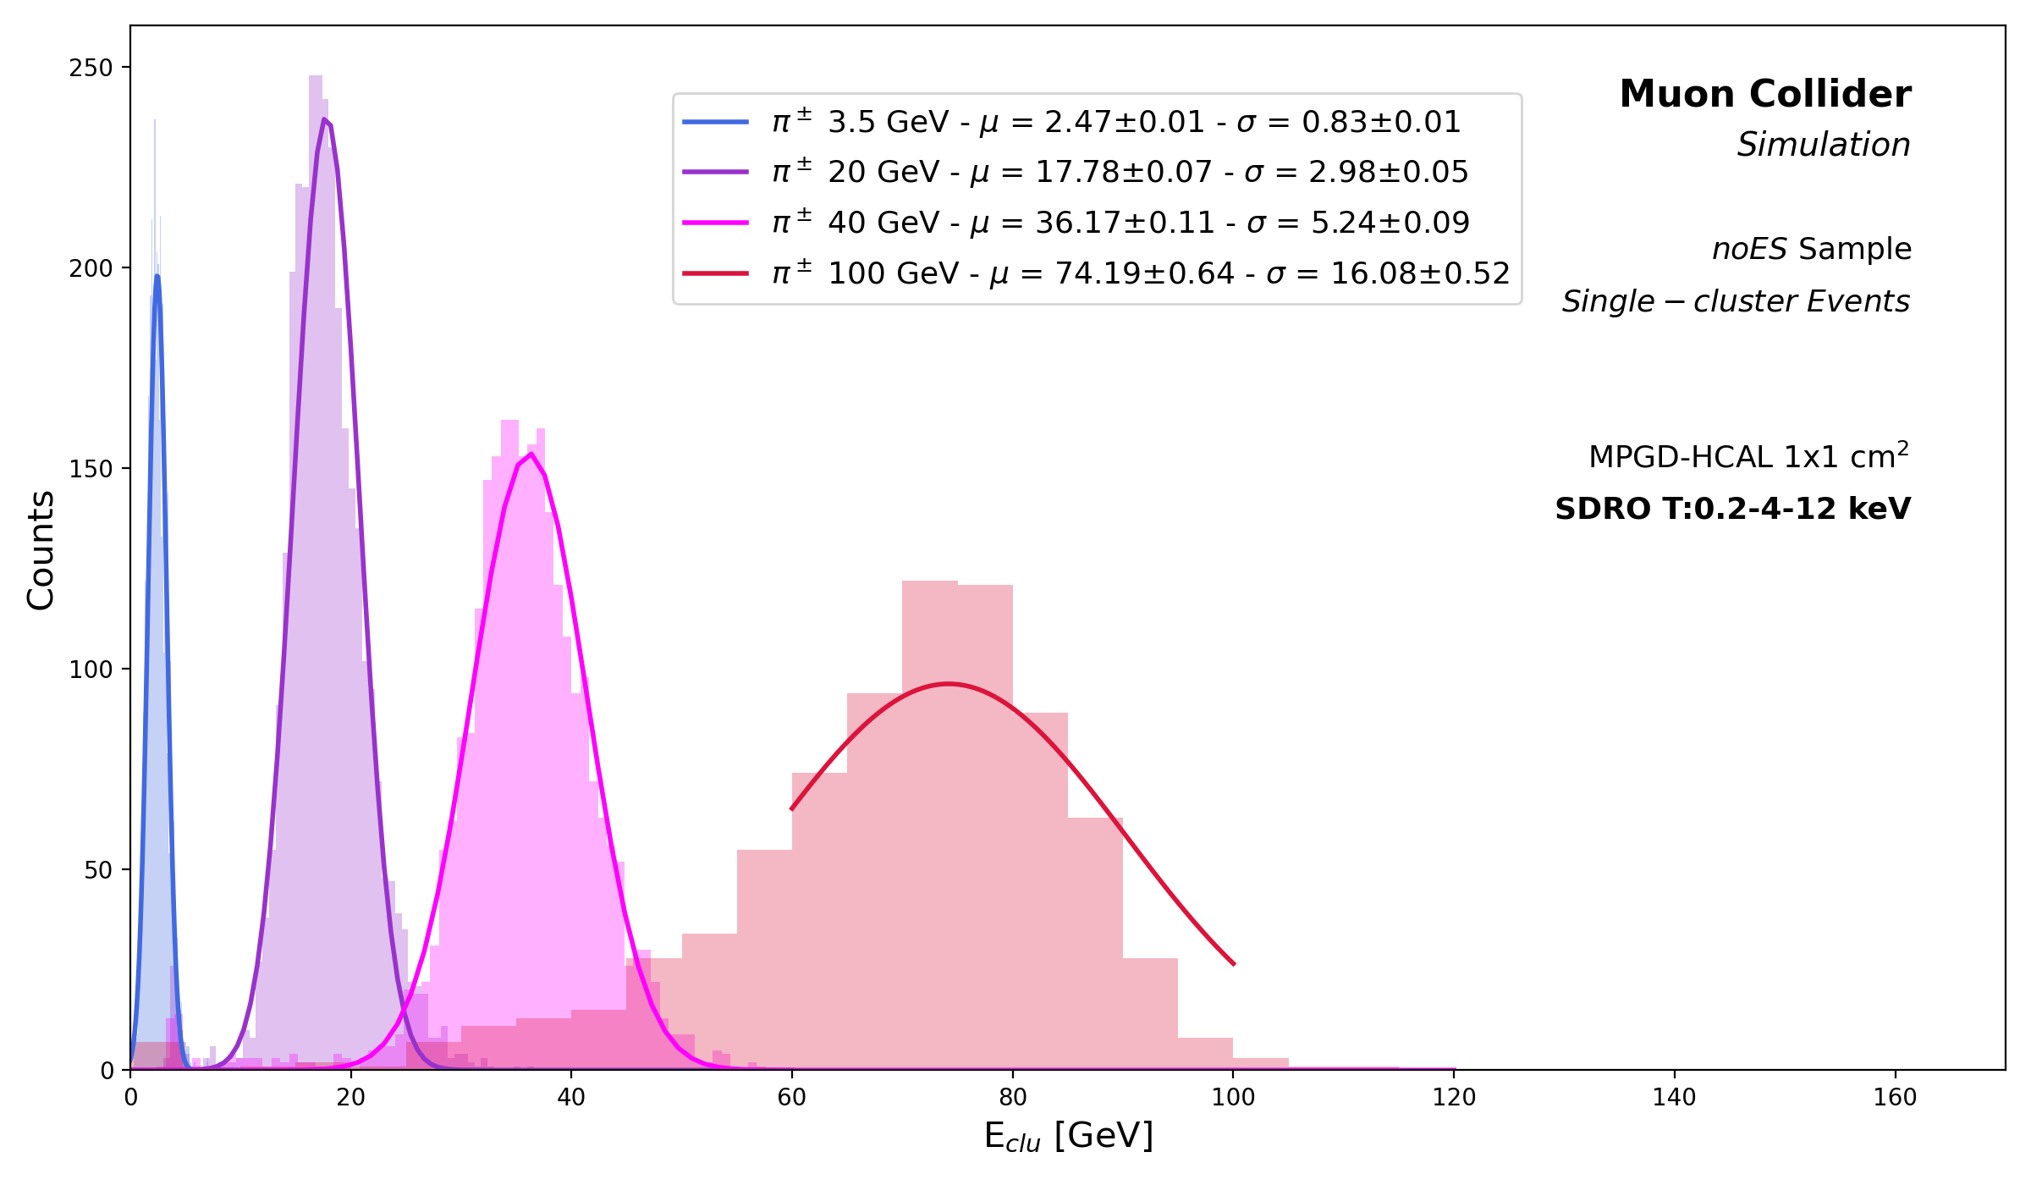
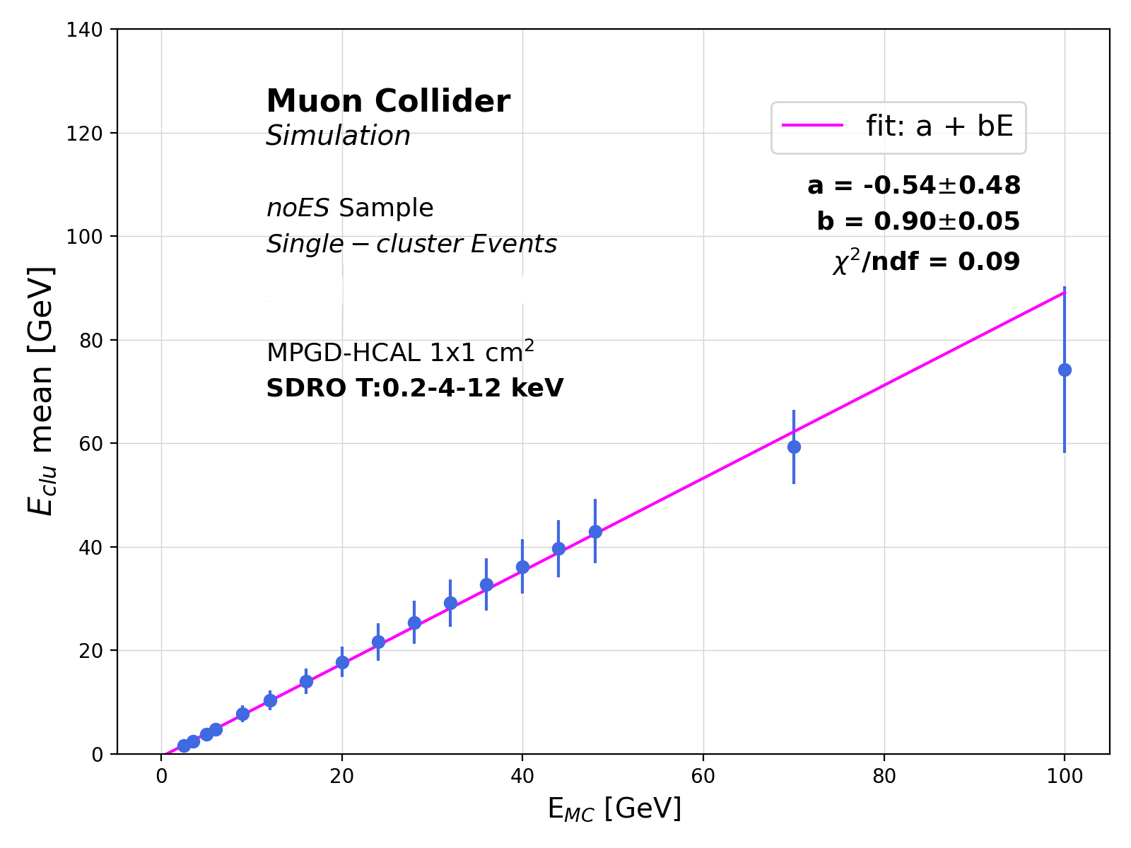
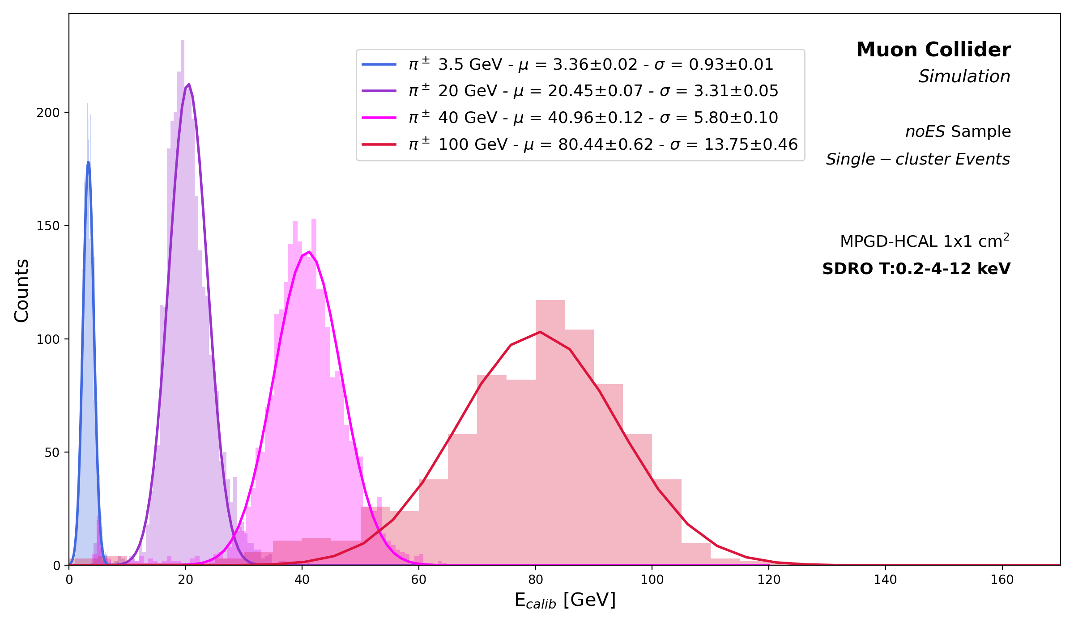
Cluster ENERGY
BEFORE CALIBRATION
LINEAR CALIBRATION – noES selection
HCAL → invisible energy → energy underestimation
CALIBRATION
Gaussian fit of the cluster energy distributions
Represent E_{clu} mean = $μ$ as a function of E_{MC}
Linear fit → apply the corrective parameters : E_{calib} = (E_{clu}-b)/a
AFTER CALIBRATION

Slide 21
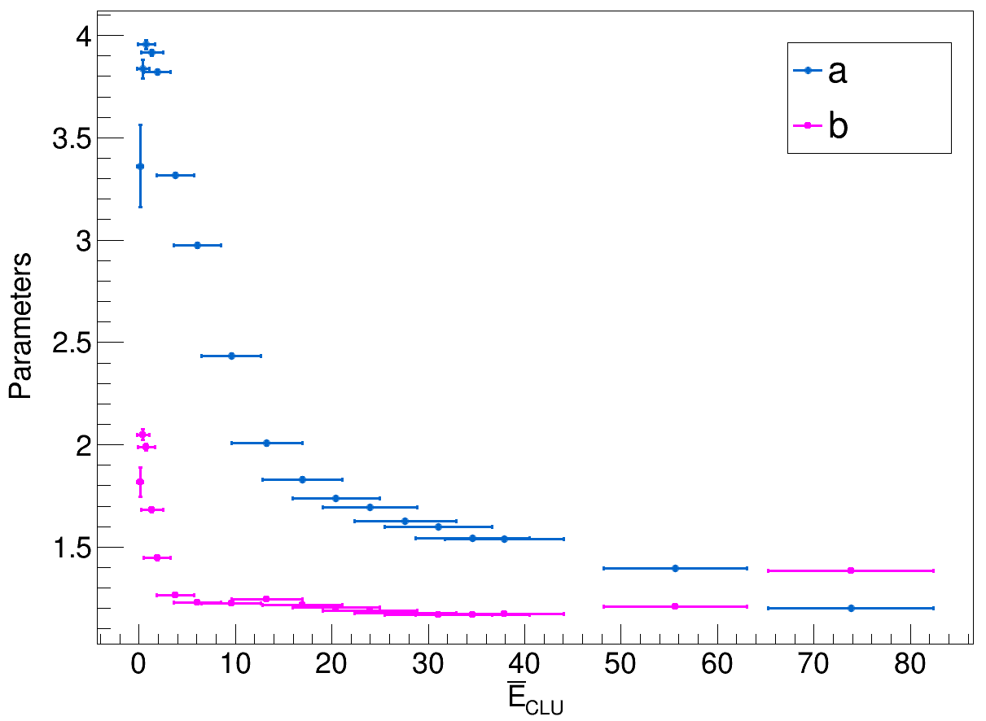
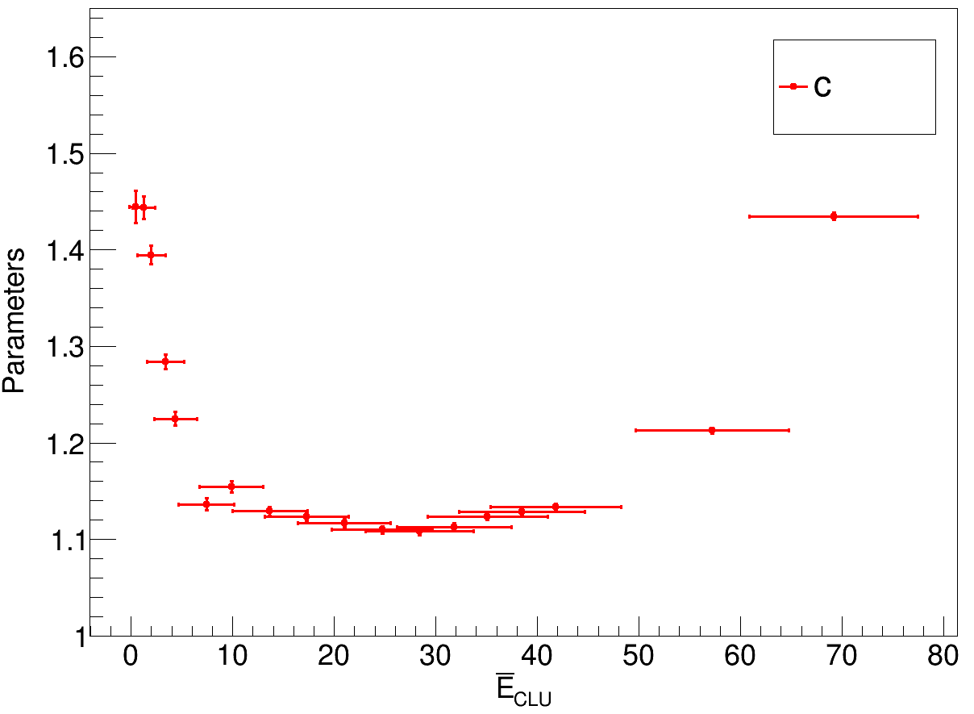
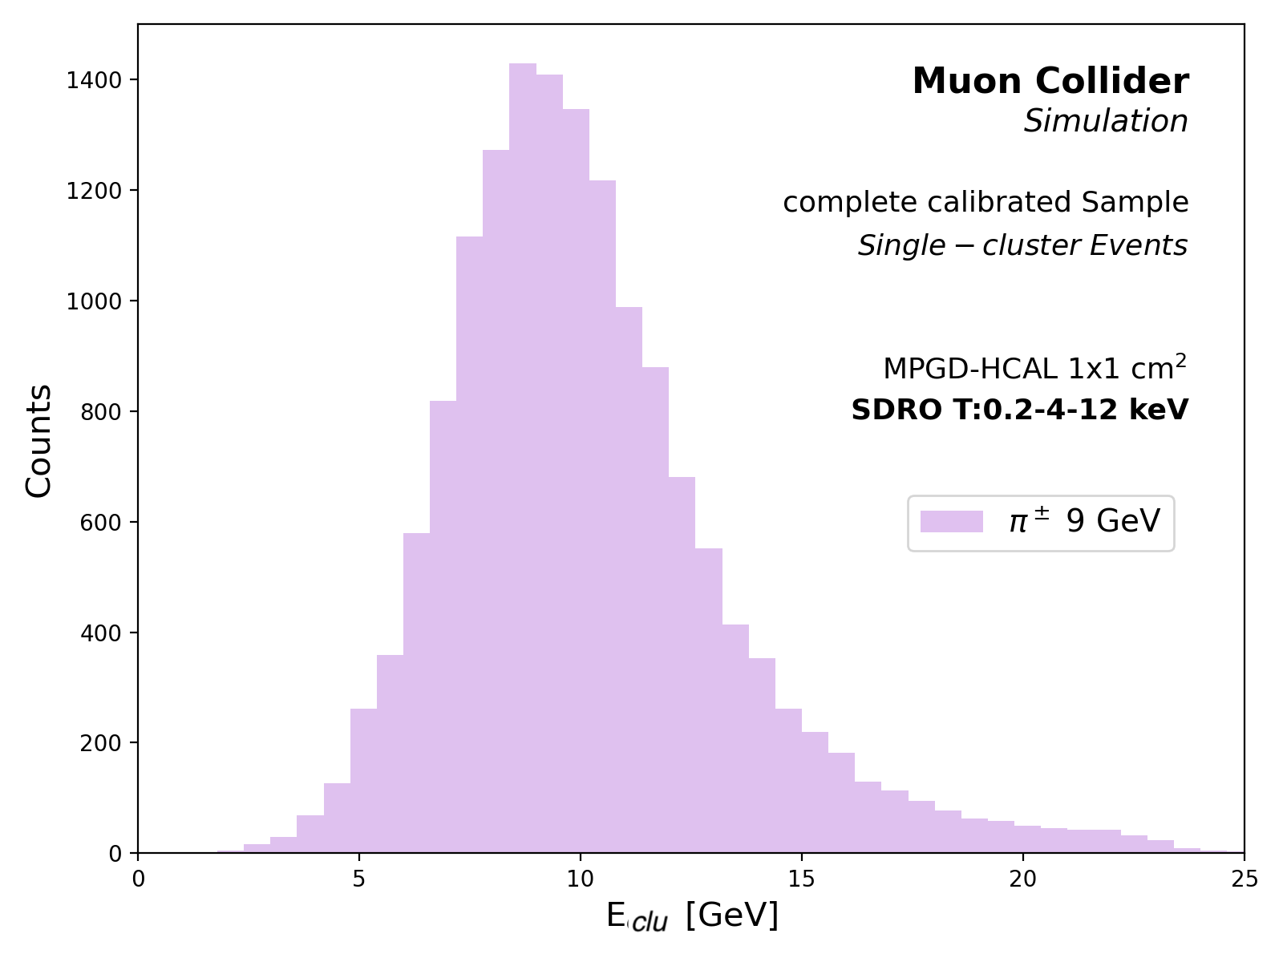
Cluster ENERGY
CALIBRATION – noES + EH sample
ECAL and HCAL have different responses
Double peaks in monochromatic $π^{±}$guns
→ separate calibrations
EH : E_{calib} = a E_{rawECAL} + b $\text{E}\text{raw}\text{HCAL}$
noES: E_{calib} = c E_{rawHCAL}
a, b and c are obtained by $χ^{2}$ minimizations
AFTER CALIBRATION

Slide 22
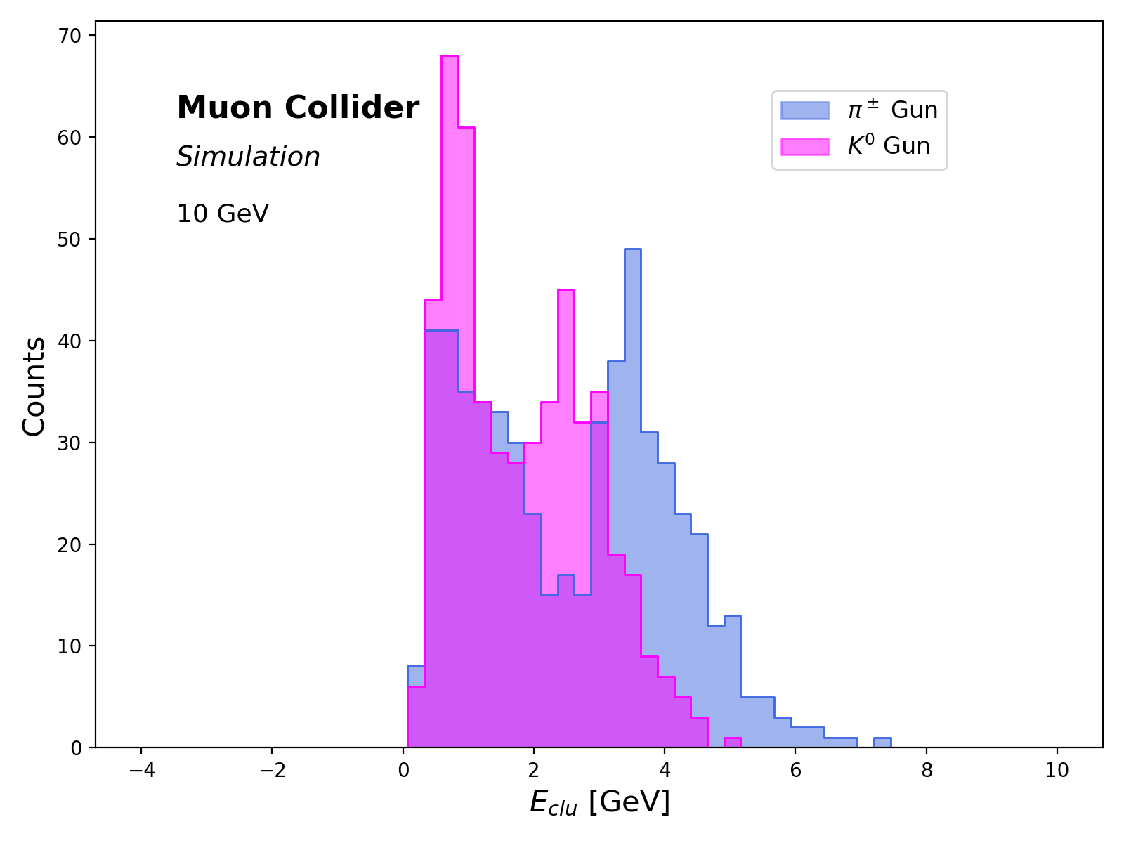
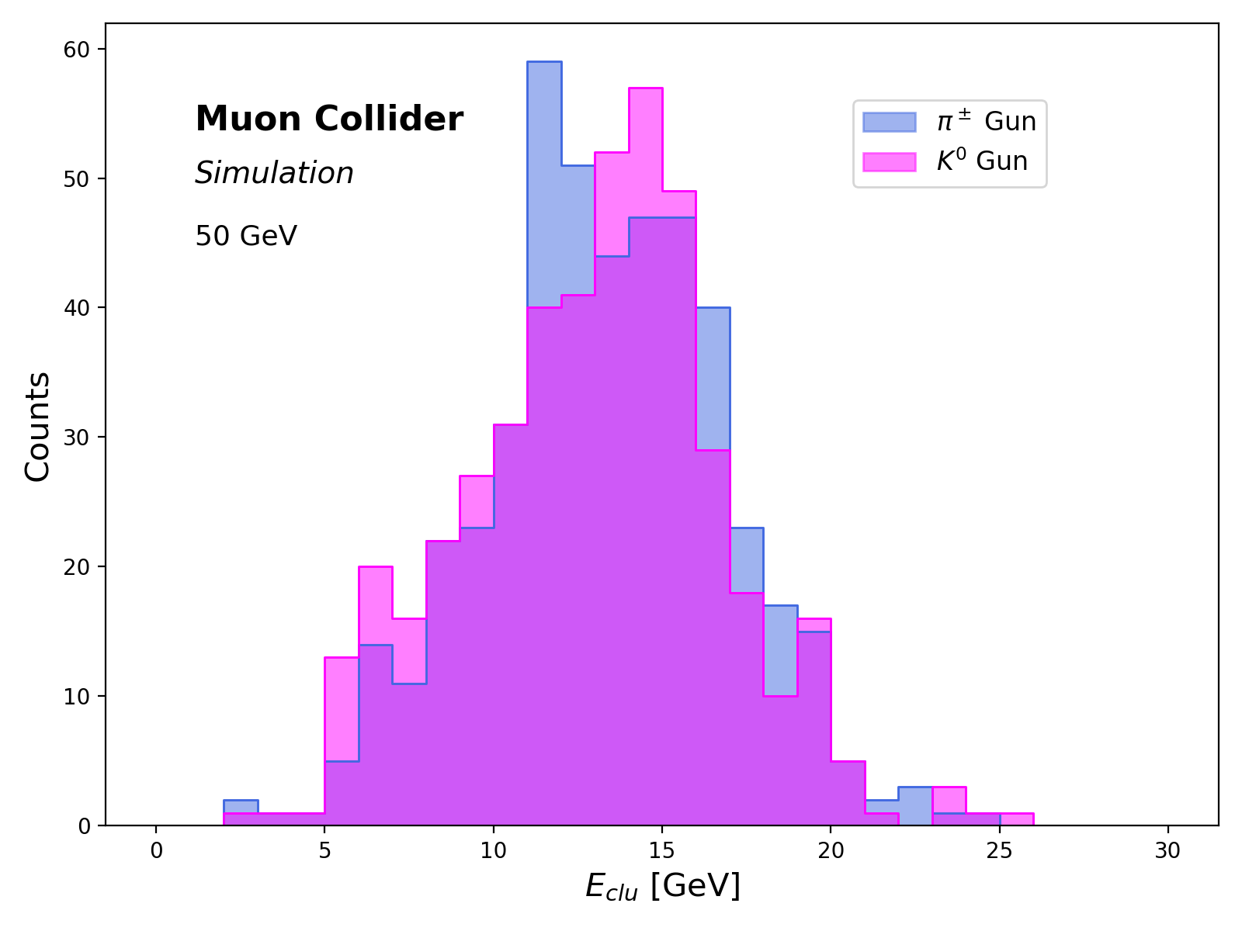
Charged vs Neutral hadrons
Similar cluster energy reconstructed for $π±$ and K⁰ at corresponding energy points
10 GeV
50 GeV

Slide 23
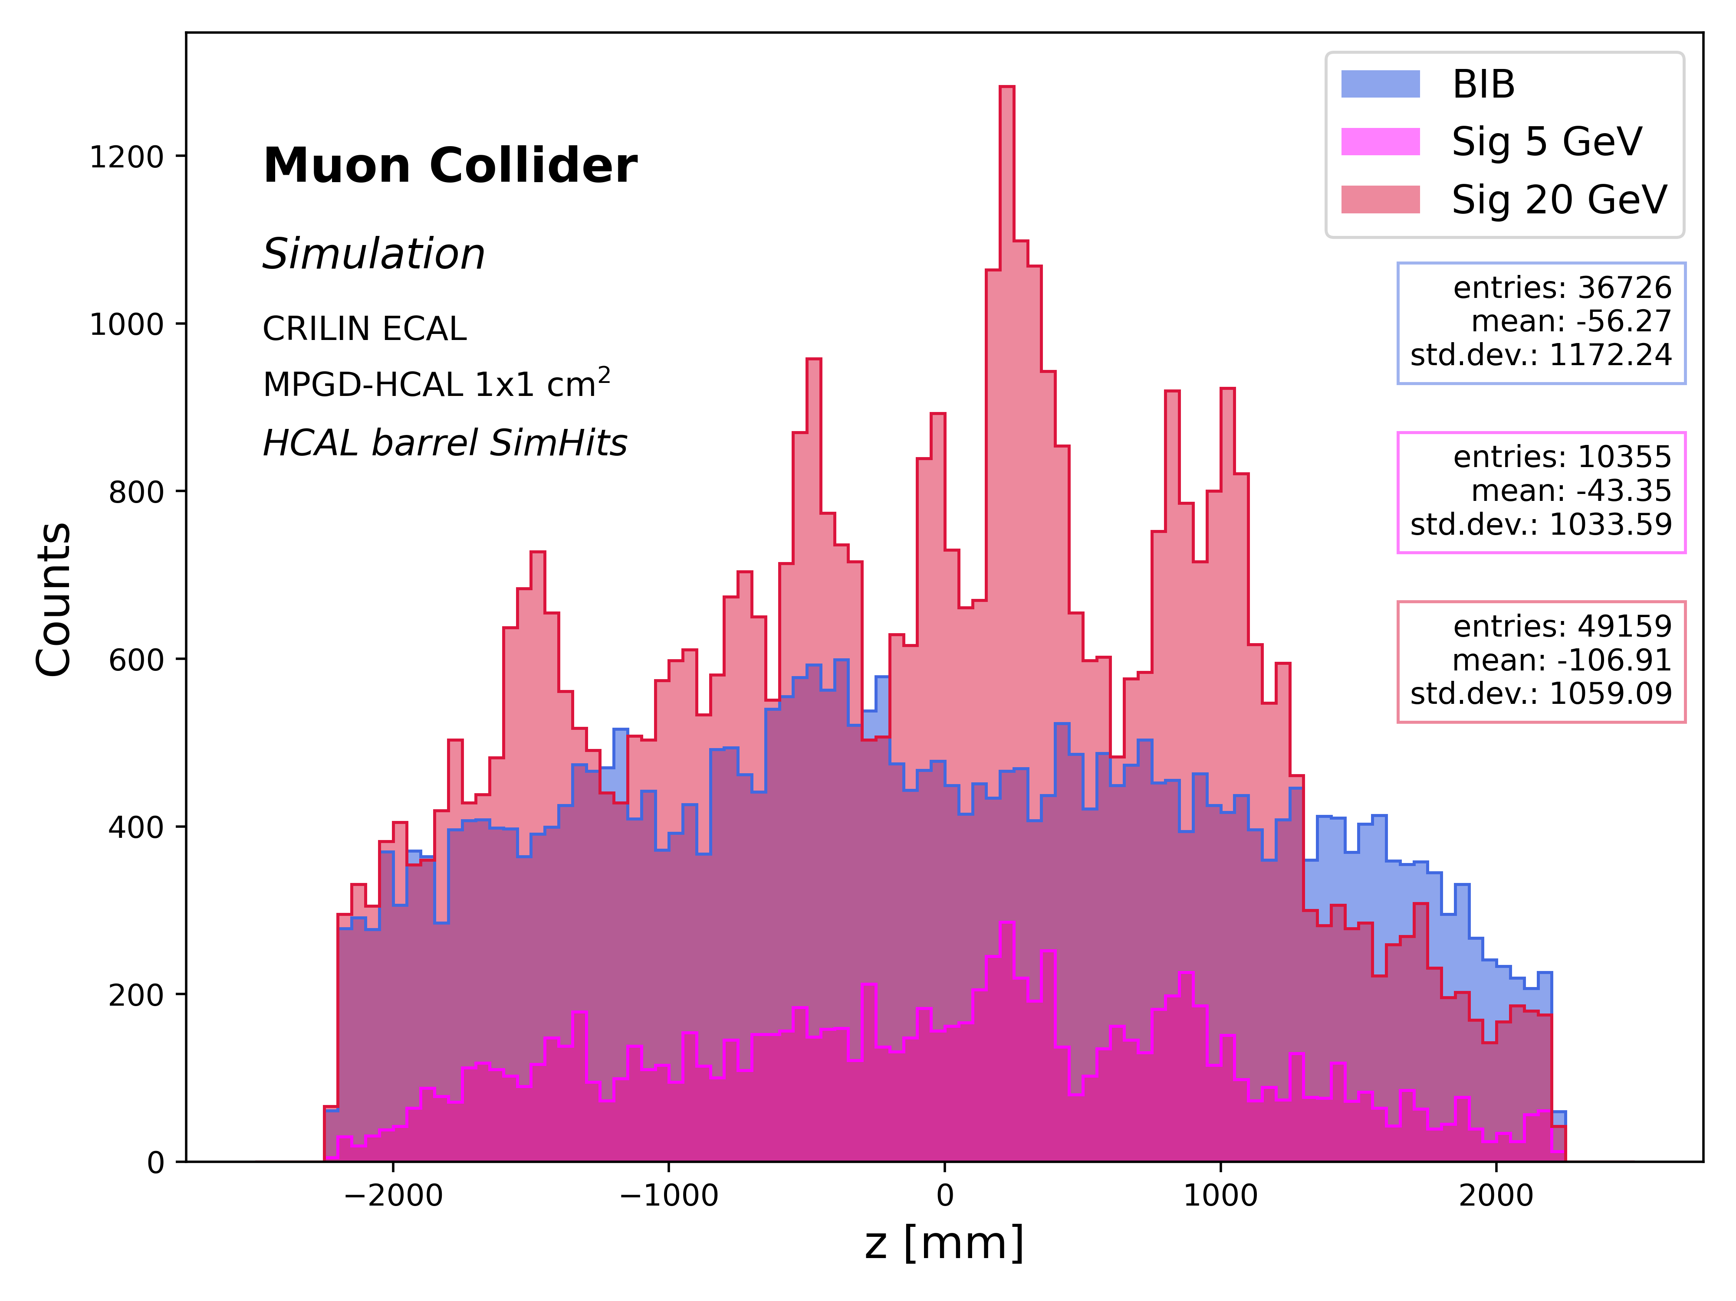
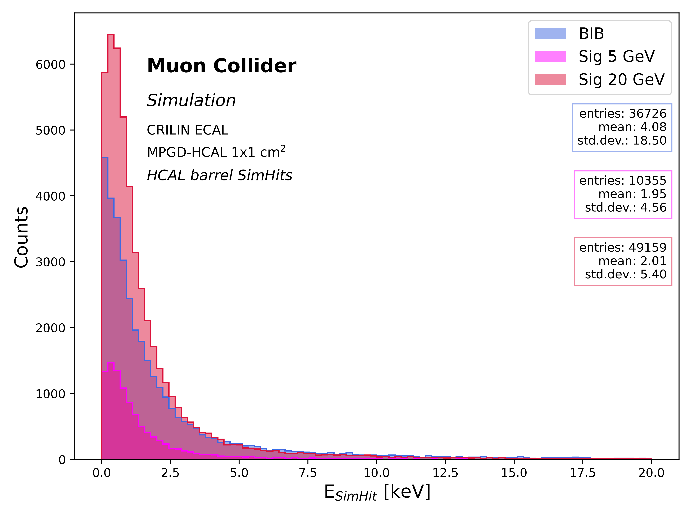
BIB CHARACTERIZATION
HCAL HITS
Uniform longitudinal distribution without prominent differences from the pion guns
→ No possible cut on the z
SimHit average energies of ~ 4 keV → twice the value of the signal hits
→ No possible cut changing the RO energy thresholds
Arrival time distribution is uniform in the range 7-20 ns, while signal peaks at 6 ns
→ Possible cut at t > 10 ns
Z-axis
HIT ENERGY
ARRIVAL TIME

Slide 24
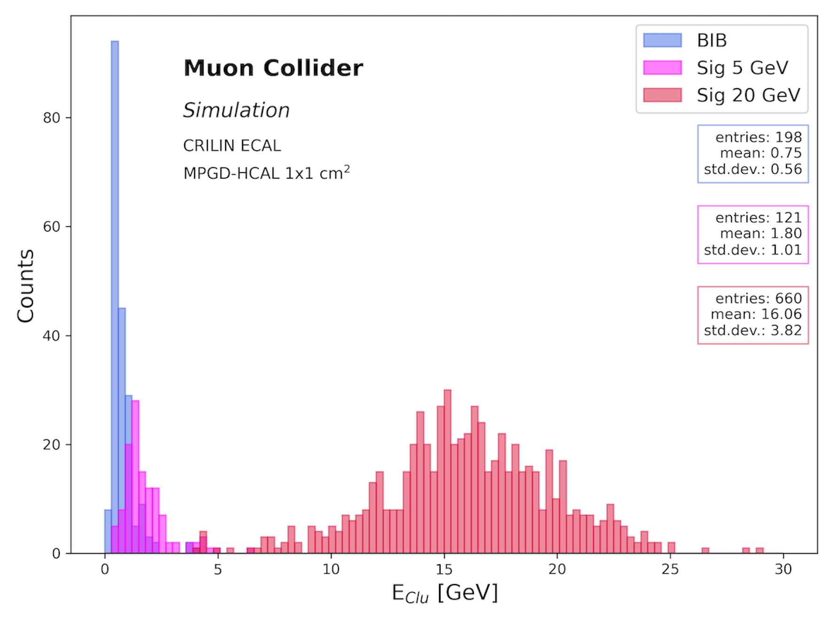
CLUSTER RECONSTRUCTion with bib
SIGNAL and BIB separately
BIB OVERLAY ON SIGNAL
BIB-only clusters have average energies of ~ 0.75 GeV
small high-energy tail partially overlapping with cluster energies of 5 GeV pions
well distinguishable from cluster energies of 20 GeV pions
Almost negligible decrease in energy :
Due to BIB ONLY CLUSTERS produced by low-energy particles
→ Overall BIB does not affect Custer energy reconstruction at E_{MC} > 5 GeV

Slide 25
CLUSTER MULTIPLICITY
Comparison AT 20 GeV
BIB-only: Low clustering efficiency: ~70% of 0-cluster events
SIGNAL vs SIGNAL+BIB:
Increase of multicluster events: on average from 1.61 (SIGNAL-only) to 3.09 (SIG+BIB) clusters per event
Decrease in clustering efficiency: from ~50% (SIGNAL-only) to ~35% (SIG+BIB) 1-cluster events
BIB-only
SIGNAL
SIGnal+BIB

Slide 26
CLUSTER-Pion ΔR
Comparison : SIGNAL - Signal+BIB
Selection on single-cluster events (fewer entries in SIGNAL+BIB)
The SIGNAL+BIB has SIGNAL clusters, BIB clusters, or MIXED clusters (RecHits from the pion or the BIB)
Hits from the BIB are uniformly distributed in space and arbitrarily far from the pion path
→ BIB and MIXED clusters result in having larger ΔR wrt the MC pion
→ Distribution means : 66% increase at 5 GeV - 87% increase at 20 GeV

Slide 27
CLUSTER SIZE
Comparison: SIGNAL - Sig+BIB
Overlaying BIB on the signal → slight decrease in clustering efficiency and cluster size
BIB and MIXED clusters have on average a larger ΔR < 0.2 not passing the matching selection criterion
BIB-only clusters have a small number of hits → decrease the mean of the distributions
SIGNAL and BIB separately
SIGNAL AND BIB merged

